Slide 1

Status of SVD Production
SVD Parallel Summary
Christoph Schwanda (HEPHY Vienna)
For the Belle II SVD group
10th VXD Belle II Workshop
September 14-16, 2016, Santander, Spain

Slide 2
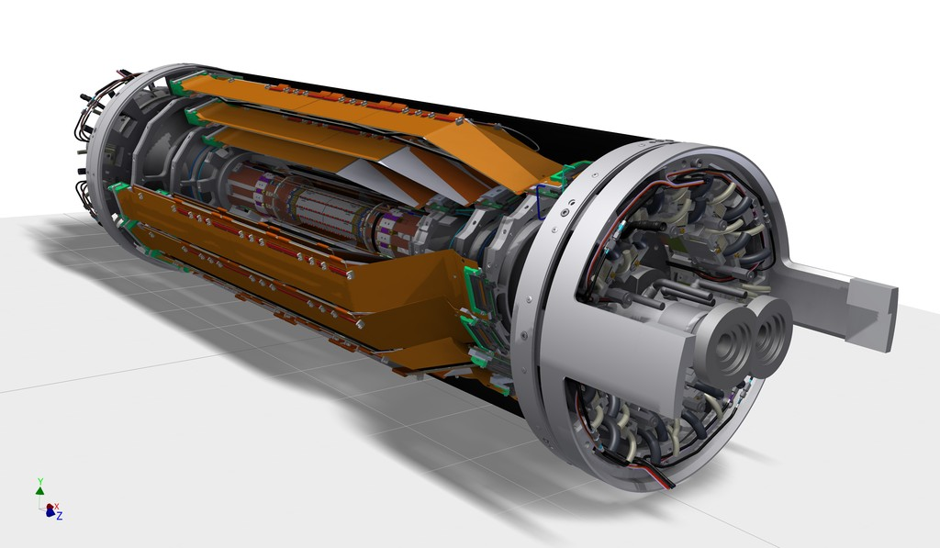
Components of the Belle II SVD
Carbon fiber
(CF) cone
Outer CF shell
End flange
End rings
Ladders
Beam pipe
PXD
(independent sub-detector inside SVD)

Slide 3
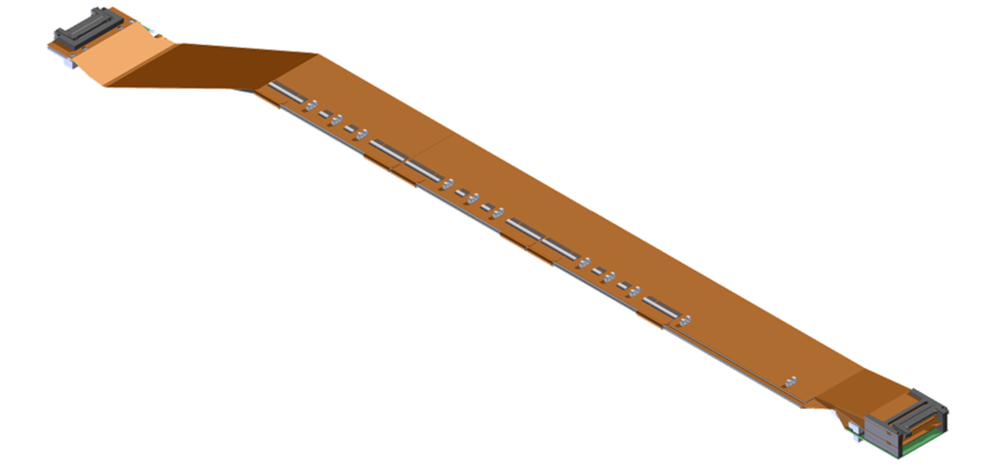
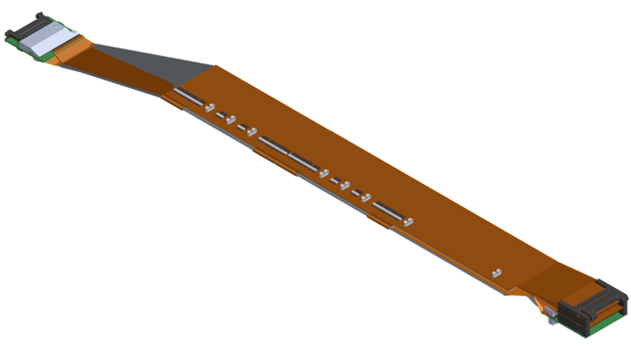
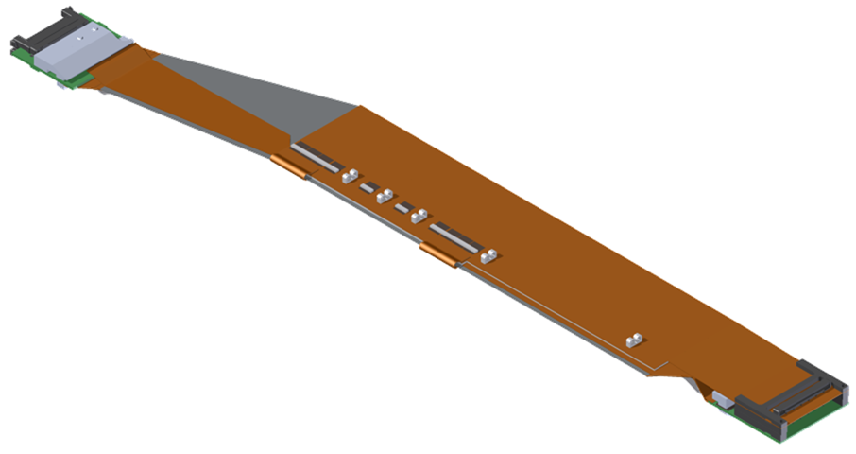
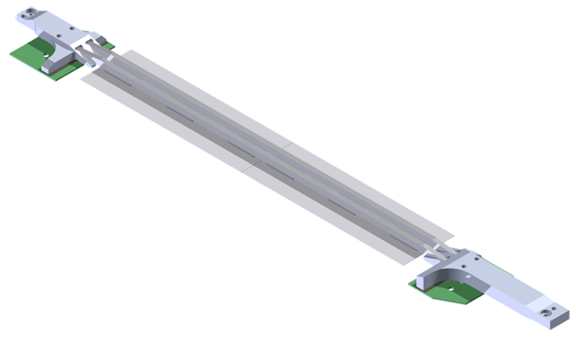
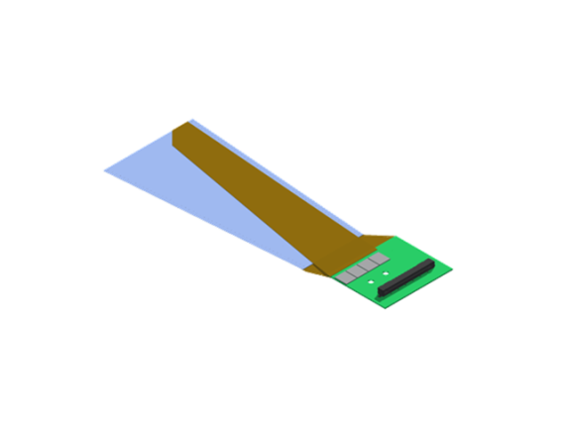
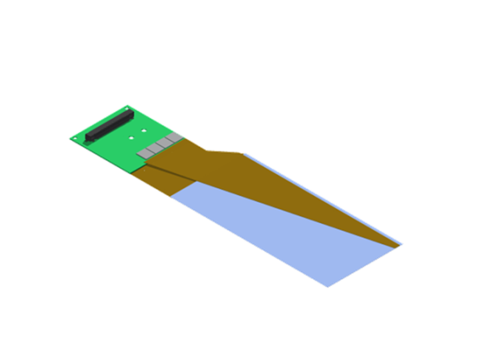
SVD ladders
Layer | Ladders (spares) | DSSDs / ladder
6 | 16 (4) | 5
5 | 12 (3) | 4
4 | 10 (2) | 3
3 | 7 (2) | 2
L6 Ladder
(Kavli IPMU)
FWD module
FWD
Origami +z
L5 Ladder
(HEPHY)
Origami ce
47 FW/BW + spares (4)
BWD
Origami -z
L4 Ladder
(TIFR)
BWD module
L3 Ladder
(Melbourne)
Cooling pipe
FWD module
(Pisa)
Cooling pipe
BWD module
(Pisa)
Cooling pipe

Slide 4
SVD ladder production status
(as of September 12, 2016)
Pisa ( FW/BW ) 100% (85%*) of the backward (forward) subassemblies completed
Melbourne ( L3 ) 5 out of 7+2 ladders completed
TIFR ( L4 ) 3 out of now 10+2 ladders completed
HEPHY ( L5 ) 4 out of 12+3 ladders completed
Kavli IPMU ( L6 ) 3 out of 16+4 ladders completed
* as of end of August

Slide 5
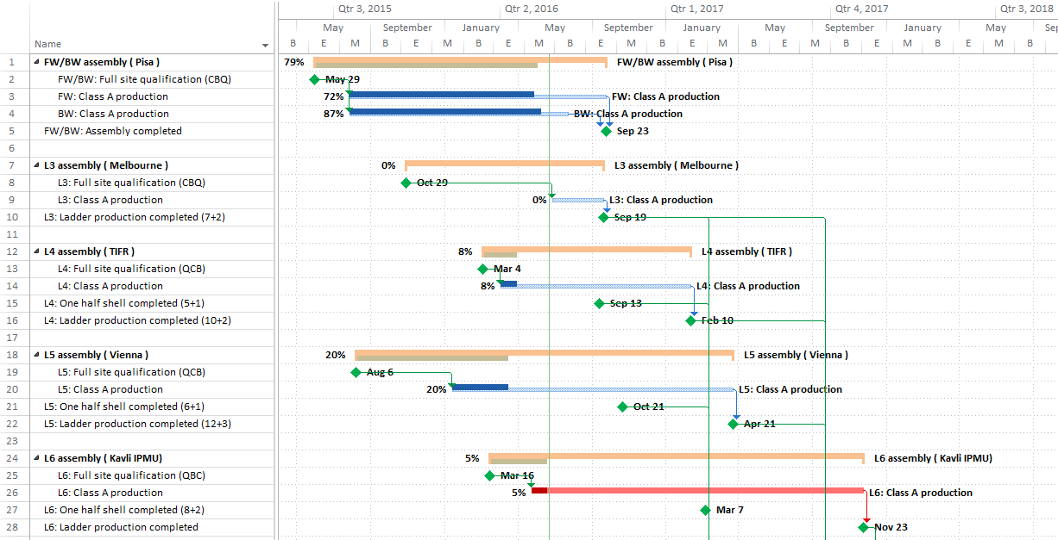
Ladder production schedule
End of L3 production:
Sep 2016
End of L6 production: Nov 2017
To be updated

Slide 6
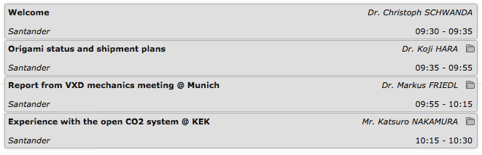
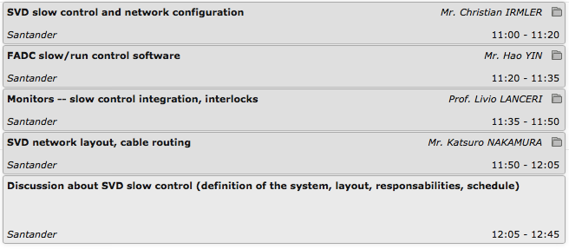
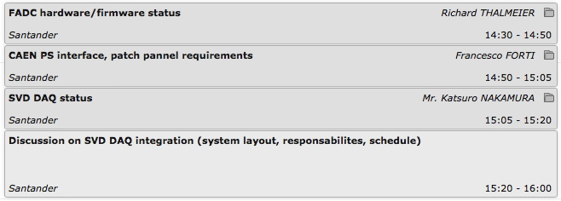
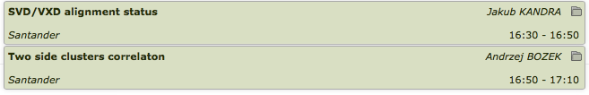
SVD parallel on Wednesday
Reports
SVD SC discussion
SVD DAQ discussion
SVD software

Slide 7
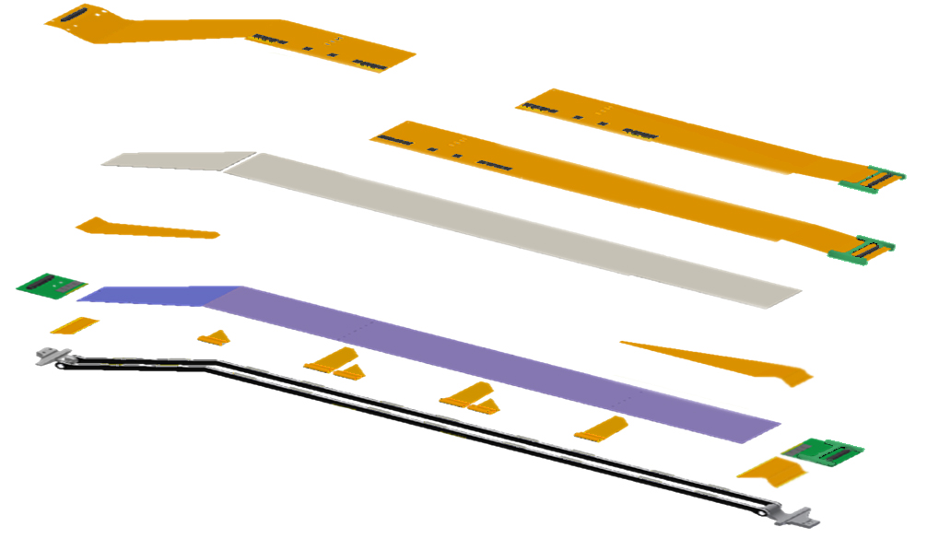
Ladder Anatomy (L6 ladder)
Origami hybrid
DSSDs
2 small rectangular (L3)
2-4 large rectangular (L4-6)
1 trapezoidal (L4-6)
APV25
Origami hybrid
Flexible circuit to transmit detector signals to the ladder ends
APV25
Readout ASIC of the strips
PA0
PF2
FlexPA (PA/PF/PB)
Flexible circuit to transmit detector signals to the APV25
PF1
PB2
AIREX
PA1
PA2
DSSD
PA0
Flexible circuit glued on the Origami hybrid to transmit n-side detector signals to the APV25
PB1
AIREX
Thermal insulator between the DSSD and APV25
Rib

Slide 8
Origami Status
Koji Hara
80 assembled, inspected so far
  30 O-Z : 25 class A, 5 e-test fail
  27 OCE : 22* class A, 4 e-test fail, 1 e-test fail but repaired
    * include 12 OCEs with APV3 ch0 noise ~ 2
  23 O+Z : 18 class A, 3 e-test fail, 2 OK but minor issue**
    ** 1 wires bent, 1 soldering to be reworked
63 will be assembled with new DISCO thinned chips + chips thinned as a whole wafer
  36 O-Z
  22 OCE
  5 O+Z

Slide 9
Electrical failures in assembled Origami
Koji Hara
Whole analog dead (all 128 chs are bad) : 6.3% (5/80)
  O-Z130 APV6 (N0), no crack, LV normal
  O+Z118 APV9 (N3), crack observed, LV low cur.
  OCE122 APV3 (P3), crack observed, LV low cur.
  OCE123 APV6 (N0), power OK on chip, LV normal
  O-Z107 APV5 (P5), discon. at soldered pad, LV low cur.
A part of chs dead : 10.0% (8/80) (1 repaired)
  O-Z 3/30 before|after our inspection: 2/17 | 1/13
  OCE 3/27 before|after our inspection: 3/15 | 0/12
  O+Z 2/23 before|after our inspection: 0/8 | 2/15
  Total 8/80 before|after our inspection: 5/40| 3/40
Short on PA0 (1 on each)
  O-Z 4 (117,121,123,146) → to be assembled

Slide 10
Expected Origami readiness at KEK
Koji Hara
 |  | O+Z ready@KEK | OCE ready@KEK | O-Z ready@KEK
week
2016/9/5 |  | 18 (3 shipped) | 22 (8 shipped) | 25 (12 shipped)
2016/9/12 | VXD workshop
2016/9/19 | "Silver week"
2016/9/26
2016/10/3
2016/10/10
2016/10/17 | B2GM |  |  | +13
2016/10/24
2016/10/31 |  |  | +10
2016/11/7
2016/11/14 |  |  |  | +12
2016/11/21
2016/11/28 |  |  |  | +11
2016/12/5
2016/12/12
2016/12/19 |  | +4 +1 | +11 +1
2016/12/26
2017/1/2 | New Year
2017/1/9
Numbers in future are before acceptance inspection at KEK
Assumed to resume APV gluing on Sep. 26

Slide 11
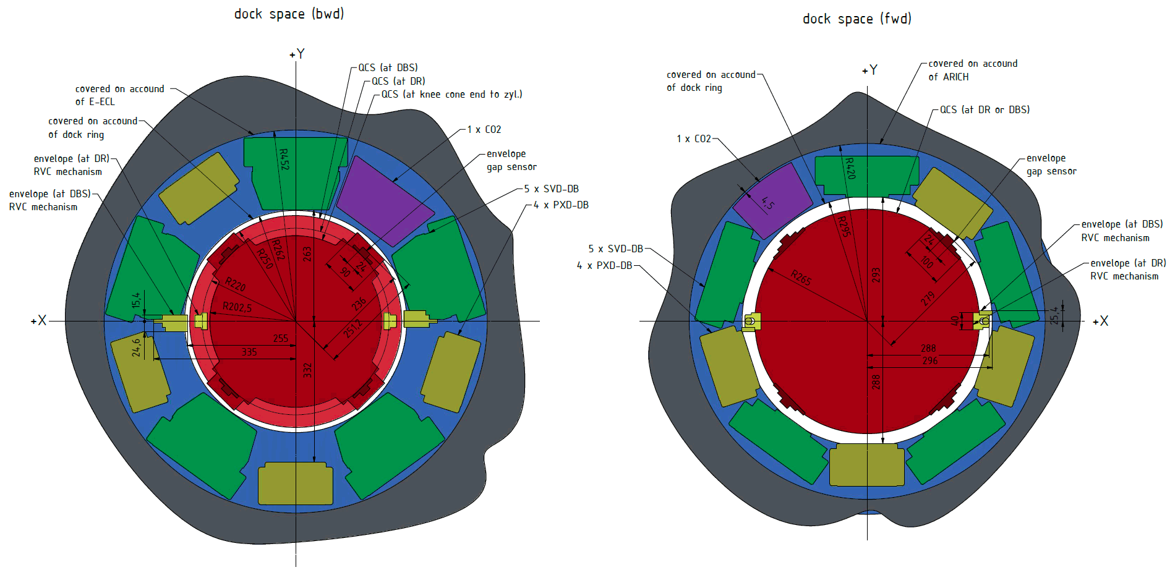
Space Around DOCK
Markus Friedl
Latest Drawing by Tscharlie

Slide 12
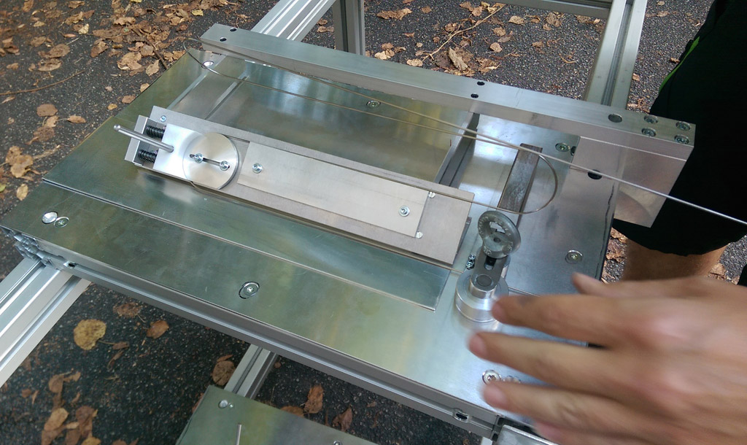
L4 Origami Pipe 3D Bending
Markus Friedl
Florian

Slide 13
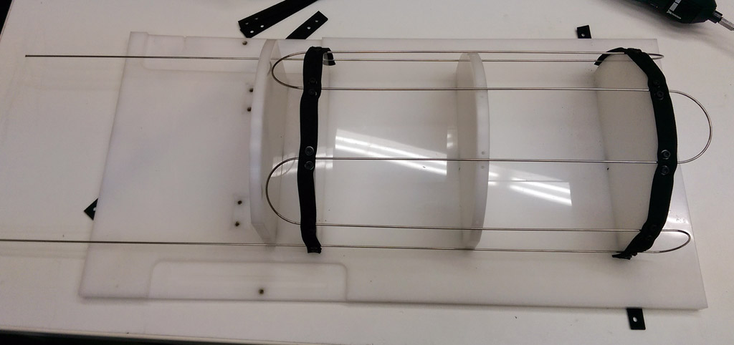
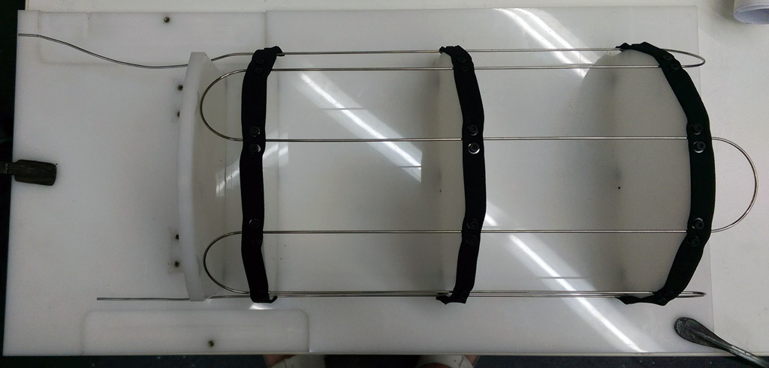
Result
Markus Friedl
Left: after 3D bending
Right: after inlet/outlet bending (manual) and cutting
  Needs more practicing…

Slide 14
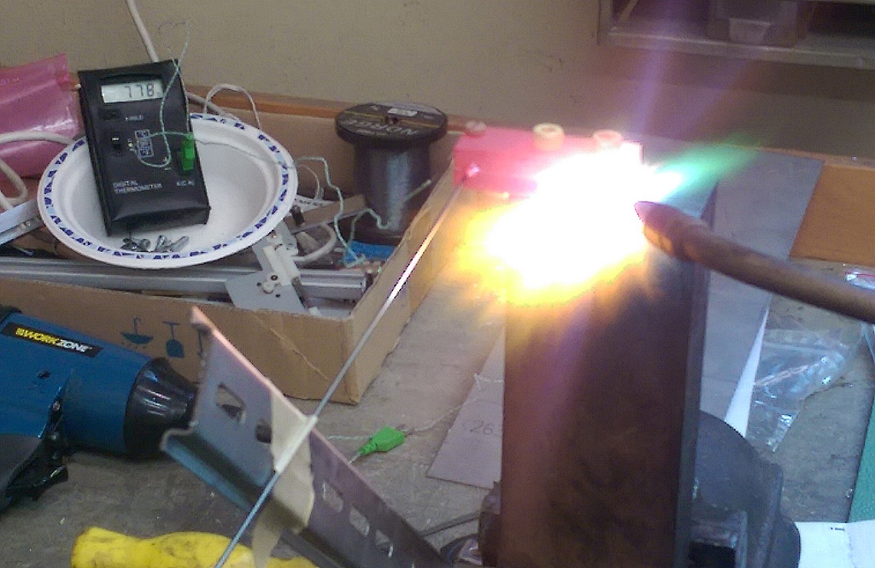
Preparation Test for Brazing
Markus Friedl
We can achieve homogeneous heat for (dummy) Streuli using a copper block and acetylene/oxygen burner
778°C
measured
here
Pipe

Slide 15
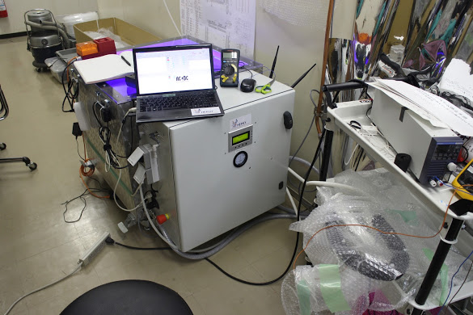
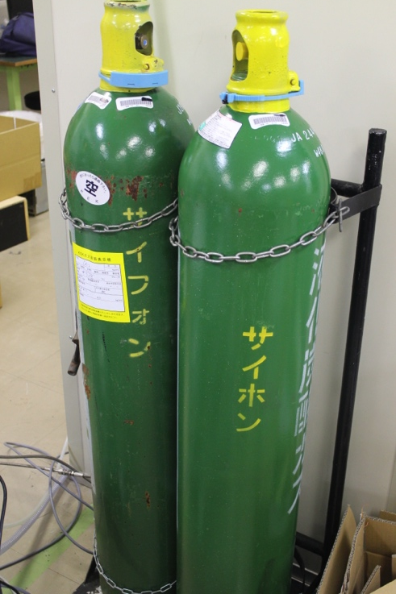
CO2 cooling system setup at KEK B1
Katsuro Nakamura
From 1 CO2 bottle, about 20kg CO2 is available for the CO2 system
  (actual amount of CO2 inside the bottle is 30kg).
Currently, once one CO2 bottle gets empty, we have to switch off the CO2 cooling system, connect to another bottle, and then restart the CO2 system.
In future, we will implement switching valves, which enable us continuous switching the bottles without stop of the system.

Slide 16
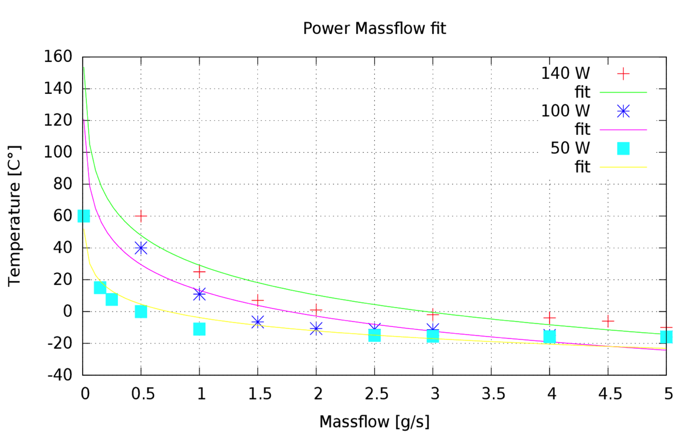
Comparison the results with before shipment
Katsuro Nakamura
Pipe temperature w/ heater
Measurement (Lukas)
Measurement (Kambara)
0W
100W
Results in 2.2 g/s shows good consistency with Lukas’s measurement and a enough cooling power for 100W load.
But, Results in 3 g/s and 4 g/s are higher temperature than Lukas’s measurement and our 2.2 g/s result.
  They looks inconsistent with our 2.2 g/s result.

Slide 17
SVD SC

Slide 18
SVD Slow Control System Overview
Christian Irmler

Slide 19
Network Configuration (Draft)
Christian Irmler
First draft, assuming that IOCs are distributed among 2 servers
  One for FADC related IOCs and a second for the rest (PS, environment, etc.)
To be discussed
Remote connection to our machines via bdaq and access gateway

Slide 20
Poorly Covered Tasks
Christian Irmler
The following tasks and subsystems are not or just poorly covered
FOS
  Same system as PXD, but can we also share IOC?
  Suppose we can use same IOC, but should run on SVD server
  Need to implement SVD specific CSS
Coordination of SC activities → SC group management
  So far, partly done by myself
  Will be busy with L5 assembly until summer 2017
Databases, archiver, gateways, system and network architecture

Slide 21
Hao Yin

Slide 22
Hao Yin

Slide 23
Hao Yin

Slide 24
Livio Lanceri

Slide 25
Livio Lanceri

Slide 26
Livio Lanceri

Slide 27
Comment
I think we need a broader discussion to finalize the interlocks
Maybe we can foresee time for this at the October B2GM

Slide 28
SVD DAQ

Slide 29
Richard Thalmeier

Slide 30
Richard Thalmeier

Slide 31
Richard Thalmeier

Slide 32
CAEN Boards: all delivered
Francesco Forti
Sense | Status | Enable
YES | YES | YES
NO | NO | YES
NO | NO | YES
Note: all channels are fully floating, but the polarity is defined by wiring
A2519A LV Board 5-15V/10A; 8 ch/board; 12 boards + 3 spares
A1519B HV Board 250V/1mA; 12 ch/board; 4 boards + 1 spare
A1510 VSEP Board 100V/10mA; 12 ch/board; 4 boards + 1 spare
One problematic board replaced by CAEN under warranty

Slide 33
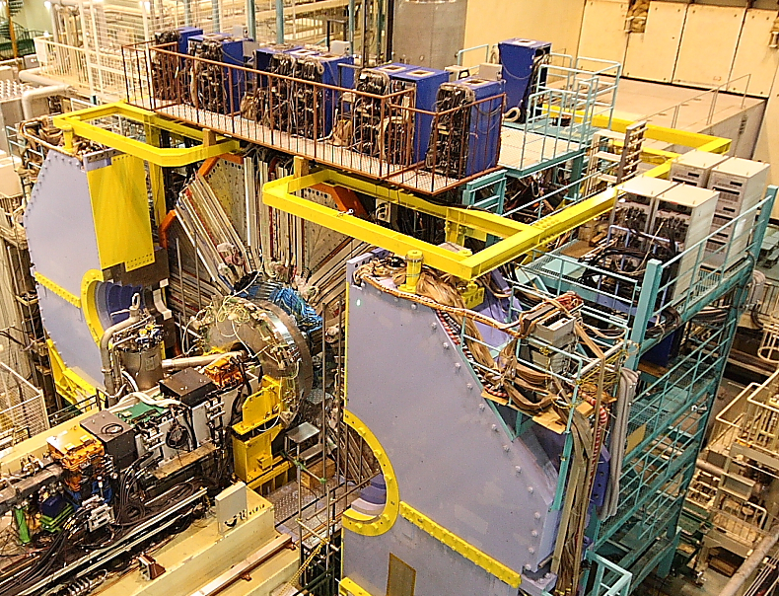
Francesco Forti
Only two racks will be required, replacing the 4 Kenwood racks

Slide 34
Power distribution panel interface
Francesco Forti
The only programmable part of the power distribution panel is the VSEP polarity select
  The rest is only signal distribution, although the LVEnable/HVEnable requires will require active components.
Requirements
  EPICS interface
  Functionality choices:
  Maintain polarity select across power cycles,
  or require reprogramming ?
    Proposal to use latching relays
  Include relay status monitoring ?
    Of course you will be able to read back the digital signal status controlling the relay. The question is whether to use 3-pole relay where one pole is used to monitor the actual switching of the relay.

Slide 35
Final system ?
Francesco Forti
Proposal: use the USOP system (from ECL) to provide local intelligence and control
Advantage: developed in Naples, easy to use and powerful, with epics drivers (see slides attached to agenda)
Disadvantage: relatively expensive and not funded at this time (working on this)
Each USOP crate requires 2 ethernet lines: one for remote control over IP, the other for normal data operation (epics PV)
Other solutions:
  other systems with I/O capability, possibly already used in Belle2 ?
  Use just one uSOP for all PDP crates ?
  Need to decide soon

Slide 36
Firmware Preparation Status
Katsuro Nakamura
Basically, minimum set of firmwares for data taking are already prepared.
  They work good in the previous DESY beam test.
However, still some necessary functions for the physics run are missing and further development are required.

Slide 37
Remaining Tasks in Firmware Development
Katsuro Nakamura
High priority: (necessary for physics run)
APV pipe-line address emulator (in FADC-Ctrl)
  the event order mismatch on FADC can be detected.
APV FIFO emulator (in master FTSW)
  prevents APV FIFO full which causes data corruption.
Improvement on common-mode correction (CMC) function. (in FADC)
  Currently 128-strips wise, but will be changed to 32-strips wise for more accurate common-mode noise reduction.
GbE data link for SVD local data taking (in FADC)
  For faster local data taking.
Remote FPGA configuration through VME access (in FADC)
Improvement on data format of FTB-DATCON link (in FTB)
  in order to increase the data size of the clock counter (currently 24-bits).
Middle priority: (not mandatory, but better to have )
Fake-hit filter (in FADC)
Zero-suppressed + Hit timing extraction mode (in FADC)
  The last data format for further data size suppression.
Function of event-by-event switching btw. 3- and 6-samples depending on trigger types. (in FADC-Ctrl + FADC)
  Necessary only for operation with about 30kHz or higher trigger rate.
New FTB data format (in FTB)
  w/ more useful information.

Slide 38
Global Schedule
Katsuro Nakamura
Dec. 2016: 3rd DESY beam test campaign
  We will use FADC ver.3 boards for this beam test.
End of Feb. 2017: Start SVD ladder mount
  We will use FADC ver.2 boards for electrical test during the ladder mount.
Jan. 2017: FADC ver.4/Junction boards test production
Mar. 2017: Test of FADC ver.4 in HEPHY and DESY
  Noise performance will be tested with permanent setup at DESY
Apr. 2017: Decision whether ver.3 or ver.4
May.-Jul. 2017: FADC ver.4/Junction board mass production
From the end of 2017:
  Phase-2: A partial VXD system will be installed for phase-2 commissioning.
  Cosmic-ray commissioning: In parallel to phase-2, full VXD will be assembled and tested with
  Full sets of FADC system and power supply are necessary by this point.
From the end of 2018: Phase-3 experiment
  Full VXD installation and operation
PS schedule must be included here.

Slide 39
summary

Slide 40
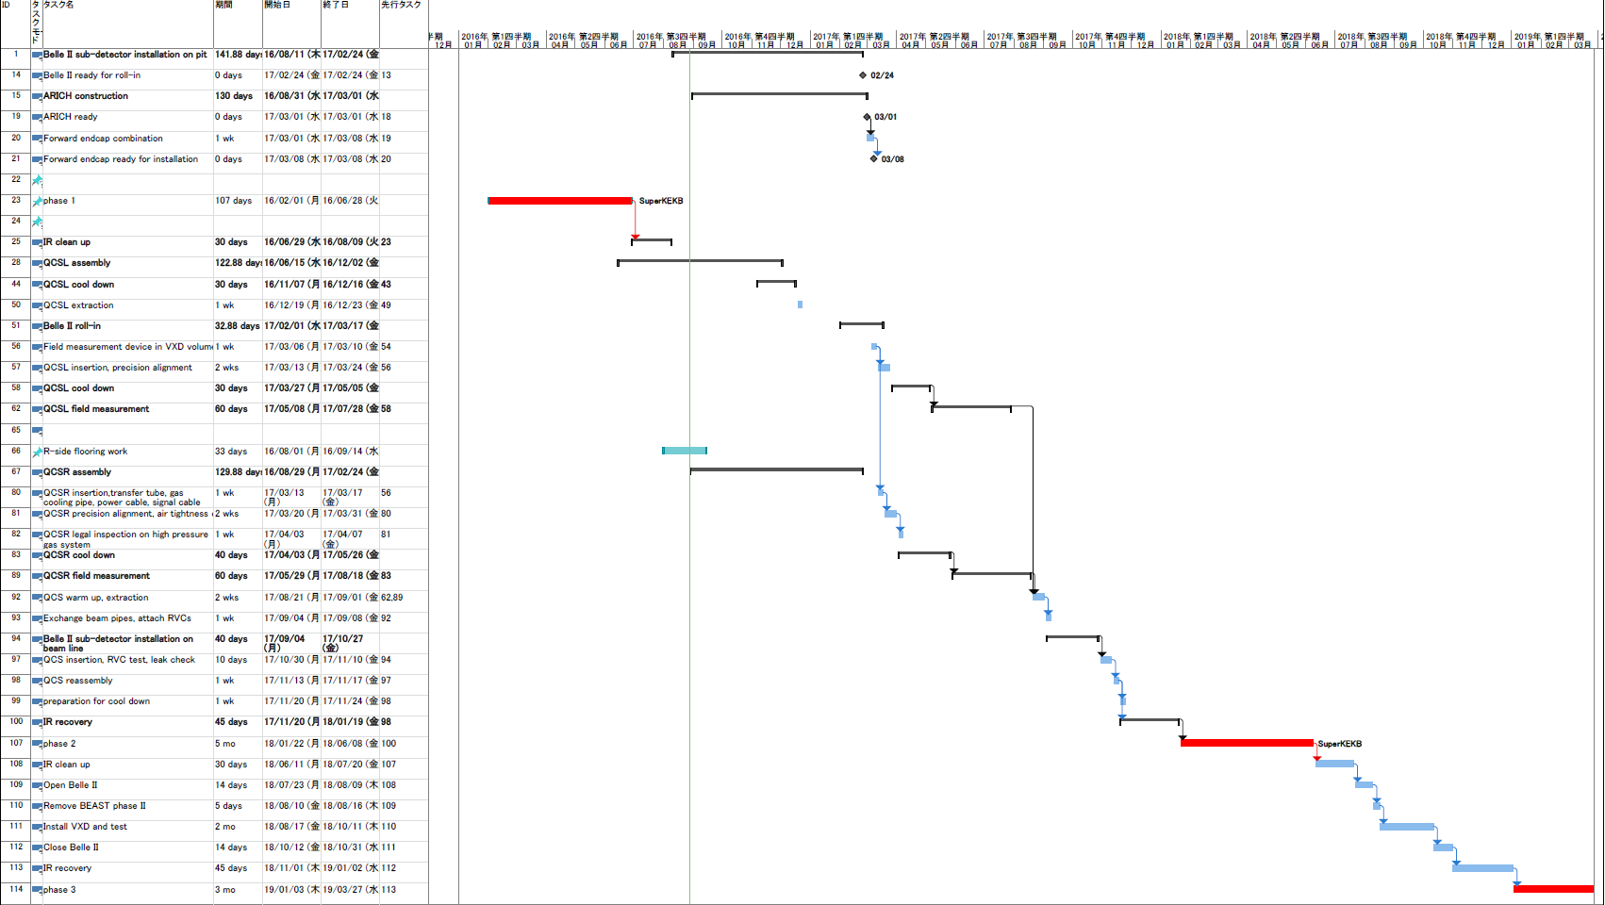
Schedule
(Recently shown by Yutaka, but it will be decided in next B2GM)
Phase 1 completed as scheduled
Additional delay by:
1, TOP PMT issue
2, FWD Endcap installation
(ARICH)
3, QCS(FWD) delivery
Belle II roll-in early 2017
Phase 2 from early 2018
TOP is not ready. Hence CDC installation cannot start.
ARICH HV is not ready and will be installed after Belle II roll-in
Phase 3 from 2019
VXD to be ready at KEK

Slide 41
Summary
Ladders
  Ladder assembly is in full swing
  We expect to meet the global schedule
Main topics @ this meeting: slow control and DAQ
  Especially the SC effort needs to ramped up
  The system is better defined after this meeting
  Manpower/schedule needs to be clarfied
  Broader discussion for interlocks

Slide 42
backup

