Slide 1
15 September 2016
Shipment to Japan >> SVD Experience
M.Friedl (HEPHY Vienna)

Slide 2
Table of Contents
Packaging
Customs Options
Normal shipment
Donation
Carnet ATA
Temporary Exportation
Carrier
Ourselves
Commercial carrier
Delivery Options

Slide 3
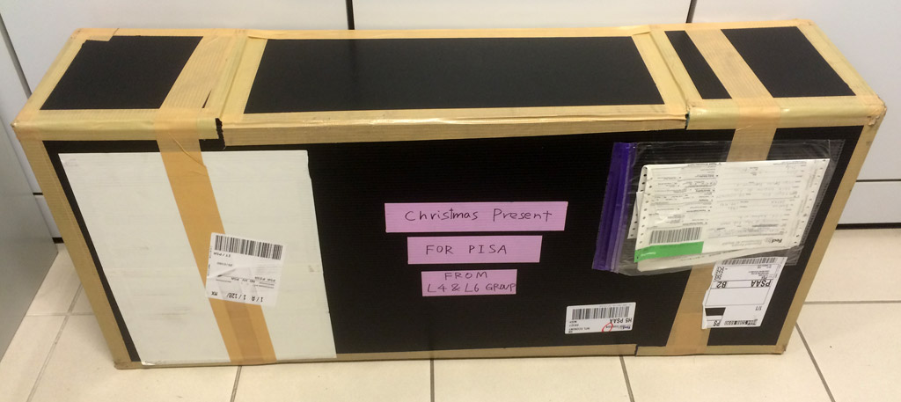
Packaging – Intro (1/2)
Sounds trivial, but don‘t underestimate!

Slide 4
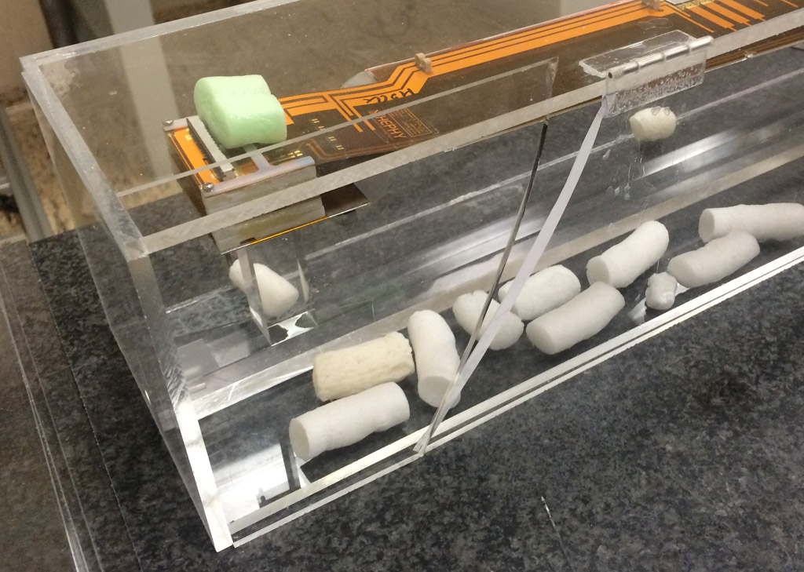
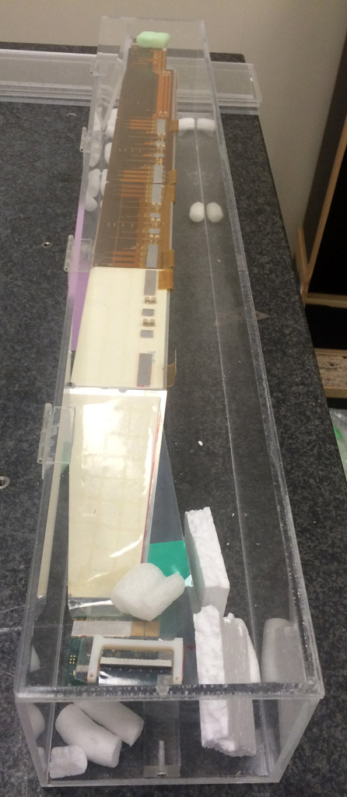
Packaging – Intro (2/2)

Slide 5
Packaging – General
Depends on carrier
Hand luggage needs less effort (always under your control – and risk!)
Checked luggage suffers mostly from ground handling
Light/small package allowing manual handling is much more prone to shock than heavy/big box requiring forklift

Slide 6
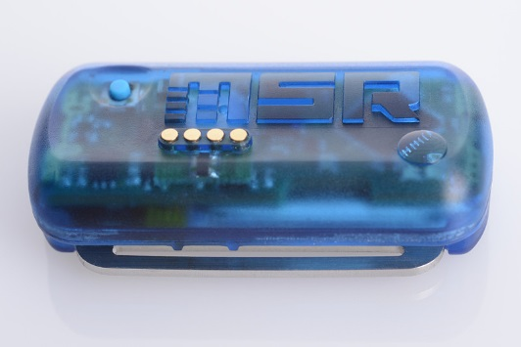
Packaging – Monitoring
Shockwatch sticker
Flask breaks and turns red if package is applied to shock above threshold
Various thresholds depending on box size
Effective psychological warning to the person handling the parcel
Data logger
Records temperature, humidity, acceleration, …
No psychological effect
A posteriori knowledge like dosimeter – when you die they know why thereafter

Slide 7
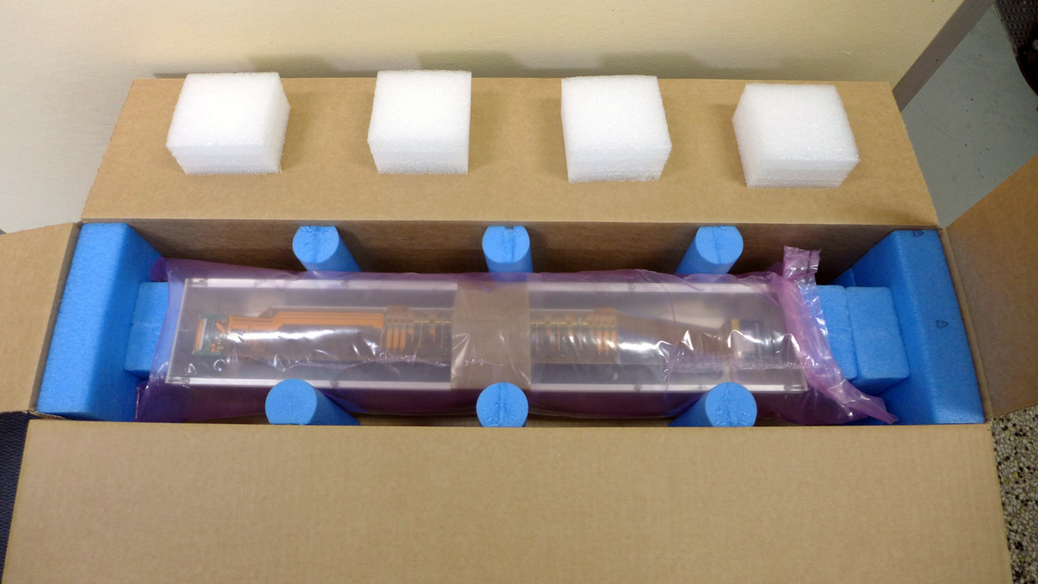
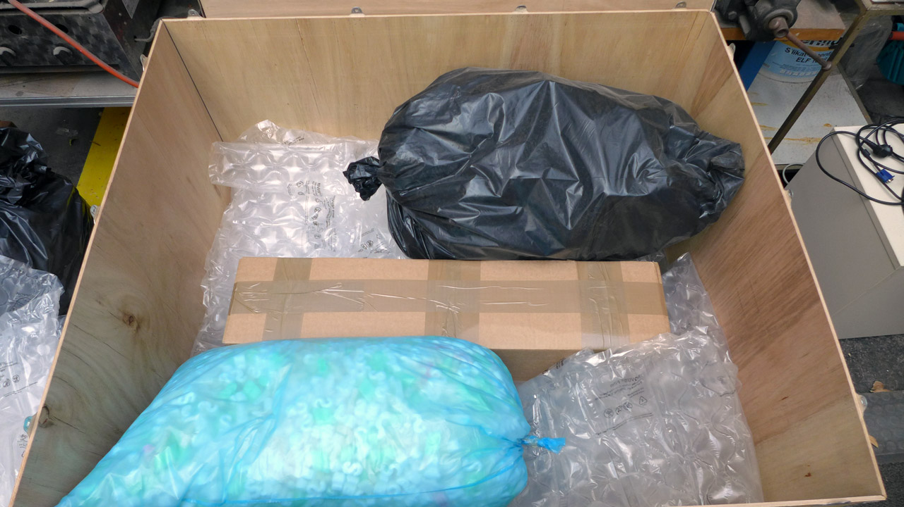
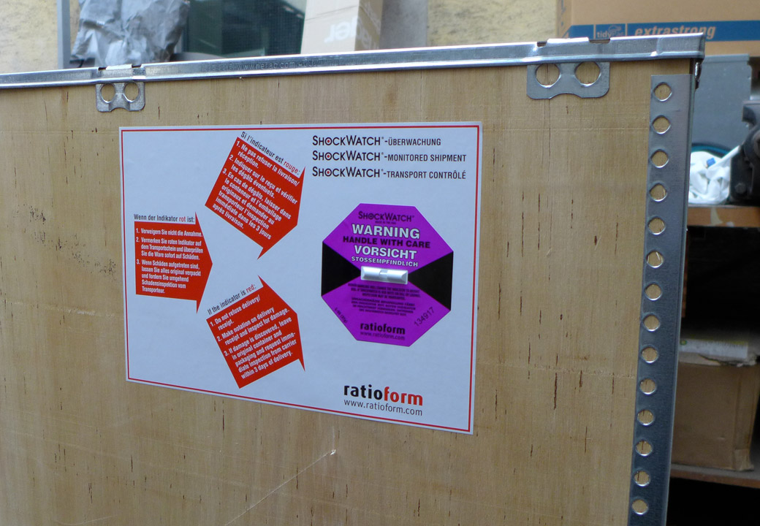
Packaging – L5 Ladders Example
Data logger
Shockwatch sticker
Air-filled cushions (shock absorber)
Ladder survived drop test from 1 meter
Shockwatch broke at 40 cm drop (>37 g)

Slide 8
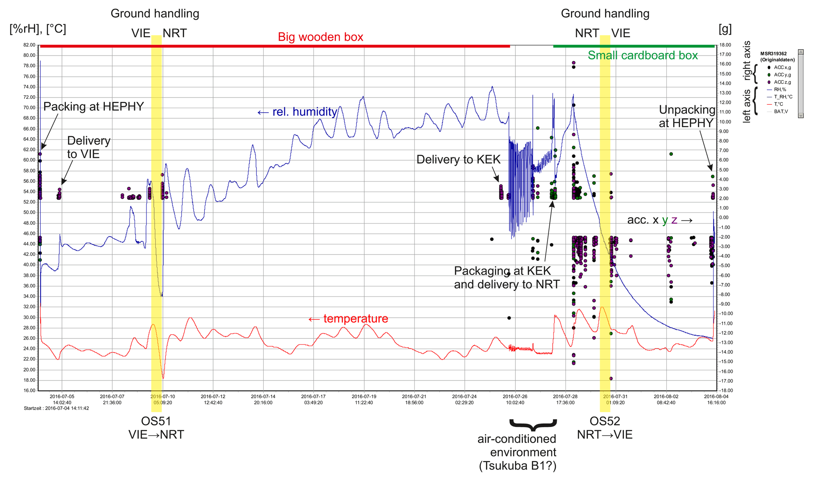
Packaging – Data Logger Output
See https://confluence.desy.de/display/BI/SVD+Logistics for explanation.

Slide 9
Customs Options – Intro
As always, there are several ways how to bring items to Japan
SVD has only used airbone carriers so far
Customs procedures depend on purpose and intended duration of goods in Japan

Slide 10
Customs Options – Normal Shipment
Requires:
(Proforma) Invoice issued by sender to receiver, should include name, serial number(s), TARIC code, value, country of origin for each item
Duration in Japan:
Forever or shorter (re-exportation possible)
Costs:
Consumption tax in Japan (8%)
Possible customs duties (depending on TARIC code)
Conclusion:
The most expensive option

Slide 11
Customs Options – Donation
Requires:
Proforma Invoice (see Normal Shipment)
MoU between your institute and KEK
Letter of Donation
Duration in Japan:
Forever! (no re-exportation!)
Costs:
None ☺
Conclusion:
The cheapest option

Slide 12
Customs Options – Comments on Donation
Success in not guaranteed a priori
SVD so far always suceeded (N=4)
Examples for successful documents are in Indico
If your institute does not allow „donation“, it might be possible to re-phrase it to satisfy both sides
It takes some time to prepare/translate documents
Allow ~2 weeks of processing in Japan
Donated items cannot ever leave Japan again
Customs can ask to see donated items anytime and this really does happen

Slide 13
Customs Options – Carnet ATA
Requires:
List of Items and values
Carnet document issued by the chamber of commerce in your country
Duration in Japan:
1 year maximum (not renewable in Japan)
Costs:
A small fraction of the items value (0.3% in Austria)
Conclusion:
The best option for beam tests or similar (self-carrying on aircraft is allowed)

Slide 14
Customs Options – Temporary Exportation
Requires:
Proforma Invoice (see Normal Shipment)
Very specific documents (not trivial)
Duration in Japan:
1 year (renewable)
Costs:
Consumption tax + duties deposit
Conclusion:
It‘s complicated – we failed to apply this option for the open CO2 system despite using Schenker company…

Slide 15
Carrier – Ourselves
L3 people chose to hand-carry their ladders (by airplane) to Japan
Best control over handling
But also full risk if something bad happens

Slide 16
Carrier – Commercial Carrier
The usual way of having something shipped from A to B
Transport insurance is normally not included, but cheap (~0.5% of value)
If a shipment of ladders disappears, it‘s very bad in terms of schedule and manpower – but at least we can recover the costs involved (especially for the DSSDs)

Slide 17
Carrier – Shipment Fragments
Airborne shipment is typically split into 3 parts:
Pickup from and delivery to air carrier (typically done by the company you hire)
Air freight (typically done by an airline)
Customs handling and local delivery in destination country
2 options → next slide

Slide 18
Carrier – Delivery Options
Basically 2 options (based in Incoterms):
1) DDP: Your shipping company is responsible for it
2) CIP Narita and „Notify“ contact in shipping document: Your shipping company‘s responsibilty ends in Narita, where a local agent takes over for customs handling and local delivery
We always do 2) with „K-Line Logistics“ as local agent hired by KEK (for both incoming and outgoing shipments)
In turn, we also do CIP Schwechat (Vienna airport) for incoming shipments to HEPHY, with Schenker being the local agent (typically doing IPR)

Slide 19
Summary
It‘s complicated, but there are solutions and experience
Feel free to contact me in case of specific questions

