Slide 1
Documentation & Whitebook
The PXD is approaching completion, the design is fixed –
However documentation is lacking or outdated
TDR: ……
Whitebook: is also too old, needs updates and revisions.
it is also a bit too verbose, with descriptions of obsolete iterations, test setups etc.
Conference proceedings: only short reports, not usable as reference.
For Jennifer it was agreed to edit a new version of the whitebook as deliverable
Deadline: November 2016
This is the first deliverable for Jennifer from the PXD group and has some importance.
Since it is not bound to the actual Belle II schedule, a delay can hardly be excused.
Groups involved in Jennifer: DESY, MPI, Bonn, Siegen, Heidelberg.
We (all of us) should use this opportunity to produce a new, up to date version of the whitebook:
Introduction into the project (for newcomers or non-Belle II readers)
Reference (should contain all relevant data about the detectir
Template for future publications (we should publish an official (NIM, JINST) paper by 2018.

Slide 2
Structure
Given the short time we need to keep the first version rather compact and extend it later
General introduction (overall detector concept, not much details)
especially for newcomers and non-Belle I readers
B) Reference Section
Detailed description of components
collections of tables, figures etc. Should contain all necessary data for reference
Performance (summary of relevant results from beam and lab tests
Operation (slow control, calibration, alignment)
Assembly and Integration (?)

Slide 3
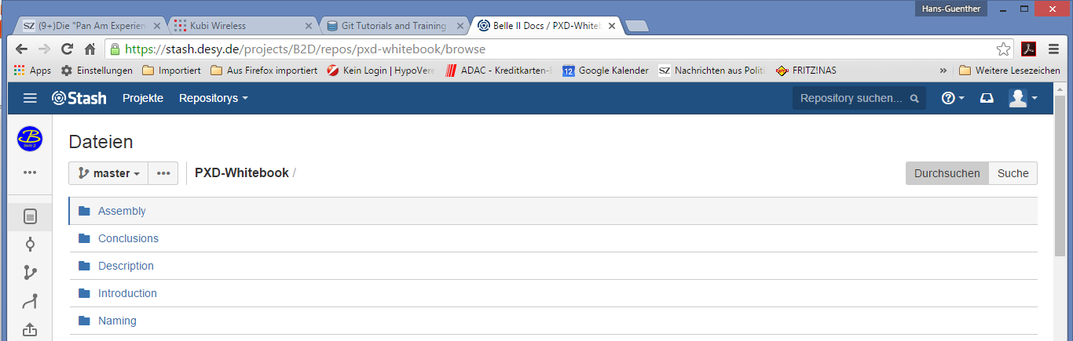
git
A git repository has been created: stash.desy.de/projects/B2D/repos/pxd-whitebook
It contains a latex templated of the document and subdirectories with templates of the various sections (but no content yet)
You can clone it (after setting up a local git repository) with
git clone ssh://git@stash.desy.de:7999/b2d/pxd-whitebook.git
Instructions at: https://www.atlassian.com/git/tutorials/#clone
You need a DESY account to access it!

Slide 4
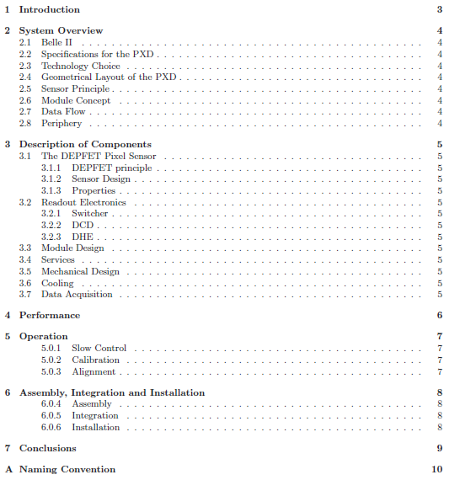
Proposed Structure
This is of course open to discussion
The latex template contains proposals for authors

Slide 5
Proposed Structure
Christian Kiesling, Hans-Günther Moser
This is of course open to discussion
The latex template contains proposals for (main) authors
This is also subject to discussion and availability
Volunteers ?
Rainer Richter
Hans Krüger
Laci Andricek
Stefan Rummel
Christian Kiesling
Hans-Günther Moser
Sören Lange
Carlos Marinas, Benjamin Schwenker
Michael Ritzert & ?
Carsten Niebuhr & ?
Christian Kiesling

Slide 6
Summary
Please sign up as author!
Install git!
Organise editorial meetings (first in 2 weeks, then bi-weekly)
Try to converge in December (I think I can delay the delivery date a bit)
Also: as original deliverable it does not need to be complete!
(and: each institution should send me a list of authors)

