Slide 1
Gated Mode Timing Observations

Slide 2
The Gated Mode
SwitcherB allows to operate Gating in two different Modes:
Gated Mode without Readout: Clocking is disabled, Clear moves to high for all gates except current one
Needs fast clocking to synchronize with correct readout position
Problem with DHPT1.0: when gating starts at end of frame, SerIn signal is omitted because of missing clock and hence full frame will be lost. Hopefully solved with new DHPT1.2 version.
Gated Mode with Readout: Clock continues to run, so frame readout will be synchronized with SerIn, Clear changes to high level immediately on non-active channels
Losing at least 600ns for turning in & out of Gated Mode
Hope for lower pedestal oscillations

Slide 3
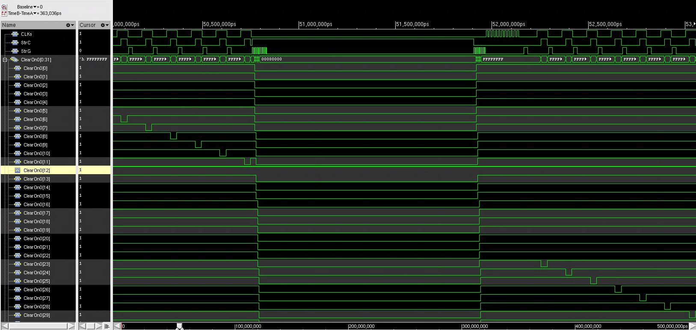
Gated Mode Simulation 11 gates @250MHz = 1,408µs
At least 5 StrG for initiating GM
Disable GM:
switch StrC to low +
falling edge of StrG
Fast
Clocking &
Returning to
Normal
Operation
224ns
Pure GM 1124ns
1 gate @250MHz = 128ns
36ns for Switching all Switcher Groups ON or OFF

Slide 4
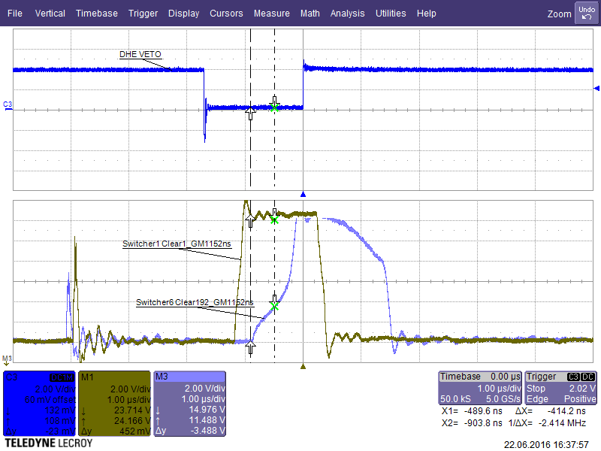
Oscilloscope Sw1/1 vs Sw6/4 GM 11 gates
Only first and last Clear contact are accessible via oscilloscope
Sw6/4
800ns ramp-up time
2.3µs total time
>1µs longer than
first Switcher group
This compares to a substantial lower rise time in the SwitcherB manual but bear in mind that 6 SwitcherBs, separated into 4 groups@8Clear channels have to be switched on at once (4 times consecutively within 36 ns)
Rise time Sw1/1 ~ 200ns
Rise time Sw6/4 ~ 800ns

Slide 5
Laser Scans GM 11 gates sequence
~200ns
Full Protection
~600ns
Laser Activation Timing moved forward in 10ns steps

Slide 6
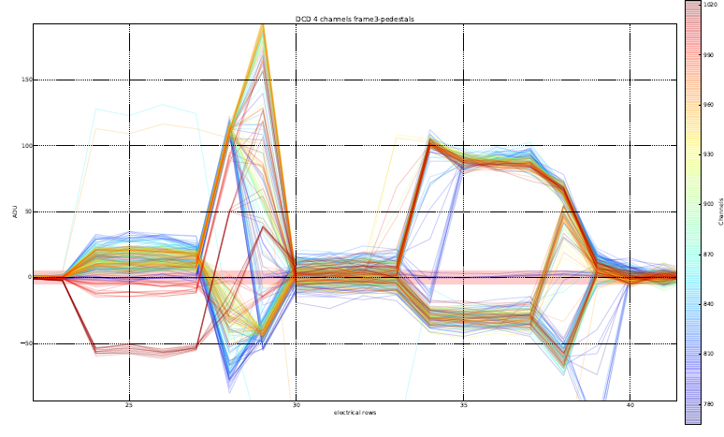
Pedestal Oscillations: 11 gates GM-sequence
Gate 34:
at least 5 StrG
signals finish GM
Gate 35-36:
Fast Clocking
GM starts at gate 24*
GM Gate 25-33 Clear High
Extreme Amplitudes delayed reaction of Switchers 200-800ns
~2-6 gates
Higher pedestals due to Sw6/4?
Total GM period of 18 gates including pedestal variations
* DHPT1.0 Bug: GM is programmed for gate 22 but normal mode repeated twice

Slide 7
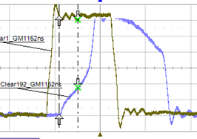
Oscilloscope Sw1/1 vs Sw6/4 GM 11 gates zoomed
gate 24
gate 28
gate 34
gate 42
Time base: 1µs/div

Slide 8
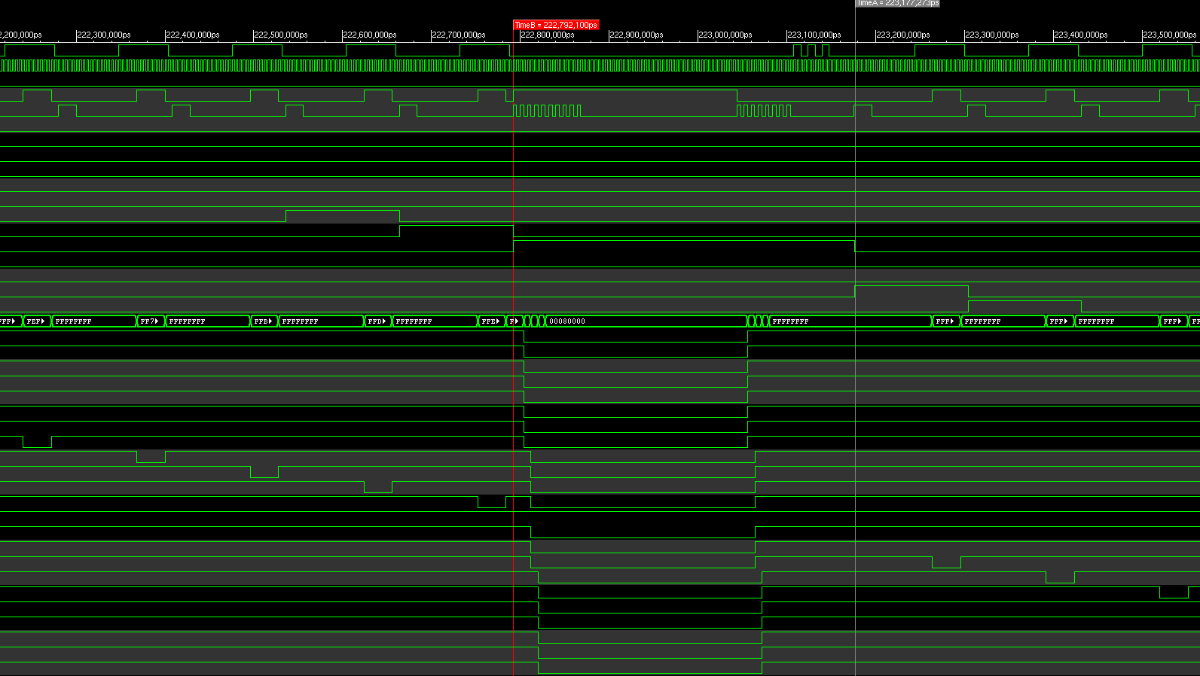
Gated Mode Simulation 3 gates @250MHz=384ns
At least 5 StrG for getting into GM
Fast
Clocking &
Returning to
Normal
Operation
84ns
Pure GM 228ns
36ns for Switching all Switcher Groups ON or OFF

Slide 9
GM11gates vs GM3gates first Clear
Measured 14V
(C_{high}=20V, C_{low} =5V)
GM protection
effective @ 9V
above C_{low}

Slide 10
GM11gates vs GM3gates last Clear

Slide 11
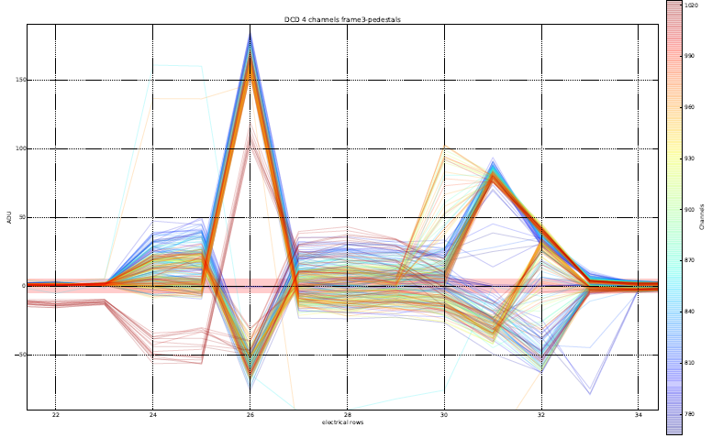
GM short 384ns sequence
same starting sequence pedestal peak at gate 26
pure GM period reduced by 7 gates,
fast clocking now only 1 gate
everything else equal
STRANGE:
Reason for higher pedestals 4 gates after stopping GM unclear
Total GM period reduced to 10 gates = 1,28µs including pedestal variations

Slide 12
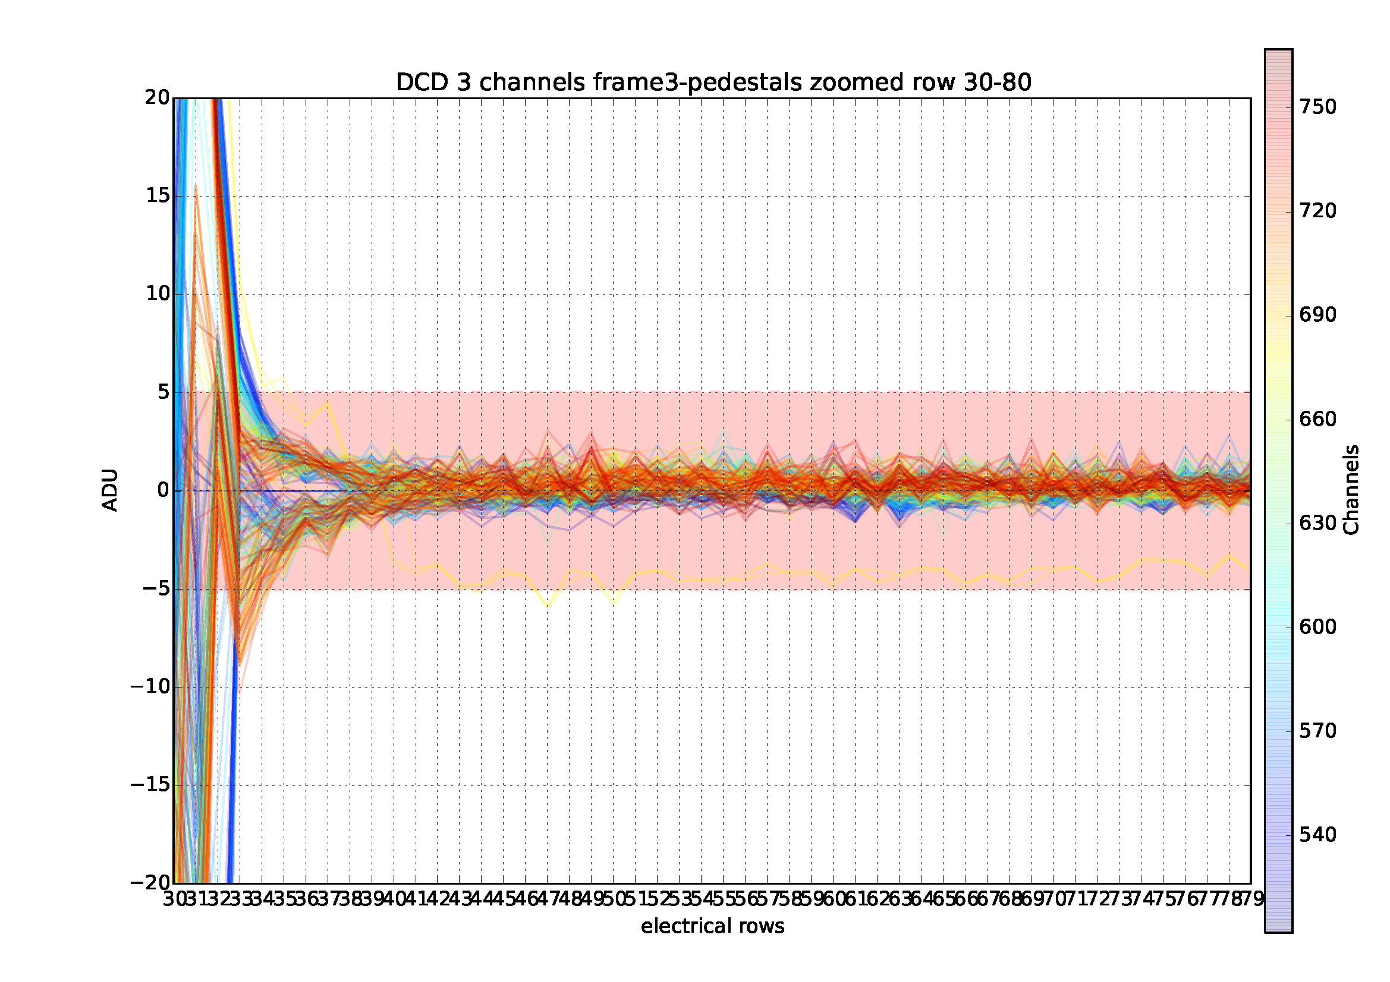
It’s not only a time constant… 250 MHz
Total GM period of 10 gates including pedestal variations

Slide 13
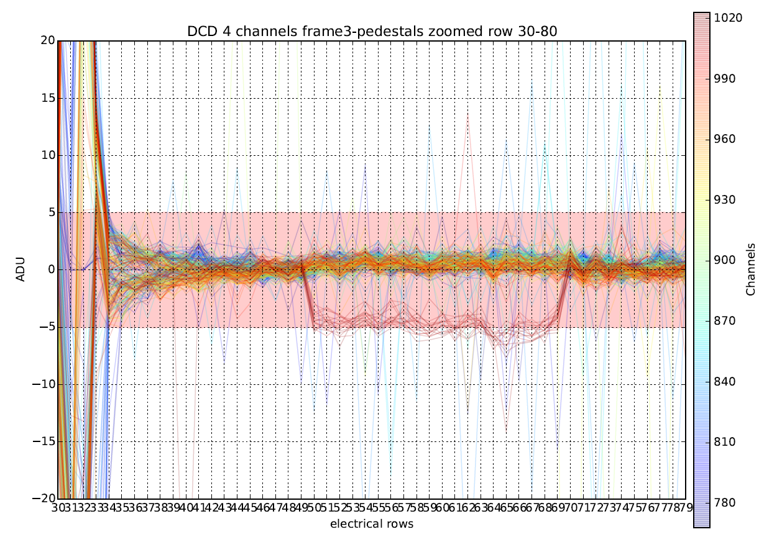
Pedestals back in range at gate 34 @285 MHz
Total GM period of 10 gates including pedestal variations

Slide 14
Short Cables – 11 Gates GM w/o RO overview
DHPT reset at
end of frame
No idea where this is coming from

Slide 15
Short Cables – 11 Gates GM w/o RO zoomed

Slide 16
Long Cables – 11gates GM w/o RO overview

Slide 17
Long Cables – 11gates GM wo RO zoomed

Slide 18
3gates GM w/o RO overview (DCD3 short cables)

Slide 19
3gates GM w/o RO zoomed (short cables)

Slide 20
6gates GM with Read-Out overview

Slide 21
6gates GM with RO zoomed
although relatively short GM period pedestal oscillations persist longer than even 11gates w/o RO
variation spread thereafter seems to be substantially lower!

Slide 22
10gates GM with RO overview

Slide 23
10gates GM with RO zoomed
Pedestal oscillations are within arbitrarily chosen threshold limit of ±5 ADUs
not before 23 gate periods = 2,94µs

Slide 24
GM11gates w/o RO analog CMC overview

Slide 25
GM11gates w/o RO analog CMC zoomed
In general ACMC looks better but risk that leveling out absorbs signal charge information

Slide 26
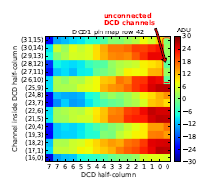
ACMC, Single Row Pedestal Oscillations
Distinct DCD-Gradient disappeared after fixing cooling problem and attaching additional capacities on dock-box and break-out board
Low IPaddIn seems to “swallow” low signal charge
BEWARE: ACMC seems to amplify higher signals

Slide 27
Analog CMC, IPAddIn = 30

Slide 28
Analog CMC, IPAddIn = 60

Slide 29
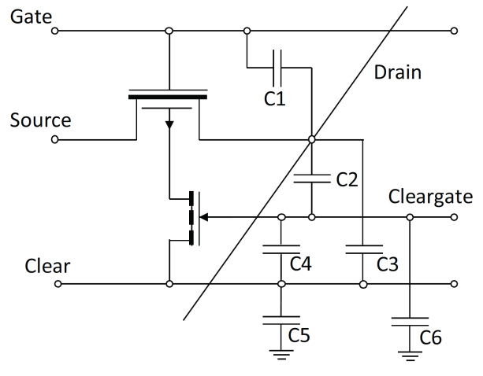
Summary (1)
Fast switching in & out of Gated Mode is key for the performance of the pixel detector
Various parasitic capacitances extend
rise and fall times of Clear voltage
at gate level
For various reasons (reducing deadtime, sync with CDC) the BELLE II collaboration wants to keep the total GM period (GM + pedestal oscillations) as short as 1µs
Pedestal Oscillations after the Gated Mode can prevent the detector from recording reasonable data
The presented analysis is based on meager Switcher Substrate connection at least for Switcher 5 + 6 (PXD9 Pilot Module), hence it is very difficult to draw accurate conclusions.

Slide 30
Summary (2)
All we have are the following observations:
Pedestal Oscillations constitute a complex process, not everything can be traced back to a time constant
Pedestal Spikes after finishing GM look strange and have potentially something to do with the long fall time for the last switchers
It was shown that the shortest GM sequence (3gates w/o RO) reduces total GM time to 10 gates which would be equivalent to ~1µs @305MHz – CAUTION because of last switcher
GM with readout seems to elongate the total GM period although once falling under a certain threshold level pedestal variations appear much smoother
Mounting additional capacities on the dock-box and the patch panel as well as the analog CMC seem to reduce the Pedestal Oscillations
Looking forward to PXD9 series 7 incorporating heavily improved switcher voltage supply lines in order to find out more resilient results

Slide 31
Thank you for your attention!

Slide 32
Analog CMC, IPAddIn = 60, ECG

