Slide 1
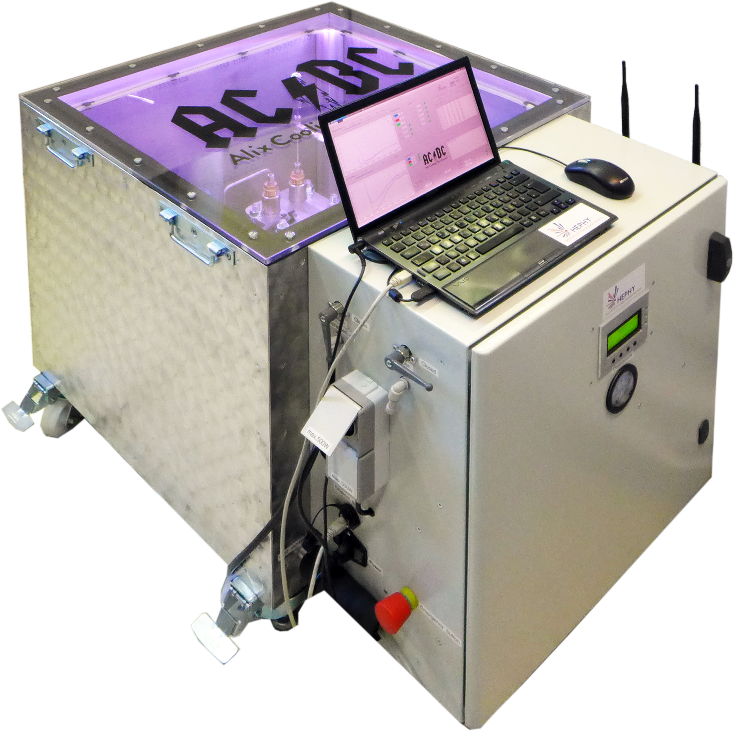
ACBC
Alix Cooling Box Control
16 Sep. 2016
ACBC
F. Buchsteiner

Slide 2
ACBC - Introduction
Open CO₂ Cooling System
O(100 W) Cooling Power
O(1 g/s) Mass flow
Cooling Box
E-Hut
2

Slide 3
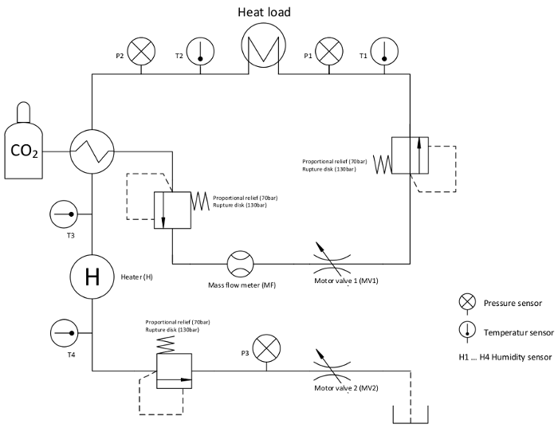
Cooling Box - Schematic
3

Slide 4
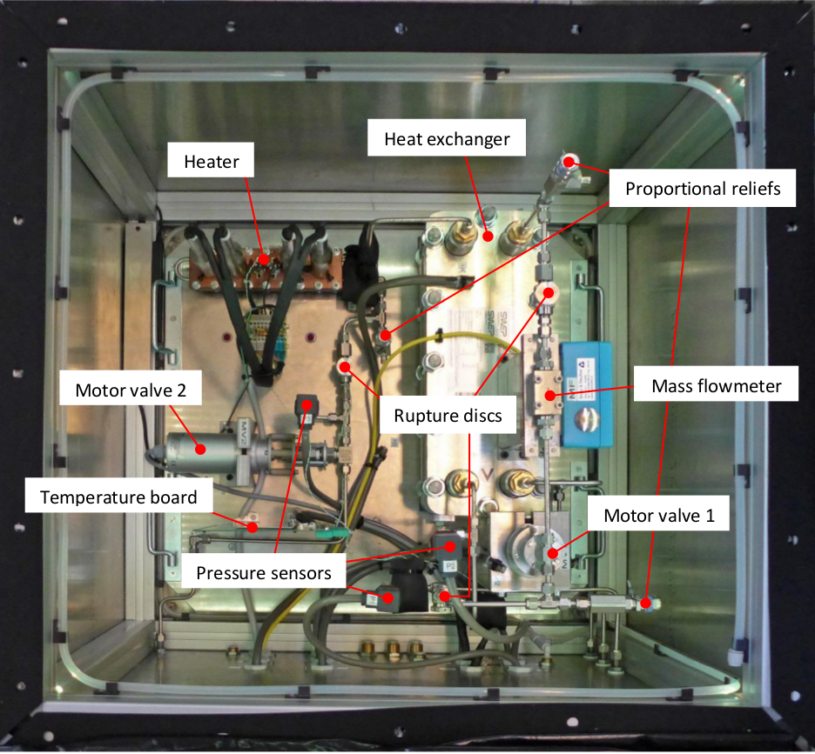
4

Slide 5
Cooling Box - Components
Heat-exchanger
  200 bar
Heater
  4 x 260 W @ 200V
Motor-valves
  10 turns
  20 positions
  +/- 0.2 %
Pressure-sensors
  P_{op} : 0 – 59 bar
  +/- 0.8%
Thermocouples
  Type: K
  T_{range}: –75°C to +250°C
Mass flow meter
  Coriolis type
  Range 0-20 g/s
5

Slide 6
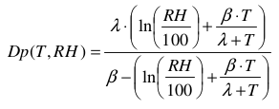
Cooling Box - Components
Dew-point (not very precise)
Temperature and relative humidity measured
Humidity - Temperature sensor (cheap):
  Temperature tolerance: -/+ 1°C
  Humidity tolerance: -/+ 5%
  Sensors not directly on cooling pipe
Calculation
  RH...relative humidity
  T...Temperature
  Alpha, beta ...Magnus parameters
6

Slide 7
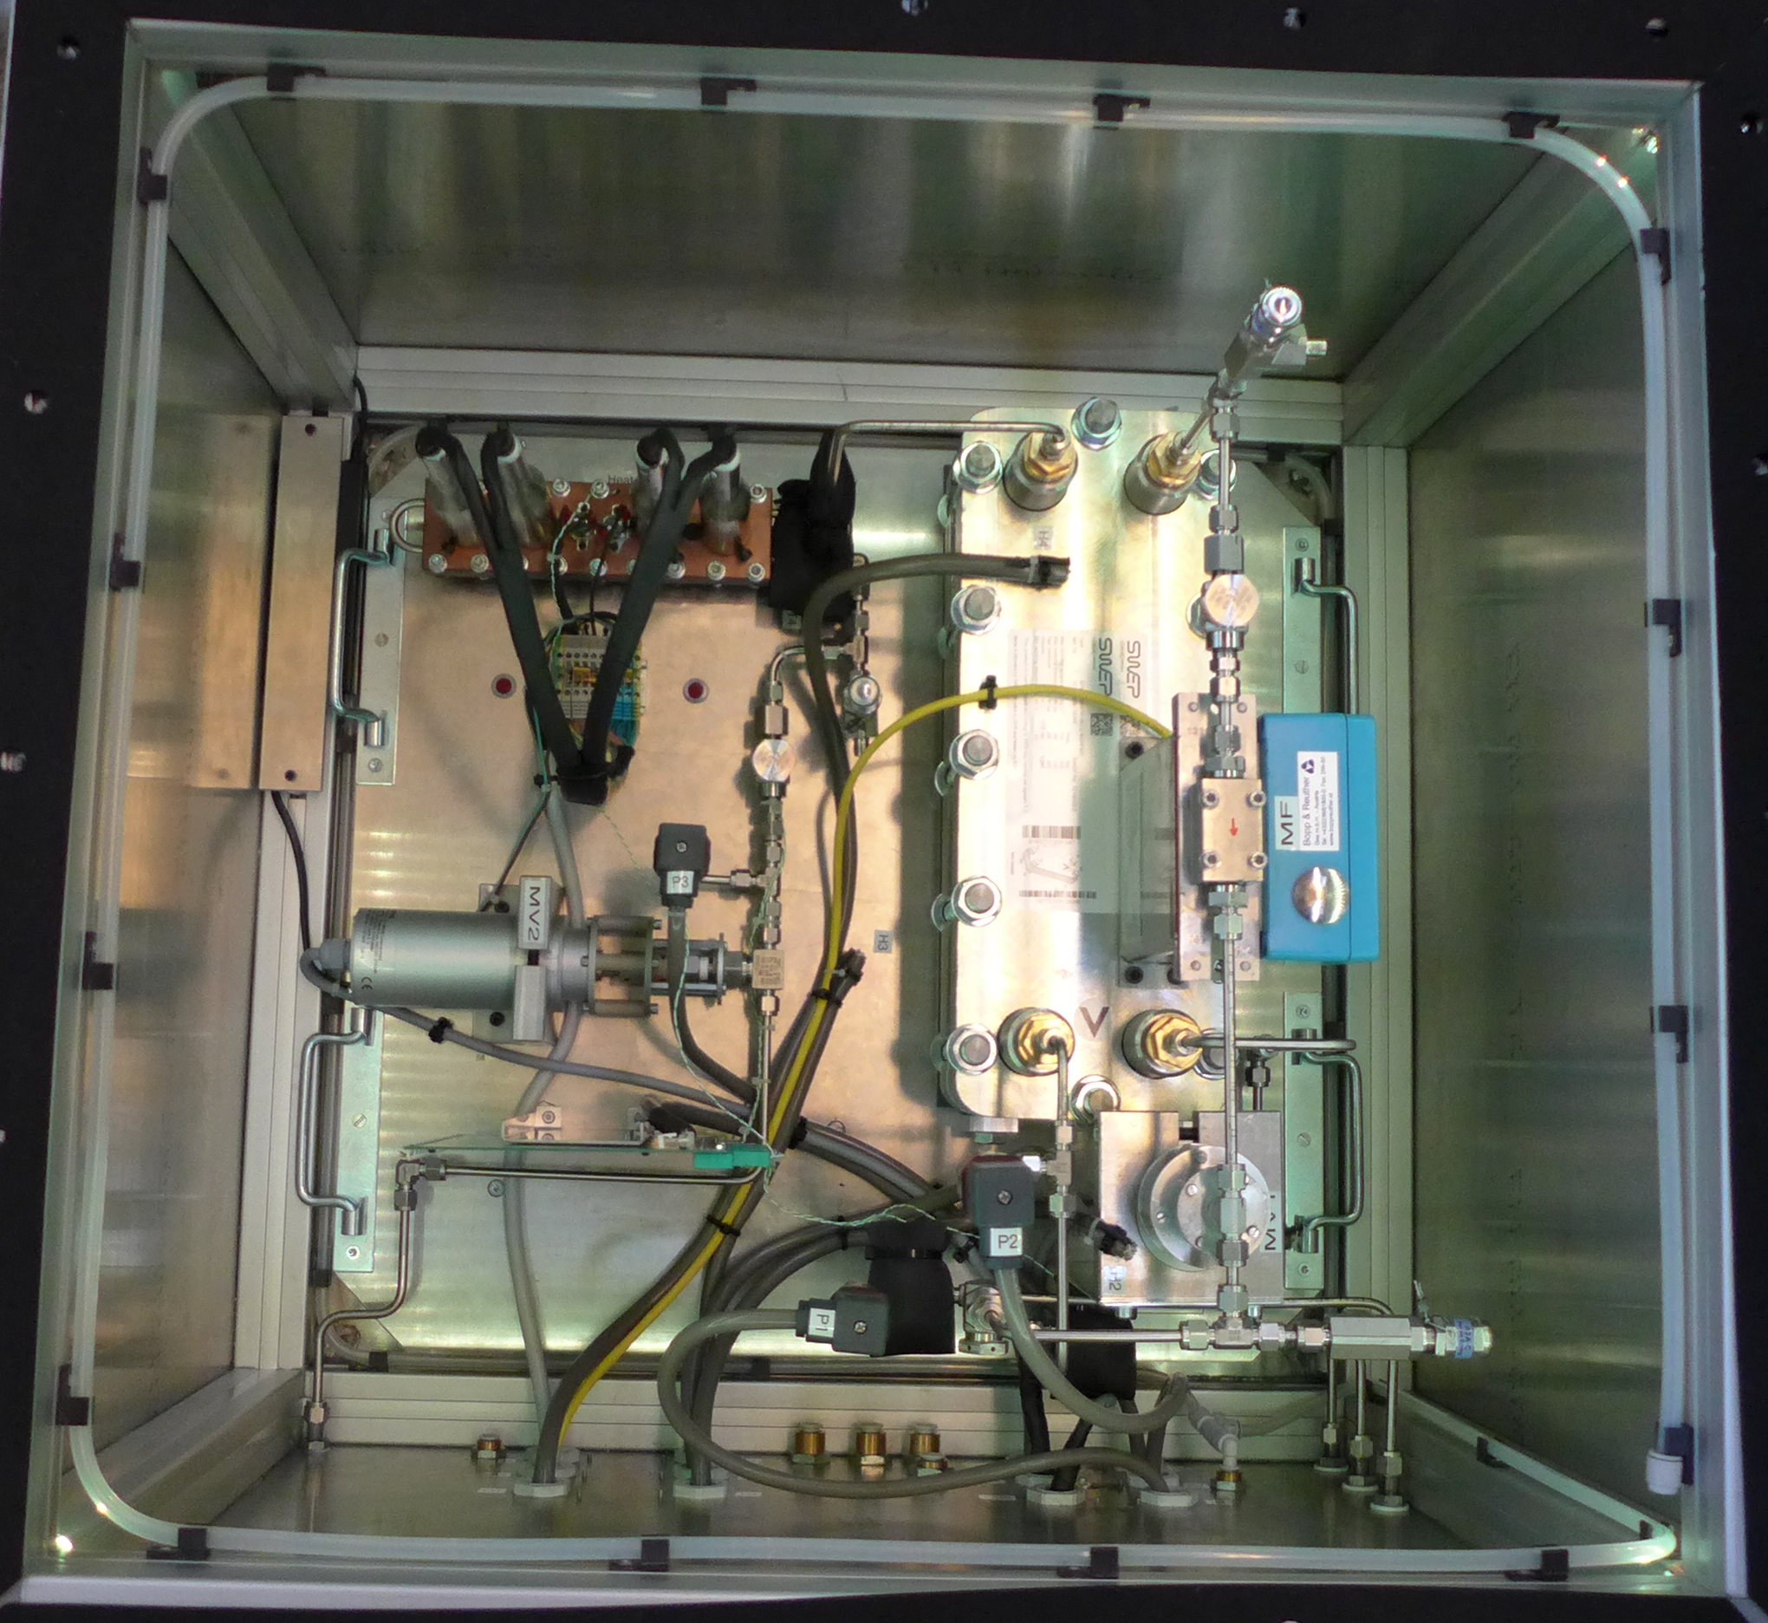
Cooling Box – Safety Components
Pressure relief valve
  Gauged at 70 bar
Burst disk
  130 bar
7

Slide 8
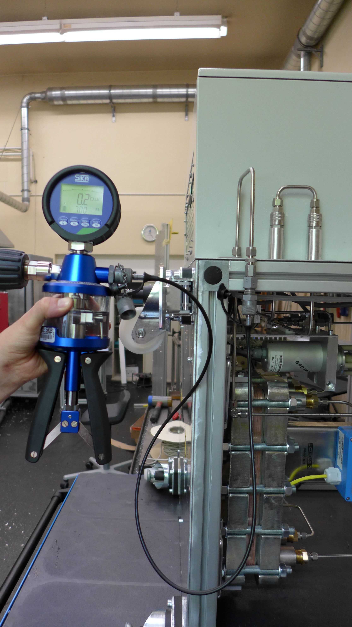
Cooling Box – Pressure Tests
Setup tested with 140 bar
  Test liquid: distilled water
  Burst disks (200bar)
  Relief valve (gauged at 300 bar)
Setup tested with 70 bar
  Test liquid: distilled water
  Burst disks (130bar)
  Final configuration of Relief valves
8

Slide 9
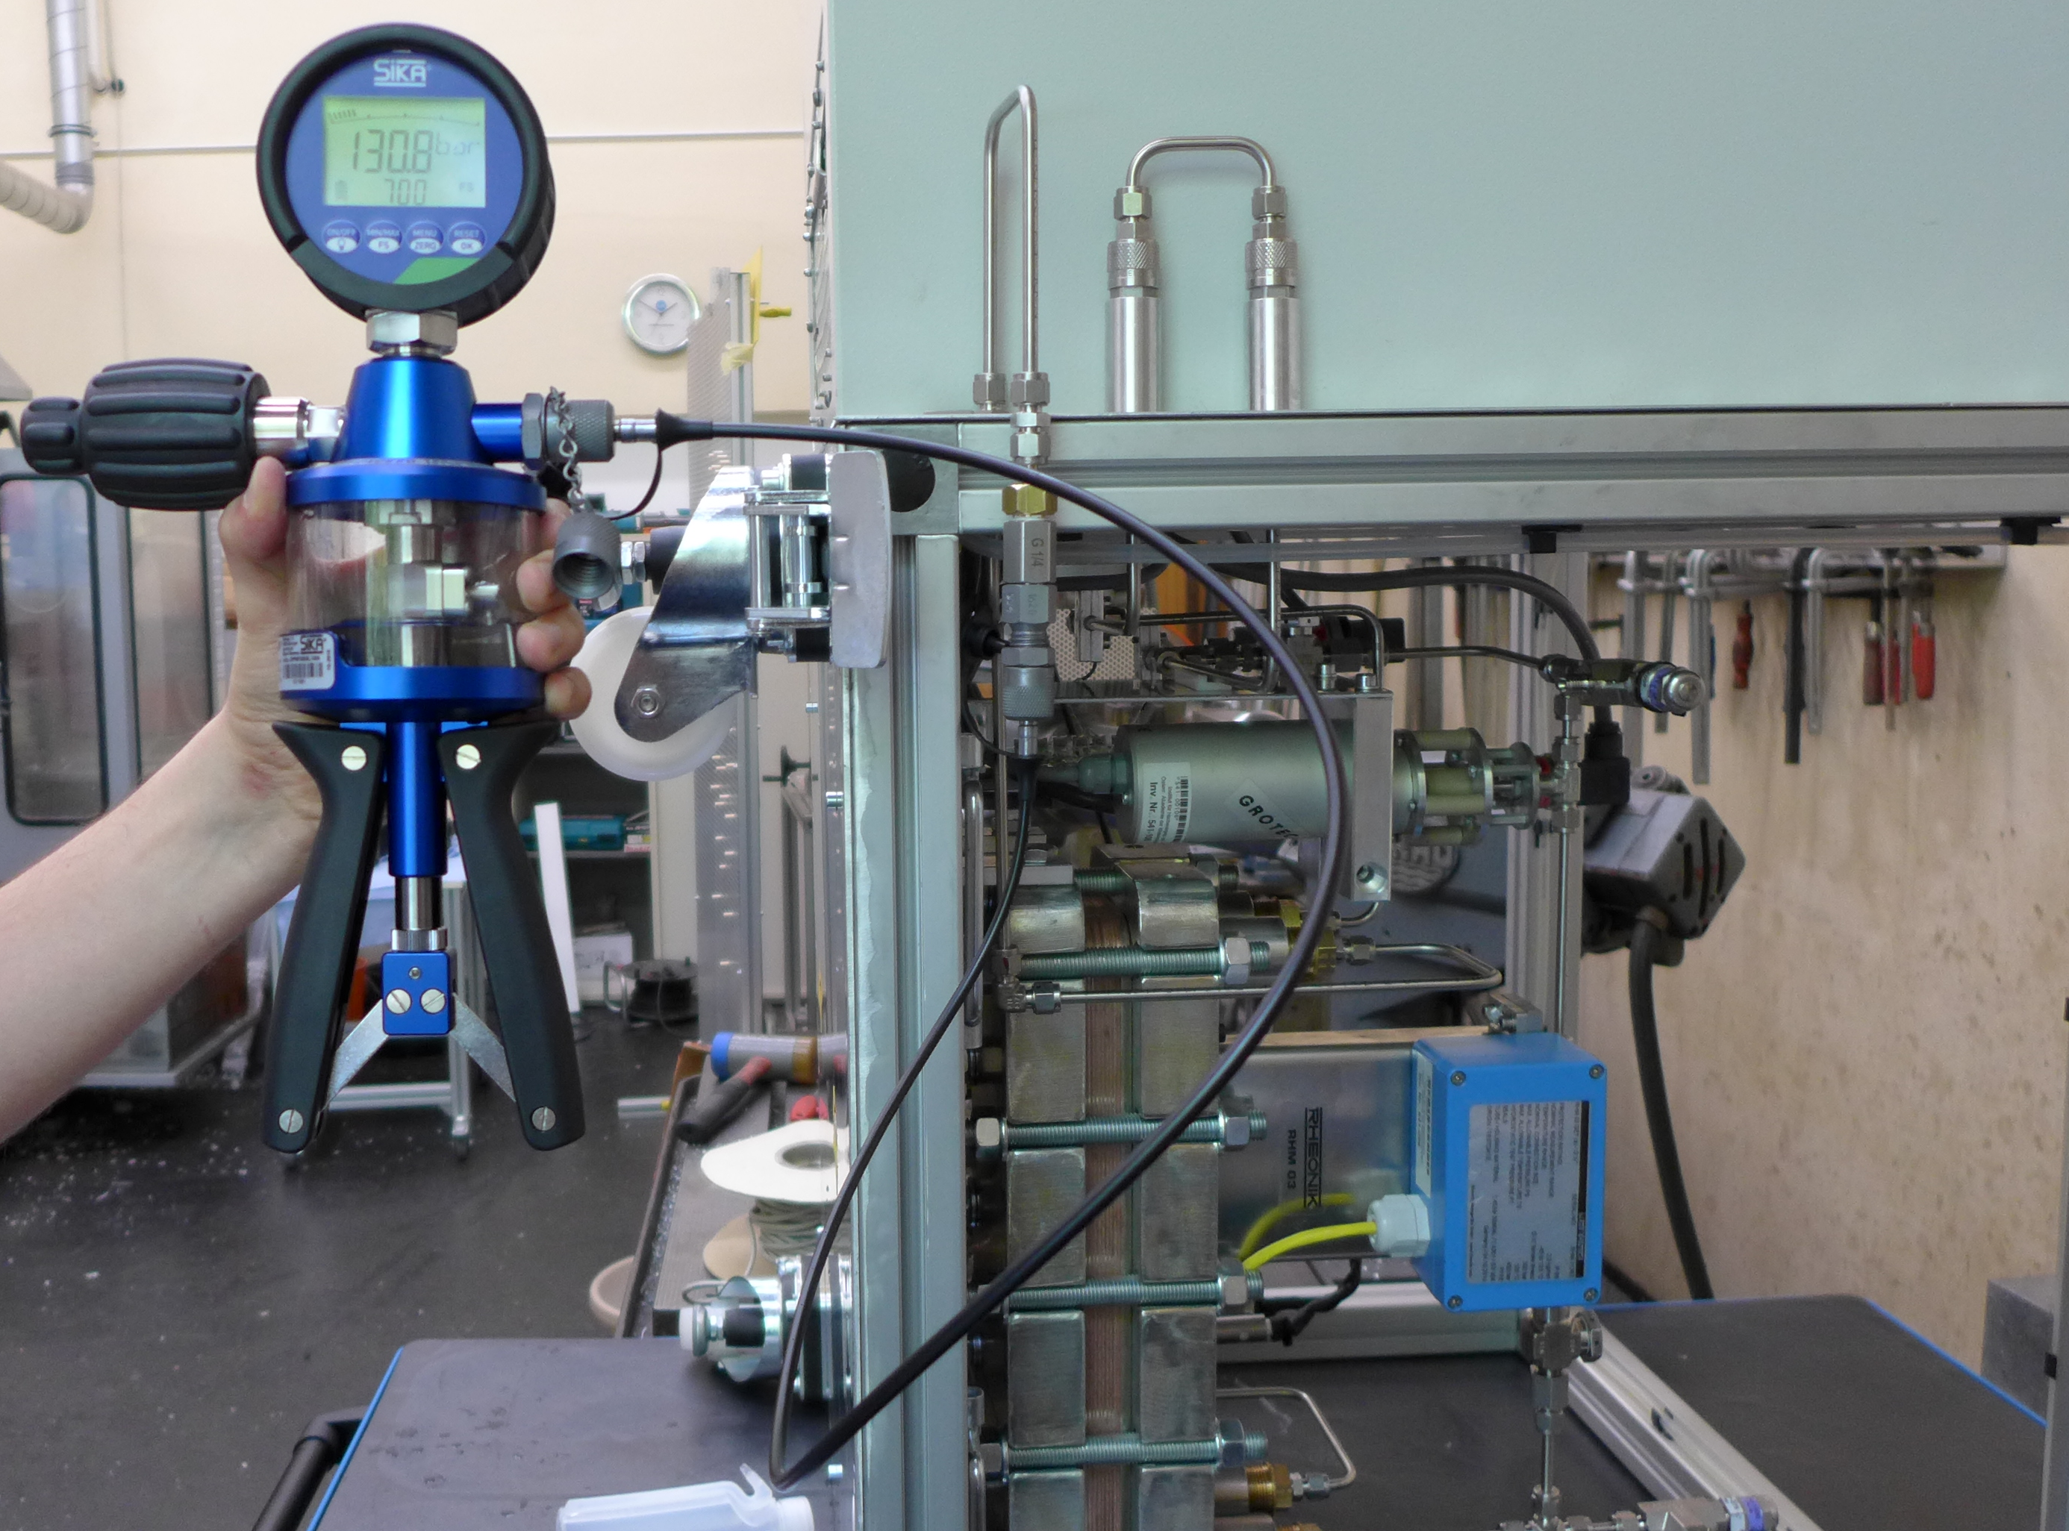
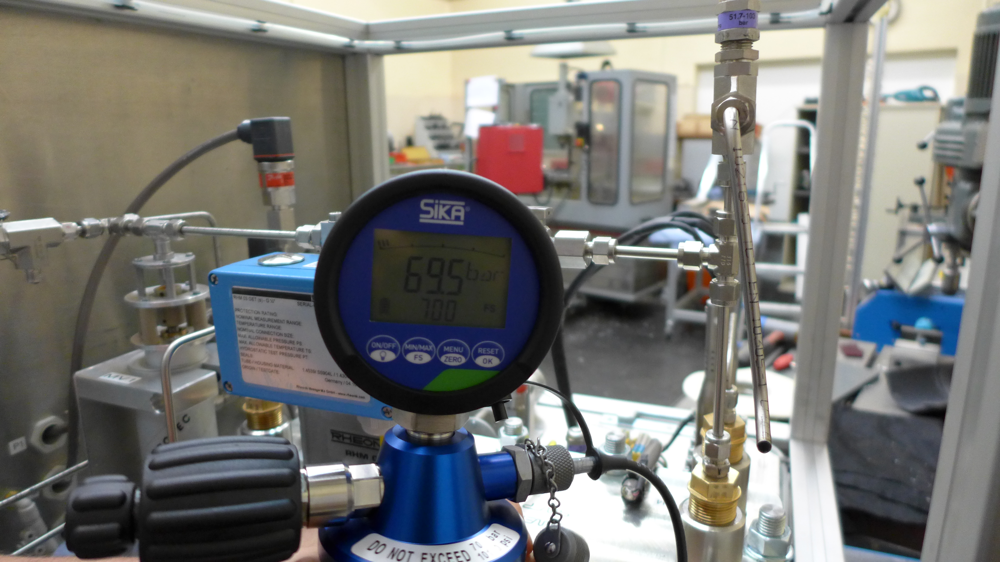
Cooling Box – Pressure Tests
9

Slide 10
Cooling Box – Dry Air
Membrane Air Dryer
  Maintenance free
  Input: 225 l/min, Output: 150 l/min
  Requires minimum pressure of 3 bar
  Feed by 3 Filters for moisture, oil and solid foreign material
Regulator with Built-in Pressure Gauge
  0.5 kPa
Volume-flow-meter
  Monitored by software
Cooling Box
  Flooded with dry air
  Sealed with EPDM with specific silenced exhausts
  Overpressure
10

Slide 11
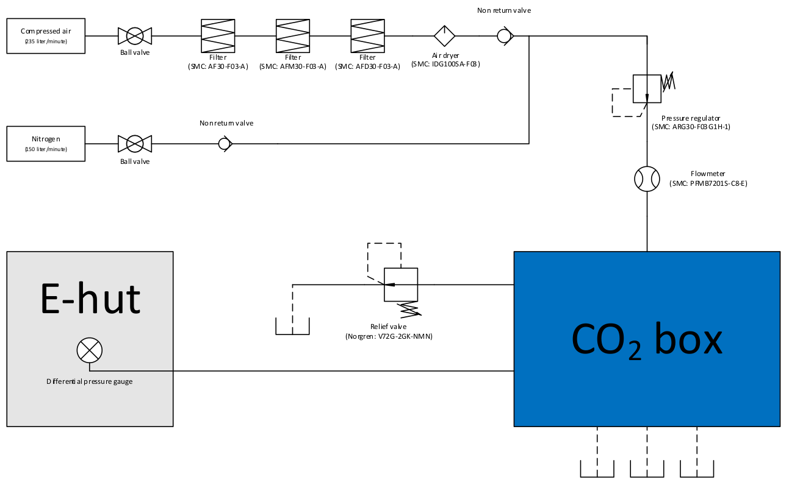
Cooling Box – Dry Air
11

Slide 12
E-Hut - Components
Dry Air Components
  Membrane + Filters + Pressure regulator
Power supplies
LCD-Display
  On/off Status
  IP address
  TCP/IP communication progress
WLAN-Router
  Provides an internal LAN
  Connects to WAN via Wireless
12

Slide 13
E-Hut - Components
Power capacitors
  Power to close motor valve 1 in case of power cut
Emergency shutdown
13

Slide 14
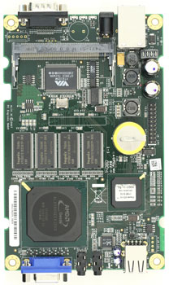
E-Hut - Components
Alix
  PC Engine with System-board
  Read Only OS
    Flash-memory protection
  Alix board v2
    I2C bus sensor data readout
  Ethernet network connection
    Connect to LAN
    TCP/IP communication via strings
14

Slide 15
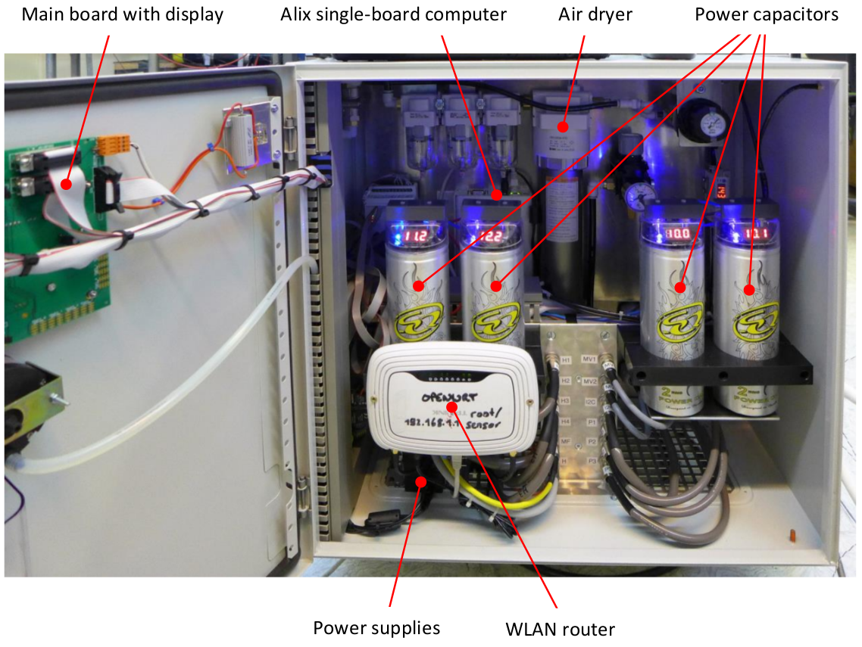
15

Slide 16
Software ACBC-GUI
Control Notebook
  Xubuntu 16.04 LTS
ACBC-GUI
  Communicates via TCP/IP with Alix
  Update rates
    5 sec for Temperatures and humidity
    1 sec for pressure, mass flow and motor valve
  Temperature graph (0-24h)
    T1-T4
  Pressure graph(0-24h)
    P1-P3
    Mass-flow (not recorded)
16

Slide 17
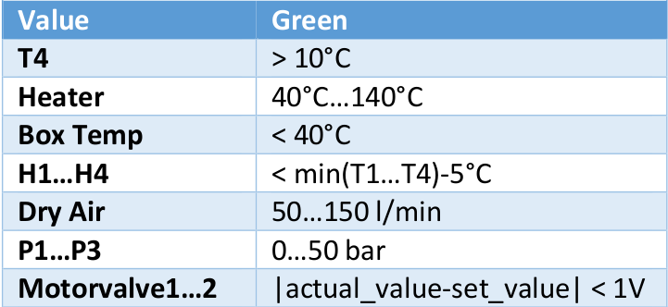
Software ACBC-GUI
  Temperature recorder
    Written into a CSV file (reset creates new file)
  LED
    Illustrate forbidden ranges
    If red alarm sound (except motor-valves)
Operation of the CO2 system requires that a person always remains
within audible distance from the notebook in order to react to possible alarms
17

Slide 18
Current Software ACBC
Mass-flow Controller
  Manual control or PI-Controller
  Mass-flow is the reference variable
  Motor-valves are the controlled variables
    Both are controlled by the same value
    Feedback variable is the returned voltage
  Set value can only be changed if ACBC-GUI is stopped
CO₂ consumption
  Calculated via mass-flow meter
  Can only be set to zero if ACBC-GUI is stopped
18

Slide 19
Planned Software Extension
Mass flow (mainly) depends on MV1
Pressure → temperature (mainly) depends on MV2
We will try to add temperature control loop on top of mass flow during October B2GM
  Slower time constant intended for mutual stability
19

Slide 20
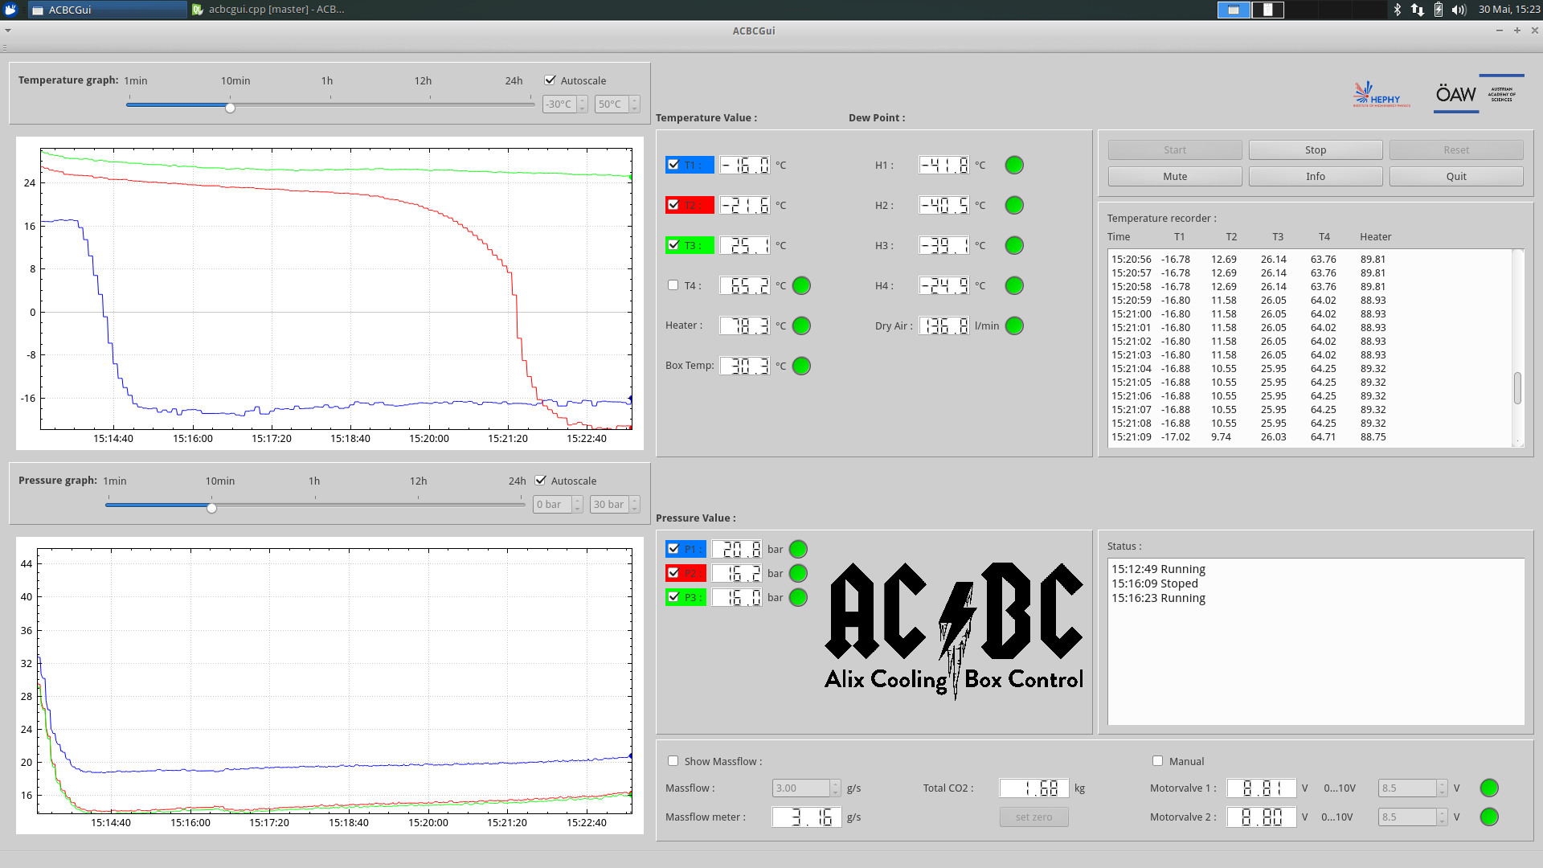
20

Slide 21
Tests and Performance
Test Setup
  20 m transfer line
    ID = 4 mm
  Test DUT
    50 cm stainless steel cooling pipe
    ID = 1.4 mm
    Armaflex isolated
    Temperature sensor
  0 W -200 W adjustable heat load
21

Slide 22
Tests and Performance
Approximation for mass-flow adjustment
  Measurement of temperature rise by lowering mass flow
  Repeated for different powers of heat load
22

Slide 23
Tests and Performance
Guidance for adjustment of the mass flow
23

Slide 24
Tests and Performance
Mass flow: 2 g/s
DUT temperature: -10C°
(not shown in plot)
50 W heat load once cold
Run duration: 1h
24

Slide 25
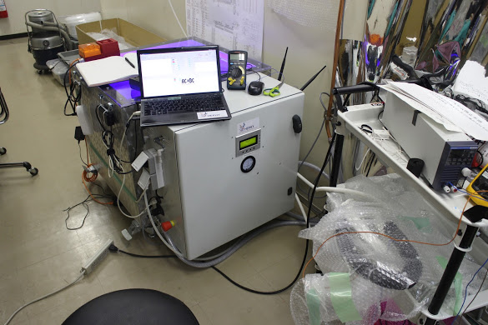
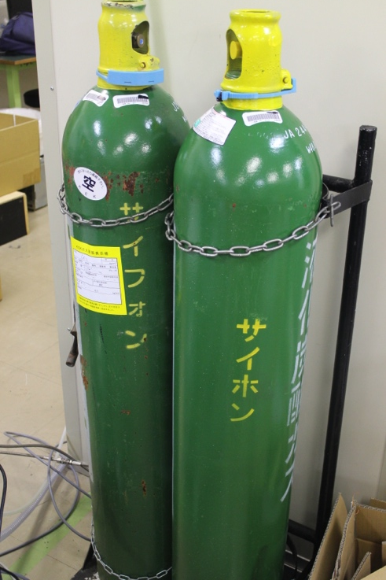
CO2 cooling system setup at KEK B1
Katsuro
From 1 CO2 bottle, about 20kg CO2 is available for the CO2 system
  (actual amount of CO2 inside the bottle is 30kg).
Currently, once one CO2 bottle gets empty, we have to switch off the CO2 cooling system, connect to another bottle, and then restart the CO2 system.
In future, we will implement switching valves, which enable us continuous switching the bottles without stop of the system.

Slide 26
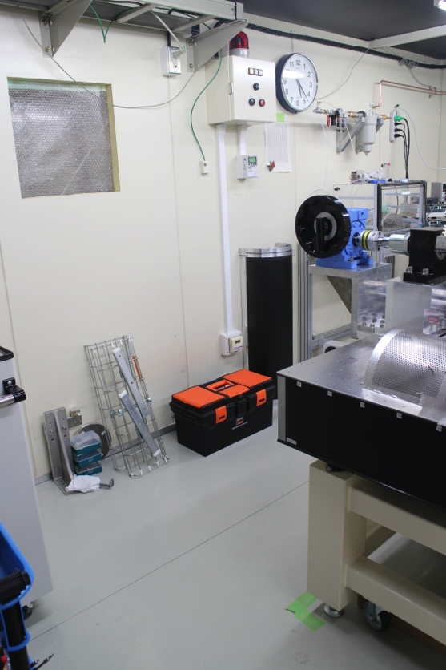
Future open CO2 system setup in clean room
Katsuro
B1 clean room
cable
window
fixed on
the table
ladder mount table
fixed on
the table
open
CO2
system
FWD inlet/outlet
BWD inlet/outlet
cover
All the cooling pipes will be laid on the floor in order to prevent dew drop from the roof.
FWD and BWD cooling lines are selected on the open CO2 system side.
All the necessary parts are under quotation now. They will be set up by the end of Oct.

Slide 27
Safety interlock system
Katsuro
We had a small accident:
  CO2 system was turned off while the heater to the dummy load was kept on.
  Fortunately, before smoke or fire, we notice it with a bad smell from the load.
  The same accident happened when Lukas tested the system.
Possible solutions:
  Interlock signal from the temperature sensor on the load.
    We will implement it soon.
  Interlock signal from the open CO2 system
    Currently, there is no such output from the system, which indicates whether the system is running properly or not.
    It is good that the system has such output for safety purpose, and this makes the system simple.

Slide 28

Thanks for your attention
Created and designed by Florian Buchsteiner, Lukas Bulla and Markus Friedl
28

