Slide 1


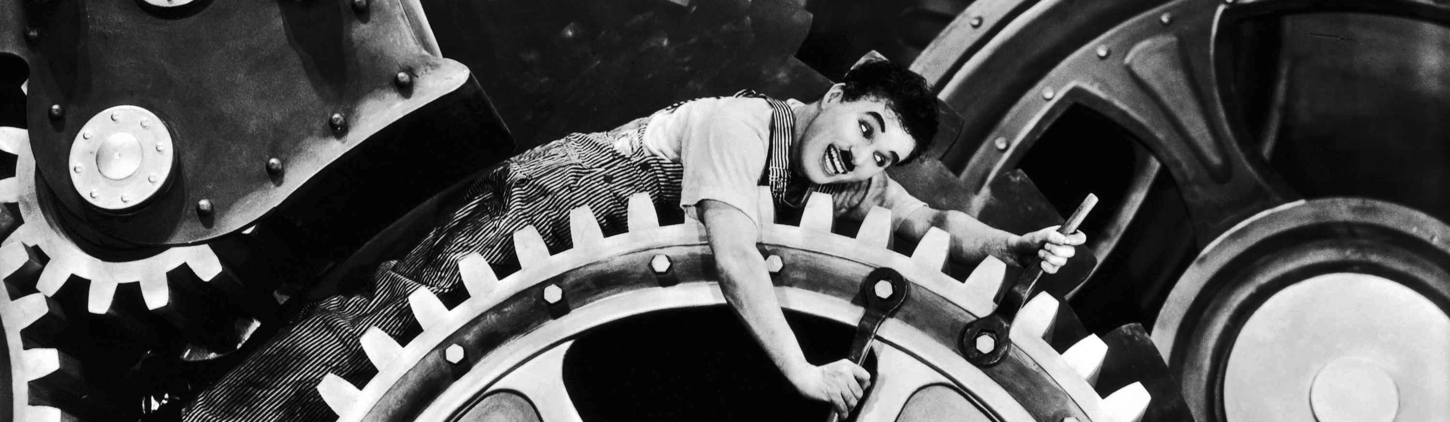
Commissioning
Install and debug software (necessary changes, EPICS!): PLC EPICS:
Check complete setup (with CERN expert)
Basic functionality tests (SCADA instructions and expert commands).
Pressurize complete system with N₂ and check for tightness.
Fill with liquid CO₂, run without insulation (cannot reach design temperature)
Complete foam insulation
Operate at design temperature
Safety inspection => June 29/30
Long term tests => July and later at KEK
Response to change of operation conditions (load on/off…)
Exercise maintenance and emergency scenarios.

Slide 2
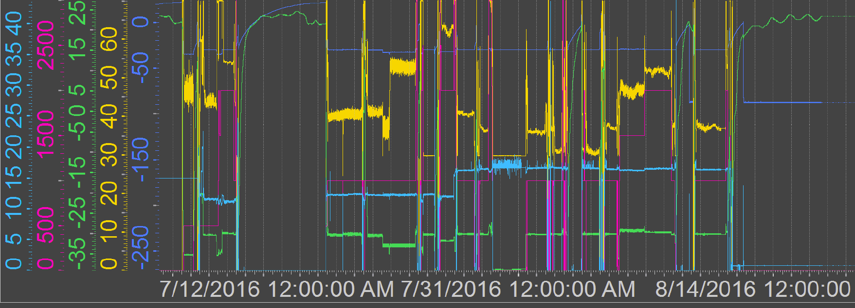
Long Term Operation
(almost) continuous operation for 1 months
12.7.16
11.8.16
CO2 temperature
Compressor speed
Accu temperature
Heater power
False alarm during 0 power operation
Installation of weighing scale
CO2 flow
Off, Zaragoza
CO₂ temperatures of -30°C (sometimes -32°C and -35°C)
Heater power in JB: 0W – 3000W
CO₂ flow 12g/s and 16g/s
Very stable operation, only 1 (false) alarm

Slide 3
Dry Out
Test for dry out: Tset = -30°C, flow: 12 g/s
Increase heater power: 2500W => 2950W
2900W
2950W
2750W
2800W
Flow increased to 16 g/s
2500W
Heater surface temperature
Dry out
Dry out can be controlled by increasing CO₂ flow
Gas temperature at outlet of heater is not very sensitive to dry out!

Slide 4
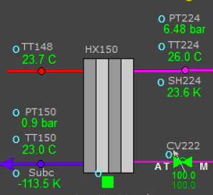
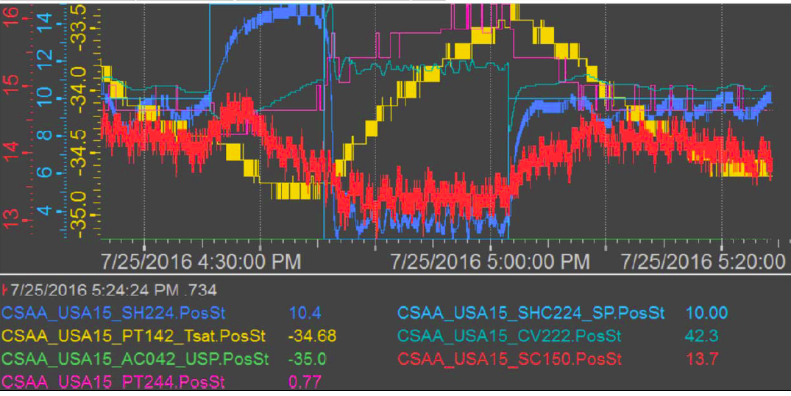
Tuning
Optimization of regulation parameters
Setpoint of superheating after main heat exchanger (SH224)
Choose setpoint to achieve lowest CO₂ temperature
15
10
10
CO₂ temperature
2.5

Slide 5
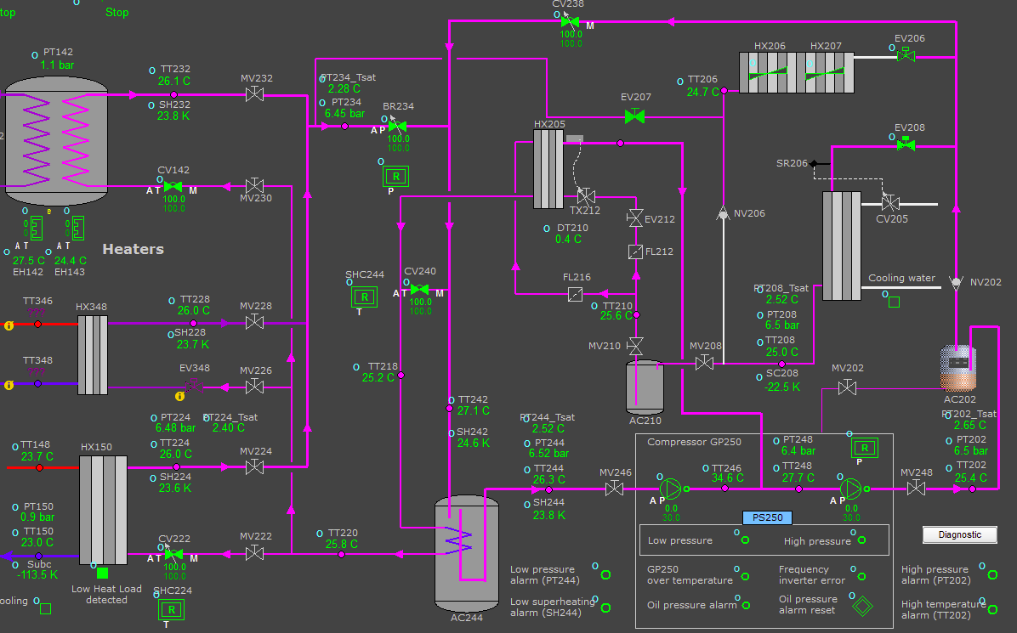
Chiller Regulation
Power off:
Regulation in the range of 300W – 3000W works without problems
But switching off from 1000W or 300W to 0W causes instabilities
Regulation is too slow and the chiller switches off
No load causes SH224 to get cold (return of liquid CO2)
SH242 and SH244 goes down
< 2K: chiller switches off,
(Danger of injecting liquid in compressor)
As regulation CV238 opens to inject hot gas and increase SH244

Slide 6
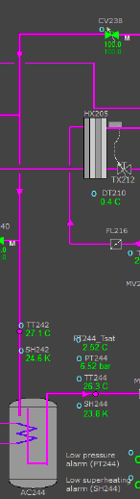
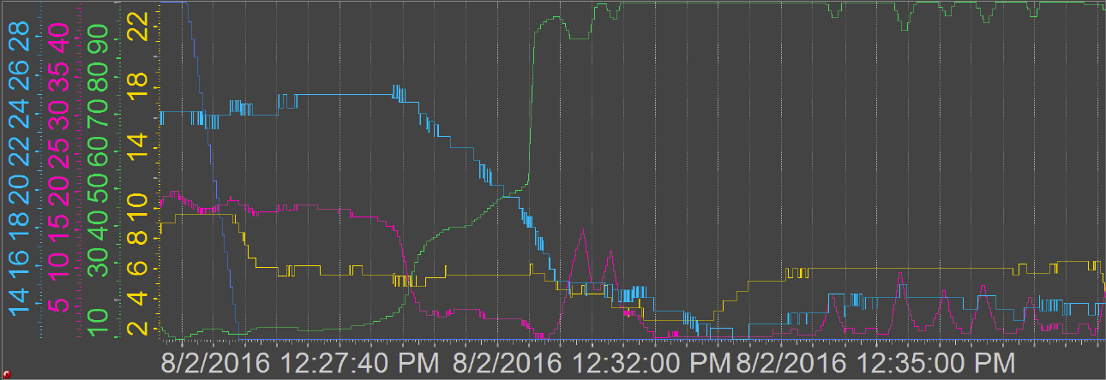
Regulation after Power Off
Return temperature goes down
Consequently CV238 opens
But too slow, SH242 drops further
at a certain threshold CV238 opens to >90%)
SH242 reacts, but shows oscillations
SH242 goes down
SH244 follows SH242 with a delay, finally just kept above alarm level
Power off
Need to find subtle compromise between PID speed and stability. Other PID controller interfere!

Slide 7
New Features
CO₂ monitor (with flashlight and sound) was installed (can be read by EPICS)
Scale to weigh accumulator and measure the CO2 content
Display (g)
rms: 33 g
Test weight (g)

Slide 8
Preparations at KEK
Clean up of area: Early October by company
400V 3-phase transformer: delivered, cabling by company, circuit breaker installed
Compressed air (6.6 bar): temporary connection being prepared
Water pipe connection (25°C, 3 bar): being prepared.
Hole drilling for anchor: ?
CO₂ bottle and cart: will be delivered in October by company
Scale for weighing CO₂ bottle: can be bought within a week
O₂/CO₂ monitor with alarm: one set delivered
Network: Lan required, Control PC will be in E-hut) ?
R404a filling: confirmed by Sanei-Giken, quotation expected
Prepare scaffolding for manifold piping: Adachi-san is taking care
Connection tubes for CO₂: request made to Suzuki-Shokan
Tools and furniture: to be ordered, delivery early October
Vacuum for flex lines: 10⁻⁷ bar, from vacuum group (or sharing helium pump)
By Shuji-san

Slide 9
Commissioning plan at KEK
IBBelle under way in vessel (MOL Brightness)
Arrival in Tokyo ~ October 12
Transport to KEK: October 18
Formalities and transport arranged (Toru-san, K Line Logistics)
Commissioning plan:
Put IBBelle in place, anchor in floor
Service connection (electricity, water, air)
IT connections (EPICS)
Power up, check software
Basic functionality tests (valves, sensors..)
Pressure & Leak test
In parallel: install JB and Manifolds
Complete connections to transfer line, JB & manifold
Fill wit R404A (company) and CO₂
Commission with internal heater
Connect to transfer lines and JB
Commission with JB; parameter optimization
Prepare for cold tests of flexlines (December?)
Training of KEK operation team
October 18-28
November 17-28 ?

