Slide 1
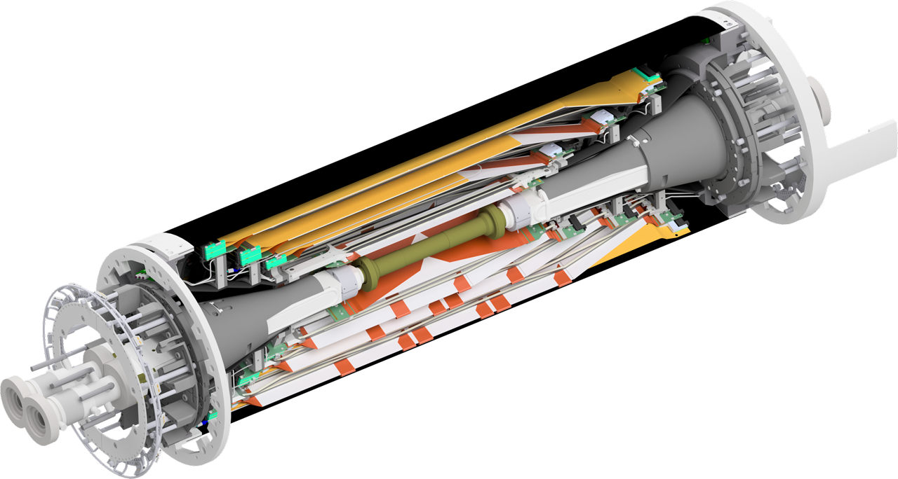
16 September 2016
SVD transportation from B1 to B4
M.Friedl (HEPHY Vienna)

Slide 2
Objective
SVD ladder assembly takes place in Tsukuba B1 clean room
Marriage with PXD must happen in B4 clean room
Thus, the task is to bring the SVD from B1 to B4
“SVD“ means
2 halves combined
With outer CF shell
With dangling cables on both sides
With or without dangling cooling pipes on both sides

Slide 3
Ways from B1 to B4 (1/2)
Option 1: elevator
Requires that the SVD assembly is no longer than the elevator is deep
Possible with cables only (flexible, can be rolled up)
Impossible with rigid cooling pipes attached
Preferred option if possible
Depends on whether cooling pipes can be attached later (in B4)
Question of whether we can reach and fasten Streuli connectors on the ceramic isolators with cables and shell in place (to be tested around October B2GM)

Slide 4
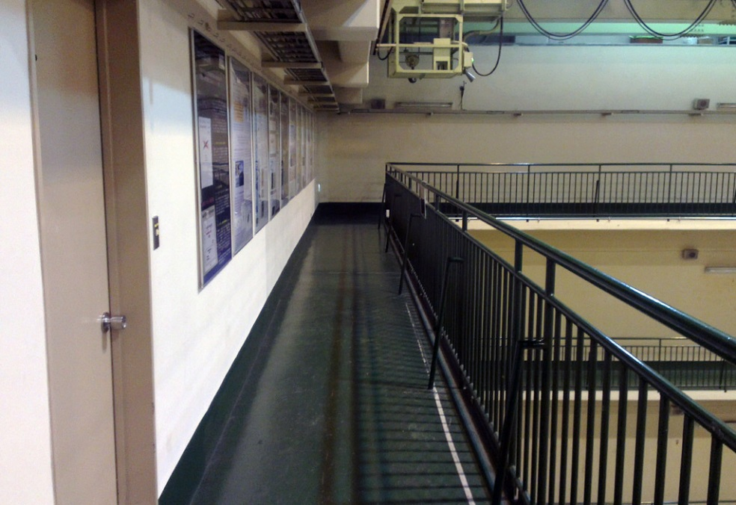
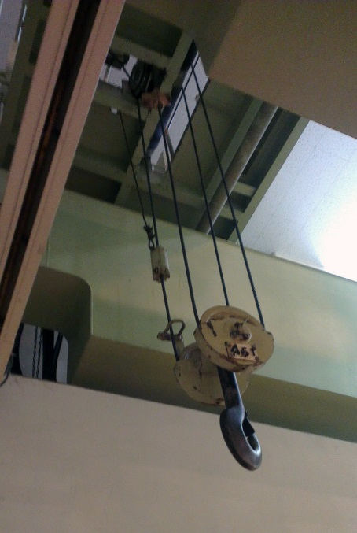
Ways from B1 to B4 (2/2)
Option 2: balcony & crane
Requires opening in the balcony (exists already)
Requires special trolley to bring SVD in a position where crane can pick it up (partly exists at KEK)
Cooling pipes can be attached during transportation

Slide 5
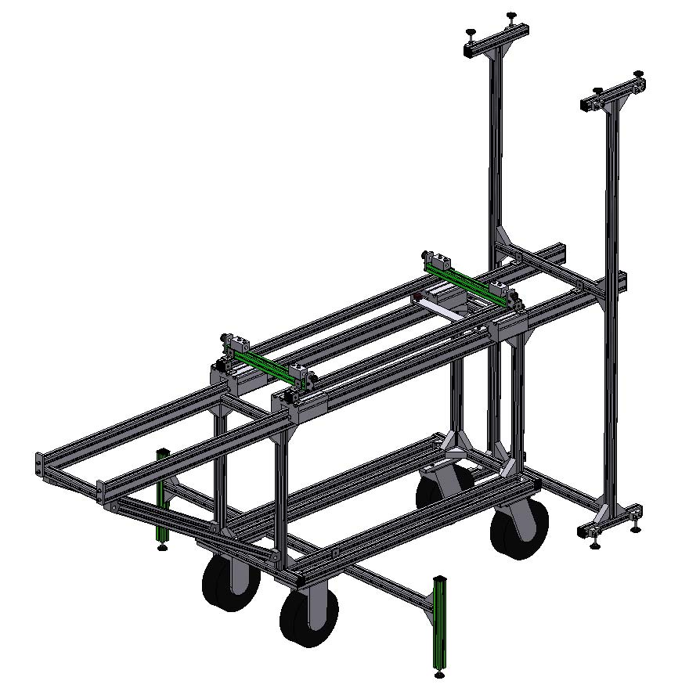
Transport Trolley
Design by David Kittlinger (MPI)

Slide 6
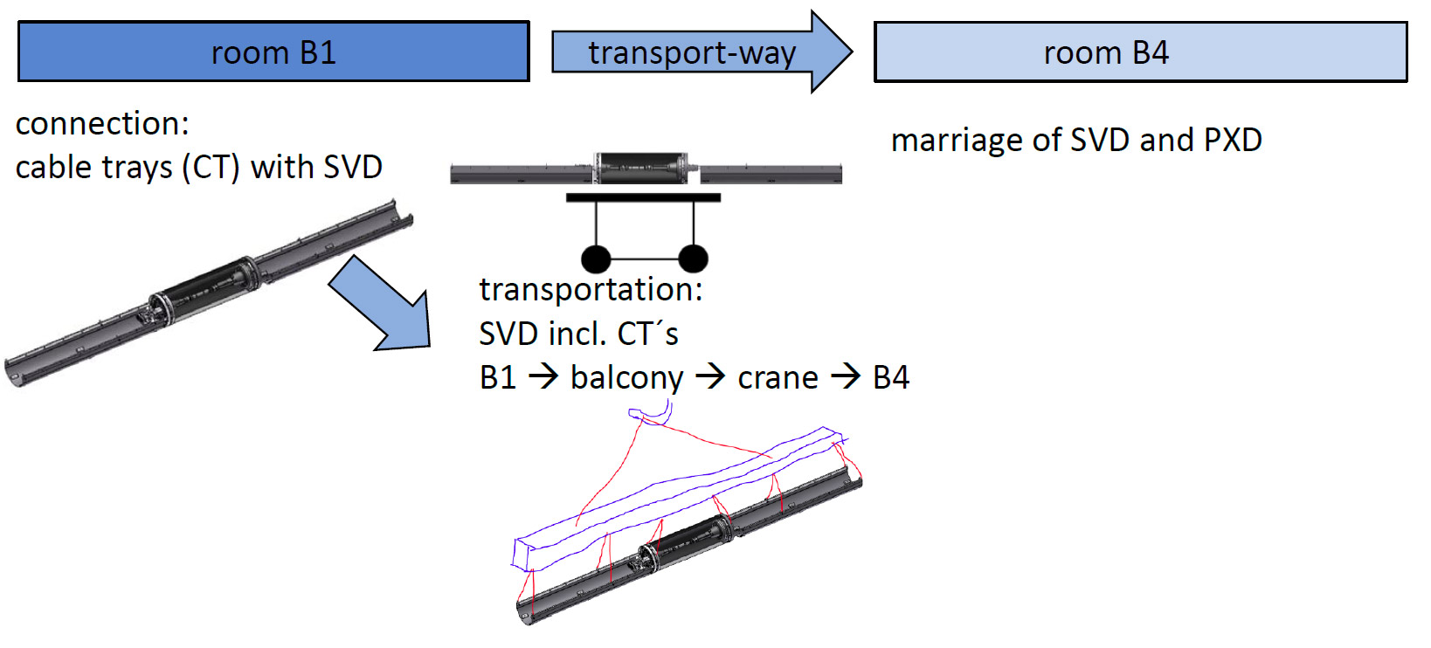
Summary Option 2
Graphics based on slide by David
Finally:
With crane to Belle II

Slide 7
Summary Option 1
Graphics based on slide by David
shorter
Elevator → B4
Finally:
With crane to Belle II

