Slide 1
SVD power supplies and power distribution panel
F.Forti, INFN and University, Pisa
  Outline
    CAEN Power supplies status
    Changes for the new FADC/Junction Board
    Power distribution functions and requirements
    Power distribution panel control and physical layout
    Short and long term schedule
  Note: information available on:
  https://confluence.desy.de/display/BI/SVD+Power+Supplies+Page
  https://confluence.desy.de/display/BI/SVD+Interfaces

Slide 2
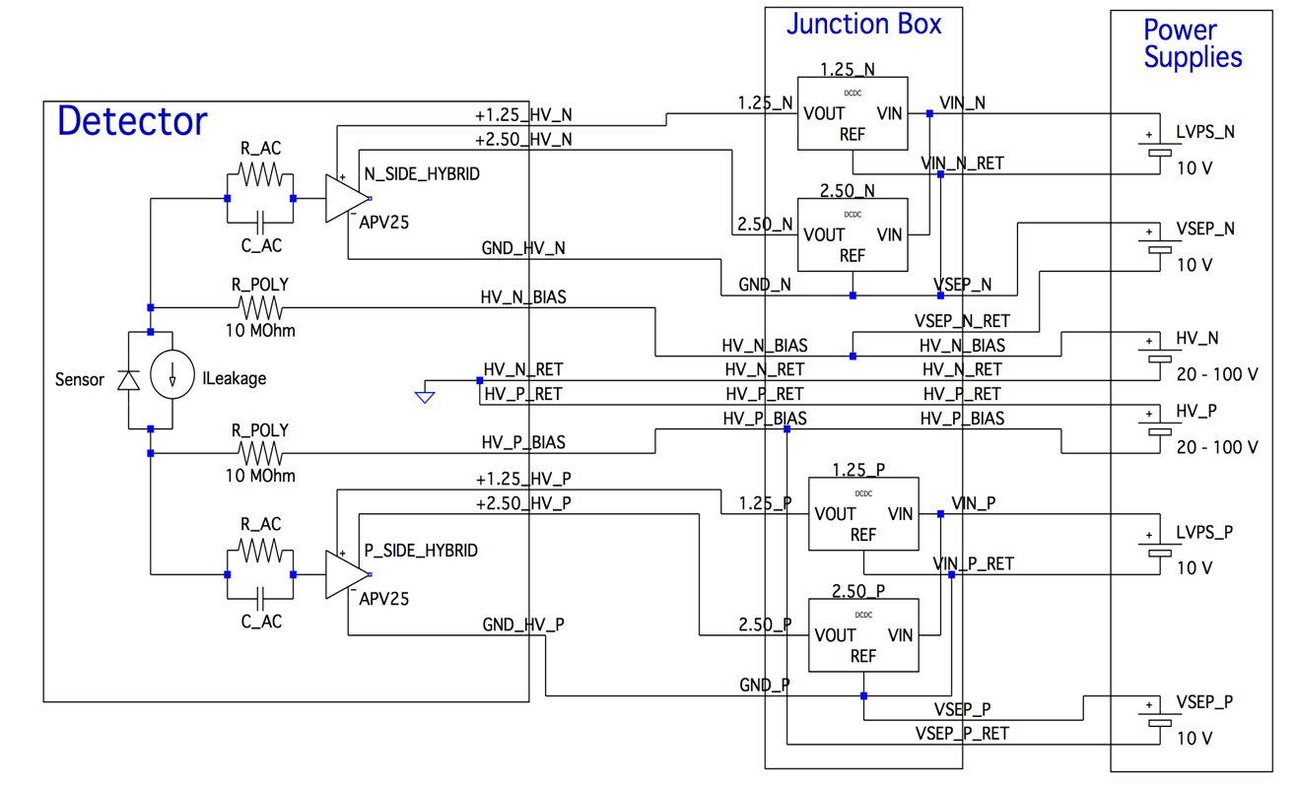
Reminder: Overall schematics in experiment
Hybrid connector
N Side separation voltage
NO GND connection here
P Side separation voltage
R_AC is finite only for pinholes

Slide 3
Modularity
Basic connections
  1 LV channel is connected to 4 hybrids through 4 DC-DC converters
  1 HV + 1 VSEP channel is connected to 8 hybrids
Old design:
  1 Junction board = 1 HV + 1 SEPV + 2 LV
New design:
  each detector module connected to only one JB
  1JB = (HV_P + VSEP_P + LVPS_P) + (HV_N + VSEP_N + LVPS_N) → 4 detector modules
  → The HV and VSEP pairs will go to 2 different JB.
The measured HV and VSEP currents will be the sum of 8 modules.

Slide 4
PN Connection changes

Slide 5
CAEN Boards: all delivered
Sense | Status | Enable
YES | YES | YES
NO | NO | YES
NO | NO | YES
Note: all channels are fully floating, but the polarity is defined by wiring
A2519A LV Board 5-15V/10A; 8 ch/board; 12 boards + 3 spares
A1519B HV Board 250V/1mA; 12 ch/board; 4 boards + 1 spare
A1510 VSEP Board 100V/10mA; 12 ch/board; 4 boards + 1 spare
One problematic board replaced by CAEN under warranty

Slide 6
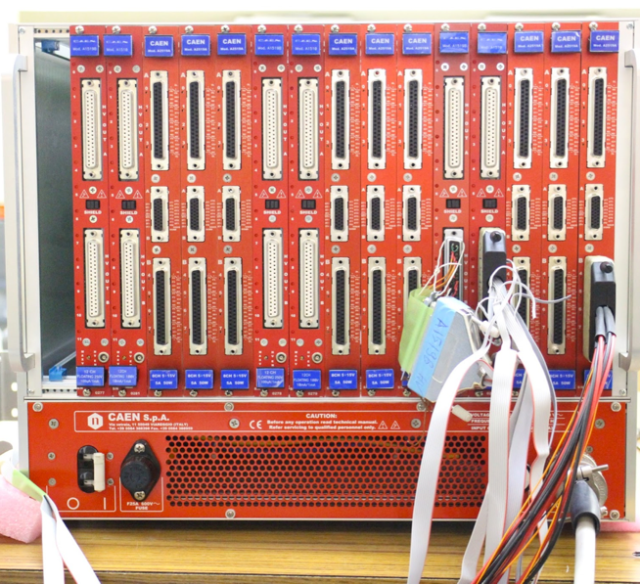
SVD PS crates and racks
One group of channels
(24 LV 12 HV 12 VSEP)
12 Junction Boards
48 sensors
One spare rack + one spare group available
Two PS crates will be needed:
  Crate 1, 4x BWD dock boxes
  Crate 2, 3x FWD + 1xBWD dock boxes
Two racks positioned on the balcony
  1 Rack should contain 1 PS Crate + 1 power distribution panel crate

Slide 7
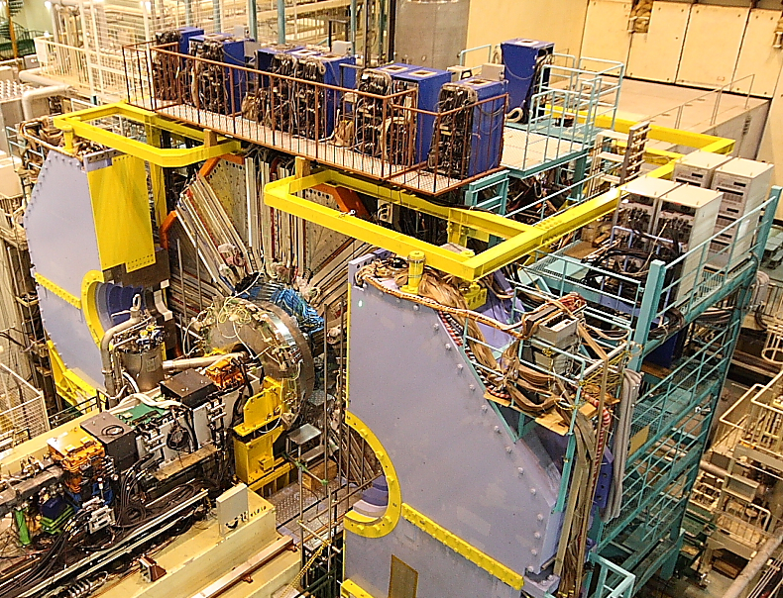
Only two racks will be required, replacing the 4 Kenwood racks

Slide 9
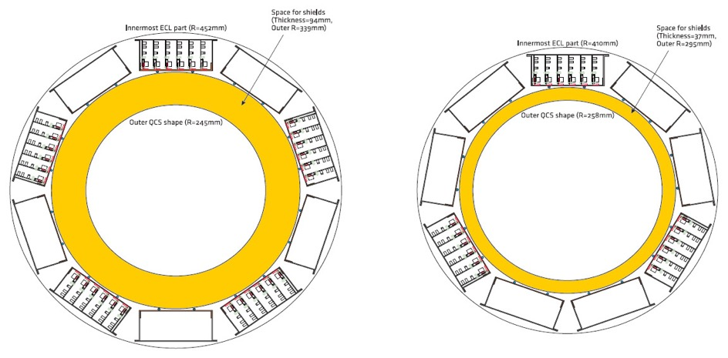
Dock boxes and Junction boards
1 dock box = 6 Junction boards
Backward : 5 dock boxes
Backward : 3 dock boxes
SVD
PXD

Slide 10
Grouping and location
Since a PS Board group corresponds to 2 dock boxes, there is not a perfect match to FWD (3) and BWD (5) dock boxes. Proposal:
  Crate 1, Group 1: 2x BWD dock boxes
  Crate 1, Group 2: 2x BWD dock boxes
  Crate 2, Group 1: 2x FWD dock boxes
  Crate 2, Group 2: 1x FWD + 1 BWD dock boxes
There is no principle against mixing BWD and FWD
  But we have the flexibility to separate them if necessary, using the third rack
  Plan to keep a spare PS Board group + 1 spare crate for quick replacement in case of failure → use for BEAST2
Different layers should not share the same HV
  Retain flexibility to change voltage symmetry between P and N by layer
  Ok from the total count, but has implications on the ladder→junction board cable routing
Place the crates on the balcony.
  1 Rack should contain 1 PS Crate + 1 power distribution panel crate.
  2 racks in total are necessary, but we should plan on 3.

Slide 11
Power Distribution Panel functions
Provide interconnection between cables from junction boards and power supply boards
  Fixed polarity for HV, Selectable polarity for VSEP
Receive the HV ENABLE and LV ENABLE signals and distribute to the PS boards.
  Generated from the interlock system
Generate a “HV ON” signal to inhibit injection ?
  Built as the OR of the individual HV ON signals.
Prevent VSEP from turning on if HV is off ?
  This function is complicated to implement and not so necessary: propose to drop
Software and hardware interface to Power Distribution Panel

Slide 12
Power Distribution Panel Connections
Long cables (17m) from Junction board to balcony have the same connector on each end
  Just repeat the same modularity and connectors of the Junction boards
Power Distribution Panel realized in 6U modules placed in a crate underneath the corresponding power supply crate.
  Separate modules for LV and HV distribution
  Back side:
    connectors to the Junction Boards
    HV connectors on back will be duplicated: a set (HV_P, VSEP_P, HV_N, VSEP_N) will bias 2 connectors in parallel → 2 junction boards
    LV connectors will have 2 LV as before, now interpreted as LVPS_P, LVPS_N
  Front side:
    connectors to the Power Supplies
    Lemo connectors for interlocks interface

Slide 13
VSEP polarity and control
VSEP functions:
  Cure pinholes, prevent large pinhole-induced currents
  Identify defects and pinholes: VSEP scan
VSEP range and set accuracy
  Generated with 100V cards, providing 100mV accuracy
  Absolute maximum range is (-10, +10)
  Relay based selectable polarity
  Use resistive divider (x10) to
  improve accuracy (10mV)
  In principle no current is
  flowing on VSEP
  To be tested on real modules
    Implemented on prototype, but not
    tested in DESY test beam

Slide 14
LV Enable and HV Enable
Enable lines prevent the channels to turn on or to turn them off in case of problems.
Use crate granularity for all input signals:
  LV ENABLE: enable turning on the LV
    For instance generated when the cooling system is working.
  HV ENABLE: enable turning on the HV and VSEP.
    Require stable beam conditions AND LV enable.
  Generated in the E-hut and sent to balcony.
Received by power distribution panel and distributed to the PS boards

Slide 15
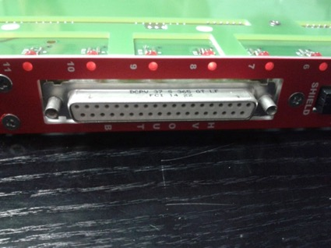
HV ON Status signal generation
We have been looking into generating a HV ON signal to be used in the interlock system:
  Local VSEP interlock: inhibit turn-on if HV is off
  Generate signal to inhibit injection when HV is ON
There is a possible technique to extract status information from the LEDs
  Run flat cable on top of connector and solder to LEDs, connect to power distribution panel to extract information.
  Not at all trivial, and requires opening all PS boards
  → Potential for damage
  A channel turned on with 0 V is ON
  Not possible to generate a signal for HV > threshold (because interferes with delicate detector bias)
Proposal: give up HW HV ON status generation
  It can still be generated in EPICS and transmitted to accelerator to inhibit normal (initial) injection
  Additional safety is guaranteed because during normal injection HV ENABLE should be OFF → if injection starts by mistake when HV is ON, it will be turned on immediately.

Slide 16
VSEP Local Interlock
There has been discussion about a VSEP local interlock, channel by channel: prevent VSEP to turn on if HV is off.
  The reason is that the sensor may be forward biased in certain VSEP polarity configurations when HV is off
  The HV status could be used to enable the corresponding VSEP line
Proposal is NOT to do this
Reasons:
  EPICS SW will in any case be responsible to provide protection against forbidden bias conditions
  Deriving a signal of HV status is hard
  HV status can only tell whether the channel is on or off, even if it is set to 0 V → not so effective

Slide 17
Power distribution panel interface
The only programmable part of the power distribution panel is the VSEP polarity select
  The rest is only signal distribution, although the LVEnable/HVEnable requires will require active components.
Requirements
  EPICS interface
  Functionality choices:
  Maintain polarity select across power cycles,
  or require reprogramming ?
    Proposal to use latching relays
  Include relay status monitoring ?
    Of course you will be able to read back the digital signal status controlling the relay. The question is whether to use 3-pole relay where one pole is used to monitor the actual switching of the relay.

Slide 18
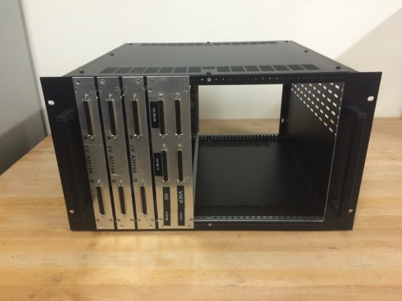
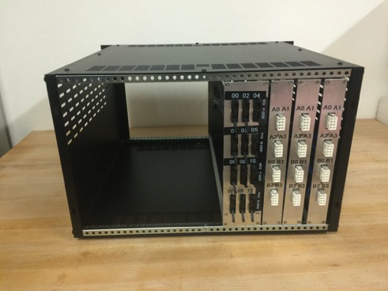
Power distribution panel prototype
Prototype built for DESY test beam
Old junction board design
Voltage divider on VSEP, but jumper based polarity select
  VSEP Not tested at DESY because of problems with VSEP board
Need to test it on real modules
Bring it to KEK and use it for testing the ladders
  For the VSEP scan we can use two VSEP source wired with opposite polarities
  Implement with special cable from PS boards → power distribution panel
Can be connected to up to 12 JB: enough for the ladder incoming test
Also needed in DESY ?

Slide 19
Final system ?
Proposal: use the USOP system (from ECL) to provide local intelligence and control
Advantage: developed in Naples, easy to use and powerful, with epics drivers (see slides attached to agenda)
Disadvantage: relatively expensive and not funded at this time (working on this)
Each USOP crate requires 2 ethernet lines: one for remote control over IP, the other for normal data operation (epics PV)
Other solutions:
  other systems with I/O capability, possibly already used in Belle2 ?
  Use just one uSOP for all PDP crates ?
  Need to decide soon

Slide 20
uSOP

Slide 21
Hardware lines controling CAEN PS
Control Lines affecting a whole crate:
  Crate power cycling: may be useful in case of software hangup during running: need 5-12V signal (could be 1 for all crates, or separate ones for each crate).
  Reset line: can reset the CPU (short pulse) without affecting the boards, or reset also all the boards (long pulse)
  Interlock: allows to prevent all channels in the crate from turning on (major failure, like fire alarm etc.)
Since we have no access to the crates during running:
  Bring all the 3 lines per crate to the e-hut so we can have maximum flexibility in controlling the crates.

Slide 22
Hardware lines to and from CAEN PS to e-hut
All lines are at crate level (x3 for each)
  From CAEN PS to e-hut : no longer generated
    One HV ON status line
      HV ON = (Any HV is ON) OR (Any SEPV is ON)
  From e-hut to CAEN PS
    Three crate control lines: Power Cycle, Reset, Interlock
    Two channel enable lines: LV enable, HV Enable
  Communication and data transfer
    One Three ethernet: 1 for PS crate + 2 USOP for Power Panel
Total count (without redundancy)
  3x( 2 Enable + 3 Control ) = 15 cable (LEMO)
  3x (1 + 2 eth) = 9 ethernet cables
    Could be less if we decide to use only one uSOP board, or if we decide to use a switch: reliabilty implications.

Slide 23
Summary of current scheme
VSEP
  Implement x10 divider to guarantee accuracy
  Polarity: remotely controlled, via relay.
  NO local VSEP enable from corresponding HV (EPICS implementation)
LV/HV Enable
  Crate level granularity
HV ON Status signal
  Abandon idea of hw generation
  Use EPICS record

Slide 24
Schedule
Open issues
  Signals technology and polarity ?
    TTL/NIM, open/close contacts
  What module is receiving/distributing the signals in the e-hut?
    Need to integrate in SC system
  Finalize intelligence to control the PDP (need feedback on funding → end of September)
Time line (assuming we can use uSOP)
  Full set of specifications discussed and decided at B2GM in Oct
  Full design by end of November 2016
  Production of the system by mid 2017
  If we have to look for another solution some more time might be needed.

Slide 25
BACKUP

Slide 26
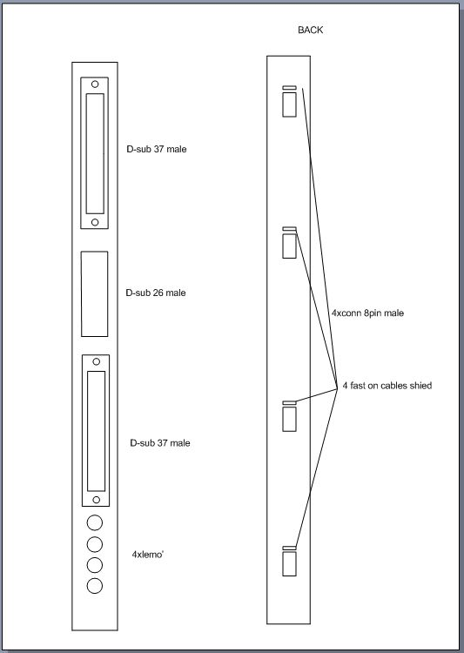
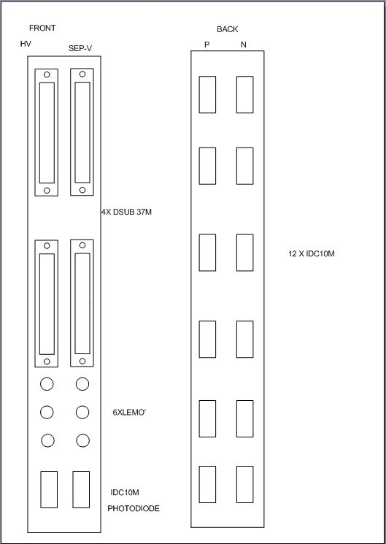
LV PP (x3 per group)
HVPP (x1 per group)
a

Slide 27
Rack and boards
In the process of evaluating the most adequate products. Elma, Schroff

Slide 28
Interlocks and Status
CAEN system have interlock/control inputs
  Lines that will disable individual channels, or channel group on same connectors, or boards, or full crate.
  Also possible to have remote crate power cycling
CAEN system have (some) status outputs
  LV Boards have status signal for a group of channel and for individual channel on service connector.
    No clear use for these signals. Disregard.
  HV Boards do not provide status signal.
    Need to generate a status signal externally.

Slide 29
Injection control diagram
These EPICS records should be readable from KEKB EPICS via CA gateway
H. Nakayama
ver. 2015.6.23
Modified FF
ver. 2016.2.01
E-hut
KEKB control room
Continuous injection
NSM status
TT-IO
(4 NIM IN , 4 NIM OUT)
EPICS record
B7 rack
Corresponding EPICS record
NSM/EPICS gateway
HVC= PEAK or STANDBY
Iwasaki FPGA
(E-hut)
Iwasaki FPGA
(KEKB
Control room)
Corresponding EPICS record
Not taking local run
optical
Set
B2_INJ:
INJECTION:ENABLE
NIM
Continuous injection
VXD BG level is safe (diamonds)
Corresponding NSM status
Normal (initial)
injection
Konno
optical
Set
B2_INJ:
NORMAL:
ENABLE
HVC= STANDBY
NIM
Corresponding EPICS record
Corresponding EPICS record
SVD PS
NIM
optical
Receive
CG_OPR:
PHYSICS
_READY
Physics ready
NIM
Physics
ready
Hardware
level signal lines
Optical lines
Software connections

Slide 30
Interface issues
Several logic standards can be used (some are supported directly by CAEN boards):
  NIM / TTL levels
  Open / close contacts
We should adopt a single standard, compatible with the rest of Belle II
  Protection against disconnected/broken cables
  Disconnected cable should always block dangerous action
In the e-hut we need a SVD specific interlock IOC for signal receiving / distribution
  Can it be the same used for the radiation monitoring ?

