Slide 1
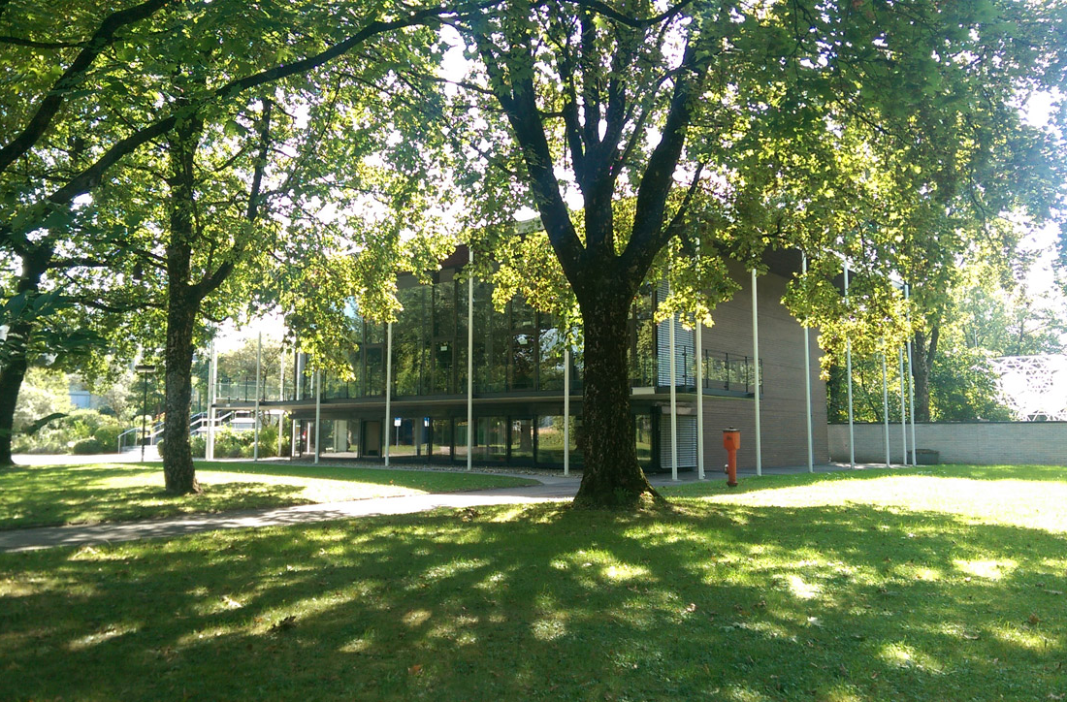
14 September 2016
VXD Meeting @ MPI
M.Friedl (HEPHY Vienna)

Slide 2
Agenda of 12 September 2016
Gemba:
  VXD installation
  Bellows installation (emergency procedure)
  VXD disassembly
Discussion:
  Schedule
  Procedures
  Various items

Slide 3
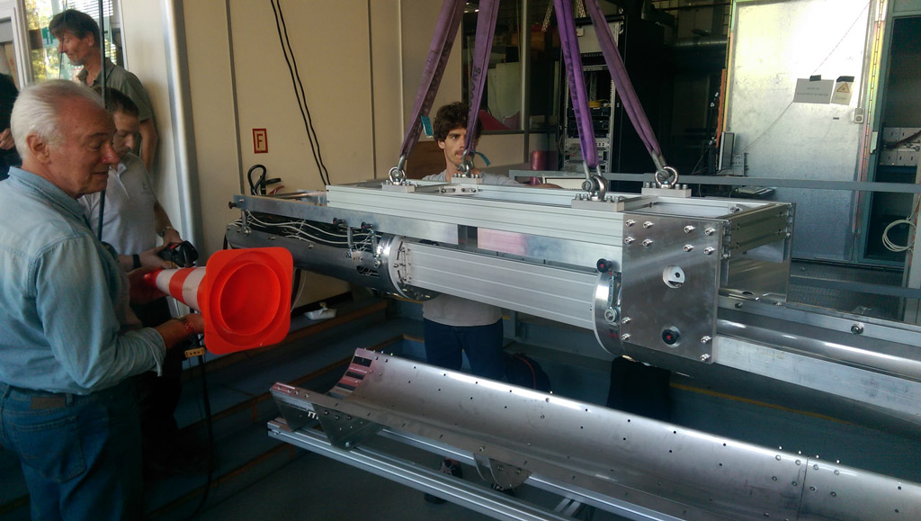
Gemba: VXD Installation (1/2)
Inserting VXD with crane tool onto the mounting tube

Slide 4
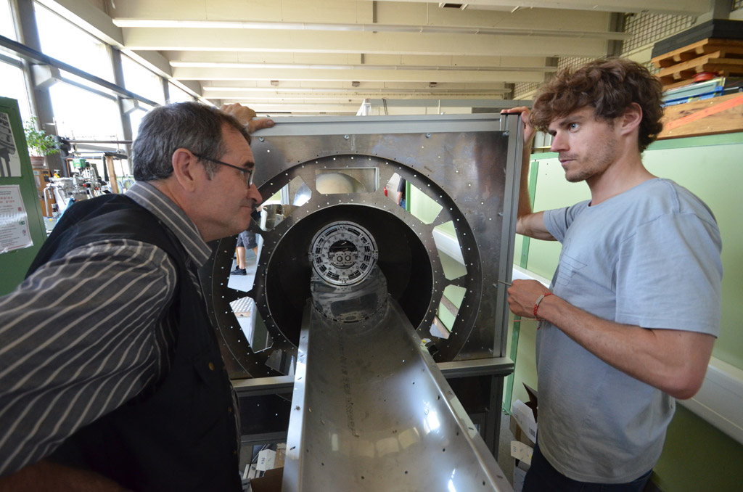
Gemba: VXD Installation (2/2)
VXD in final position

Slide 5
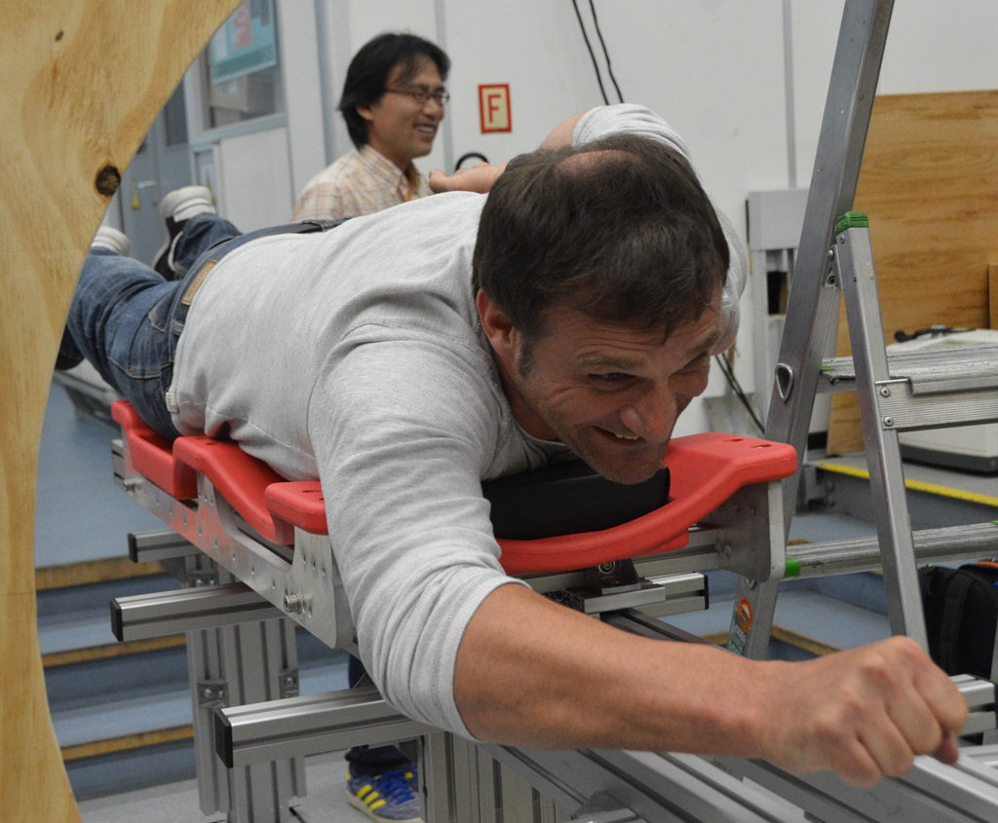

Gemba: Bellows Installation (1/3)
Super-Karsten on the installation panel (before sliding in)

Slide 6
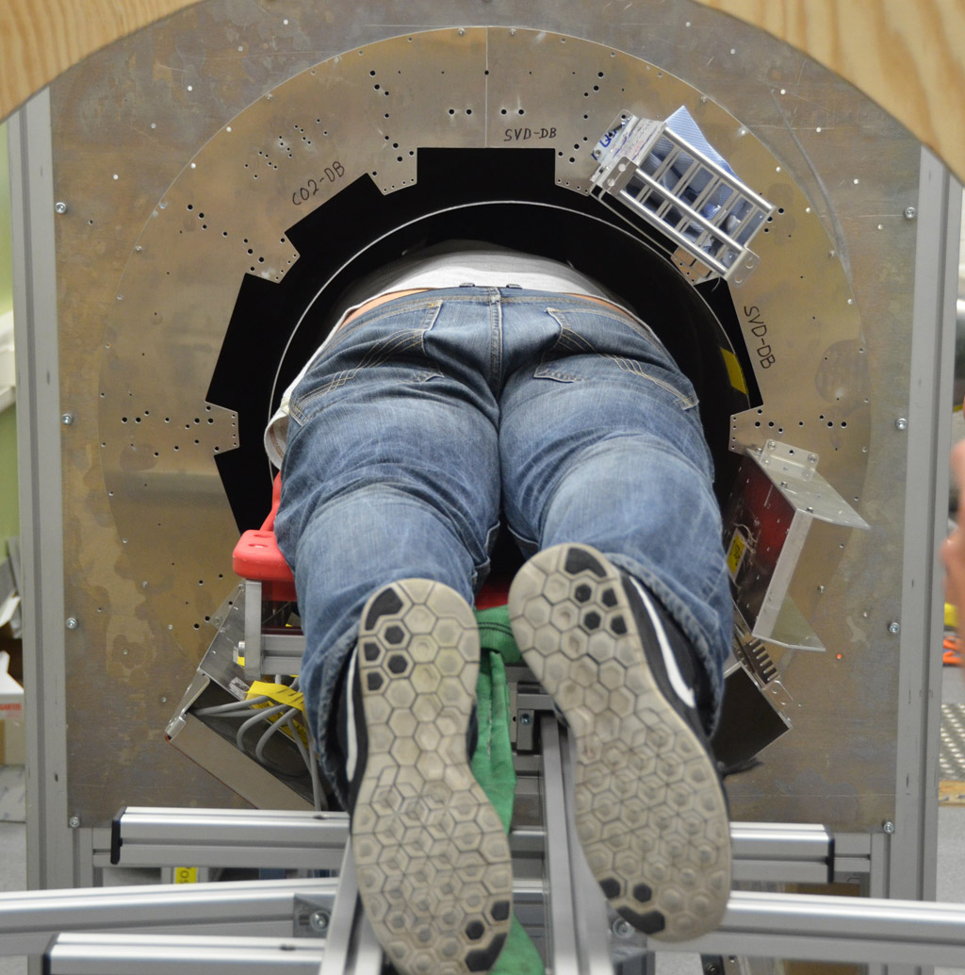
Gemba: Bellows Installation (2/3)
Working inside the CDC – emergency procedure, not default!

Slide 7
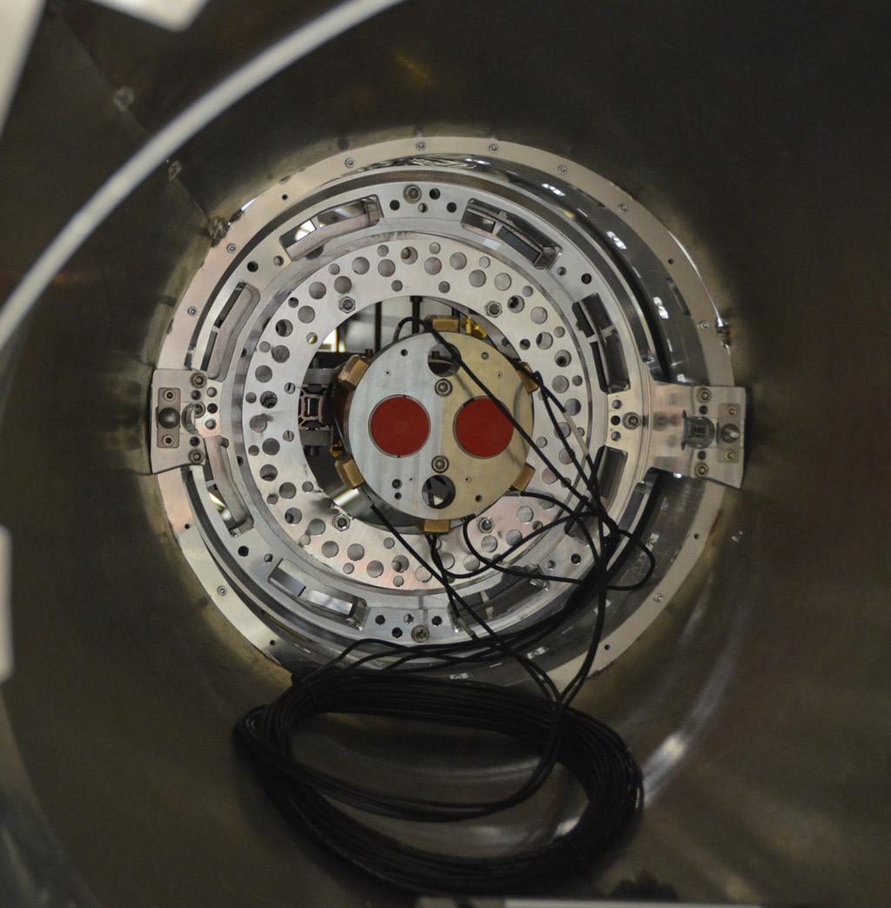
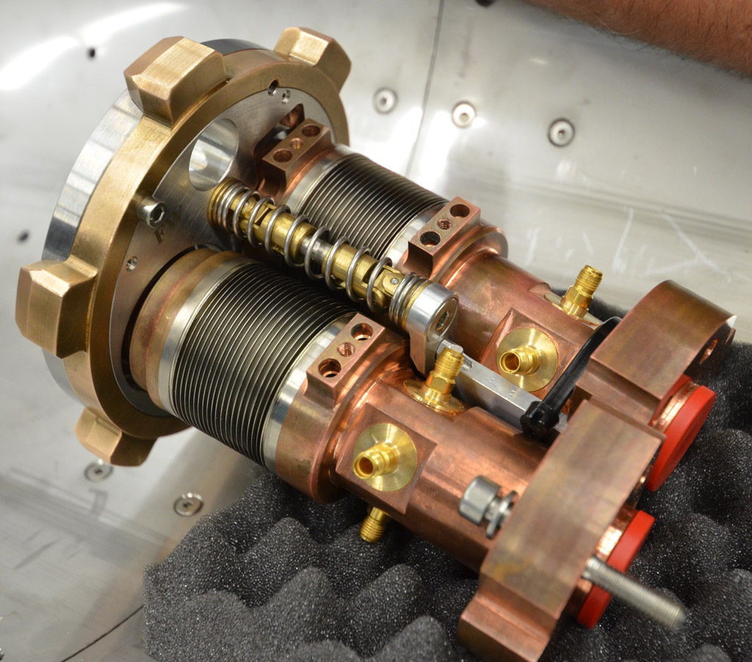
Gemba: Bellows Installation (3/3)
Result

Slide 8
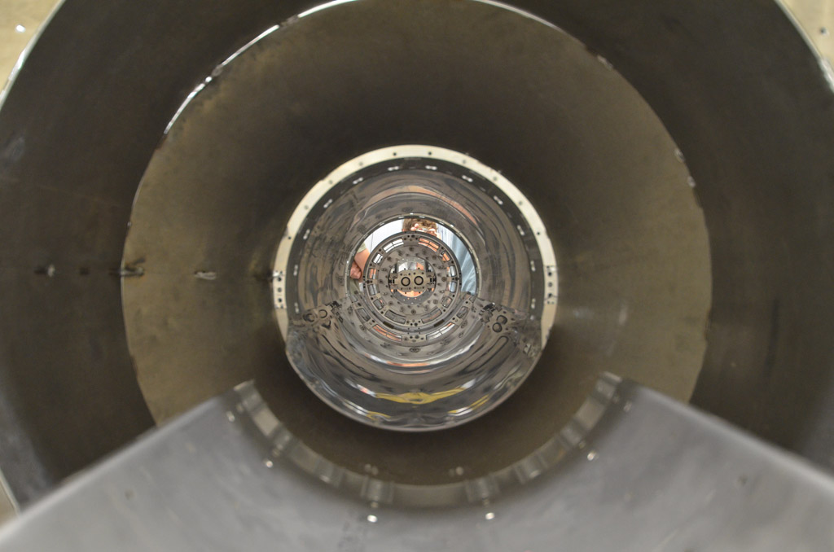
Gemba: VXD Disassembly
Extraction of VXD

Slide 9
Gemba Summary
AIM concept is working
Minor modifications/tuning needed in all phases
Bellows (un)installation (emergency procedure) inside CDC is tricky, but possible
Setup will be shipped to KEK after October B2GM
See https://kds.kek.jp/indico/event/22562/contribution/7/material/slides/0.pptx for details

Slide 10
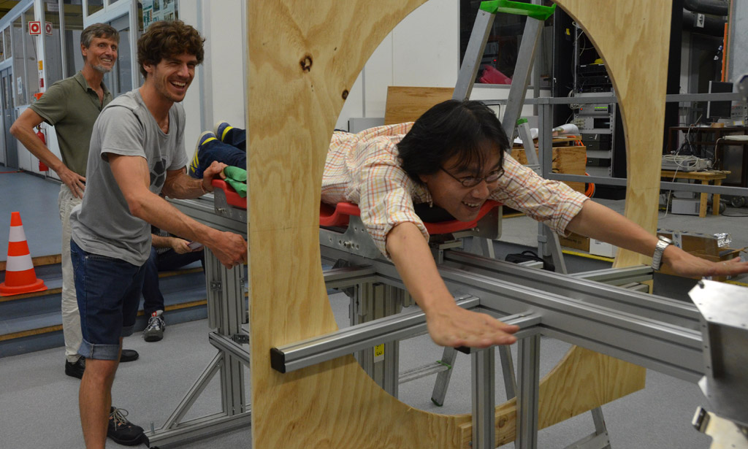
Discussion
Showing some slides by Shuji
See https://kds.kek.jp/indico/event/22562/contribution/0/material/slides/0.ppt for full presentation

Slide 11
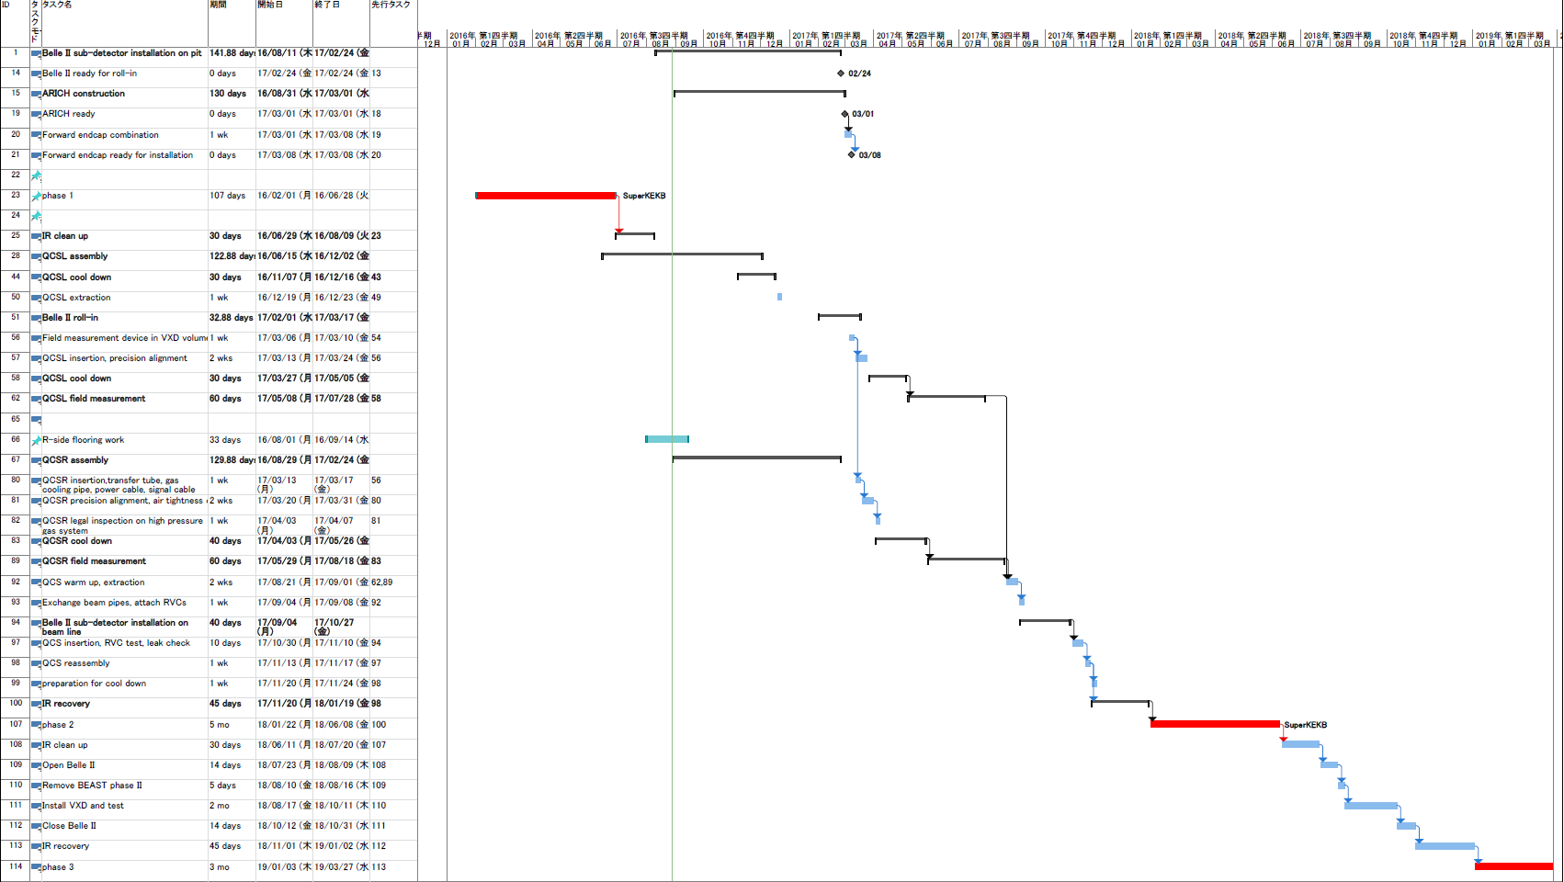
Schedule
(Recently shown by Yutaka, but it will be decided in next B2GM)
Phase 1 completed as scheduled
Additional delay by:
1, TOP PMT issue
2, FWD Endcap installation
(ARICH)
3, QCS(FWD) delivery
Belle II roll-in early 2017
Phase 2 from early 2018
TOP is not ready. Hence CDC installation cannot start.
ARICH HV is not ready and will be installed after Belle II roll-in
Phase 3 from 2019
VXD to be ready at KEK

Slide 12
Space issue

Slide 13
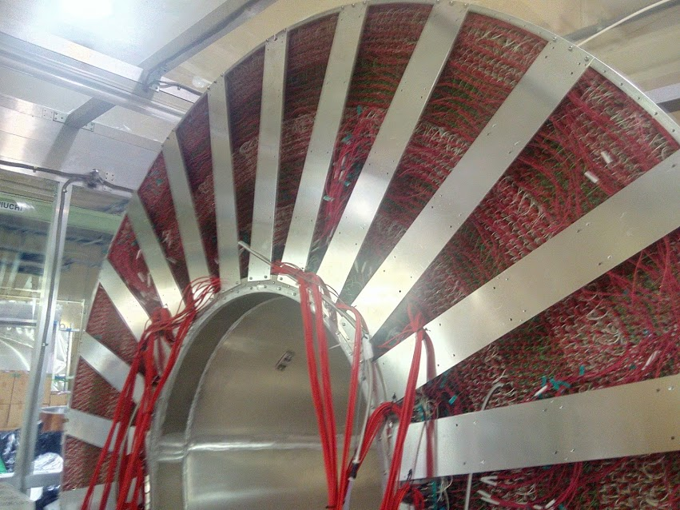
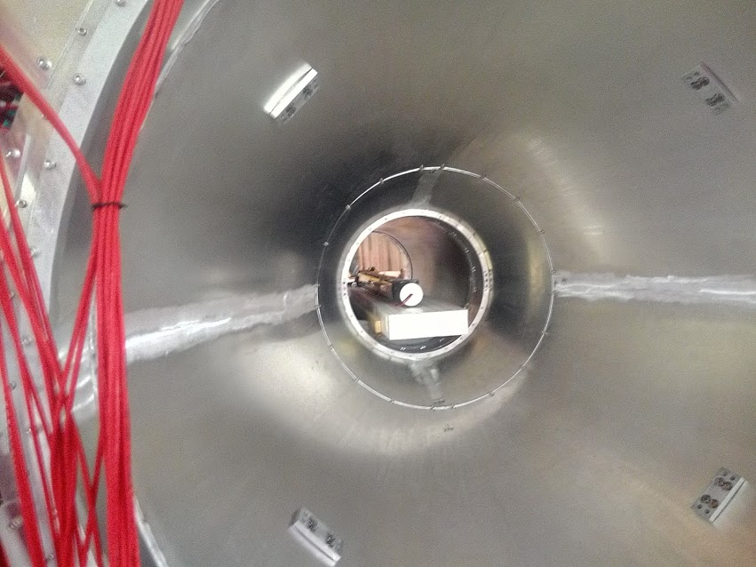
CDC status
FWD support frames have been installed
Threads for VXD services have been
implemented
CDC will be installed around end of Oct.
Gap sensor connection block

Slide 14
Preparation for IBBelle
400 V transformer : delivered
400 V power patch panel: finished
Clean up of IBBelle room: early Oct.(ordered)
Clean up of crane area: early Oct.(ordered)
CO2 alarm system (stand alone for Tsukuba hall): delivered
Filling work of R404a coolant: ordered
CO2 gas bottle: confirmed to deliver in Oct.
Water cooling pipe connection: by Kawai-san
  Temporal piping for system test
6 bar air piping work: Shuji preparing the list(a few days for delivery)
  Temporal piping for system test
Anchoring work of IBBelle: on discussion (no issue)

Slide 15
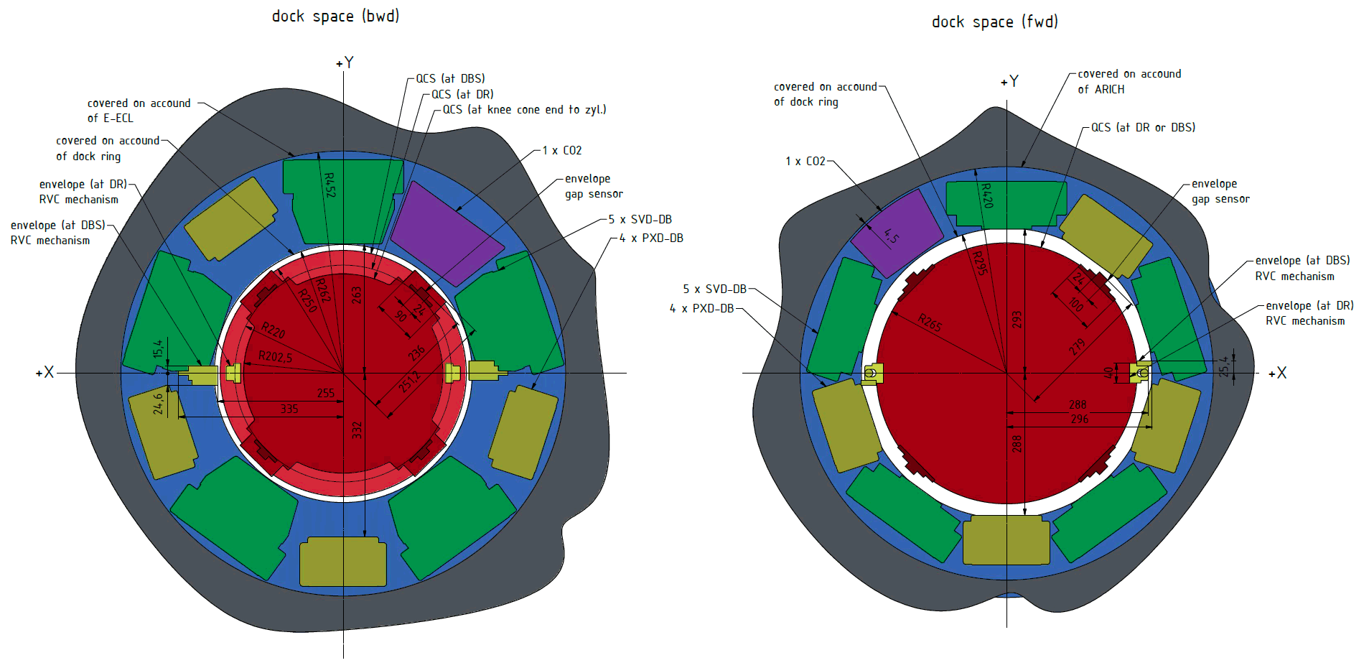
Space Around DOCK
Latest Drawing by Tscharlie

Slide 16
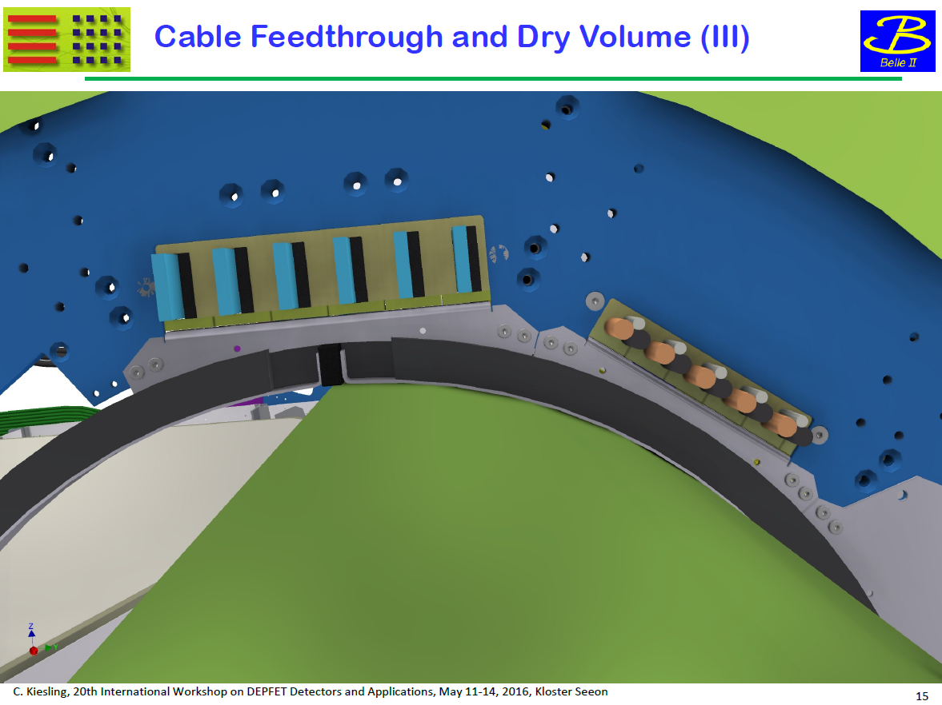
Inner brackets to fix cable holder
Also to make smooth circle shape for EPDM
EPDM foam to make warm dry volume (between QCS and dock ring)

Slide 17
12th Oct: IBBelle at Tokyo port
  Support of custom work/repacking work
  Space clean up have to be finished
18th Oct. IBBelle delivery to KEK (but B2GM!!)
  Installation (anchoring)
  Service connection(AC400V, water, air, network)
  System check
  Manifold installation (when?)
5th Dec.: starting piping work (listing up of material and also test, tools)
  CO2 flex line connection
    Vacuum isolation check
  N2 piping work
    Flow rate measurement (because of 6 bar N2)
  Paraffin piping work
    Circulation test
  Piping for Sucking air
    Dew point measurement test
  Cabling work
    Feasibility check of each cabling path

Slide 18
Webcams in Tsukuba Hall (1/2)
Announced by Shuji
BWD side: http://tsukuba-b1cam-2.kek.jp/live/index.html?Language=1&ViewMode=pull
FWD side: http://tsukuba-b1cam-1.kek.jp/live/index.html?Language=1&ViewMode=pull
Pan and zoom controls
Requires VPN connection to KEK
  Form to request access can be downloaded from Belle secretary website
Useful to monitor TOP and CDC businesses in real time

Slide 19
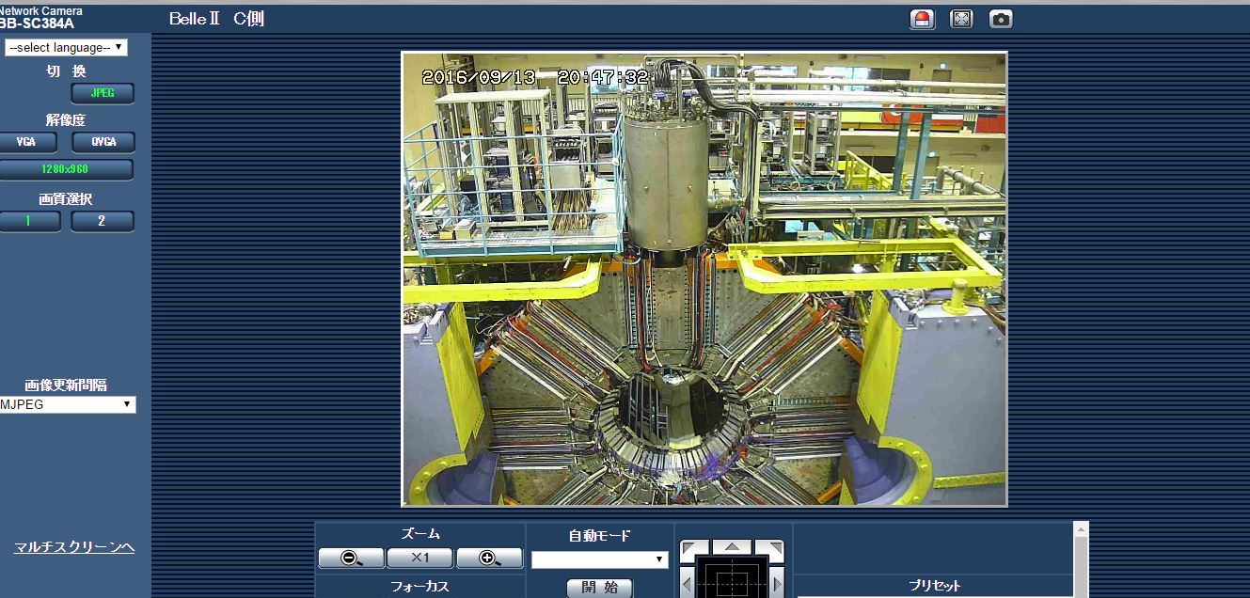
Webcams in Tsukuba Hall (2/2)
BWD side camera

Slide 20
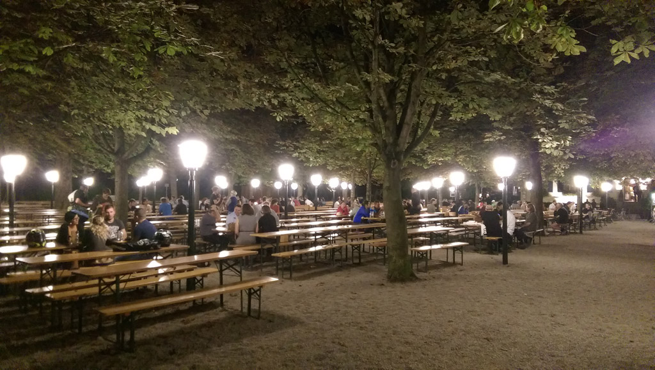
Final Discussions in Different Location
Aumeister beer garden

Slide 21

Mechanics News from HEPHY

Slide 22
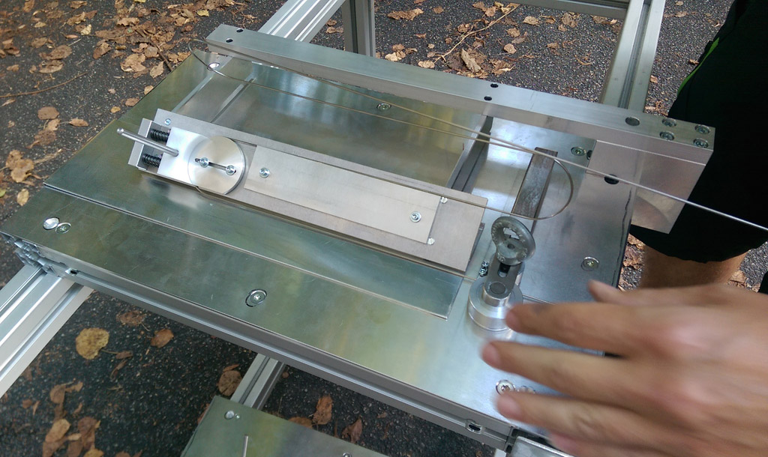
L4 Origami Pipe 3D Bending
Florian

Slide 23
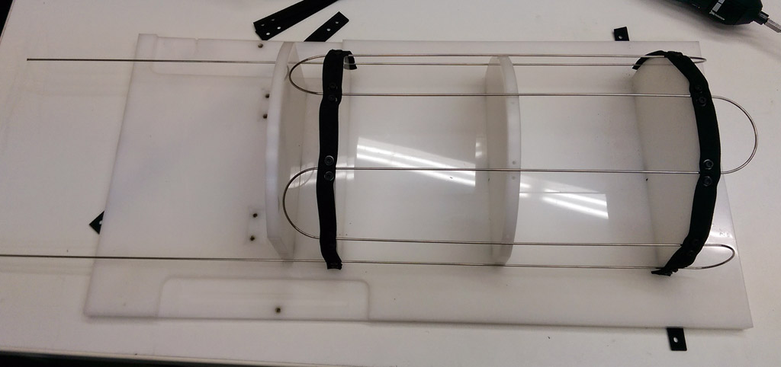
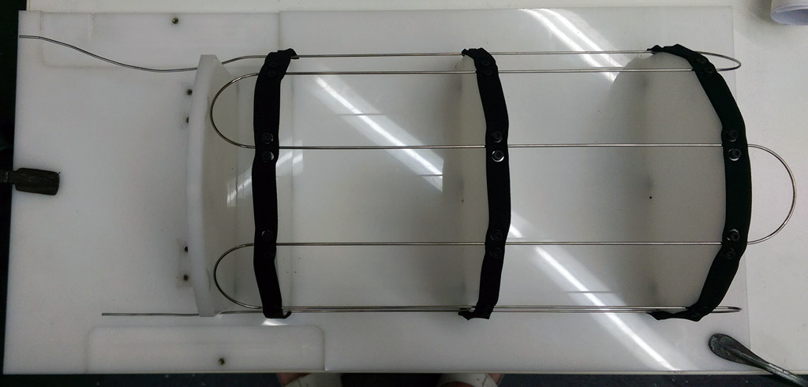
Result
Left: after 3D bending
Right: after inlet/outlet bending (manual) and cutting
  Needs more practicing…

Slide 24
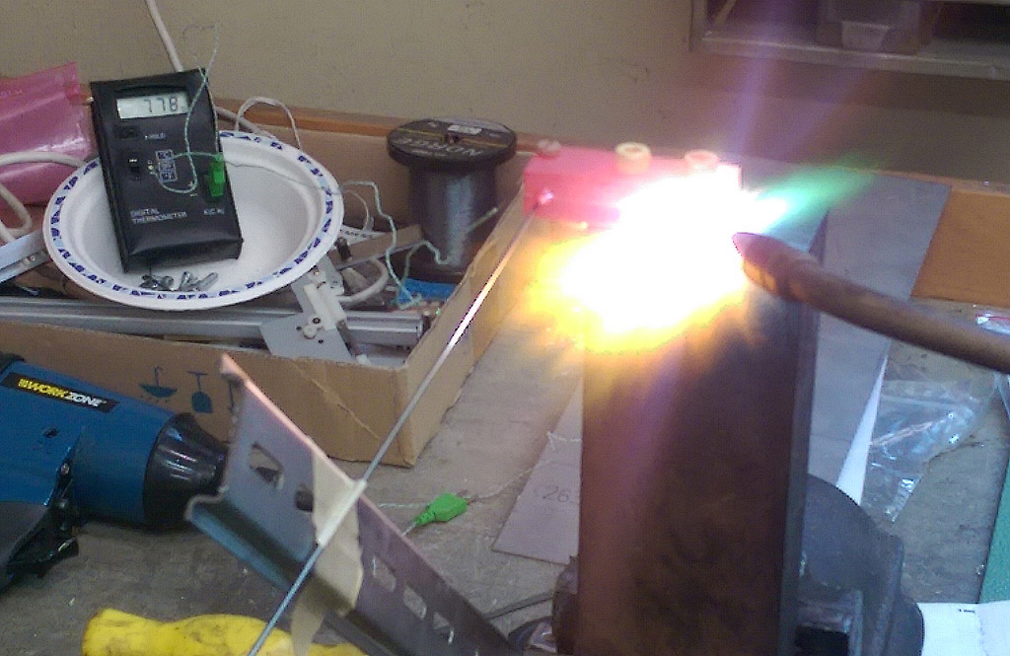
Preparation Test for Brazing
We can achieve homogeneous heat for (dummy) Streuli using a copper block and acetylene/oxygen burner
778°C
measured
here
Pipe

Slide 25
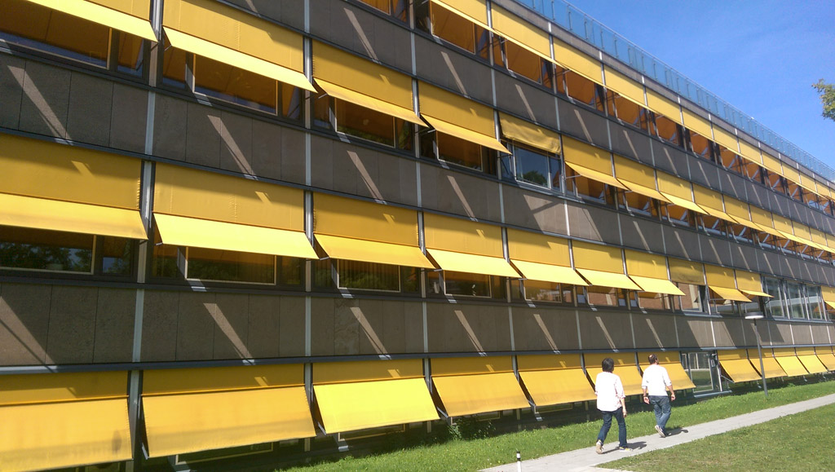
Thank you for your attention!

