Slide 1
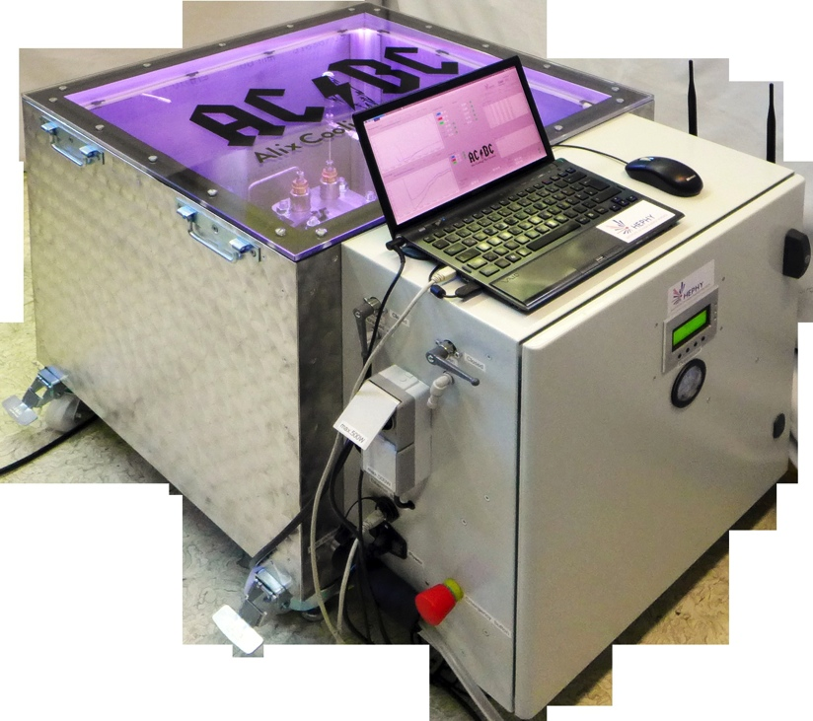
Experience with the open CO2 system @ KEK
Katsuro Nakamura
Sep. 14, 2016 10th VXD workshop

Slide 2

Open CO2 system
Open CO2 cooling system developed by HEPHY
O(100W) cooling power
Li-CO2 is supplied by bottles outside.
Automatic control of the CO2 flow rate is implemented. But not CO2 temperature (= CO2 pressure) currently.
Naoya Kambara (Tokyo University of Science) is studying the system at KEK.

Slide 3
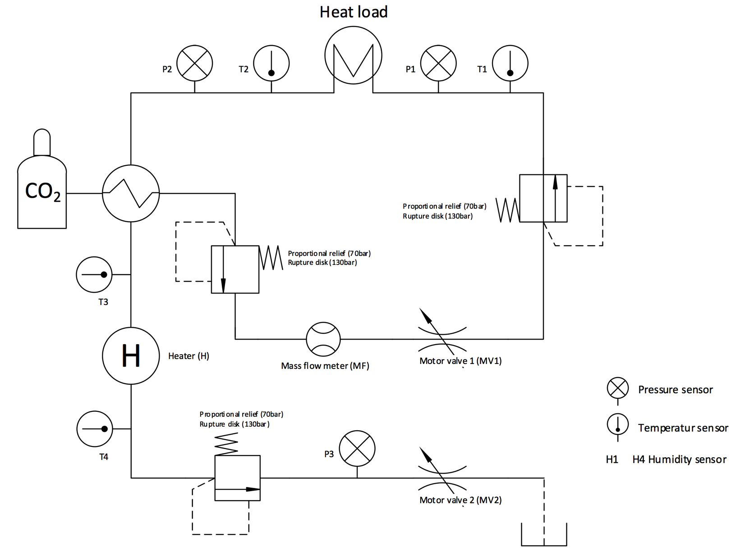
System Flow Diagram
= SVD ladders
T2
T1
-20 deg. ~ -10 deg.
w/ controlled pressure.
2-phase mixture
pressure
monitor 2
temp.
monitor 2
pressure
monitor 1
temp.
monitor 1
heat
exchanger
almost room temperature
w/ bottle pressure
liquid state
safety valve 2
temp.
monitor 0
T0
safety valve 1
temp.
monitor 3
feedback
(in auto-mode)
T3
flow meter
safety valve 3
pressure
monitor 3
almost room temperature
w/ air pressure.
gas state
temp.
monitor 4
almost room temperature
w/ control pressure.
gas state
exhausted to outside

Slide 4
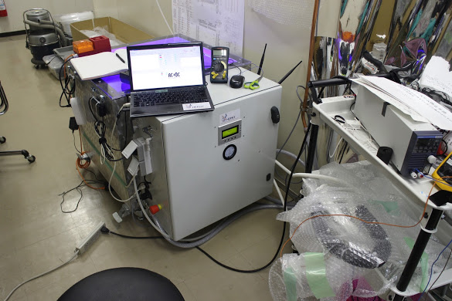
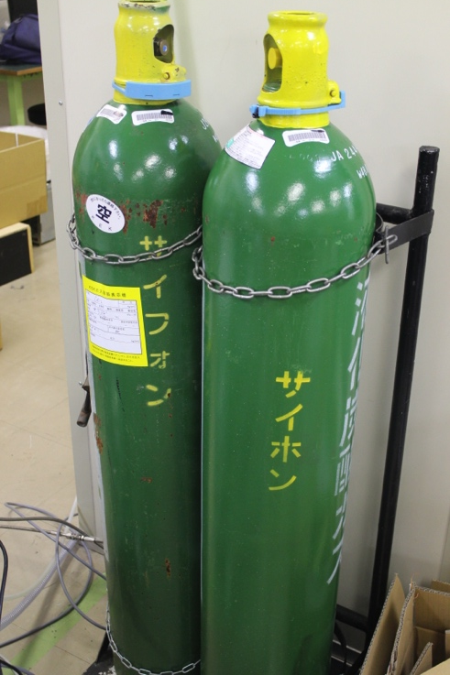
CO2 cooling system setup at KEK B1
From 1 CO2 bottle, about 20kg CO2 is available for the CO2 system
  (actual amount of CO2 inside the bottle is 30kg).
Currently, once one CO2 bottle gets empty, we have to switch off the CO2 cooling system, connect to another bottle, and then restart the CO2 system.
In future, we will implement switching valves, which enable us continuous switching the bottles without stop of the system.

Slide 5
Requirements on the open CO2 system
Role of the open CO2 system
  Cooling test during SVD ladder mount. (highest priority)
    Test thermal conductance between endmounts/bridges and Endrings.
    Test thermal conductance between ORIGAMI cooling pipes and APV25 chips (through Keratherms).
  Test SVD ladder performance under the cooling down (secondary priority)
    Mechanical deformation study under the cooling
      DESY is also performing this study with dummy ladders, but check it with a real ladder (class-C) is preferable.
    Possibly, study of S/N ratio improvement (Maybe w/ class-B- ladder).
Requirements
  100W cooling capability
    Total power dissipation from ORIGAMI APV25s in half L6 ladders (the largest unit in the cooling test):
    8[ladders] x 30[APV25s/ladder] x 0.4[W/APV25] = 96[W]
  Stabilities in temperature and CO2 flow control
  Reasonable CO2 gas consumption
  Reasonable test time

Slide 6
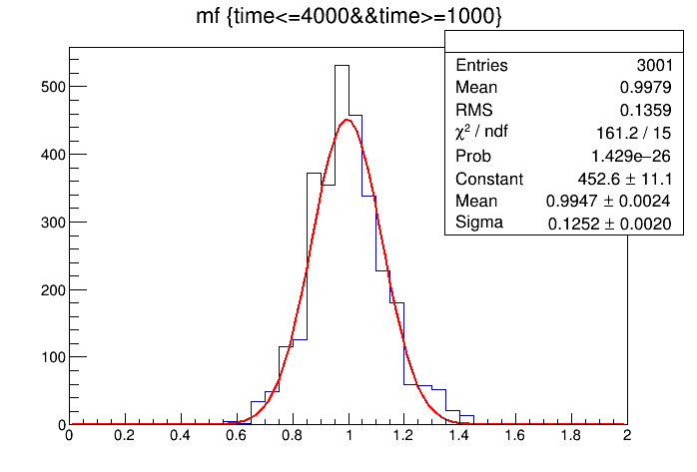
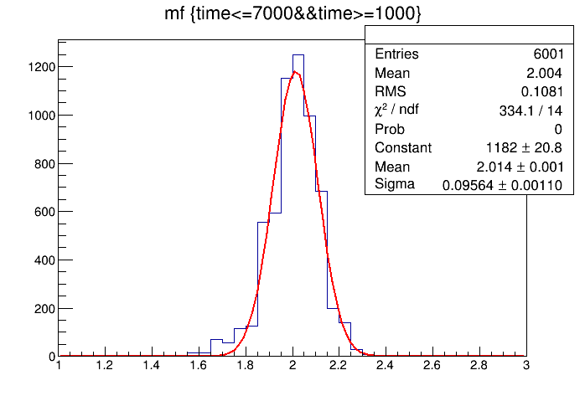
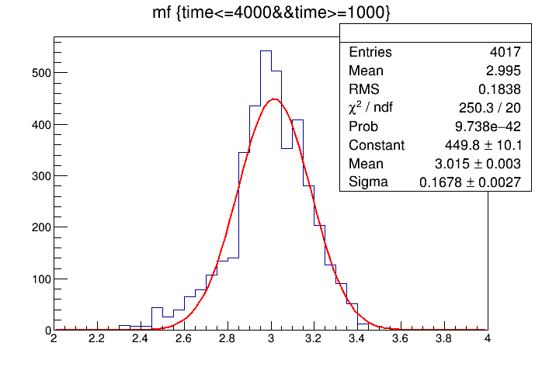
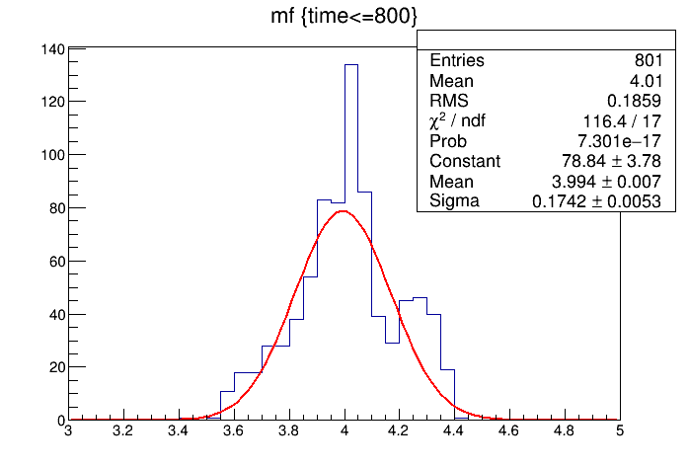
Stability of Flow Rate (Deviations in Flow Rate)
flow rate: 1.0 g/s | flow rate 2.0 g/s
flow rate: 3.0 g/s | flow rate: 4.0 g/s
The system was operated in automatic mode.

Slide 7
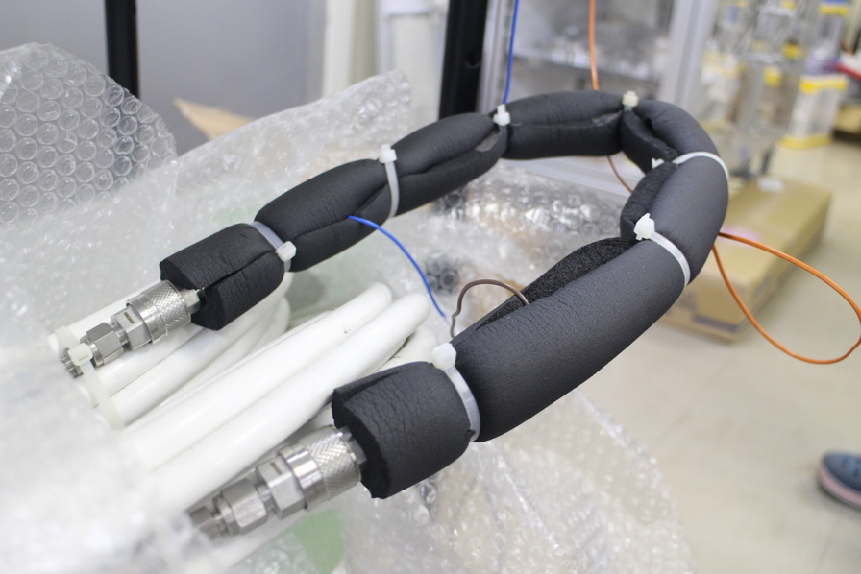
Cooling Capability Test (Setup)
Voltage supply applies a load on the test pipe directly.
  Pipe: SUS304, OD: 1.6mm, ID: 1.4mm
  Voltage supply: max. 20V, max. 20A (max. 400W)
The resistance of the pipe limit the power up to about 260W.
Monitor pipe temperature with a sensor on the pipe.

Slide 8
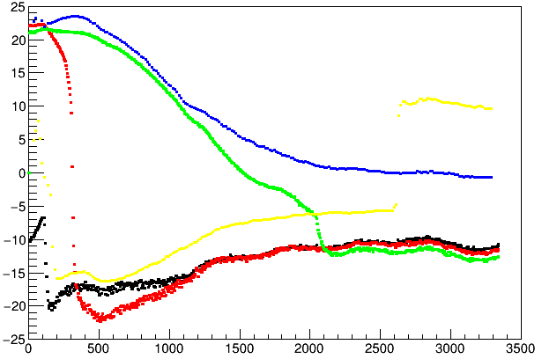
Cooling Capability Test (Results)
Flow rate: 3 g/s
temperature [℃]
Resulting pipe temperatures
T0:
(heat ex. 1st out)
flow rate [g/s] | pipe temp. [℃] w/o load | pipe temp. [℃] w/ 100W load
2.2 | -17 … -16 | -7 … -6
3.0 | -5 … -4 | 10 … 11
4.0 | -7 … -6 | 6 … 7
T3:
(heat ex. 2nd out)
pipe temp.
T2:
(after heat load)
T1:
(before heat load)
time [s]
start CO2 system running
heater is off
heater is on
turn on 100W heater here
We tested flow rates of 4 g/s, 3 g/s, and 2.2 g/s under a heat load of 100W.
In any flow rates, there are no difference in T1 and T2.
  → Still cooling power was remaining after the heat load.
But pipe temperatures become lower for higher mass flow.

Slide 9
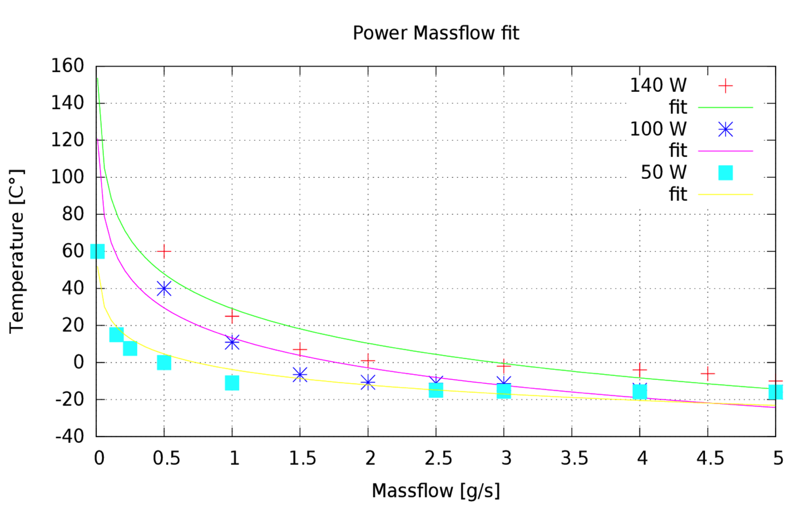
Comparison the results with before shipment
Pipe temperature w/ heater
Measurement (Lukas)
Measurement (Kambara)
0W
100W
Results in 2.2 g/s shows good consistency with Lukas’s measurement and a enough cooling power for 100W load.
But, Results in 3 g/s and 4 g/s are higher temperature than Lukas’s measurement and our 2.2 g/s result.
  They looks inconsistent with our 2.2 g/s result.

Slide 10
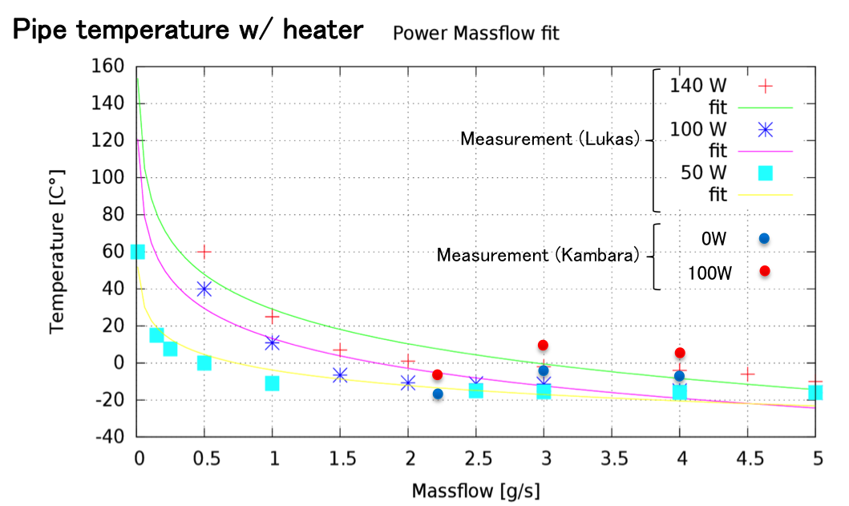
Reasons of the inconsistency
Flow rate: 3 g/s
temperature [℃]
T0:
(heat ex. 1st out)
T3:
(heat ex. 2nd out)
pipe temp.
T2:
(after heat load)
T1:
(before heat load)
just after system is
started running
after system is
well stabilized
time [s]
We saw large drift in the pipe temperatures during CO2 system operation.
  The CO2 temperature is getting higher during the operation. About 10 degrees difference was observed between the beginning and later.
  2.2g/s measurement: done earlier, 3.0g/s, 4.0g/s measurement: done later
  → Need to control the CO2 temperature T1 ( = pressure P1) as well as the flow rate.
Also thermal isolation form is not tightly surrounded on the pipe.
  → We will improve the the form attachment.

Slide 11
Control of CO2 Temperature
Drift in CO2 temperature (= pressure) during operation
  Because the current system doesn’t control CO2 temperature, the temperature changes during operation.
  We have to be very careful for the temperature drift, otherwise we loose reproducibility of the cooling test results.
  If the system gets stabilized and we don’t change the valve settings, the temperature seems stable. But, the system stabilization takes about 1000s (about 17min.) and consumes 4 kg CO2 in 4 g/s flow rate.
And in the current automatic mode, the stabilized temperature is about -10 degrees, but not less than that.
  Do we need to use -20 degrees?
  Preferable, because it is worth to check mechanical performance of ladders under -20 degrees or lower with the open CO2 system.
  In this case, a solution for -20 degrees is manual-mode operation, but stability is not guaranteed.
    Even turning on heat load can change the CO2 temperature in manual mode.
Can we control the CO2 temperature?

Slide 12
CO2 Temperature Control Scheme
= SVD ladders
T2
T1
-20 deg. ~ -10 deg.
w/ controlled pressure.
2-phase mixture
pressure
monitor 2
temp.
monitor 2
pressure
monitor 1
temp.
monitor 1
heat
exchanger
almost room temperature
w/ bottle pressure
liquid state
safety valve 2
temp.
monitor 0
T0
safety valve 1
temp.
monitor 3
valve 1 (MV1)
T3
flow meter
safety valve 3
pressure
monitor 3
valve 2 (MV2)
almost room temperature
w/ air pressure.
gas state
temp.
monitor 4
almost room temperature
w/ control pressure.
gas state
exhausted to outside

Slide 13
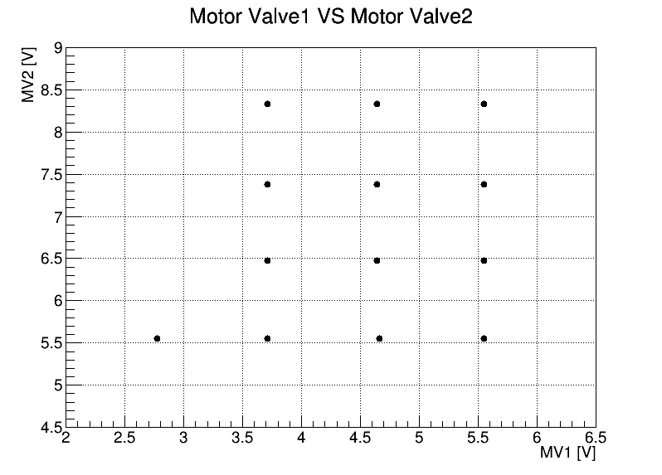
Flow rates in MV1-MV2 map
Flow rates are almost constant in the boxes
Flow rate
We scanned flow rates
in manual mode.
3.1±0.2 g/s
3.2±0.1 g/s
3.9±0.1 g/s
2.9±0.1 g/s
3.2±0.2 g/s
3.8±0.2 g/s
2.8±0.2 g/s
3.3±0.2g/s
3.8±0.1 g/s
2.4±0.1 g/s
2.8±0.1 g/s
3.3±0.2g/s
3.6±0.2 g/s

Slide 14
Pressure in MV1-MV2 map
Pressures (P1)
We scanned pressures
in manual mode.
17.7±0.3 bar
18.1±0.3 bar
21.2±0.4 bar
-20.8±0.9 ℃
-21±1 ℃
-16±1 ℃
Region of -20 degrees
18.3±0.3 bar
19.7±0.2 bar
21.9±0.3 bar
-20.7±0.9 ℃
-18±1 ℃
-15.3±0.7 ℃
19.2±0.3 bar
20.4±0.4 bar
23.7±0.2 bar
-19.5±0.7 ℃
-17.6±0.6 ℃
-13.2±0.6 ℃
18.6±0.3 bar
20.9±0.2 bar
23.3±0.4 bar
25.3±0.3 bar
-20.5±0.8 ℃
-17.2±0.7 ℃
-13.7±0.6 ℃
-11.1±0.6 ℃

Slide 15
Solution for CO2 temperature control
In manual mode, we can control the CO2 temperature.
    The first valve (MV1) controls flow rate.
    The second valve (MV2) controls pressure (= temperature).
  However, this manual operation doesn’t have good stability.
    We have to keep checking the temperature monitor to adjust the valve frequently, especially in the beginning of operation.
    Even if we apply heat load, this changes the temperature and we need to change the valve setting again.
Ideally, temperature control in automatic mode is rather preferable and useful
  as well as we are controlling flow rate.
  But, maybe, need more development time…

Slide 16
Time and CO2 consumption
CO2 consumption until the temperature gets stabilized:
  2.0 g/s: 14 kg
  3.0 g/s: 6 kg
  4.0 g/s: 4 kg
Larger flow rate looks better to minimize the CO2 consumption until the stabilization.
In the current automatic mode, if we change the flow rate after the stabilization, the temperature gets unstable again.
  Change from 4.0 g/s to 2.0 g/s after the stabilization to save CO2 is not good option due to this phenomena.
So far, keep running in automatic mode of 4.0 g/s flow rate is the best operation considering the test time and CO2 consumption.
flow rate [g/s] | time [s] | CO2 consumption [kg]
1.0 |  | （more than 5kg）
2.0 | 7000 | 14
3.0 | 2000 | 6
4.0 | 1000 | 4
cf. 20kg CO2 are available from 1 bottle.

Slide 17
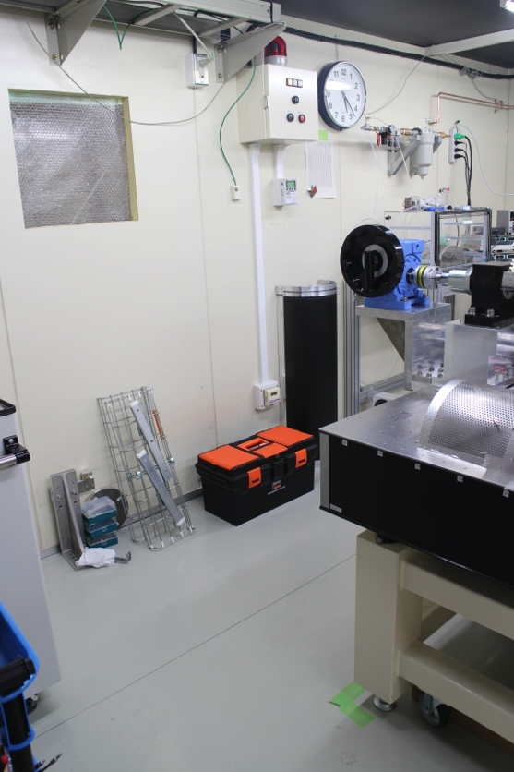
Future open CO2 system setup in clean room
B1 clean room
cable
window
fixed on
the table
ladder mount table
fixed on
the table
open
CO2
system
FWD inlet/outlet
BWD inlet/outlet
cover
All the cooling pipes will be laid on the floor in order to prevent dew drop from the roof.
FWD and BWD cooling lines are selected on the open CO2 system side.
All the necessary parts are under quotation now. They will be set up by the end of Oct.

Slide 18
Safety interlock system
We had a small accident:
  CO2 system was turned off while the heater to the dummy load was kept on.
  Fortunately, before smoke or fire, we notice it with a bad smell from the load.
  The same accident happened when Lukas tested the system.
Possible solutions:
  Interlock signal from the temperature sensor on the load.
    We will implement it soon.
  Interlock signal from the open CO2 system
    Currently, there is no such output from the system, which indicates whether the system is running properly or not.
    It is good that the system has such output for safety purpose, and this makes the system simple.

Slide 19
Summary
Cooling capability
  Even flow rate of 2.2 g/s shows excellent cooling performance.
Stability in automatic-mode operation.
  Flow rate: excellent stability
  Temperature: At least needs 17min. and 4 kg CO2 until the stabilization. Moreover, we cannot achieve -20 degrees.
    Temperature control as well as flow rate control would be preferable.
Flow rate during the test
  4.0 g/s seems the best considering the test time and CO2 consumption.
System setup in B1
  Now ongoing. Setup will finish by the end of Oct.
Interlock system
  We will implement an interlock system based on temperature sensors.

Slide 20
backup

Slide 21
CO2 phase diagramf

Slide 22
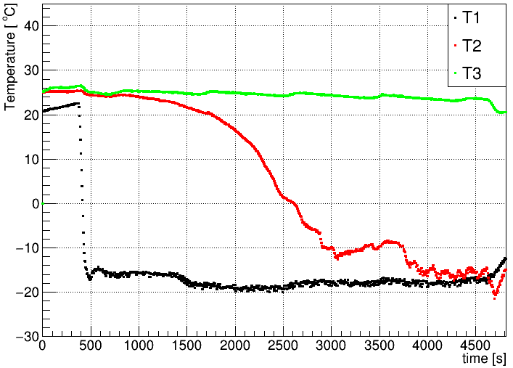
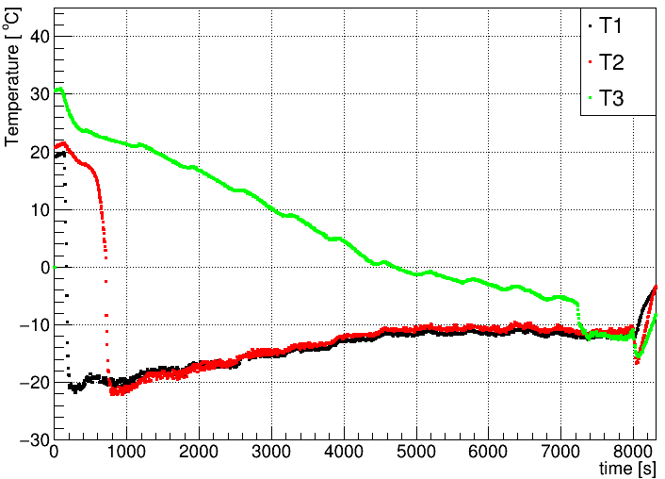
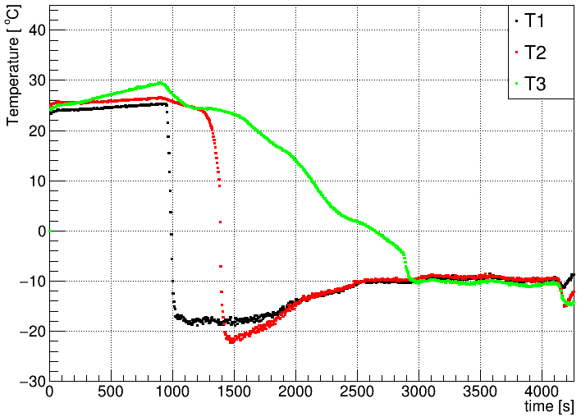
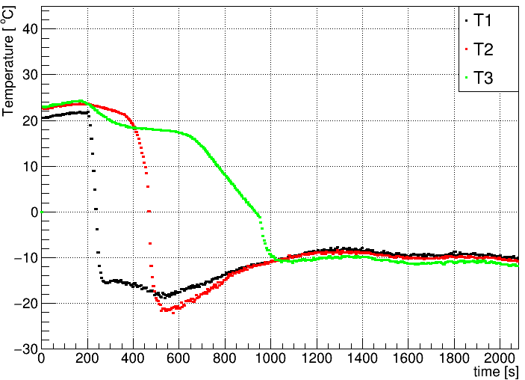
Temperature Drift
1.0 g/s
2.0 g/s
before heat load
after heat load
after heat ex. 2nd line
fixed on
the table
3.0 g/s
4.0 g/s
Equilibrium temperature is about -10 degrees for all flow rates.

