Slide 1
Status of FOS Activities for Beast II. Santander, January ^{th} VXD Workshop
D. Moya, I. Vila,J.González
Instituto de Física de Cantabria (CSIC-UC)

Slide 2
Outline
Beast II Fangs FOS monitoring system
FBG sensors characterization
Fibers integration in Beast II
Outlook

Slide 3
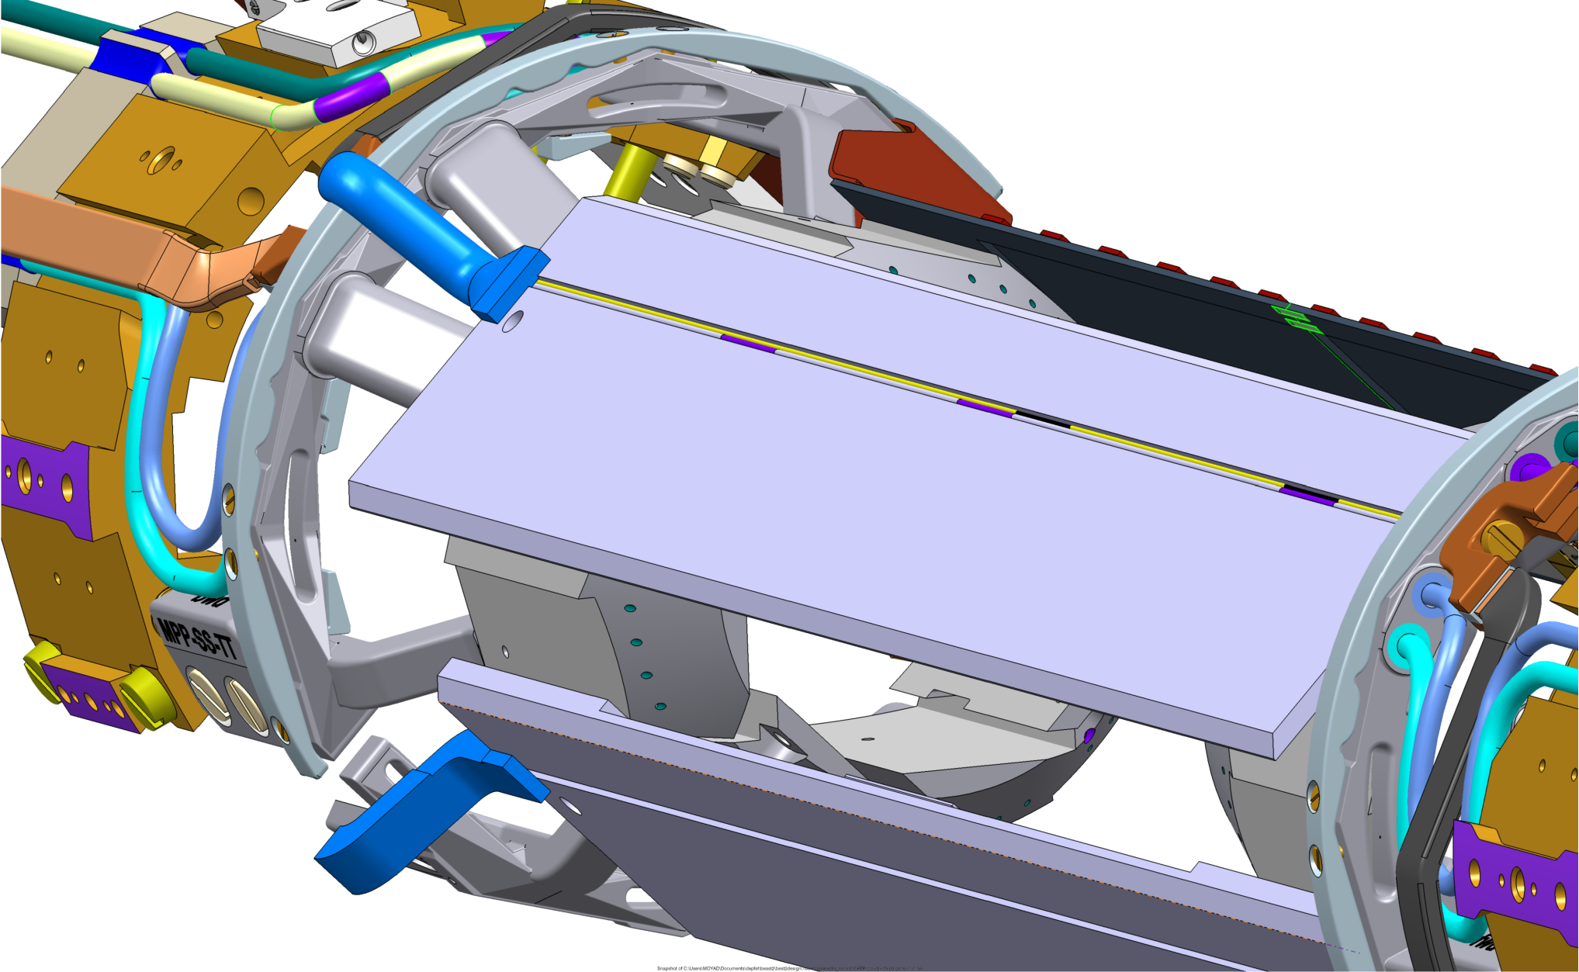
Fiber cables and sensors for Beast II
Each FANG two fibers along 1x1 mm groove
(polyimide+acrylate)

Slide 4
FOS for Beast II
Fiber | Coating | Sensitive | Nº of sensors | Cable length
FA42* | acrylate | T | 3 | 3 meters
FA43 | acrylate | T | 3 | 3 meters
FA44 | acrylate | T | 3 | 3 meters
FA45 | acrylate | T | 3 | 3 meters
F43 | polyimide | T +RH% | 2 | 0.7 meters
F42 | polyimide | T +RH% | 1 | 0.7 meters
F54 | polyimide | T +RH% | 2 | 3 meters
DAQ integration using January test beam EPICS driver
* Spare fiber

Slide 5
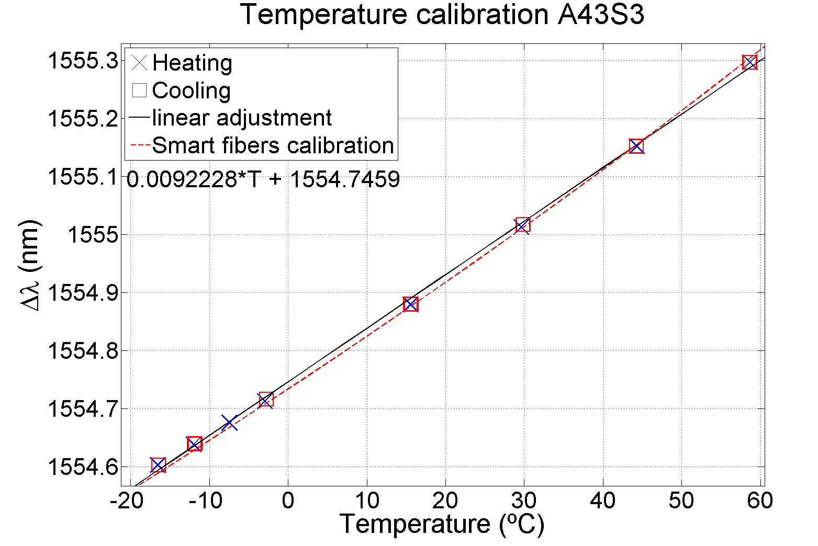
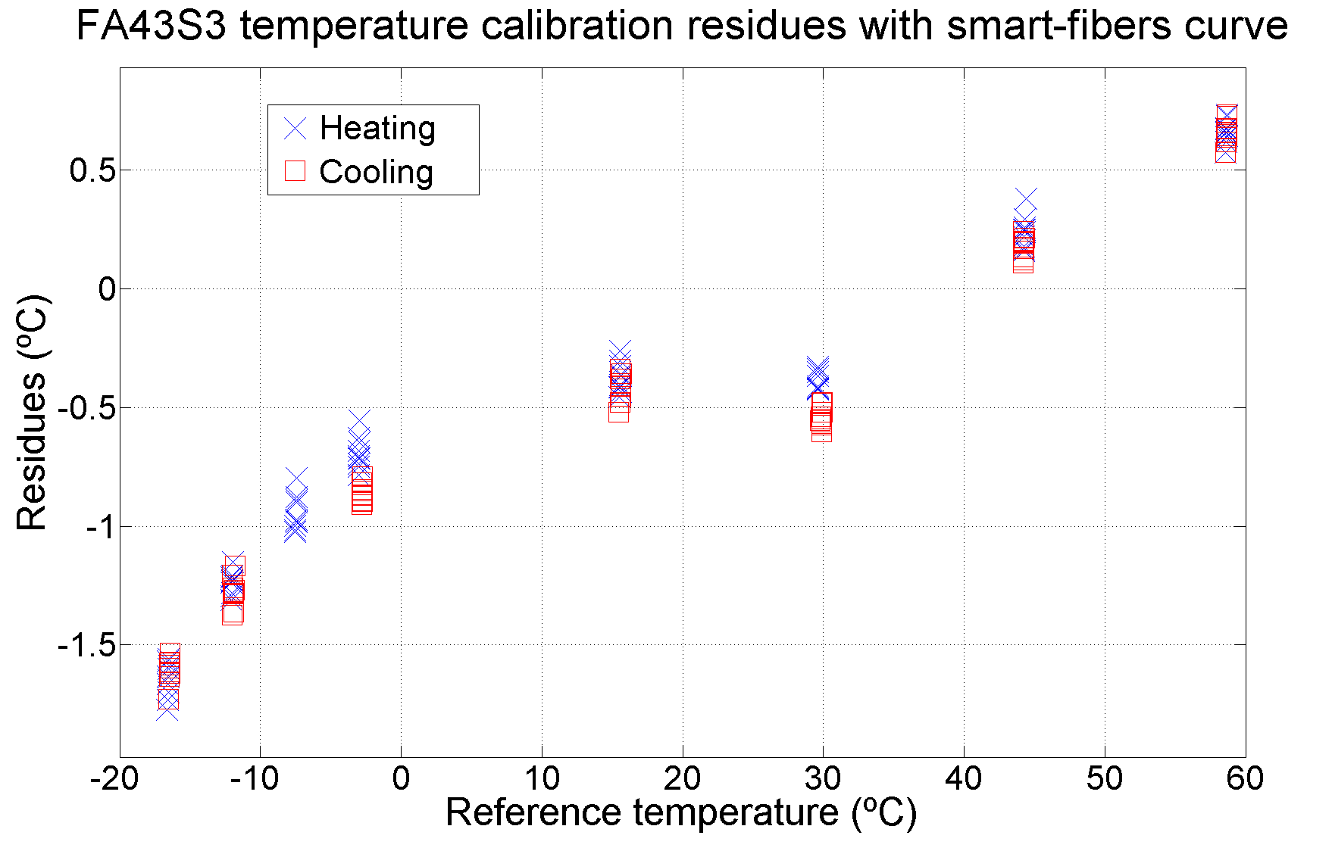
Fibers thermal calibrations: Acrylate fibers
Calibrated by the supplier in -30/60 ºC range
Results compared with our calibrations at IFCA. Difference bellow uncertainty.
Residues with smart fibers cuadratic adjustment

Slide 6
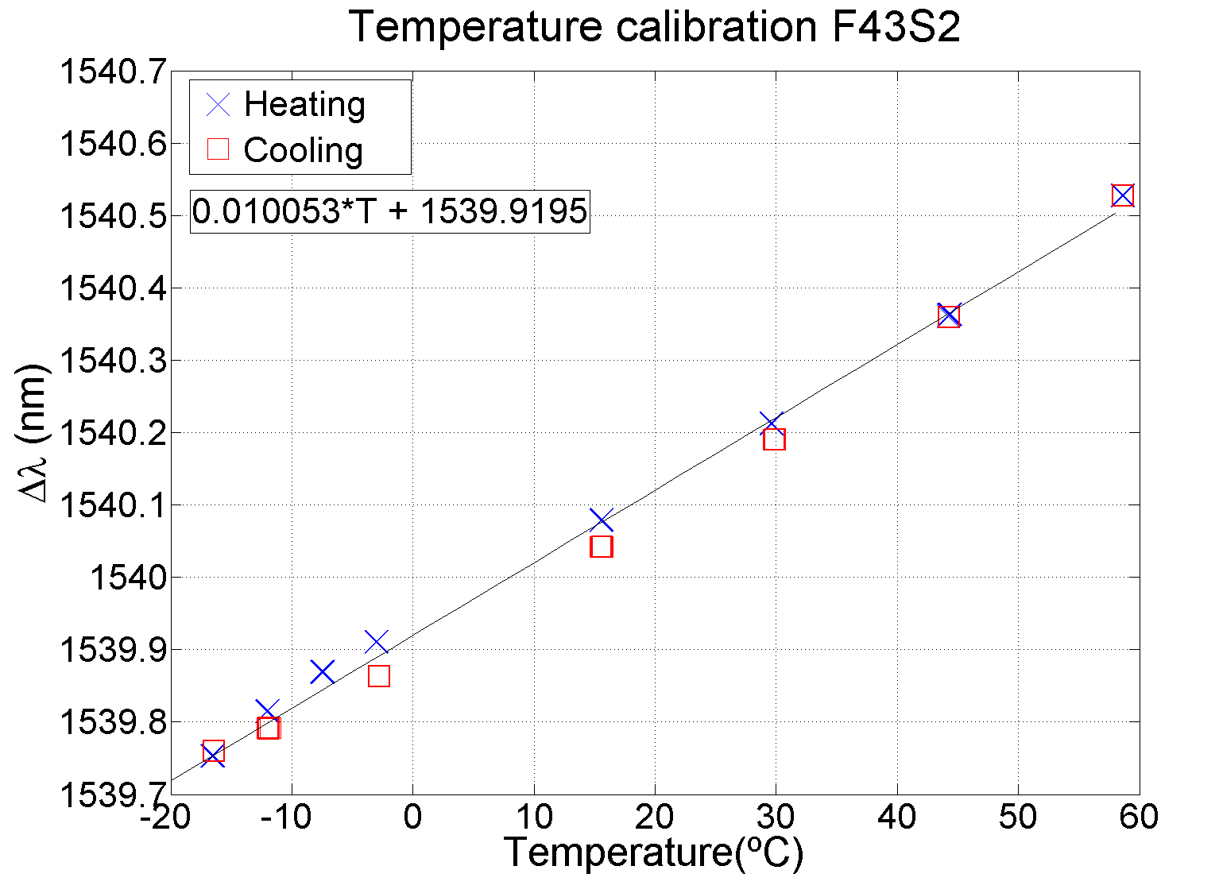
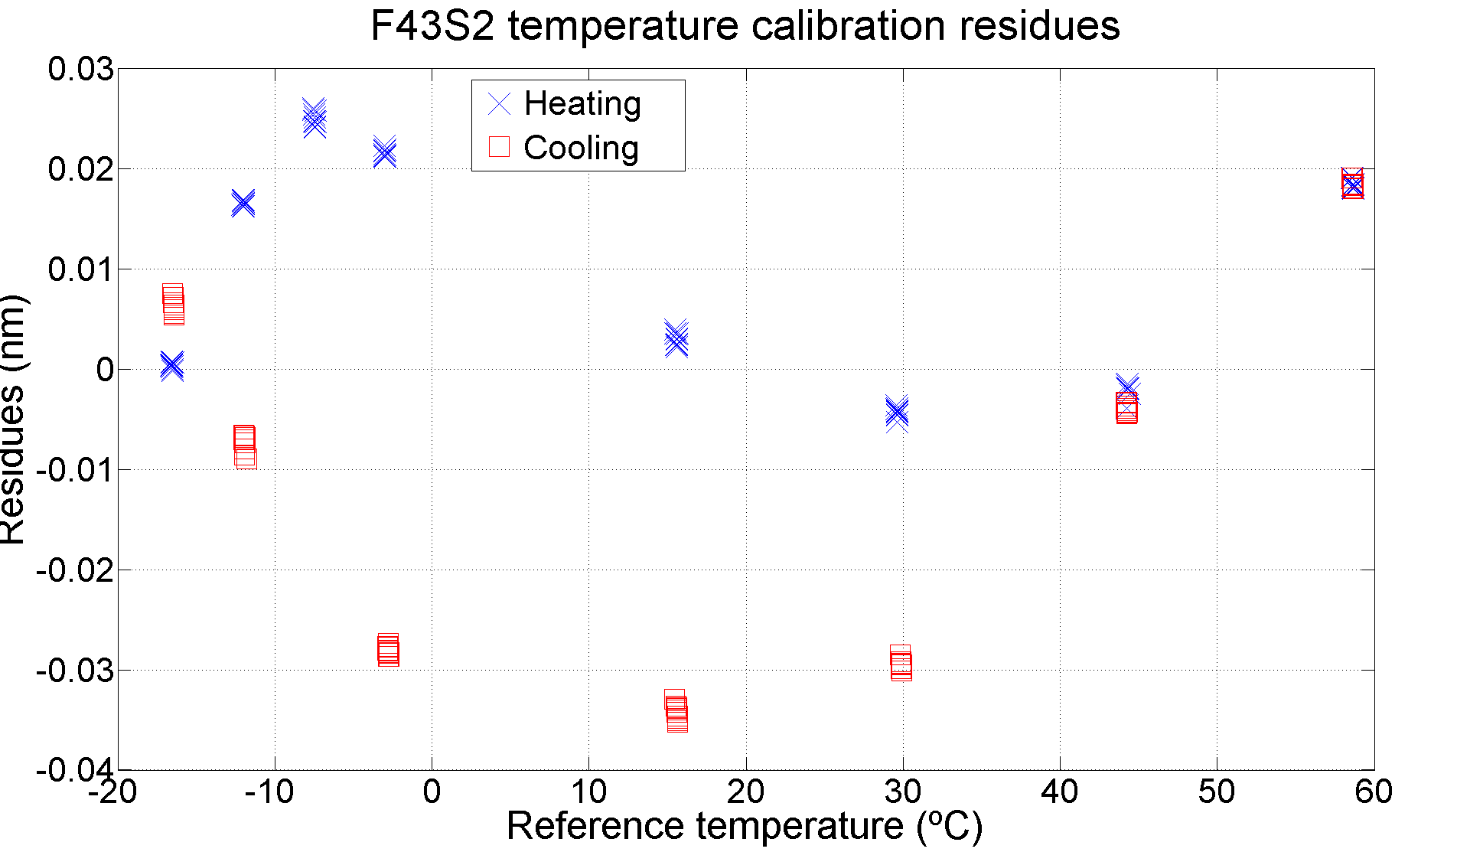
Polyimide thermal calibrations at IFCA
Environmental humidity must be reduced during calibration to avoid systematic errors. (from 9%RH to below 3%RH)

Slide 7
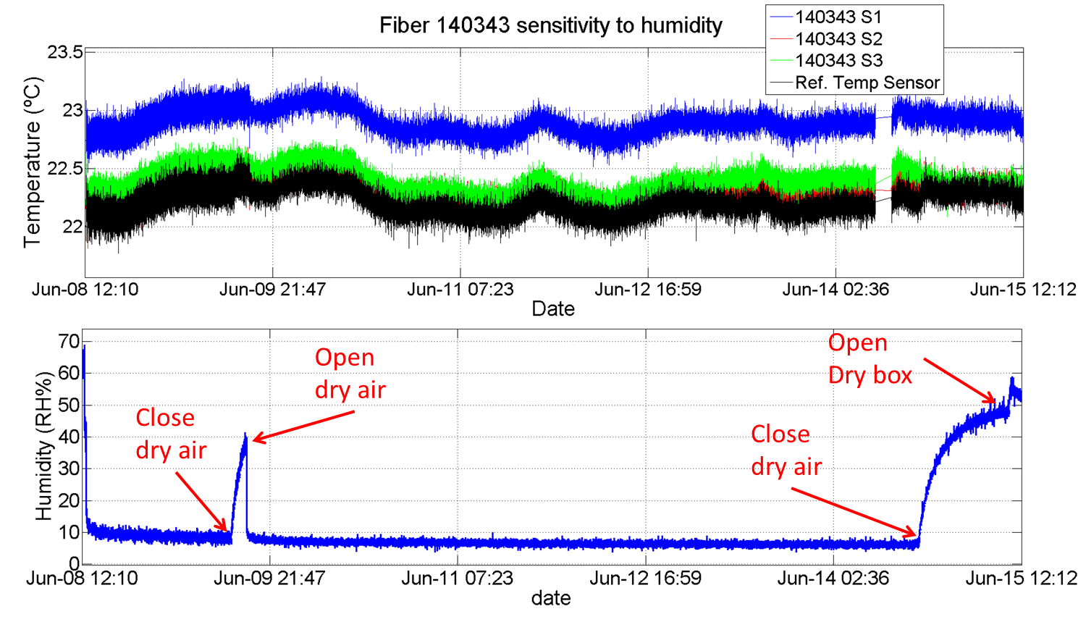
Acrylate fibers sensitivity to humidity
Acrylate fibers under dry environment during six days without any effect in the signal.

Slide 8
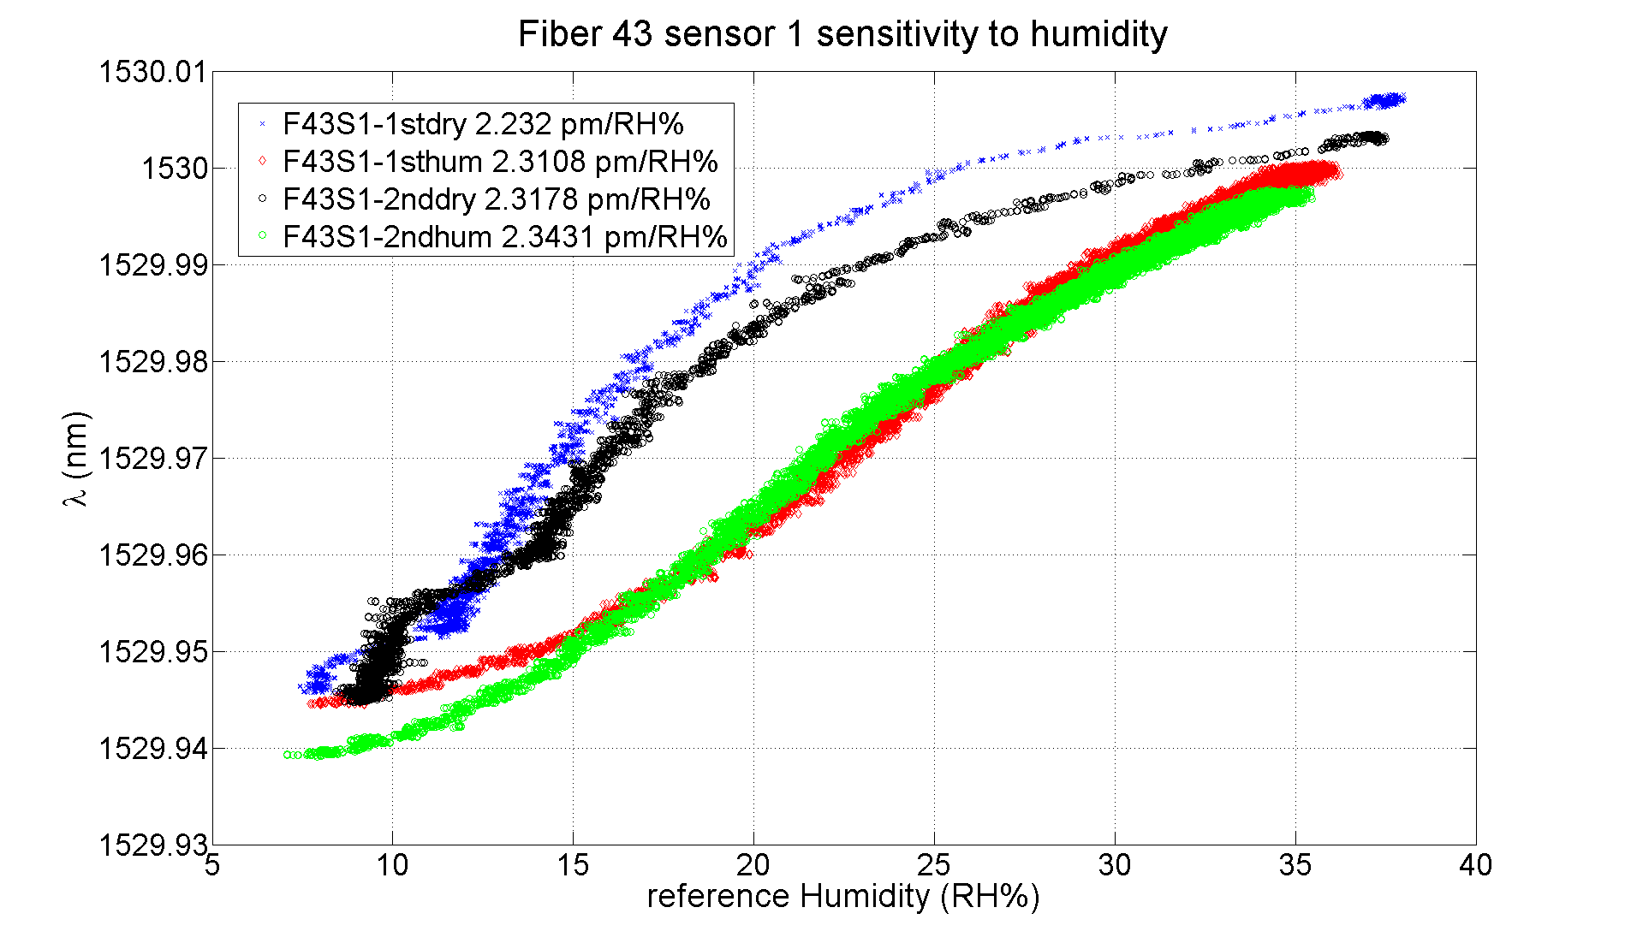
Polyimide fibers sensitivity to humidity
F43 and F54 calibrated against humidity Before TB april 2016.

Slide 9
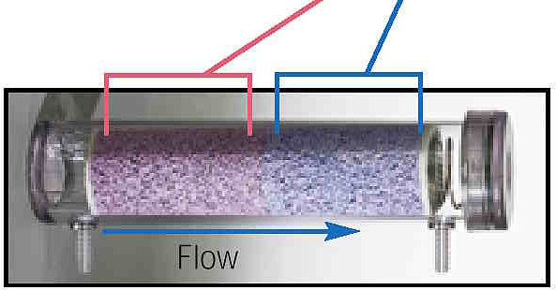
Polyimide fibers sensitivity to humidity
During Humidity 2016 Test beam fibers calibration two problems:
Sensitivity to humidity seems to change at lower humidity
Different curve for drying and incrementing humidity cycles.
A better calibration to be done going to lower humidity (using drierite desiccants) and with a better flow rate control ( drying speed control)
Exhausted
Active

Slide 10
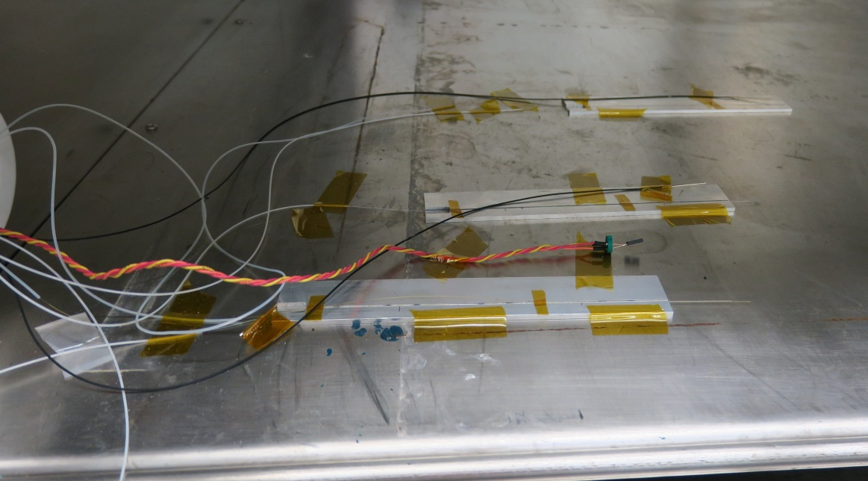
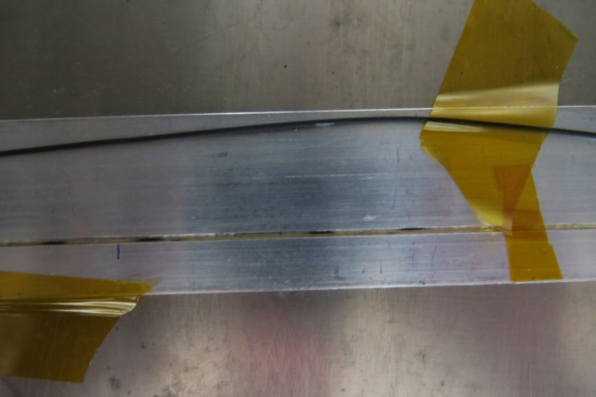
Beast II fibers temperature & humidity cross-calibration
Humidity calibration at different temperatures at ITA climatic chamber of Beast II fibers (Acrylate-Polyimide):
Test the dependence of the humidity sensitivity with temperature
Minimum humidity defined by minimum dew point of 5ºC.
Test done, data analysis ongoing.
Temperature Ref.
Humidity Ref
Polyimide + acrylate
in 1x1 mm groove
Kapton guide
Fake Fangs

Slide 11
Fibers integration in Beast II.
Some issues with fibers integration
Teflon protective tube must be fixed just in the output of the Fang ( in order not to transmit stress to the fiber). This makes quite difficult the routing of the fiber. A 3d printed adaptor proposed. The integration must be checked.
A system inside FANG volume in order to avoid the fibers going out from the groove (fixing radial position)
Acrylate fibers are long enough but two of polyimide fibers are very short for arriving to the docks (F43 and F42). Possible interconnection at mid-way? Fiber can be fused ( 4-5 mm x 50 mm length protection needed).

Slide 12
Fibers integration in Beast II. Fiber guiding
Both fibers inside 0.9/0.6 mm tube
Fiber guide and locking glued directly on FANG

Slide 13
Conclusions
Working on a fibers characterization for phase II
Thermal calibrations done for both acrylate and polyimide fibers. Polyimide fibers calibration to be improve.
Fibers characterized with humidity. More studies ongoing:
Analysis temperature dependence of humidity sensitivity
Study the possible sensitive changes at lower humidity
Sensors integration must be studied in more detail and fibers routing must be studied and define.

