Slide 1
Testing of ASICs at KIT
Richard Leys, Roberto Blanco, Ivan Peric

Slide 2
Probe Cards
Test systems
Two new DCD probe cards have been designed and produced (PTSL)
PC135 can contact all the digital outputs with bumps (the old probe card only half of outputs).
PC22 can contact the test pads using standard needles and tests DCDs at full speed
(The new DCD4.x hast bumps and test- (wire-bond) pads)
One Switcher PC_Sw has been designed and produced
Additionally, the old probe cards from Heidelberg are available
DCDnew/old
DCDnew/old
DCDnew
Old
Ptsl 135
Ptsl 22

Slide 3
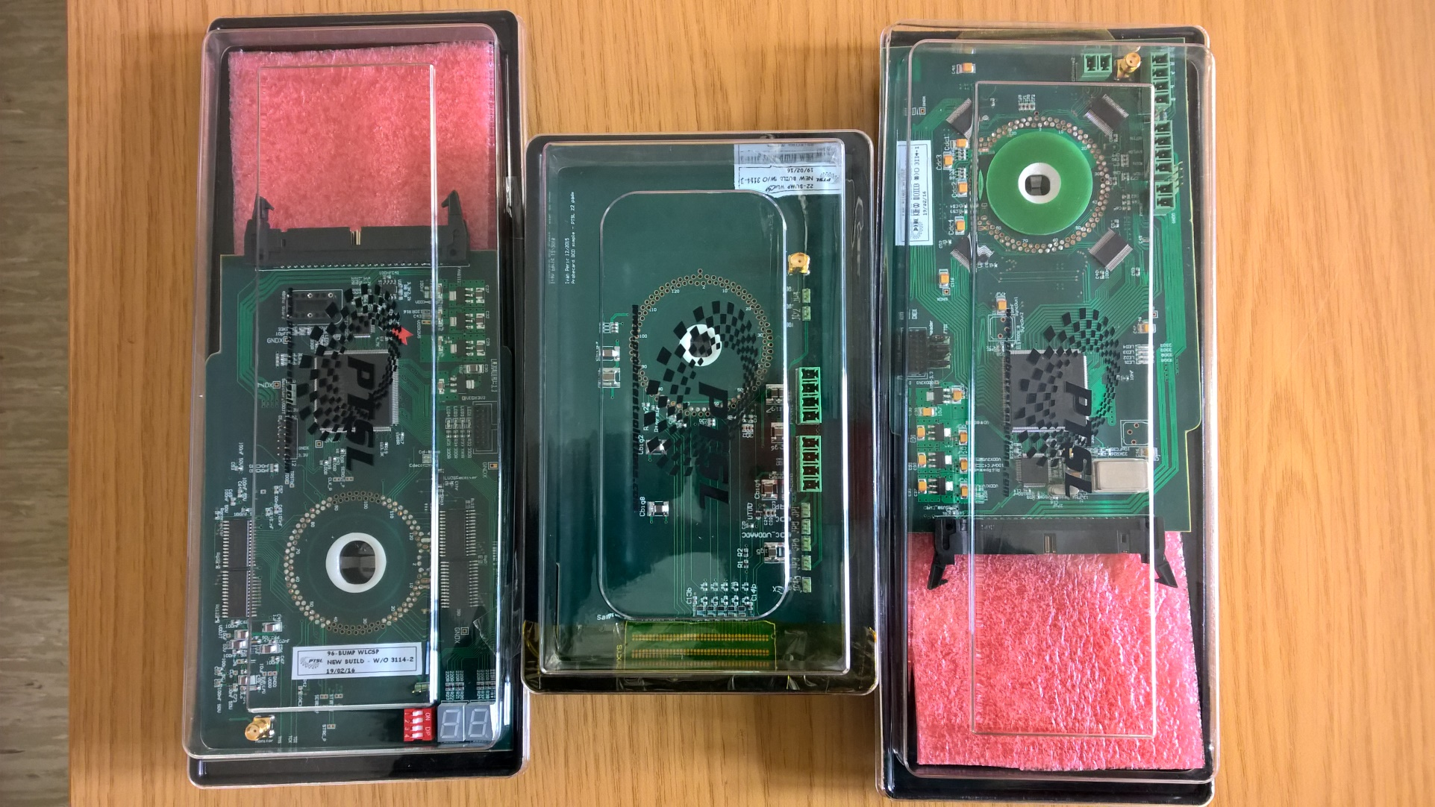
Probe Cards
…
PC_Sw
PC22
PC135

Slide 4
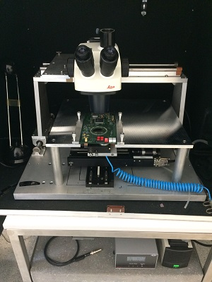
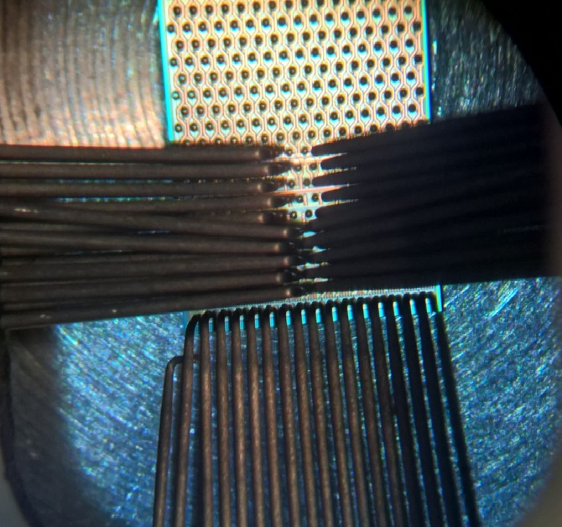
…
Until July the small probe-station at KIT (IEKP) was used

Slide 5
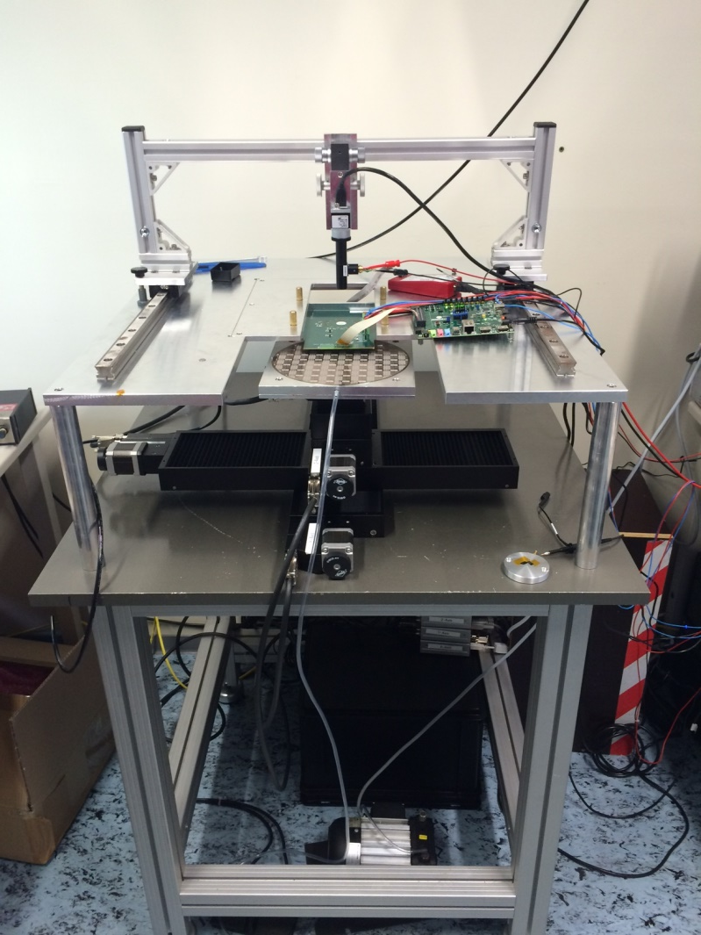
DCD
Since beginning of September the new automatic (self made) probe station works
DCDs have been successfully tested using the PC22
JTAG test can be done easily, we are currently working on the improvement of the ADC tests via JTAG

Slide 6
Probe Station
Positioning and Stepping Software written for windows (by Richard Leys)
Runs on standard Java, easily extensible to add helper features
Simple Programmable position change to step on the ASICs
Ready for picture processing if needed
Chip testing runs from the Linux MRO software
Will be tweaked to ease testing, like polling for ID while placing the probes
Automatic stepping + testing could be implemented, but it does not look like it is really needed
Test results could be saved in a database format
Maybe overkill, a simple list of valid chips on wafers is enough
Any good suggestions are welcome

Slide 7
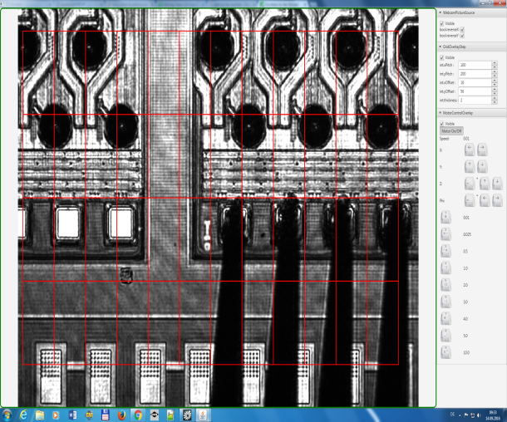
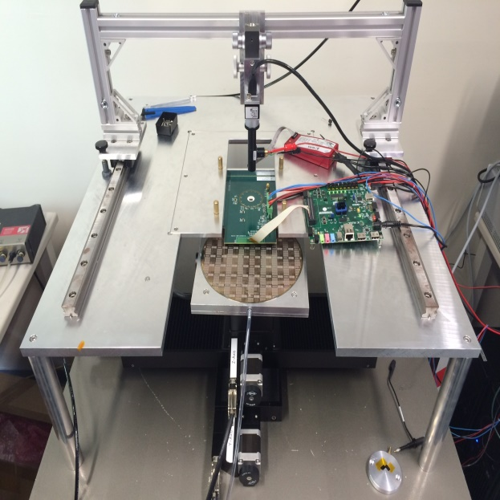
Probe Station
Placement Control (windows)
Wafer or Single Chip Carrier
Exchangeable Probe Boards
Chip Test (Linux MRO SW)

Slide 8
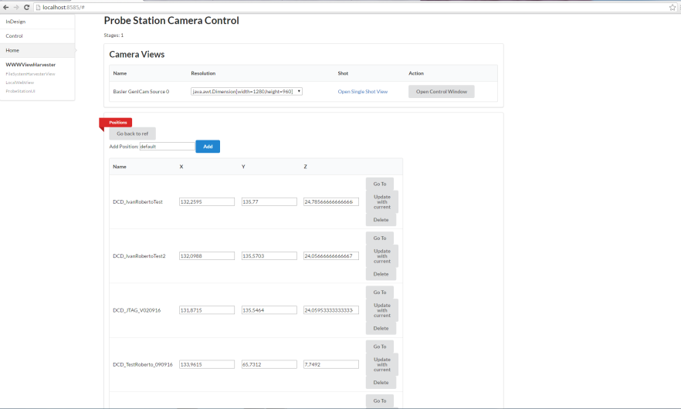
…
Software developed
DCD tested with the PC22 using the additional probe pads
Probe pads contacted by standrad needles

Slide 9
…
DCD Readout software
JTAG ADC readout
JTAG ID Test

Slide 10
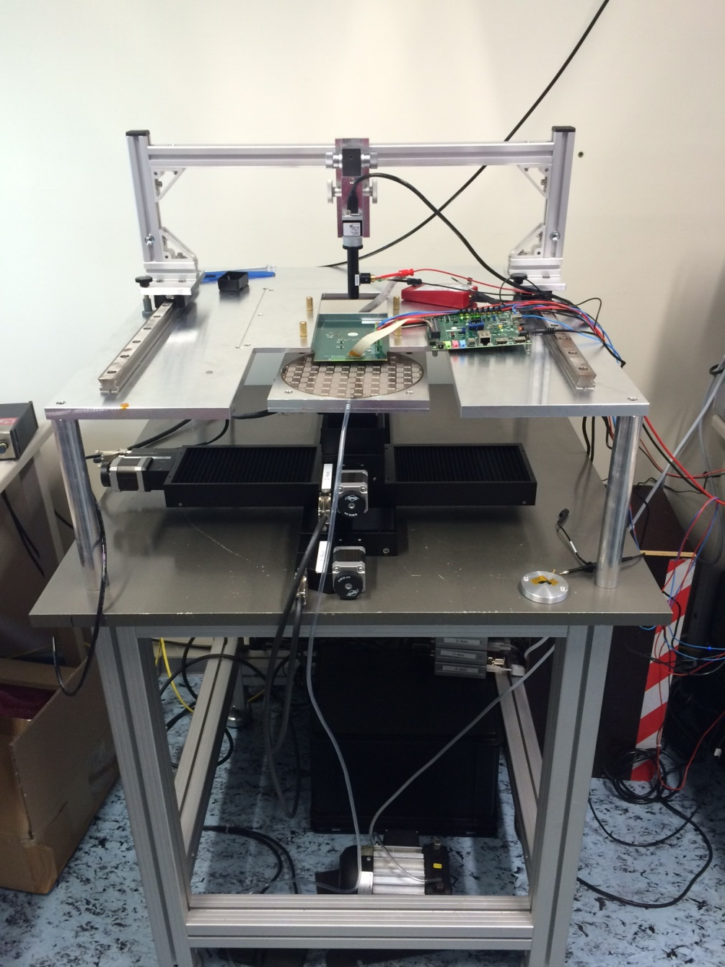
…
…

Slide 11
…
Problems:
Probe station was not provided (in operational state) on time – thanks to effort of Richard and Roberto it is now working
The PTSL PC135 was damaged – will be repaired
We are using PC22 instead

Slide 12
Summary
Since beginning of September the new automatic probe station works
DCDs have been successfully tested using the PC22
Positioning and stepping software written for windows in our group
Ready for picture processing if needed
Can be extended for automatic stepping + testing if needed

