Slide 1
Origami Status
Koji Hara (KEK)
2016 Sep. 13

Slide 2
Origami Status
80 assembled, inspected so far
30 O-Z : 25 class A, 5 e-test fail
27 OCE : 22* class A, 4 e-test fail, 1 e-test fail but repaired
* include 12 OCEs with APV3 ch0 noise ~ 2
23 O+Z : 18 class A, 3 e-test fail, 2 OK but minor issue**
** 1 wires bent, 1 soldering to be reworked
63 will be assembled with new DISCO thinned chips + chips thinned as a whole wafer
36 O-Z
22 OCE
5 O+Z

Slide 3
Electrical failures in assembled Origami
Whole analog dead (all 128 chs are bad) : 6.3% (5/80)
O-Z130 APV6 (N0), no crack, LV normal
O+Z118 APV9 (N3), crack observed, LV low cur.
OCE122 APV3 (P3), crack observed, LV low cur.
OCE123 APV6 (N0), power OK on chip, LV normal
O-Z107 APV5 (P5), discon. at soldered pad, LV low cur.
A part of chs dead : 10.0% (8/80) (1 repaired)
O-Z 3/30 before|after our inspection: 2/17 | 1/13
OCE 3/27 before|after our inspection: 3/15 | 0/12
O+Z 2/23 before|after our inspection: 0/8 | 2/15
Total 8/80 before|after our inspection: 5/40| 3/40
Short on PA0 (1 on each)
O-Z 4 (117,121,123,146) → to be assembled

Slide 4
OCE test status
4 APVDAQ tested, 8 remained -> measured
No dead channels in these 12 OCE
Ch0 slightly noisy (noise level > 2 ) → continues
Cable swap (N ←→ P) → no change
Waiting for >30 min. after LV up → no change
O-Z133 for comparison→ noise level of APV3 ch0 ~ 1.5
New cables (both N and P) → no change
Measured remaining 8 OCE → same tendency
Other minor issue
Tiny bump on PA0 on OCE109
Small dark region on the APV analog line on OCE133

Slide 5
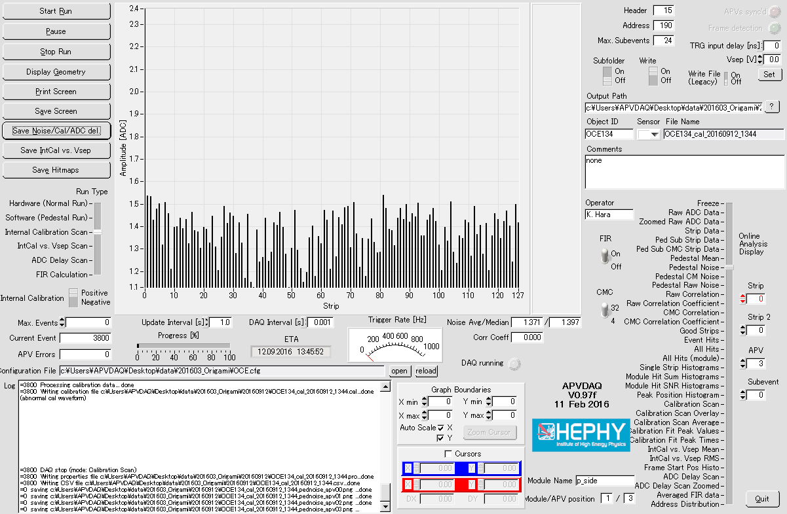
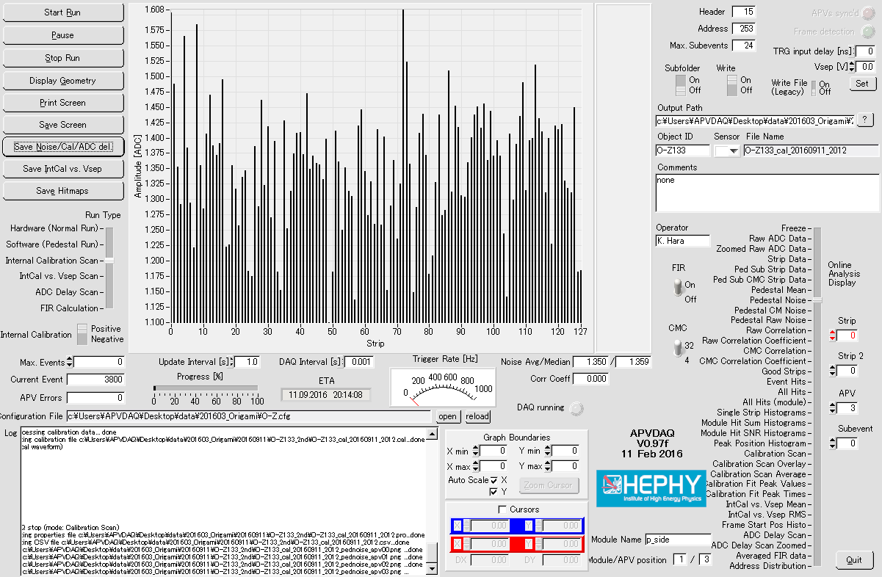
OCE134
APV3 ch0
O-Z133
APV3 ch0
(measured for comparison)

Slide 6
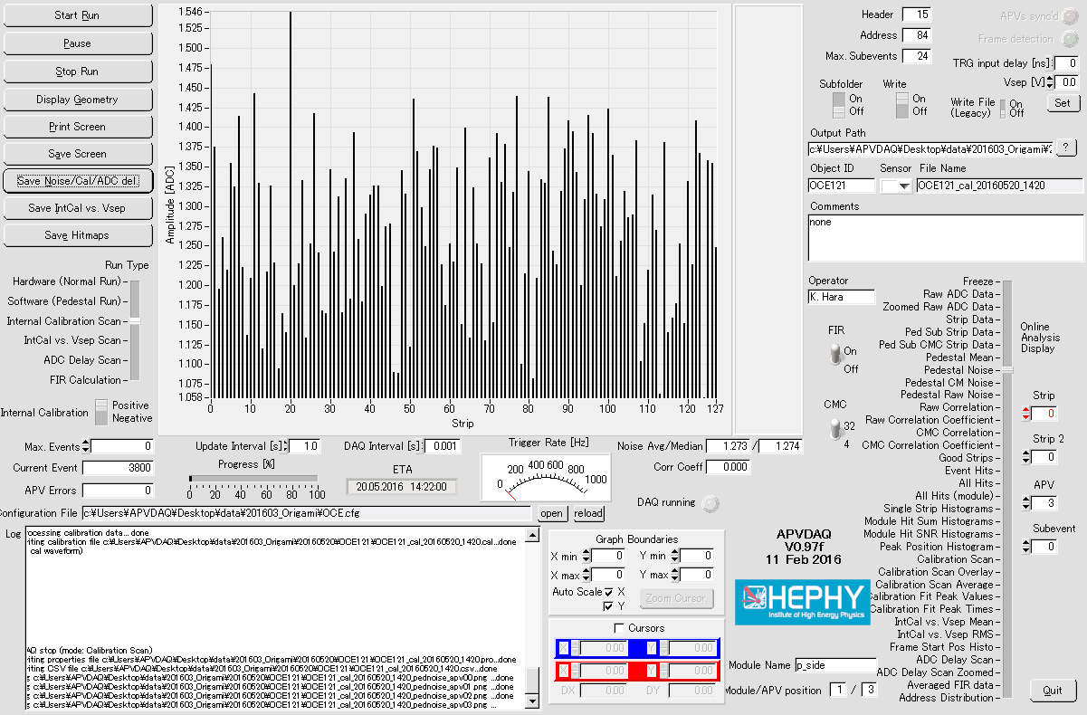
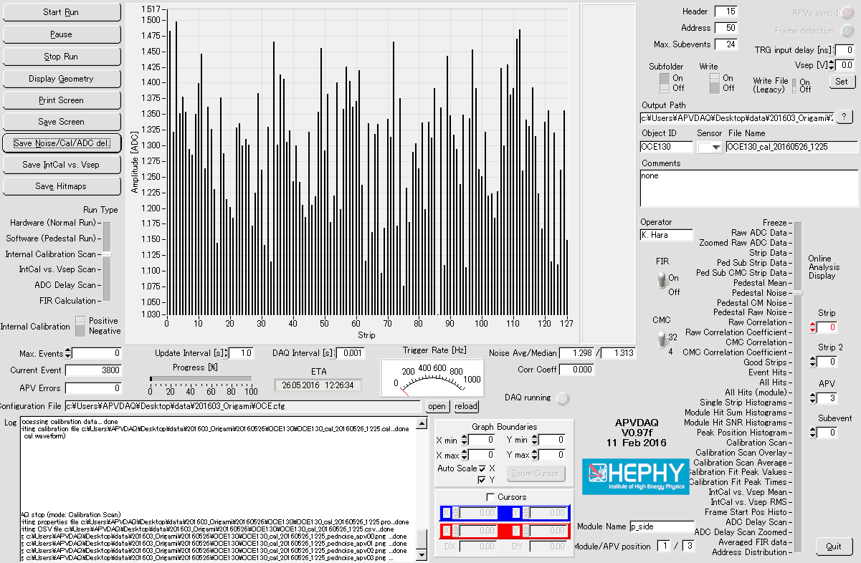
OCE121 (May 20)
APV3
OCE130 (May 26)
APV3
Noise level ~1.5 in OCE measured in May
Hybrid cables have been replaced several times after the last time OCE measured in May
(not re-measured with the current system)

Slide 7
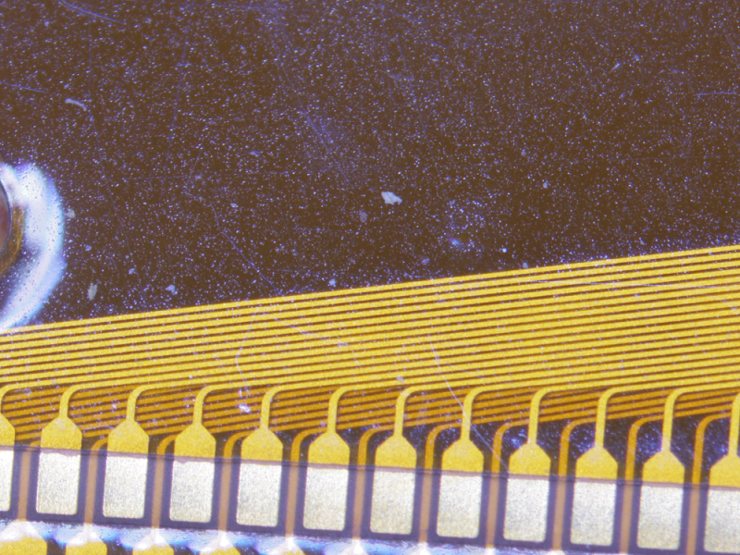
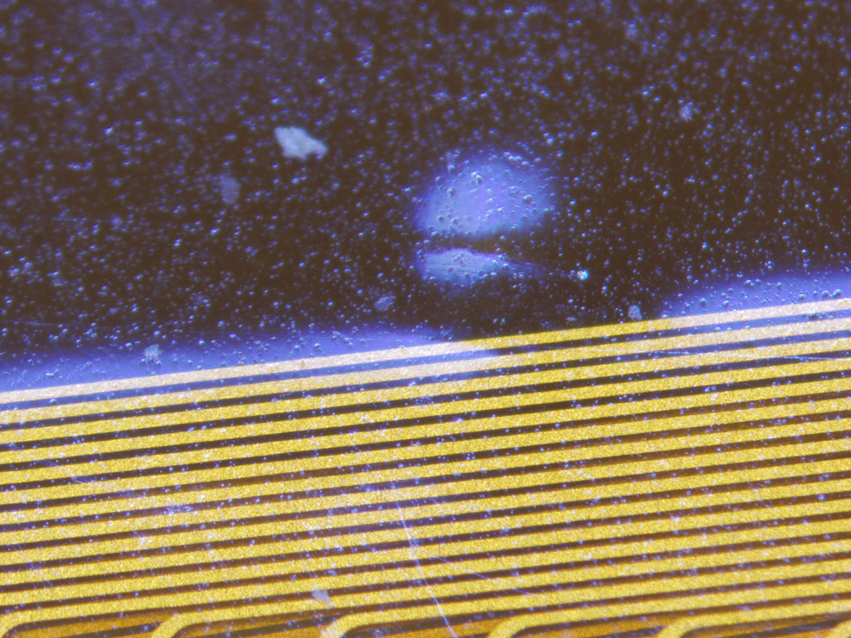
Tiny bump on OCE109
Not bubble
Not on the signal line
Very small
→ Not harmful

Slide 8
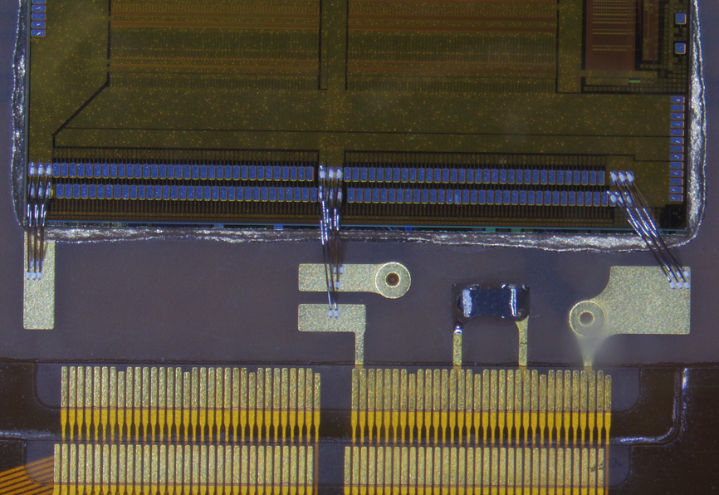
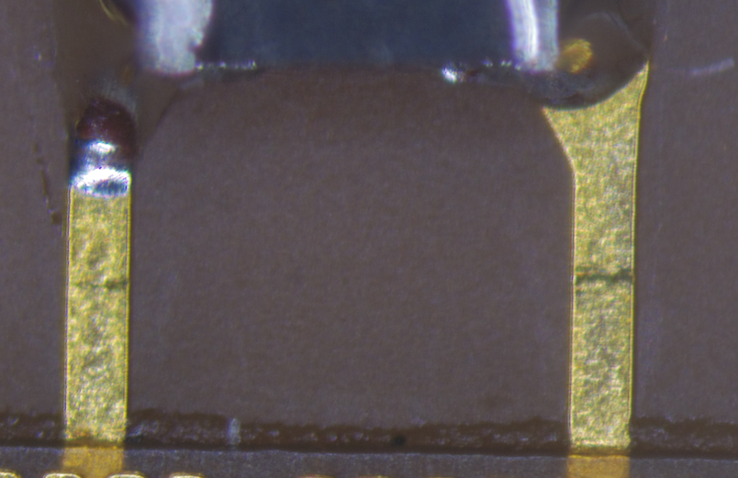
OCE133 N2
Small “dark” (deformation?) region
APVDAQ data are OK

Slide 9
Expected Origami readiness at KEK
 |  | O+Z ready@KEK | OCE ready@KEK | O-Z ready@KEK
week
2016/9/5 |  | 18 (3 shipped) | 22 (8 shipped) | 25 (12 shipped)
2016/9/12 | VXD workshop
2016/9/19 | "Silver week"
2016/9/26
2016/10/3
2016/10/10
2016/10/17 | B2GM |  |  | +13
2016/10/24
2016/10/31 |  |  | +10
2016/11/7
2016/11/14 |  |  |  | +12
2016/11/21
2016/11/28 |  |  |  | +11
2016/12/5
2016/12/12
2016/12/19 |  | +4 +1 | +11 +1
2016/12/26
2017/1/2 | New Year
2017/1/9
Numbers in future are before acceptance inspection at KEK
Assumed to resume APV gluing on Sep. 26

Slide 10
 | +Z 15 pcs | +Z 4 (new Origami) | +Z 0 (Ass. Pend.) | +Z 0 (replace) | +Z 1 replacement
week |  |  |  |  | O+Z118 (Origami crack)
2016/9/12
2016/9/19
2016/9/26 |  | Soldering
2016/10/3 |  | Soldering |  |  | Soldering
2016/10/10 |  | e-test1 |  |  | e-test1
2016/10/17
2016/10/24 |  | prebending |  |  | prebending
2016/10/31 |  | aging |  |  | aging
2016/11/7
2016/11/14
2016/11/21 |  | Assembly |  |  | Assembly
2016/11/28 |  | Assembly |  |  | Assembly
2016/12/5 |  | Assembly |  |  | Assembly
2016/12/12 |  | e-test2 |  |  | e-test2
2016/12/19
2016/12/26
2017/1/2

Slide 11
 | CE 12 pcs | CE 10 | CE 10 (new Origami) | CE 1 (Ass. Pending) | CE 1 replace
week |  |  |  | OCE132 (small peeling on 1 PA0 pad) | OCE122 (Origami crack)
2016/9/12 |  |  | Soldering
2016/9/19 |  |  | Soldering |  | Soldering
2016/9/26 |  |  | e-test1 |  | e-test1
2016/10/3
2016/10/10 |  | Assembly
2016/10/17 |  | Assembly
2016/10/24 |  | e-test2
2016/10/31
2016/11/7
2016/11/14
2016/11/21 |  |  | Assembly | Assembly | Assembly
2016/11/28 |  |  | Assembly | Assembly | Assembly
2016/12/5 |  |  | Assembly | Assembly | Assembly
2016/12/12 |  |  | e-test2 | e-test2 | e-test2
2016/12/19
2016/12/26
2017/1/2

Slide 12
 | -Z 15 pcs | -Z 13 | -Z 12 | -Z 6 (new Origami) | -Z 4 (Ass. Pending) | -Z 1 replace
week |  |  |  |  | O-Z117,121,123,146 (1 PA0 short) | O-Z140 (bad plating)
2016/9/12
2016/9/19
2016/9/26 |  | Assembly |  | Soldering |  | Soldering
2016/10/3 |  | Assembly |  | Soldering |  | Soldering
2016/10/10 |  | e-test2 |  | e-test1 |  | e-test1
2016/10/17
2016/10/24 |  |  | Assembly
2016/10/31 |  |  | Assembly
2016/11/7 |  |  | e-test2 | Assembly | Assembly | Assembly
2016/11/14 |  |  |  | Assembly | Assembly | Assembly
2016/11/21 |  |  |  | e-test2 | e-test2 | e-test2
2016/11/28
2016/12/5
2016/12/12
2016/12/19
2016/12/26
2017/1/2

Slide 14
O-Z status
O-Z1XX
Planned to assemble 66 O-Z
61 on DB (O-Z100-160)
Assembly completed : 30 (25 class A, 5 e-test fail)
Shipped to assembly sites : 12
Ready for shipment : 13
E-test failure : 5 (107,110,112,119,130)
Soldering finished : 31 (25 to be assembled, 4 pending (PA0 shorts), 2 rejected)
PA0 short (1 short on each): 4 (117,121,123,146) → kept at KEK
Plating issue : 1 (O-Z140) → replacement will be produced and assembled
Blister due to high temp. of solder iron: 1 (O-Z111) → replaced
Being assembled at REPIC : 25 (new APV chips will be used)
Soldering to be started: 7
13 newly produced Origami
1 being produced to replace O-Z140
Origami delivery to KEK Sep. 13

Slide 15
OCE status
OCE1XX
Planned to assemble 48 OCE
59 on DB (OCE100-158) (incl. 8 destroyed (100-106,110) )
Assembly completed : 27 (22 class A, 4 e-test fail, 1 repaired, 12 to be checked)
Shipped to assembly sites : 8 (class A)
Ready for shipment : 2
E-test failure : 4 (122,123,129,125)
E-test failure, repiared : 1 (112 @ HEPHY)
Soldering finished : 11 (10 to be assembled, 1 kept at KEK)
PA0 short : 0
Being assembled at REPIC : 10 (new APV chips will be used)
Small damaged Pad on PA0 (1 sensor side pad , bottom layer) : 1 (OCE132)
Soldering to be started: 10
13 newly produced, sent to Saiden

Slide 16
O+Z status
O+Z1XX
Planned to assemble 27 OCE
32 on DB (OCE100-145) (incl. 2 destroyed (114,115) and 1 solder on pad (105 )
Assembly completed : 23
(18 class A, 1 OK but wires bent, 1 to be reworked, 3 e-test fail)
Shipped to assembly sites : 3
Ready for shipment : 15
OK but wires bent : 1 (109, kept at KEK)
E-test OK but soldering rework needed : 1 (125)
E-test failure : 3 (111,113,118)
Soldering finished : 0
PA0 short : 0
Being assembled at REPIC : 0
Soldering started : 4
6 newly produced Origami sent to Saiden

