Slide 1
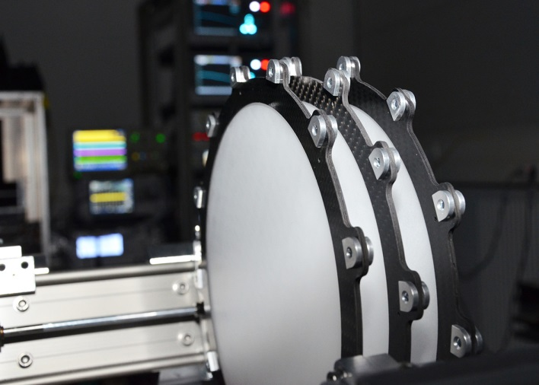
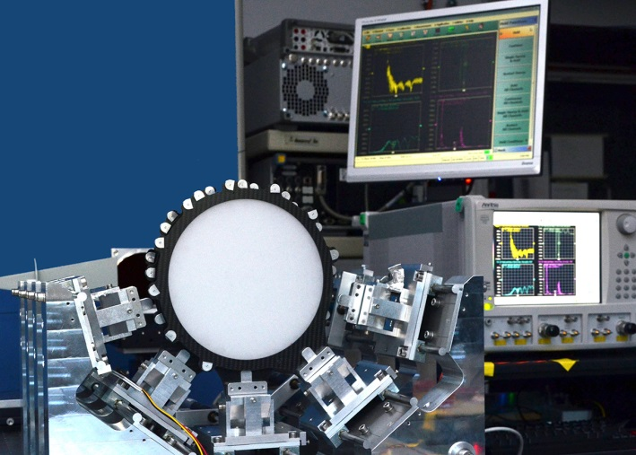
MadMax:The Cluster Seed Project
B. Majorovits
The idea
Realization
Current activities
Further plans

Slide 2
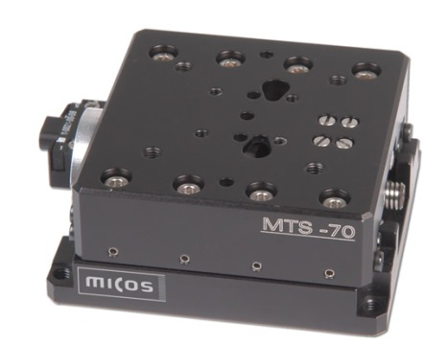
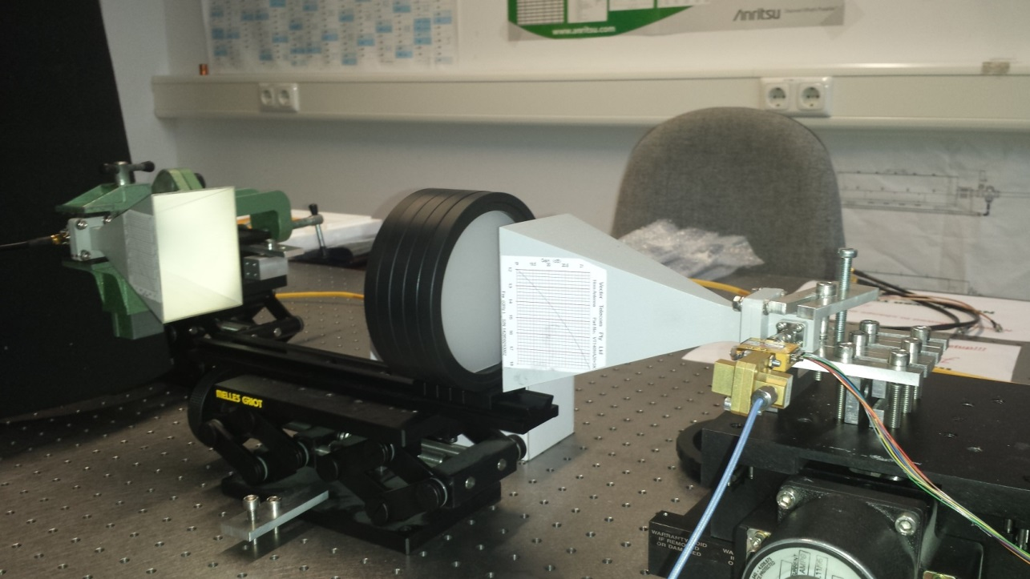
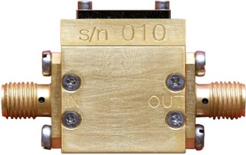
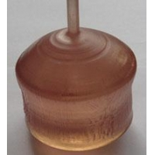
Proposed seed project
High precision motors to test ~μm precision of relative plate positioning
Different high ε plates with diameter 200mm to test transmission behavior for different ε: → cross check simulations, ε dependence, tiling of plates, precision of geometries
Cryogenic low noise amplifier for reference measurements

Slide 3
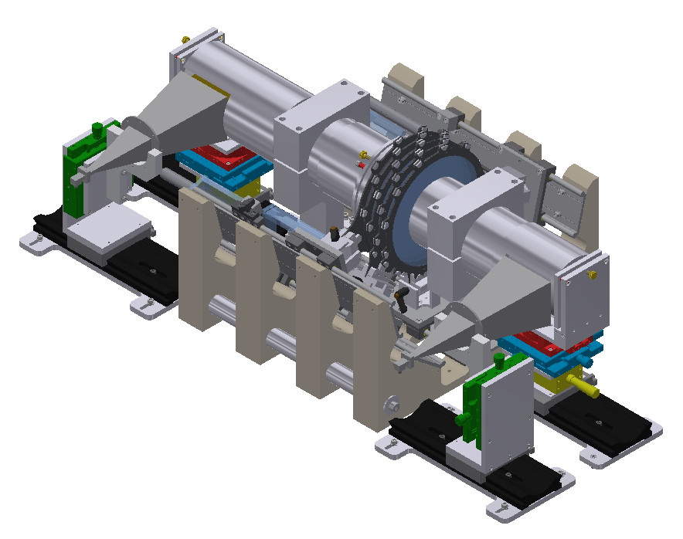
First prototype setup at MPI
Wave guides
Removable copper mirror
Mirror
Horn antenna
Dielectric discs
Mirror
Ref. signal in →
Precision motors
Prototype setup partly funded as seed project by:
Slides for discs
Cryo-tank
Signal out ←
Germanium
Array
Water / Myon-Veto (Č)‏

Slide 4
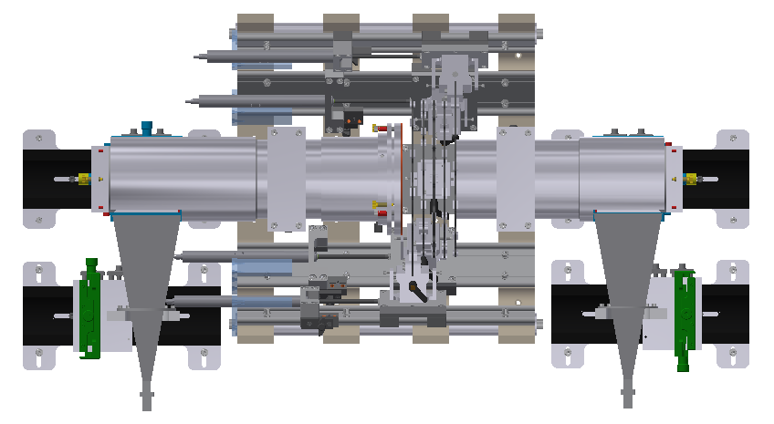
First prototype setup at MPI
Test correlation btw. transmission and boost factor
Test needed disc precision
Evaluate uncertainties
R&D on tiling
Prototype setup partly funded as seed project by:

Slide 5
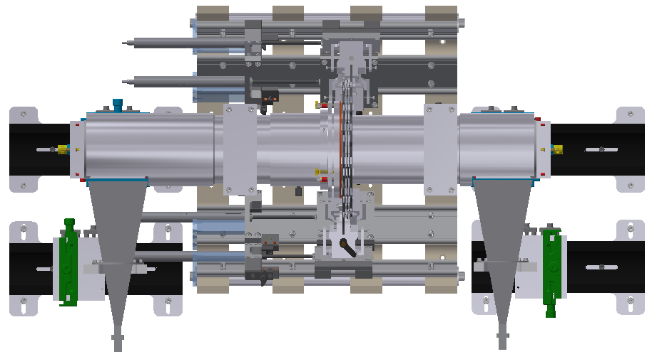
First prototype setup at MPI
Test correlation btw. transmission and boost factor
Test needed disc precision
Evaluate uncertainties
R&D on tiling
Prototype setup partly funded as seed project by:

Slide 6
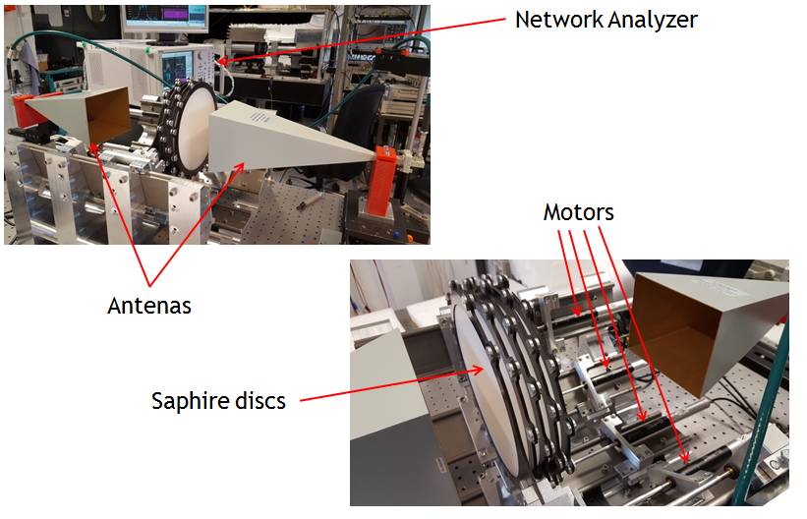
First prototype setup at MPI
Transmission and reflection measurements
Prototype setup partly funded as seed project by:

Slide 7
Further plans
2016:
Learned a alot already (See Olafs talks)!
Ordered 15 additional precision motors
Ordered additional sapphire plates
2017 -- ?:
Add five additional motors to lower frame
Upgrade of symmetric upper frame with motors
Tests with up to 20 discs → can we scale up?
Crucial for tests to understand behavior of booster!

