Slide 1
MadMax
Experiment: Algorithm to Place Discs
MadMax Mini Workshop
MPP
C. Moore
November 21, 2016
Notes:
<number>

Slide 2
Outline
Resonator Control: Problem Background
Obtaining S11 (Reflection) Frequency Response
  Measurement - Vector Network Analysis
  Simulation - ADS/Qucs
Signal Processing
  A direct comparison
  Problems with Experiment and Model
  Signal Flow Diagram
Fitting Algorithm
  Starting Point: A Naive Genetic Algorithm for Best Fit
  Control Strategies
Initial Results
Refined Model
Ongoing Work
Notes:
<number>

Slide 3
Resonator Control
Problem Background

Slide 4
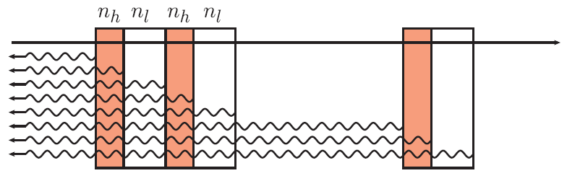
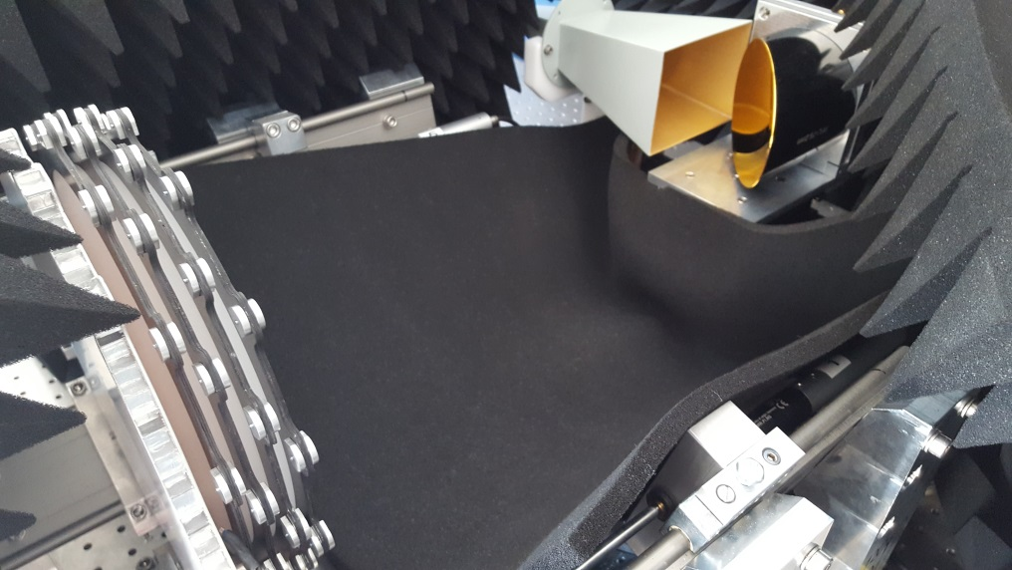
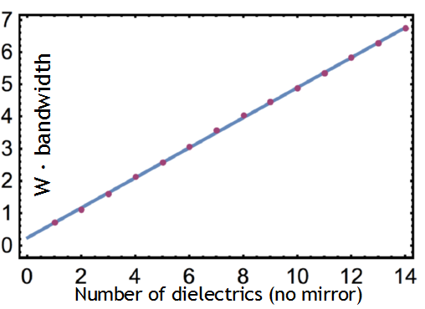
Prior Knowledge
Detector Motivation
“Photon Boost” Method
Instrument Layout

Slide 5
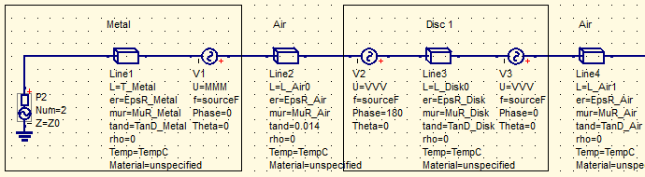
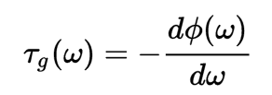
A Fitting Problem
Measuring Boost Factor?
There is no way to measure the Boost Factor curve directly
But we can simulate
Boost Factor by including
voltage sources at
dielectric boundaries
Can we fit the experiment configuration to simulation?
Absolute position control of disc spacing gives good starting point
But we may be able to improve this with a fitting algorithm
Other ways to control the fit?
Phase (Or Group Delay: Derivative of Phase)
Magnitude

Slide 6
Resonator Control
Obtaining S11 (Reflection) Frequency Response

Slide 7
S11: Measurement
Measurements taken with a VNA
  Vector Network Analyser, output: Scattering, or “S” Parameters
S11 (Reflection)
Experiment relies on a mirror
Reflection coefficient is the only measurement we can use
A function of frequency
Time domain = iFFT(S11)
We can observe impedance discontinuities in the time domain by taking the Fourier transform of the reflection scattering parameter

Slide 8
S11: Simulation
Simulation Tool
Industry Standard : ADS (commercial, comprehensive, costly)
Fitting tool : Qucs (open source, limited functionality)
Fitting Model
Waveguide elements used to model free space and sapphire
Ideal, does not include:
Waveguide cutoff & dispersion
Horn antenna
Unintentional impedance discontinuities
Environmental reflections and RF interference
Simulation Methods
“S Parameter Simulation” : S11 Reflection Phasor
“AC Simulation” : Boost Factor Curve

Slide 9
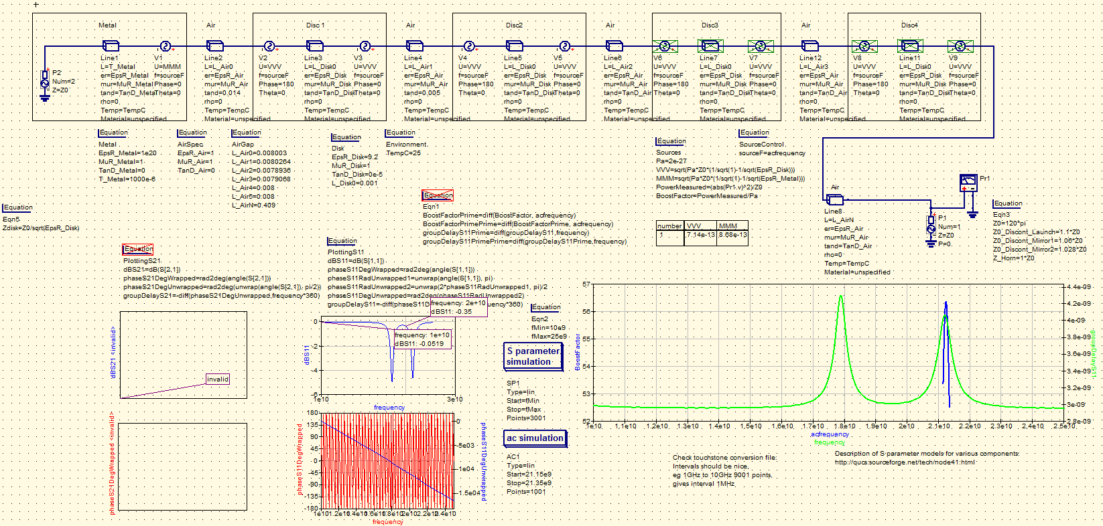
S11: Simulation Schematic
Qucs Simulation Schematic: 2 disks, 1 mirror

Slide 10
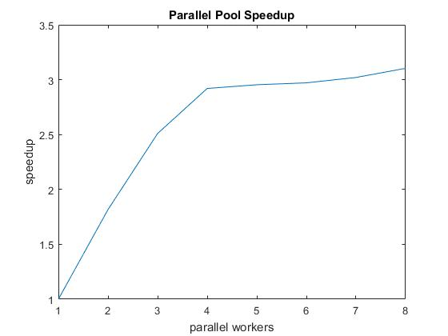
S11: Simulation Control
A Matlab function to control simulations
Allows for rapid testing of algorithms
Parallelism opportunities with Matlab Parallel Computing Toolbox
Process:
  Open schematic txt file
Search/Replace disc space values
  Run simulation
  Convert S11 to Touchstone
  Convert BoostFactor to .csv
  Copy to Matlab workspace
Simulation Performance (Intel i7 CPU):
~1 second for 3000 frequency points, single process
~3x speedup on 4 physical cores in local Parallel Pool (IO bottleneck?)
Intel i7 has 4 physical cores
(8 virtual with Hyper-Threading)

Slide 11
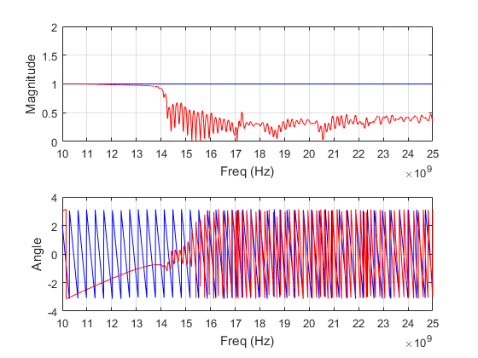
S11: Measurement (Freq Domain)
Mirror only: Simulation (Blue) vs Measured (Red)

Slide 12
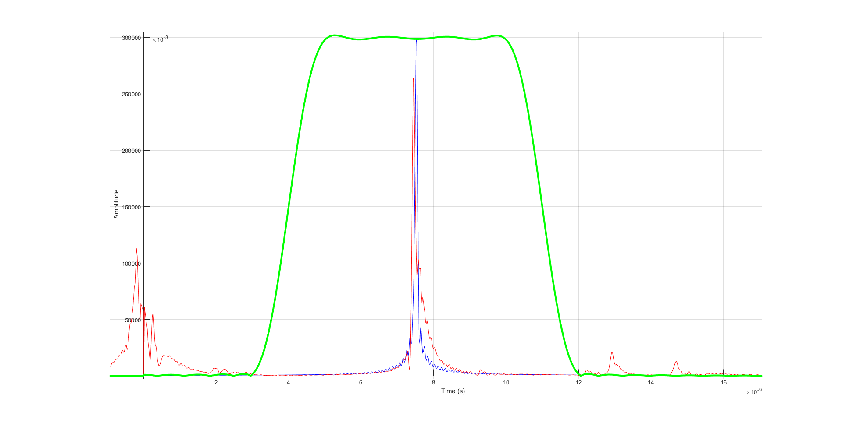
S11: Measurement (Time Domain)
Mirror only: Simulation (Blue) vs Measured (Red)

Slide 13
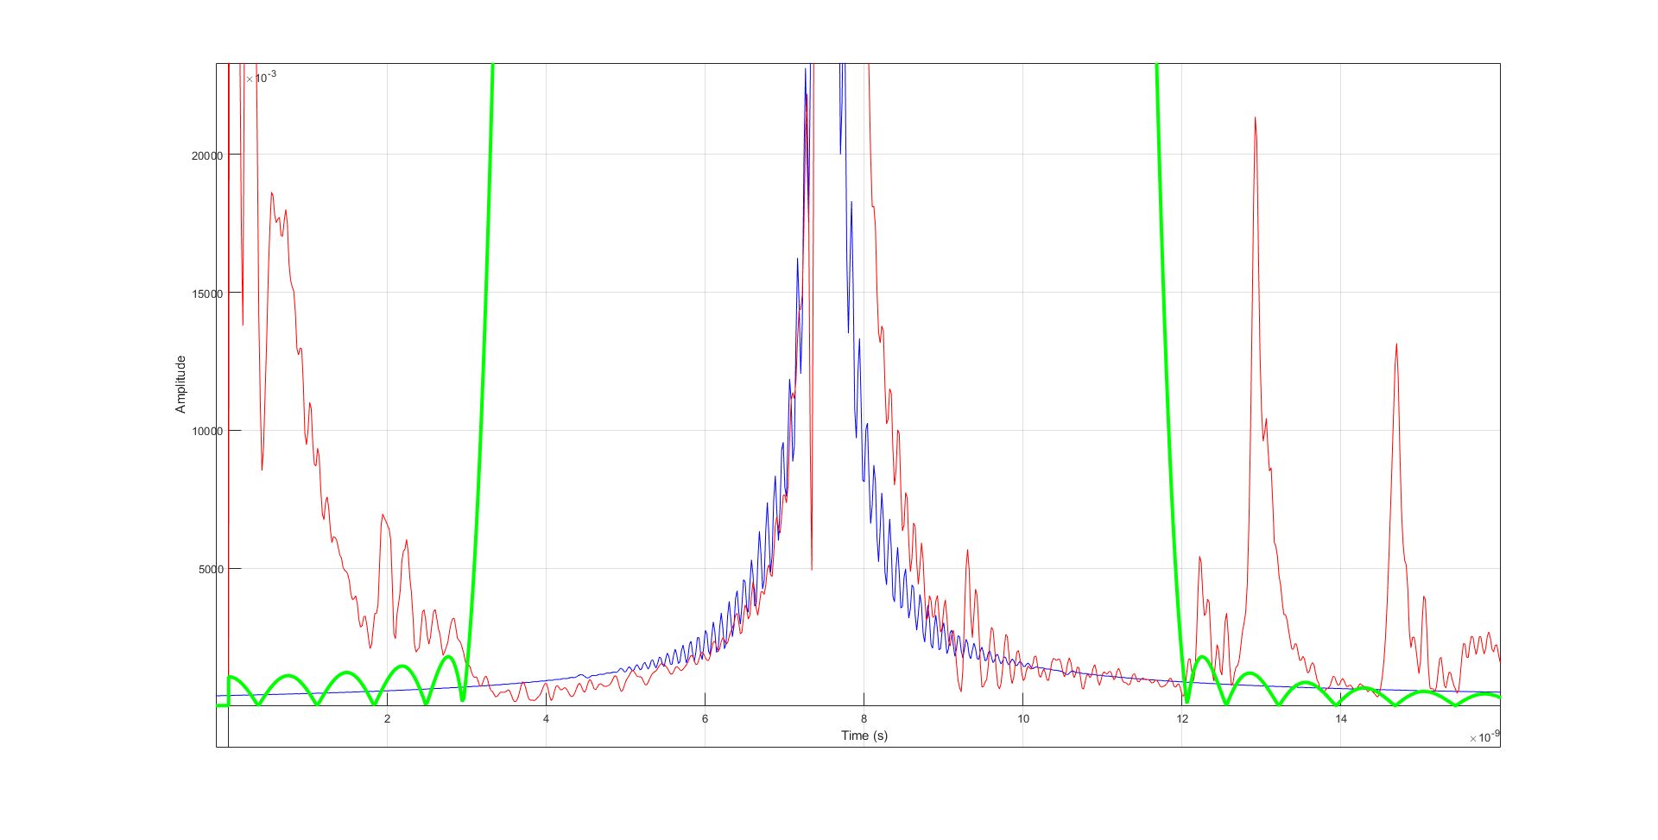
S11: Measurement (Time Domain)
Mirror only: Simulation (Blue) vs Measured (Red)

Slide 14
Adaptor, Waveguide and Horn
Some characterstics are difficult to simulate
Waveguide Cutoff & Dispersion
Capacitive effects
Horn effectivity (frequency dependant) & sidelobe loss
Can be calibrated out of measurement
Mirror should have a very narrow time impulse response
Determine transfer function between gated mirror and simulation
Becomes the calibration file, removed from all measurements
Requires calibration process and signal processing

Slide 15
Resonator Control
Signal Processing

Slide 16
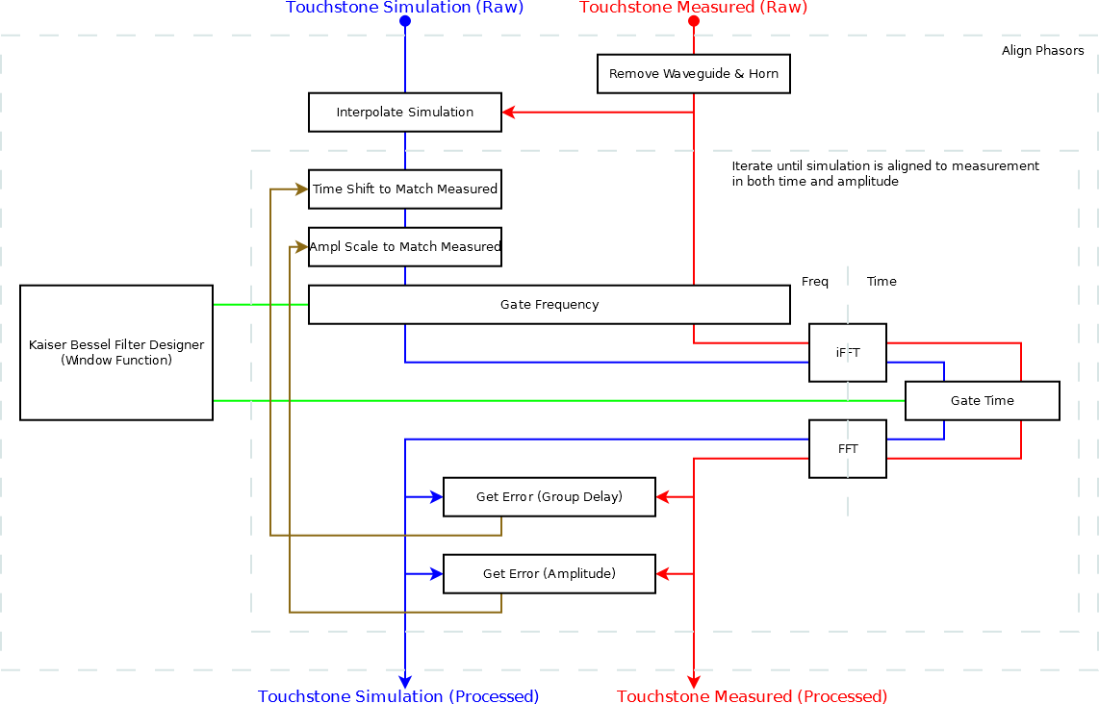
Signal Processing Diagram

Slide 17
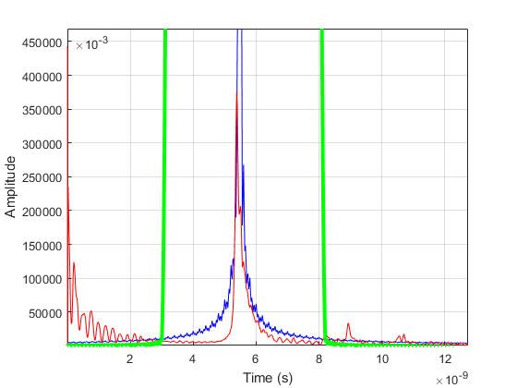
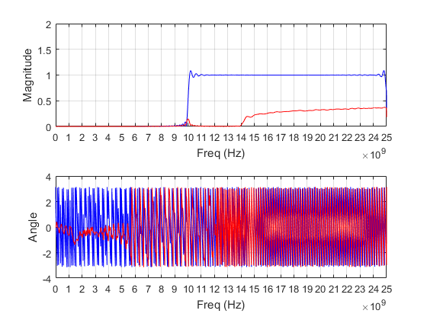
Adaptor, Waveguide and Horn
Time Domain
Bode
Mirror Configuration, legend omitted for improved execution speed
Simulation: Blue Measurement: Red GateTime: Green

Slide 18
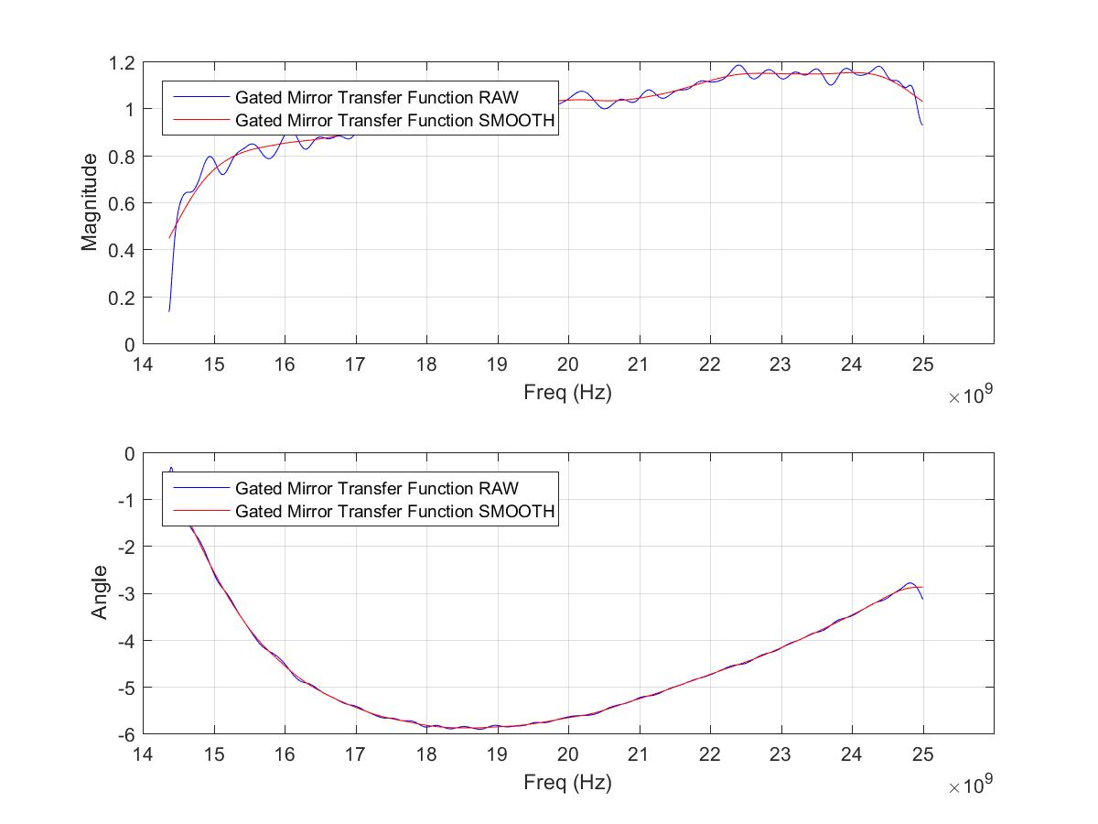
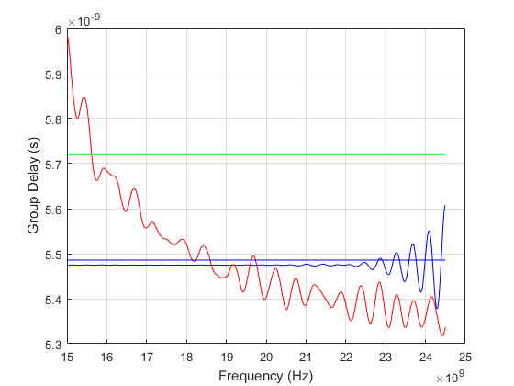
Adaptor, Waveguide and Horn
Calibration File
Group Delay of Calibration File

Slide 19
Installing Discs
8mm Configuration, Manually Tuned
Experiment:
Perform calibration
Install a disc, fit to simulation by comparing group delay
Repeat, until 4 discs installed
Simulation:
Separate simulation required for each step
Original manual process performed in LabView, but replicated here with Matlab
Limitations in network analyser (computation and display)
More flexibility in signal processing in Matlab
Better adjustment of Kaiser Bessel window parameters

Slide 20
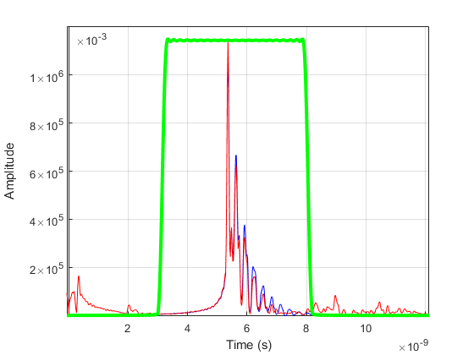
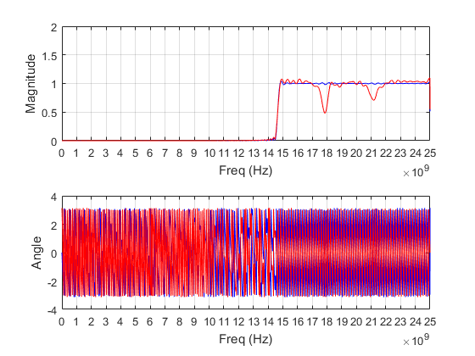
2 Disc Model, Ideal Candidate for Fitting
Processed Signals (Time/Frequency)
Note multiple undesired reflections in measurement (rejected)
Hints that model is still missing something
2 Disc Configuration, legend omitted for improved execution speed, smoothed for clarity
Simulation: Blue Measurement: Red Kaiser Bessel Time Gate: Green

Slide 21
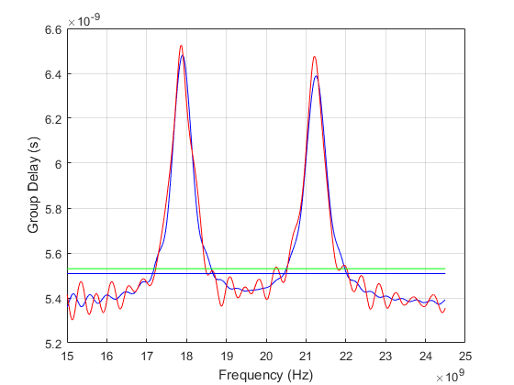
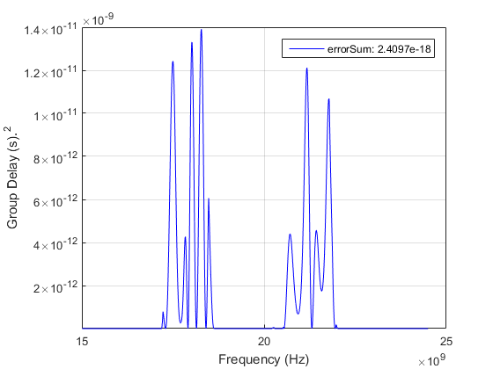
2 Disc Model, Ideal Candidate for Fitting
Processed Signals (Group Delay, Error)
Reject ringing from fitness measure
Minimise error, first measure of fitness: errorSum (least squares)
2 Disc Configuration, legend omitted for improved execution speed, smoothed for clarity
Simulation: Blue Measurement: Red Rejection Threshold: Green

Slide 22
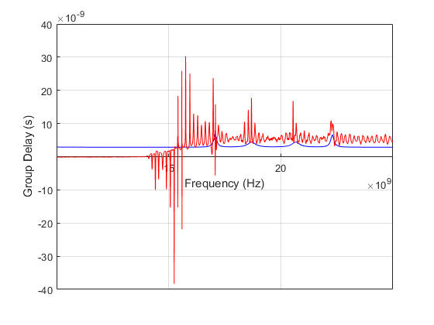
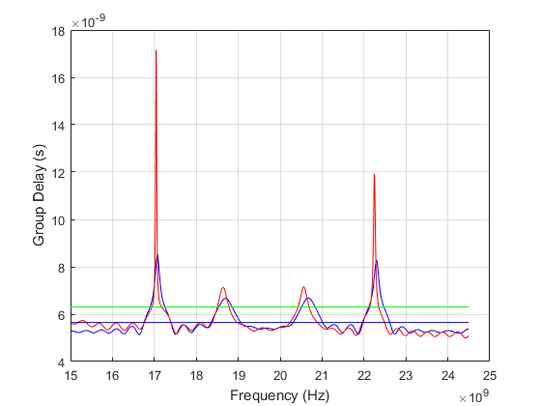
4 Discs, Group Delay, Pre/Post Sig Processing
Group Delay Raw
Group Delay Processed (Time Gate)
4 Disc Configuration, legend omitted for improved execution speed
Simulation: Blue Measurement: Red
We need to improve the method, some effects not accounted for

Slide 23
Resonator Control
Fitting Algorithm

Slide 24
What can we fit?
1) Fit Simulation to Simulation ← DONE
Verifying suitability of Qucs against ADS
Troubleshoot numerical problems
2) Fit Simulation to Experiment ← DONE
One measurement from experiment (slow)
Many simulations, parallelism opportunities (quick)
Allows us to test algorithms in real world scenario
3) Fit Experiment to Simulation ← OPTIMISING
Original purpose of fitting algorithm

Slide 25
First Algorithm
The System
2 variables (space1, space2)
1 fitness measure (Sum of Square Residuals)
Naive Approach
Random dither on spacings, close in on the optimal solution
Evolutionary/Genetic?
Uniform/Normal distribution?
Most Promising
Try a configuration based on a wide uniform distribution
If improved residual, use this configuration
After failing to improve the residual, reduce the random variation
Repeat until termination criteria reached (residuals/variation)
Now we have one “Solution”

Slide 26
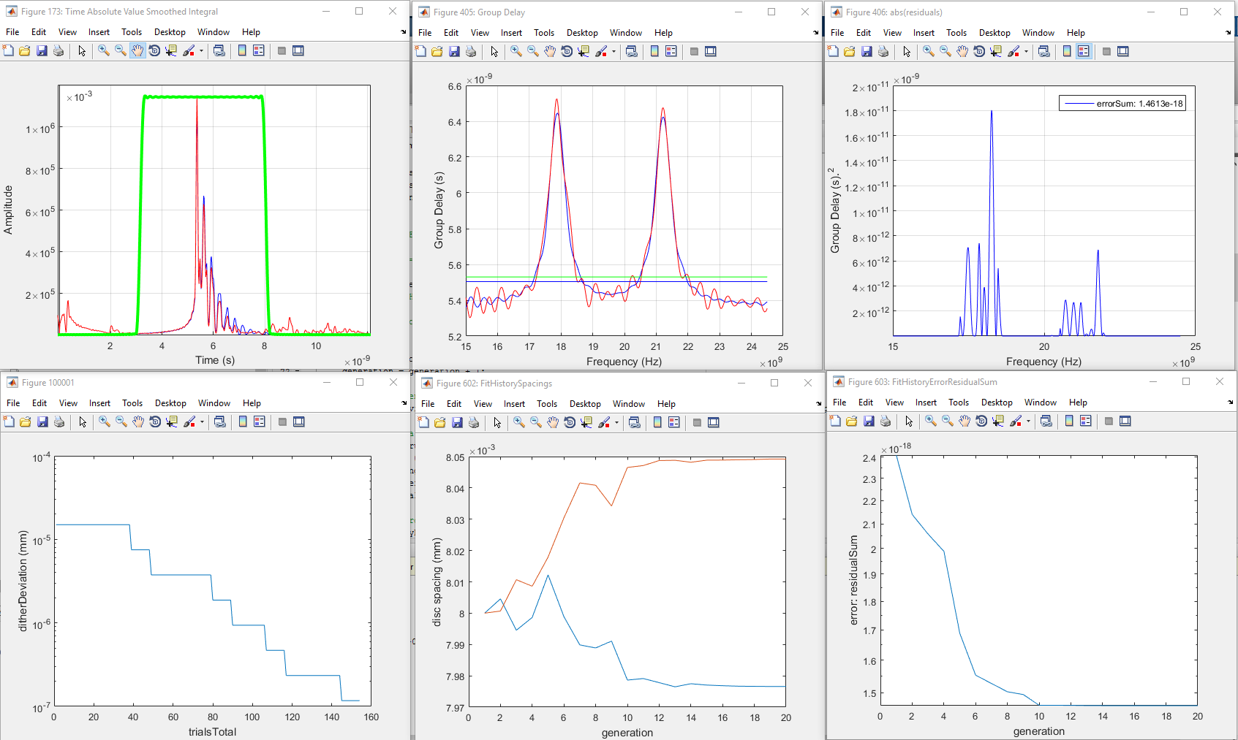
A “Solution”

Slide 27
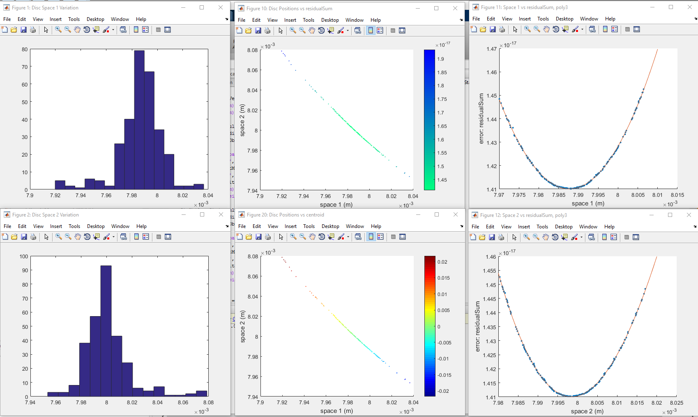
300 Solutions (Mutation: Gaussian)

Slide 28
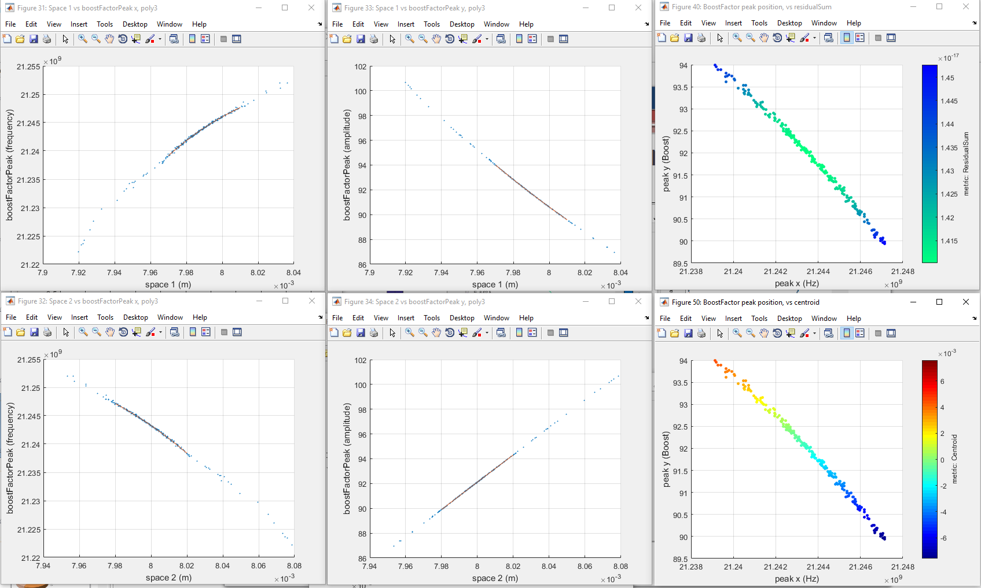
300 Solutions: Variation in BoostFactor

Slide 29
Increasing Number of Discs
We need to address issues in the comparison first
Time response shows measurement decaying faster
Several dips in magnitude unaccounted for
Loss in resonator
Including loss between discs resolves errors in:
Bode magnitude
Group delay
Mechanism:
Disc angle?
Gaussian beam widens within resonator?

Slide 30
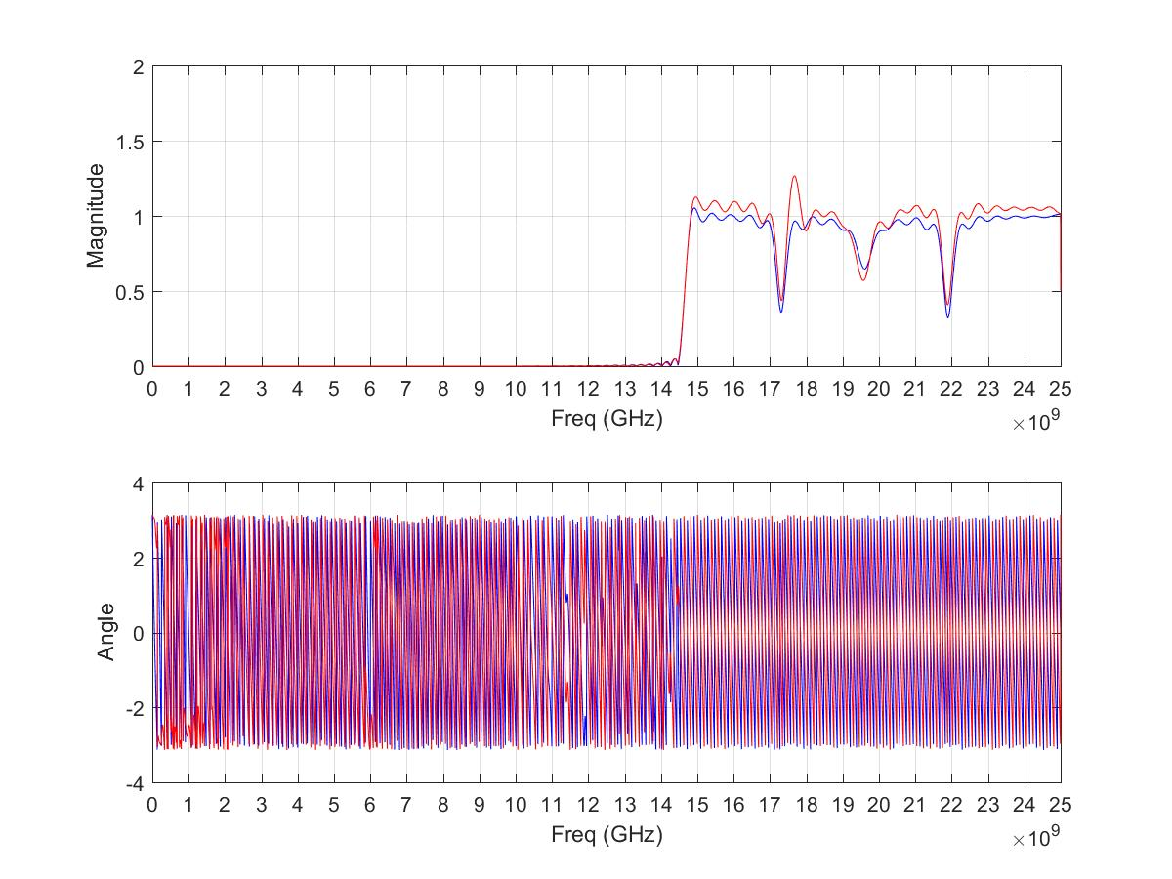
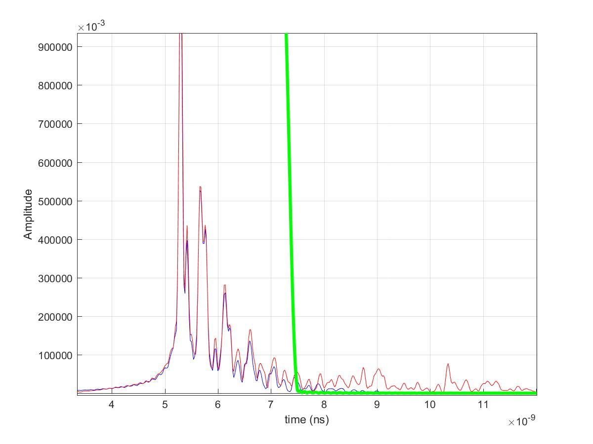
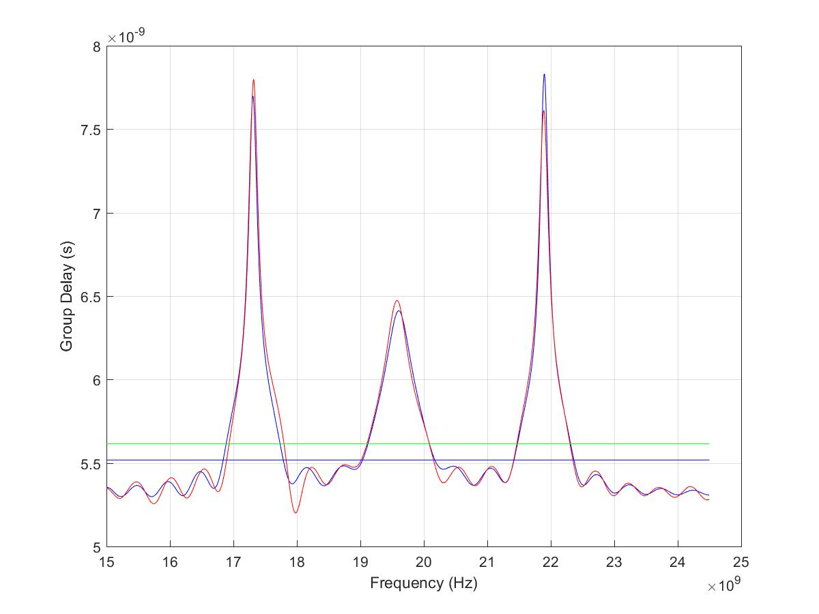
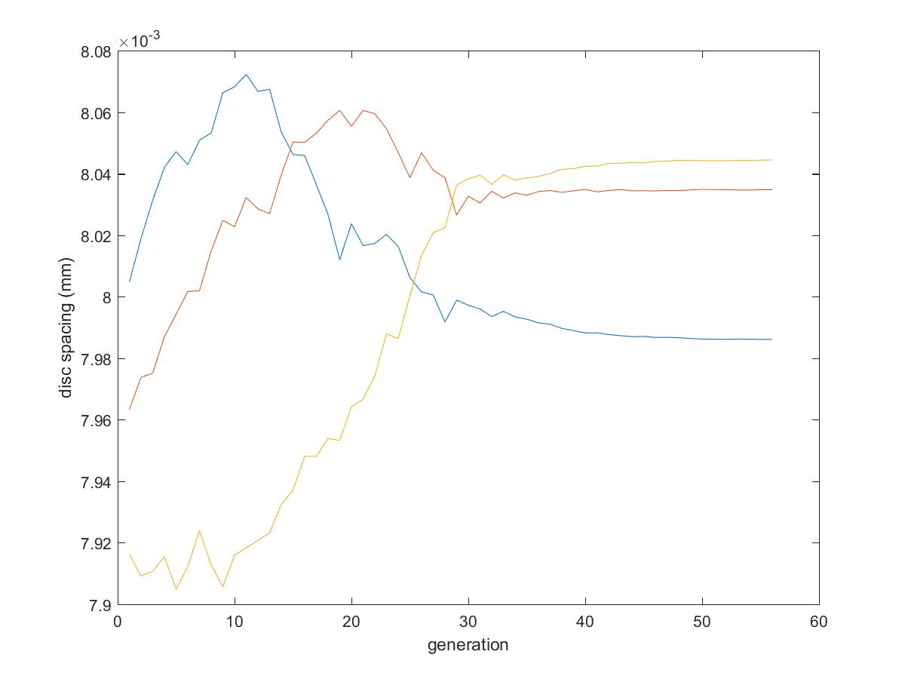
3 Discs Fitted, Improved Model

Slide 31
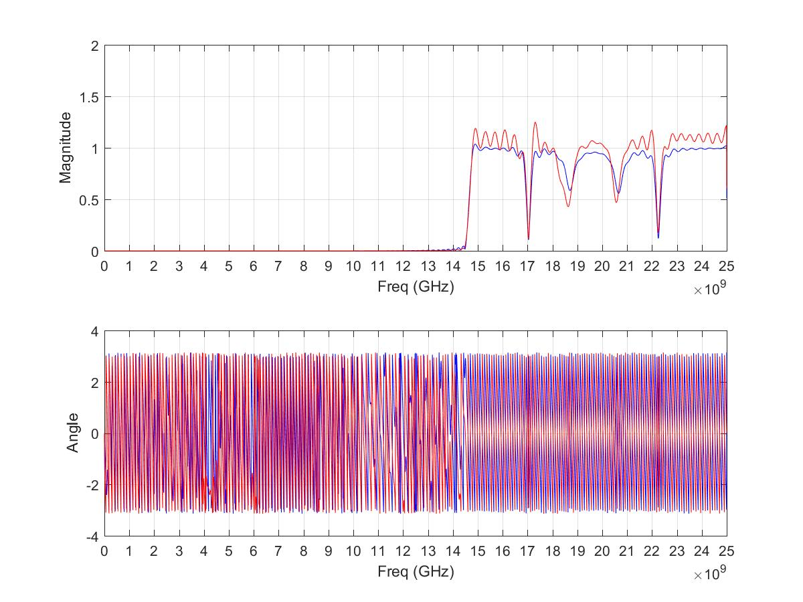
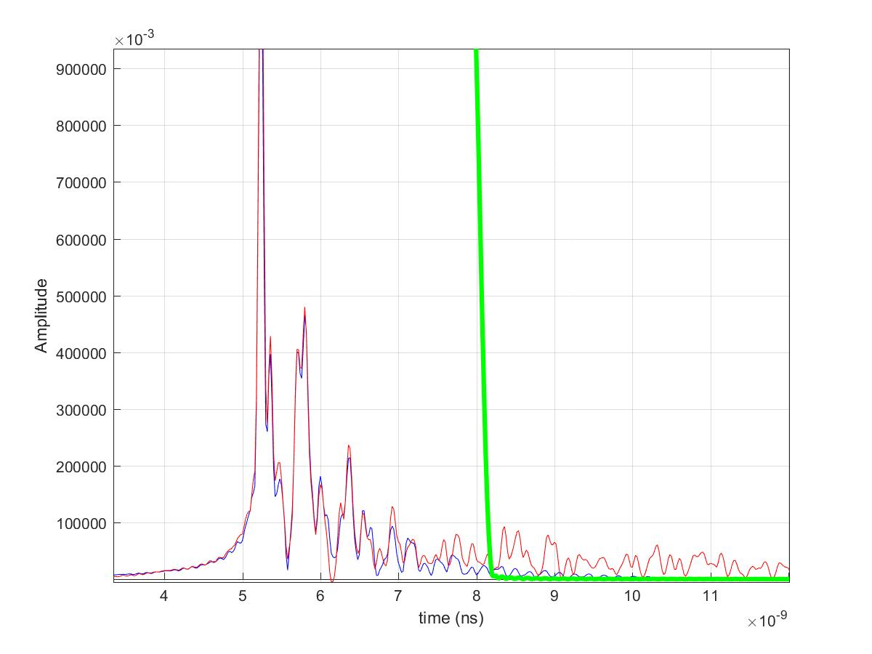
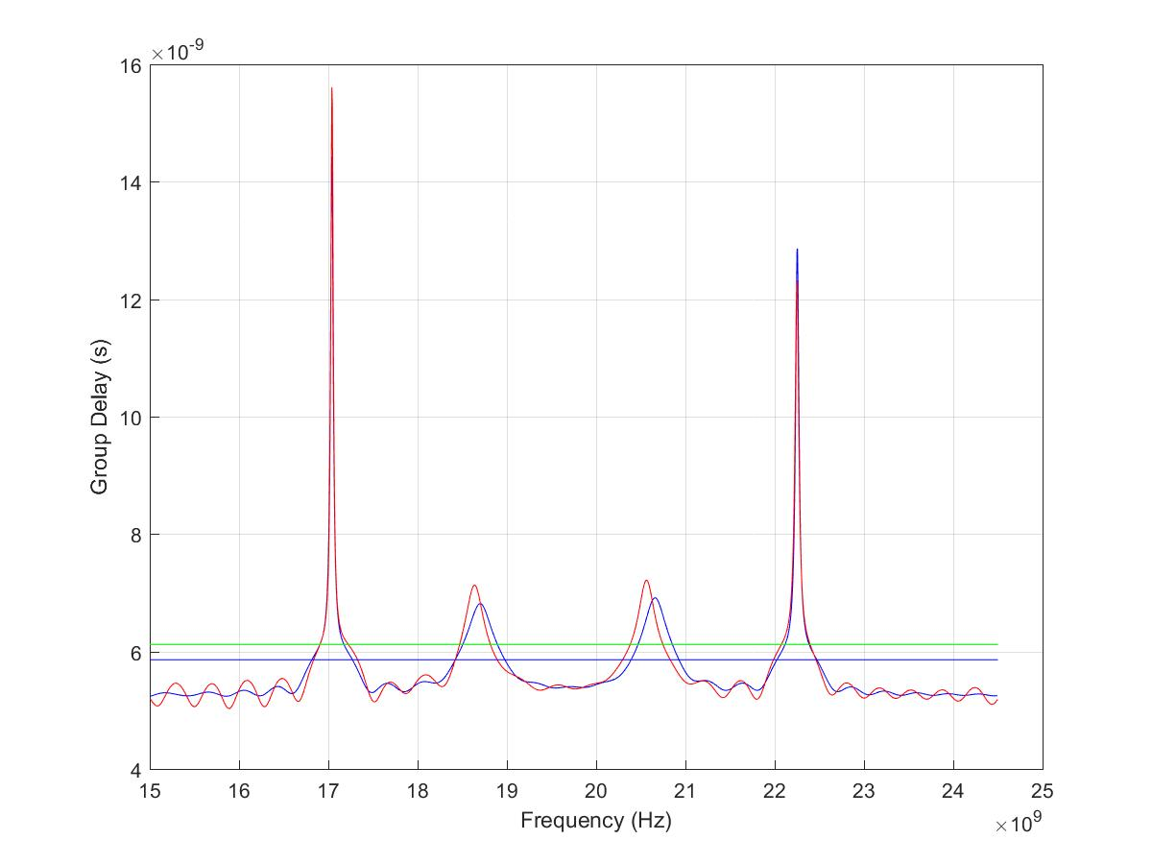
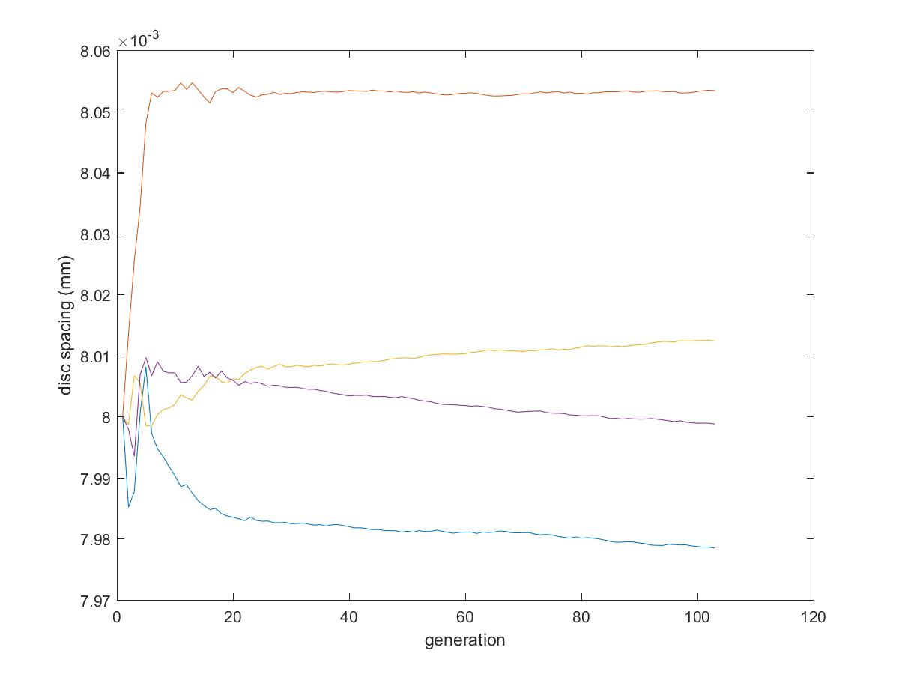
4 Discs Fitted, Improved Model

Slide 32
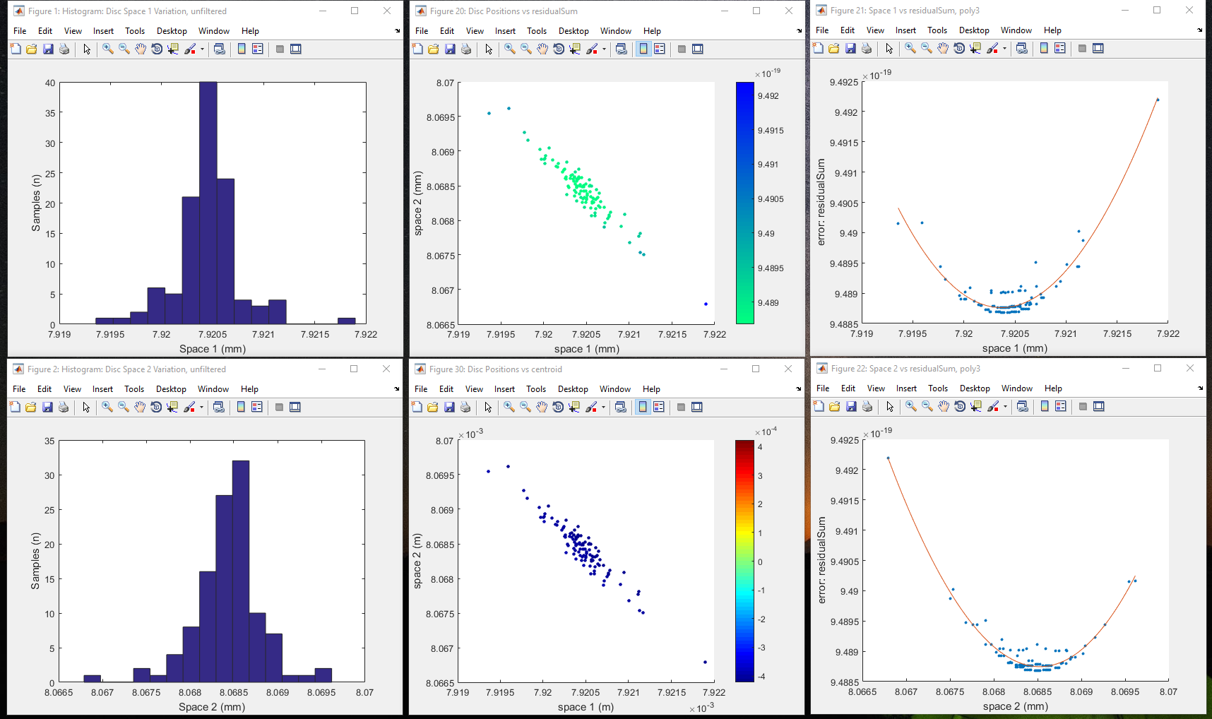
Latest Results (2 Discs, ~100 Solutions)

Slide 33
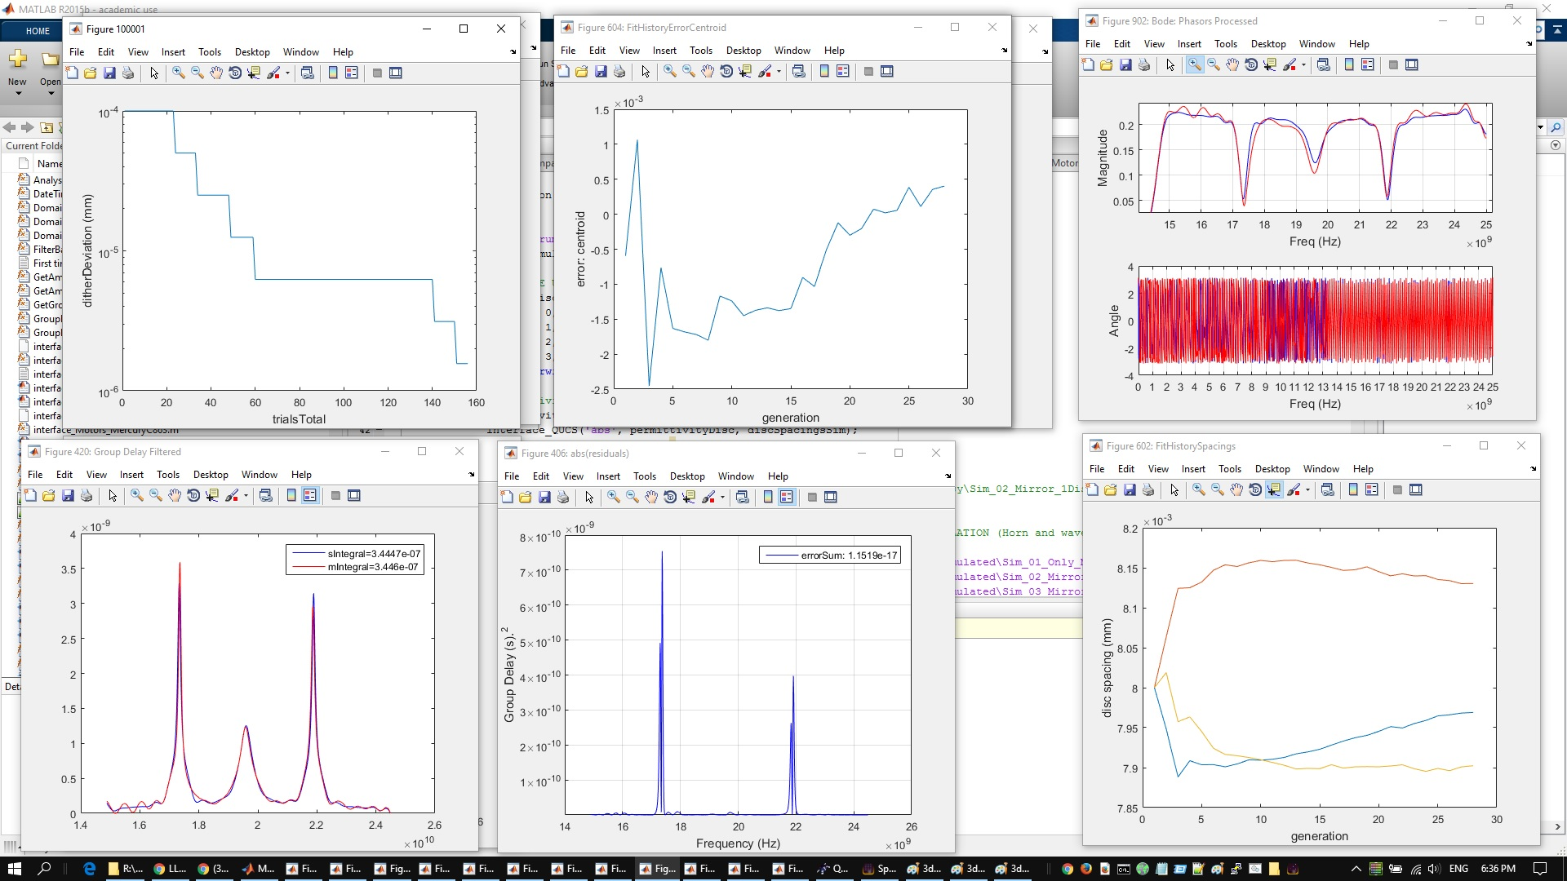
Latest Results (3 Disc, one “Solution”)

Slide 34
Findings & Further Work
Findings
Improved model
Group delay peak “sharpness” results from loss between discs
Evolutionary/Genetic algorithm fits to better than:
+/- 1um for low discN
Boost factor peak variation with fit quality
Further Work
Cleaner measurement & more accurate model
Understanding loss
Reducing time to fit instrument to model
Currently one solution ~30min
Scaling with number of discs (time to fit, repeatability)
Fitting the instrument to arbitrary shapes
Thank you for listening

