Slide 1
DCD waveform measurements
-
DHE DAC & DCD ADC gain
-
Offset strength measurements
F. Lütticke, B. Paschen
On behalf of the Lab and Test Beam Groups

Slide 2
DCD communication
DCD
x64
x1
DHP
Transmitter
Reference
VDD
VDD
VDD
VDD
VDD
!D
D
DOx[y]
GND
VREF
VDD
floating
VDD
VDD
D
!D
GND
Receiver
GND
GND
GND
GND
x64
DCDBpp 3: Uses VDDD
For DCDB 4.1/2: Planed to connect reference to to VDDA. Done?
Can be overwritten from the
Outside (this measurement!)

Slide 3
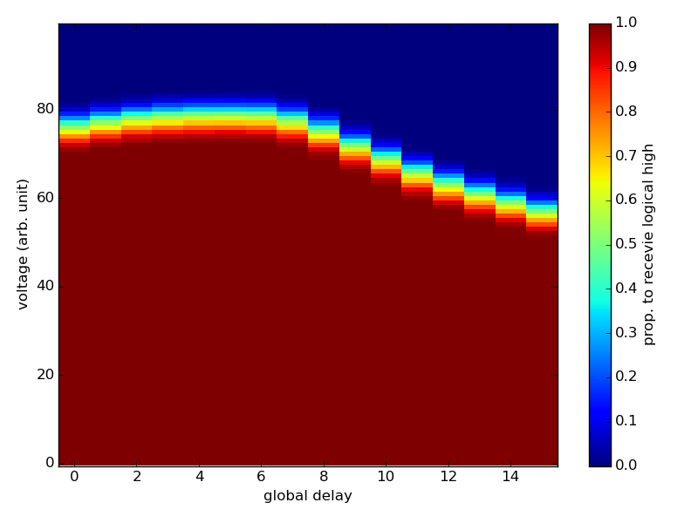
Results (DCDBpp + DHPT1.0)
High VREF: Always receive logical 0
Low VREF: Always receive logical 1

Slide 4
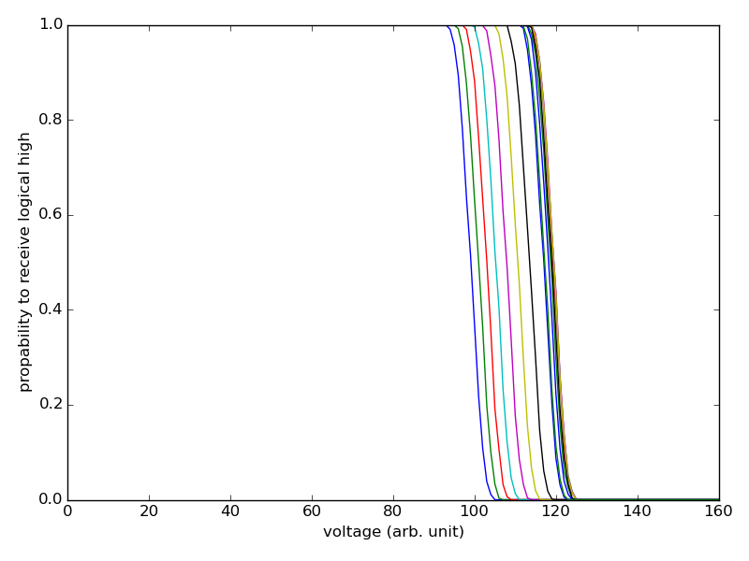
Extract voltage threshold from data to get absolute voltages

Slide 5
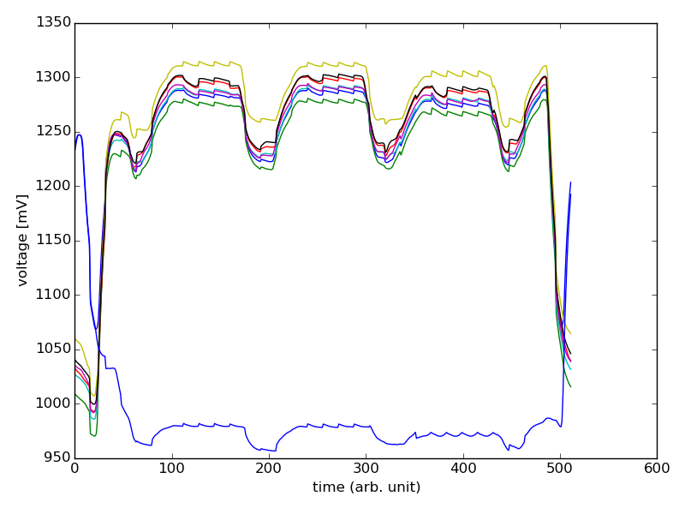
All bits of one link at 1.9V VDDD DCDpp 3, 250 MHz

Slide 6
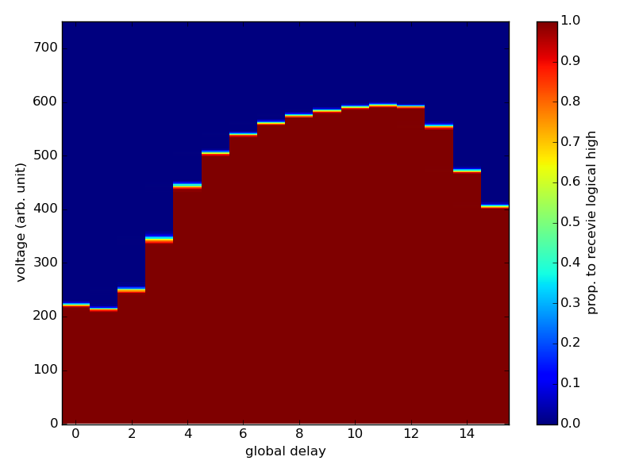
Results (DCD4.1 + DHPT1.1)
High VREF: Always receive logical 0
OLD
Less noise on line
“faster” high/low transition
Low VREF: Always receive logical 1

Slide 7
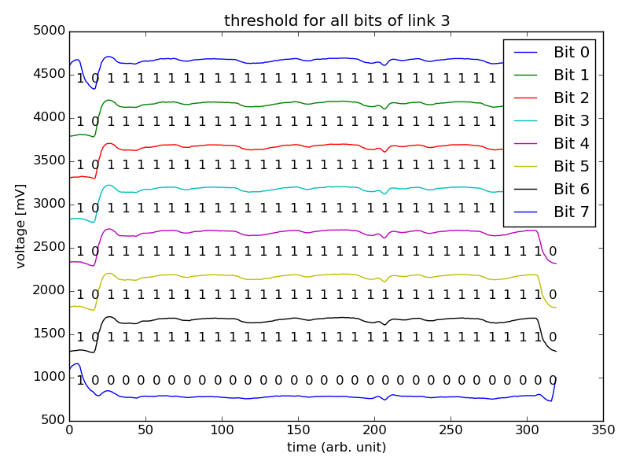
DCDB4.1 lines stacked

Slide 8
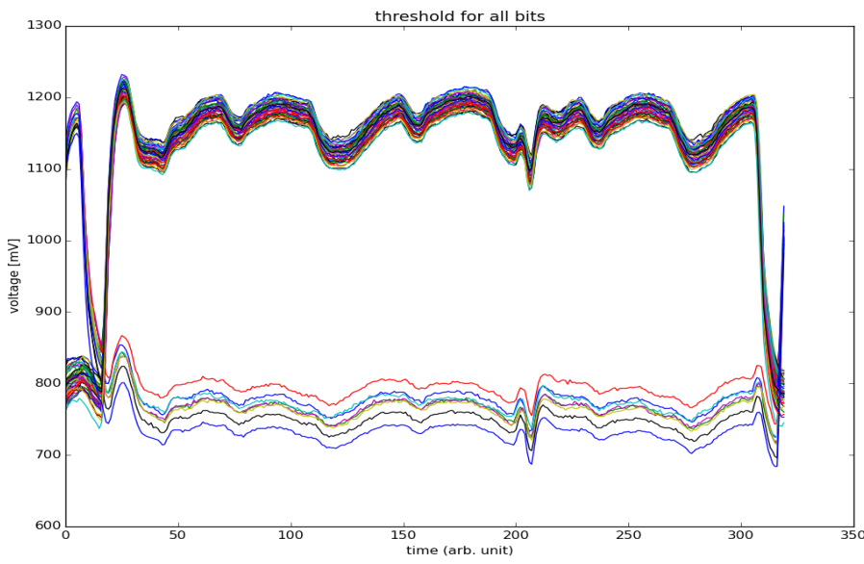
All bits, all links at 1.9V VDDD DCD 4.1, boost on, 305MHz

Slide 9
Comparison
OLD, 250 MHz
~300mV
~400mV

Slide 10
Comparison (cont’d)
New, 305MHz
1 link
New, 305MHz
all links
OLD, 250 MHz
~150mV
~300mV

Slide 11
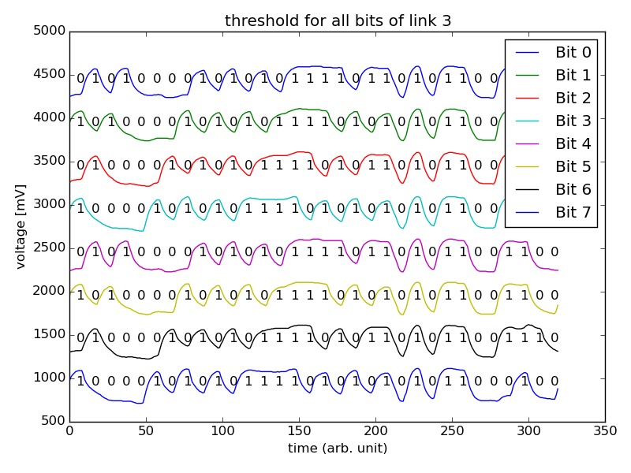
DCDB4.2 lines stacked
LSB
MSB

Slide 12
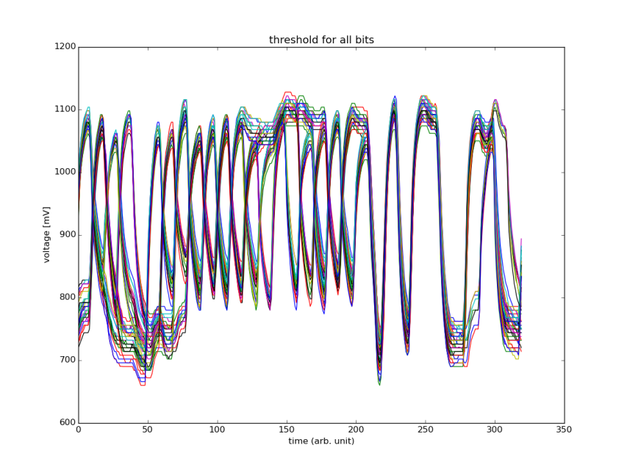
All bits, all links at 1.8V VDDD DCD 4.2, boost on, 305MHz
Artifacts due to low noise and large steps

Slide 13
1.8V VDDD DCD 4.2, 305MHz, Boost comparison
Boost On
Boost Off

Slide 14
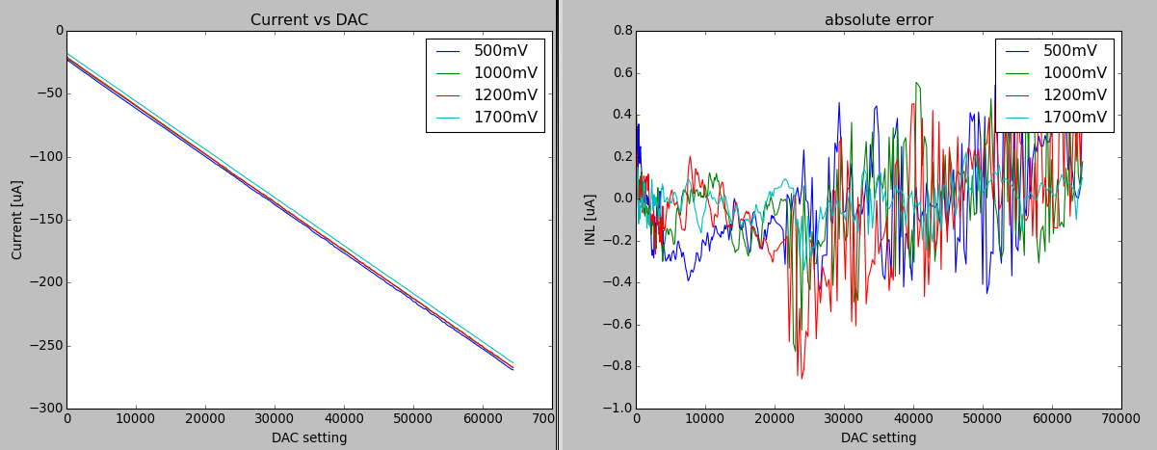
DHE current source – new DHE
Offset of around 20uA
resisitivity 226.8 kOhm
-3.827 +- 0.006 nA/DAC

Slide 15
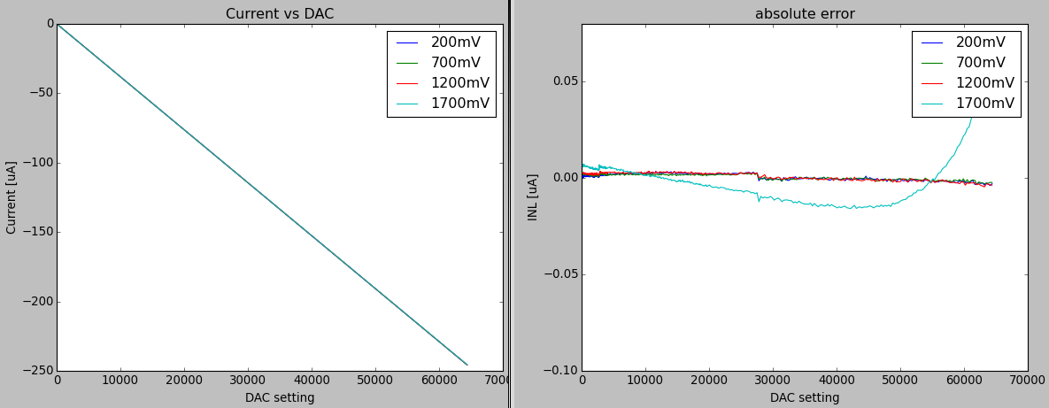
DHE current source – old DHE
Offset of around 0.05uA
resisitivity 135301.1 kOhm
-3.814 +- 0.000 nA/DAC

Slide 16
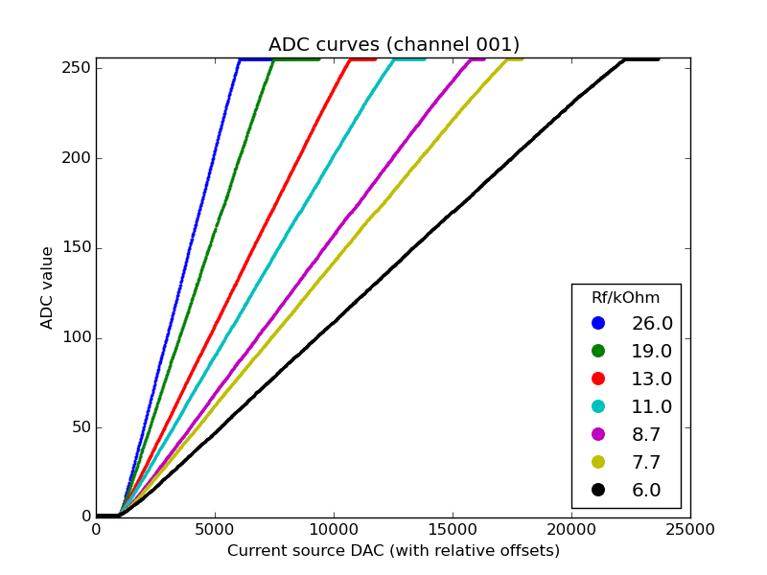
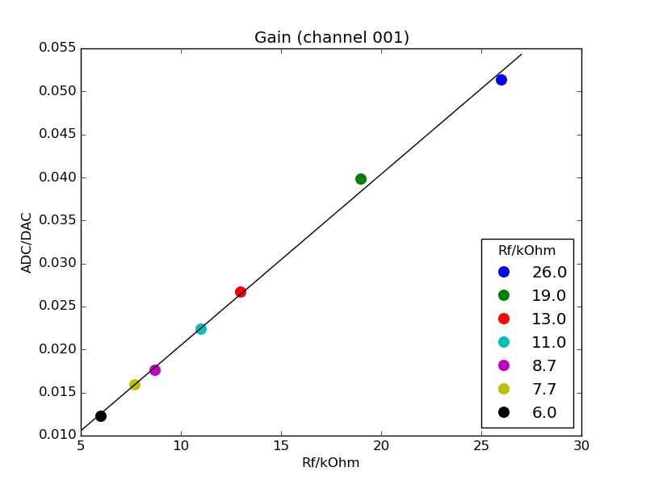
gain of H5.0.26 – DCDB4.2
Rf [kOhm] | gain [nA/ADC] | range [uA] | range (+-100 ADC) [uA]
26 | 75 | 19 | 15
19 | 96 | 25 | 19
13 | 144 | 36 | 29
8.7 | 171 | 44 | 34
7.7 | 217 | 61 | 48
6.0 | 313 | 80 | 63

Slide 17
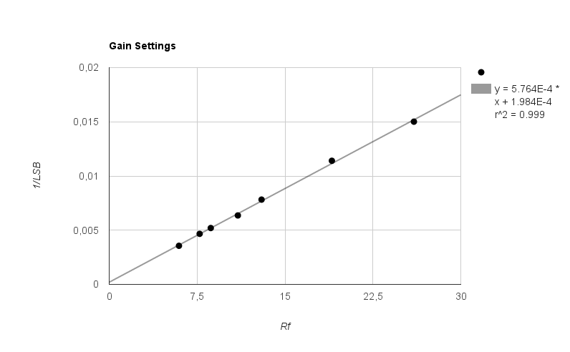
gain of H5.0.26 – DCDB4.2
 | DCDB4.2 Bonn | DCDB4.1 Göttingen | DCDB4.2 Bonn | DCDB4.1 Göttingen
Rf [kOhm] | gain [nA/ADC] | gain [nA/ADC] | range [uA] | range[uA]
26 | 75 | 67 | 19 | 17
19 | 96 | 88 | 25 | 22
13 | 144 | 128 | 36 | 33
11 | 171 | 156 | 44 | 40
8.7 | 217 | 192 | 56 | 49
7.7 | 239 | 213 | 61 | 55
6.0 | 313 | 278 | 80 | 72
luetticke@uni-bonn.de

Slide 18
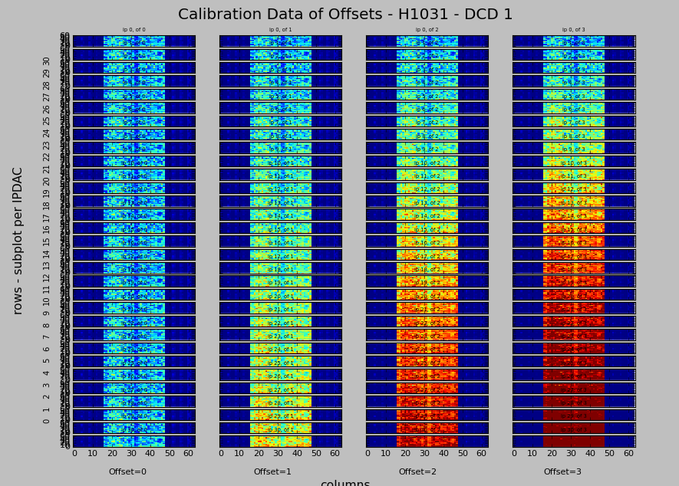
Offset Calibration (DCD4.2 + DHPT1.1)

Slide 19
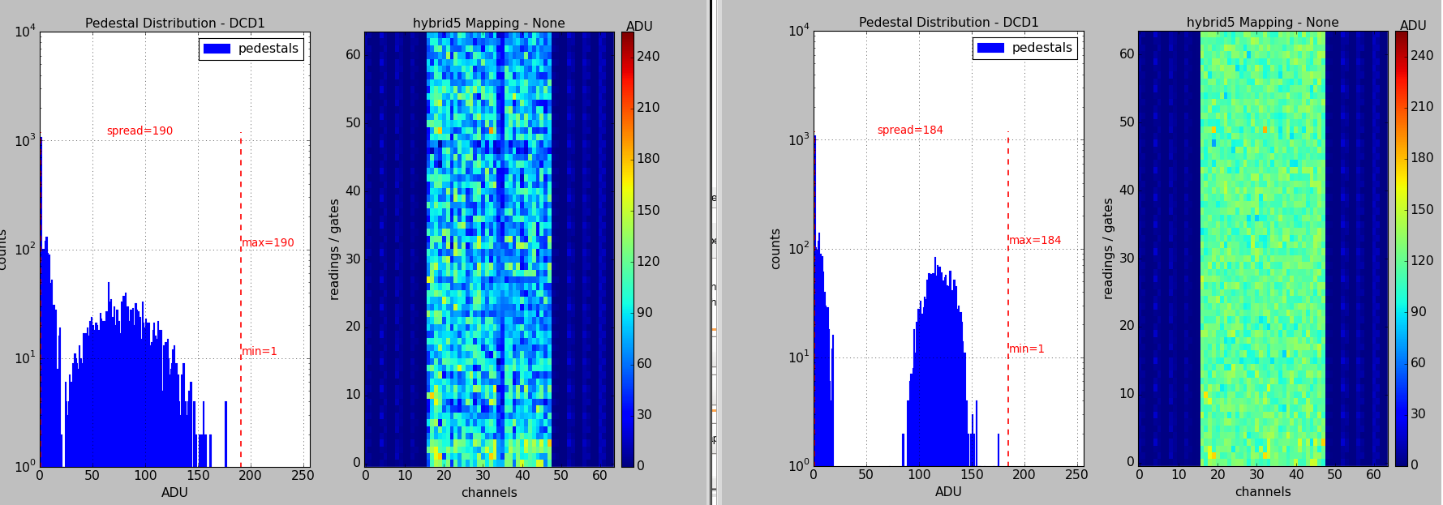
Offset Optimization(DCD4.2 + DHPT1.1)

Slide 20
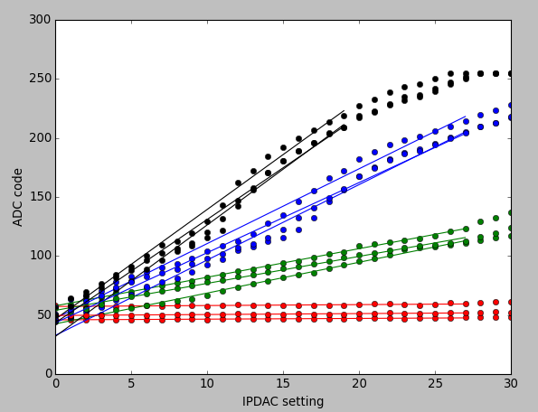
Offset strength (DCD4.2 + DHPT1.1)
Design value
Strength
Range
8.57LSB/DAC
1.2uA/DAC 3.6 x I₀
152 uA
180 uA
5.87LSB/DAC
0.84uA/DAC 2.4 x I₀
106 uA
120 uA
2.35LSB/DAC
0.34uA/DAC 1 x I₀
43 uA
60 uA
0.05LSB/DAC
0 uA/DAC

