Slide 1
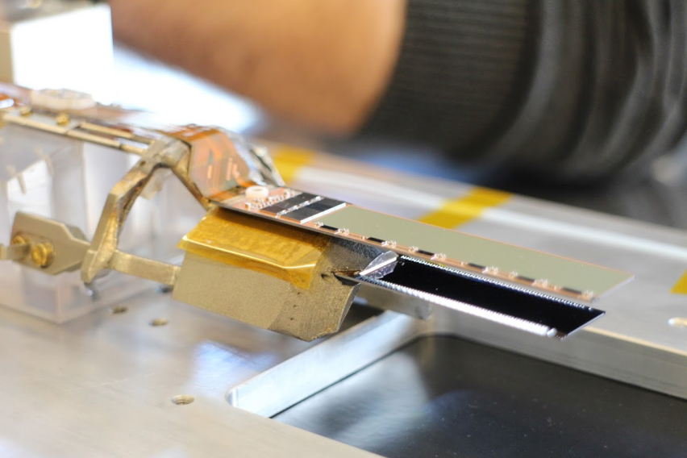
List of PXD9 Pilot Modules
DHPT1.0 & DCDPP
W30-OB1
W30-OB2 (switcher problems due to test with
Both mounted on cooling block
DHPT1.1 & DCDPP
IB and OB mounted on SCB
W36-IF used to check probe card setup
W36-IB in preparation for TUM (DHPT-DHE interface)

