Slide 1
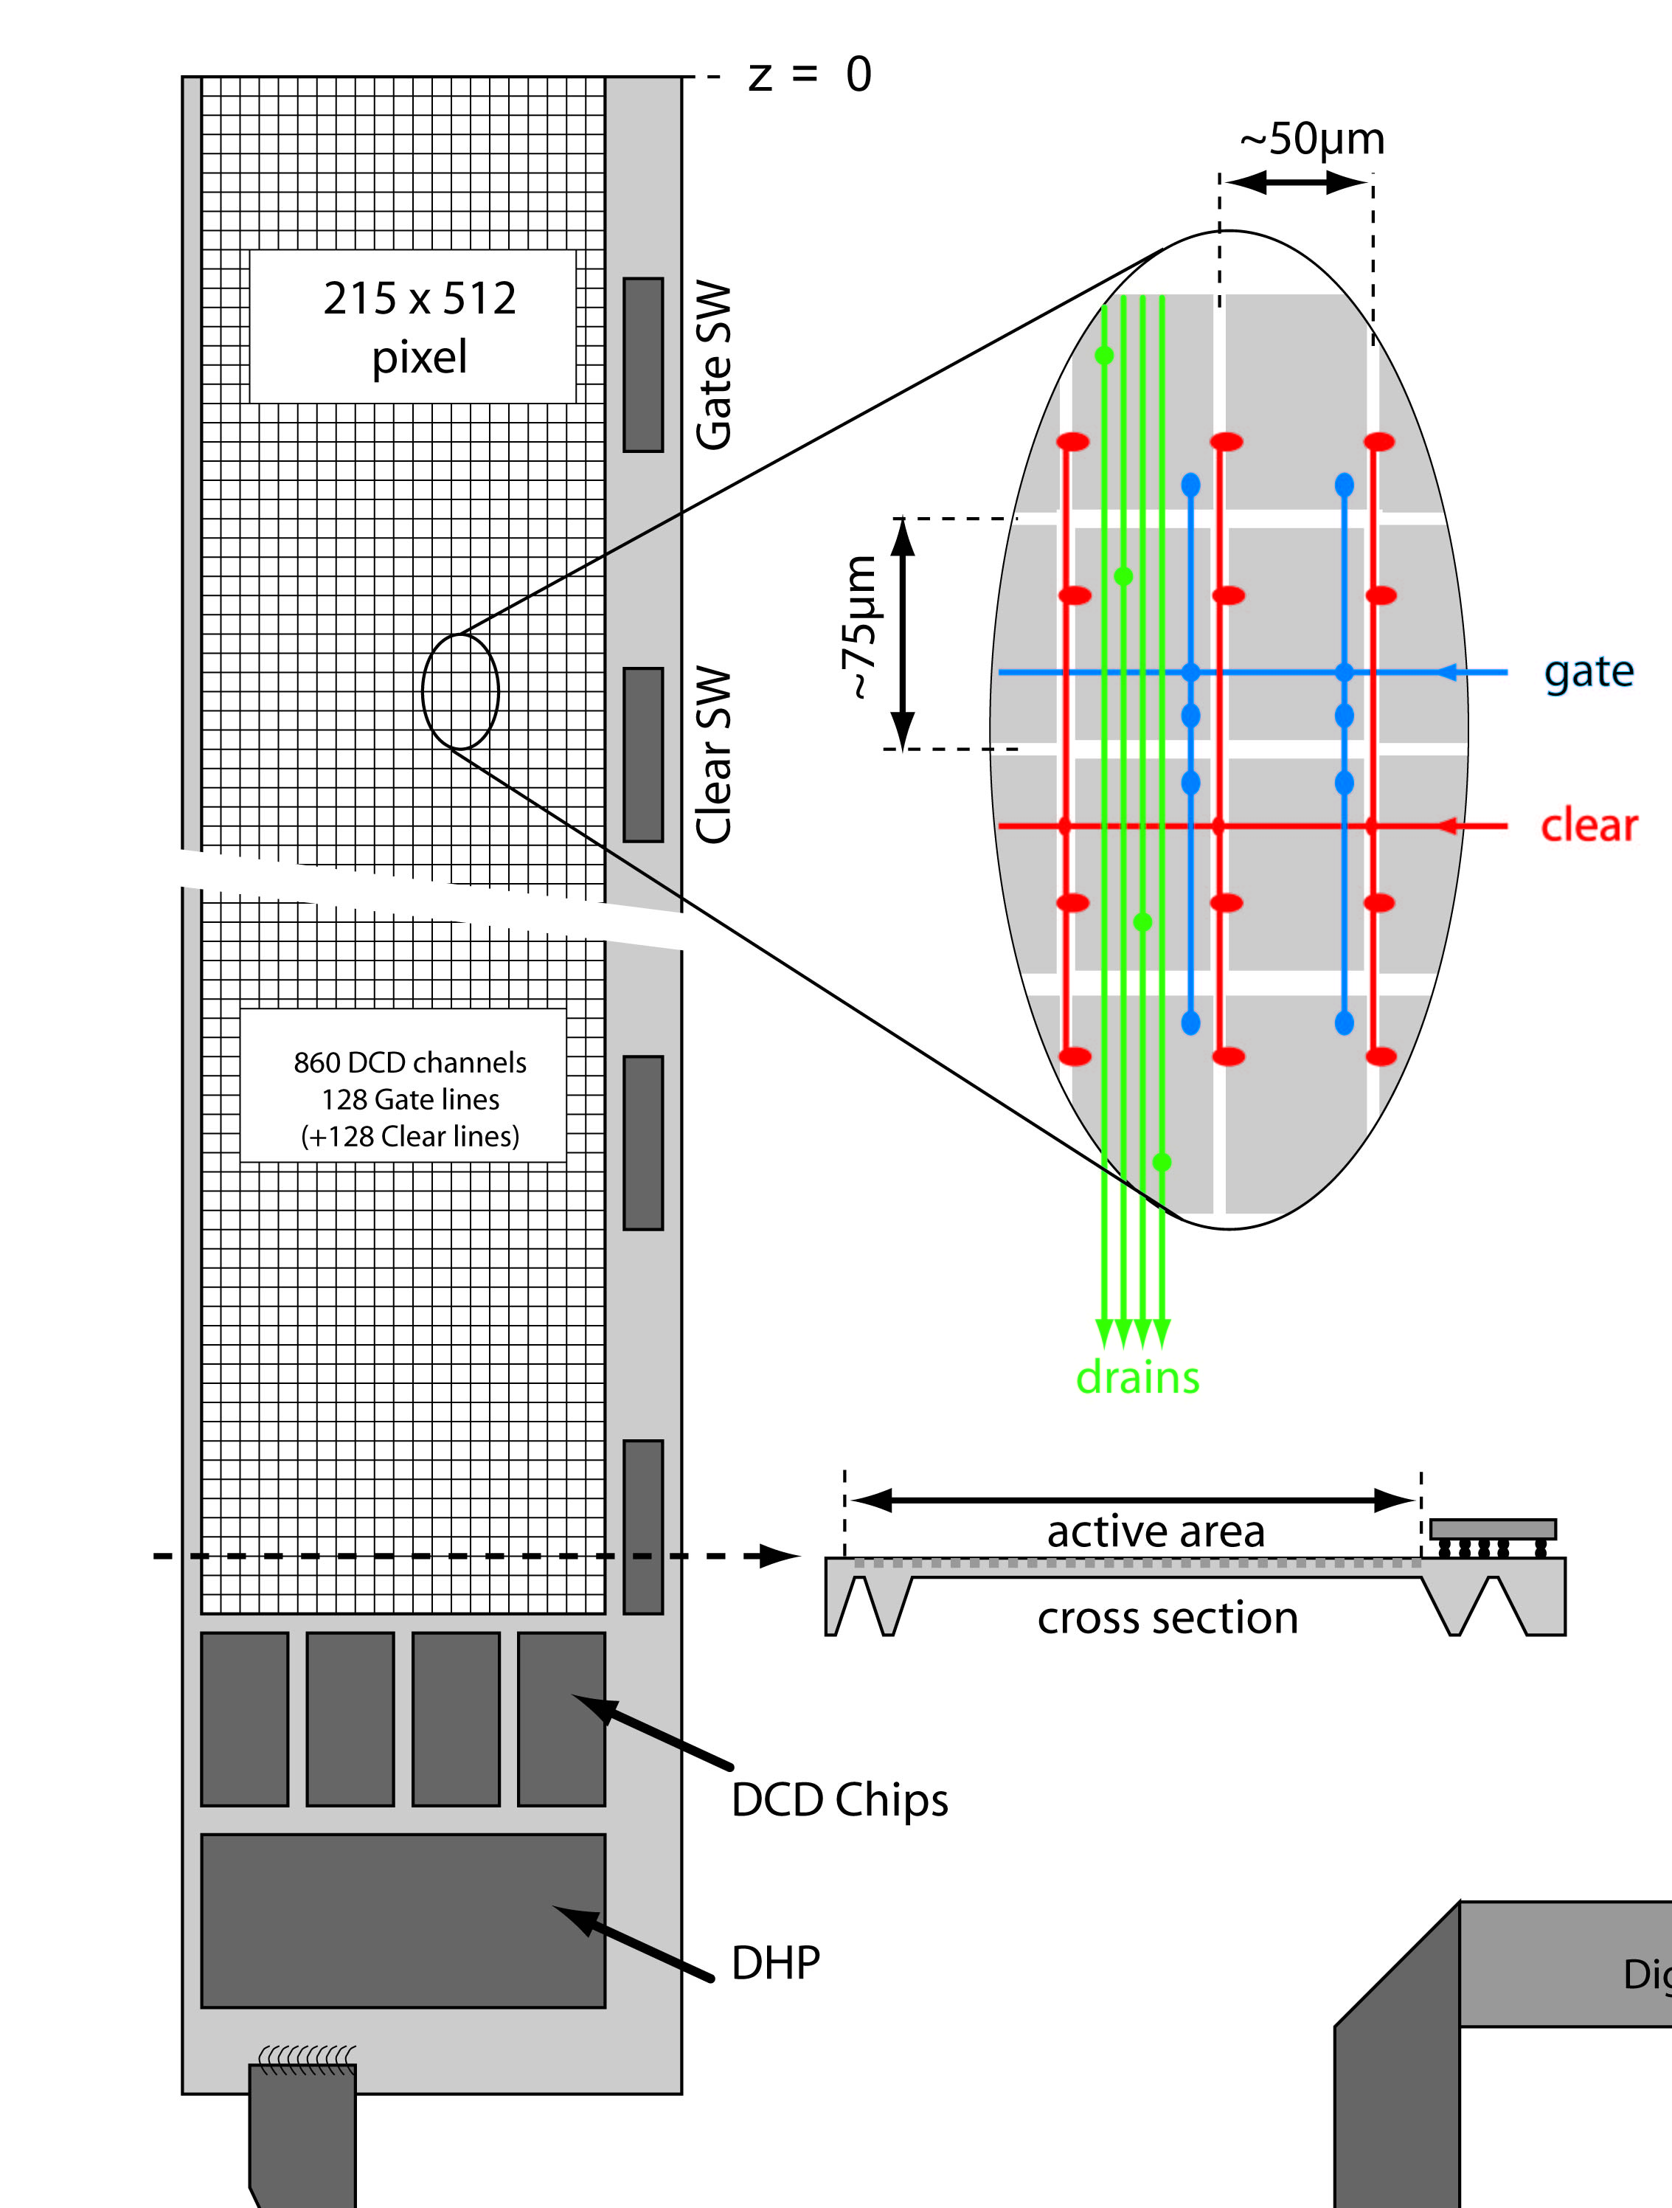
Interconnection Sensor - ASICs
SuperBelle (and ILC) Ladder:
-: MCM – ASICs in different technologies
on Sensor as substrate
-: bump bonds only on balconies
-: ~ 250 bumps/chip
-: 150 - 200 µm pitch
-: Baseline: Au stud bump bonds → Christian’s talk
-: what are the other options??

Slide 2
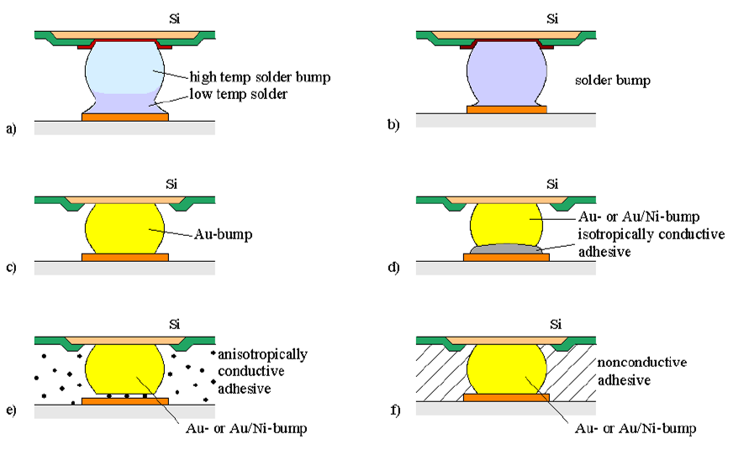
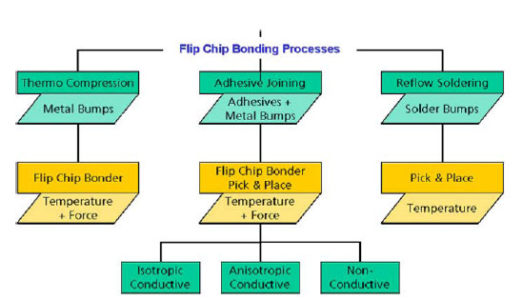
Technologies
or In
In general you always have :
Bumping of the ASICs
Prepare the landing pads on the substrate (sensor)
Flip-Chip ASICs to sensor and join electrically and mechanically

Slide 3
ASIC Bumping
Au stud and Pactech Solder jetting on metal studs → in-house bumping
-: on chip level
-: described by Christian, applicable to all ASIC technologies
2. Indium bumps: (→ CMS Pixels, space applications)
-: on wafer level by evaporation
-: few specialized Labs (PSI, Alenia)
-: need full wafers for external bumping!!! → expensive!!!
3. Solder bumps: (ATLAS Pixels, ALICE, etc …) → external bumping of the ASICs
-: Wafer process, mostly thru mask electroplated
-: commercially available in MPW runs
- IBM C4 and C4NP: 200 micron pitch
- UMC, TSMC: external bumping services (SPIL and others), ~150 micron pitch

Slide 4
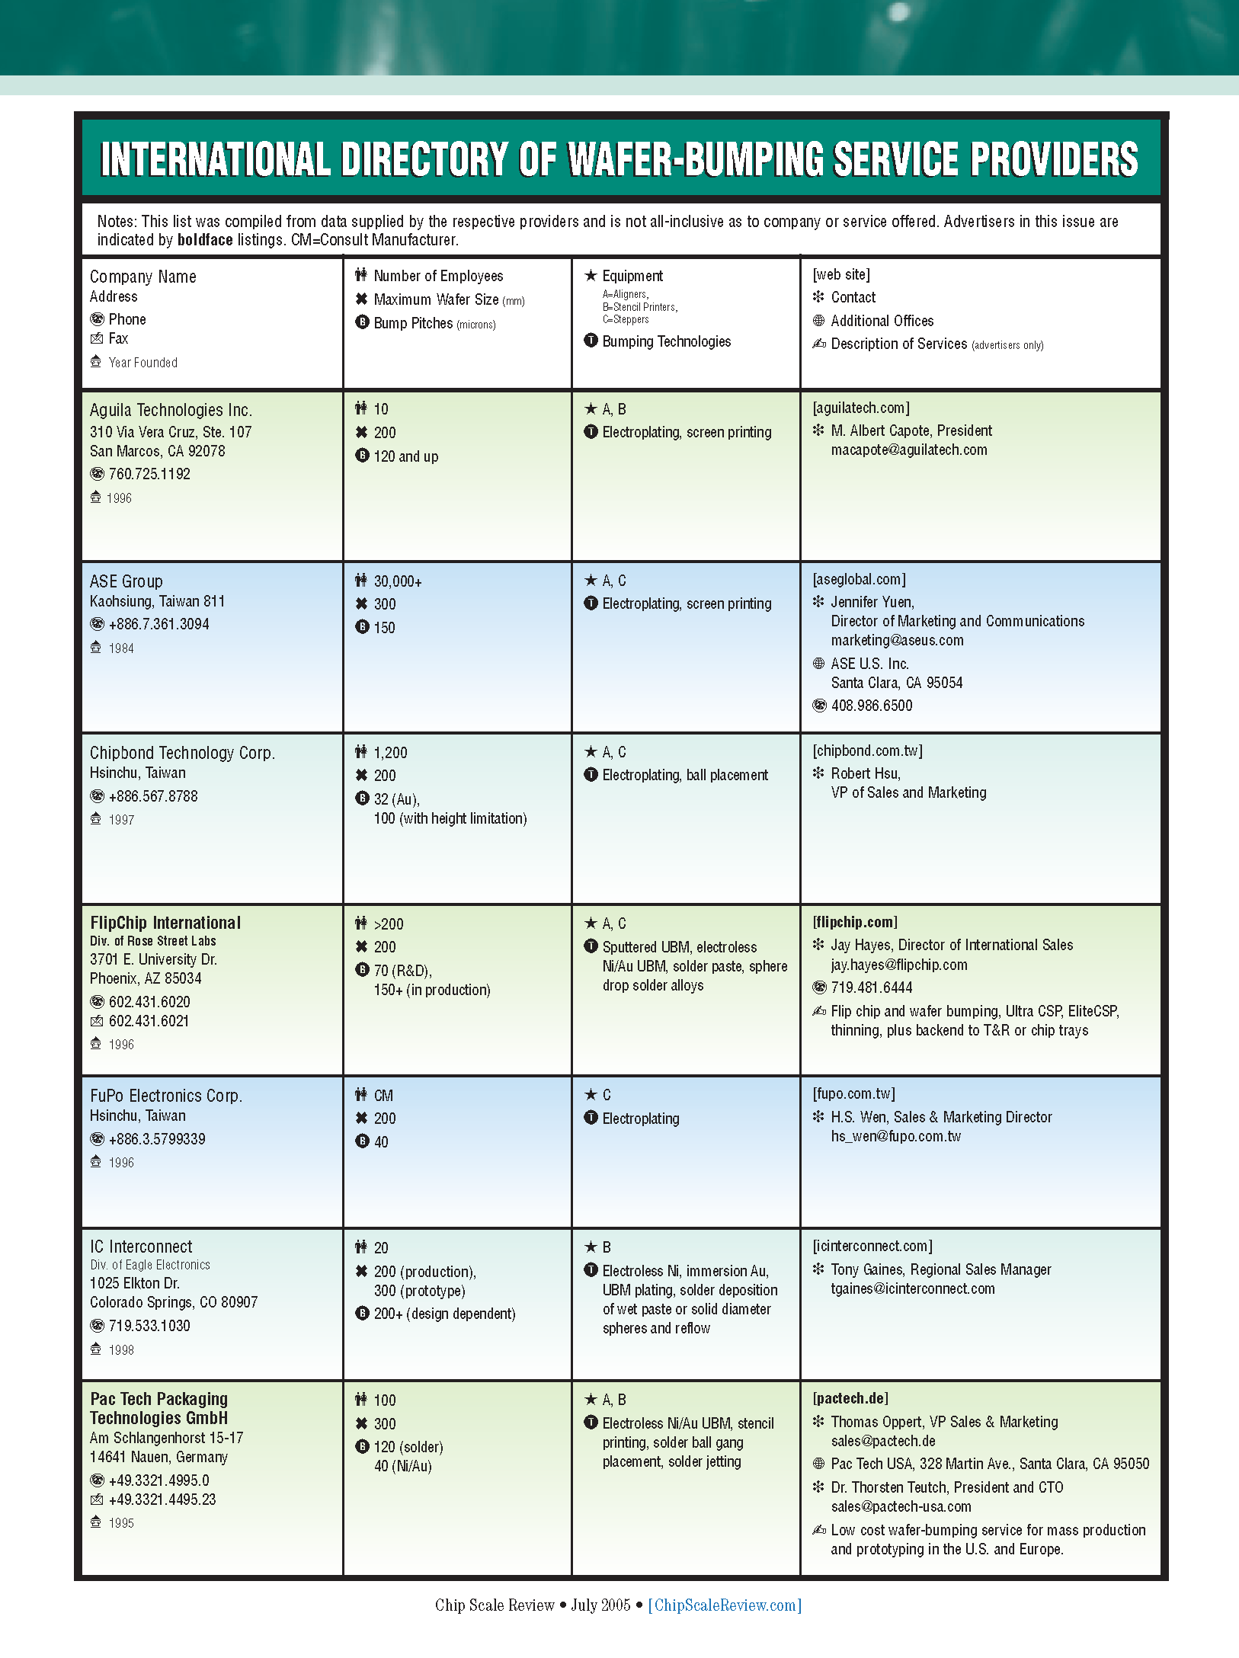
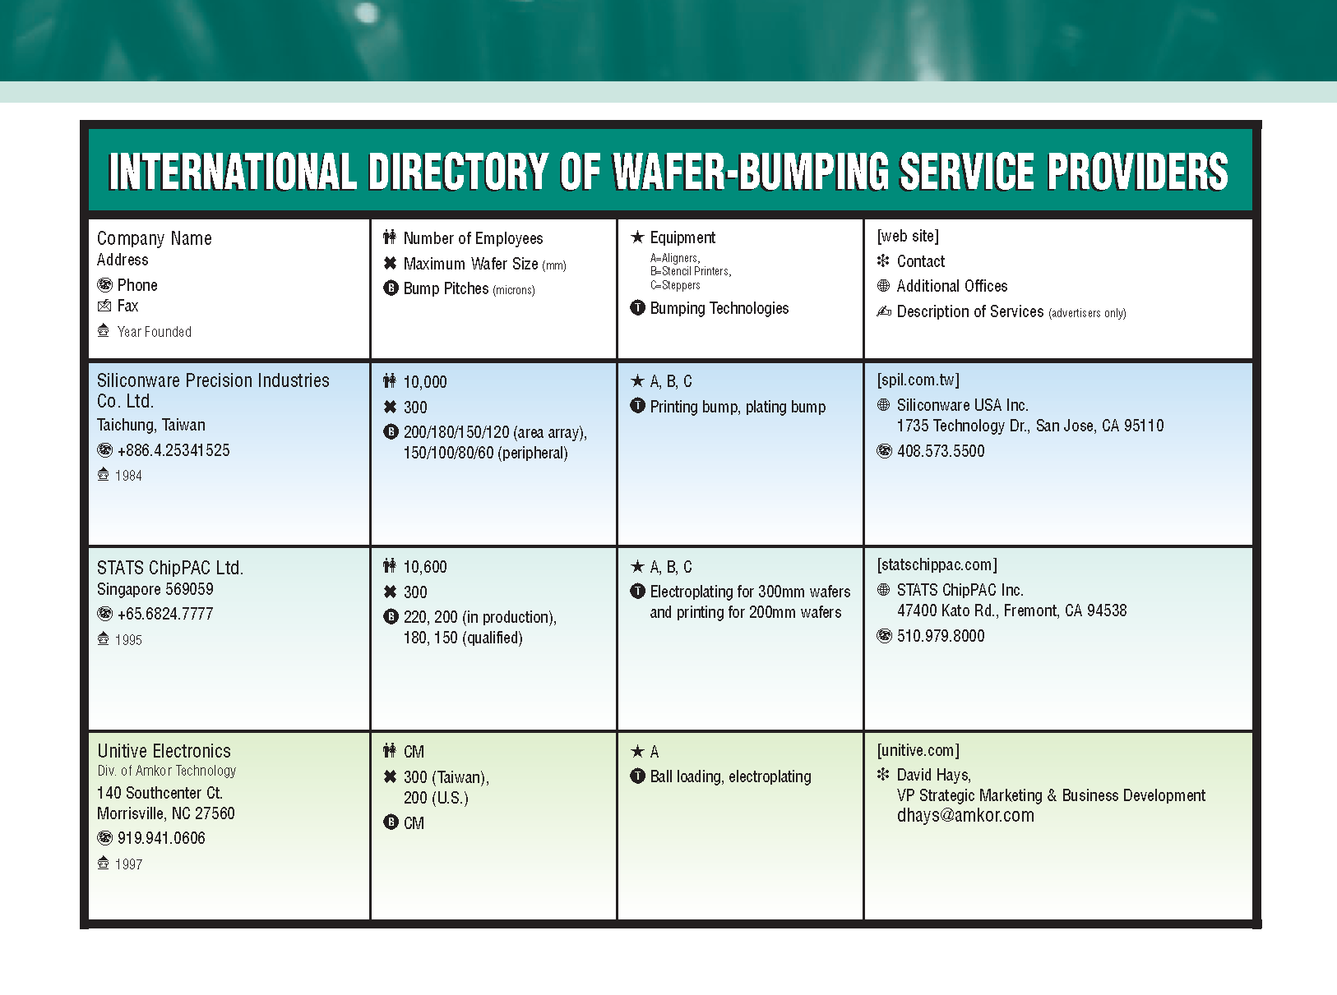
Bumping Services for ASICs → ask google ....
-: various bump metallurgies, pitches etc.
-: some have contracts with ASIC fabs
(SPIL, FlipChip International...)
-: dummy chips for tests, bumped, with custom
layout, can be ordered
-: technology: almost exclusively solder bumps

Slide 5
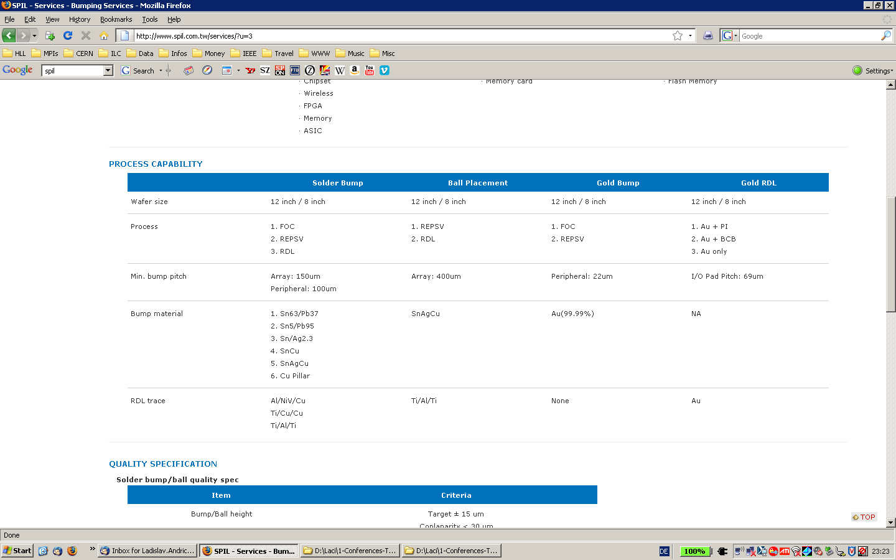
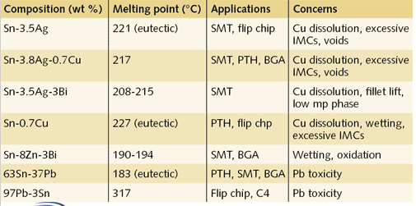
SPIL in Taiwan/China
In Cooperation with TSMC (via Europarctice), UMC???
www.spil.com.tw

Slide 6
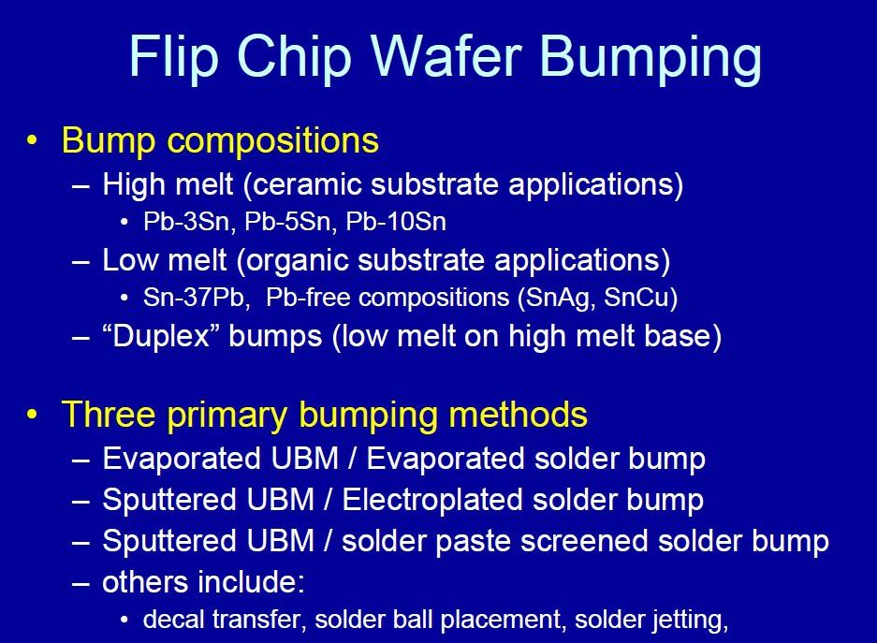
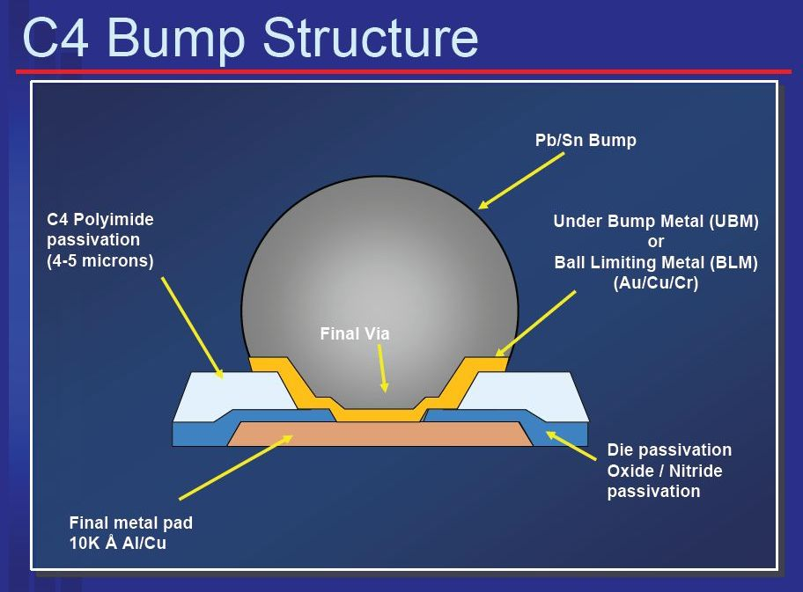
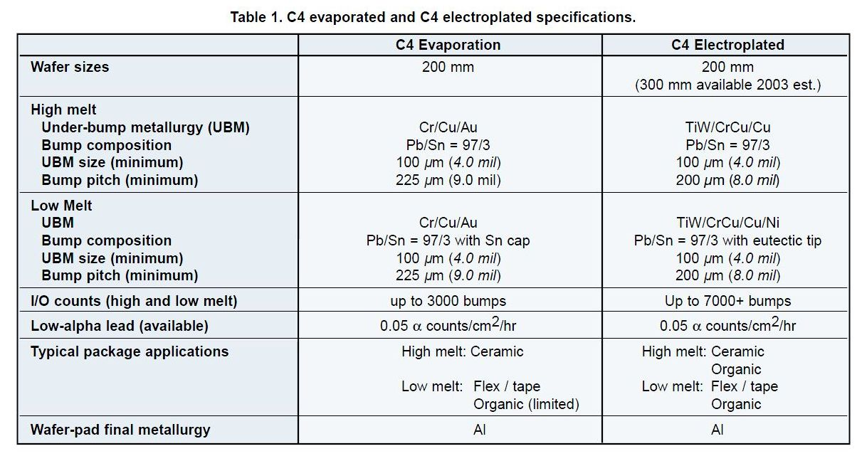
C4 Bump from IBM
‘Package Interconnects’ , J.R. Wilcox
IBM, January 2006
IBM MicroNews, Vol.8, No.2, 2002

Slide 7
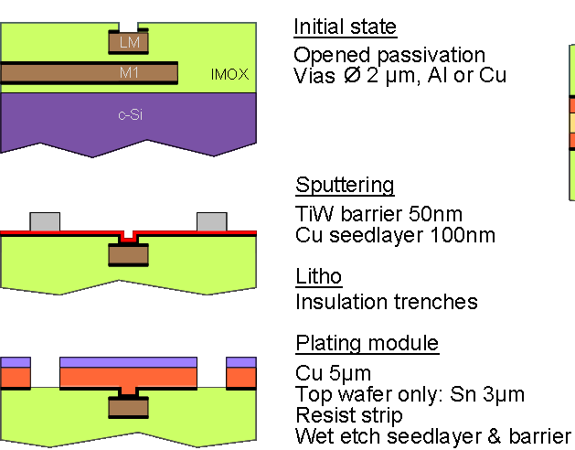
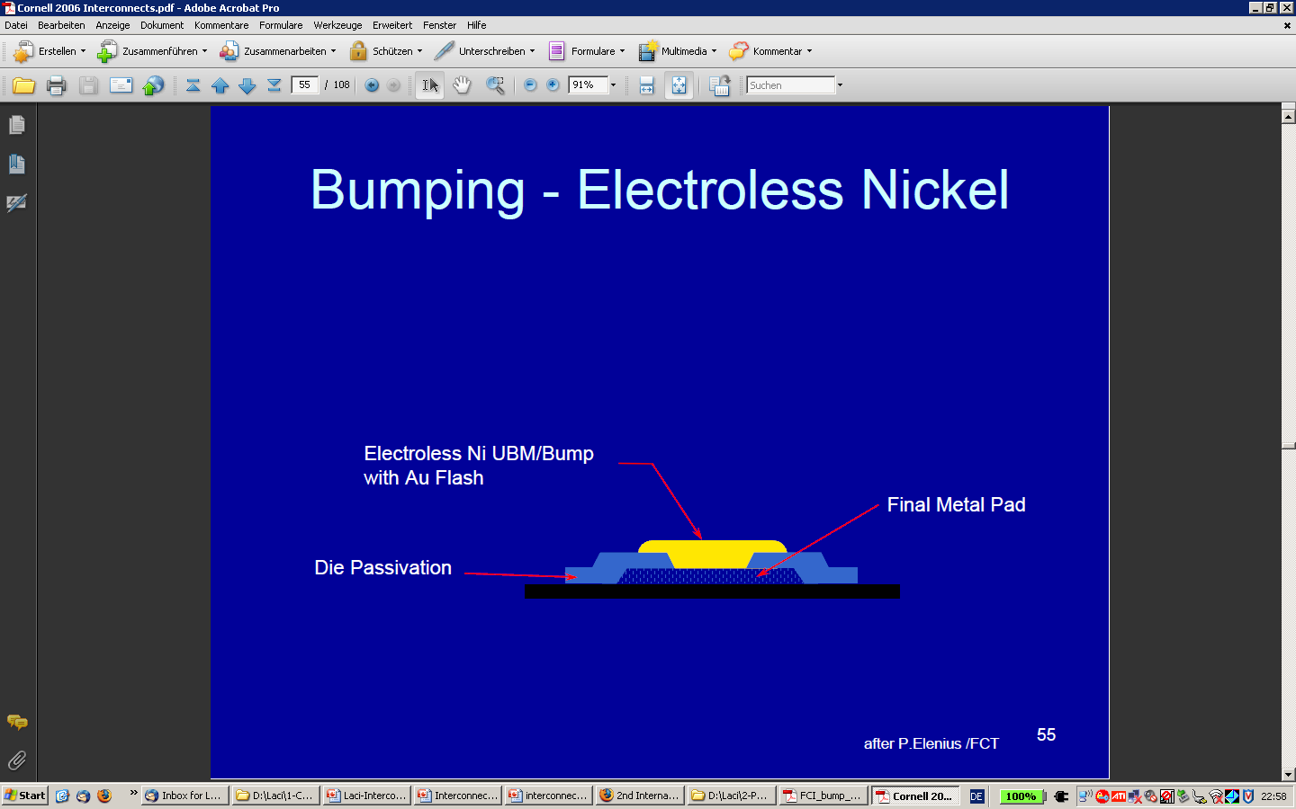
UBM for the Sensor → Landing Pad
Starting point:
1.) read out chips with solder bumps from external supplier
2.) Sensor wafer, last metal Alu2, BCB passivated , from clean room
UBM on Sensor
Through mask electroplating:
-: Sputter Ti:W Barrier
-: Sputter Cu seed layer
-: electroplating of Cu, Sn, PbSn ... tbd ..
Electroless Nickel/Gold (ENIG):
-: electrochemical reaction gives Ni and
thin Au layer on exposed Al pads
-: Lithography step needed
-: landing pad defined by mask
wetable pad
-: but also RDL (additional metal layer!!)
-: No Lithography, no masks
-: passivation opening is the landing pad
→ wetable pad, but no metal traces for RDL

Slide 8
IBM 200mm Wafer Bump Offering (to Hans Krueger via Mosis)
Electroplated C4, PbSn 97/3, in two Options:
-: high temp. reflow: 345 – 375 degC
-: low temp. reflow: 215 – 255 degC
Lead-free, C4NP (“new process”):
-: SnAg 99.5/0.5
-: bump size smaller → 100 µm!
-: reflow at 235 – 255 degC
Low T Option preferred
BCB has Tg ≅ 350°C
This means for the landing pad on the sensor:
-: Cu as landing pad should be okay for both low temp. options, but needs verification
→ Use thru mask electro-plated TiW/Cu-sp/Cu-ep
-: Design rules for Copper traces similar to metal on the Sensor: 5/5 (width/spacing)
-: Distance from the landing pad to the next Cu trace not yet completely clear!
-: Diameter of the landing pad ca. 100 µm - same as UBM/BLM on the ASIC

Slide 9
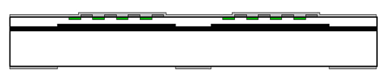
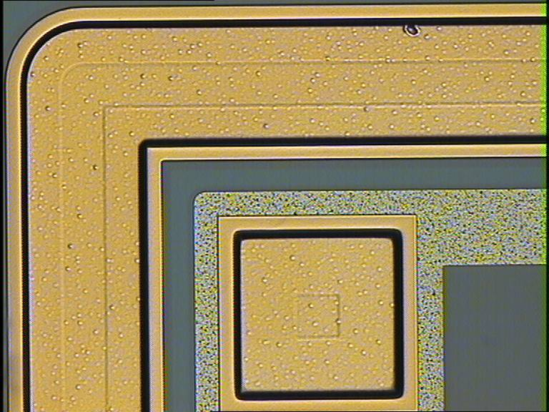
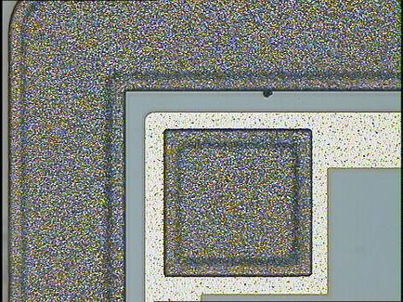
HLL PiN Diodes .... with Cu und Sn (done at IZM)
Diodes (our standard test vehicles) have been produced on SOI Wafers, top layer: 50 μm thick, 150 Ω.cm
TiW
Cu
Corner of a 10 mm² Diode, with Cu
Al
BCB
SiO₂
-: BCB layer with openings to define
TiW/Cu/Cu(/Sn) System
-: Handle wafer acts as back side protection
layer during the IZM processing
-: Metal system done at IZM:
100 nm TiW, sputtered
200 nm Cu, sputtered
1 μm Cu, through mask electroplated
-: on a 2nd Wafer: TiW + 5 μm Cu + 1 μm Sn
same diode, with Cu/Sn

Slide 10
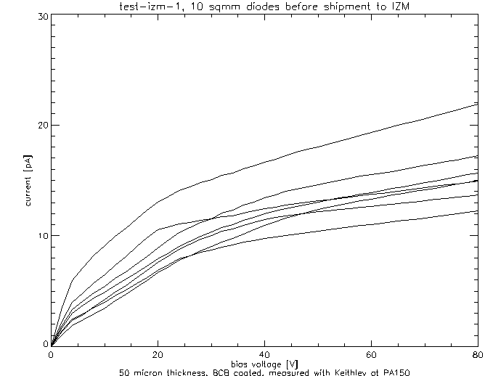
HLL PiN Diodes .... with Cu und Sn (done at IZM)
Correlation of the reverse current at full depletion
(50 V) before and after Cu metallization
-: right after Cu-System application (black diamonds)
-: after 320 degC in forming gas (red diamonds)
→ No significant effect of Cu metallization noticeable!
-: IV Curves before Cu metallization
-: measured at HLL, right before shipment
to IZM
-: from CV curves → full depletion at 50 V

Slide 11
Test HLL PiN Diodes .... with Cu pads made at CNM
TiW
Cu
BCB
SiO₂
BCB
p⁺⁺
Cu
Al
n-
n⁺⁺
6 Wafers
processed in the HLL R&D Lab
3 SOI Wafers,
50 micron top layer
Handle wafer as back side protection
3 std. HiRes Wafers
No back side protection
1 Wafer: Minimal contact openings on top side
Oxide as additional barrier against Cu
1 Wafer: Minimal contact openings on top side
Oxide as additional barrier against Cu
2 Wafers: Large contact openings on top side
The only barriers are TiW and BCB
2 Wafers: Large contact openings on top side
The only barriers are TiW and BCB

Slide 12
Process flow and Status of the HLL-CNM Test
-: at HLL:
a. Pre-processing of test diodes up to BCB openings
→ almost done, only BCB missing, finished in ~3 weeks
b. characterization before Cu
-: at CNM, Barcelona (common small project of CNM and HLL) :
a. TiW and Cu seed sputtering
b. Lithography (plating mask)
c. electro-plating of Cu (5 micron)
d. resist striping and removal of the seed layers
-: at HLL:
a. characterization after Cu

Slide 13
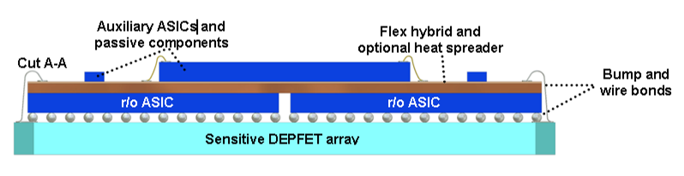
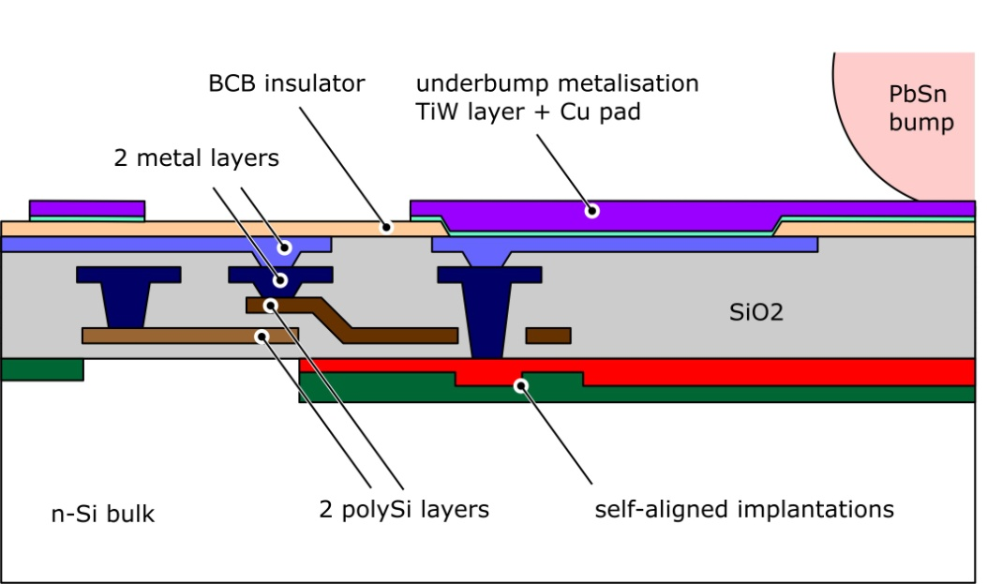
Synergy with XFEL DEPFETs
-: Hybrid Pixel Detector with DEPFETs
-: 4000 bumps per chip (C4)
-: one bump per pixel, ~200 µm pitch
-: 16 ASICs and 2 sensor chips per ladder
-: 3rd metal layer in Cu will be used to
reinforce the clear lines

Slide 14
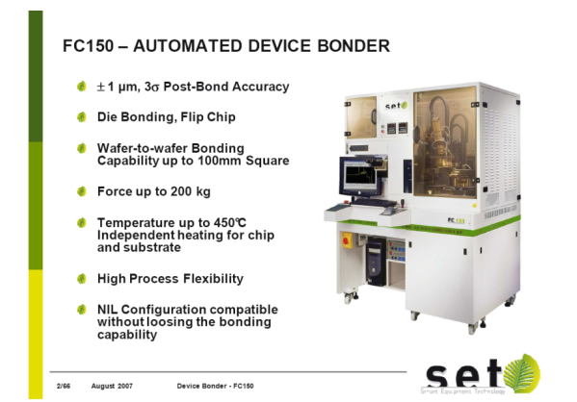
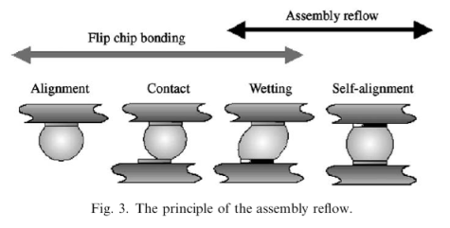
Summary
-: HLL will extend its processing capabilities and integrate UBM (landing pads including 3rd metal layer)
for solder bumps on the sensor substrate. Time line is given by the XFEL project; expect UBM
on the sensor to be available in the 2nd quarter of 2010.
-: First tests are done and more are scheduled in collaboration with CNM this summer.
-: SuperBelle can take advantage of this:
→ solderable pads on the sensor for passive components and connectors
→ affordable external bumping services for DHP and DCD(?)
→ conventional technologies for Flip-Chip with low pressure, low temperature,
and hopefully re-workable
-: so far so good, but still some open questions:
1.) What about Switcher bumping?
a.) Pactech solution (chip wise gold stud with solder jetting) …
c.) Bumping on chip level → very(!!) cumbersome, painful, and expensive
b.) conventional gold stud???
2.) What about the Flip-Chip?
-: Sensor as substrate → special tooling
-: moderate reflow temperatures (≤ 250..300°C)
-: preferentially flux-less to avoid residues
-: reworkable …

Slide 15
Backup slides follow

Slide 16
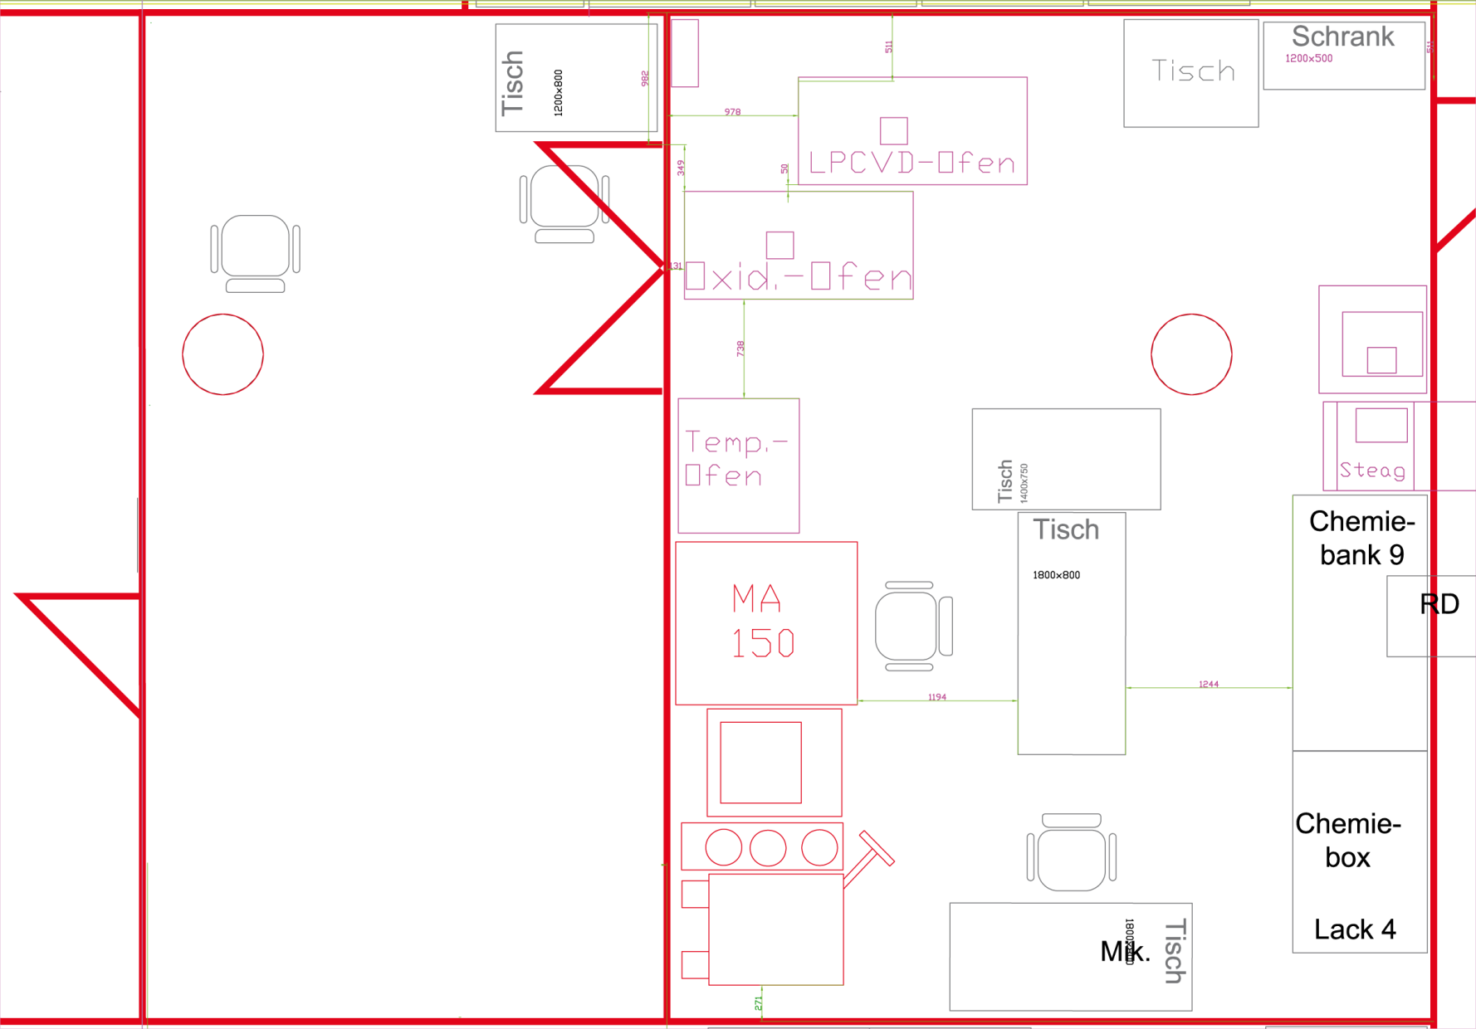
Installation of the back-end processing at HLL
Flip Chip
R&D Lab
Back-end post processing
MA
Wet Bench
Sputter

Slide 17
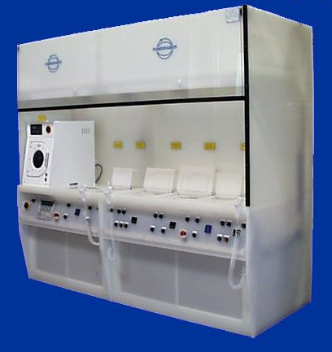
Wet Bench Concept
~ 4m
HP
Rinse/Dry
Solvents
QDR
Etch
Bath
EP Cu &
PbSn?
SC
Something like that …
-: First contacts with manufacturer established
-: technical discussions started
-: Prize tag: ~ 200k

Slide 18
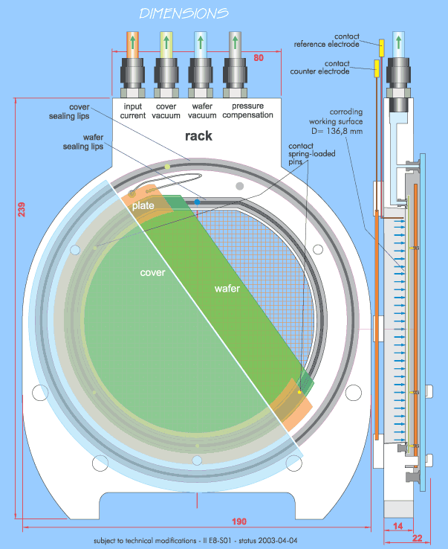
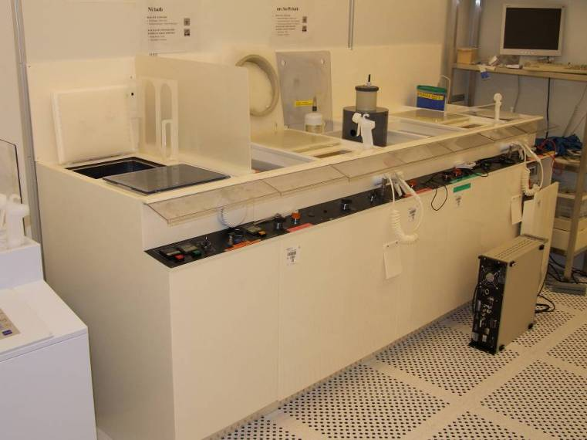
Beispiel: VTT fuer ALICE und LHCb Pixel Sensoren - Galvanik
Wet bench for electroplating

Slide 19
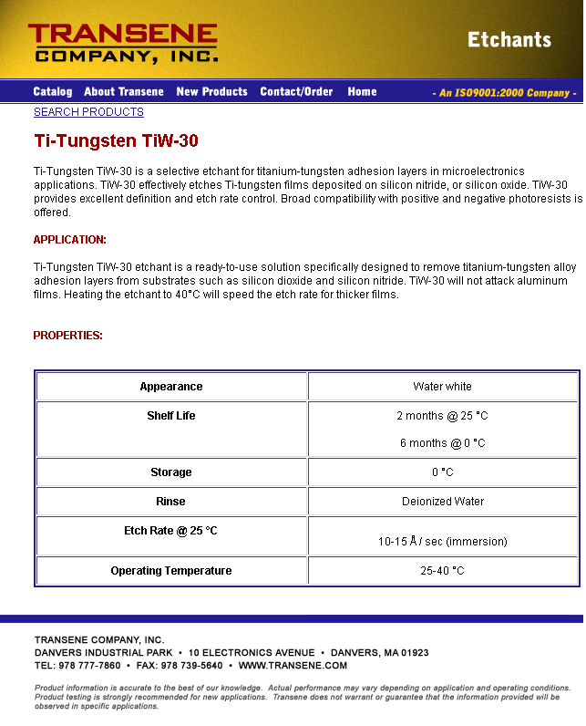
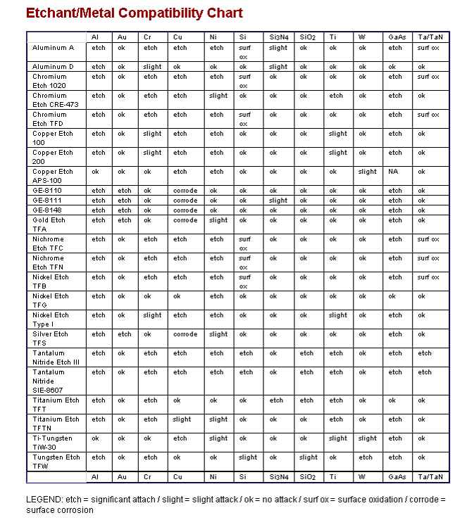
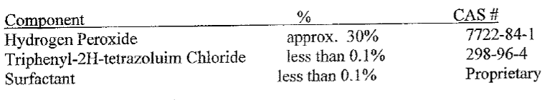
Ti:W Etching

Slide 20

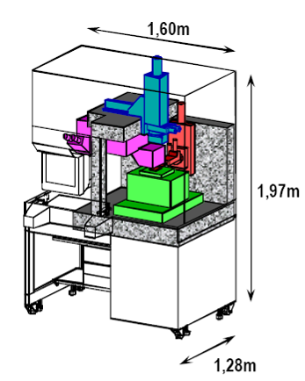
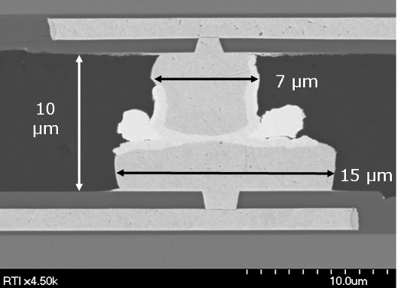
SET FC150 (ehemals Suess)
Installiert bei:
-: IZM Berlin
-: CNM Barcelona
-: RTI North Carolina .... (→ Fermilab SLID Versuche)
SLID @ RTI

Slide 21
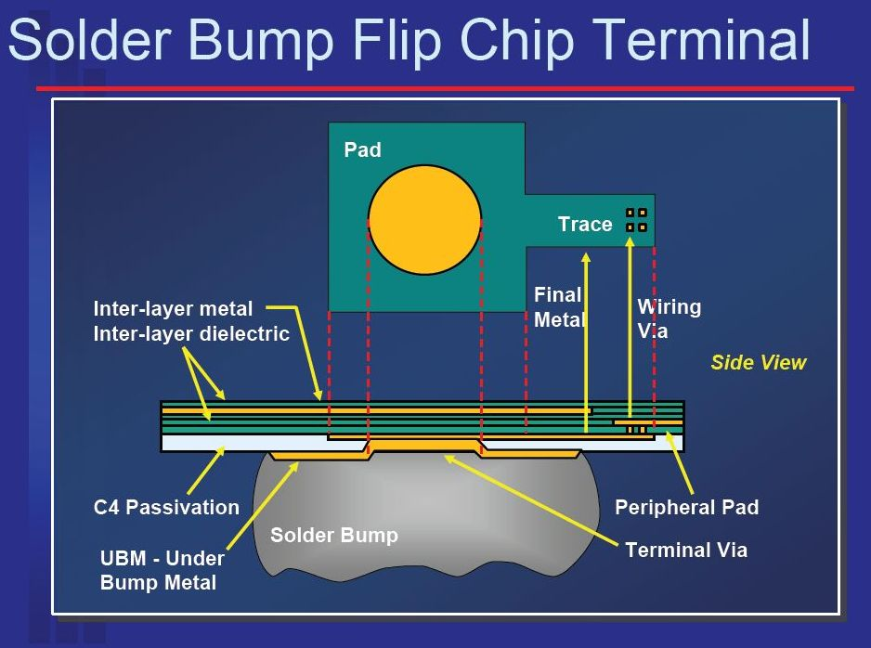
C4 Bump (only a few details…)
‘Package Interconnects’ , J.R. Wilcox
IBM, January 2006
100 µ
For “4 on 8”
130 µ
Precise design rules available in IBM Design Kit

