Slide 1
Module Tests at MPP
Test setup prepared by Philipp Leitl
2 setups for module tests
1 setup for ladder Tests
Aim:
QC of modules after kapton attachment
Grading (A, B, ….)
Characterization (Pedestals, noise, maps of noisy/dead pixels…)
Optimization (data links….)
Tools:
Laser illumination (full module, no laser spot on backside possible)
Cd-Source

Slide 2
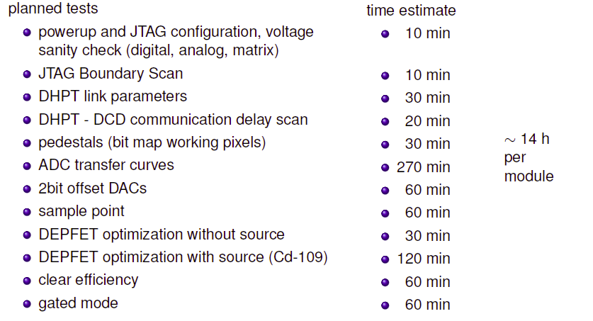
Tests planned
Times are estimated (we havn’t tested a ‘normal’ module yet)
Some tests may be obsolete, additional tests may be necessary (need experience)
Aim: test 2 modules and 1 ladder / week

Slide 3
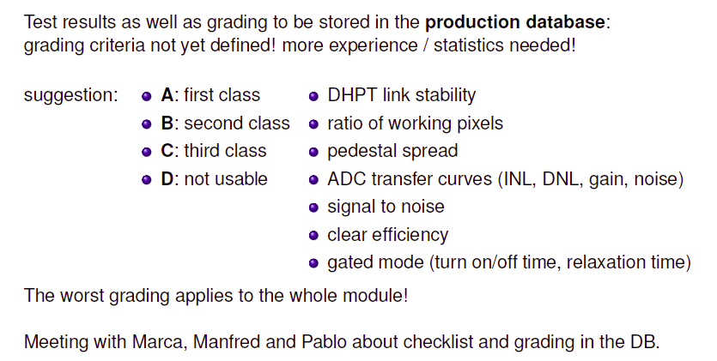
Evaluation

Slide 4
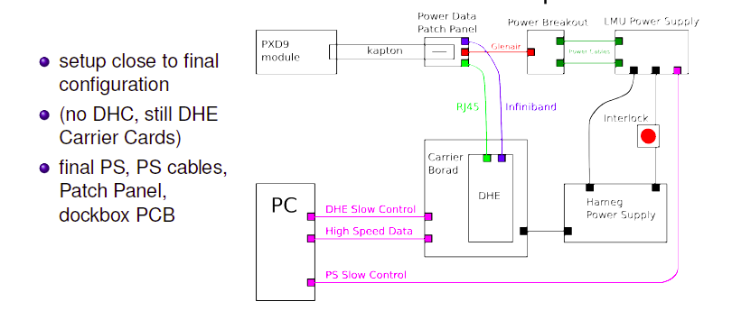
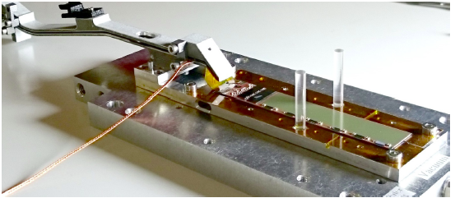
Setup

Slide 5
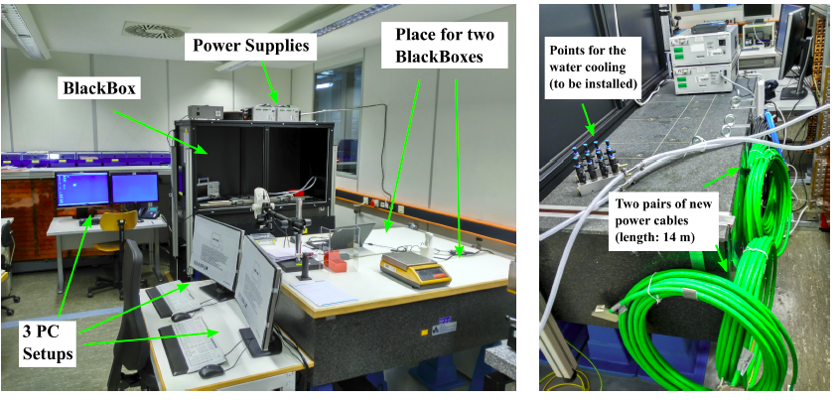
Status: Hardware
PCs, Powers Supplies, DHEs, cables exist (two power supplies still missing)
One of two black boxes exist (2 others in work)
C_{d}¹⁰⁹ source delivered (not yet installed), motor stage to be ordered
Laser delivered (not yet installed)
Need more patch panels (we have only 4, will go to DESY)

Slide 6
Status: Test Activity
The basic tests can already be performed (except source and laser, to come soon)
The setup could be verified with W30OB2
Plan was to start with the PERSY/Beam Test modules
However, due to problems with these module the test activity was transferred to the HLL
No progress during the last few weeks
Need to start again to get experience (IF and OF modules are now at MPP. Restart next week)
=> Transition from debugging to routine testing

Slide 7
Lessons learned
The tests at MPP are for QC, not for debugging or failure analysis
High throughput needed, limited time per module (during series production)
=> Problematic modules need to be put aside and measured elsewhere
Need test capacities elsewhere (HLL, ….)
analysis of problematic modules (repair, rework?)
tests beyond the scope of the MPP QC tests:
Laser scans (spot)
Gated mode tests (optimization)
Long term tests (stability…)
Explore alternative operation modes (optimization)
……………..

