Slide 1

Overview
MPI for Physics: 100 Year Anniversary
Detector and Technology Developments for Particle Physics (and beyond)
(or: Excellent Science needs Excellent Scientists + Excellent Detectors)
  Introduction
  HYBUC: the hyperon bubble chamber
  Fixed-target spectrometer experiments
  Large volume tracking detectors: TPC
  Liquid argon calorimetry and associated electronics
  Solid state detectors for particle physics and X-ray astronomy
  Photo detectors and Cherenkov telescopes for TeV photon astronomy
  GERDA: neutrino-less double $β$-decay
  Summary
In this talk
- I look back on some of the beautiful detectors developed and built at the MPI-Physik for astro particle- and particle physics, and on the experiments in which they were used.
- These developments have allowed the MPI-Physik to play a lead role in many experiments, which have shaped and are shaping particle and astro-particle physics.
- These developments also found applications in other science fields and commercial products.

Slide 2
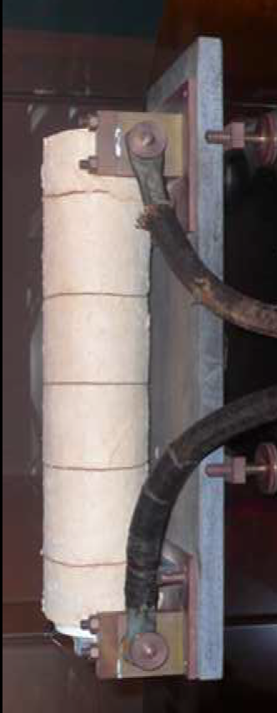
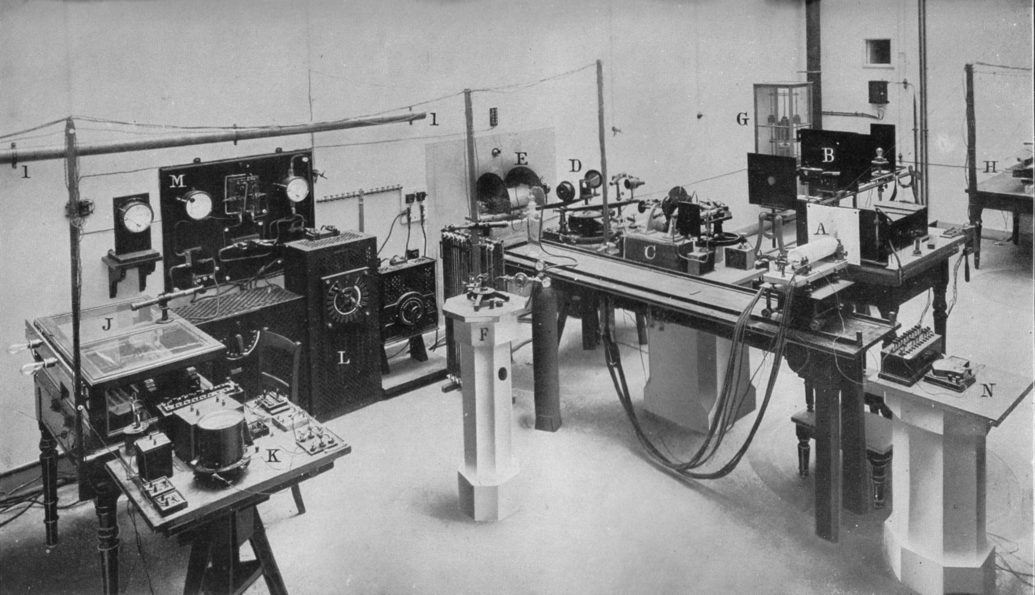
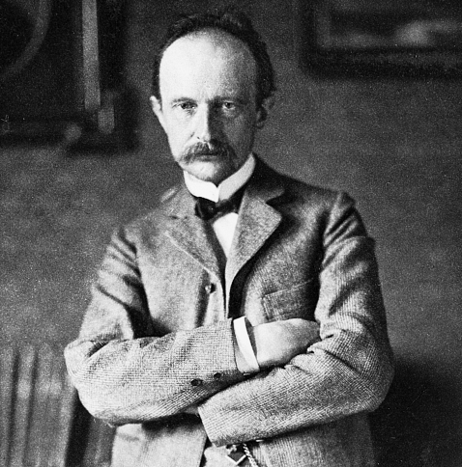
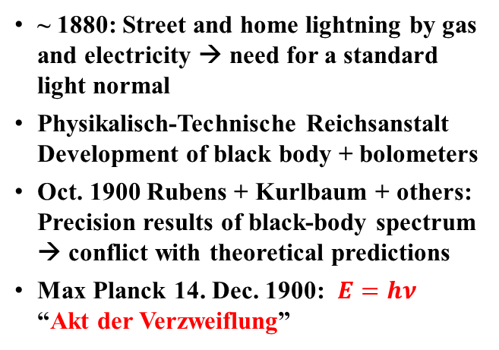
Introduction
Precision measurements, Max Planck and the beginning of Quantum Mechanics
  ~ 1880: Street and home lightning by gas and electricity → need for a standard light normal
  Physikalisch-Technische Reichsanstalt Development of black body + bolometers
  Oct. 1900 Rubens + Kurlbaum + others: Precision results of black-body spectrum → conflict with theoretical predictions
  Max Planck 14. Dec. 1900: $E=hν$ “Akt der Verzweiflung”
  MPI-Physik: Innovative detectors ⊗ excellent experiments ⊗ original theoretical ideas

Slide 3
HYBUC – dedicated hyperon bubble chamber
HYBUC: Hyperon bubble chamber - MPI-München, Vanderbilt-University (1970-1973)
Physics: magnetic moment μ_{Σ} of Σ⁺ (uus) → does simple quark-model describe structure of baryons ?
Method: K⁻ p → π⁻ + Σ⁺ (↑) → p π⁰ Σ⁺ precesses in B-field; decay (10⁻¹⁰ s) measures μ_{Σ}
Challenges: 11.5 Tesla field ! high statistics: (2 Mio. pictures → 70 000 Σ⁺-decays)
Results: 10 physics publications
Highlight: μ_{Σ} = (2.30 ± 0.14) μ_{N}: an impressive early confirmation of the simple quark model and a very beautiful experiment !
p
π⁻
Σ⁺
K⁻
the „typical“ event

Slide 4
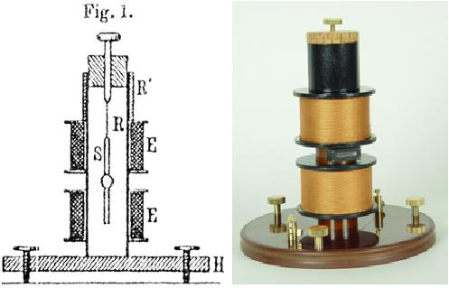
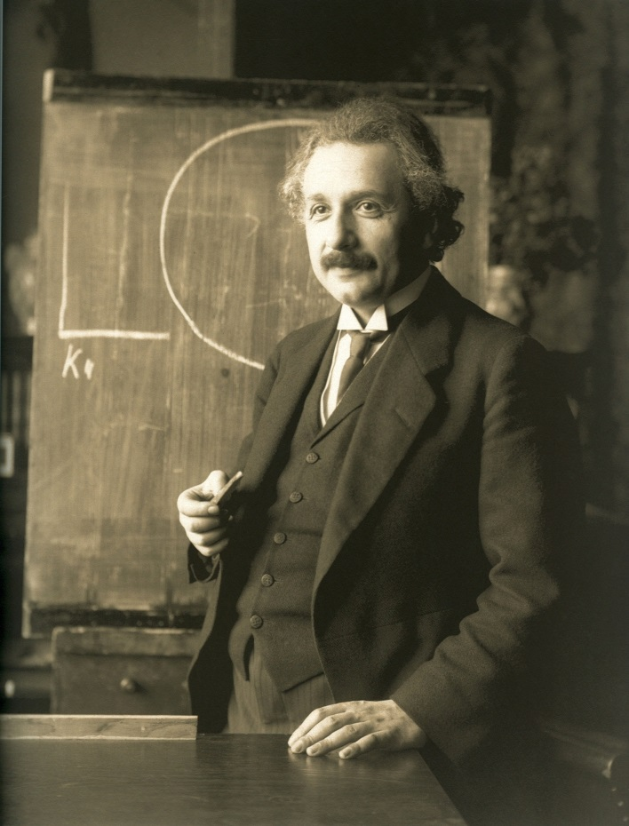
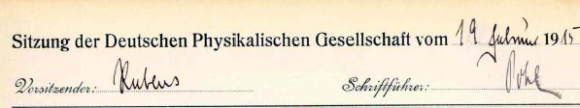
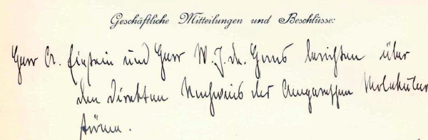
Albert Einstein and magnetic moments
Albert Einstein: 1st director of the Kaiser Wilhelm Institut für Physik
Ampère 1820: Molecular currents postulated → Magnetism linked to angular momentum
Einstein–de Haas 1915: Experimental demonstration → Agreement with theory (at that time!)
Improved measurements → Einstein’s only experi-ment off by factor 2 ! → explained by electron spin
Understanding the spin of hadrons remains a puzzle
  Shall we believe experiments by theoreticians if they know already the result?

Slide 5
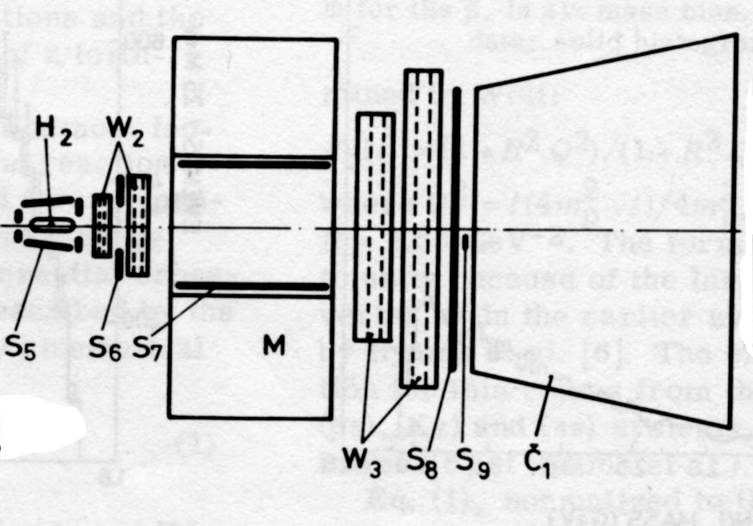
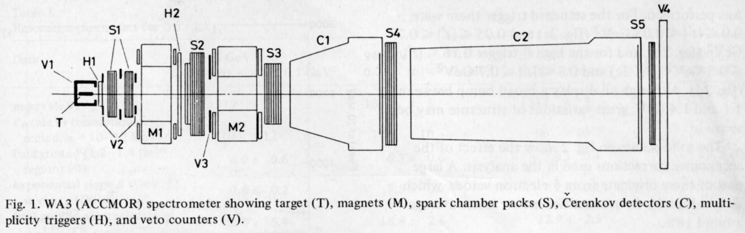
Fixed target spectrometer experiments
Fixed target spectrometer experiments: CERN-Munich (PS) → ACCMOR SPS (1970-1989)
Physics studied:
  - Hadron (meson) spectroscopy: unflavoured, strange and charmed hadrons
  Hadronic production mechanism (model independent analyses, meson exchange and soft diffraction)
  → More than 100 publications
Challenges:
  - Large acceptance → large tracking detectors
  Precision measurement of angles and momenta
  Particle identification → large, multicell C-detectors
  High statistics → selective trigger + state-of-the-art DAQ
  (for the time) very complex analyses
CERN-Munich Spectrometer
17.2 GeV/c beam
8 m
WA-3 SPS-W-hall → NA12/32 SPS-N-hall
up to 220 GeV/c
30 m

Slide 6
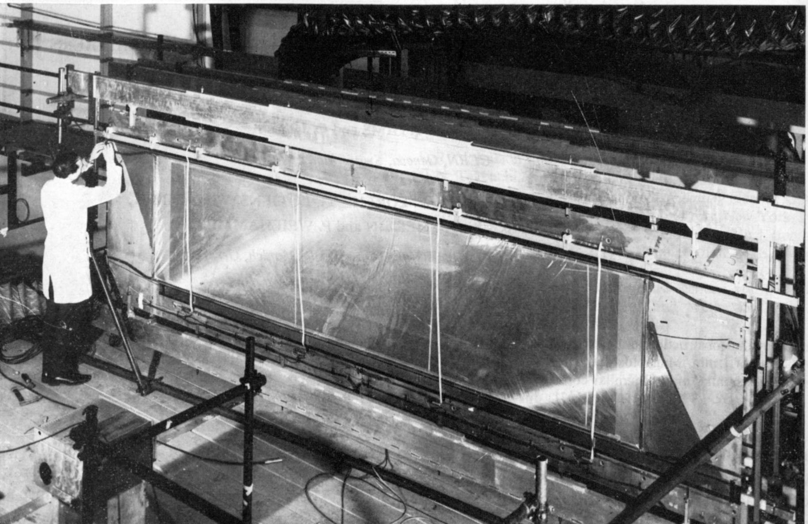
Fixed target spectrometer experiments
(up to) 80 huge high precision spark chambers (in NA32 drift chambers):
  Largest chambers: 4m x 2m – simple but effective and reliable design (lived for 15 years!)
  Electronics (magnetostrictive) read-out with inductive pick-up coils
  Position resolution: 200 μm ! + precision overall alignment of detector components
  Elegant + precise set-up allowing for easy servicing and change of spectrometer geometry!
+ Large multi-cellular Cernkov counters → expertise later used in HEGRA→ MAGIC→ CTA
  After 1980: Si-detectors with ~ 5 μm resolutions were pioneered in NA-32 (CCDs+Si-strips), which made extension of program to charm possible
large spark chambers of the CERN-Munich experiment

Slide 7
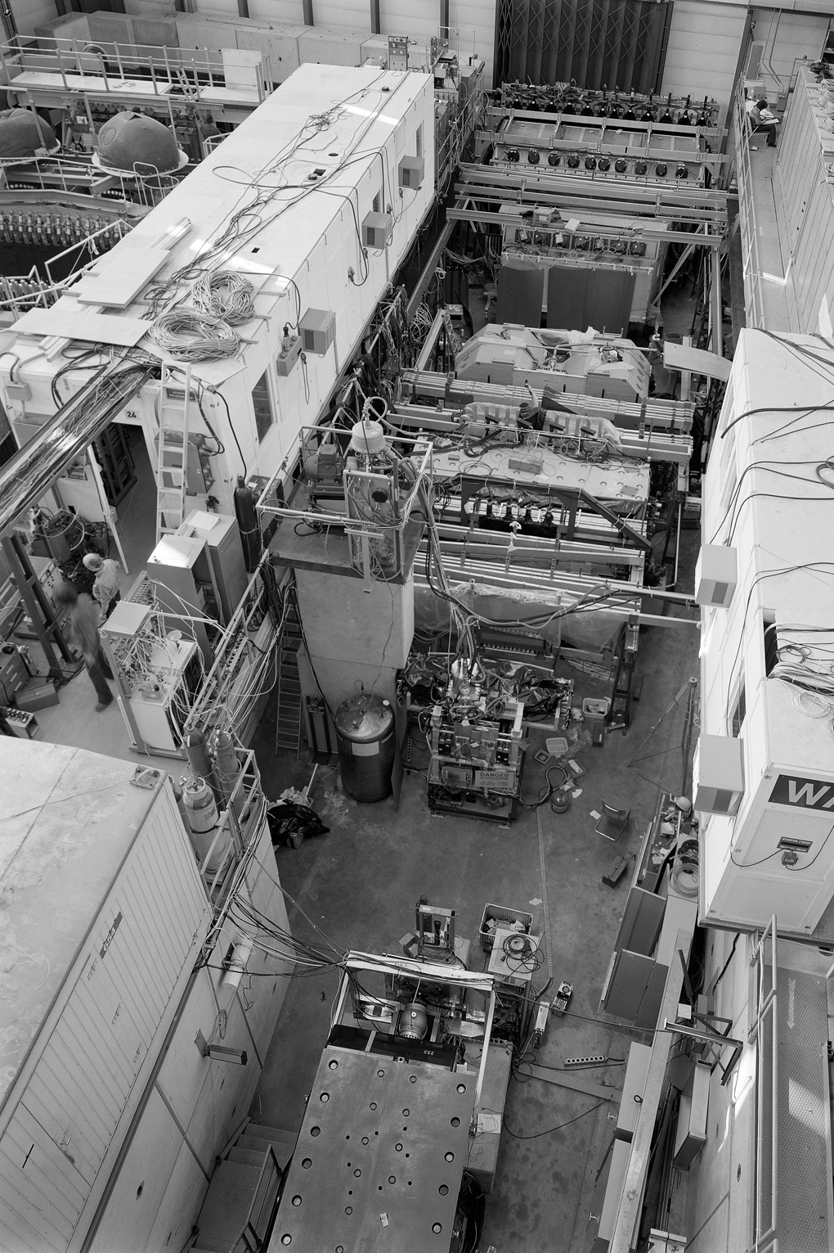
Fixed target spectrometer experiments
  Pioneered fixed target spectrometers → template for many experiments
WA3: W-hall of the CERN-SPS →
CERN-Munich +: E-hall of the CERN-PS ↓

Slide 8
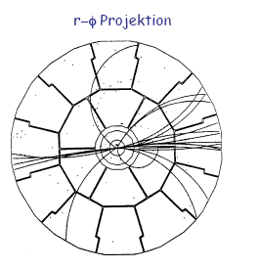
Large volume gas tracking detectors
Large volume gas tracking detectors: streamer chambers and TPCs
Aim: (for study of high-multiplicity events at colliders and fixed target (heavy ion) experiments)
- Complete and precise 3-dimensional reconstruction of complex high-multiplicity events with minimal material
- Charged particle identification using ionization (dE/dx)
MPI: development to perfection of streamer chamber and time projection chamber (TPC)
Principle of operation of TPC:
E-, B-field
Charged particles ionize chamber gas
Electrons drift (up to 2.5 m) in uniform E- and B-field to chambers on end plates
Chambers measure pulse shape → from position and time → 3-dimensional position measurement
Resolution (ALEPH) σ_{r,φ} = 170 μm
σ_{z} = 750 μm
particle
for wire- or other chamber

Slide 9
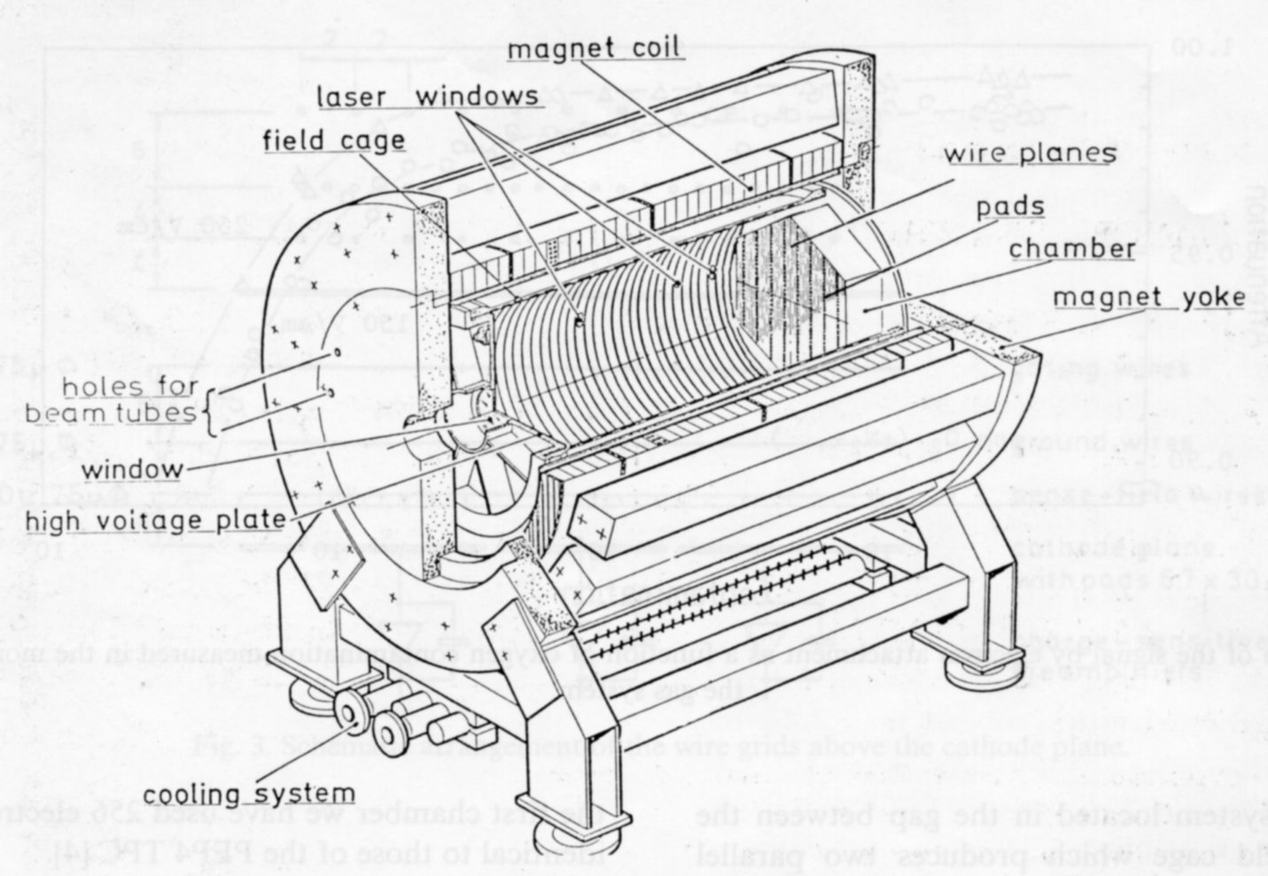
Large volume gase tracking detectors
Large volume gas tracking detectors: TPC
TPC: LBL – Pep4: pioneering work – but still lots of understanding and improvement needed
MPI: Development to perfection of time projection chamber (TPC) + leading role in construction and exploitation for physics of a number of TPCs
1983: TPC 90 → working horse for an in-depth understanding of a large volume TPC:
- Diffusion of drifting electrons
- Gas amplification in strong E/B-fields
- “Laser tracks” ionisation
- Gas chemistry and purity
- Response function + electronics
- Optimization and test place
for read-out chambers and
read-out electronics
- …
A “Musterbeispiel” how to syste-
matically solve a complex
experimental problem and train
excellent students and post-docs
1.2 Tesla field
90 cm
TPC 90: entirely built in MPI-workshop

Slide 10
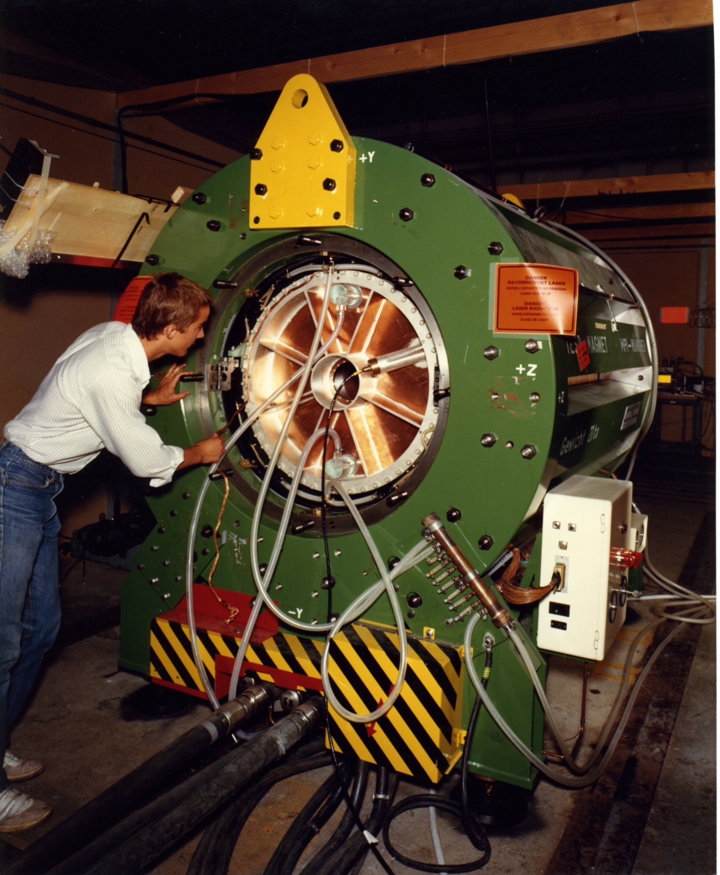
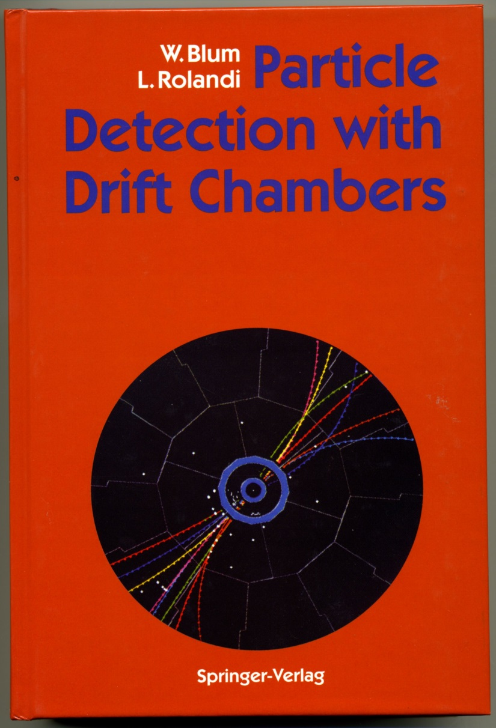
Large volume gaseous tracking detectors
TPC 90: R&D on gaseous detectors
→ Much of the work found its way into textbooks:
TPC 90: entirely built at MPI-workshop

Slide 11
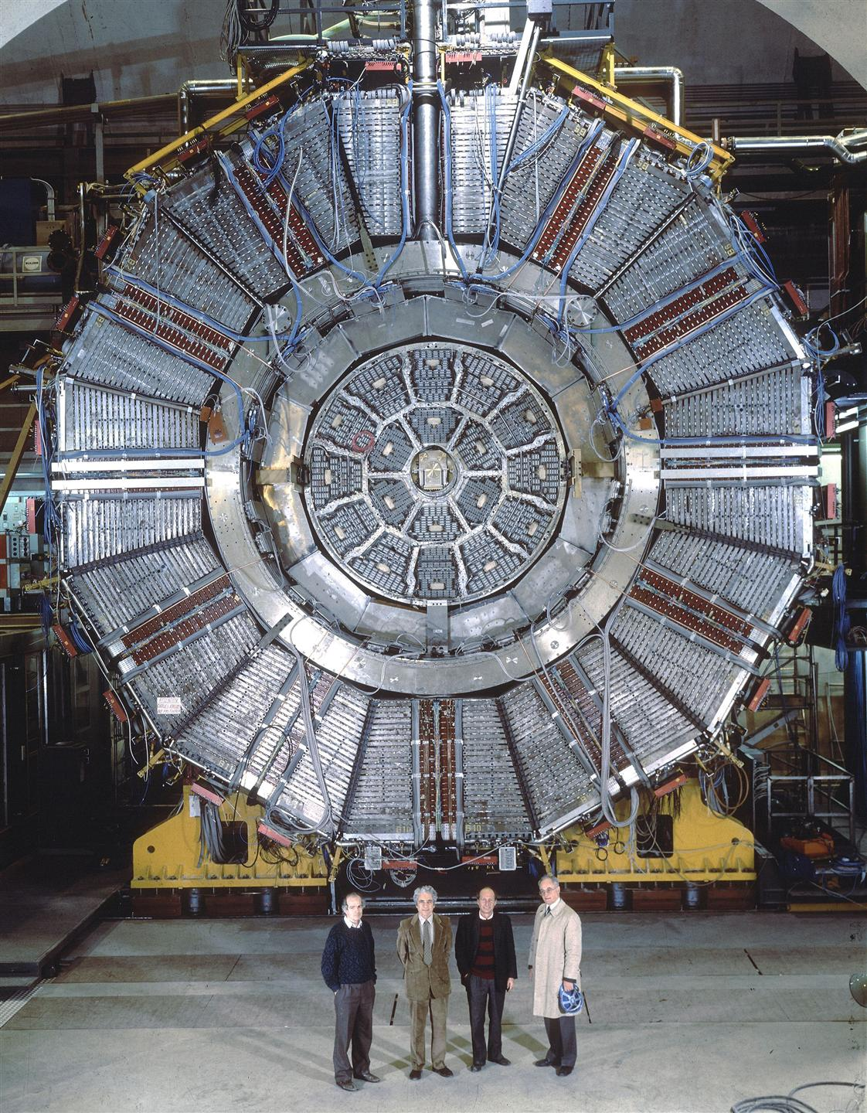
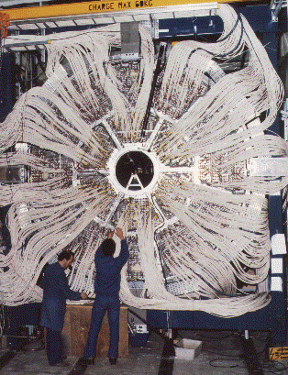
Large volume gaseous tracking detectors
→ ALEPH TPC
after connecting 47000 cables!

Slide 12
Large volume gaseous tracking detectors
→ ALEPH TPC: some events at LEP (e⁺e⁻interactions up to 209 GeV centre-of-mass energy), which demonstrate the impressive performance and pattern recognition abilities
91 GeV
3 jets at W⁺ W⁻ threshold
161 GeV
3 jets at Z⁰
200 GeV
161 GeV
μ + 2 jets at W⁺ W⁻ threshold
4 jets at the highest LEP energies
Physics results: → for precision electro-weak physics → talk by D.Schlatter

Slide 13
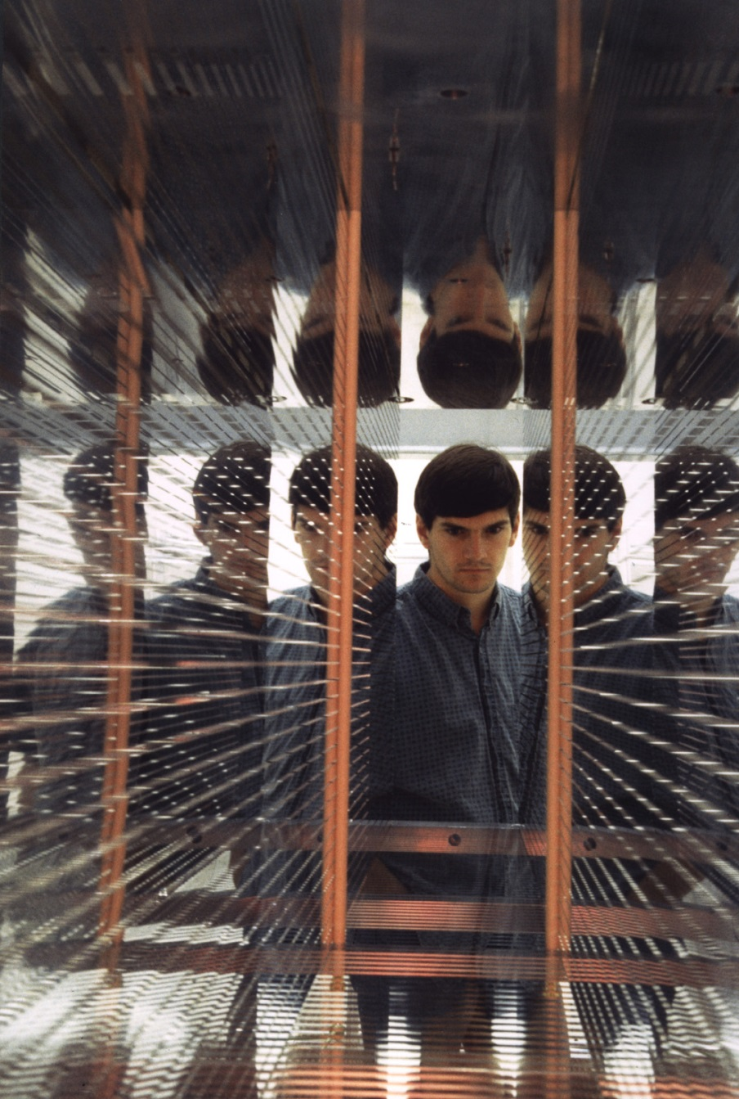
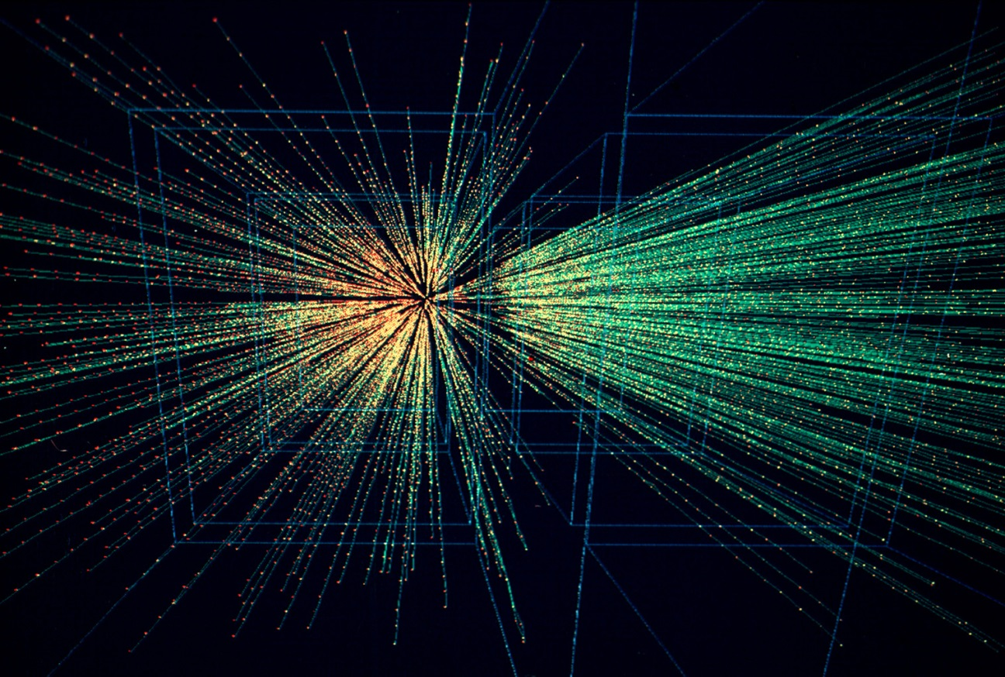
Large volume gaseous tracking detectors
→ CERN NA49: TPC for fixed target heavy ion interactions
NA49 TPC: field cage
NA49 charged tracks from heavy ion collision

Slide 14
Large volume gaseous tracking detectors
→ NA49 TPC → STAR TPC → ALICE TPC: most impressive tracking performance
Au + Au @ 140 A⋅GeV
  A development which has shaped experimental particle physics

Slide 15
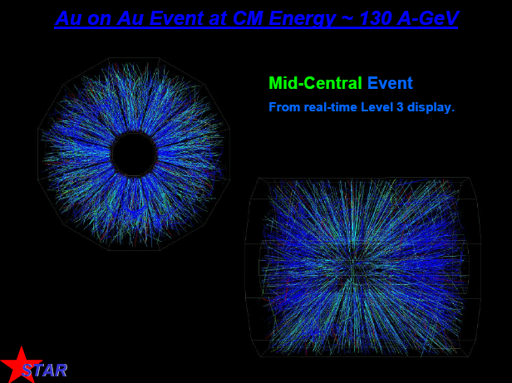
Large volume gaseous tracking detectors
→ NA49 TPC → STAR TPC → ALICE TPC: most impressive tracking performance
Au + Au @ 140 A⋅GeV

Slide 16
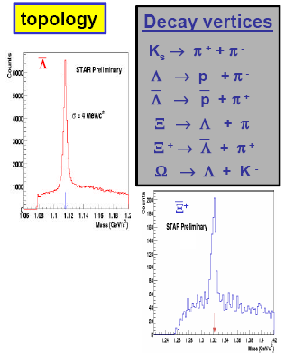
Large volume gaseous tracking detectors
→ STAR TPC: most impressive tracking and particle identification performance
+
→ R&D for further improved TPC for ILC

Slide 17

Liquid argon calorimetry
Calorimetry and associated electronics: liquid argon CELLO → H1 →ATLAS (+ 4π calorimetry for fixed target experiments (NA5), low T calorimeters for WIMP-searches, crystal calorimetry with Si-sensor read-out, non-hep applications and many more)
At the heart of every collider detector: tracking ∙ calorimetry
Challenges and requirements:
- Energy and position measurement of electrons, charged and neutron hadrons over entire solid angle + missing energy “measurement”
- Uniformity of response (%); stable calibration and reliable operation in hostile environment
- Particle identification: e/γ – hadrons – μ’s
- Timing (adapted to bunch crossing rate of collider: 100 ns@HERA and 25 ns@LHC
- Fast signal for trigger decision – to select the rare interesting events
Technology chosen at MPI: liquid Ar (LAr) sampling calorimeters
Challenges of LAr:
- Pulse shaping (speed) ↔ electronics noise (capacitance!)
(+ large number of channels + complex el. connections
→ ATLAS: “cold GaAs electronics !)
- Purity (electron life time) need << ppm
- Mechanical tolerances + HV stability
- But: LAr is intrinsically radiation hard
with CELLO (PETRA) → H1 (HERA) → ATLAS (LHC)
Q(T) = ∫I (t)dt
no pulse-shaping
I (t)
25 ns bunch crossing of LHC
after pulse-shaping with t_{p}=50 ns
MPI world-leading centre to master such challenges

Slide 18
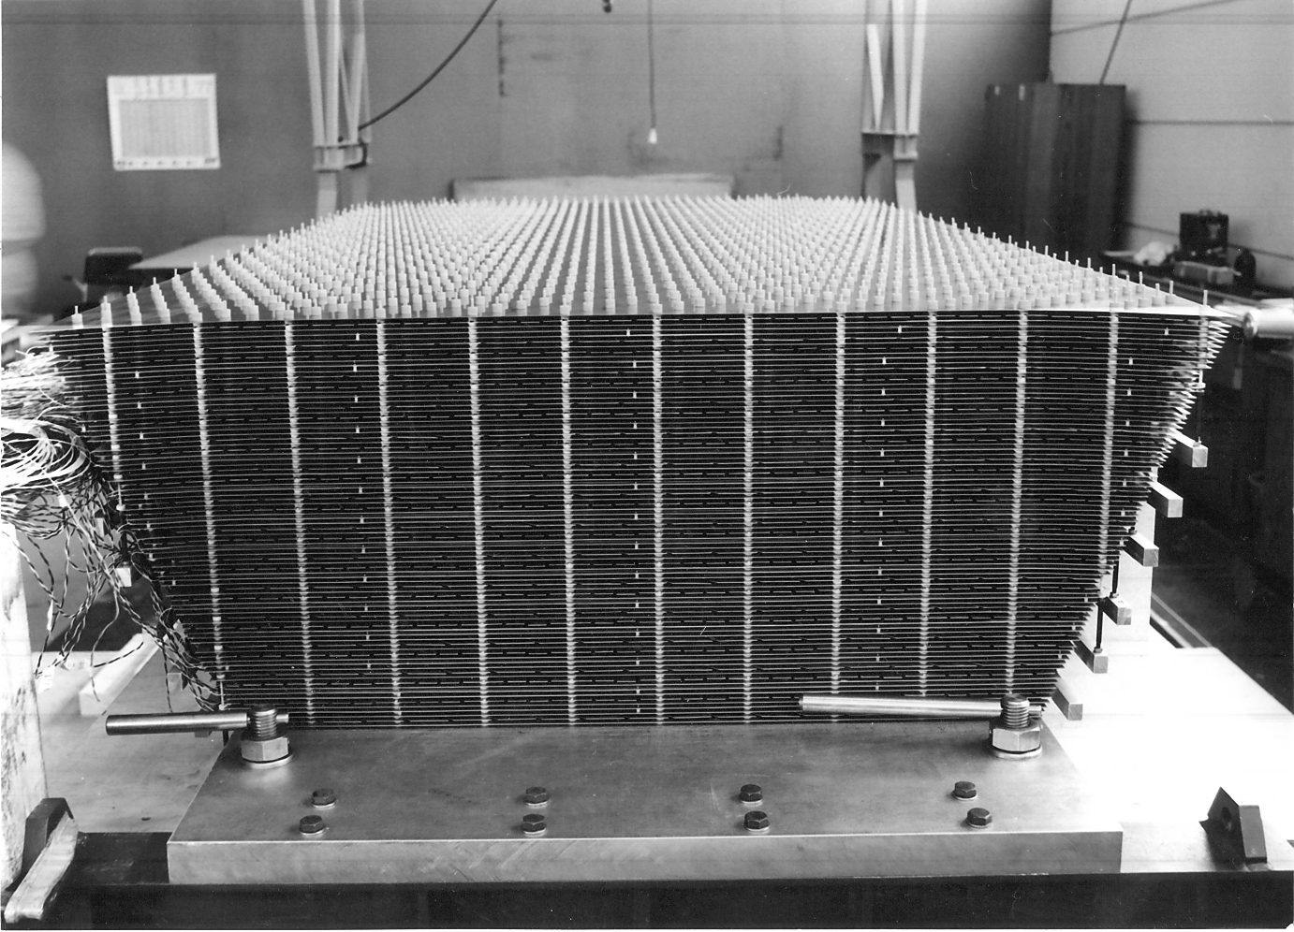
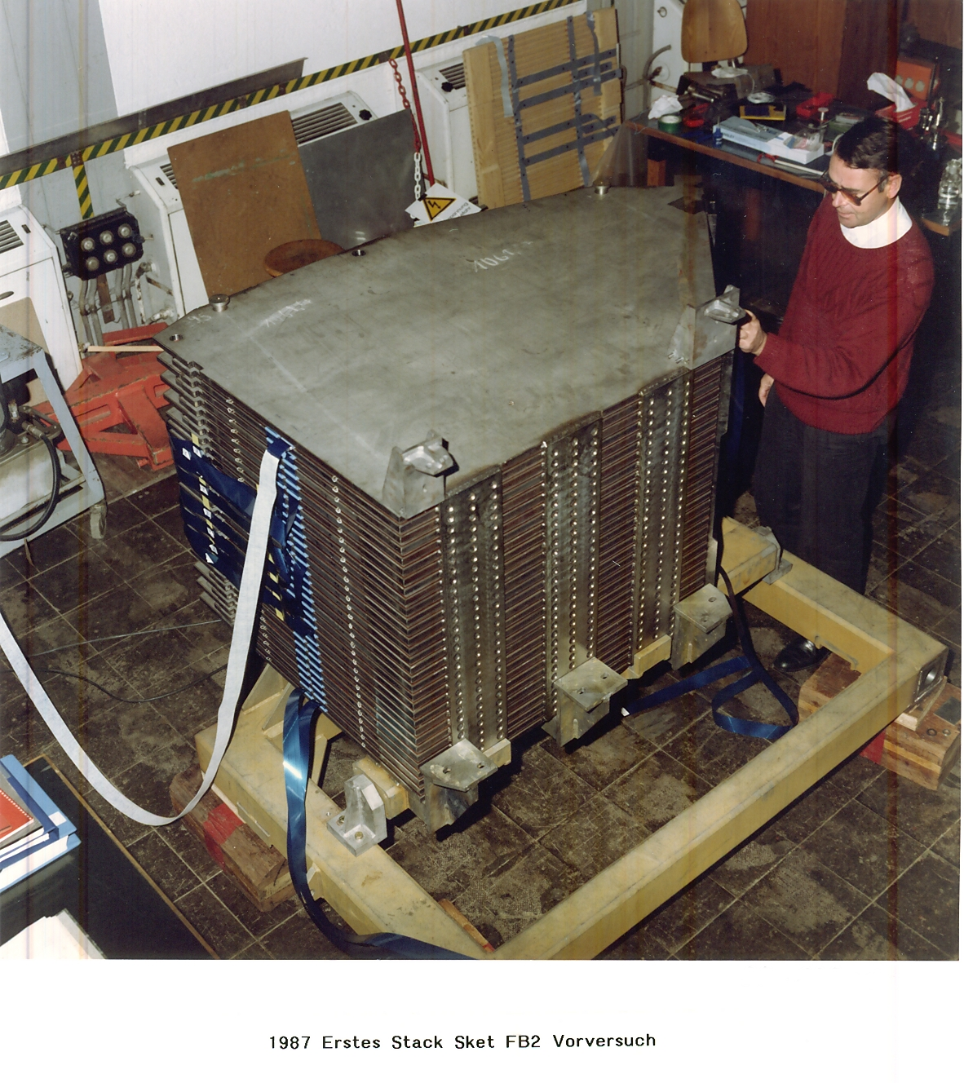
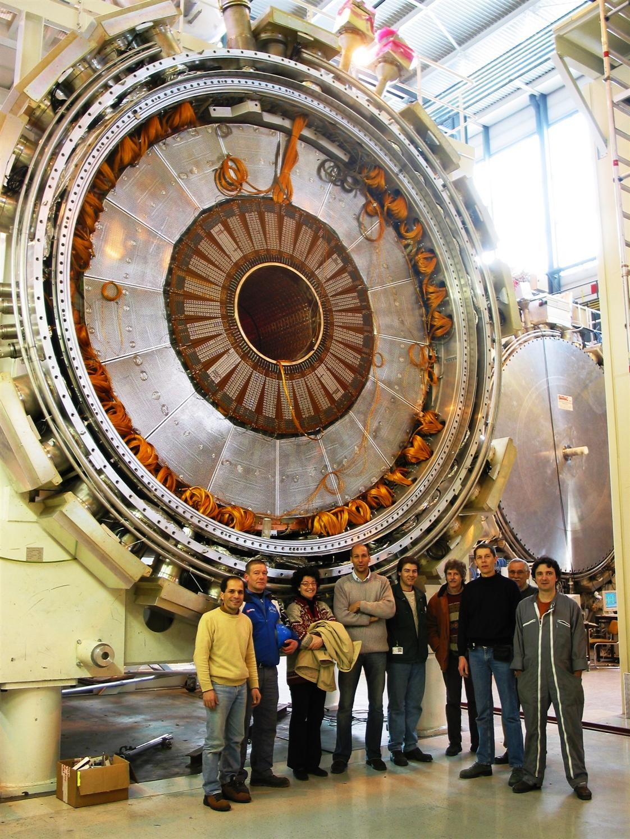
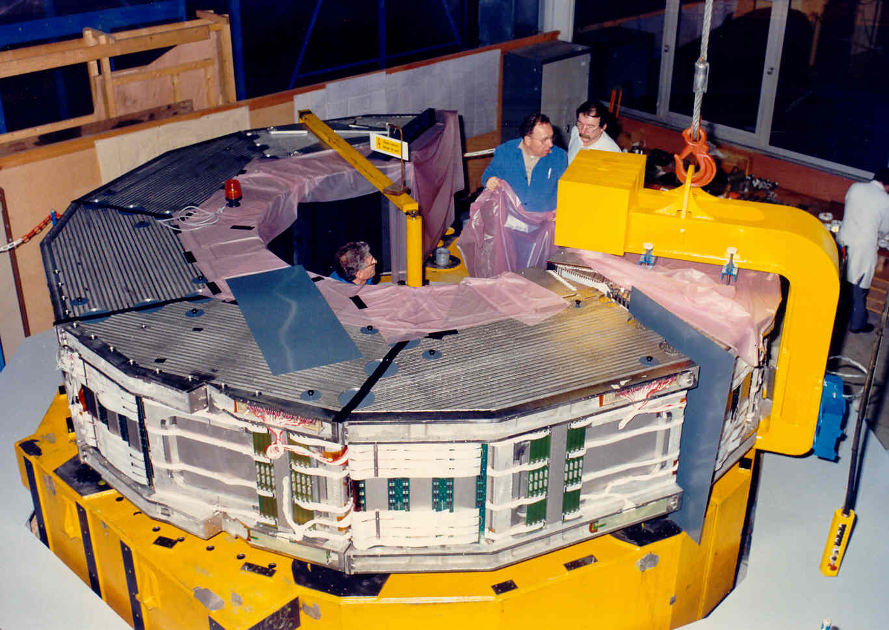
Liquid argon calorimetry
LAr calorimetry@MPI:
H1 LAr calorimeter
CELLO LAr calorimeter
H1 LAr calorimeter
ATLAS end-cap

Slide 19
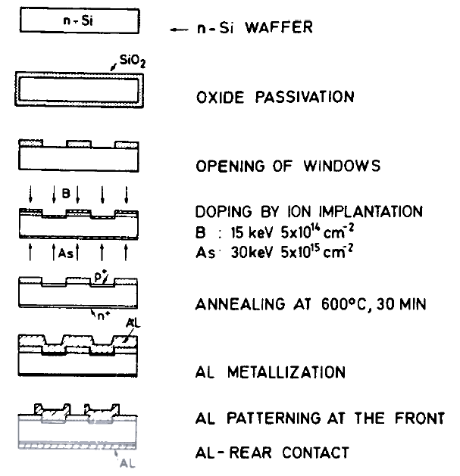
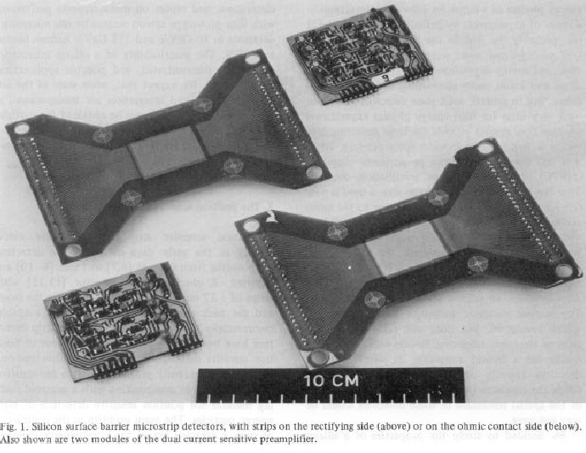
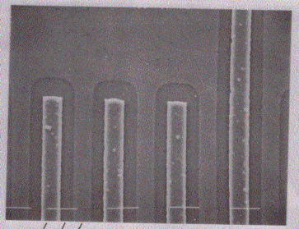
Silicon detectors
Solid state detectors: NA11/32 → ALEPH → ATLAS → Röntgen Astrophysics → BELLE II → …
After discovery of charm (1974), τ-lepton (1975) and beauty (1977) with lifetimes cτ ~100 μm: need fast (ns), and precise (μm) electronic tracking detectors
1980 J.Kemmer (TUM): highly developed Si-technology transferred to detector-grade (kΩ⋅cm) material
“Miniaturized” low-noise amplifiers in thick field hybrid technology available (at MPI electronics workshop!) and hep groups started with VLSI design
1980: NA11 collaboration (NB first Ringberg meeting!)
→ develop Si detectors (micro-strips (MPI) and CCDs)
20 μm

Slide 20
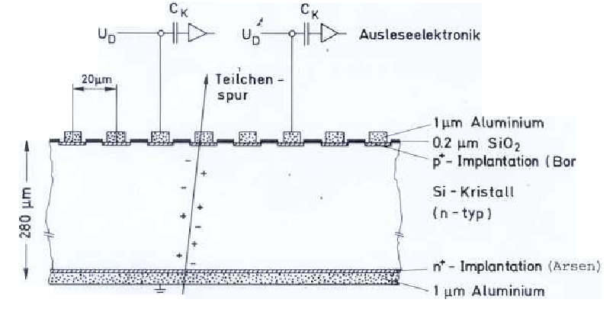
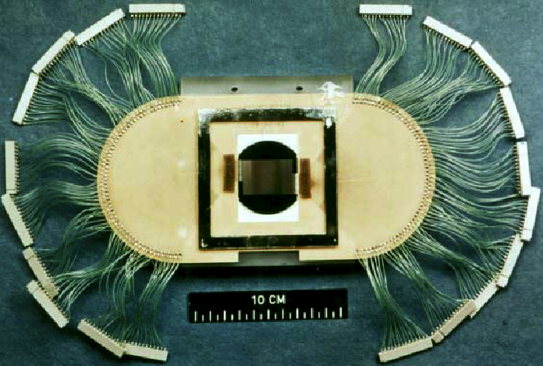
Silicon detectors
1981: first detectors in beam:
24 x 36 mm, 1200 strips
20 μm strip pitch
60 μm readout pitch
- Area Si telescope: 0.01 m²
→ 5.4 μm accuracy
→ 100 % efficiency
- Built at the MPI-workshop a high resolution vertex detector (6 beam + 6 vertex detectors) with a total of 2000 channels running in early 1982
A major break-through in electronic detectors

Slide 21
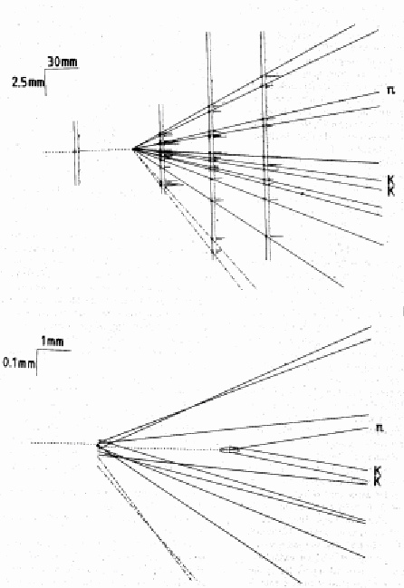
Silicon detectors
NA11/32 results on charm:
- Precision mass measurements: D⁰, D±, D*(2010)±, D±_{S}, Λ_{c}, Ξ_{c}⁺, Ξ_{c}⁰ (in several cases best mass values and first identified decays)
Lifetimes D⁰, D±, D*(2010)⁺, D±_{S}, Λ_{c}, Ξ_{c}⁺, Ξ_{c}⁰, and branching fractions,
Hadronic production of charmed particles at (relatively) low energies (QCD)
MPI+TU have been the starting point of the success story of silicon detectors now used in all collider experiments
and
MPI (HLL) continues to play a leading role
and
major impact on novel applications of silicon detectors in many fields
production + decay
D_{S}→ π⁺ Φ(→ K⁺K⁻)
π⁺
K⁺
K⁻

Slide 22
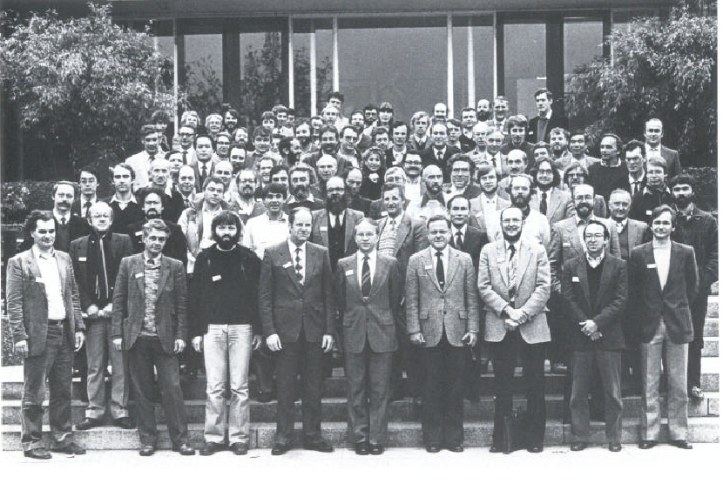
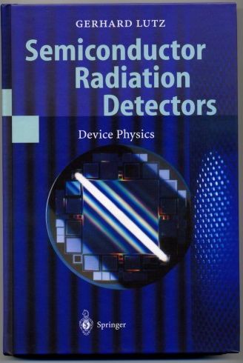
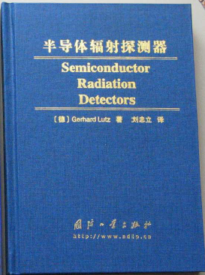
Silicon detectors
MPI became the leading semiconductor detector laboratory in the 80-ies
1983: 3rd European Symposium on Semiconductor Detectors at Munich

Slide 23
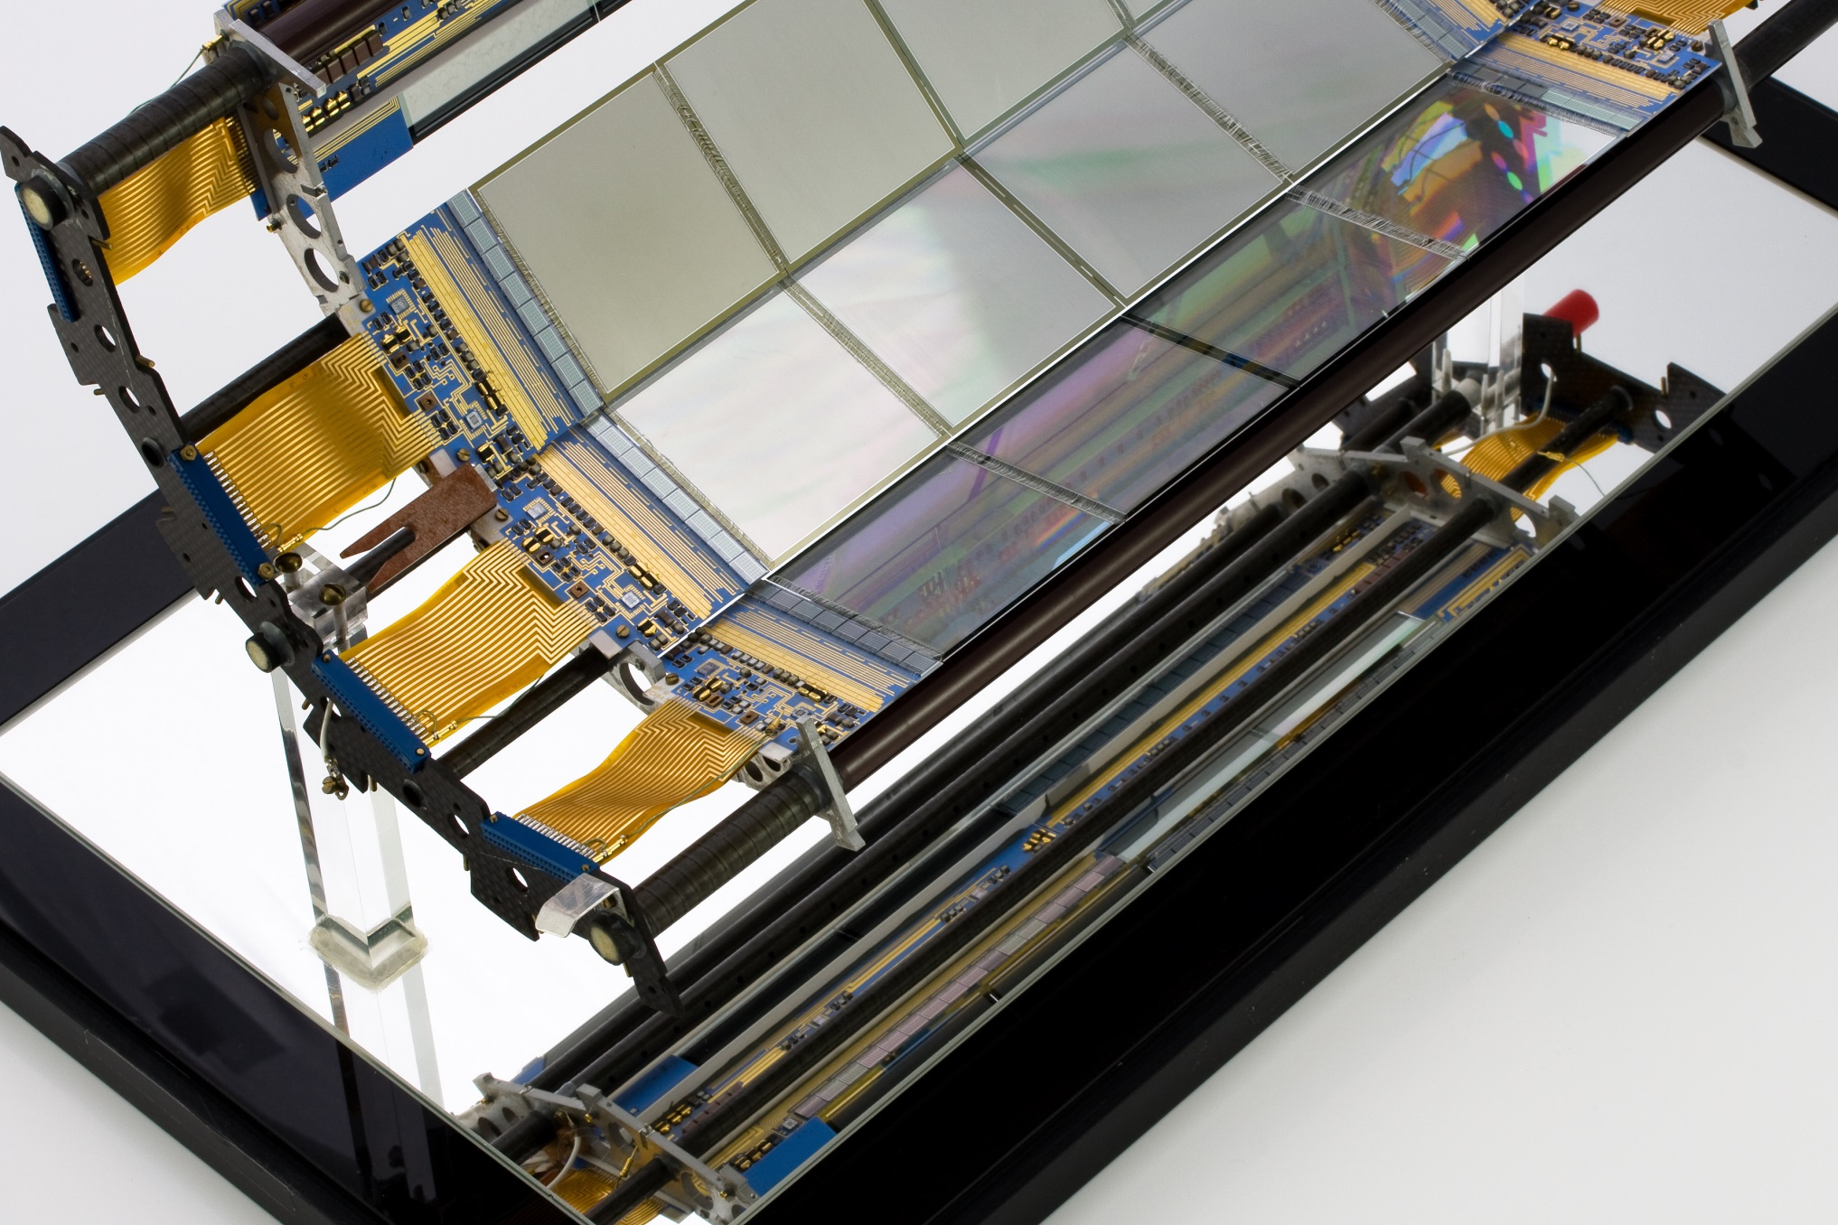
Silicon detectors
Solid state detectors: NA11/32 → ALEPH → ATLAS an impressive development
Aleph silicon detector (version 0 → exhibited here at MPI !)
version 0: operating in ALEPH 1990-1991
73 728 channels; δ = 12 μm x 12 μm,
first “double-sided” vertex detector at collider,
lifetime B_{s} and τ; -mixing + much more

Slide 24
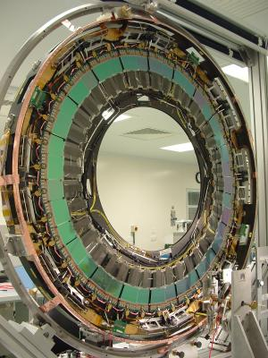
Silicon detectors
Silicon detectors: NA11/32 → ALEPH → ATLAS an impressive development
ATLAS silicon tracker
15 552 sensors – 61 m²
~80 μm pitch, 5 μm alignment accuracy
rad. tolerant for > 10 y LHC operation

Slide 25
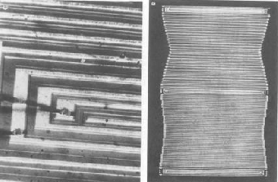
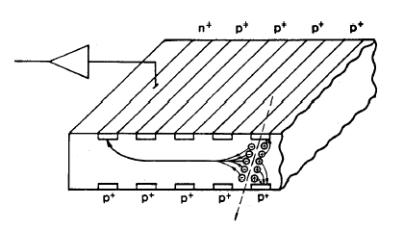
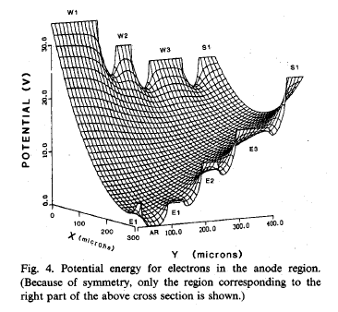
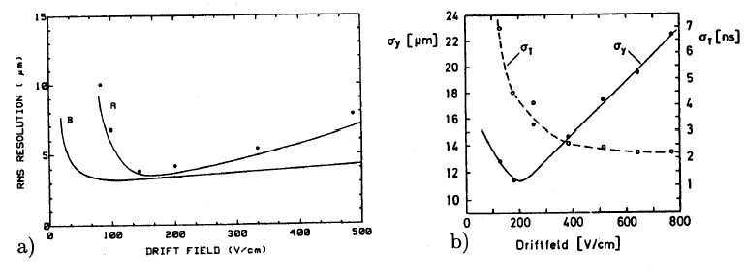
Silicon detectors
Silicon detectors: Si-drift chambers and further developments
Principle of Si-drift chamber (Gatti+Rehak) → shaping the E-field inside of detector
n⁺
n⁺ anode
p⁺ field
shaping
electrodes
3 μm resolution
3 μm -
Position resolution using laser spot
using beam particles
MPI attracted leading Si detector experts

Slide 26
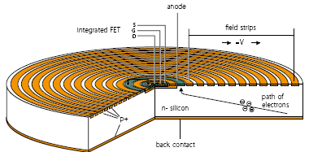
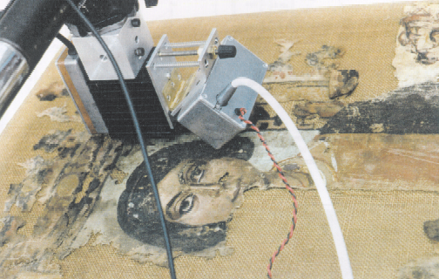
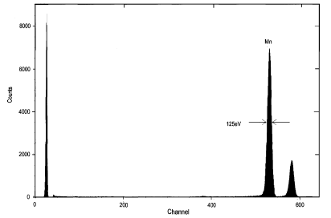
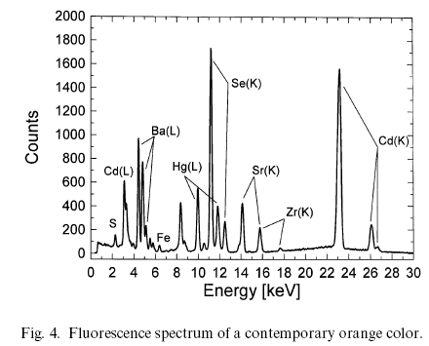
Silicon detectors
Solid state detectors: Cylindrical drift chamber for high resolution X-ray spectroscopy
Applications in industry, research, art, ….
→ portable XRay-fluorescence system
X-rays
- Low capacitance (~ independent of area) + on-detector FET → energy resolution: 121eV@6keV (-10°C)
- Back irradiation → ultra-thin “window” → low E_{γ} !
⁵⁵Fe X-ray source

Slide 27
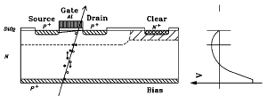
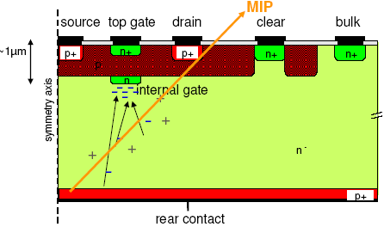
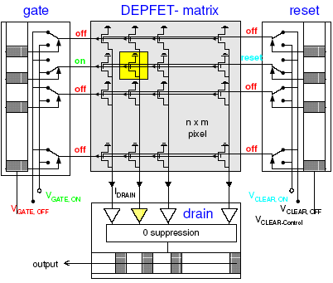
Silicon detectors
Solid state detectors: DEPFET pixel detector
Matrix readout (e.g. ILC 13x100mm² 25μm² pixels-5W):
- connect gates/clears horizontally to select/clear signal rows
- connect drains(+sources) vertically and amplify I or V → no shift of charge !!!
- sequence: enable row → read (I_{sig}+I_{ped}) → clear → subtract (I_{ped}) → next row
- read 10x2048 rows in 50 ns (20 MHz)
50-500μm
- Sideward depletion (Si-drift chamber)
- Potential minimum for e⁻ ~1μm underneath transistor channel by “deep” n-implant
- Transistor channel steered by external gate and by internal gate
- Very low C (~fF) → low noise (<1e for circular structure, 10 e for linear structure)
- Achieved amplifications ~400pA/e (int. gate)
“Outstanding” performance → R&D and sensor production for:
  - vertex detectors → BELLE II in Japan
  - X-ray astronomy
  - Photon-research
  - Bio-medical applications, …

Slide 28
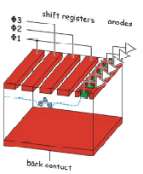


Silicon detectors
Solid state detectors: fully depleted npCCDs for X-ray science (astrophysics → SR-research)
Principle of operation (pnCCD)
XMM-Newton observatory
→ deep X-ray sky
(CCD = Charged Coupled Device)
particle or X-ray
Charge from entire detector depth stored below electrodes → Sensitive to high E X-rays
Thin back contact + low noise → Sensitive to low E X-rays Clocking of shift-registers → transfer charge to anodes of low capacitance = low noise (at close to ambient temperature)
→ Superior performance
deep X-ray sky: 10⁶ sec observation → - distant galaxies with massive black holes
“colours” → info on black holes + surround.
most “blue objects” XMM-N. discoveries

Slide 29
Silicon detectors
Fully depleted CCDs for X-ray science: view of chemical composition of Tycho supernova remnant

Slide 30




Low-light photo detectors
Since > 50 years: One of the leading labs for improving and developing novel photo-detectors for low-light application in collaboration with industry and research labs
Detector types:
Major improvements:
  Photo-detection efficiency
  Wavelength range
  Noise by cross-talk
Major progress in understanding → Enabling novel applications
“Classical” vacuum photomultipliers
APD arrays
(avalanche photodiodes)
1440 pixel SiPM camera “FACT”
SiPMs
(silicon photmultipliers)

Slide 31

High energy γ -astronomy
Low-light photodetectors used in Cherenkov telescopes for GeV/TeV γ astronomy: HEGRA → MAGIC → CTA → pioneering role of MPI in this field of research, but also with major impact on medical applications, calorimetry, sensing, …
Calibration and alignment
of MAGIC C-telescope at Las Palmas
17 m telescope Ø
γ-energy threshold ~25 GeV

Slide 32





GERDA: Neutrino-less double β decay
Can one measure a decay with $T_{1/2}=O({10}^{26}yr)$ without background ?
  Is the neutrino its own anti-particle? (since > 50 years a most fundamental question!)
  Isotopes with forbidden β decay: e.g. ⁷⁶Ge
  ⁷⁶Ge enriched crystals + pulse-shape analysis
  Ultra-clean materials + shielding + vetos
enriched ⁷⁶Ge detector
$μ$-veto
Ge
LAr
H₂O
Yes, they can! (die schaffen das!)

Slide 33
Summary I
100 years MPI-Physik ≡ (also)
Excellence in detectors and their use in innovative experiments
Apologies to all the excellent work, which I did not mention – thank you for providing me with information

Slide 34


Summary II
Many thanks to the visionary founding fathers of the Kaiser-Wilhelm-Institute for Physics 100 years ago
Karikatur auf die Gründung der Kaiser-Wilhelm-Gesellschaft.
Untertitel: “Beim Friedensfürsten.
Die drei Könige aus dem Morgenland bringen ihre Weihnachtsgeschenke”
(aus A. Hermann, Die Geschichte der Deutschen Physikalischen Gesellschaft 1899–1945)

