Slide 1
The Strong CP Problem and Axions
R. D. Peccei
UCLA
MPI 100th Anniversary Munich, October 2017

Slide 2
The Strong CP Problem and Axions
The U(1)_{A} Problem of QCD
The ‘t Hooft Solution
The Strong CP Problem and its Resolution
Axions and their Role in Cosmology
Looking for Invisible Axions Experimentally
Concluding Remarks

Slide 3
The U(1)_{A} Problem of QCD
In the 1970’s the strong interactions had a puzzling problem, which became particularly clear with the development of QCD.
The QCD Lagrangian for N flavors
L_{QCD} = -1/4F_{a}^{μν} F_{aμν}- Σ_{f}‾q_{f} (-iγ^{μ}D_{μ} + m_{f}) q_{f}
in the limit m_{f} → 0 has a large global symmetry: U (N)_{V}x U (N)_{A}
q_{f} → [e ^{iαaTa/2}]_{ff’} q_{f’} ; q_{f} → [e ^{iαaTaγ5/2}]_{ff’} q_{f’}
Vector Axial

Slide 4
Since m_{u}, m_{d} << Λ_{QCD}, for these quarks the m_{f} → 0 limit is sensible. Thus one expect strong interactions to be approximately U (2)_{V}x U (2)_{A} invariant.
Indeed, one knows experimentally that
U(2)_{V} = SU(2)_{V} x U(1)_{V} ≡ Isospin x Baryon #
is a good approximate symmetry of nature
⇒ (p, n) and (π±, π°) multiplets in spectrum
For axial symmetries, however, things are different. Dynamically, quark condensates
form and break U(2)_{A} down spontaneously and, as a result, there are no mixed parity multiplets

Slide 5
However, because U(2)_{A} is a spontaneously broken symmetry, one expects now the appearance in the spectrum of approximate Nambu-Goldstone bosons, with m ≈ 0 [ m→ 0 as m_{u}, m_{d} → 0 ]
For U(2)_{A} one expects 4 such bosons (π, η). Although pions are light, m_{π} ≈ 0, there is no sign of another light state in the hadronic spectrum, since m²_{η}>> m²_{π} .
Weinberg dubbed this the U(1)_{A} problem and suggested that, somehow, there was no U(1)_{A} symmetry in the strong interactions

Slide 6
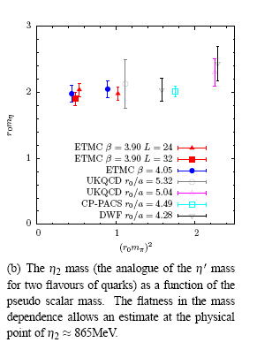
That there is no U(1)_{A} symmetry emerges explicitly in lattice QCD calculations, which show that indeed, as m_{π} → 0,
m_{η} → constant

Slide 7
It is useful to describe the U(1)_{A} problem in the language of Chiral Perturbation Theory, which describes the QCD dynamics for the (π, η)- sector
Beyond the breaking term induced by the quark mass terms, the effective Chiral Lagrangian for this theory needs to be augmented by an additional term which breaks explicitly U(1)_{A},
Defining Σ = exp i/F_{π} [τ_{a}π_{a} +η] and including a symmetry breaking pion mass m²_{π} ~ (m_{u}+ m_{d}) one has:
L_{eff} = ¼F²_{π} Tr ∂_{μ}Σ ∂^{μ}Σ† + ¼F²_{π} m²_{π} Tr (Σ + Σ† ) - ½M²_{o} η²
Provided M²_{o} >> m²_{π} this allows m²_{η}>> m²_{π} , but what is the origin of this last term?

Slide 8
The ‘t Hooft Solution
The resolution of the U(1)_{A} problem is due to ‘t Hooft who realized the crucial dynamical role played by the gluon pseudoscalar density
Q =
Even though in the massless quark limit U(1)_{A} is an apparent symmetry of the QCD Lagrangian , the current J^{μ}₅ associated with the U(1)_{A} symmetry is anomalous [Adler Bell Jackiw]
= N Q
where N is the number of massless quarks

Slide 9
Since Q enters in the anomaly equation, if it is dynamically important the U(1)_{A} problem should be resolved, because then there is really no conserved U(1)_{A} current
This can be checked by explicitly including Q in the Chiral Lagrangian describing the low energy behavior of QCD [Di Vecchia Veneziano]
Taking into account the anomaly in the U_{A}(1) current and keeping terms up to O(Q²) one has:
L_{eff} = ¼F²_{π} Tr ∂_{μ}Σ ∂^{μ}Σ† + ¼F²_{π} m²_{π} Tr (Σ + Σ† )
+ ½ i Q Tr [ln Σ-ln Σ† ] + [1/ F²_{π} M²_{o}] Q² +…
In this Lagrangian, Q is essentially a background field and can
be eliminated through its equation of motion:
Q = -i/4 [F²_{π} M²_{o}] Tr [ln Σ-ln Σ† ] = ½ [F_{π} M²_{o}] η +...

Slide 10
Using this result for Q, the last two terms in L_{eff} reduce to:
½ i Q Tr [ln Σ-ln Σ† ] + [1/ F²_{π} M²_{o}] Q² →-½M²_{o} η²
providing an effective gluonic mass term for the η meson,
and thus resolving the U_{A}(1) problem
Although one can see directly from the Chiral Lagrangian how the dynamical role of Q removes an apparent Nambu Goldstone boson (the η) from the spectrum, this follows also directly from QCD
It can be traced to the non trivial properties of the QCD vacuum which involve a new dimensionless parameter – the vacuum angle θ [‘t Hooft]
I’ll sketch below the principal points

Slide 11
Because the integral of Q is a topological invariant:
ν = ∫ d⁴x Q = ∫ with ν = 0, ± 1, ±2,… ,
all transition amplitudes in QCD contain sums over distinct sectors characterized by the winding number ν.
The contributions of the ν≠0 sectors break the U(1)_{A} symmetry
Furthermore, one can show that gauge invariance introduces a parameter θ associated with the sum over the distinct ν sectors in the QCD transition amplitudes [e ^{i ν θ} is Bloch phase]
A = Σ_{ν} e ^{i ν θ} A_{ν}
The parameter θ can be connected with the structure of the QCD vacuum and its presence gives an additional contribution to the QCD Lagrangian

Slide 12
This can be seen as follows. In the case of QCD, by having to sum over the distinct ν sectors, the usual path-integral representation for the vacuum-vacuum transition amplitude is modified to read:
₊<vac|vac>₋ = Σ_{ν} e ^{i ν θ} ∫δA e ^{i} ^{S[A]} δ( ν - ∫ )
Denoting the QCD vacuum as | θ >, one can re-interpret the θ term in the sum over ν as an addition to the usual QCD action
That is:
where

Slide 13
The Strong CP Problem and its Resolution
The resolution of the U(1)_{A} problem, however, engenders another problem: the strong CP problem
As we have seen, effectively the QCD vacuum structure adds and extra term to L_{QCD}
This term conserves C but violates P and T, and thus it also
violates CP
This is problematic, as there is no evidence of CP violation in the strong interactions!

Slide 14
In fact, the θ term produces an electric dipole moment for the neutron of order:
d_{n} ≈ e m_{q}/M_{n}² θ ≈ 10⁻¹⁶ θ ecm
The strong experimental bound d_{n}< 2.9 x 10⁻²⁶ ecm requires the angle θ to be very small θ < 10⁻⁹ - 10⁻¹⁰ [ Baluni; Crewther Di Vecchia Veneziano Witten].
Why θ should be this small is the strong CP problem
Problem is actually worse if one considers the effect of chiral transformations on the θ-vacuum
Because of the chiral anomaly, these transformations change the θ-vacuum [Jackiw Rebbi ]:
e^{iαQ}5 | θ > = | θ + α >

Slide 15
If besides QCD one includes the weak interactions, in general the quark mass matrix is non-diagonal and complex
L_{Mass} = -‾q_{iR} M_{ij} q_{jL} + h. c.
To diagonalize M one must, among other things, perform a chiral transformation by an angle of Arg det M which, because of the Jackiw Rebbi result, changes θ into
θ_{total} = θ + Arg det M
Thus, in full generality, the strong CP problem can be stated as follows: why is the angle θ_{total} , coming from the strong and weak interactions, so small?

Slide 16
There are only three known classes of solutions to the strong CP problem:
Anthropically θ_{total} is small
CP is broken spontaneously and the induced θ_{total} is small
A chiral symmetry drives θ_{total} → 0
I will make no comments on i
Although ii. is interesting, the models which lead to θ_{total} ≈ 10 ⁻¹⁰ are rather complex and often are at odds with the CKM paradigm and/or cosmology
In my opinion, only iii. is a viable solution, although it necessitates introducing a new global, spontaneously broken, chiral symmetry

Slide 17
In principle, of course, this additional chiral symmetry could be intrinsic to QCD if the u-quark had no mass, m_{u} = 0 [Kaplan Manohar]. However, calculations on the lattice exclude the m_{u} = 0 solution
Leutwyler
MILC Collaboration
rules out m_{u}=0
at 10σ

Slide 18
Helen Quinn and I proposed the first prototype chiral solution [40 years ago!] suggesting that the SM had an additional U(1) chiral symmetry (now called U(1)_{PQ}) which drives θ_{total} → 0
Recently a number of variant chiral solutions have been proposed:
- Hook and independently Fukuda Harigaya Ibe Yanagida use a Z₂
symmetry which takes SM <-> SM’ and an anomalous U(1)
symmetry to drive θ_{total} → 0
- Ahn uses a flavored version of U(1)_{PQ} [A₄ x U(1)_{PQ} ] to accomplish
the same
- Kawasaki Yamada Yanagida use instead [SU(3)x U(1)_{PQ} ] as a flavor
group
These are all very natural solutions to the strong CP problem, since chirality effectively rotates the θ -vacua away:
e^{-i θQ}5 | θ > = | 0 >

Slide 19
Axions and their Role in Cosmology
I’ll focus here on the simplest chiral solution
Introducing a global U(1)_{PQ} symmetry, which is necessarily spontaneously broken, replaces:
θ ⇒ a(x) / f_{a}
Static CP Viol. Angle Dynamical CP conserving Axion field
and, effectively, eliminates CP violation in the strong sector
⇒
Here f_{a} is the scale of the breaking of the U(1)_{PQ} symmetry , while a(x) is the Nambu Goldstone axion field associated with the broken symmetry [ Weinberg Wilczek]

Slide 20
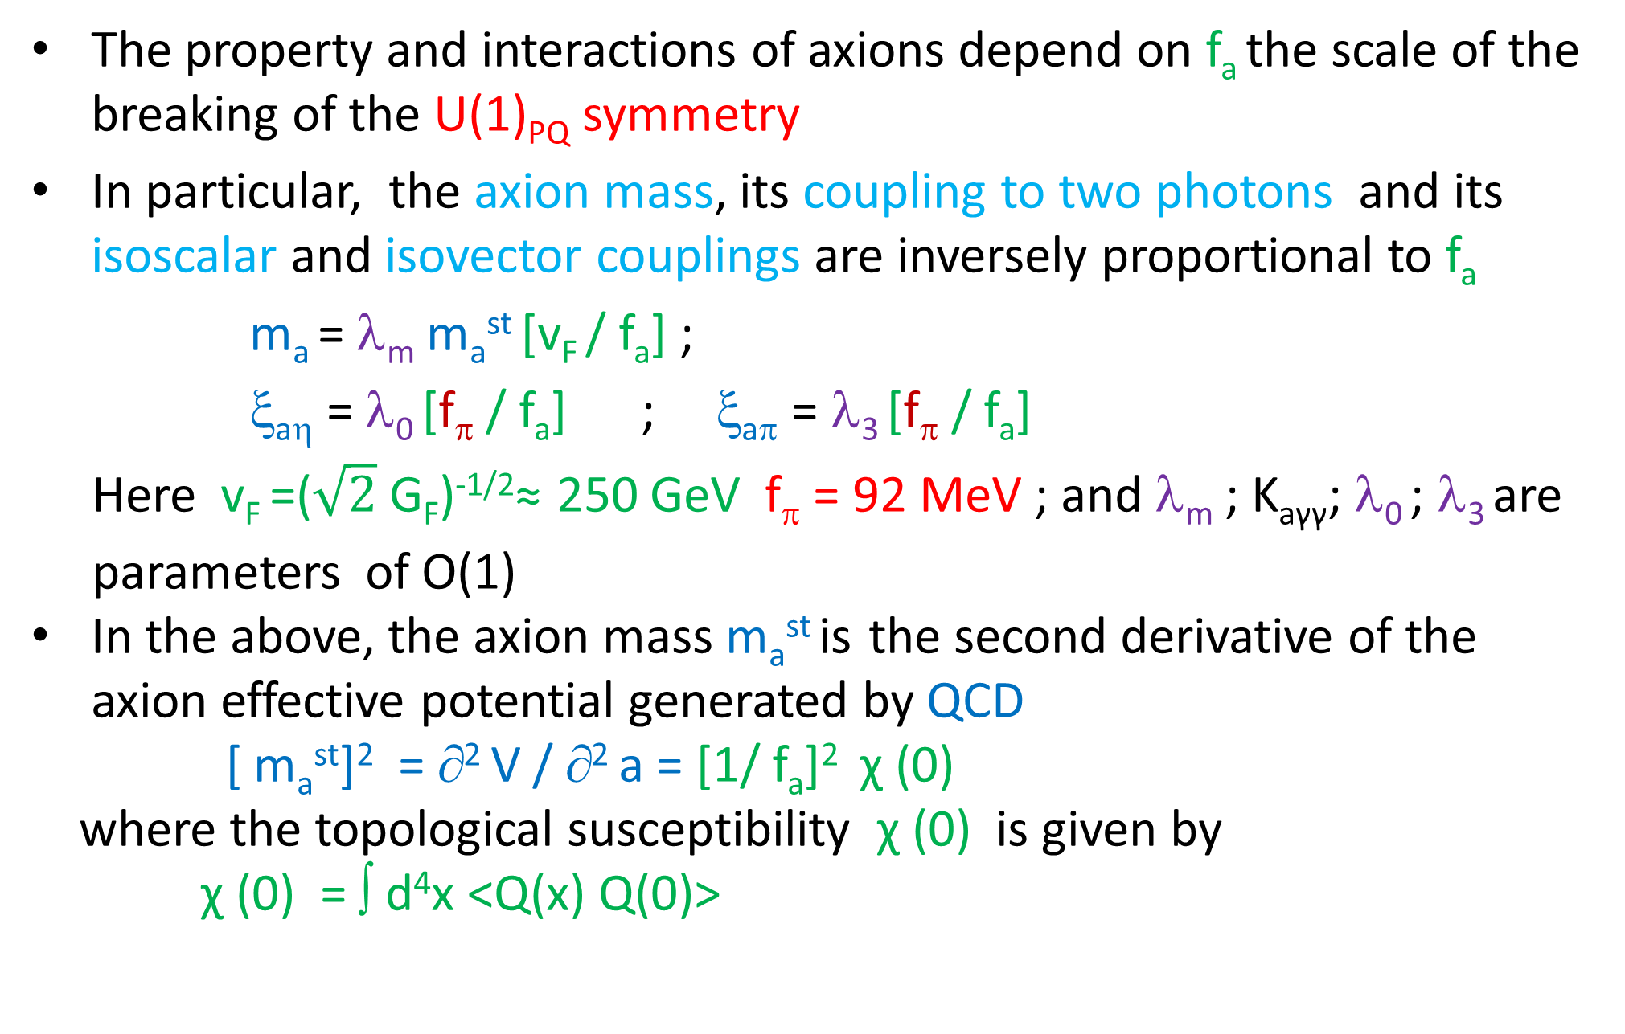
The property and interactions of axions depend on f_{a} the scale of the breaking of the U(1)_{PQ} symmetry
In particular, the axion mass, its coupling to two photons and its isoscalar and isovector couplings are inversely proportional to f_{a}
m_{a} = λ_{m} m_{a}^{st} [v_{F} / f_{a}] ;
ξ_{aη} = λ₀ [f_{π} / f_{a}] ; ξ_{aπ} = λ₃ [f_{π} / f_{a}]
Here v_{F} =($\sqrt{2}$ G_{F})^{-1/2}≈ 250 GeV f_{π} = 92 MeV ; and λ_{m} ; K_{aγγ}; λ₀ ; λ₃ are
parameters of O(1)
In the above, the axion mass m_{a}^{st} is the second derivative of the axion effective potential generated by QCD
[ m_{a}^{st}]² = ∂² V / ∂² a = [1/ f_{a}]² χ (0)
where the topological susceptibility χ (0) is given by
χ (0) = ∫ d⁴x <Q(x) Q(0)>

Slide 21
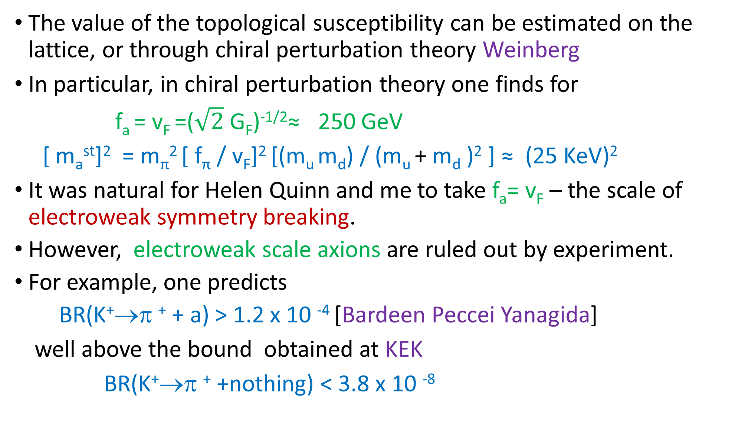
The value of the topological susceptibility can be estimated on the lattice, or through chiral perturbation theory Weinberg
In particular, in chiral perturbation theory one finds for
f_{a} = v_{F} =($\sqrt{2}$ G_{F})^{-1/2}≈ 250 GeV
[ m_{a}^{st}]² = m_{π}² [ f_{π} / v_{F}]² [(m_{u} m_{d}) / (m_{u} + m_{d} )² ] ≈ (25 KeV)²
It was natural for Helen Quinn and me to take f_{a}= v_{F} – the scale of electroweak symmetry breaking.
However, electroweak scale axions are ruled out by experiment.
For example, one predicts
BR(K⁺→π ⁺ + a) > 1.2 x 10 ⁻⁴ [Bardeen Peccei Yanagida]
well above the bound obtained at KEK
BR(K⁺→π ⁺ +nothing) < 3.8 x 10 ⁻⁸

Slide 22
The choice f_{a} = v_{F} is not necessary to solve the strong CP problem
If f_{a} >> v_{F} then the axion is very light, very weakly coupled and very long lived and such invisible axion models remain viable
These models introduce fields which carry PQ charge but are SU(2)XU(1) singlets . Two different generic models exist:
i) DFSZ Models [Dine Fischler Srednicki; Zhitnisky]
These models add to the PQ model a scalar field σ which carries PQ
charge and f_{a}= <σ> >> v_{F}
ii) KSVZ Models [Kim; Shifman Vainshtein Zakharov]
Only a superheavy quark Q and a scalar field σ carry PQ charge.
The dynamics is such that f_{a}= <σ> >> v_{F} and M_{Q} ≈ f_{a}

Slide 23
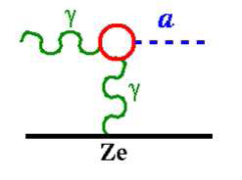
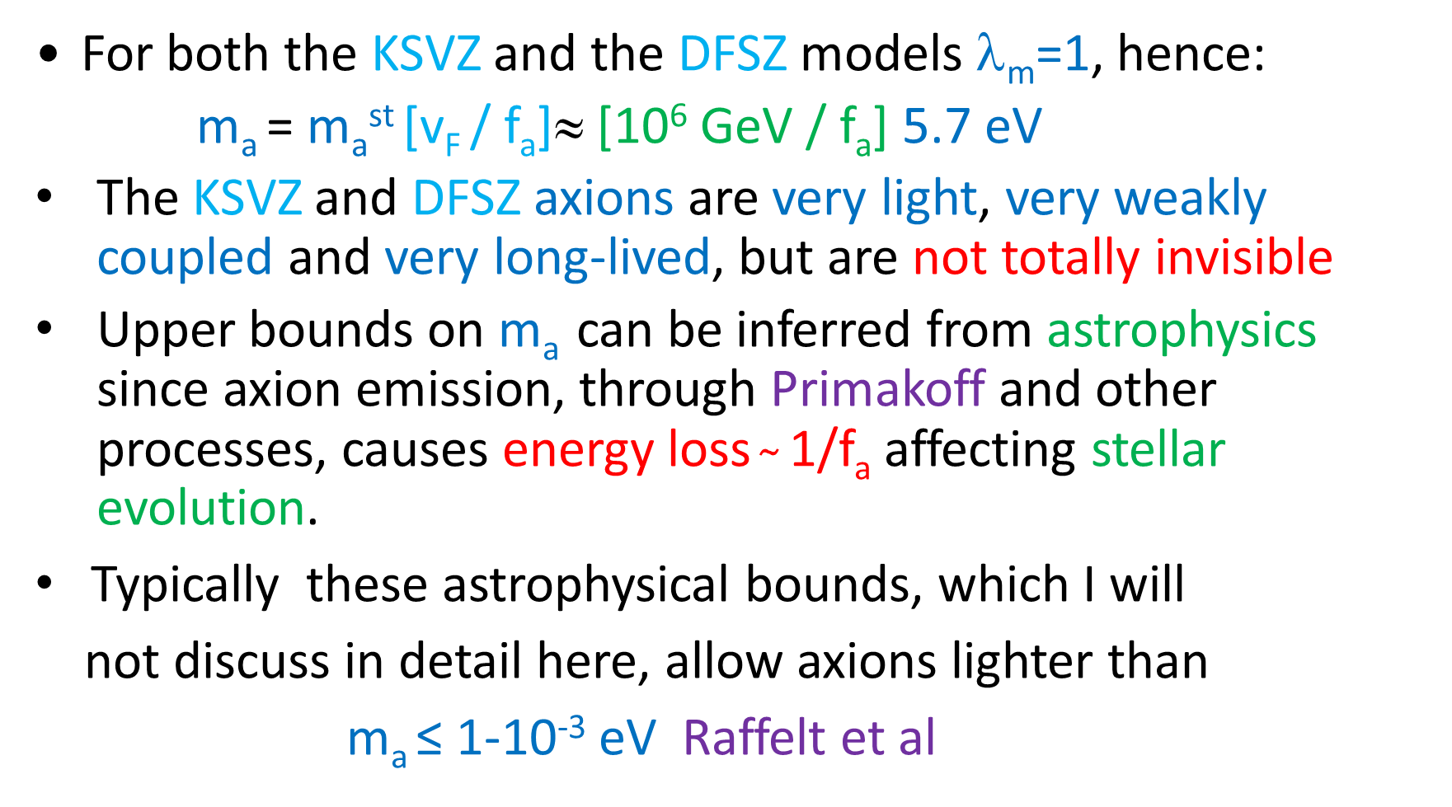
For both the KSVZ and the DFSZ models λ_{m}=1, hence:
m_{a} = m_{a}^{st} [v_{F} / f_{a}]≈ [10⁶ GeV / f_{a}] 5.7 eV
The KSVZ and DFSZ axions are very light, very weakly coupled and very long-lived, but are not totally invisible
Upper bounds on m_{a} can be inferred from astrophysics since axion emission, through Primakoff and other processes, causes energy loss $̴$ 1/f_{a} affecting stellar evolution.
Typically these astrophysical bounds, which I will
not discuss in detail here, allow axions lighter than
m_{a} ≤ 1-10⁻³ eV Raffelt et al

Slide 24
Rather remarkably, cosmology gives a lower bound for the axion mass (upper bound on f_{a} ) [Preskill Wise Wilczek; Abbott Sikivie; Dine Fischler] and axions can have a significant cosmological role
Physics is simple to understand. When Universe goes through the U(1)_{PQ} phase transition at T ̴ f_{a} >>Λ_{QCD} the QCD anomaly is ineffective and θ is arbitrary. Eventually, when Universe cools to T ̴Λ_{QCD} the axion gets a mass and θ → 0.
The coherent p_{a}=0 axion oscillations towards this minimum contribute to the Universe’s energy density and act as cold dark matter
The detailed results depend on whether the PQ phase transition occurs before or after inflation and I’ll sketch the main issues in both cases

Slide 25
The equation of motion for the axion field:
∂² a /∂² t + 3H(t) ∂ a/ ∂ t = - ∂ V( a )/ ∂ a
gives the evolution of the axion field in the Universe, where H(t) is the
expansion rate of the Universe with H(t) ~ 1/t ~ T² /M_{P}
In a suitable approximation, the axion potential can be taken as
V(a) = χ(T) [ 1 – cos (a / f_{a} ) ]
where the susceptibility χ(T) can be calculated in QCD [Figure]and gives a
temperature dependent axion mass m_{a} (T) = [χ(T)] ^{1/2} / f_{a} which drops rapidly
with temperature
At temperatures of O (T≈ f_{a} ) the axion field takes an initial value a = f_{a} θ_{i} and remains at that value until m_{a} (T) ≈ H(T), which occurs at temperatures of order a GeV, when it starts oscillating about the minimum of the potential
The energy density of these oscillations could account for the Universe’s energy density in cold dark matter

Slide 26
Borsanyi et al
Slope of χ (T) same
as that of DIGA, but
normalization differs

Slide 27
The first case to consider is having the PQ phase transition happens before (or during) inflation
During inflation the axion field is homogenized over enormous distances. Thus only the evolution of the p_{a}=0 mode is relevant
A recent calculation of the axion contribution to Universe’s energy density [Ballesteros et al] then gives
Ω_{a}h² = 0.176±0.029 [f_{a}/10¹² GeV]^{1.17} [θ_{i}²]
where θ_{i} is the initial misalignment angle
This quantity is bounded by the density of Cold Dark Matter in the Universe:
Ω_{CDM}h² = 0.120 ± 0.003 WMAP Planck
If one assumes that axions are the dark matter in the Universe, this then gives a relation between θ_{i} and f_{a} :
θ _{i}= 0.83 ± 0.06[10¹² GeV/ f_{a}]^{0.585}

Slide 28
The table below gives some typical values for θ_{i} and f_{a} θ_{i}
The axion mass follows from the relation
m_{a} = 5.7 [10⁶ GeV / f _{a}] eV
and for pre-inflationary axions is not fixed since the initial misalignment
angle θ_{i} is not
These results for f_{a} θ_{i} give an interesting bound, suggested long ago by Lyth, which originates because inflation induces measurable quantum fluctuations in the axion field
Let me discuss briefly this bound
f_{a} (GeV) | 10¹² | 10¹⁵ | 10¹⁸
θ_{i} | 0.83 | 1.8 x 10⁻² | 3.1 x 10⁻⁴
f_{a}θ_{i} (GeV) | 8.3 x 10¹¹ | 1.8 x 10¹³ | 3.1 x 10¹⁴

Slide 29
Axions engender, so called, isocurvature axion perturbations which correspond to fluctuations in the initial misalignment angle θ_{i}
These fluctuations have a power spectrum given by:
Δ²_{a}(k) = [2 |δθ_{i}| / θ_{i} ]² = [H_{I} /π θ_{i} f_{a} ]²
where H_{I} is the Universe’s expansion rate during inflation
Both WMAP and Planck have put bounds on the ratio:
β_{iso} = Δ²_{a}(k) /(Δ²_{R}(k) + Δ²_{a}(k) )
where Δ²_{R}(k) measures the curvature perturbation spectrum.
At k= 0.002 Mpc⁻¹ these collaborations find:
β_{iso}< 0.036 (95% CL) Planck β_{iso}< 0.047 (95% CL) WMAP
This bound on β_{iso} implies a bound on the isocurvature axion
perturbations at k= 0.002 Mpc⁻¹

Slide 30
Using the best fit result of Planck for Δ²_{R}(k) :
Δ²_{R}(k) =2.2 x 10 ⁻⁹ (k/ 0.05 Mpc ⁻¹) ^{-0.04}
the bound on β_{iso} implies
Δ²_{a}(k ) < 9.25 x 10 ⁻¹¹
Hence the fluctuation in the initial misalignment angle is very small:
|δθ_{i} |/ θ_{i} < 4.8 x 10 ⁻⁶
and there is a strong bound on the expansion rate during inflation:
H_{I} < 3 x 10 ⁻⁵ θ_{i} f_{a}
For a sensible range of PQ scales [10 ¹² GeV < f_{a} < 10 ¹⁸ GeV] this Lyth bound on H_{I} ranges from 2.4 x 10 ⁷ GeV to 9.3 x 10 ⁹ GeV . Taking this bound at face value, makes only low energy scale inflation models tenable. Conversely, if one could establish H_{I} is large, then pre-inflationary axions are ruled out

Slide 31
Let us now consider the other possibility, when the PQ phase transition happens after inflation
Because the PQ phase transition occurred after inflation, no isocurvature fluctuations ensue in this case
However, as emphasized originally by Sikivie, in this case other dynamical issues arise due to the formation of axionic strings and domain walls, which are not erased by inflation
At T ≈ f_{a} U(1)_{PQ} gets spontaneously broken, and one-dimensional defects: axionic strings, around which θ= a/f_{a} winds by 2π, are formed
These axionic strings have an energy per unit length μ ≈ f_{a}² ln L f_{a}, where L is the inter-string separation. These strings decay very efficiently into axions up to temperatures T ≈ Λ_{QCD}

Slide 32
When T ≈ Λ_{QCD} U(1)_{PQ} is explicitly broken by the gluon anomaly. However, since under a PQ transformation θ→ θ + 2αN_{fl} (where N_{fl} is the number of quarks carrying U(1)_{PQ} ) a Z(N_{fl}) discrete symmetry is preserved
Because of this Z(N_{fl}) symmetry there are N_{fl} degenerate vacuum states for the axion field. As a result, neighboring regions in the Universe which are in different axion vacua are separated by domain walls.
At T ≈ Λ_{QCD} , since θ winds by 2π as one goes around an axionic string, the axion field passes through each minimum. As a result each axionic string becomes the edge to N_{fl} domain walls, and the process of axion radiation stops

Slide 33
If N_{fl.} > 1 (like in the DFSZ model) this string-wall network is stable and has a sizable surface energy density
σ ≈ m_{a} f_{a} ² ≈ 6.3 x 10⁹ GeV³ [f_{a} /10¹² GeV]
This is a real problem, since the energy density in these walls dissipates slowly as the Universe expands [Zeldovich Kobzarev Okun]
ρ_{wall} = σ T
and ρ_{wall} now would vastly exceed the closure density of the Universe
This disaster is avoided if N_{fl} =1. Even though there is a unique vacuum, domain walls still form and attach to an axionic string –one wall per string.
However, as Everett and Vilenkin showed, these walls very rapidly get chopped up into pieces, each enclosed by strings. These structures are unstable and disappear by radiating axions

Slide 34
It follows that, if the PQ symmetry breaks after inflation, the Universe contains many patches which have different initial angles θ_{i}.
In this case the coherent p_{a}=0 axion oscillations towards the minimum will give a contribution to the Universe’s energy density corresponding to an average initial angle θ_{i}²= <θ²>= π²/3
Whence one expects
Ω_{a}h²=0.176 ± 0.029 [f_{a}/10¹² GeV]^{1.17}<θ²> = 0.579 ± 0.095 [f_{a}/10¹² GeV]^{1.17}
Equating this to the Universe’s cold dark matter density Ω_{CDM}h² = 0.12 gives
f_{a} = [1.77 ± 0.25] x 10 ¹¹ GeV
which gives an axion mass in the range
28 μeV < m_{a} < 36 μeV
However, axions radiated by the axionic strings also contribute to Ω_{a}h²

Slide 35
There has been an ongoing controversy on how much the axions radiated by these N_{fl} =1 walls, as well as by axionic strings, contribute to the Universe’s energy density
Gondolo and Visinelli gives the following range for the ratio α of the contributions to the energy density of string/wall decay compared to that for p_{a}=0 oscillations :
0.16 [Sikivie et al] < α = Ω_{str/wall} /Ω _{p=0} < 186 [Battye Shellard]
Using the recent estimate of Hiramatsu et al α = 19 ± 10 gives
m_{a} = (32 ± 4)x 10⁻⁶ eV) (1 + α )^{.884} = (32 ± 4) x 10⁻⁶ eV (20 ± 10 )^{.884}
pushing m_{a} quite close to the astrophysical upper bound!
A recent estimate of Ballesteros et al gives a narrower range
50 μeV < m_{a} < 200 μeV

Slide 36
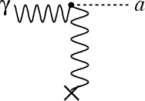
Looking for Invisible Axions
There are many searches underway for invisible axions and I’ll conclude by briefly discussing some of these experiments
A number of experiments use Sikivie’s idea of converting axions into photons by using a B-field in a resonant cavity
The key coupling g_{aγγ} is inversely proportional to f_{a}
= g_{aγγ} a E . B
The longest running experiment is ADMX which started at LLNL over a decade ago, but now has moved to the Univ. Washington
It probes the parameter space that would allow invisible axions to be the dark matter in the Universe

Slide 37
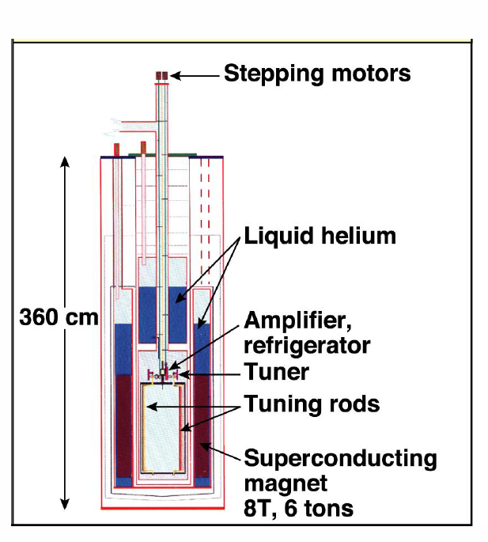
Schematically ADMX looks like the Figure below, a large volume cavity in a strong magnetic field
For m_{a} ≈ 10 μeV the photon frequency which ADMX must detect is in the GHz range
The ADMX experiment so far has
explored the axion mass range
1.9 μeV < m_{a} < 3.3 μeV
at an appropriate strength g_{aγγ} for axions
to be the dark matter in the Univers

Slide 38
A second generation experiment ADMX Gen2 is now running hoping to search for axions with mass up to m_{a} = 40 μeV

Slide 39
Another Haloscope has reported results recently, for larger axion masses 23.5 μeV < m_{a} < 24 μeV, but not quite at the strength needed to detect KSVZ axions
Brubaker et al

Slide 40
Currently a large effort is underway in Korea in the Center for Axion and Precision Physics Research (CAPP) to mount a series of experiments to detect dark matter axions
Figure shows area in g_{aγγ} - m_{a} plane expected to be accessible

Slide 41
Haloscopes based on cavity resonators have difficulty probing axion masses above m_{a} ≈ 40 μeV because the strength of the signal is proportional to the volume of the cavity V and
V ~ 1/ ν³ ~ 1/m_{a} ³
This limitation is bypassed by dielectric haloscopes, such as those proposed by the MADMAX experiment, consisting of a series of parallel dielectric disks with a mirror on one side, all within a B field parallel to the disks
Schematically A A. Caldwell et al

Slide 42
Theory of dielectric haloscopes fully developed in paper by Millar, Raffelt, Redondo, and Steffen
When an interface between different dielectric media is inside a B field an oscillating axion field acts as a source
of electromagnetic waves
The emission rate of these waves can be boosted by constructive interference, by judiciously placing multiple dielectric layers
As the Figure shows this technique can
potentially search the high frequency range of
10- 100 GHz, corresponding to axion masses in
the range
40 μeV < m_{a} < 400 μeV

Slide 43
It is possible that the PQ symmetry breaking occurred before inflation and the misalignment angle is θ_{i}<< 1.
In this case, dark matter axions are associated with larger scales of U(1)_{PQ} breaking [e.g. if θ_{i} = 1.8 x 10 ⁻² then f_{a} = 10¹⁵ GeV] and the axions are superlight [m_{a} = 5.7 x 10 ⁻⁹ eV for this example]
In many ways PQ breaking scales f_{a} ≈ (10¹⁵- 10¹⁸) GeV are very natural, since axions are ubiquitous in string theories [Svrcek Witten]
Remarkably, one might be able to detect such high PQ breaking scales and superlight dark matter axions [Graham and Rajendran ]

Slide 44
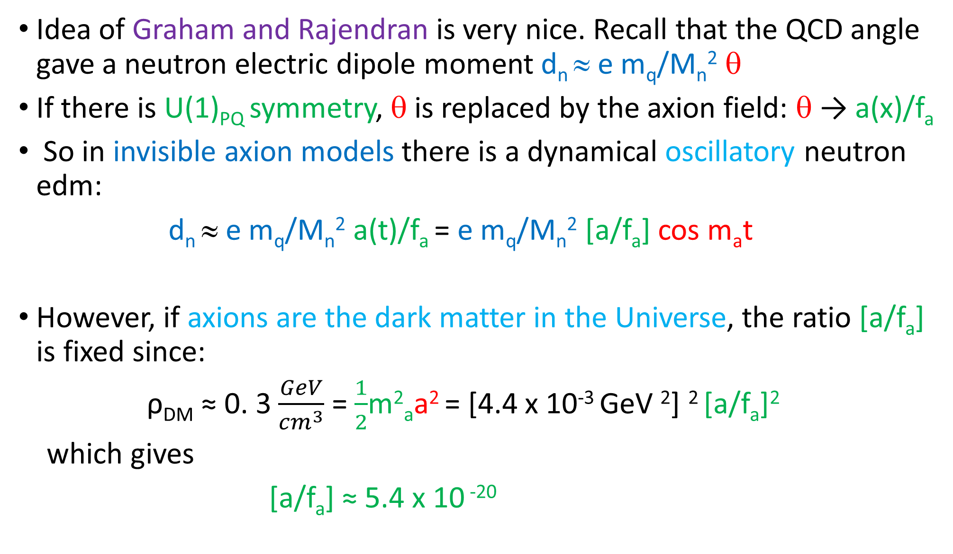
Idea of Graham and Rajendran is very nice. Recall that the QCD angle gave a neutron electric dipole moment d_{n} ≈ e m_{q}/M_{n}² θ
If there is U(1)_{PQ} symmetry, θ is replaced by the axion field: θ → a(x)/f_{a}
So in invisible axion models there is a dynamical oscillatory neutron edm:
d_{n} ≈ e m_{q}/M_{n}² a(t)/f_{a} = e m_{q}/M_{n}² [a/f_{a}] cos m_{a}t
However, if axions are the dark matter in the Universe, the ratio [a/f_{a}] is fixed since:
ρ_{DM} ≈ 0. 3 $\frac{GeV}{{cm}^{3}}$ = $\frac{1}{2}$m²_{a}a² = [4.4 x 10⁻³ GeV ²] ² [a/f_{a}]²
which gives
[a/f_{a}] ≈ 5.4 x 10 ⁻²⁰

Slide 45
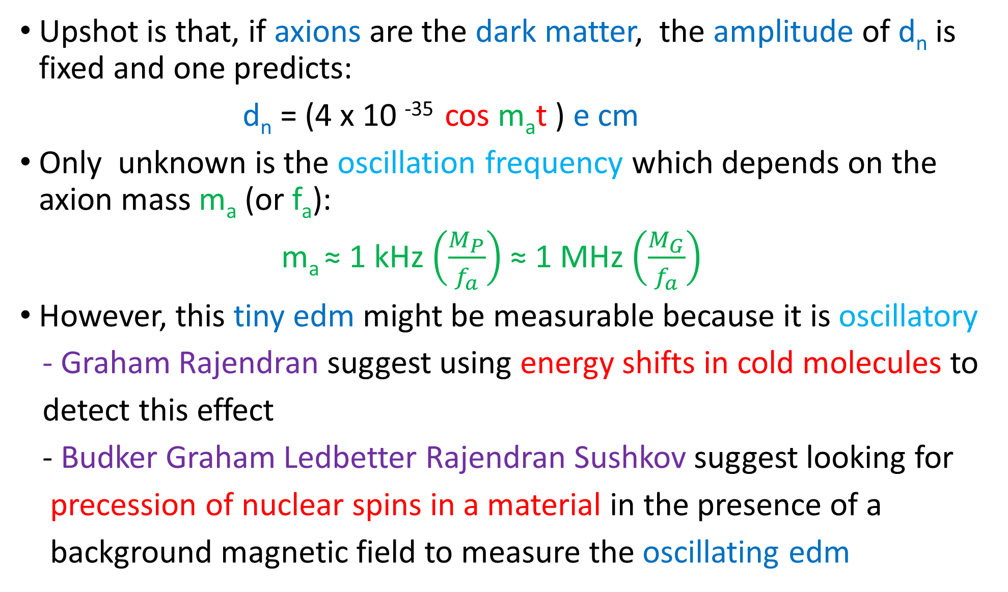
Upshot is that, if axions are the dark matter, the amplitude of d_{n} is fixed and one predicts:
d_{n} = (4 x 10 ⁻³⁵ cos m_{a}t ) e cm
Only unknown is the oscillation frequency which depends on the axion mass m_{a} (or f_{a}):
m_{a} ≈ 1 kHz $\left(\frac{M_{P}}{f_{a}}\right)$ ≈ 1 MHz $\left(\frac{M_{G}}{f_{a}}\right)$
However, this tiny edm might be measurable because it is oscillatory
- Graham Rajendran suggest using energy shifts in cold molecules to
detect this effect
- Budker Graham Ledbetter Rajendran Sushkov suggest looking for
precession of nuclear spins in a material in the presence of a
background magnetic field to measure the oscillating edm

Slide 46
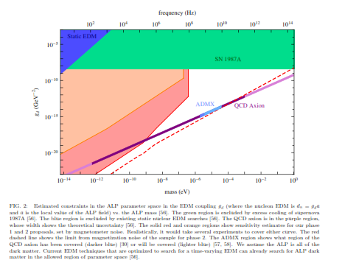
Figure shows the estimated reach of the proposed Budker et al experiment [CASPER]
m_{a} < 10⁻⁹ eV
^{f}_{a} > 6 x 10¹⁵ GeV

Slide 47
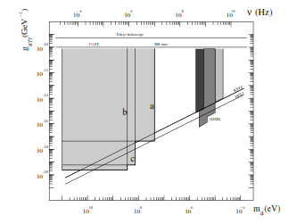
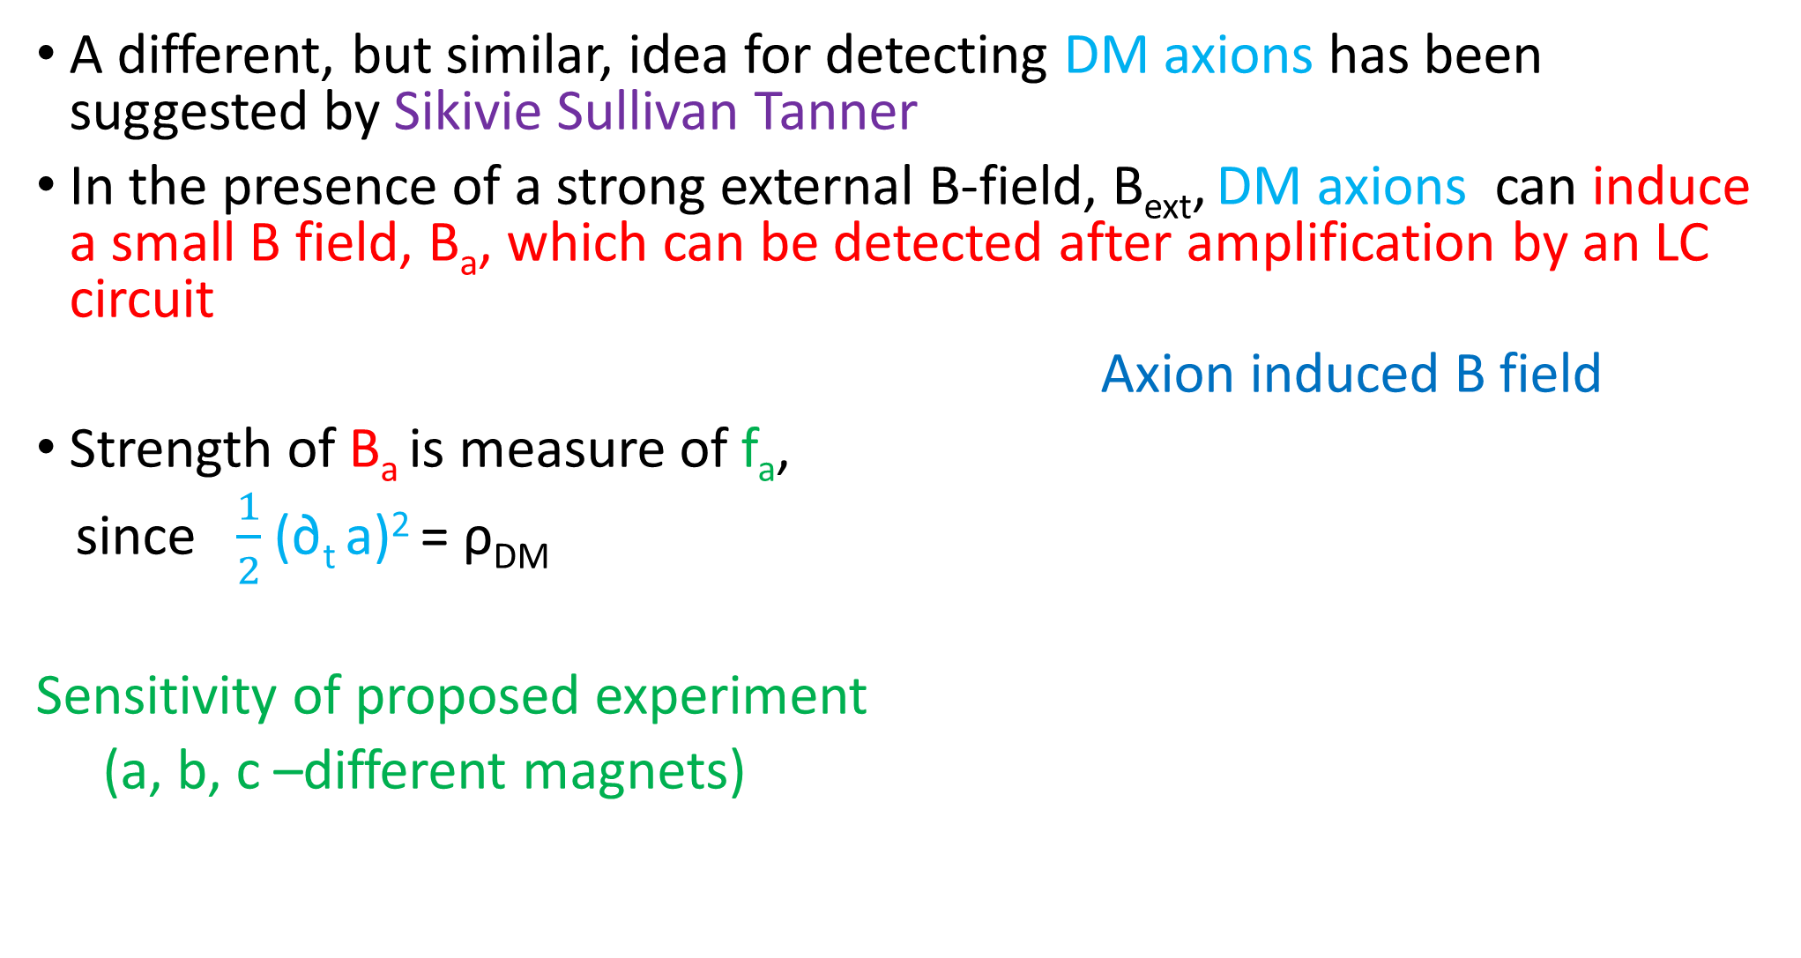
A different, but similar, idea for detecting DM axions has been suggested by Sikivie Sullivan Tanner
In the presence of a strong external B-field, B_{ext}, DM axions can induce a small B field, B_{a}, which can be detected after amplification by an LC circuit
Axion induced B field
Strength of B_{a} is measure of f_{a},
since $\frac{1}{2}$ (∂_{t} a)² = ρ_{DM}
Sensitivity of proposed experiment
(a, b, c –different magnets)

Slide 48
Concluding Remarks
The existence of an additional chiral symmetry- like U(1) _{PQ} -remains the most compelling solution to the strong CP problem
The concomitant axions play an interesting cosmological role and arise naturally in theories beyond the Standard Model
There are both ongoing and proposed experiments which in the next decade or so should tell us if axions exist

