Slide 1

Gamma-ray astronomy: discovery perspectiveS
Karl Mannheim
Institut für Theoretische Physik und Astrophysik
Julius-Maximilians-Universität Würzburg
Notes:
Gamma rays discovered 1900, 5 years after X-rays (in Würzburg), 1 year later Heisenberg was born in Würzburg

Slide 2
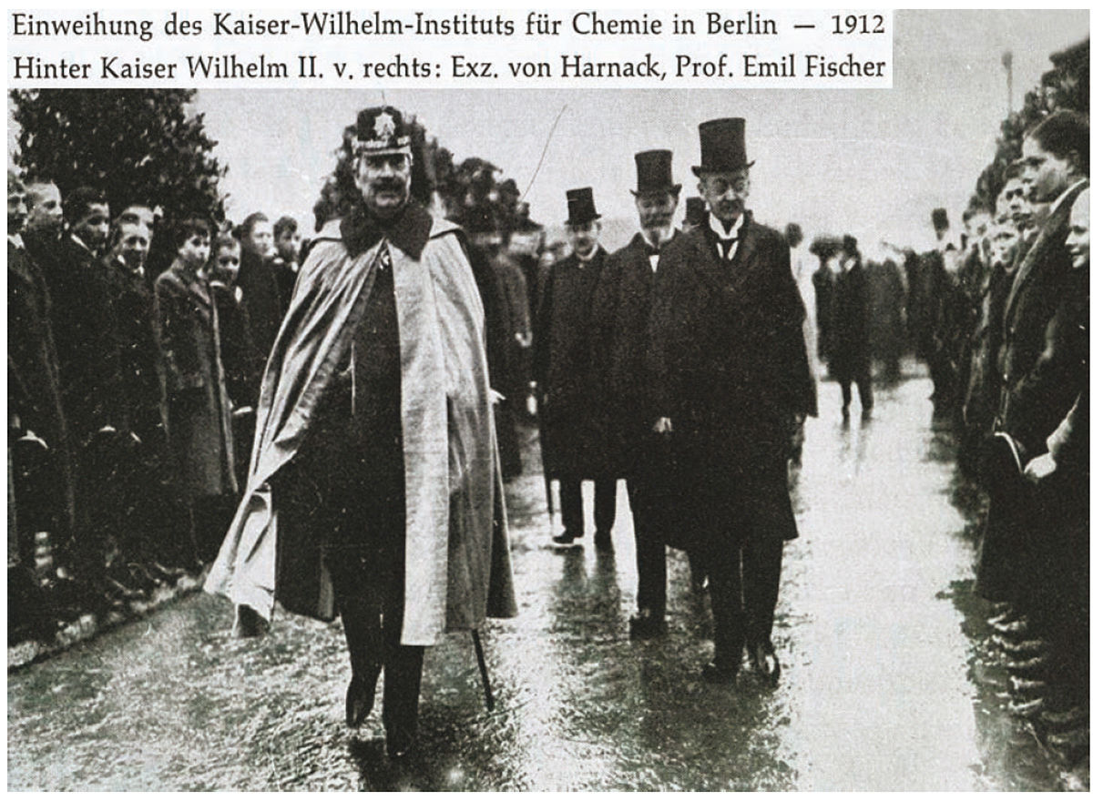

Slide 3
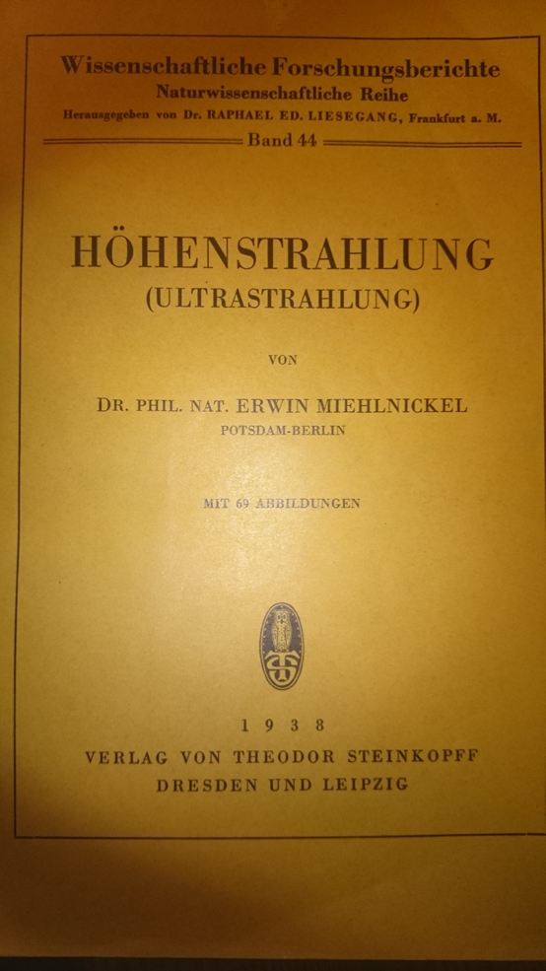
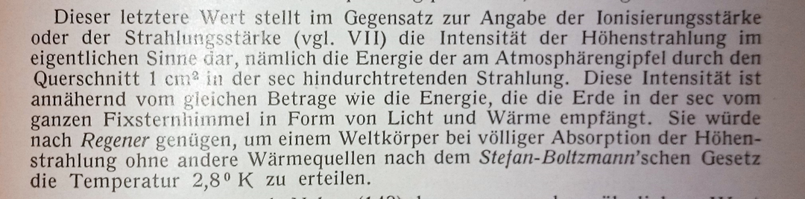
Legacy
1900: Paul Ulrich Villard discovers γ-rays in Straßburg (just 5 years after Röntgen discovered X-rays in Würzburg)
1912: Hess & Kohlhörster find ionizing radiation component rising with altitude
Gamma rays due to decay of „Uratom“?
Energy flow comparable to visible light

Slide 4

Star-Begotten by H.G. Wells (1937)
The Mind of Mr. … Is Greatly Troubled
Mr… Learns about Cosmic Rays
Mr. … Wrestles with an Incredible Idea
Dr. … Is Infected with the Idea
Prof. … Takes Up the Idea in His Own Peculiar Fashion
‘…you lay the burden of change and mutation—and in fact all the responsibility for evolution—on those little cosmic rays! Countless myriads fly by and miss. Then one hits—Ping! Ping!—and we get a double-headed calf or a superman.‘
'What an unsettled universe it is!'
1937

Slide 5

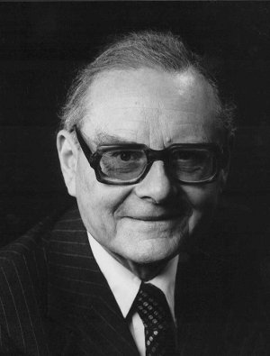
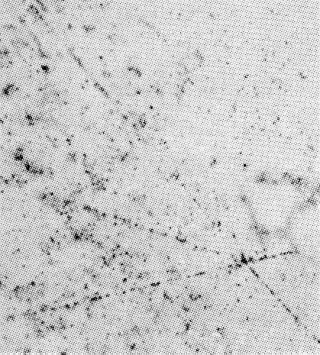
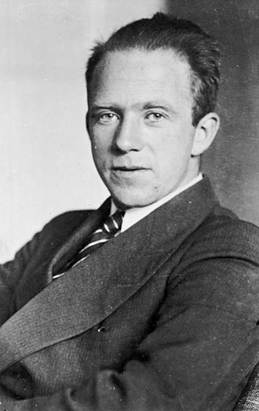
1938: Auger shows shower development due to cosmic ray primary and secondary particles.
1943: Heisenberg studied cosmic ray interactions using balloons („Kernzertrümmerung“) in the Max-Planck-Institut für Physik in Göttingen.
1958: Under directors Werner Heisenberg and Ludwig Biermann, the institute moved to Munich to become the MPI für Physik und Astrophysik.

Slide 6
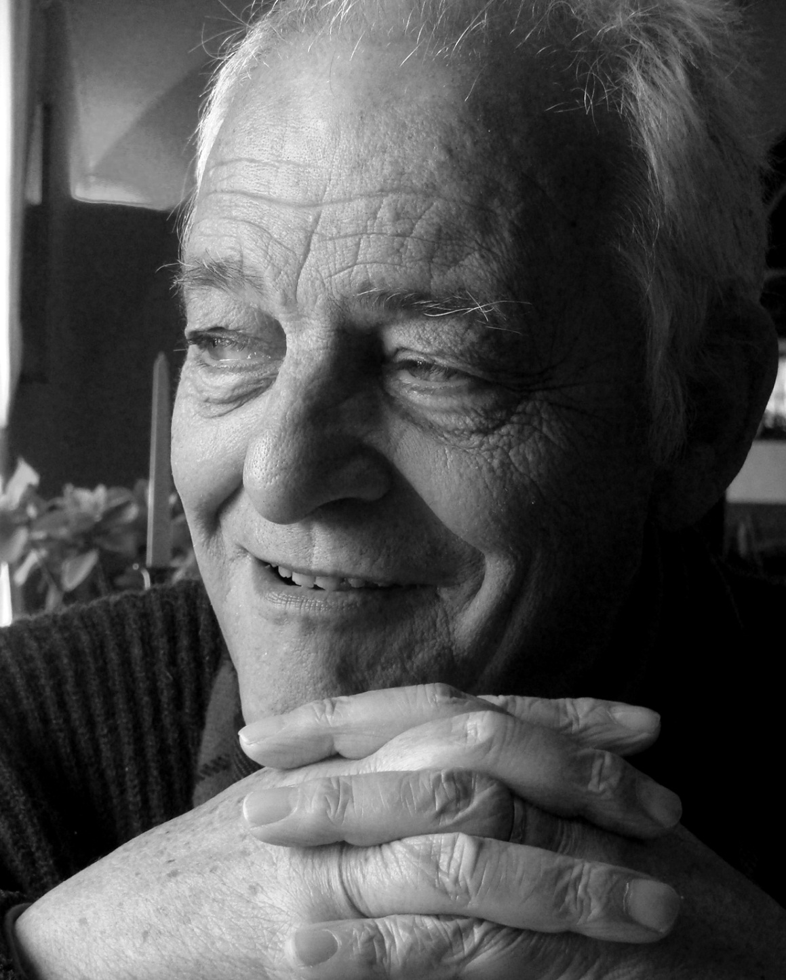
Gamma-Astrophysics branch
1949, 1951 Fermi suggests acceleration due to collision with magnetized clouds
1956 Cocconi: “Intergalactic space and cosmic rays”
1963 Ginzburg & Syrovatsii: „Origin of Cosmic Rays“
1977 Krymskii, Axford et al.: Diffusive shock acceleration
….
1989 Weekes: „Whipple“ Imaging Air Cherenkov telescope
HEGRA, MAGIC, CTA @ MPI München (MasahiroTeshima)
HEGRA, H.E.S.S., CTA @ MPIK Heidelberg (Jim Hinton)
U Eckart Lorenz
June 21st, 2014

Slide 7
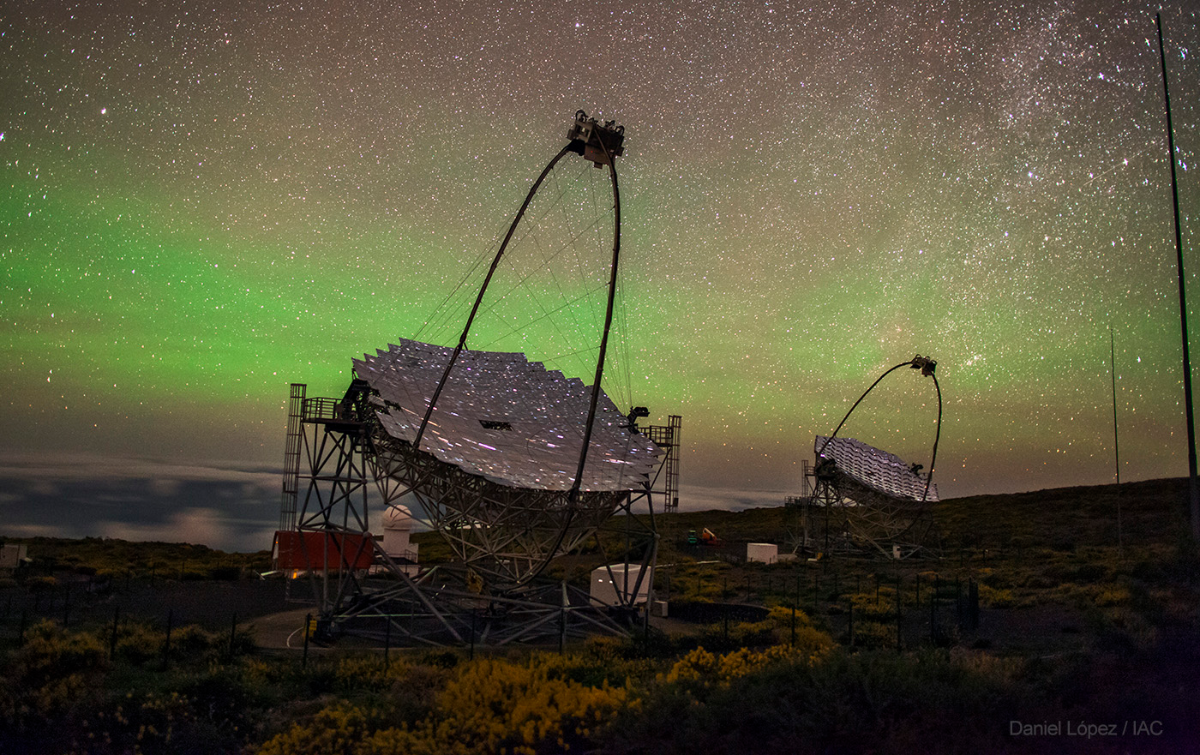

Slide 8
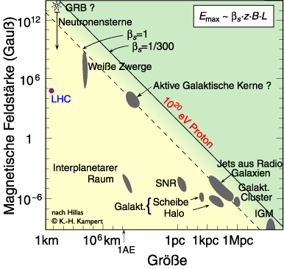
Paradigm („Standard Model“)
Shell-type supernova remnants: CRs up to knee energy of ~ 1 PeV (e.g. Völk & Biermann)
Radio galaxies: UHE CRs up to 100 EeV (e.g., Rachen & Biermann)
Maximum energy
Spectral index
Emissivity
Chemical composition
Diffusive shock acceleration
Supernova explosions
Accreting supermassive black holes

Slide 9
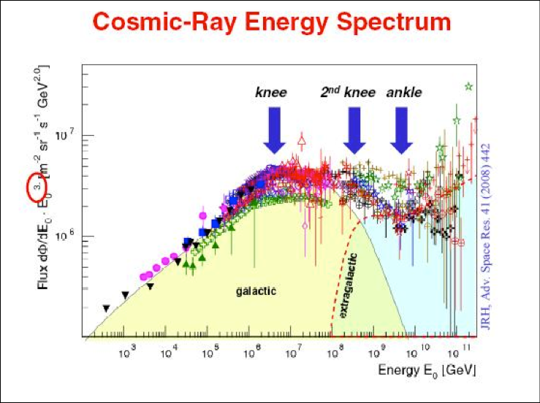
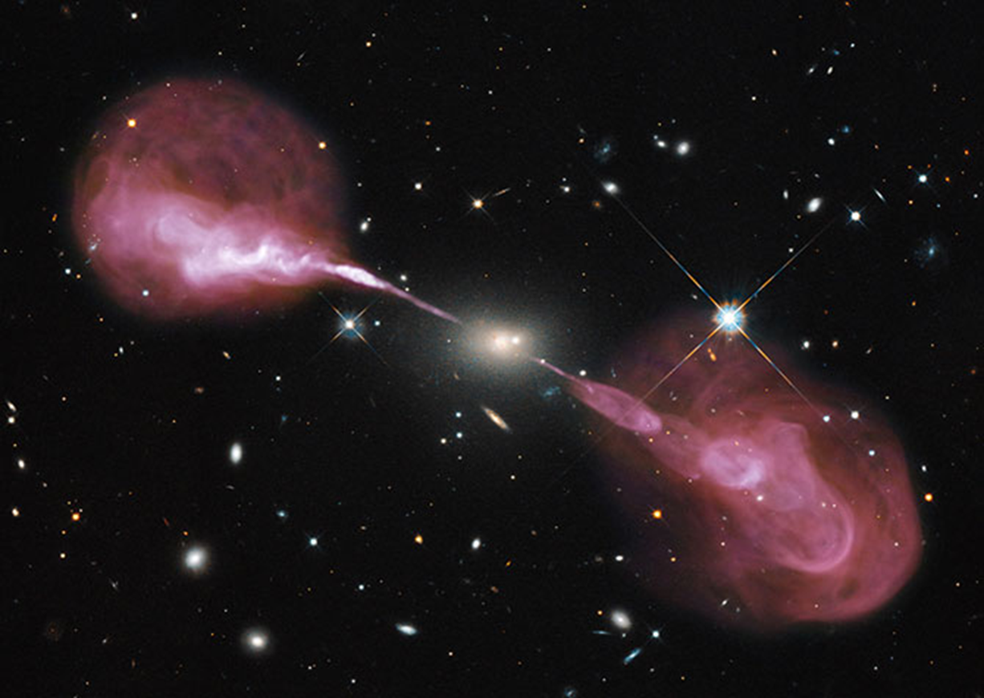
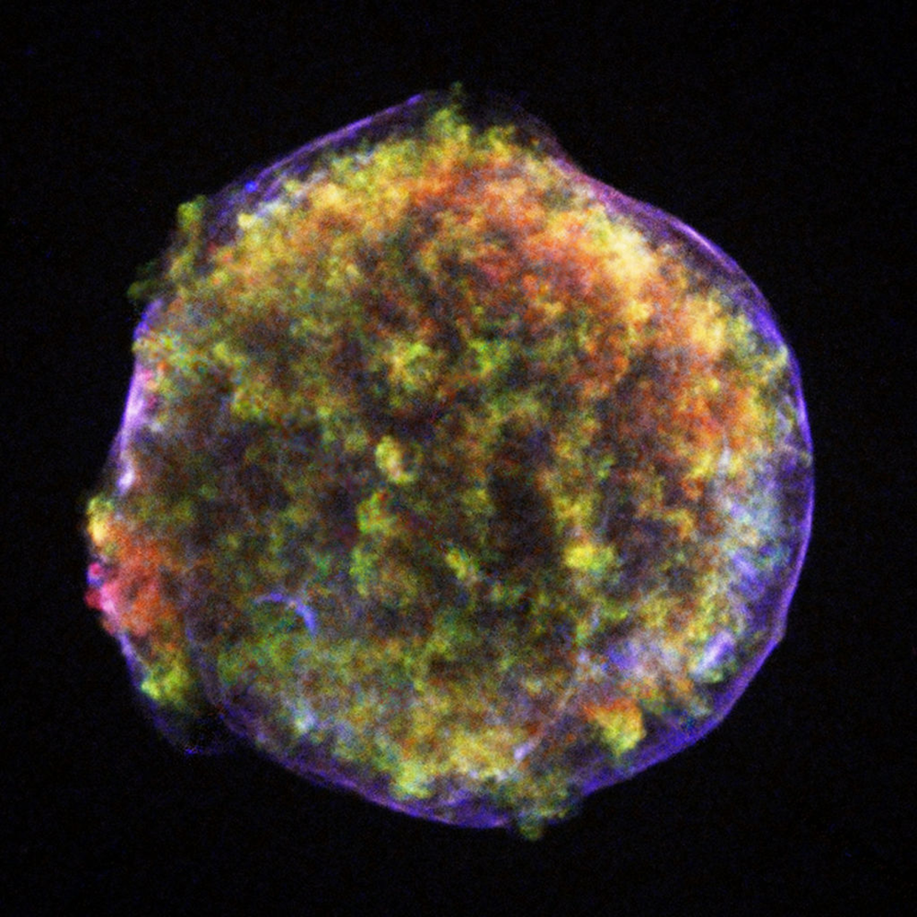

Slide 10
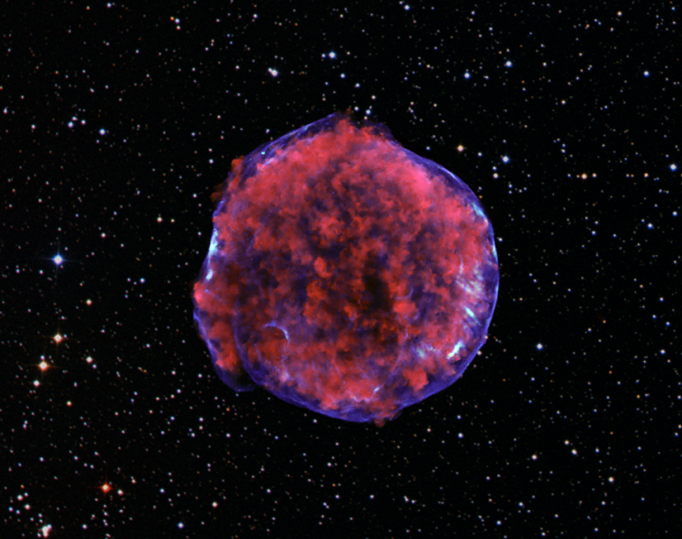
Paradigm
Magnetic field amplification at shock required
Non-linear effects in diffusive shock acceleration (e.g., Bykov et al. 2014).
Observationally difficult to prove
NASA/Chandra

Slide 11
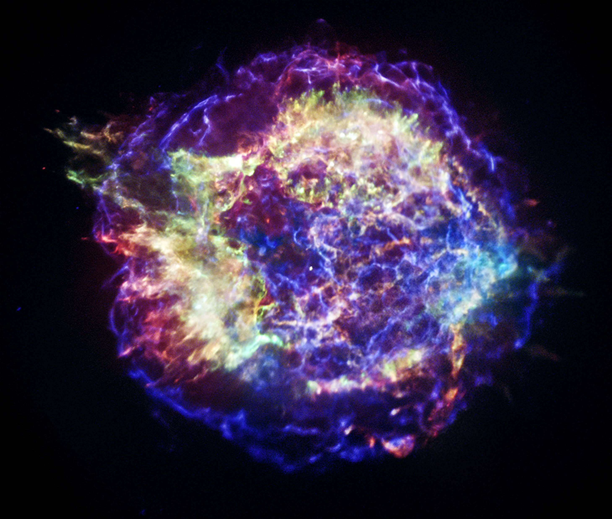
Paradigm shifting ….
X-rays
Supernova remnant Cas A: Spectrum cuts off below knee energies
Ahnen et al. (MAGIC), 2017
NASA/Chandra

Slide 12
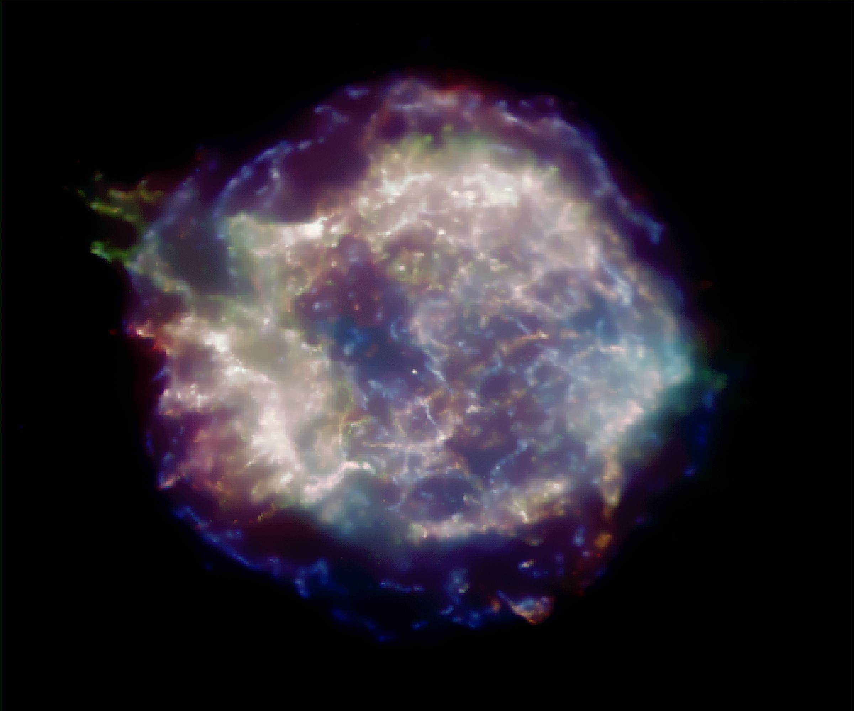
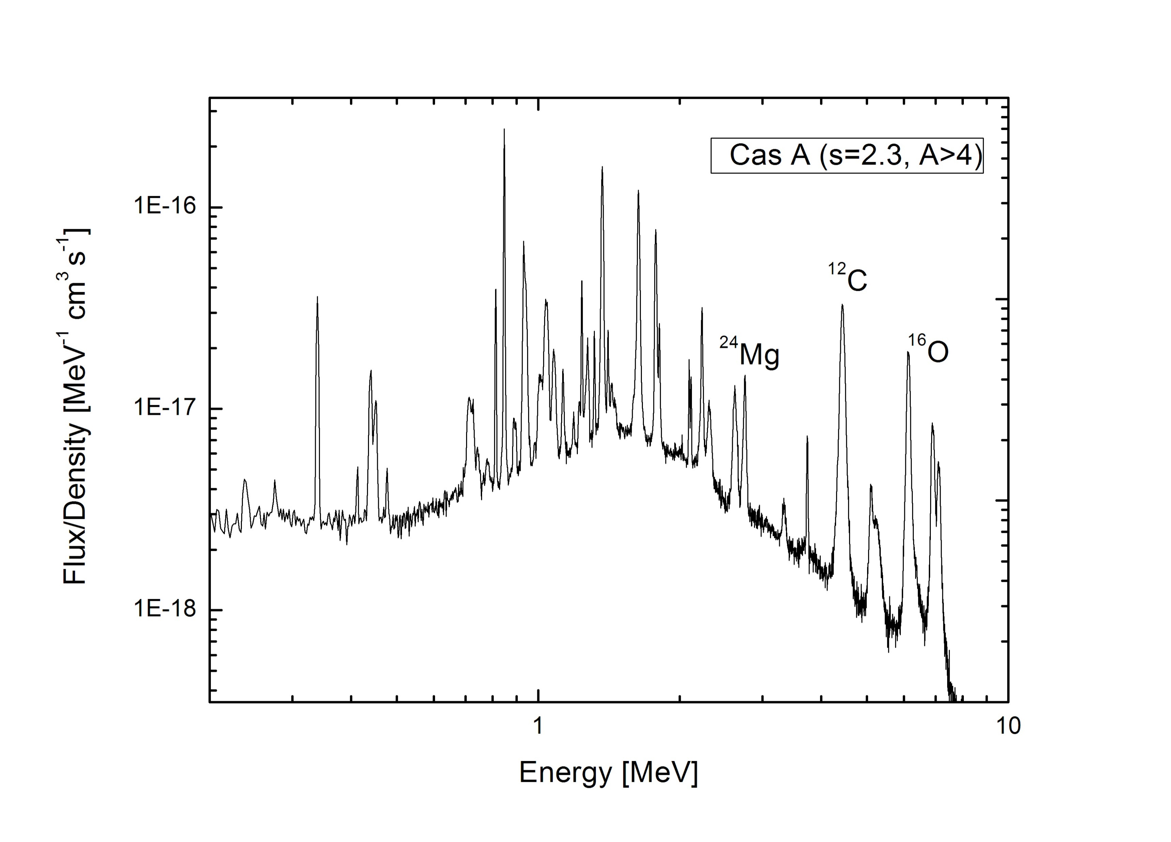
Overproduction of Lithium by spallation?
Nuclear collisions enrich the ISM with spallation products
Cosmic rays 10 MeV – 100 MeV determine spallation yields
Increase primordial abundances of light elements (Lithium and Boron)
Nuclear de-excitation lines at MeV energies
Observable with next-generation MeV space telescope (eASTROGAM)
Summa, Elsässer, Mannheim (2011)

Slide 13
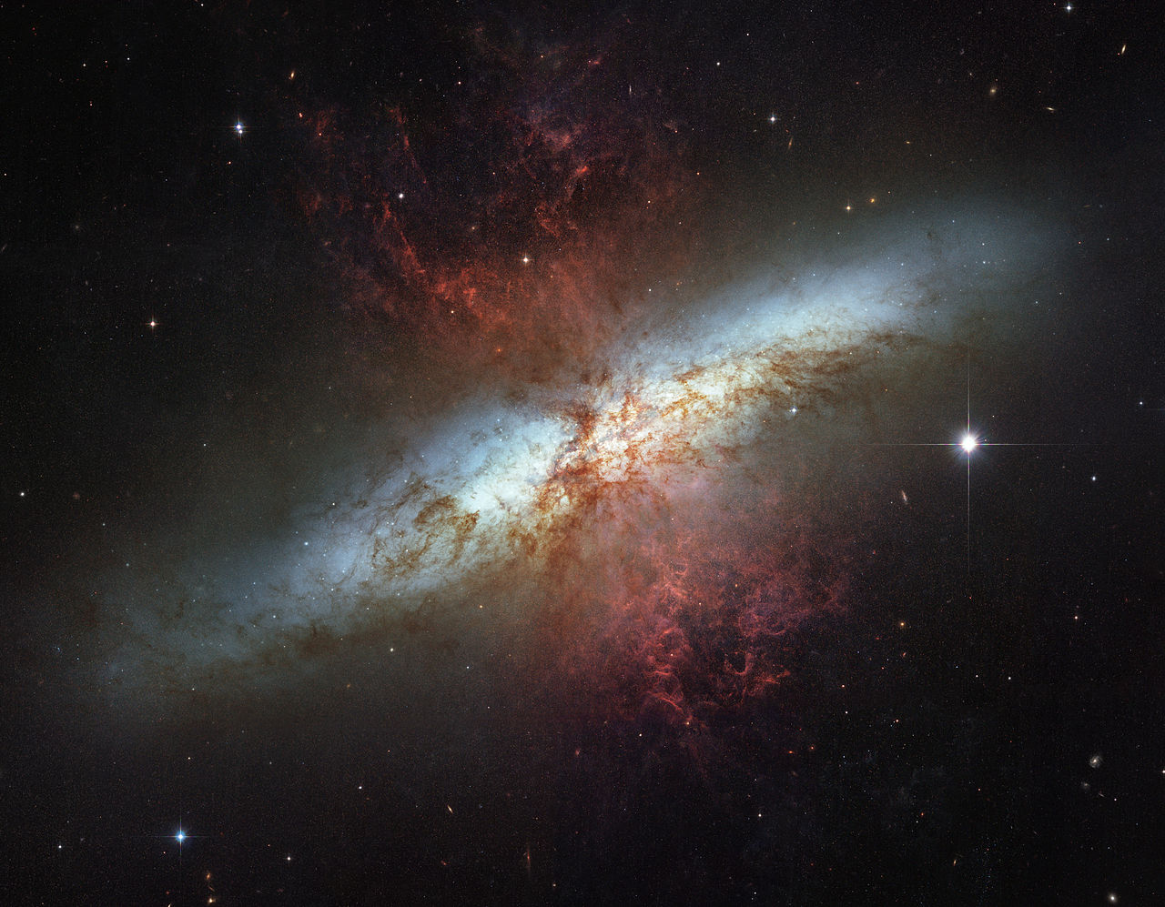
TeV gamma rays in starburst galaxies: Pulsar wind nebulae?
KM et al., Astropart. Phys. 35, 797 (2012)
NASA/HST

Slide 14
AMS-02 positron flux:
Deviations from propagation-model predictions
Are gamma-ray emitting pulsars responsible for the positrons?
Is the CR propagation model (GALPROP) making wrong predictions?

Slide 15
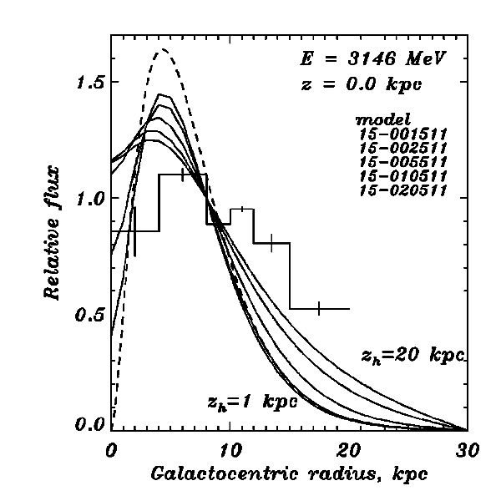
Radial gradient problem:
Supernova remant and cosmic ray emissivity do not match
Strong central source in our Galaxy?
Strong and Moskalenko 1998
Torsten Ensslin: D3PO analysis of Fermi-LAT data (>100 MeV)

Slide 16
Cosmic ray interactions with matter: Neutrinos from Supernova Remnants
Learned & Mannheim (2000)
γ Cyg
IceCube
KM3Net
Cas A
IC444

Slide 18
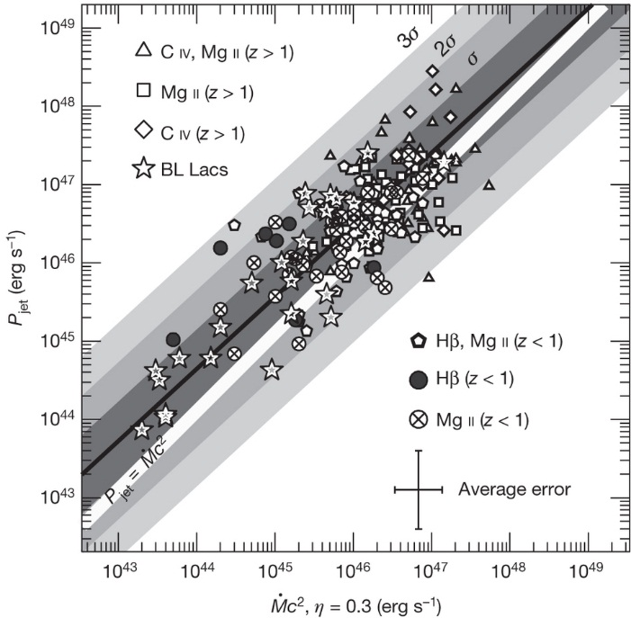

Radiojets from spinning black holes
Hercules A
Credit: NASA
VLA/HST-WFC3
P_{jet} ~ L_{accretion}
Rawlings & Saunders, Nature (1991)
E_{tot} ~ 10% M_{BH}

Slide 19
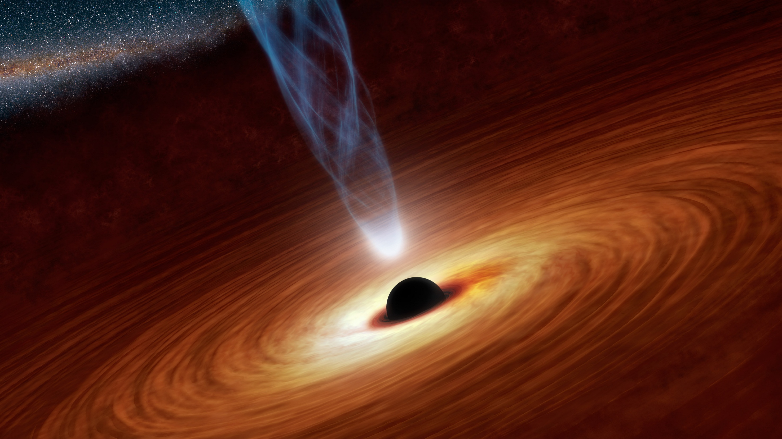
Quasar:
Black Hole with high accretion rate
Francis et al. 1991
λ^{-4/3}
Accretion disk
Eddington luminosity
L_{E} = 4πG_{N}Mm_{p}c/σ_{T}
= 10¹¹ L₈ (M/10⁶M₈)
Growth time
t_{E} = Mc²/L_{E} = 4 x 10⁸ yrs

Slide 20
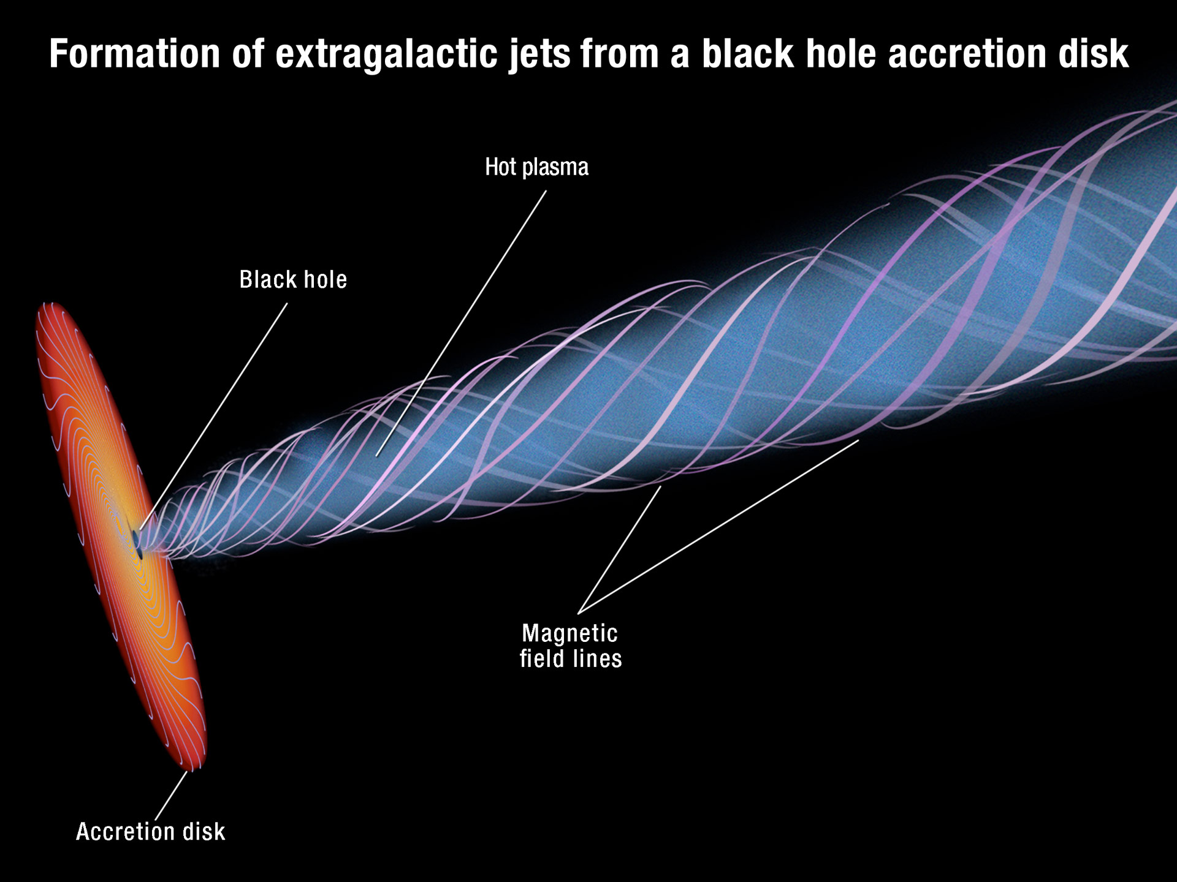
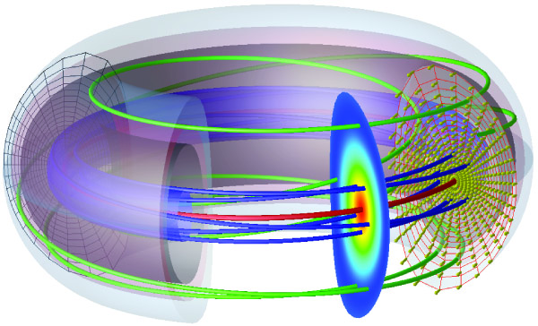
Grad-Shafranov Equation
Black Hole Jet
Tokamak

Slide 21
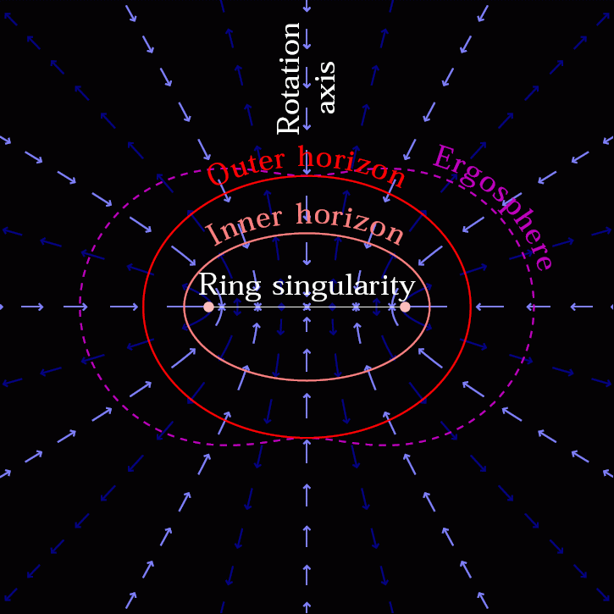
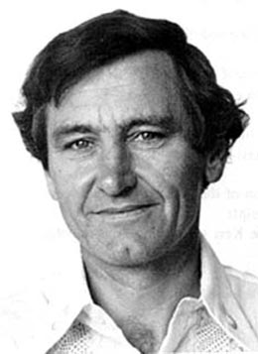
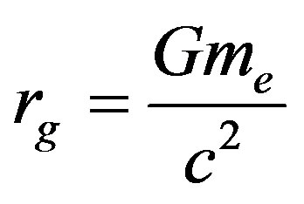
Vacuum solutions of Einstein‘s equations

Slide 22
Plasma-injection and particle acceleration
Neronov et al. (2012):
Using the exact solution due to R. Wald for a poloidal magnetic field parallel to the angular momentum of the black hole, protons are suggested as the seed particles

Slide 23
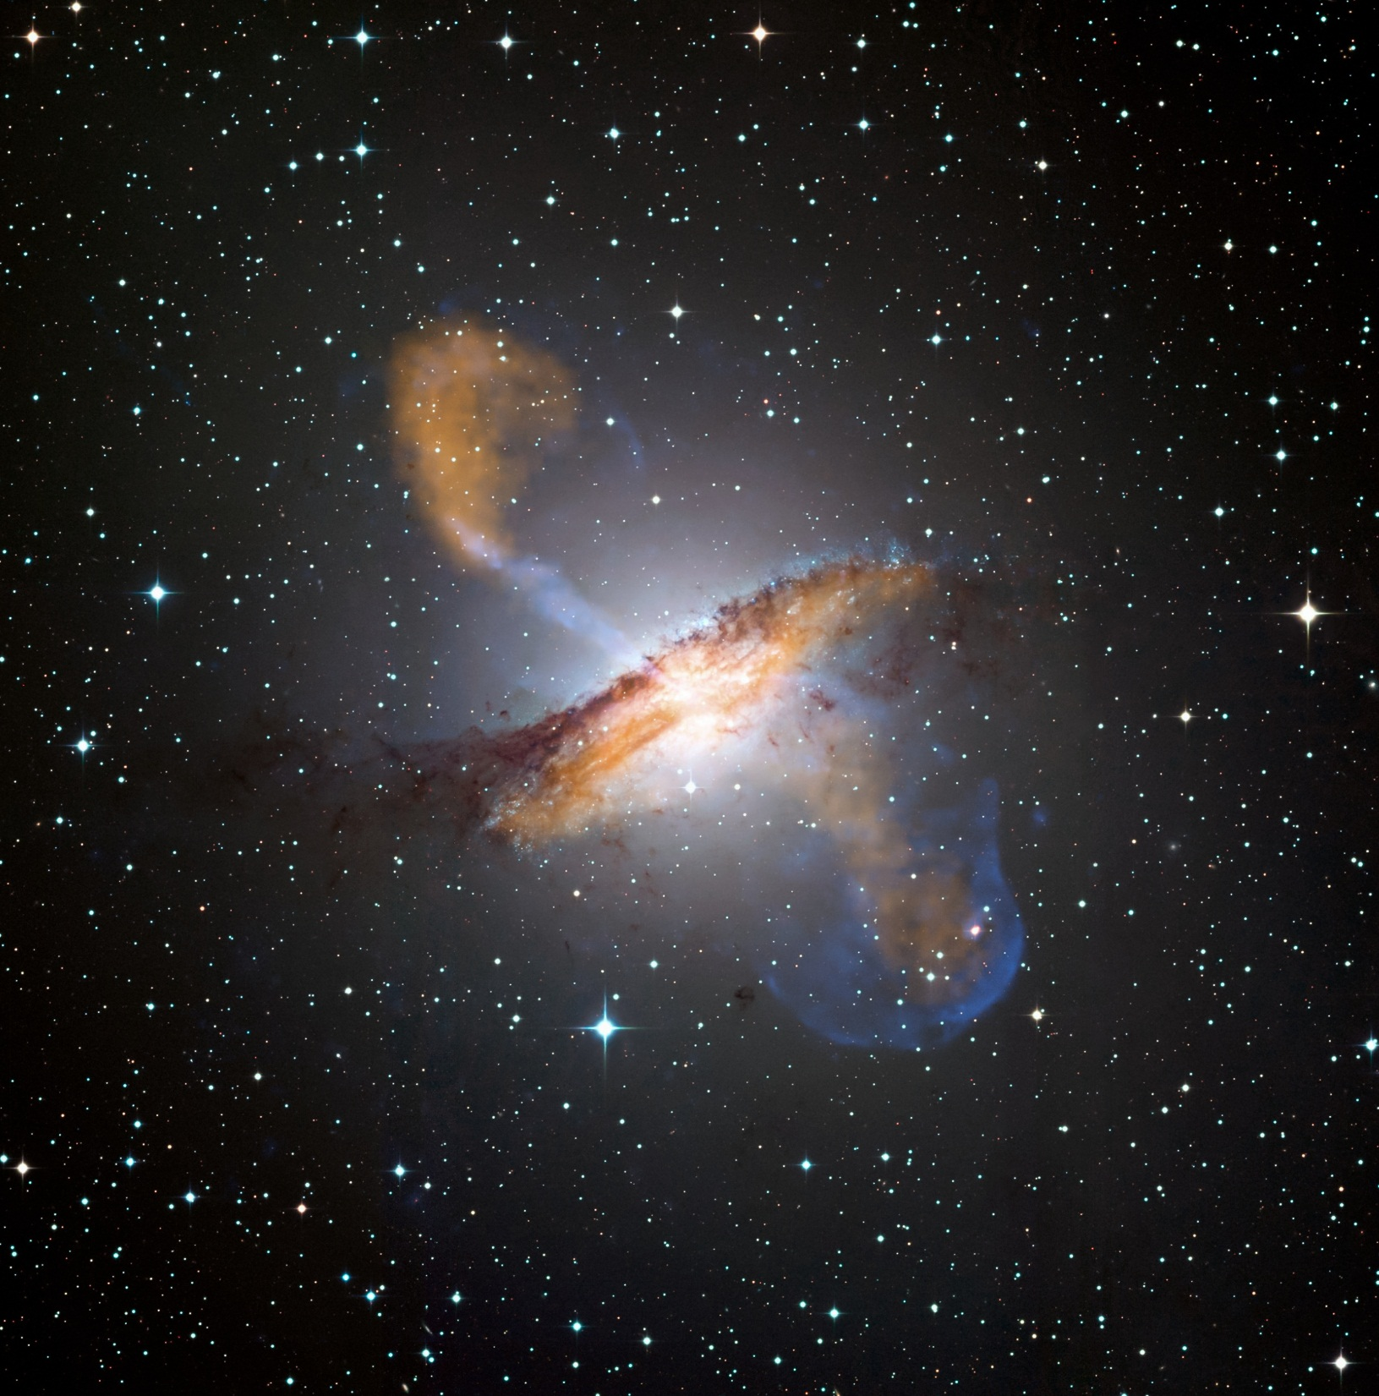
Plasma-injection and particle acceleration
„Neutron bomb“ could explain UHE cosmic rays after β-decay (avoiding adiabatic losses)
λ_{n} ~ 100 γ₁₀ kpc
Chandra/Apex

Slide 24
Spinning Black Holes
Transform matter into radiation with ~ 10% - 50% efficiency
Accelerate protons to ~ 10²⁰ eV (UHE cosmic rays)
Pull observers into another Universe
Create Big-Bang-like relativistic plasma ergospheres
Give rise to an information paradox – event horizon or firewall

Slide 25
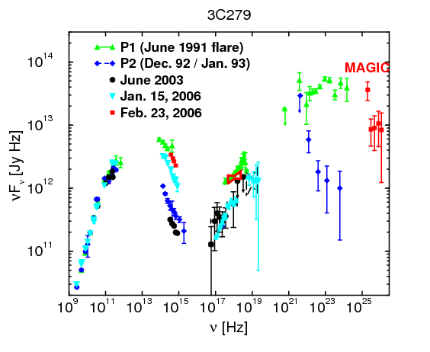
UHE Cosmic rays in extragalactic jets: Gamma-ray emission
EBL
Mannheim (1993)
Boettcher (2009)

Slide 26
Multi-messenger conjecture of 1995
KM, Astropart.Phys.3, 295 (1995):
„A striking similarity exists between the energy fluxes of diffuse y-rays above 100 MeV and cosmic ray protons above the ankle … The corresponding prediction (assuming photo-pion decay in extragalactic jets) of a neutrino flux therefore rests on a firm basis. “
Kowalski 2016

Slide 27
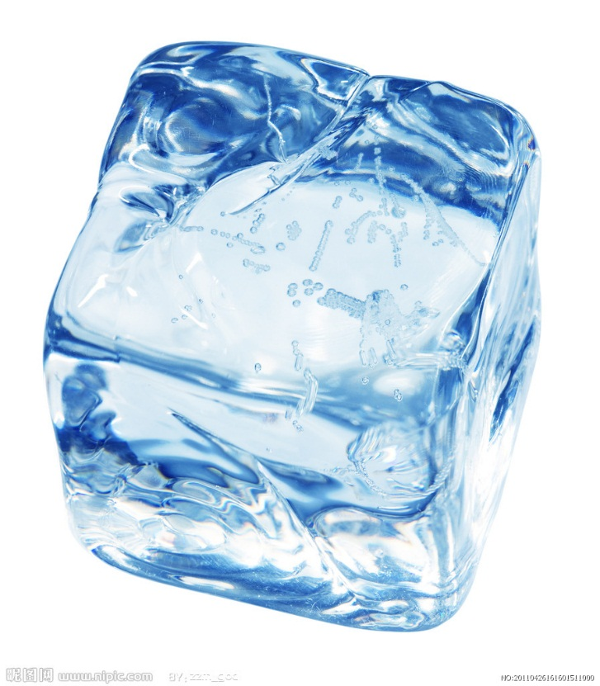
ICECUBE „Physics Breakthrough 2013“
KM, Astropart. Phys. 1995

Slide 28
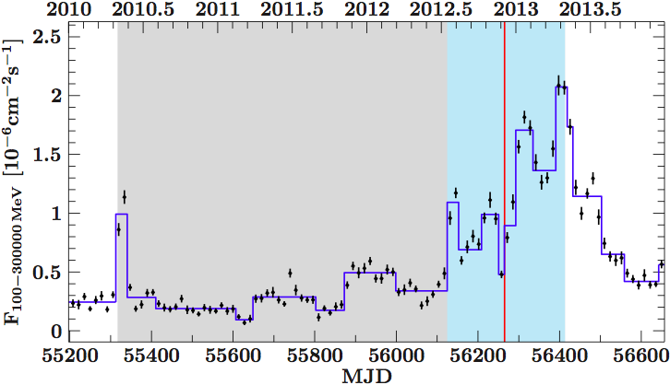
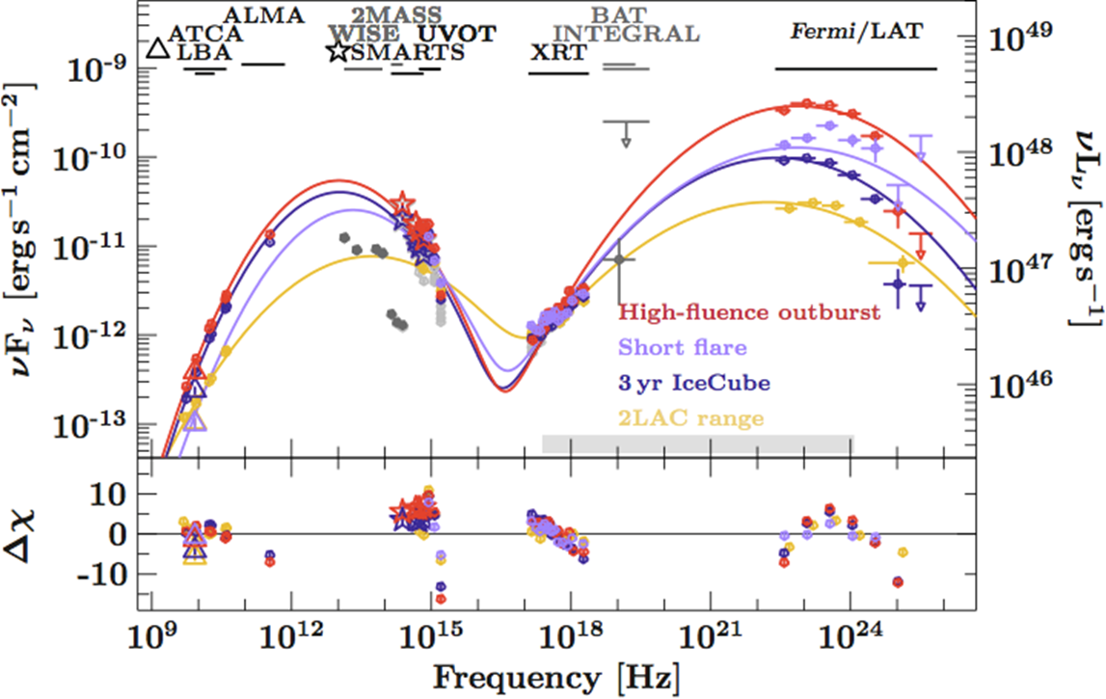
PKS B1424-418 Gamma outburst detected by Fermi-LAT:
Fluence sufficient for a PeV neutrino event during IceCube measurements Kadler et al. (& KM), Nature Phys. (2016)
5% chance probability for association between brightest Fermi blazar outburst at the position of the most energetic IceCube neutrino event

Slide 29

First-time detection of VHE gamma rays by MAGIC from a direction consistent with the recent EHE neutrino event IceCube-170922A
ATel #10817; Razmik Mirzoyan for the MAGIC Collaboration
on 4 Oct 2017; 17:17 UT
Credential Certification: Razmik Mirzoyan (Razmik.Mirzoyan@mpp.mpg.de)
Subjects: Optical, Gamma Ray, >GeV, TeV, VHE, UHE, Neutrinos, AGN, Blazar
Referred to by ATel #: 10830, 10833
After the IceCube neutrino event EHE 170922A detected on 22/09/2017 (GCN circular #21916), Fermi-LAT measured enhanced gamma-ray emission from the blazar TXS 0506+056 (05 09 25.96370, +05 41 35.3279 (J2000), [Lani et al., Astron. J., 139, 1695-1712 (2010)]), located 6 arcmin from the EHE 170922A estimated direction (ATel #10791). MAGIC observed this source under good weather conditions and a 5 sigma detection above 100 GeV was achieved after 12 h of observations from September 28th till October 3rd. This is the first time that VHE gamma rays are measured from a direction consistent with a detected neutrino event.

Slide 30
Extragalactic origin of UHE Cosmic Rays
E > 8 EeV
6.4 % anisotropy with 5.2 σ
Aab et al. (PAO Collaboration), 2017

Slide 31
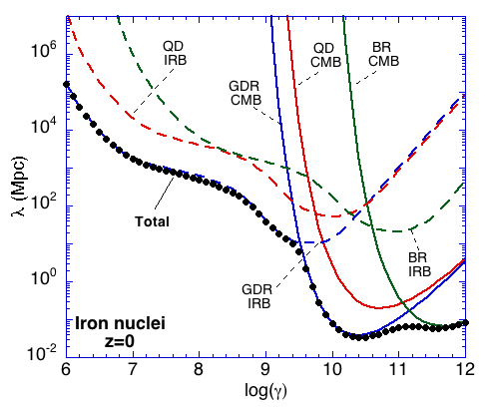
Anisotropy and spectum ok (Rachen & Biermann), but UHE chemical composition observed by PAO seems to be too heavy
PAO (2015)
Allard (2009)

Slide 32
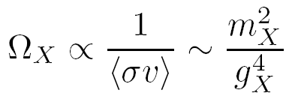
WIMP Miracle:
Dark Matter indirect detection
X
q
_
X
q
m_{X} ~ 100 GeV, g_{X} ~ 0.6 → Ω_{X} ~ 0.1

Slide 33
Dark Matter Limits for Dwarf Spheroidals
Fermi-LAT data combined with 158h Segue-1 MAGIC data
(JCAP 02, 039)
Caveat: Recent Triangulum recalibration
J-factors assume FNW profiles

Slide 34
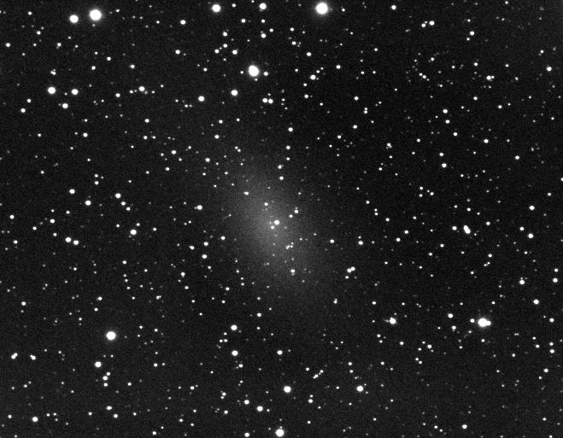
Particle Data Group (2016)
Dwarf spheroidal galaxy NGC147 in the Local Group.
Similar to Segue 1, with an age of 13 Gyrs the oldest known galaxy (Frebel et al. 2014)
M/L ~ 3400 M₈/L₈
M. Doro (for the MAGIC Collaboration), 2017

Slide 35

Radio galaxies provide natural background for dark matter searches
Saxena, Summa, Elsässer, Rüger, & Mannheim, EPJC 71, 1815 (2011)

Slide 36
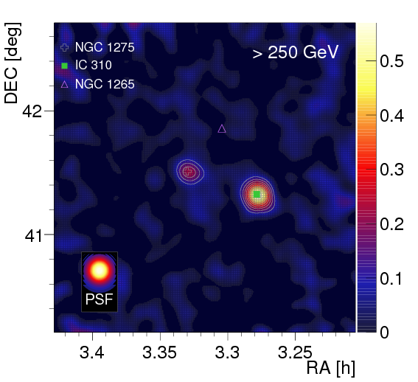
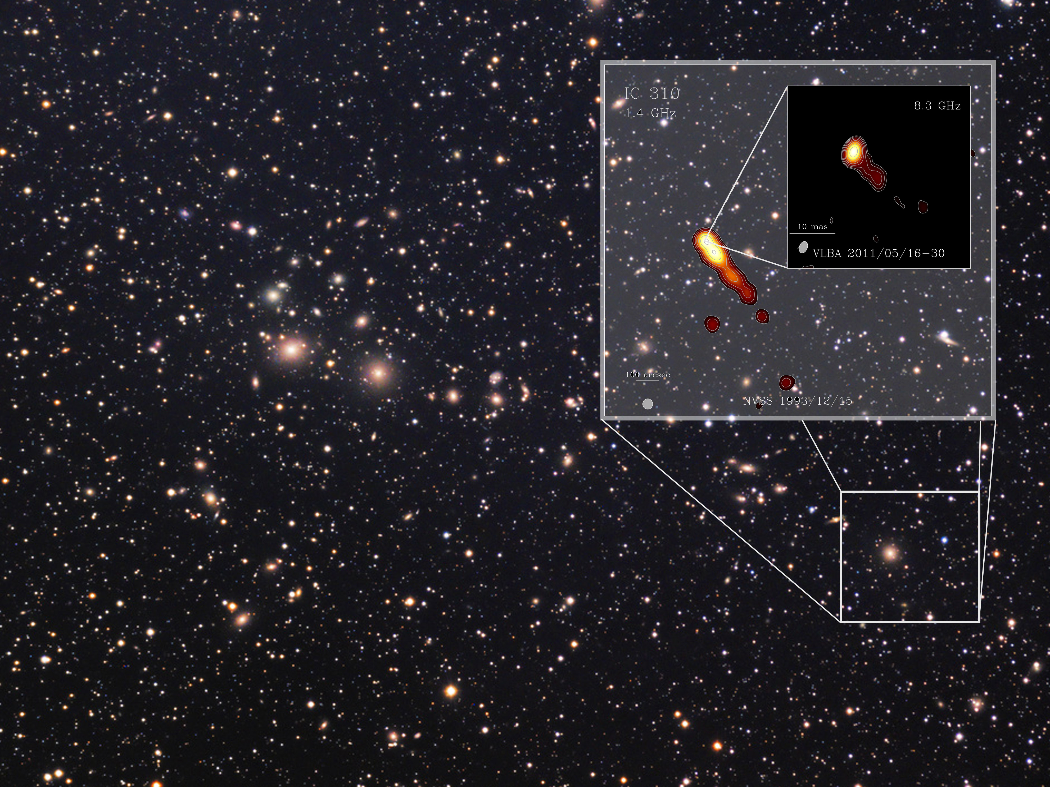
Perseus Cluster of galaxies with 2 x 10¹⁵ M₈

Slide 37
The Perseus Cluster (A&A 589, A33):
NGC 1275, IC310, and Cosmic Rays
Magnetic field strength > 10 μG?
Damping of relativistic particles due to wave excitation, cascading and subsequent thermal dissipation (Pfrommer)?

Slide 38
More peaked CR profile (Pinzke & Pfrommer 2010)
More extended CR profile (Zanandel et al. 2014)
Γ = 2.33

Slide 39
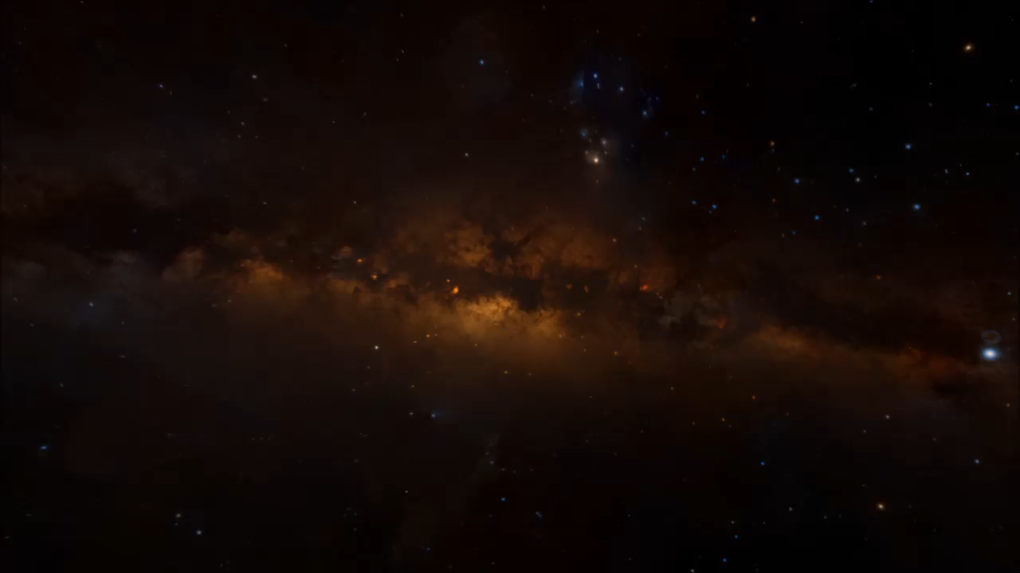
Rosetta Stone IC 310

Slide 40
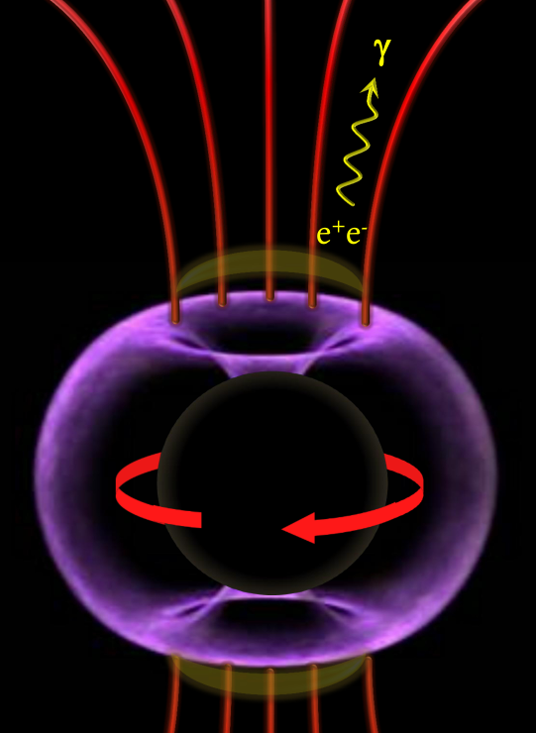
Aleksic et al. (MAGIC Collaboration), Science (2014)
Hot ion supported torus with 10⁹ K electrons
Levinson & Rieger (2011)
IC310
τ_{γγ} = 200 L/L_{E} < 1
Vacuum gaps
E parallel B
Particle acceleration
Potential drop 10²⁰ eV
Pair production at very high energies
Gamma-ray emission
K. Hirotani
Multi-TeV gamma rays

Slide 42
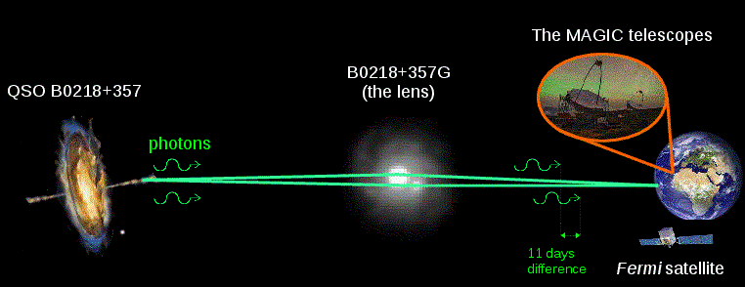
Gravitationally lensed quasar B0218+357 at redshift z=1
z=0.94
z=0.68

Slide 43
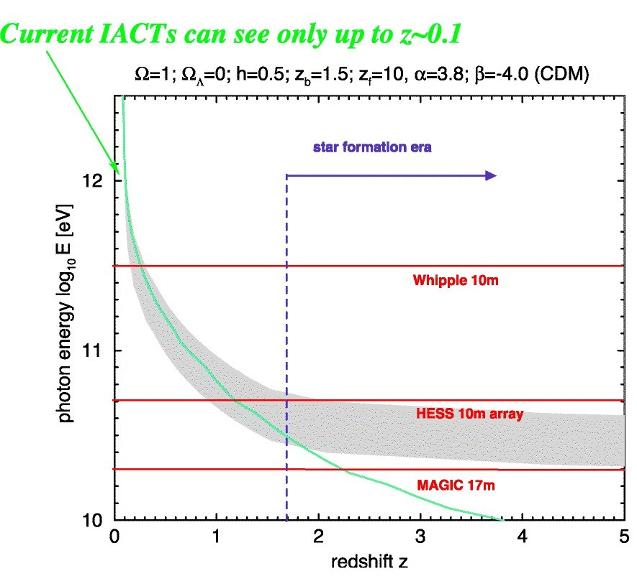
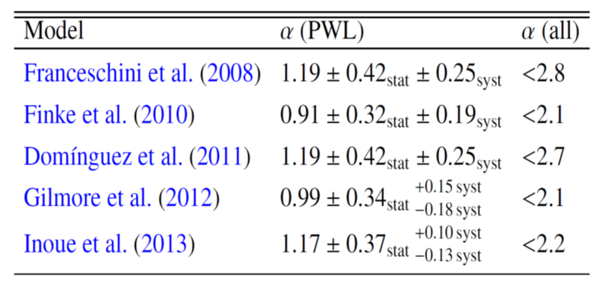
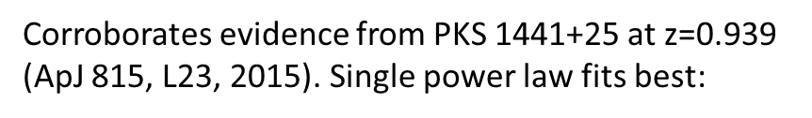

Gamma-ray horizon due to pair creation in collisions with photons from the extragalactic background light
20-year-old prediction prior to MAGIC operations (KM, Ludwig-Biermann-Award Lecture 1997) based on semi-empirical EBL model
B0218+357, PKS 1441+25

Slide 44
Origin
Gamma-ray astrophysics
CR
SF
BH
DM
Acc
ISM
Li
QG
CH₄
B
e⁺
A*
Anomalous dispersion
Particle acceleration
Annihilation
Interactions with neutral gas
Black holes
Magnetic fields
Chemical composition and radioactive isotopes
Star formation
Antimatter
Life & chemistry
Spallation

Slide 45
Future of observational gamma-ray astronomy
Knödelseder (2016)

Slide 46
Discovery perspectives of gamma-ray astronomy
MAGIC world-leading IACT: The best is yet to come….
Newly armed with sum trigger logic and high-ZA technique (→ Razmik Mirzoyan)
CTA-North (LST): Potential to boost low-threshold observations
Large redshift blazars, radio galaxies, clusters of galaxies, pulsars, GRBs, starburst galaxies, pair halos.
Explore realms of BH ergosphere (variability), large-scale magnetic fields (intergalactic cascading), multi-messenger connections with neutrinos and UHE cosmic rays.
CTA-South (Implementation Array): Deep survey of Milky Way
Ecosystem: eROSITA, eASTROGAM, SKA radio observatory

Slide 47
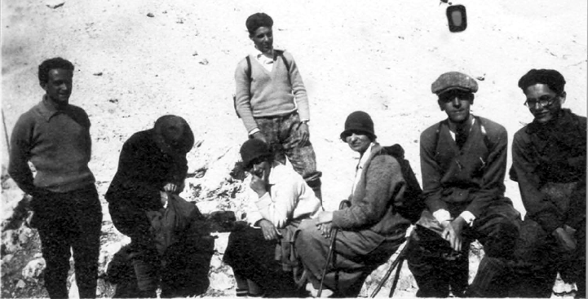
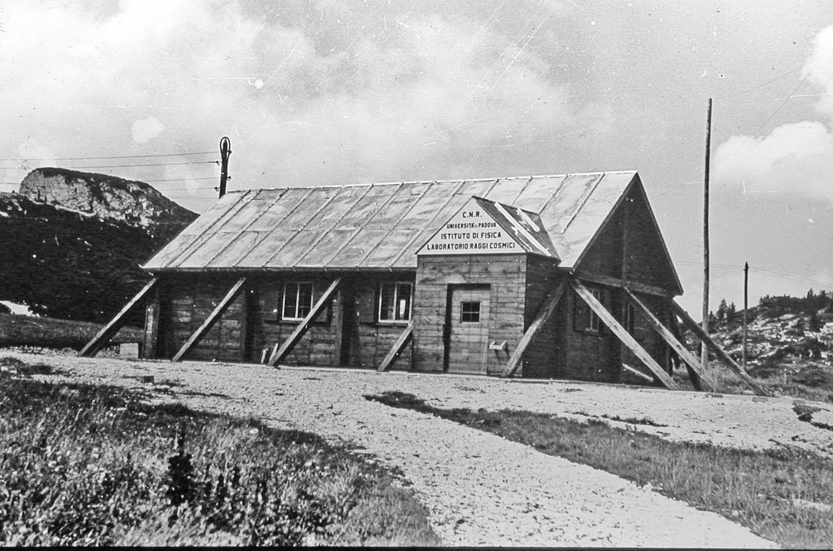
Cosmic ray origin - beyond the standard model(s) San Vito di Cadore, Dolomites, 2014 & 2016 http://www.crbtsm.eu/
Edited by: Omar Tibolla, Luke Drury, Massimo Persic, Sarah Kaufmann, Heinz Völk, Karl Mannheim, Alessandro De Angelis
Fermi
Amalfi
Marmolata Cosmic Ray Station →

Slide 48
"Obwohl das menschliche Genie in verschiedenen Erfindungen mit verschiedenen Mitteln zu einem und demselben Ziel antwortet, wird es nie eine Erfindung weder schöner, noch leichter, noch kürzer als die der Natur finden, weil in ihren Erfindungen nichts fehlt und nichts überflüssig ist.„
Leonardo da Vinci

Slide 50
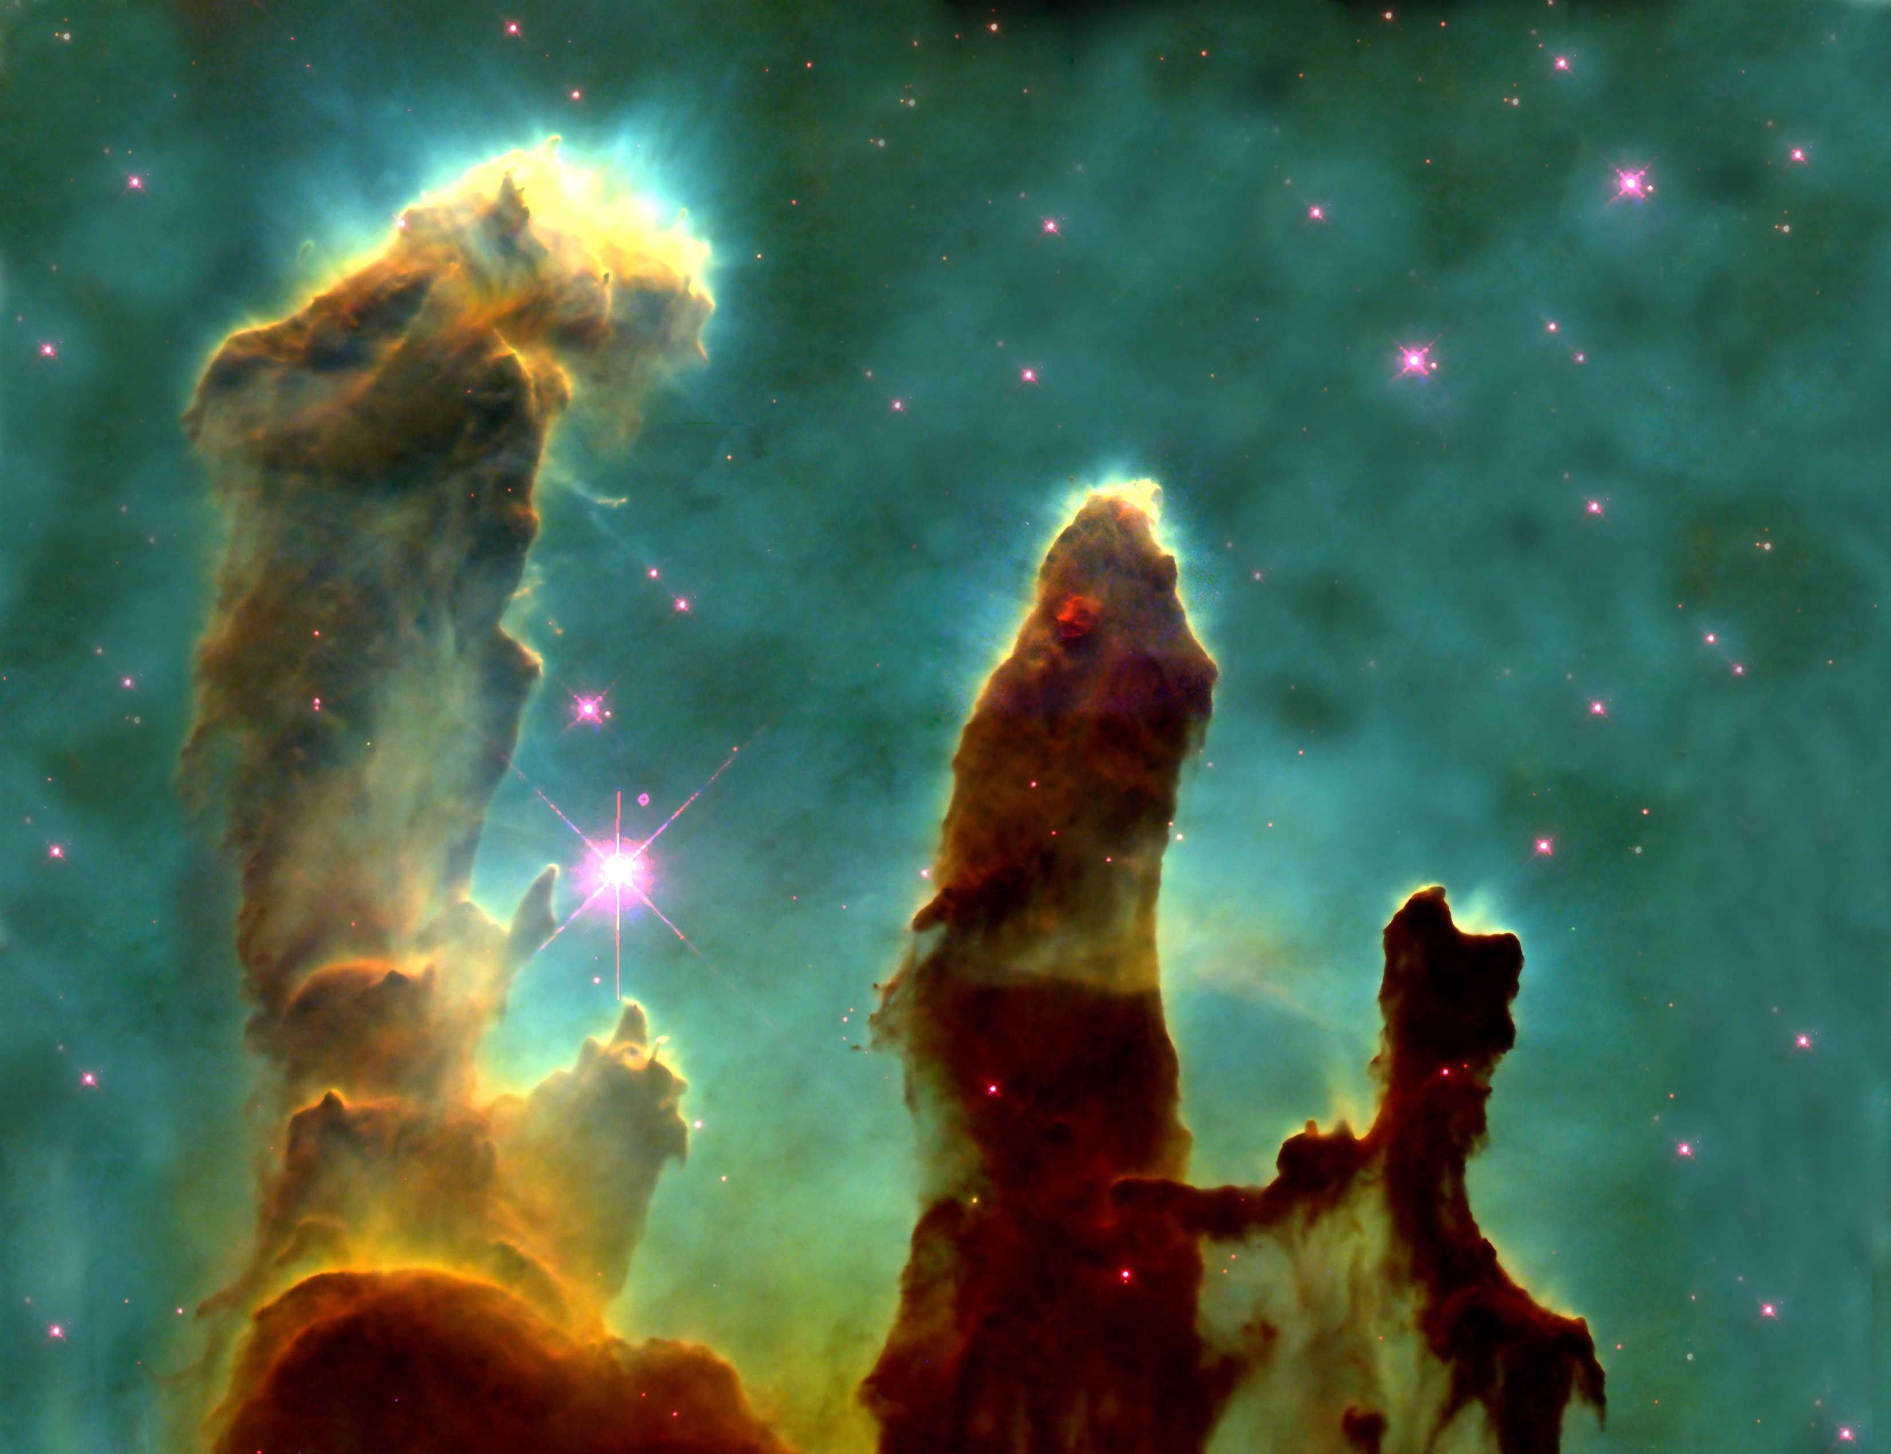

Slide 51
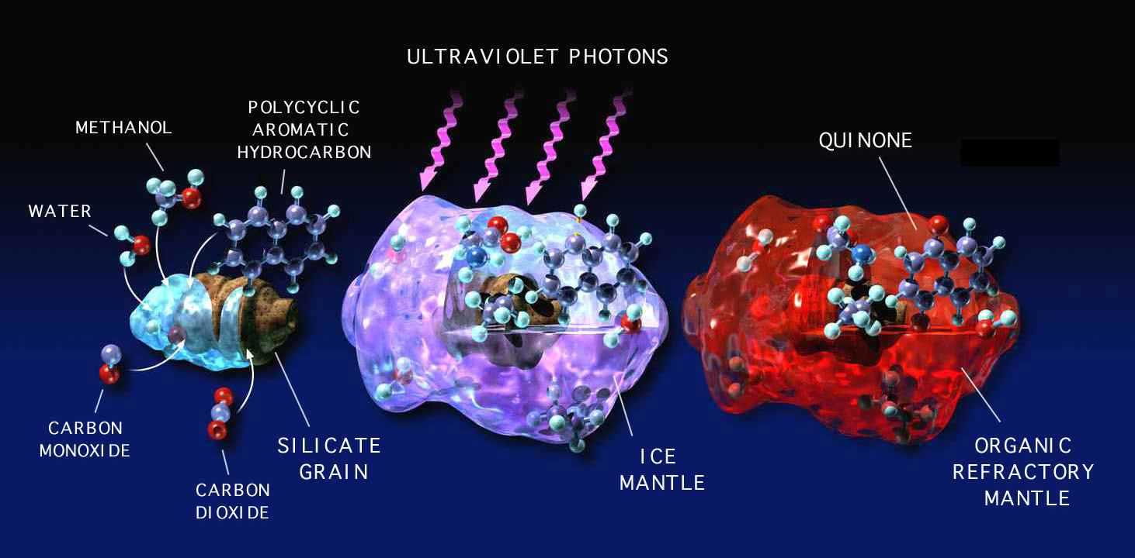

Slide 52
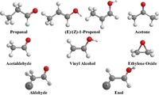
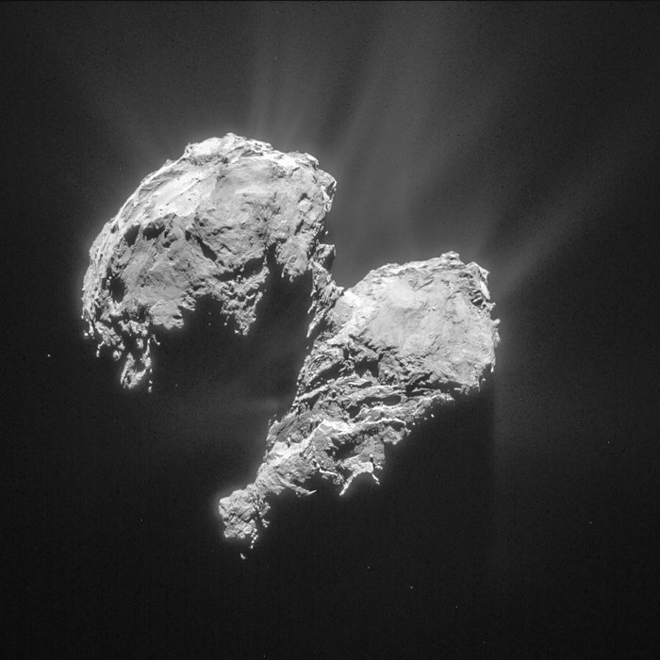
Feedback of cosmic rays: The cold (non-equilibrium) chemistry in ice
Interstellar space and in partiular molecular clouds are filled with icy grains formed by water sticking on silicate or ferrite cores
Cosmic rays induce complex molecular reaction networks in these ice grains
Confirmed in laboratory experimtents and simulations (M.J. Abplanalp, PNAS,2016)
Rosetta probe contained organic molecules from icy material formed in the Kuiper belt

Slide 53
Pulsed emission from the Crab up to 1 TeV
(A&A 585, A133)
→ Gamma-ray emitting zone much closer to LC than previously thought

Slide 54
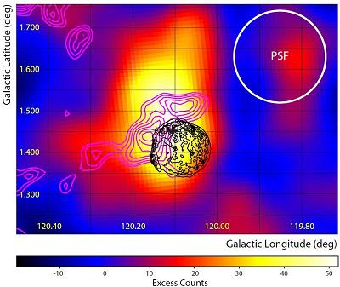
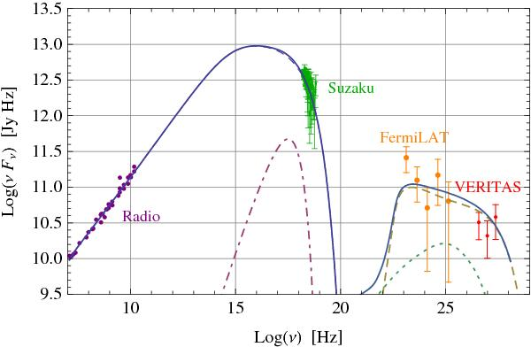
Cosmic ray interactions with matter in Tycho‘s Supernova Remnant: Gamma rays
π⁰ → γγ
Acciari et al. (2011)
Morlino (2012)

Slide 55
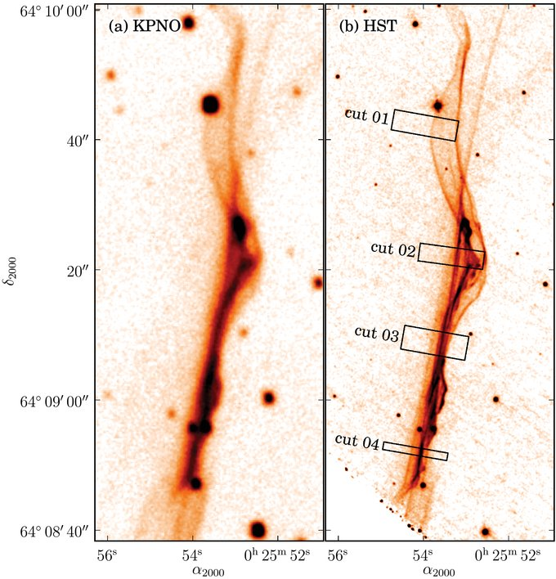

Cosmic ray interactions with neutral gas: Injection efficiency from Balmer lines
Lee et al. (2010)
Morlino (2012)

Slide 56
Integral field spectroscopy: SN 1006
„Variations in the broad line widths and the broad-to-narrow line intensity ratios across tens of atomic mean free paths suggest the presence of suprathermal protons, the potential seed particles forgenerating high-energy cosmic rays.“
Nicolic et al. (2013)

Slide 57


Slide 58


Feedback of cosmic rays:
Cosmic ray driven outflows

Slide 59
Peebles!
CMB
AGN average SED (Elvis et al.): u_{X}~ 0.2 u_{acc}
Galaxies
AGN

Slide 60


Lightning strikes
on Nov 12/13, 2012

Slide 61

10% Coronal Mass Ejections evolve into interplanetary shock waves
Shock acceleration vs. magnetic reconnection seeded in electric current sheet

Slide 62

AGN in Phoenix Cluster
Jet-induced star formation
Blue: X-rays (Chandra)
Red: CO 3-2 (ALMA)
Background: optical (HST)

Slide 63
Learned & Mannheim (2000)
(4) M95 prediction for photo-production in synchrotron target
-
IceCube 2013
(6) M95 prediction for proton-proton interactions in ambient matter

Slide 64


pMSSM
parameter scan

Slide 65
32 of the 40.000 neutrino theory papers are mine! Worth the paper?
Three most cited: 422, 342, 262

Slide 66
The machine
(Lovelace, Nature, 1976)
Unipolar inductor: 10²⁰ eV potential drop
Ultra-relativistic proton beam: photo-production of secondaries
Relativistic electron return current

Slide 67

Kerr metric (1963) in Boyer-Lindquist coordinates
for a black hole rotating in the φ - direction
Angular momentum per unit mass (Kerr parameter)
= 0 (singularity)
Frame-dragging: mixed coordinate terms due to off-diagonal terms in metric tensor g_{μυ}
= 0 (event horizons)
For a → 0 the Schwarzschild metric (1915) is recovered.

Slide 68
Vacuum solutions of Einstein‘s equations
Inner (Cauchy) and outer horizons solving Δ=0
Scharzschild horizon r₊ = 2 GM = r_{S} (a → 0)
Maximally rotating Kerr horizon r₊ = GM = r_{S} /2 (a → GM)
(often a* = a/GM is used)
Maximally spinning Black Holes are just half the size of Scharzschild Black Holes (and non-charged)

Slide 69
Vacuum solutions of Einstein‘s equations
The ergosphere is the region defined by
where even light (propagating in the φ-direction) stands still as it is forced to corotate with spacetime. Matter moves even slower than light with negative energy trajectories. The ergospheric minimum radius r₀ = r₊ = GM (for a=a_{max}=GM) occurs at the poles (θ=π/2), and the maximum radius r₀ = r_{S} = 2GM is achieved at the equator (θ=0).

