Slide 1
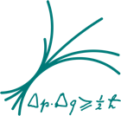

27-Years History of MPP
Measuring γ & Cosmic Messages
From the Universe by
HEGRA, MAGIC & CTA
Razmik Mirzoyan
For the MPP Astrophysicists
Max-Planck-Institute for Physics, Munich, Germany

Slide 2
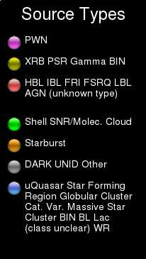
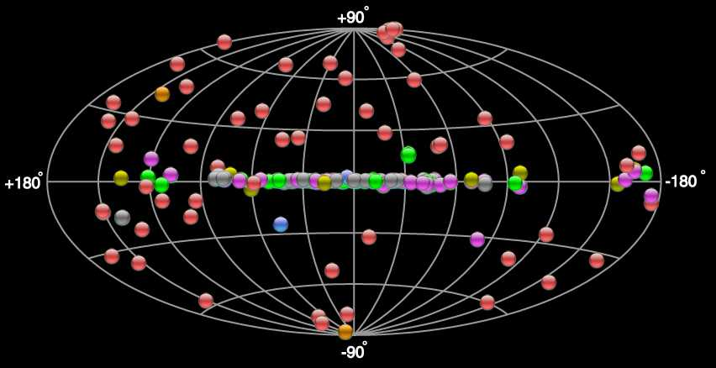
Today‘s VHE γ−ray Sources in the Sky
http://tevcat.uchicago.edu/
≥ 176 Established Sources

Slide 3
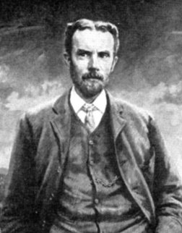
Cherenkov light: the beginnings
In a series of publications Oliver Heaviside has calculated and predicted the main features of a special emission when an e- movs in a transparent medium with a speed higher than that of light.
The work of the genius, who advanced his time by half a century, was not appreciated by contemporary scientists and was forgotten. In 1912 he calculated the geometry and the angle of emission relative to the axis of movement of the charge (1888, 1889, 1892, 1899, 1912a,b)
Please note that during the end of 19th century scientists believed the space was feeled-in with Ether.

Slide 4

Cherenkov light: the beginnings
Pavel Cherenkov: born July 28th 1904 in a poor peasant family in village Novaya Chigla, Voronezh province.
1924-1928 studying in Voronezh sate university.
1930: postgraduate student at the Institute of Physics of Soviet Academy of Sciences in Sankt-Petersburg (later on FIAN).
Had to find the fluorescence nature of solvents of uranium salts, emitting bluish light
In 1934-1937 perfored a series of brilliant experiments and discovered the emission, which later on was named after him

Slide 5
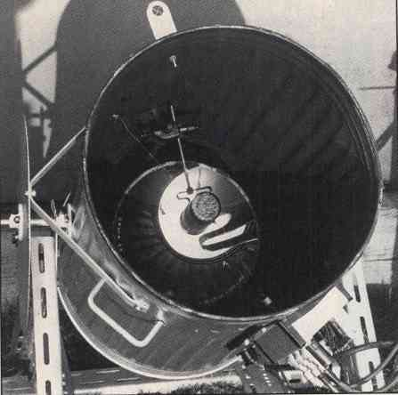
The Experimental Beginning
1953
By using a garbage can,
a 60 cm diameter mirror
in it and a PMT in its focus Galbraith and Jelly had discovered the
Cherenkov light pulses
from the extensive air
showers.

Slide 6
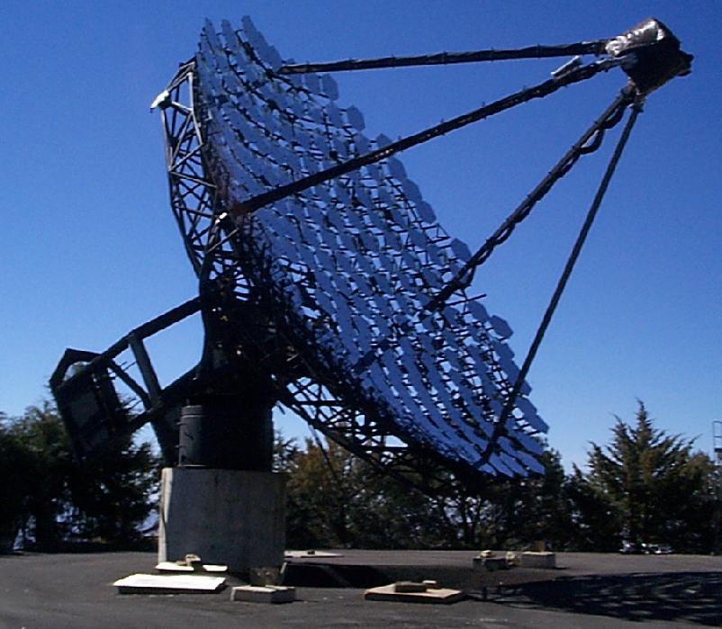
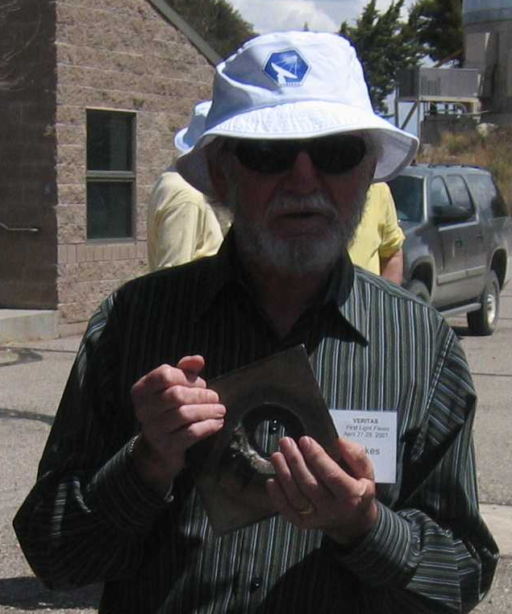
The Pioneer Trevor Weekes and his 10m Ø Whipple telescope gave birth to γ-ray astrophysics: 9σ from Crab Nebula in 1988 !
„If a telescope can within
a few sec. evaporate a solid
piece of steel, it can also
measure gamma rays“
;-)

Slide 7
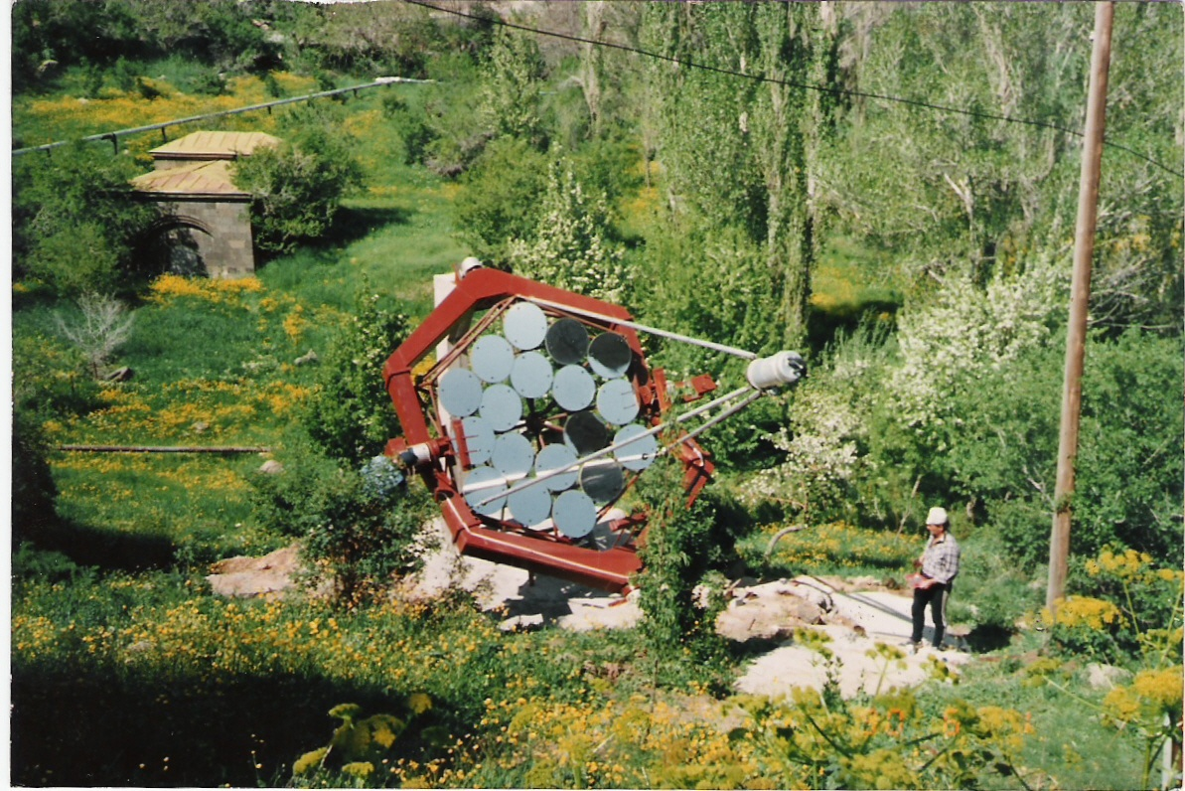
The 1st telescope (of 5 planned) we´ve built: 1989
Nor Amberd cosmic ray
Station, mount Aragats,
2000 m a.s.l., Armenia

Slide 8
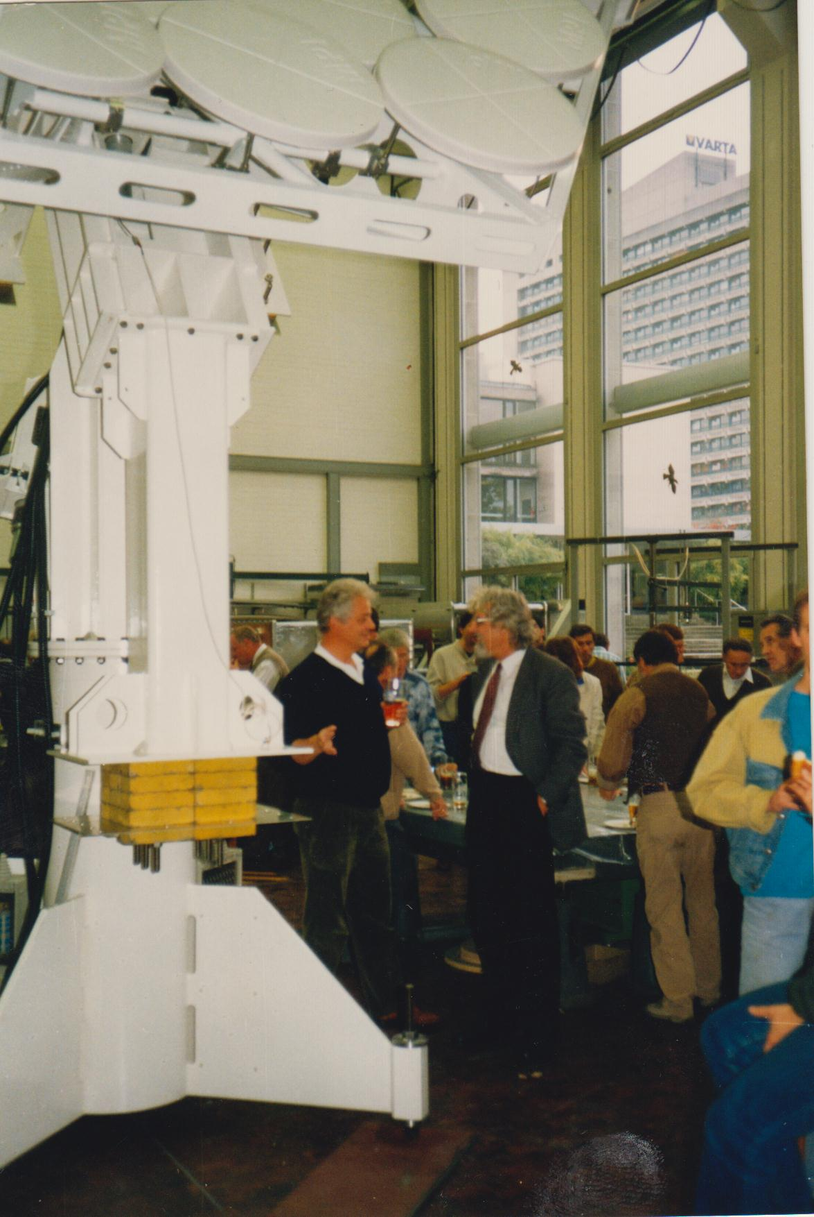
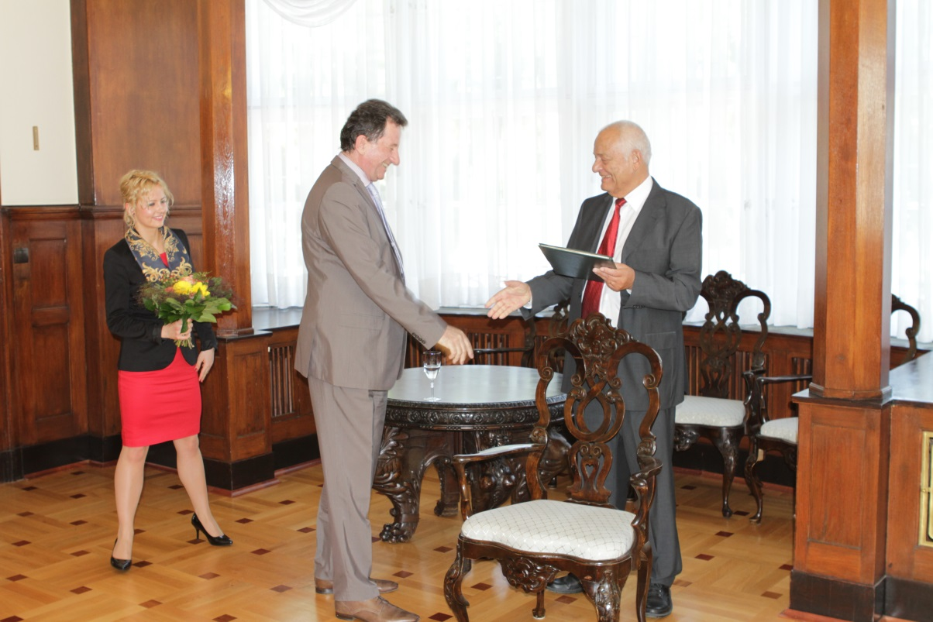
Eckart Lorenz, the driving motor of HEGRA, MAGIC, CTA in MPP
Inauguration of the HEGRA 1st telescope
in the workshop of MPP; 1991

Slide 9
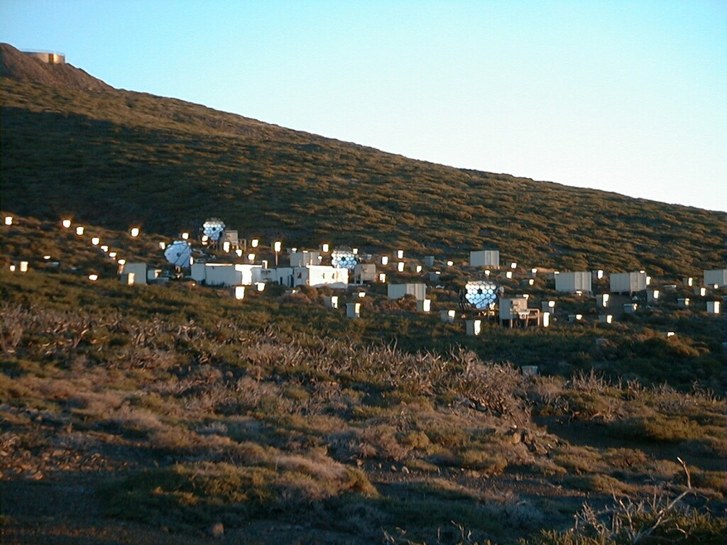
The HEGRA detector, including
6 air Cherenkov imaging telescopes
Location: ORM @ La Palma
Operation 1992 - 2002
CT6
CT3
CT1
CT4

Slide 10
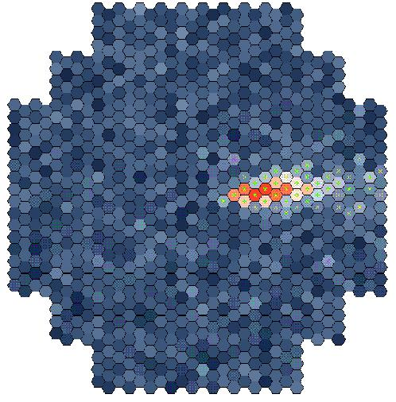
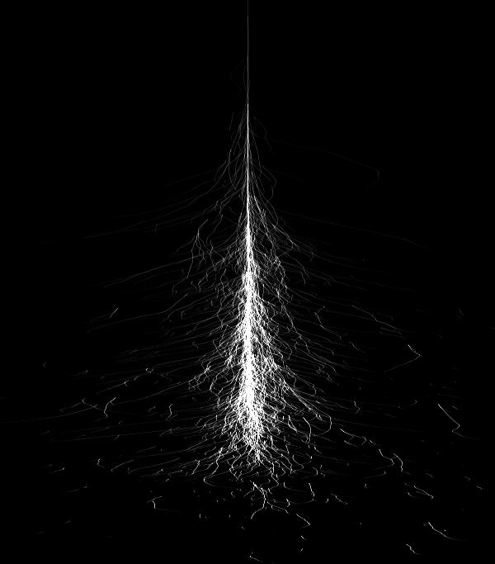
The IACT principle
Multiple telescopes
allow one to
precisely measure
the impact point
of air shower’s axis
and hence its E

Slide 11
Galactic and extragalactic sources seen by the HEGRA air
Cherenkov Telescopes.
Flux is presented in Crab units. H: HEGRA; C: CAT; W: Whipple; T: 7-Tel. Array
Source | Type | Distance kpc or z | σ = σ(Η) | Flux (in Crabs) | Experim.
Crab Nebula Cas A TeVJ2032+4130 | Plerion SNR (shell) Unknown | 1.6 kpc 3.4 kpc Unknown | >> 10 ~ 6 ~ 7 | 1.0 0.03 0.03 | Many HEGRA HEGRA
Mkn 421 Mkn 501 1ES 1959+650 H1426 1ES 2344+514 M87 | BL Lac BL Lac BL Lac BL Lac BL Lac Radio gal. | 0.030 0.034 0.047 0.129 0.044 0.0044 | >> 10 >> 10 >> 10 ~ 7 ~ 4 ~ 4 | 0.04 - 8 0.33 – 11 0.05 – 2.2 0.03 – 0.08 0.03 0.03 | Many Many H, W, C, T H, W, C H, W H

Slide 12
HEGRA movie

Slide 13
HEGRA publications
During its existence the HEGRA collaboration has published:
  72 articles in peer reviewed journals

Slide 14
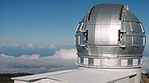
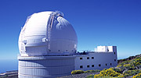
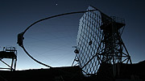
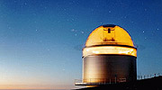
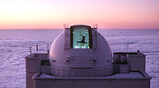
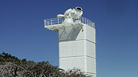
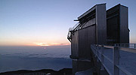
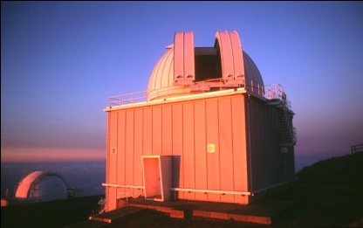
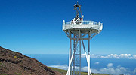
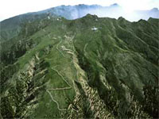

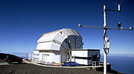
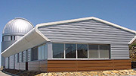
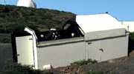
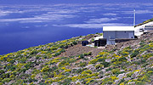
The Main Telescopes of the “Roque de los Muchachos” European Northern Observatory
ORM is located on the Canary island of
La Palma, at a height of
2200-2400 m a.s.l.

Slide 15
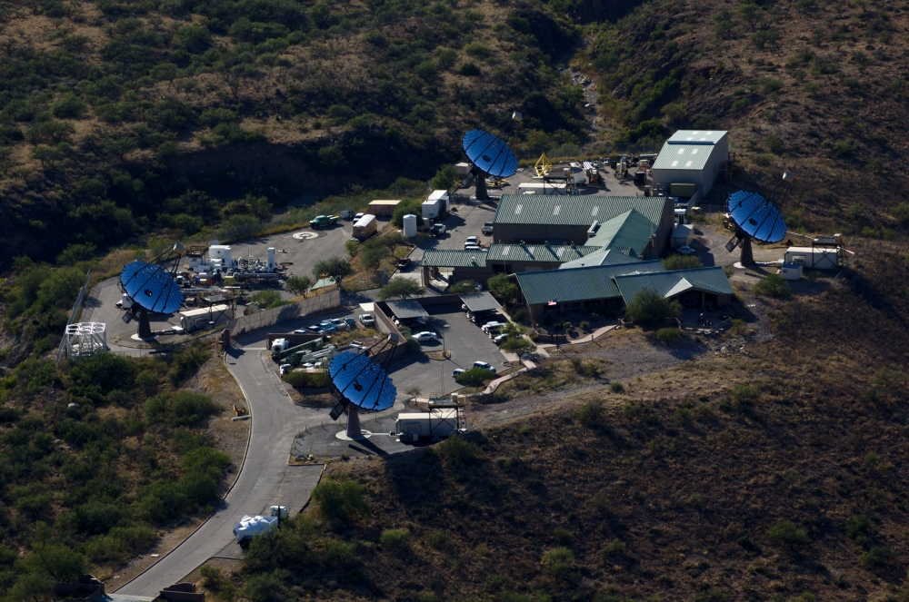
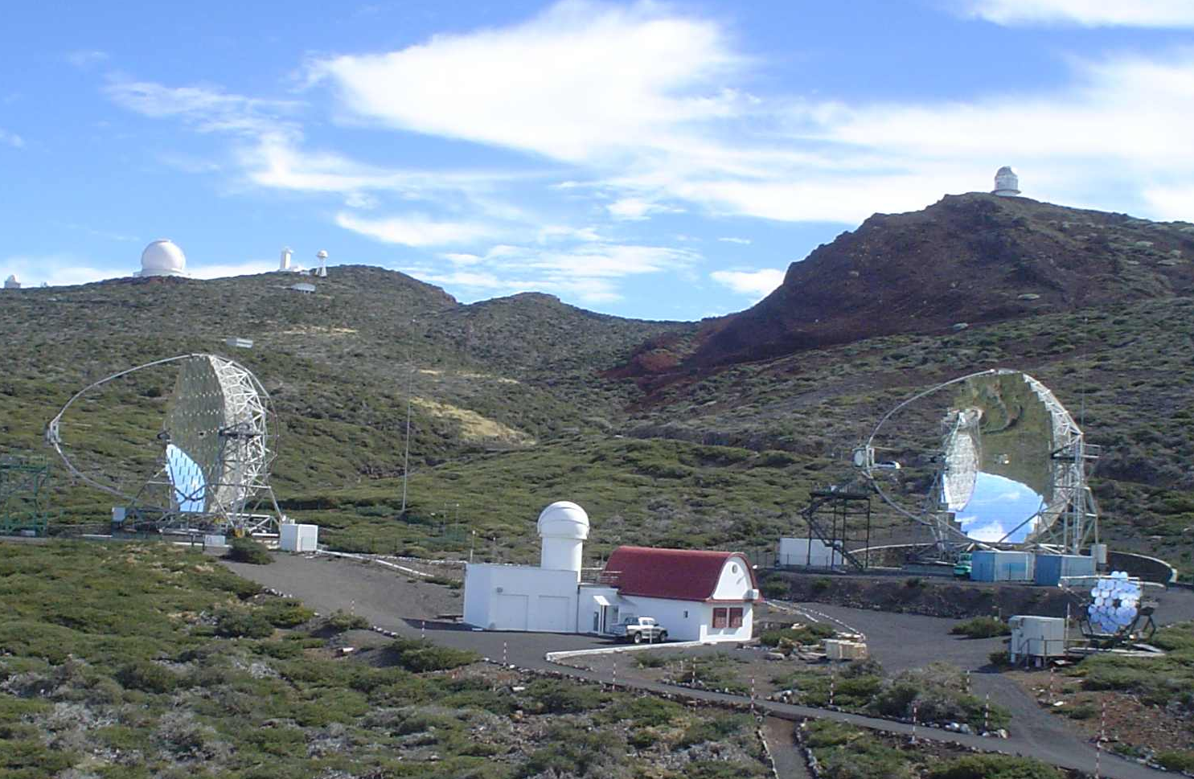
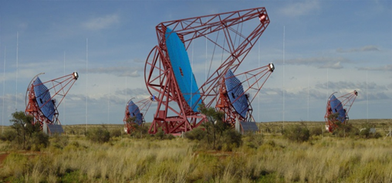
VERITAS, H.E.S.S. & MAGIC: the triumphal procession of VHE γ-astro-physics is continueing
and today…

Slide 16
Unique feature of MAGIC & CTA LST Telescopes is
High-Tech
Best PMTs worldwide, with peak <QE> ~43 %, ph.e. CE ≥ 94 %
Reinforced carbon-fiber frame for the MAGIC reflectors
Active Mirror Control for Imaging Air Cherenkov Telescopes
ns fast analog signal transmission via optical fibers
Active cooling and temperature stabilization, sealed camera
Fiber-optic multiplexed 2 Gsample/s FADC system
Mat lacquer coating for PMTs, enhancing QE by ~15-20 %
Delay scheme for analog signals in several ns range
Diamond-milled all-aluminum mirrors
Hemispherical input window PMTs
Developed record parameter sensors: SiPMs, GaAsP HPDs, ….

Slide 17
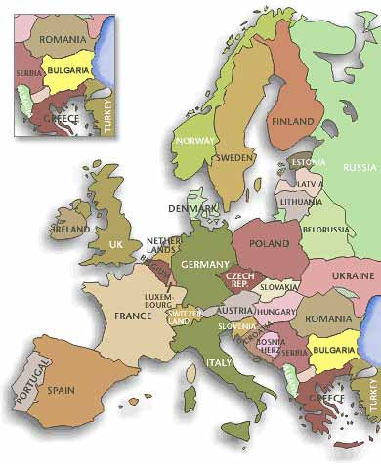
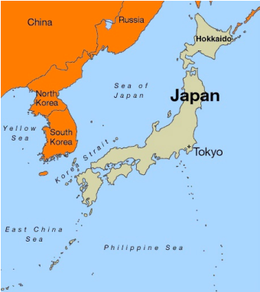
~170 Collaborating Astro-Physicists, 11 Countries
Armenia Yerevan
Bulgaria Sofia
Croatia Consortium (Zagreb, +…)
Finland Consortium (Tuorla, +…)
Germany DESY Zeuthen, U. Dortmund,
MPI Munich, U. Würzburg
Japan Consortium (Kyoto, Tokyo, +…)
Italy INFN & U. Padova, INFN Pisa & U. Siena, INFN Como/Milano Bicocca, INFN Udine/Trieste & U. Udine,
INAF (Consortium: Rome, Milan, +…)
Poland Lodz
Spain U. Barcelona, UAB Barcelona, IEEC- CSIC Barcelona, IFAE Barcelona, IAA Granada, IAC Tenerife, U. Complutense Madrid, CIEMAT Madrid
Switzerland ETH Zurich
India Saha Inst. Nucl. Physics, Kolkata

Slide 18
MAGIC movie

Slide 19
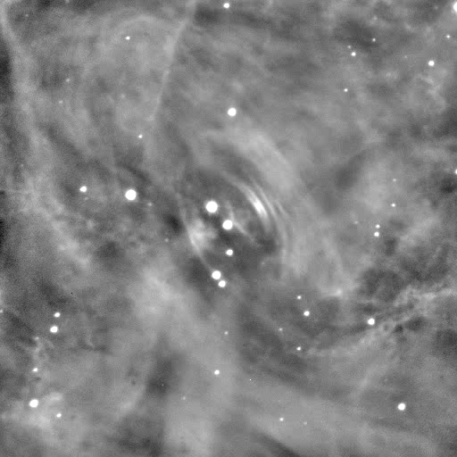
The Crab pulsar & MAGIC
Aliu et al. (MAGIC collab.)
Science 322 (2008) 1221
First detection of emission above 25GeV for a pulsar
Aleksic et al (MAGIC collab.), ApJ, 742 (2011) 43,
First spectrum 25-100GeV
Aleksic et al (MAGIC collab.), A&A, 540 (2012) A69
First spectrum 50-400GeV
Aleksic et al (MAGIC collab.),
A&A 565, L12 (2014)
Discovery of Bridge Emission
Aleksic et al (MAGIC collab.),
A&A, 585 (2016)
Tera-electronvolts pulsed gammas

Slide 20
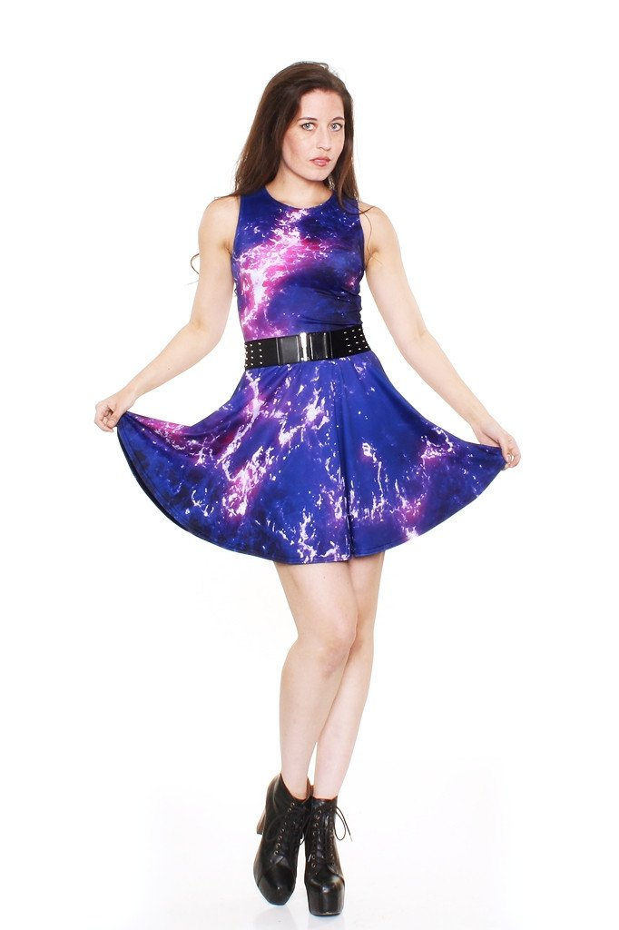
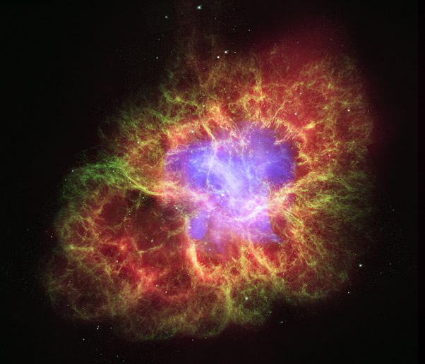
Crab Nebula
Results on Crab Nebula make astrophysics more
popular and fashionable in our society, the best proof
is shown below
Crab A-line dress
only $79.00

Slide 21
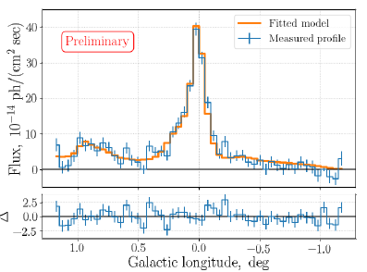
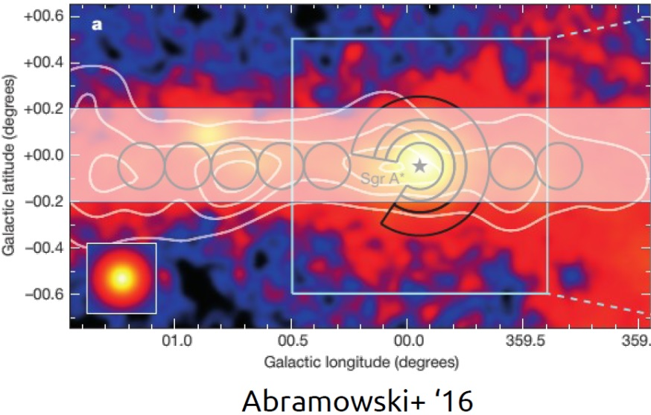
Galactic Center seen by MAGIC
Galactic plane brightness scan
This contains Arc, G0.9, Sgr*
We searched for ~1/R^{α} type profiles
Our data suggests a peaked CR profile
with index ~1.2 - 1.5
Publication is under preparation

Slide 22
The most distant sources at VHE (TeVCat)
z>0.368
MAGIC discovered 9 from the 13 sources with z > 0.3

Slide 23
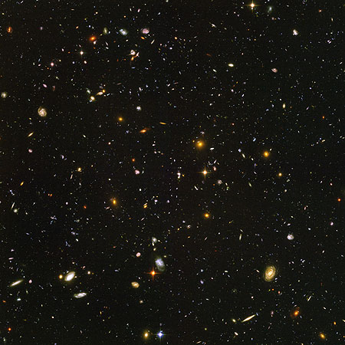
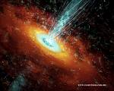
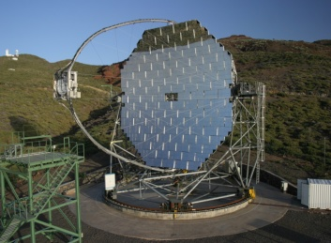
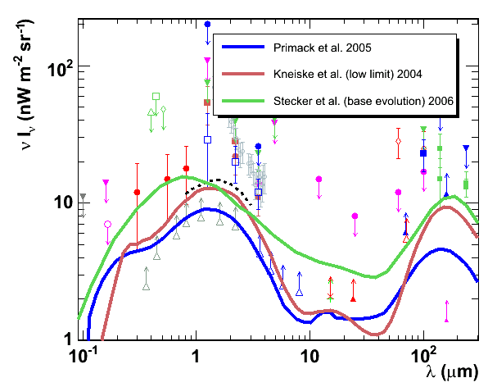
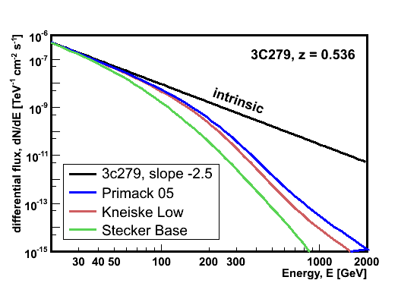
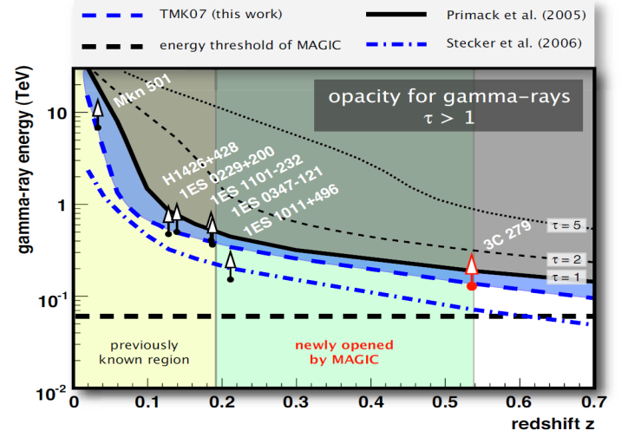
Gamma Ray Absorption by the EBL
Extragalactic Background Light
blazar
IACT
γ_{VHE}
γ_{EBL}
e⁺
e⁻
MAGIC
SCIENCE
320 (2008)
Notes:
23

Slide 24
Flat Spectrum Radio Quasars
The most luminous sources: γ-ray emitting AGN class
-the VLBA jets with high Doppler factors, “knots” in the jet
-optical spectrum shows broad emission lines
-SED: low synchrotron peak frequencies (infrared)
In VHE (>100GeV) γ-rays 7(?) known, 6-MAGIC:
3C279 (MAGIC in Feb 2006 and Jan 2007, single night detections, MAGIC in Feb 2014 detection of weak signal
PKS1510-089 (H.E.S.S. in March-Apr 2009, MAGIC in Feb-Apr 2012, March-June 2013 no VHE variability)
PKS1222+216 (MAGIC single night in June 2010, VERITAS and MAGIC several nights in Feb 2014)
PKS1441+25 and B0218+357 the newbies
S4 0954+65 and BL Lac disputed classifications

Slide 25
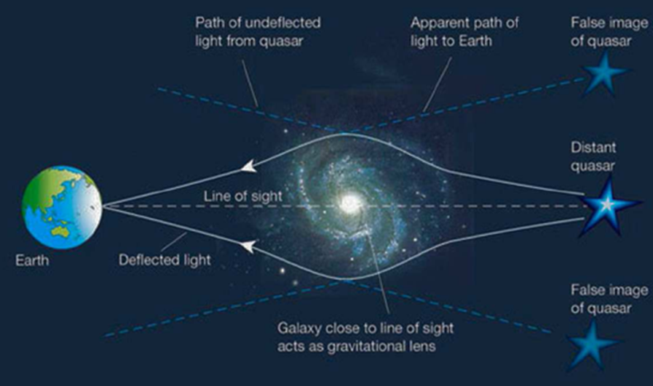
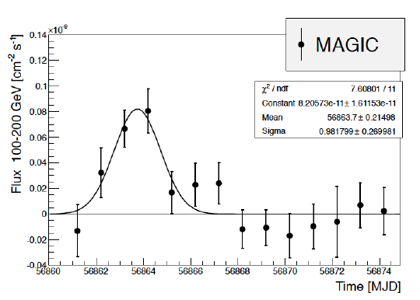
Discovery of Gravitationally Lensed Blazar B0218+357 residing at the red shift 0.944
In 2012 Fermi observed high state, with many overlapping flares
Fermi claimed 11.46 ± 0.16 days delay for the lensed component
On July 13/14 2014 Fermi again observed a high state
Magic started observing 2 days before the predicted delayed signal and kept on-going till 5th of August

Slide 26
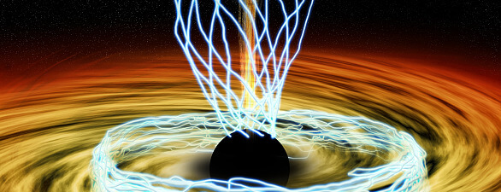
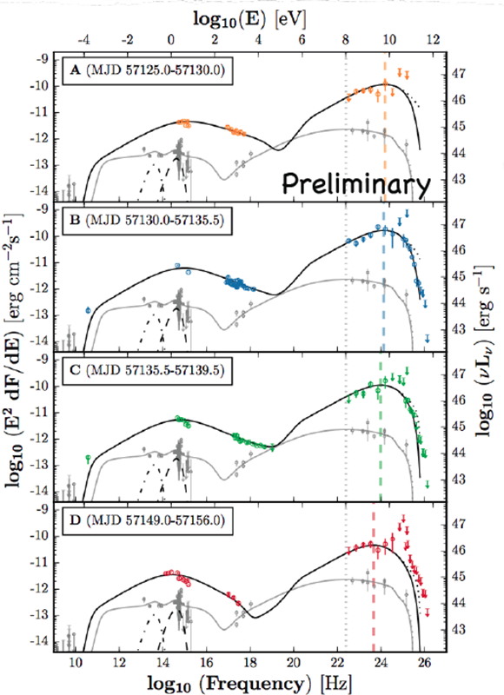
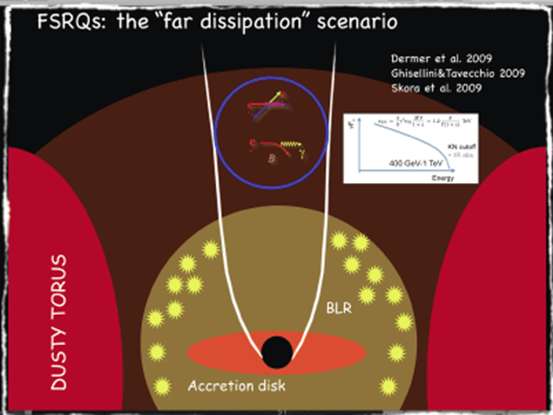
Discovery of FSRQ PKS-1441 +25; 25 σ, > 4000 γ
Along with S3 0218 +357,
z = 0.944, this is the most distant
VHE source: z = 0.939
Lack of absorption features in the
measured HE - VHE γ-ray spectra
allows one to constrain the location
of emitting region to be far from the
center
40 – 250 GeV energy range

Slide 27
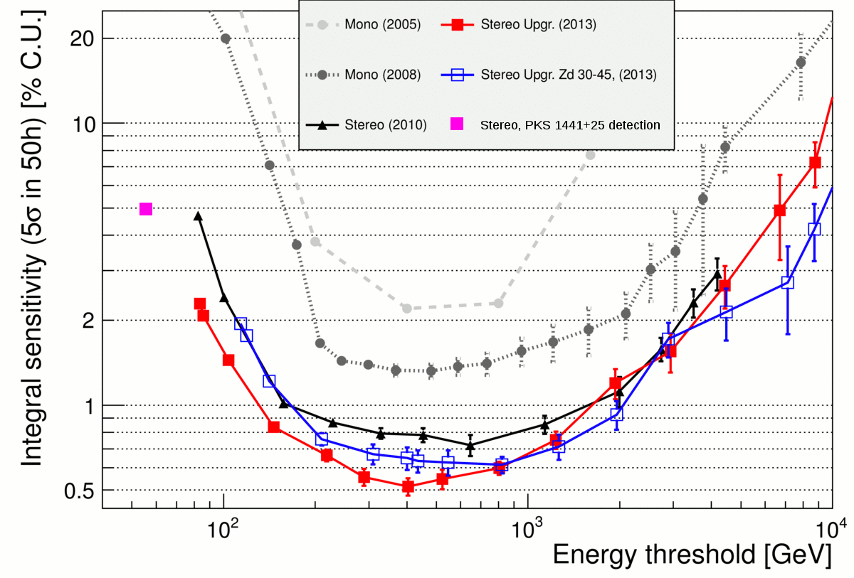
MAGIC Sensitivity

Slide 28
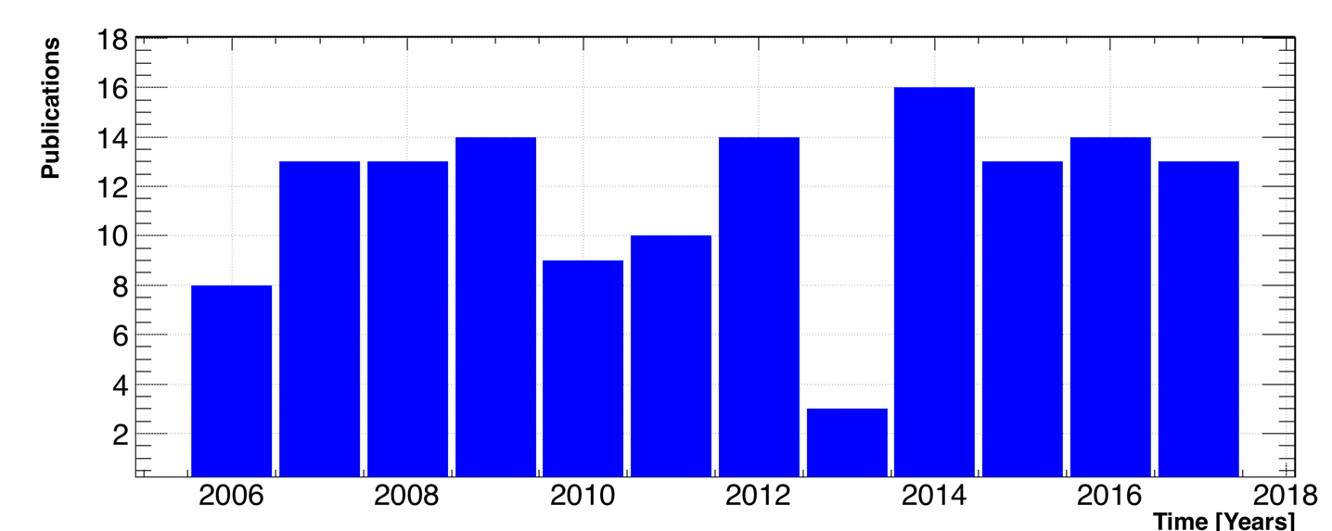
A bit of MAGIC statistics
Number of publications in peer reviewed journals: 140
Number of citations in peer reviewed papers : 7123
Total number of downloads (all MAGIC papers, all years) : 55000
Number of
publications/year

Slide 29
Commissioning of new Sum-Trigger-II revives MAGIC operation down to a few tens of GeV
New Stereo Analog Trigger for Very Low Energy Observations
Development initiated and is driven by the MPP MAGIC Group
- Sum of analog signals
of a patch of PMTs
comparable in size to the
expected size of the low
energy images
- Use low photon signals
below the single channel
threshold
- Integration over larger area
- Increases S/N at low E

Slide 30
Crab Pulsar With the New Sum-Trigger-II
Energy Range: 30 – 200 GeV
signal significance 2.3 σ/√(hour)

Slide 31
Very fresh data: Discovery of the 3rd VHE pulsar by MAGIC (details to be announced soon)
Sum-Trigger data & analysis

Slide 32




Cartoon on longer path length in atmosphere for an EAS @ large zenith angle observations
small zenith angle
Large zenith angle

Slide 33

MAGIC Getting a Second Wind at ≥ 100 TeV With Very Large Zenith Angle (VLZA) Observations
Development is Initiated and Driven by the MPP MAGIC Group
Sunset in
La Palma
Now we are working with a novel for IACTs calibration method of the
atmospheric absorption as well developing a very precise, advanced
calibration, based on a small optical telescope with a spectrograph

Slide 34
VLZA γ event measured from a PeVatron candidate source at E ≥ 100 TeV
Novel results will be released to public in several weeks from now
E = 141.8 TeV

Slide 35
IceCube Recent EHE Event & MAGIC

Slide 36

IceCube Recent EHE Event & MAGIC
During Sept. 28 - Oct. 4th
2017 MAGIC measured
from the direction of a
Fermi blazar, within 6’ from
the alerted IceCube EHE event
170922A, a significant signal.
Now working out to
determine the red shift of
the source and its spectrum
If the IceCube - Fermi – MAGIC detections are from the same source,
this will be the 1st time proof of the long-anticipated ν – γ connection

Slide 37

Significant Improvements of Sensitivity at the Lowest and the Highest Energies Due to New Techniques of Sum-Trigger-II & VLZA Observations

Slide 38
The next ~5 years
MAGIC is in its best ever historical sensitivity and in a best
shape
We are publishing 1-st class results at a very high rate
Due to two recent novelties, just commissioned and included
into MAGIC operation, the project got a “second wind”, by
significantly increasing its sensitivity and the dynamic range
at the lowest energies, down to ~30 GeV (and even below)
(SUM-Trigger-II) and at the highest energies ≥ 100 TeV (VLZA
observations)
We hope to operate MAGICs for ~5 more years and have a
smooth transition into the CTA era (MAGIC will play a very
important role in commissioning the LST telescopes)

Slide 39
Celebration – workshop devoted to the 15 years of operation of MAGIC next year
We are aiming to organize an international conference for
celebrating the 15 years operation of MAGIC and its science
highlights in the beginning of summer 2018 in La Palma

Slide 40


The Next Major γ Ray Instrument: CTA
CTA: > 1400 members from > 170 institutions
CTA is the next major instrument in VHE γ astro-physics; total ~120 telescopes of 3 different sizes
CTA telescopes will cover
the energy range 0.02 –
-100 TeV with significantly
higher sensitivity than the
Current instruments

Slide 41


CTA North (top) and South (bottom) Observatories

Slide 42

Design of the 23m Ø Large Size Telescope of CTA
The plan is to build 4 LST
telescopes in the CTA North
location (La Palma) within
the next couple of years
The 1st 23m Ø LST
prototype is under
construction in La Palma
It will be commissioned and
inaugurated in 2018
Measurements with
unprecedented sensitivity will
become reality just in a few
years from now

Slide 43
LST construction movie

Slide 44
Backup slides

Slide 45

Gravitational lensing

Slide 46
How can one study the SED of a lensing source ?
Not an easy task
Flux magnification must be taken into account
  Radio and optical images can be used for lens modeliing
  and arriving at the magnification
What data can be called simultaneous ?
  Simultaneous data can help to find out the magnification;
  otherwise one may appear as an additional variability
Possible absorption in the emission in the lensing object
  Can happen in any of the two images, quasi-independently

Slide 47

Gravitational lense system B0218
(also known as S3 0218+357)

Slide 48

MAGIC + Fermi LAT SED
Unfolded spectrum is measured in the range 65 – 175 GeV
De-absorbing the
MAGIC spectrum
(Dominguez et al.
2011 EBL model) the
index is ~2.3
preliminary

Slide 49
The potential of gravitational lensing events
One can study the gravity at ~100 GeV (take radio)
Locating the emission region (need a very fast flare)
Micro-lensing
In addition to the bulk of the galaxy the photons will encounter also
individual stars
The (micro-)lensing on them will be too small to distinguish individual
images, but the observed flux would vary as the source passes projected
position of the source
Magnification changes will depend on the size of the emission region and
the variability of the magnification ratio on the projected speed of emission
region w.r.t. stars in lens
The magnification ratio variability on the time scale of months, when
explained as microlensing on stars, can put strong constraints (small, non
relativistic) on the emission region (Neronov, Vovk, Malyshev, 2015)
Same study can be done in VHE gamma rays in future flares

Slide 50
High red-shift blazars
High red-shift VHE blazars have a large scientific impact on cosmology, particle physics, basic physics and are becoming important tools for studying the space traversed by γ-rays:
Extragalactic Background Light (EBL)
Intergalactic Magnetic Fields (IGMF)
Tests of Lorentz Invariance Violation (LIV)
Search for Axion Like Particles (ALPs)

Slide 51

MAGIC B0218 & MWL
MAGIC: a single ~2 day long
flare at the expected time of
arrival
● Fermi-LAT: Clear leading flare,
detected also significant
emission during the trailing flare,
but difficult to prove that the
emission really larger than
between the two components
● No enhanced emission during
the second component of the
flare in X-rays and optical range

Slide 52
B0218+357
Gravitational lensed objects allow us to have a 2nd look at a flare
We have a possible, self-consistent SED model for the B0218+357
outburst
VHE spectrum consistent with the current EBL models
There is still much more that we can do when we will detect
another flare of this source in both A and B images

Slide 53


Probing the EBL models with PKS-1441 +25
MAGIC measured the
spectrum from 40 – 250 GeV
In the 1st time we got the
opportunity to check the EBL
models till the red shift z ~1
The measured spectrum is
compatible with current
generation of models:
Dominguez+11, Franceschini+08,
Gilmore+12, Scully+14

Slide 54
Discovery of Gravitationally Lensed Blazar B0218+357 residing at the red shift 0.944
Flat spectrum radio quasar at z=0.944
Gravitationally lensed by a spiral galaxy (seen face-on) at z=0.68
It is the farthest known VHE source and the only one lensed !

Slide 55

“FRSQ problem”
Emission scenario; close to
central engine OR just
outside BLR OR at 43GHz
VLBA core?
• Close to central engine: fast
variability most naturally
explained, but BLR should
absorb the VHE photons
• If outside BLR, where do the
seed photons for IC
scattering come from, how
to produce the small
emission region
Cartoon of the possible locations of the
emitting region

Slide 56


PKS-1441 +25
Two flux states can be distinguished
during the flare
Flux halving time is ~ 6 days
No signal after the moon-break
period

Slide 57

Complex HEGRA array on the Canary island of La Palma: 1992 – 2002 (~ 200m x 200m)

Slide 58

French scientists
M.L. Mallet
published 3 articles on the
bluish glow in transparent liquids (1926-1929).
On the left one can see a scan of one of those papers (1926)
Mallet recongnised the continuous spectrum of emission that was contradicting the fluorescence theory, but failed to offer any deep explanation

Slide 59

The pioneer instrument for covering the electromagnetic spectrum in the E ~ 30 - 200 GeV

Slide 60
System of 2 MAGICs: the main parameters
Energy threshold (trigger): ~ 50 GeV
Energy threshold in “Sum-Trigger” modus: 30 - 35 GeV
Energy resolution: 15 % - 23 % for E ≤ 10 TeV
Angular resolution: 0.07° for E ≥ 300 GeV; 0.05° @ 1 TeV
Sensitivity: source with 6/1000 of Crab Nebula 5σ in 50h
Light-weight construction, only ~ 70 T
Fast re-positioning to any coordinates in the sky: 25s/180°
Opto-electric design optimized to provide ~ 2.5ns FWHM pulses
Data digitized by using DRS4 chips operated at 1.67 GigaSample/s
Producing ~ 1 TB data per observation night per telescope

Slide 61

Lensing of B0218+357

Slide 62

The extensive way of CTA

Slide 63
PeVatrons are believed to be the sources of galactic cosmic rays
(Berezhko & Völk, 2007)
Very likely the cosmic ray “knee” is due to the chemical composition of accelerated cosmic rays
In general one expects
E_{max} ~ Z of the particle
(Peters, 1961)
Until few years ago one believed E_{max}~ 10¹⁴ eV for protons
Since the mechanism of the magnetic field amplification has been put forward (Bell, 2004) , one believes that E_{max} ~ 3x10¹⁵ eV for protons

Slide 64

SED PKS-1441 +25
Lack of absorption features in the measured HE - VHE γ-ray spectra allows one to constrain the location of emitting region to be far from the center
External Compton scenario

Slide 65

The powerful way of CTA

Slide 66


Alexander Chudakov and the Cherenkov Technique for
Gamma Ray Astronomy
1921-2001
Crimea Experiment 1959-1965, Chudakov, et al., (SNR, radio galaxies)

Slide 67


Complex Extensive
Air Shower Detector
HEGRA
The main components
were:
252 scintillation huts
100 AIROBICC huts
17 Geiger towers (for µ‘s)
6 Cherenkov telescopes

Slide 68


HEGRA telescopes
CT1 started to collect data in August 1992
The 1st signal from Crab Nebula obtained
in October1992
CT2 – CT6
The 1st telescope of
HEGRA, the CT1 (before
upgrade in 1997)

Slide 69



Extragalactic Sky at VHE
Seen by MAGIC
65 sources (TeVCat)
http://tevcat.uchicago.edu/

