Slide 1
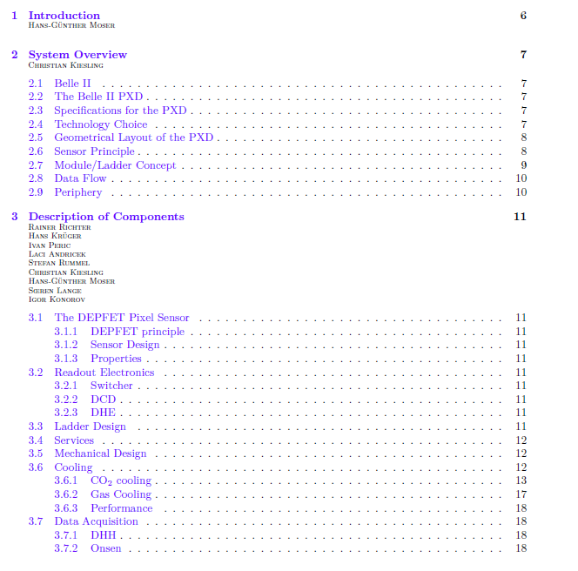
Whitebook
One page exists
four pages exist (HGM)
Ca. 10 pages exist (HGM)

Slide 2
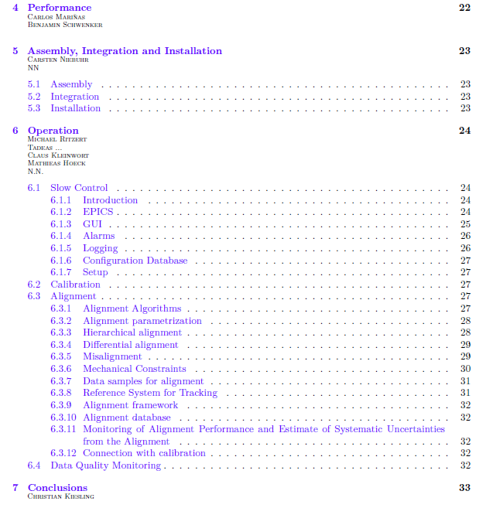
three pages exist (Michael Ritzert)
five pages exist (Claus Kleinwort)

Slide 3
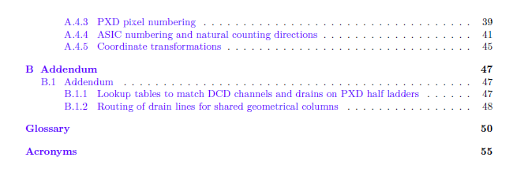
exists (Manfred Valentan)

