Slide 1
Charles University
Prague
Cluster shape correction and alignment status
Tadeáš Bilka, Peter Kodyš, Peter Kvasnička,
Charles University, Prague
21st DEFET workshop, May 30, 2017, Ringberg Castle

Slide 2
Outline
Why correction base on cluster shape.
Angle dependence of correction.
How it works, scheme, data flow.
How to obtain corrections –
Full pixel correction
Simulations
Real data
Some details, theory and technicalities.
Results od corrections.
Current status and plan.
Alignment and calibration framework in basf2 status

Slide 3
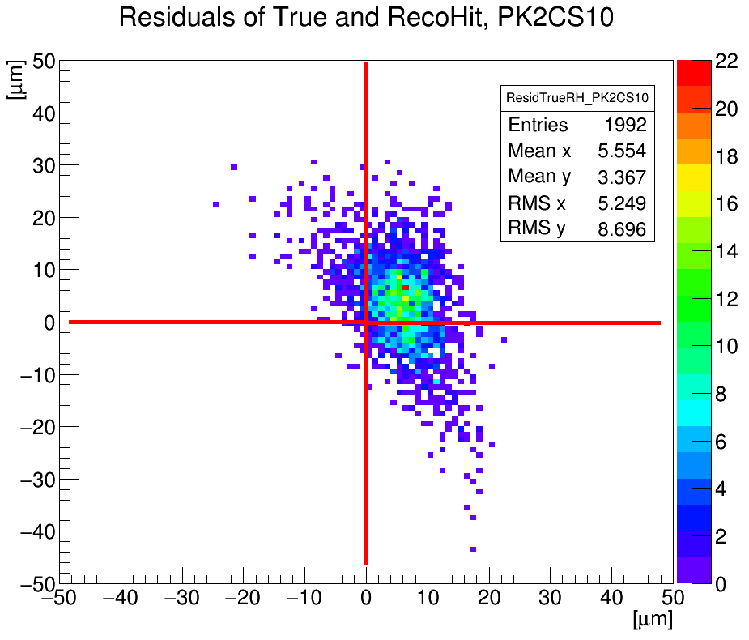
Why correction base on cluster shape
There is observed and also simulate significant missposition of reconstructed position of clusters compare with true position (in simulation) or track position (in real data from test beams). We call it Bias of position. Bias is strongly depend of angle of track over sensor, see next slides.
Effect was observe especially on “L” shape clusters.
In Belle II we expect ~ 6% od “L” shape clusters on PXD.
Generally we identify 15 kinds of shapes and automatic correction procedure is check and create corrections for every shape kind.
We are expect not in all of shapes will be seen bias od position.
In addition we find a way how to set more realistic Error Estimation of shape kinds.
Branch in basf2: feature/vxd-track-dependent-hit-reconstruction

Slide 4
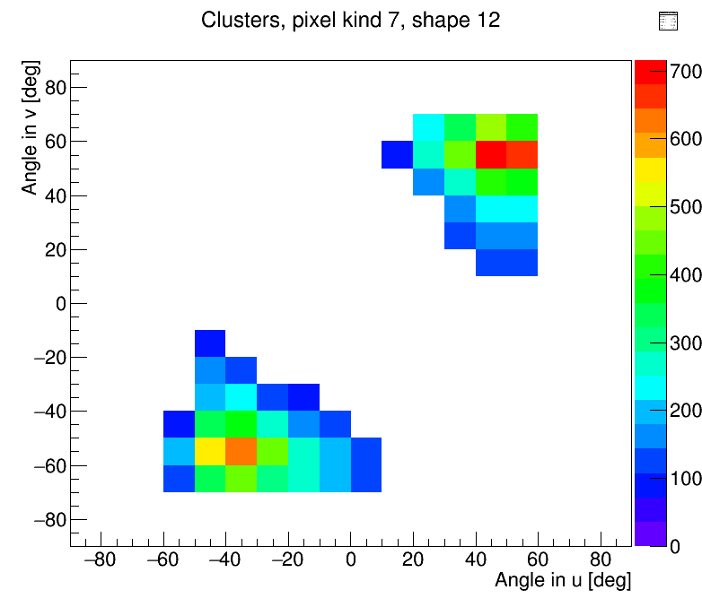
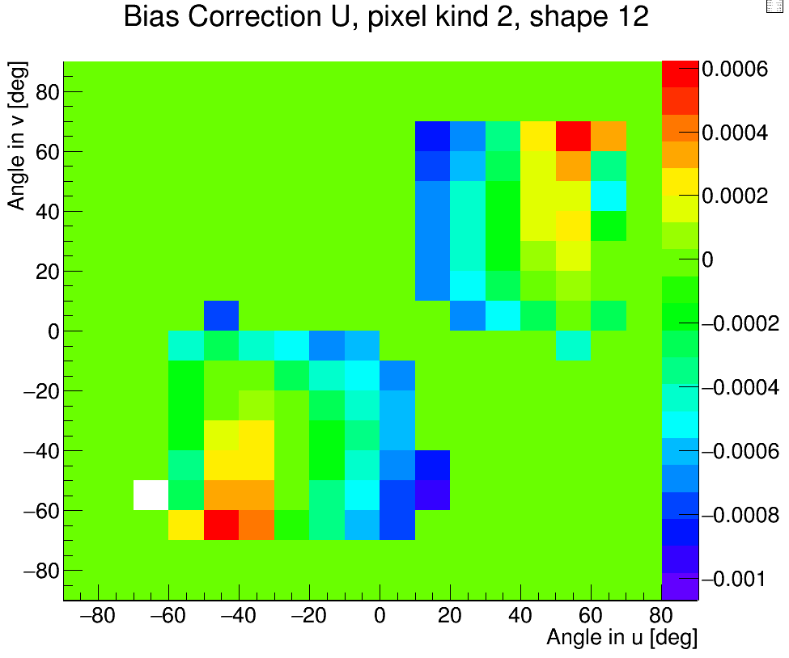
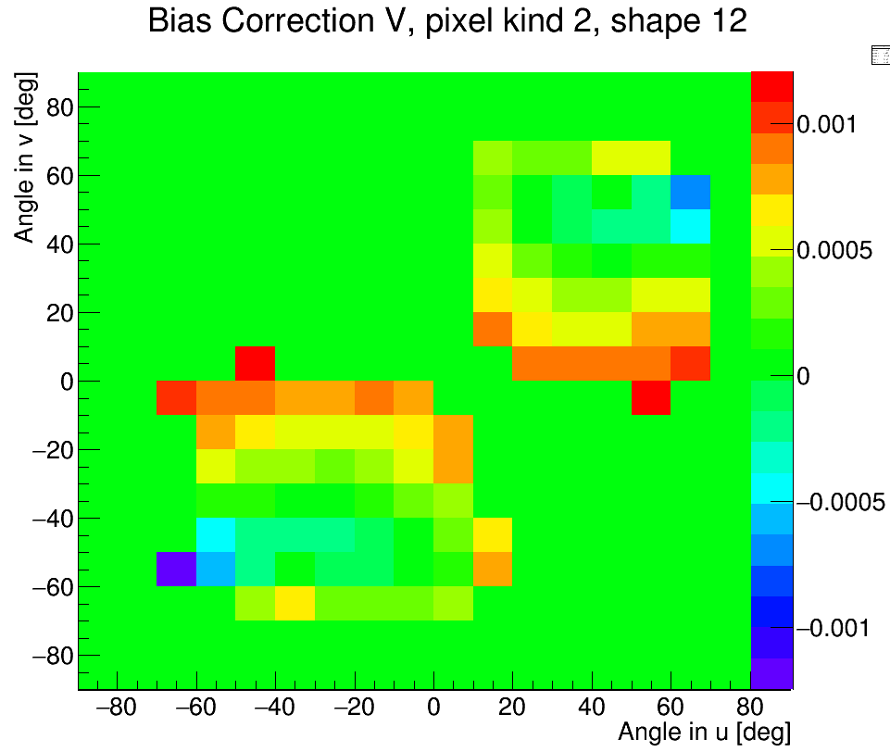
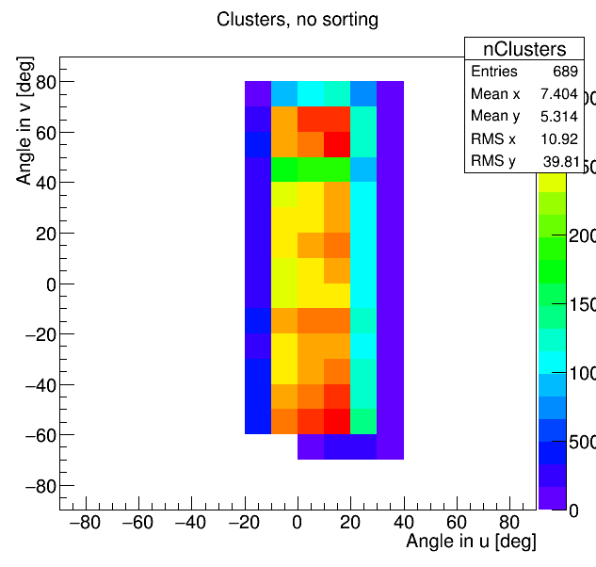
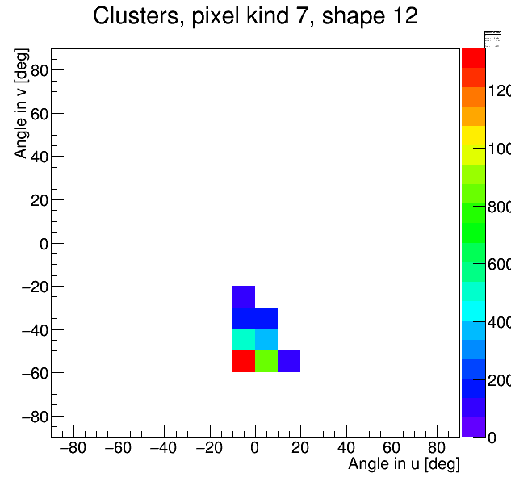
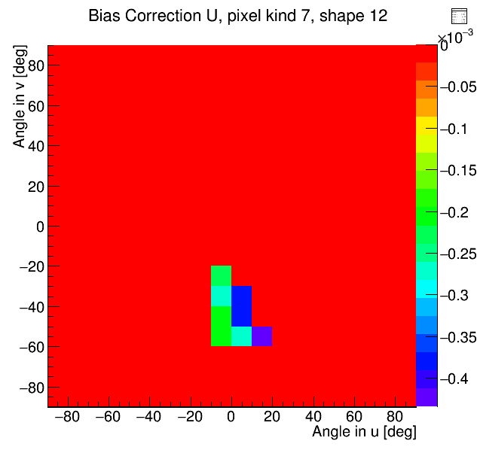
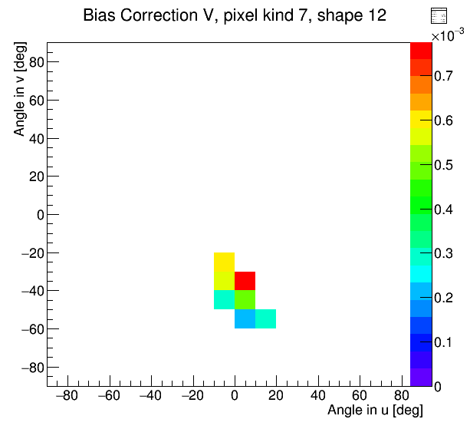
Angle dependence of correction – example for one “L” shape
Cluster occupancy
Bias in u
Bias in v
Full PK2 Sh12 angle range
BelleII angle range
TB angle range
There exist bias dependence from angle.
Bias change value and sign depend of angle.
Belle II use only subrange of all angles (20 %).
Cluster shape use only subrange of Belle II (“L”: 1.5 %).
BelleII PK7 Sh12 angle range

Slide 5
How it works, scheme, data flow
Real data or Simulations
Cluster
SpacePoint
TrackFinder use SpacePoint
Inside RecoHit after asking of position and error estimation
Condition database, stand alone file, select version of corrections
No angle info so no looking for correction
TrackCandidate create RecoHit
Activation of correction & exist angle info so looking for correction
CheckCorrection
Corrections
TrackFitter use RecoHit with corrs
Return only if exist Cor ≠ 0
Track from corrected RecoHits

Slide 6
How it works, scheme, creation of corrections
Real data
Simulations
Cluster
Create Bias and Error Estimation corrections from track info
Create Bias and Error Estimation corrections from true simulations
Cluster
SpacePoint
Merge Bias and Error Estimation corrections from all sources
TrackFinder use SpacePoint
Create final correction file
TrackCandidate create RecoHit
Condition database, stand alone file, select version of corrections
TrackFitter use RecoHit without corrections
Full angle range
Create source data with unbiased track residuals from RecoHit
Belle II angle range
Create source data with true position residuals from RecoHit

Slide 7
How to obtain corrections
There are in principle 3 ways how to obtain corrections:
Full pixel correction
Simulations
Real data

Slide 8
How to obtain corrections – full pixel correction
Residual plot represent true bias and error estimation information from simulation, distribution should match with real data distributions. Agreement confirm correct simulation of pixel properties.
Advantage: full angle range can be simulate.
Possible problem on differences between pixels, unhomogeneities on staves.
About 10 millions samples per pixel kind is needed for creation.

Slide 9
How to obtain corrections – simulations
Residual plot contain track error and cluster error, similar for error estimation information, calculation is not so precise compare with true point analysis.
Belle II angle range only can be simulate.
Possible problem on differences between pixels, unhomogeneities on staves.
About 1 million samples per pixel kind is needed for creation.
real data:
Including real differences between pixels and unhomogeneities on staves.
Could be change over life time of PXD depend of irradiation damage of pixels.
Problems are shown on next slide:

Slide 10
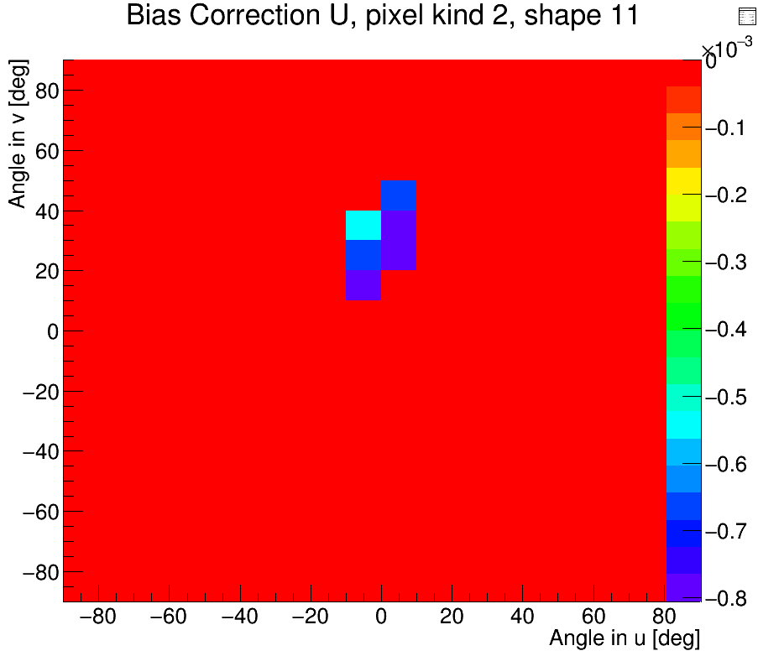
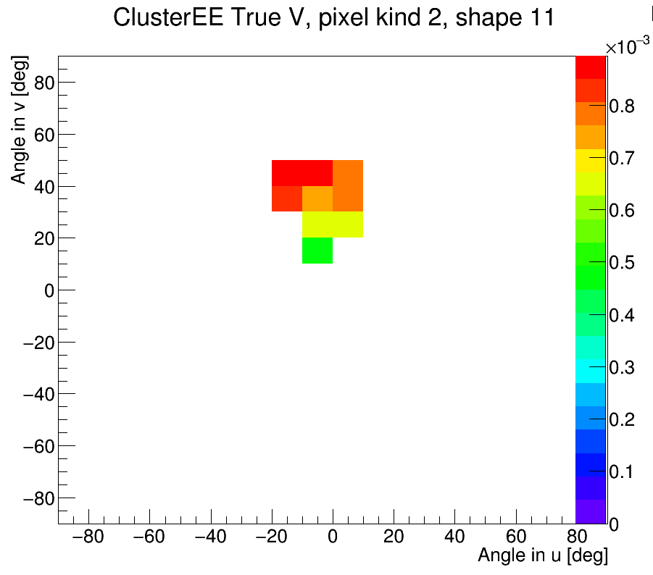
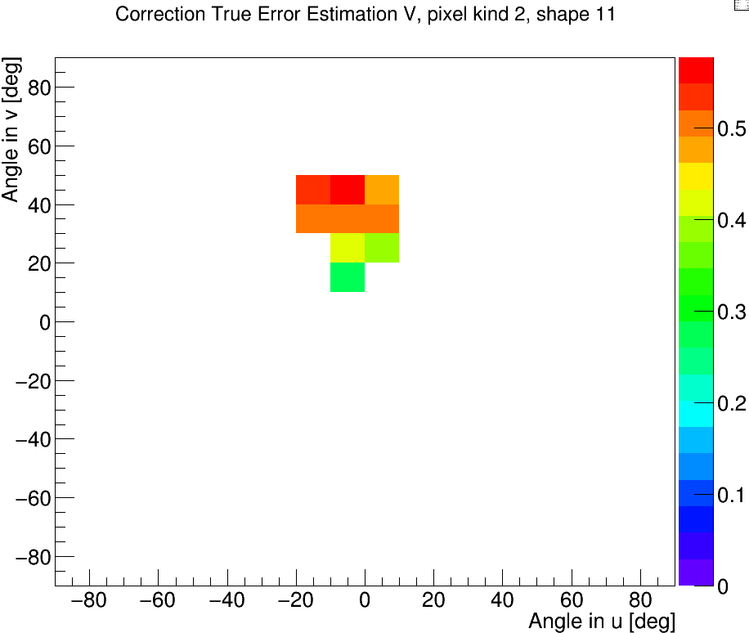
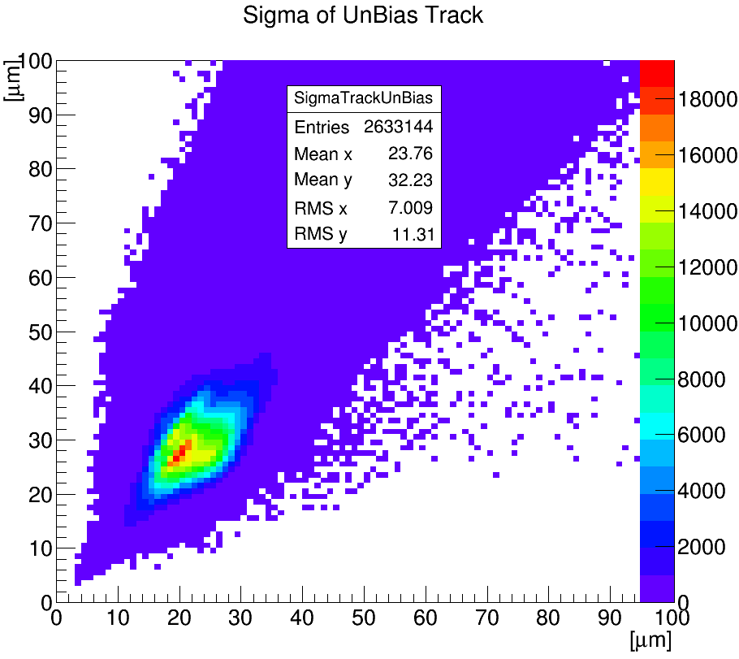
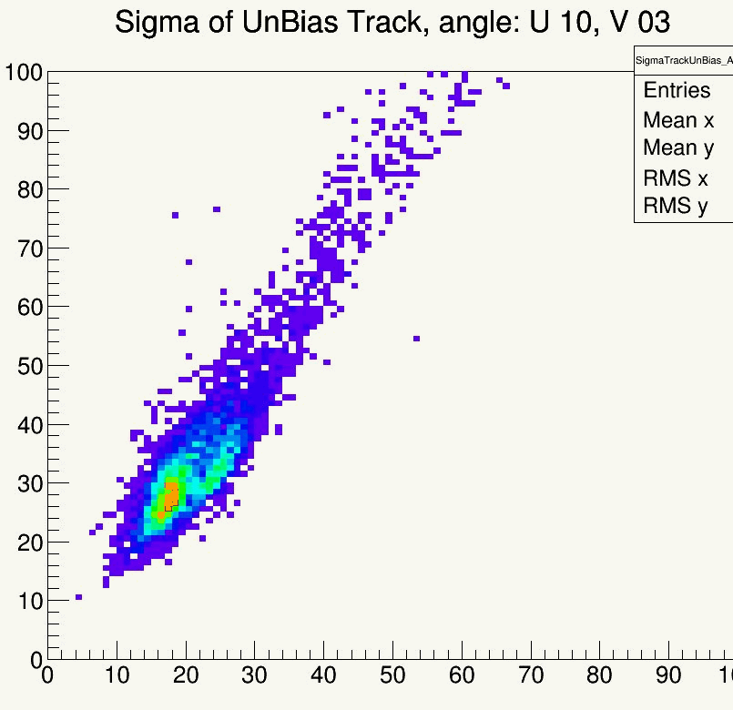
Some details, theory and technicalities
CBX 96-20, Robert Kutschke, Anders Ryd, September 02 1996, Billoir Fitter for CLEO II, Chapter 8 Residuals: for biased and unbiassed tracks residual variance
Sigma(residual_unbias)^2 = Sigma(cluster)^2 + Sigma(track_unbias)^2
Correction of bias PK2 CS11
True EE for PK2 CS11
Correction of EE:
EE from all tracks of Belle II experiment
Changes of Track EE over angle
Final correction is on range +-10 % of true for 100 samples or more

Slide 12
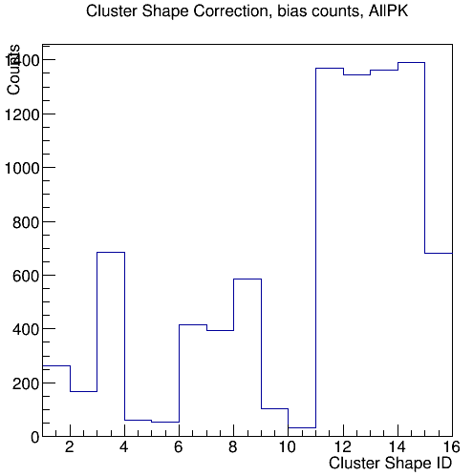
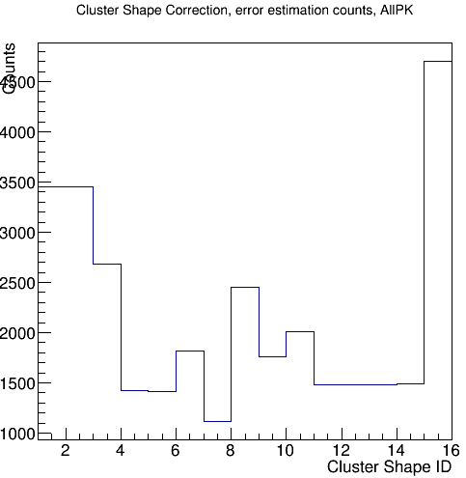
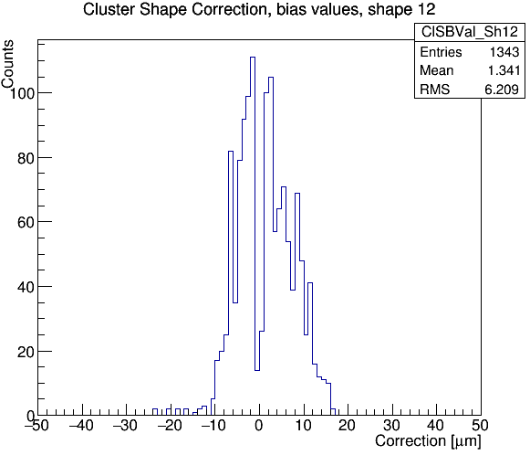
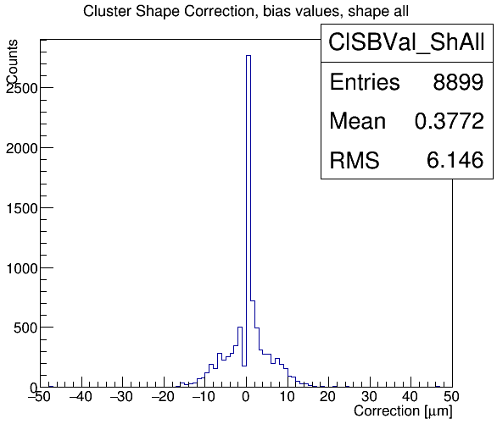
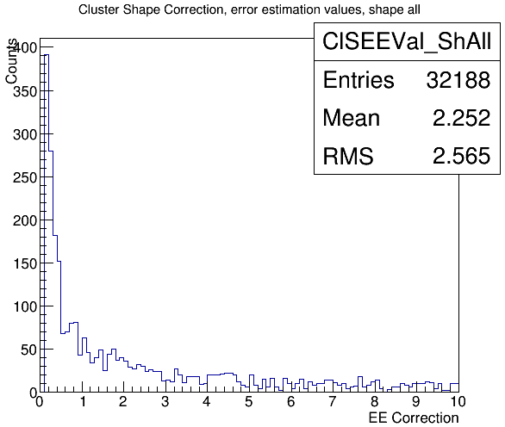
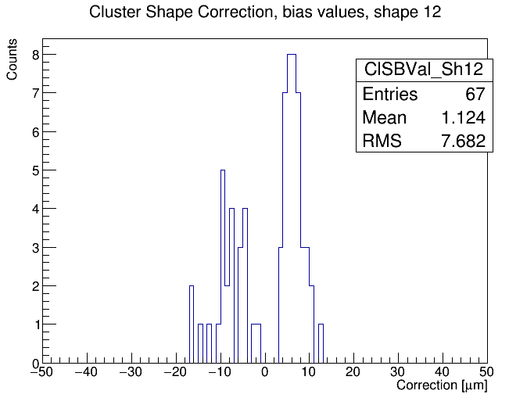
Results
No. of Bias Cors @ ClShape
No. of ErrEst Cors @ ClShape
Bias value @ ClSh=12, AllAngles
Bias value Cors @ ClShape
ErrEst value Cors @ ClShape
Bias value @ ClSh=12, Belle II

Slide 13
Current status and plan
Applying of bias in RecoHit – done
Applying of Error Estimation Correction – close done
Creation of sources – done today
Creation of corrections – bias: done
Creation of corrections – EEC: done
Merging of corrections to one file: done
Using stand alone file of corrections – done
Using conditional database – far of realization, depend of request
Comment: data are storing in format TVectorD acceptable with database
Further plan:
Create DQM of ClusterShapeCorrection – partly done
Confirm Corrections with real data from TB – far of realization

Slide 14
Alignment and calibration framework in basf2 status

Slide 16
Thank you for your attention.

