Slide 1
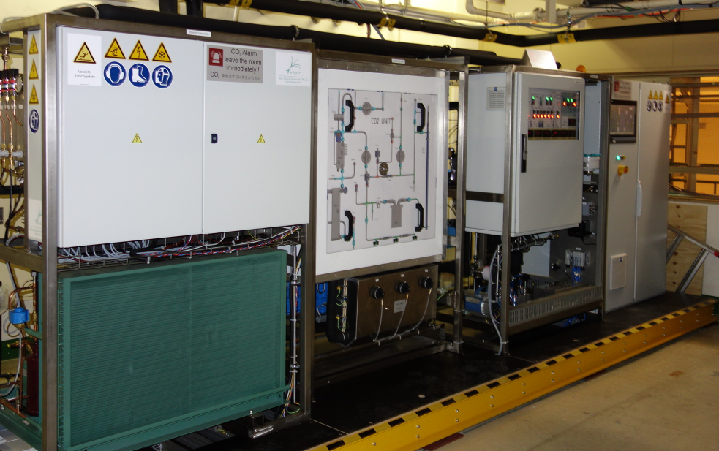
Status CO₂ Cooling
IBBelle: Reconnection after Belle II Roll in
N2 System, Heaters
Marco?

Slide 2
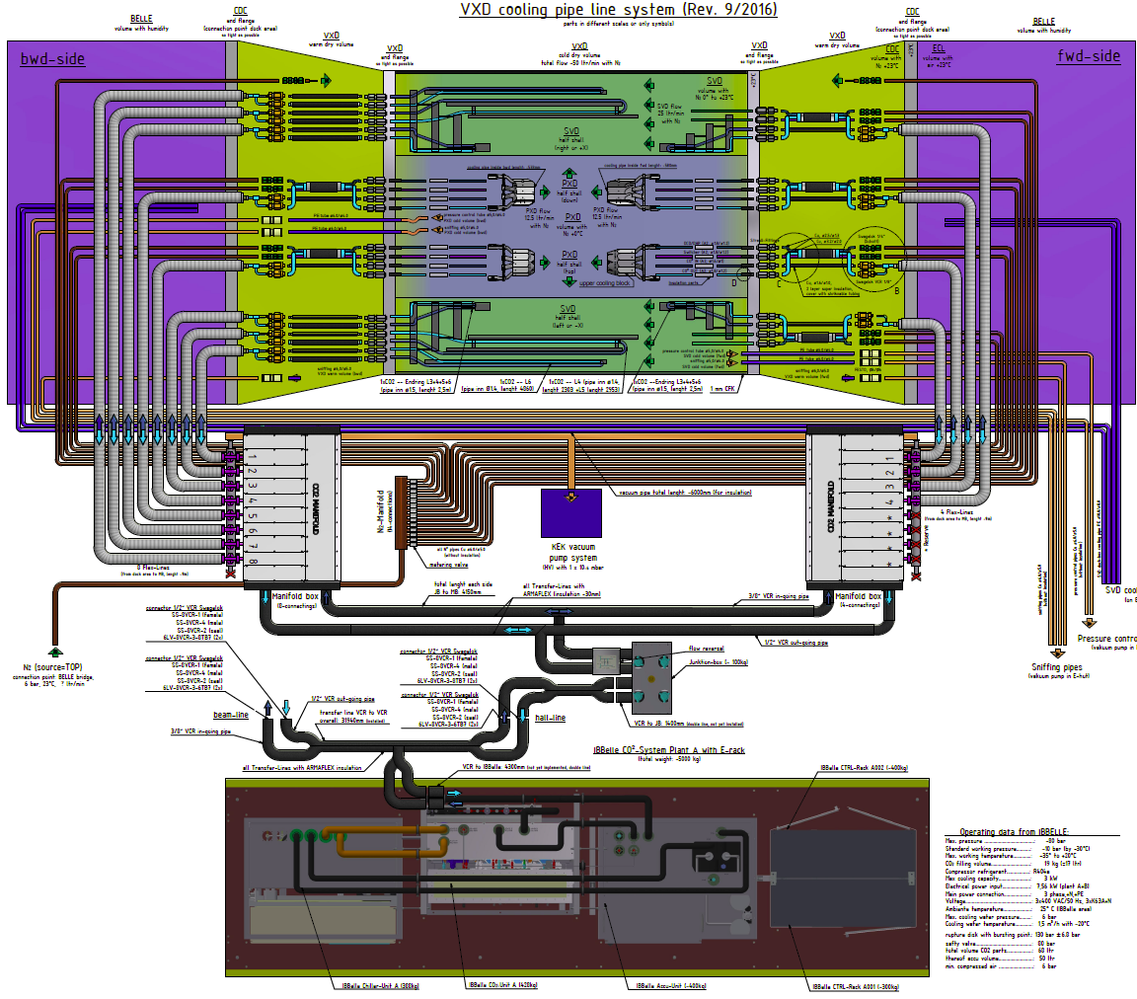
CO2 System
VXD needs 12 cooling circuits:
(4 PXD, 8 SVD)
The CO₂ flow is split in the manifolds into these 12 branches (BWD: 8, FWD: 4)
Vacuum insulated flex lines transport the CO₂ to the dock boxes (connection to detector)
Furthermore: 14 N₂ lines for gas cooling (copper tubes)
Manifold
(FWD)
Manifold (BWD)
Junction Box
IBBelle

Slide 3
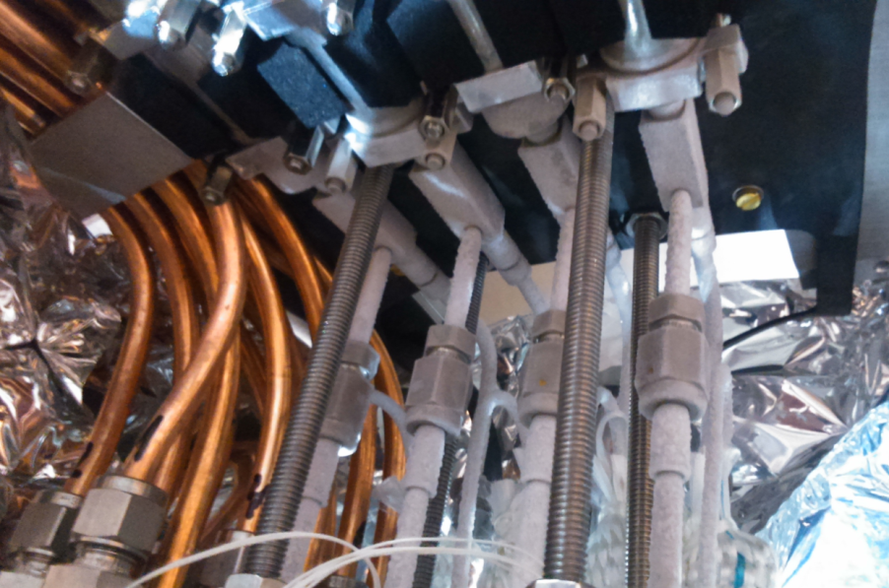
Commissioning of IBBelle at KEK
IBBelle, transfer Lines, Junction Box, Manifoldes installed in 2016
=> demonstrated 3000W cooling power at -30°C
Flexlines. Dock boxes ,N2 installed January 2017 (Karsten Gadow)
=> all 12 lines are cooled
April: IBBelle emptied and disconnected
from transfer lines => roll in
May: re-connection, filling
Restarted without problems
New:
Status signals installed (interlocks)
Pressure monitors for cooling water and
pressuried air
Swith over control from WinCC OA to EPICS

Slide 4
Interlocks
IBBelle issues 3 interlock levels (24V ‘WAGO’ levels, inverted: ‘on’: no alarm):
Unit off or running, but no circulation of CO₂
Unit interlocked (internal fault).
Unit off or running and CO₂ circulating,
but temperature set point not yet reached.
4) Running and temperature set point reached
The logic can be programmed differently
Two interlocks can be accepted:
Complete shut down.
Warm operation (Provide cooling but CO₂ temperature above dew point).
Level 2) should be used humidity in warm volume is detected or if flex line vacuum is bad. However, it takes ~ 30 min to go from -30°C to 10°C or vice versa
Level 1) is ok to prevent a start. A shut down during operation may lead to unpredictable conditions: The tubes may be filled partially with liquid, cold CO₂ which may flow back and forth uncontrolled. It takes ½ day for the system to warm up!

Slide 5
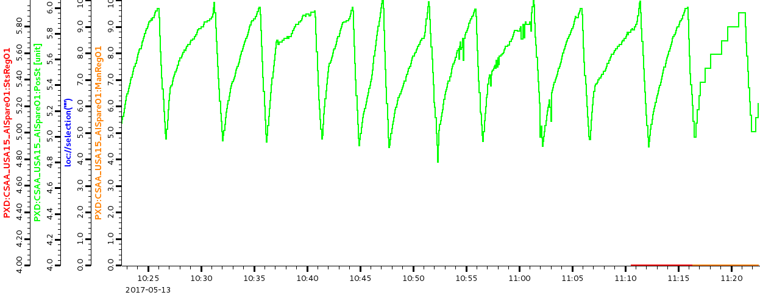
Pressure Sensors
Pressure sensors (provided by KEK)
Input and output pressure of cooling water
Pressure of compressed air
Integrated in PLC and EPICS
Air pressure sometime too low:
Oscillates between 5 and 6 bar
Pneumatic valves need > 5.5 bar to work properly. Below 5 bar the might go to ‘safe state’ (switches off IBBelle)
Install buffer vessel with one way valve (KEK)

Slide 6
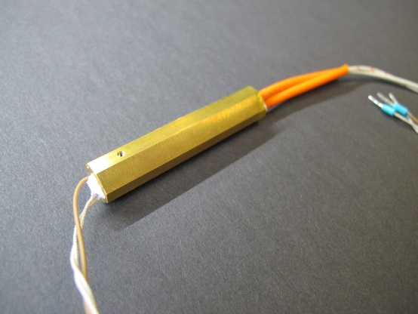
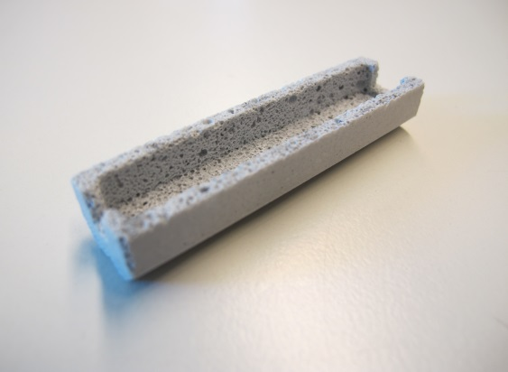
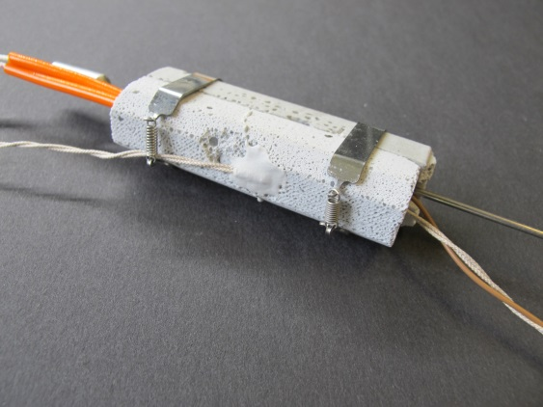
Heaters and NTC sensors
Each CO₂ branch will be equipped with a 100W heater (inlet) and a NTC sensor (outlet)
Temperature monitoring of each individual branch.
During commissioning: dummy power.
With detector: can control onset of CO₂ evaporation.
NTC sensors will be read out be Trieste system.
Control and interlock system for heaters under construction at MPI
Heaters automatically interlocked if T > 80°C
Control by on/off puling of 50Hz 230V supply
Power switching during AC zero crossing (no transients => low noise)
Heater with metal case to clip on CO2 tube
Foam ceramics insulation
(1/2 shell)
Heater with
Insulation and sensor

Slide 7
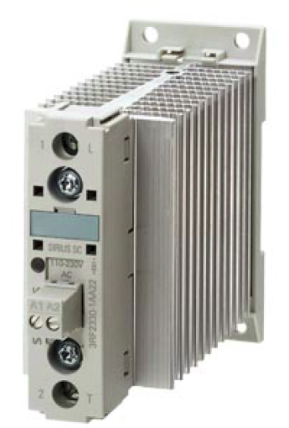
Tests
Needle valve
Manometer
Pt100
heater
Pt100
Pt100
Backpressure regulator
Open, simple CO2 system to test
Heat transfer, max. temperature,
Interlock and noise, …..
CO₂-bottle
Important: noise tests of Siemens 3RF2330-1AA04 power switch
DC system difficult

Slide 8
MARCO
Plan: IBBelle for phase II, MARCO for integration (PXD & SVD)
Have MARCO till end of 2017, CERN asked to have it then (Integration & phase II in 2018!)
Can IBBelle serve both?
Power ok, but no independent operation of two systems possible
Max. allowed CO2 volume would be exceeded => veto by KEK safety
Build unit B (with accumulator):
estimated construction time: 8 months (IBBelle: 12 months)
(delivery of accumulator: 6 months)
shipment: 2 months
commissioning: 1-2 months)
But: assembly space and manpower not available
Cost: > 100 k€
Copy MARCO ?
Others?
No
No

Slide 9
Conclusions
Shipment, customs, installation at KEK went according to schedule.
Transfer lines to junction box and manifolds Installed.
Flex lines and CO₂ dock boxes installed.
CO₂ circulated up to dock boxes (~40m downstream from IBBelle).
Reconnection after roll in ok.
EPICS control works
IBBelle is able to cool >3000 W @ -30°C (required: 1100 W).
All 12 parallel branches are serviced.
To be done:
Test, construct, install and commission heater system
Replacement of MARCO ?

