Slide 1








An Active High QE
Photocathode
for single soft photon detection
Harry van der Graaf Hong Wah Chan, Annemarie Theulings, Violeta Prodanović, John Smedley, Kees Hagen, Lina Sarro, Gert Nützel, Serge D. Pinto
Supported by ERC – Advanced 2012 “MEMBrane” 320764
Light 17
Ringberg Castle, Germany
Oct 17, 2017

Slide 2
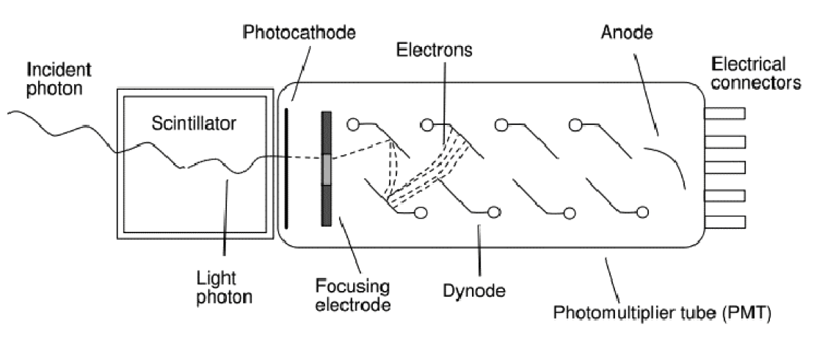
A very successful soft photon detector: the Photomultiplier (1934 -1936)
‘good’ quantum efficiency
rather fast
low noise @ high gain: very sensitive
little dark current, no bias current
radiation hard
quite linear
voluminous, bulky & heavy
no spatial resolution, not even 1D
expensive
quite radioactive
can’t stand B fields
Amplification by multiplication: low noise!

Slide 3
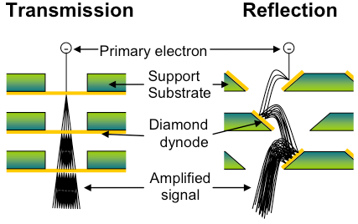
Dynode: amplification by multiplication
New: the Transmission Dynode
Tynode®
Trynode®

Slide 4

The Timed Photon Counter TiPC “Tipsy”concept: advancing PMT’s
Photomultiplier tubes
High gain
Low noise
Secondary Electron Yield (SEY)
Gain = δ^{N}
…Can we make it smaller?
Transmission dynodes – Tynodes
Dark noise free electron multiplication mechanism
Stacking the photocathode, Tynodes and pixel chip → compact device
Pixelated detector → spatial resolution (imaging)
Operation of the detector in high B-field.
Time resolution: few ps due to form factor and straight electron path’s
2D spatial resolution = 10 µm
4

Slide 6
Path towards first prototype
We have created many tynodes of various sizes and materials
Most recently, we have achieved transmission yields of 5.5 with 5 nm MgO membranes, coated with 2.5 nm TiN, without other special surface treatments
Now working towards building a first prototype device
MEMS technology

Slide 7
Al₂O₃ Measurements and Simulation using
low-energy GEANT extensions
Measurement
Simulations
10 nm
25 nm
50 nm
A decrease in yield, combined with increase in optimum primary electron energy is observed as a function of sample thickness
Good correlation to measurements seen for the simulations.

Slide 8
Theory: solid state physics. Now: wide knowledge of Silicon only.
Relevant processes:
soft photon absorption: photo-effect, electron binding energy; band gap
(photo )electron & hole lifetime
mobility, diffusion & scattering of photo-electrons
energy gain and energy loss of photo-electrons when traveling through matter
at surface: work function, electron affinity, probability of electron emission

Slide 9
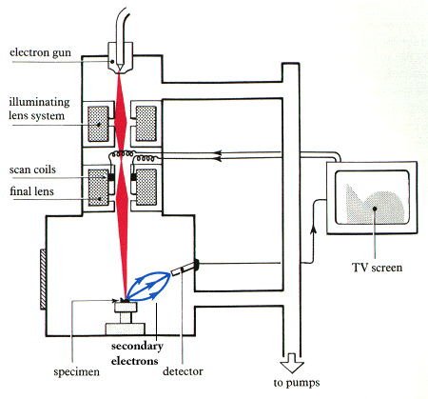
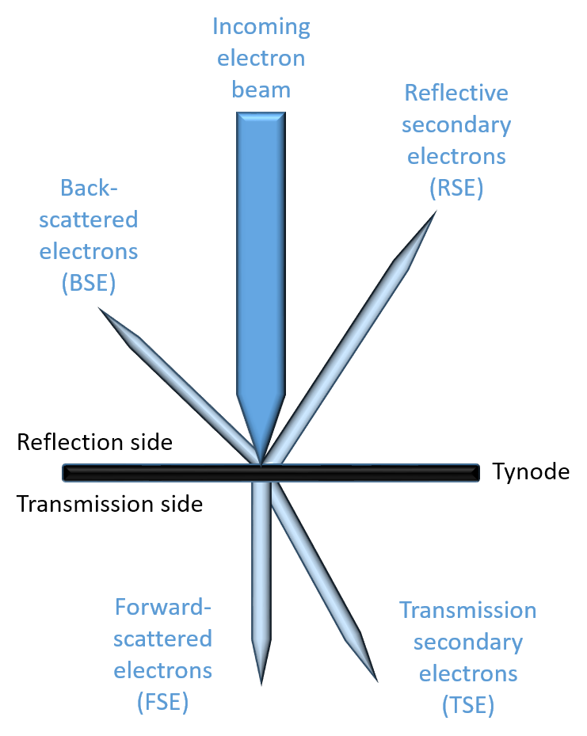

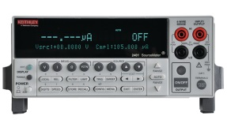
TSEY Measurement in SEM
Scanning Electron Microscope:
  Electron beam energy
  Measure beam current
  Acquire image (4.2 min)
Keithley 2450 Sourcemeters
  Measure Sample Current
  Measure anode Collector Current
Repeat for different beam energies
Process data
SEM e⁻ beam
sample holder
anode
Keithley source meters

Slide 11
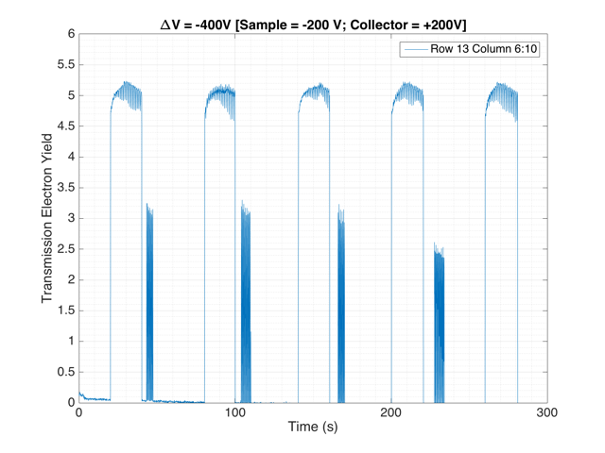
!! 5.2 !!
TSEY
November 2016: TSEYmax = 5.5

Slide 12
Further yield improvement:
  fully exploration of Extracting Field Bonus
  Surface termination
  Tynode annealing
  better vacuum
  bake out
  the active Tynode - Trynode
graphene
bulk ALD: ~ 100 atomic layers
1 V bias
graphene
Negative Electron Affinity layer
(Cs, H, B termination)
Extracting field E

Slide 13
a high Quantum Efficiency photocathode

Slide 14
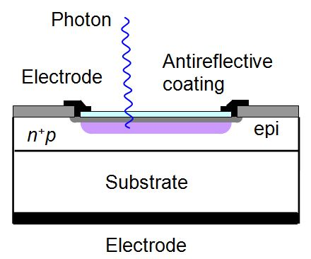
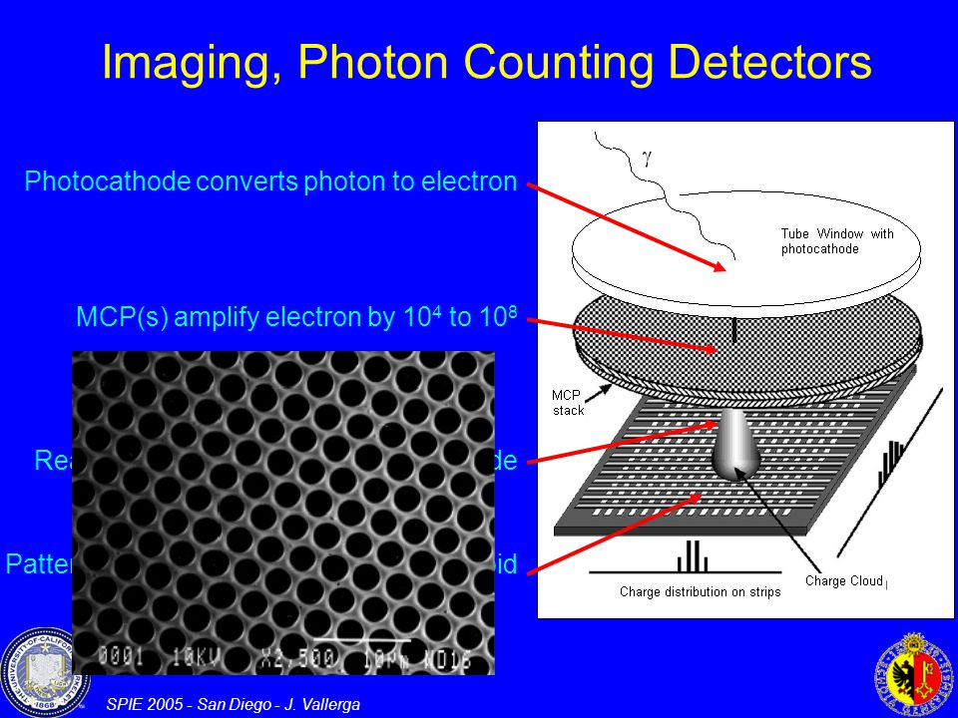
New Single Soft Photon
Detectors
noise QE ΔT
✔
Si PMs
MCPs (+ pixel chip)
Planacon Photonis
John Vallerga
Nicolas Wyrsch
the Tynode: Tipsy
MEMBrane project
✔
✔
✔
✔✔

Slide 15
Principle
Window
glass, quartz, sapphire
(bi) alkali layers
absorption
diffusion
emission
QE never exceeds 0.5 in principle
real practical solutions (Photonis, Hamamatsu) are classified

Slide 16
Tipsy’s only limitation: its efficiency equals the QE of photocathodes: 0.4 at best
Therefore: the High Quantum-Efficiency (QE) Photocathode
Window
glass, quartz, sapphire
graphene
[Alkali, Ge] monolayers
graphene
termination (Cs, H)
δ V
Active photocathode: drift field pushing electrons to emission vacuum surface
electric field created in between by potential defining graphene planes
all layers build up individually by atomic layer deposition ALD
electron emission stimulated by negative electron affinity by termination
First designed after ab initio simulations of 3D atomic building blocks
Proposal for theoretical concept study: let us first understand the present state-of-the-art

Slide 17
1 Bias field over absorption layer
δ V
Sandwich absorption layer by means of graphene
prevent electron/hole injection at electrode
alternative: apply strong surface dopant: termination

Slide 18
2 Negative electron affinity at emission side
δ V
Termination of emission surface, in combination with presence of electrode at emission side
These functionalities must be optimised.

Slide 19
3 Optimise positive effect of extracting field
δ V
E
Shottky effect
Fohler-Nordheim tunneling
The required extracting field can be much stronger:
emitted electrons must have landing energy of 200 – 1000 eV
distance between photocathode and first tynode can be very small: 20 μm

Slide 20
4 Apply semiconductor layer
window
electrode
absorption layer
termination
E
Apply semiconductor as absorber: acts as dielectric (insulating) layer when biased by
external extracting field.
The extracting field propagates into the absorption layer.
Absorption layer will be polarised: a photo-electron will drift towards the emission side.

Slide 21
5 Apply Atomic Layer Deposition ALD
window
electrode
Atomic Layer Deposition: rapid development in MEMS technology
First: theoretical model: VASP simulations

Slide 22
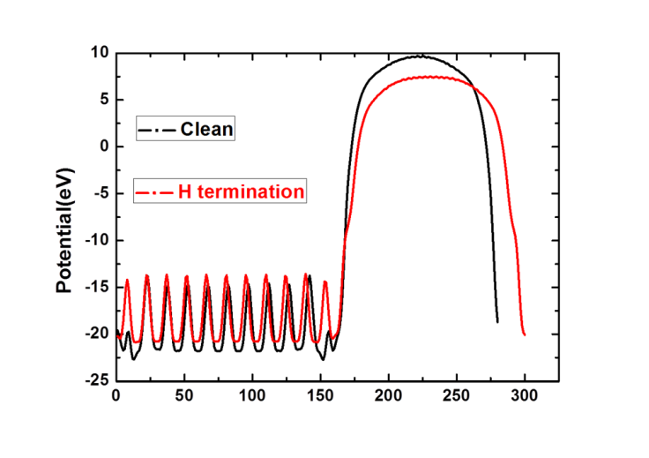
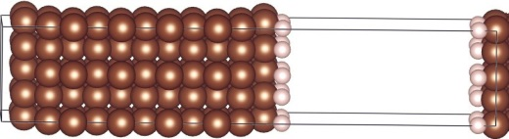
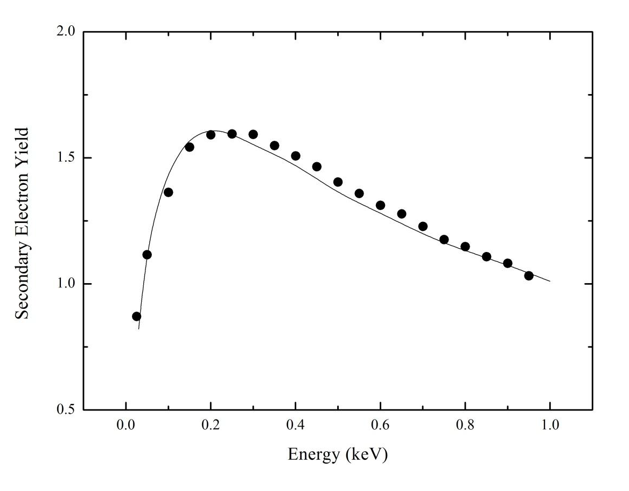
Solid State Physics
Density Functional Theory simulations
Electron density, energy distributions
density structure,
band gap
work function,
optical data
Monte Carlo simulations
Vienna Ab-Initio Simulation Program
VASP
(T) SEY

Slide 23
Tipsy’s only limitation: its efficiency equals the QE of photocathodes: 0.4 at best
Therefore: the High Quantum-Efficiency (QE) Photocathode
Window
glass, quartz, sapphire
graphene
[Ge?] monolayers
graphene
termination (Cs, H)
δ V
Proposal for theoretical concept study: let us first understand the present state-of-the-art photocathodes.
Cooling of the new photocathode is likely to be required in order to limit thermal electron emission. Note that the tynode stack is a noise-free amplifier!
The new photocathode will be non-transparent and will look black!

Slide 24
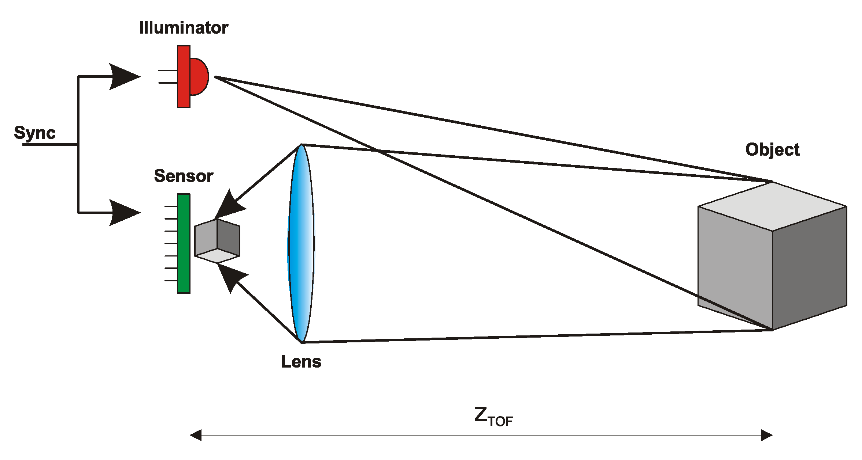
Tipsy (with high QE photocathode):
digital single soft photon sensitive, with high efficiency
20 – 2 ps time resolution per photon
(2D) spatial resolution: 10 μm
very low shot noise (dark current)
Data driven counting rate per pixel
total data rate of 5 GHz/s
Applications
Consumer products
Night goggles: most sensitive light detection Tipsy in iPhone S10 (2022)?
Prompt 3D Imaging with z-resolution of 0.5 mm Tipsy in iPhone S10 (2022)?
3D Machine viewing: robotics
Self-driving of vehicles: situation info source: prompt 3D radar like image

Slide 25
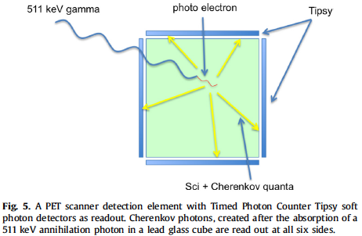
Medical Imaging: The Cherenkov-ToF-PET scanner
4D (X,Y,Z,t) measurement of conversion point of 511 keV quantum:
only 3 ChQs are required for 4D fix using GPS algorithm
…PET is no longer Tomography…..

Slide 26
with 10 ps time resolution:
Reconstruction of
interaction point:
origin of all prompt
Cherenkov photons:
4D GPS analysis method:
Only 3 Cherenkov photons
are required for fix in 3D position and time

Slide 27
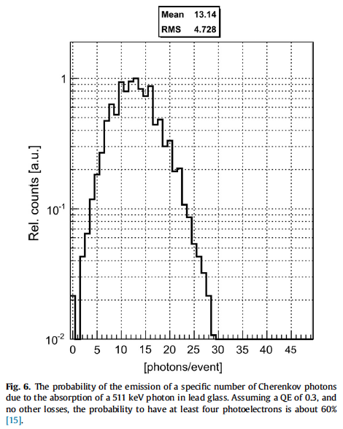
Cherenkov photons emitted
by 511 keV photo-electron
in lead glass

Slide 28
MIP detection using e-Brane
e-Brane: surface with a high probability to emit at least
one electron at the passage of a MIP (in position and time)
- low electron affinity of emitting surface
3PM experiment: naked but black shielded PMs in MIP testbeams
glassplate thick 0.1 mm e-Brane: sufficient Cherenkov photons!
muon
MIP

Slide 29
the future: the Cherenkov tracker
Ch Photon + MIP detector
transparent (mylar) foil
Vacuum!
Cherenkov photons are emitted with given angle with track
see TORCH

Slide 30
Future inner (central) tracker in collider experiments:
the Cherenkov tracker
very low detector mass
Tipsy layer at safe distance from interaction point
no extrapolation
Tipsy
Cylindrical layer
thin transparent foils
generating Cherenkov photons
The Vacuum Cherenkov CentralTracker

Slide 31
Conclusions
New MEMS technology, namely Atomic Layer Deposition ALD, may enable the development of a new generation of photocathodes
New solid state theoretical physics models are required first, leading towards the development of new ALD technology
With better soft photon detectors, Cherenkov photons are becoming more important. Scintillators are slow and may be phased out.

Slide 32
Harry van der Graaf Hong Wah Chan, Annemarie Theulings, Violeta Prodanović, John Smedley, Kees Hagen, Lina Sarro, Gert Nützel, Serge D. Pinto
Supported by ERC – Advanced 2012 “MEMBrane” 320764
H. van der Graaf et al.: The Tynode: A new vacuum electron multiplier.
Nucl. Instr. & Methods, in press. http://dx.doi.org/10.1016/j.nima.2016.11.064. T
H. van der Graaf et al.: Potential applications of electron emission membranes in medicine.
Nucl. Instr & Methods, special Medical Physics issue on “Advances in detectors and
applications for Medicine”. A809 (2016) 171-174. http://dx.doi.org/10.1016/j.nima.2015.10.084.

