Slide 1
Front End Read-Out for Fast Photosensors
A. Casajus, D. Gascon, R. Graciani, S. Gomez, J. Mauricio, E. Picatoste, A. Sanuy, D. Sanchez, A. Sanmukh
ICCUB//SiUB, University of Barcelona

Slide 2
Outlook
Introduction
PACTA: High Dynamic range Preamp
MUSIC: Multipurpose SiPM RO chip
FlexToT: linearized ToT RO chip
New developments

Slide 3
I. Introduction
Plenty of readout ASICs for photosensor read-out…
New members: STiC, Petiroc, Citiroc, ToFPET, PACIFIC, etc
Chip name | group | year | Technology | channels | Application
FLC_SiPM | OMEGA | 2004 | BiCMOS 0.8µm | 18 | ILC HCAL
NINO | CERN | 2004 | CMOS 0.25µm | 8 | ALICE TOF
MAROC2 | OMEGA | 2006 | SiGe 0.35µm | 64 | ATLAS lumi
SPIROC | OMEGA | 2007 | SiGe 0.35µm | 36 | ILC HCAL
PETA | Heidelberg | 2008 | CMOS 0.18µm | 40 | PET
RAPSODI | Krakow | 2008 | CMOS 0.35µm | 2 | Snooper
BASIC | Bari | 2009 | CMOS 0.35µm | 32 | PET
SPIDER | Ideas | 2009 | CMOS 0.35µm | 64 | Spider rich
© W. Kucevisz (Krakow)

Slide 4
I. Introduction
Many of them are designed for specific applications
  Of course… they are ASICs
  However it means that the readout architecture constrains the use of the chip to particular systems
    For instance many of them are designed for PET applications and it becomes difficult to use them elsewhere
The goal of this talk is not to present one more ASIC
But to discuss how to build different FE systems for different applications based on ASICs which provide
  Flexibility
  High performance

Slide 5
I. Introduction
Our approach combines:
  An ASIC performing key analog functions
  A digitizer that can be adapted and optimized for a given application

Slide 6
I. Introduction
This digitizer can range from:
  A high performance waveform sampling system (SCA)
    Many examples: DRS, NECTAr, SAM, etc
  A TDC based on a low cost FPGA
    10 ps resolution is possible

Slide 7
I. Introduction
Regarding the ASIC: what key analog functionalities should it perform?
  Impedance adaptation
  Current mode approach for timing
    High speed & low noise
  Input voltage control (for SiPMs)
  Shaping
  Summation
    To build large are photodetectors
  Discrimination
  Time-over-threshold (ToT)
    Linearization
    Low cost digitizer (FPGA TDC)
All our designs
Section III (MUSIC chip)
Section IV (FlexToT chip)

Slide 8
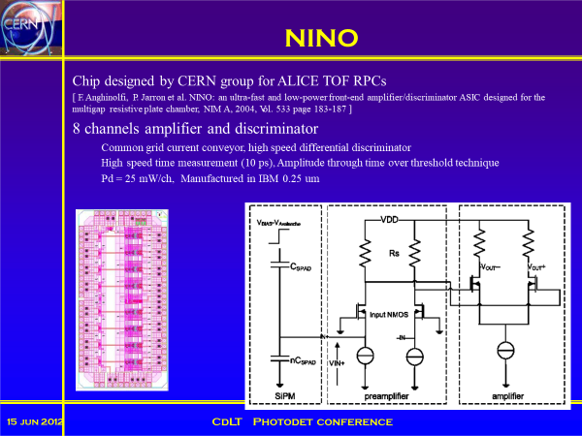
I. Introduction
Must say we did not invent this approach…

Slide 9
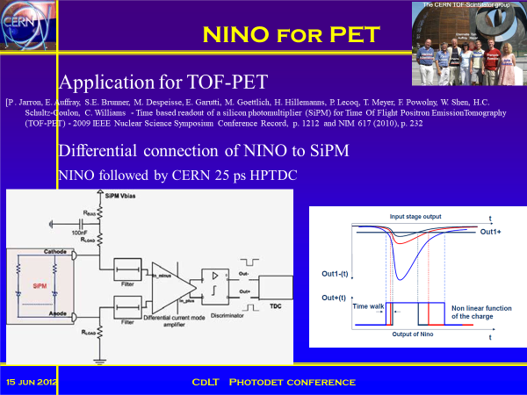
I. Introduction
Must say we did not invent this approach…

Slide 10
Outlook
Introduction
PACTA: High Dynamic range Preamp
MUSIC: Multipurpose SiPM RO chip
FlexToT: linearized ToT RO chip
New developments

Slide 11

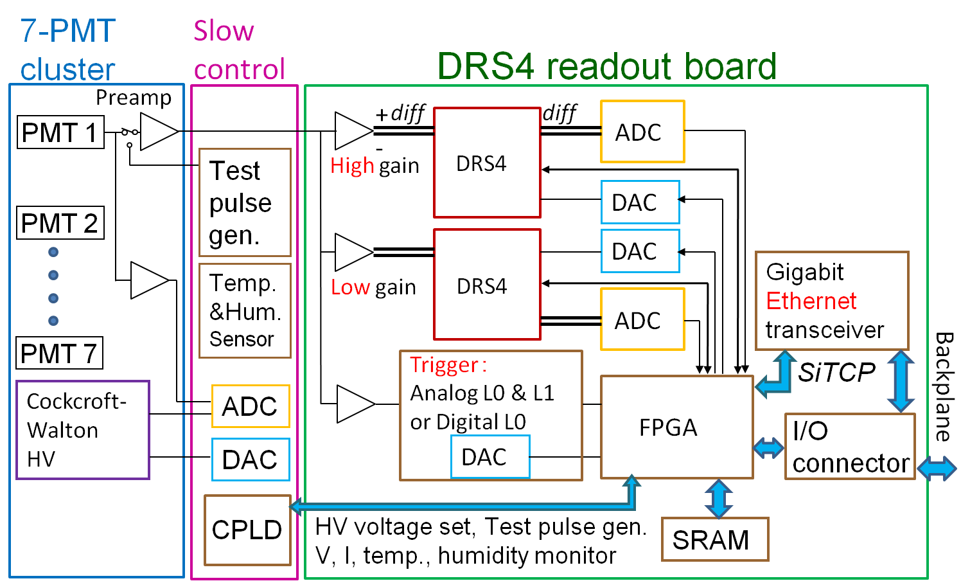
II. PACTA: High Dynamic range Preamp
CTA LST and MST (NECTAr) cameras
  Based on PMT at low gain(40k)
  Requires high dynamic range preamp
    From single photon to > 1000 pe
    High BW
    Low noise
  Readout is based on a proven concept
    Waveform sampling at > 1 GS/s
    Analog/digital trigger
LST cluster
LST PMT unit

Slide 12
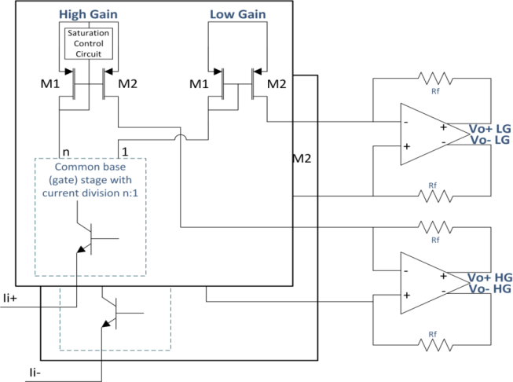
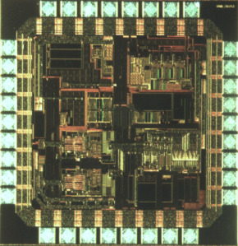
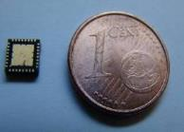
II. PACTA: High Dynamic range Preamp
Double transimpedance gain: 1.2kΩ (HG) and 80 Ω (LG)
Dynamic range > 15 bits
-3 dB bandwidth of 450 MHz
Low input referred noise: 10 pA/√Hz
Noise (ENC): 4700 electrons
  10 ns of integration time
2400 chips for the first LST camera
15000 chips being produced for next LSTs and MSTs cameras
PACTAv1.4 chip 2 mm²
QFN32 package
Back from foundry Oct. 2012
Single photoelectron at very low PMT gain: 40K

Slide 13
II. PACTA: High Dynamic range Preamp
Transimpedance gain (integral of the pulse) and linearity
  HG about 1 KOhm
  LG about 50 Ohm
  Relative non-linearity error < 2 %
    100x(Meas-Fit)/Fit
100 phe
1 phe

Slide 14
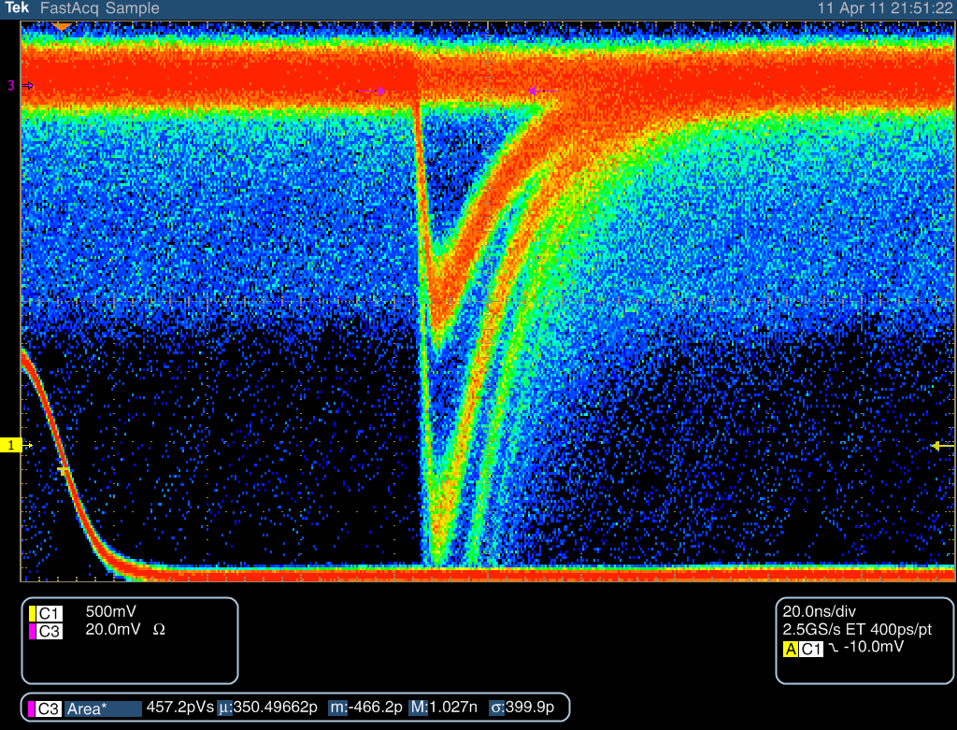
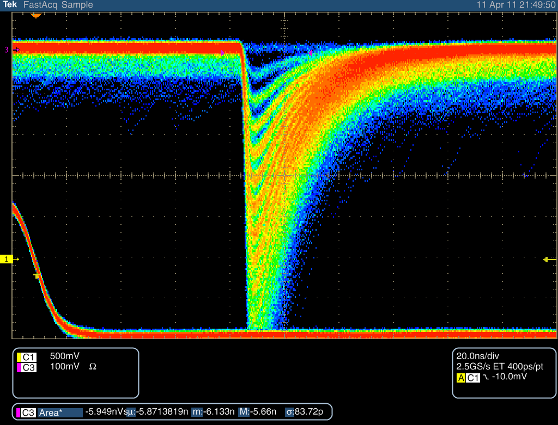
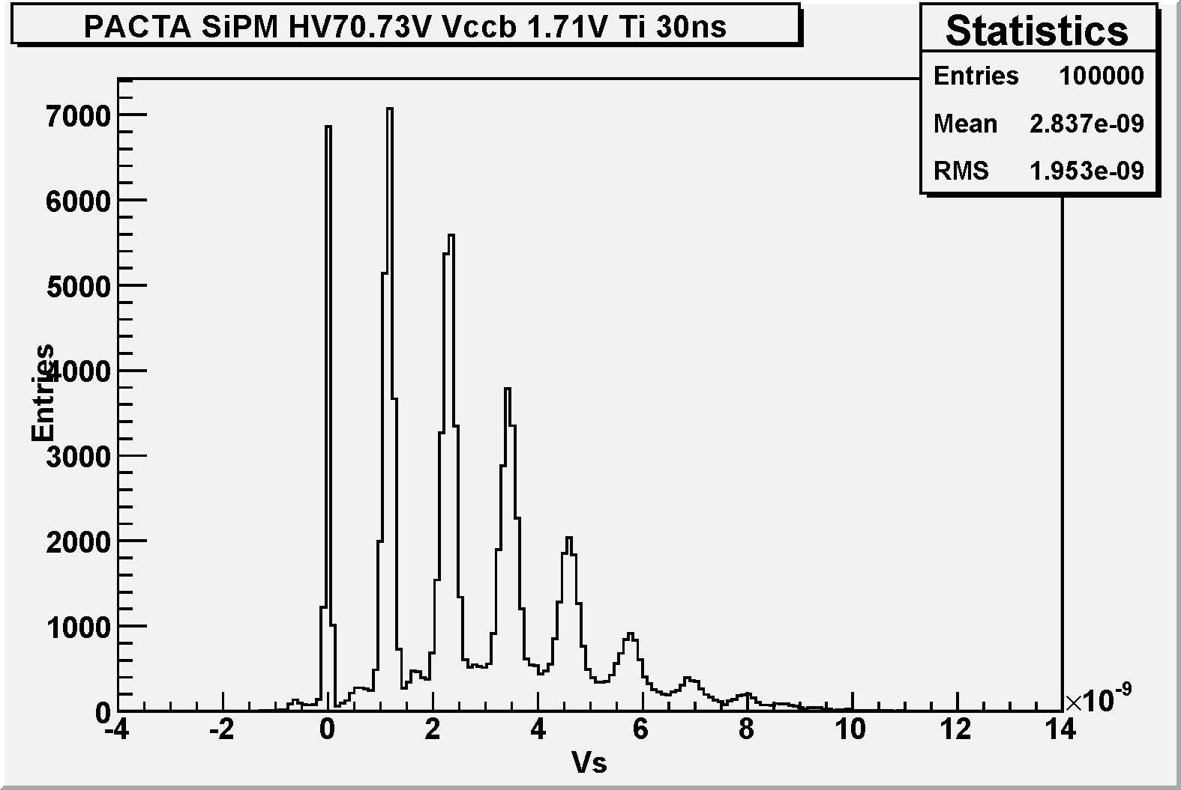
II. PACTA: High Dynamic range Preamp
Tests with SiPM
  Low Zin current mode circuit are well suited for SiPM readout
  DC coupling without external components
  We just took an available MPPC (S10931-050P)
    1 V overvoltage
  Recovery time seems to be dominated by internal SiPM time constant
20 ns
14

Slide 15
Outlook
Introduction
PACTA: High Dynamic range Preamp
MUSIC: Multipurpose SiPM RO chip
FlexToT: linearized ToT RO chip
New developments

Slide 16
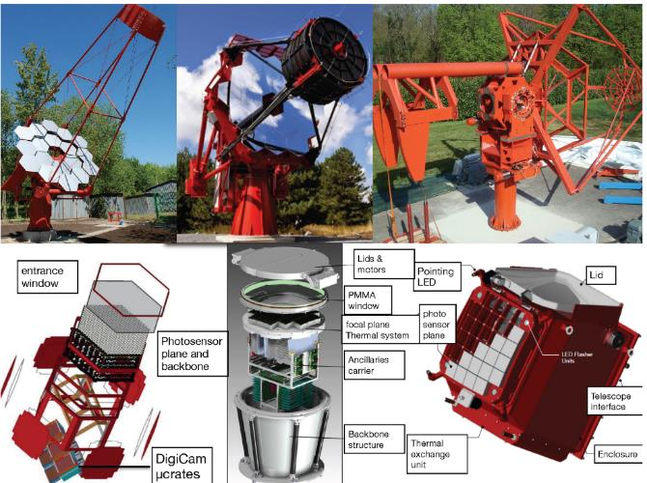
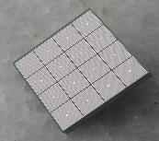
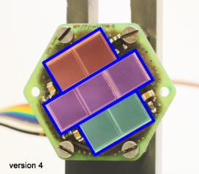
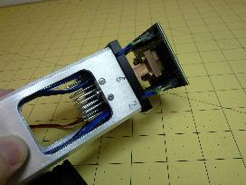
III. MUSIC: Multipurpose SiPM RO chip
SiPMs are replacing PMTs in many applications
Dedicated FE electronics is needed to fully exploit SiPM performace
We present a multipurpose chip integrating many of those functions:
  Eg: IACTs
CTA-SCT (dual mirror)
cta-us.physics.ucla.edu
inspirehep.net/record/1306235
D. Fink et al. “SiPM Based Focal Plane Instrumentation Prototype for the MAGIC Telescopes”, PD15, 2015
T. Montarulli et al. “The small size telescope projects for the Cherenkov Telescope Array”, ICRC2015
  MUSIC

Slide 17
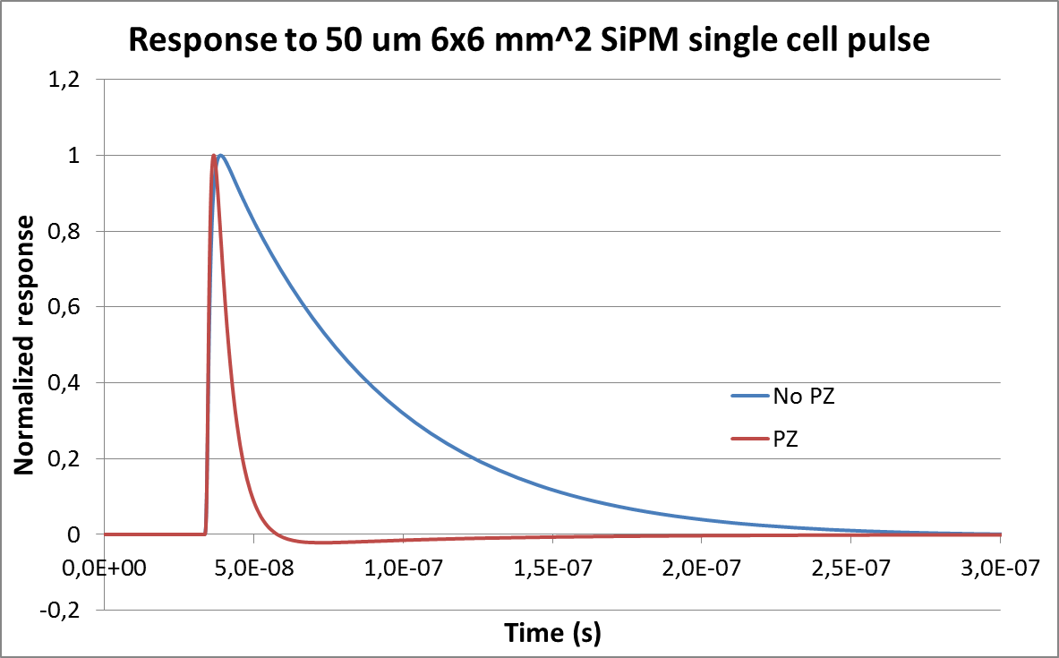
III. MUSIC: Multipurpose SiPM RO chip
Front end electronics for SiPM is needed to:
  Shape the input signal
    Large SiPM recovery time constant may cause saturation or distortion because of pile up
    Pole-zero cancellation or high-pass filters are often used

Slide 18
III. MUSIC: Multipurpose SiPM RO chip
Front end electronics for SiPM is needed to:
  Preamplify for SNR optimization
    Even if “nominal” gain is in the order of 10⁶ only a fraction of the charge is used for fast read-out systems
    The “effective” for a fast system can be between 2 and 10 times lower than the nominal gain

Slide 19
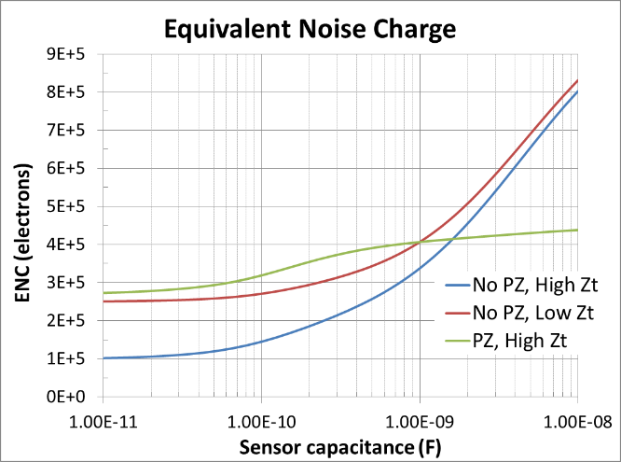
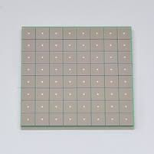
III. MUSIC: Multipurpose SiPM RO chip
Front end electronics for SiPM is needed to:
  Impedance adaptation: low input impedance for fast systems
  Low noise front end is required for large SiPMs
  Equalize over-voltage in SiPM arrays (not always needed)
    SiPM capacitances range from 10s pF to more than several nF
  Series noise < 2 nV/sqrt(Hz)
  Parallel noise < 20 pA/sqrt(Hz)

Slide 20
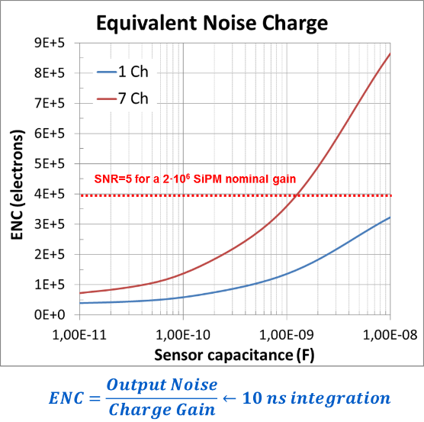

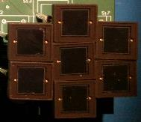

III. MUSIC: Multipurpose SiPM RO chip
Front end electronics for SiPM is needed to:
  Combine (sum) the signal of several SiPMs
    Typically SiPM size ranges from 1x1 to 6x6 mm^{2*}
    To replace a PMT in some application SiPMs signals need to be added
    Low noise FE electronics becomes mandatory !
7 x SIPM
6x6 mm² each
1 x PMT
18 mm diameter
  Series noise < 2 nV/sqrt(Hz)
  Parallel noise < 20 pA/sqrt(Hz)
$$≈$$
*7x7mm² and some custom larger SiPMs exist

Slide 21
III. MUSIC: Multipurpose SiPM RO chip
MUSIC 8 ch ASIC integrates all those functionalities
Individual channel amplification with adjustable pole-zero cancellation (analog)

Slide 22
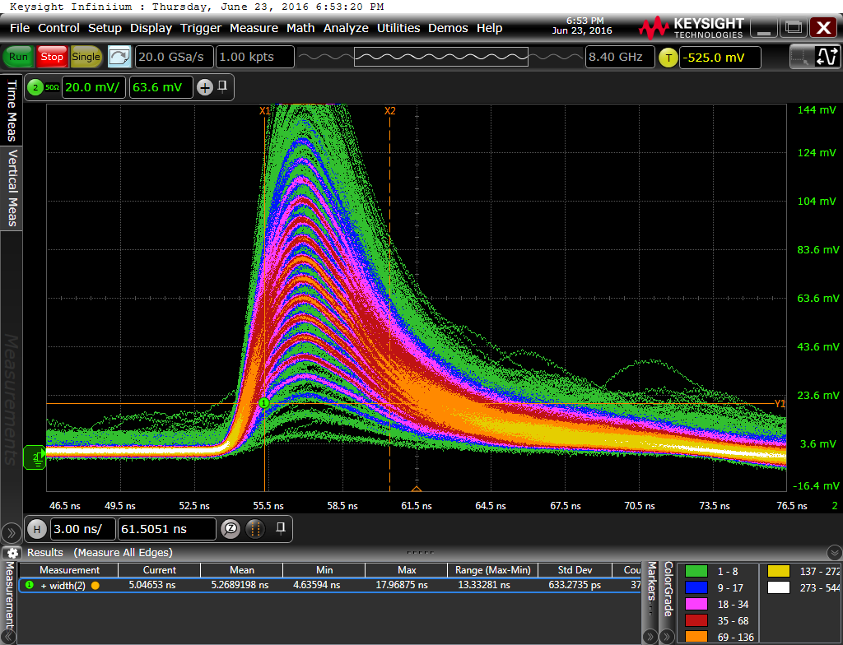
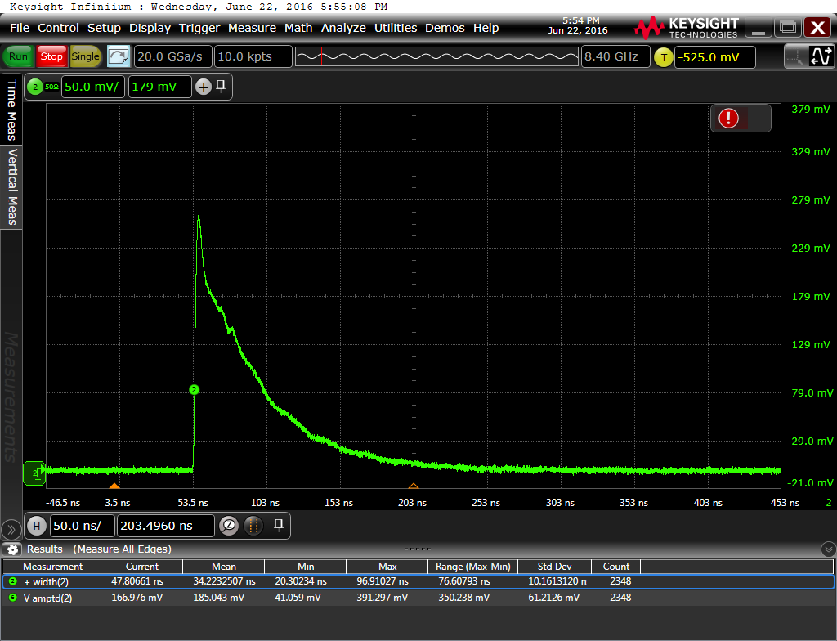
III. MUSIC: Multipurpose SiPM RO chip
Output for a LCT4 MPPC ( 3x3 mm²)
No Pole Zero FWHM = 100ns
Pole Zero FWHM ≈ 6ns

Slide 23
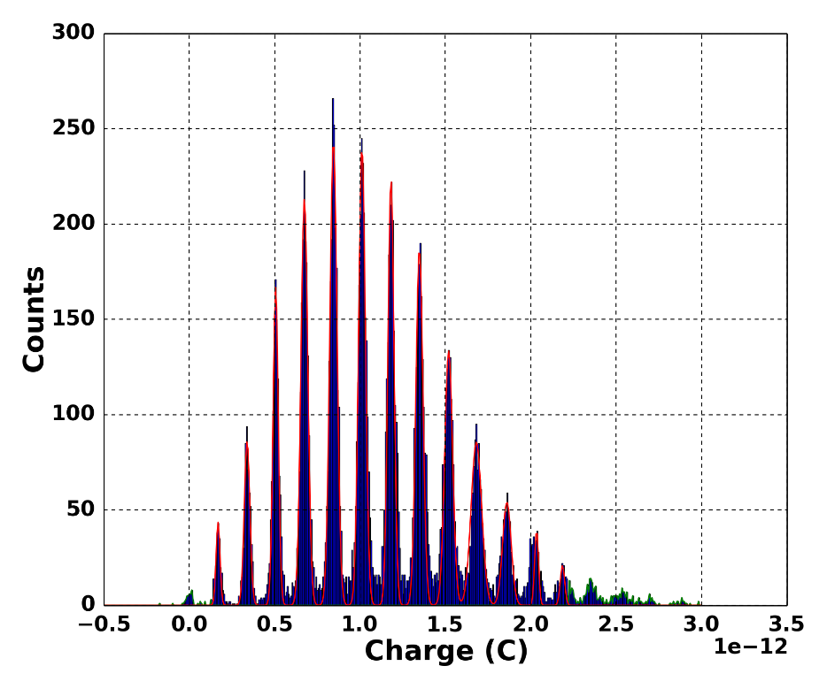
III. MUSIC: Multipurpose SiPM RO chip
Charge spectrum for a LCT4 MPPC ( 3x3 mm²)
Pole-zero cancellation
Excellent resolution with FWHM of 5 ns

Slide 24
III. MUSIC: Multipurpose SiPM RO chip
MUSIC 8 ch ASIC integrates all those functionalities
Individual channel amplification with adjustable pole-zero cancellation (discriminated)

Slide 25
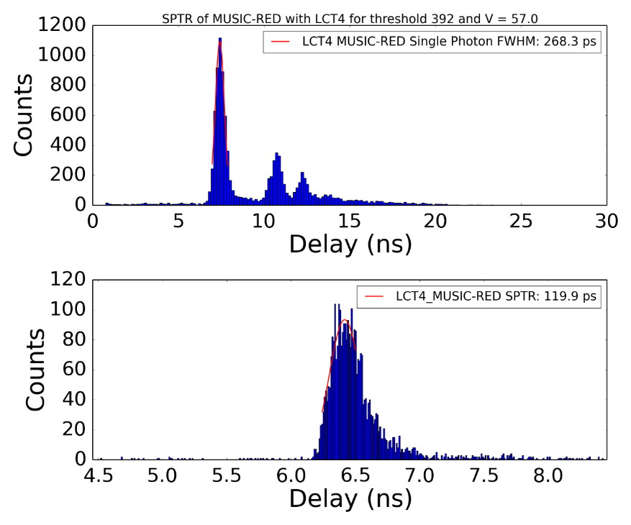
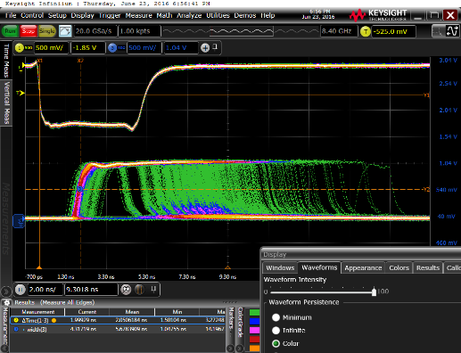
III. MUSIC: Multipurpose SiPM RO chip
Output for a LCT4 HPKK MPPC ( 3x3 mm²)
  Picosecond laser
  Pole-zero cancellation
  Single Photon Time Resolution about 100 ps (@ 5V OV)
1 photon
Laser trigger signal
600nm, 50 ps FWHM
2 photon
3 photon
Pulse width histogram
Jitter of the first photon (SPTR)

Slide 26
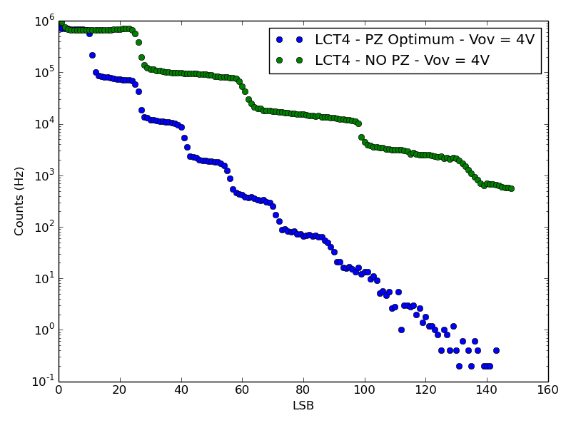
III. MUSIC: Multipurpose SiPM RO chip
Dark count rate staircase plot (no laser signal):
  Scan the rate of the SiPM signals that are over a certain threshold
With and without pole-zero cancellation
LCT4 HPKK MPPC 3x3 mm²
Threshold (a.u.)

Slide 27
III. MUSIC: Multipurpose SiPM RO chip
MUSIC 8 ch ASIC integrates all those functionalities
Summation of 1 to 8 channels with double gain (high dynamic range) and tunable pole-zero cancellation

Slide 28
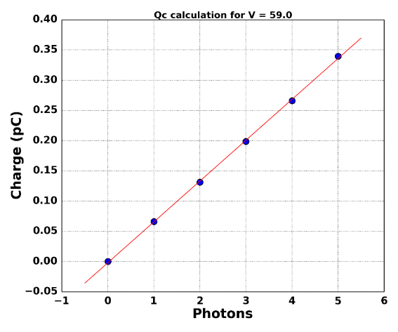
III. MUSIC: Multipurpose SiPM RO chip
MUSIC configuration: the adder takes only 1 channel
  Pole-zero cancellation: trade-off between resolution and speed
  High transimpedance gain (MUSIC)
S13360-6050 SiPM
6x6 mm², 50 um cell
1.2 nF capacitance
4 V overvoltage
S13360-6050 SiPM
6x6 mm², 50 um cell
1.2 nF capacitance
7 V overvoltage

Slide 29
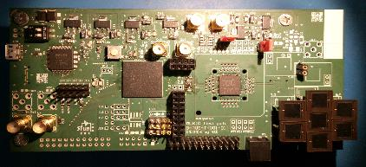
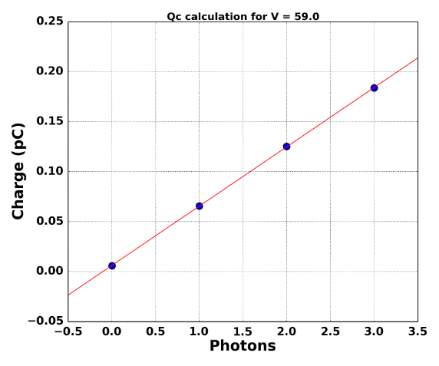

III. MUSIC: Multipurpose SiPM RO chip
MUSIC configuration: the adder takes 7 channels
  Noise is much higher (sqtr(7))
  But pe (cell) peaks can still be identified
  Channels have been equalized by MUSIC anode ctrl voltage
S13360-6050 SiPM
6x6 mm², 50 um cell
1.2 nF capacitance
4 V overvoltage
S13360-6050 SiPM
6x6 mm², 50 um cell
1.2 nF capacitance
7 V overvoltage
7 x SIPM
6x6 mm² each
$$≈$$
1 x PMT
18 mm diameter

Slide 30
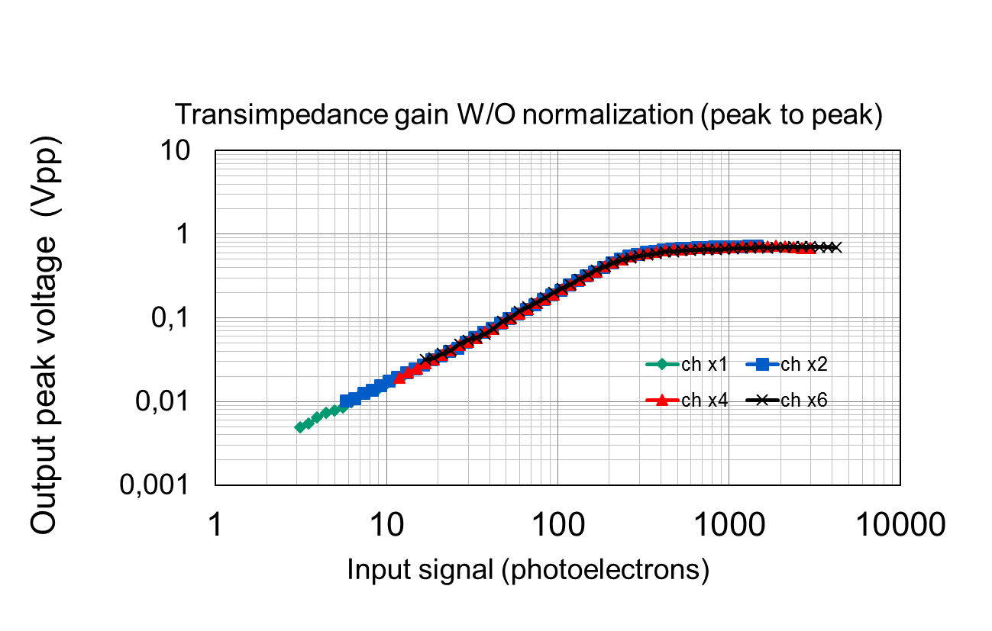
III. MUSIC: Multipurpose SiPM RO chip
Dynamic range for S13360-6050@6V overvoltage
Optmized pole-zero cancellation
High gain path output
Response for n input channels (signal injected in n channels)
Reponse independent on the number of active channels
Summation works
Total number of pe

Slide 31
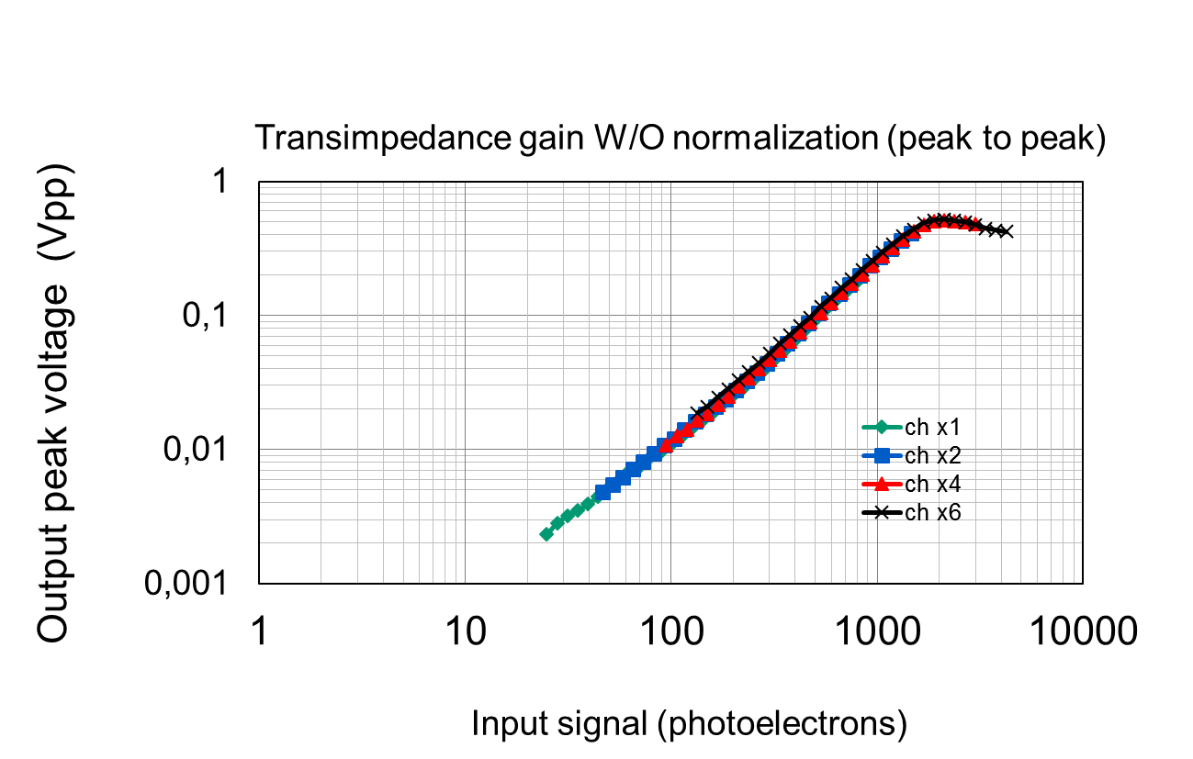
III. MUSIC: Multipurpose SiPM RO chip
Dynamic range for S13360-6050@6V overvoltage:
  Optmized pole-zero cancellation
  Low gain path output
Response for n input channels (signal injected in n channels)
The bi-gain system allows to achieve a dynamic range of > 1000 pe
  Dynamic range limited by signal injection circuit
Reponse independent on the number of active channels
Summation works
Total number of pe

Slide 32

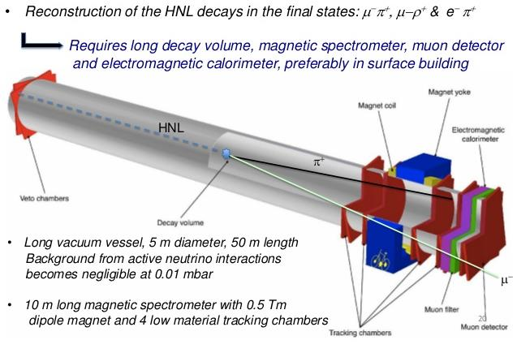
III. MUSIC: Multipurpose SiPM RO chip
SHIP experiment is a new general-purpose beam dump facility at the SPS (CERN) to search for hidden particles
  Predicted by a very large number of recently elaborated models of Hidden
  Dark matter, neutrino oscillations, and the origin of the full baryon asymmetry

Slide 33
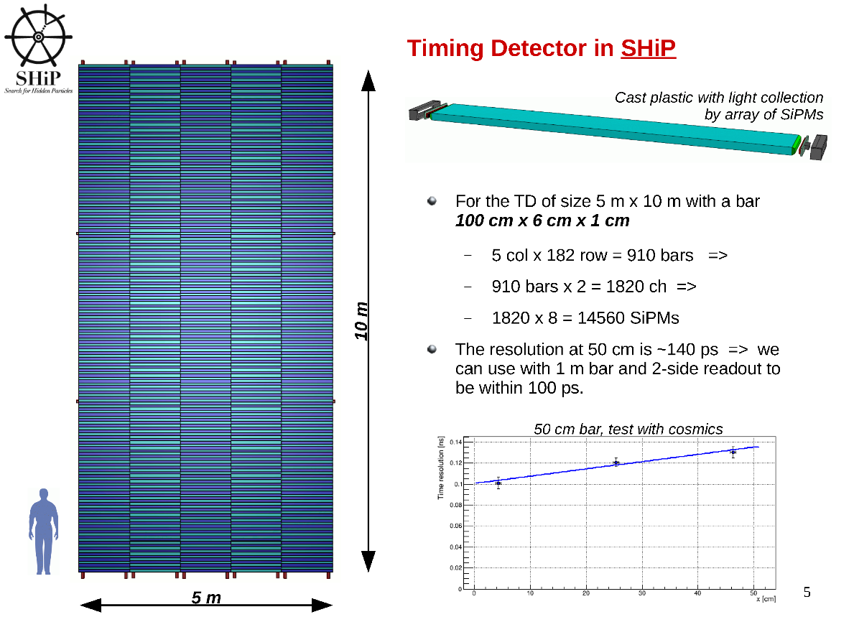
III. MUSIC: Multipurpose SiPM RO chip

Slide 34
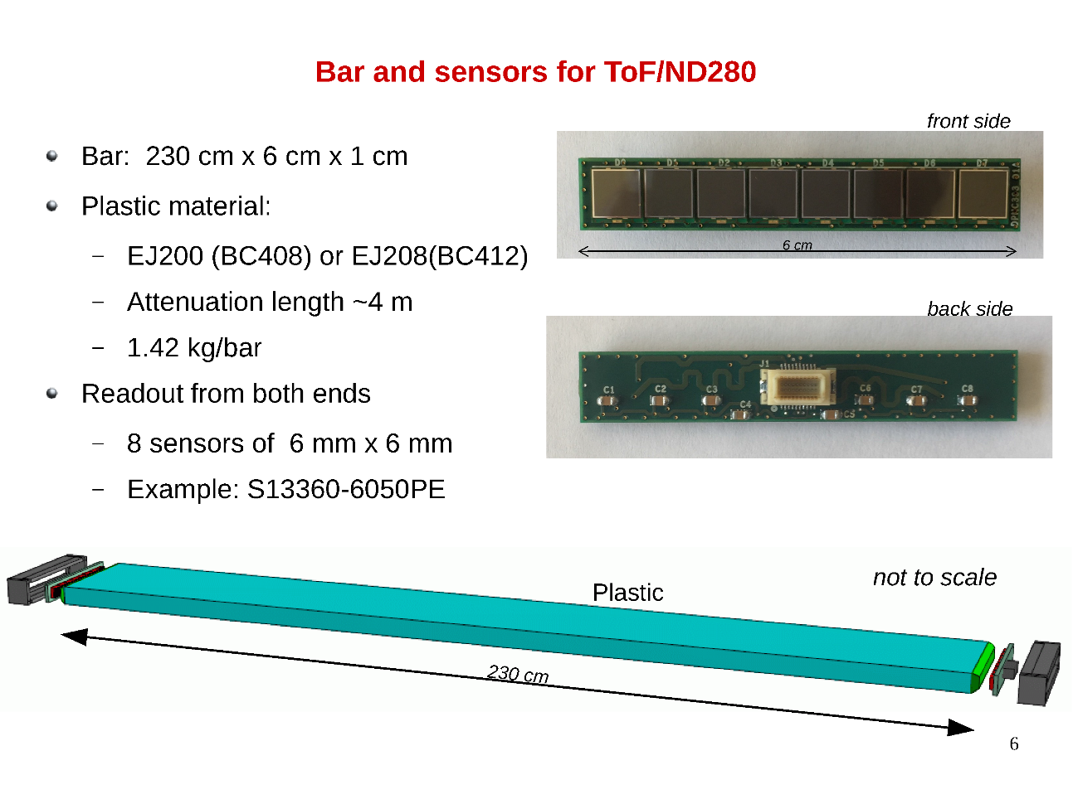
III. MUSIC: Multipurpose SiPM RO chip

Slide 35
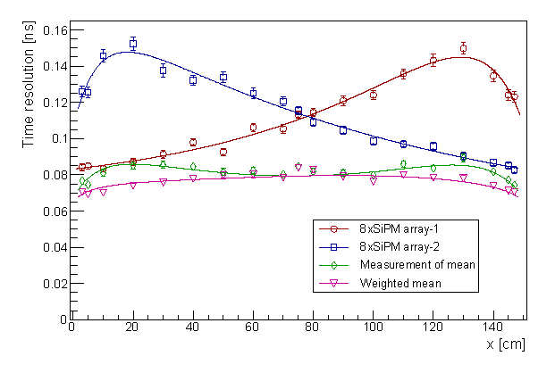
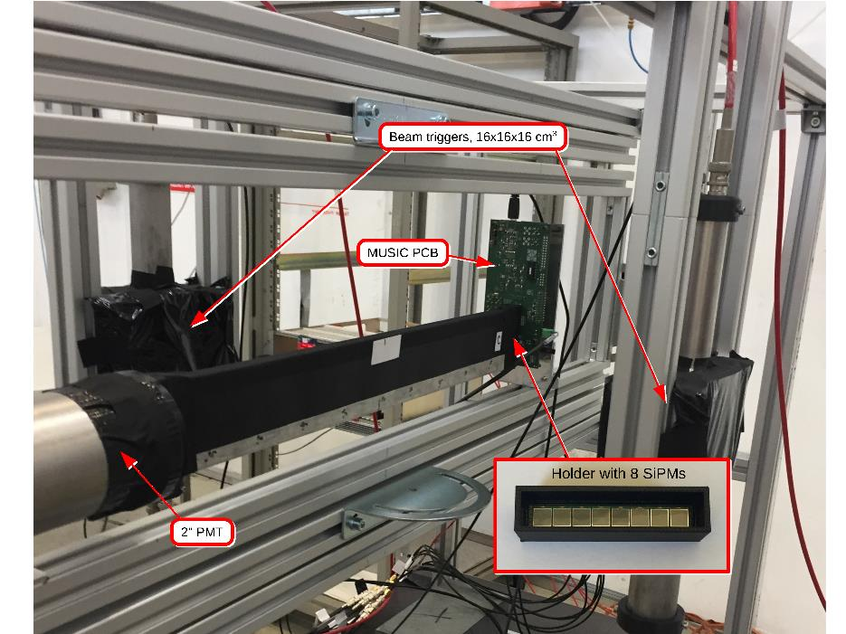
III. MUSIC: Multipurpose SiPM RO chip
Timing sub-detector test beam with MUSIC chip
  By Univ. Geneva & Univ. Zurich
  MUSIC in summation mode (8 6x6 mm^2 SiPMs)
    Bar read-out at both ends
  2.5 GeV/c muon beam at the CERN PS
  Readout with Wavecatcher
    Fast analog memory (LAL & IRFU/CEA)
Resolution < 100 ps
Measurements with the 150 cm x 6 cm x 1 cm bar.
Time resolution as measured by the SiPM arrays at both ends of the bar as a function of the interaction point along the bar.
© A. Kornezev (Univ. Geneva)

Slide 36
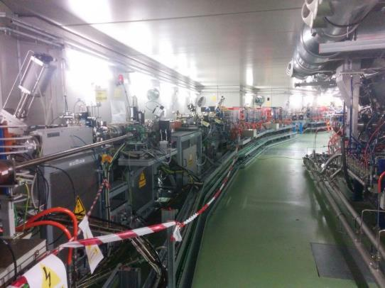
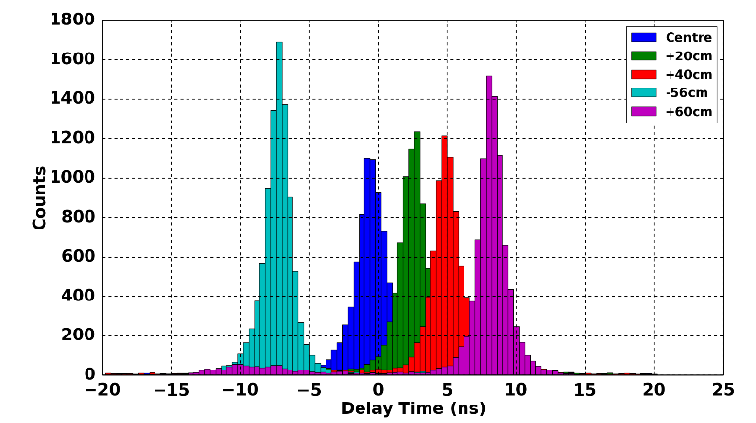

III. MUSIC: Multipurpose SiPM RO chip
Studying the possibility to develop a beam loss monitoring system based on scintillating fibers
  Collaboration with Alba synchrotron General idea:
  Fiber along the beam pipe or in selected regions
  Losses are detected by a rate increase
  With timing information, additional postion information
    Preliminary results: 20 cm resolution for a 2 m fiber of 1 mm diameter
20cm resolution
Thanks to C. Joram (CERN) for providing SciFibers

Slide 37
Outlook
Introduction
PACTA: High Dynamic Preamp
MUSIC: Multipurpose SiPM RO chip
FlexToT: linearized ToT RO chip
New developments

Slide 38
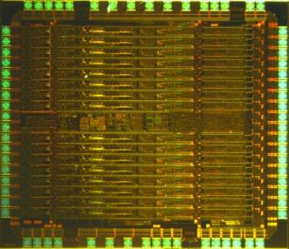

IV. FlexToT: linearized ToT RO chip
Joint project with CIEMAT to develop a time-over-threshold ASIC for SiPM based PET
  ICCUB: expertise on electronics and microelectronics design for detector FE
  CIEMAT: expertise on PET and medical imaging instrumentation
FlexToT
16 channel
SiGe BiCMOS 0.35um
Aaustriamicrosystem
10 mm²
3.3 V (10 mW/ch)
QFN 64
Notes:
38
38

Slide 39
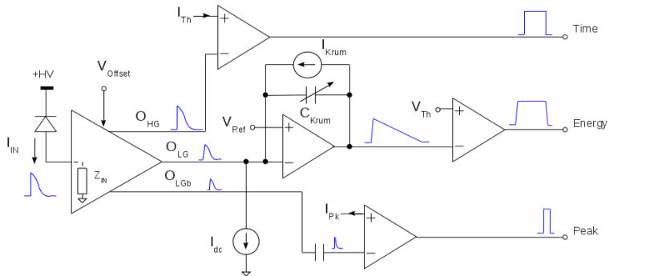
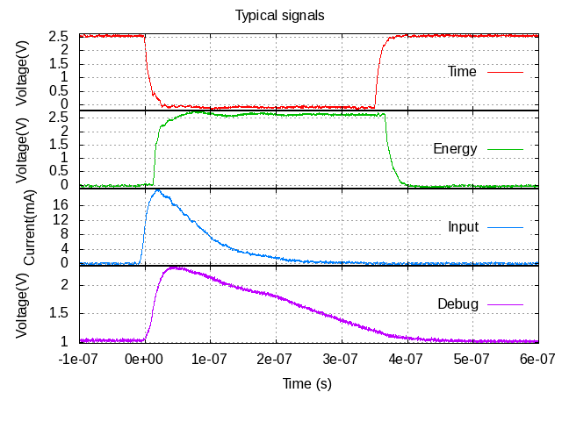
IV. FlexToT: linearized ToT RO chip
A Flexible ASIC for SiPM RO (PET, SPECT, Compton)
  Novel current mode input stage
  Time resolution for ToF
  Time over Threshold RO
    No ADC
17 October 2017
Notes:
39
39

Slide 40
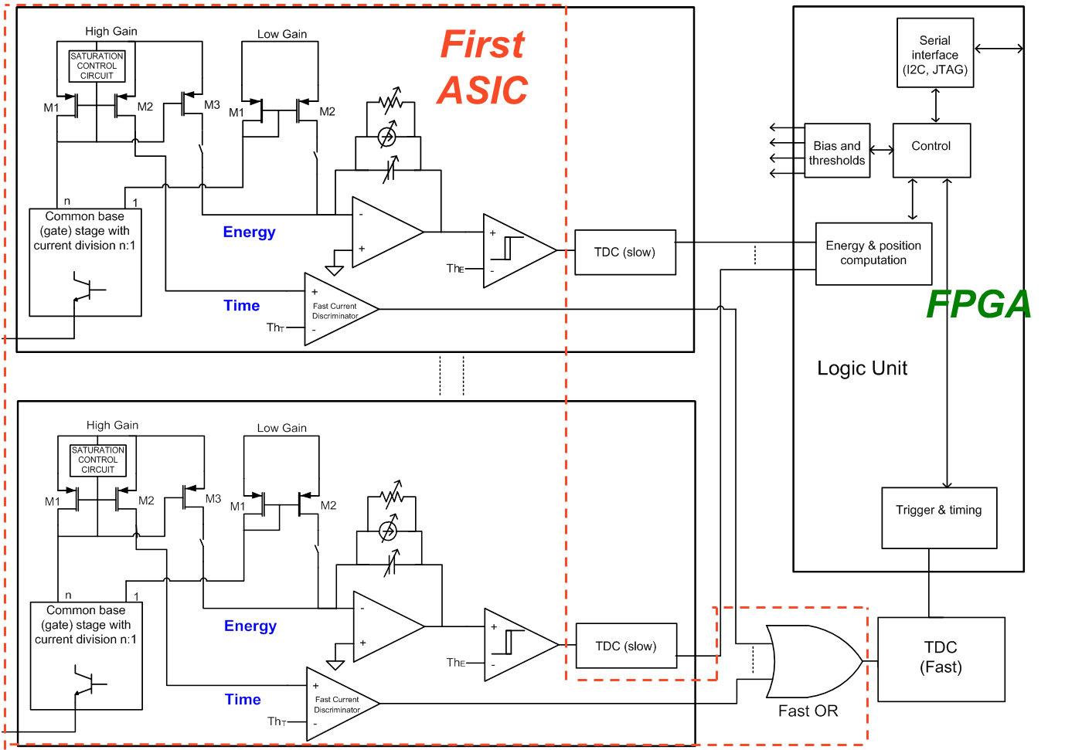
IV. FlexToT: linearized ToT RO chip
Why FlexToT is flexible?
  Different scintillator time constants
  Trading-off resolution versus rate
  Accurate analog processing directly connected to FPGA
    TDCs and signal processing are in FPGA: reconfigurable !
Notes:
40
40

Slide 41
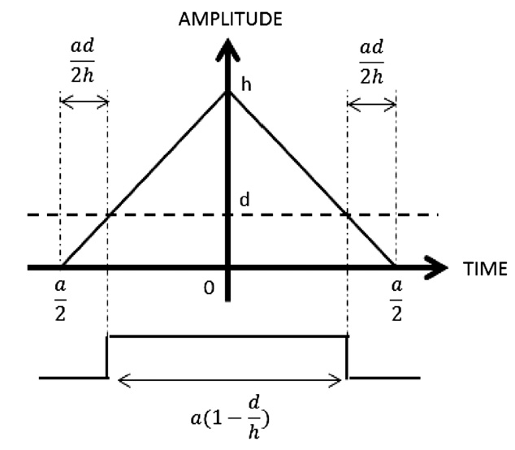
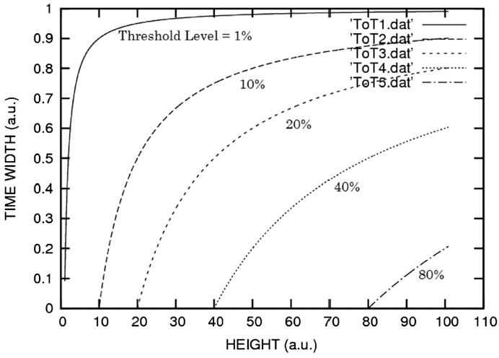
IV. FlexToT: linearized ToT RO chip
Configurable ToT
  Non-linear vs linear
  Tuneable feedback current
    Rate vs resolution
Classical ToT is non-linear
  CSP+Shaper+Discriminator
Orita, NIMA 648, S24-27, 2011
Notes:
41
41

Slide 42
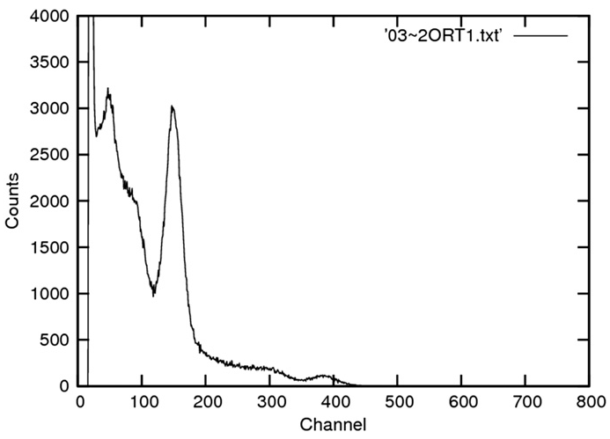
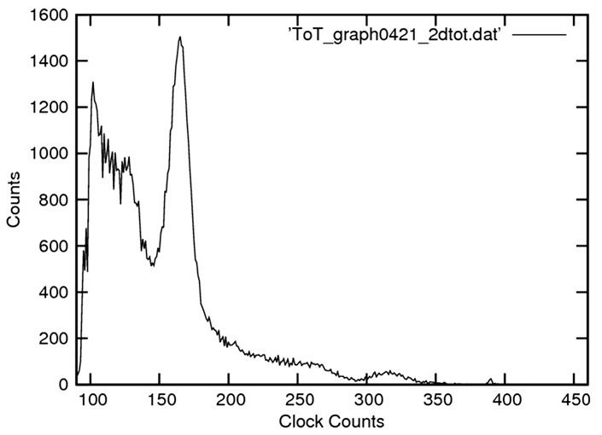
IV. FlexToT: linearized ToT RO chip
No linear ToT may degrade resolution
Linear ToT is possible
  Used in Medipix, Timepix, Dosepix ASICs family
  Also proposed for PET
  Tuneable feedback current (IFB)
    Rate vs resolution
Non linear ToT
Linear ToT
Orita, NIMA 648, S24-27, 2011
I_{FB}
C_{FB}
Notes:
42
42

Slide 43
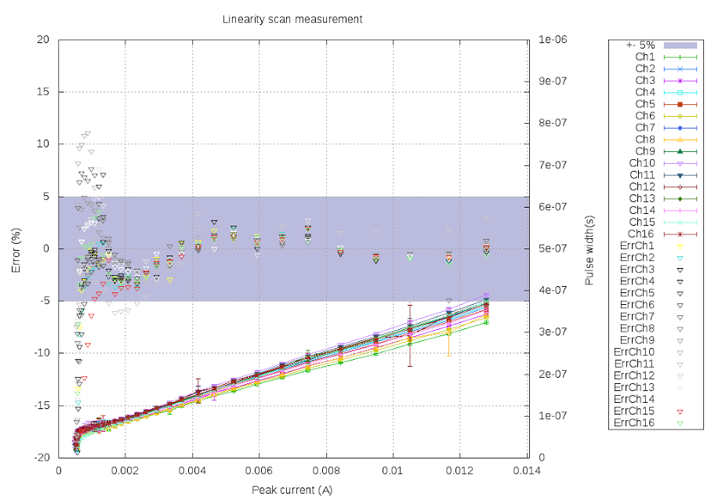
IV. FlexToT: linearized ToT RO chip
Good linearity and uniformity
  With only comparator threshold offset equalization
Different operating ranges can be covered
Notes:
43
43

Slide 44
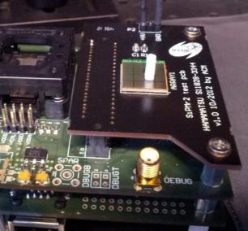
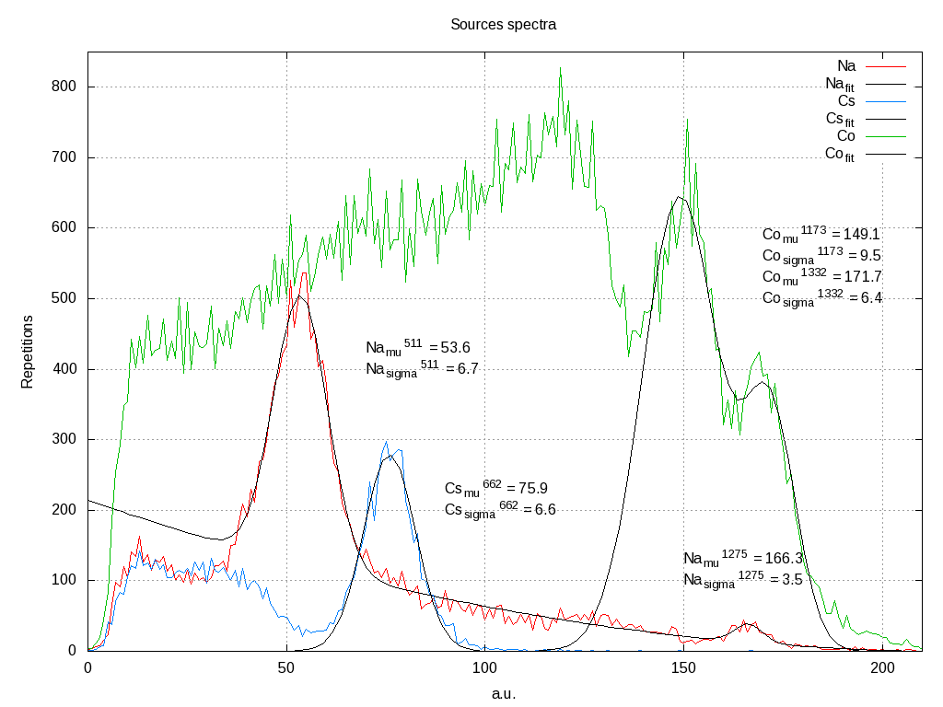
IV. FlexToT: linearized ToT RO chip
Spectroscopy with linear ToT
Notes:
44
44

Slide 45
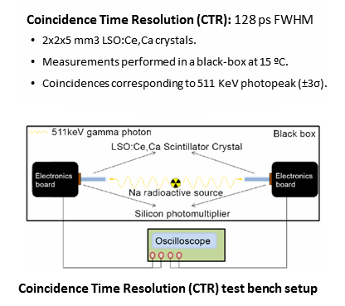
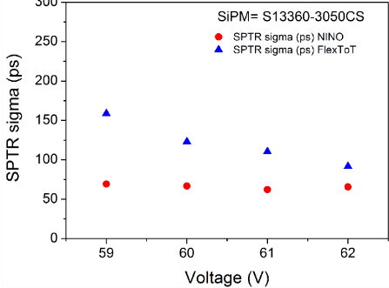
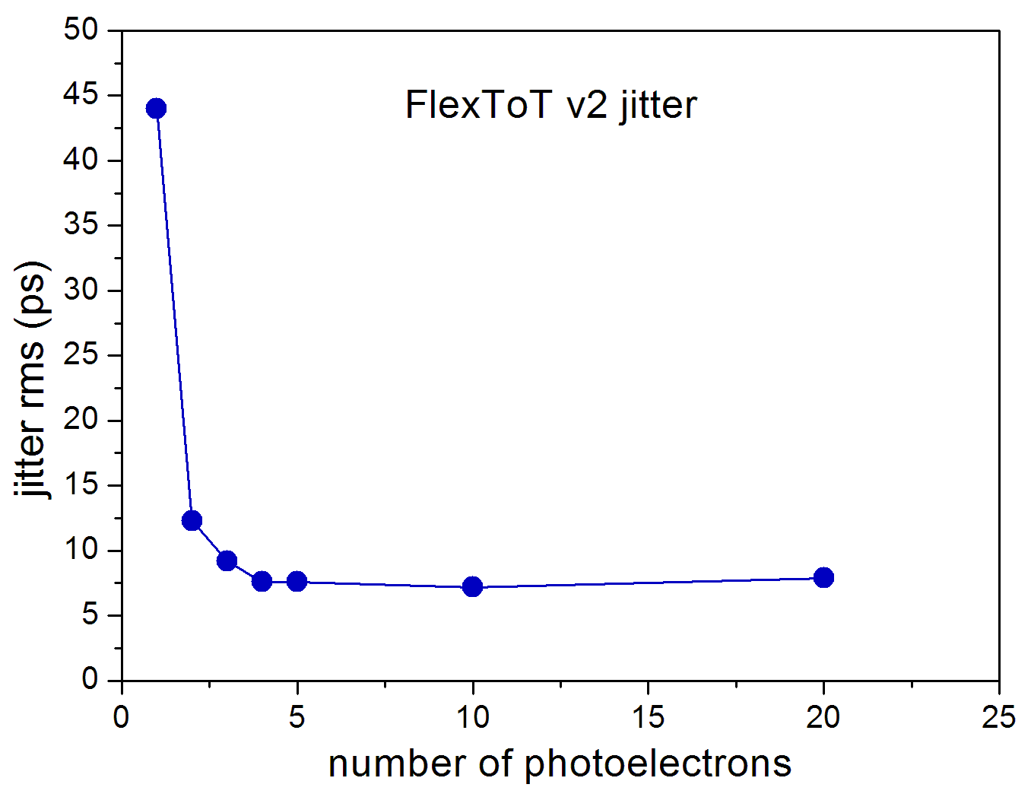


IV. FlexToT: linearized ToT RO chip
Measured @ CERN:
  Single Photon Time resolution (SPTR)
  Coincidence Time Resolution (CTR)
  Supported by FAST COST ACTION
    Many thanks to E. Auffray and S. Gundacker
  Similar results as for NINO but 3 times lower power consumption
CTR: 123 ps
SPTR=90ps
Jitter floor: 7 ps rms

Slide 46




IV. FlexToT: linearized ToT RO chip
Pisa University has develpped a FPGA based TDC readout for FlexToT
  Based on Arria 10 FPGA
    TDC: 38 ps resolution
  System CTR: 116 ps FWHM !
  Energy resolution: 8 % FWHM @ 511 KeV
  Dead time < 5ns
P. Catra,
G. Sportelli
2 LYSO xtals 3x3x5 mm3
NUV-SiPM
CTR: 116 ps FWHM
Ge68 spectrum
8.8 % FWHM
Timing distributions for different source positions

Slide 47
Outlook
Introduction
PACTA: High Dynamic Preamp
MUSIC: Multipurpose SiPM RO chip
FlexToT: linearized ToT RO chip
New developments

Slide 48

V. New developments
FE electronics must have low jitter to achieve good timing
  Low noise
  High slew rate: dV/dt
    Not only high BW !
High BW and low noise are the key for low electronics jitter
Differential readout can help in:
  Increasing dV/dt (if coupled to a differential sensor)
  Rejecting common mode noise
  But intrinsic noise increases: problem for SE sensors
C. De La Taille, Photodet conference, 2012
Example: NINO ASIC
See C. Williams talk at NDIP2014

Slide 49

V. New developments
NINO is a FE chip used in many applications
  “Old design” in 250 nm
  Could gain a lot in BW (dV/dt) and jitter by scaling down the design !
65 nm
> 10 GHz
0.25 um
< 2 GHz
W. Sansen, "Analog IC Design in Nanometer CMOS Technologies," VLSI Design, 2009 22nd International Conference, 2009

Slide 50

V. New developments
Collaboration between CERN and ICCUB to develop a 65 nm FE chip optimized for timing applications
  First user meeting was held recently: https://indico.cern.ch/event/646451/
    Please let us know if you are interested
Different types of fast photo-sensors:
  PMTs and MCPs
  SiPMs
  New structures: Typsy, LAPPD, micromegas, etc
Use previous concepts:
  Current mode
  Flexibility and configurability
  Linearized ToT
M. Campbell
R. Ballabriga
J. Fernandez

Slide 51

V. New developments
Why do we need to improve time resolution?
Enabling direct 3D PET event localization eliminating the need for statistical image reconstruction.
  Recent results: 100 ps time resolution barrier can be broken
  A new technological breakthrough is required to achieve direct 3D event localization
Direct 3D PET
< 20 ps gives mm resolution !

Slide 52

V. New developments
How to achieve it?
http://iopscience.iop.org/article/10.1088/0031-9155/61/7/2802/pdf
Timing resolution of the sensor for a single photon
New developments in photo-detection and FE electronics
Scintillator rise time (light emission)
SPTR < 20 ps !!!
New scintillators: prompt light emission (Cherenkov light, nanocrystals)

Slide 53
V. New developments
 | PMT* | SPAD | aSiPM | dSiPM | MCP
PDE | 35% (blue) | 70% (green) | ~45% (blue) | ~25% (blue) | 35%
SPTR | 200ps | 20ps | 80ps (3x3mm2) | 120ps | 20ps
Gain | 1e8 | 1e6 | 1e6 | - | 1e6
DCR | <100 Hz/cm2 | 10Hz 100um | 100 kHz/mm2 | >1M Hz/mm2 | <100 Hz/cm2
ENF | 1.1 | 1.0x | 1.1 | ? | 1.05
Radiation hardness | Good | lower | lower | lower | Good
Reliability/Life | Good | Good | Good | Good | moderate
magnetic field tolerance | bad | Good | Good | Good | moderate
Temperature sensitivity | Good | Good | Good | Good | Good
Excellent SPAD timing resolution is degraded by the current aSIPM and dSIPM architectures: interconnection, skew, etc
Fast Advanced Scintillator Timing
A COST ACTION (TD14101)

Slide 54
V. New developments
No detector is yet valid to reach a SPTR of 20 ps !!!
The problem can not be solved only by FE optmization
NEW SENSOR+FE system is required !!!

Slide 55



V. New developments
3D integration allows 1 TDC per SPAD: no interconnection problem
Very low power TDCs have been designed (100 uW)
SPAD arrays in CMOS technology
Research at TU Delft
(group of E. Charbon):
SPADnet
3D-integration (flip chip)
J. Mata Pavia, M. Wolf, E. Charbon, IEEE NSS, 2014
Courtesy of E. Charbon
Anyway a typical SiPM has thousands cells 3600x100uW=360 mW (40 mW/mm²)
per cristal/SiPM not affordable !!!!

Slide 56
V. New developments
Two enemies to fight to:
  Capacitance: Slope (dV/dt) and noise !
  Interconnection and non-uniformities: TTS, delay, etc
R&D on new hybrid sensors
  SiPM microcells divided in subgroups
    Each subgroup is readout by analog buffer and processed: sum, disc, TDC…
  Use best technology for sensor and for electronics
    Similar as for pixel detectors in HEP: exploit vertical integration technology
    Cooperation between sensor industry and FE developpers is required !

Slide 57
V. New developments
Two enemies to fight to:
  Capacitance: Slope (dV/dt) and noise !
  Interconnection and non-uniformities: TTS, delay, etc
SPTR should approach to the one of the SPAD
  Sensor capacitance is much smaller
  Interconnection can be equalized
Other advantages: high PDE & “clean” technology
HYBRID APPROACH
For SiPM/SPAD and also for other techs…

Slide 58
  Thanks a lot for your attention !!!
  Questions ?
  dgascon@fqa.ub.edu

Slide 59
III. MUSIC: Multipurpose SiPM RO chip
Input
  Up to 8 pixels (6x6 mm² SiPMs)
  Possible to disable each input reducing overvoltage by 4V
Outputs:
  OR trigger
Control
  Every block and channel can be disabled (power down)
  SPI control: gain, PZ parameter, disc th
Additional features

Slide 60


III. MUSIC: Multipurpose SiPM RO chip
AMS SiGe 0.35um BiCMOS
Area: 9 mm²
64-QFN 9x9mm package
Power consumption between 15 and 30 mW/ch depending on the operation mode
Received in Q2 2016

Slide 61

III. MUSIC: Multipurpose SiPM RO chip

Slide 62


V. New developments
Analog SiPM
Digital SiPM
Courtesey of T. Frach & PDPC

Slide 63


II. MATRIX TDC
MATRIX is a 4 ch 15 ps TDC
  4 input channels.
  15-ps nominal time bins.
  Jitter: 10 to 20 ps.
  Linearity: 4 ps.
  Power: 11.3 mW / channel.
Technology: CMOS 180 nm
J. Mauricio et alt. “MATRIX: a 15 ps resistive interpolation TDC ASIC based on a novel regular structure”, JINST 2016.

Slide 64


Measurement Results
Linearity:
    INL = ± 10.2 ps
    RMS INL < 3.7 ps
    DNL = ± 4.7 ps
    RMS DNL < 1.1 ps

Slide 65






Measurement Results
Jitter (pulse generator + MATRIX TDC):
  TDC jitter is dominated by PLL.
    M = 4 has a natural frequency ($ω_{n}$) 2X M = 8 and thus jitter improves.
    Improved by factor > 2 in MATRIXV2 TBC: just received
PLL M | TDC Jitter (ps)
 | Uncalibrated | Calibrated
4 | 9.7 | 9.3
8 | 13.4 | 12.9
16 | 21.2 | 20.6
$$K_{VCO}=VCO gain \left[\frac{Hz}{V}\right]$$
$$ω_{n}=\sqrt{\frac{K_{VCO·}I_{CP}}{M·C_{1}}}$$
$$I_{CP}=CP current [A]$$
$$M=fb divisor$$
$C_{1}=large loop−filter cap [F]$
Notes:
This indicates that most of the TDC jitter is caused by PLL...
- When we move from M=4 to M=16, TDC jitter twices.
- This is because PLL natural frequency decreases by 2.
- In conclusion, we can improve jitter in further MATRIX versions by improving the PLL.

Slide 66
MATRIX TDC Specifications
#Channels | 4
Resolution | 15 ps (sub-delay), 10 ps (statistical)
Linearity | < 4 ps RMS
Jitter | < 10 ps (v1), < 5 ps (v2)
Power consumption | 45 mW
Dynamic range | 1280 ns
Max. Input rate | 10 MHz (sustained), 50 MHz (peak)
Dead time | < 20 ns
Reference clock | 50 / 100 / 200 MHz
Outputs | Individual Single Ended LVDS
Configurability | SPI

Slide 67

Other FE ASICs: PACIFIC
PACIFIC: A 64 ch ASIC for Scintillating Fiber Tracking in LHCb Upgrade
Collaboration with Heidelberg, LPC-Clermont, IFIC-Valencia
130 nm CMOS technology
Similar input current conveyor as in FlexToT
Current conveyor with very low impedance input (≈ 30Ω)
  Adjustable gain / dynamic range
  Input voltage adjustment
Fast tunable shaper
  Pole-zero cancellation to cancel slow SIPM time constant
  A FWHM of 5 ns is achieved for single-cell signal
Dual interleaved 25ns gated integrator
  Almost no dead time
  Average photo-statistical fluctuations
  Maximize charge collection (25 ns integration)
2 bits 40MS/s flash non-linear ADC
Power consumption < 8mW/channel @ 1.2 V

