Slide 1
Models of the signal response from SiPMs and PMTs
Oleg Kalekin
Giacomo Principe
Light-17 Workshop
Ringberg 16 October 2017

Slide 2
PMT response model #
Photo-conversion and electron collection
Conversion of photons in electrons and subsequent collection by the dynode system is a random binary process: Poisson distribution
Amplification
The response of a multiplicative dynode system to a single photon electron can be approximated by a Gaussian distribution
Low charge processes
No photoelectron are emitted (Pedestal) - Gaussian distribution
PMT response function (charge distribution)
Convolution of these 2 functions
But …
Discrete Processes
thermo-emission from photocathode or dynodes
Exponential function
# Bellamy et. al. (1994) Absolute calibration and monitoring of a spectrometric channel using a photomultiplier

Slide 3
Tests of R12992-100 PMTs
Controversial fit results:
When using custom amplifier resulting in high electronics noise (wide pedestal):
  Stable good quality fit
  No exp noise
When using FlashCam electronics resulting in low electronics noise and good signal-pedestal separation
  Unstable fit with poor quality sometime
  Probability of exp noise jumps from measurement to measurement for the same PMT
  Pedestal taking in outside of the signal region reveals no exp noise
Reason:
Exp noise in fit just mimics another effect – non Gaussian shape of the single photo electron (s.p.e.) distribution

Slide 4
PMT response model
No exp noise
Long tail on the left side of s.p.e. distribution
Pedestal described by more than one gauss
To be implemented in the fit model:
S.p.e. distribution as a combination of constant and gauss functions
Multiple p.e. as simple gauss functions using sigma and mean derived from s.p.e distribution

Slide 5
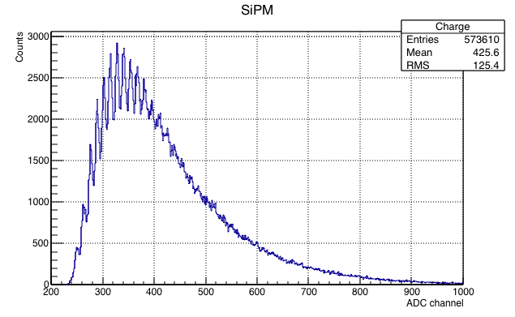
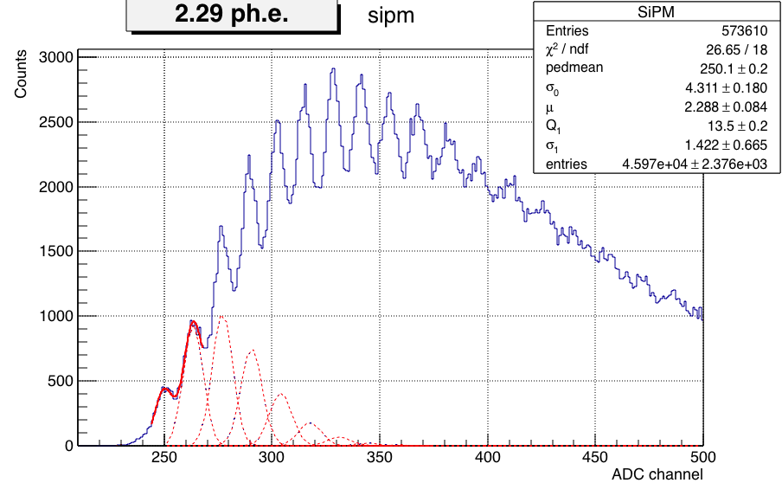
SiPM response model
The same basic model: Poisson+Gauss
Cross-talk as probabilities P0, P1, …, Pm that 1 p.e. produces 0, 1, …, m-1 additional p.e.
Number of p.e. from Poisson changed with cross-talk probabilities using multinomial distribution
SiPM measured with CTA TARGET ASIC
Expected μ – mean #p.h. easily estimated from k=0 of the Poisson N_{k}=Nμ^{k}e^{-μ}/k!
μ=-log(N₀/N) = 4.77 ph
Fit without cross-talk in the range 0-1 p.e. leads to much smaller μ

Slide 6
Multinomial distribution
n – number of p.e. in Poisson
x₁, …, x_{k} => 0, …, k-1 – number of cross-talk electrons
p₁, …, p_{k} (Σp_{i}=1) – probabilities of cross-talks
Example:
Poisson probabilities P₀, P₁, P₂
probabilities of cross-talks p₀=0.5, p₁=0.2, p₂=0.2, p₃=0.1
#p.e. 0 1 2 3 4 5 6 7 8
P₀ P₀
P₁ ✕ 0.5 0.2 0.2 0.1
P₂ ✕ 0.25 0.2 0.24 0.18 0.08 0.04 0.01
Satisfying of the condition Σp_{i}=1
Redefinition of probabilities of cross-talk in fit as following (each in range [0-1]):
P(≥1 p.e.)=Pr(1+) => p₀=1-Pr(1+)
P(≥2 p.e.)=Pr(2+)✕Pr(1+)=> p₁=Pr(1+)✕(1-Pr(2+))
P(≥3 p.e.)=Pr(3+)✕Pr(2+)✕Pr(1+)=> p₂=Pr(1+) ✕Pr(2+)✕(1-Pr(3+))
…

Slide 7
SiPM response model
Some parameters fixed to speed up the fit
1ph – 28.4%
2ph – 5.4%
3ph – 6.2%
4ph – 5.1%
5ph – 0%
6ph – 0%
7ph – 9.2%
Known problem of non-linearity at large amplitudes may cause longer tail

Slide 8
SiPM response model summary
Cross-talk modelled with multinomial distribution
Advantage:
Probabilities of cross-talk multiplicities per one initial photo electron
Disadvantage:
Fit duration grows rapidly with mean p.e. number and with cross-talk multiplicity.
Therefore, more effective and useful for small mean p.e.

