Slide 1







The Tynode
a new vacuum electron multiplier for ultra fast pixelised particle detectors
On behalf of the MEMBrane project:
Harry van der Graaf, Jeff de Fazio, Conny C.T. Hansson
Hong Wah Chan, Annemarie Theulings, Violeta Prodanović, John Smedley, John Sinsheimer, Kees Hagen, Carel Heerkens, Lina Sarro, Gert Nützel, Serge D. Pinto, Neil Budko, Behrouz Raftari, Wouter de Landgraaf, Henk van Zeijl
Supported by ERC – Advanced 2012 “MEMBrane” 320764
Light 17
Ringberg Castle, Germany
Oct 17, 2017

Slide 2
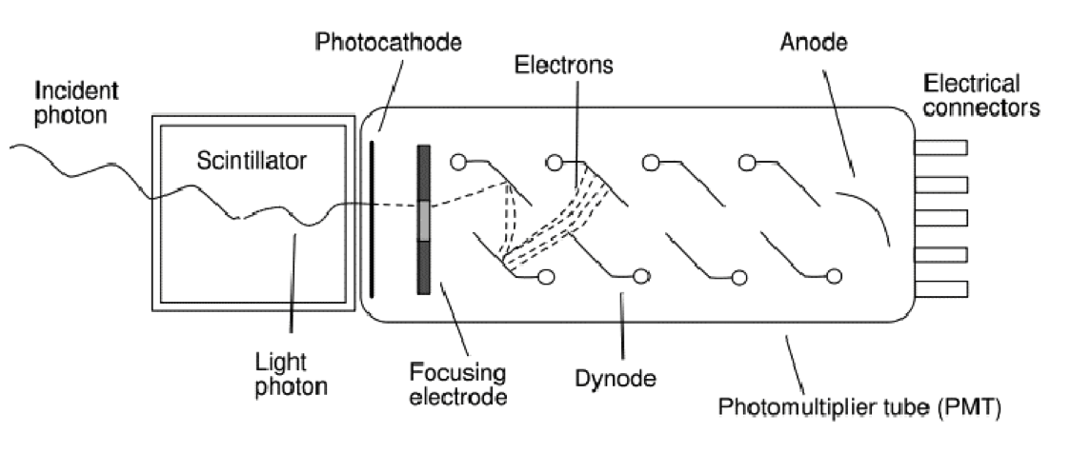
A very successful photon detector: the Photomultiplier (1934 -1936)
‘good’ quantum efficiency
rather fast
low noise @ high gain: very sensitive
little dark current, no bias current
radiation hard
quite linear
voluminous, bulky & heavy
no spatial resolution, not even 1D
expensive
quite radioactive
can’t stand B fields
Amplification by multiplication: low noise!

Slide 3
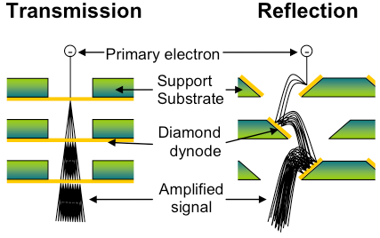
Dynode: amplification by multiplication
New: the Transmission Dynode
Tynode®
Trynode®

Slide 4

The Timed Photon Counter TiPC “Tipsy”concept: advancing PMT’s
Photomultiplier tubes
High gain
Low noise
Secondary Electron Yield (SEY)
Gain = δ^{N}
…Can we make it smaller?
Transmission dynodes – Tynodes
Dark noise free electron multiplication mechanism
Stacking the photocathode, Tynodes and pixel chip → compact device
Pixelated detector → spatial resolution (imaging)
Operation of the detector in high B-field.
Time resolution: few ps due to form factor and straight electron path’s
2D spatial resolution = 10 µm
4

Slide 6

Path towards first prototype
We have created many tynodes of various sizes and materials
Most recently, we have achieved transmission yields of 5.5 with 5 nm MgO membranes, coated with 2.5 nm TiN, without other special surface treatments
Now working towards building a first prototype device
MEMS technology

Slide 7
Transmission dynodes
30 μm
SiN
Si
Thickness: 5 – 50 nm
Array: 64 by 64
Conductive layer: Titanium nitride ~2 nm
SEE layer: ALD Al₂O₃ or ALD MgO

Slide 8

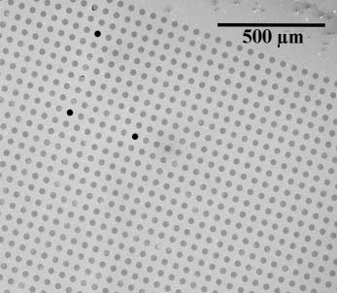
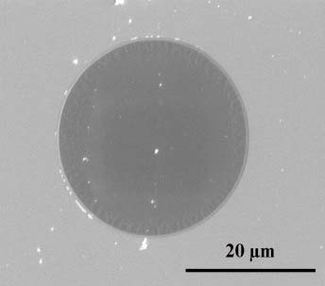
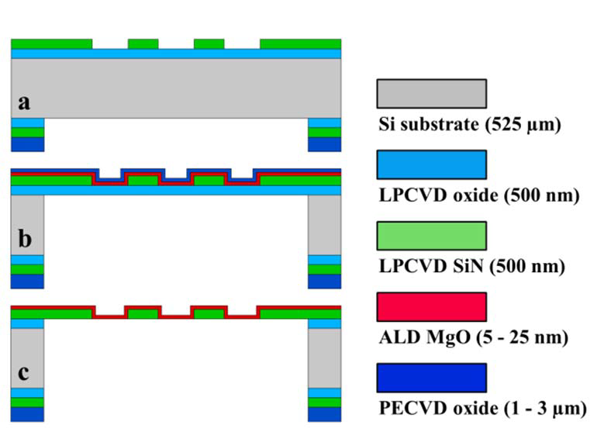
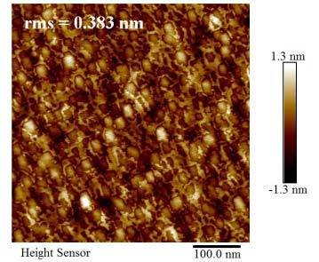
MEMS fabrication of Tynodes: ALD MgO
Thermal ALD reactor with (Mg(Cp)₂) and H₂O as precursors
Deposition temperature: 200 °C
Measured stress: ~ -200 MPa
Growth rate = 0.165 nm/cycle (3 + 15 + 1 + 15 sec)
SEM captures of 5 nm thin MgO membranes in 64 x 64 array
8
AFM image of released 25 nm thin MgO
membrane

Slide 9
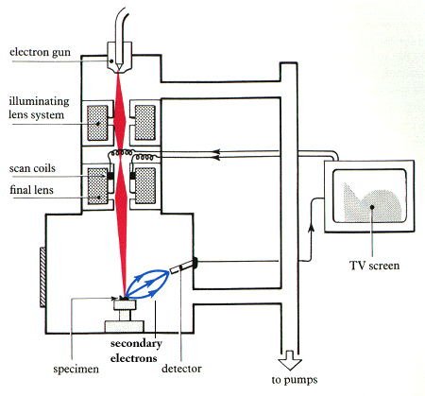
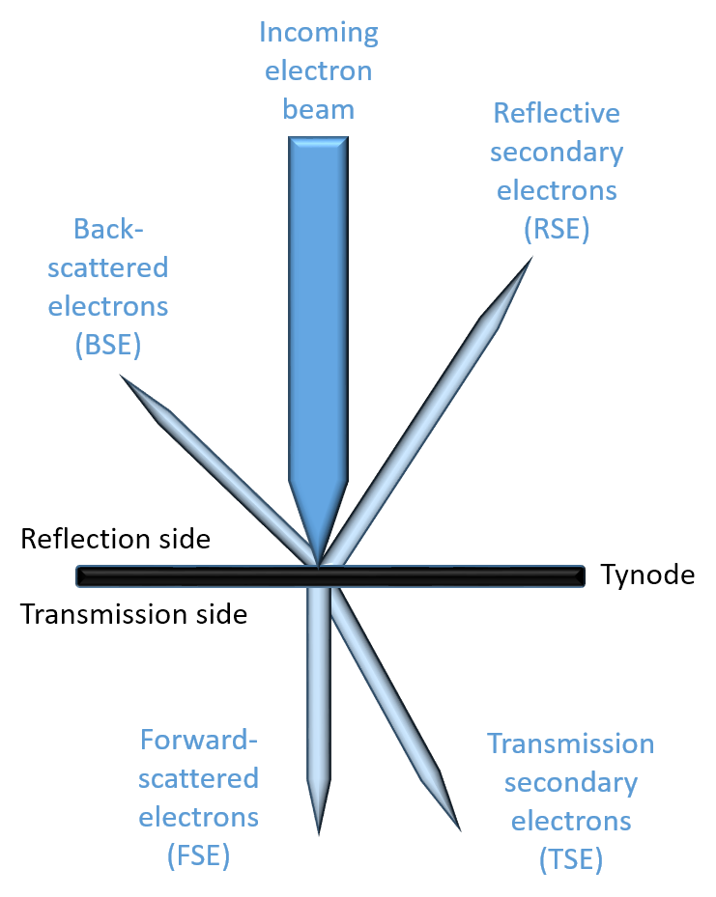

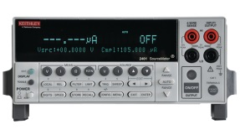
TSEY Measurement in SEM
Scanning Electron Microscope:
  Electron beam energy
  Measure beam current
  Acquire image (4.2 min)
Keithley 2450 Sourcemeters
  Measure Sample Current
  Measure anode Collector Current
Repeat for different beam energies
Process data
SEM e⁻ beam
sample holder
anode
Keithley source meters

Slide 11
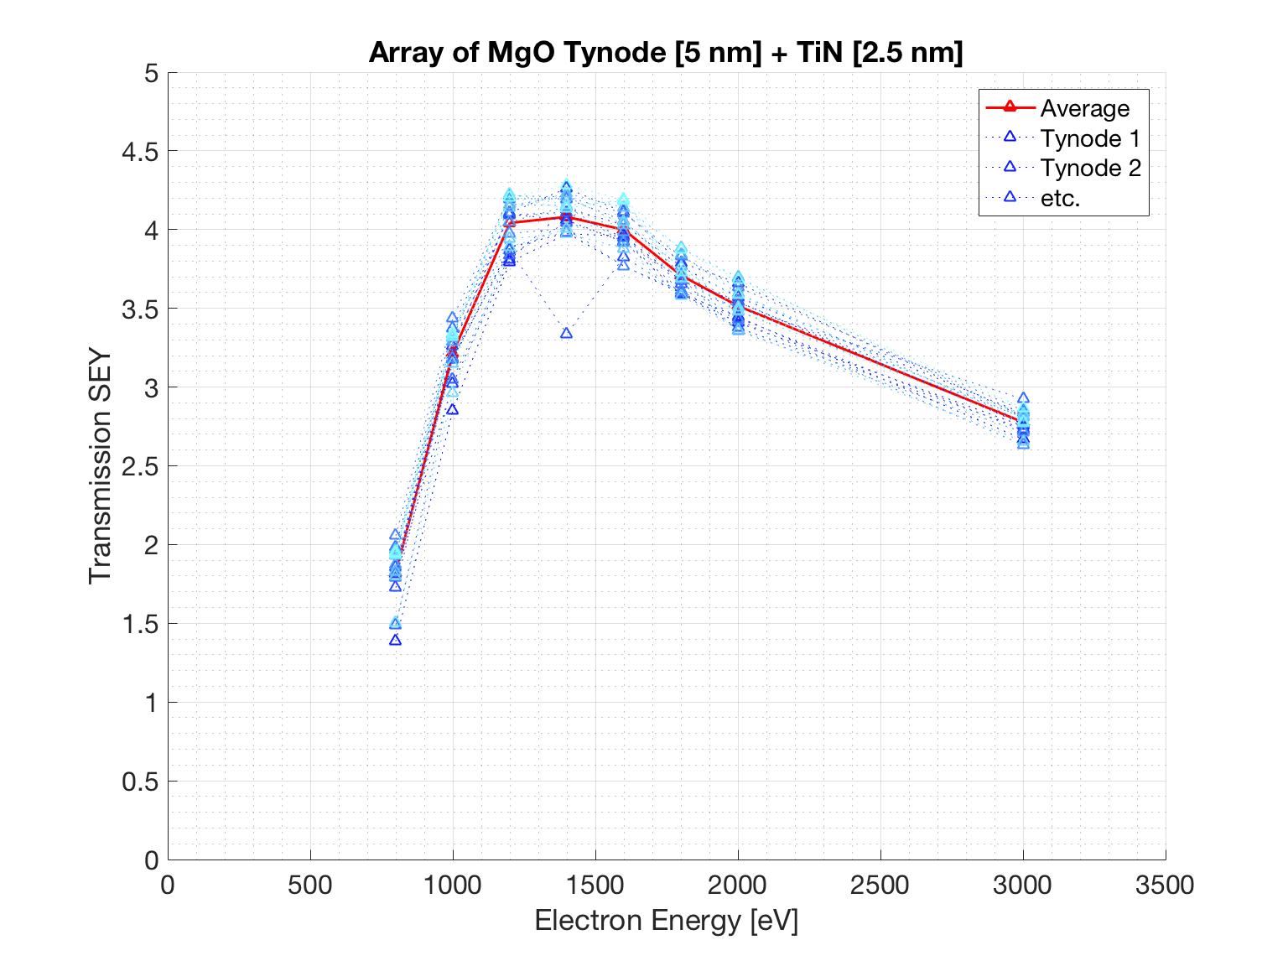
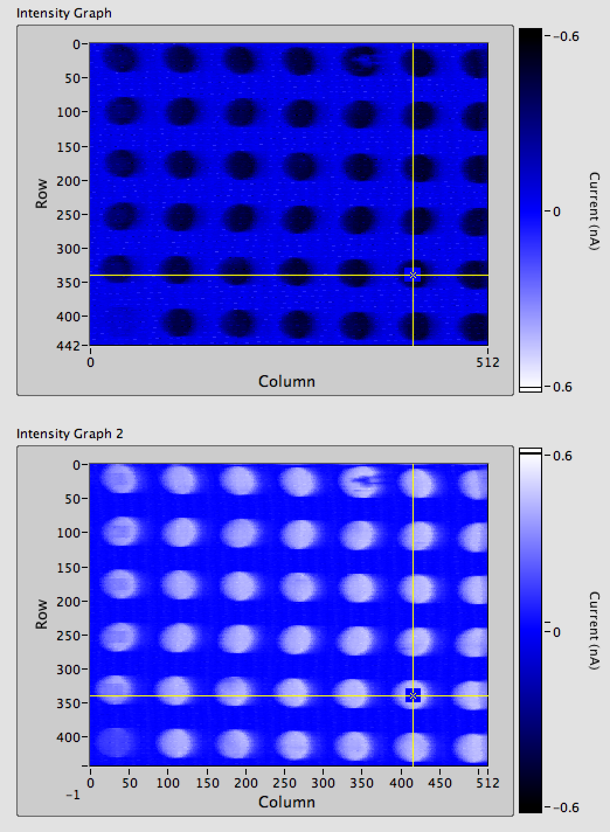
Measurement method: Scanning

Slide 12
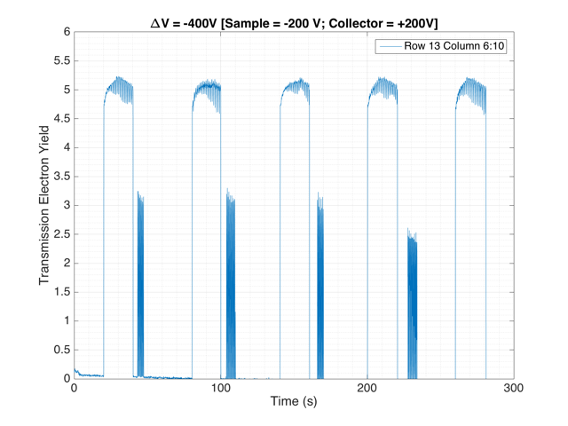
!! 5.2 !!
TSEY
November 2016: TSEYmax = 5.5

Slide 13
Al₂O₃ Measurements and Simulation using
low-energy GEANT extensions
Measurement
Simulations
10 nm
25 nm
50 nm
A decrease in yield, combined with increase in optimum primary electron energy is observed as a function of sample thickness
Good correlation to measurements seen for the simulations.

Slide 14
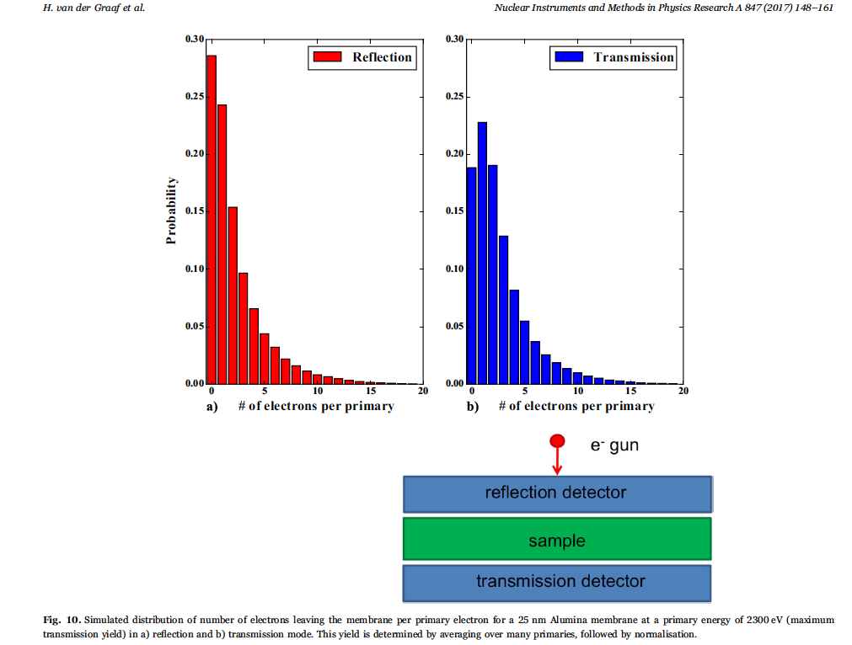

Slide 15
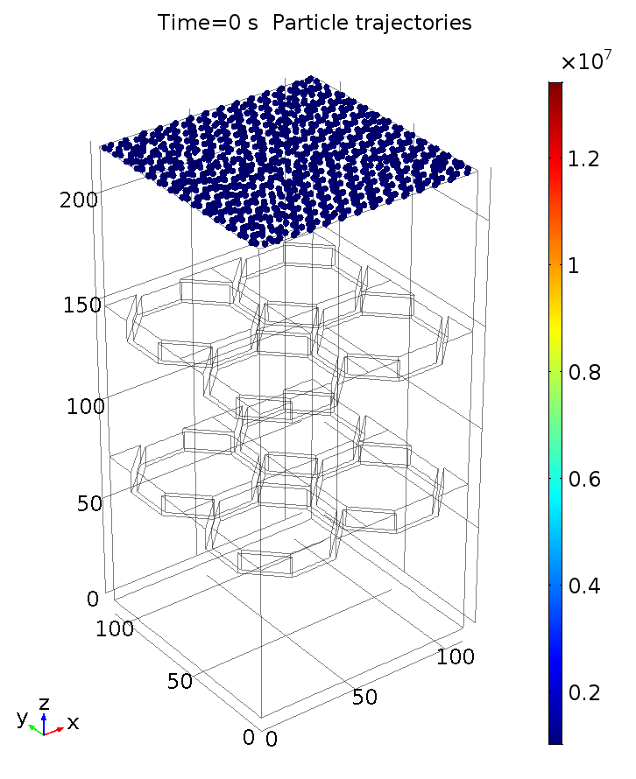
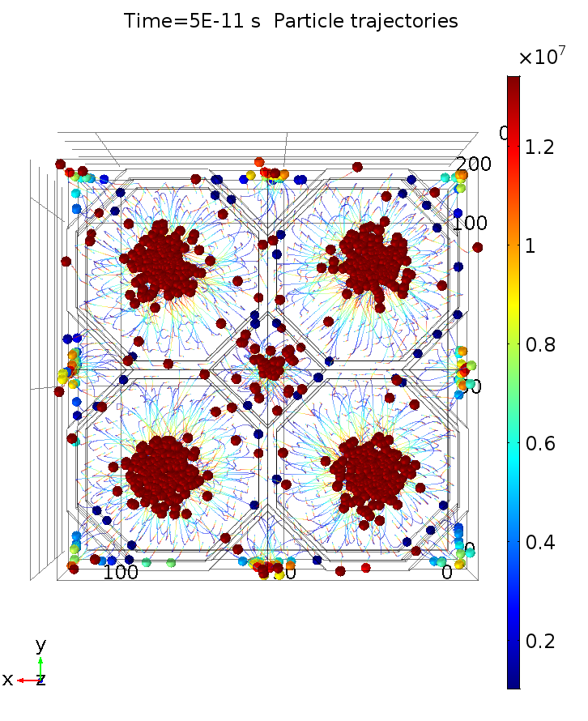
Tynode 2.0: ALD Metamaterials

Slide 16
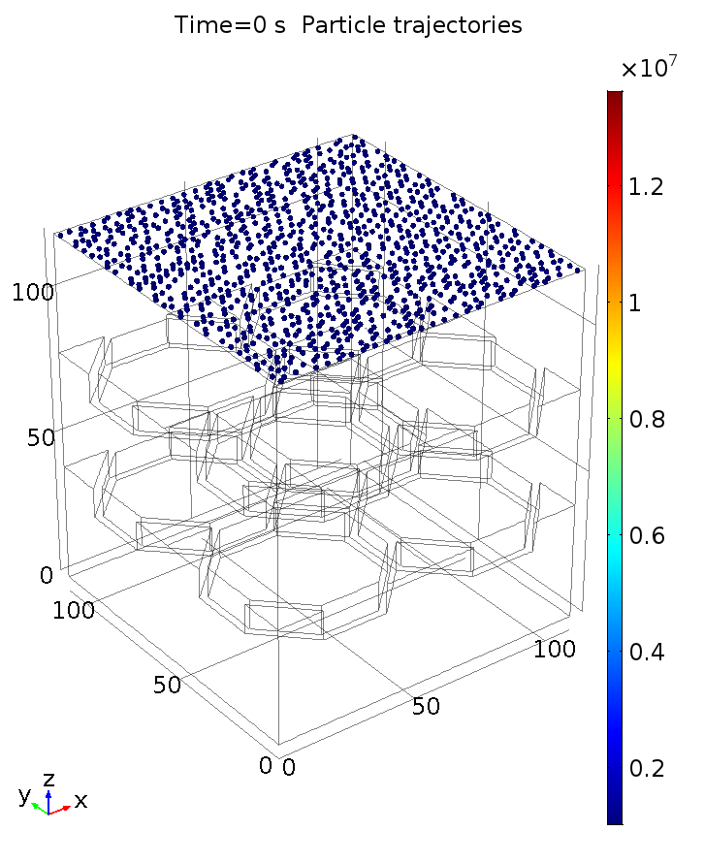
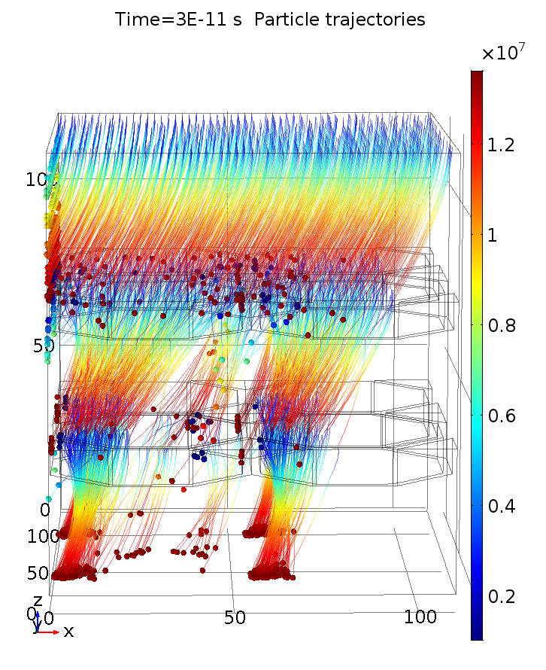
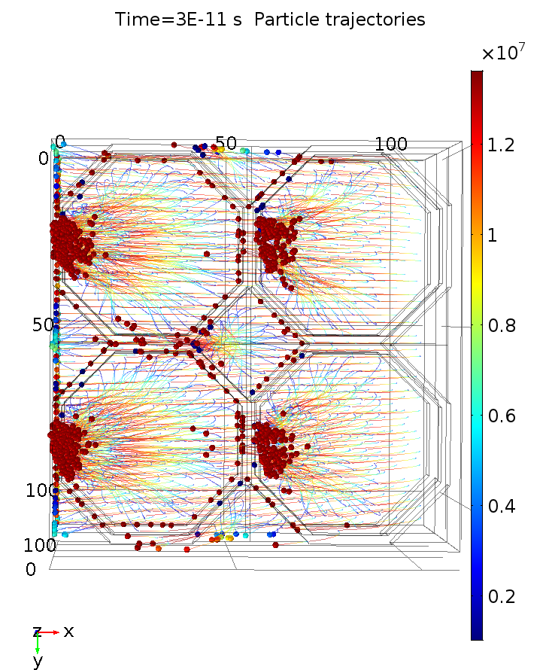
Magnetic field

Slide 17
Concept - Fabrication TipsyZero into a Photonis PLANACONTM Style Device
TimePix-1 pixel chip on Kyocera carrier board
● Ultra high vacuum compatible, sealing with Planacon window, photocathode compatible
TipsyZero will be limited to the 10 ns bin size of TPX-1 or 1 ns bin size of TPX-3
a new TimePix NN with 10 ps time resolution
Fan-out ceramic with metalized top-traces for HV distribution
Metal studs and weld ribbons to electrode rings
Backside metalized ASIC (TIMEPIX) with tynodes eutectic bonded into envelope + wirebonds

Slide 18
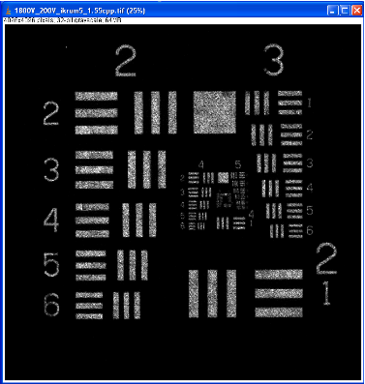
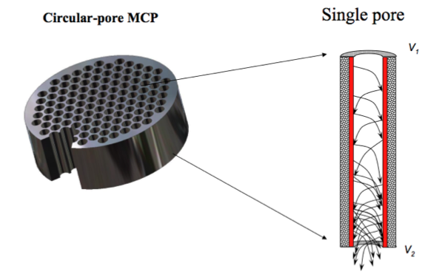
Use a MicroChannelPlate MCP?
MCP (in
vacuum)
John Vallerga: TimePix + MCPs
Nicolas Wursch: MEMS-made MCPs
Great improvements: acceptance, gain, gain stability
LAPPD project!
But: MC simulations: time resolution limited to 10 – 20 ps
Quantum Limited Imaging Detectors, RIT 2009, John Vallerga, jvv@ssl.berkeley.edu

Slide 19
Henry Frisch et al.
Development of MgO Atomic Layer Deposition: thanks for that!

Slide 20
Further yield improvement:
  fully exploration of Extracting Field Bonus
  Surface termination (note measurements at Brookhaven)
  Tynode annealing
  better vacuum
  bake out
  the active Tynode - Trynode
graphene
bulk ALD: ~ 100 atomic layers
1 V bias
graphene
Negative Electron Affinity layer
(Cs, H, B termination)
Extracting field E

Slide 21
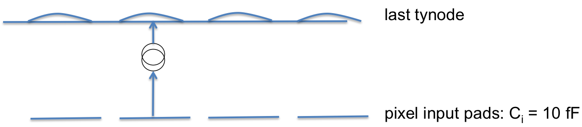
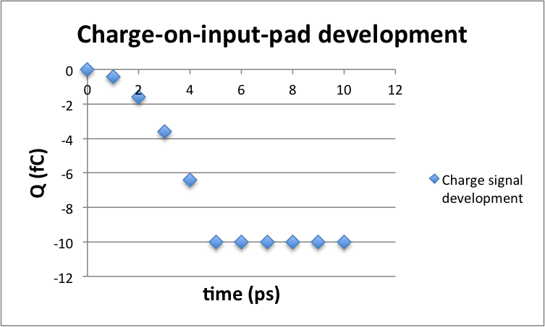
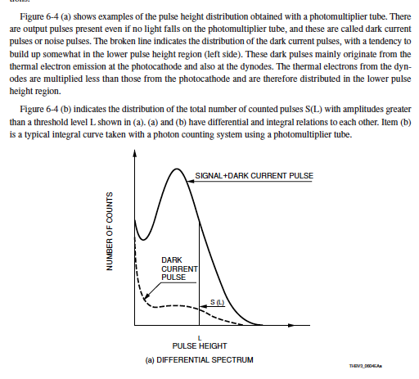
Why is Tipsy so fast?
signal is build when
electrons cross the last gap
electron mobility in vacuum: free electron!
amplitude distribution
60 k e⁻

Slide 22
Trend in Si-PMs: 3D separation of sensor and pixel chip
avalanche sensor
bump bondings
pixel chip
Digital (single photon sensitive) detector: input capacitance ~ 10 fF
With time resolution better than 20 ps: pixelisation: no signal processing possible
Time resolution below 10 ps: limited by present Si technology
development of PIX 20: a digital pixel chip with a 20 ps “counting” TDC per pixel.
After that, with ToT correction 1 ps potential!

Slide 23
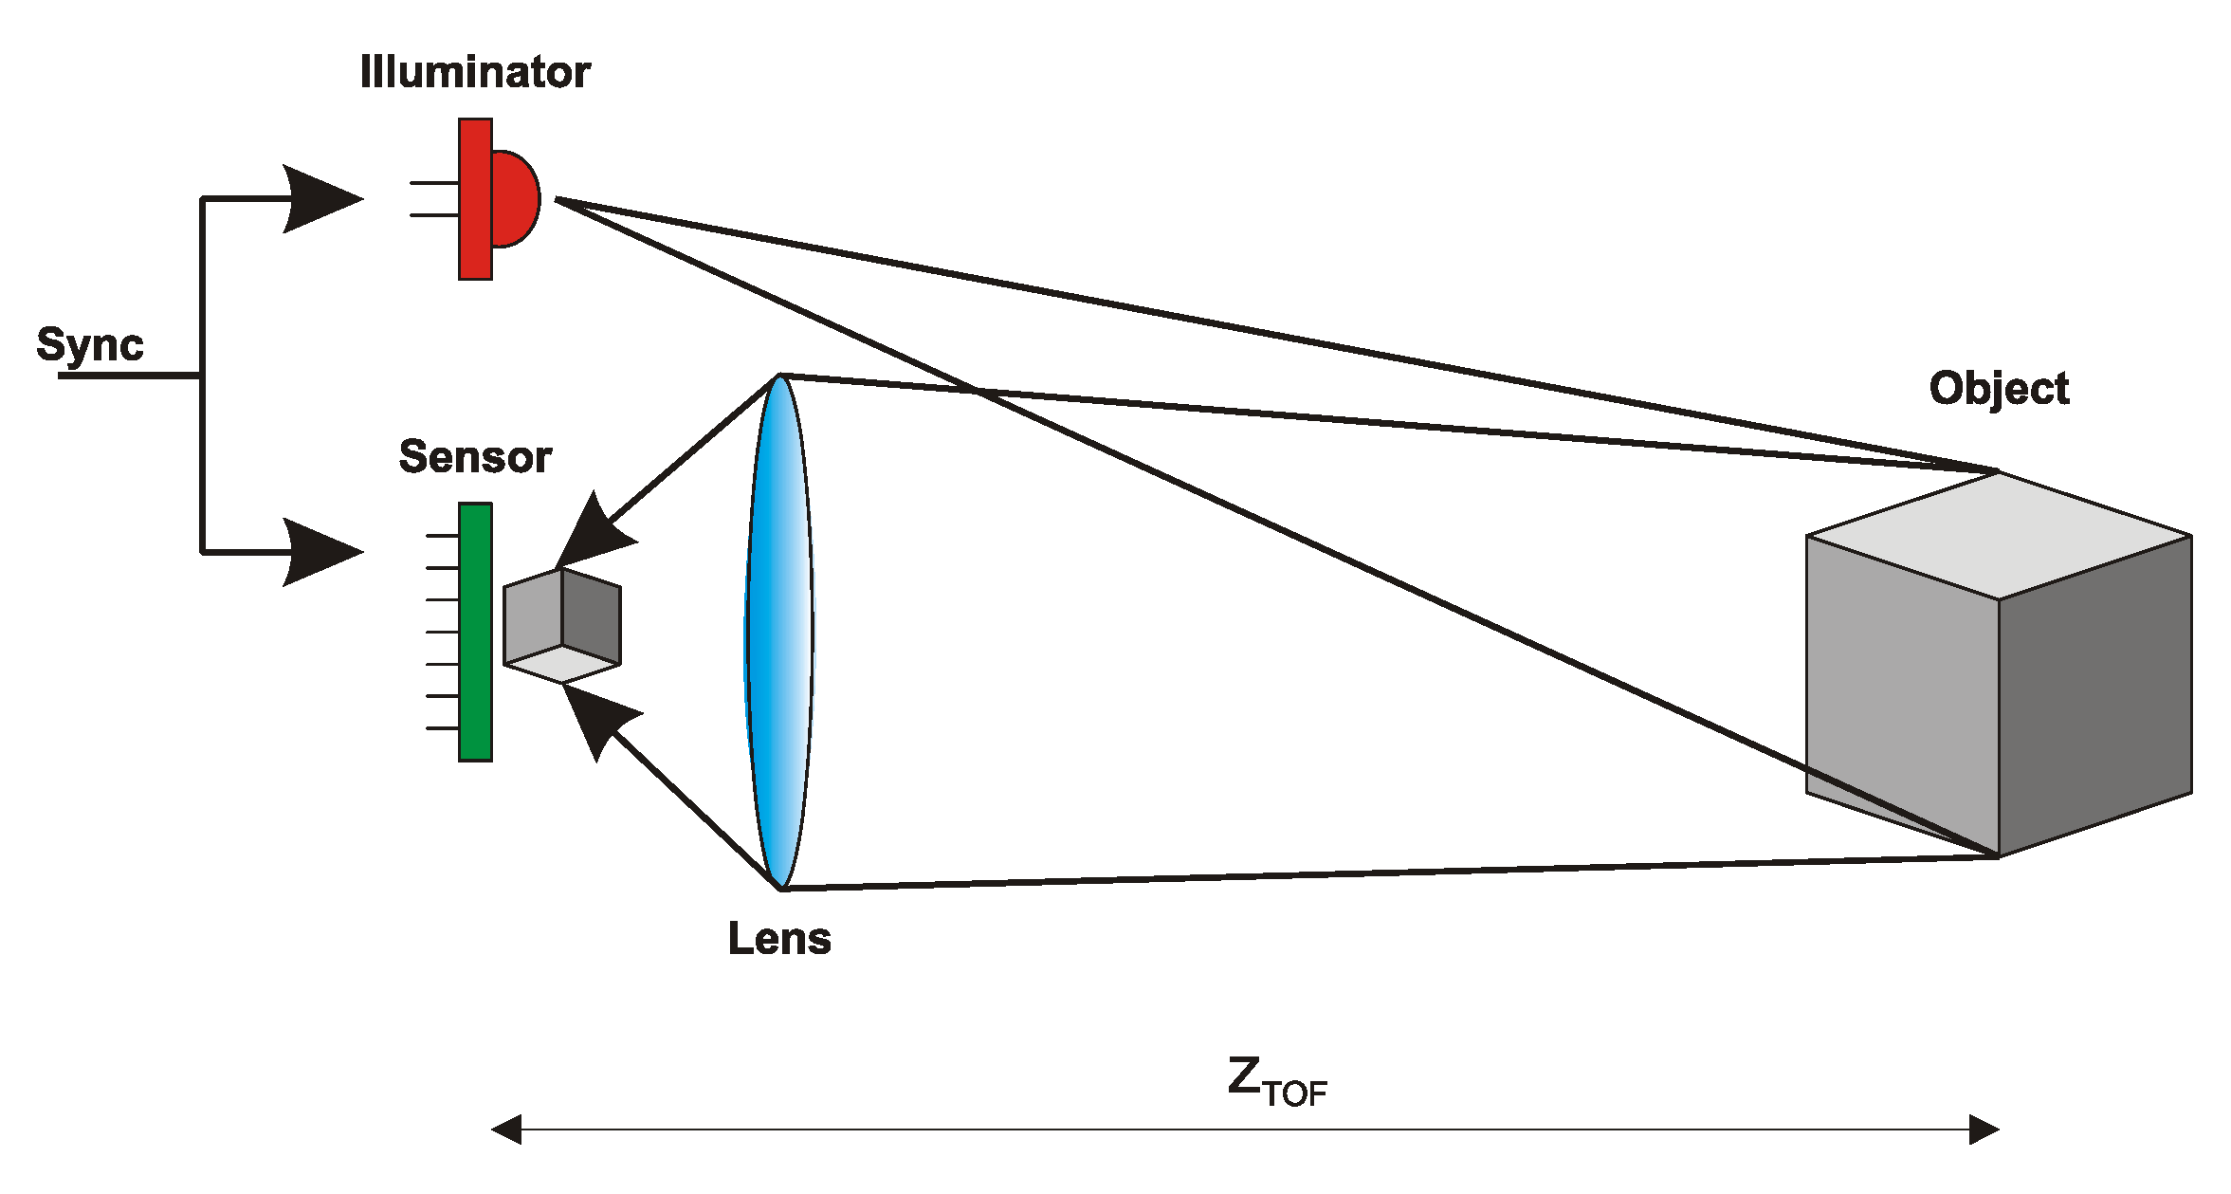
Tipsy applications
(assuming high QE and 20 – 10 ps time resolution)
Consumer products
Night goggles: most sensitive light detection Tipsy in iPhone S10 (2022)?
Prompt 3D Imaging with z-resolution of 0.5 mm Tipsy in iPhone S10 (2022)?
3D Machine viewing: robotics
Self-driving of vehicles: situation info source: prompt 3D radar like image

Slide 24
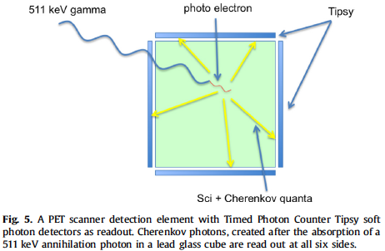
Medical Imaging: The Cherenkov-ToF-PET scanner
4D (X,Y,Z,t) measurement of conversion point of 511 keV quantum:
only 3 ChQs are required for 4D fix using GPS algorithm
…PET is no longer Tomography…..

Slide 25
with 10 ps time resolution:
Reconstruction of
interaction point:
origin of all prompt
Cherenkov photons:
4D GPS analysis method:
Only 3 Cherenkov photons
are required for fix in 3D position and time

Slide 26
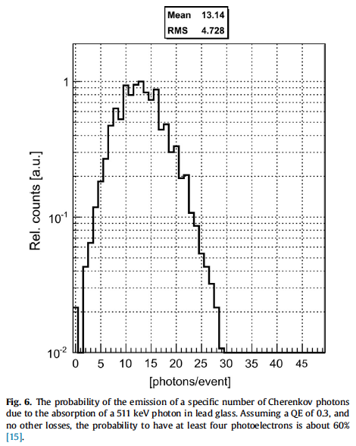
Cherenkov photons emitted
by 511 keV photo-electron
in lead glass

Slide 27
MIP detection using e-Brane
e-Brane: surface with a high probability to emit at least
one electron at the passage of a MIP (in position and time)
- low electron affinity of emitting surface
3PM experiment: naked but black shielded PMs in MIP testbeams
glassplate thick 0.1 mm e-Brane: sufficient Cherenkov photons!
muon
MIP

Slide 28
the future: the Cherenkov tracker
Ch Photon + MIP detector
transparent (mylar) foil
Vacuum!
Cherenkov photons are emitted with given angle with track
see TORCH

Slide 29
Future inner (central) tracker in collider experiments:
the Cherenkov tracker
very low detector mass
Tipsy layer at safe distance from interaction point
no extrapolation
Tipsy
Cylindrical layer
thin transparent foils
generating Cherenkov photons
The Vacuum Cherenkov CentralTracker

Slide 30
Conclusions
Ultra fast, digital (single electron, low light level) detectors must be pixelised in order 1) to provide (X,Y) spatial resolution, 2) to limit the input capacitance to a minimum and 3) to enable a high total counting rate.
Transient data recording (and processing) per pixel is not practical/possible
Ultra fast detectors require a specific digital pixel chip with a (counting) TDC + memory per pixel.
A stack of tynodes may generate the so far fastest detector charge signal, completed within 5 ps
The time resolution of a Tipsy detector may be limited by state-of-the-art Si-CMOS electronics (or GaAs, ……)
Cherenkov photons are prompt & rapid: scintillator photons are slow ………..and outdated as soon as the QE of photocathodes is improved.

Slide 31
The Tynode
a new vacuum electron multiplier for ultra fast pixelised particle detectors
On behalf of the MEMBrane project:
Harry van der Graaf, Jeff de Fazio, Conny C.T. Hansson
Hong Wah Chan, Annemarie Theulings, Violeta Prodanović, John Smedley, John Sinsheimer, Kees Hagen, Carel Heerkens, Lina Sarro, Gert Nützel, Serge D. Pinto, Neil Budko, Behrouz Raftari, Wouter de Landgraaf, Henk van Zeijl
Supported by ERC – Advanced 2012 “MEMBrane” 320764
H. van der Graaf et al.: The Tynode: A new vacuum electron multiplier.
Nucl. Instr. & Methods, in press. http://dx.doi.org/10.1016/j.nima.2016.11.064. T
H. van der Graaf et al.: Potential applications of electron emission membranes in medicine.
Nucl. Instr & Methods, special Medical Physics issue on “Advances in detectors and
applications for Medicine”. A809 (2016) 171-174. http://dx.doi.org/10.1016/j.nima.2015.10.084.

