Slide 1
Wide Range Charged Particle Detection Using Fast Scintillator and Si-PM
18-Oct-2017
El-Mul Technologies, Ltd.
Amit Weingarten, Ph,D, R&D Manager
Notes:
1

Slide 2
Outline
Who are we?
Challenges of electron and ion detection
Sensor comparison
Si-PM as sensor in SEM and TOF systems
Si-PM feasibility study: dynamic range, stability, timing simulations
Summary and future needs

Slide 3
El-Mul Technologies Ltd.
El-Mul is 25 years old, ~30 employees, privately owned company located in Rehovot, Israel
Specializes in design and manufacturing of detectors for charged particle detection in SEM, FIB (ion-electron beams), lithography, and Mass Spectrometry systems
Manufacturing >1000 detectors / year

Slide 4
Challenges in Charged Particle Detection
Limited Space: BSE in SEM, Mass Spec, TOF SIMS
Fast detection: TOF, charging in SEM
Wide dynamic range: most systems require ≥3 orders of magnitude
Heat evacuation: in-vacuum systems
Lifetime: cost of ownerships

Slide 5
Basic Requirements
Detection efficiency 100% (all particles reaching the detector will produce signal)
Two working regimes
  Pulse Counting mode: I_{input}< few pA
  Analog (current) mode: 1 pA < I_{input}<1 nA
Linearity over analog regime (typically ~1%)
Overall timing FWHM for pulse separation <5ns (Scintillator + sensor)
Envelope can be as small as few mm (at least in one dimension)
Power < 1 Watt

Slide 6
Possible Sensors
 | Pros | Cons
PMT | Large dynamic range Linear | Large - complicated mechanics, complex LG/ fiber → low LCE Limited output current Heat generation
Si diode | High QE Thin Large dynamic range Linear | High capacitance – noisy and slow for large areas Low gain –additional amplifier
Si-PM | Small- simpler mechanics and LG → high LCE Lower overall cost Lower heat | Complex electronics Linearity (?) Gain & thermal stability (?)
MCP / Electron Multiplier | Fast High gain Linear | Low QE Short lifetime High voltage required

Slide 7
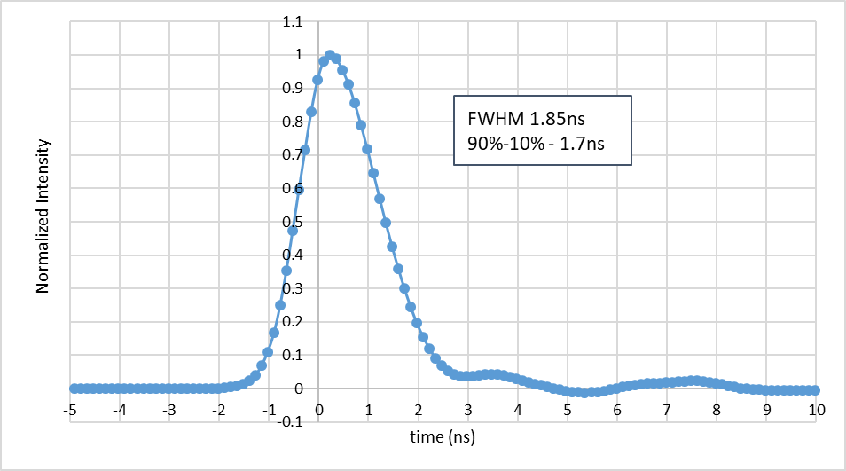
Fast Scintillator
An enabler for using a fast light sensor is a fast scintillator
El-Mul developed ScintiFast: inorganic high-yield fast scintillator
  Photon yield: 50-200 photons / 10keV electron
  Decay time: <0.5ns to 1.5ns
  Trade-off between yield and decay time

Slide 8
Backscattered Electron Detector
To achieve high BSE collection efficiency (CE) in SEM systems, detector is best placed between the column and the sample
Typically large area Si-diodes are used for high CE, but this results in high capacitance that limits the speed and produce noise
Suggested alternative: thin scintillator and light guides, coupled to few Si-PM.
  Advantage: high speed, high gain, low noise

Slide 9
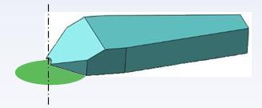
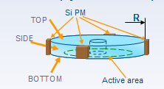
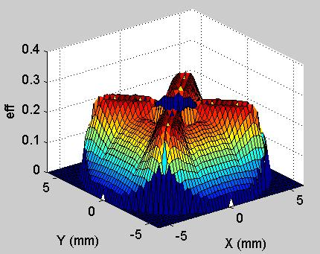
Backscattered Electron Detector
To achieve high efficiency and good uniformity, various material, geometrical designs and coatings were simulated
Al coating
Light Guide
Si-PM
scintillator

Slide 10
Ion Detectors
Ion detectors are needed in FIB, Mass spec, TOF-SIMS
Single ion detection is required
When fast detection is needed, detectors are based on either MCPs, electron multipliers, or plastic scintillators (with PMT) which have limited lifetime
Other limitations are space and heat

Slide 11
Example: Ion Detector
Required wide dynamic range from low rate (single ions) in pulse counting mode to high current up to ~1nA
Single ions up to ~3pA → Rate < 2x10⁷ ion/sec ~50ns between pulses → need <5ns resolution to ensure no overlap
Analog mode 1pA-1nA with 1% linearity
Very limited space: Si-PM is natural choice due to small size and low heat consumption
Electronics
Scintillator
(at HV)
Si-PM
Ion-Electron Convertor
Light Guide
Ions

Slide 12
Analog Regime
1 pA <I_{ion}< 1 nA
Assuming: electron CE from convertor of 100%, scintillator yield of 50ph/e @5kV, Light CE of 33%, QE / PDE of 25% @ sensor, gain ~ 2.3x10⁵
  → 1μA < I_{OUT}< 1mA
Well above dark current level
For using PMT, one needs to work at much lower gain. Since amplifier gain is limited by bandwidth, additional amplification stage is needed
  → cost and noise

Slide 13
Si-PM Selection (3x3mm)
 | 10μm | 15μm | 25μm | Comments
Gain @ recommended Vb | 1.4x10⁵ | 2.3x10⁵ | 5.2x10⁵
PDE | 0.1 | 0.25 | 0.35
# of pixels | 90,000 | 40,000 | 14,400
Ph-e/e | 1.6 | 4 | 5.6 | For 50ph/e from scintillator; 33% LCE
Linearity (at max Iin) | 0.18% | 1% | 3.8%
Values are based on Hamamatsu datasheets
Linearity was estimated using:
N_{fired}=N_{total} [1-exp(-N_{photon}*PDE/N_{total})]

Slide 14

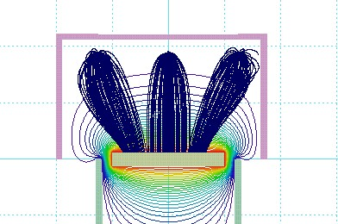
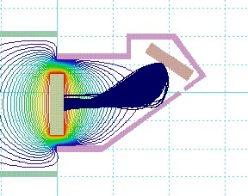
Electron Collection From Convertor
Converter
Scintillator and convertor are few mm only
Electrons emitted from the middle and 4 corners of the converter
4-5kV are required so all electrons will be collected
incoming ions
Scintillator
12eV SE trajectories – top view
12eV SE trajectories – side view

Slide 15
Si-PM Feasibility – Questions Addressed
Timing and electronics
Dark count – what is the threshold required to eliminate false detection?
Linearity
Gain and thermal stability

Slide 16
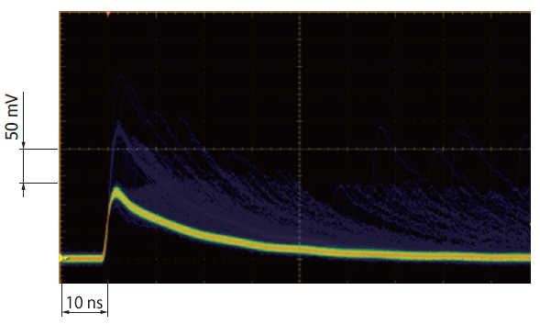
Timing
With dedicated electronics that gives fast output pulse: FWHM ~1.5ns
Taken from SensL datasheet

Slide 17
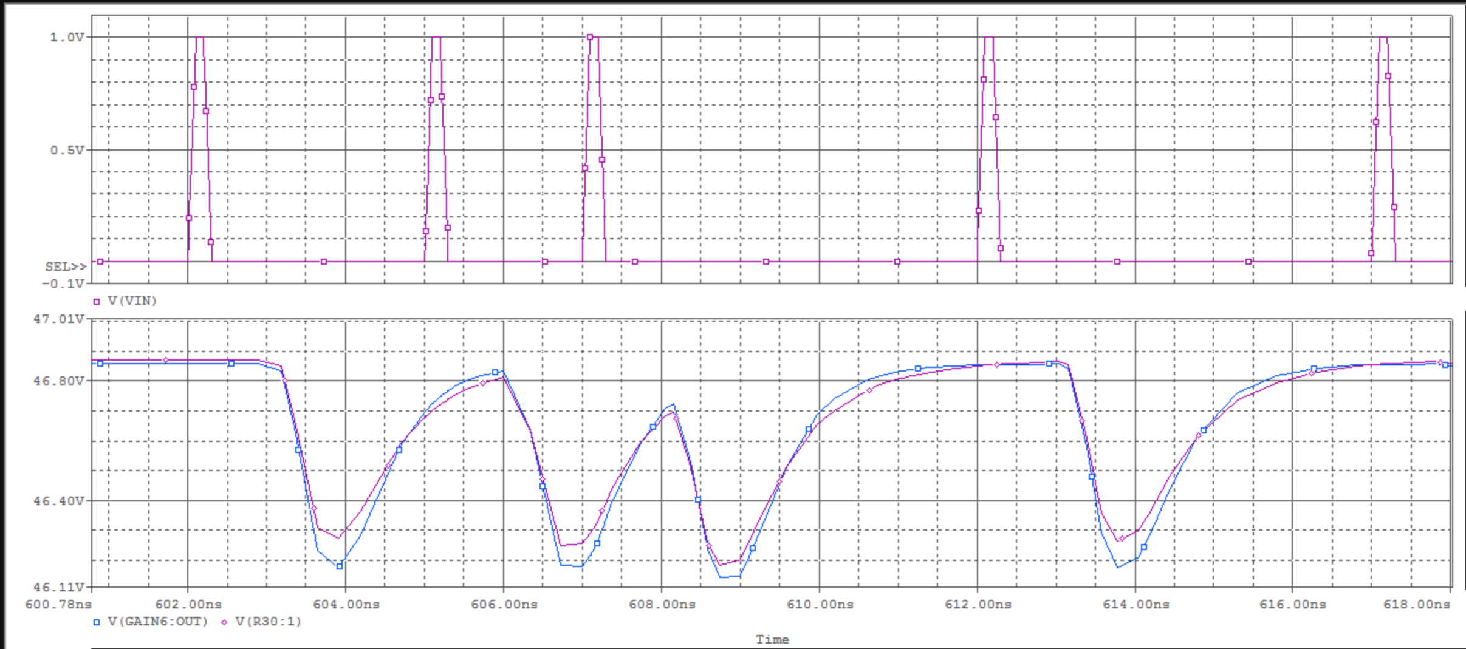
Electronics Design
Pre-Amplifier circuit was designed with small resistor as load to enable large bandwidth
Simulations were performed with 0.5ns input pulse that simulate input from scintillator. Pixel Capacitance 0.05pF
Predicted pulse decay is ~2ns
2ns per major tick

Slide 18
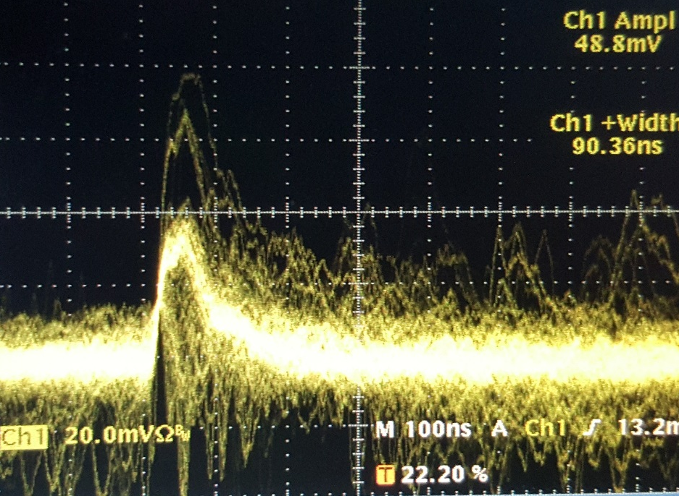
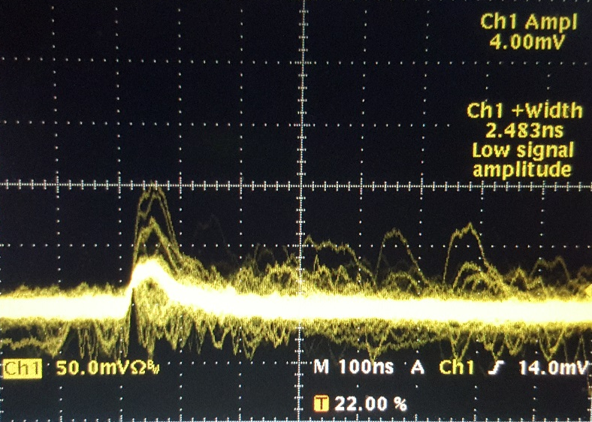

Dark Events Distribution
With 15μm pixel – pulses were too low to characterize . 50μm pixels were used
According to Hamamatsu datasheet: 3% are double Ph-e events due to cross talk
Some triple Ph-e events are seen but 4 Ph-e events are very rare (many seconds)
Raising trigger level > 4ph-e – no triggering at all
2 Ph-e
3 Ph-e
Afterpulses
1 Ph-e
4 ph-e threshold can be used giving negligible “false detection”

Slide 19
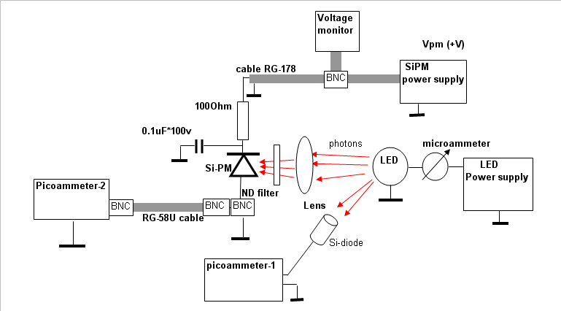
Stability Measurements Set-Up
LED source operated by function generator: variable frequency, amplitude, duty cycle
  LED stability is monitored in real time by Si-diode
Output reading by scope
Si-PM was placed on thermal pad placed on Cu plate

Slide 20
Experimental Setup
Lens
LED
Si-PM mount on Cu plate
Pulser-1 (T3, T4)
Pulser-2
(T1, T2)
“Line” or “scan”
Scope
T1
T2
T3
T4
“Frame”
Idle time

Slide 21
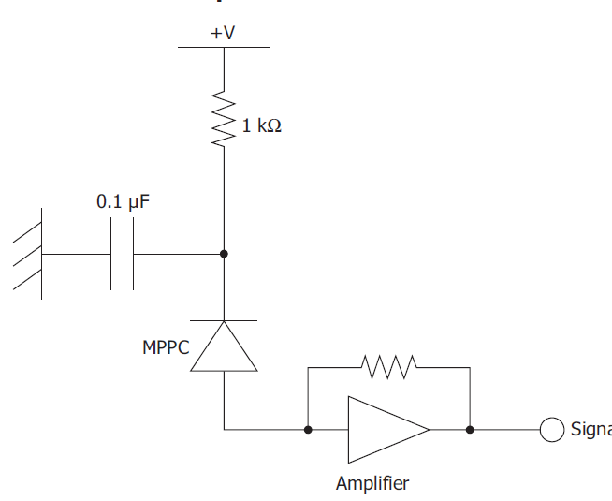
Bias Circuit Optimization
Bias circuit scheme is shown
We use 100Ω to minimize voltage drop of the bias voltage with high current (1mA=100mV)
Increasing the capacitance showed improved stability within “line”
  Charge in small capacitor too small to supply the required current during the “line” stage (up to 1μC)
At 100uF the signal becomes very stable
100Ω
100μF

Slide 22
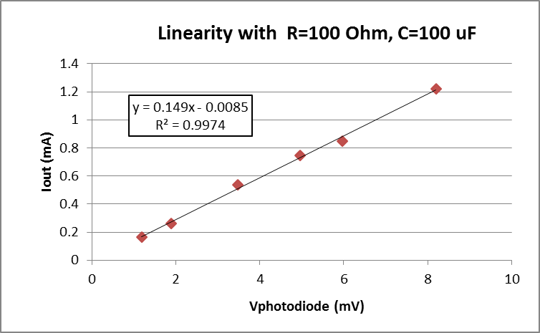
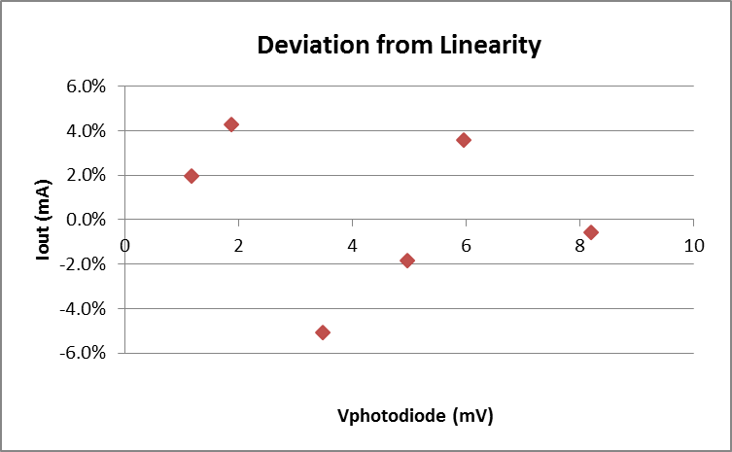
Linearity
Linearity was tested over a range of ~10 up to upper limit of analog regime
Deviations up to 6% but no trend – most likely result from inaccuracies

Slide 23
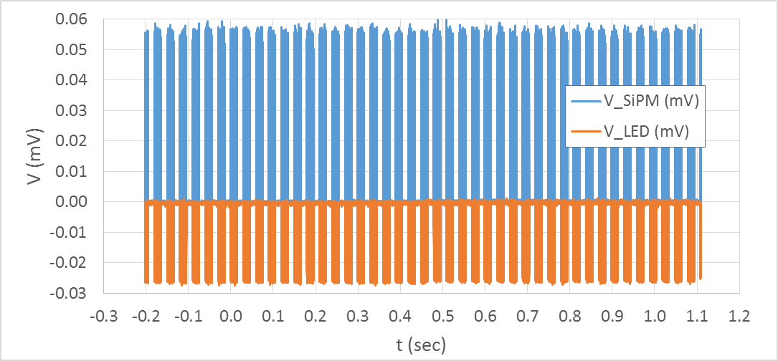
Frame Stability – Measured Traces
At 20μs sampling rate, acquisition of 1.3s → 43 full frames

Slide 24
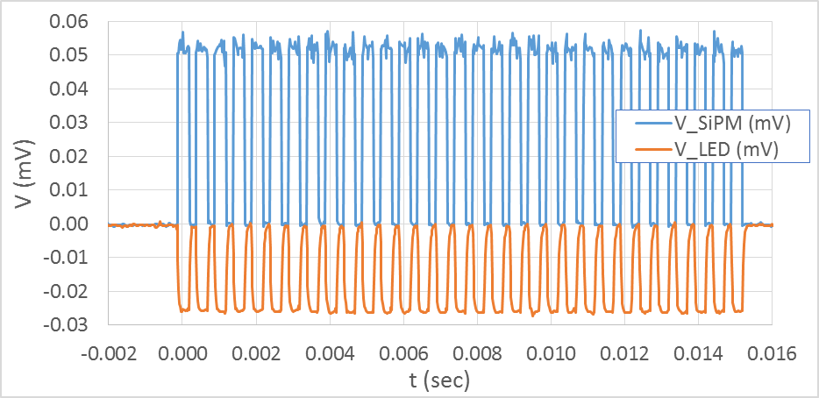
Stability within Frame
LED relative stdev of line-average within frame: 0.5%
Si-PM Relative stdev of line-average within frame: 1.2%

Slide 25
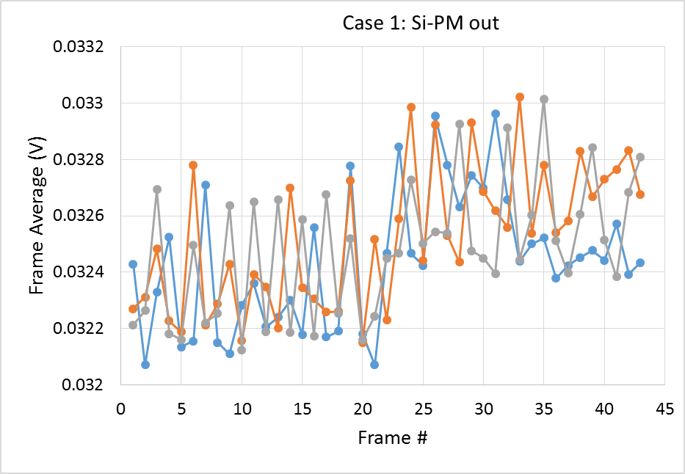
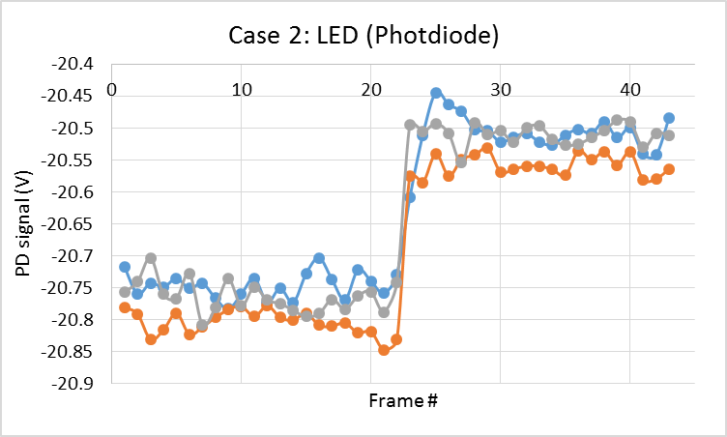
Measurement Results Examples
Within acquisition: range of frame average variations ±1%
“Jump” at middle of the acquisition is from scope because it is seen also in LED signal in the same direction (positive) although the photodiode signal is negative
LED / Photodiode stability within acquisition is ~0.2% (before step and after step)
Frames 1-22 and 23-43 should be analyzed separately

Slide 26
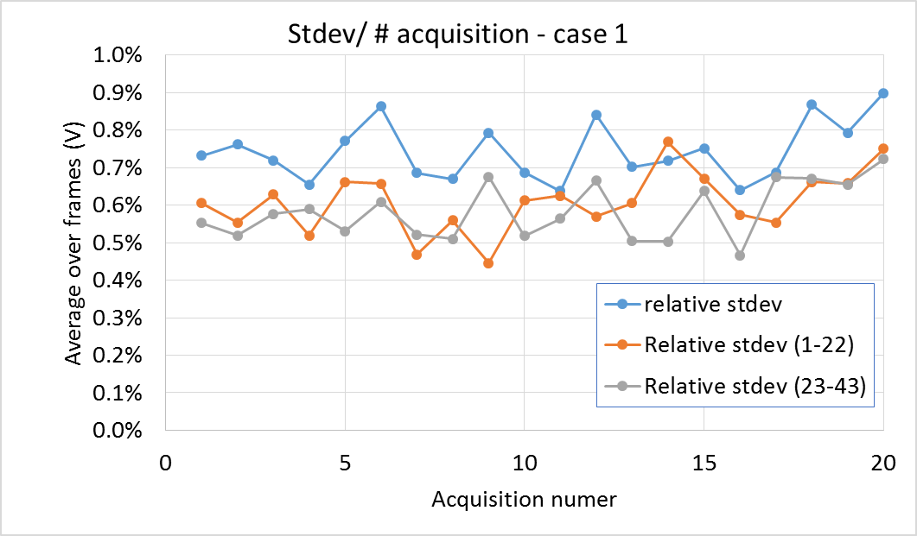
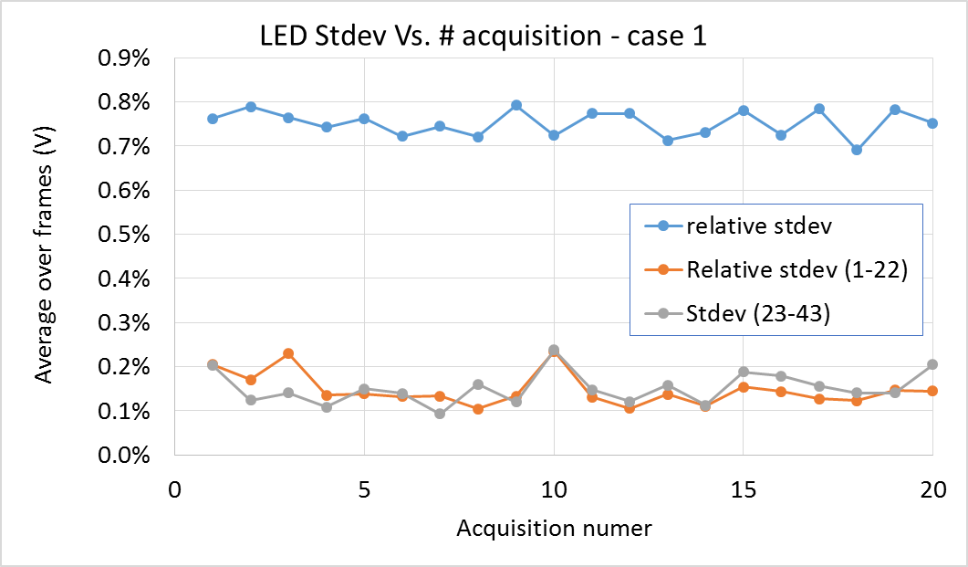
Variations Between Acquisitions
Stdev of frames average before “jump” and after “jump” is 0.5-0.7%
LED Stdev of frames is much smaller: 0.1-0.2%

Slide 27
Stability Conclusions
Frame-to-frame variations over 1sec between 0.1-0.2% and 0.5-0.6% for different pulse durations, although in all cases LED show <0.2% variations.
Line-to-line variations ~1.2% (LED 0.5%)
Reason for difference is not clear. Measurement not taken consecutively – possibly stray light or other source of noise.

Slide 28
Open Questions
Effect of cross talk at low side of analog regime
Effect of Gain temperature variation on SNR and stability
  Response to ambient temperature variations ~1.5% per degree
On bench no issue was observed, but in vacuum…?

Slide 29
Summary
We demonstrated that for some SEM and Mass Spec configurations, Si-PM can be the sensor of choice offering the best solution for the system from both design and performance considerations
Si-PM was characterized to verify compatibility to system requirements:
  Dark count: >3 ph-e threshold can be used for pulse counting regime giving negligible “false detection”
  Linearity: linear over ~10 in the upper end of analog regime
  Stability over 1 hour, 0.1-1.2% variations
Pre-amplifier simulations support feasibility

Slide 30
Future Needs
Larger Si-PM with small pixels – wider dynamic range
Lower dark current and cross talk
Higher PDE for lower pixels
  Also enables reducing scintillator high voltage
Faster, smaller pixels (but with reasonable PDE)

Slide 31

Thank You!
Questions and Discussion
Notes:
31

