Slide 1
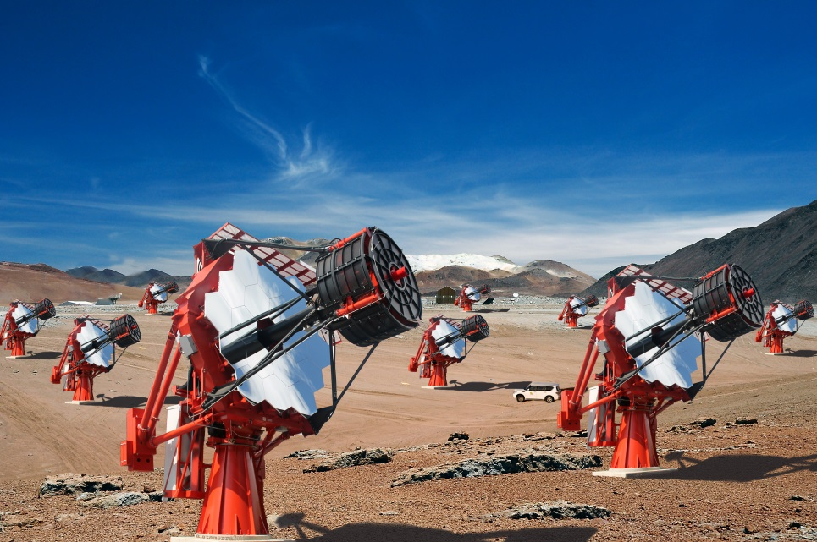






LIGHT 17
Universidade de São Paulo
Instituto de Astronomia, Geofisica
e Ciencias Atmosferica
Characterization of recently manufactured LVR2 and LVR3 HPK SiPMs suitable for SST-2M telescope
Giovanni Bonanno – INAF Catania
for the ASTRI Collaboration & the CTA Consortium
G. Bonanno – INAF O.A. Catania – LIGTH 17 – Ringberg Castle, 19 – October 2017

Slide 2


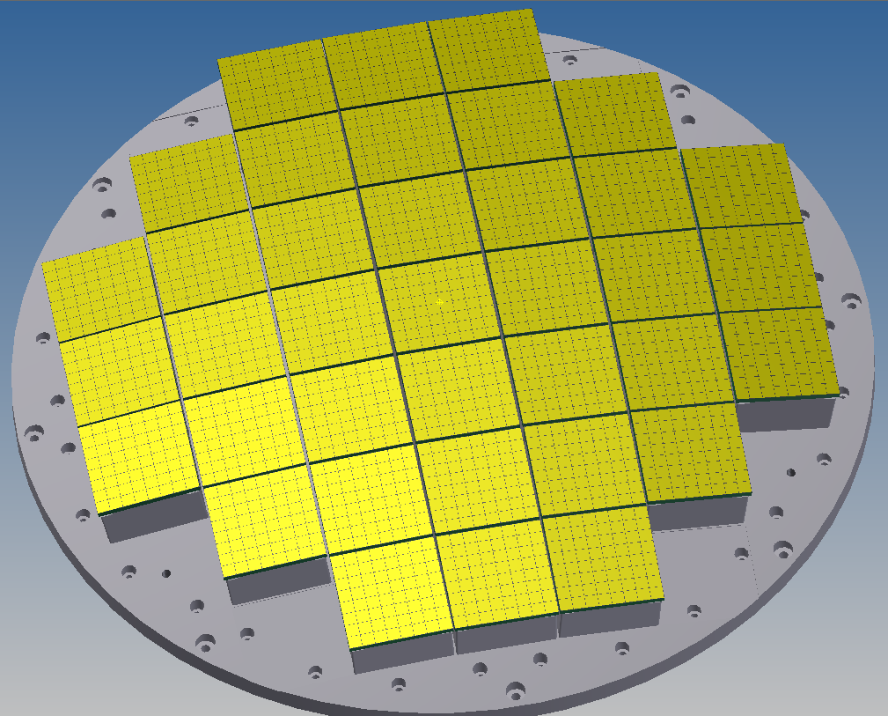
Summary
Why 57.4mm x 57.4mm with 7x7 mm² pixels
Characterized detectors
Characterization Setup
Optical Cross Talk evaluation of LVR2 7075
PDE at 405 nm vs OV measurements
PDE in the 285nm – 850nm spectral range
LVR3 vs LVR2 comparison
Effect of the IR filter on the OCT
G. Bonanno – INAF O.A. Catania – LIGTH 17 – Ringberg Castle, 19 – October 2017

Slide 3
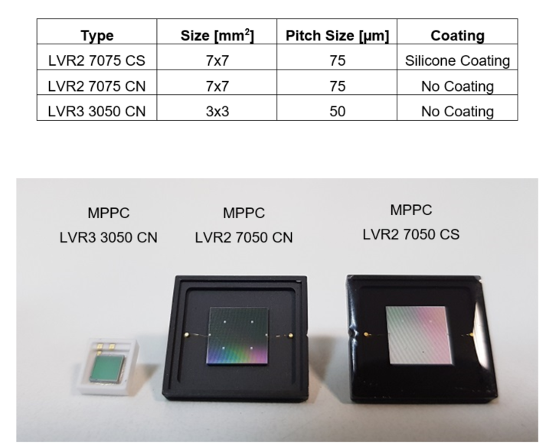
Characterized devices
G. Bonanno – INAF O.A. Catania – LIGTH 17 – Ringberg Castle, 19 – October 2017

Slide 4
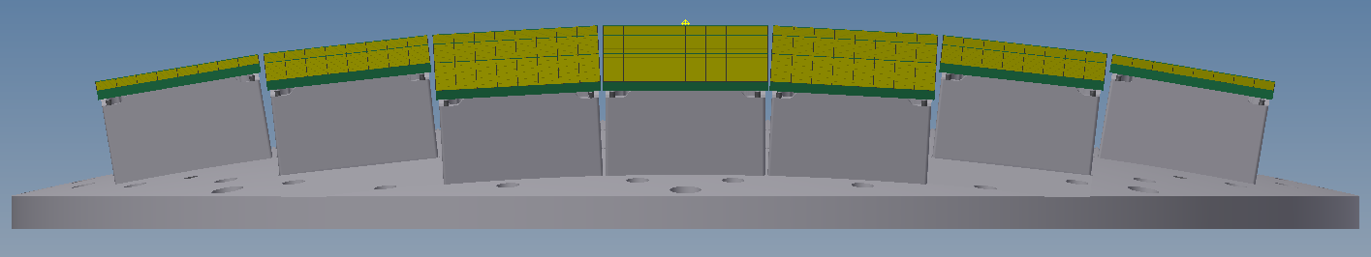
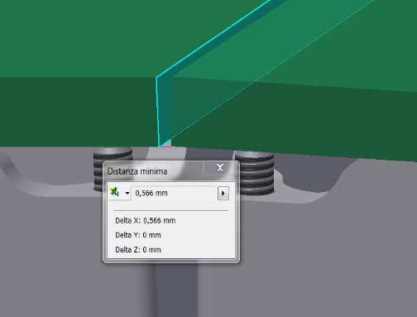
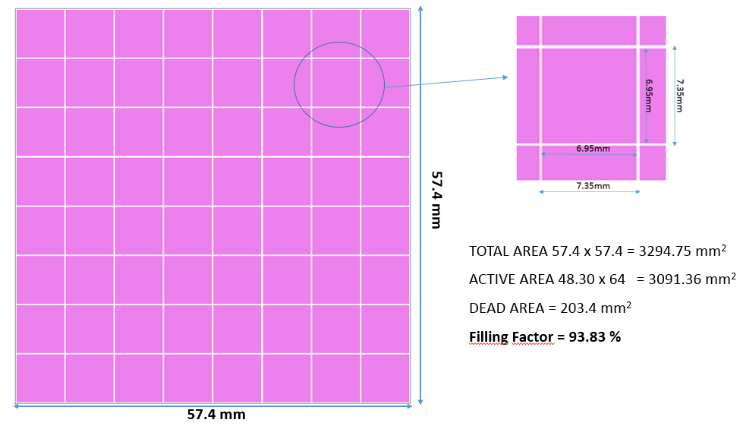
Why 57.4mm x 57.4mm with 7x7 mm² pixels
PDM coverage by assembling 7x7 mm² chips with 0.2 mm interspace
Sensitive area:
6.975 x 6.975 mm² (75 µm cell)
93 x 93 = 8649 micropixels
Minimum distance
for safety conditions
57.4 mm
8 x 8 pixels
7x7 mm²
FF= 93.8%
FILLING FACTOR PER TILE:
93.8% !!!
57.4 mm
G. Bonanno – INAF O.A. Catania – LIGTH 17 – Ringberg Castle, 19 – October 2017

Slide 5
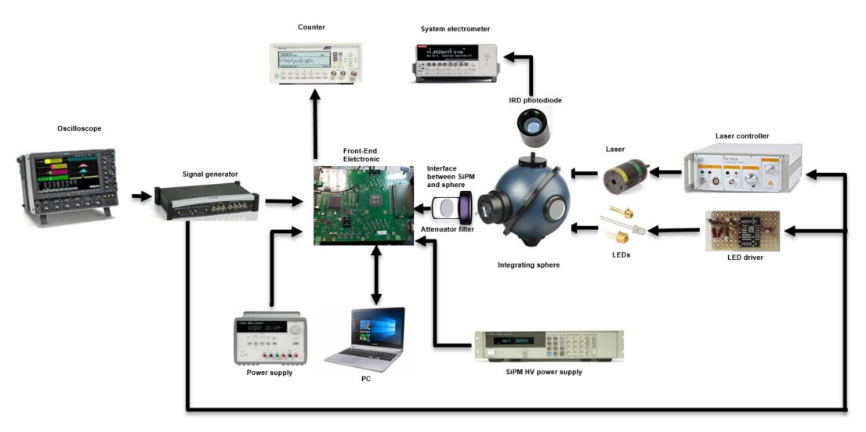
Characterization Setup based on pulsed sources
Reference Photodiode NIST calibrated
Pulse Generator
LASER and LED Drivers
Citiroc
FEE
Calibrated Neutral
Density Filter
Integrating
Sphere
G. Bonanno – INAF O.A. Catania – LIGTH 17 – Ringberg Castle, 19 – October 2017

Slide 6
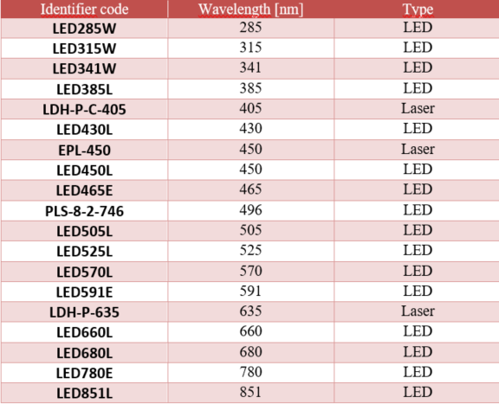
Pulsed sources available at our lab
19 pulsed light sources in total are available at the COLD lab: 3 LASERs and 16 LEDs
They allow to cover the 285nm – 850nm spectral range
G. Bonanno – INAF O.A. Catania – LIGTH 17 – Ringberg Castle, 19 – October 2017

Slide 7
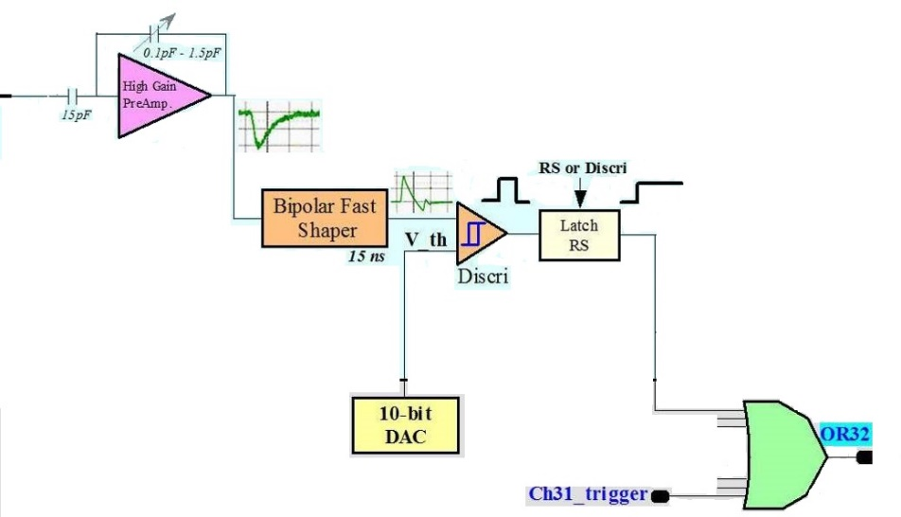
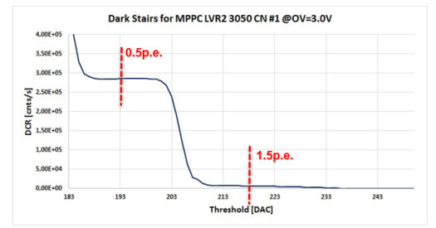
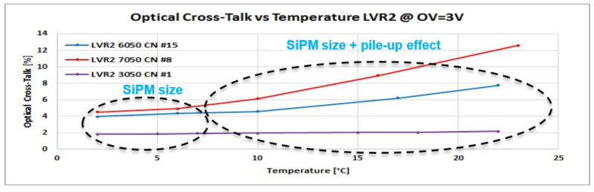
OCT evaluation through Dark stairs
Electronics inside the ASIC for staircase measurements
Shaping time 15 ns
Fast Shaper
PZC inadequate
OCT versus temperature. Below 5°C, the OCT depends only by the SiPM size while above 5°C the OCT is affected by the pile-up effect. PZC inadequate..
G. Bonanno – INAF O.A. Catania – LIGTH 17 – Ringberg Castle, 19 – October 2017

Slide 8
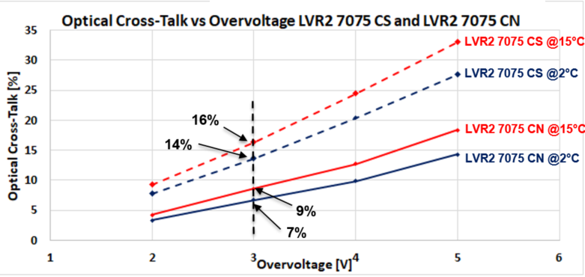
LVR2 7075 - OCT vs OV – CS and CN type
The OCT values to be considered (close to the effective) are those at 2°C
G. Bonano – INAF O.A. Catania – LIGTH 17 – Ringberg Castle, 19 – October 2017

Slide 9
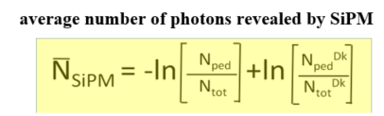

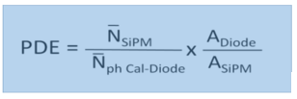
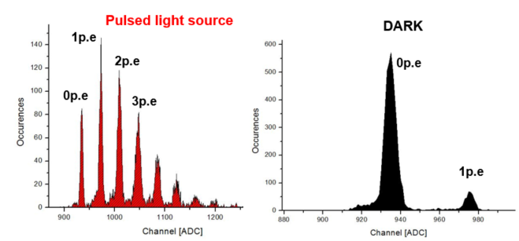
PDE measurements with pulsed sources
PHD for the MPPC 3x3 mm² (micro-cell 75µm) flashed (left plot) and in dark (right)
G. Bonanno – INAF O.A. Catania – LIGTH 17 – Ringberg Castle, 19 – October 2017

Slide 10
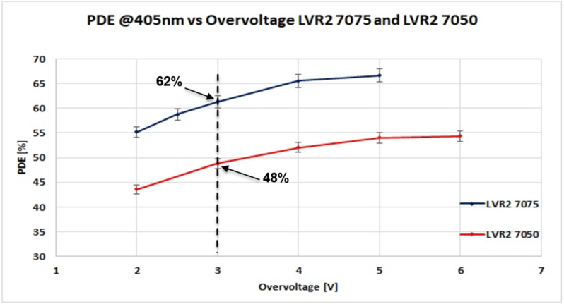
PDE @405nm vs OV: Comparison 7075 vs 7050
The PDE at 405nm of the 7075 is 14% greater than that of the7050 at all Over Voltages in the 2V - 6 V range.
G. Bonanno – INAF O.A. Catania – LIGTH 17 – Ringberg Castle, 19 – October 2017

Slide 11
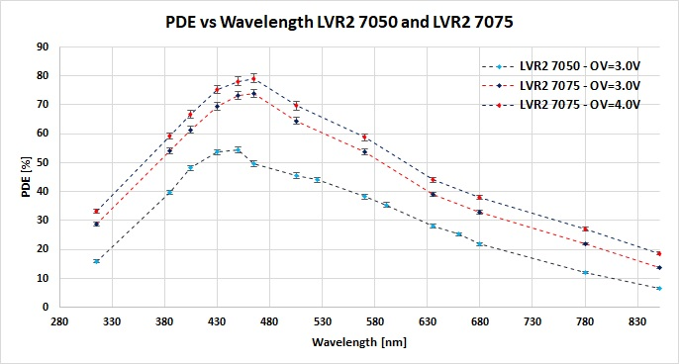
PDE in the 300nm – 850nm spectral range
78%
74%
54%
At 3V of OV the PDE at the peak of the 7075 is about 20% greater than that of the 7050
At 4V of OV where the T.E. is about 97% at the peak we found a “never achieved” PDE of about 78%!!! Compatible with a FF of 84% and a QE of 95%
G. Bonanno – INAF O.A. Catania – LIGTH 17 – Ringberg Castle, 19 – October 2017

Slide 12
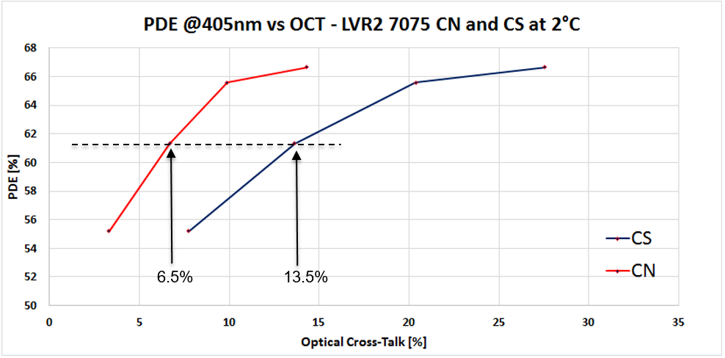
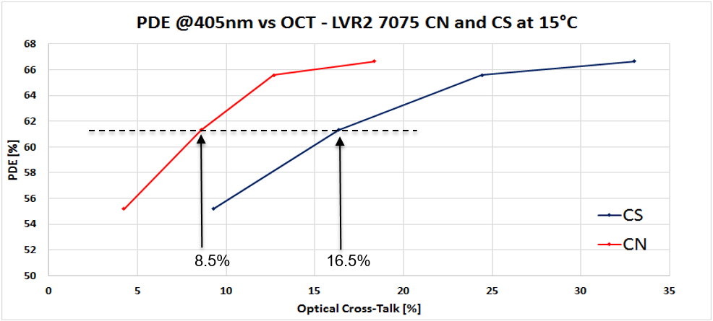
PDE@405nm vs OCT
PDE versus OCT is evaluated at two temperatures 2°C and 15°C
At 2°C the DCR is lowered and the pile-up effect is reduced
15°C is the ASTRI camera working temperature
A FEE able to operate a good PZC will allow lower OCT independently from temperature
G. Bonanno – INAF O.A. Catania – LIGTH 17 – Ringberg Castle, 19 – October 2017

Slide 13
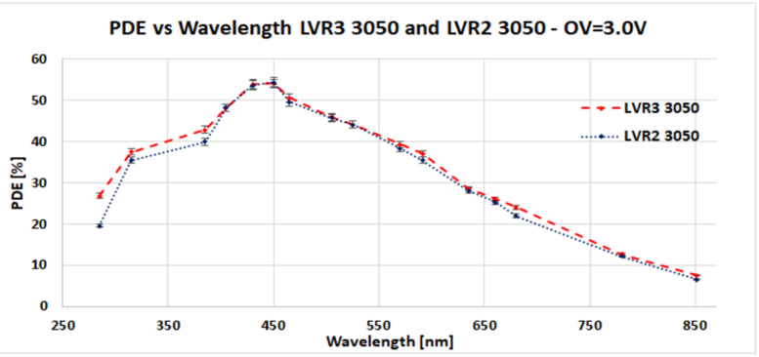
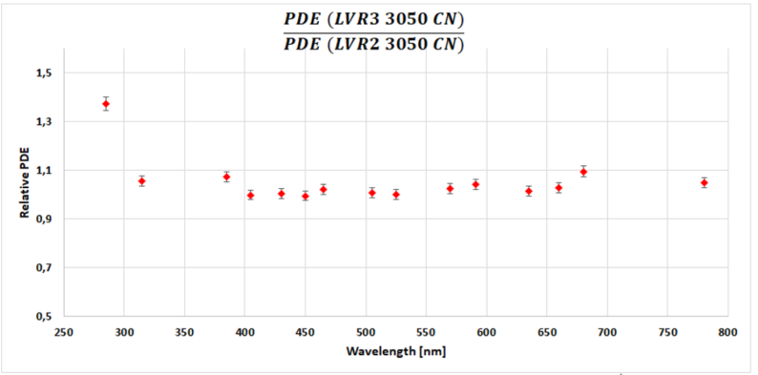
Relative PDE of the LVR3 respect to the LVR2
G. Bonanno – INAF O.A. Catania – LIGTH 17 – Ringberg Castle, 19 – October 2017

Slide 14
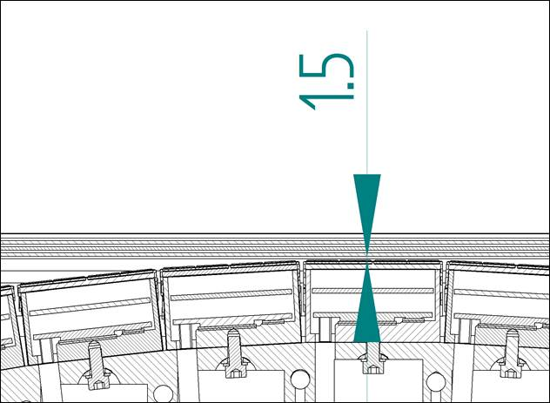
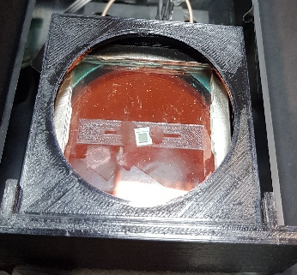
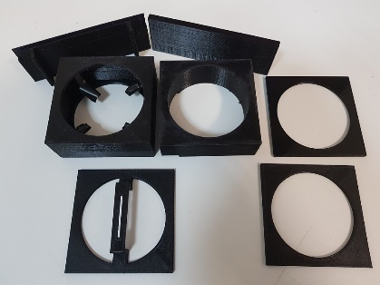
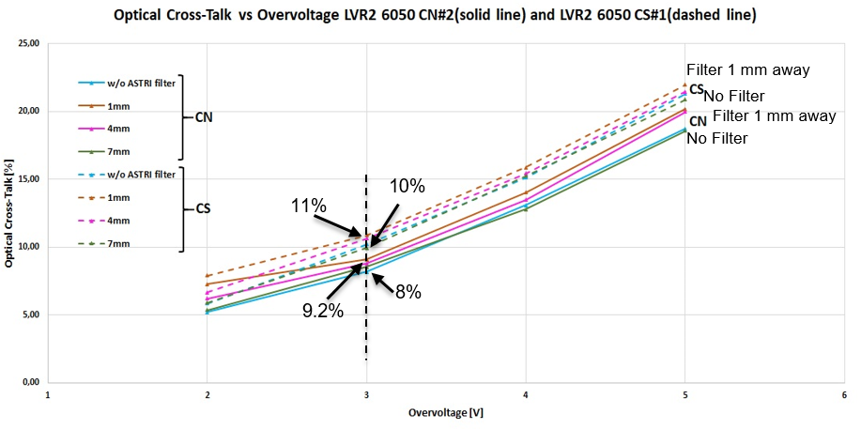
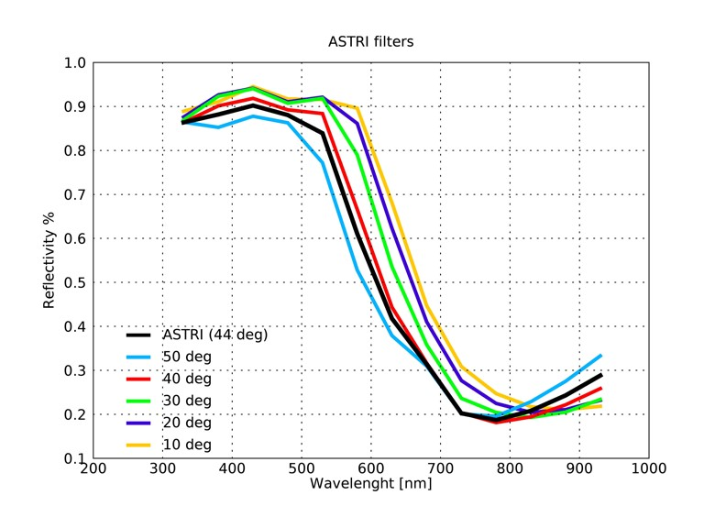
Effect of the IR filter on the OCT
Three plates IR-Filter
Minimum distance in mm between the central SiPMs and the first filter plate
G. Bonanno – INAF O.A. Catania – LIGTH 17 – Ringberg Castle, 19 – October 2017

Slide 15
Conclusions
The characterization carried out demonstrates that the 7x7 mm² with 75µm microcell SiPM can achieve very high PDE and low OCT
The OCT essentially depends on:
Sensitive area dimensions
Coating on top of the sensitive area
Optics in front of the detector
In the ASTRI camera we have to take into account two more effects :
Pile-up due to the operating temperature or better to say to the DCR
Inefficient Pole-Zero Cancellation (PZC) of the Front End Electronics (FEE)
A FEE with an appropriate PZC will remove these two effects.
At 3V of overvoltage a PDE of 74% at a peak has been found, and even better at 4V, where the OCT is less than 10%, an impressive peak of about 78% has been measured.
A new LVR3 series has been manufactured that improves the response in the 285 – 380 nm spectral range.
G. Bonanno – INAF O.A. Catania – LIGTH 17 – Ringberg Castle, 19 – October 2017

