Slide 1
Deep learning possibilities for GERDA
Philipp Holl, Max-Planck-Institut für Physik
21.07.2017

Slide 2
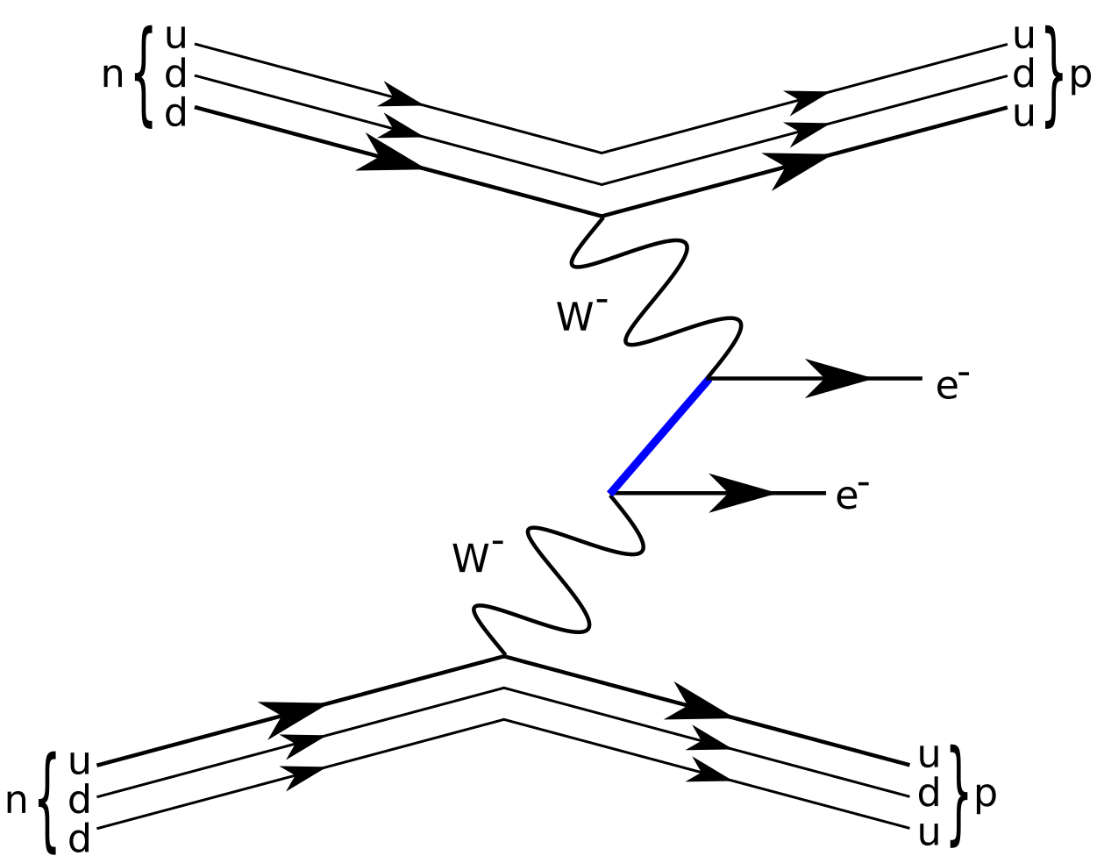
Neutrinoless double beta decay ($0νββ$)
Only possible if neutrino has Majorana component
Could help explain matter dominance in universe

Slide 3
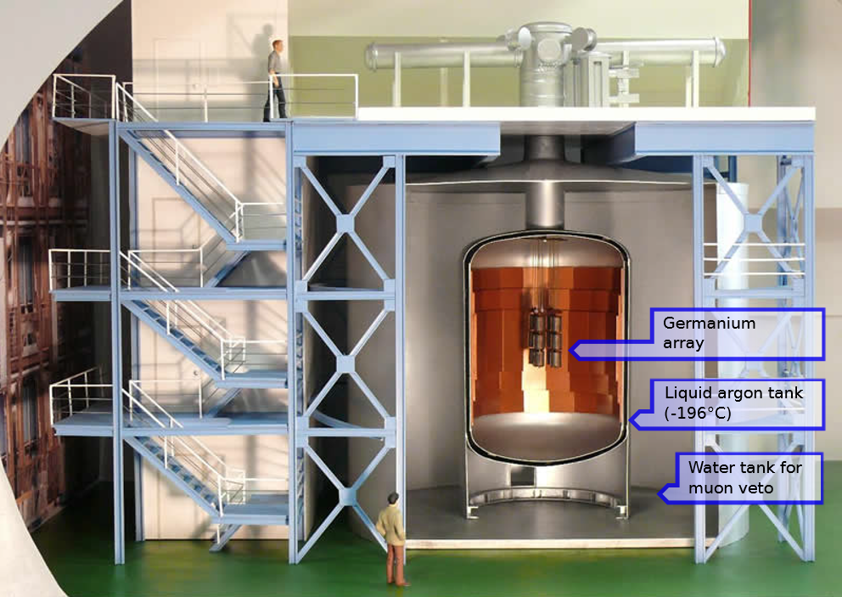
GERDA: Search for $0νββ$ in Ge
40 kg of enriched Germanium-76
Underground laboratory @ Gran Sasso, Italy

Slide 4
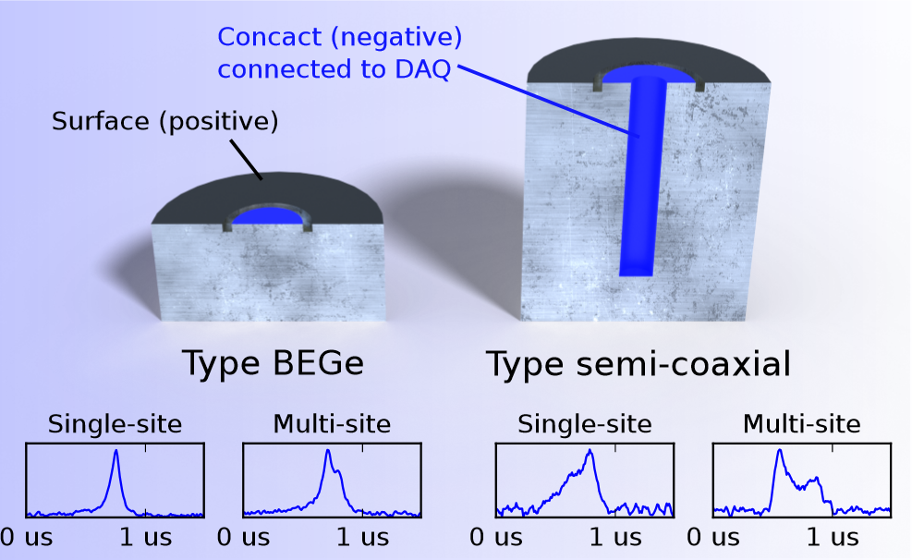
Rejecting background events
Event origins
Discrimination
Signal? ($<1$ event/yr)
Energy
Muons
Muon detectors
Radioactive decays
Liquid argon scintillation
Pulse shape discrimination
(PSD)

Slide 5
Issues of current analysis
Long cables
Noise from long cables impacts PSD performance
PSD not stable over time
How can we improve performance and get rid of existing issues?

Slide 6
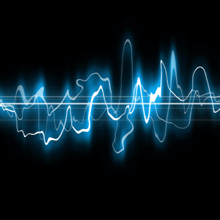
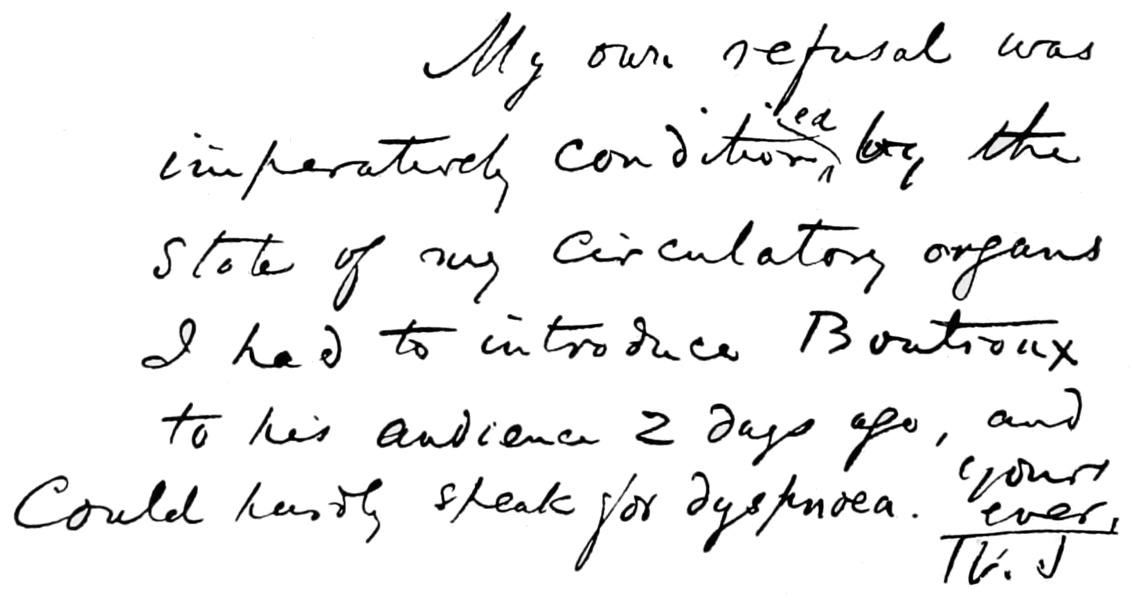
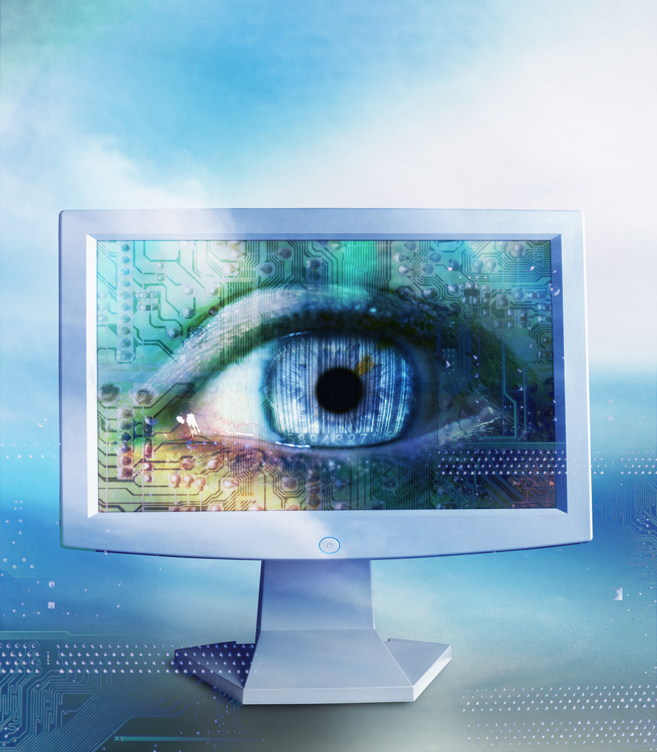
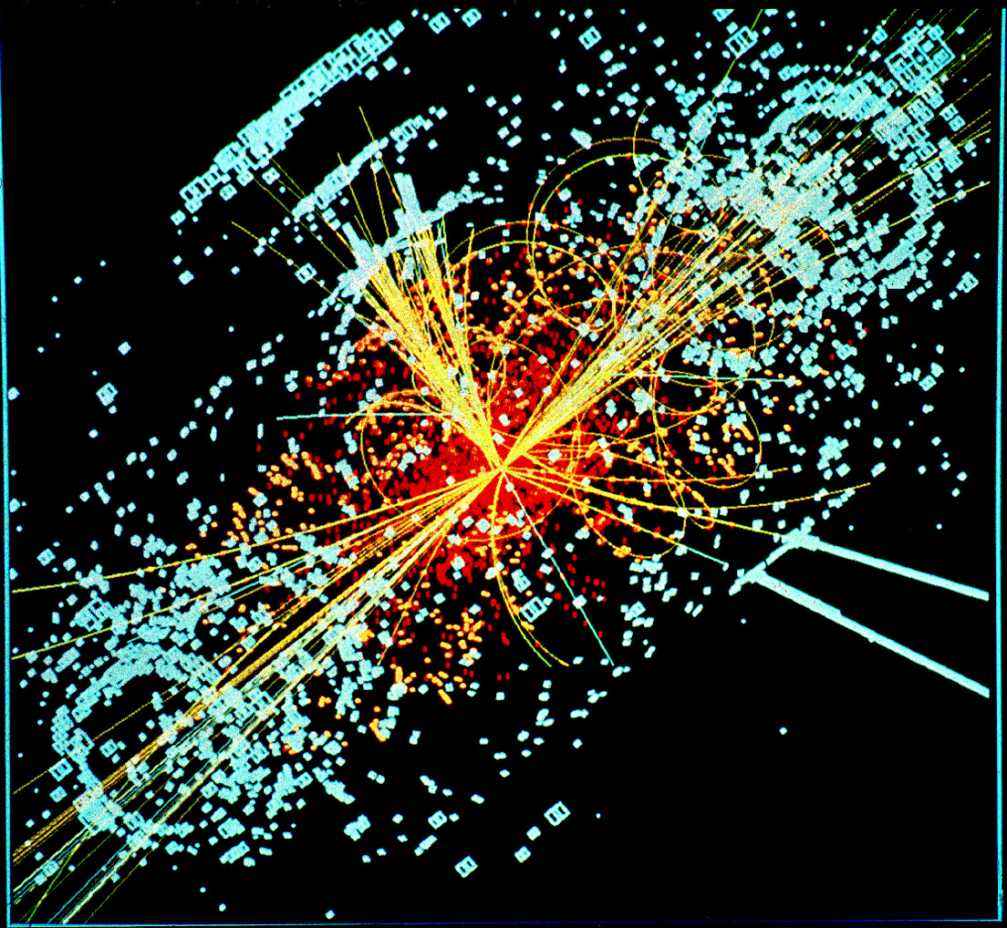
Why deep learning?
https://commons.wikimedia.org/wiki/File:Sound_wave.jpg
https://www.flickr.com/photos/downloadsourcefr/16361602656
https://commons.wikimedia.org/wiki/File:CMS_Higgs-event.jpg
Speech recognition
Text recognition
Image classification
Particle reconstruction
Deep learning is about recognizing patterns
Notes:
(1 min)

Slide 7
Naïve approach
Why smart preprocessing is needed

Slide 8
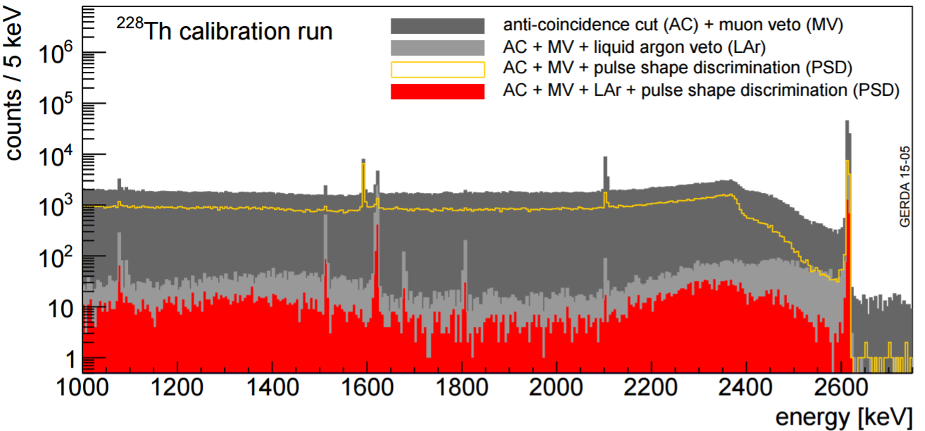
Training a neural network
Calibration spectrum
Compton scattering
Bi, Tl,… decay lines (relatively pure signal/bkg-like)
Peaks can be used as proxies for signal-like and background-like events

Slide 9
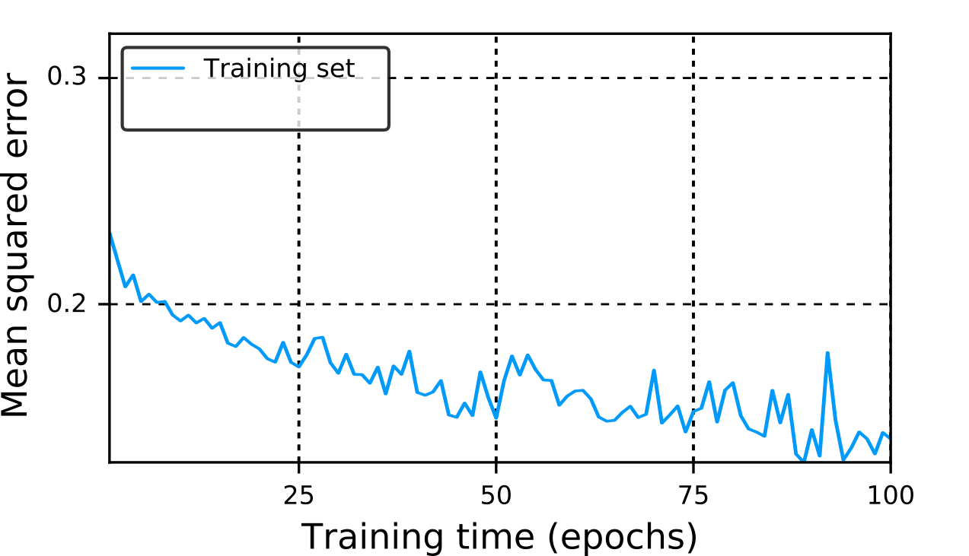
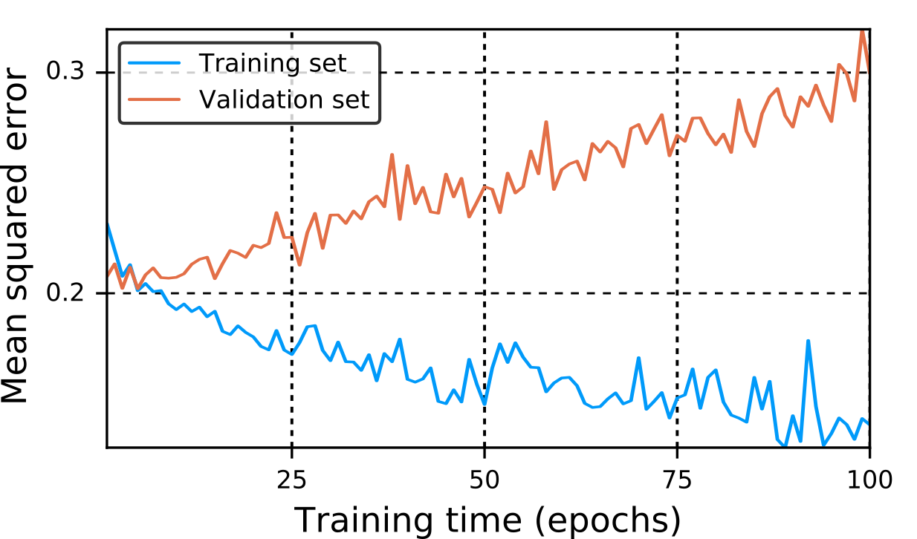
Training a neural network
Classifier
Preprocessing
Train a neural network on the labelled pulses
Network converges to stable solution with good performance.
Problem: Bad performance on new data
Notes:
Network remembered data

Slide 10
Fighting overfitting
~1 year of data taking
~10.000 events per class per detector
Split into training/validation/test sets
~5000 left for training
Rule of thumb: 10-100 times more data than learnable parameters
How big can the network be?
> 5000 parameters
50
50
50 inputs
~140 parameters
10
5
7 inputs
Can such a tiny network do efficient classification ?
Yes
How can we get an event down to 7 parameters?
…
Notes:
The cross validation curve was rising from the beginning
Clever algorithm reduces from 1000 to 50

Slide 11
Autoencoder
Unsupervised information reduction

Slide 12
Autoencoder magic
~1.000.000 events total (unlabelled)
~10.000 events per peak (labelled)
Autoencoder
Deep learning based algorithm that learns to compress data
No labels required

Slide 13
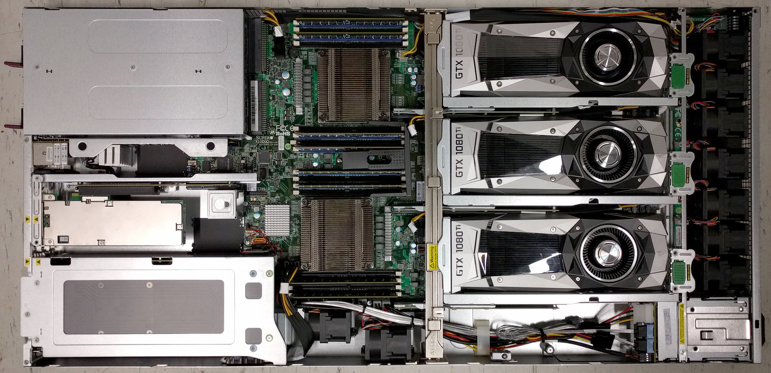
How it works
Determine number of compact parameters
It turns out 7 is pretty good
Setup network with random initialization
Train on all pulses

Slide 14
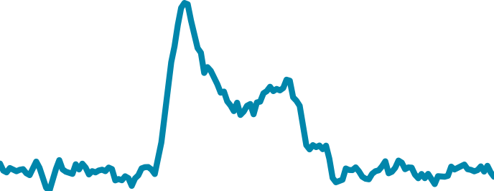
Encoder & decoder
7
7
7
Encoder
Decoder
7
7
7
Encoder & decoder are trained from data
Unbiased compact representation
What information is being stored?
Notes:
Compact representation hard to visualize

Slide 15
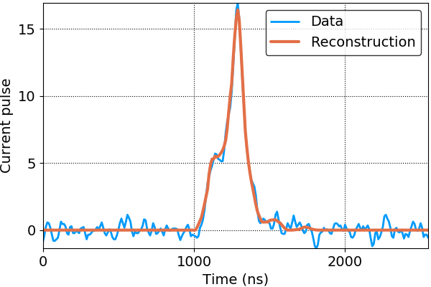
Information reduction to 7 parameters
ANG1 - Calibration data above 1 MeV from run53-64
Encoder
Decoder
Reconstructions contain less information
Only the most relevant data is stored
Noise is discarded as it follows no pattern
Notes:
Noise is discarded as it follows no pattern … except when does

Slide 16
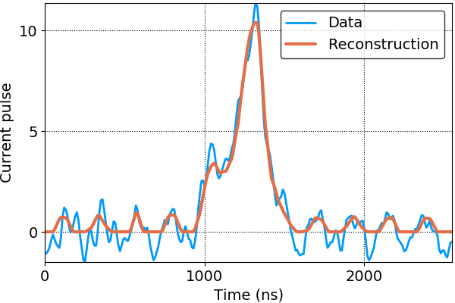
Correlated noise
ANG5 - Calibration data above 1 MeV from run53-64
Encoder
Decoder
Some detectors show highly correlated noise
Reconstructions capture the important features of the pulse very well

Slide 17
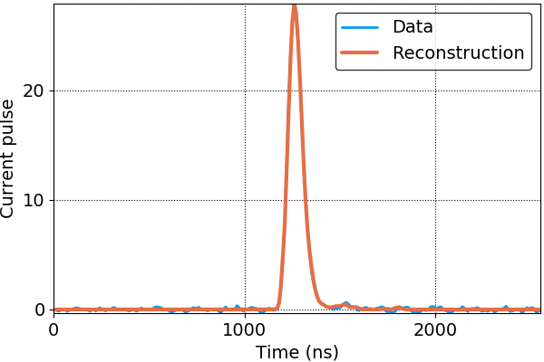
Accurate peak height
GD00A - Calibration data above 1 MeV from run53-64
Encoder
Decoder
Peak height for signal-like events very accurate for BEGes

Slide 18
Combined analysis
Classification after autoencoder preprocessing

Slide 19
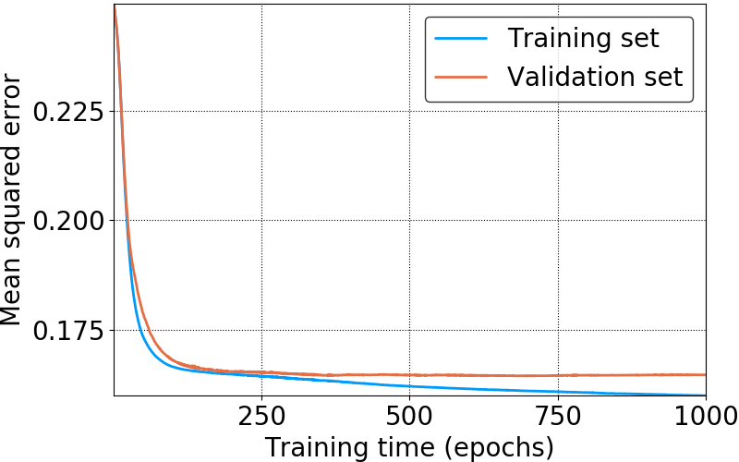
Combined PSD
Preprocessing
encoder
7
Classifier
7
7
Train neural network on compact representation
Few learnable parameters required, less overfitting

Slide 20
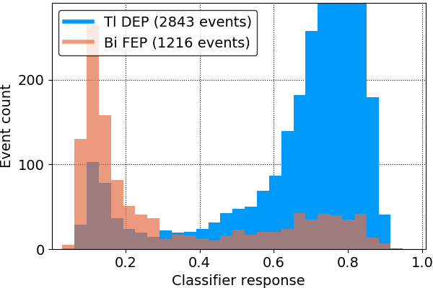
Signal-background classification
GD00A - Calibration data above 1 MeV from run53-64
10
5
7 inputs
Tiny classifier with 141 parameters
Trained on Tl (signal) and Bi peak (background)

Slide 21
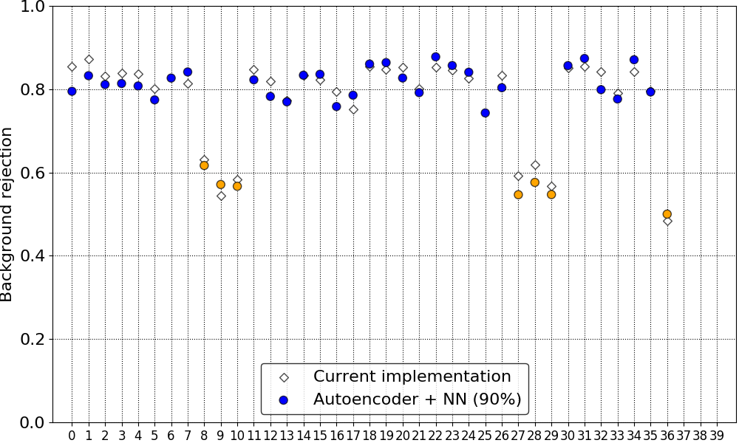
Performance on calibration data
1
2
3
4
5
6
7
Performance equal to current methods
Less dependent on noise
No manual corrections required

Slide 22
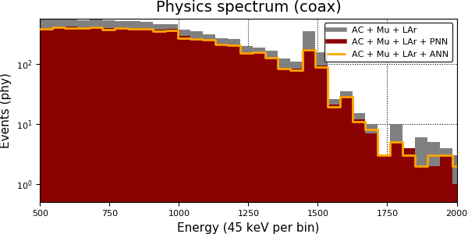
Performance on physics data

Slide 23
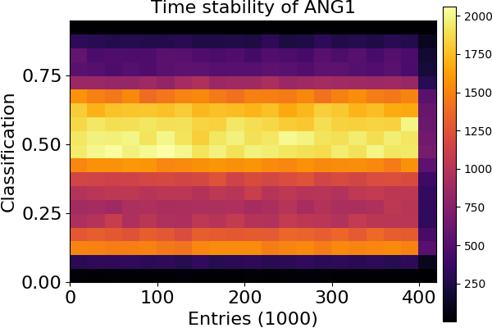
Time stability
Almost all detectors show no significant deviation over time

Slide 24
Summary & Outlook
New method for pulse shape analysis
Bias-free, nonlinear information reduction with autoencoder
Competitive compared to current methods
No time-dependent corrections required
Relatively independent of noise level
Future possibilities
Training on simulation data
A/E or energy reconstruction after noise-filtering by autoencoder

Slide 25
Backup

Slide 26
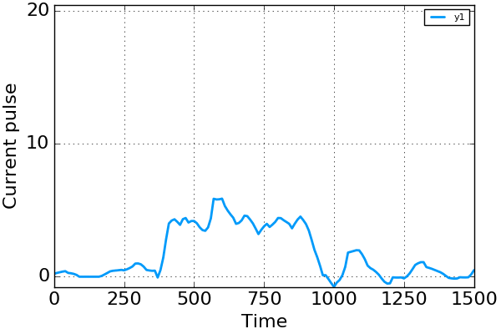
Can we go lower than 7?
1.0
0.51
0.82
0.12
0.0
1
1
1
Decoder
Single parameter autoencoder
“A/E for coax detectors”

Slide 27
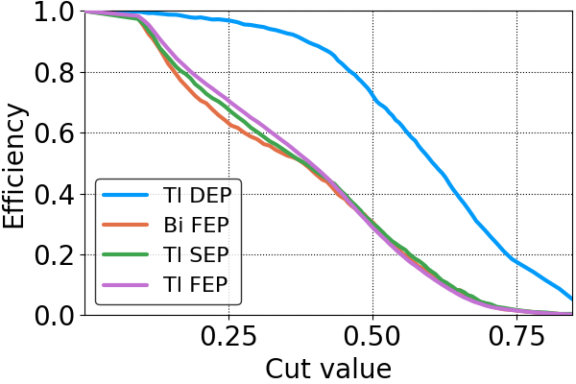
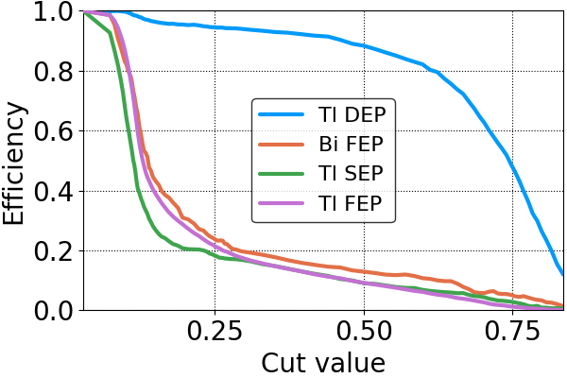
Peak efficiencies
Coax
BEGe
Peak fit model:
Gaussian + first order polynomial
ANG1 & GD00A, test set of run 53-64
Background peaks have very similar performance
Tl SEP usually has best rejection

Slide 28
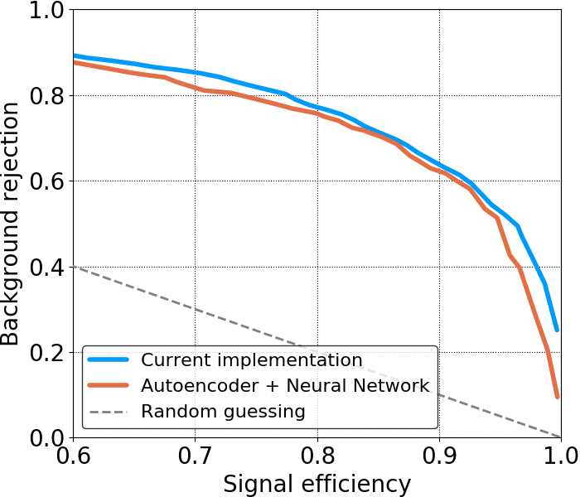
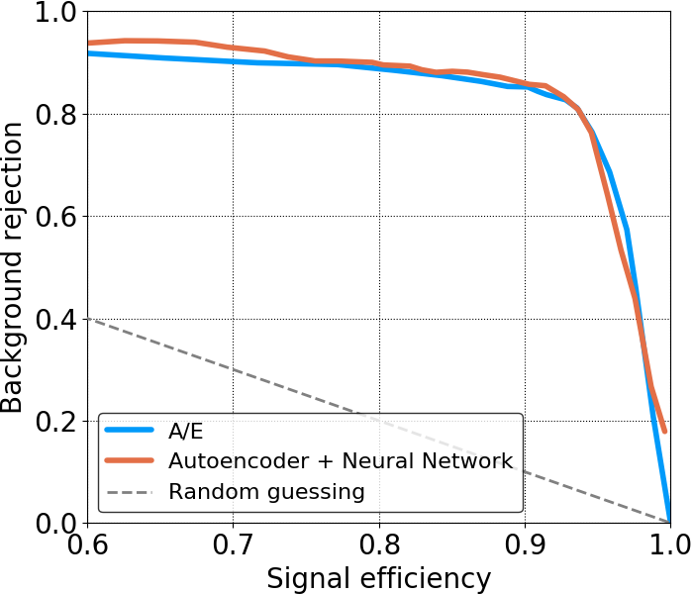
Efficiencies on calibration data
Coax
ANG5 - Calibration data above 1 MeV from run53-64
BEGe
GD00A - Calibration data above 1 MeV from run53-64
Results competitive with current implementations

Slide 29
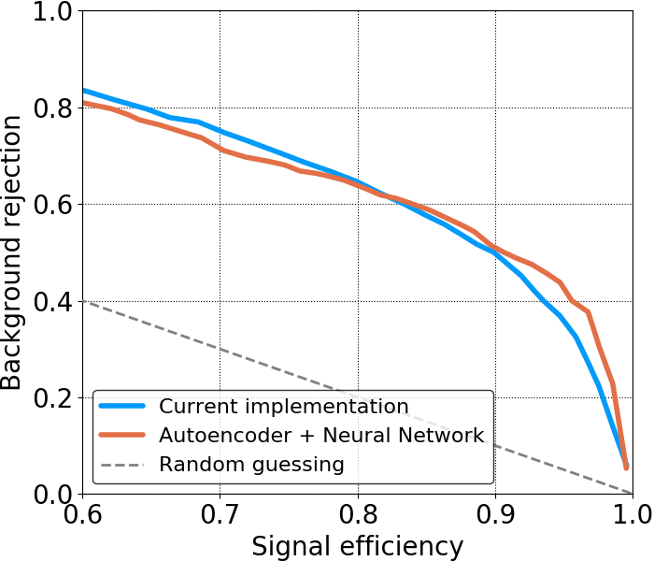
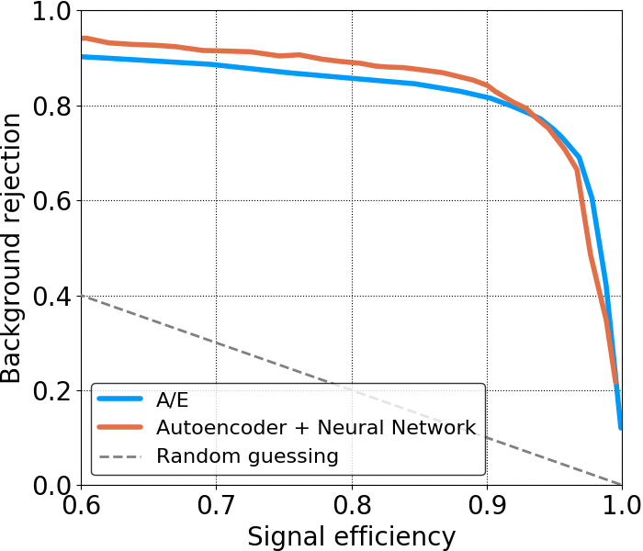
Efficiencies on calibration data
Coax
ANG1 - Calibration data above 1 MeV from run53-64
BEGe
GD91C - Calibration data above 1 MeV from run53-64
Especially good performance for detectors with high noise level

Slide 30
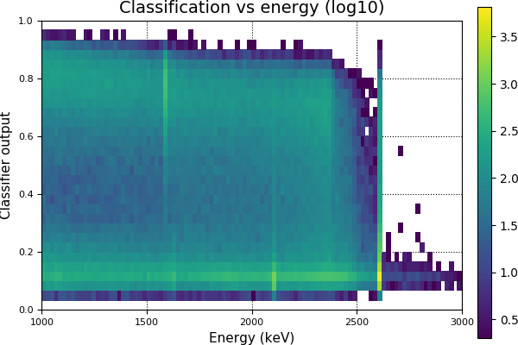
Energy dependence
GD00A - Calibration data above 1 MeV from run53-64
DEP
Cut
Bi FEP
SEP
FEP
Clear separation between SSE and MSE on all energy scales
Notes:
Only trained on DEP and FEP

Slide 31
Mean efficiencies
Efficiencies evaluated on 40% of Phase IIb
Mean of all detectors that are used for current analysis
DEP
FEP
SEP
FEP
Comp.
$$2νββ$$
90%
18%
(17%)
13%
(12%)
16%
(15%)
52%
(44%)
86%
(84%)
90%
43%
(41%)
47%
(45%)
45%
(45%)
65%
(63%)
79%
(77%)
BEGe
Coax
PNN
(Current)
$2νββ$ from 1 to 1.3 MeV
Compton at $Q_{ββ}±30$ keV
Performance similar to current methods
Almost all differences can be explained by different algorithm to set cut value

