Slide 1
MDT-ASD (“Legacy ASD”)
History, design choices, and motivations
John Oliver
Major design work done ~ 1998 – 2001
John Oliver – Harvard University
Eric Hazen, Christophe Posch – Boston University
For complete description, see
“ATL-MUON 2002-2003
Rev 2.1 10-Sep-2007

Slide 2
ASIC Processes for Muons – A Brief History
Until 1993, we worked on Muon Spectrometer for SDC (Solenoidal Detector Collaboration) at the Supercollider.
Worked on bipolar processes with U. Penn – Transision Radiation Detector (or was it Straw Tube Tracker?)
First discussions with ATLAS started in ~ 1995 after demise of SSC
At the time, HEP community was experimenting with bipolar, biCMOS^{[1]}, and CMOS for detector front ends
CMOS processes were available in US through MOSIS and prototypes (MPWs) were cheap….very cheap!
One could build prototype preamps for ~$5k
Scale (gate length) was getting smaller by the year 3u → 1u → 0.5u
We started building & testing preamp/shapers using 1u then headed to 0.5u ~ 1997 or so
Settled on HP 0.5u CMOS through MOSIS
Process was epitaxial, not by our choice, but that’s what was available (see following slide)
Process yielded peaking times ~ 15ns deemed “good enough” for MDT shaping
[1] eg “DMILL”

Slide 3
Bulk vs Epitaxial CMOS
Transistor
Guard ring structures
High resistivity bulk
Low resistivity substrate
(common to entire chip)
High resistivity epi
Transient electric field lines generated in transistors tend to terminate on
Guard ring structures in bulk processes
Guard ring structures and substrate in epi processes →Dangerous!
Epi processes were used commercially to prevent transistor “latchup” in inverter and other structures
Note that these CMOS structures were “simple” at the time, not sophisticated as today’s processes → no “trenches” or other fancy stuff!

Slide 4
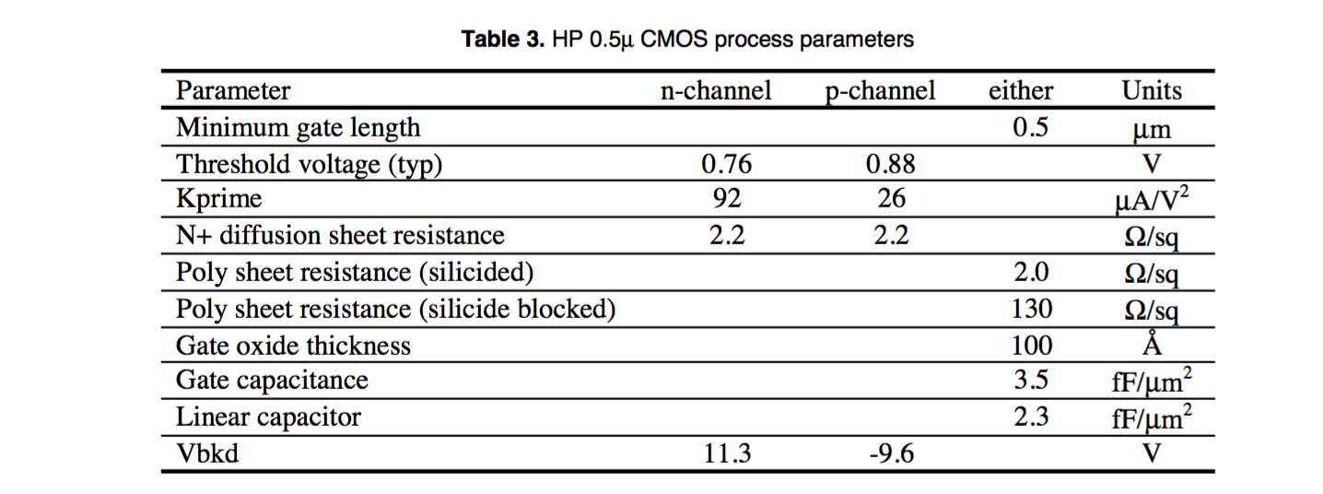
Passive components
Resistors: Silicide blocked poly → ~ 12kΩ easy
Capacitors: “Linear” or MIM up to 10pf or more
Capacitors built in two vertically opposite halves to equalize bottom plate strays

Slide 5
Notes
a) Zin (120 Ω) small compared with Z0 of tube (380 Ω)
b) Noise dominated by termination

Slide 6
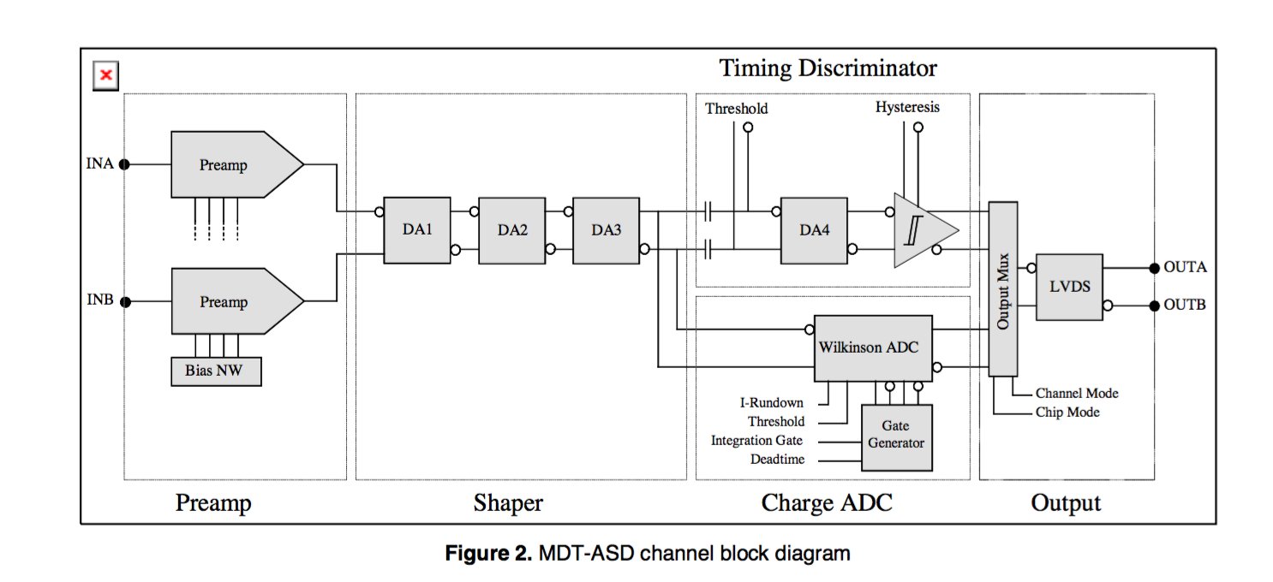
Circuit Architecture
&
Motivation

Slide 7
Circuit Architecture
&
Motivation
Concern that epitaxial process (low resistivity substrate) can lead to substrate coupling if one is not careful
Any transients coupled into substrate anywhere can couple back into high gain input stages.
Guard rings will not prevent this.
Decided on fully differential architecture all the way through.
Two independent low input impedance transimpedance preamplifiers (Idea comes from Mitch Newcomer who used this configuration for Straw Tube Tracker [I think?] in bipolar process)
Motivation for this configuration was to render any input pickup differential, and thus cancelled by subsequent stages.
This feature works “sort of” but less effective than one might think. To be fully effective, input external (R & C) loads on both preamps would have to be the same. Actually, they are very different.
Differential feature makes for easy DC balance after preamps

Slide 8
Circuit Architecture
&
Motivation (continued)
< 15ns peaking time, fast fall time → Transimpedance amplifier ie not a charge integrator
Multiple gain/shaping stages with pole/zero networks to yield final bipolar shaping
All control logic (real time) is hand built and fully differential.
All real time logic traces (differential) sit over bypassed well to further isolate from substrate.
Result was that no digital substrate coupling was ever observed.

