Slide 1
Measurements on the ASDv5 chip at MPI
MPI-Milano-Harvard Design Review, may., 29th-30st, 2017
Robert Richter, MPI Munich

Slide 2
Introduction
A birds eye view of the MDT R/O

Slide 3
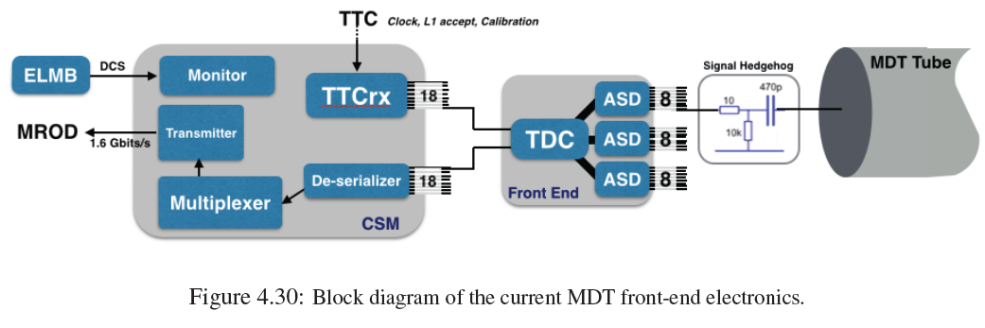
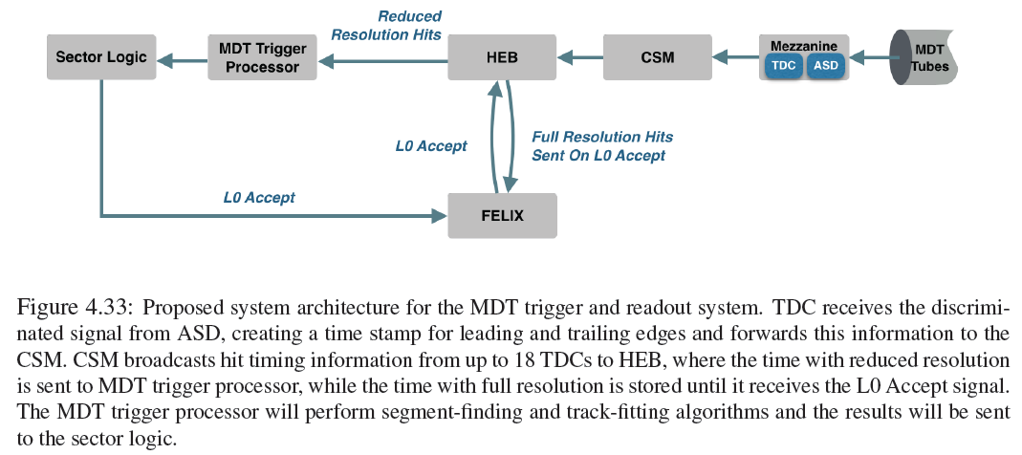
The old and new architecture of the MDT R/O
The present R/O system has only one data stream, MDT tube to the permanent storage of the drift times in the MROD
data storage stream
The future R/O system will have one data stream for permanent storage in the FELIX and a second stream towards the MDT Sector logic. The Trigger processor does a fast, low latency determination of track position and slope.
trigger stream
data storage stream
For the trigger stream a short latency is mandatory (~2-3 μs), because the raw data can‘t be held for a long time in the FE elx. In contrast, the full spatial resolution is not needed for triggering. Therefore the 3 lsb‘s can be suppressed. The Hit Extraction Board (HEB) separates the 2 streams.

Slide 4
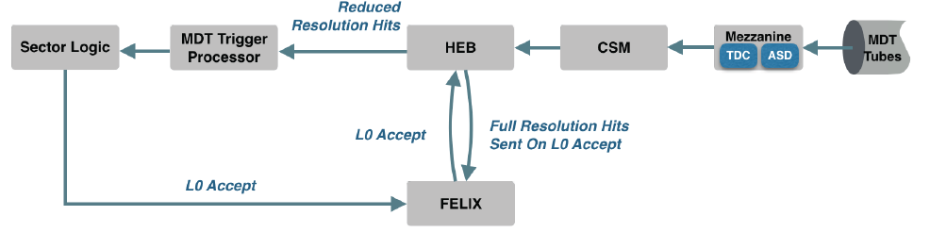
Status of the MDT R/O concept definition
Some details of the architecture are still under discussion: e.g.
(a) work distribution between CSM and HEB
(b) trigger processor: CPU or FPGA based?
(c) optimisation of latency
Architecture fully defined.
Only need higher BW for data R/O (80 →320 Mbps)
trigger stream
data storage stream

Slide 5
Time schedule MDT FE elx for Phase-II

Slide 6
Status of the ASD design

Slide 7
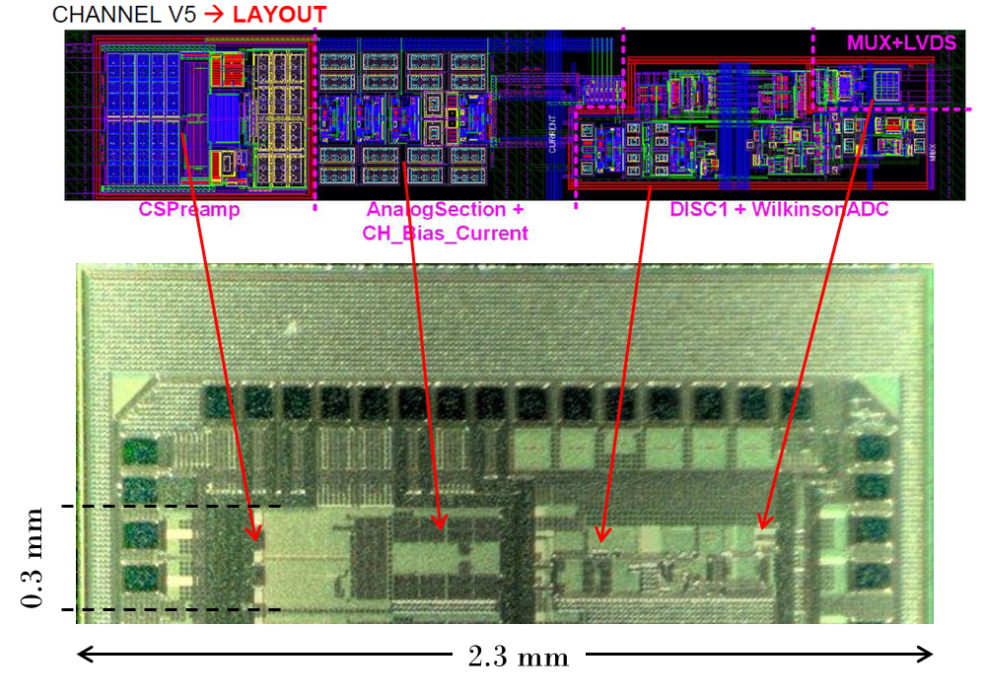
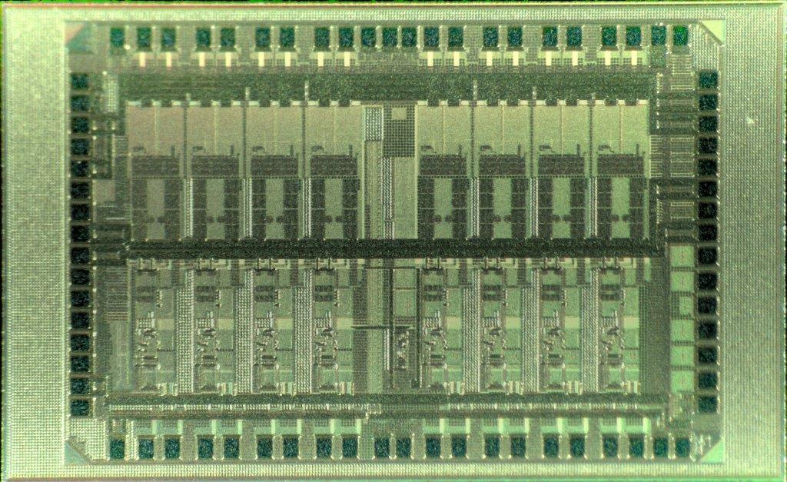
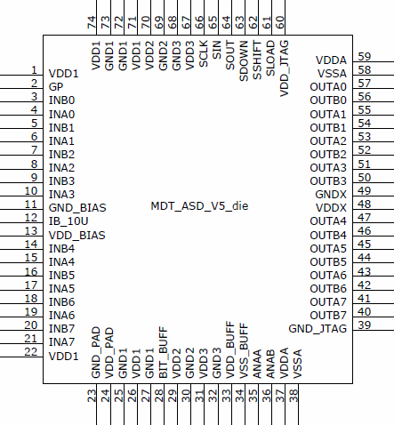
ASDv5: a snapshot with the microscope
ch 0
2.26 mm
3.38 mm
ch 7
ch 0
Submission: aug, 15, 2016
Reception of 40 chips: nov, 10, 2016
Test in the lab: dec, 2016 – march, 2017
Test in the beam w. γ-background: may, 2017
ch 7

Slide 8
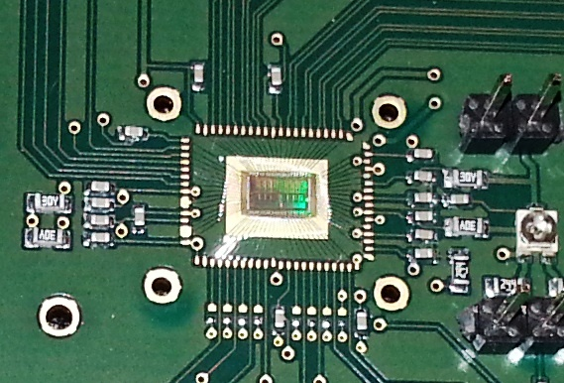
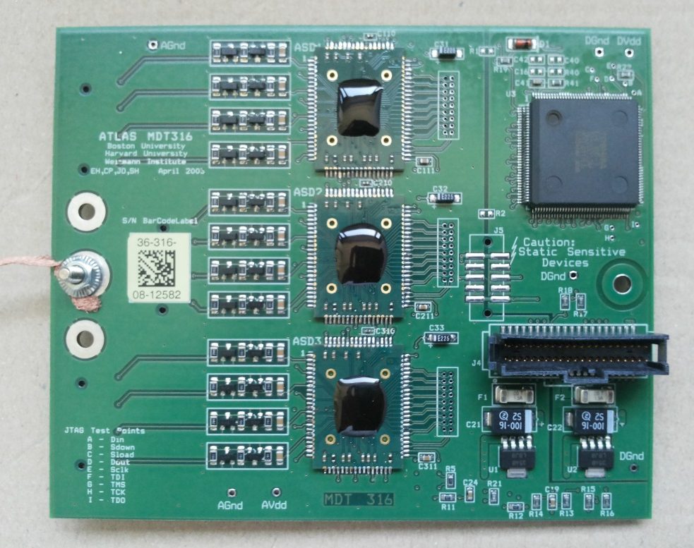
ASDv5: test environment
Tests in the Lab:
Chip directly bonded on a test board
Tests on MDT chambers:
3 chips bonded on adapter boards & mounted on a special mezzanine card. So, tests are in a real elx environment: protective network, TDC (digital activity), R/O via CSM, standard voltage regulators
All layout work by Varuzhan Danielyan

Slide 9
Status of ASD design

Slide 10
Starting Point for the New ASD Design
Basis for New ASD design: specs for the existing ASD
Aim: re-do the design, avoiding the known bugs
Full, detailed documentation in: https://edms.cern.ch/file/899037/2/ASD_Manual_vs_2007.pdf

Slide 11
Design aims, remaining issues compared to 1 year ago
Work to be done:
Delay times don‘t match between the 8 chanels:
Discriminator-to_preamp coupling
Uniformity of pulse length vs. charge of the ADC
Uniformity of programmable dead time
Non-uniformity of integration gates among 8 channels
Digital problem:
Fix errors in JTAG coding of hysteresis setting etc.
New issues:
Bias current: internal or external generation?
Reduce power consumption?
aim for next submission in aug./sept. 2017 ….
Solved !
Solved !
Solved !
Pending !
Pending !
Yes? No?
How?
11

Slide 12
Measuring program at MPI
Risetime
  Without capacitive load
  With capacitive load, equiv. to detector capacity
Gain and dynamic range
  Linearity
  Saturation behaviour
S-curve measurements and noise
Matching of
  deadtime
  rundown current
  integration gates
Matching between different chips
Power consumption vs. V_{cc}
  Junction temperature (lifetime !)
  Heat load for the environment
All measurements by Sergey Abovyan

Slide 13
The discriminator-to-preamp feedback issue

Slide 14
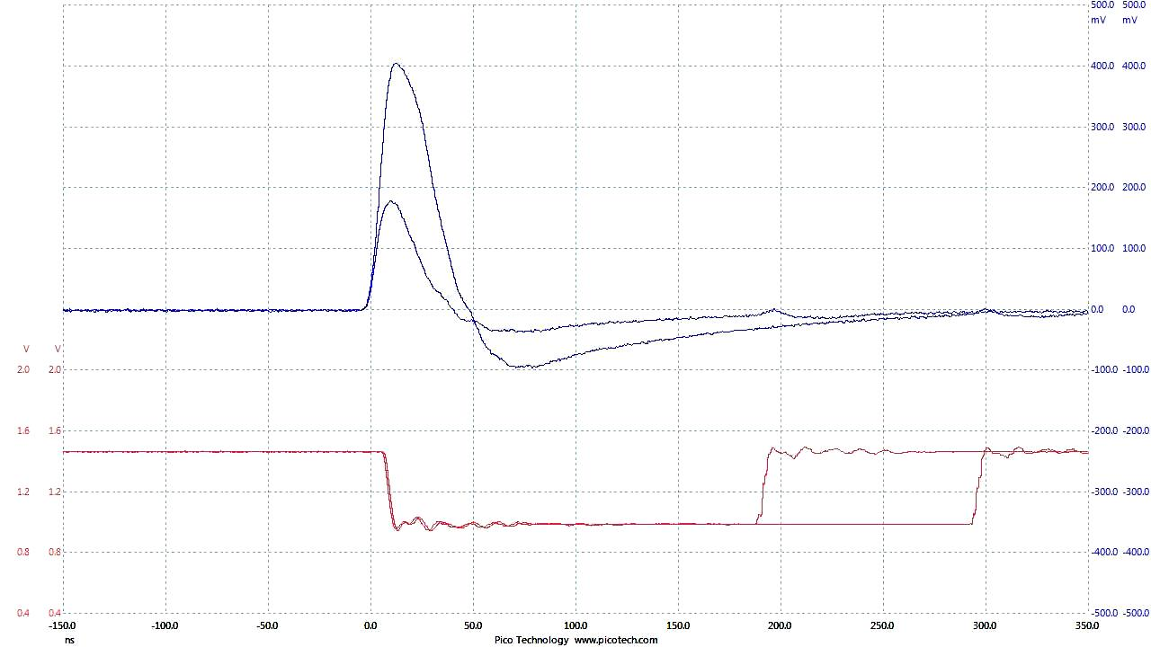
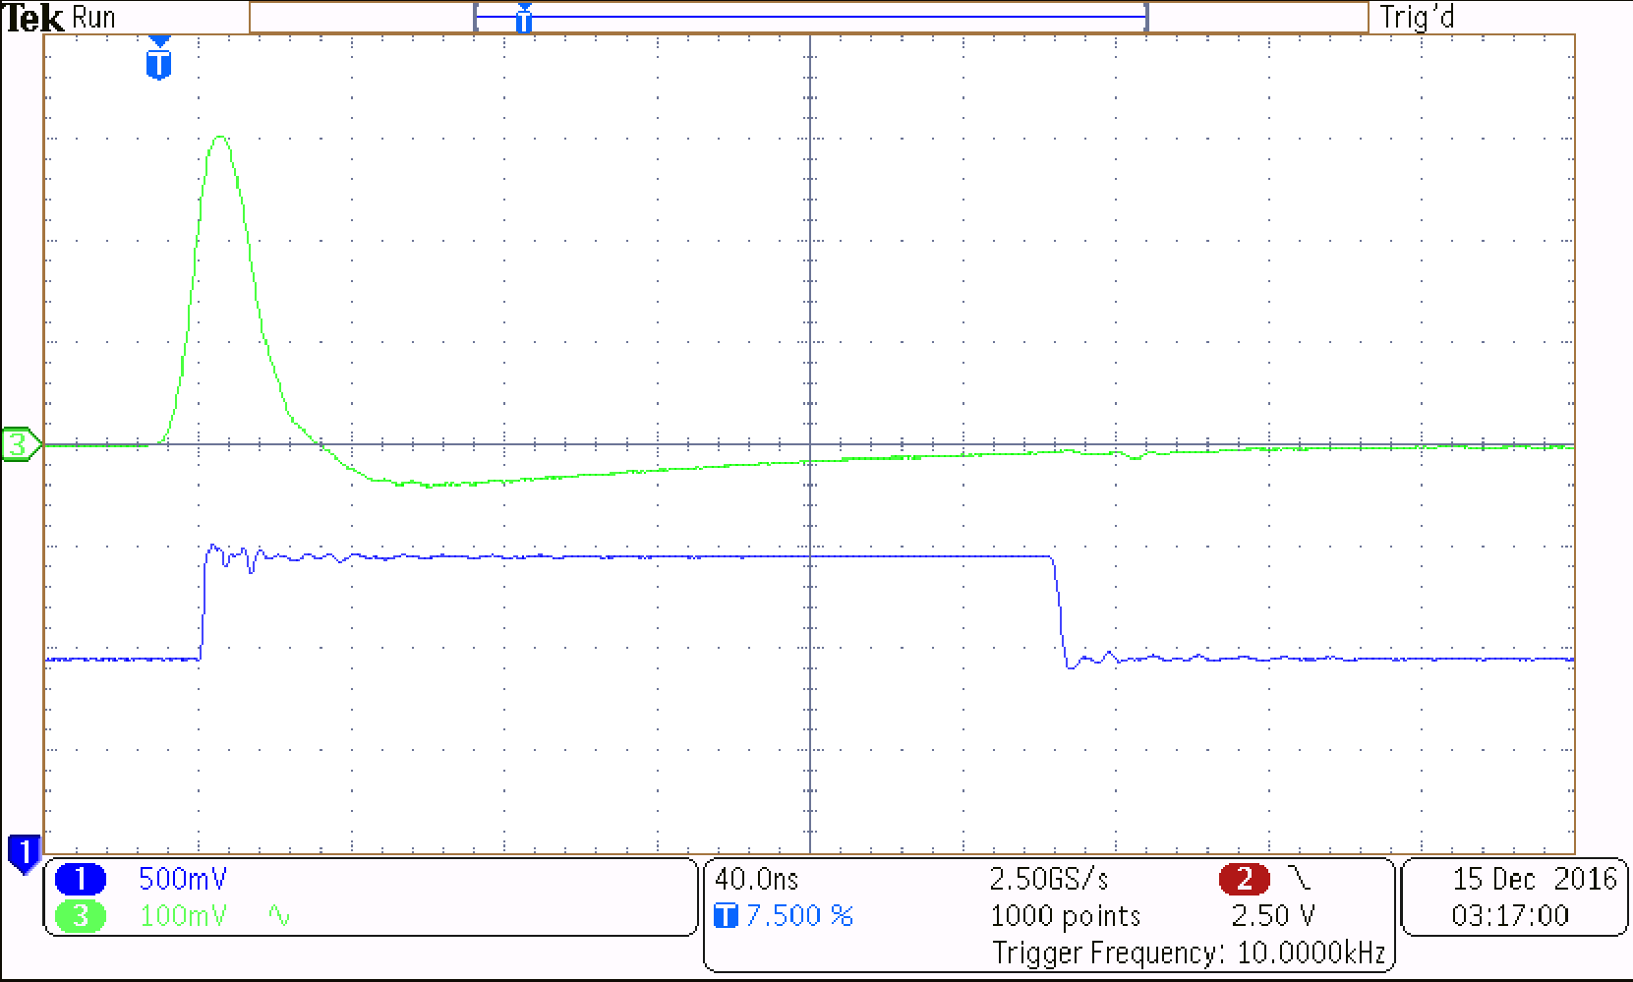
Most important result: discrim. feedback gone
ASD_Vs_4
feedback of discr. output to input of preamp (~35 mV)
ASD_Vs_5
Analog monitor and discrim. output (40 ns/div.)
The feedback of discr. output to the preamp input in vers. 4 led to self-sustained oscillations when operating at low thresholds. The problem disappeared in vers. 5.

Slide 15
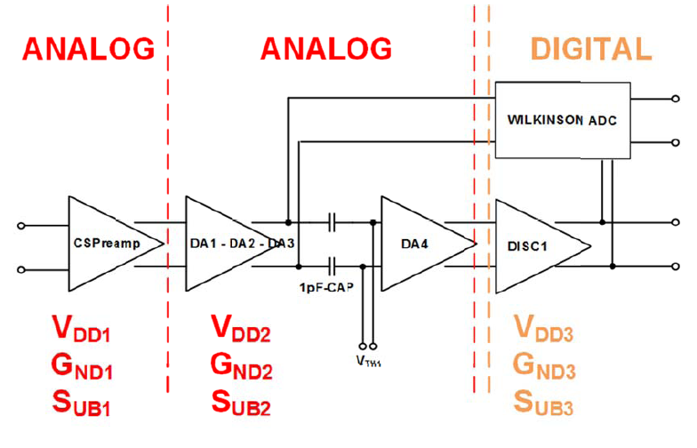
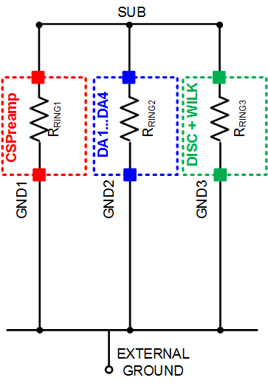
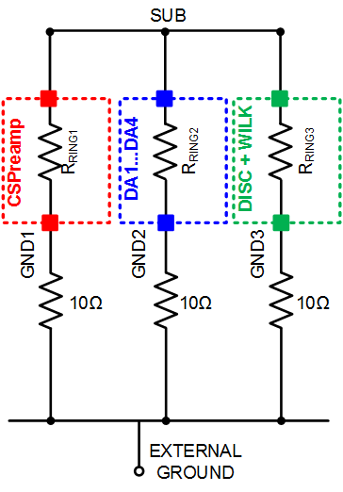
Discr-to-Preamp coupling in ASD Vs.4
Working hypothesis: coupling is due to the common substrate, which connects analog and digital circuitry
Corresponding grounding diagram
ASD Vs4:
the 3 main functional blocks are separately connected to the external ground, but are also connected among each other by the substrate
Ideal
Real
There is always some parasitic resistivity in the path to the external ground: current in one branch may create a small ΔV in the others

Slide 16
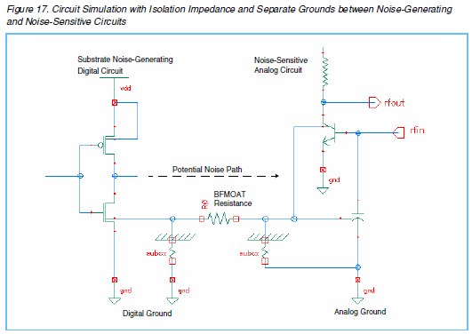
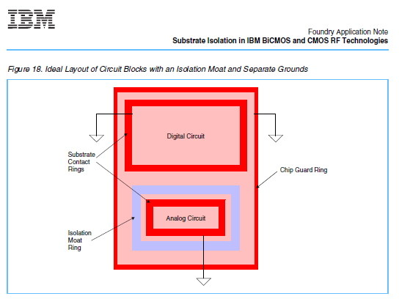
Separating digital and analog circuitry
Recommendation IBM: BFmoat
separate the substrates for digital and analog by a moat (circular trench) of low-conductivity BF₂⁺

Slide 17
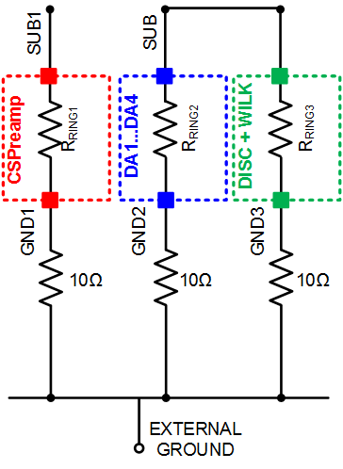
Circuit models for the grounding concept
Ideal grounding
Reality
(10 Ω as an example)
Separating the substrates decouples the analog part from the digital activity

Slide 18
Rise time, gain, linearity and saturation behaviour

Slide 19
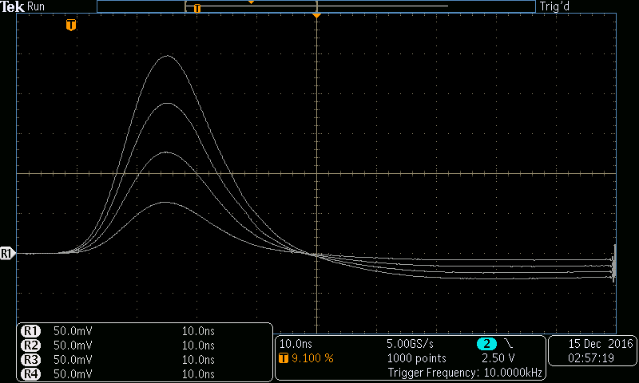
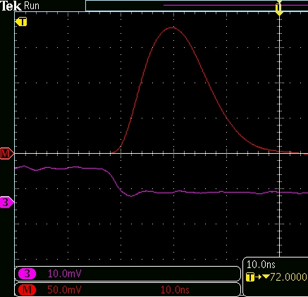
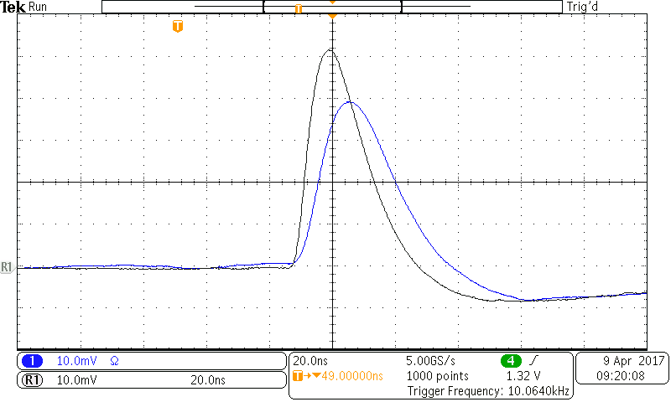
Rise time with & w/o capacitive load ASDv5
Rise time 10, 20, 30, 40 fC, no cap. Load (10 ns/div.)
Rise time expanded (10 ns/div.)
Corresp. measurement with ASD1
Rise time w/o and with 56 pF capacitive load (20 ns/div.)

Slide 20
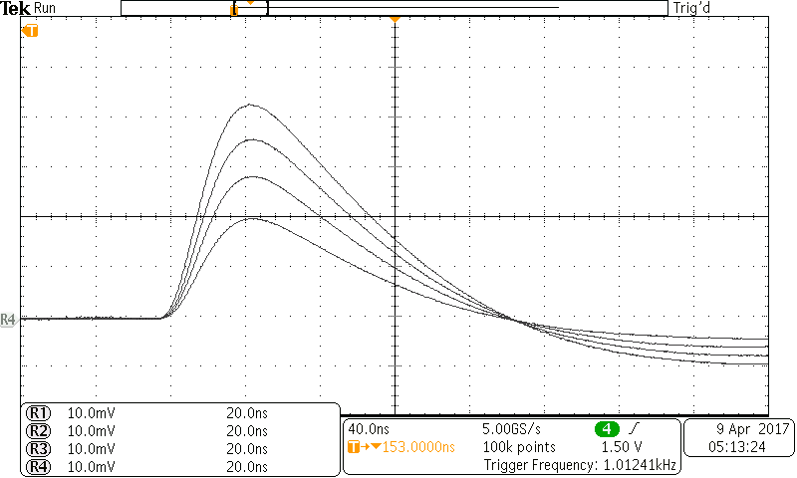
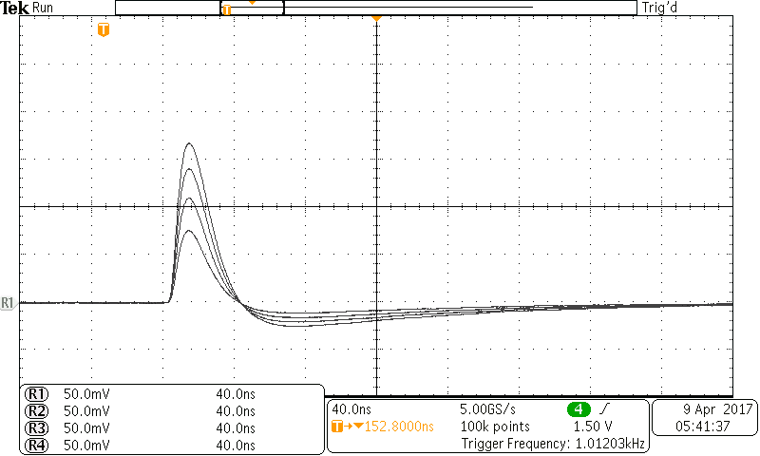
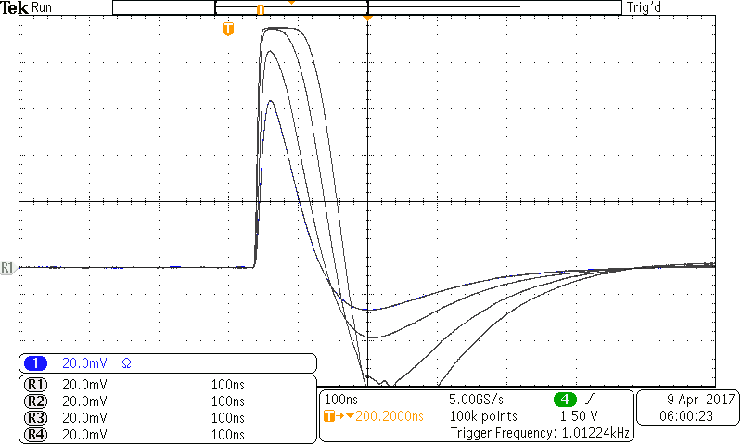
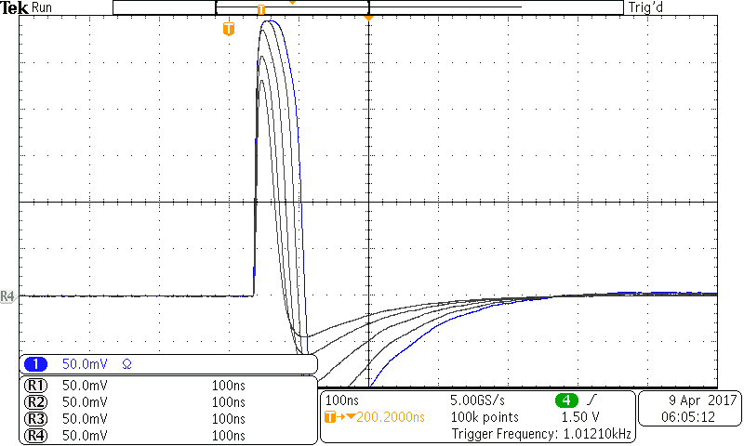
Saturation behaviour ASD1 and ASDv5
ASD1
ASDv5
Linear range up to about 30 fC
40 ns
40 ns
Step response at 20, 30, 40 and 50 fC
Step response at 20, 30, 40 and 50 fC
Response to heavy overload:
return to zero inside 100-150 ns; end of undershoot after about 300 resp. 500 ns
100 ns
100 ns
Step response at 50, 100, 200, 500, 1000 fC
Step response at 50, 100, 200, 500, 1000, 2000fC

Slide 21
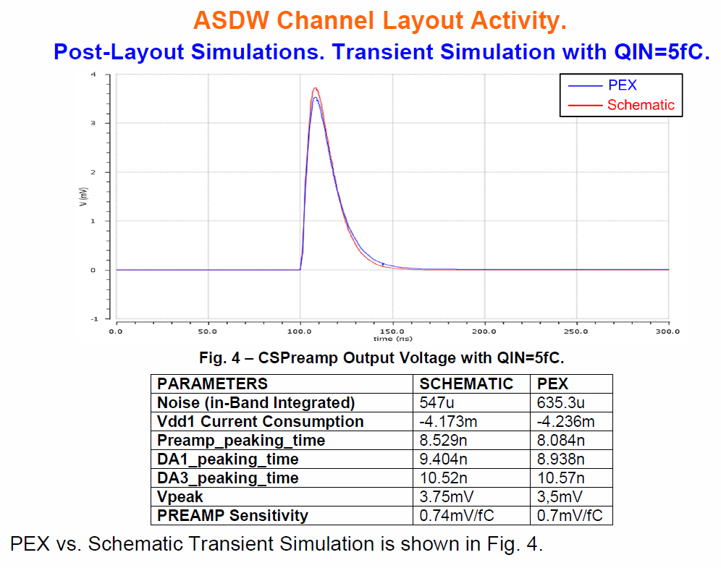
E.g.: PLX vs. SPICE simulation of pre-amp risetime
SPICE
PEX
NB: peak time
@disc.: + 2 ns
Conclusion: simulation of peak time in good agreement with measurement

Slide 22
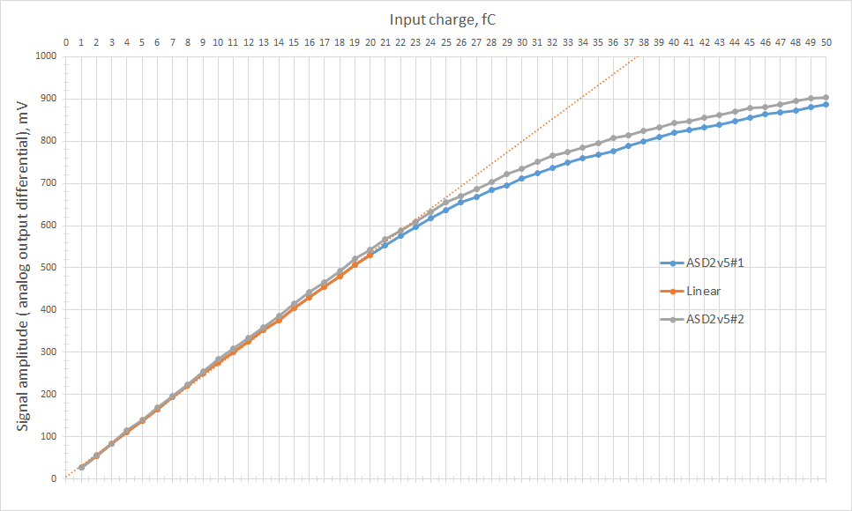
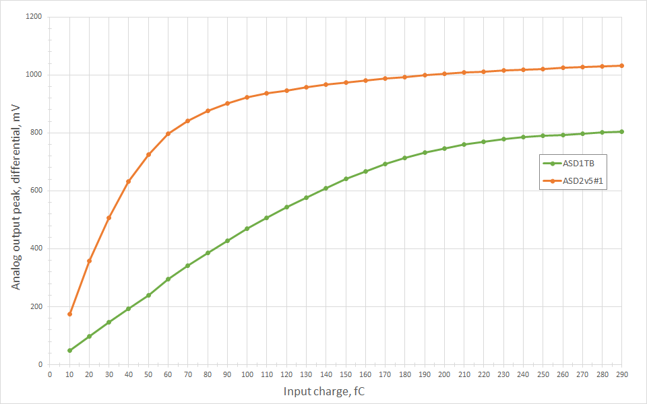
Gain and range of linearity for ASD1 and ASDv5
Good gain matching chip-to-chip:
Voltage vs. input charge for 2 different chips (channel #7)
Linearity btw. input charge and peak voltage:
ASD1 up to about 150 fC
ASDv5 up to about 50 fC

Slide 23
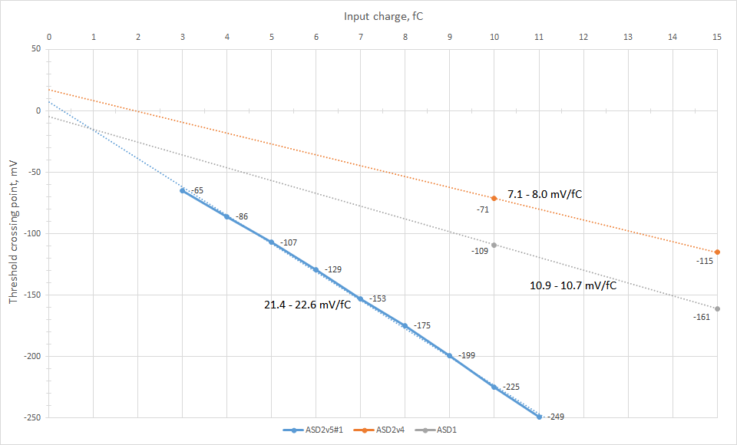
Threshold Scans
Result: Gain of ASDv5 about 2 times the one of ASD1 (legacy)
Question: Is there any reason to reduce the gain of the next version (ASDv6) ?

Slide 24
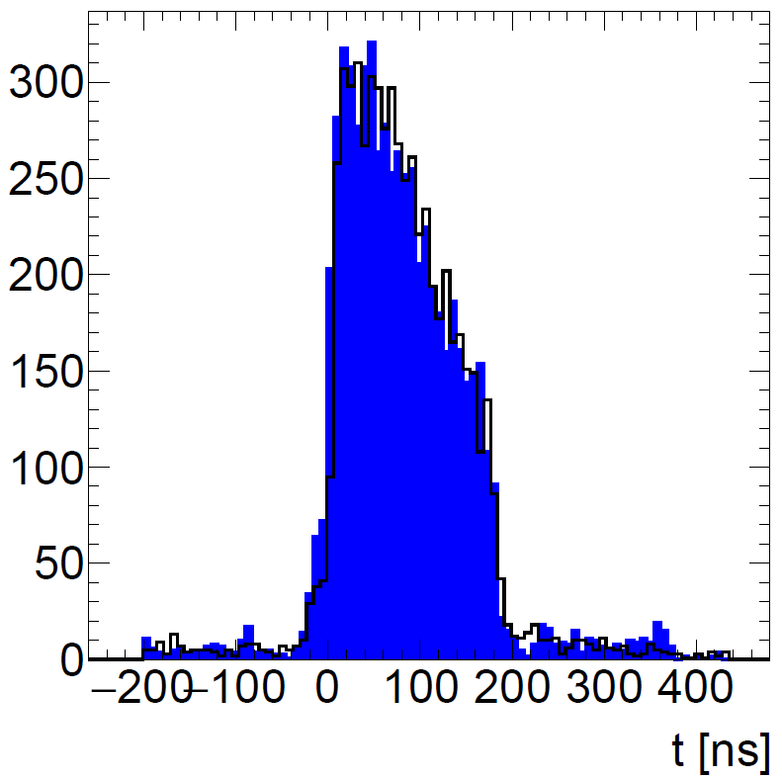
Measurement of the drift-time distribution with cosmic muons in the GIF++
Drift time distr. With ASDv5 (blue) and ASD1 (black line).
Next step: replace cosmics by muons from test beam at CERN.

Slide 25
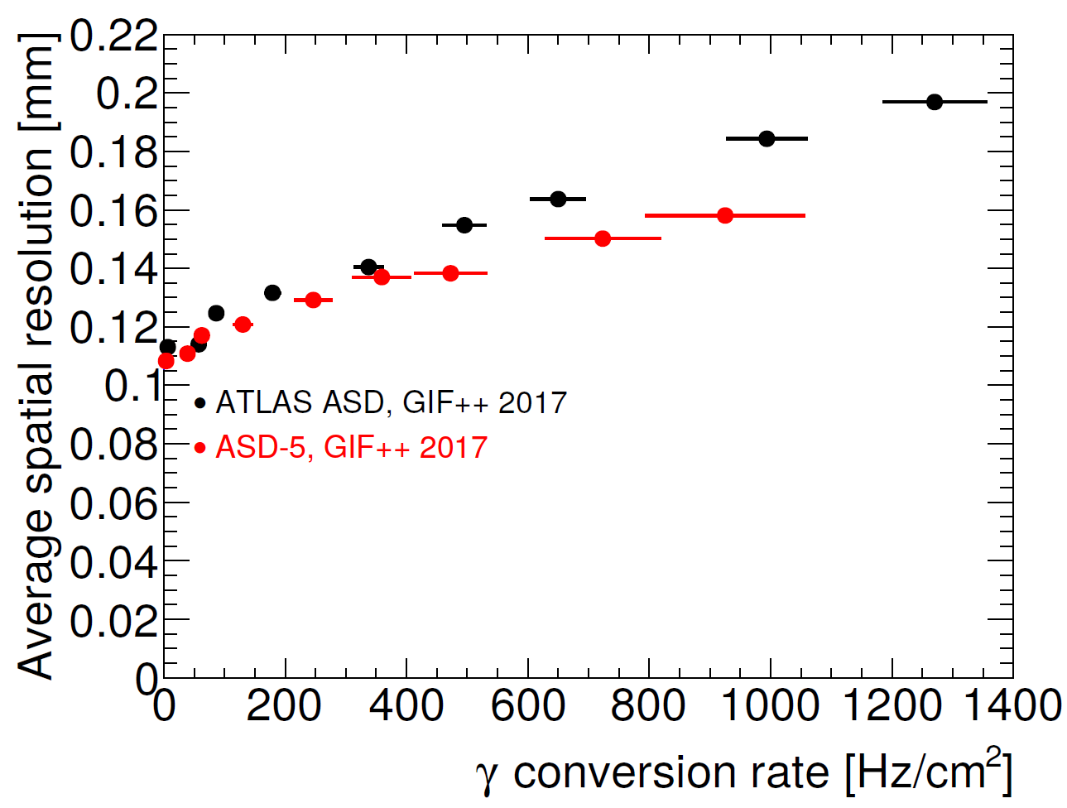
Spatial resol. of ASD1 and ASDv5 in the Test Beam
Spatial resolution vs. gamma conversion rate in the GIF++ at CERN.
Slewing corrections have not been applied.
→ With Olivers comment, see below, one would conclude that the resolution on beam particles of both chips is at the same level.
Comment Oliver Kortner:
As the counting rate per tube depends on the distance of the tubes from the radioactive source and the tubes read out with the ASD-5 chips are at larger distance from the source than the tubes with the old ASD chips, they experienced a lower gamma background flux than the tubes with the old chips.

Slide 26
Threshold variation

Slide 27
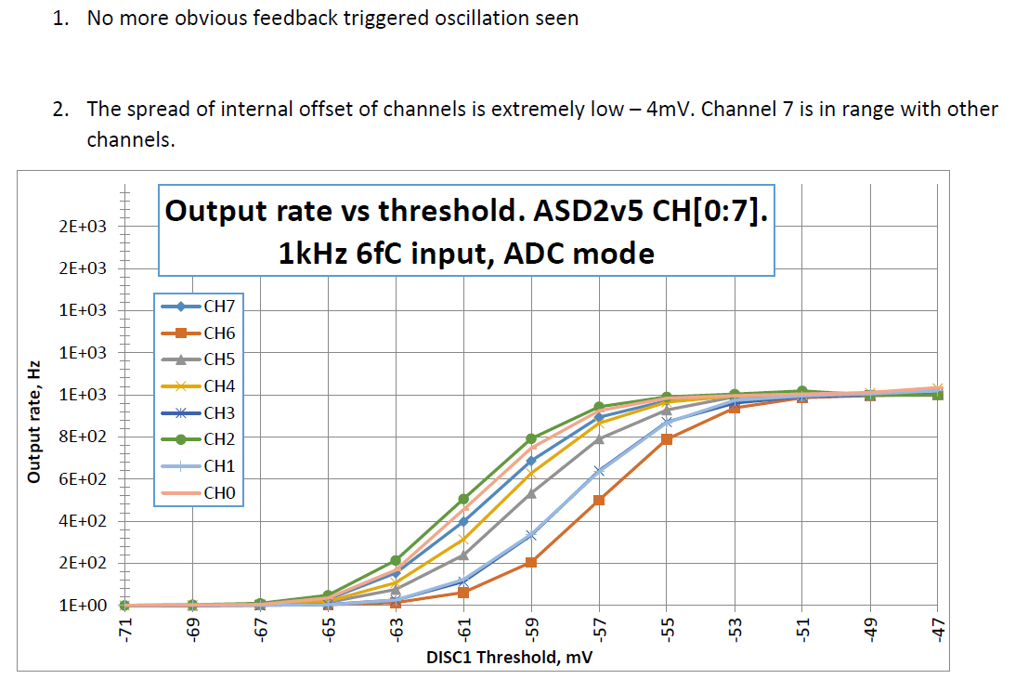
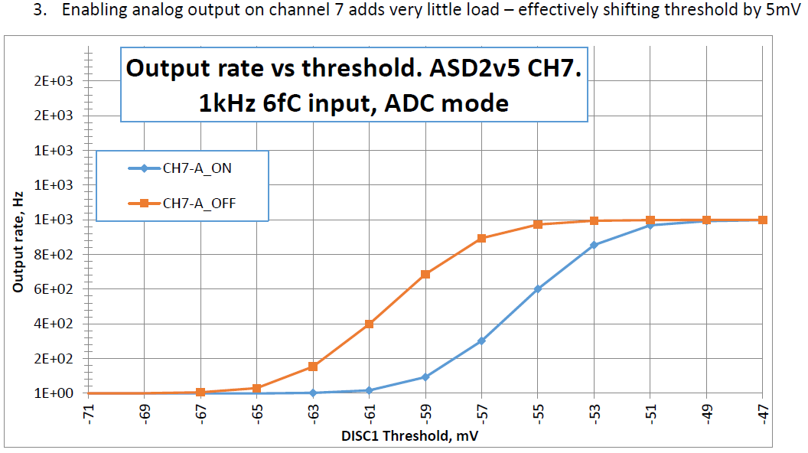
Threshold variation only 4 mV; ch 7 in range
From: ASD2v5_basic_tests_14.12.16.pdf (Sergey A.)
~4 mV spread
ON-OFF =
~5 mV
→ A threshold sweep over all 8 channels shows only 4 mV variation.
→ All 8 channels very close to each other (including channel 7 with
monitor output)

Slide 28
Matching of dead time, rundown current integration gates

Slide 29
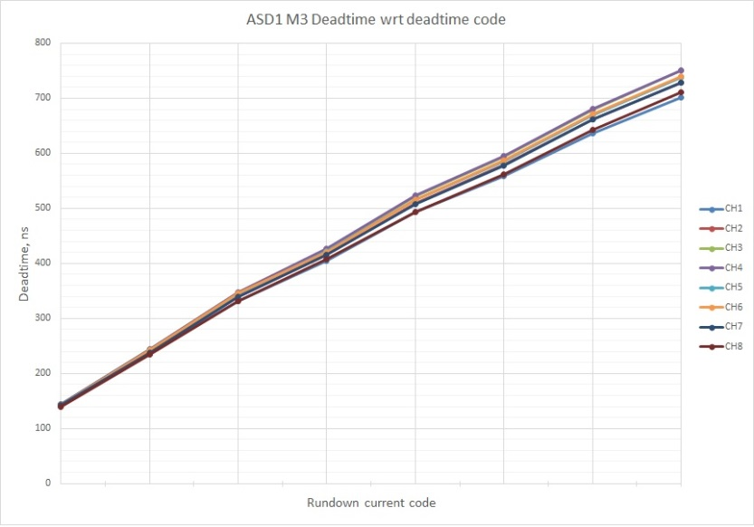
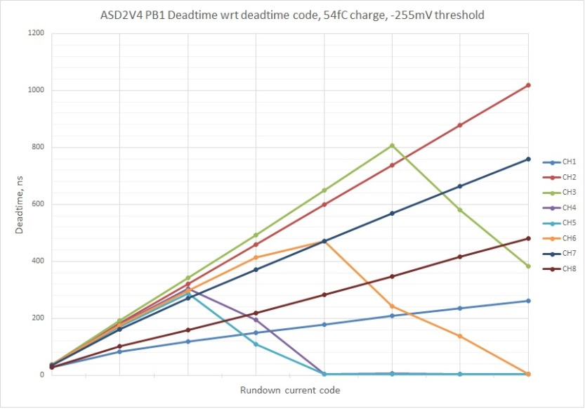
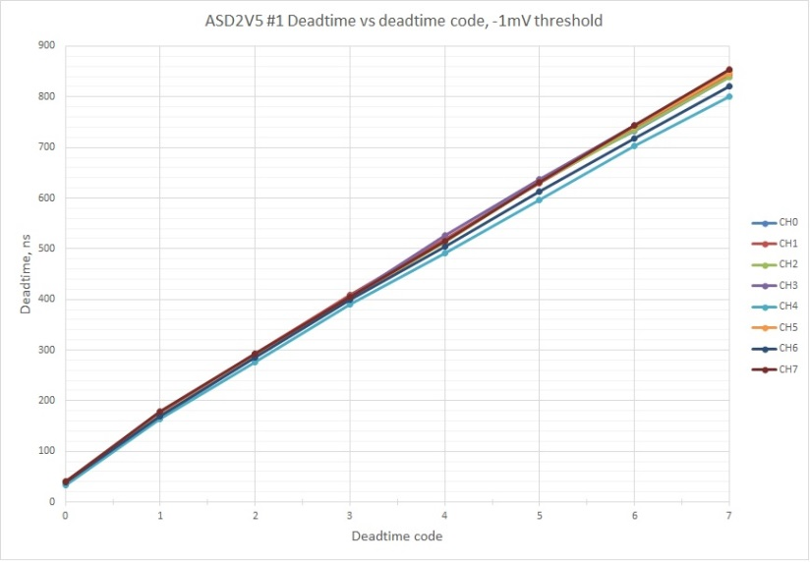
Dead time vs. dead time code: fixed
The legacy ASD: OK
d.t. max: ~740 ns
The ASD Vs.4 (2014):
Big variations betw. the 8 channels
d.t. max: ~1000 ns
Dead time [ns]
Dead time [ns]
Dead time code
Dead time code
The ASD, vs. 5 (2016): OK
d.t. max: ~820 ns
Dead time [ns]
Similar behaviour of the ADC reading (trailing-leading edge) vs. run-down current code
Dead time code

Slide 30
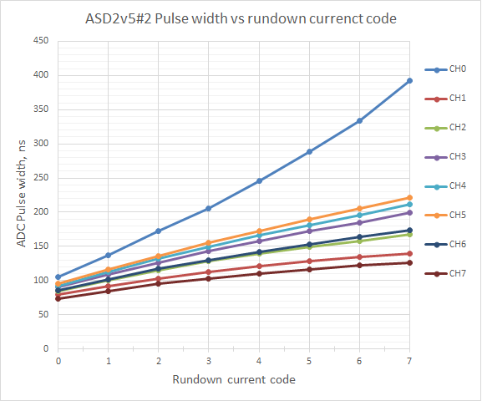
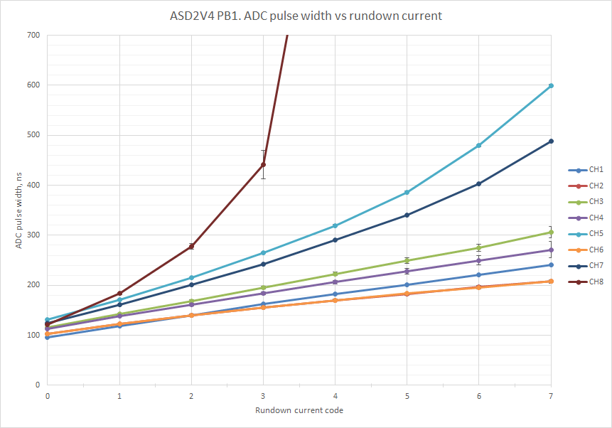
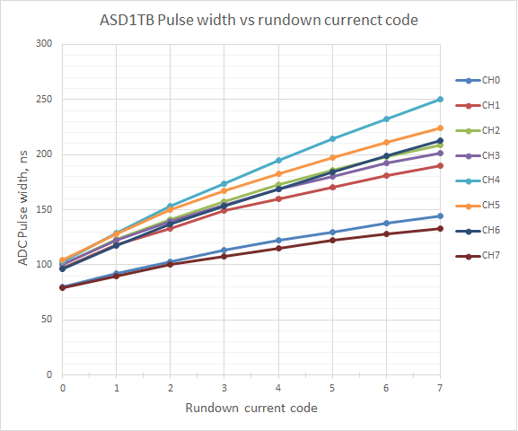
ADC vs. run-down current code much improved
ASD vs.5 (2016): improved, but not perfect
ASD vs.4 (2014): large ch-to-ch spread
ch0: 400 ns
ch7: ???
ch0: 600 ns
ADC pulse width[ns]
ADC pulse width[ns]
ch4: 480 ns
Max. width: 170+-50 ns
Max. width: 230+-50 ns
Min. width: 90+-15 ns
NEW
Min. width: 110+-20 ns
OLD
Operating point 2:
90-170 ns
Run-down curr. code
Run-down curr. code
The legacy ASD: significant spread
ASD_Vs.5 signif. better than Vs.4, but not OK:
Maybe this is not only a problem of run-down current, but also one of the integration gate.
This possibility has not yet been taken into account and needs study!
Max. width: 220+-40 ns
ch0,ch7: 140+-10 ns
Min. width: 90+-10 ns
legacy
Operating point 2:
100-150 ns
Run-down curr. code

Slide 31
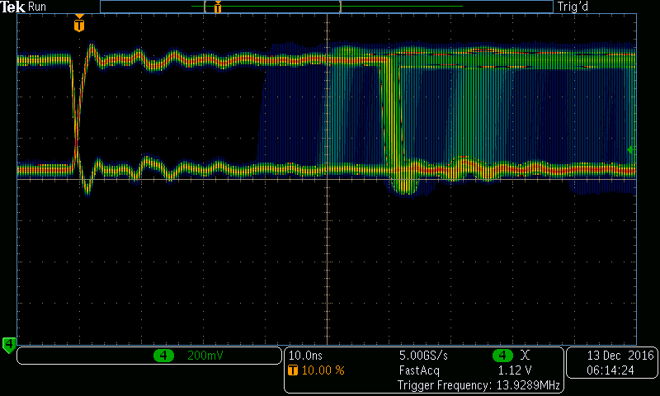
No metastable states in the lvds output!
ASD1
ASDv5
Response of the legacy ASD to noise pulses
Response of the ASD Vs.5 to noise pulses
legacy
NEW
5 ns/div
10 ns/div
The lvds outputs from the legacy ASD:
→ not all signals reach logic level 1.
→ Cause of the „pair-mode problem“.
Conclusion: the problem of meta-stable logical states is gone

Slide 32
Time schedule of futher prototyping, production and expected cost
Chip ID |  | submiss. | reception | packaging | full charac- terization | quan- tity | approx. Cost (kCHF)
Vs. 5 | present vs. | Aug-16 | Nov-16 | Dec-16 | Feb-17 | 40 | 25
Vs. 6 | next vs. | Aug-17 | Nov-17 | Dez-17 | Feb-18 | 40 | 25
Vs. 7 | prod. prototype | May-18 | Aug-18 | Nov-18 | Dez-18 | 40 | 25
Vs. 7 | production | May-19 | Aug-19 | Nov-19 |  | 120 k | 330 *)
Conclusion: beginning 2020, batches of tested chips will become available
*) For 120k chips: 40 chips à 7.7 mm2 per reticle; 60 reticles/wafer = 2400 chip/wafer --> 50 wafers. Assume 230k CHF for the masks and 2 kCHF/wafer. (The cost of packaging, test gear and testing is not included).

Slide 33
Jobs list for submission of ASDv6
(my view)
reproduce measurements with simulation - already done?
reproduce all relevant measurements with packaged chips
  Signal/Noise? Influence of digital activity on mezzanine board? - done
  Spacial resolution with cosmic tracks - done
Decide on gain (voltage/input charge)
Fix JTAG shift register problem (hysteresis bits stuck)
bias current ON or OFF chip?
prepare coherent documentation - partly contained in TDR
Open Qs:
Matching between different chips (check at least 10 packaged chips for failure or misbehaviour)
Power consumption vs. V_{cc}
  Junction temperature (lifetime !)
  Heat load for the environment

Slide 34
Backup Slides

Slide 35
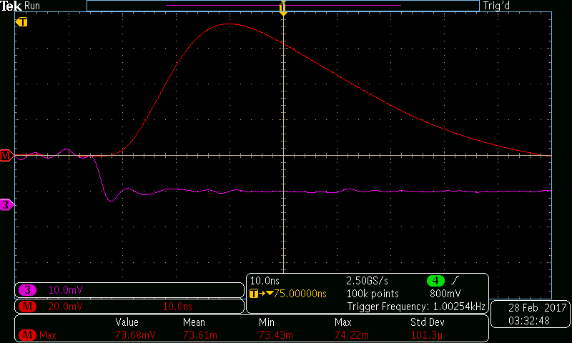
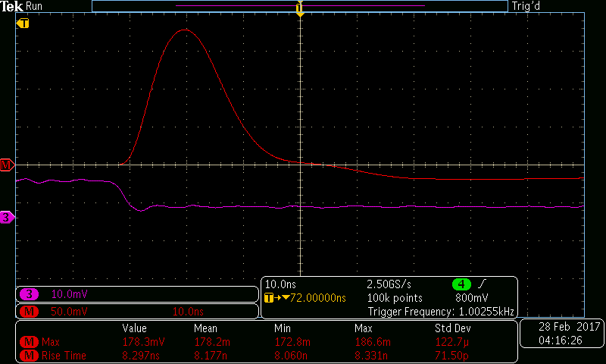
Risetime of ASD1 vs. ASD5
The legacy ASD
The ASDv5
The legacy ASDv1 has a peaking time of nearly 20 ns, while the ASDv5 has less than 10 ns?!
The step response is more symmetric for ASDv% than for ASDv1?

Slide 36
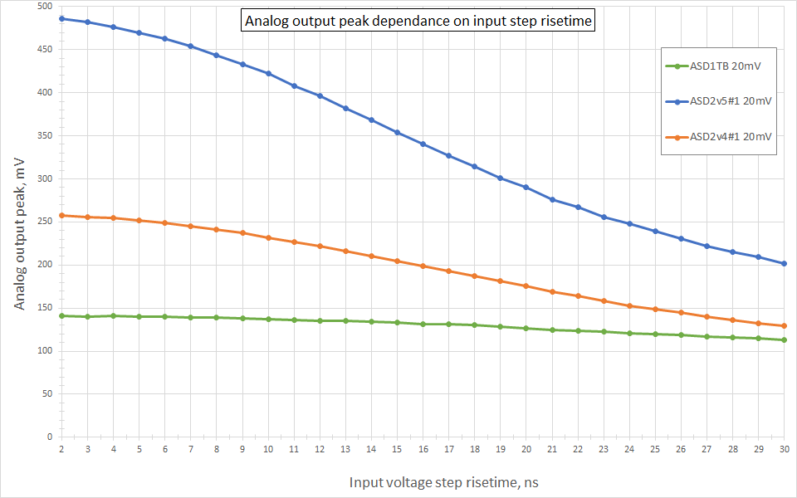
Influence of test pulse rise time
Conclusion: due to ist shorter integration time, the peak voltage of the ASDv5
depends significantly on the real rise time of the „voltage step“ on the input test capacitor.
(But up to about 5 ns rise time this effect is still insignificant for practical purposes.)

Slide 37
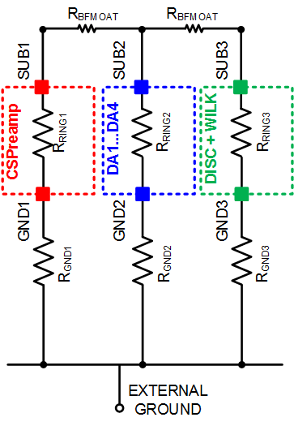
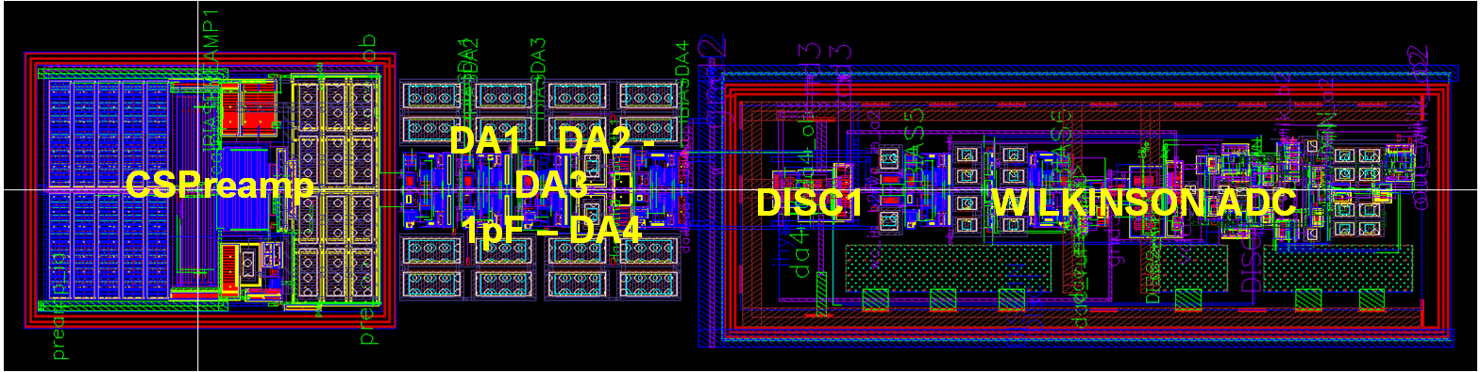
Simulation of substrate/grounding concept
Substrates, may be separated by BF Moat
Ground/Substrate routing introduces
parasitic components between
    Different grounds
    Different substrates
    Substrates and grounds
„User“ circuits
Parasitic resistors to GND (unavoidable)
Several combinations of SUB and GND were
simulated to look for the best solution (next slide)
Charge Sensing Preamp:
the sensitive analog part
The Shaping stages
The Digital Part: Discrim. & Wilkinson ADC

Slide 38
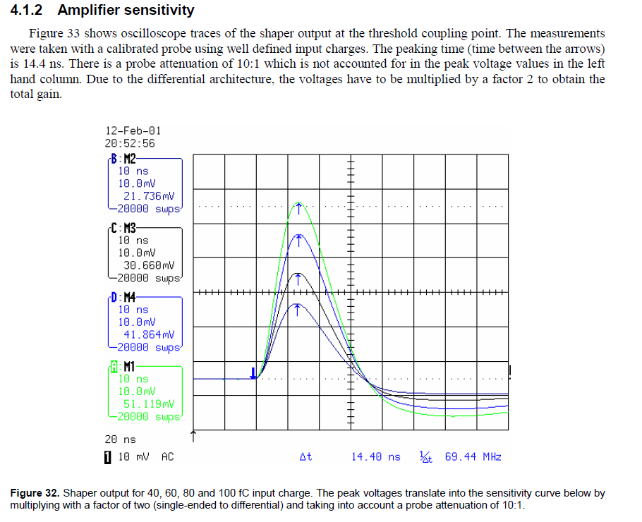
Measured rise time of ASDv1 from Manual

Slide 39
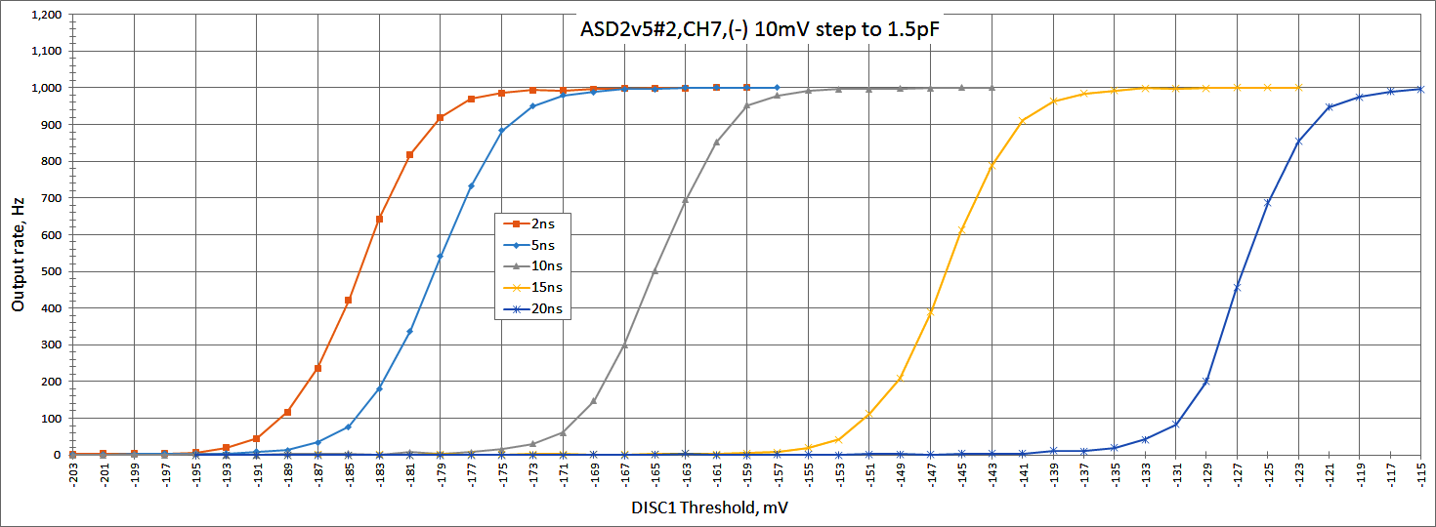
S-curve measurements and noise
ASD2_v5_S_Curve_scan_ch_7_vs_risetime

Slide 40
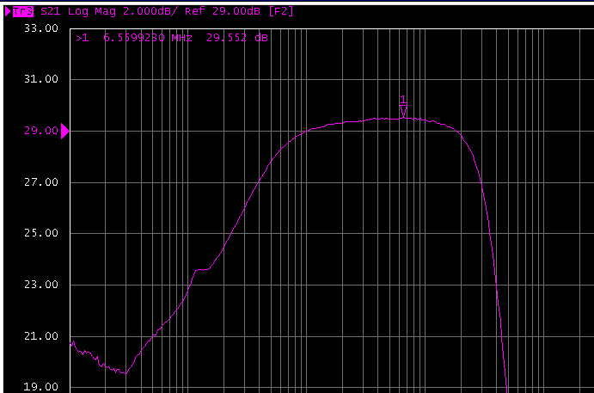
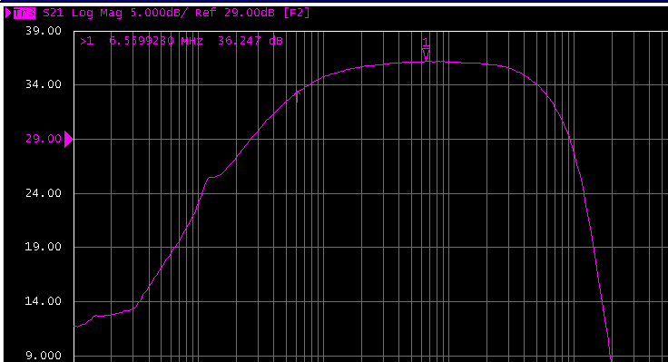
Frequency sweep input-to-analog monitor
(Bode plot)
Corner freq.
~ 0.7 MHz
Corner freq.
~ 70 MHz
Corner freq.
~ 0.35 MHz
Corner freq.
~ 30 MHz
0.1 MHz
1 MHz
10 MHz
100 MHz
0.1 MHz
1 MHz
10 MHz
100 MHz
The legacy ASD
The ASDv5
ASDv5 has a higher corner frequency (3 dB point) than legacy ASD
This must also be visible in the rise time
May be a consequence of reducing stray capacitances and/or „better“ 130 nm technology
This is an advantage to retain for better timing measurement (→ less slewing!!)

