Slide 1
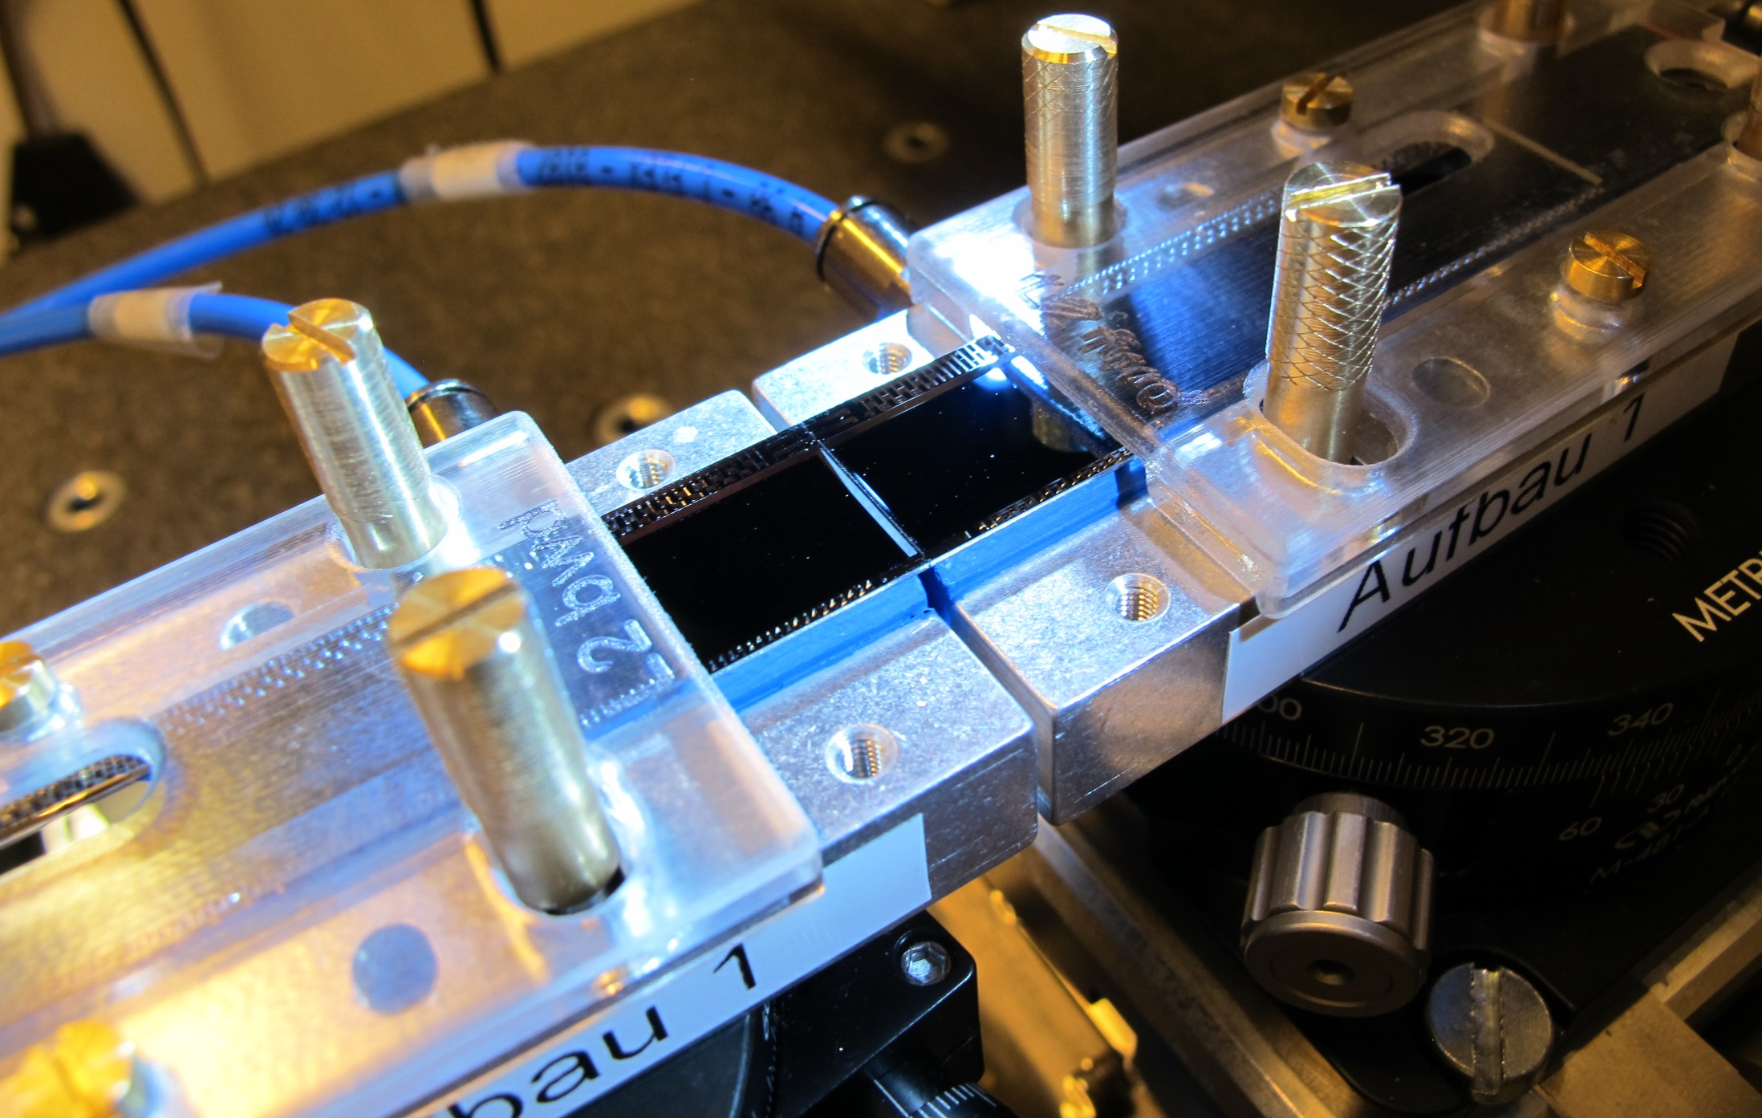
Ladder Assembly
All tools and jigs produced
Glue dispensing works
Pull tests ok
9 dummy ladders assembled

Slide 2
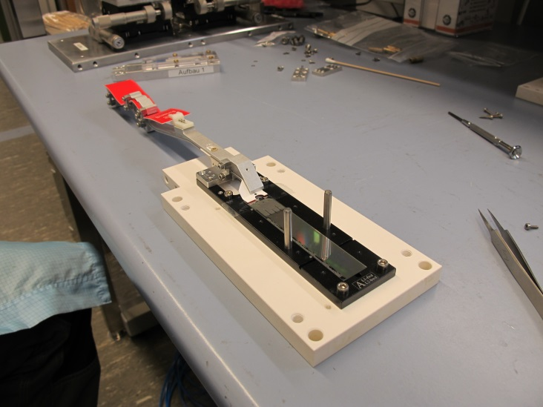
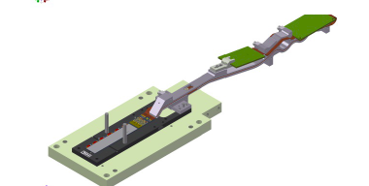
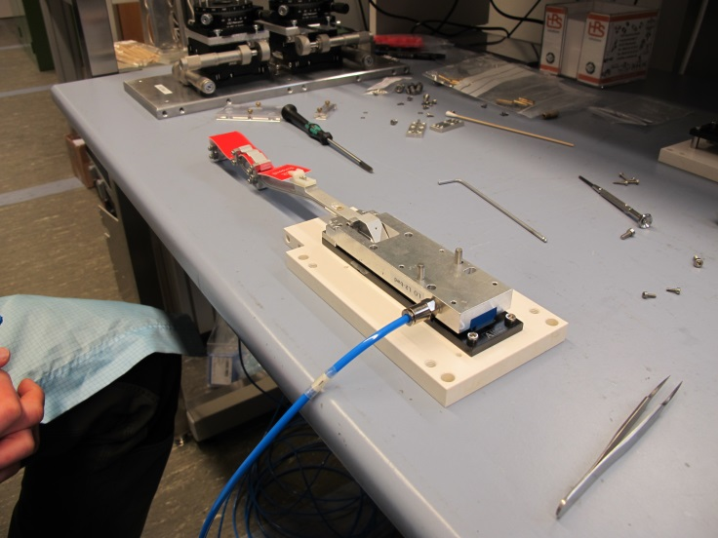
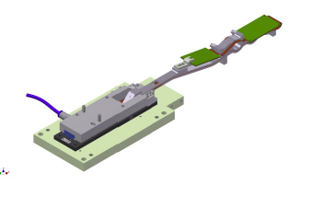
Transfer on vacuum jig
Modules arrive with kapton attached (tested)
Vacuum jig for turning and ladder gluing
Fits on top side (cut outs for switcher)
Mode from microporous plate (gentle vacuum on sensor top side)
Vacuum jig on sensor
Screw kapton jig to vacuum jig
Unscrew kapton jig from base jig

Slide 3
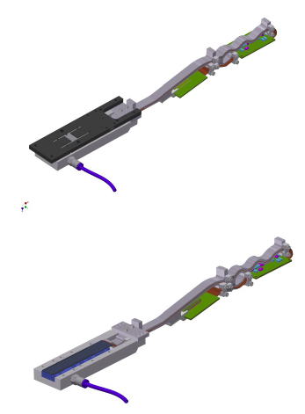
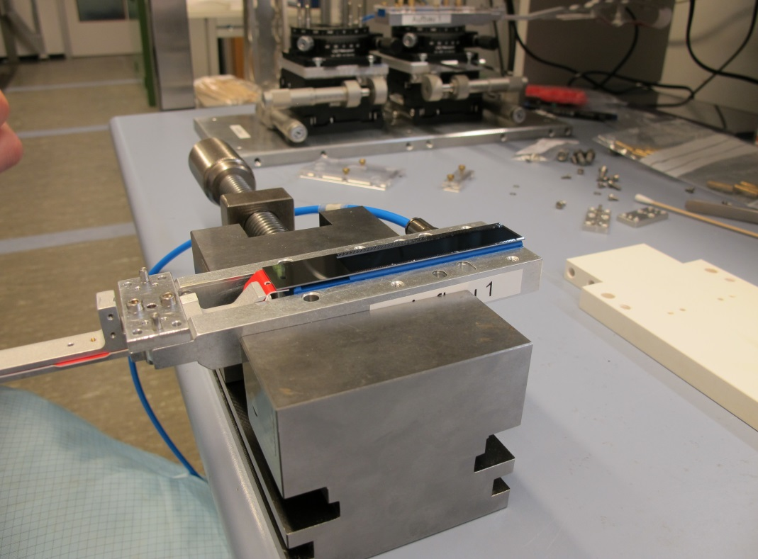
Remove base jig
Turn around and take off base jig

Slide 4
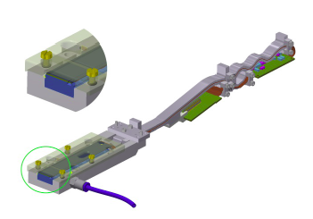
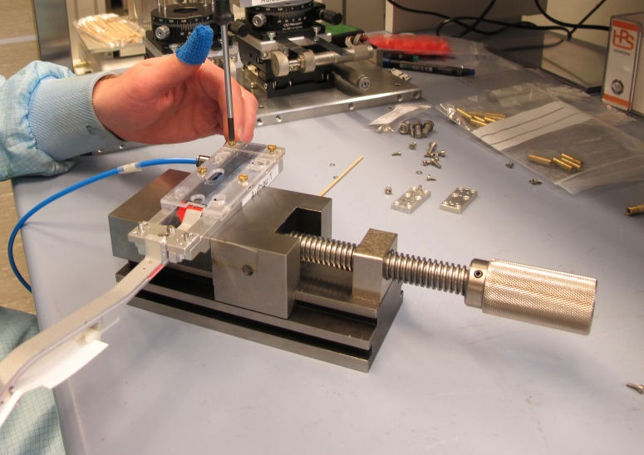
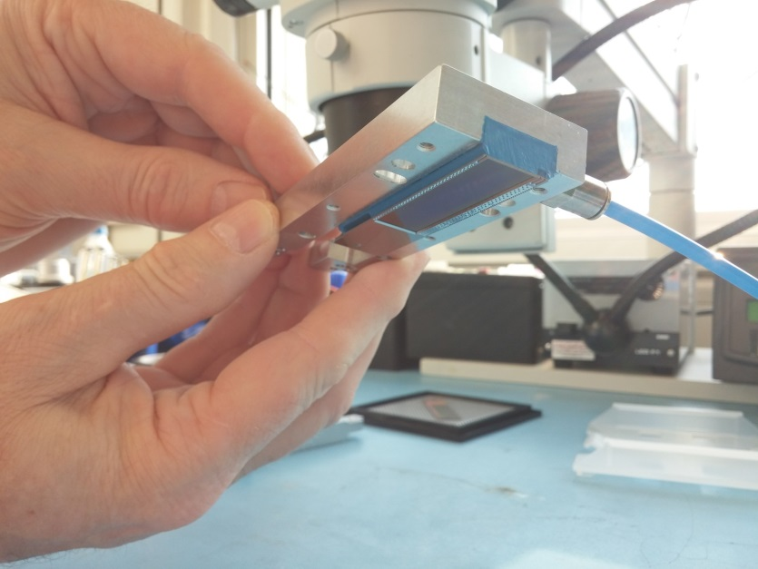
Prepare for glue dispensing
Add protective cover
to be sure: module is securely held by
Vacuum…

Slide 5
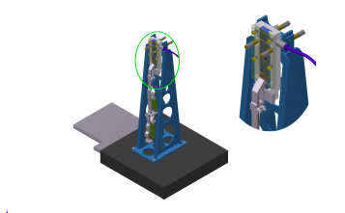
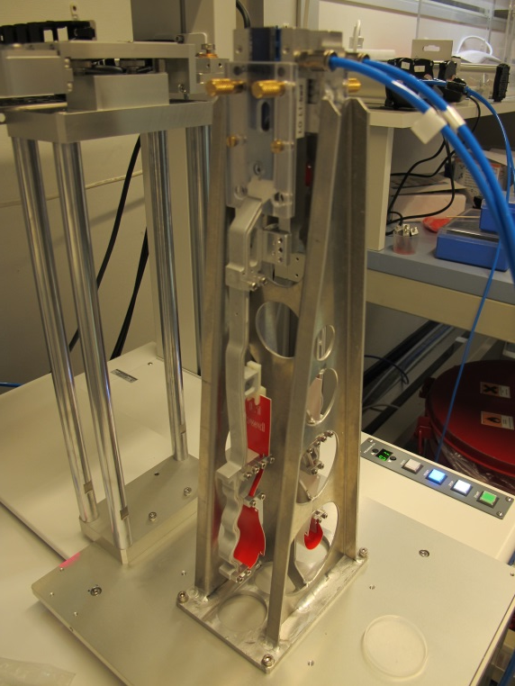
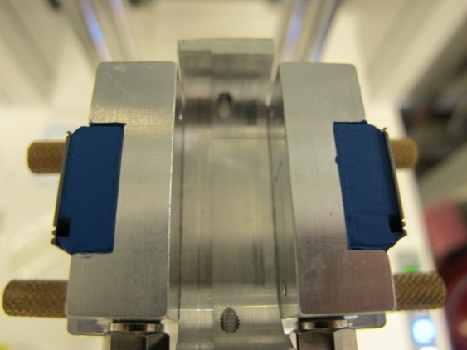
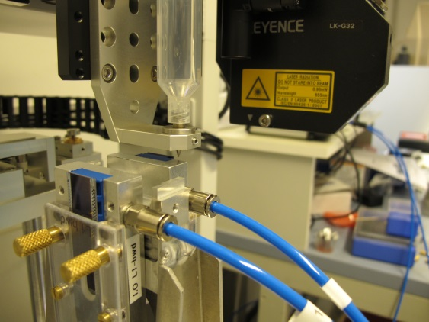
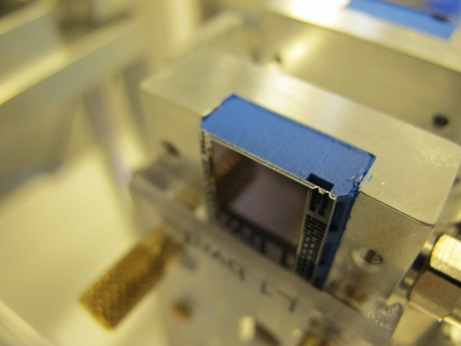
Mount on glue dispenser
2nd module is prepared the same way
Glue is automatically dispensed on both modules in one step

Slide 6
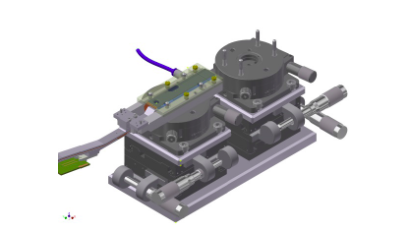
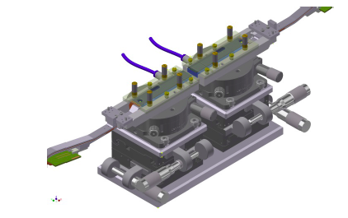
Place modules on alignment jig
bwd module 1st
fwd module 2nd

Slide 7
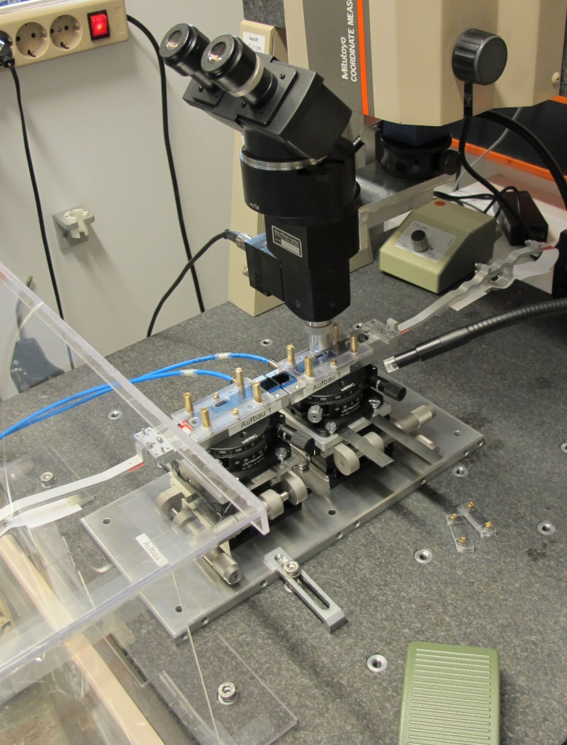
Align and glue together
Precision achieved:
10 µm over full length of ladder
Modules are pushed together to 30µm to ensure good contact and distribution of the glue.
Then they are driven apart to the nominal gap of 80µm

Slide 8
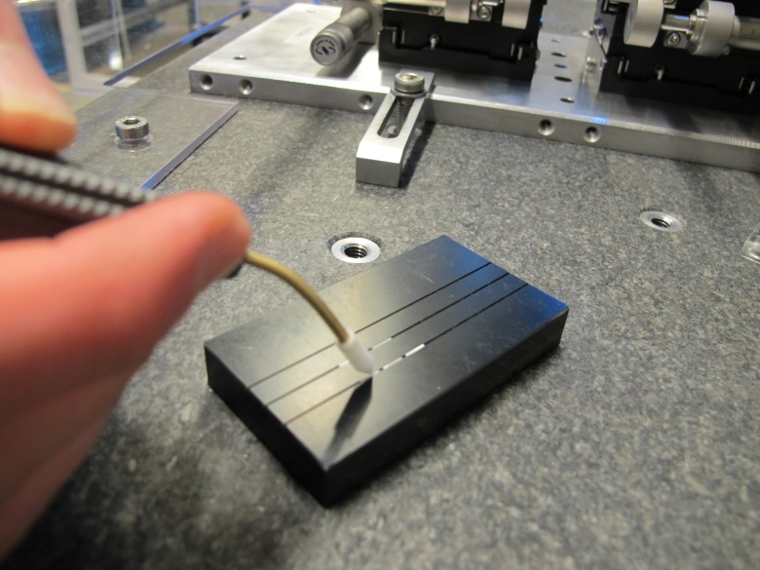
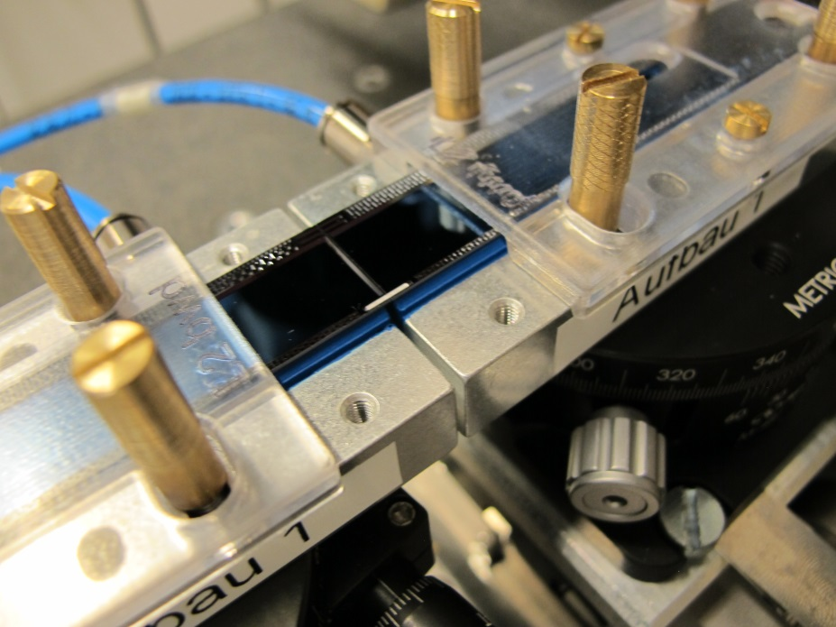
Add ceramic stiffeners
Stiffeners are handled with a vacuum tool
Glue is applied with a needle (works better than with a dispenser)

Slide 9
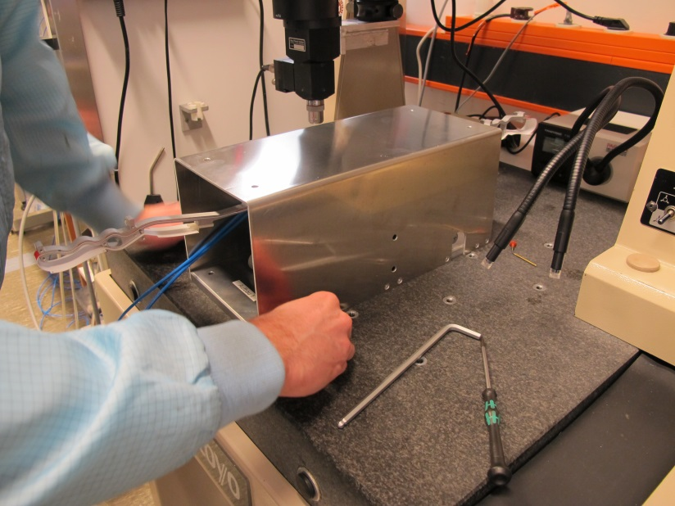
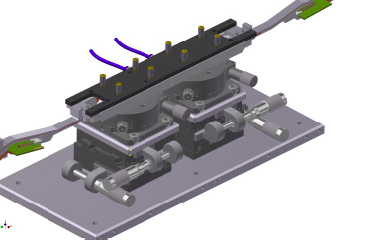
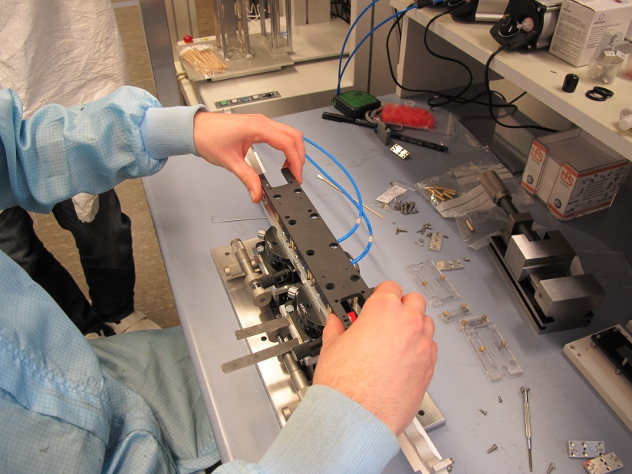
48h later….
For curing the ladder is covered and put apart
After curing ladder base jig is added

Slide 10
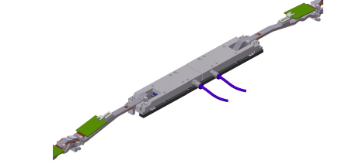
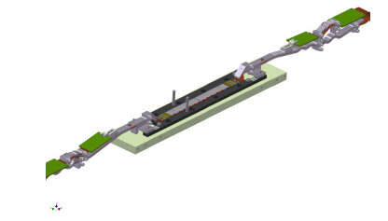
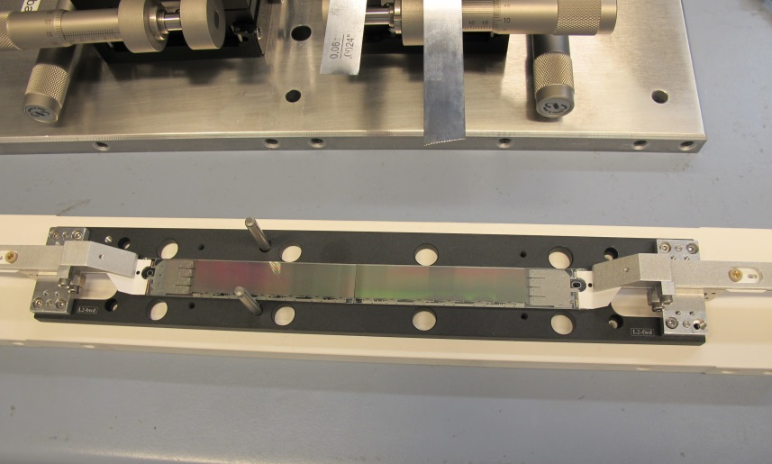
Remove vacuum jigs
Fix kapton jigs to ladder base jig
Unscrew vacuum jig
Remove ladder and turn over

Slide 11
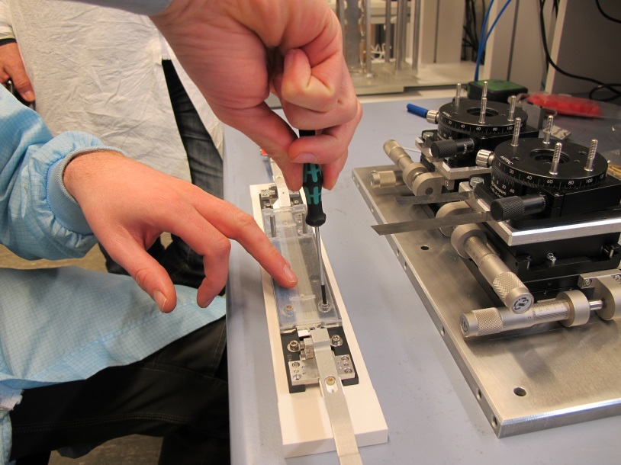
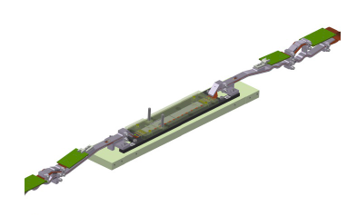
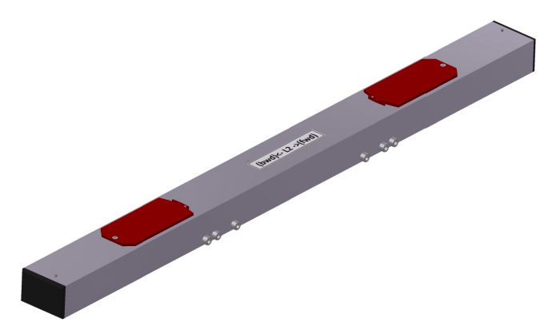
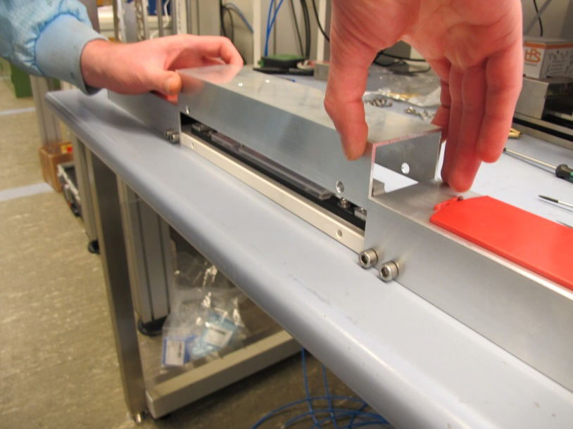
Protect and store
Add cover for sensors
Put in transport/storage box

Slide 12
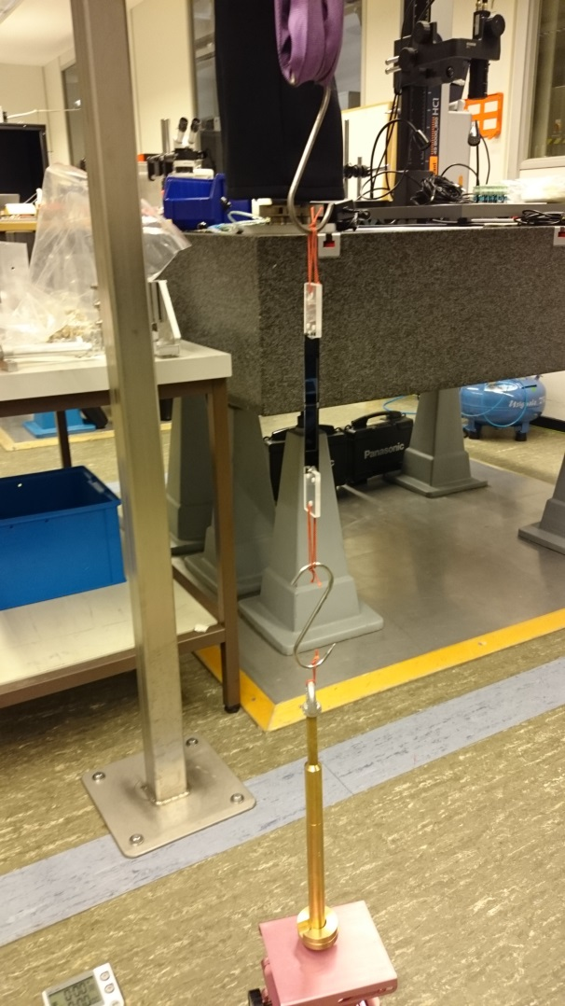
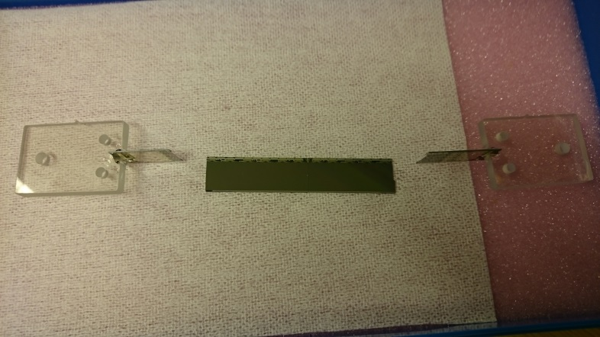
Pull Tests
Strip pattern: breaks at > 3 kg
Dot pattern weaker (~2 kg)
3 kg is considered sufficient (silicon breaks at ~3 kg)
Confirmed by pull test of dummy ladder
=> 3.9 kg =>

Slide 13
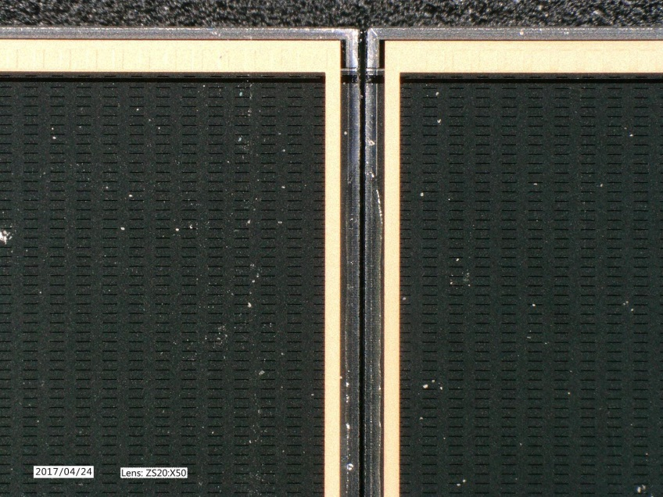
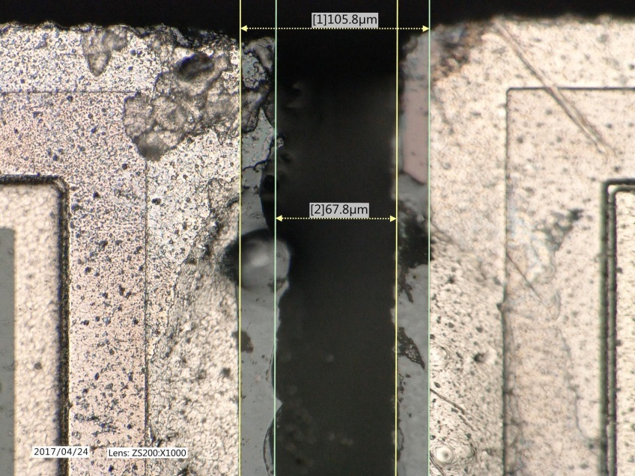
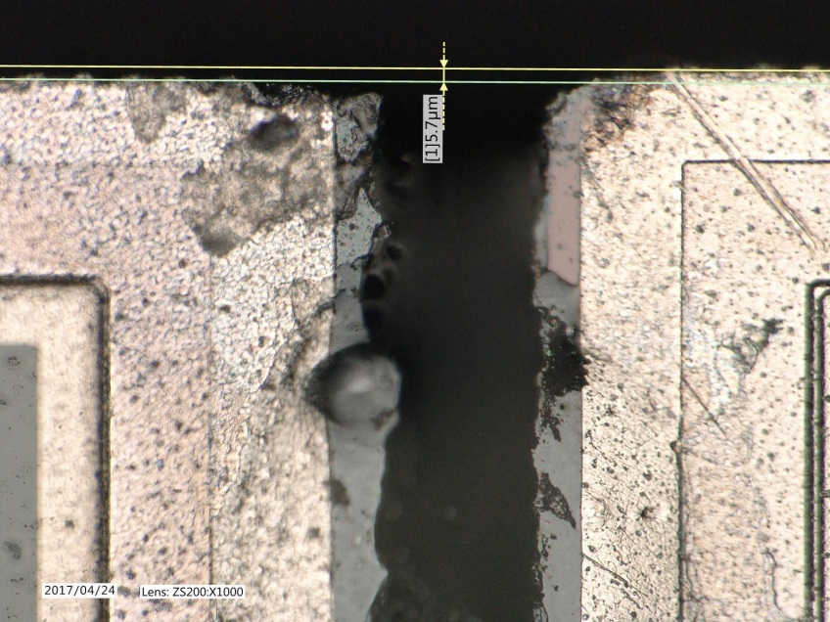
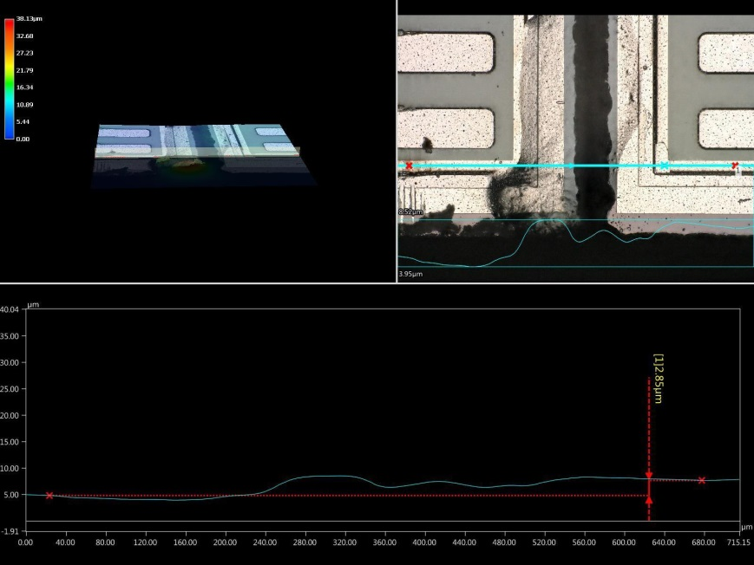
Protocol
Glue gap
Delta z
Delta x
Delta h

Slide 14
Statistics
Delta h
Glue gap
Ok after additional clamp
Will be updated with more statistics
All in µm

Slide 15
Problems
When we glued the first ladders with electrical dummies and real modules we observed
shorts in the switcher electrical lines
W37_IB / W31_IF (electrical dummy) W37_IB clear_on/off, appeared during tests
W38_IB / W40_IF (phase II ladder) W38_IB gate_on/off, immeadiatly
W01_IB / W45_IF (2nd grade) W01_IB clear_on/off, immeadiatly
All modules worked before gluing!
Suspicion: damage during gluing
Optical inspections: no obvious damage, no shorts by particles
Analyses of nature of short: inside switcher
=> exclude short on Kapton, wire bonds, balcony
=> exclude short in matrix region (e.g. clear/source)
Why only bwd? Tested W31_IF on the IB test stand => similar short observed
Conclusion (with high confidence level): not due to ladder gluing, but due to test setup
when the setup was dismounted and mounted again, the problem disapeard, seems it was a temporary fault

Slide 16
Actions
Ladder gluing stopped around KW 37
Setup:
malfunction of power supply (or PS control)
corrupted switchter sequence
(we observed that the IB DHE did load corrupted sequences)
Power supplies replaced by ones with overvoltage protection (OVP)
Switcher Sequence checked after loading (automatic startup sequence)
This took time, but is done now.
Ladder gluing can resume (after October 10, due to vacations of the operator)
Impact on schedule:
we can glue 2 ladders a week with one setup
2nd setup can be used interleaved, so ~ 4 ladders can be glued in a week
should not be the bottleneck

Slide 17
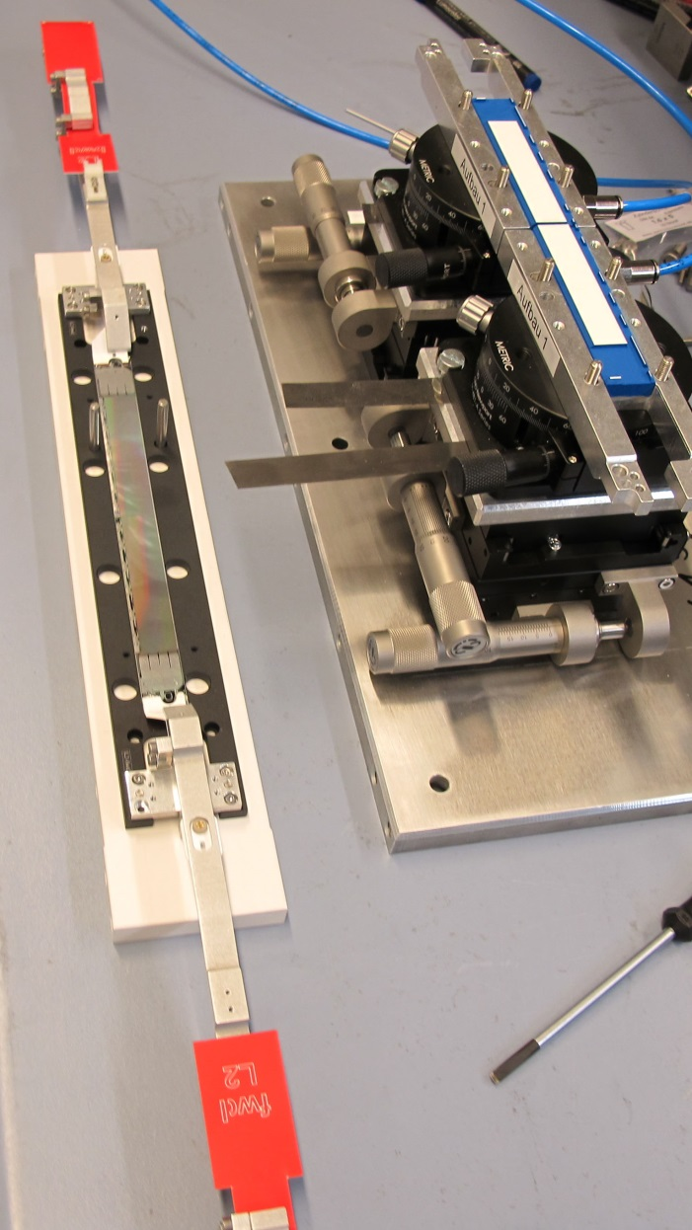
Summary
Module/Ladder assembly procedure defined.
Tooling is designed and produced.
All jigs are produced (for 80 modules & 40 ladders).
Gluing with automatic dispenser tested. Pull strength ok.
9 dummy ladders assembled
plain thinned silicon, plastic ‘kapton’
thinned silicon with copper, real kapton
Including ASIC dummies
Available: 5 outer ladders, 1 inner ladder
2 Prototype ladders produced (partially working modules)
L1_X12 (W37_IB W31_IF)
L2_X12 (W31_OB1 W30_OF1)
2 Production ladders produced
L1_001 (W38_IB W40_IF)
L1_03 (W01_IB W45_IF)
Unfortunately damaged by malfunctioning test setup

