Slide 1
PhDnet Survey 2017
Previewing the Report
16th PhD General Meeting
08.11.17
Survey Working Group – Miguel Borges

Slide 2
General information
Notes:
Use this slide to frame the presentation – it’s originally a presentation given at the General Meeting and it’s a preview look at the report out due later this year
The report goes more in-depth into some of the issues, and a lot is not present here.
There’s also more information present in the text of the report itself, information that doesn’t have a figure attached

Slide 3
Survey construction
The 2012 survey + new topics from SG
Four teams: Construct, Collect, Analyze, Report
Slack and LimeSurvey
Excel, R and a dash of MATLAB
Overleaf – LaTeX
Data protection compliance
Notes:
Use this slide to explain the execution of the survey
A team of about 10 people from the PhDnet built and ran the survey based off the 2012 survey and the new directions that the Steering Group had set
It ran from early July to mid August of 2017
The last point refers to how we made sure it followed the MPG guidelines for participation consent, anonymity and data storage
Note: unless otherwise indicated, all percentages are calculated after removing all data, for each question, for participants who indicated not wishing to answer that specific question.

Slide 4
Overview
Demographics
Working conditions
Career perspectives
Equal Opportunities
Funding
Networks
Notes:
A description of the structure of the presentation (and of the report)
Each figure slide has the figure text down here in the notes, in italic; we hope this is sufficient to explain the context and meaning of the figures.
If a figure is still unclear and your audience is really curious about it, e-mail Miguel Borges (miguel.borges@mpi.nl) or Rafael Laso Perez (rlperez@mpi-bremen.de), and we will try to find the answer.

Slide 5
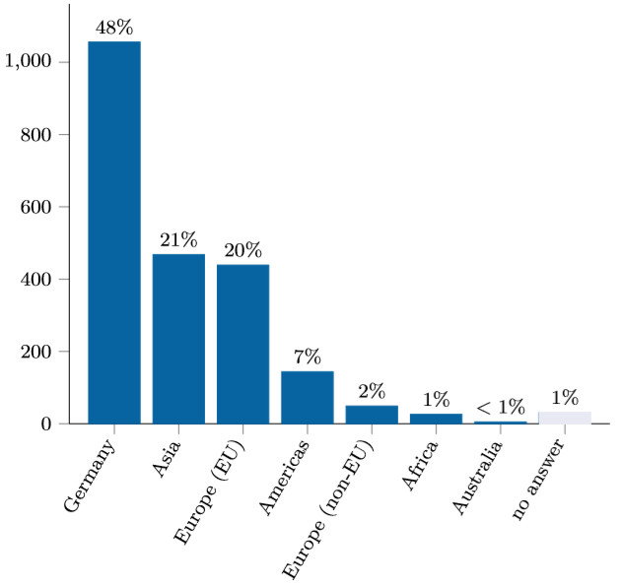
1. Demographics – Nationality
2218 DRs in total, out of 4500
2012: 60% German
Notes:
““What is your nationality? Should you have multiple nationalities, please select the one you feel best represents you.'' Responses of non-German researchers grouped by continent, and EU membership where applicable. Y-axis show number of answers.”
We had 2218 respondents in this survey. Not all answered every question, since virtually all gave the option to decline answering. In 2012, the survey had about 1800 respondents.
Although this seems to be a significant increase, we were not able to find an accurate estimate of the total number of Doctoral Researchers in 2012.
48% are German, down from 60% in 2012, with most of the difference made up by Doctoral Researchers from Asian countries and European EU countries.

Slide 6
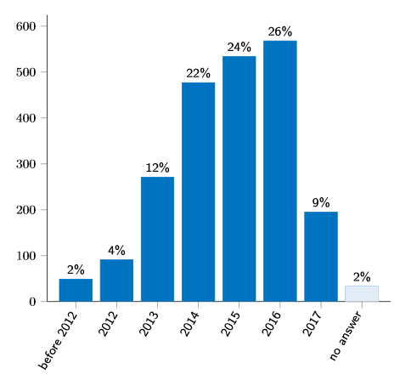
1. Demographics – Gender identity
Notes:
“When did you start your doctoral research?'' Y-axis shows the number of answers.”
This figure suggests that most of the sample of Doctoral Researchers responding to the survey were in the first, second or third years of their PhD.
This is not unexpected, since Doctoral Researchers in their 4th year and above are likely to be busier with write-up and concluding their project.

Slide 7
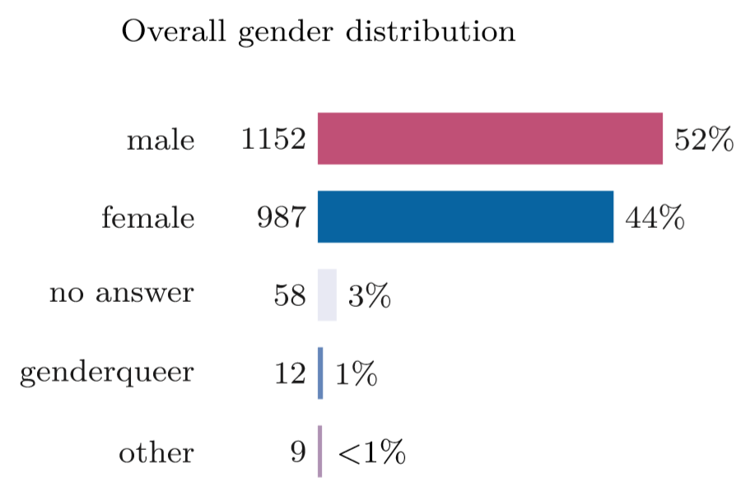
1. Demographics – Gender identity
Notes:
”To which gender identity do you most identify?'' Top: all responses; Middle: responses grouped by section; Bottom: number of total responses per section.”
Looking at this per section, BM is balanced while CPT maintains the 2 to 1 imbalance also reported in 2012 suggesting little progress over the past 5 years.
On top of this, HS was pretty balanced in 2012, and now seems to have developed a nearly 2 to 1 ratio as well (about 900 responses came from BM and CPT each, HS only had approximately 300 respondents in the survey)
Brief note on non-binary/genderqueer: this percentage is roughly in line with UK and US studies into the percentage of non-binary and trans people in society.
I mention this because, due to the relatively low number we didn’t feel confident in the statistical validity of singling out this group as a third pillar of all gender identity splits we do later. But this much is clear: non-binary people are part of the Society.

Slide 8
Overview
Demographics
Working conditions
Career perspectives
Equal Opportunities
Funding
Networks

Slide 9
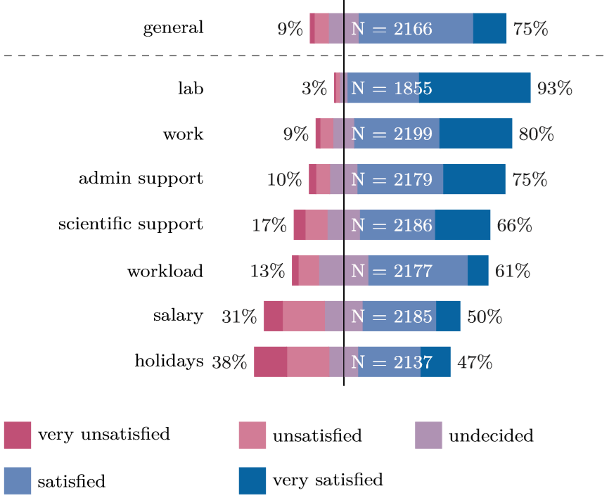
2. Working conditions – Overall satisfaction
Notes:
“Please rate your overall satisfaction with the following aspects of your PhD''. The black line indicates a reference point of neutral satisfaction (“undecided''); the ratio of responses stating “unsatisfied'' and “very unsatisfied'', or “satisfied'' and “very satisfied'' is given by the percentages on either side of the bar.”
General = General satisfaction
Lab = Satisfaction with lab equipment
Work = Satisfaction with work environment
Admin and scientific support = Satisfaction with administrative and scientific support
The rest of the items are self-explanatory
Salary and Holidays/vacation days are the main elements of dissatisfaction

Slide 10
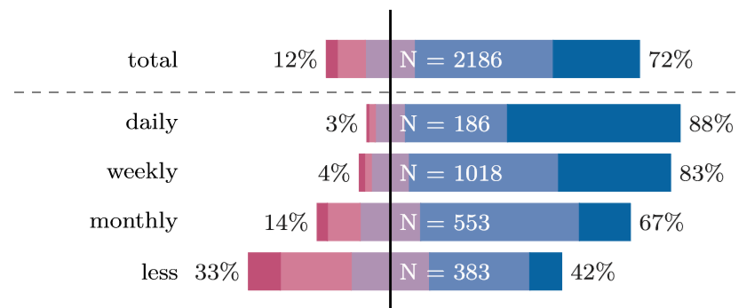
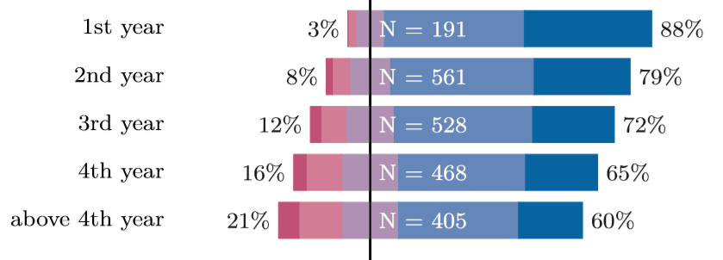
2. Working conditions – Supervision satisfaction
Notes:
“Please rate your overall satisfaction with your PhD supervision''
Responses grouped by: frequency of meeting with supervisor (daily to less than once a month) and year of PhD”
The less frequent the meetings, and the later the year, the more likely participants are to be dissatisfied with supervision

Slide 11
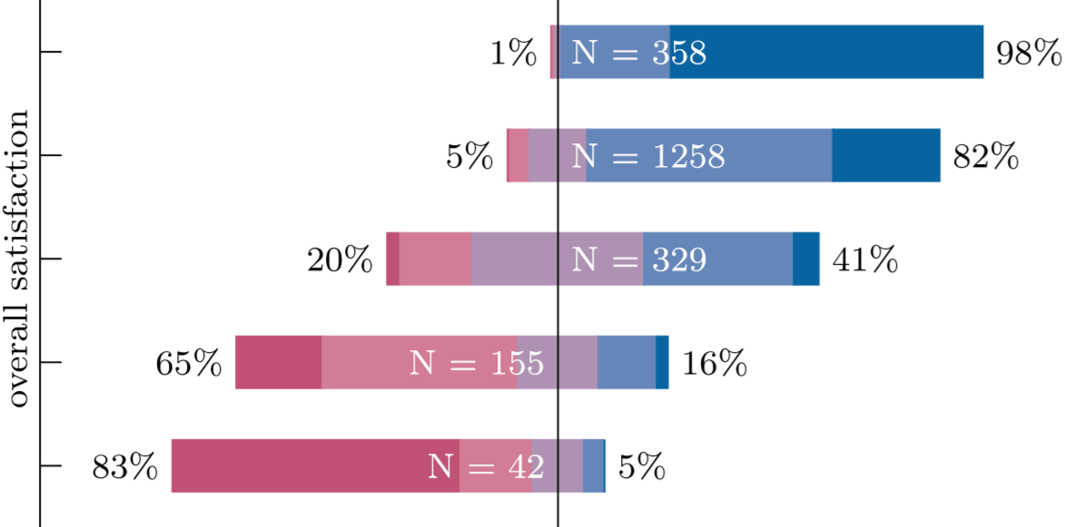
2. Working conditions– Satisfaction x Supervision
Notes:
NOTE: The rest of the figure is under white blocks. Those blocks fade away with animation to reveal each of the barplots.
“Please rate your overall satisfaction with your PhD supervision''. Responses grouped by responses for the question ``Please rate your overall satisfaction with the following aspects of your PhD: Overall satisfaction”
Y-axis, from top to bottom – Very satisfied overall to Very unsatisfied overall
X-axis (and color coding) – Right (blue) is satisfied, Left (red) is dissatisfied
Those more satisfied with their PhD project were more likely to be satisfied with their supervision

Slide 12
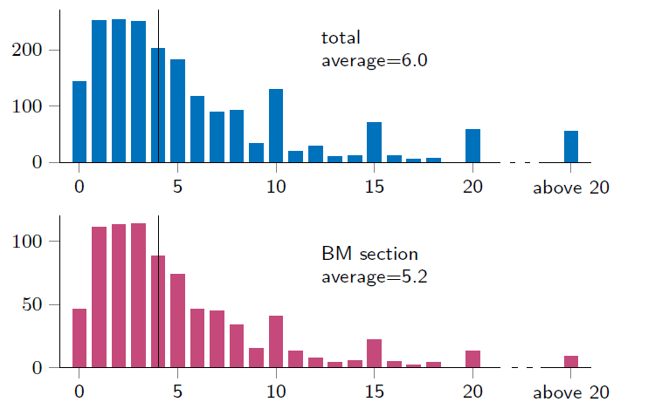
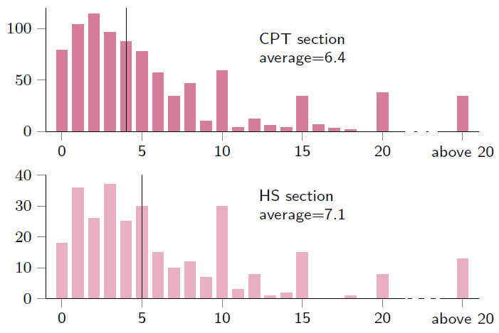
2. Working conditions – Students per supervisor
Notes:
“How many other doctoral researchers does your official supervisor have?'' It should be noted that the number reported does not include the respondents themselves. Medians are indicated by the vertical lines.”
How many students is a supervisor responsible for, on average? MPS guidelines suggest 9, PhDnet guidelines suggest 5
X axis is number of students, Y axis is DRs reporting this value
These numbers correspond to the answer to “How many OTHER DRs does your supervisor oversee?” so the real number is this plus one
Keep in mind that this is about ANY person in a supervisory position, from Directors to Post-docs

Slide 13
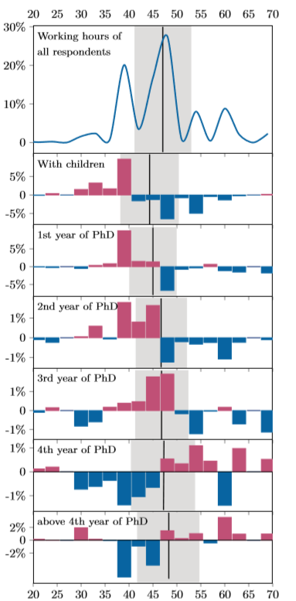
2. Working conditions – Working hours
Working hours
47 on average
With children
As the project advances in years
Notes:
“How many hours do you work per week?'' Top: total responses binned (3h) to show the overall distribution of working hours, the Y-axis reports percentage of total responses. Bar plots: each plot shows how the overall likelihood to work these hours when taking into account different aspects of a doctoral researchers studies i.e. whether they have children or which year of their doctoral studies the are in. The black line corresponds to the average working hours, the grey area shows the 1-sigma standard deviation. The top plot is a density plot for the frequency of DRs reporting a certain number of working hours. “

Slide 14
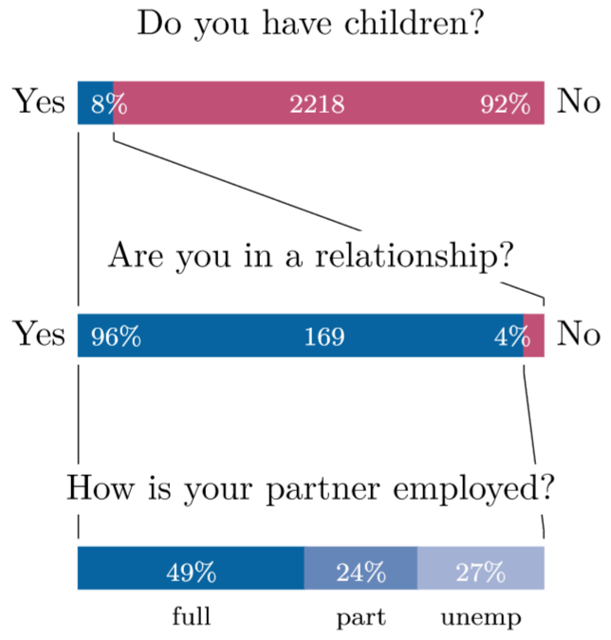
2. Working conditions – Parenthood
Notes:
“Do you have children or are you currently expecting at the moment?'', “Are you in a relationship?'', “What is your partner’s employment status?”

Slide 15
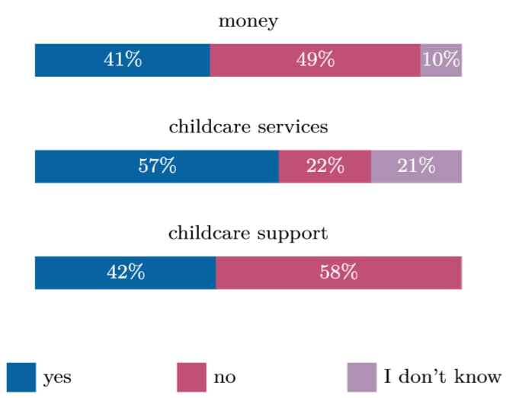
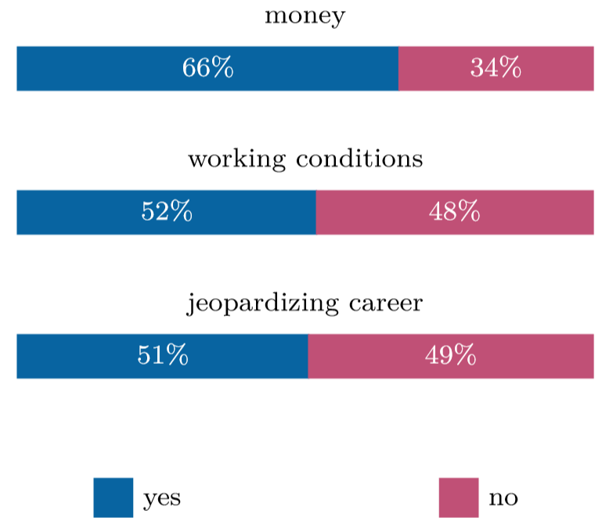
2. Working conditions – Parenthood
Notes:
Left: Do you feel like having enough money to raise a child in your city?'', ``Does your institute offer support in childcare services?'', ``Do you feel there is sufficient support (financial and organizational) from your institute for raising a child?'' These questions were only asked to DRs who indicated being parents.
Right: For those that responded Yes to “Would you like to have children but feel it is not the right time in your career?'‘, we asked “Why?”

Slide 16
2. Working conditions – Comments
“I've seen my professor once a year for the better part of my PhD time. My assigned supervisor is motivated but lacks the necessary knowledge to fully support me.”
“I really appreciate [my professor's] introduction and discussion at a PhD conference for young researchers at [my institute]. [My professor] really pointed out the strength of my presentation and made a very kind introduction.”
“I can't say anything, my formal supervisor has thousands of ways to delay my PhD...”
“I felt like I was expected to deliver results right from day one.”
Notes:
These are comments that Doctoral Researchers responding to the survey have left for certain questions in this section. They have only been edited for length or to remove identifiable information.

Slide 17
2. Working conditions – Comments
“Maternity leave does not entitle an extension to the contract, so all women in the institute are basically required to choose between finishing their PhDs or having children”
“Working 60 hour/week, including weekends makes it hardly possible to plan a family.”
“I believe that having contact with other doctoral researchers that need to deal with equally restricted conditions due to maternity [...] in their PhD could help.”
“Frequent comments on how much my parental leave costs the project, and how my absence is bad for the project (without acknowledging how much I worked for free for the project, and how many extra hours I have put in previously, as I am paid 60\%).”
Notes:
These are comments that Doctoral Researchers responding to the survey have left for certain questions in this section. They have only been edited for length or to remove identifiable information.

Slide 18
Overview
Demographics
Working conditions
Career perspectives
Equal Opportunities
Funding
Networks
Notes:
Now lets move on to the topic of the doctoral researcher’s career perspectives

Slide 19
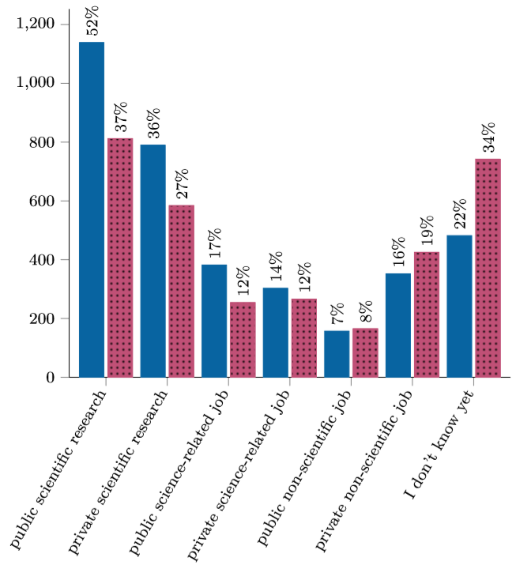
3. Careers – Hopes and plans
Notes:
“”Where would you like to work in the future (next 10 years)?'', and “Where do you think you will work in the future (next 10 years)?'' (dotted)”.
Blue corresponds to where DRs would like to work in the future, red corresponds to where they think they will work.
Public scientific research still seems to be the most attractive, with few wanting a public non scientific job.
However, DRs are generally not very confident they’ll be doing what they planned.

Slide 20
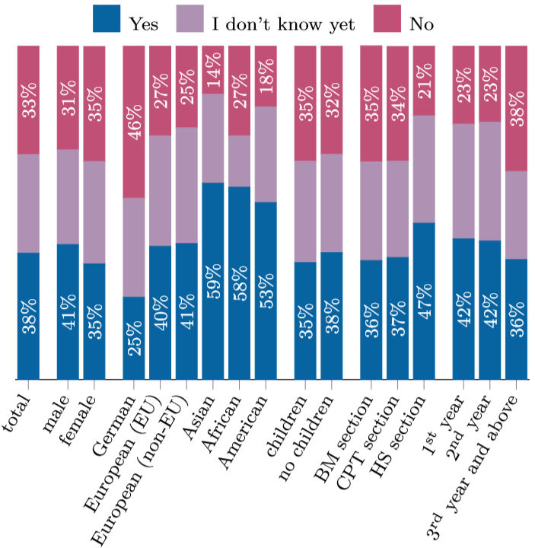
3. Careers - Academia
Notes:
“Do you intend to pursue a career in academia (aspiring to a professorship or other permanent research position) after finishing your doctoral research?'' Percentage of total responses grouped by gender, nationality, section and parenthood.”
German DRs are the least likely to want to pursue an academic career.
DRs coming from outside of Europe, and those from the HS section are more likely to want to pursue an academic career.
Once DRs reach the 3rd year of their project, many more are clear about not wanting to pursue an academic career.

Slide 21
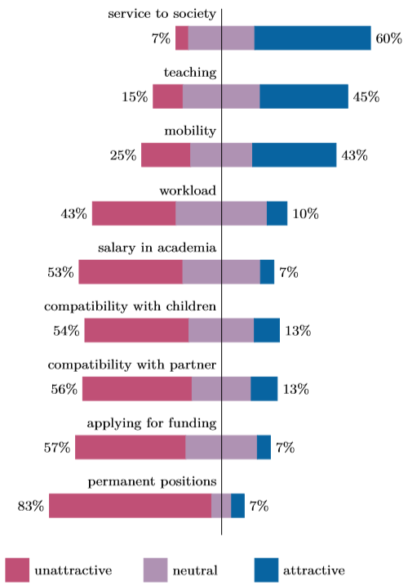
3. Careers – Academia
Notes:
How do you judge the following aspects of an academic research career?
DRs are worried about funding, compatibility with having a partner and the lack of permanent positions.
DRs find teaching and the possibility of being of service to society attractive

Slide 22
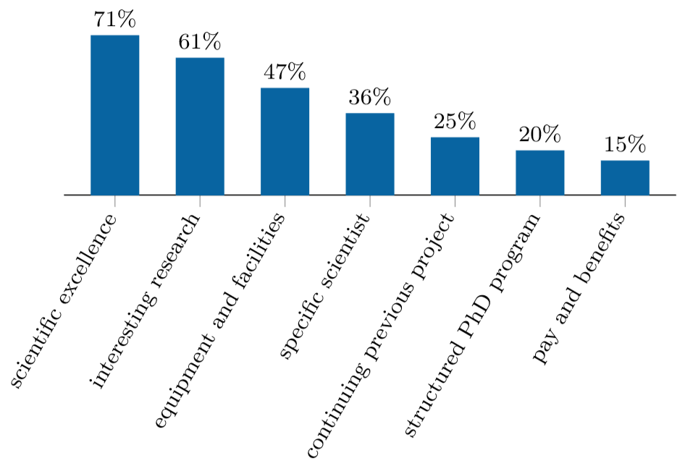
3. Careers – Why join the MPS?
Notes:
“Why did you start your work on your doctoral thesis at the Max Planck Society?'' Percentage of total responses. Multiple answers possible.
71% joined for the reputation for scientific excellence, 61% joined due to interesting and novel research being done at their Institute
Maintaining these two standards is the key to attracting DRs

Slide 23
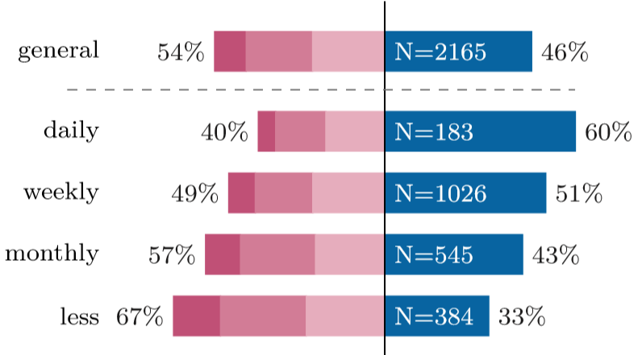
3. Careers – Would you quit?
Notes:
Have you ever thought about giving up your PhD?'' Responses grouped by frequency of supervisor meetings.
Like before, the full figure is covered and revealed by advancing the animation.
Here, blue = “Never”, and the red from light to dark is rarely to often.

Slide 24
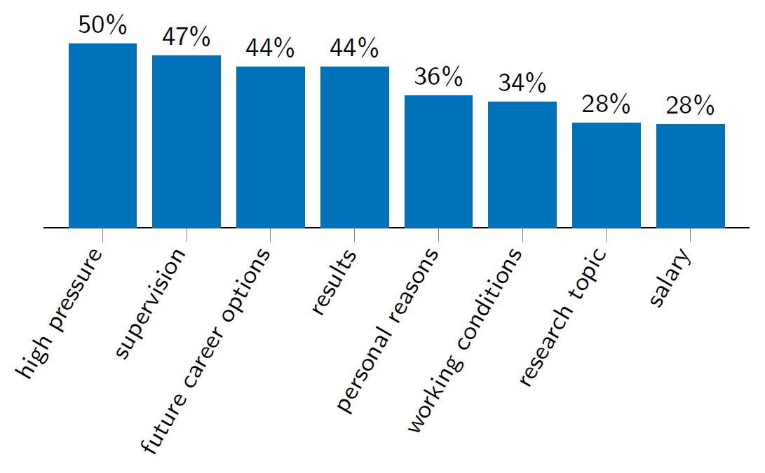
3. Careers – Would you quit?
Notes:
“Why did you think about giving up your PhD?'' Responses from participants who indicated that they think about quitting their doctoral research “occasionally'' or “often'' (N=669). Multiple answers possible.”

Slide 25
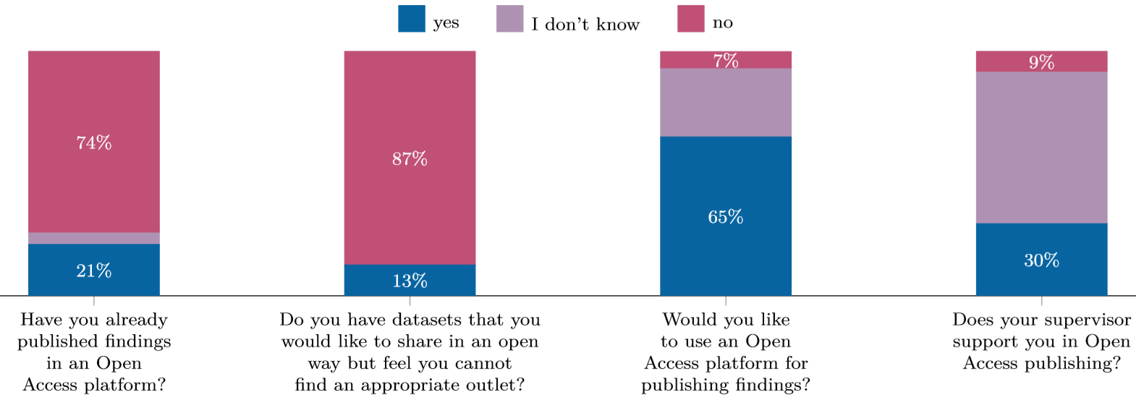
3. Careers – Open Access
Notes:
“Responses concerning Open Access publishing represented as percentage of total responses. Full questions on x-axis.”
Most DRs haven’t published in Open Access platform, but also don’t have datasets they would be able to share.
The lack of supervisor support compared to DR interest suggests that supervisors are not incentivizing or enabling DRs to publish in Open Access platforms

Slide 26
Overview
Demographics
Working conditions
Career perspectives
Equal Opportunities
Funding
Networks

Slide 27
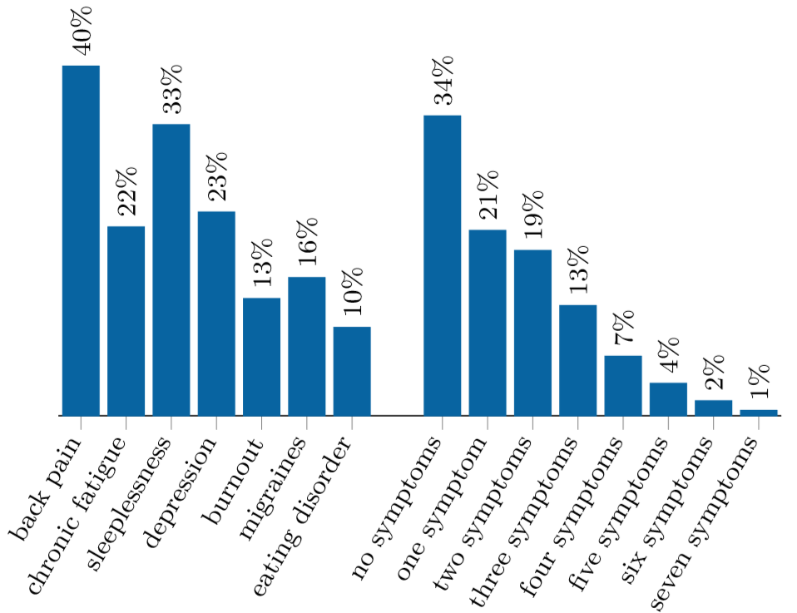
4. Equal Opportunities – Stress and mental health
Mental health diagnosis
About 6% report having been diagnosed with a mental health issue (4.7% + 1.3% who only said so in comments)
Notes:
During your doctoral research, have you had health problems with any of the following conditions?''. Multiple answers possible. Also included are percentages of respondents giving multiple affirmative answers to symptoms listed.
Mental health issues are often undiagnosed, but still 6% report NEW diagnoses
Following in the 2012 survey’s footsteps we asked for self-reports of symptoms considered indicators of high stress.
Depression is here, which we kept only for continuation form 2012, however the Survey team isn’t very confident on whether to keep this item in the future or not.
In 2012, roughly same number reported at least 1 symptom, but reports of 3 or more have increased by comparison.

Slide 28
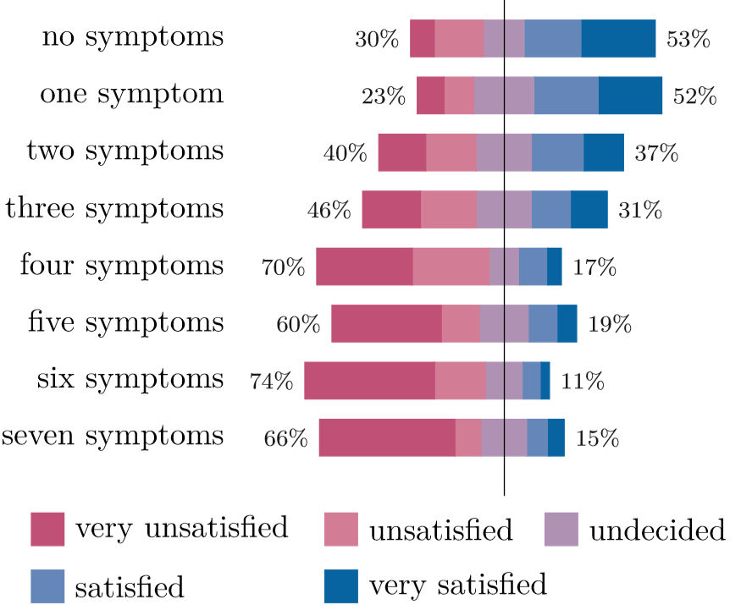
4. Equal Opportunities – Stress and mental health
Notes:
“”During your doctoral research, have you had health problems with any of the following conditions?'' Responses grouped by answer to ``Please rate your overall satisfaction with your PhD supervision'‘”

Slide 29
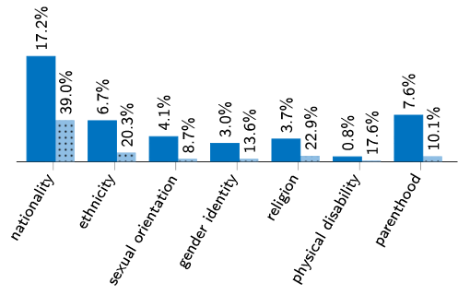
4. Equal Opportunities – Discrimination
Note: the height and percentage value over the red bars uses relative and not absolute values (e.g.: 39% of the 17.2% who identify as part of a minority for nationality have felt discriminated against.
Notes:
“”Do you identify as part of a minority group based on the following grounds?'‘, in blue as a total percentage of respondents and “Have you ever felt discriminated against during your work at the Max Planck Society on the basis of:” in red, as total percentage of those who report identifying as part of respective minority. Multiple answers possible.”

Slide 30
4. Equal Opportunities – Comments
“My supervisor frequently makes inappropriate remarks resulting from lab members being women/mothers. I think he is often unaware of the effect of his remarks, but they are none the less insulting.”
“[...] often I am part of meetings where I am the only woman, and in those cases often the others do not address me personally when they have questions about my research, but address others from my group (e.g. an engineer) who clearly do not know much about my research.”
“The amount of female-only opportunities is probably right regarding gender equality in science, but sometimes it doesn’t feel fair.”
Notes:
These are comments that Doctoral Researchers responding to the survey have left for certain questions in this section. They have only been edited for length or to remove identifiable information.
Additionally, there were frequent comments expressing frustration with the EO officer elections: complaints about not representing those who identify as male, complaints about excluding LGBT researchers or researchers with disabilities who happen to not identify as female
There were also additional comments about mental health issues and a disappointment that finding help isn’t facilitated by the institutes, especially for non-german researchers

Slide 31
4. Equal Opportunities – Comments
“I have experienced that Germans treat other Germans or those who speak German better, and I felt they guess my ethnicity from the color of my skin.”
“I was assaulted based on my nationality by my formal supervisor, even racist comments about my parents, but since I need to finish the PhD I never reported it to HR. I hope one day I can.”
“Many scientists at our institute are atheists and some of them at least imply that being religious is stupid and goes against science.”
“People make fun of what I eat and what I cook. When there is an official party (e.g. department barbecue) a vegetarian option is not even considered.”
“Thank you for caring.”
Notes:
These are comments that Doctoral Researchers responding to the survey have left for certain questions in this section. They have only been edited for length or to remove identifiable information.
Additionally, there were frequent comments expressing frustration with the EO officer elections: complaints about not representing those who identify as male, complaints about excluding LGBT researchers or researchers with disabilities who happen to not identify as female
There were also additional comments about mental health issues and a disappointment that finding help isn’t facilitated by the institutes, especially for non-german researchers

Slide 32
Overview
Demographics
Working conditions
Career perspectives
Equal Opportunities
Funding
Networks

Slide 33
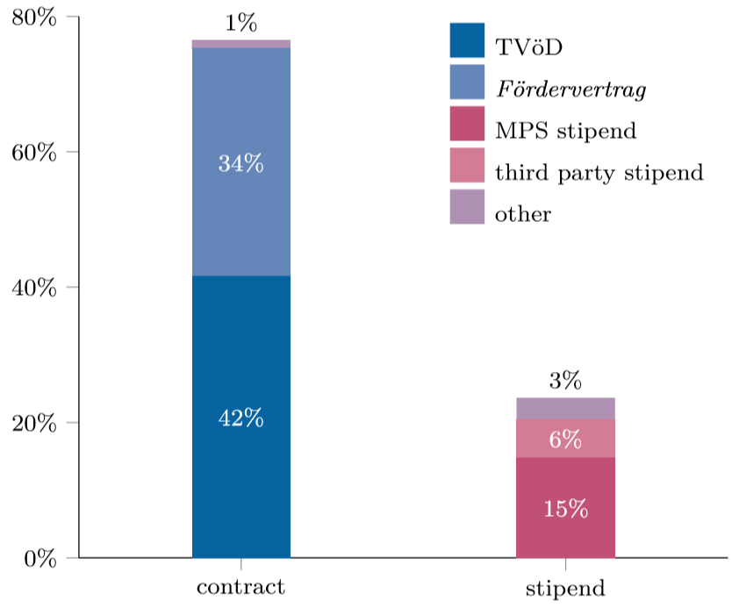
5. Funding – Contracts and stipends
Notes:
“How is your doctoral research financed?”
Most DRs are now on contracts but a high percentage report not knowing. There are also clashes between reported contract type and number of holidays.
This suggests a deeper issue: institutes are not doing enough to inform DRs about the type of contract they have. While not necessarily a problem, pragmatically speaking, it might open some DRs to being exploited if they don’t know what their contract requires them to do.

Slide 34
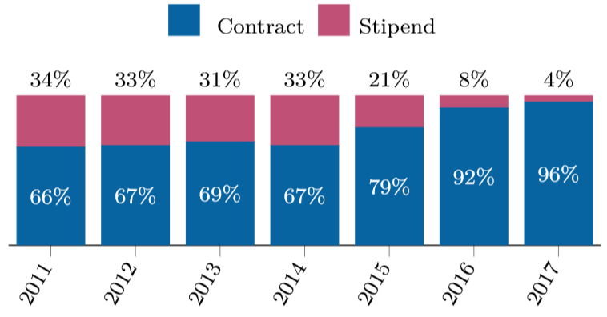
5. Funding – Contracts and stipends
Notes:
“”How is your doctoral research financed?'' Responses grouped by start year. Responses from students starting before 2011 were excluded from this analysis due to insufficient data. Responses stating “I don't want to answer this question'' or “I don't know” were excluded for this analysis.”
Looking now exclusively at those who do indicate knowing what their contractual status is, responses suggest good progress on contract intake.

Slide 35
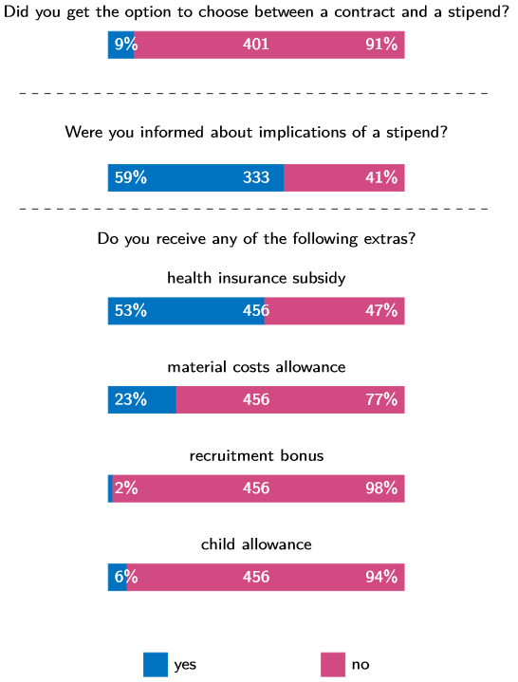
5. Funding – Contracts and stipends
Notes:
“Details about stipends, looking only at respondents who report being on a stipend. Full question text for Top and Bottom plots included in the figure, Middle: “Have you been informed about your options concerning health insurances (i.e. difference between public and private health insurance, contractual limitations) and other implications of the stipend (pension, work obligations) before accepting it?“. The answers for the second question were "Fully Informed" (7) and "Partially Informed" (191) are only shown as "Yes“ for visualization purposes.”

Slide 36
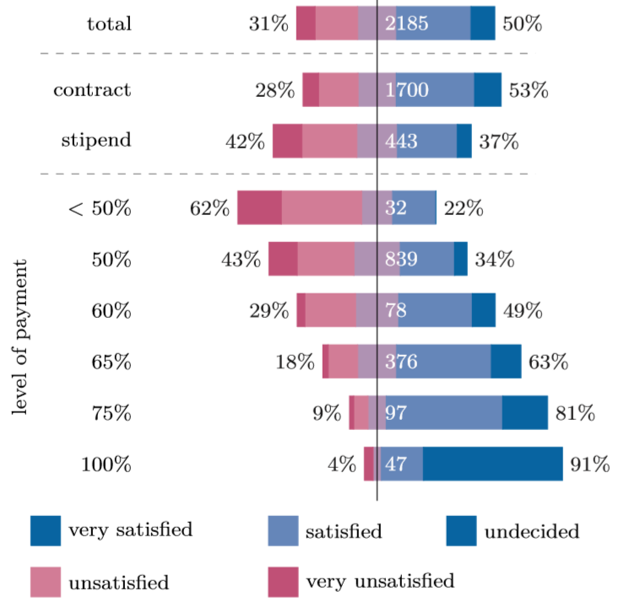
5. Funding – Contracts and stipends
Notes:
“Please rate your overall satisfaction with the following aspects of your PhD: Salary and benefits.'' Top: total salary satisfaction; Middle: salary satisfaction vs funding method; Bottom: salary satisfaction vs level of payment according to TVöD (only shown for levels with upwards of 30 respondents.)”

Slide 37
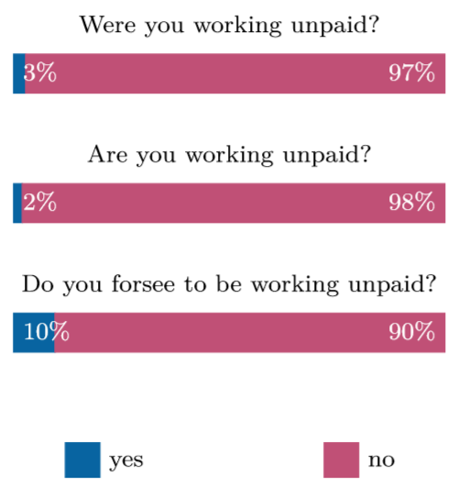
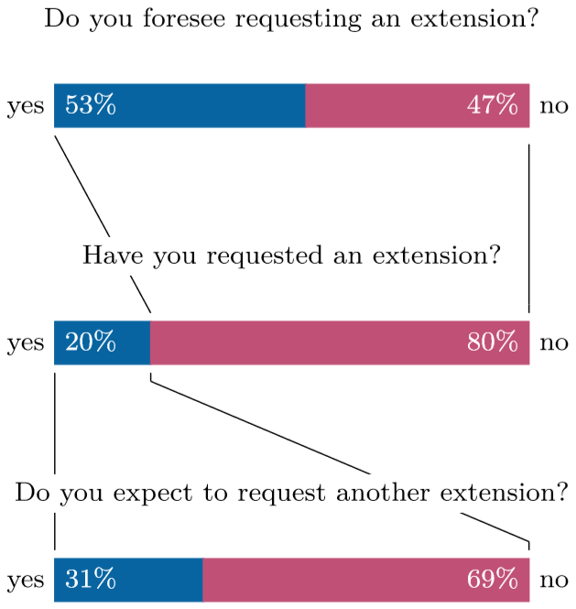
5. Funding – Extensions
Notes:
Left: “Are you, were you or do you foresee to be, working unpaid for your doctoral research?”
Right: “Extension of Funding. Full questions presented in the figure.”

Slide 38
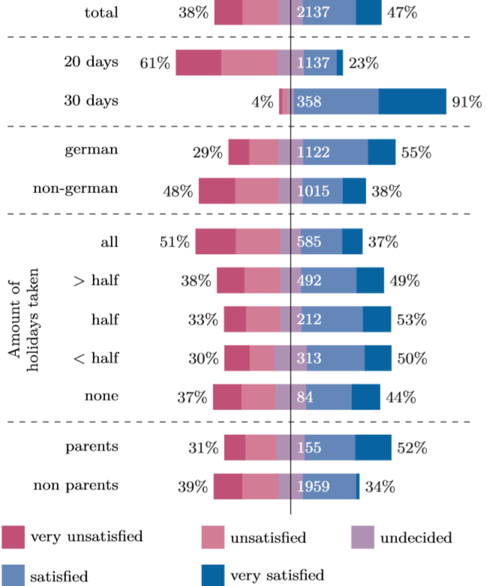
5. Funding – Holidays
Notes:
“”How satisfied are you with your holidays?'' Responses presented taking into account various aspects of a researchers life: satisfaction based on contractually available holidays, German vs non-German nationality, percentage of holidays taken and parenthood.”
Most of the DRs not satisfied with their holidays have 20 days of holidays, and non-Germans were more likely to not be satisfied with their holidays than Germans

Slide 39
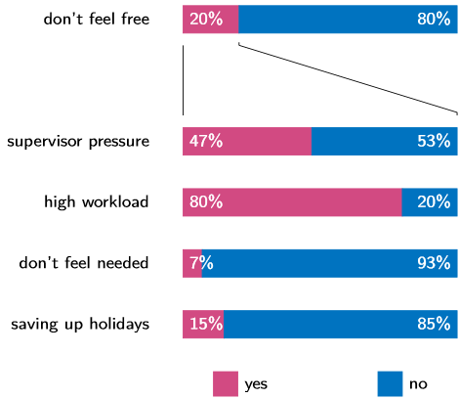
5. Funding – Holidays
Notes:
“”Why do you not feel free to take all holidays available to you?'' Multiple answers possible.”
Top plot: Affirmative responses to the statement “I don’t feel free to take all holidays available to me”
Other plot: responses to each of the 4 presented potential reasons

Slide 40
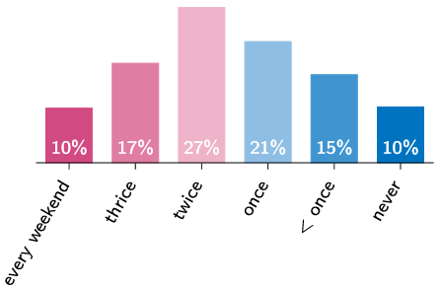
5. Funding – Weekends
Notes:
“How often do you work on weekends?”
Options were “Every weekend”, “Three weekends per month”, “Two weekends per month”, “One weekend per month”, “Less often than one weekend a month”, “Never.

Slide 41
5. Funding – Comments
“This is mainly in regards to who gets contracts vs stipends at the institute. Foreigners always get stipends.”
“We have a contract inequality issue where some people get 30 days of holidays but others only 20. I am on a 20 day contract and with the amount of energy I feel I need to invest when I'm at work I feel I need to take more holidays to be productive and sane.”
“Please try to increase the amount of holidays for those who have only 20 days! That's not enough, especially for those students whose home town is far away! Thanks!”
“In past few years inflation has been rising but the amount of money in stipends remains the same. MPS is now providing contracts for newcomers but there is no talk about the misery of stipend holders. “
Notes:
These are comments that Doctoral Researchers responding to the survey have left for certain questions in this section. They have only been edited for length or to remove identifiable information.

Slide 42
5. Funding – Comments
“I have been shocked to learn that my salary is much lower than that of my German colleagues. [My city] is an exceedingly expensive city, and I have only been able to stay in this position on account of the institute's travel support and my mother, who gives me [extra financial support]”
“When asking for a contract instead of a stipend I was told that ‘not even Germans get a contract’”
“The MPG is an awesome place to conduct research and to study. I feel privileged to be here to study. The work environment, especially the atmosphere between fellow researchers is outstanding. That being said, financially the situation is borderline for someone who has to support a family. The main contributing hardship factors are the high rent level in the general area and related long commutes.”
Notes:
These are comments that Doctoral Researchers responding to the survey have left for certain questions in this section. They have only been edited for length or to remove identifiable information.

Slide 43
Overview
Demographics
Working conditions
Career perspectives
Equal Opportunities
Funding
Networks

Slide 44
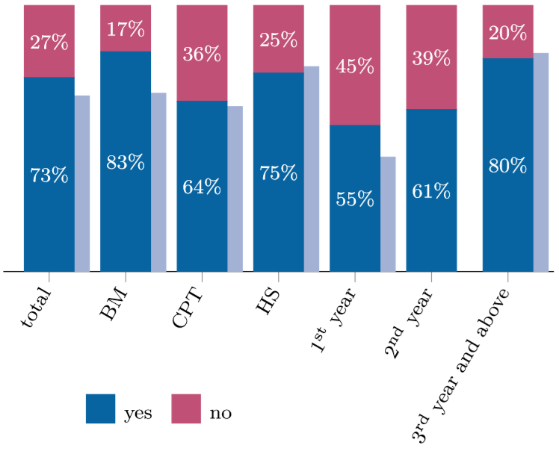
6. Networks – PhDnet
Notes:
“”Do you know about PhDnet?'' Responses grouped by section as well as years since beginning the doctoral research. Results are compared to those given in the 2009 report for 1st year doctoral researchers and 4th year researchers, respectively.”
The light blue bar indicate those who answered Yes in 2009. No data was available apart from 1st and 4th year DRs in 2009.

Slide 45
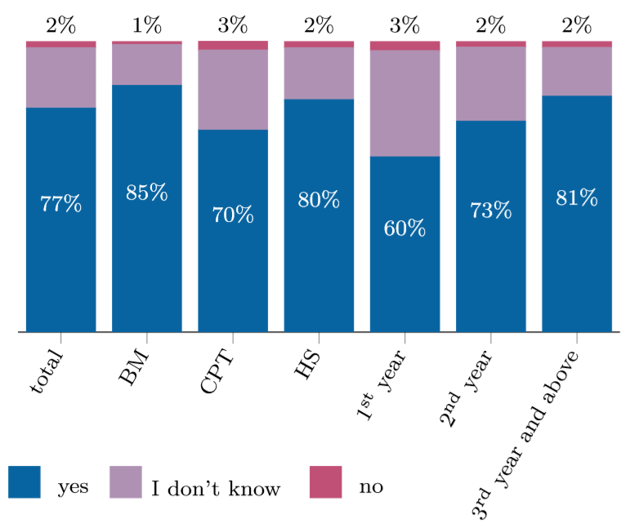
6. Networks – External reps
Notes:
“Does your institute have an External PhD representative?”

Slide 46
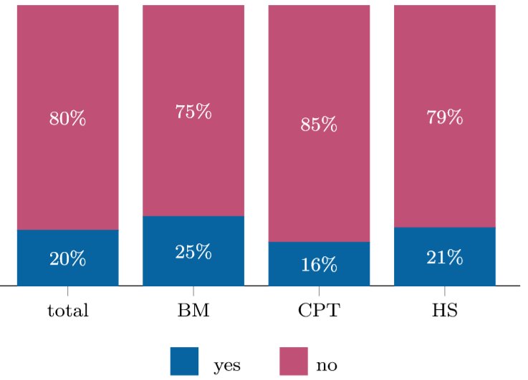
6. Networks – MPAA
Notes:
““Do you know about the Max Planck Alumni Association?'' Responses grouped by section.”

Slide 47
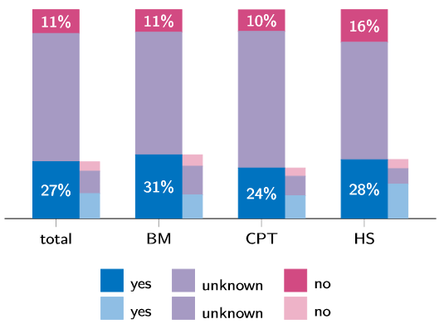
6. Networks – Local alumni networks
Notes:
“”Does your institute have an alumni network? If yes, has your alumni association organized any kind of event in your institute in the past year?'' Responses grouped by section.”
The smaller bars look into whether, for those DRs that reported a local alumni association, this association has setup an event in the past year.

Slide 48
Wrapping up
The well-being of doctoral researchers – better science, more happiness
Satisfied with their work, dissatisfied with work/life balance, stress, salary, benefits
A reliable switch to contracts
Low spirits regarding career prospects
Improving supervision – probable gains
Wide variability across institutes and across sections
What a top-level survey like this misses are the real cases of distress, especially since DRs at a later point in their project were less likely to reply
Notes:
The well-being of doctoral researchers is the key to innovative and impactful science and, most importantly, to their happiness
Researchers are satisfied with their work, but report issues with work/life balance, stress, salary and benefits.
Several MPG DRs worry about their career.
Focusing on improving the frequency of supervision, where appropriate, might have a big impact on satisfaction.
What a top-level survey like this misses are the real cases of distress, especially since DRs at a later point in their project were less likely to reply

Slide 49
Wrapping up
Special thanks to:
The Steering Group, Rafael in particular for his relentless support
The members of the Survey working group
Daniel Herde, from the 2012 Survey group
Ilka Schiessler Gäbler from GA
Every single one of the 2218 doctoral researchers who responded – you!

Slide 50
Wrapping up
The 2017 Survey working group team is:
Anna Baun, MPI for Polymer Research – Construct, Collect
Miguel Borges, MPI for Psycholinguistics – Coordinator, Construct, Report
Alice Cezanne, MPI of Molecular Cell Biology & Genetics – Collect, Report
Thiane Carneiro, MPI for Dynamics of Complex Technical Systems – Collect
Amie Fairs, MPI for Psycholinguistics – Collect, Analyze, Report
Aoife Hanet, MPI for Developmental Biology – Construct, Collect
Johannes Kaub, MPI for Anatomically Resolved Dynamics – Report
Rafael Laso Pérez, MPI for Marine Microbiology– SG link
Rima Schüssler, MPI for Nuclear Physics– Construct, Collect, Report
Edgar Steiger, MPI for Molecular Genetics – Analyze, Report

Slide 51
Discussion
Thank you for your attention!

