Slide 1



Hunting GRBs and other Transients with MAGIC.
L.A. Antonelli
INAF-OAR & ASI-SSDC

Slide 2
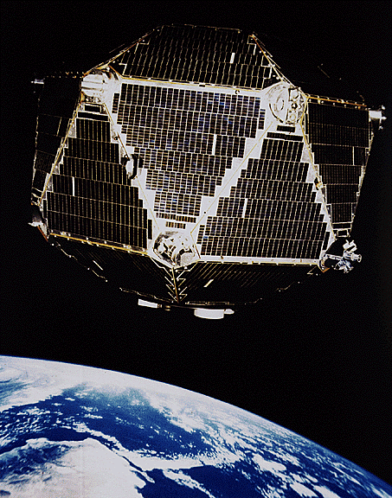
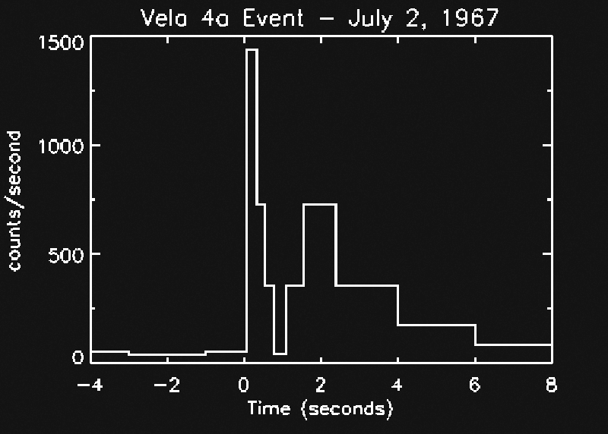
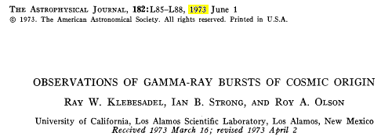
Gamma Ray Bursts

Slide 3
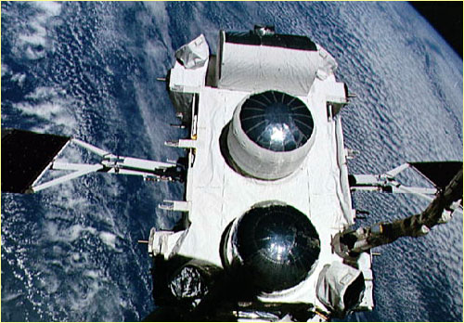
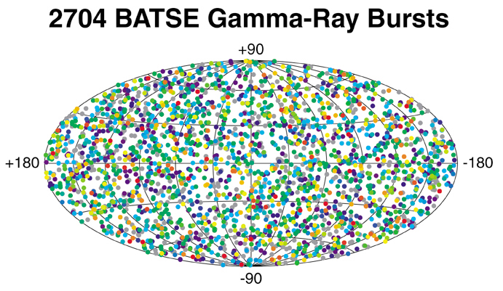
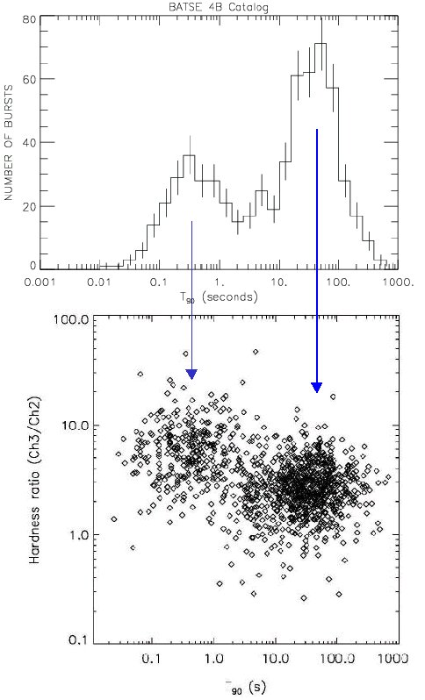
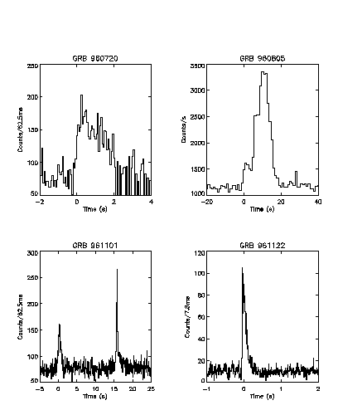
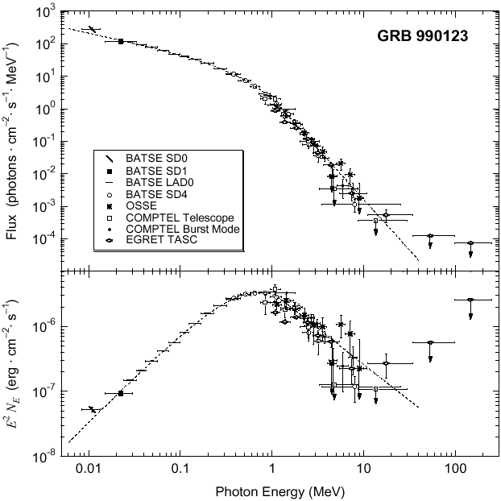
GRB: status of the art at the end of ‘90
isotropic distribution
α
_{β}
E_{p}
bimodal distribution in duration
SED described by Band law
very different LCs

Slide 4
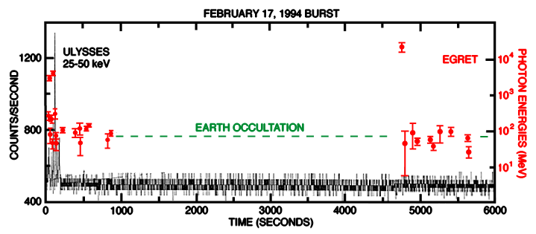
VHE Properties of GRBs
Hurley et al. 1994
A 18 GeV photon observed by EGRET 90 minutes after the start of the GRB
Evidence for second component

Slide 5
GRB & Alert Systems
BACODINE: BAtse COordinates DIstribution NEtwork
GCN: Gamma-ray Coordinates Network
GCN/TAN: GCN/Transient Astronomy Network

Slide 6
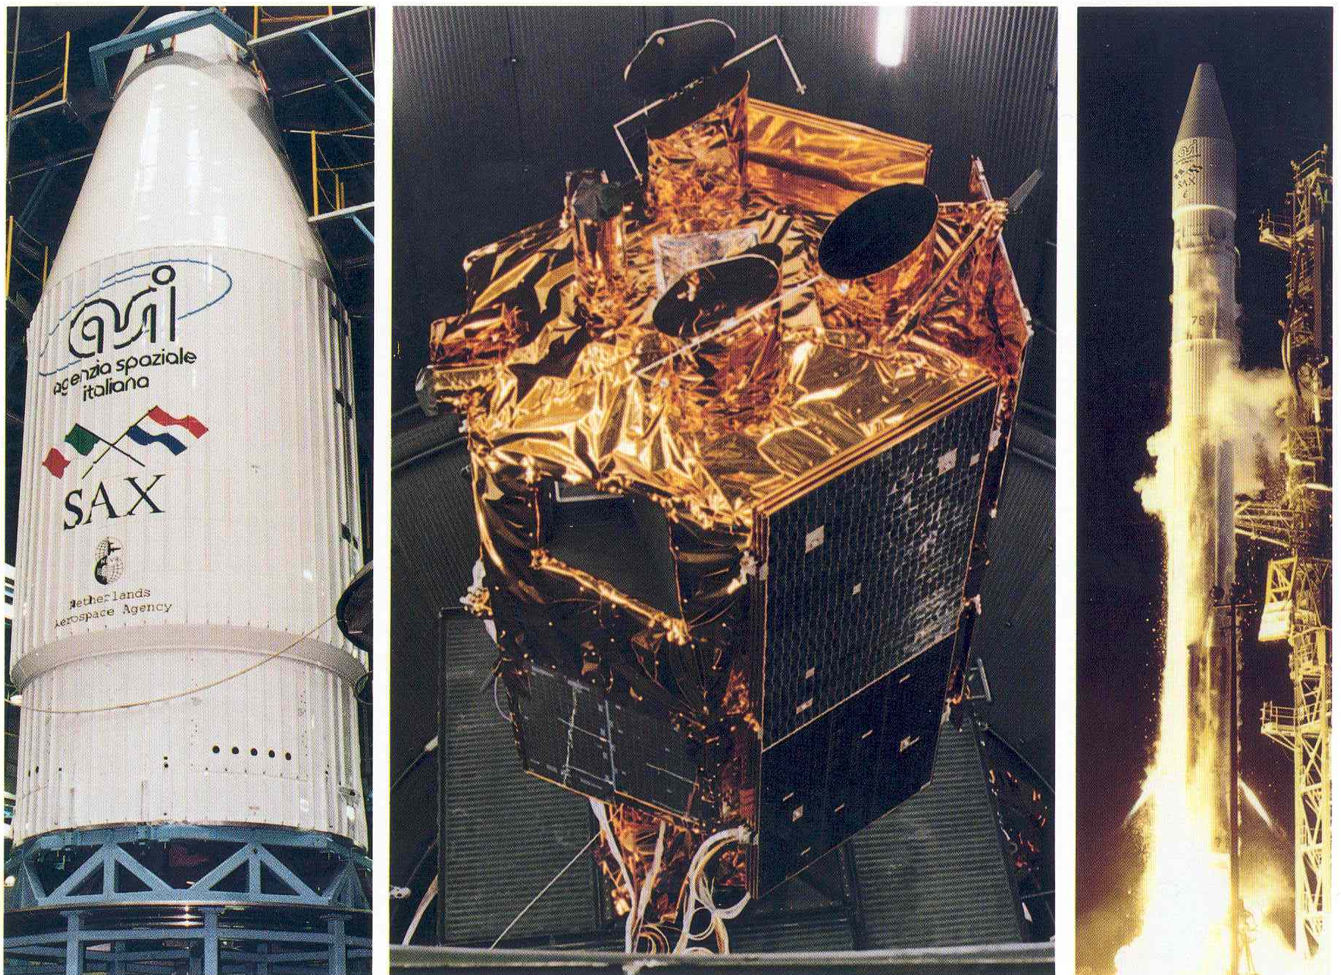
BeppoSAX and the new era for GRBs
Italian-Dutch Satellite for X-ray Astronomy:
Launched: on April 30, 1996
Switched-off: on April 30, 2002,
De-orbited: on April 30, 2003
First and last observation of a GRB on July 20, 1996 and on April 30, 2002
Many instruments working at different energies and with different field-of-view: a sort of “Christmas Tree” (cit.)

Slide 7
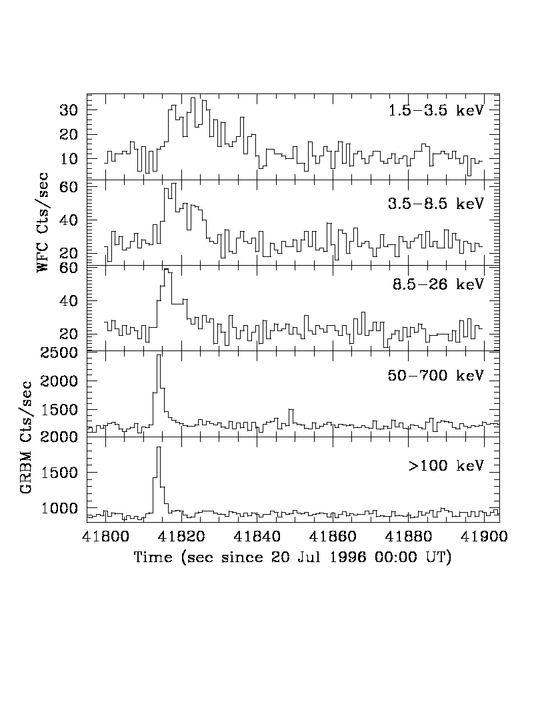
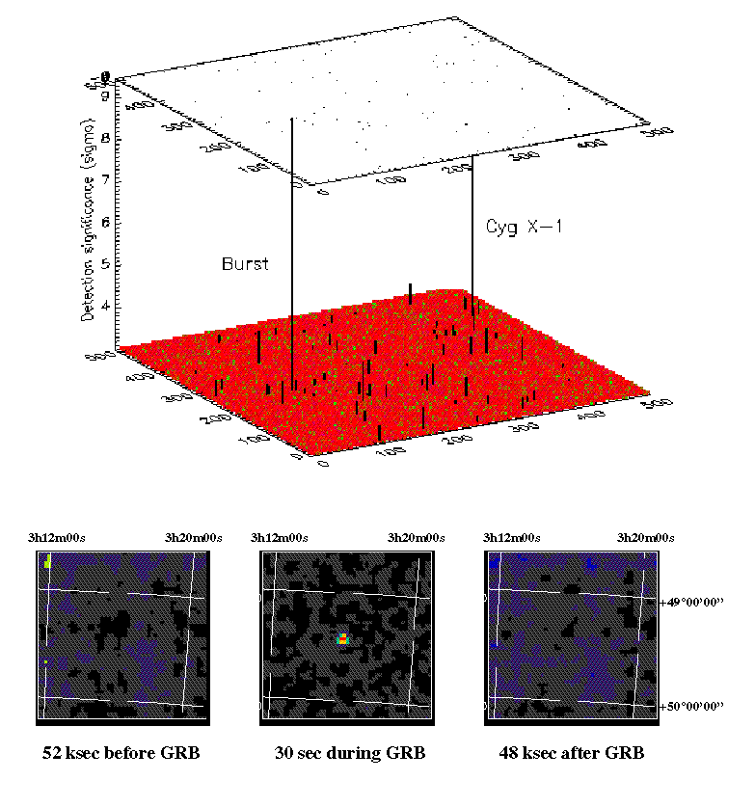
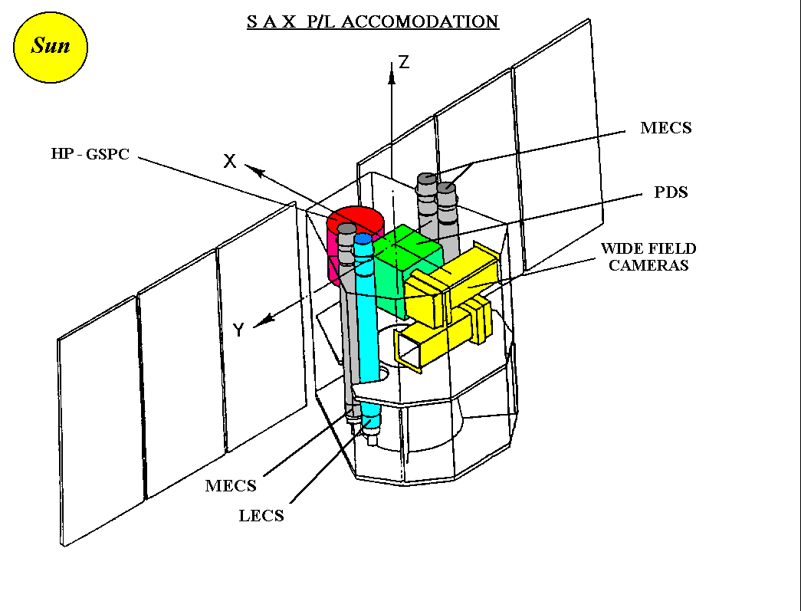
GRB960720: the 1st GRB the field was observed with NFI on october…
BeppoSAX & GRBs

Slide 8
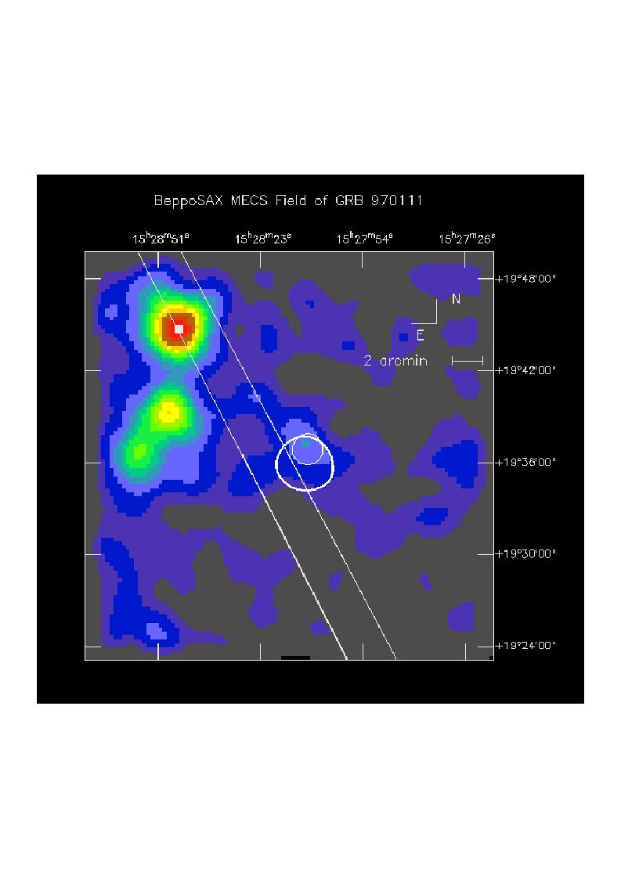
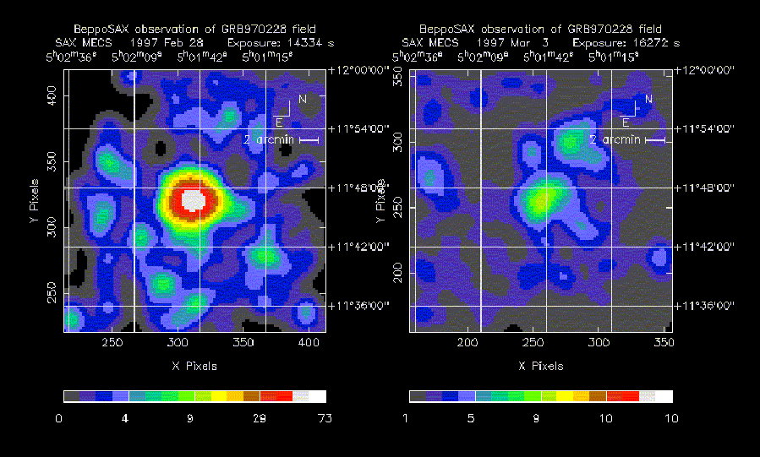
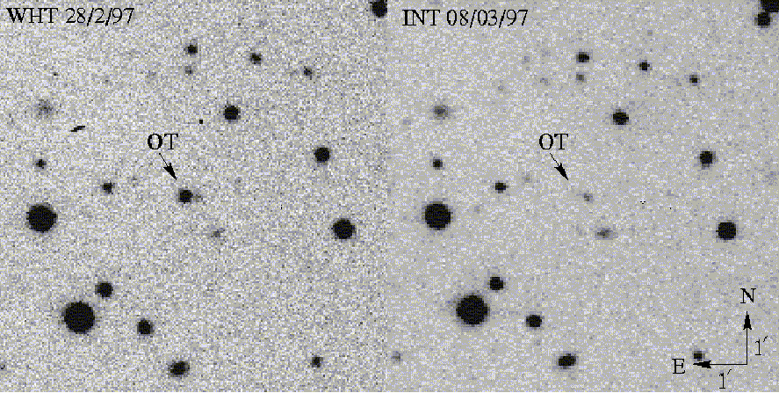
GRB afterglows
GRB970111: Triggered by GRBM and localized by the WFC of BeppoSAX fast follow-up (16 hrs after the GRB) by the NFI.
(Feroci, Antonelli, Guainazzi, et al., 1998)
GRB970228: Fast follow up (8hr) led to discover a bright unknown X-ray source in NFI. A second pointing 3 days after showed the source faded.
(Costa, … LAA, et al., 1997)
Thanks to the good X-ray position an optical fading source could be observed.
(Van Paradijs, et al., 1997)

Slide 9
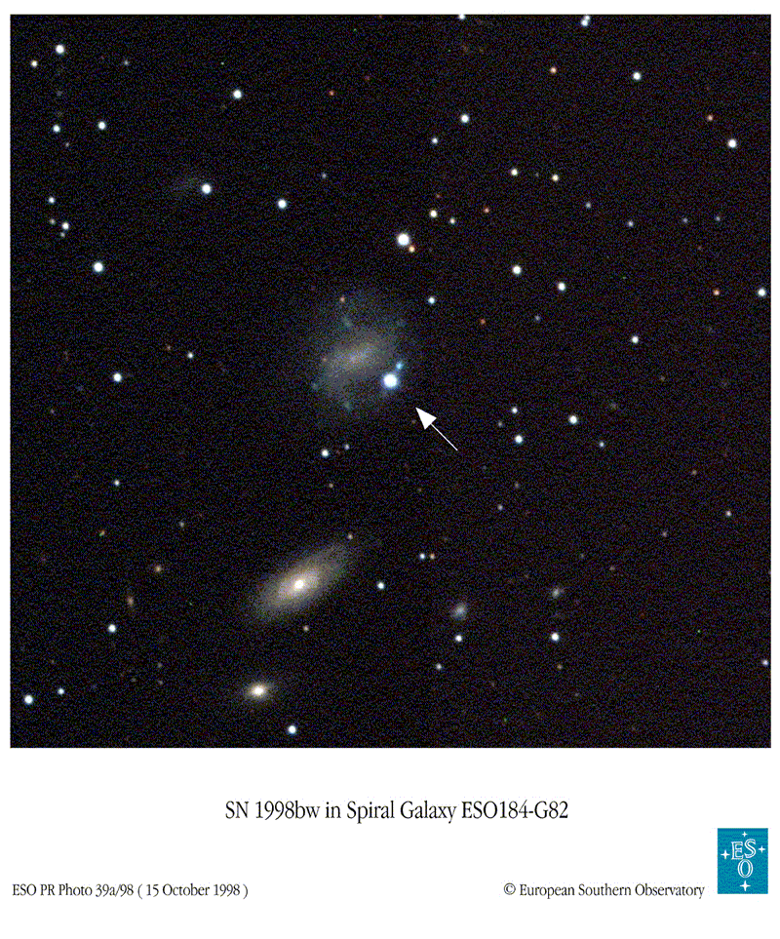
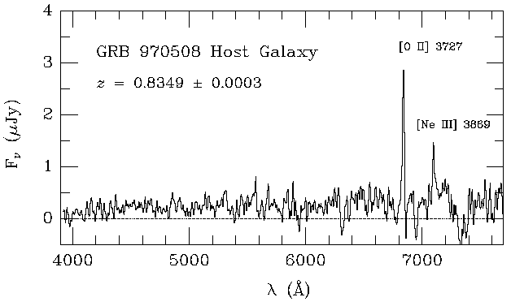
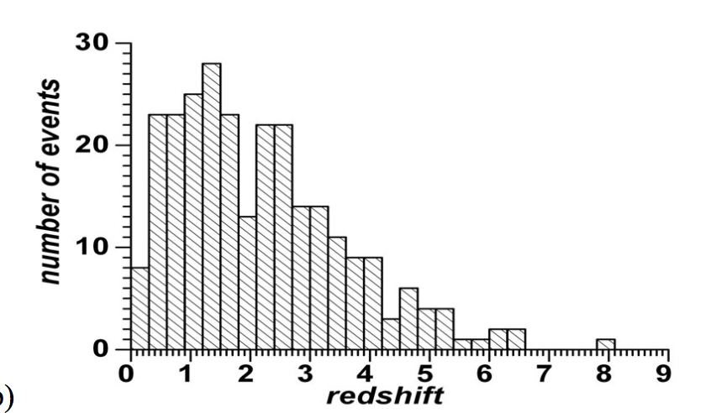
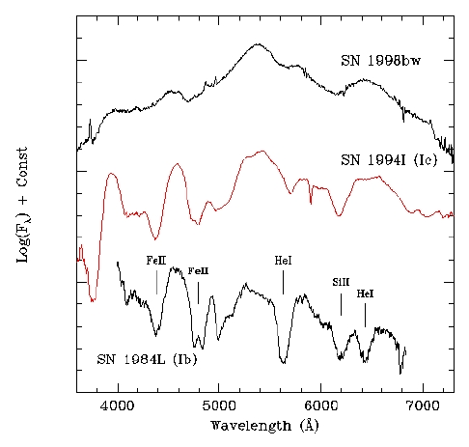
GRBs as Extragalctic Sources
Metzeger et al., 1997
Notes:
Direct evidence of a relativistic expanding source. In the first 3 weeks the radio source exhibited erratic variations that then disappeared. if it is due to diffractive scintillation of radio waves on interstellar electrons, the damping of the fluctuations later on indicates that the source had expanded to a greater size: 1 month => 10¹⁷ cm knowing source distance, a relativistic velocity is derived (Frail et al., 1997).

Slide 10
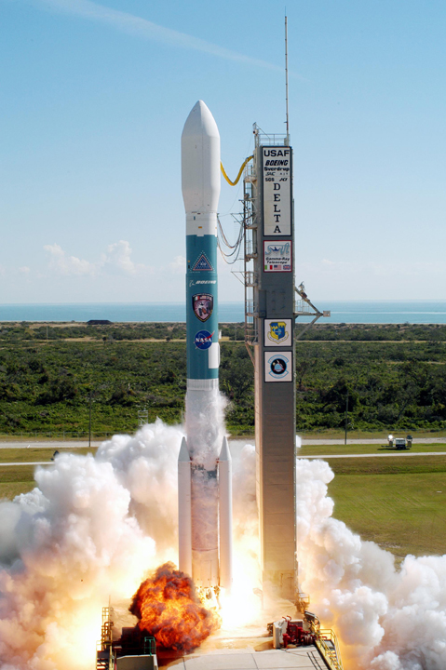
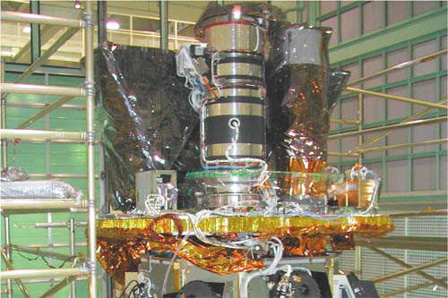
SWIFT
NASA MIDEX Mission selected in 1999
Primary science is to study gamma-ray bursts throughout the Universe
International hardware participation from UK and Italy
Launched on November 20, 2004
  Autonomous re-pointing, 70 - 120 sec

Slide 11
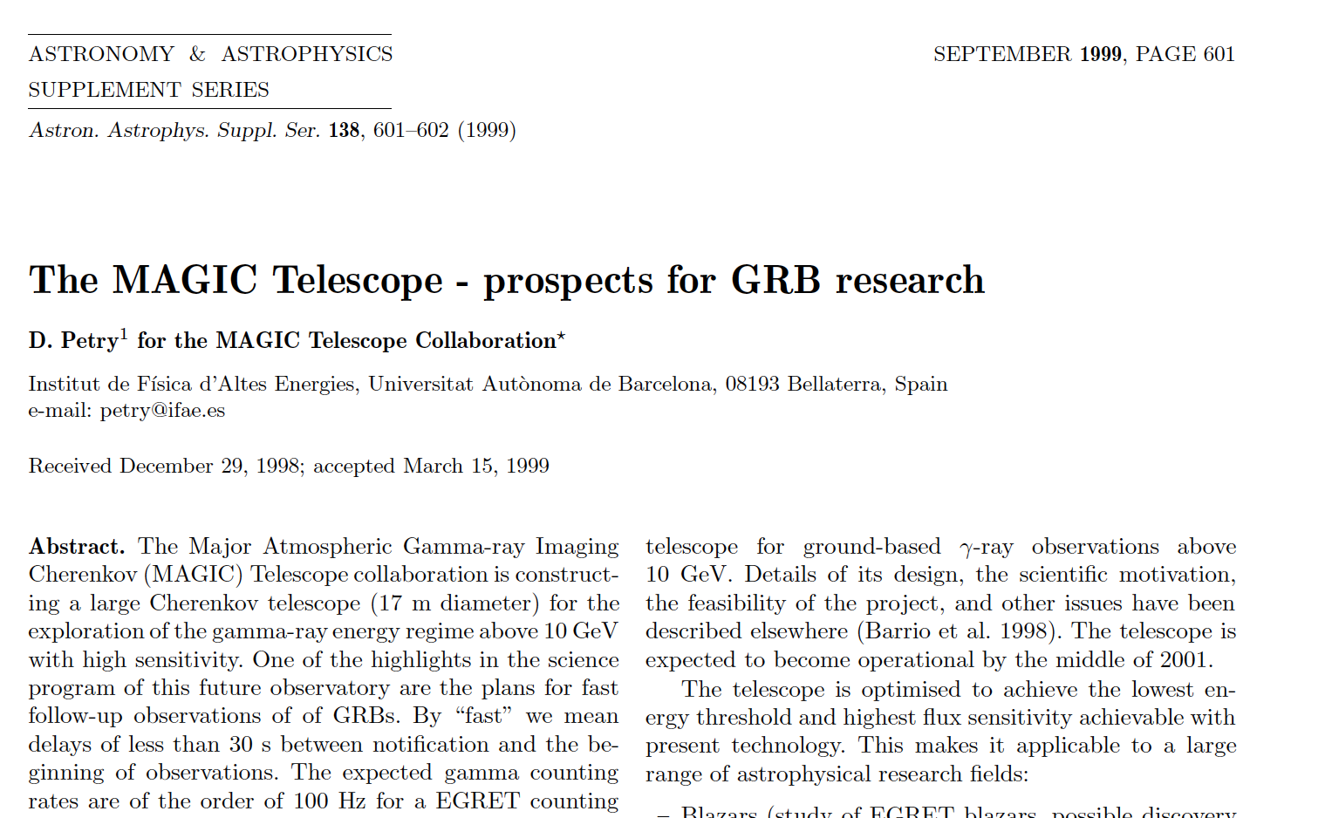
MAGIC & GRBs

Slide 12
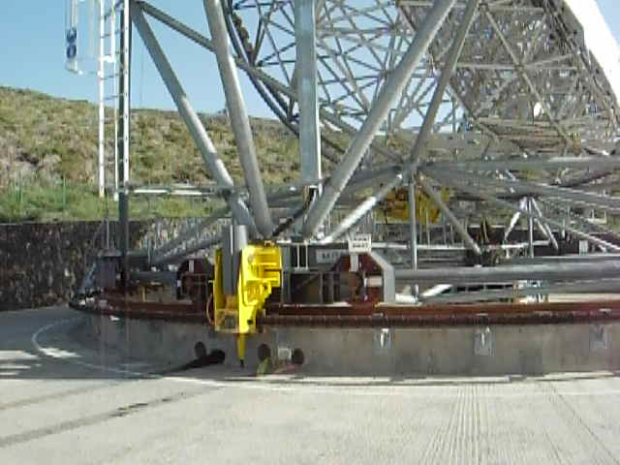
MAGIC & GRBs

Slide 13
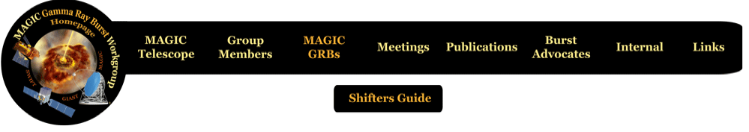
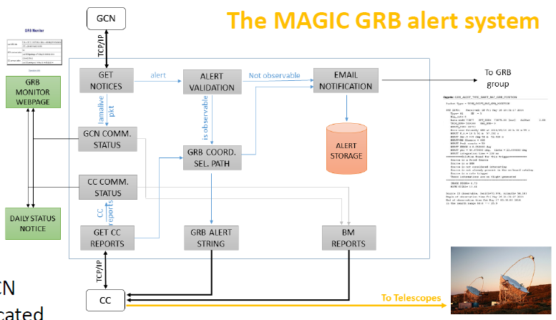
MAGIC & GRBs
Dedicated Automatic Alert System
Dedicated data reduction chain
Dedicated group
Burst Advocate Organization
MWL activities

Slide 14
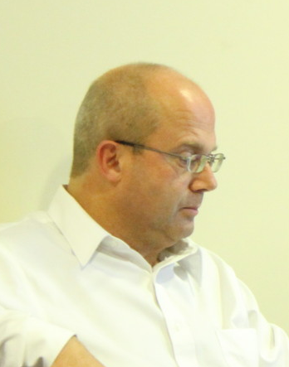
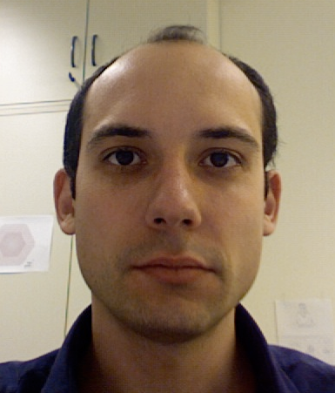
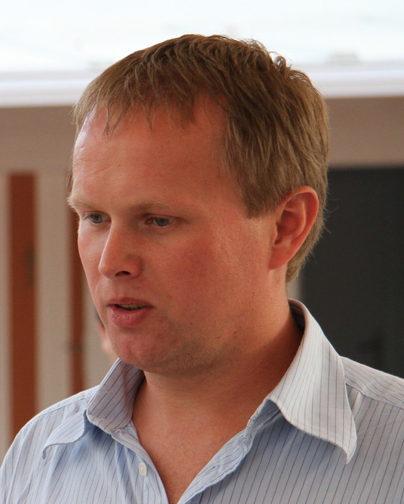
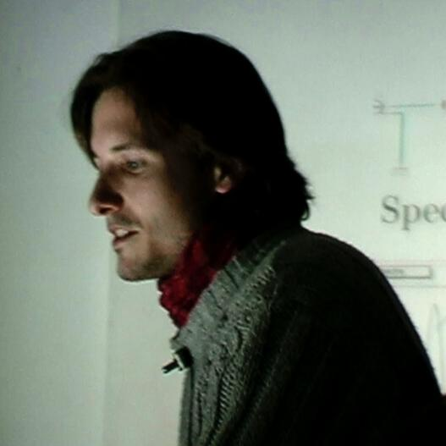

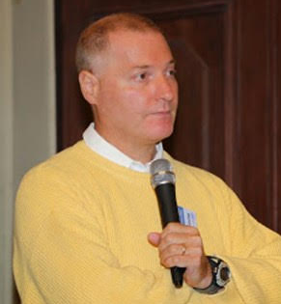
MAGIC & GRBs

Slide 15
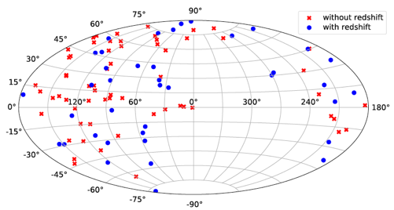
MAGIC GRBs
courtesy A. Berti
101 GRBs followed up 8-10 GRBs/year 39 GRBs with known z

Slide 16
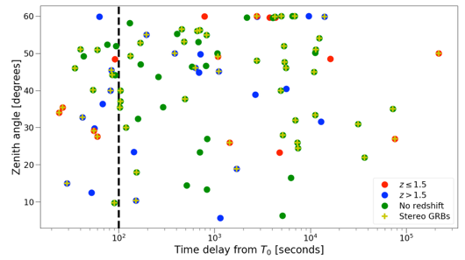
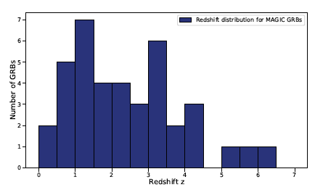
MAGIC GRBs
courtesy A. Berti
24 GRB within 100 s from T_{burst}
faster f-up 24s from T_{burst}

Slide 17
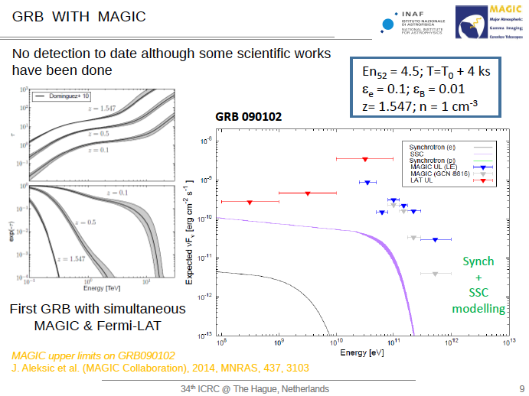
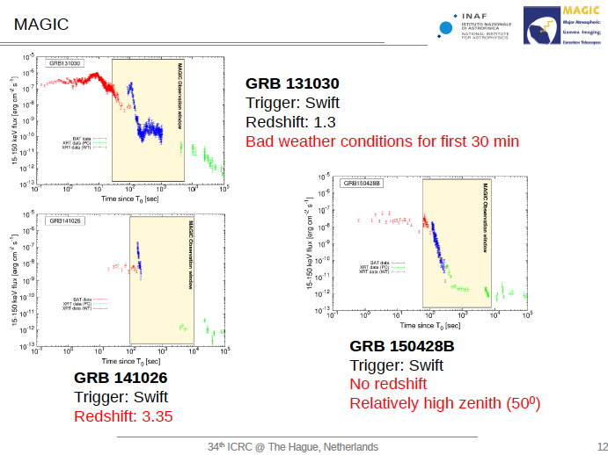
MAGIC Results on GRB
for more see Koji’s talk on friday
Courtesy A. Carosi

Slide 18
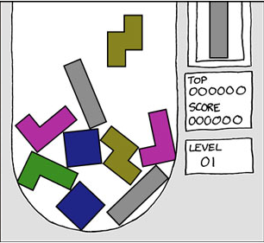
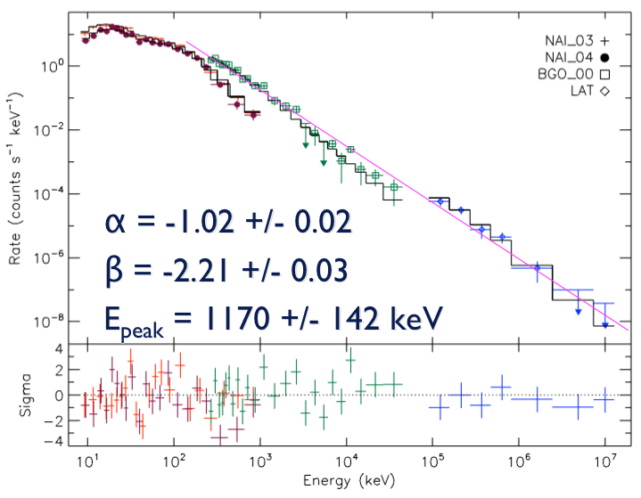
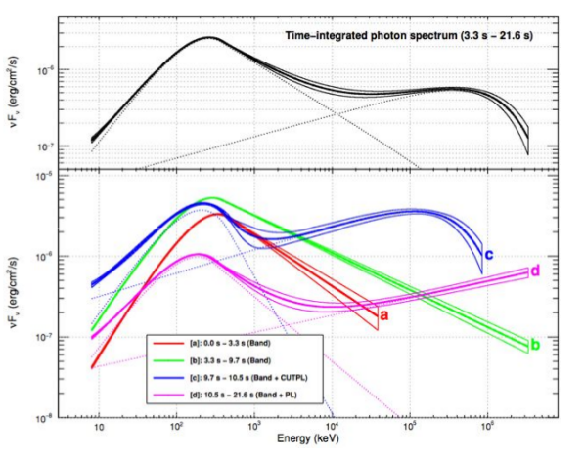
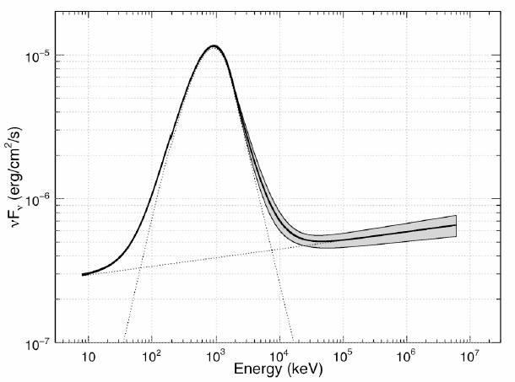
Why continue to observe with MAGIC?
Still a lot of contradictory results from HE observations
with FERMI LAT
GRB080916C
GRB080916C: HE emission
Consistent with Band function
Abdo+2008
Abdo+2009
Distinct emission
components
GRB090926B
GRB090902B
Ackerman+2011

Slide 19
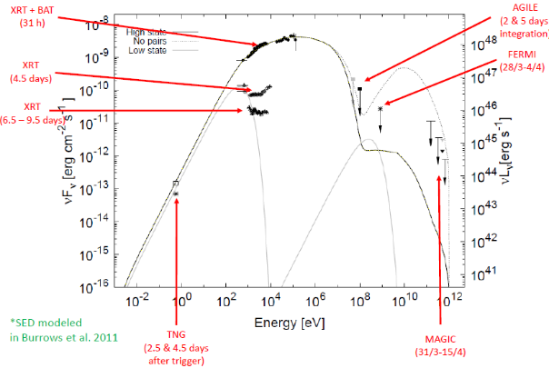
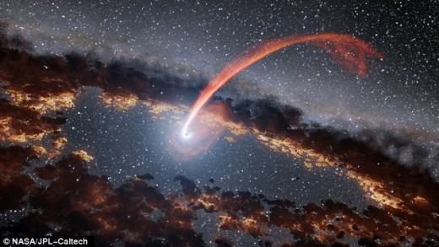
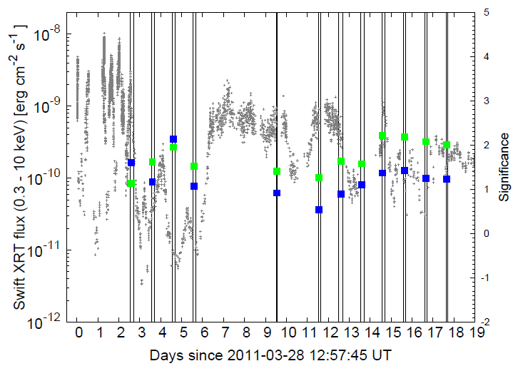
MAGIC Results
Not GRBs only!
SW J1644+57
Tidal disruption event
MAGIC Coll., A&A, 2013, 55, 112

Slide 20
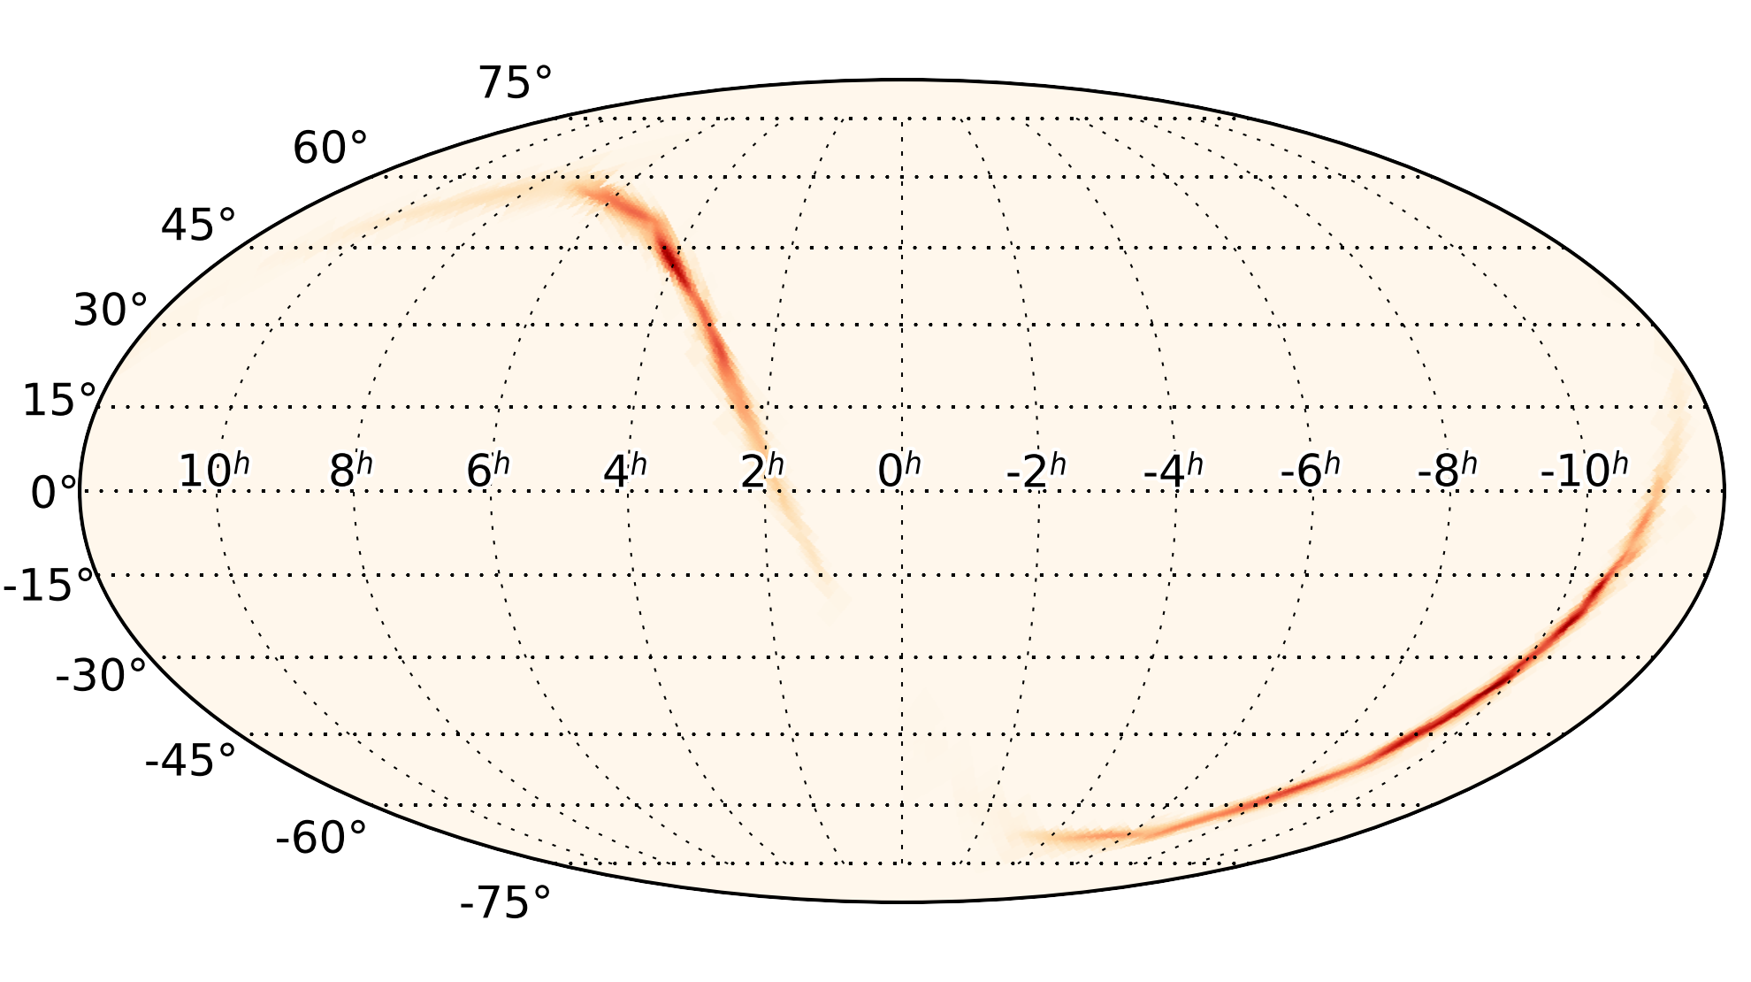
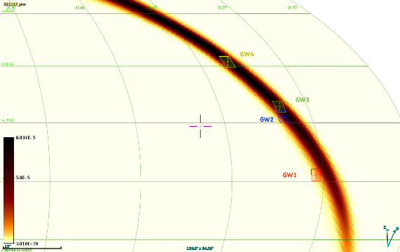
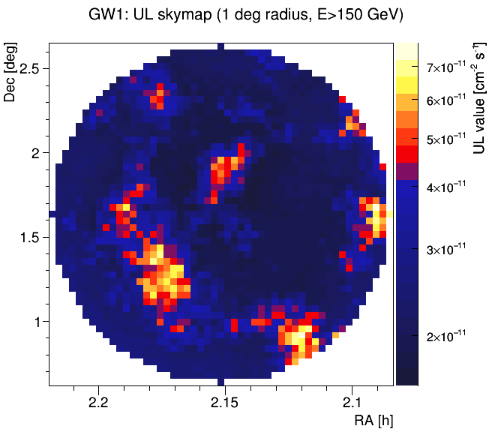
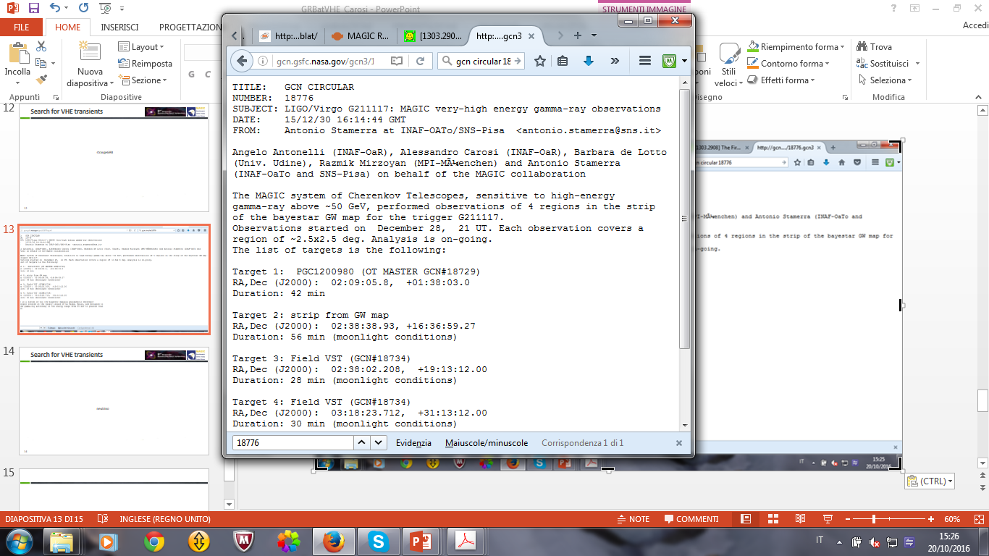
MAGIC follow-up of GW151226
Surfing Waves: MAGIC follow-ups of GW events
Status after O2
MAGIC Pointings
MAGIC-LVC MoU
MAGIC observations of 3 events
Analysis completed for GW151226
Analisys still on going for other events
No excesses found
The observed merger of NS-NS is a strong motivation for this program
GCN #18776
Notes:
Immediate repositioning/late follow up
Scanning mode? n pointings?
association mode? (closeby galaxies)
- Dedicated analysis tools

Slide 21
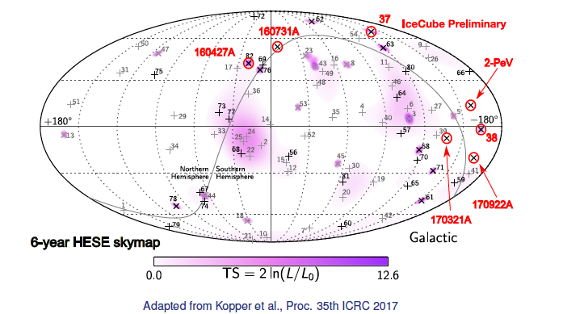
MAGIC follow-ups of neutrino events
Since 2012 MAGIC is inside the Gamma-ray Follow-Up (GFU)
HESE+EHE: 4 real-time alerts observed after delivery of AMON GCN Notices
Archival tracks: 2 HESE (37 and 38) and 2PeV track (Highest Energy Track, HET)
More than 30 h of observations
No significant detection to report but one … (see next talks)

Slide 22
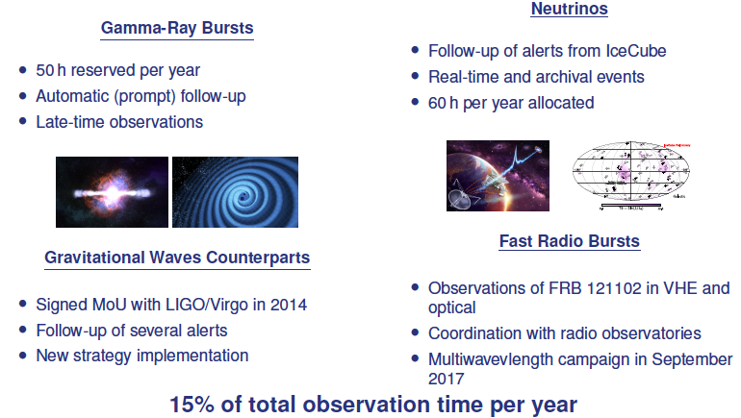
The MAGIC Transient Program

