Slide 1

Non-Standard Technologies and
Interconnections
Thinning and Micro-Mechanics
  Key technologies
  Some Examples
Interconnection Technologies
  Conventional Solder Bump Bonding
  Bumpless Interconnection

Slide 2
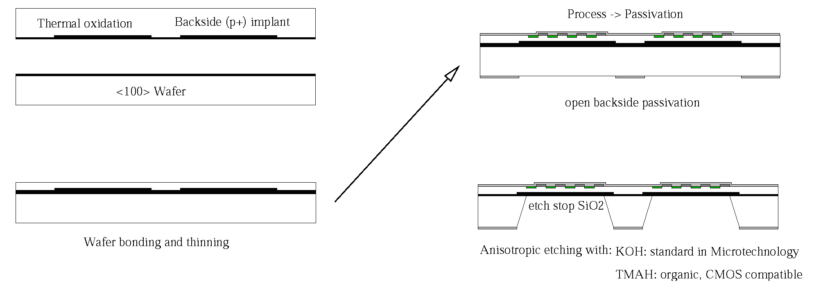
Processing thin detectors - The Idea
a) oxidation and back side implant of top wafer
c) process ➔ passivation
Top Wafer
Handle <100> Wafer
open backside passivation
b) wafer bonding and grinding/polishing of top wafer
d) anisotropic deep etching opens "windows" in handle wafer
Key Process Modules:
-: Wafer Bonding and thinning of top layer
→ MPI Halle (Gösele et al.) and SICO → Industry (Tracit/Soitec) → Engineered BSOI
-: Etching of the Handle Wafer → HLL
-: Litho on extreme topographies → HLL
Developed initially for ILC VXD, the technology found its way into other projects:
-: production of thin (75 and 150 μm) ATLAS pixel sensors for sLHC
-: first production of Geiger-mode APDs on 70 μm top layer
-: thin DEPFETs for Belle II

Slide 3

The industrial partner for SOI Wafer…
Tracit at Grenoble
-: spin off from LETI, now part of Soitec, the world market leader for SOI Wafers
-: top and handle wafer delivered by MPI
-: pre-processing of top wafer at MPI
-: 25 engineered BSOI wafers prepared at Tracit/Soitec
-: DSP, ≈ 420 µm overall thickness, 50 µm top layer
Siltronic, FZ, DSP, <100>, t=450µm, 400Ω.cm, Phosphorous
230 nm thermal oxide
structured Boron implant, through BOX, 90 keV, 5e14 - 1e15 cm-2
alignment marks in BOX: 60nm step
hydrophilic bond
at Tracit/Soitec
top layer: 50 µm
≈420 µm
DSP
Siltronic, FZ, DSP, <100>, t=450µm, 400Ω.cm, Phosphorous
after bonding, grinding and double sided polishing

Slide 4
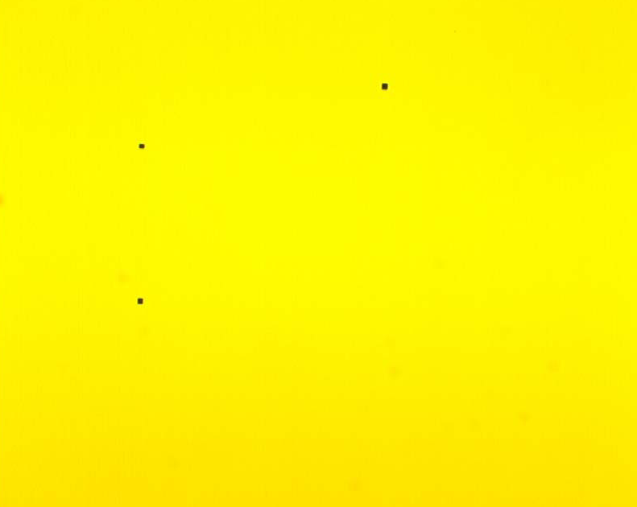
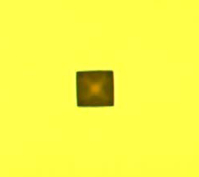
The back side (of the medal..)
Since 2005 three different batches → good results, no voids, only perfect SOI wafers delivered ….
But then, at the recent order for the Belle II prototyping, suddenly:
Issue seen during back side photo resist coating at HLL:
-: pyramidal pits on the back side,
~20 µm lateral dim., ~ 15 µm deep
1. caused by pin holes in the screening oxide during
front side thinning
2. Soitec simply “forgot” to grind back and
polish the handle wafer.
Stack is still ~485 micron thick!
Long and many discussions followed…..
after a failed re-work, we decided to process these imperfect SOI wafer for the prototyping (small risc!!)
other pre-tests with Soitec/Tracit have to follow before we order the final batch
→ It’s always time (and money) consuming to work as a small partner with larger companies!!
And it’s frustrating and risky, if you don’t have the process under control…..

Slide 5
Processing thin detectors - The Idea
a) oxidation and back side implant of top wafer
c) process ➔ passivation
Top Wafer
Handle <100> Wafer
open backside passivation
b) wafer bonding and grinding/polishing of top wafer
d) anisotropic deep etching opens "windows" in handle wafer
Key Process Modules:
-: Wafer Bonding and thinning of top layer
→ MPI Halle (Gösele et al.) and SICO → Industry (Tracit - Soitec) → Engineered BSOI
-: Etching of the Handle Wafer → HLL
-: Lithography on extreme topographies → HLL

Slide 6
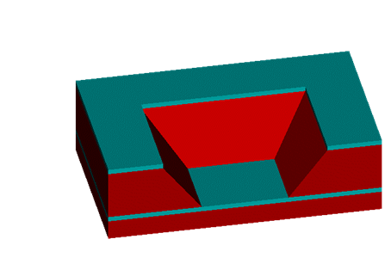
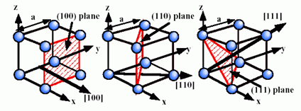
Deep Anisotropic Wet Etching (KOH, NaOH…TMAH…)
Takes advantage of the single crystal structure of the Bulk
TetraMethyl Ammonium Hydroxide
Etche rate in (100) direction much than for higher indexed planes…
+: good selectivity to oxide (and Al with tricks..)
+: no alkali ions (CMOS compatible)
-: poorer selectivity to (111) (≈30:1)
-: rough surface after etching (hillocks)
-: 5 wt.% TMAH + (NH₄)₂S₂O₈
at 87 ºC:
etch rate Si(100): ≈60 μm/h
54.72º
Notes:
organic alikaline solution, photo resist developer

Slide 7
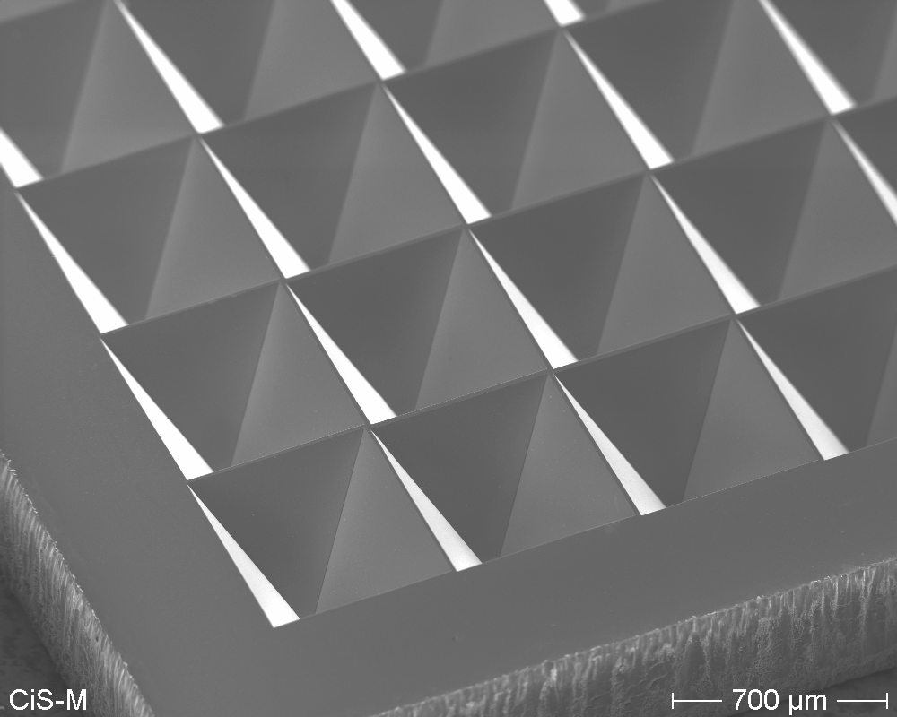
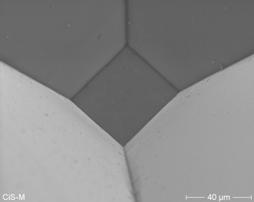
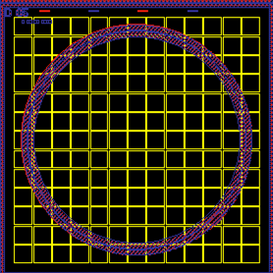
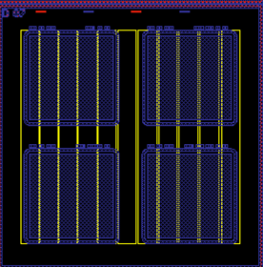
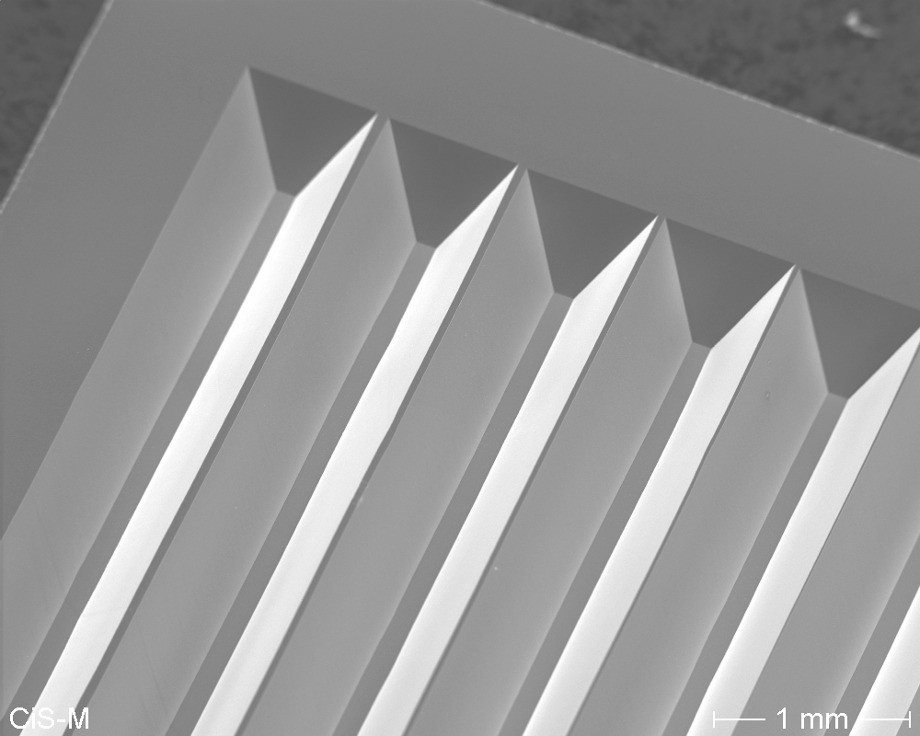
SEM pictures

Slide 8
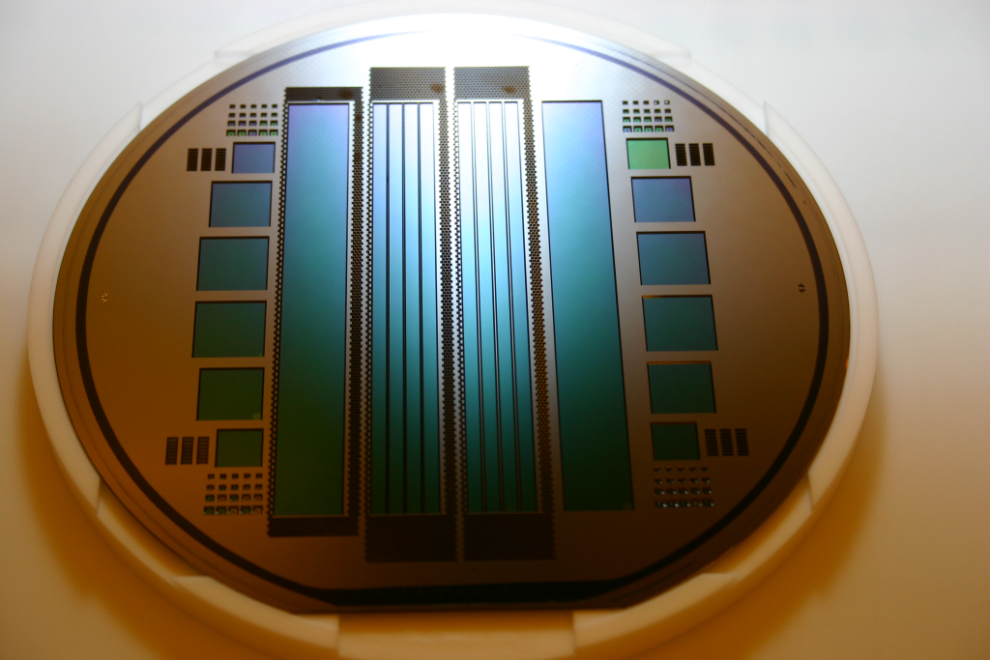
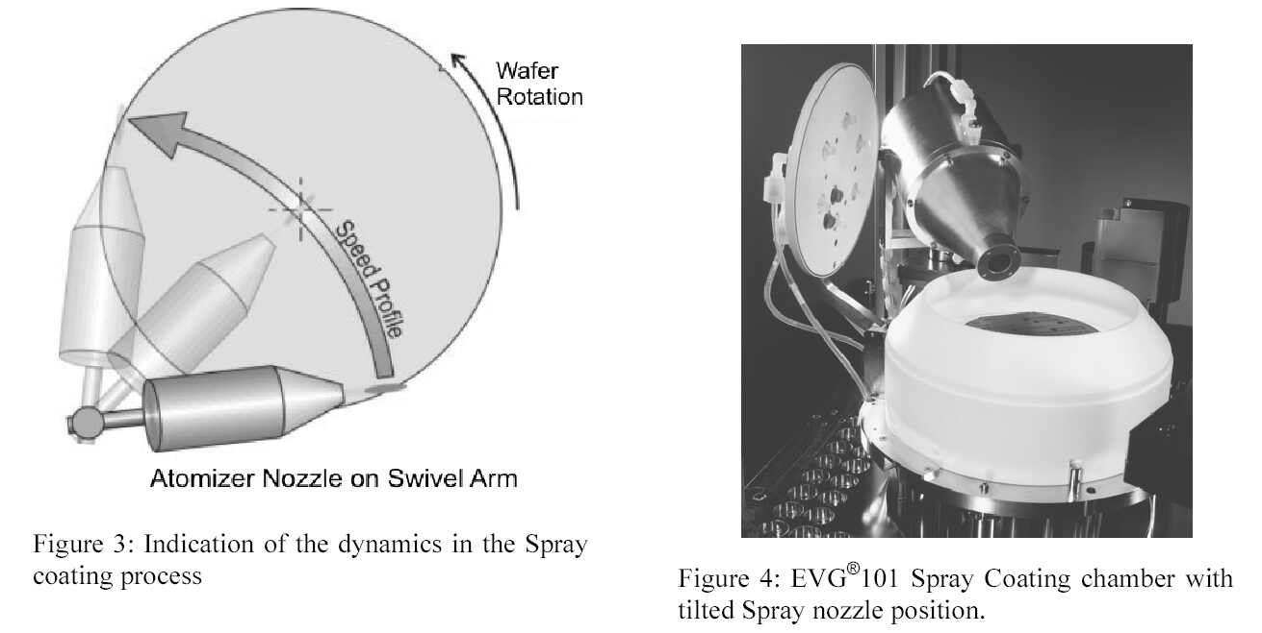
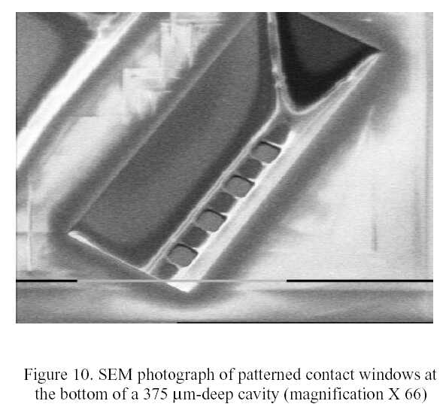
Lithography on extreme topographies → Spray Coating
Usually: spin coating of the wafer with photo resist
This is almost impossible after deep etching
of the handle wafer.
Spray Coating with photo resist! Then
  Etch contact to buried implant
  Sputter Alu
  Patterning of Alu
contact opening and metallization
after etching of the handle wafer

Slide 9
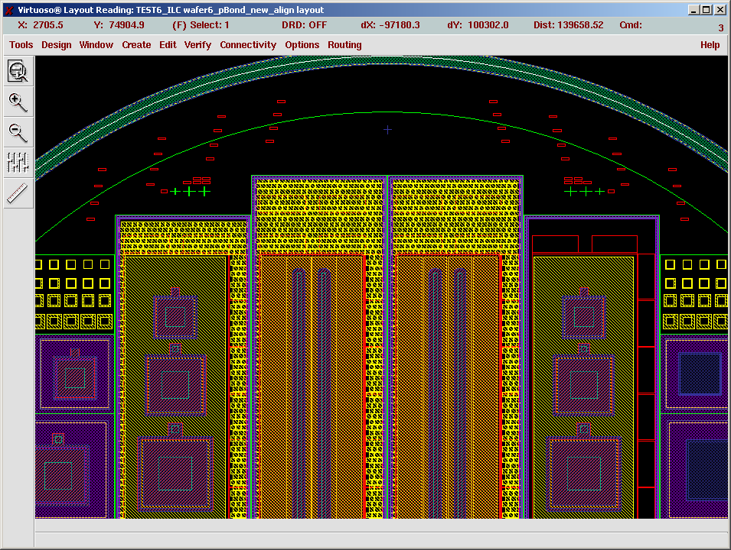
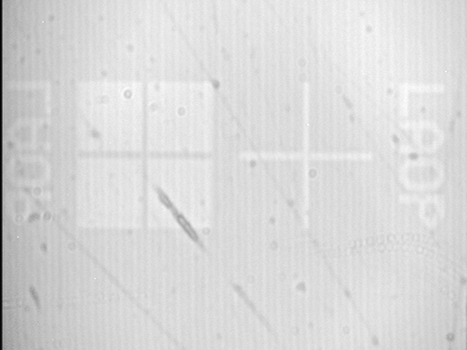
Large area diodes
Alignment marks
in BOX to find the
partial p-implant
after bonding
IR photo: 60 nm step in BOX
Diodes with
various areas
4 "full size" 1st layer ILC ladders
100x13 mm², 1 and 3 mm frame
along the long side

Slide 10
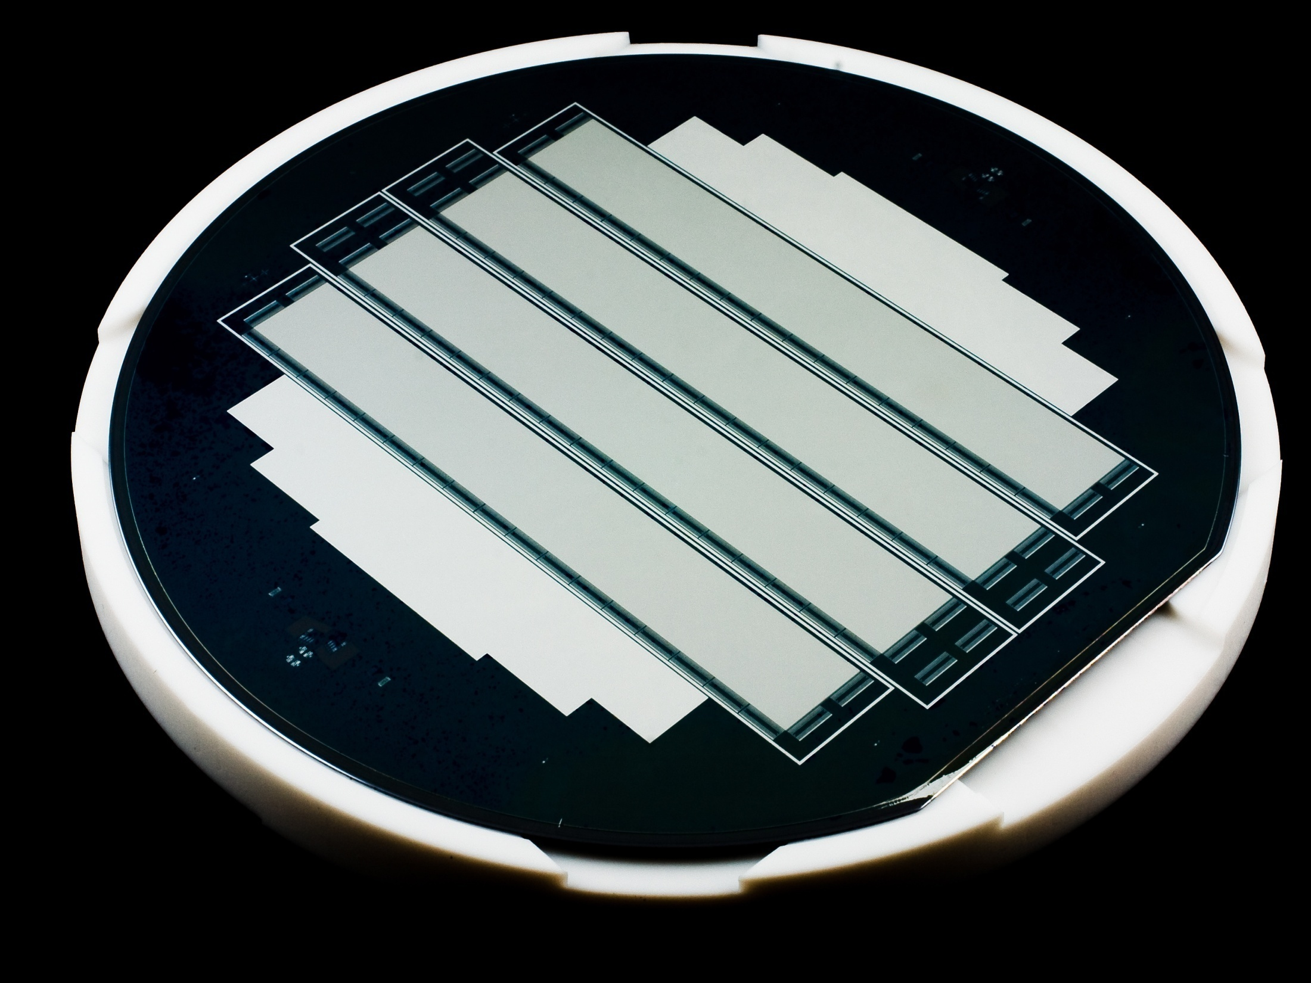
Large area diodes - characteristics

Slide 11
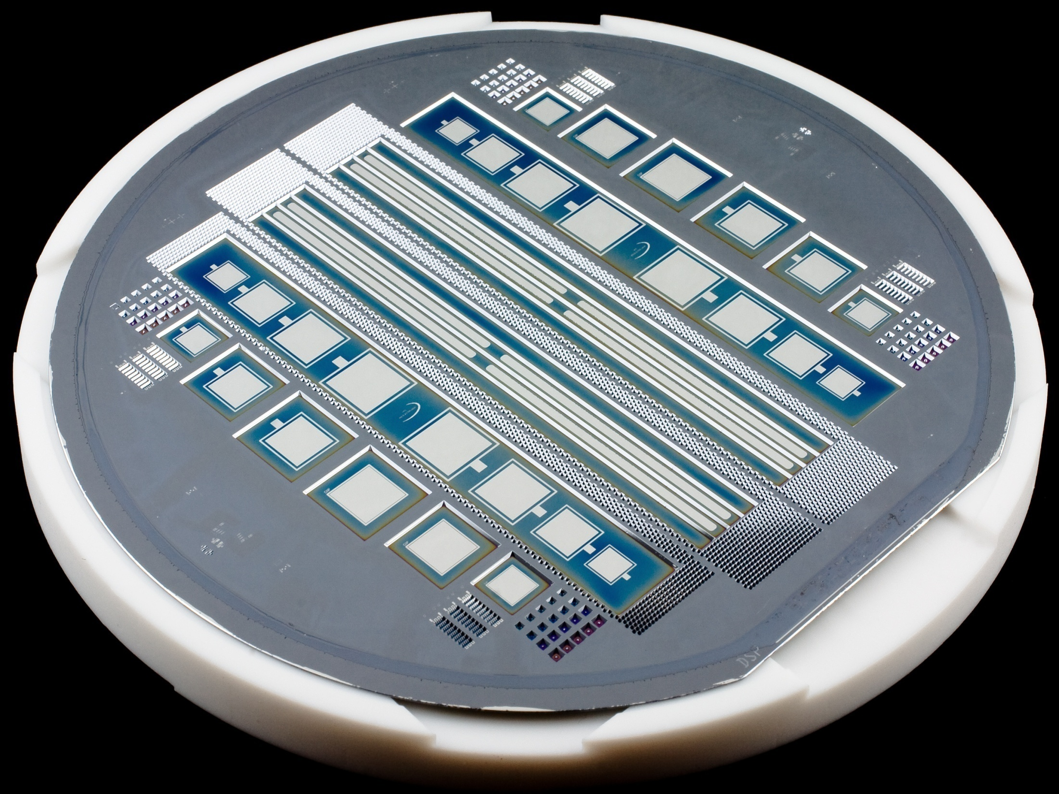
Large area diodes - characteristics

Slide 12
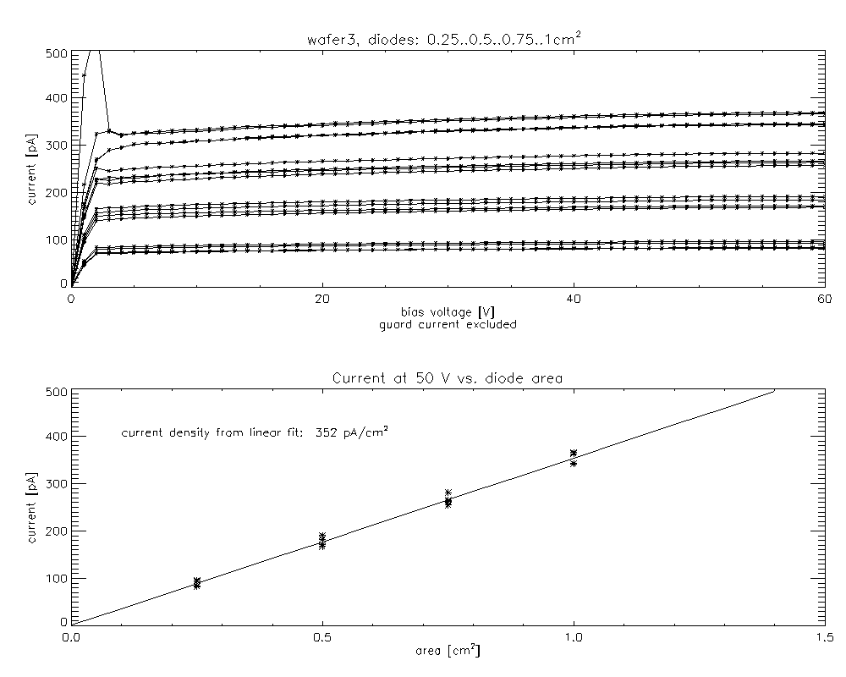
Large area diodes - characteristics

Slide 13
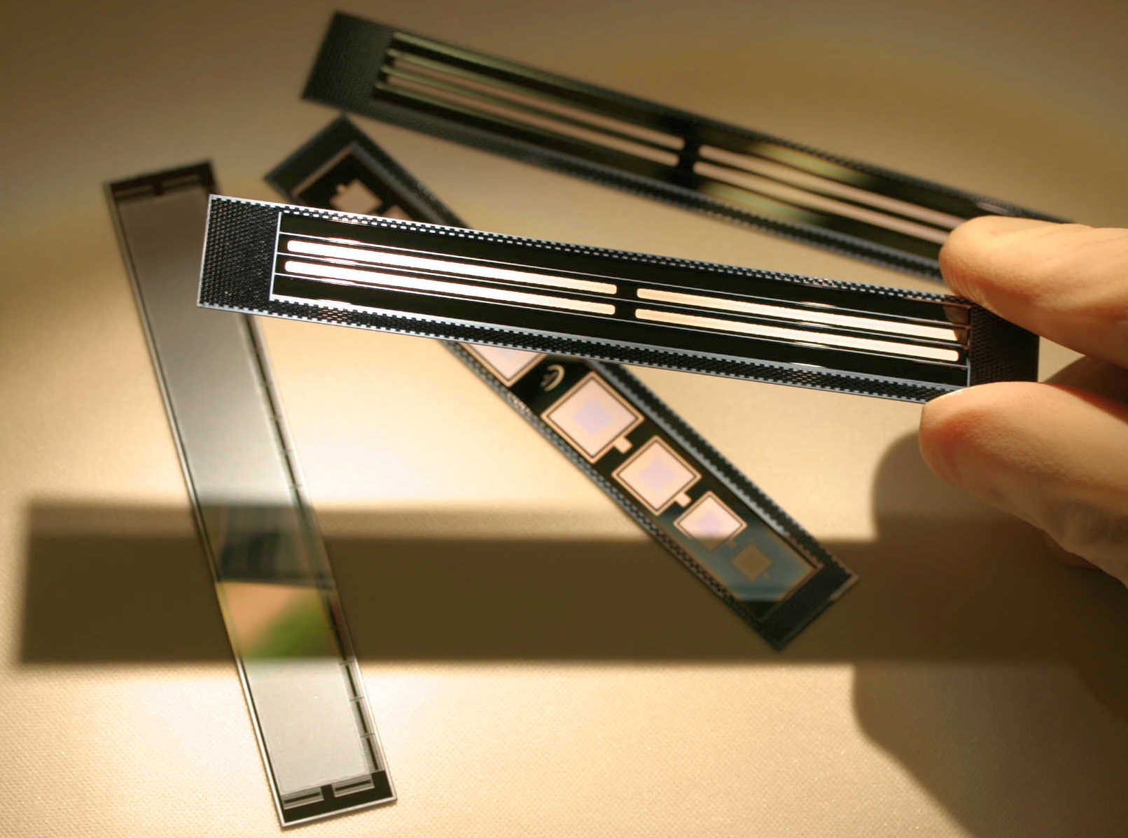
Large area diodes - characteristics

Slide 14
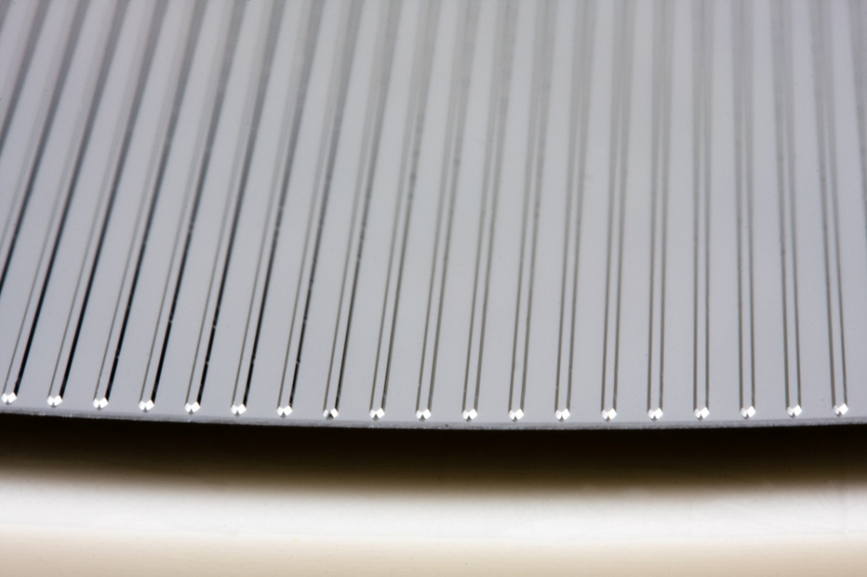
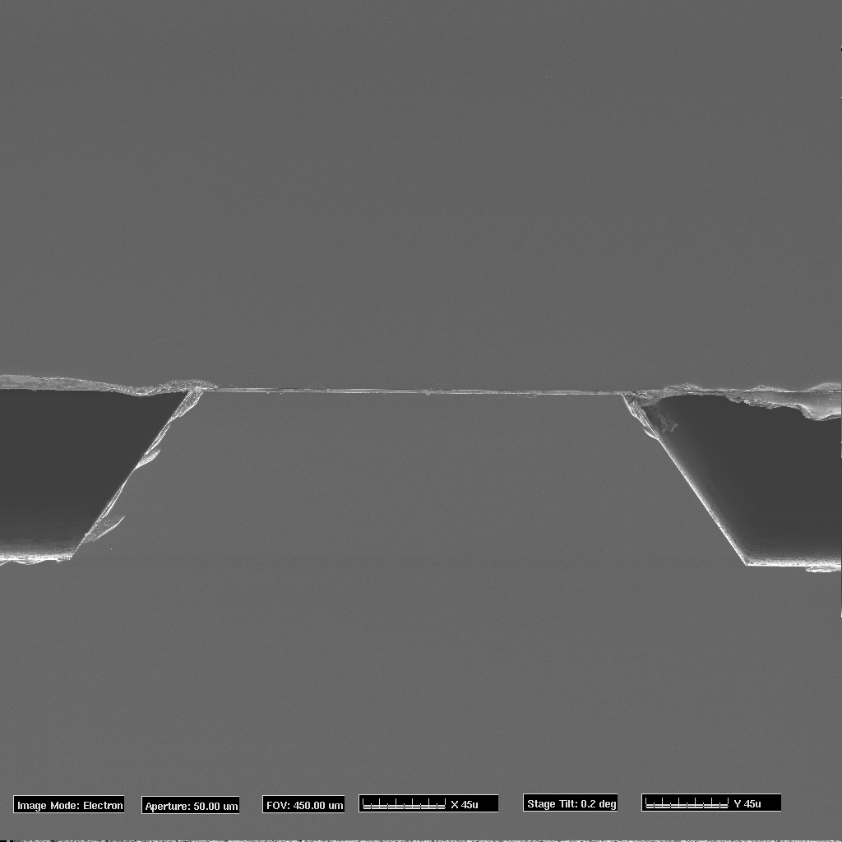
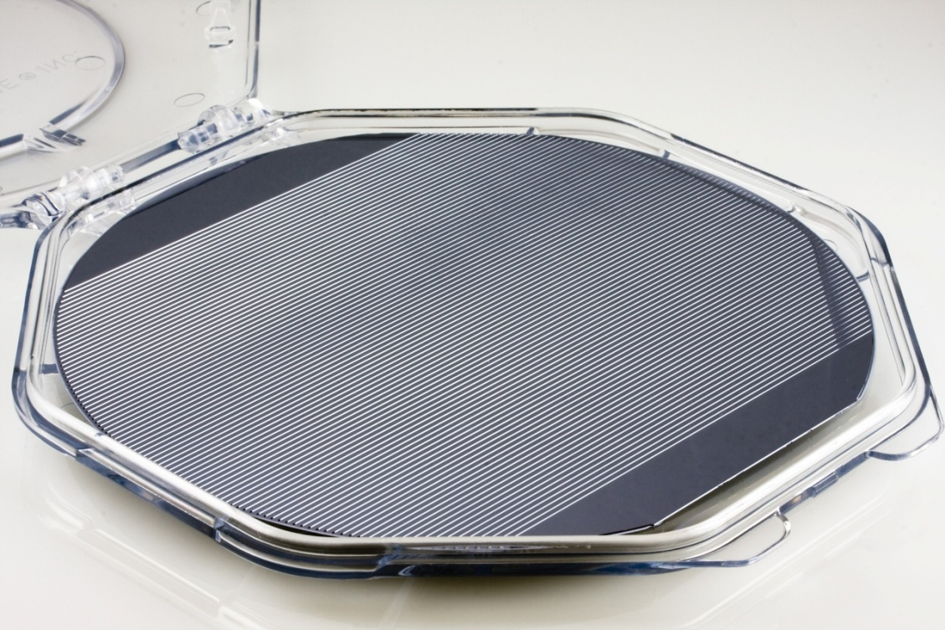
Silicon pores (channels) for X-Rays or fluids or …
Au coated wafer
3 µm Au-Si Alloy
Ribbed silicon wafer
Courtesy of Cosine and ESA

Slide 15
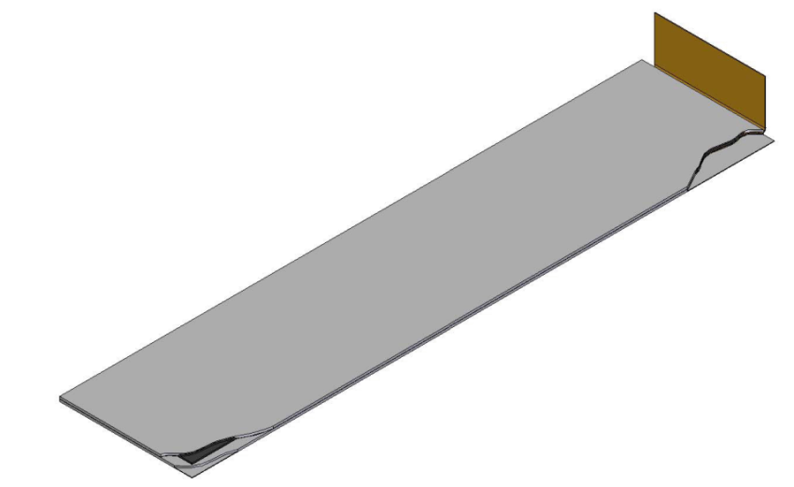
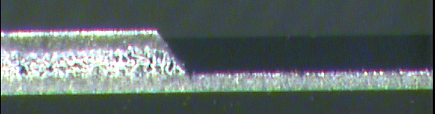
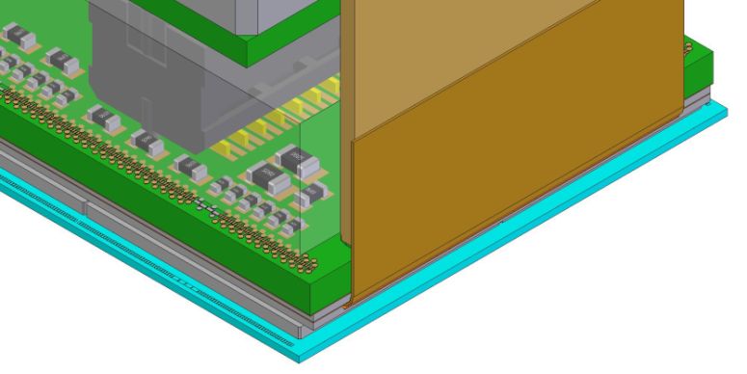
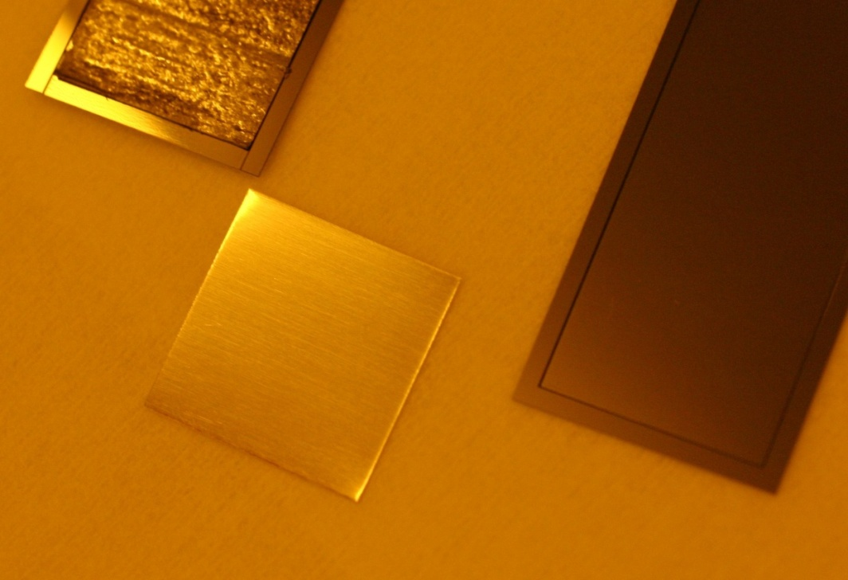
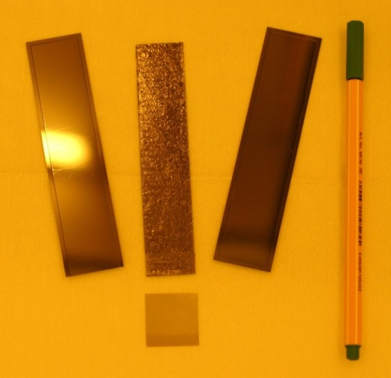
XFEL: Si-TPG Sandwich as heat spreader
Silicon: mechanical strength
TPG: thermal management
→ CTE of Silicon (~2.4 ppm/K)
&
→ Heat conductivity close to TPG
~ 1000 W/Km
450 µm
100 µm

Slide 16
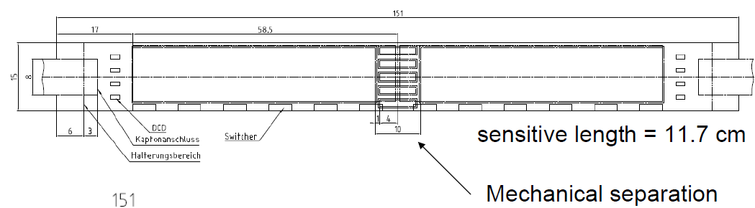
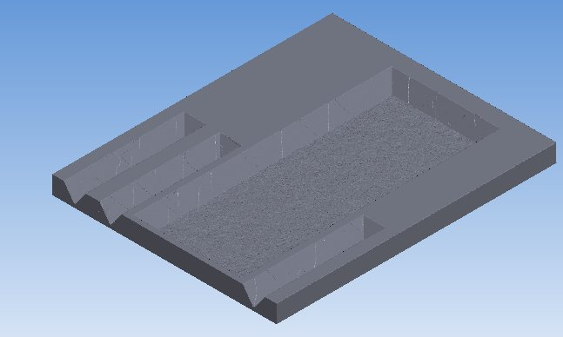
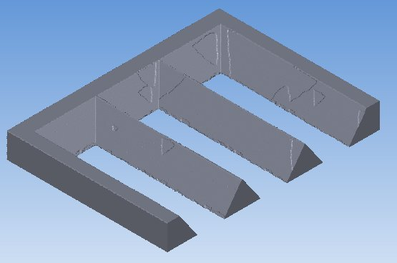
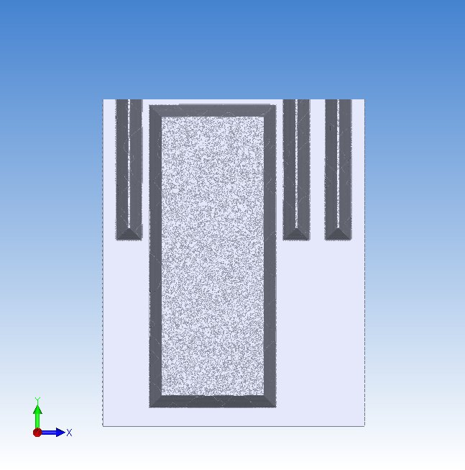
Micro-mechanics at Belle II – ladder joint
Low-mass joint between two
Ladders at the second layer of
Belle II PXD…
1 mm
3 mm

Slide 17
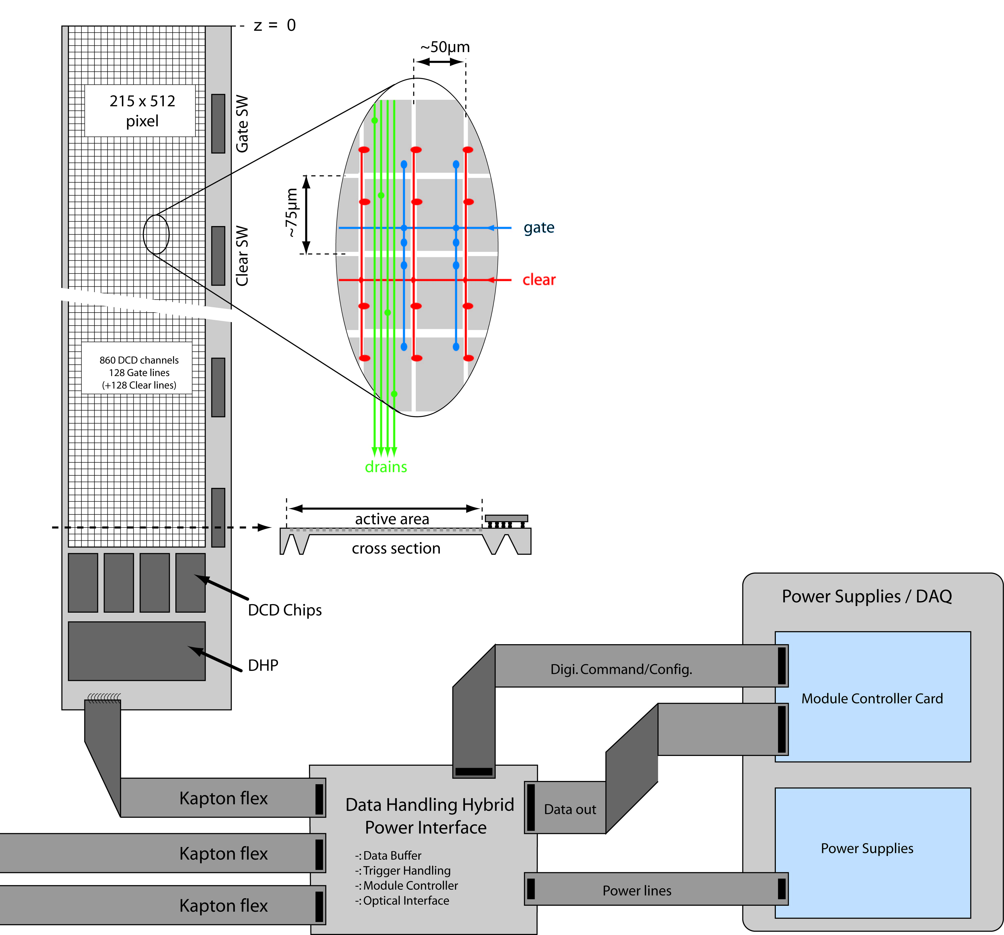
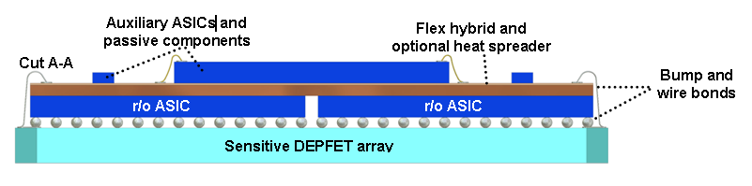
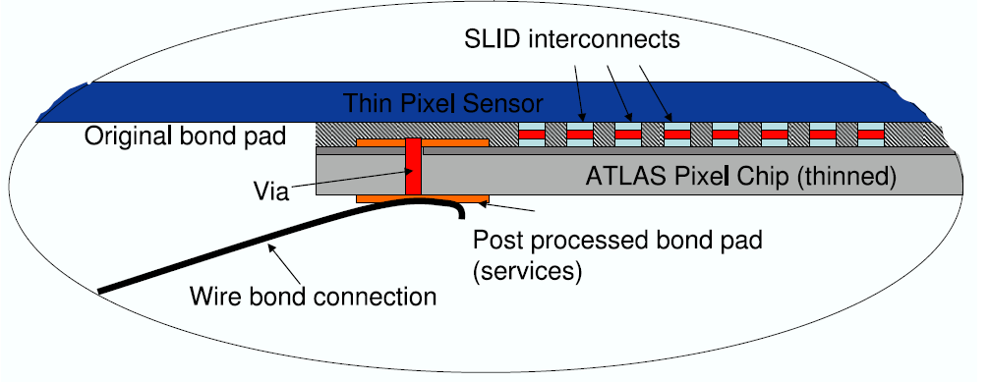
Interconnection Sensor - ASICs
2. XFEL:
-: 1-on-1 connection DEPFET ←→ front-end
-: ~4000 pixel/ ro-chip and 16 chips in sensitive area
-: 200 µm pitch
-: frame rate 5 MHz
3. ATLAS Pixel sLHC upgrade:
-: 1-on-1 connection Thin pad detector ←→ front-end
-: Vertical integration project with IZM Munich
-: 50 µm pitch
-: frame rate 40 MHz
1. Belle II (and ILC):
-: MCM – ASICs in different technologies
on Sensor as substrate
-: bump bonds only on balconies
-: ~ 250 bumps/chip, 150 - 200 µm pitch
-: frame rate: 100 kHz

Slide 18
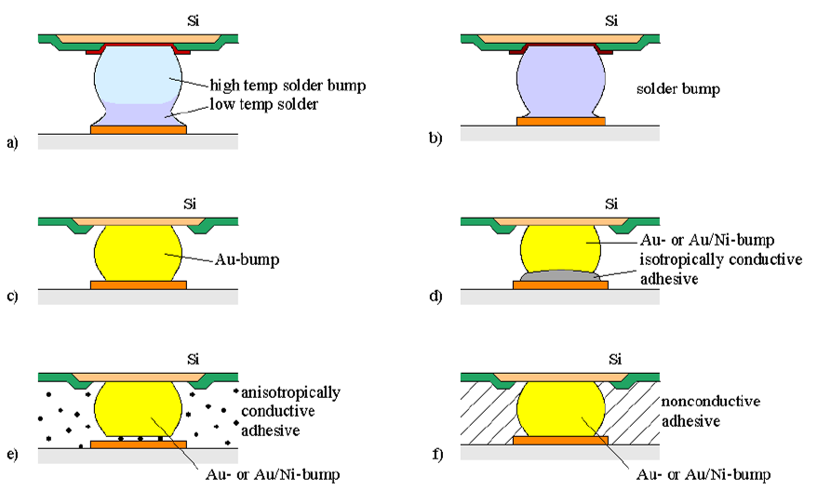
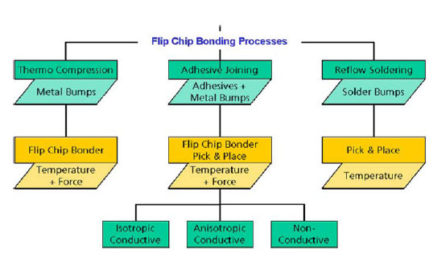
Conventional Flip-Chip Technologies
or In
In general there is always:
Bumping of the ASICs
Preparing the landing pads on
the substrate (sensor)
Flip-Chip ASICs to sensor and join
electrically and mechanically
→ mostly solder bumps (PbSn or SnAg or SnAgCu)
-: Wafer process, but commercially available in MPW runs
- IBM "C4“ : 200 µm pitch
- UMC, TSMC : by external bumping fabs (SPIL...)
150 - 180 µm
-: ITRS Packaging road map says: pitch ≅ 100 µm bis 2015,
okay for applications like XFEL, Belle II and similar

Slide 19
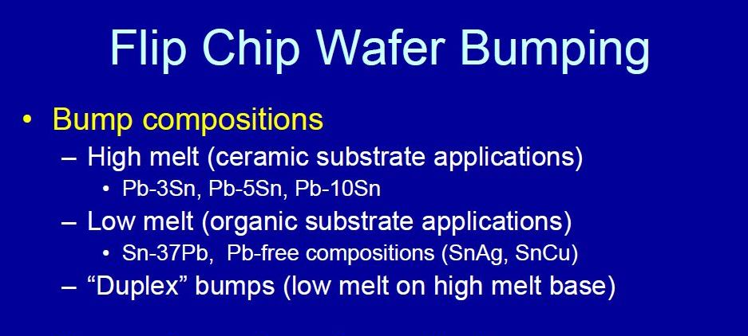
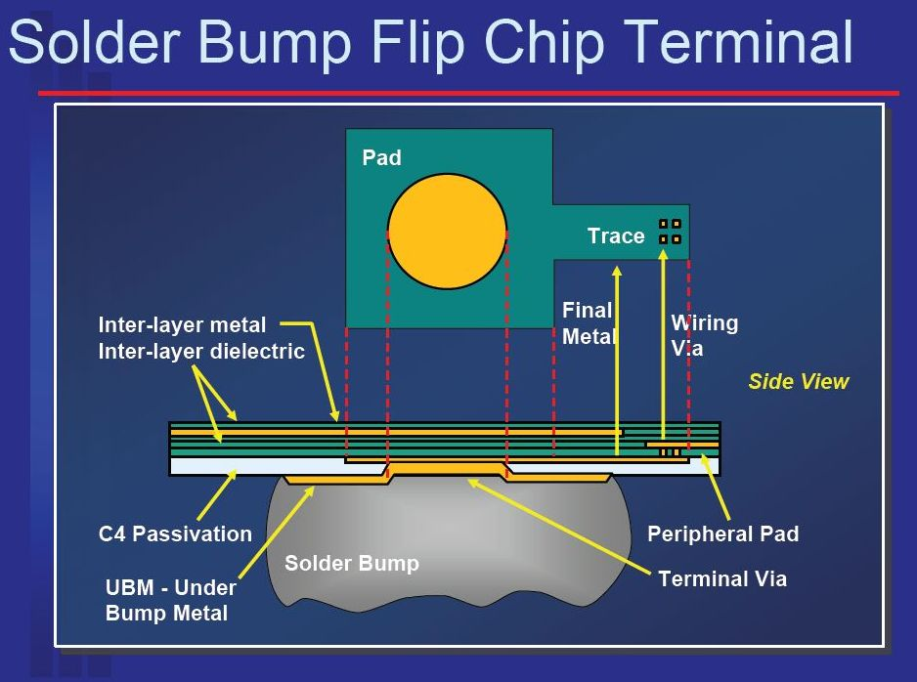
Some Details on C4 Bump from IBM
‘Package Interconnects’ , J.R. Wilcox
IBM, January 2006
Electroplated C4, PbSn 97/3, in two Options:
-: high temp. reflow: 345 – 375 degC
-: low temp. reflow: 215 – 255 degC
Lead-free, C4NP (“new process”):
-: SnAg 99.5/0.5
-: bump size smaller → 100 µm!
-: reflow at 235 – 255 degC
100 µm

Slide 20
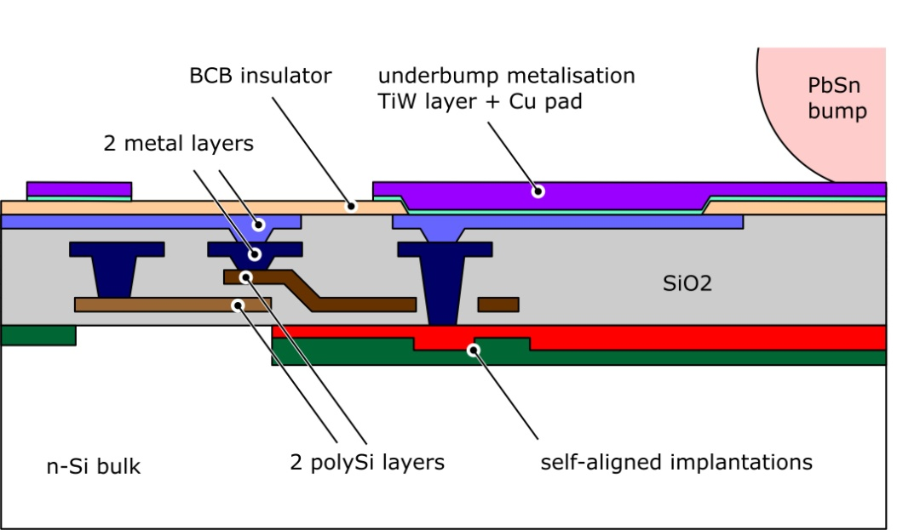
The Goal
→ Multi Chip Module (MCM) with one large DEPFET sensor and already bumped r/o ASICs
-: actually, should not be that very challenging ... ATLAS Pixel did it already, CMS, ALICE as well ...
but it's different now, in particular for the XFEL Ladders
-: maintain low leakage current level (few hundred pA/cm²)
and
-: bump bonding procedure has to be compatible with sensitive entrance window at the
back side and active devices under the bump!
Solderable Cu landing pad on the sensor
a nice side product is a 3rd metal layer
in low res. Cu!!!!
Flip-chip and solder the ASIC

Slide 21
The UBM Process
Sensor wafer, last metal Alu2, BCB passivated , from clean room
1..3
Sputter Ti:W (100nm) und Cu (200nm)
Lithography: thick photo resist
Thru mask EP: 3-5 µm Cu (and Sn cap)
Resist strip
wet etch Cu
Wet etch Ti:W: H₂O₂ (with additives)
Sn ep
Cu ep
Ti:W/Cu seed layer
4
5
6

Slide 22
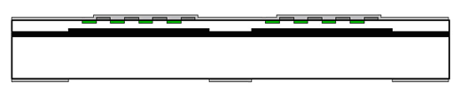
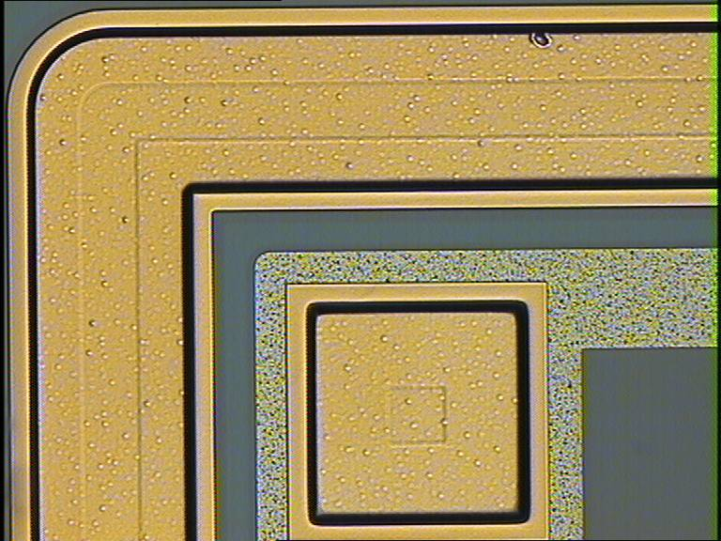
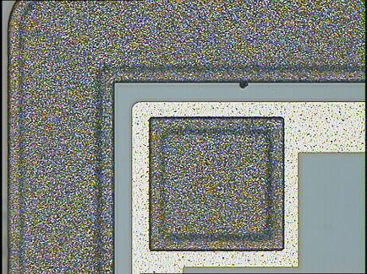
HLL PiN Diodes .... with Cu und Sn (done at IZM)
Diodes (our standard test vehicles) have been produced on SOI Wafers, top layer: 50 μm thick, 150 Ω.cm
TiW
Cu
Corner of a 10 mm² Diode, with Cu
Al
BCB
SiO₂
-: BCB layer with openings to define
TiW/Cu/Cu(/Sn) System
-: Handle wafer acts as back side protection
layer during the IZM processing
-: Metal system done at IZM:
100 nm TiW, sputtered
200 nm Cu, sputtered
1 μm Cu, through mask electroplated
-: on a 2nd Wafer: TiW + 5 μm Cu + 1 μm Sn
same diode, with Cu/Sn

Slide 23
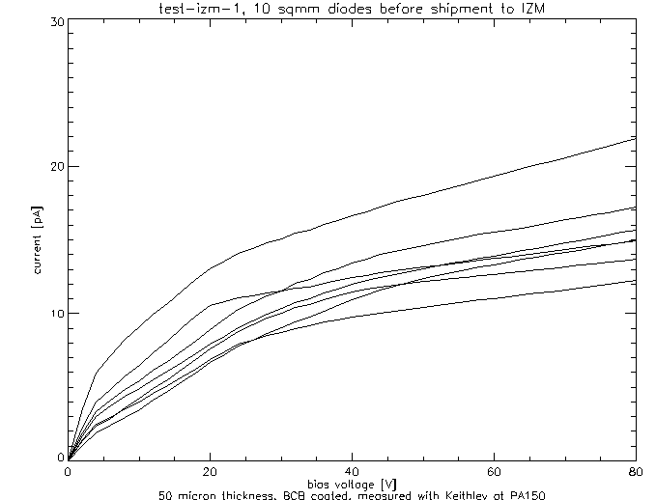
HLL PiN Diodes .... with Cu und Sn (done at IZM)
Correlation of the reverse current at full depletion
(50 V) before and after Cu metallization
-: right after Cu-System application (black diamonds)
-: after 320 ˚C in forming gas (red diamonds)
→ No significant effect of Cu metallization noticeable!
-: IV Curves before Cu metallization
-: measured at HLL, right before shipment
to IZM
-: from CV curves → full depletion at 50 V

Slide 24
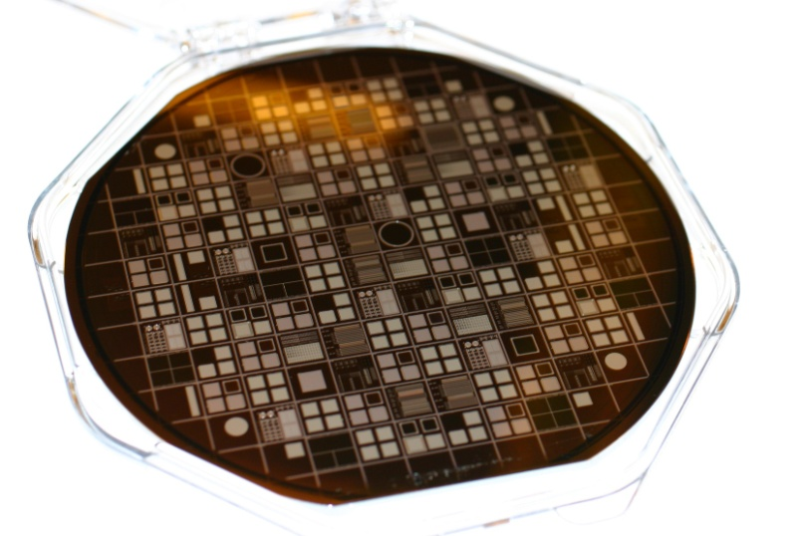
HLL PiN Diodes .... with Cu pads made at CNM
at HLL:
a. Pre-processing of 3 SOI and 3 Std. up to BCB openings
PiN Diodes, MOS Caps. many test structures for:
- design rules
- contact and sheet resistance
- contact “chains”
b. characterization before Cu
-: at CNM, Barcelona :
a. thru mask electroplating of Cu
→ first test wafer is being processed this week at CNM
PiN diodes on SOI Wafer,
50 µm thick fully depleted
PiN diodes on std.. Wafer,
450 µm thick fully depleted

Slide 25
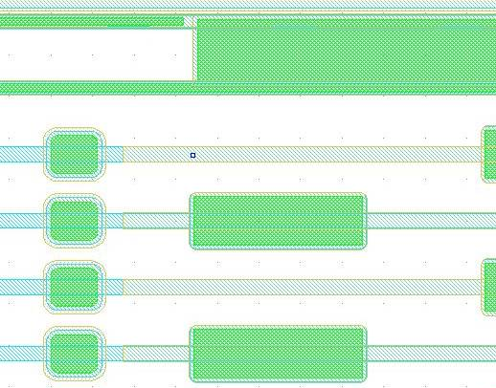
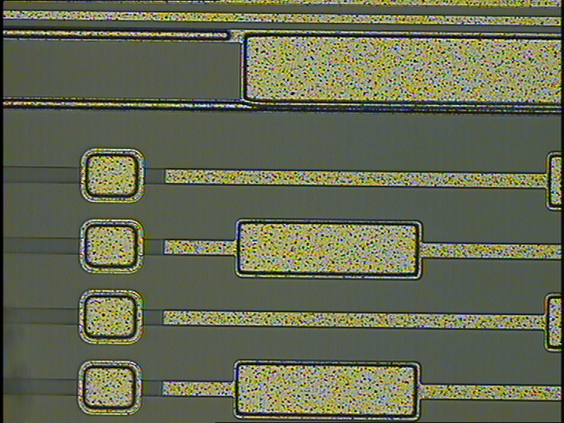
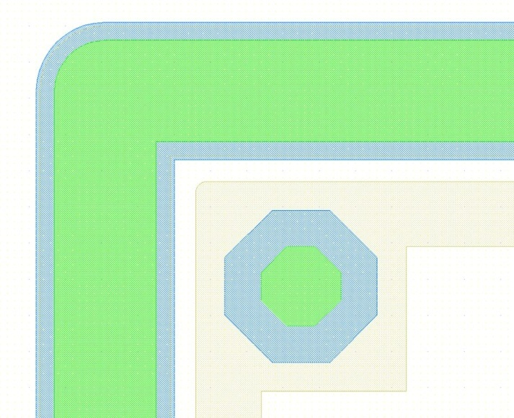
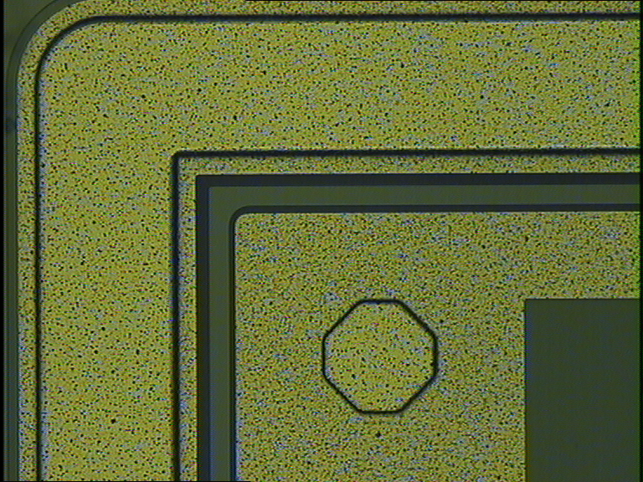
A few details: mask and real world
Alu
Alu pads
Copper
BCB opening

Slide 26
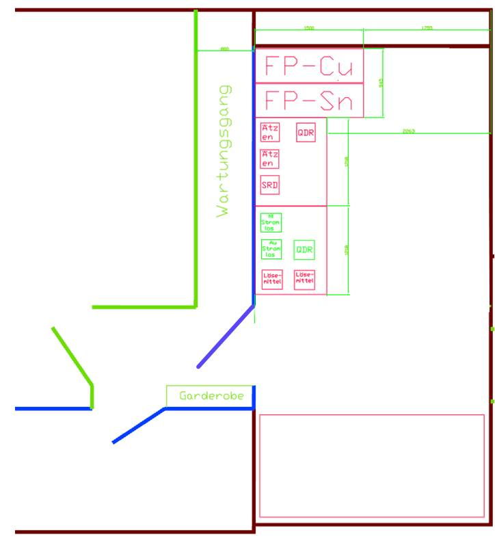
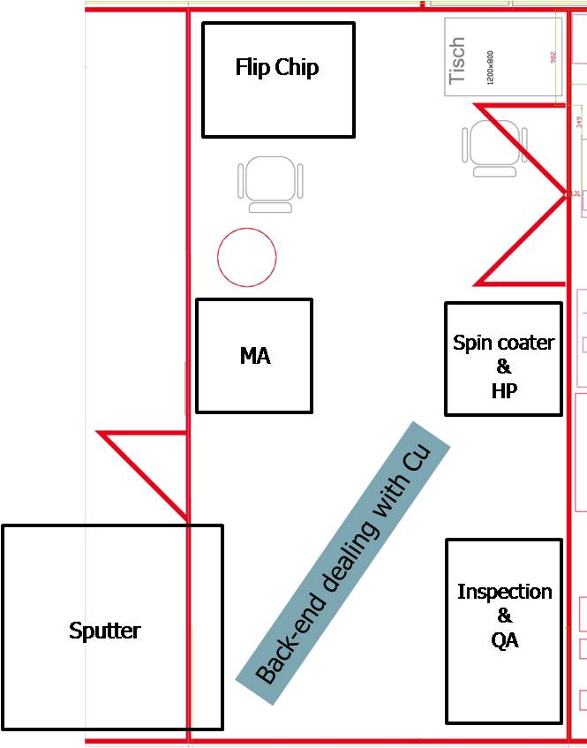
Electroplating and Flip Chip at HLL
Cu and Sn electroplating
Electroplating line in basement
Cu Back-end in clean room

Slide 27


Flip Chip Bonding → "pick-and-place"
-: after dicing of the sensor, the ASICs have to be flip chip bonded……….
-: dedicated machine for chip-to-chip assembly
-: alignment accuracy 1 µm (3 sigma)
-: no pressure needed!!! Fluxless possible….
-: in situ reflow for single chip
-: additional reflow furnace for mutli-chip
assemblies
Installed at:
-: IZM Berlin
-: CNM Barcelona
….. But it of course have to be adapted to our spezial needs
(i.e. sensitve back side of the sensors..)

Slide 28

The Future: "SLID" - "SOLID" - bumpless Cu-Sn bonding
ca. 5kg/cm²
SLID: Solid Liquid Interdiffusion
-: Cu+Sn layers → Cu₃Sn alloy
-: for electical and mechanical connection
-: min. pitch determined by pick and place
10.5 µm
Misalignment ~ 1 um
Infineon and IZM:
Chips on handle wafer bonded to base wafer
RTI with direct chip-to-chip attach

Slide 29




In Summary
-: The implementation of “non-standard” technologies for thin detectors lead to new ideas and
opened the field for new applications, micro-machining is one of the nice spin-offs.
-: The HLL is installing a back-end process line for the interconnection ASIC-Sensor
-: thru mask electroplating of sensors for UBM
-: 3rd metal layer in Cu (low impedance wiring!!!)
-: Flip chip assembly of commercially available bumped chips
-: The limit of the interconnection technology is given by the availability of bumped chips from
commercial suppliers (currently 150 to 200 µm), not by the technology itself.
-: The back-end line will be compatible with the latest developments of the microelectronics industry:
-: micro bumps (Pb free..)
-: bump-less interconnections (CuSn alloy)
-: fine pitch vertical integration of chips with Thru Silicon Vias

Slide 30
Backup slides follow

Slide 31



Electroplating Line
Result after
-: a lot of discussions with two equipment manufacturers (Ramgraber and Rena)
-: consultation of process experts and chemical suppliers for electro-plating
Fountain plater for Cu and Sn, etch baths for Seed layer removal, solvent area,
configuration finished.
Status: - Final meeting next week → fine tuning and price negotiations
- formal “call for bids” to sent out in the next 10 days
- delivery early 2010

Slide 32

Fountain Plater - Principle

Slide 33


Fountain Plater - Reality

Slide 34



Visit at Rena Application Lab, Freiburg (Br.)

Slide 35


"Chip to Wafer"
target wafer with placed chips
after removal of the handling substrate
chips on handling substrate
1. tested and diced chips are placed on a handling substrate with alignment marks
2. Handling substrate flipped and aligned to target wafer
3. SLID (temperature and pressure)
4. removal of handling substrate

Slide 36

Face-to-Face SOLID Process (IFX)
Top chip
Cu and Sn coating
Bottom chip
Cu coating, bond pads
No underfill
Inter chip vias
15 x 15 µm²
5 µm vias to LM
Redistribution
Insulation trenches
15 µm
Passive area
heat spreader
External IOs
standard wire bonds

Slide 37


The 3rd Layer - InterChip Vias (ICV) → IZM, Munich
Passivation
ILD 5-7 µm
Isolation
Tungsten Plug
Si 10 µm
Copper
Inter-diffused Copper / Tin Alloy
Alloy

Slide 38

The 3rd Layer - InterChip Vias (ICV) → IZM, Munich
1. thin the attached
chip and make a
contact to the
buried metal layer
2. or….face up attachment
of a thin chip to the
target wafer →
After Thinning on Target Substrate
Chip Thickness 10 µm

Slide 39

The 3rd Layer - InterChip Vias (ICV) → IZM, Munich
Fabrication of Tungsten-filled InterChip Vias on Top Substrate
Via Opening and Metallization
Bonding to Handling Substrate
Thinning

Slide 40


The 3rd Layer - InterChip Vias (ICV) → IZM, Munich
Fabrication of Tungsten-filled InterChip Vias on Top Substrate
Via Opening and Metallization
Thinning
Opening of Plugs
Electroplating
Copper

Slide 41
The 3rd Layer - InterChip Vias (ICV) → IZM, Munich
Fabrication of Tungsten-filled InterChip Vias on Top Substrate
Passivation
ILD 5-7 µm
Isolation
Tungsten Plug
Si 10 µm
Via Opening and Metallization
Thinning
Opening of Plugs
Through Mask Electroplating
Copper
Alignment and Soldering
Alloy
Sn

Slide 42



SET FC150 (ehemals Suess)
Installiert bei:
-: IZM Berlin
-: CNM Barcelona
-: RTI North Carolina .... (→ Fermilab SLID Versuche)
SLID @ RTI

Slide 43
Test HLL PiN Diodes .... with Cu pads made at CNM
TiW
Cu
BCB
SiO₂
BCB
p⁺⁺
Cu
Al
n-
n⁺⁺
6 Wafers
processed in the HLL R&D Lab
3 SOI Wafers,
50 micron top layer
Handle wafer as back side protection
3 std. HiRes Wafers
No back side protection
1 Wafer: Minimal contact openings on top side
Oxide as additional barrier against Cu
1 Wafer: Minimal contact openings on top side
Oxide as additional barrier against Cu
2 Wafers: Large contact openings on top side
The only barriers are TiW and BCB
2 Wafers: Large contact openings on top side
The only barriers are TiW and BCB

Slide 44



Ti:W Etching

Slide 45


Bumping Services for ASICs → ask google ....
-: various bump metallurgies, pitches etc.
-: some have contracts with ASIC fabs
(SPIL, FlipChip International...)
-: dummy chips for tests, bumped, with custom
layout, can be ordered
-: technology: almost exclusively solder bumps

Slide 46


SPIL in Taiwan/China
In Cooperation with TSMC (via Europarctice), UMC???
www.spil.com.tw

Slide 47


Direct Wafer Bonding
animation from: www.mpi-halle.mpg.de
bonding front spreads outwards with ca. 1cm/sec
Q.-Y. Tong and U. Gösele “ Semiconductor Wafer Bonding ”
John Wiley & Sons, Inc.

Slide 48




Direct Wafer Bonding
Q.-Y. Tong and U. Gösele “ Semiconductor Wafer Bonding ”
John Wiley & Sons, Inc.

