Slide 1
Module Testing at HLL – W08_OB1
Belle II Weekly – 07.02.2018

Slide 2
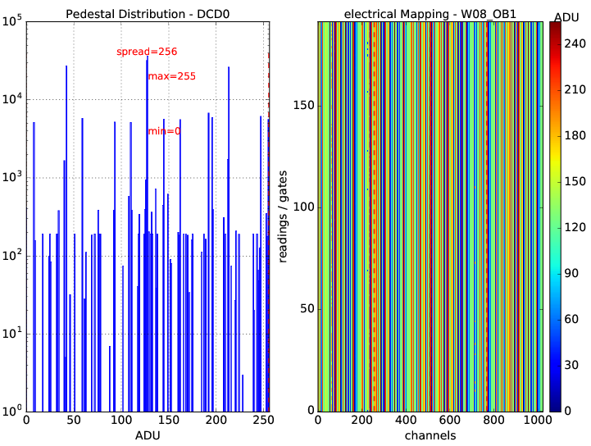
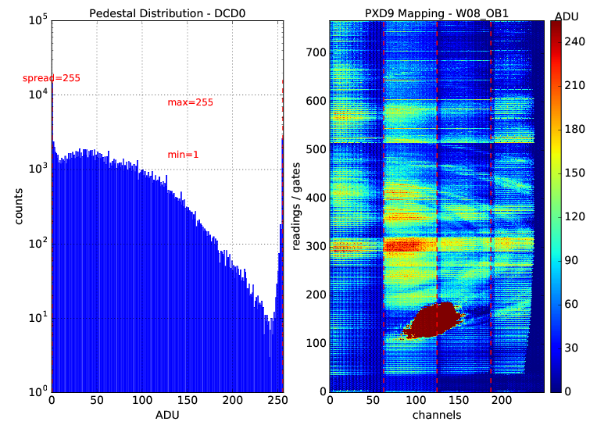
W08_OB1 – Probe card testing
All steps passed (module classified as perfect):

Slide 3
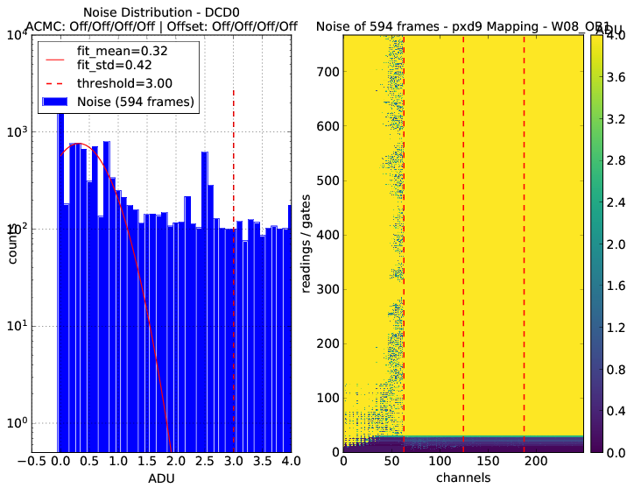
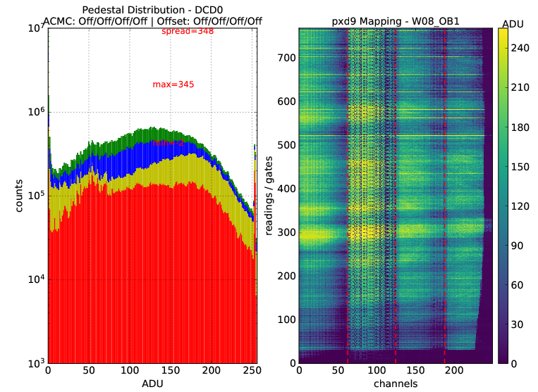
W08_OB1 – Testing at MPP
HSLink scan passed/fine
Delay scan passed/fine
Pedestals show problems: “corrupted lines” in ASIC pair 2, high noise due to that
Sent to HLL for debugging

Slide 4
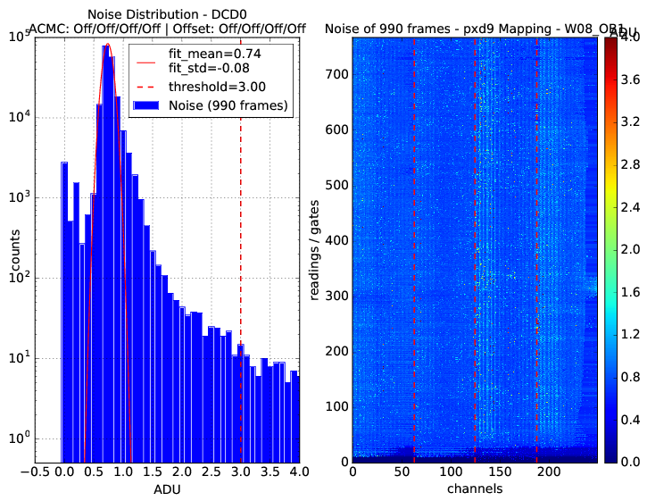
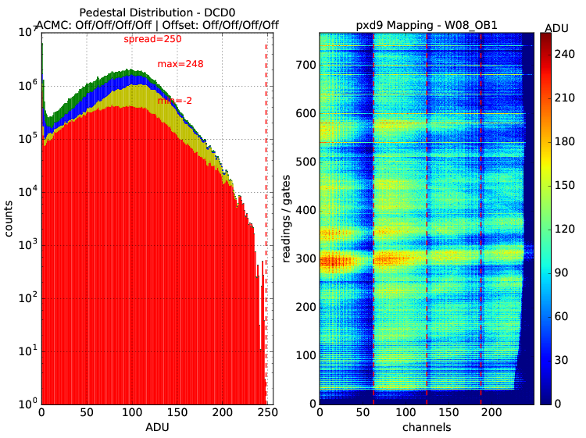
W08_OB1 – Pedestals at HLL
Pedestals look good: no “corrupted lines”, just like in probe card testing
Noise looks good as well
Rest of the mass-testing performed at HLL

Slide 5
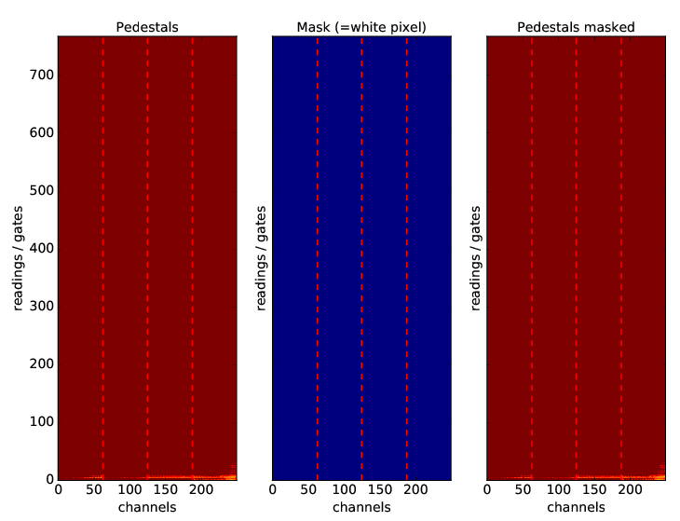
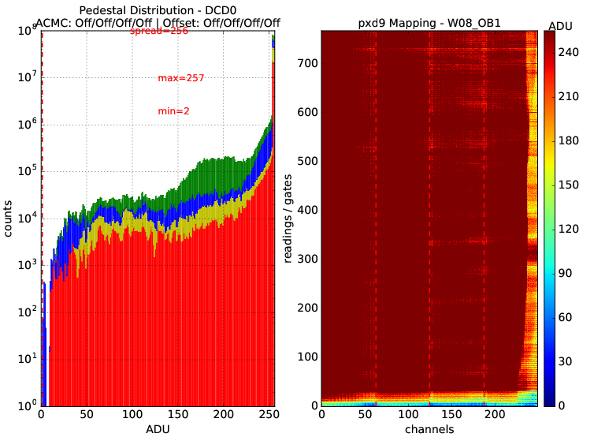
W08_OB1 – Broken Drain Analysis
No broken drain lines found

Slide 6
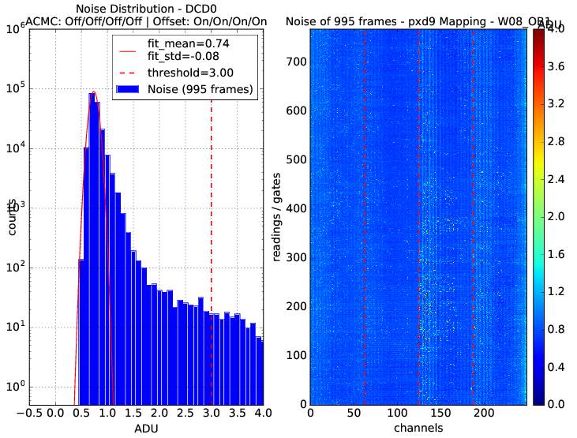
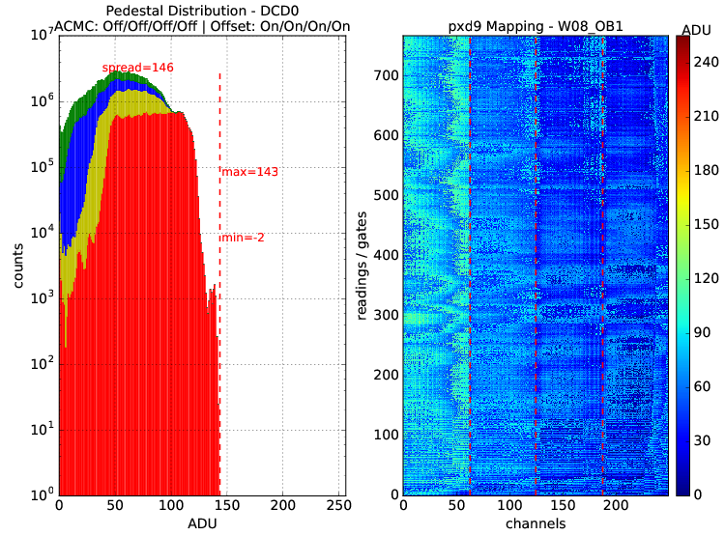
W08_OB1 – First offset calibration
Optimization ran at GateOn1/2/3 = -1.0V
Results satisfactory for first scan

Slide 7
W08_OB1 – ADC analysis
ELOG entries # 6499, 6550, 6554, 6557
IPSource: 80 85 75 85 IPSource2: 70 80 55 70
DCD-Refin: 250mV DCD-Amplow: 750mV
IFBPBais: 70 70 70 65
IPSourceMiddle: 73 75 75 71
Result: alive_channels 100.00 A Comment: channels total 1000 | good 1000 | dead 0

Slide 8
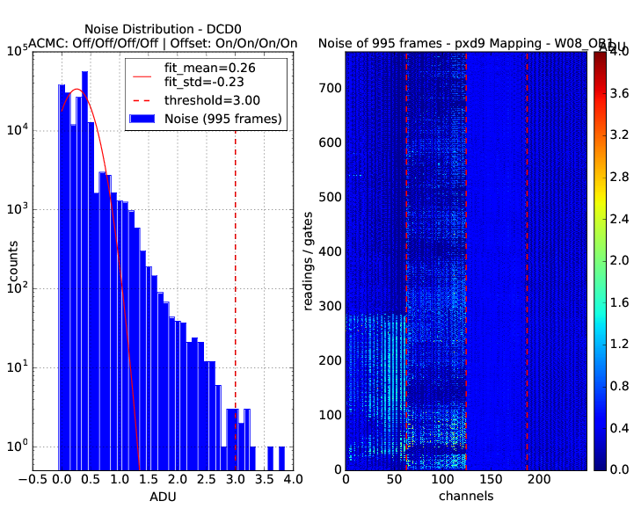
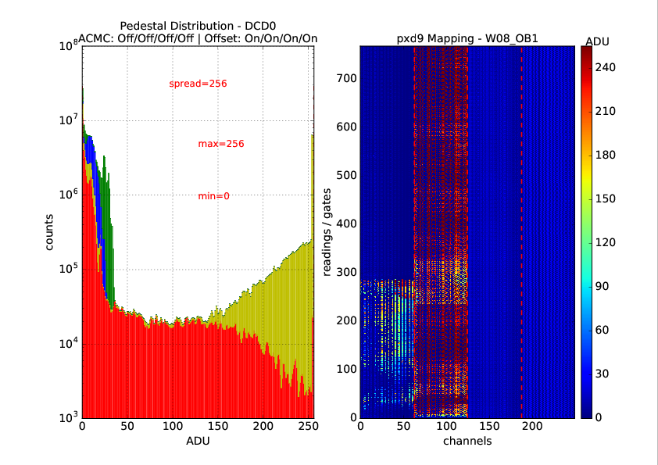
W08_OB1 – Second offset calibration (I)
Optimization ran at GateOn1/2/3 = -2.7V/-2.6V/-2.6V (100mA @ Source)
Not satisfactory at all!

Slide 9
W08_OB1 – Comparison to Testing at MPP
Comparison with MPP:
(Almost?) Same pattern in ASIC-pair 2!

Slide 10
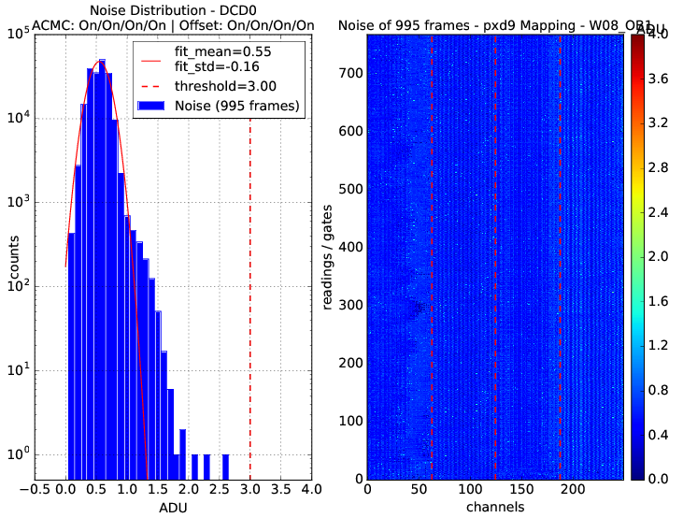
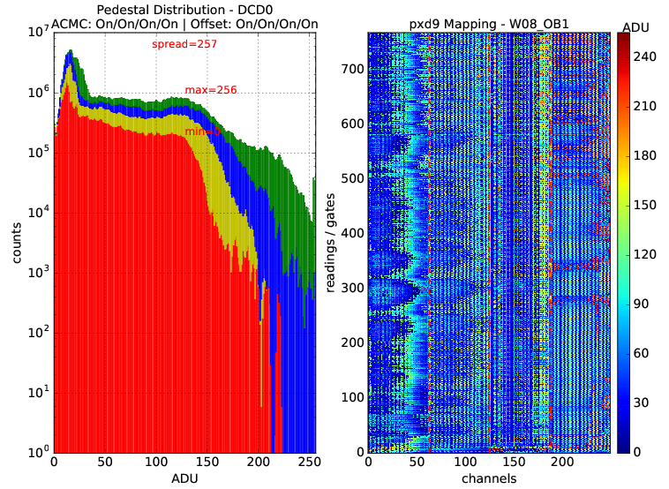
W08_OB1 – Second offset calibration (II)
After module power-down/up and with analog CMC:
Still not very nice…

Slide 11
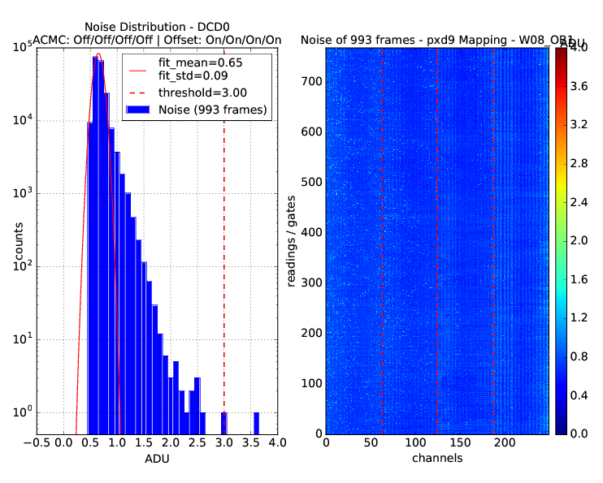
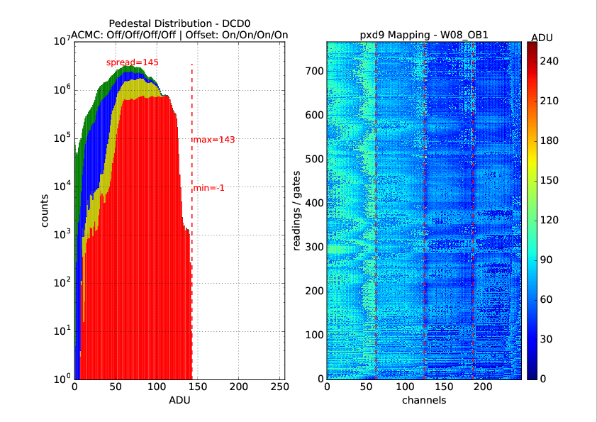
W08_OB1 – Second offset calibration (III)
Started three more offset calibrations with lower GateOn voltages:
Essentially the same picture
Loaded offsets of first calibration with GateOn at -1.0V:
Still looking good.

Slide 12
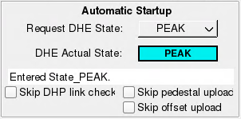
W08_OB1 – Problem analysis
Problem A located in digital power-up procedure:
On power-up “Skip offset upload” is set
No offset data or offset data from other module (commit copied from prev. module?)
After power-up: Offsets get uploaded and enabled
Can cause pattern in pedestals
Problem B located in JTAG/ASIC stability on W08_OB1:
Experienced several times on this module only problems with uploading offset data
Reupload of offset data fixes this problem
However: Strong irradiated area seems to prevent offset calibration from giving satisfactory results even when the above problems are avoided (as possible)

Slide 13
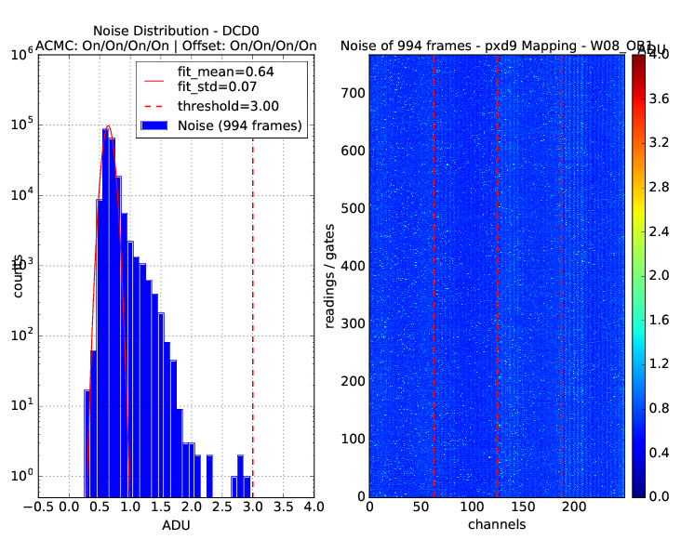
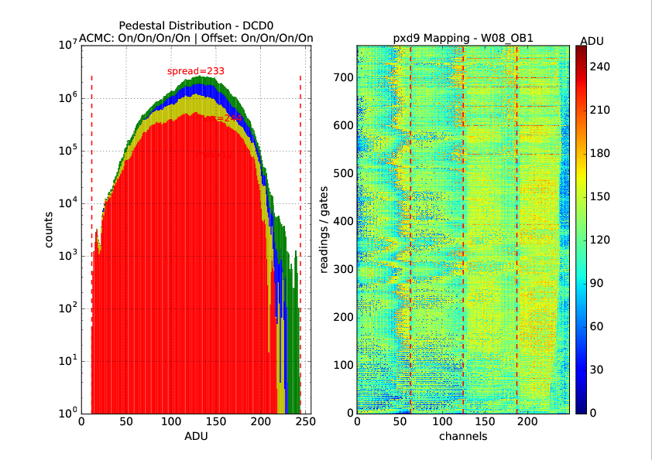
W08_OB1 – Manual offset calibration
Started with first offsets (before ADC, at GateOn = -1.0V)
Set GateOn = -2.0V
Took several pedestals, manually tuning IPDAC and VnSubOut:
VNSubIn: 36/35/34/34 IPDAC: 30/27/22/22 VnSubOut: 105/95/90/80

Slide 14
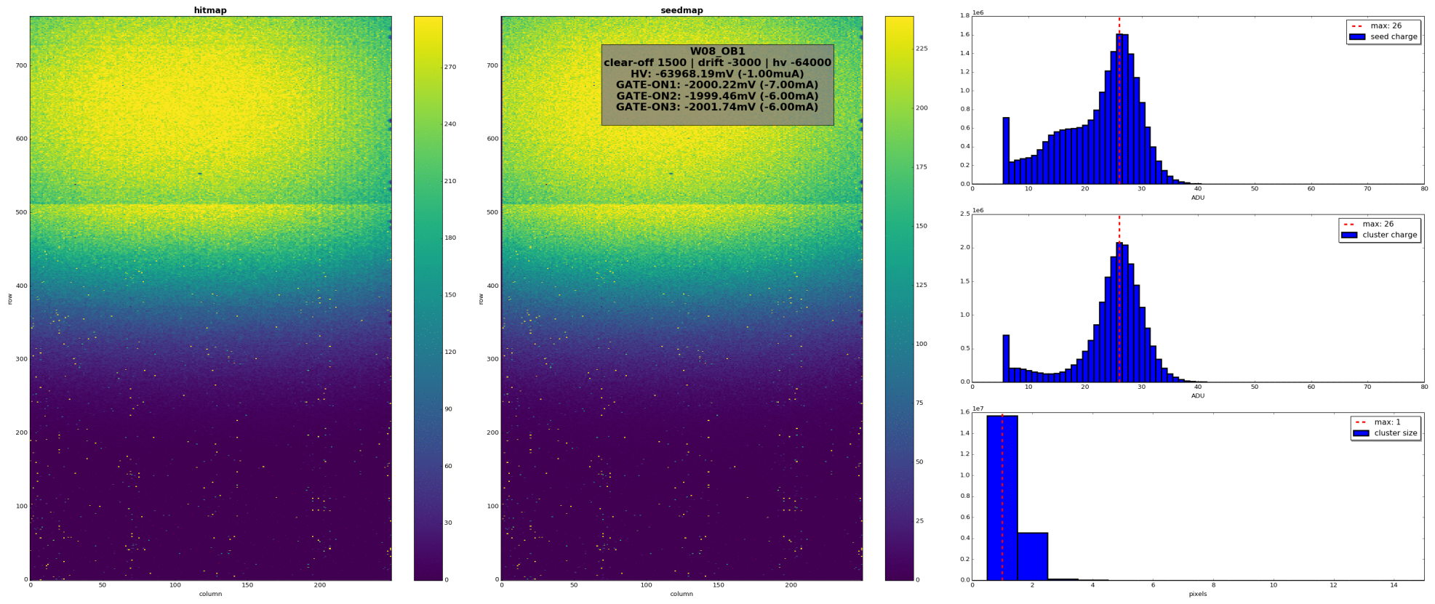
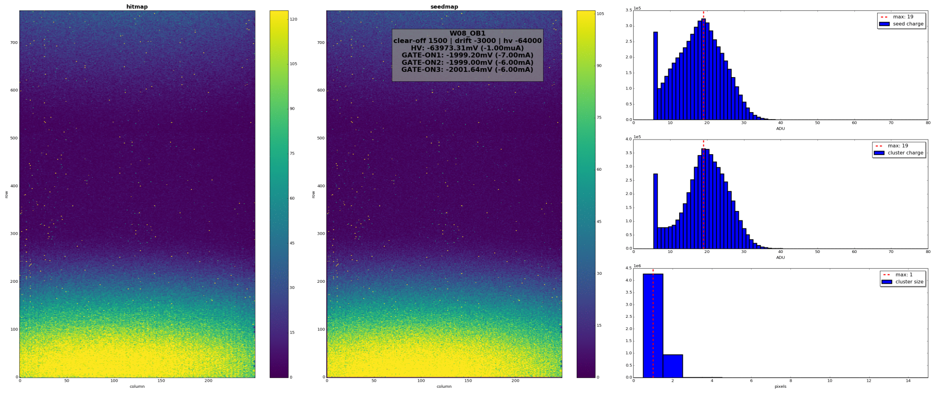
W08_OB1 – Source Scan
Several good settings found. Chosen: HV: -64V, Drift: -3V, Clear-off: 1.5V
Looking good, full scan still not working 100%. But Grade A very likely.

