Slide 1
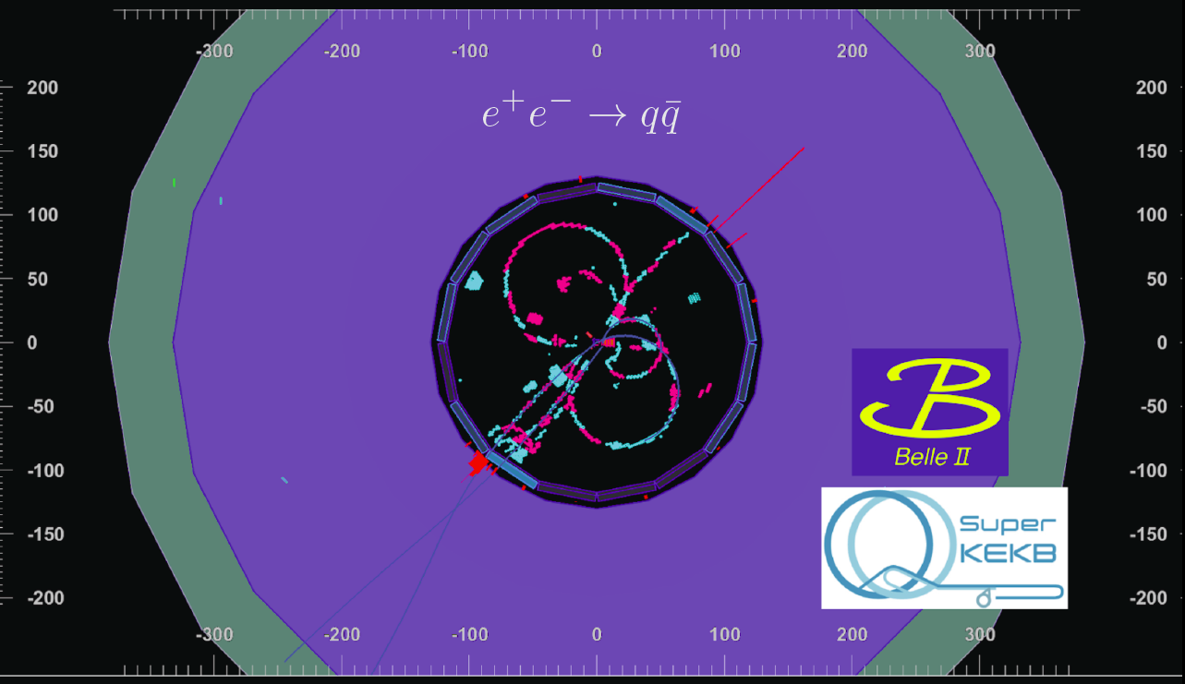
Belle II
Introduction
Status of SUPERKEKB and Belle II
Phase II
Phase III
Activities at MPI
Cooling
Detector Assembly
Computing
Physics Analysis
Summary

Slide 2
Team & Responsibilities
Director: Allen Caldwell
Project Leader: Hans-Günther Moser
Staff: Vladimir Chekelian, Frank Simon (FD)
Emeritus: Christian Kiesling
Postdocs: Luigi Li Gioi (till 2018), Felix Müller, Boqun Wang (from 2019),
Fabian Krinner (from 2019, S. Paul), Thibaud Humair (from 2019, FD)
PhD Students: Philip Leitl, Felix Meggendorfer, Sebastian Skambraks, Benedikt Wach, Hendrik Windel, Thomas Kraetzschmar (FD), Fernado Abudinen (till 2018),
Sara Pohl (till 2018)
Master Students: Sara McCarney, Markus Reif, Ketevan Parlagashvili, Mohamed Albalawi, Mansour Atalawi
Bachelor Students: Sandro Christoph, Oskar Tittel
Guests: Wan Kun (Tokyo University)
Technical Support: Ullrich Leis, Karlheinz Ackermann, Sven Vogt, Christoph Knust, Enrico Töpper, Walter Kosmale, David Kittlinger, Andreas Wunderl, Janick Albrecht, Miriam Modjesch, Markus Fras, Stefan Horn, Reinhard Sedlmeyer…….
PXD: Module Tests, Ladder assembly and mounting, services, installation
IBBelle CO₂ Cooling System (Operation and regular maintenance transferred to KEK)
Neural Net z-Trigger
Computing (Tier II cluster at MPGCC)
Management: IB chair till June 2018 (HGM), Convener TDCPV (L. Li Gioi), Leader PXD commissioning (F. Müller)

Slide 3

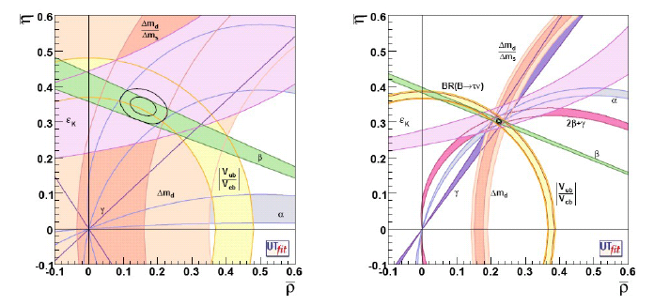
Physics at B-factories
Main Motivation: CP-violation
Measurements of CKM matrix elements and angles of the unitarity triangle
Measurements of rare decays (e.g., B→τν, Dτν)
Others (τ, LFV)
Motivation for SuperKEKB/Belle II:
Test Standard Model (SM) as precisely as possible
=> Over-constrain unitarity triangle
=> Look for deviations from SM
=> Increase sensitivity for rare decays
=> Indirect discovery of New Physics via loops
Nobel Prize 2008: Kobayashi & Maskawa
Confirmation of CKM theory by BaBar & Belle
With 50 ab⁻¹ (same central values)
Babar/Belle
(~1.5 ab⁻¹)

Slide 4
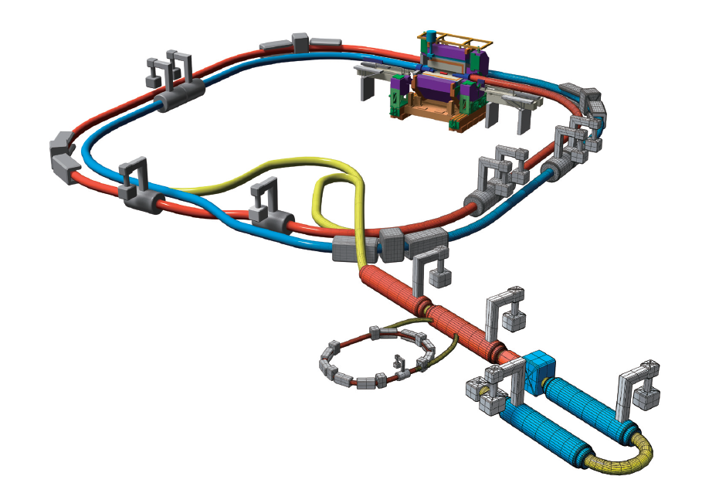
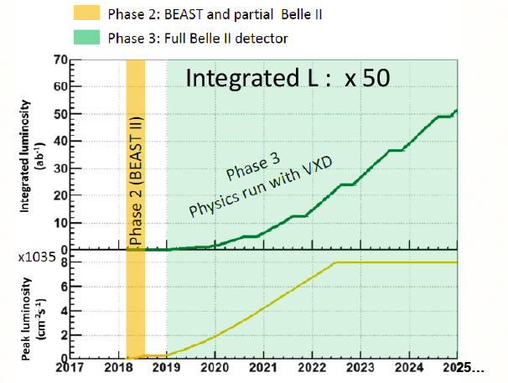
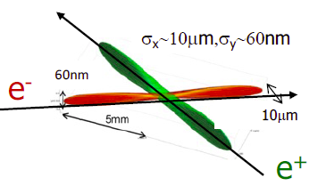


SuperKEKB: L = 8x10³⁵/cm²/s
e⁺ 4GeV 3.6 A
New superconducting /permanent final focusing quads near the IP
Upgrade KEKB to reach
L = 8 x 10³⁵ cm⁻²s⁻¹
(40 x luminosity of KEKB)
Nano Beams: 10µm x 60nm
Increase beam current (x2)
Reduce asymmetry (boost)
KEB: βγ = 0.42 (8 GeV, 3.5 GeV)
SuperKEKB: βγ = 0.28 (7 GeV, 4 GeV)
e⁻ 7GeV 2.6 A
Replace short dipoles with longer ones (LER)
Add / modify RF systems for higher beam current
Damping ring

Slide 5
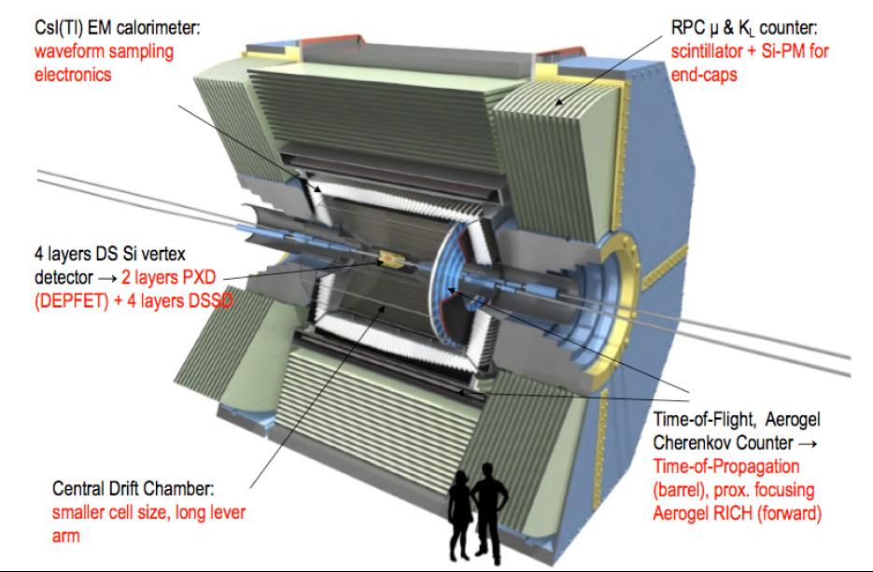
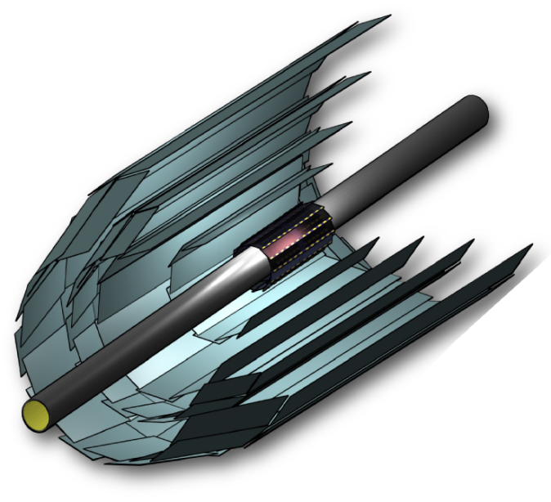
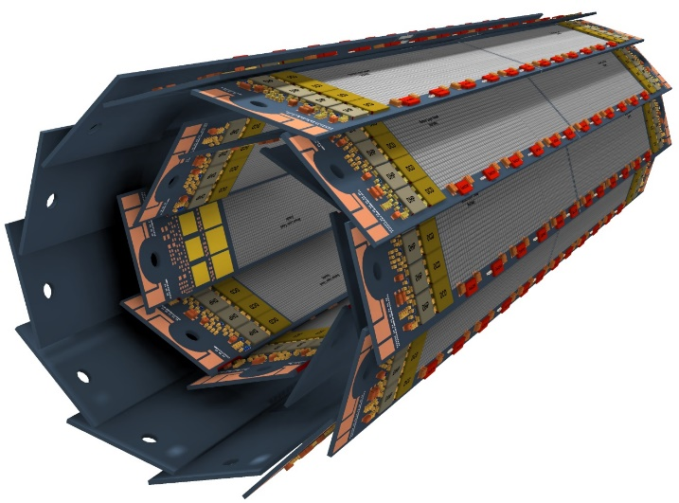
Belle II
SVD: 4 layer Si strip detector (DSSD)
(R = 3.8, 8.0, 11.5, 14.0 cm)
PXD: 2 layer Si pixel detector (DEPFET technology)
(R = 1.4, 2.2 cm)
monolithic sensor, thickness 75 µm (!),
pixel size 50 x 55 µm² to 50 x 85µm²
Belle II: 908 members, 113 institutions, 26 countries
σ [µm]
100
Belle
50
30μm
20
Belle II
15μm
0
0.4
0.8
1.2
1.6
2.0
pβsin(θ) [GeV/c]

Slide 6
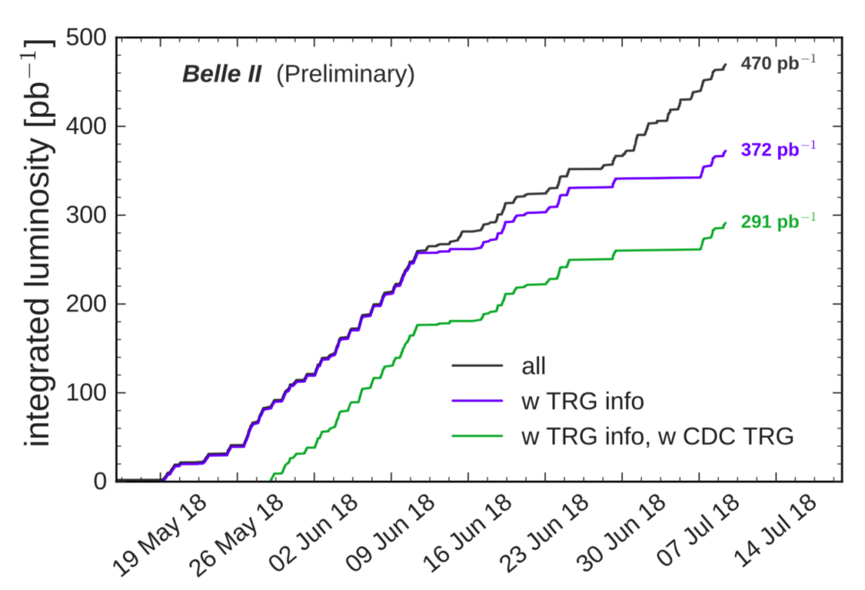
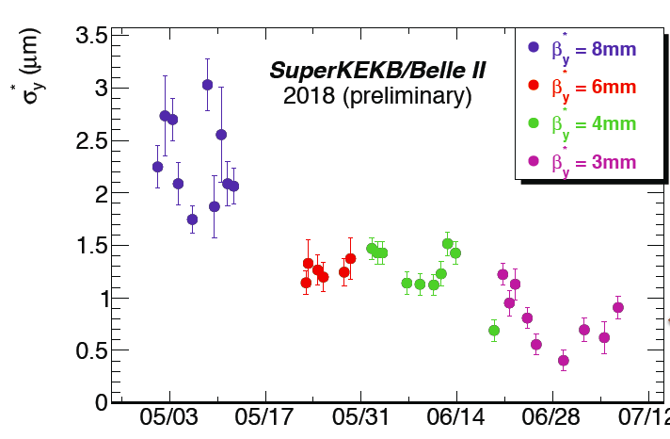
Phase II Run
Motivation:
Verify nano-beam setup
Achieve O(10³⁴cm⁻²s⁻¹)
Achieve safe operation conditions for vertex detector (radiation, stability)
Operation: March – July 2018
Peak luminosity: 5.6 x 10³³cm⁻²s⁻¹
Integrated luminosity: 470 pb⁻¹ (on tape, most of the run was machine development)
β*_{y} = 3mm, σ*_{y} = 333nm
Background (radiation) ok for VXD, still needs improvement, though
< 500nm

Slide 7
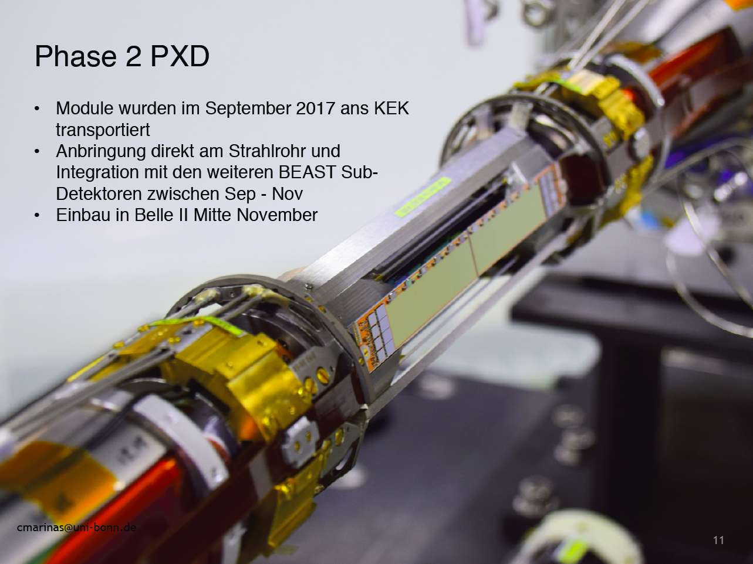

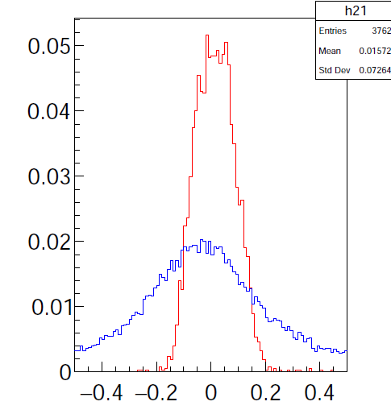
Phase II PXD
4 PXD Modules (inner and outer layer)
Integrated with SVD sector and other
Beast detectors (CLAWS, FANGS, Plume)
Operated March-July 2018
Z₀ (interaction region)
CDC only
SVD, PXD

Slide 8
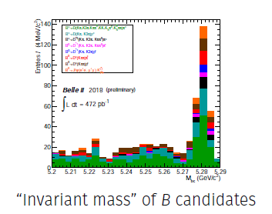
First Hadronic Event

Slide 9
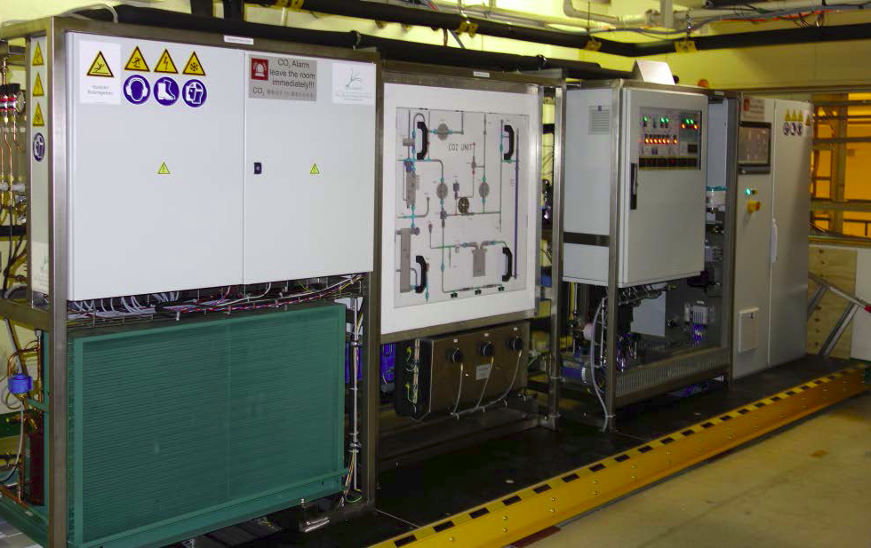
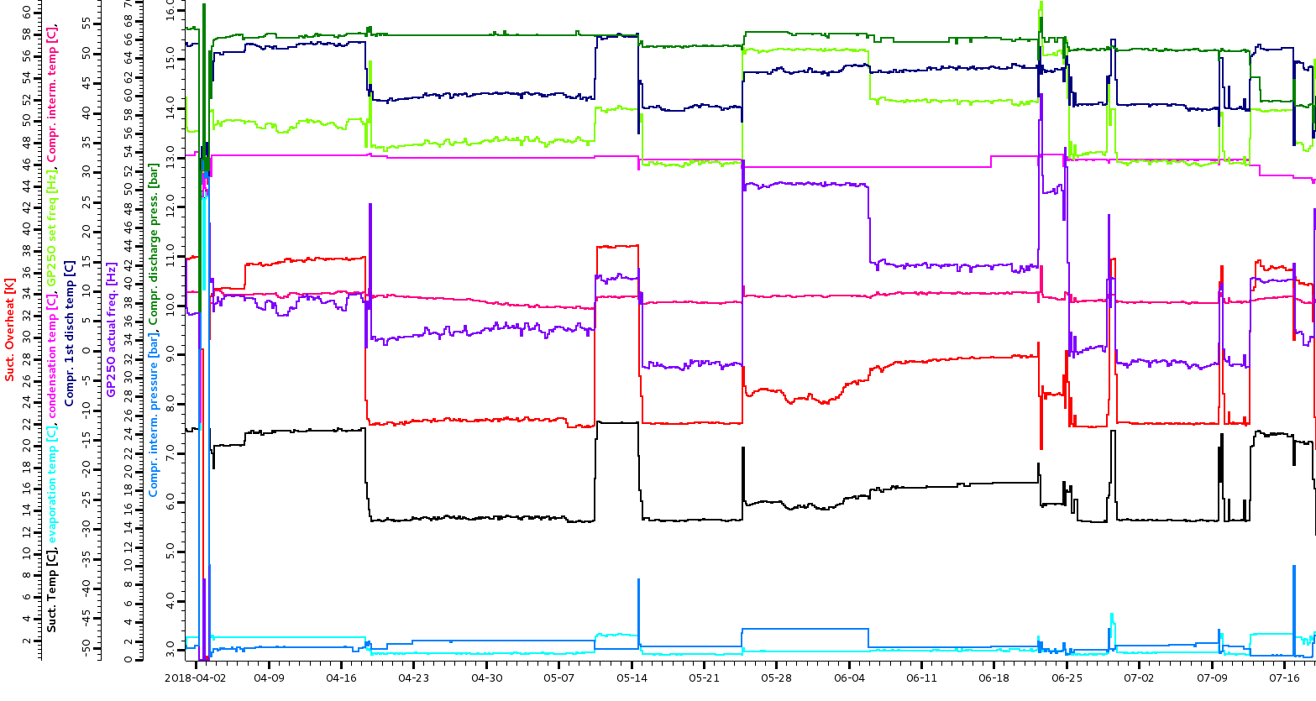
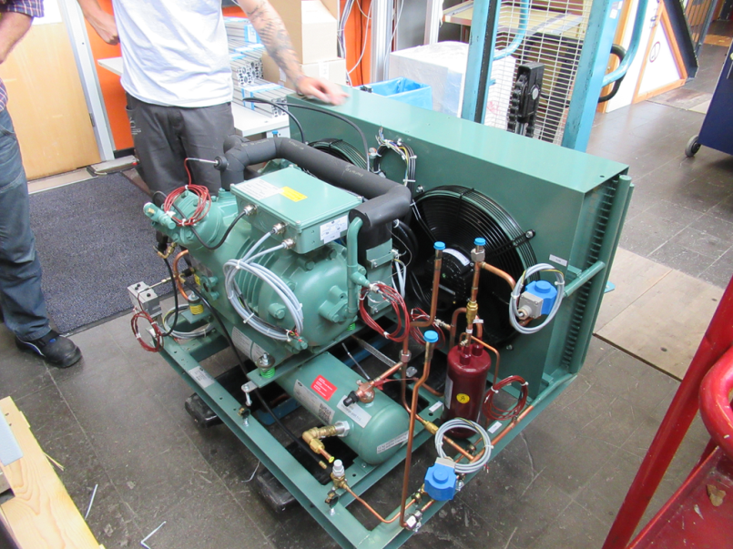
IBBelle Status
IBBelle ran continuously from March to July without problems
Total ON time from January to July: 180 days.
Few stops due to QCS quenches (power instabilities) and (false) humidity alarms
August 2018: compressor failure
Spare compressor shipped to KEK and installed
Reason for failure understood and fixed
IBBelle up again for Phase III

Slide 10
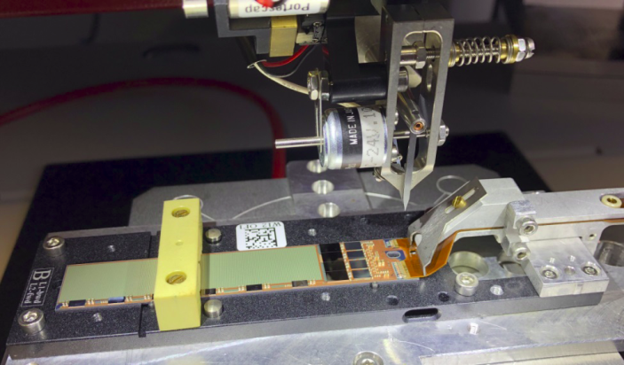
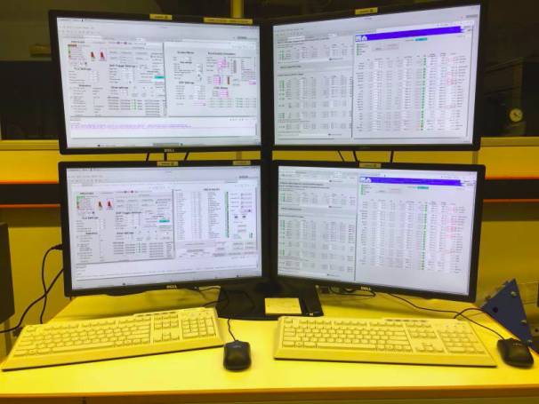
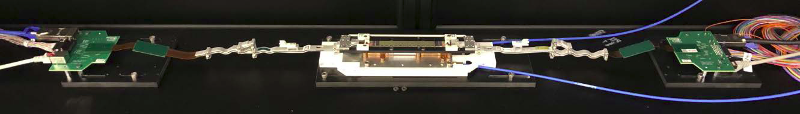
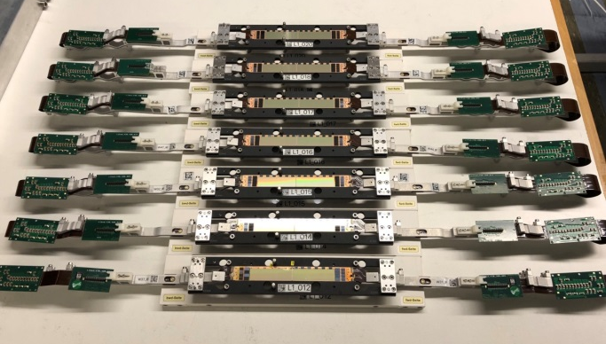
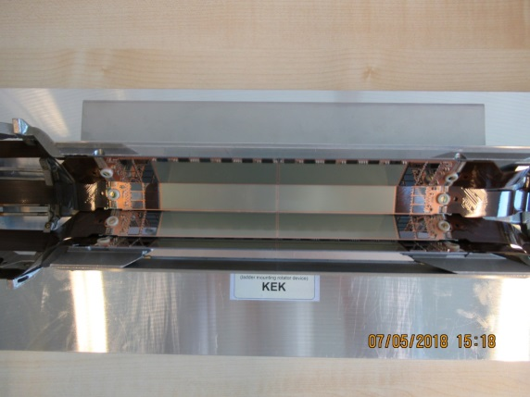
Detector Production
Kapton attachment to modules (bonding)
Electronic Tests
Gluing of two module to a ladder
Mounting of ladders to the support

Slide 11
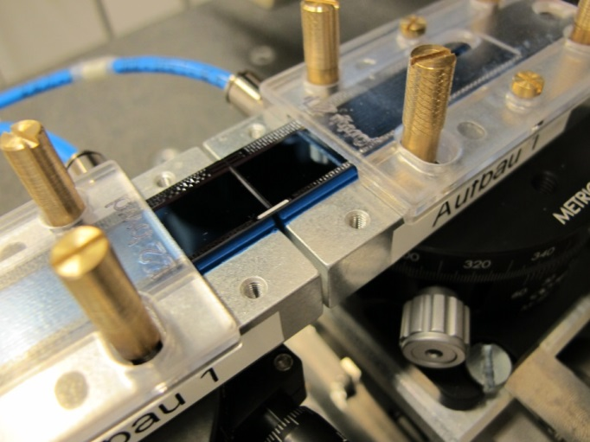
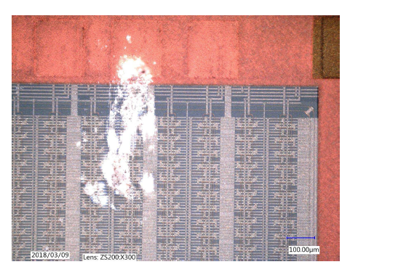
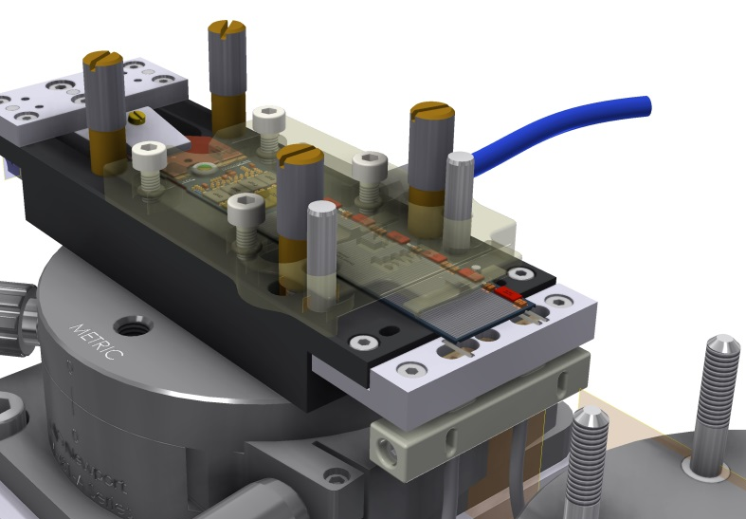
Ladder Gluing
Gluing of the first 8 inner ladders worked without problem
Then we observed fatal detector damages during the gluing procedure
Dust particles penetrated the protection layer and destroyed the detector surface
Sensitive detectors surface was pressed (by vacuum) to the ceramic chuck
Need access to backside to insert ceramic joints
Old: Module fixed on frontside, joints attached from above (by hand)
Production slowed down an stopped
2nd layer modules could not be produced in time
Phase III PXD has only inner layer
Assembly procedure will be modified
2nd layer will be installed in 2020
Backup sensors in production in HLL
New: Module fixed on backside, joints attached from below (lifting tool)

Slide 12
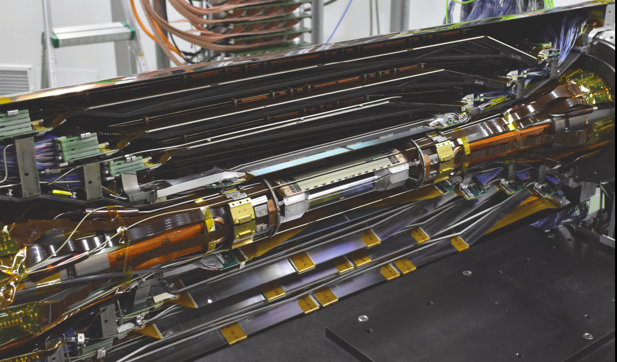
Integration with SVD: VXD
PXD shipped to KEK in August
Integration in Belle II: November 21

Slide 13
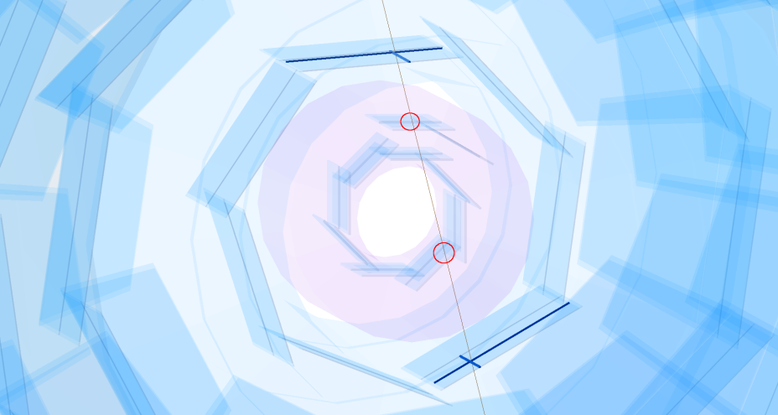
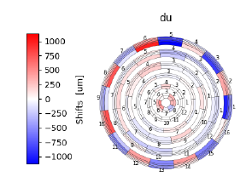
Commissioning
Cosmic Data (alignment)
Commissioning after insertion in Belle I
all modules are working
Pedestal data ok
Still some problems with data rate jumps
(probably unstable clock)
Data taking to start March 10, 2019
Preliminary (J. Kandra)

Slide 14
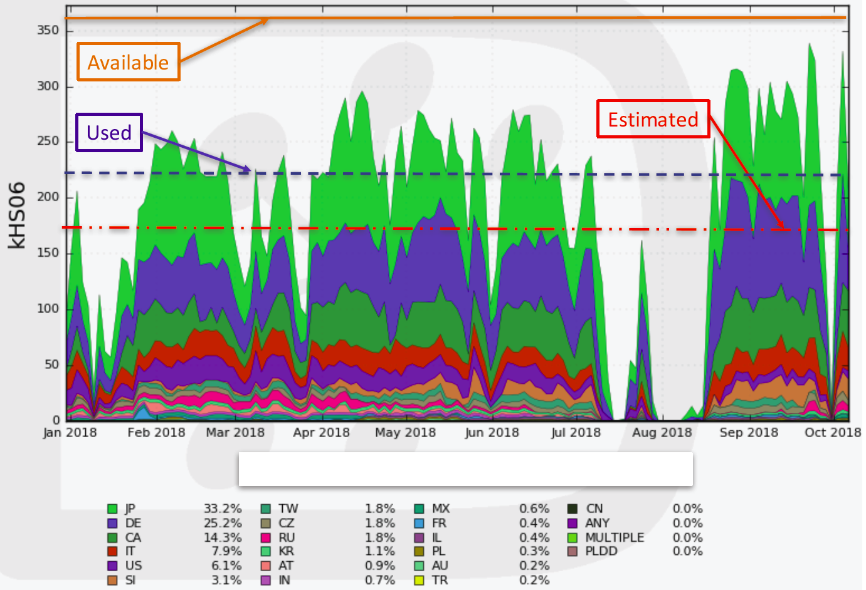
Computing
MPP (MPCDF in Garching) provided in 2108 17429 HEP-SPEC06 and 153 TB storage to Belle II MC production
Germany:
DESY, KIT, MPP

Slide 15
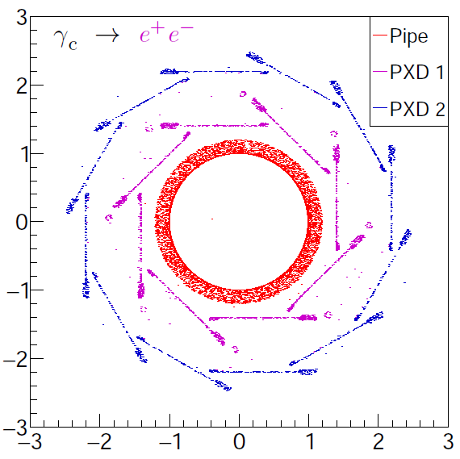
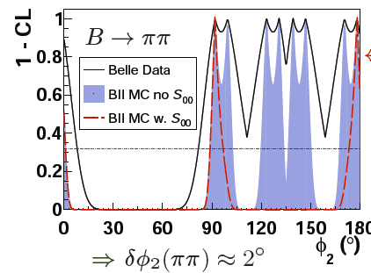
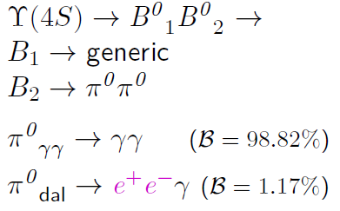
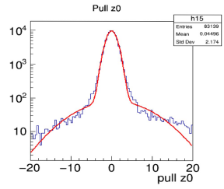

Physics & Software
Feasibility Studies:
Prospects of B⁰ -> π⁰π⁰
(Fernando Abudinen)
Resolve ambiguities using B⁰ -> ρρ
Analyses planned with Belle II data:
CP violation in B -> Kπ (Belle II: Benedikt Wach)
Search for non standard τ decays: τ -> l + invisible (Belle & Belle II: Thomas Kraetzschmar)
Increase efforts in 2019 with new manpower (postdocs from FD (Frank Simon) and Stefan Paul)
Software: B-tagging (F..Abudinen)
Resolution function (Parlagashvili)
Resolution of Δτ for time dependent CPV
Contribution to systematic error

Slide 16
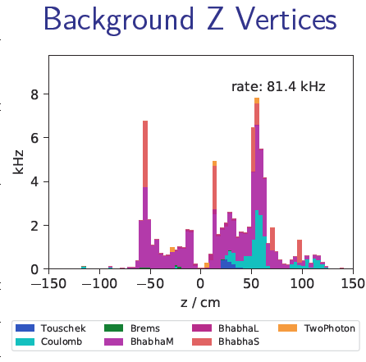
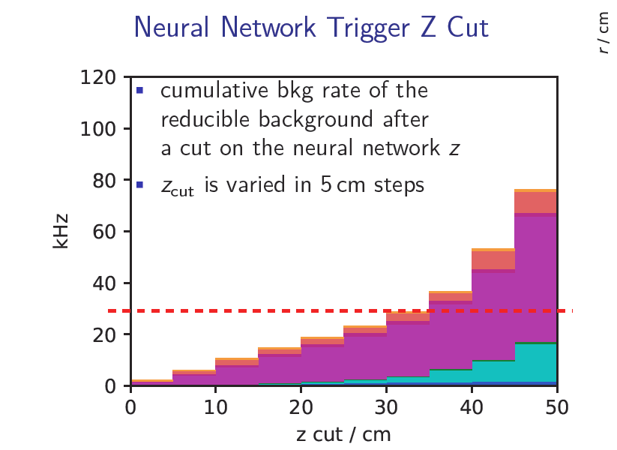
Neural Network Trigger
Trigger on z information of CDC tracks using a neural network
2 track trigger possible (τ, low multiplicity rare decays)
Z-resolution: 2 cm => cut at 6 cm
Reduce ~80 kHz background rate to < 30kHz (DAQ limit)

Slide 17
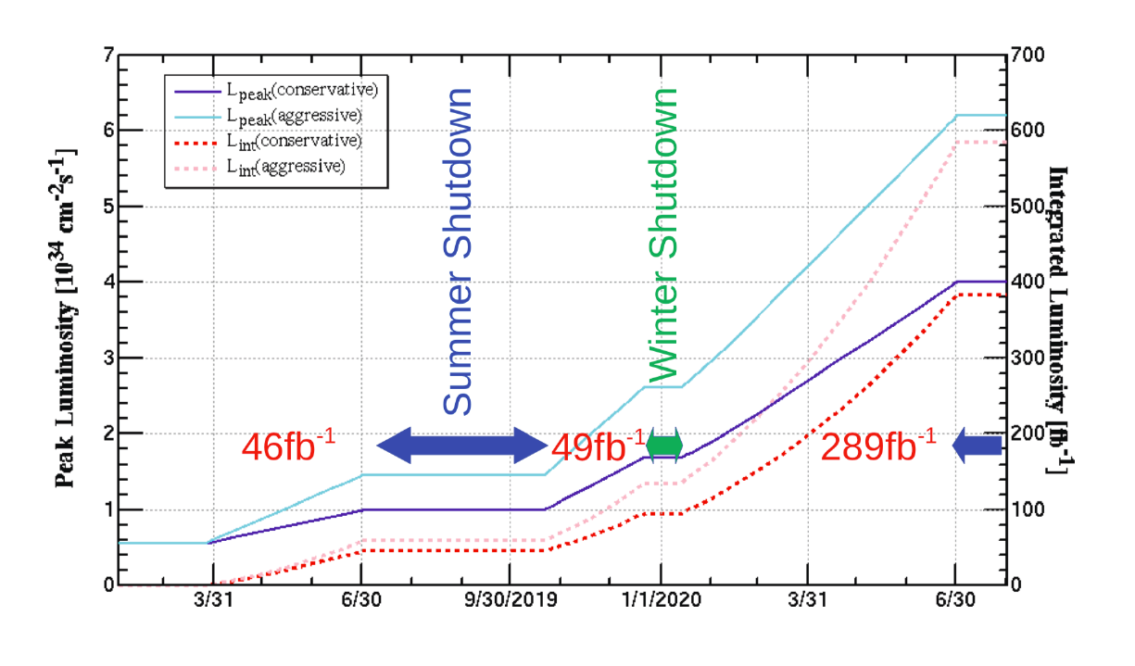
Summary
Phase II (March – July 2018):
SuperKEKB achieved first collisions,
L=, Lint = nb⁻¹
4 PXD modules in Beast II performed well
Phase III:
PXD inner layer completed and installed due to technical problems and delays 2nd layer will be completed in 2020
Production of additional (backup and replacement) sensors started in HLL
Phase III Data Taking: start in March 2019
Preparing for Physics (expected soon)
In 2019/2020
Prepare replacement detector with 2nd layer
=> need technical manpower
=> lab space

Slide 18
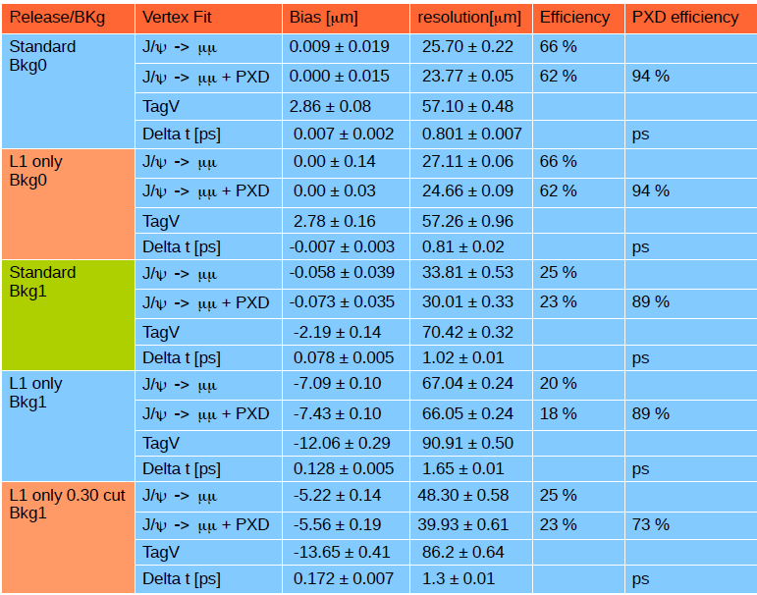
1 Layer versus 2 Layers

