Slide 1


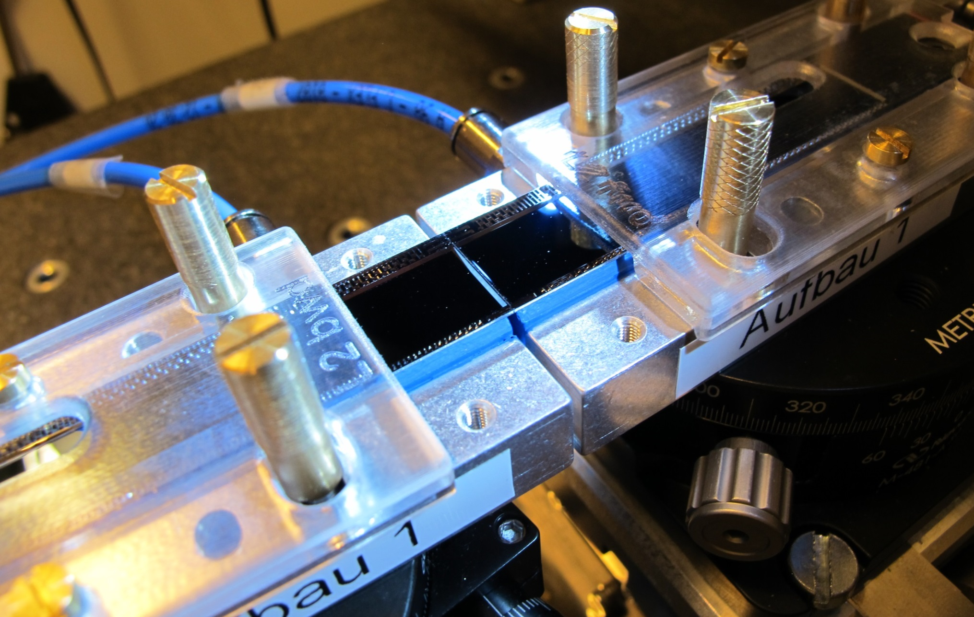
Ladder Assembly
Improved Procedure
22st International Workshop on DEPFET Detectors and Applications
8th April 2018
Hans-Guenther Moser, Felix Mueller, Enrico Toeppner

Slide 2
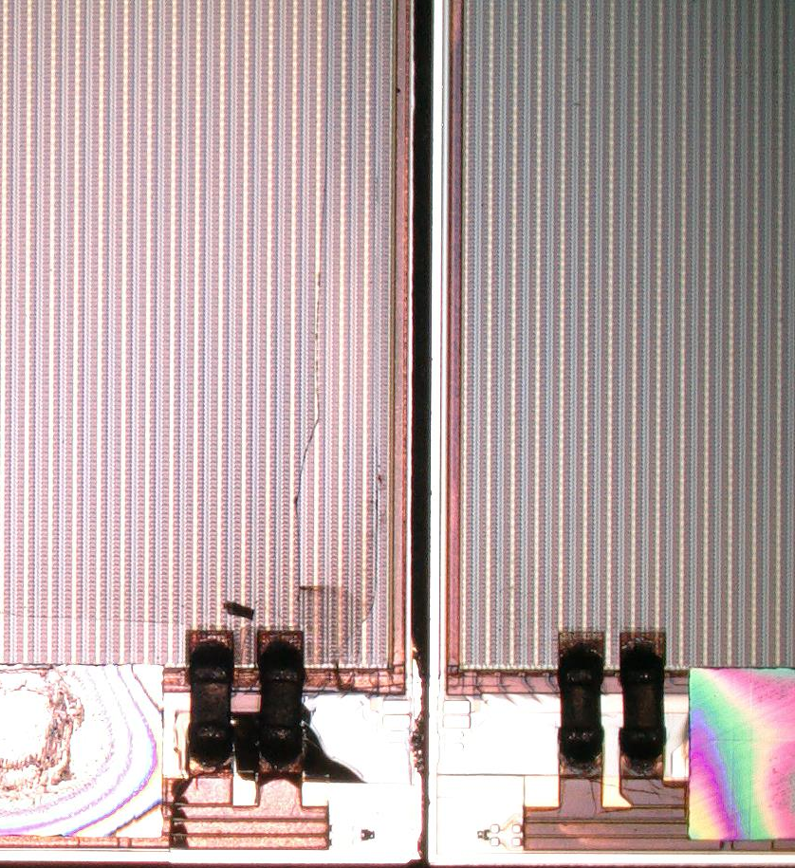
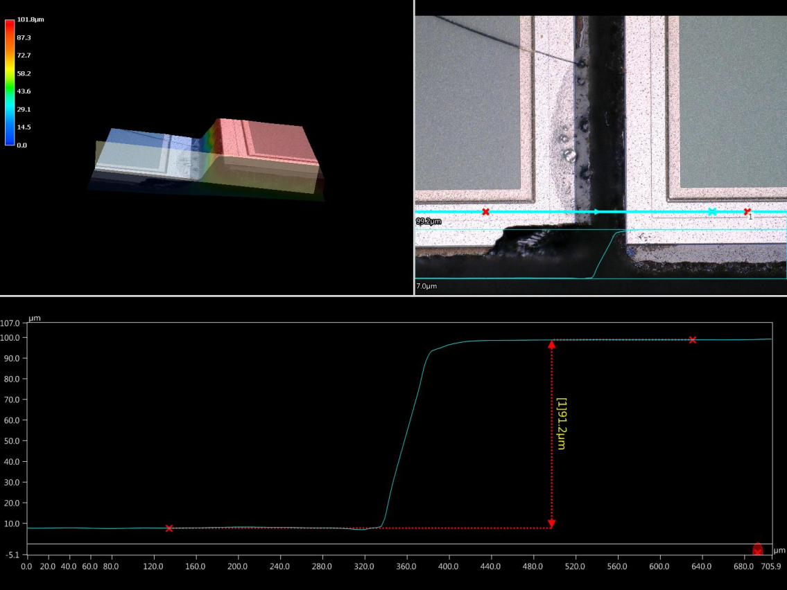
Accidents L2_022
L2_022: BWD module mechanically broken due to height offset
⇩
L2_023: dummy modules glued → procedure “okay”
W11_OF2: power up without any problem
W06_OB1
W11_OF2
~90 um

Slide 3
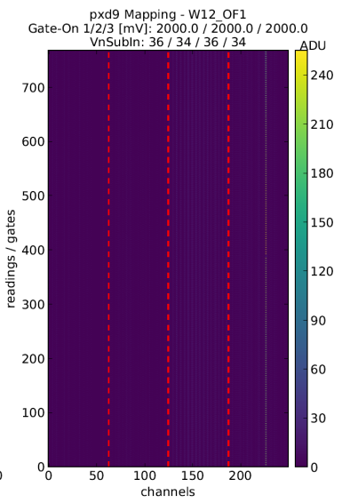
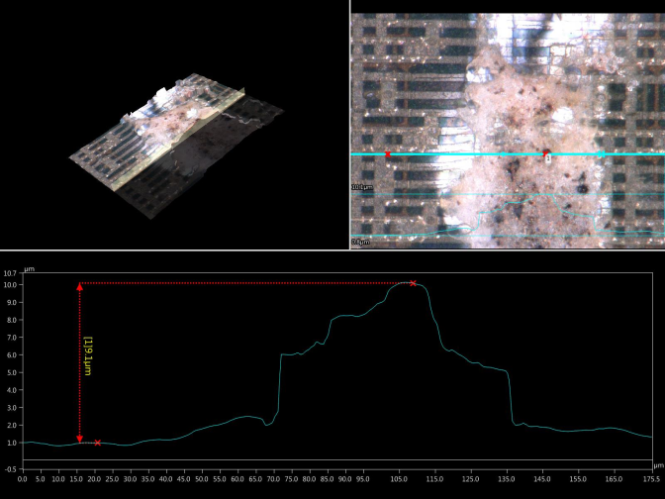
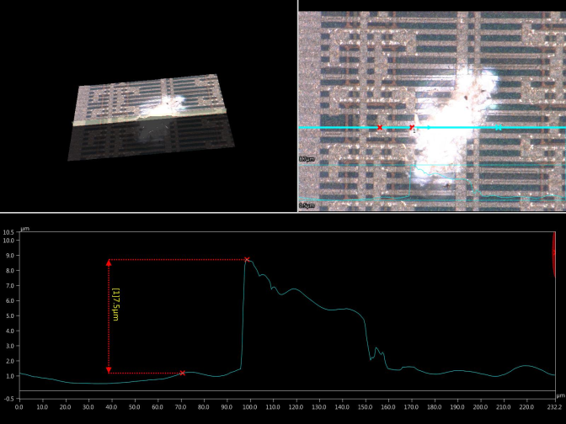
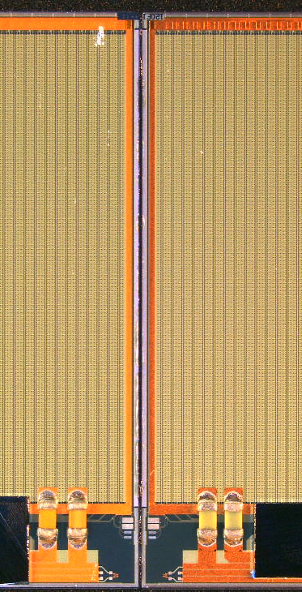
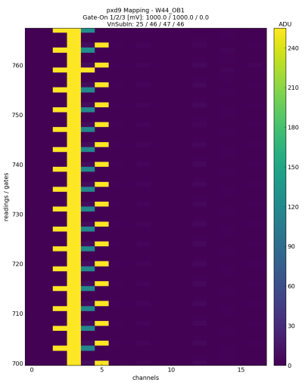
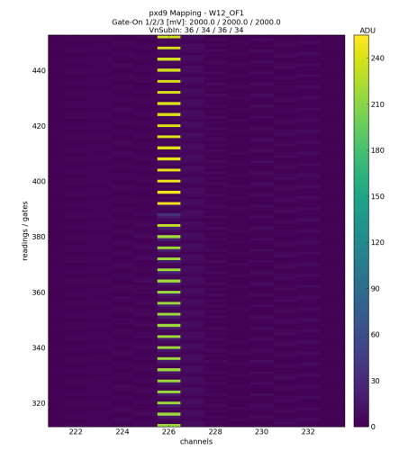
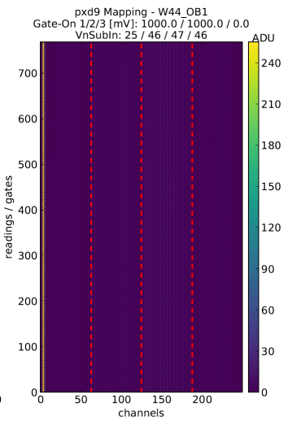
Accidents – L2_024
L2_024: particles on surface caused shorts in some pixels
  gate-off and gate-on in current limit during power up
  source current (20 mA) although gates are off
  shorts over matrix → current flows directly to drains
W44_OB1
W12_OF1
~9 um

Slide 4
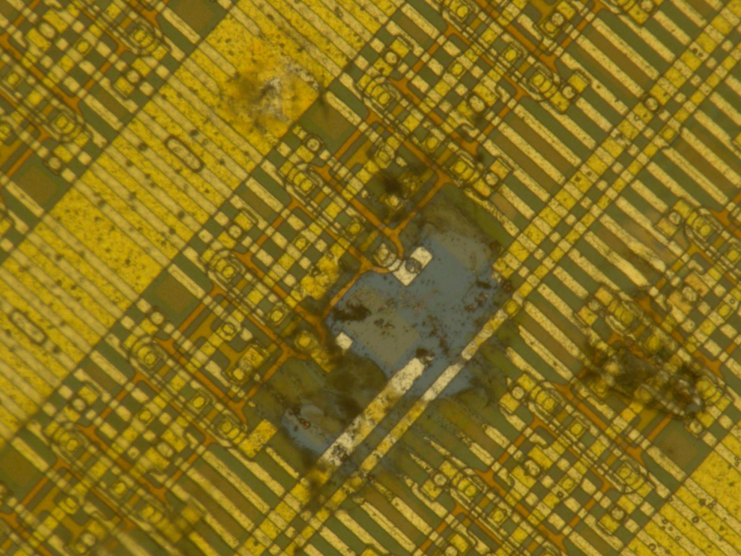
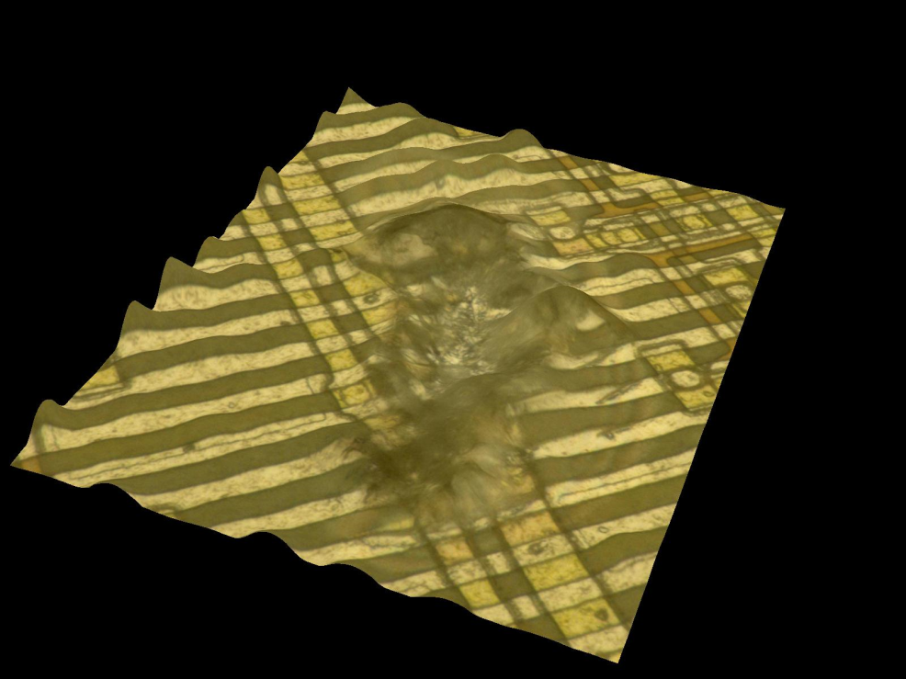
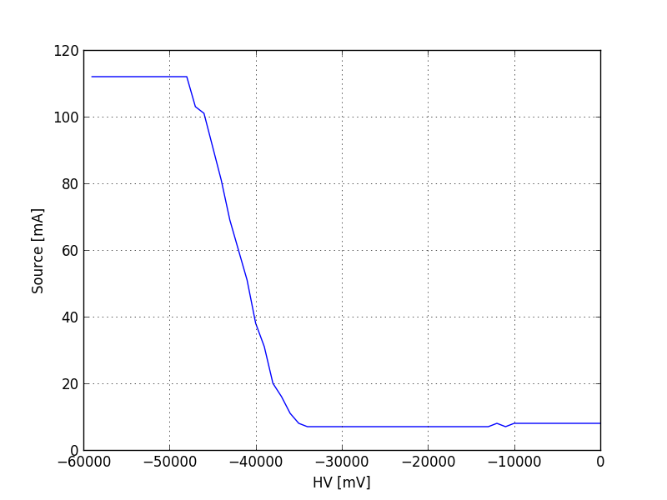
L2_024 – repair and effect
W44_OB1
W12_OF1
HV current too high if HV is lower than -35 V
=> Ladder is broken

Slide 5
Discussions and Conclusions about accidents
Ladder gluing procedure needs to be revised!
  Clean all modules before the assembly – send to HLL
    Remove particles by air
    Remove particles by special Q-tips
  Clean the module jigs just before they are used
    Use the microscope for optical inspection
    Use Flashlight, Q-tips and needles to see and remove particles
    Document with pictures (see next slides)
  Check vacuum!
    Used manometer to measure the vacuum strength
    0.4 bar at vacuum pump (tubes and jig need to be considered)
    negligible (0.06 bar) vacuum at jig, which is exposed to modules (see next slides)
    Inspect jigs for burrs (Grate): optical and with straightedge (Haarlineal)

Slide 6
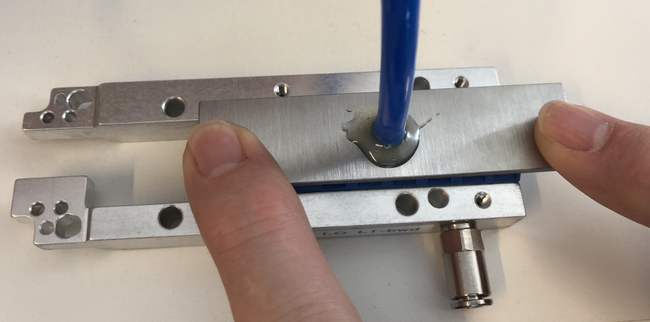
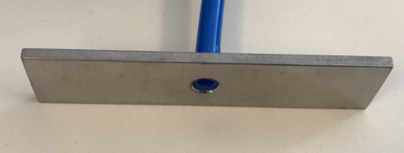
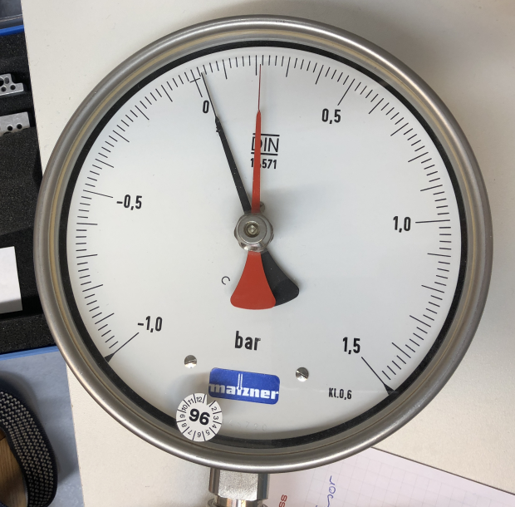
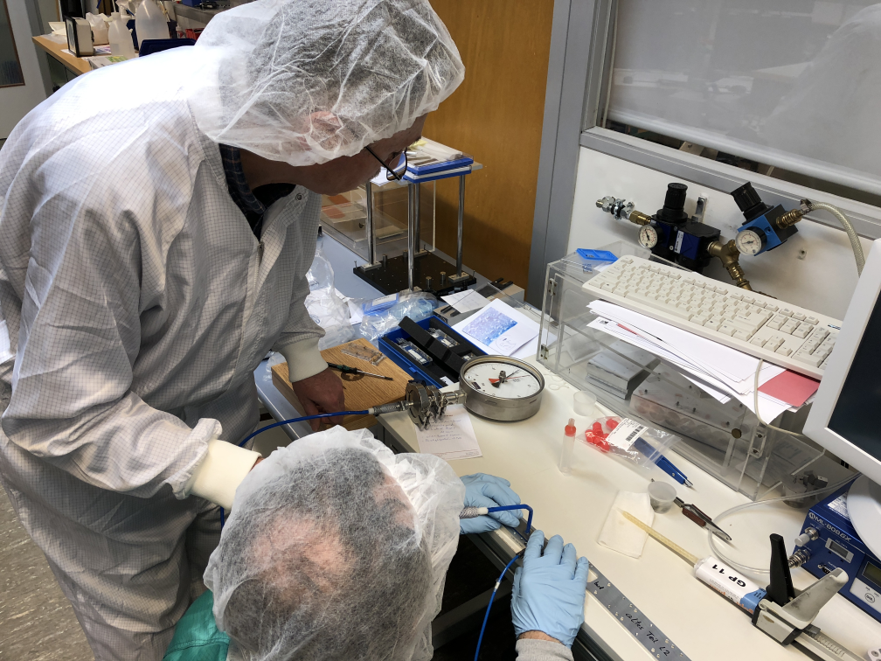
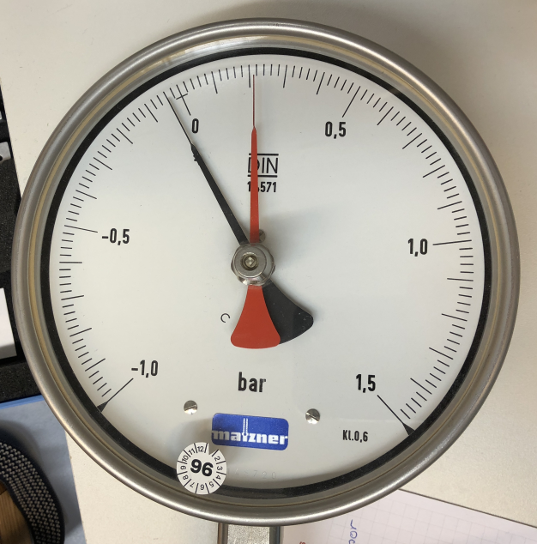
Vacuum strength
Pump off
Pump on
=> difference: -60 mbar

Slide 7
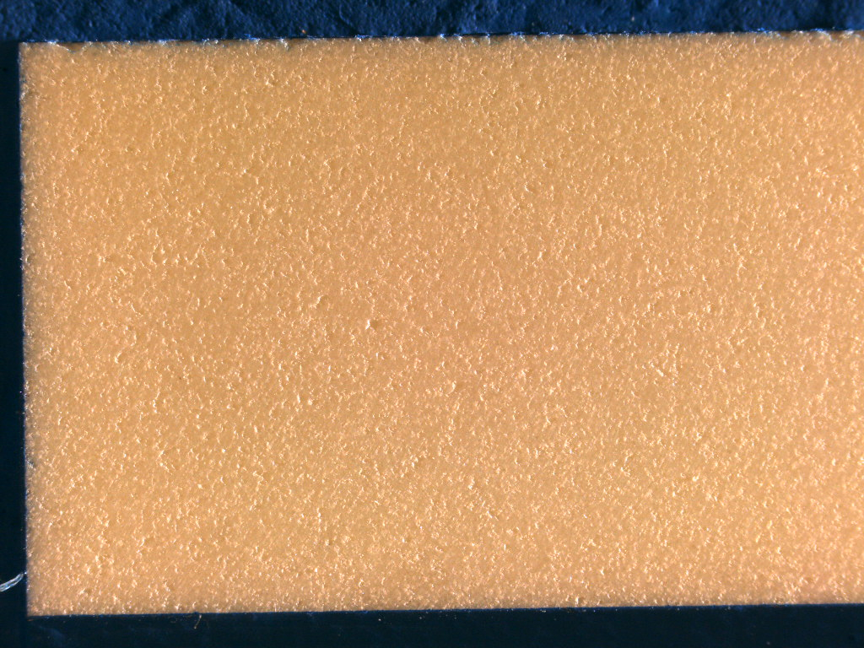
Pictures of the jig before gluing
L1 set 1, FWD
Remove it by tweezers

Slide 8
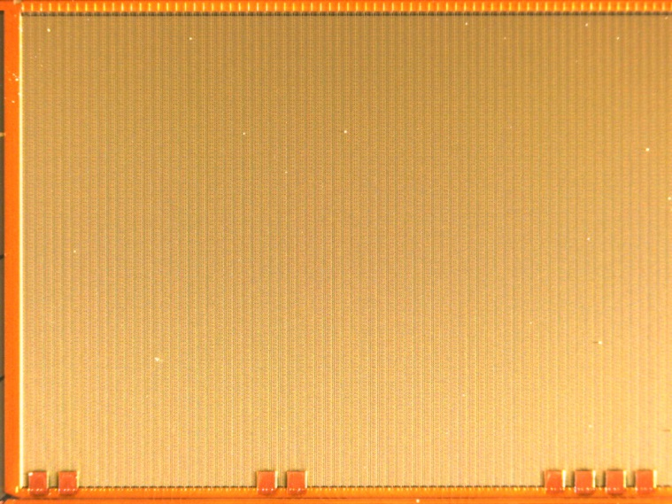
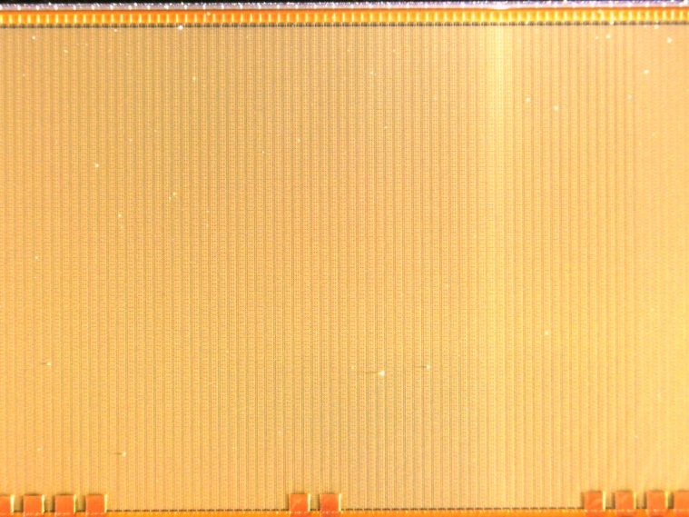
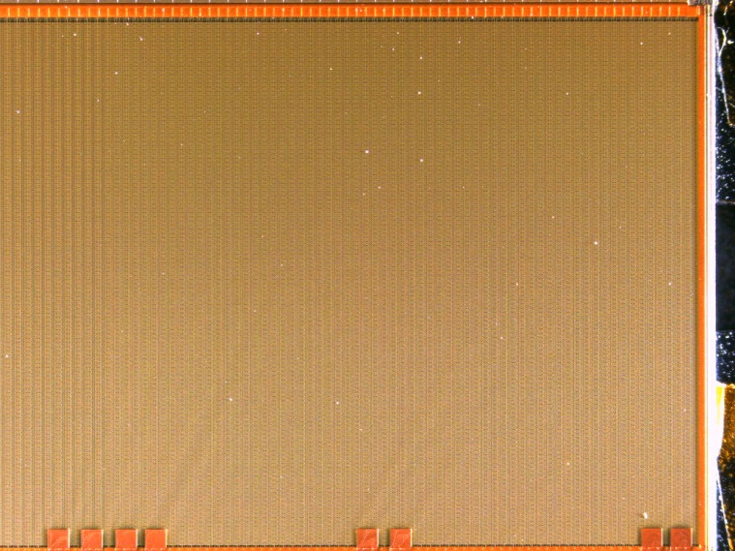
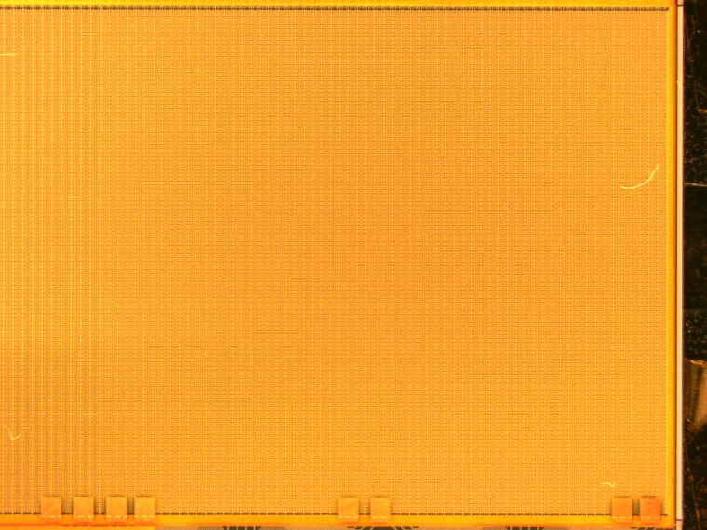
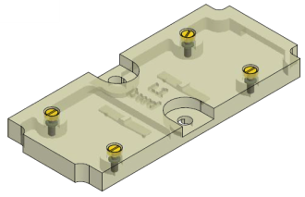
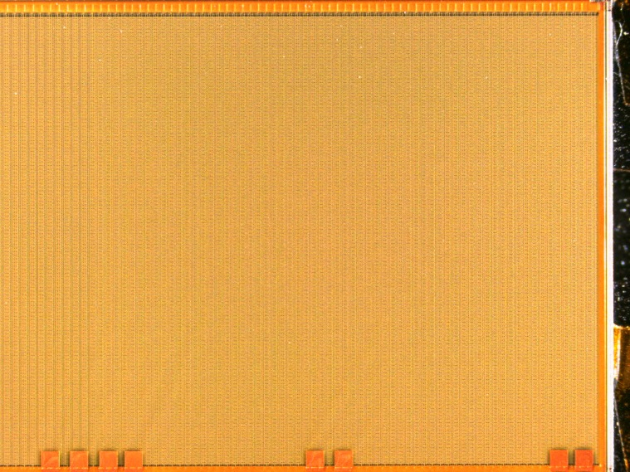
Dummy Module W01_IF before gluing
Initial condition
Use filtered air in order to remove the particles from the surface
Use LUJ-SMcs to protect. After removing it again:
LUJ-SMcs =
ladder universal jig – sensor module clamping set

Slide 9
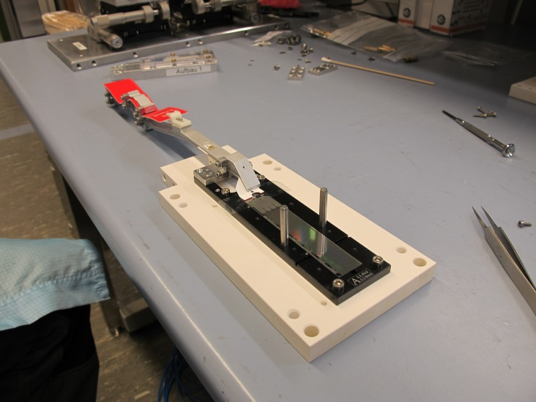
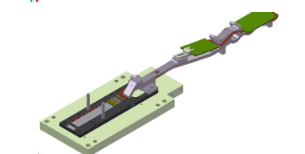
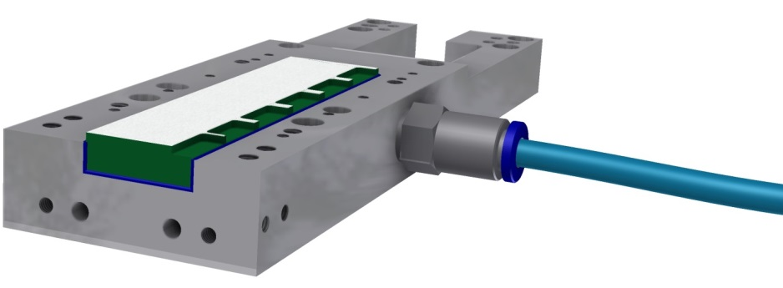
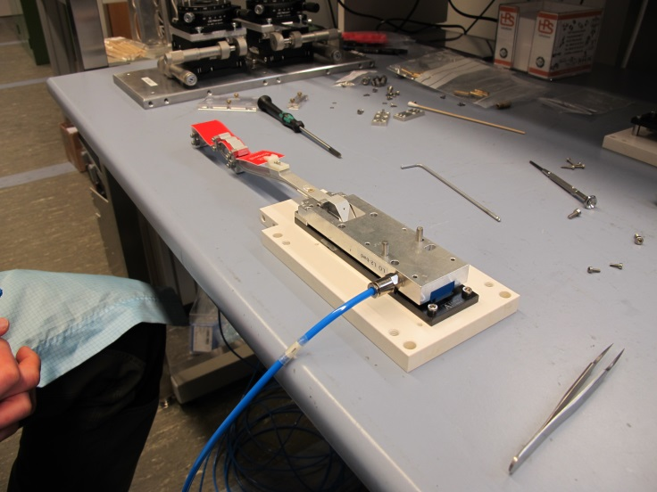
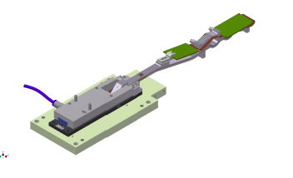
Transfer on vacuum jig
Modules arrive with kapton attached (tested)
Vacuum jig for turning and ladder gluing
fits on top side (cut outs for switcher)
Mode from microporous plate (gentle vacuum on sensor top side)
Vacuum jig on sensor
Screw kapton jig to vacuum jig
Unscrew kapton jig from base jig

Slide 10
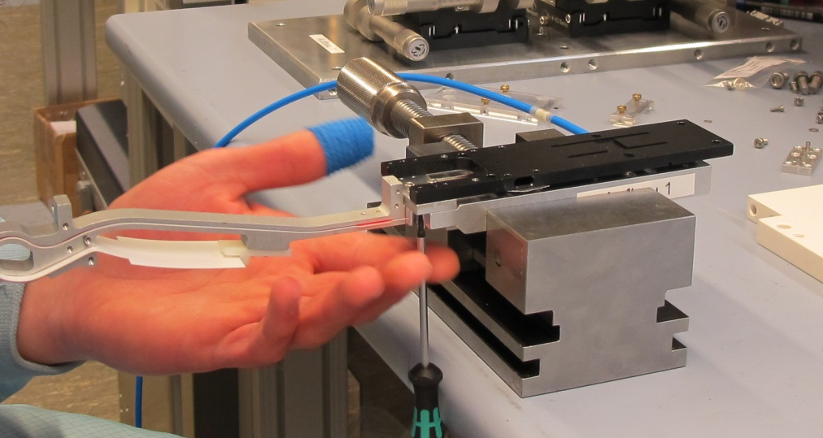
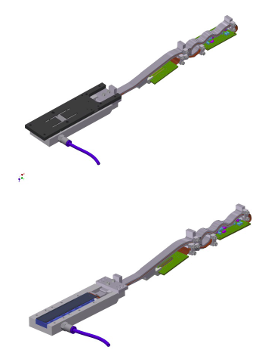
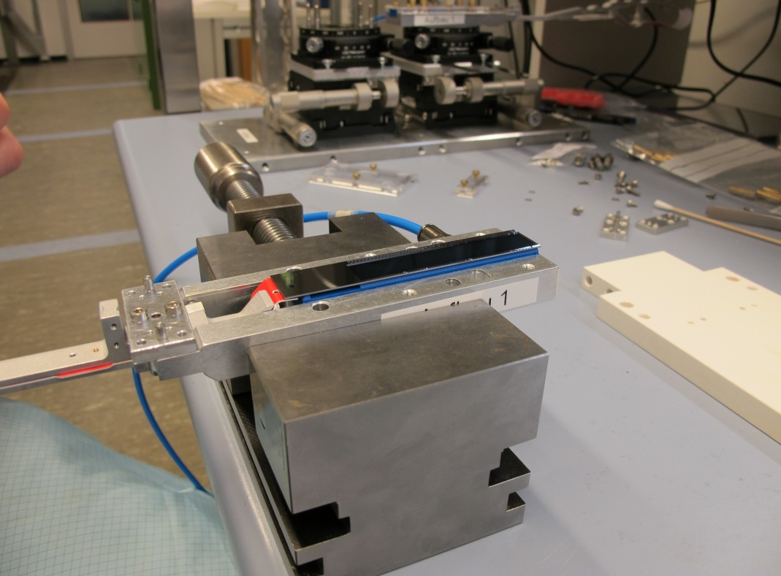
Remove base jig
Turn around and take off base jig (LUJ-Sbj)

Slide 11
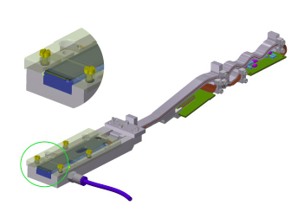
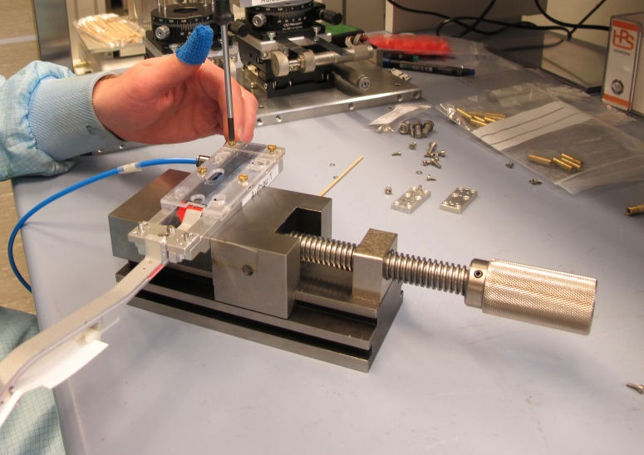
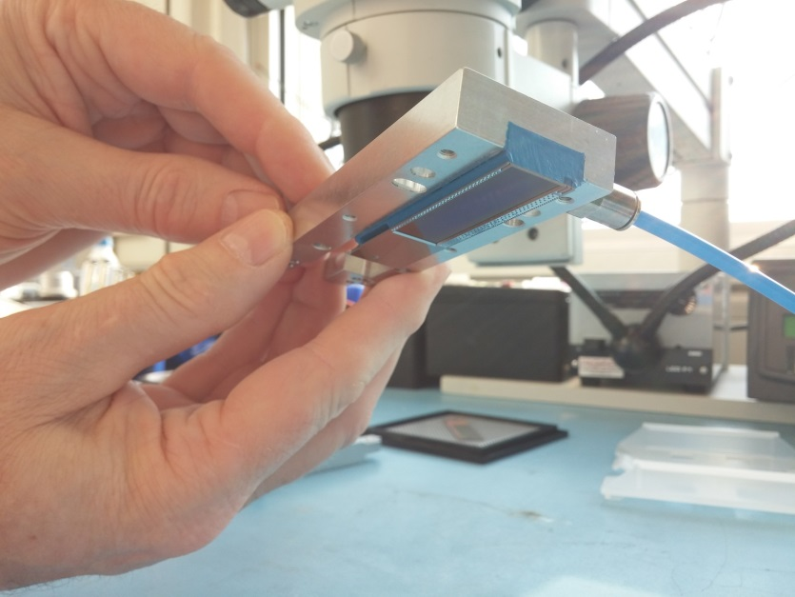
Prepare for glue dispensing
Add clamping set (LUJ-SMcs)
to be sure: module is securely held by
vacuum…

Slide 12
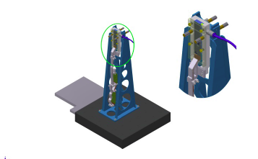
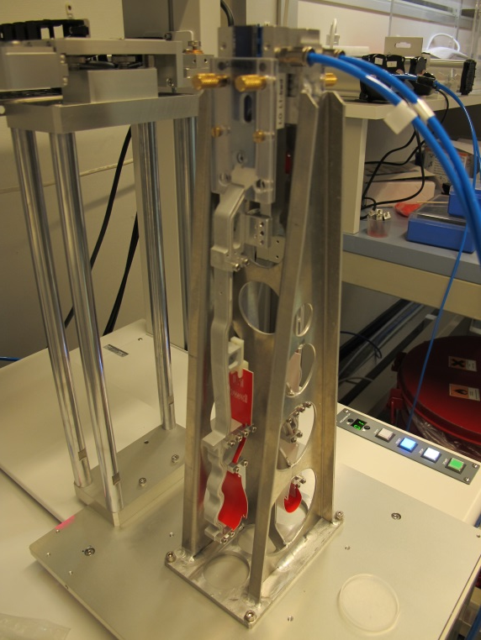
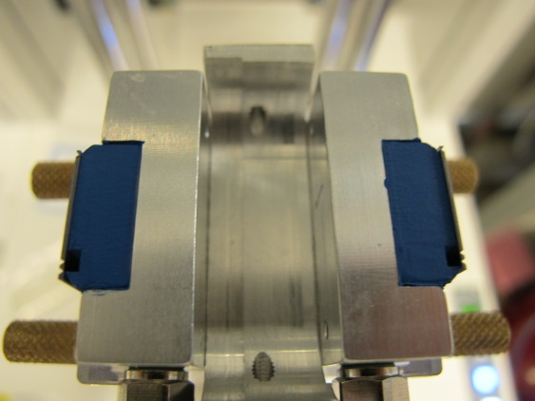
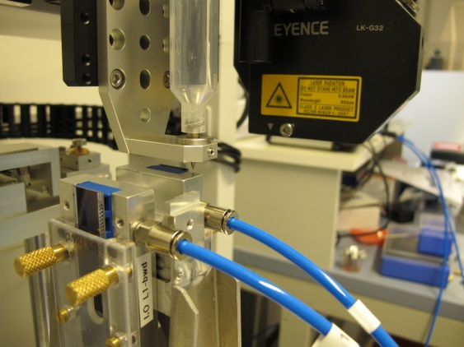
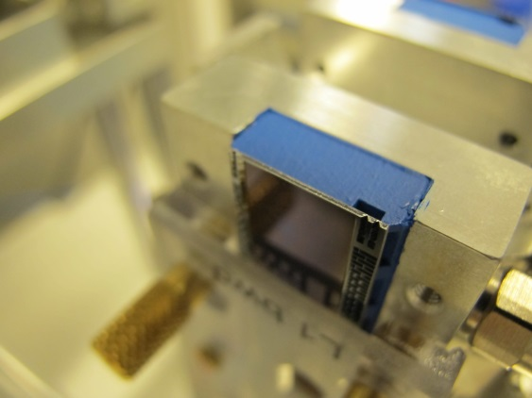
Mount on glue dispenser
2nd module is prepared the same way
Glue is automatically dispensed on both modules in one step

Slide 13
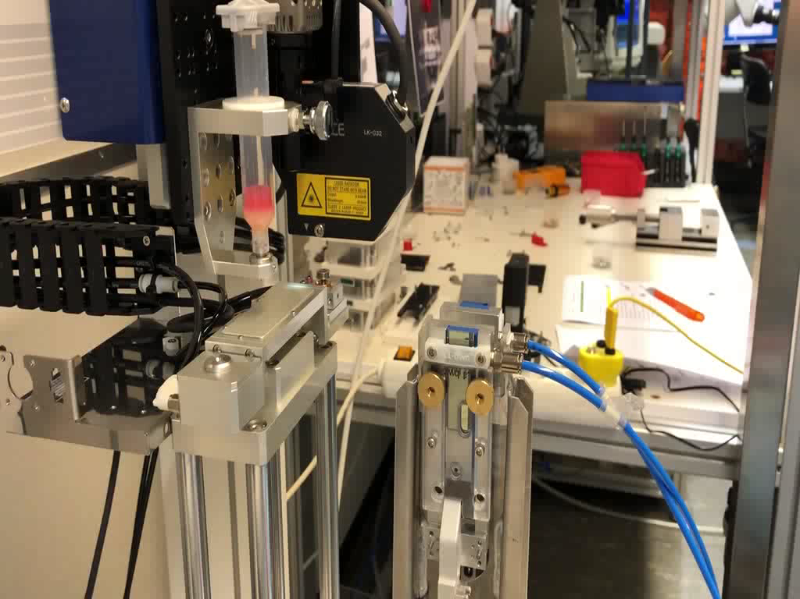
Glue Dispenser

Slide 14
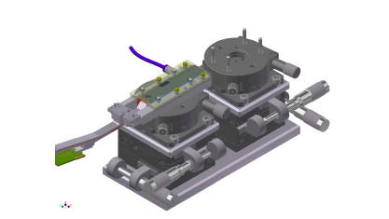
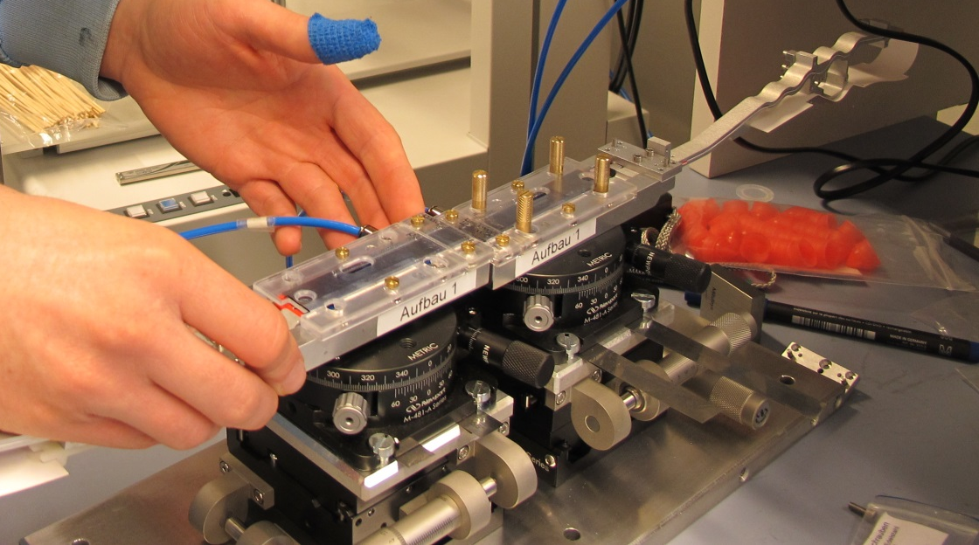
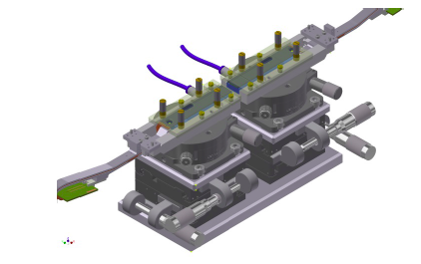
Place modules on alignment jig
bwd module 1st
fwd module 2nd

Slide 15
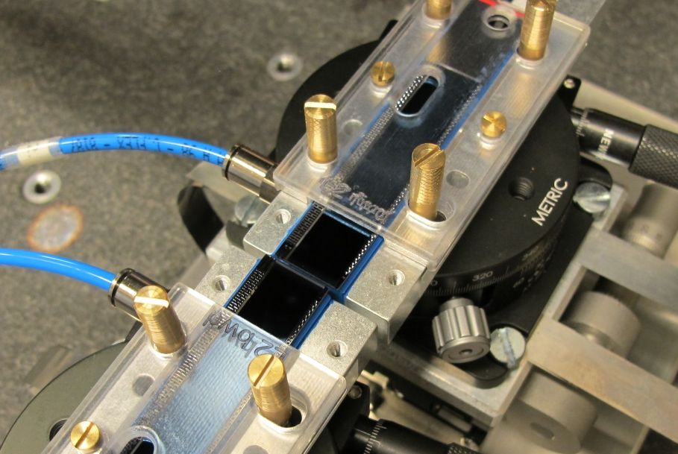
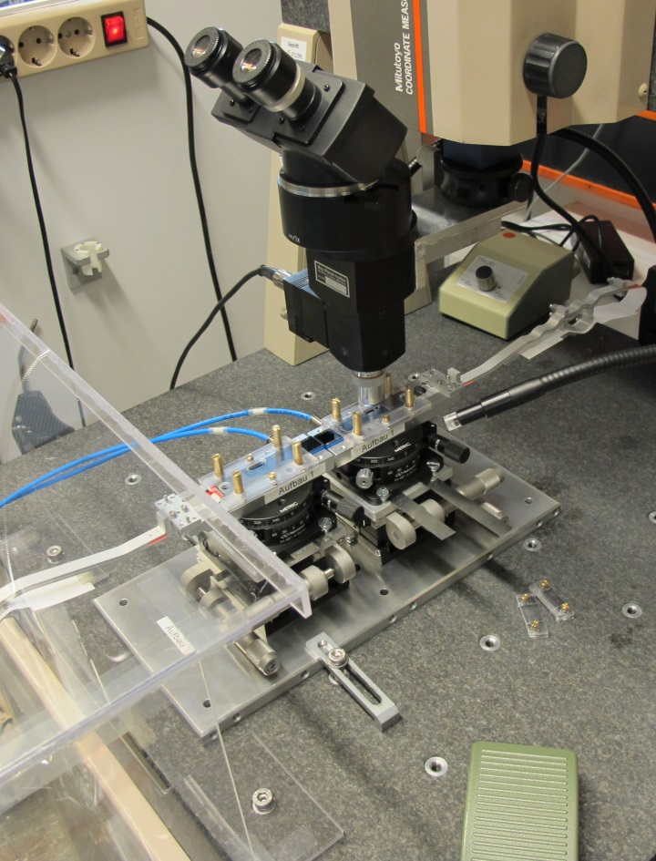

Align and glue together
Precision achieved:
10 µm over full length of ladder
Modules are pushed together to 30 µm to ensure good contact and distribution of the glue.
Then they are driven apart to the nominal gap of 80 µm

Slide 16
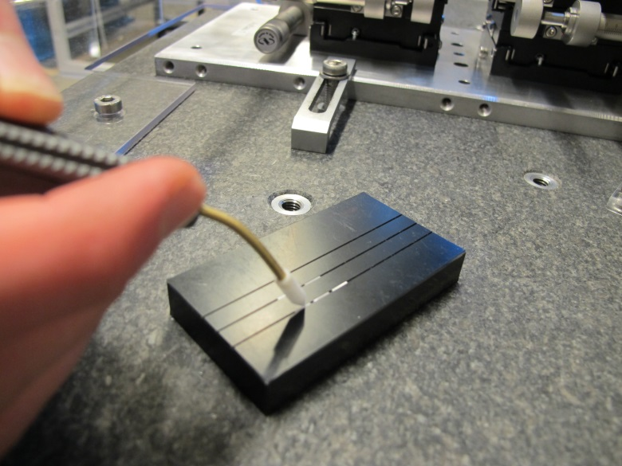
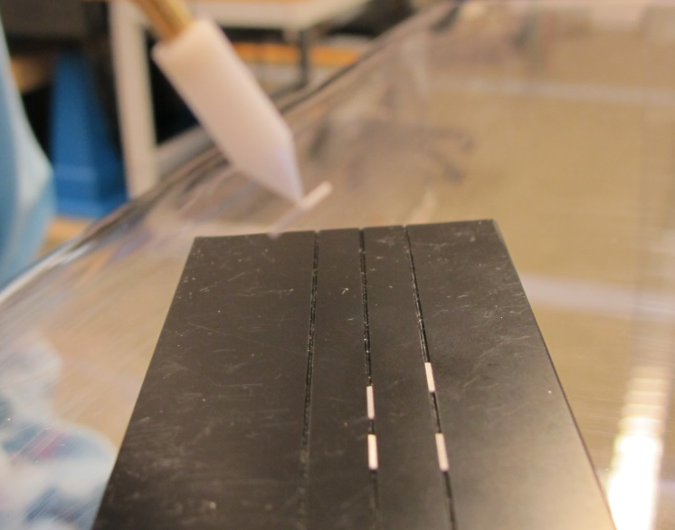
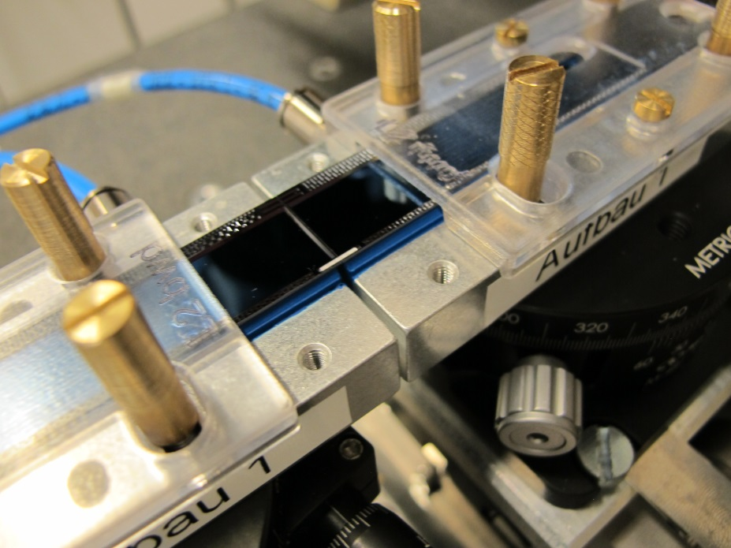
Add ceramic stiffeners
Stiffeners are handled with a vacuum tool
Glue is applied with a needle (works better than with a dispenser)

Slide 17



48h later….
For curing the ladder is covered and put apart
After curing ladder base jig is added

Slide 18





Remove vacuum jigs
Fix kapton jigs to ladder base jig
Unscrew vacuum jig
Remove ladder and turn over

Slide 19




Protect and store
Add cover for sensors
Put in transport/storage box

Slide 20



Pictures after gluing L1_025 – before gluing L1_026
Using Q-tip, needle and air
L1 set 1, FWD

Slide 21


Pictures after gluing

Slide 22




Protocol
Glue gap
Delta z
Delta x
Delta h

Slide 23

Summary – Dummies / Prototypes
Dummy ladders assembled
  plain thinned silicon, plastic ‘kapton’
  thinned silicon with copper, real kapton
  Including ASIC dummies
  L1_025 (W08_IB & W01_IF)
  L1_026 (W10_IB & W38_IF)
  L1_027 (W33_IB & W33_IF) – currently done
2 Prototype ladders produced
  L1_012 (W37_IB & W31_IF)
  L2_010 (W31_OB1 & W30_OF1)
  L2_023

Slide 24
Summary – L1 Modules & L1 Ladders
Production ladders produced
  L1_012 - Switchers removed
  L1_013 - overheated & separated
  ✔ L1_014 – IB: many broken pixels (G94.4)
  ✔L1_015
  L1_016 – short (10 drains affected, rest working)
  ✔L1_017
  ✔L1_018
  ✔L1_019 - Switcher power off problem
  ✔L1_020
  ✔L1_021
Future ladders
  W03_IB, W42_IB fully tested (grade A)
  W09_IB, W43_IF (kapton rework / reattachment)
  P3-6: W04_IB, W13_IB, W09_IF, W13_IF (wait for Kapton attachment)
  W04_IF need some rework (strange pedestal picture, HLL)

Slide 25
Summary L2 Modules & Ladders
Production ladders produced
  L2_022 – mechanically broking during gluing process
  L2_024 – surface mechanically damaged during gluing
Future ladders
  W09_OF1, W09_OB1, W43_OF1 (kapton rework / reattachment or Switcher rework)
  W32_OB2, W33_OB1, W42_OB1, W42_OB2, W45_OB2, W46_OB1, W08_OB1, W08_OB2, W09_OB2 (grade A)
  W12_OB1, W12_OB2 (grade B)
  W46_OB2, W05_OB1 (unknown grade)
  W44_OB2, W03_OB1 (under test)
  W09_OB1, W04_OB1, W10_OB1 (P3-7, waiting for kapton attachment)
  W32_OF1, W32_OF2, W33_OF2, W41_OF1, W45_OF1, W08_OF2, W11_OF1, W33_OF1 (grade A)
  W46_OF1, W46_OF2 (under test)
  W45_OF2 (DHP short, reworked)
  W02_OF1, W03_OF2, W04_OF1, W05_OF1 (waiting for Kapton attachment)

Slide 26
Backup

Slide 27


Pull Tests
Strip pattern: breaks at > 3 kg
Dot pattern weaker (~2 kg)
3 kg is considered sufficient (silicon breaks at ~3 kg)
Confirmed by pull test of dummy ladder
=> 3.9 kg =>

