Slide 1
Imaging capabilities of the EDET-80k detector
Ibrahym Dourki
22nd International Workshop on DEPFET Detectors and Applications
8-1 April 2018, Ringberg Castle, Germany
Ibrahym Dourki, PhD Student
Max Planck Institute for the Structure and Dynamics of Matter, Center for Free Electron Laser Science (CFEL)
Luruper Chausee 149
D-22761 Hamburg (Germany)
ibrahym.dki@gmail.com
ibrahym.dourki@mpsd.mpg.de

Slide 2
Outline
Introduction: TEM, Bio samples and radiation
Simulation of detector performance
Charge sharing
Signal processing
Noise
Imaging capability of EDET: DQE
Conclusion and outlook

Slide 3
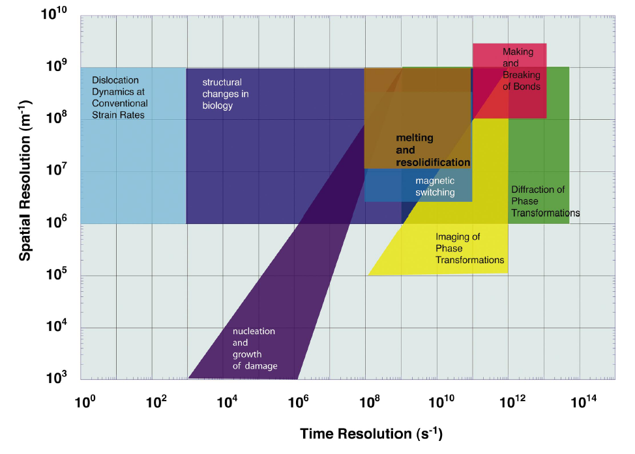
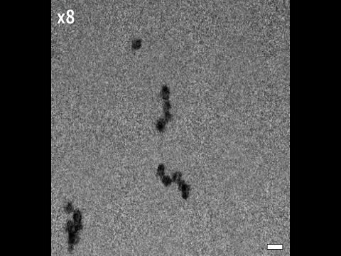

Introduction
Goal: Real space and real time imaging using TEM.
Fast molecular dynamics in biology:
Need direct and fast detector: EDET-80kHz
DNA self assembly
80 000 Hz
Some phenomena classified by spatial and temporal resolutions [1]
200 nm
Keskin et al. J. Phys. Chem. Lett. 6, 4487−4492 (2015)
W. E. King et al., J. Appl. Phys. 97, 111101, (2005).

Slide 4
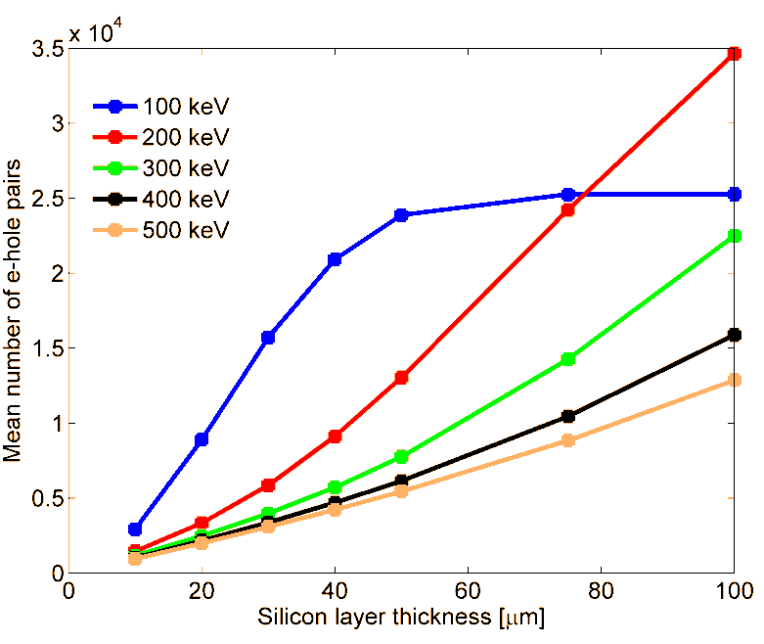
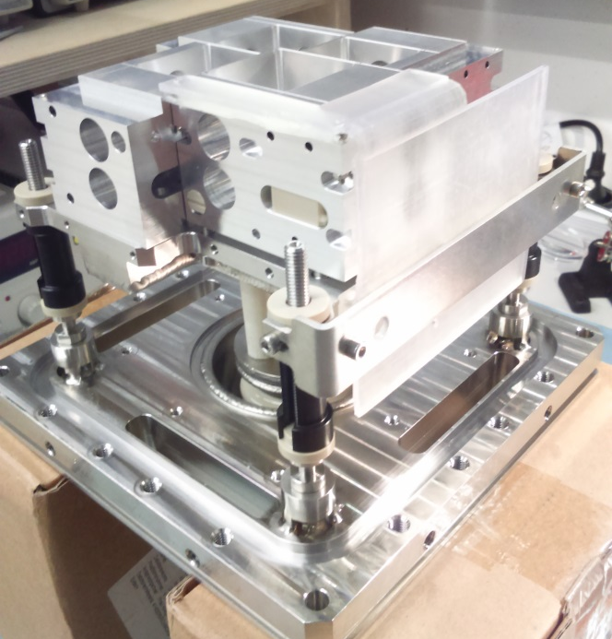
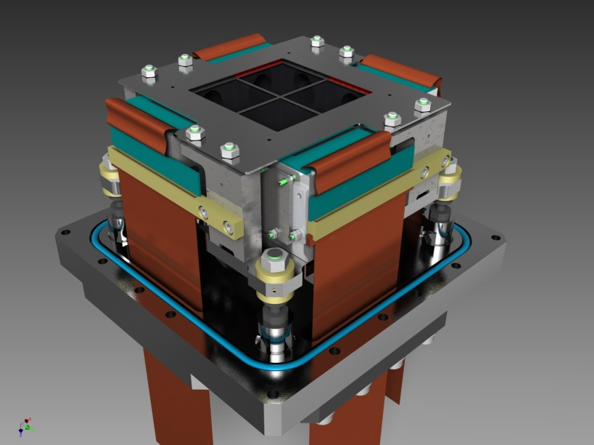
Low dose to avoid radiation damage of the sample
- Need direct detector with large DQE
Large charge handling capability:
- Thin sensor (e.g. 50 µm) with 100 % Detection efficiency
Single electron detection with high probability
Fast Readout: 80 kHz
- 100 frames form one movie of 1.28 ms
I. Dourki et al. 2017 JINST 12 C03047
Shielding
e-
512x512 pixels

Slide 5
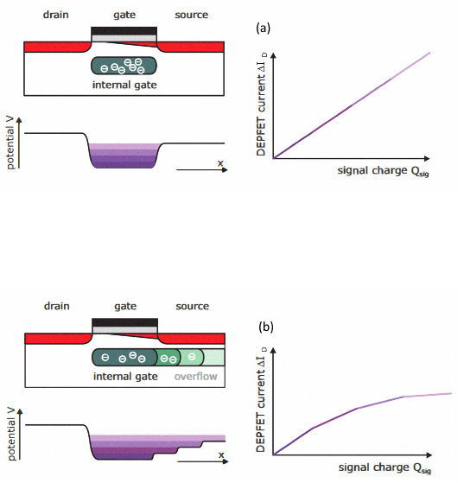
DEPFET response and the number of ADC bits are the key factors determining the achievable dynamic range of EDET-80
g_{q}=3.7133x10⁻⁵ µA/e-
Fast saturation and limited DR
g_{q}=2.1064x10⁻⁴ µA/e-
Rainer, HLL
Tools:
Monte Carlo simulation: detector modeling
DEPFET technology concept with signal compression
fulfill these requirements
Single e- resolution and large DR
M. Porro et al. , IEEE Trans. Nucl Sci. (2012)
P. Lechner et al. , IEEE Nuc. Sci. Sym. (2011)

Slide 6
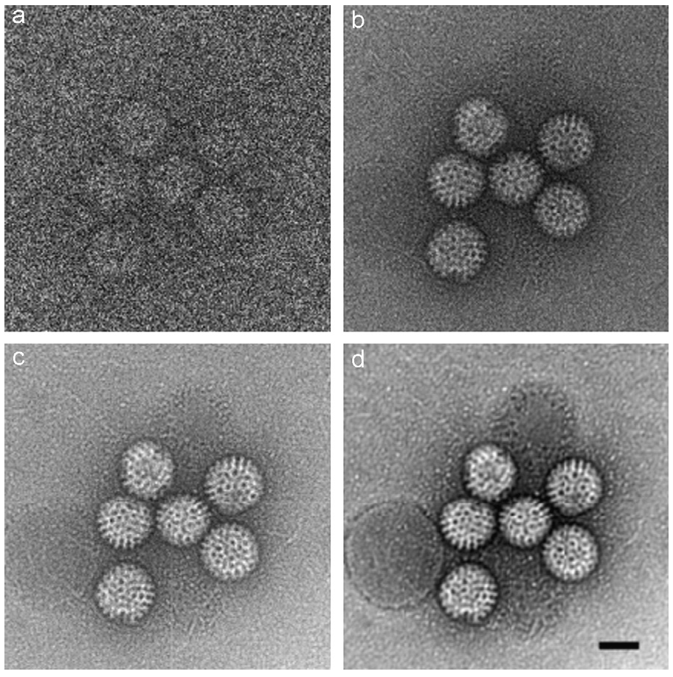
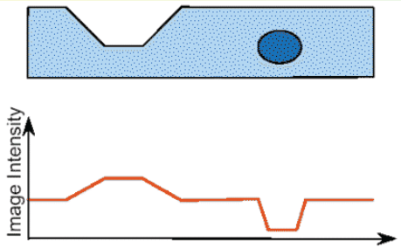
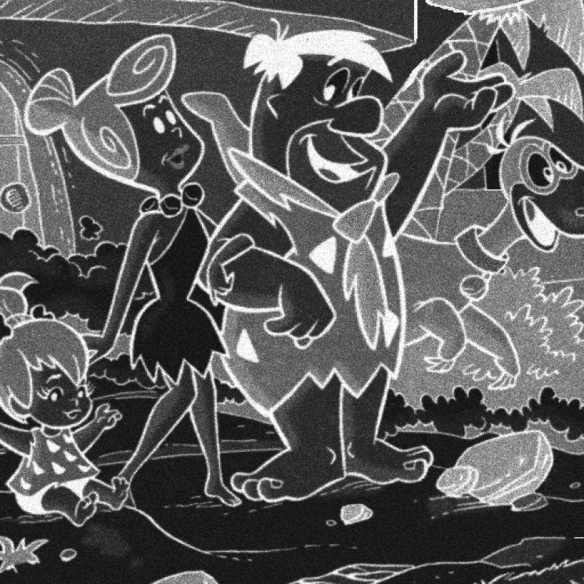
TEM movie
Dynamic range limit: Speed is the goal….not beauty
0.4 e-/pixel (scaled)
40 e-/pixel (scaled)
Lit.: G. McMullan and a. R. Faruqi, Nucl. Instruments Methods Phys. Res. Sect. A Accel. Spectrometers, Detect. Assoc. Equip. 591, 129 (2008).
3500 e-/pixel (scaled)
16000 e-/pixel (scaled)
0.5 mu
►100 el/px Poisson only
►100 el/px Poisson only

Slide 7
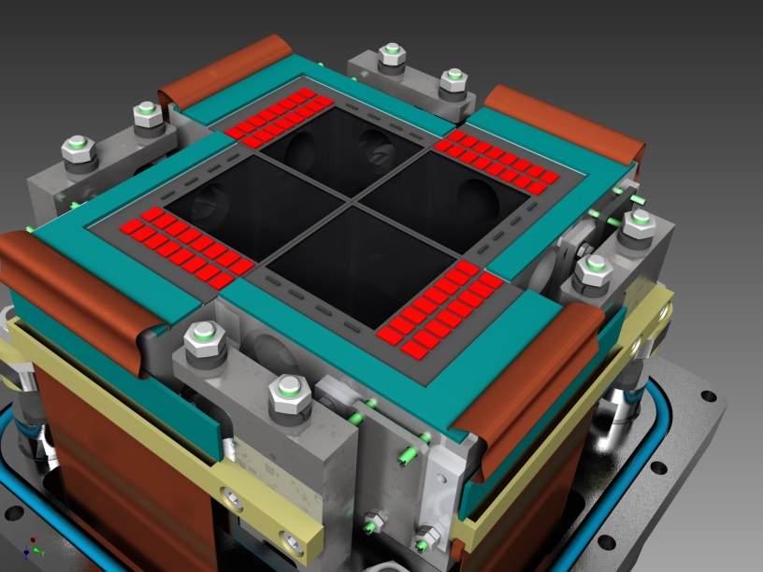
Detector specification and simulation
Shielding
e-
Direct hit electron detector
512x512 pixels
Megapixel detector made up of four quadrants (512x512)
512 x 512
Pixel size: 60 µm x 60 µm
512 x 512
Dynamic range > 200 primaries
512 x 512
Full frame recording at 80kHz (Four-fold rolling shutter mode)
512 x 512
DMC
DCD
Switcher
High statistical probability to discriminate single electron hits
High detection efficiency
Digitization: 8 bit resolution
Applications: Fast Imaging Experiments (e.g. TEM)
Notes:
1) We changed: quantum -> detection
Switcher:
1- Switch on / off the DEPFET
2- Switcher performs also clear operation of the DEPFET via switching between two voltages → clear pulse
DCD: Drain Current Digitizer: Digitize the drain current from matrix
DHP (Data Handeling Processor) : Data Handeling of the digital domain. It is responsible for data reduction (reduces the amount of data via zero suppresion of non-hit pixels and assigns the time stamps to the event) and send data off the module to the backend electronics.

Slide 8
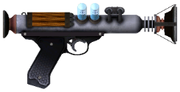


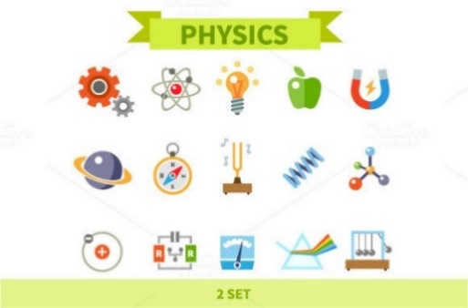


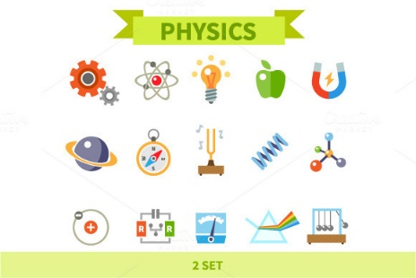





EDET DATA
Fundamental statistics of process
e-h pair creation
e-h pair creation
DepFET
Source
Obsevable
Poisson noise (G4)
?
Landau noise (G4)
Charge coll. (ext.)
Fano noise (ext.)
Current noise (est.)
Backscatter (G4)
*read out
*thermal & leak
*cosmic (-)
Digitization
Look-up tables
ADU
DAQ
Analog noise DCD (est.)
Granularity
*b. scatter correction
!
DCDE gain k₁
*pedestals
ADU | e- (primary) | +err | -err
0 | 0 | 1 | 0.5
1 | 0.2 | 0.4 | 0.1
...
255 | 150 | 19 | 18
Biased Analysis
ESTIMATOR
Biased Results
Simulation
Calibration
Experiment

Slide 9
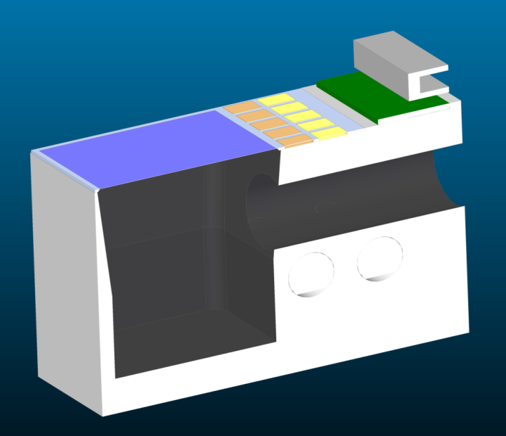
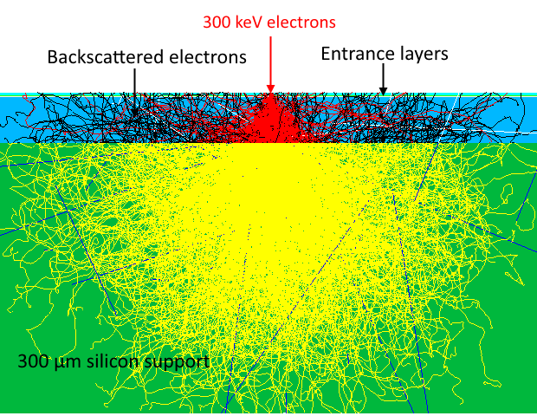
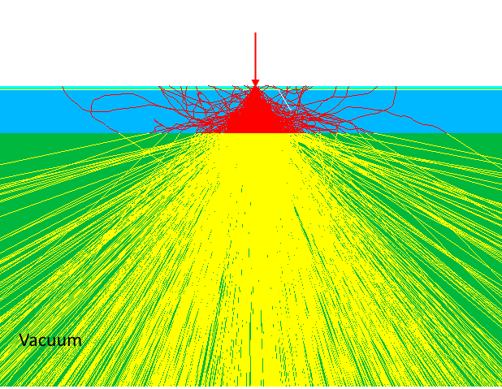
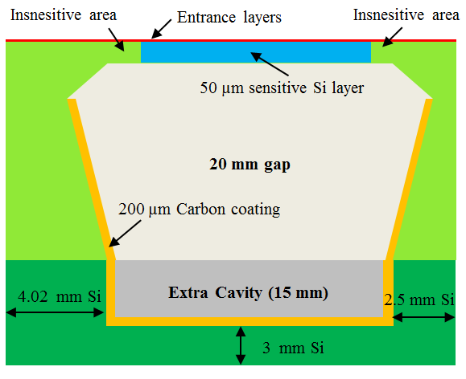
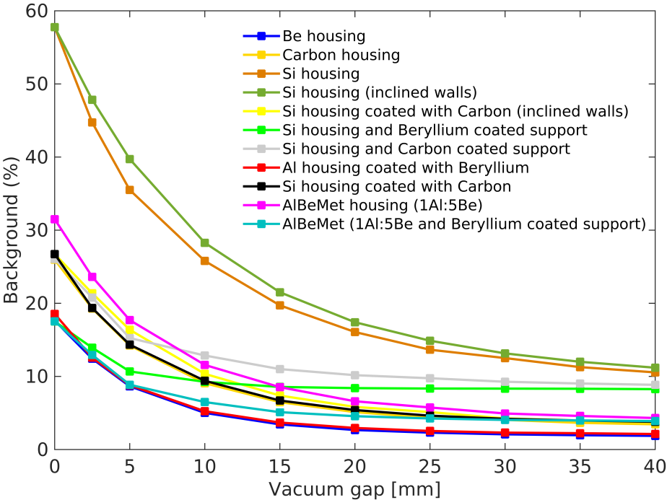
Simulation of detector performance
Sloped wall
35 mm gap
Straight wall
Detector design optimization
Backscattering reduction

Slide 10
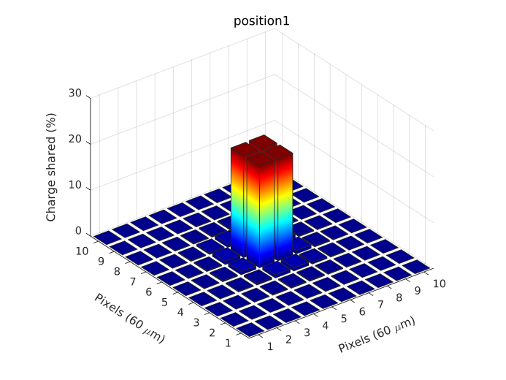
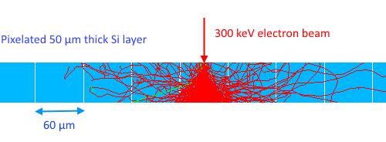
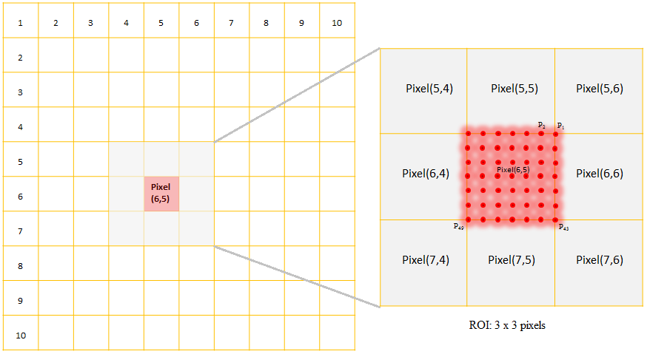
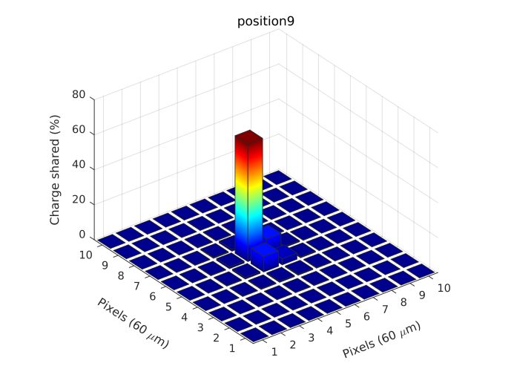
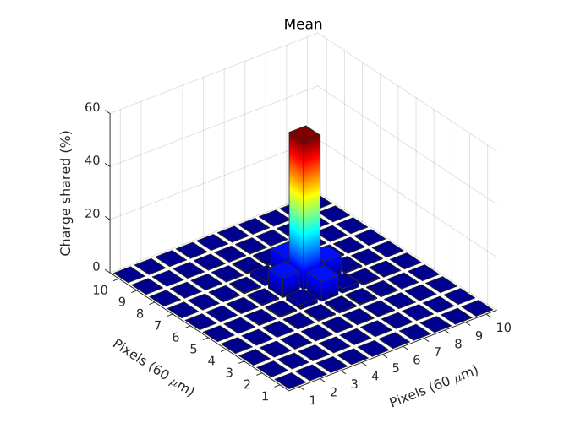
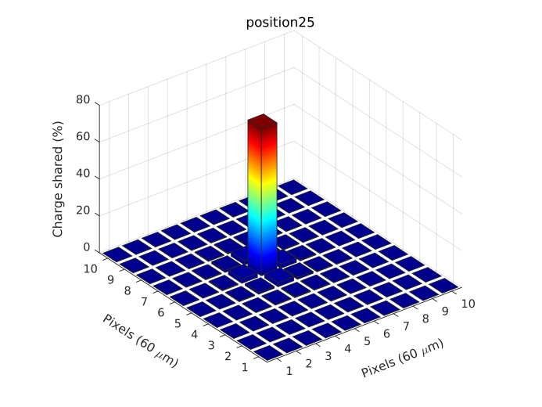
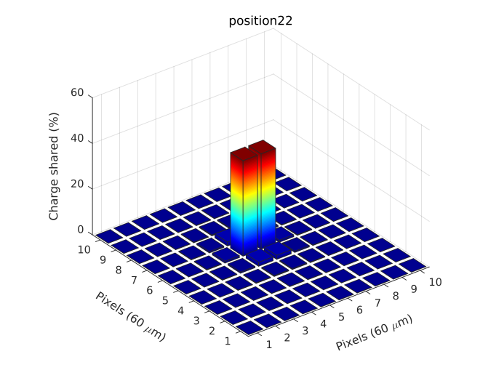
Charge sharing
55.7 %

Slide 11
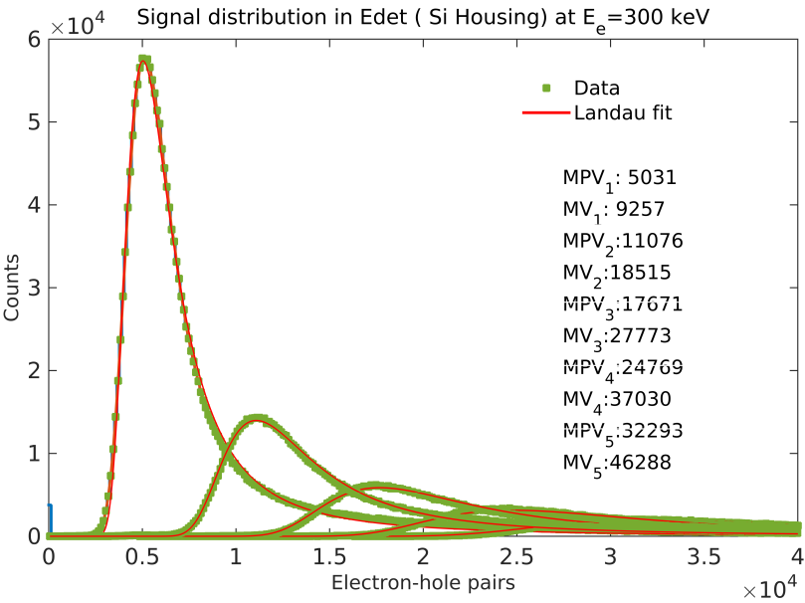
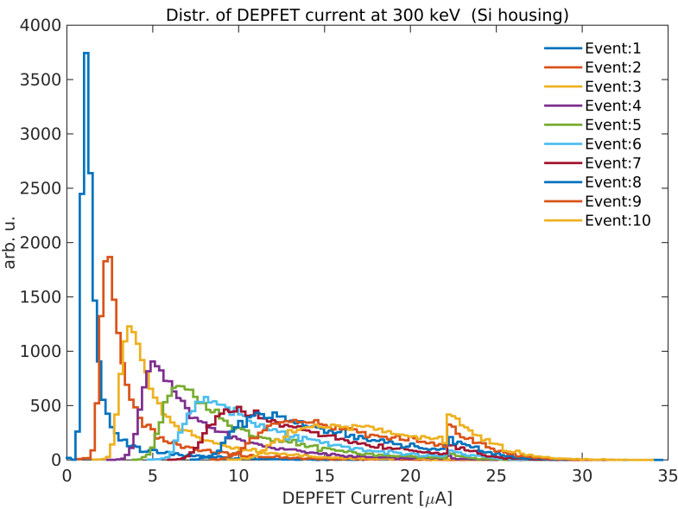
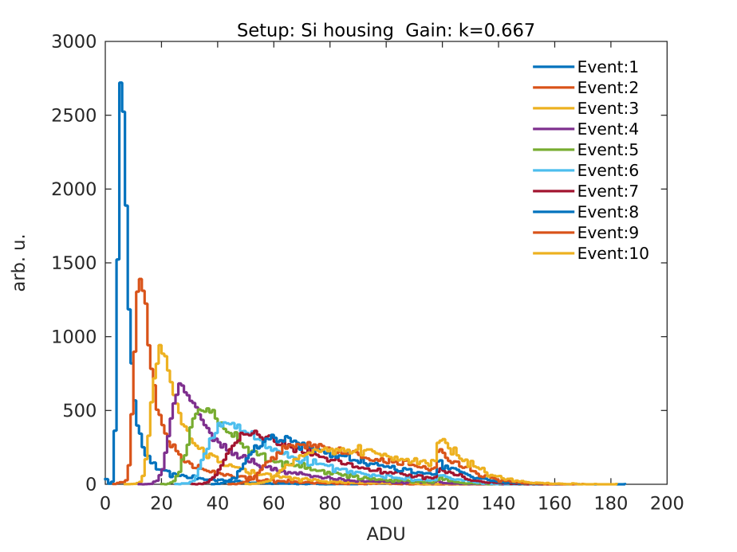
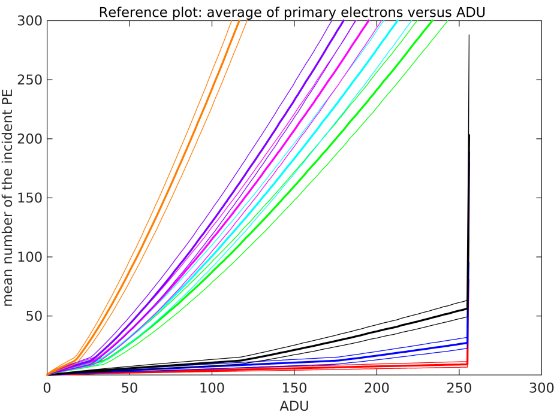
Without Poisson noise
1) e-h pairs distribution
2) DEPFET current distribuion
3) Digitization: ADU distribuion
4) Mean of PE in vs. ADU

Slide 12
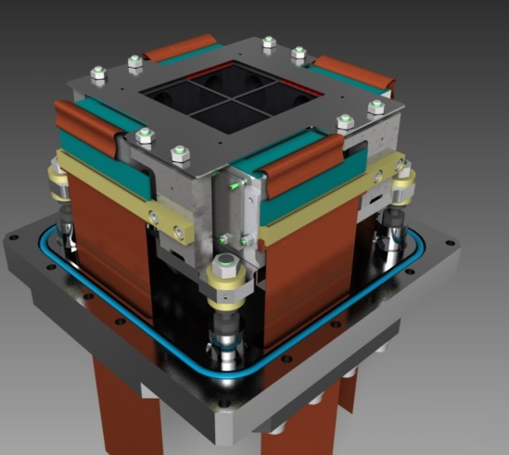
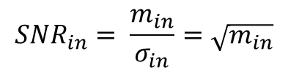


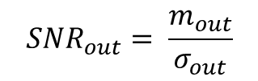
With Poisson noise
Assumption: Electrons hitting detector obey Poisson statistic
Noise: standard deviation: $σ=\sqrt{m}$
$$P\left(k\right)=\frac{m^{k}}{k!}e^{−m}$$
k: events (k= 1,2,…,N)
m: Average of the number of events
For each Poisson event, a corresponding number of e-h pairs
is calculated: noise is now added to e-h pairs generated in Edet
For 1 event: S_{in1} = S_{i1}+n_{i1} (n₁ is the noise)
For 2 events: S_{in2} = S_{i2}+n_{i2}
For 3 events: S_{in3} = S_{i3}+n_{i3}
. . . .
. . . .
For N events: S_{inN} = S_{iN}+n_{iN}
$${SNR}_{in}= \frac{m_{in}}{σ_{in}}=\sqrt{m_{in}}$$
e-
$${SNR}_{in}$$
$${SNR}_{out}= \frac{m_{out}}{σ_{out}}$$

Slide 13
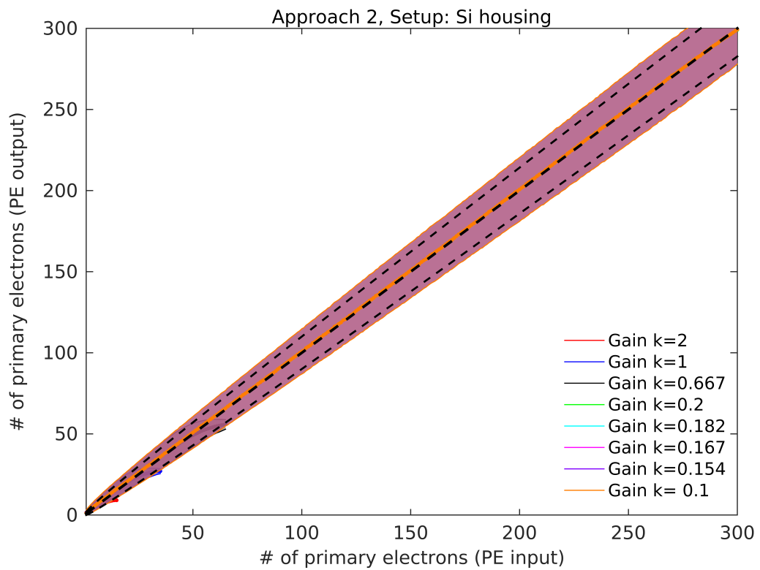
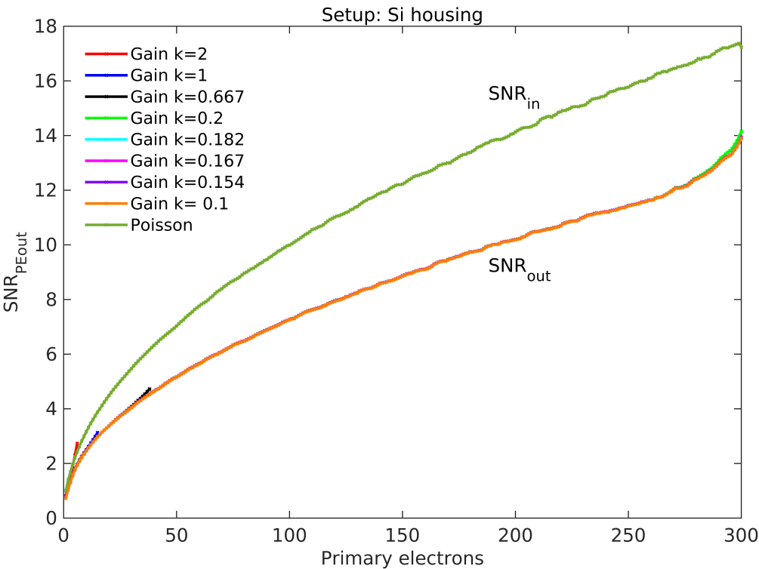


Poisson noise
$${SNR}_{in}= \frac{min}{σin}$$
$${SNR}_{out}= \frac{mout}{σout}$$
Poisson noise is dominant!
Linear relatioship between PE input and PE out for k<0.667 (full 8bits DR is filled)
Response departs from linearity: k>0.667
Higher gain: single electron resolution
Lower gain: Whole high dynamic range is covered

Slide 14

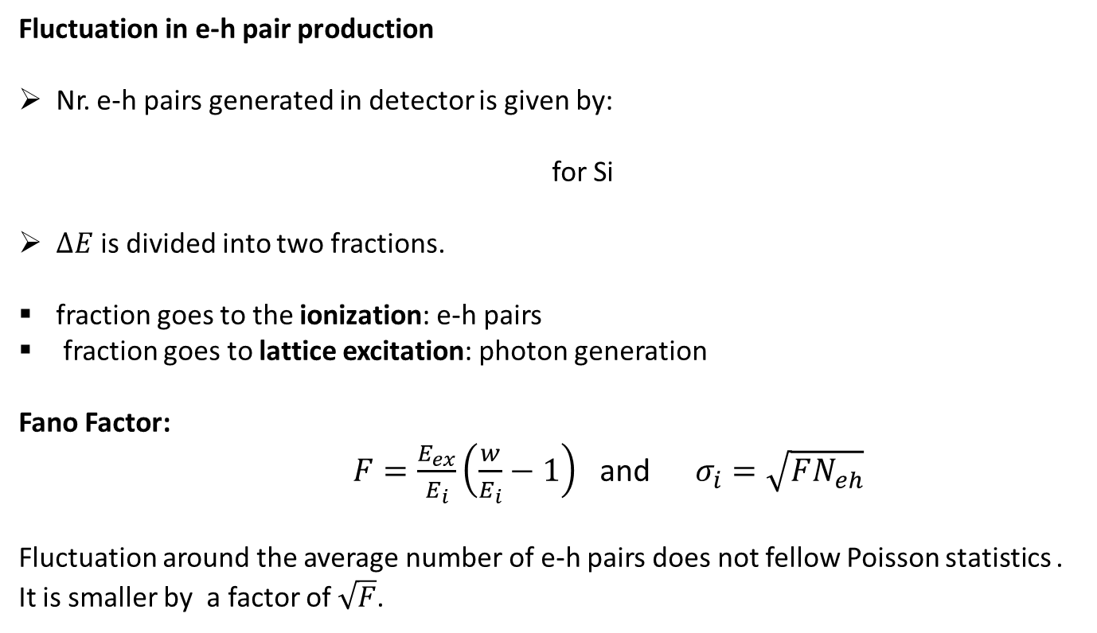



Fano Factor
photon
e-
Fluctuation in e-h pair production
Nr. e-h pairs generated in detector is given by:
for Si
$∆E$is divided into two fractions.
fraction goes to the ionization: e-h pairs
fraction goes to lattice excitation: photon generation
Fano Factor:
$F=\frac{E_{ex}}{E_{i}}\left(\frac{w}{E_{i}}−1\right)$ and $σ_{i}=\sqrt{FN_{eh}}$
Fluctuation around the average number of e-h pairs does not fellow Poisson statistics . It is smaller by a factor of $\sqrt{F}$.
e-
+
+
e-
e-
$$∆E$$
$$N_{eh}=\frac{∆E}{w}$$
+
$$w=3.62 eV$$
e-
+
$$E=E_{ex }N_{ex}+E_{i}N_{i}$$

Slide 15
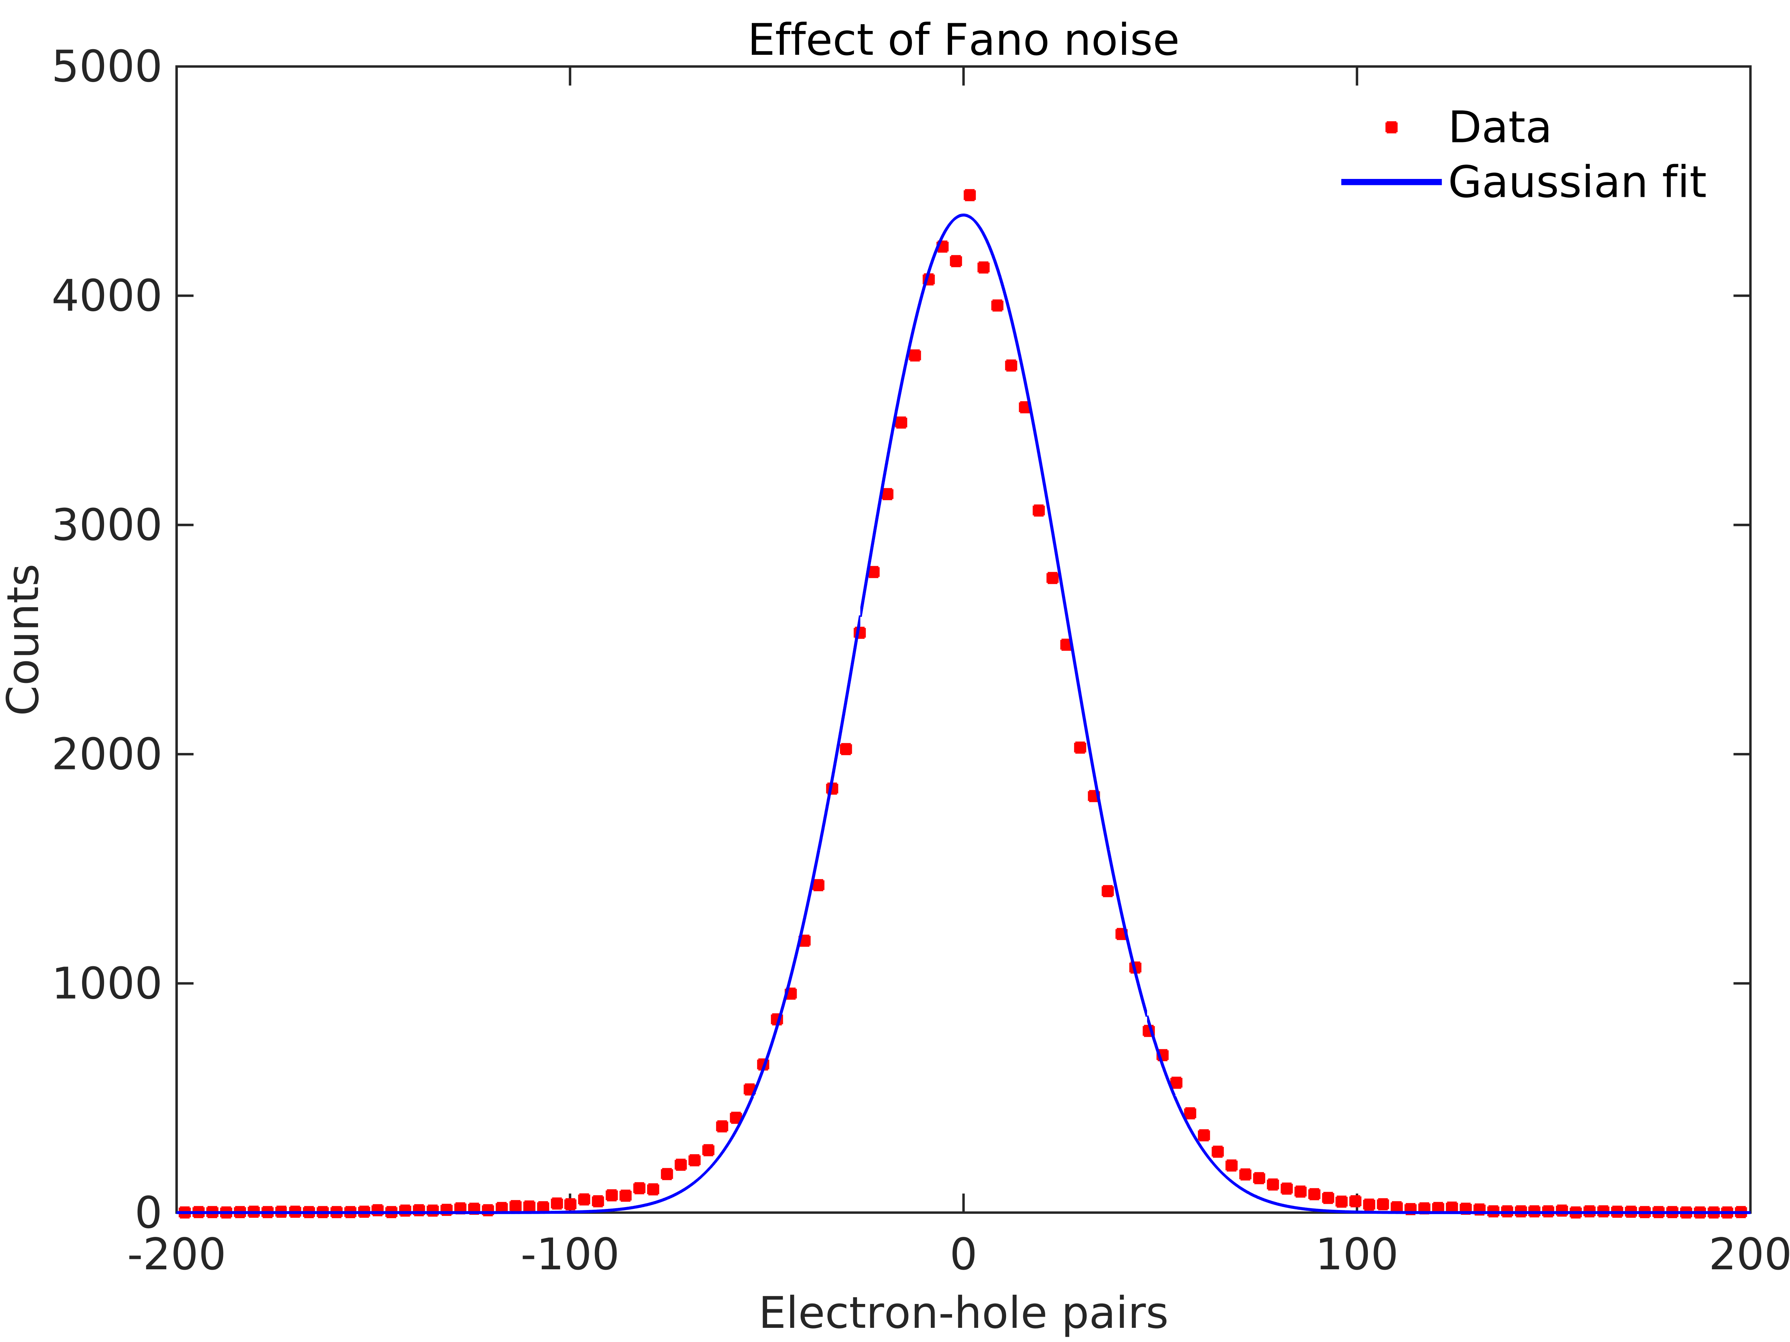
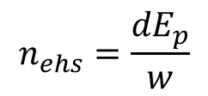

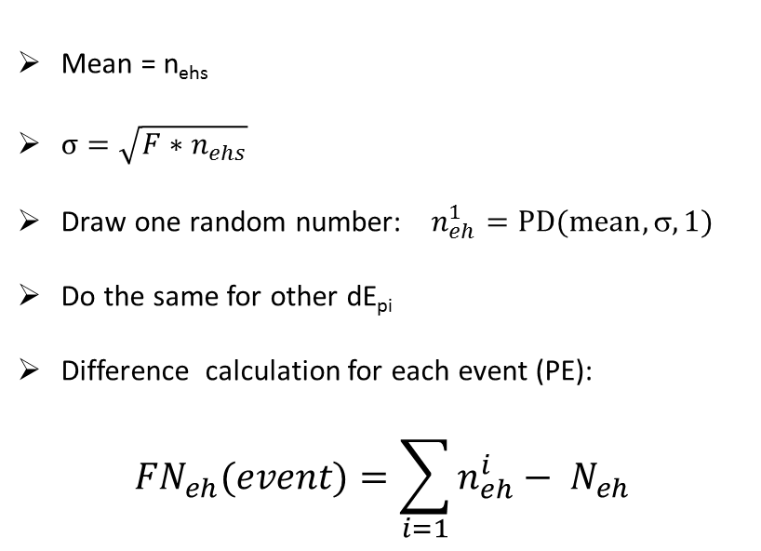

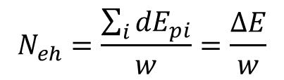
e-
$$n_{ehs}=\frac{{dE}_{p}}{w}$$
$$N_{eh}=\frac{\sum_{i}{{dE}_{pi}}}{w}=\frac{∆E}{w}$$
dEp₂
dEp₁
dEp₃
dEp₅
dEp₄
dE_{pi} : Energy depsoition per step
n_{ehs} : Number of e-h pairs generated in this setp
N_{eh} : Total number of e-h pairs
dEp₆
Mean = n_{ehs}
$σ=\sqrt{F∗n_{ehs}}$
Draw one random number: $n_{eh}^{1}=PD(mean,,1)$
Do the same for other dE_{pi}
Difference calculation for each event (PE):
$${FN}_{eh}(event)=\sum_{i=1}{n_{eh}^{i}}− N_{eh}$$
PD(mean, $σ, rnd$)
$$σ=30 e−$$

Slide 16
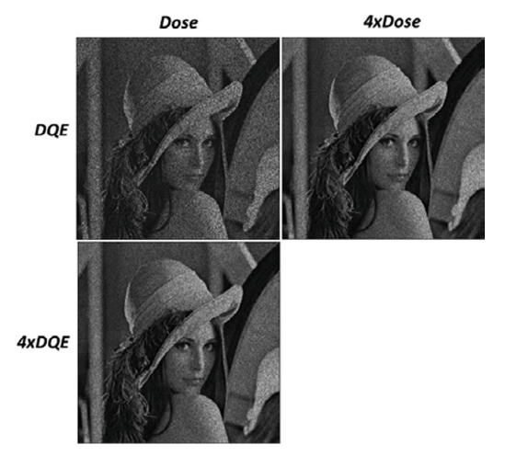
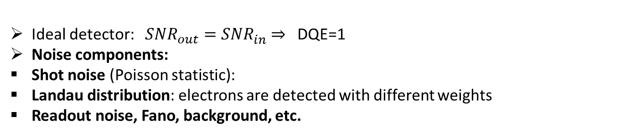

Imaging capability of EDET: DQE and MTF
Radiation senistive samples: DQE is a key
2xDQE achieves same SNR with half the dose.
33 %
SNR_{in}
SNR_{out}
Detector
$DQE(0)=\frac{{SNR}_{out}^{2}}{{SNR}_{in}^{2}}$ ≤ 1
M. Kuijper et al. / Journal of Structural Biology 192 (2015) 179–187
Ideal detector: ${SNR}_{out}^{}={SNR}_{in}^{}$ ⇒ DQE=1
Noise components:
Shot noise (Poisson statistic):
Landau distribution: electrons are detected with different weights
Readout noise, Fano, background, etc.

Slide 17
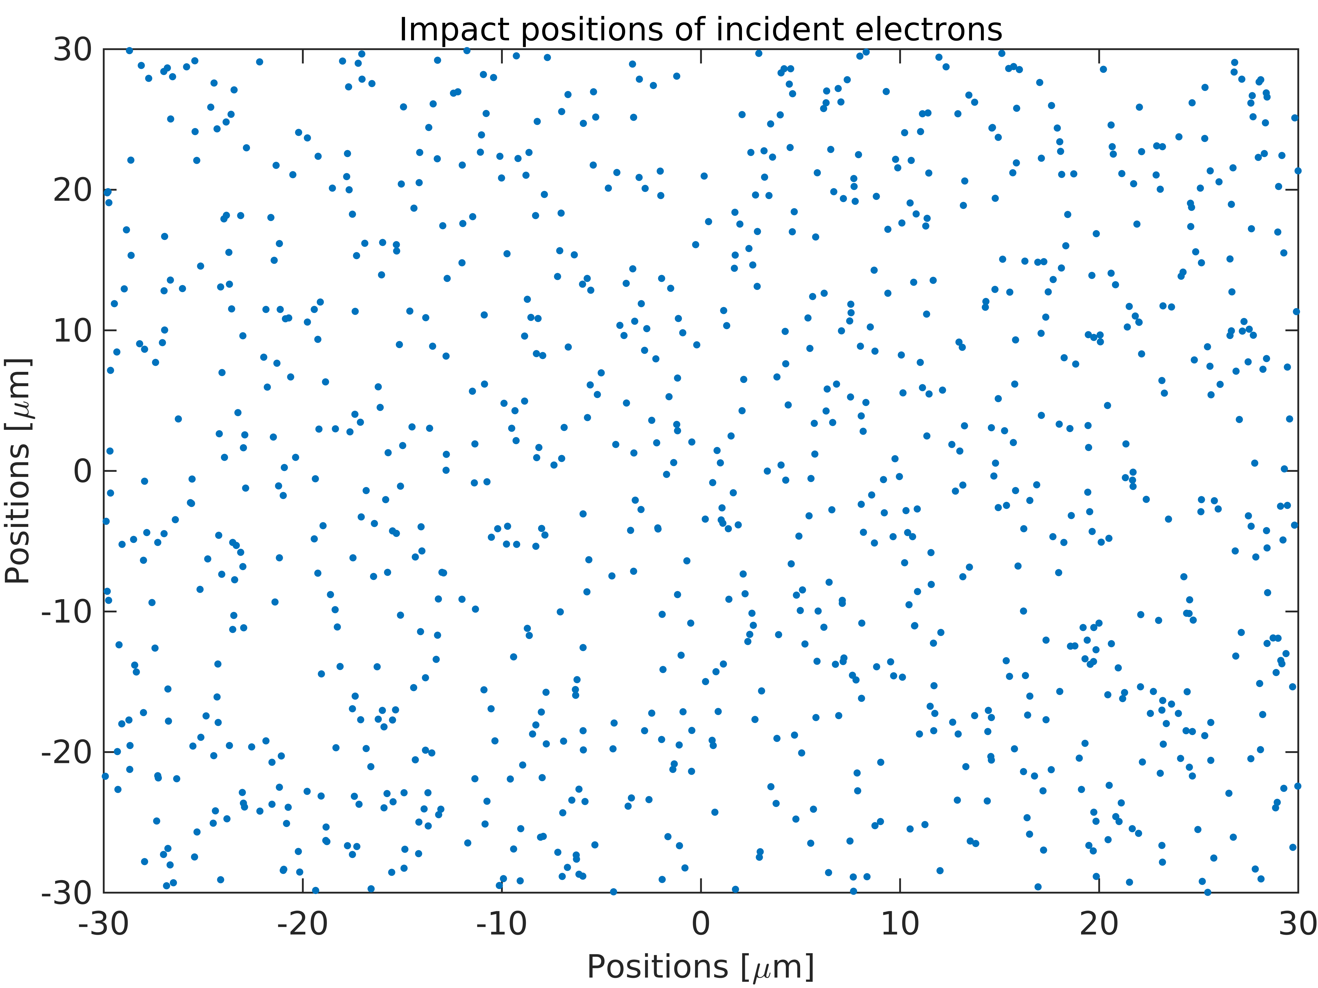

Quantization of DQE
Infinit pixel
Cluster
Single hits
DQE veruse dose

Slide 18
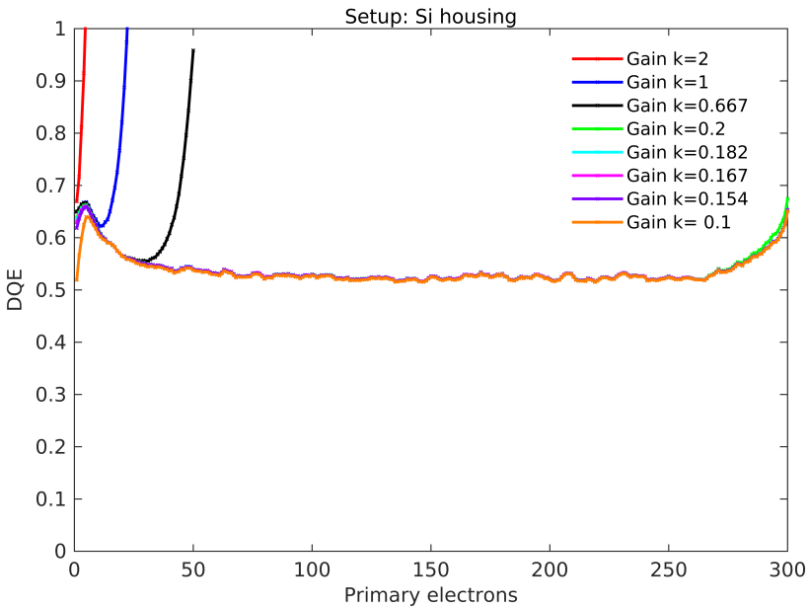
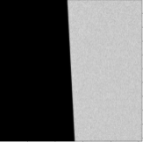
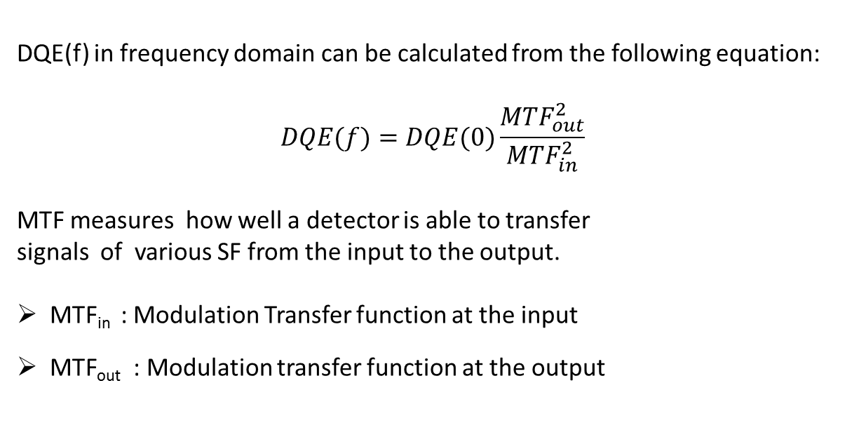
  Non-spatial counting capabilities: Infinity-pixel
DQE(f) in frequency domain can be calculated from the following equation:
$$DQE(f)=DQE(0)\frac{{MTF}_{out}^{2}}{{MTF}_{in}^{2}}$$
MTF measures how well a detector is able to transfer
signals of various SF from the input to the output.
MTF_{in} : Modulation Transfer function at the input
MTF_{out} : Modulation transfer function at the output
DQE(0)
MTF is calculated from slanted edge
e-

Slide 19

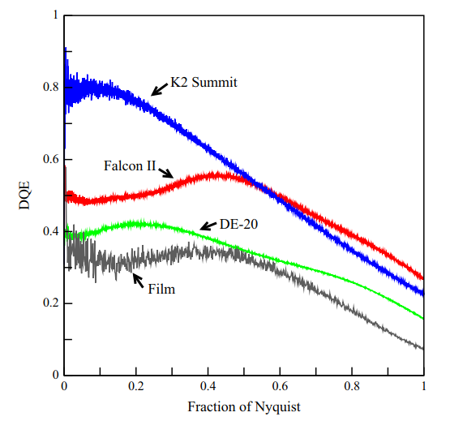
  Non-spatial counting capabilities: Infinity-pixel
DQE(0)
G. McMullan et al. / Ultramicroscopy 147 (2014) 156–163
Detector | #pixel | Pixel length [mu] | A per pixel at mag. 50k | Object length at mag. 50k [mu] | Ava. Speed [fps] | Max. Speed [fps] | Sweet flux [e-/px/s]
Falcon III | 20 M | 14 | 2.8 | 0.41 | 40 | -> | 160
K2 Summit | 14 M | 5 | 1 | 0.38 | 400 | -> | <2
DE-20 | 17 M | 6.4 | 1.3 | 0.67 | 25 | -> | 100
EDET_80k | 1 M | 60 | 12 | 1.2 | 1000 | 80 000 | 20 000

Slide 20
Summary & Outlook
Detailed detector simulation studies have been performed.
A competitive direct detector with improved imaging performance has been identified.
Dominant source of noise in the detector: Poisson noise
Next steps:
DQE in spatial frequency domain
DQE from single hits
DQE vs. Dose
Notes:
Summary & Outlook

Slide 21
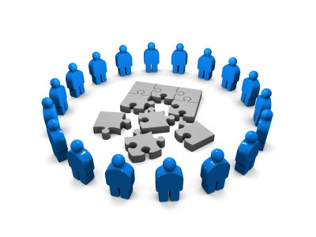




EDET Team: Acknowlegements
HLL ► Ladislaw Andricek ● Martin Hensel ● Christian Koffmane ● Jelena Ninkovic ● Gerhard Schaller ● Martina Schnecke ● Florian Schopper ● Andreas Wassatsch ● Christian Zirr
KIT ► Ivan Peric
USI ► Klaus Gärtner
MPSD ► Ibrahym Dourki ● Sascha Epp ● Djordje Gitaric ● R. J. Dwayne Miller ● Fabian Westermeier

Slide 22
Thank you for your attention

