Slide 1
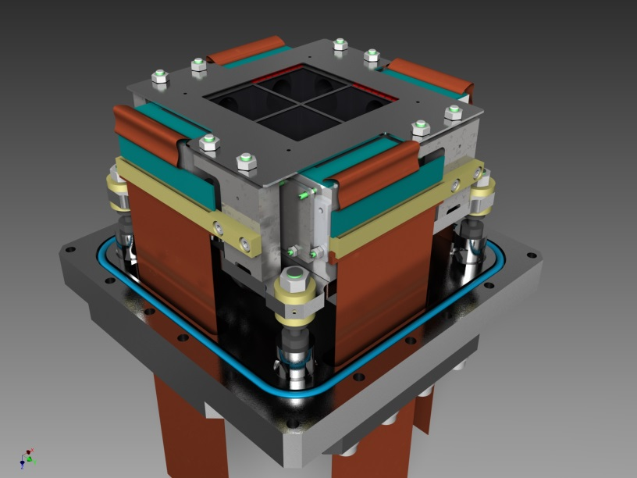
DAQ system design.
Overview
Introduction.
EDET. Data flow.
DAQ tasks.
Questions & Solutions.
Resources overview.
Hardware & Software + time*manpower.

Slide 2
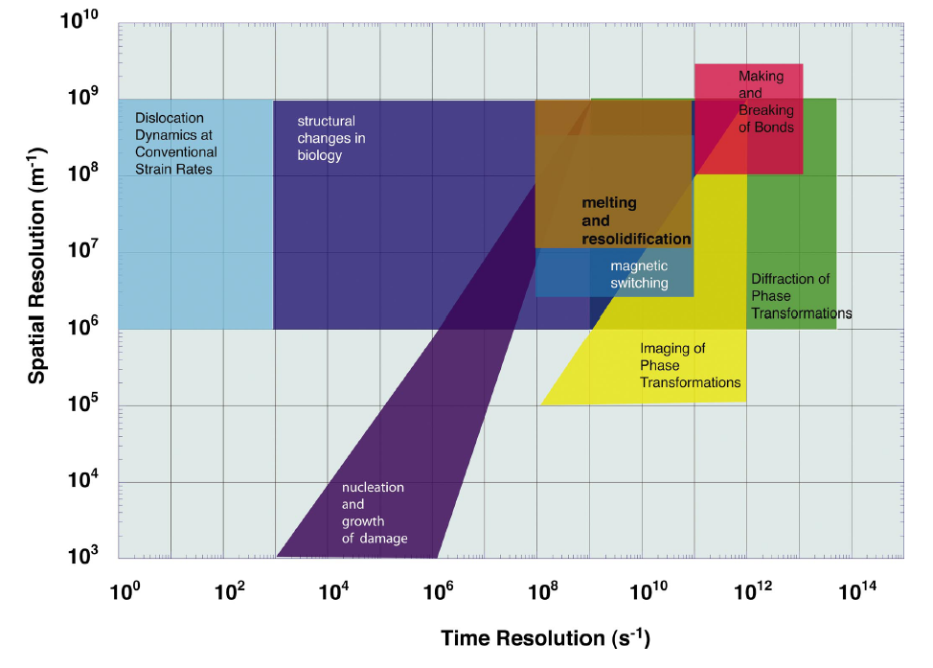
DAQ system design.
What is EDET aiming for?
80 000 Hz
1 Hz
Large molecules interaction,
Substance structural changes.

Slide 3
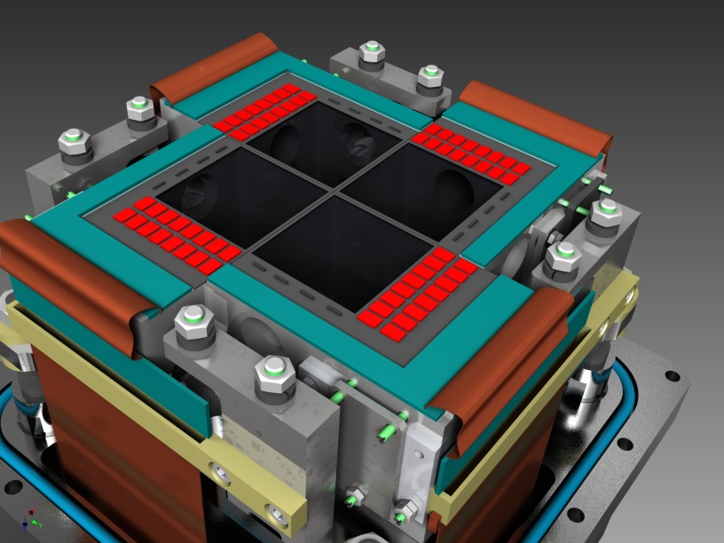
DAQ system design.
How does should it look like?
Shielding
e-
512x512 pixels
Detector FPA consisting of 4 individual, independent modules.
Each quarter consists of DEPFET ASM together with electronics and mechanical support
DEPFET matrix 512 x 512 pixels
1 Mpixel = 4 x 512 x 512 pixels
Real-space imaging in the focal plane of a TEM
Grey-scaled image
DMC
DCD
Switcher

Slide 4
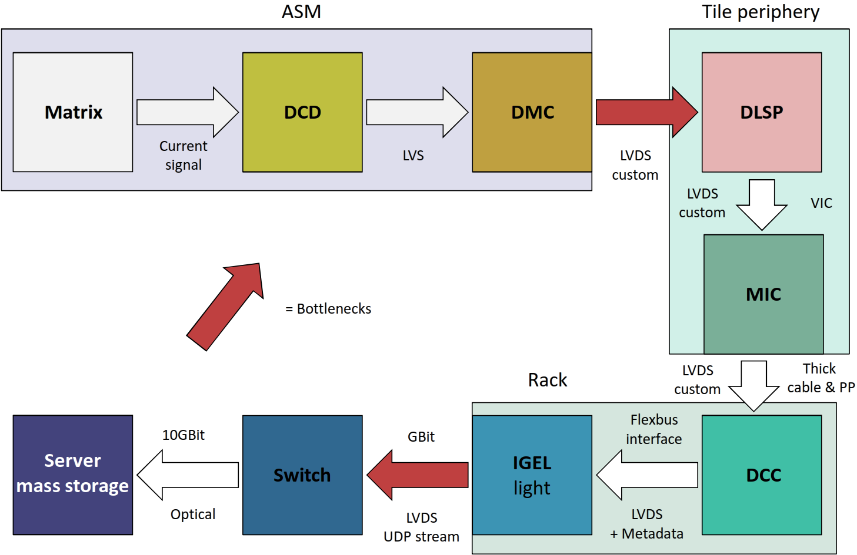
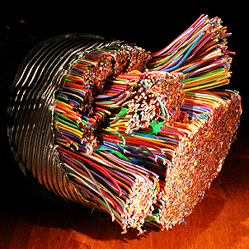
DAQ system design.
DAQ. Initial approach datapath overview.

Slide 5
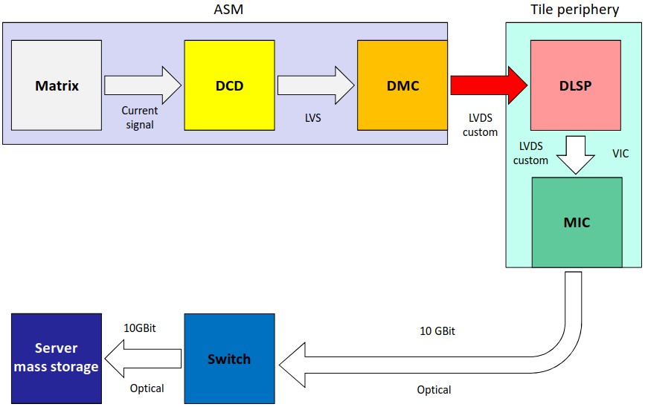
DAQ system design.
DAQ. Actual approach datapath overview.
Point of the most interest for today‘s topic.

Slide 6
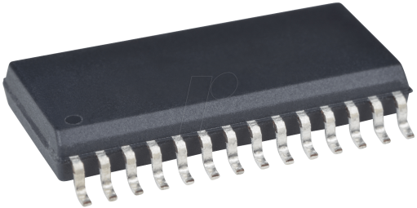
DAQ system design.
All-silicon module (ASM).
Matrix
512x512
DCD x 8
DMC(DHPT) x 8
SRAM buffer
for 10² frames;
LVDS driver;
Analogue
lines
8 x 8
digital
lines

Slide 7
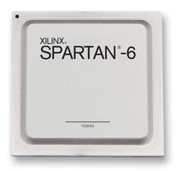
DAQ system design.
DAQ. Actual approach datapath overview.
8 x DMC
(DHPT)
DLSP(pcb)
LVDS buffering
Simulation shall give us an answer, whether to use the buffer or painlessly bypass it (ChK).
8 x 8
LVDS lines or
(8 x CML lines)
Notes:
A candidate to be removed from the design.

Slide 8
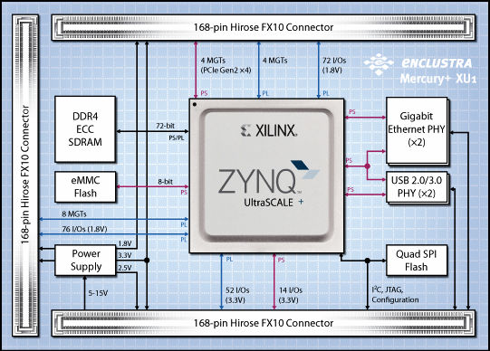
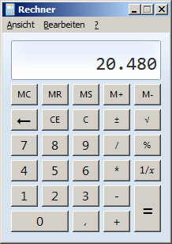
DAQ system design.
DAQ. Actual approach datapath overview.
DLSP
MIC(+MIC Service Module(MSM))
64 x 320 Mb/s LVDS pairs
20,48 Gb/s
Notes:
We have entrusted the data handling to a high-end Xilinx SoC populated on a very compact PCB with and I beleive we made a right choice. By the next slides I‘ll show you why I think so.

Slide 9
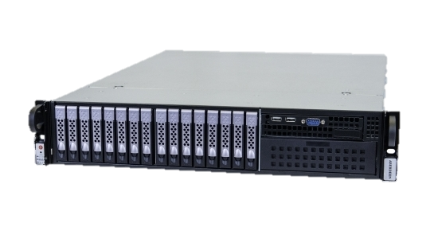
DAQ system design.
DAQ. Actual approach datapath overview.
MIC
Network and Storage array
2 x 10GBASE-SR
Requirements:
Write rate 8GB/s
Capacity enough for 1 hour

Slide 10
DAQ system design.
EDET backend firmware tasks.
Provide data path from the sensor to the storage (excluding new bottlenecks if possible);
Metadata encapsulation;
Configuration data delivery to every part of the system in vertical direction;
Inter-module link communication:
Trigger and clock distribution to the neighboring tiles;
Configuration data delivery in horizontal direction and monitoring data transition;
Houskeeping:
Power module;
DLSP;
Operator UI;
Trigger signal generation(!)
Notes:
Splitting the DAQ system into several independent tasks.

Slide 11
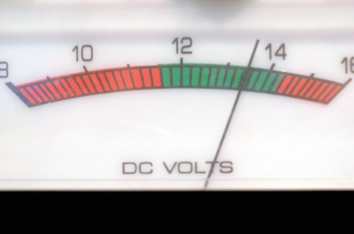
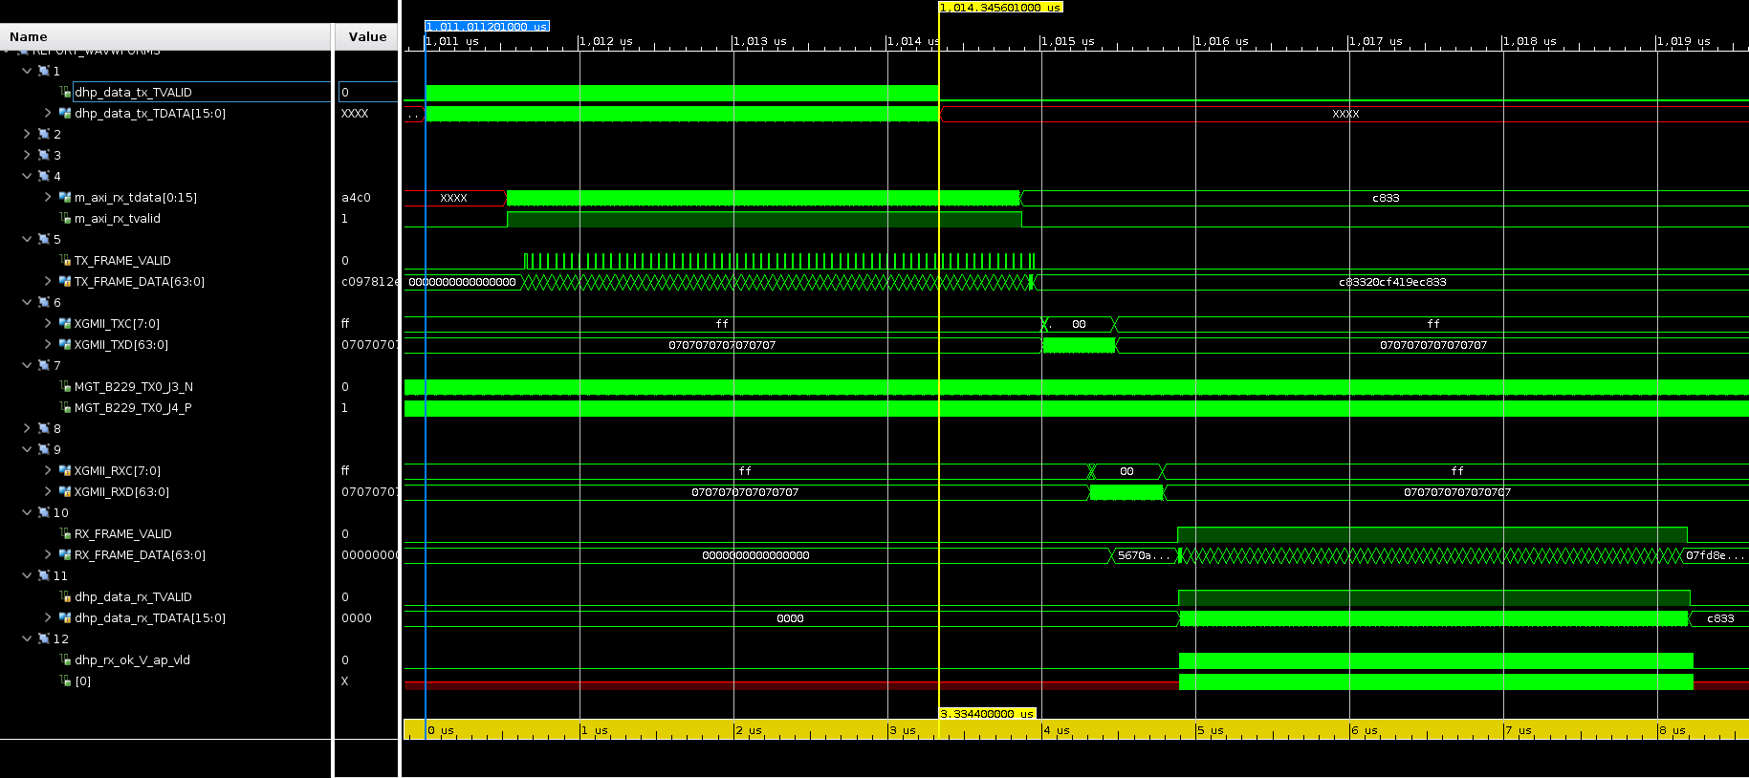
DAQ system design.
High speed data path. Test mode.
Programmable logic
DHPT data generator/checker
9
16
16
1
8
AXI interconnect
1
16
64
64
2
7
3
2
Aurora IP 1,6Gb/s
8b10b
XG Ethernet
UDP/IP/MAC
3
4
5
64
64
6
4
6
7
8
Loopback
PCS/PMA
9
Loopback
5
Notes:
Splitting the DAQ system into several independent tasks.

Slide 12
DAQ system design.
Metadata encapsulation.
Programmable logic
AXI interconnect
16
16
16
64
64
Image reshaping,
Metadata generation and incapsulation
+
Meta
+
Meta
+
Meta
16
16
16
Aurora IP 1,6Gb/s
8b10b
XG Ethernet
UDP/IP/MAC
XG Ethernet
UDP/IP/MAC
PCS/PMA
PCS/PMA
8
SFP+
SFP+
Notes:
Splitting the DAQ system into several independent tasks.

Slide 13
DAQ system design.
Vertical configuration
Programmable logic
Processing system
AXI interconnect
Linux Kernel
1. Where to keep configuration data(MIC or Network)?
2*. How to configure the tool? (SSH, xUI)
3*. How and where to keep track of state changes? (text log, CSV, EMACS/CS Studio)
4. Where to keep the filesystem? (Locally or NFS)
User software
IP
IP
IP
File system
JTAG
DCD: >80
DHPT: ~60
DMC: ~50
Notes:
That section gives me more questions than answers.

Slide 14
DAQ system design.
Inter-module link communication (ILC)
PL
PS
Aurora OR
USXGMII
MGT
Linux Kernel
AXI interconnect
User software
G
M or S
File system
Summary
1G/10G Ethernet link between adjacent tiles;
Wired connection for clock and trigger.
Aurora OR
USXGMII
MGT
PL
Aurora OR
USXGMII
MGT
PS
AXI interconnect
Linux Kernel
User software
G
M or S
File system
Aurora OR
USXGMII
MGT
Notes:
That section gives me more questions than answers.

Slide 15
DAQ system design.
Housekeeping
Programmable logic
Processing system
AXI interconnect
Linux Kernel
User software
Functionality:
Configuration,
Current device state reading,
State tracking,
Reports generating.
I²C
I²C
File system
I²C
Command line interface?
eXtended UI (xUI)
DLSP
MPM
Notes:
That section gives me more questions than answers.

Slide 16
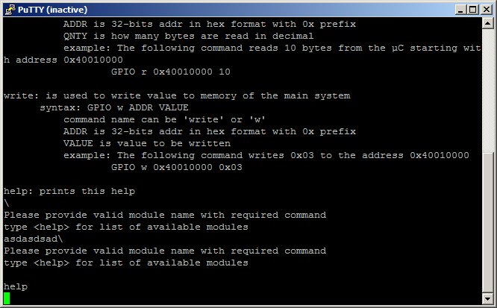
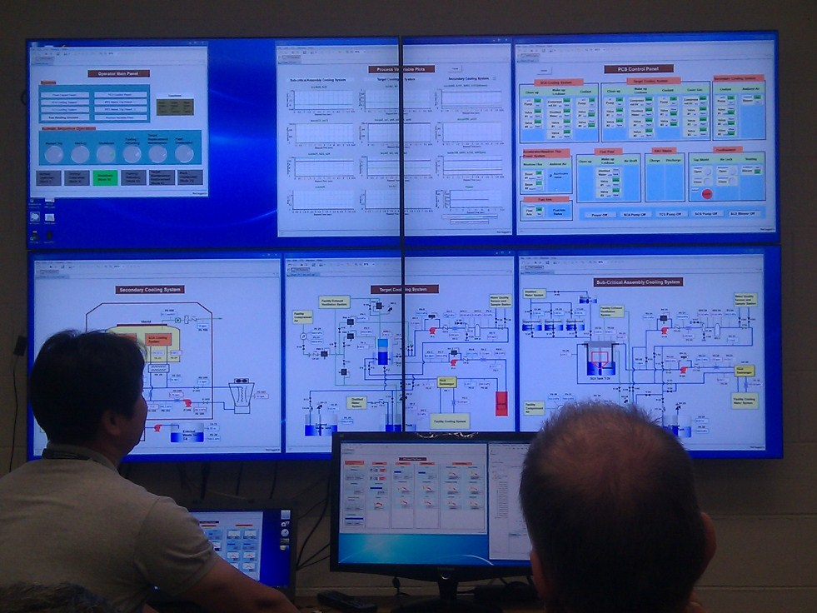
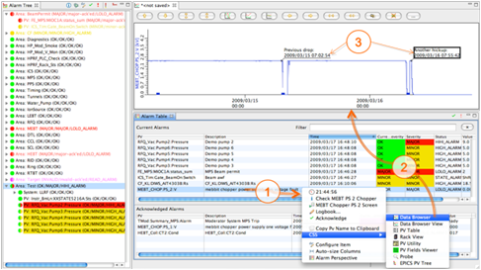
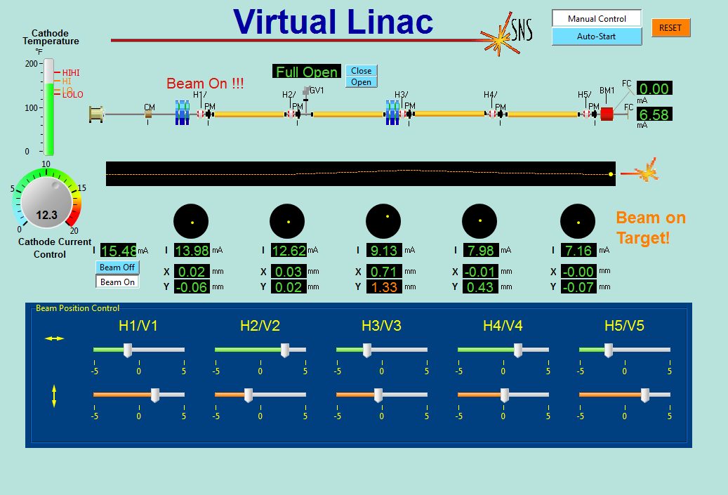
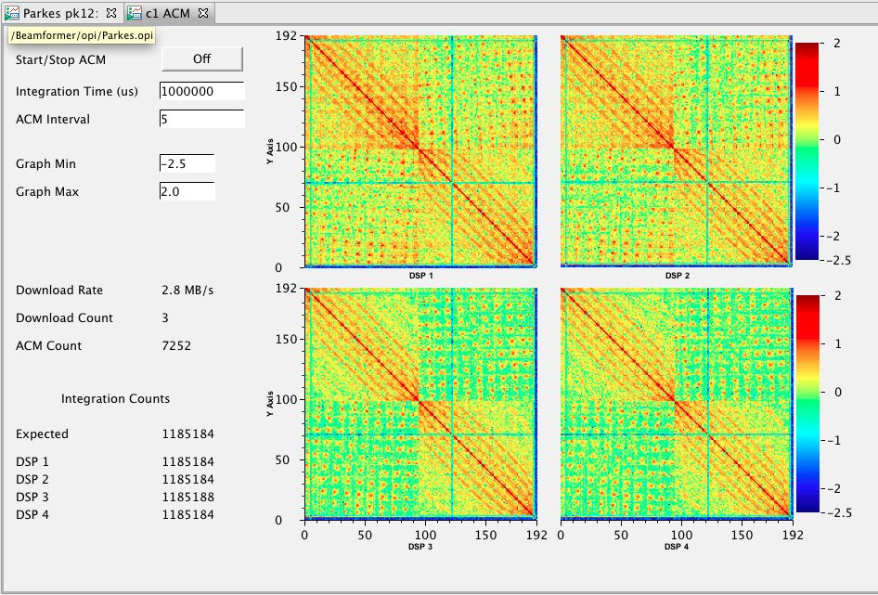
DAQ system design.
Operator UI.
DCD: 83
DHPT: 59
DMC: ~50
Total order ~4,4*10³
Processing system
User software
File system
Command line
Graphical

Slide 17
DAQ system design.
Trigger signal generation.
Blind time
F
Read-out (Blind) time
F
Blind time
Filmed time | Blind time
1,28ms (11%) | 10,24ms (89%)
F
Blind time
PL
G
M or S

Slide 18
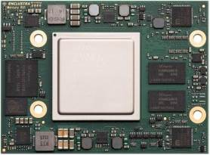
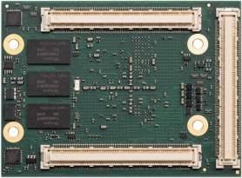
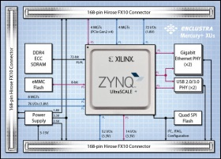
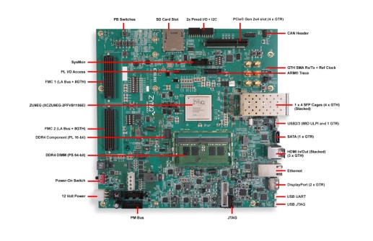
DAQ system design.
Resources overview.
Hardware
Software
Xilinx synthesis EDA + simulator
SoC board
GCC cross-compiler
Xilinx devkit
MIC service module (in design)

Slide 19
DAQ system design.
Summary.
High speed data path. Simulated. Ok.
Image reshaping and metadata generation.
Configuration:
Storage: local initial configuration(RO), local user modified(RW) and Network.
Type: Database.
Instrument state data:
Monitor current state with xUI(CS Studio).
Log past events (EMACS).
Intelligent trigger system.
Metadata generation.

Slide 20
DAQ system design.
Thanks for your attention.
To be continued…

