Slide 1
EDET Hybrid Measurement Results

Slide 2
OVERVIEW
FROM HYBRID5 to EDET-HYBRID
PHILOSOPHY
CHANGES
COMPLETED COMPONENTS
MAPPING ISSUES
STANDARD MEASUREMENTS
CALIBRATION ISSUES

Slide 3
Motivation for new E1 Hybrid Board
Space Constraints
EDET small matrix (active area: 12x7mm²) larger than BELLE small matrix (7.68x3.84mm²) permitting connections to all DCDE and Switcher channels → new wirebond adapter
Integrate new connections
compatibility to BELLE PS & PSP → Glenair connectors
Switcher substrate line, Switcher V_{ref} line
enabling sense lines to all ASIC voltages
Decision on data interface
Change 2nd infiniband (JTAG lines) connector to RJ45 in order to get rid of JTAG breakout board

Slide 4
Philosophy
Starting with the functional BELLE II chain all components are stepwise replaced and tested
Infini
band
Infini
band
JTAG
Break-
Out
Board
BELLE II
PS
Hybrid5 Board
Infini
band
Infini
band
Samtec
DHP
DCD
B-matrix
RJ45
Infini
band
SW
RJ45
Infini
band
DHE
DHE

Slide 5
CHANGE (I) – DCDE
Starting with the functional BELLE II chain all components are stepwise replaced and tested
Infini
band
Infini
band
JTAG
Break-
Out
Board
BELLE II
PS
Hybrid5 Board
Infini
band
Infini
band
Samtec
DHP
DCDE
B-matrix
RJ45
Infini
band
SW
RJ45
Infini
band
DHE
DHE

Slide 6
CHANGE (II) – EDET MATRIX
Starting with the functional BELLE II chain all components are stepwise replaced and tested
Infini
band
Infini
band
JTAG
Break-
Out
Board
BELLE II
PS
Hybrid5 Board
Infini
band
E-matrix
Infini
band
Samtec
DHP
DCDE
RJ45
Infini
band
SW
RJ45
Infini
band
DHE
DHE

Slide 7
CHANGE (III) – EDET HYBRID BOARD
Starting with the functional BELLE II chain all components are stepwise replaced and tested
JTAG
Break-
Out
Board
BELLE II
PS
E1 Hybrid Board
Infini
band
Samtec
DHP
DCDE
E-matrix
SW
RJ45
RJ45
Infini
band
DHE
DHE

Slide 8
CHANGE (IV) – PSP
Starting with the functional BELLE II chain all components are stepwise replaced and tested
JTAG
Break-
Out
Board
PSP
E1 Hybrid Board
Infini
band
Glenair Micro D 51
PSP
Breakout-Board
DHP
DCDE
E-matrix
Glenair Micro D 51
SW
RJ45
RJ45
Infini
band
DHE
DHE

Slide 9
E1 – I – 01

Slide 10
PSP Breakout-Board – Final Board

Slide 11
Wire-Bonding then (BELLE II) …
DOWN
UP
DOWN
UP
UP
DOWN
UP
DOWN

Slide 12
… and today (small EDET matrix) same WBA
UP
DOWN
UP
DOWN
UP
DOWN
UP
DOWN

Slide 13
MAPPING APPROACH (1)
wire-bonding starts with closest pad rows, i.e. 1->1, 2->2, 3->3, 4->4
0 1 2 3
3 2 1 0

Slide 14
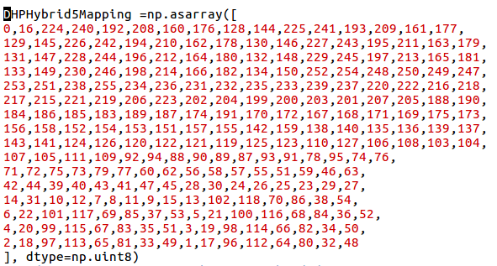
MAPPING APPROACH (2)
Matrix Arrangement
255 | 253 | 254 | 252
251 | 249 | 250 | 248
247 | 245 | 246 | 244
243 | 241 | 242 | 240
239 | 237 | 238 | 236
235 | 233 | 234 | 232
231 | 229 | 230 | 228
227 | 225 | 226 | 224
223 | 221 | 222 | 220
219 | 217 | 218 | 216
215 | 213 | 214 | 212
211 | 209 | 210 | 208
207 | 205 | 206 | 204
203 | 201 | 202 | 200
199 | 197 | 198 | 196
195 | 193 | 194 | 192
191 | 189 | 190 | 188
187 | 185 | 186 | 184
183 | 181 | 182 | 180
179 | 177 | 178 | 176
175 | 173 | 174 | 172
171 | 169 | 170 | 168
167 | 165 | 166 | 164
163 | 161 | 162 | 160
159 | 157 | 158 | 156
155 | 153 | 154 | 152
151 | 149 | 150 | 148
147 | 145 | 146 | 144
143 | 141 | 142 | 140
139 | 137 | 138 | 136
135 | 133 | 134 | 132
131 | 129 | 130 | 128
127 | 125 | 126 | 124
123 | 121 | 122 | 120
119 | 117 | 118 | 116
115 | 113 | 114 | 112
111 | 109 | 110 | 108
107 | 105 | 106 | 104
103 | 101 | 102 | 100
99 | 97 | 98 | 96
95 | 93 | 94 | 92
91 | 89 | 90 | 88
87 | 85 | 86 | 84
83 | 81 | 82 | 80
79 | 77 | 78 | 76
75 | 73 | 74 | 72
71 | 69 | 70 | 68
67 | 65 | 66 | 64
63 | 61 | 62 | 60
59 | 57 | 58 | 56
55 | 53 | 54 | 52
51 | 49 | 50 | 48
47 | 45 | 46 | 44
43 | 41 | 42 | 40
39 | 37 | 38 | 36
35 | 33 | 34 | 32
31 | 29 | 30 | 28
27 | 25 | 26 | 24
23 | 21 | 22 | 20
19 | 17 | 18 | 16
15 | 13 | 14 | 12
11 | 9 | 10 | 8
7 | 5 | 6 | 4
3 | 1 | 2 | 0
DCD WB
0 |  | 16
64 | 32 | 80 | 48
1 | 96 | 17 | 112
65 | 33 | 81 | 49
2 | 97 | 18 | 113
66 | 34 | 82 | 50
3 | 98 | 19 | 114
67 | 35 | 83 | 51
4 | 99 | 20 | 115
68 | 36 | 84 | 52
5 | 100 | 21 | 116
69 | 37 | 85 | 53
6 | 101 | 22 | 117
70 | 38 | 86 | 54
15 | 102 | 13 | 118
7 | 11 | 8 | 9
14 | 10 | 31 | 12
25 | 29 | 23 | 27
28 | 24 | 30 | 26
43 | 47 | 41 | 45
42 | 39 | 44 | 40
51 | 46 | 59 | 63
56 | 57 | 58 | 55
79 | 60 | 77 | 62
71 | 75 | 72 | 73
78 | 74 | 95 | 76
89 | 93 | 87 | 91
92 | 88 | 94 | 90
107 | 111 | 105 | 109
106 | 103 | 108 | 104
125 | 110 | 123 | 127
120 | 121 | 122 | 119
143 | 124 | 141 | 126
135 | 139 | 136 | 137
142 | 138 | 159 | 140
153 | 157 | 151 | 155
156 | 152 | 158 | 154
171 | 175 | 169 | 173
170 | 167 | 172 | 168
189 | 174 | 187 | 191
184 | 185 | 186 | 183
207 | 188 | 205 | 190
199 | 203 | 200 | 201
206 | 202 | 223 | 204
217 | 221 | 215 | 219
220 | 216 | 222 | 218
235 | 239 | 233 | 237
234 | 231 | 236 | 232
253 | 238 | 251 | 255
248 | 249 | 250 | 247
134 | 252 | 150 | 254
198 | 166 | 214 | 182
133 | 230 | 149 | 246
197 | 165 | 213 | 181
132 | 229 | 148 | 245
196 | 164 | 212 | 180
131 | 228 | 147 | 244
195 | 163 | 211 | 179
130 | 227 | 146 | 243
194 | 162 | 210 | 178
129 | 226 | 145 | 242
193 | 161 | 209 | 177
128 | 225 | 144 | 241
192 | 160 | 208 | 176
 | 224 |  | 240
enter correct pad connections from the layout in an excel sheet
electrical row consists of 4 geometrical rows
the pad arrangement for the EDET-Small-Matrix does not fully correspond to the geometrical numbering: 3,2,1,0 → 3,1,2,0
sort by DCD channel index & reversely by matrix index and copy corresponding matrix to python program mapping.py

Slide 15
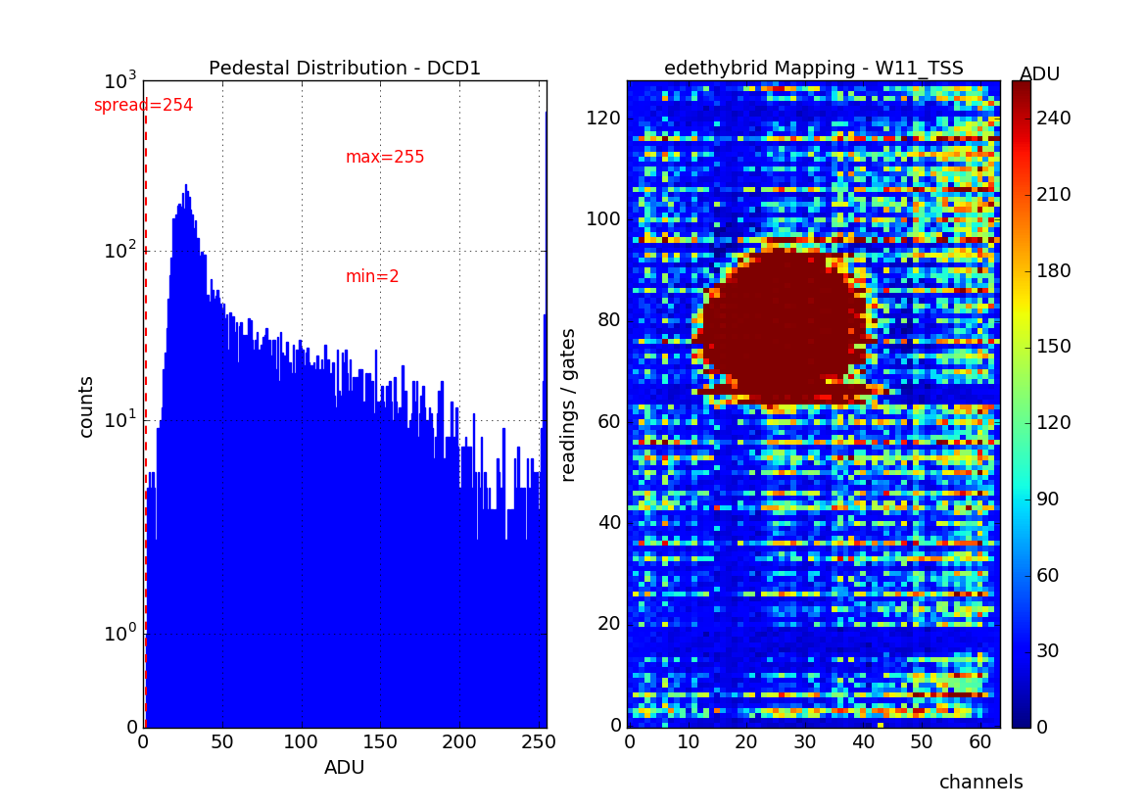
MAPPING – FUNCTIONAL TEST
E1-I-02 Hybrid Board

Slide 16
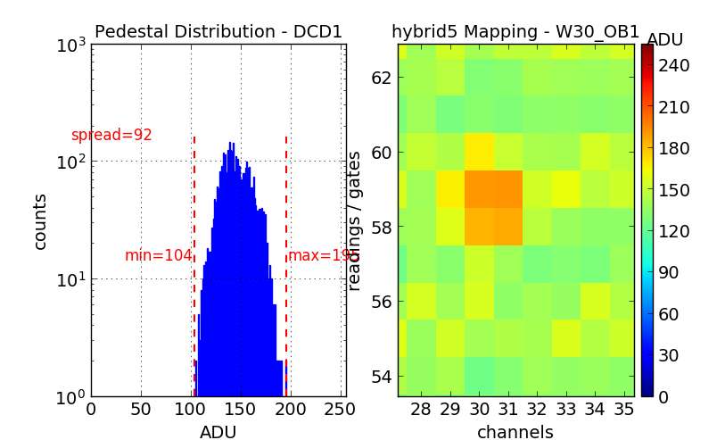
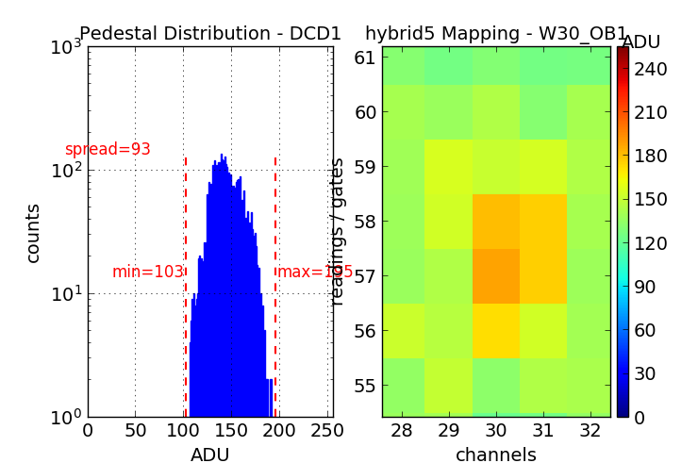
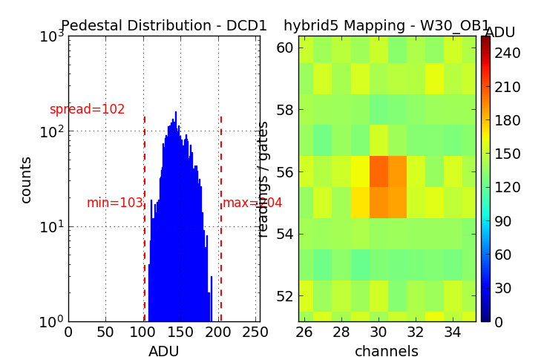
Laser Spot x-direction

Slide 17
DCDE-Manual DAC-Registers

Slide 18
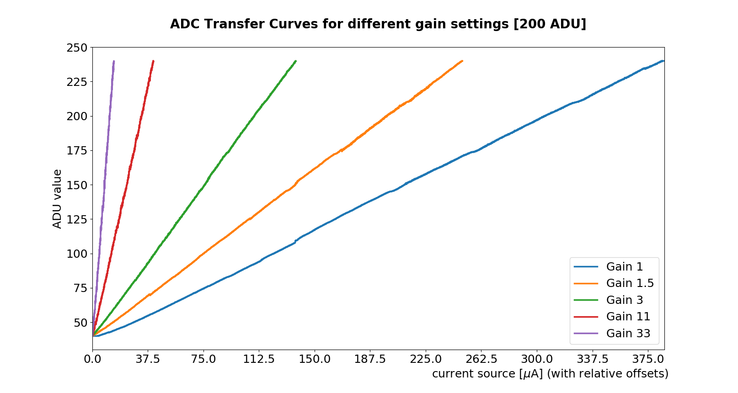
DCDE Gain Variation
En30 | En60 | En90 | En120 | Gain | Times lowest Gain
1 | 1 | 1 | 1 | 0.061 | 1.0
0 | 1 | 1 | 1 | 0.063 | 1.0
1 | 1 | 1 | 0 | 0.065 | 1.1
0 | 1 | 1 | 0 | 0.067 | 1.1
1 | 0 | 1 | 1 | 0.087 | 1.4
0 | 0 | 1 | 1 | 0.091 | 1.5
1 | 0 | 1 | 0 | 0.095 | 1.6
0 | 0 | 1 | 0 | 0.100 | 1.7
1 | 1 | 0 | 1 | 0.154 | 2.5
0 | 1 | 0 | 1 | 0.167 | 2.8
1 | 1 | 0 | 0 | 0.182 | 3.0
0 | 1 | 0 | 0 | 0.200 | 3.3
1 | 0 | 0 | 1 | 0.667 | 11.0
0 | 0 | 0 | 1 | 1.000 | 16.5
1 | 0 | 0 | 0 | 2 | 33
R_{f}: En30 = 30k
En60 = 3k
En90 = 1.5k
En120 = 15k
R_{s} = 15k
$$Gain=\frac{R_{f}}{R_{s}}$$
Gain | dynamic range for 200 ADU [µA]
1 | 380
1.5 | 250
3 | 137
11 | 41
33 | 15
Resistor | EDET | BELLE
En30 | 30k | 19k
En60 | 3k | 15k
En90 | 1.5k | 26k
En120 | 15k | not used

Slide 19
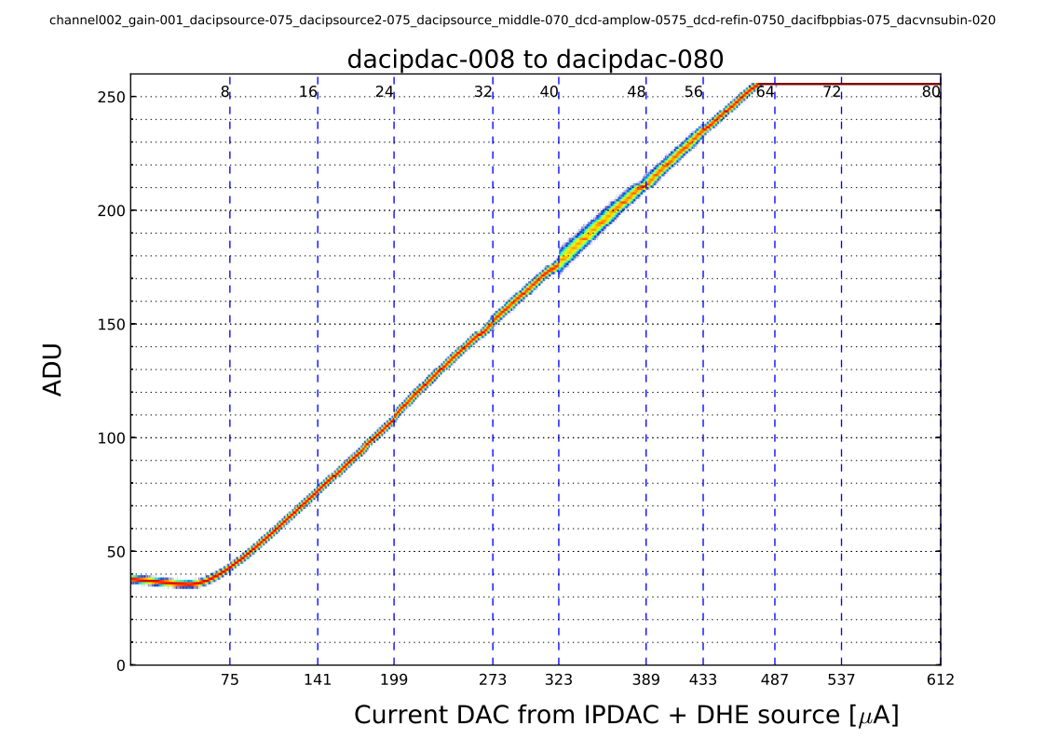
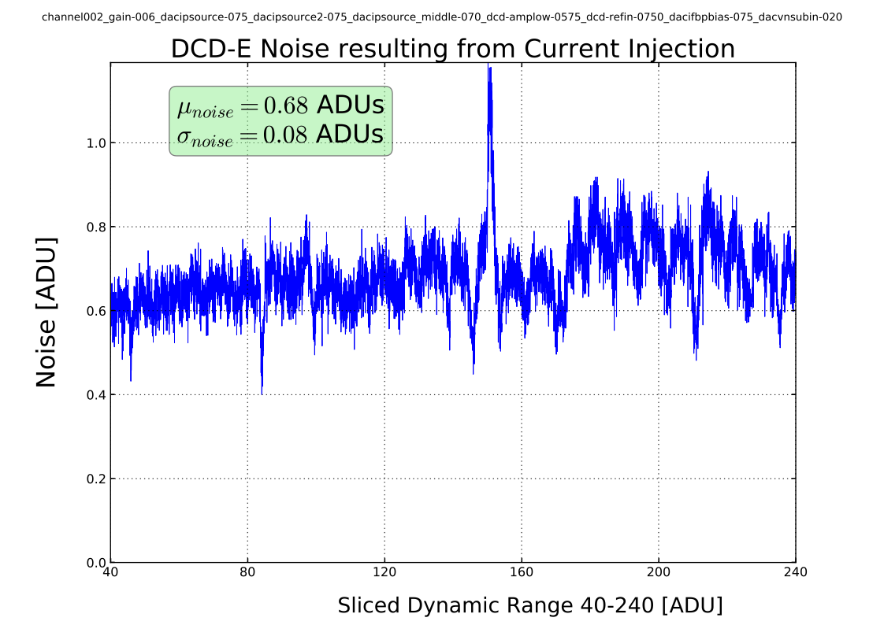
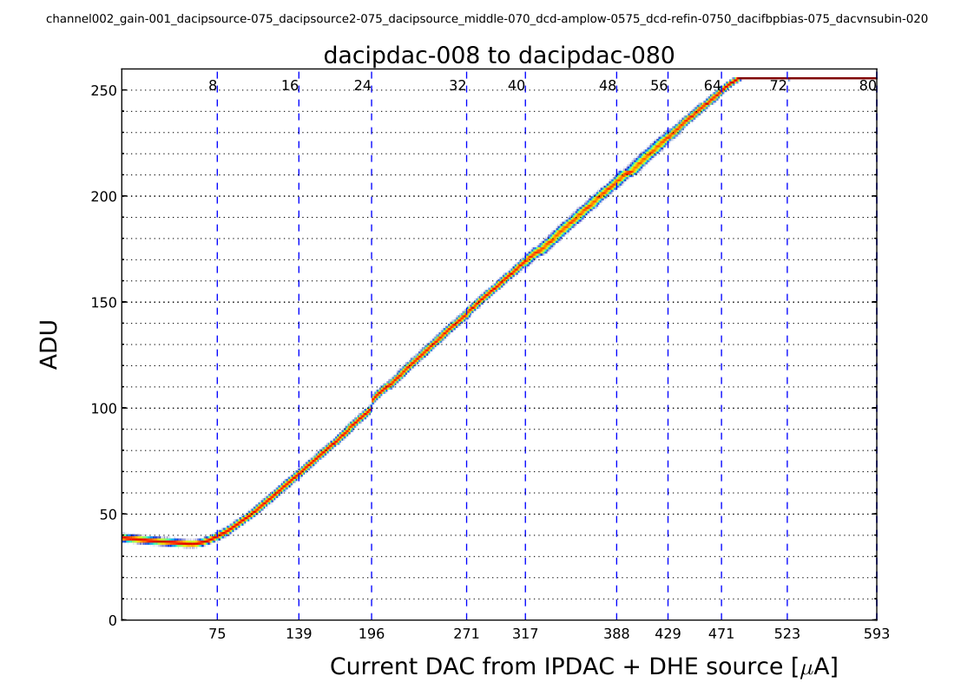
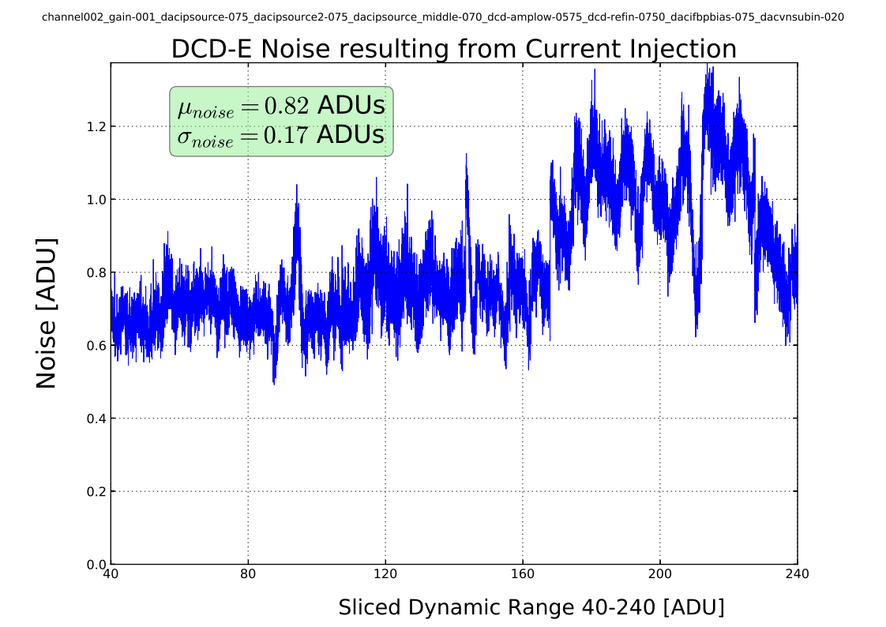
BELLE (top) vs EDET (bottom) PS – low gain
DHE current source limited to 75µA → solution: compound curves with IPDAC

Slide 20
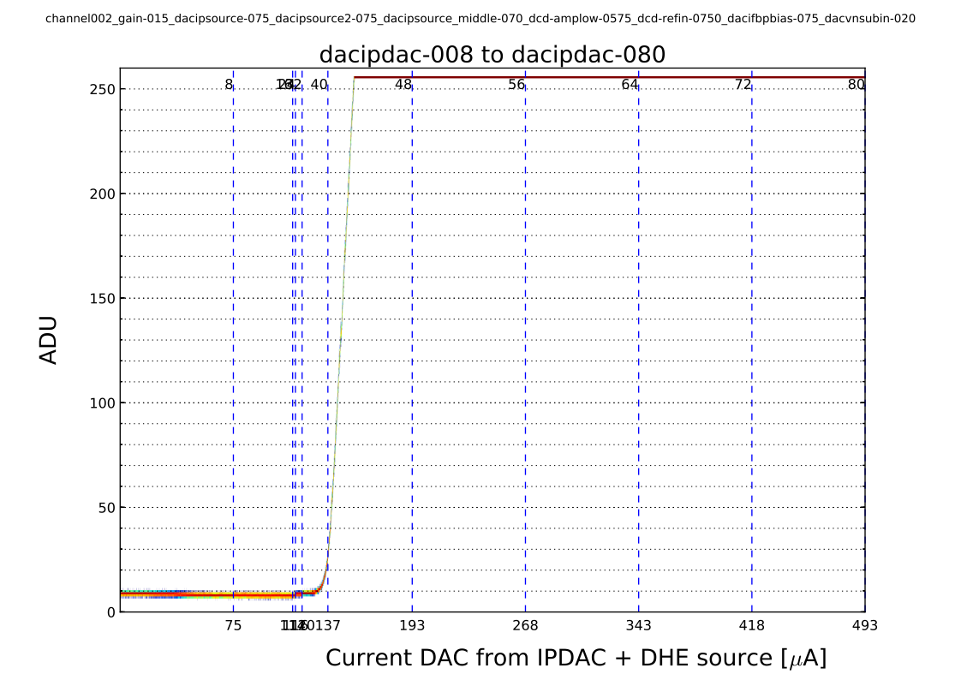
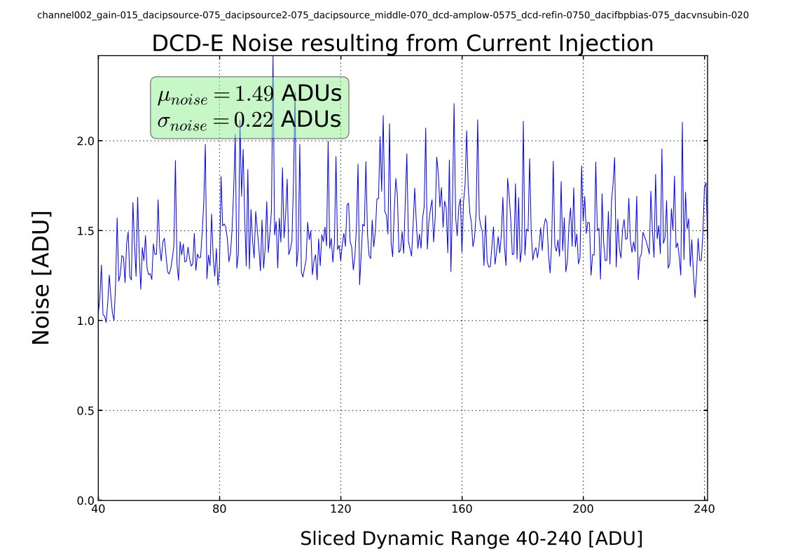
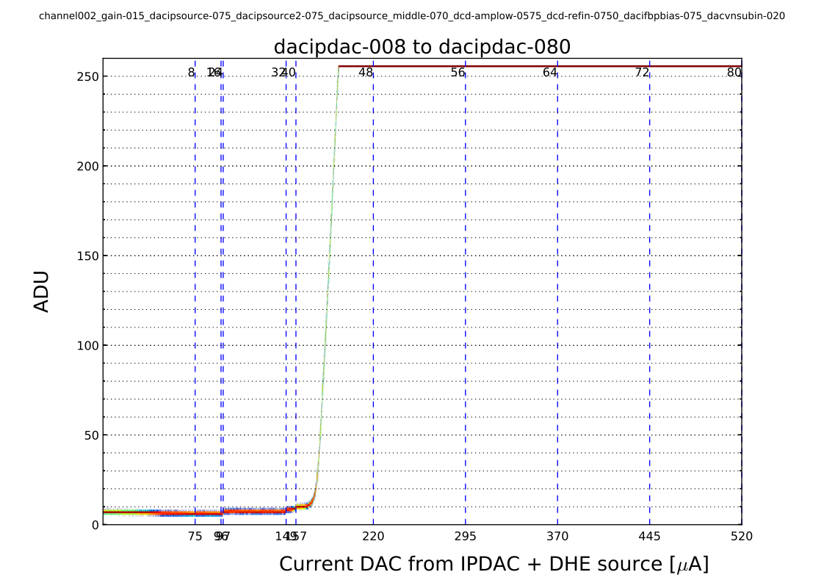
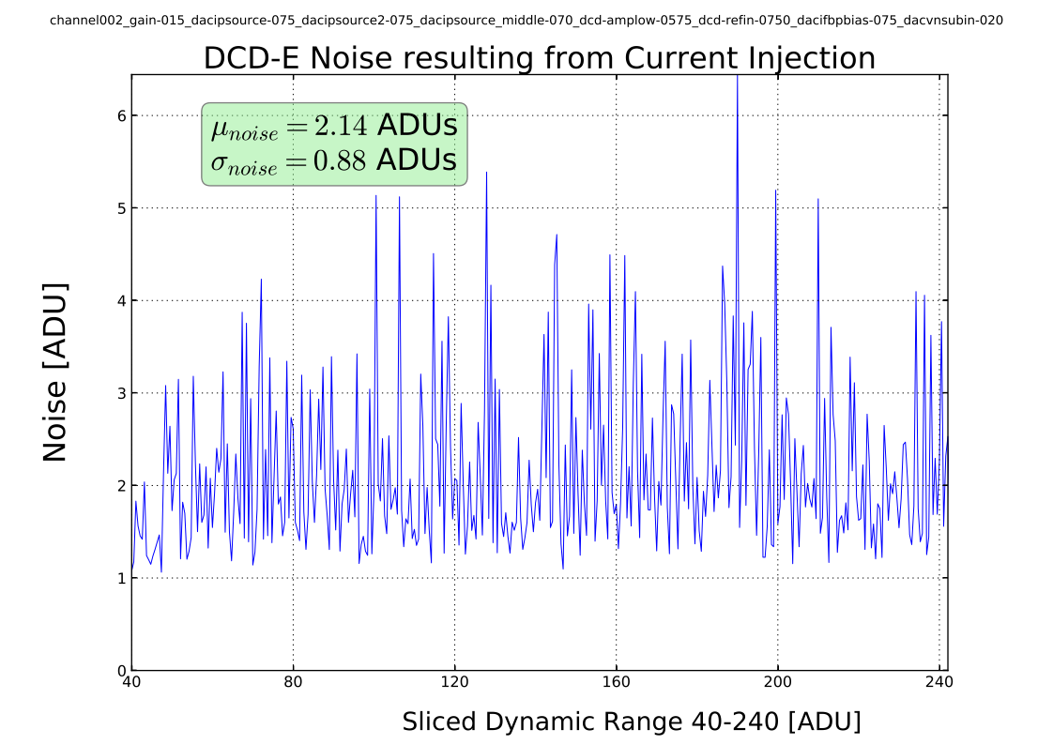
BELLE (top) vs EDET (bottom) PS – high gain

Slide 21
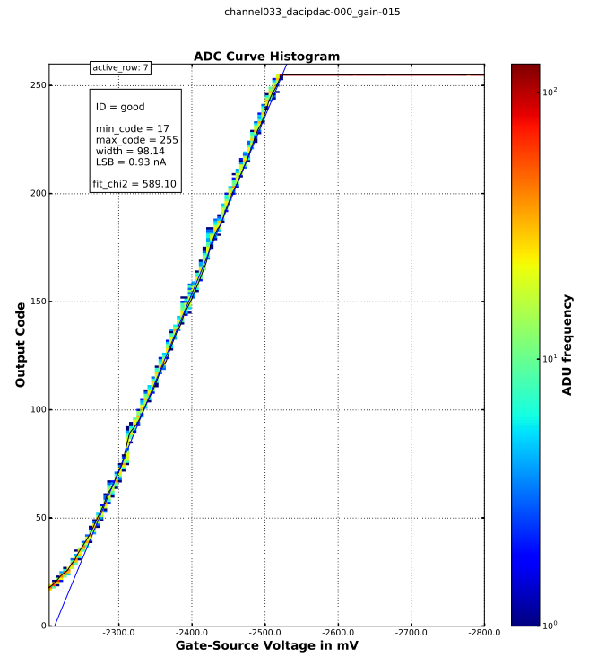
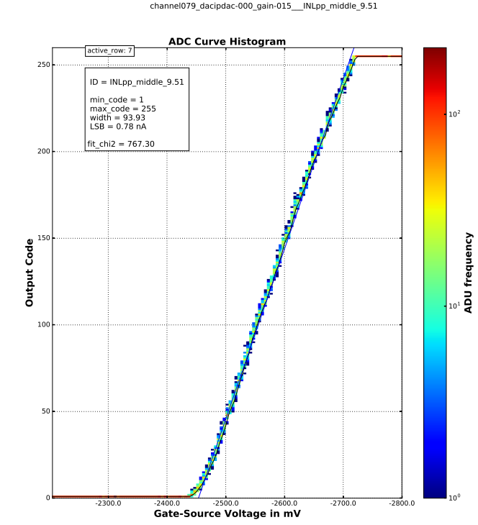
Matrix based Transfer Curves – high gain

Slide 22
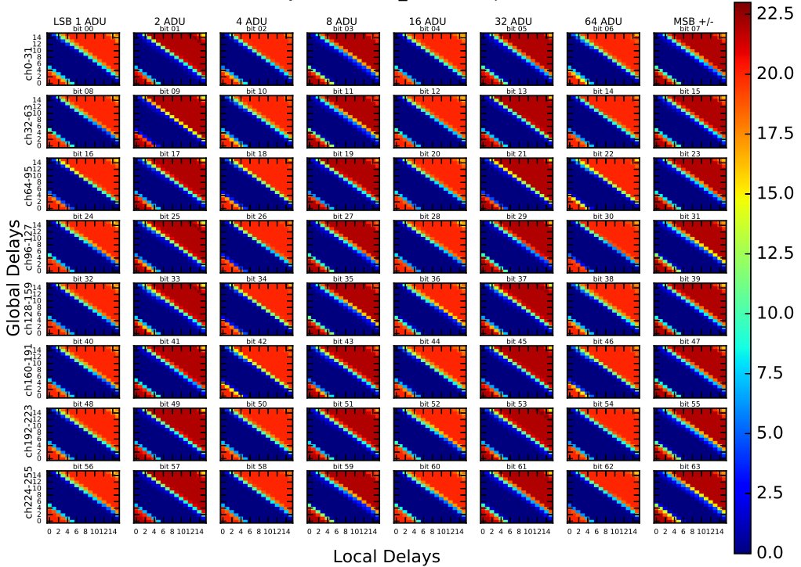
DELAY SCAN – E1-I-04

Slide 23
CALIBRATION BRAINSTORMING
METHOD
DESCRIPTION
PROS
CONS
X
-
ray Source
Cd
109
22keV
•
acceptable interaction
•
generates only
about
6000
probability
geometry allows for only 1
-
(low energy)
•
2
•
equipment
HLL
available
events per readout
X
-
ray Source
beyond 140keV
•
no vacuum
apparatus necessary
•
very low photoabsorption
(high energy)
(corresponds to 10ADUs)
probability of 0.01%
•
Compton effect dominates
•
availability of Source
β
-
emitter
Sr
90
continuous spectrum
•
generates over 100,000 e/h pairs
•
around
300 keV
(I. Dourki)
electrons would leave the
detector, so escape energy has
to be measured (scintillator)
α
emitter
Am
241
5.486MeV
•
forces
internal gate capacity to
•
vacuum
device and
(encapsulated as 60keV
maximum level (1,000,000
)
corresponding interconnection
γ
hardware necessary
-
source usable)
•
detector radiation damages
•
radiation protection
N
SEM/TEM
•
gradual increase of both
•
vacuum
device and
intensity (in 10eV steps up to
corresponding interconnection
300keV) and quantity of
hardware necessary
Laser
660nm
•
easy focusing
•
exact energy transfer unknown
•
intensity
controllable via applied
(approximation with optical
voltage and time (pulsing)
power meter)
equipment HLL available
only cell
-
by
-
•
•
cell calibration
CLEAR Backinjection
capitalizes on
variation of
•
relatively
quick calibration of all
•
level of original backinjection not
integration time
pixels possible
known (but can be measured
indirectly
–
laser)
•
finding
optimal operation point
for all pixels (process variation)

Slide 24
Above 60keV Compton Scattering dominates
Source: NIST data

Slide 25
Different Energetic Primary Electrons
Ibrahym Dourki

Slide 26
Spectra of high energetic electrons leaving Si
Ibrahym Dourki

Slide 27
average path length of electrons in Si
Ibrahym Dourki

Slide 28
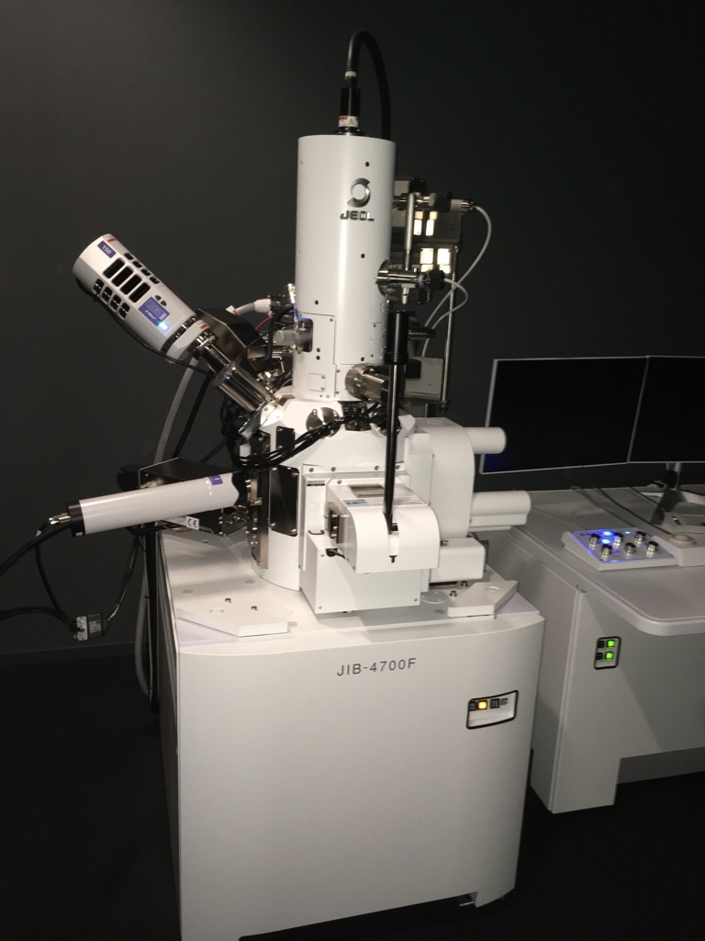
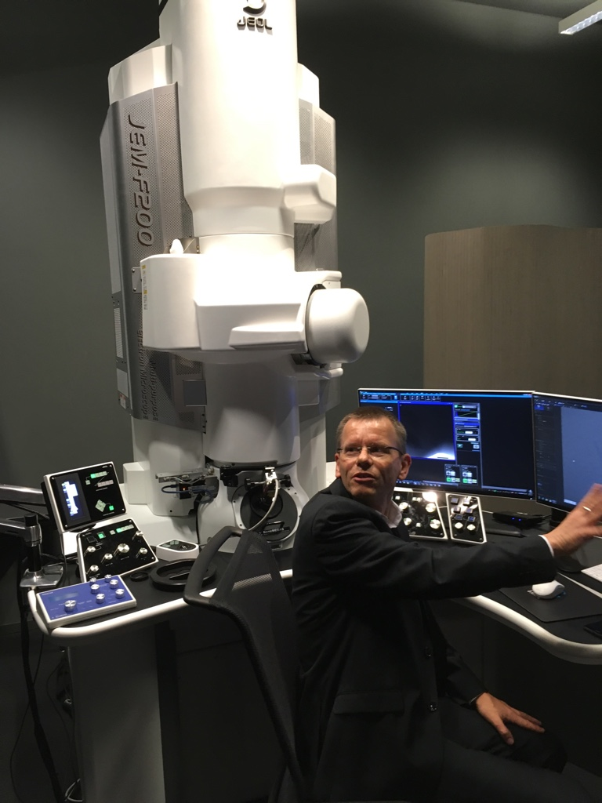
SEM/TEM – JEOL

Slide 29
SOLUTION
Calibrate laser pulse with Cd¹⁰⁹ source in high gain mode (from BELLE experience about 20 ADU, which corresponds to 1-2 ADU in lowest gain mode)
Step-increase of pulse count within one readout period in order to measure a discrete gain curve

Slide 30
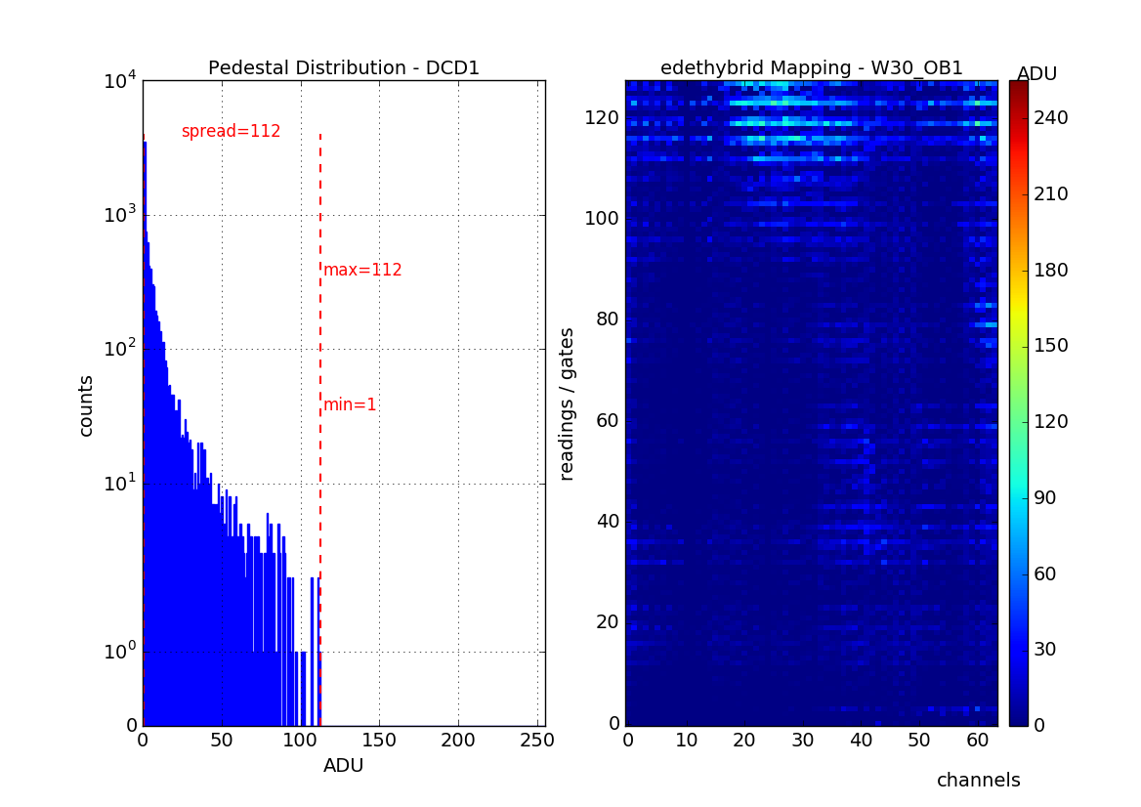
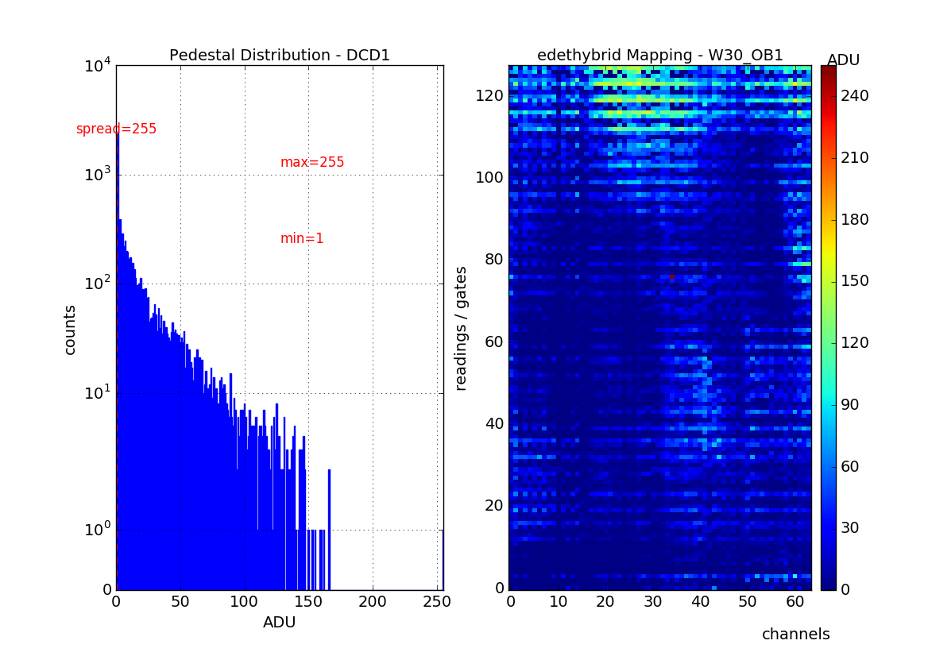
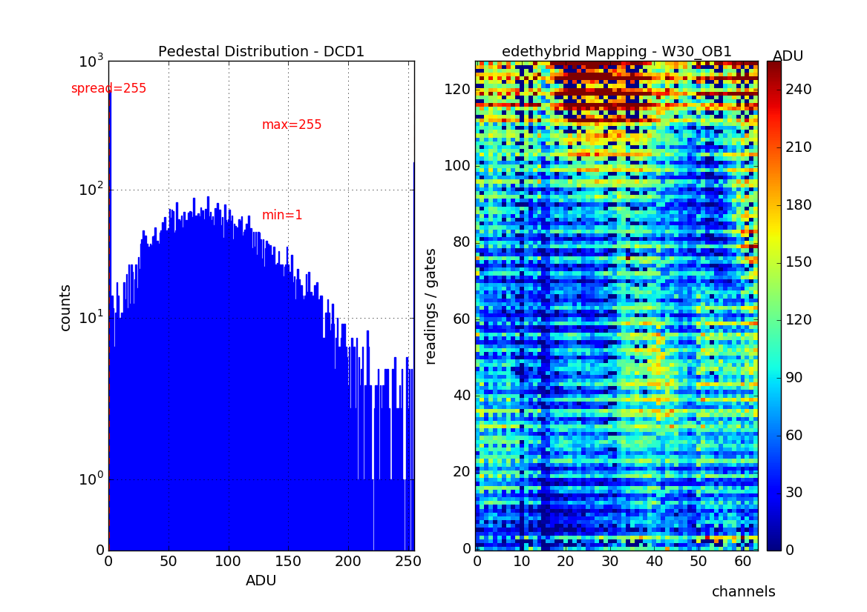
Find optimal HV-Voltage 0V,-10V, -20V, -30V

Slide 31
Expected Cd109-Peak – Calculations
$$g_{q}\sim \frac{1}{W^{1/2}L^{3/2}}\sqrt{I_{drain}}$$
$$g_{q}^{smat}\sim \frac{1}{{4.4}^{1.5}×{28.6}^{0.5}}=0.020$$
$$g_{q}^{spix}\sim \frac{1}{{5.4}^{1.5}×{21.6}^{0.5}}=0,0171$$
$$g_{q}^{belle}\sim \frac{1}{{3.6}^{1.5}×{13.4}^{0.5}}=0.044$$
parameter | value | unit
L(small matrix gate) | 4.4* | µm
L(small pixel gate) | 5.4* | µm
W(small matrix gate) | 28.6* | µm
W(small pixel gate) | 21.6* | µm
DCD-E dynamic range (high gain) | 20 | µA
→ 1 ADU | 78.4 | nA
Cd109 – 22 keV | ≈6000 | e⁻
small pixel measured g_{q} | 200 | pA/e⁻
6000 x 200pA → 1.2µA | 15.3 | ADU
$I_{drain}^{smat}$, $I_{drain}^{spix}$ | 74, 100(140) | μA
→ rescaled by $\sqrt{I_{drain}}$ and g_{q} | 15.3 (13.0) | ADU
* For wet etching normally a value of 1.4µm has to be deducted (in case of L) or added (in case of W) respectively from the design value; here it was plasma-etched → only 0.6µm

Slide 32
Calculated hits with Cd-Source

Slide 33
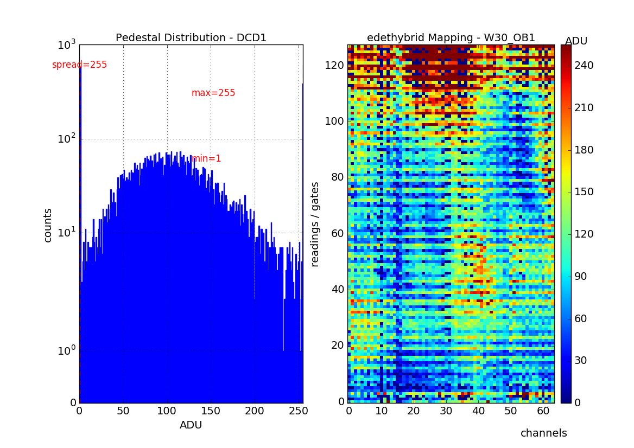
Find optimal Voltages: high offset dispersion
E1-I-04 Hybrid Board
GateOn= -1,660mV
ClearOn=18,000mV
ClearOff=3,000mV
HV= -25,000
higher (vs BELLE) offset dispersion due to
higher g_{m} (32%)
higher gain (15%)
different threshold level
…
$$g_{m}\sim \sqrt{\frac{W}{L}}$$

Slide 34
Cd-Source Measurement (1)

Slide 35
Cd-Source Measurement (2)
CONCLUSION: channel-length of 5µA should be chosen

Slide 36
NEXT STEPS
Optimize Settings for Source Measurements
Calibration of low gain/signal compression with Laser Pulse
Integration of PSP

Slide 37
THANK YOU FOR YOUR ATTENTION

Slide 38
PSP Breakout-Board – electronic schematics
Connector x2
Power Group x7 +
2 x 6-pole jumpers for AGND & DGND
Sense Group x19
PCB standard size (W x L x H)
100mm x 160mm x 1.6mm
Normal Load Group x18
circuit diagram/layout documents the electrical wiring of different components
define footprints and functionalities in component library

Slide 39
PSP Breakout-Board - Design
FC/PC Terminated Fiber

Slide 40
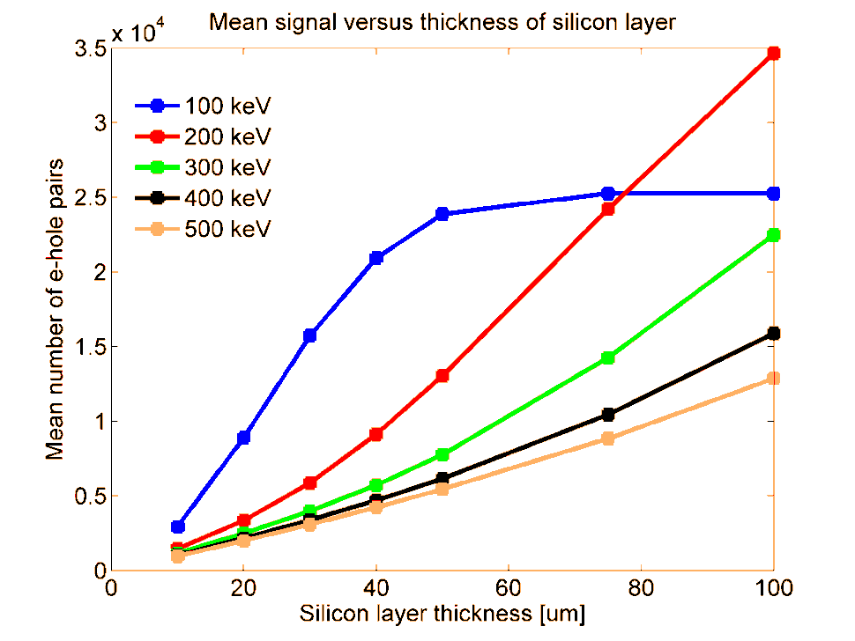
DCDE Noise
Gain | range 200 ADU [µA] | Current/ADU [µA] | DCDE noise [ADU] | DCDE noise [µA]
1 | 380 | 1.9 | 0.92* | 1.75
1.5 | 250 | 1.25 | 0.69 | 0.86
3 | 137 | 0.69 | 0.69 | 0.48
11 | 41 | 0.2 | 0.96 | 0.19
33 | 15 | 0.08 | 1.50 | 0.12
1 primary electron generates $≈8000 e^{−} \left(300 keV\right)$
$≈24,000 e^{−}\left(100 keV\right)$
in 50µm thick silicon detector
EDET detector response for
$1^{st}primary electron=300 pA$
${100}^{th}electron=60 pA$
→Incremental Signal for
$1^{st}primary electron=2.4 µA$
${100}^{th}electron=0.48 µA$
*Maybe too high because of discrete IPDAC transition
DCDE noise mainly induced
by quantization error (0.5 ADU)
Not relevant because of statistical deviations
for spatiotemporal signal generation
$$Δ primary e^{−}= \sqrt{primary e^{−}}$$
100 | 100 | 100 | 100
100 | 110 | 100 | 100
100 | 110 | 90 | 100
100 | 90 | 100 | 100
Ibrahym Dourki (CFEL)

Slide 41
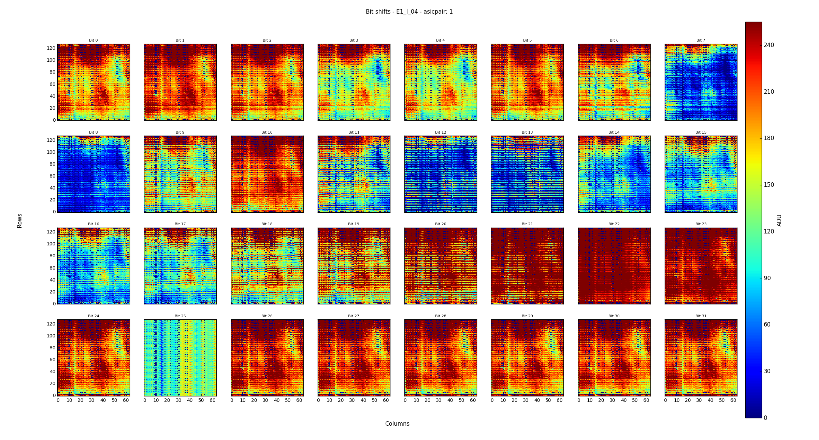
SAMPLING POINT SCAN – E1-I-04

