Slide 1
DEPFETs for the GREST project
22nd International Workshop on DEPFET Detectors and Applications
A. Bähr, A. Feller, D. Mießner, J. Ninkovic, M. Polovykh, R. Richter, F. Schopper, J. Treis

Slide 2
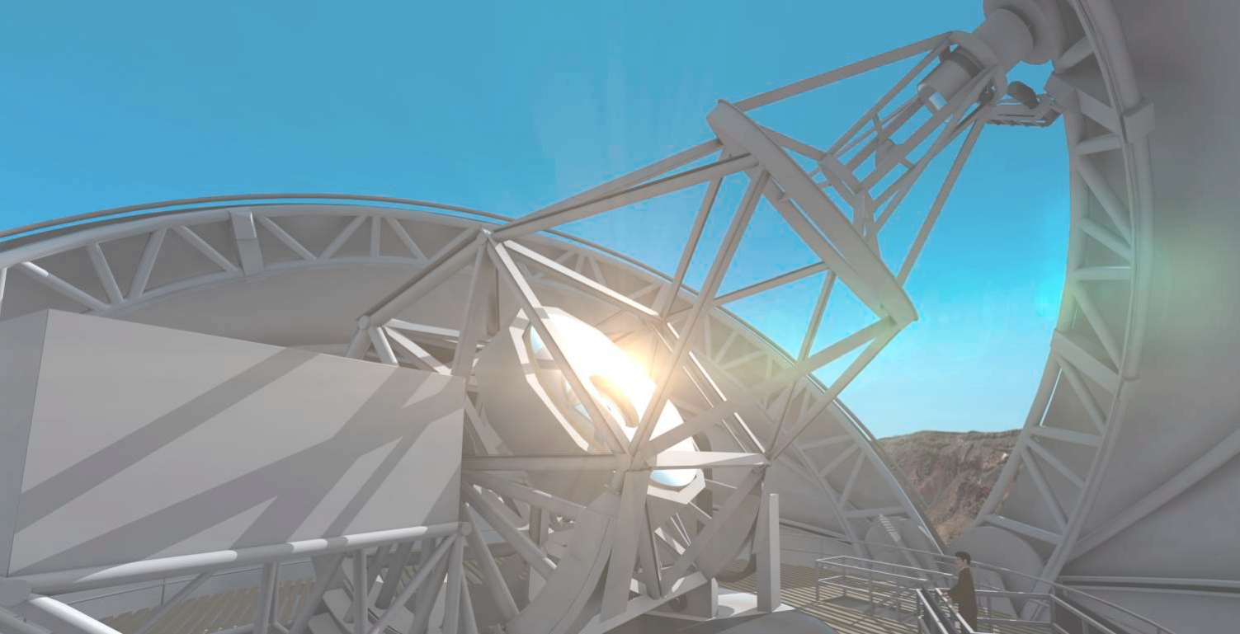
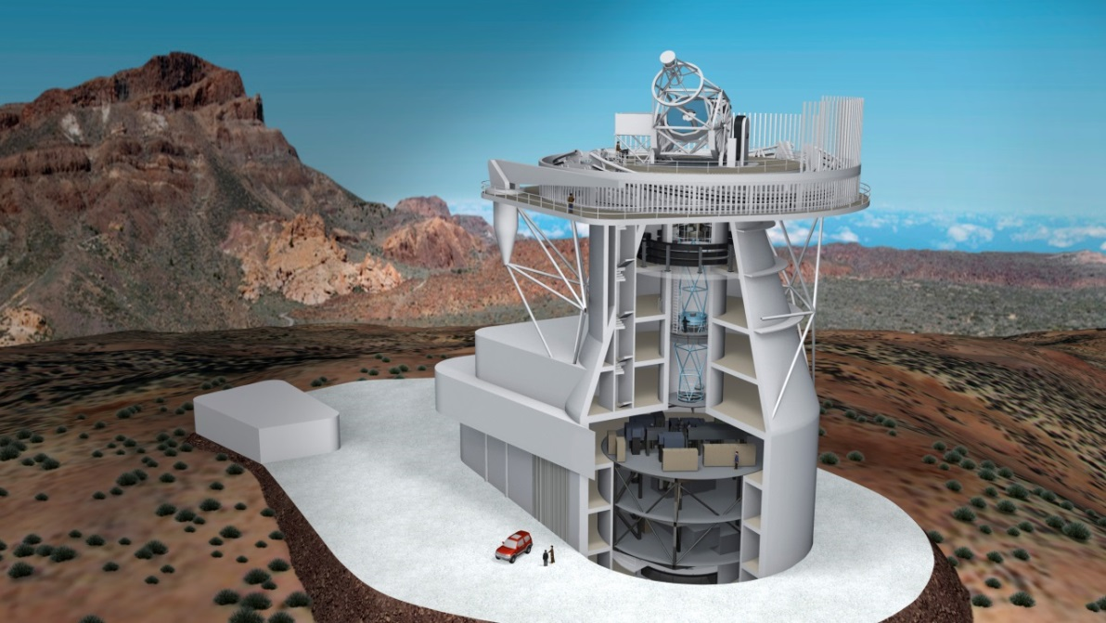
GREST - Getting Ready for the European Solar Telescope
Notes:
A venture for the development of new technologies for the application at EST

Slide 3
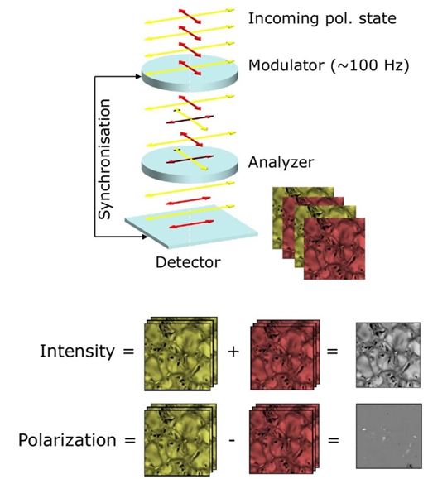
GREST
Notes:
Through Modulator and Analyzer, the polarisation at a given point in time is encoded as intensity variation. By detecting the intensity variation for 4 different polarization states, the complete polarization information can be retrieved.
For standard sensors Modulation and Frame rate are coupled.

Slide 4
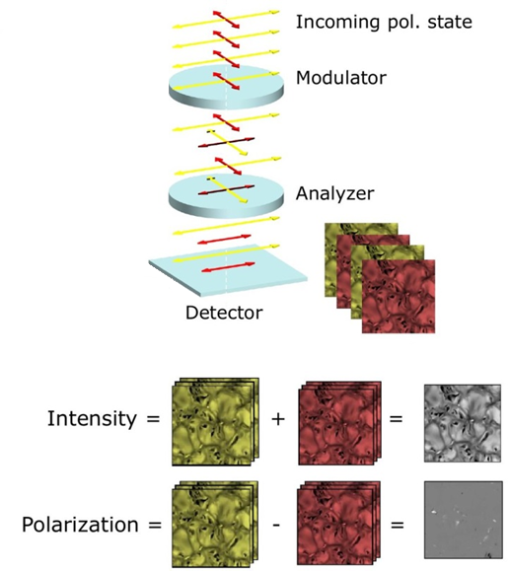
GREST
Modulation ~ 10 kHz
Frame-Rate ~ 400 Hz
Notes:
We intend to built a sensor that is capable to decouple modulation frequency and frame rate.
How are we going to do that?

Slide 5
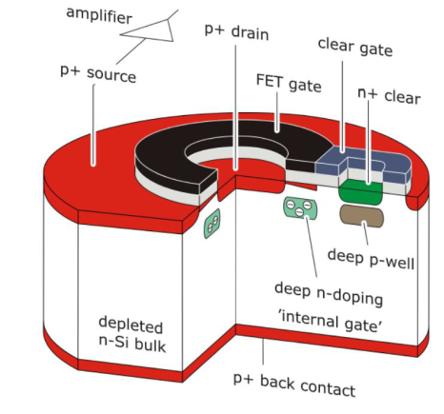
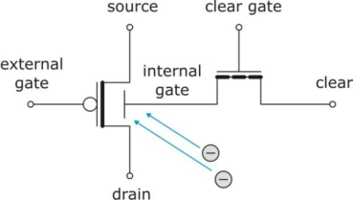
DEPFET
intrinsic amplification
low noise
backside illumination
100% fill-factor
intrinsic amplification
low noise
backside illumination
100% fill-factor

Slide 6
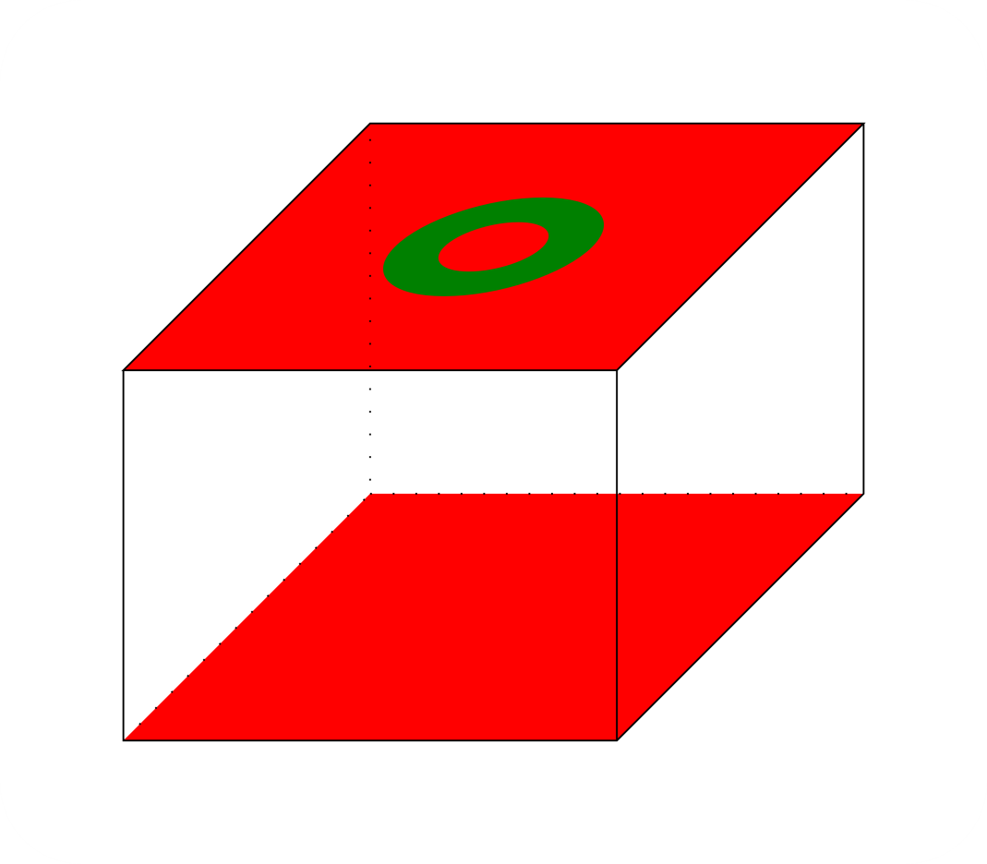
DEPFET
intrinsic amplification
low noise
backside illumination
100% fill-factor

Slide 7
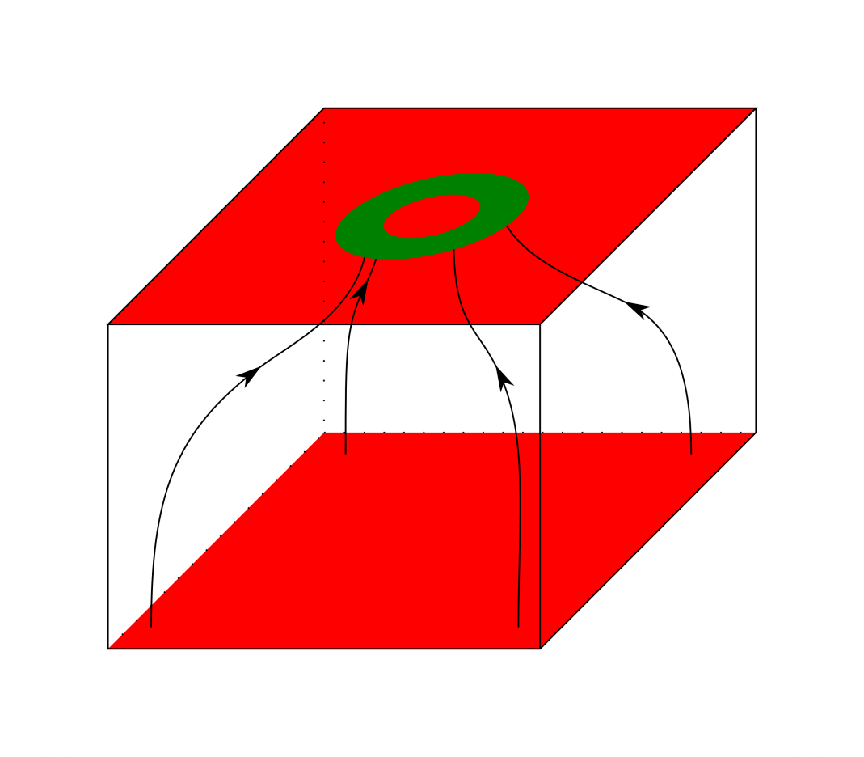
DEPFET
intrinsic amplification
low noise
backside illumination
100% fill-factor

Slide 8
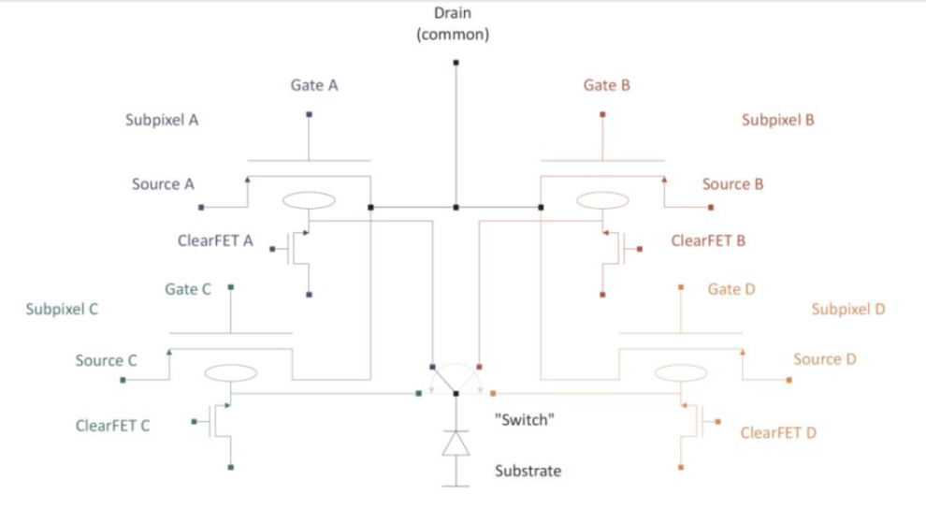
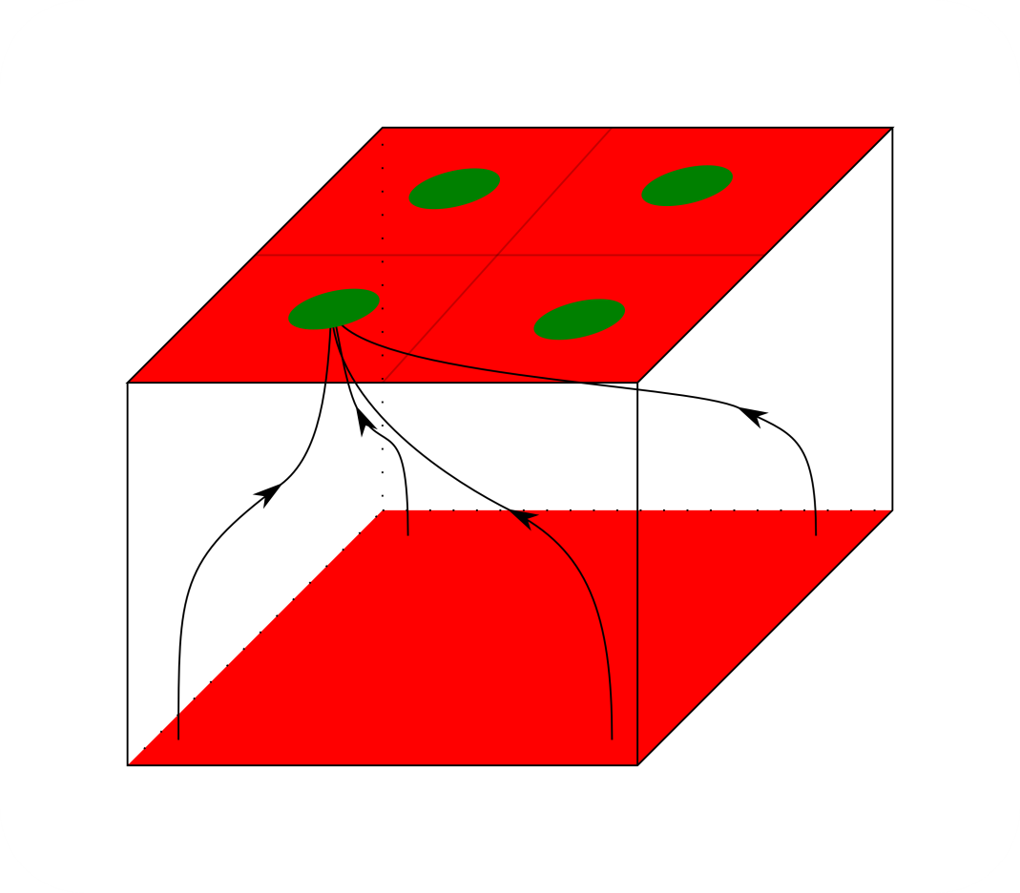
Quadropix
four storage areas
fast modulation

Slide 9
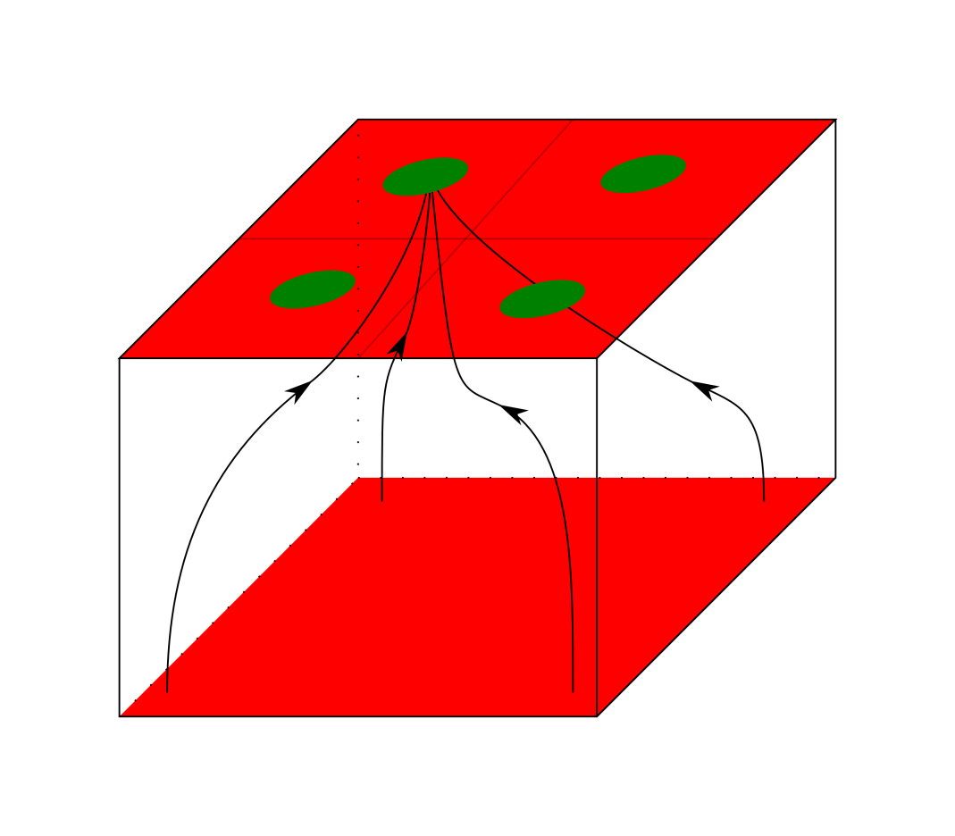
Quadropix
four storage areas
fast modulation

Slide 10
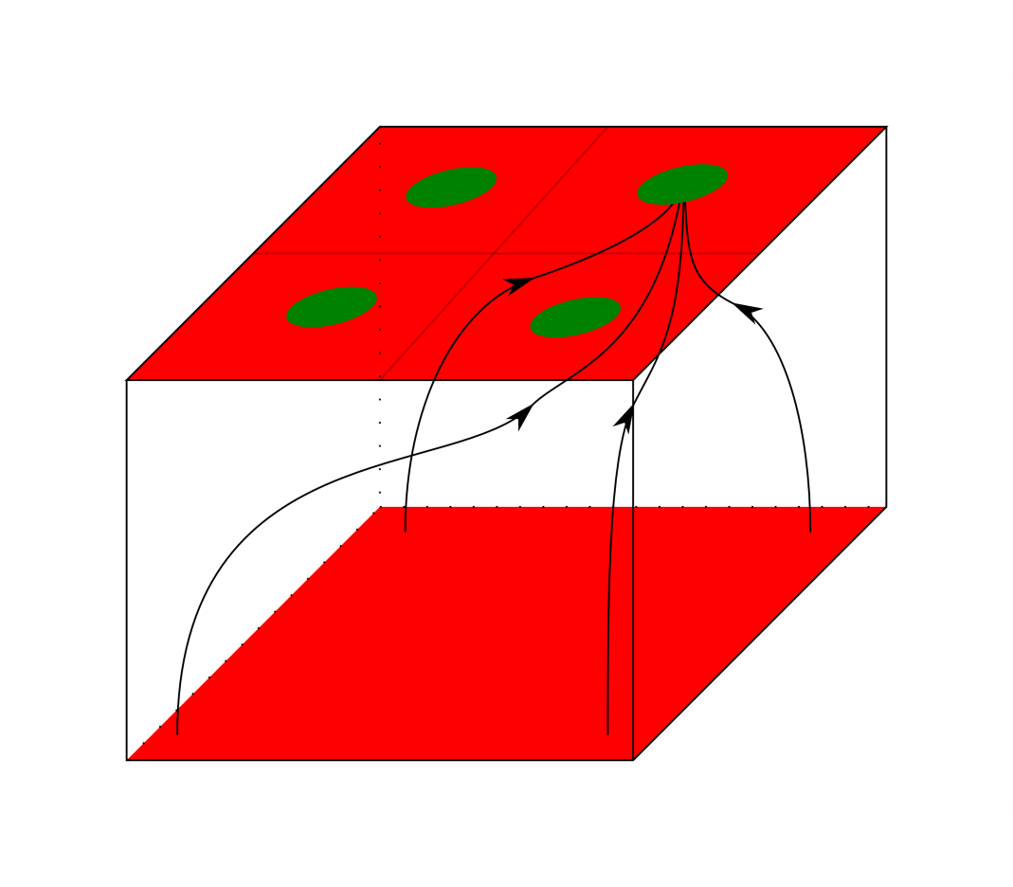
Quadropix
four storage areas
fast modulation

Slide 11
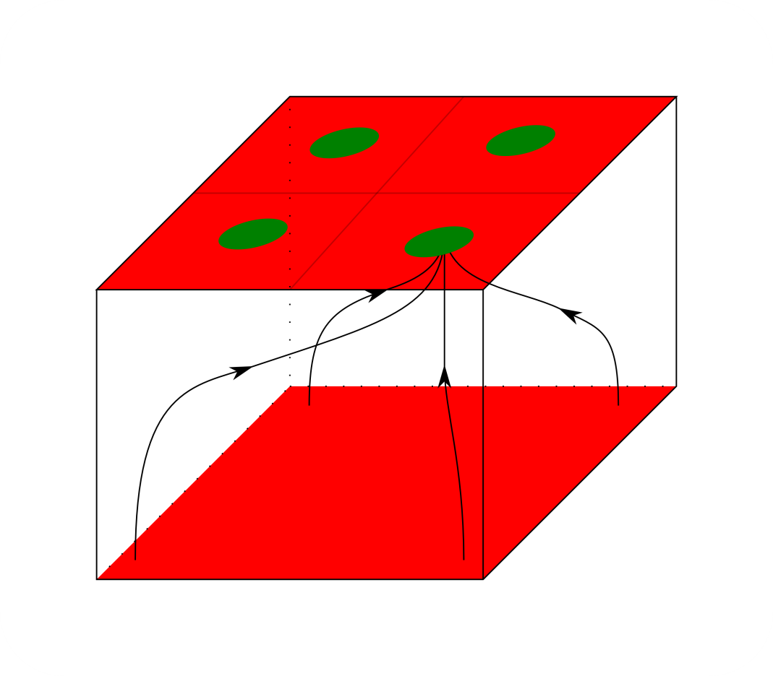
Quadropix
four storage areas
fast modulation

Slide 12
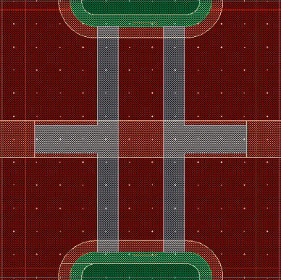
Quadropix
four storage areas
fast modulation
drain A
drain B
gate A/B
cleargate A/D
clear A/D
cleargate B/C
source A/D
source B/C
clear B/C
gate C/D
drain D
drain C

Slide 13
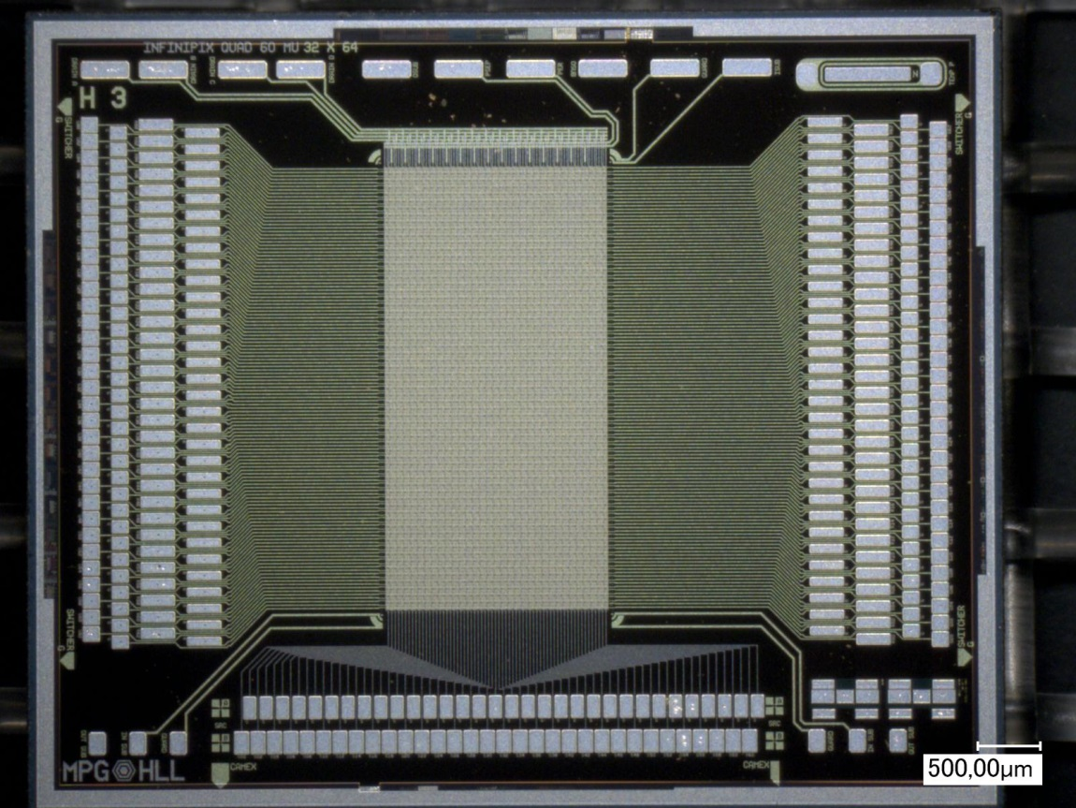
Prototype Sensor
production of first batch finished
Test Sensor: 64 x 32 Quadropixel
60 x 60 µm² pixel size
450 µm bulk
Notes:
Devices were fabricated based on 2D simulations
prototypes are produced and were already pre-characterized

Slide 14
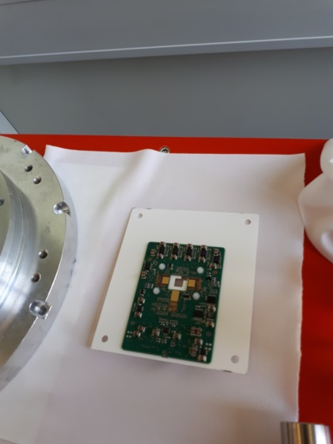
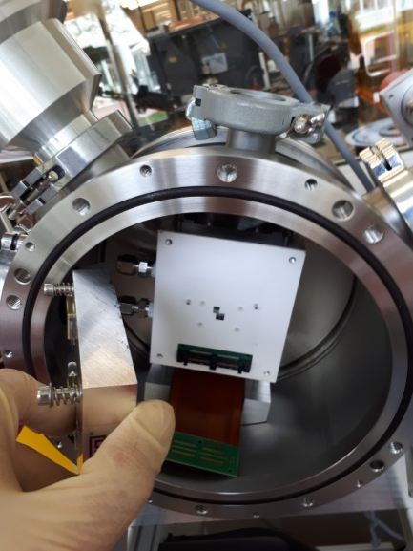
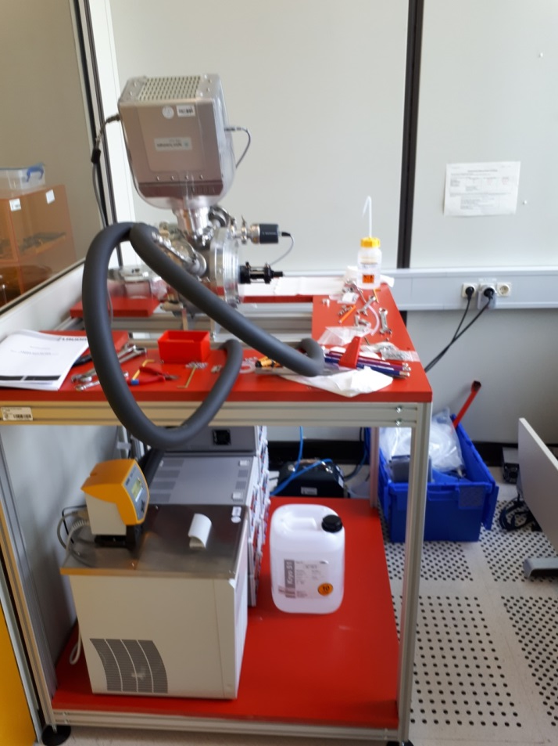
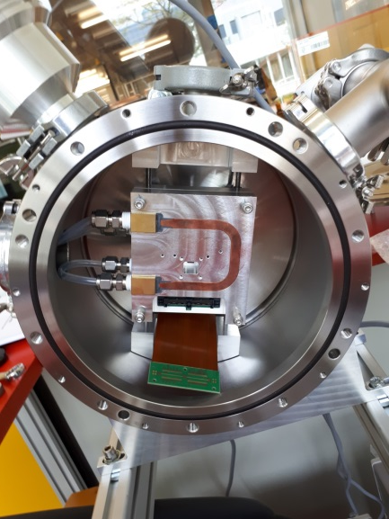
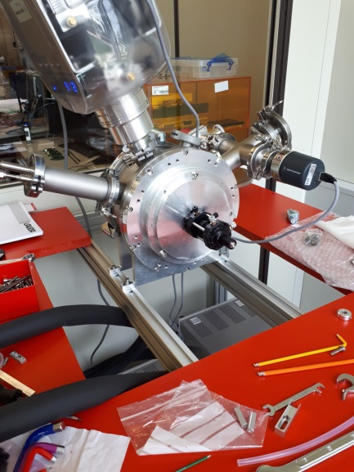
Measurement Setup
B

Slide 15
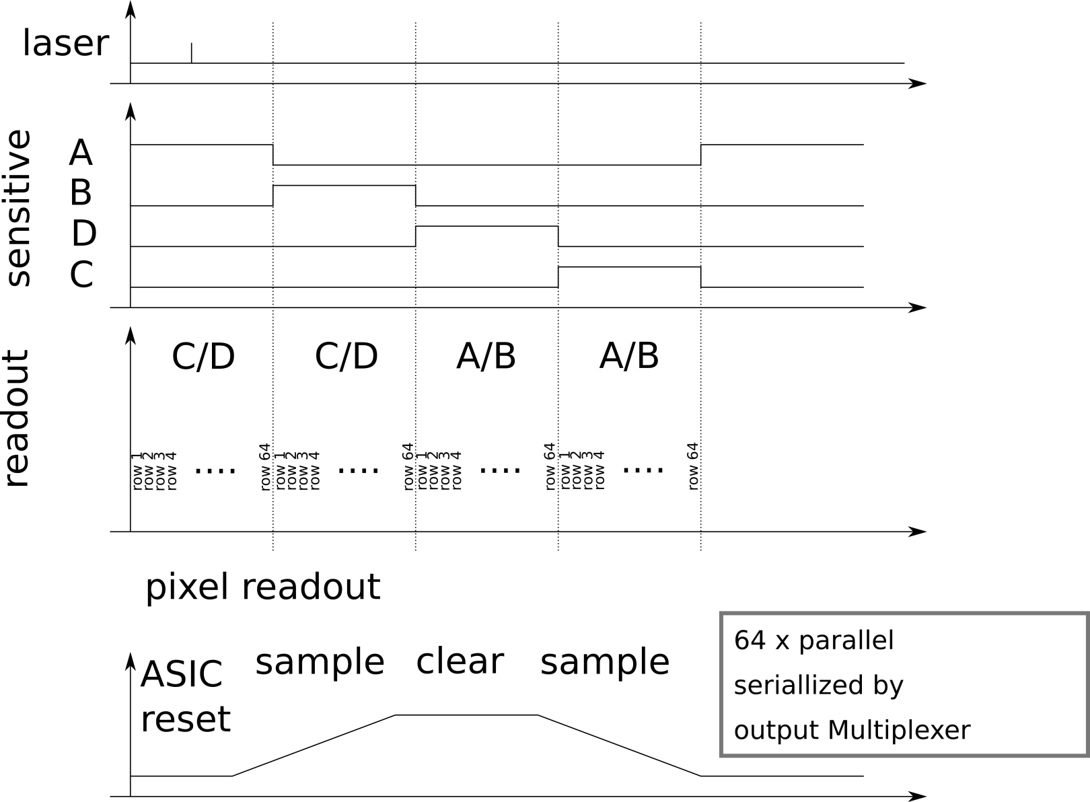
Test Sequence

Slide 16
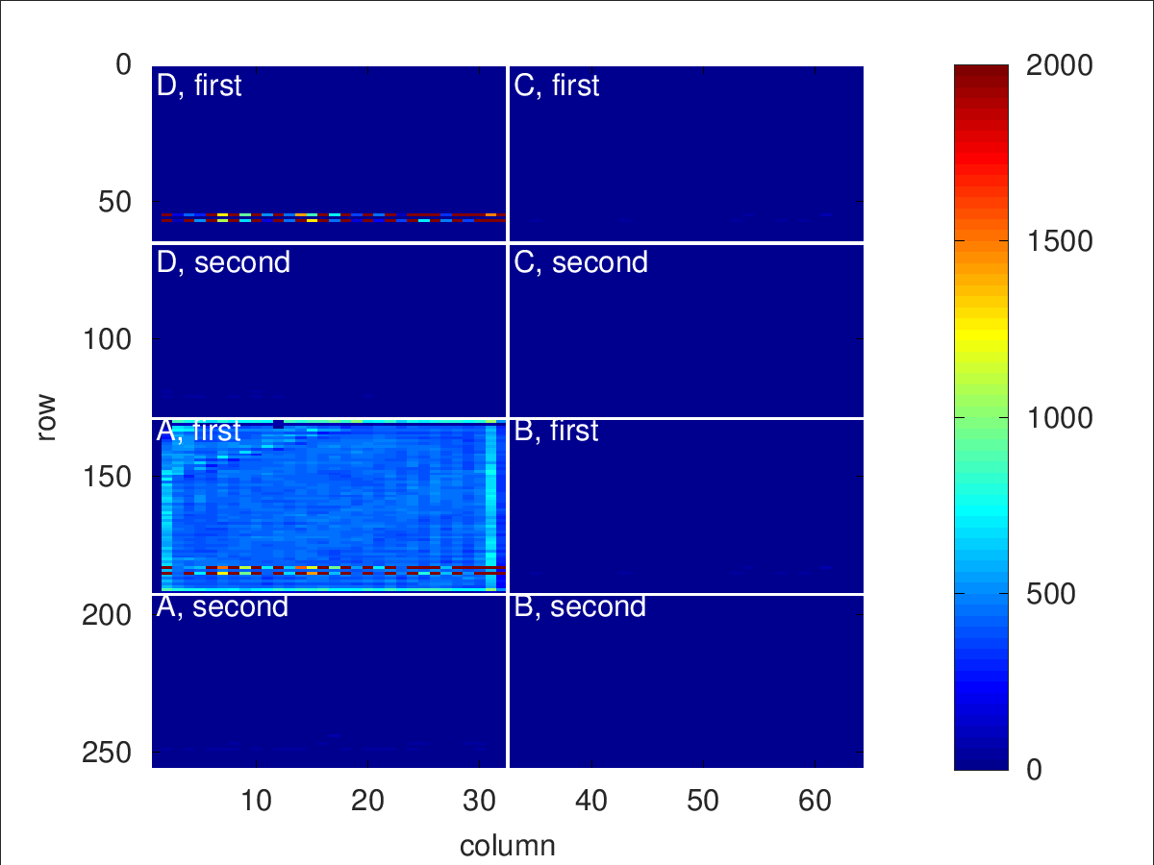
Target Measurement
injection while A collects

Slide 17
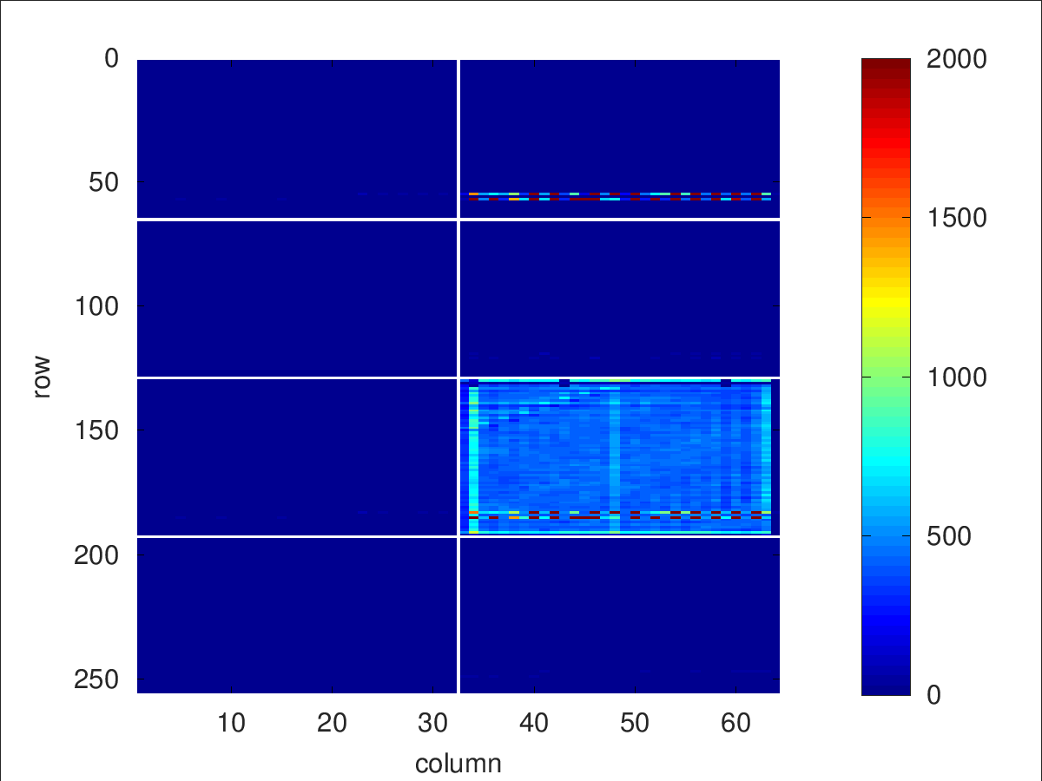
Target Measurement
injection while B collects

Slide 18
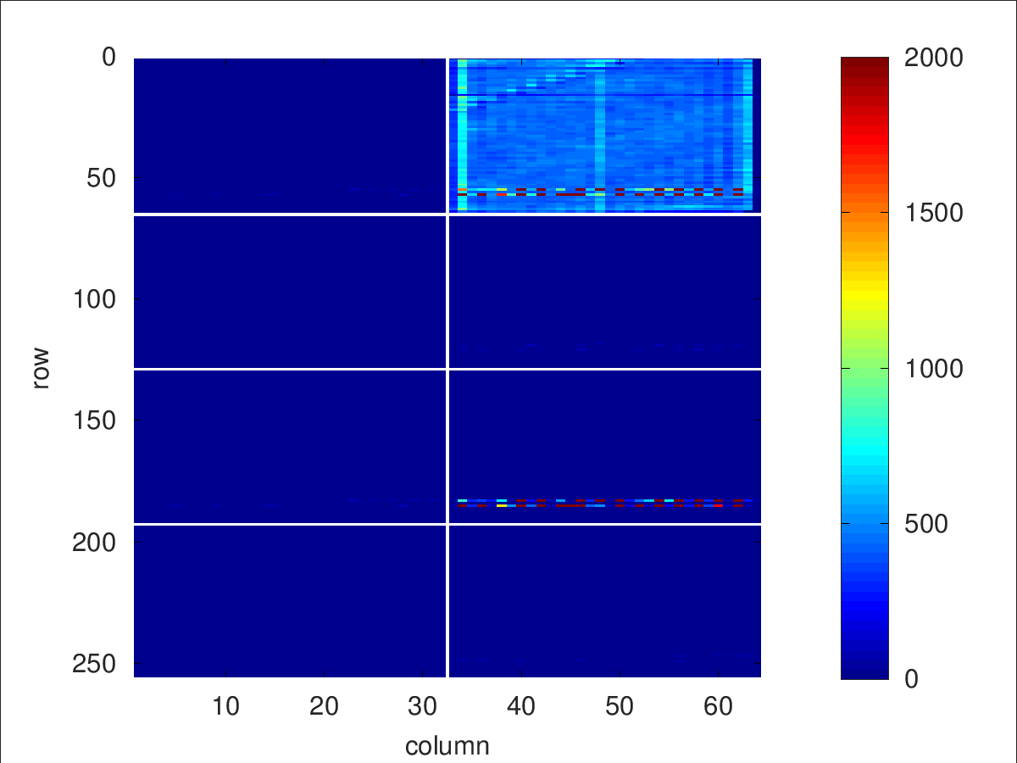
Target Measurement
injection while C collects

Slide 19
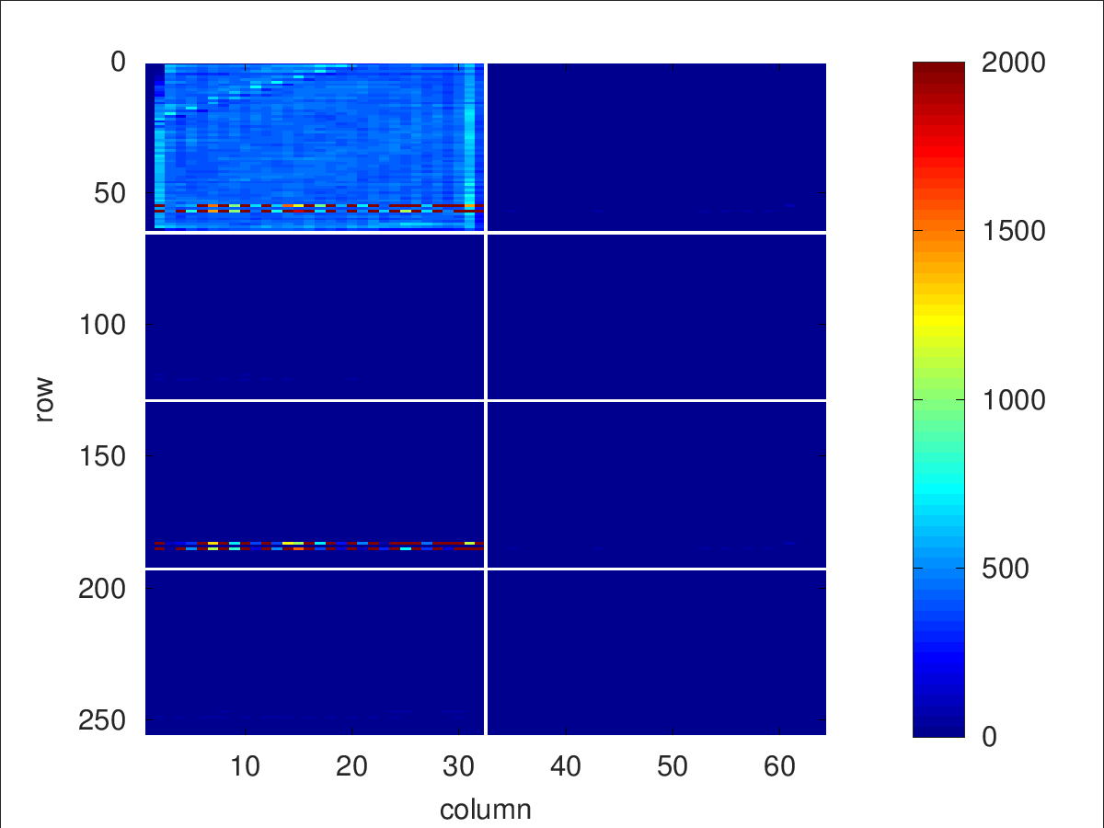
Target Measurement
injection while D collects

Slide 20
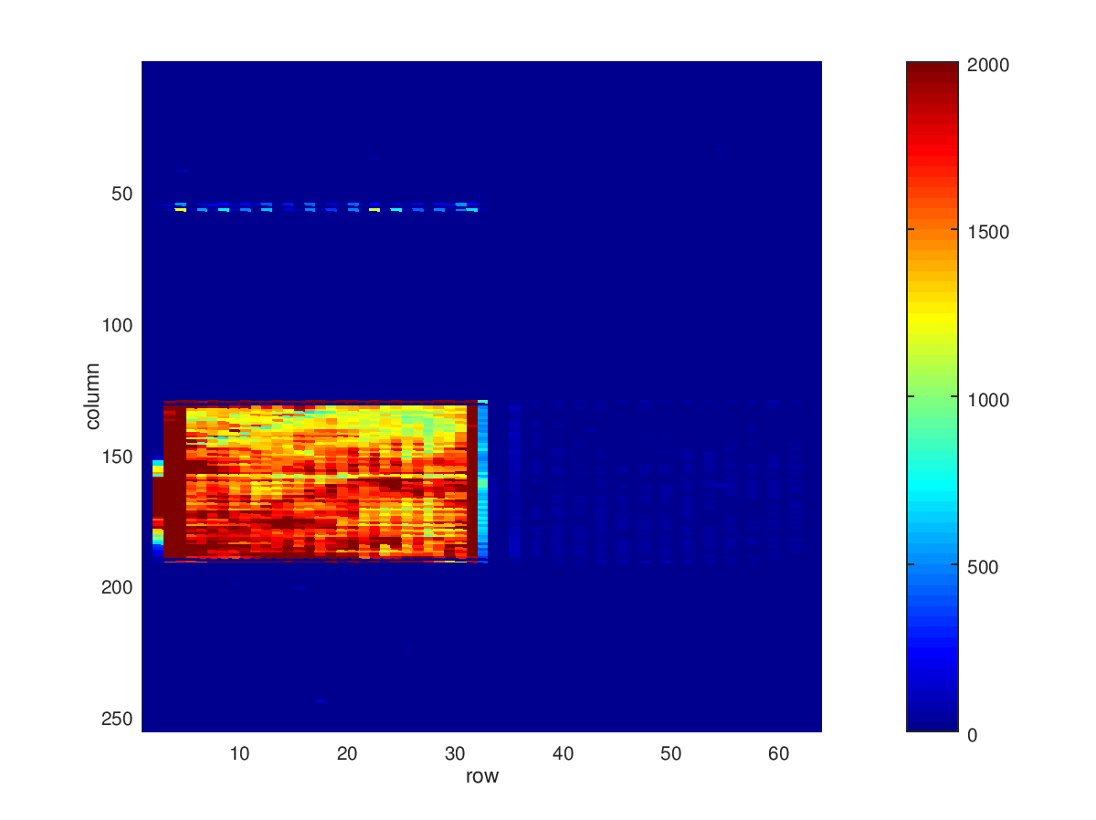
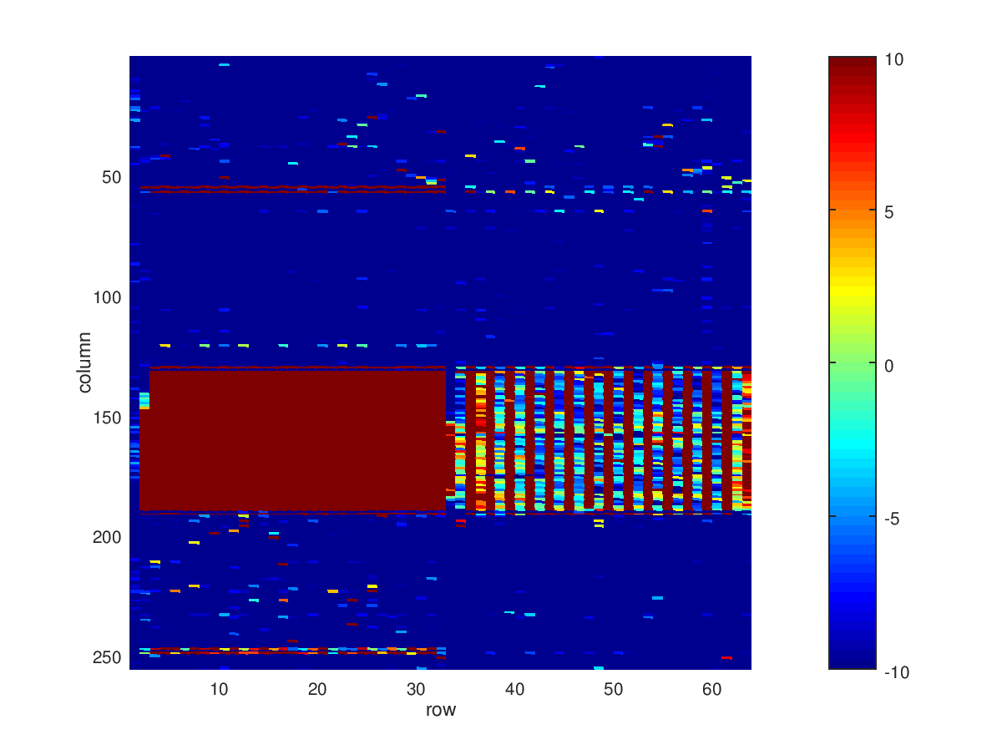
Standard Buffer

Slide 21
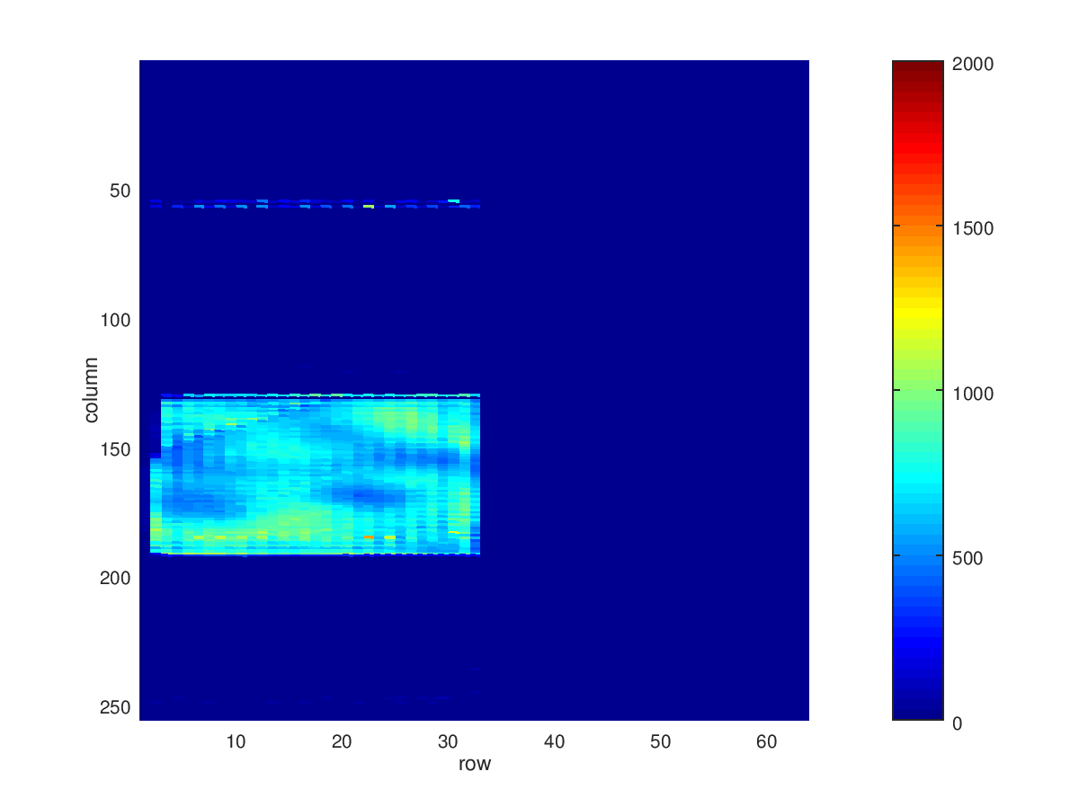
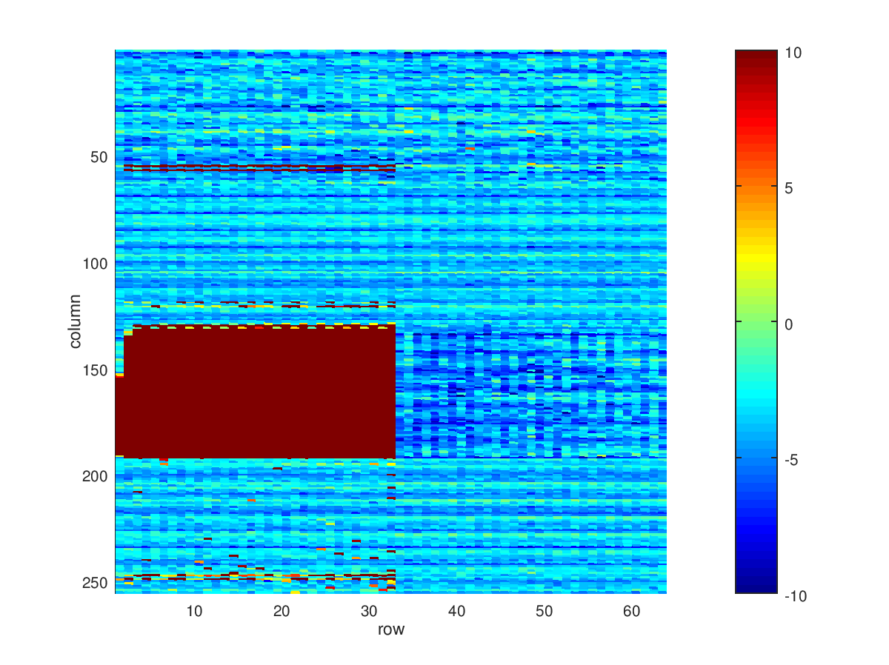
Debugging Buffer

Slide 22
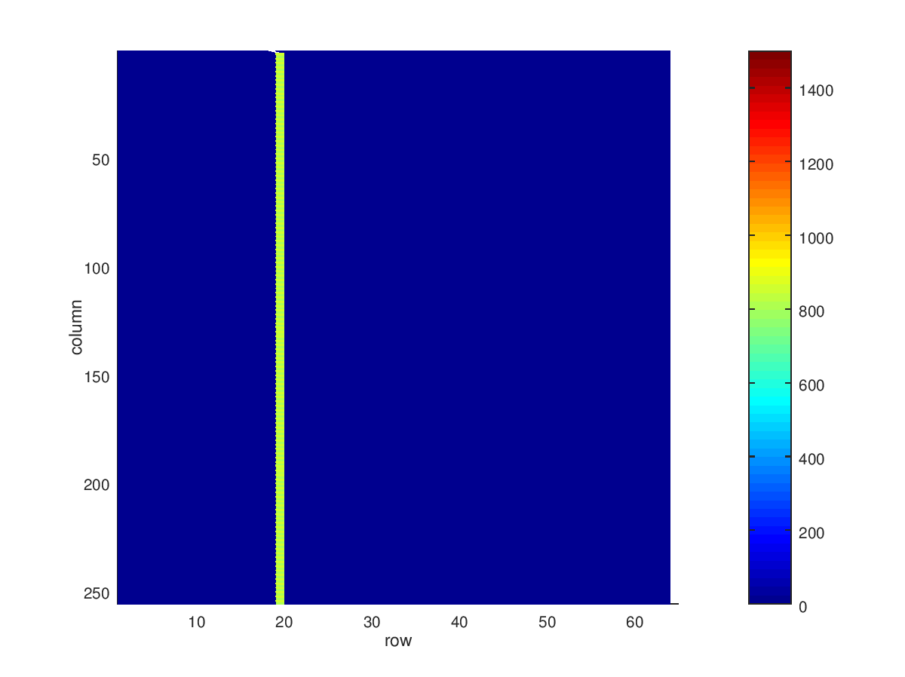
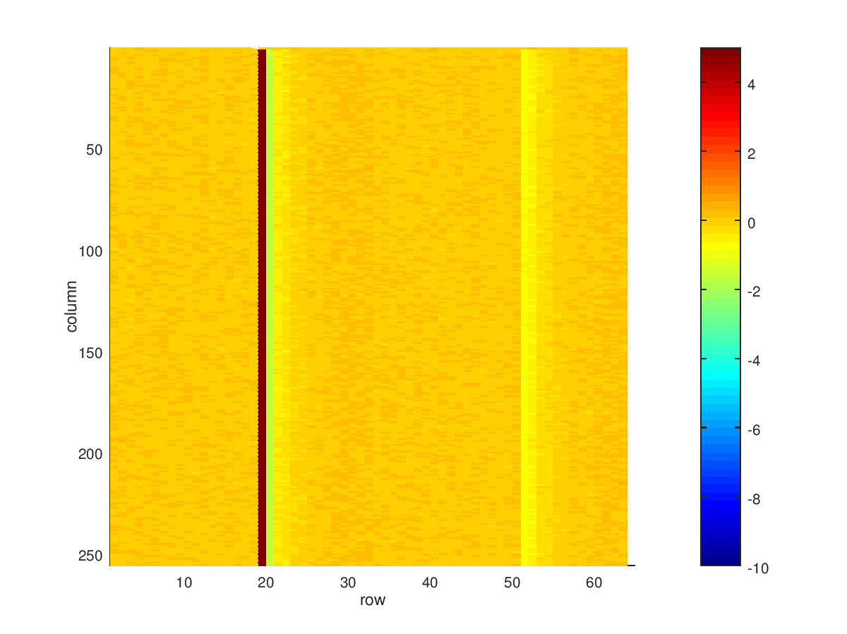
Debugging Buffer / ?Cross – Talk?

Slide 23
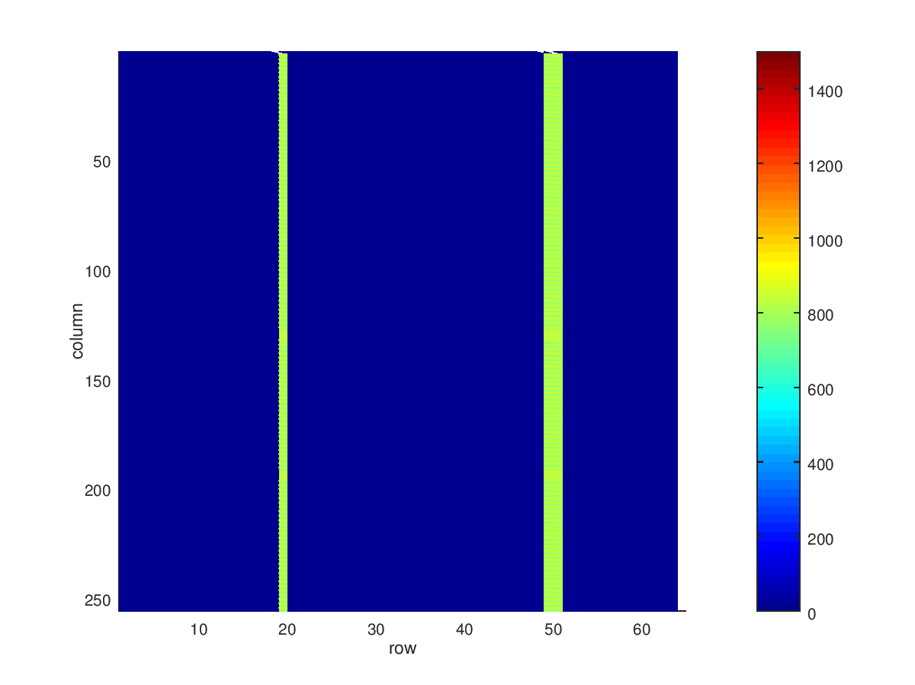
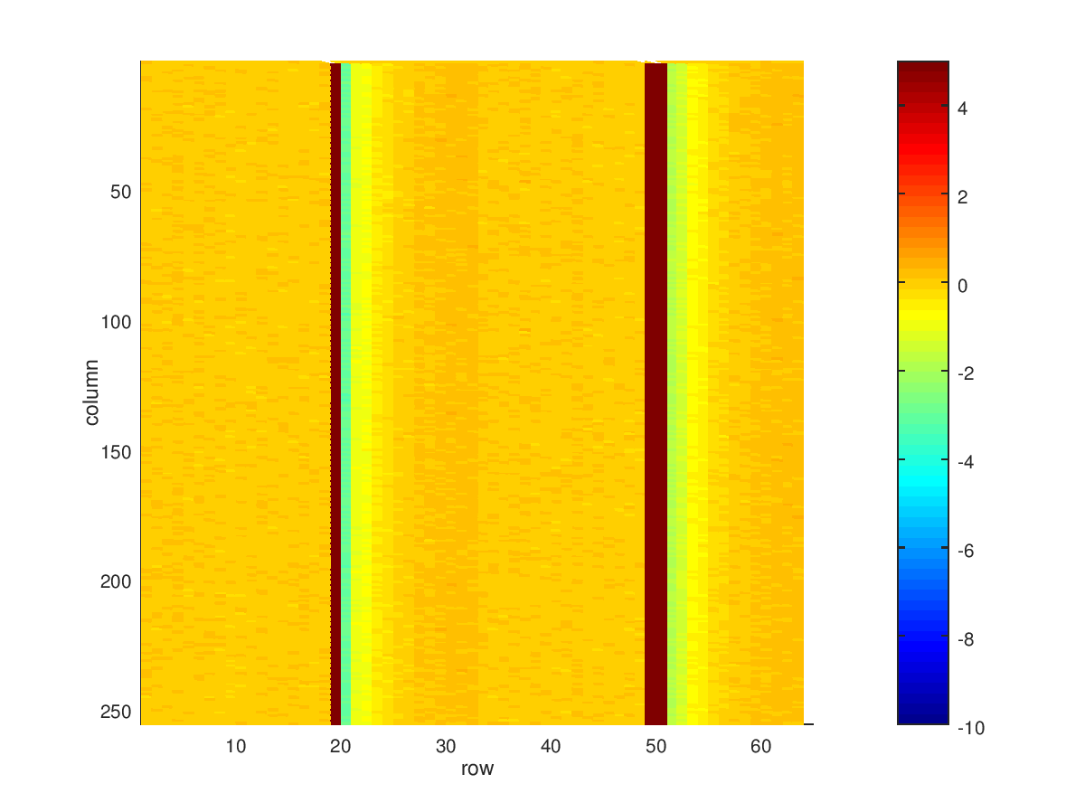
Debugging Buffer / ?Cross – Talk?

Slide 24
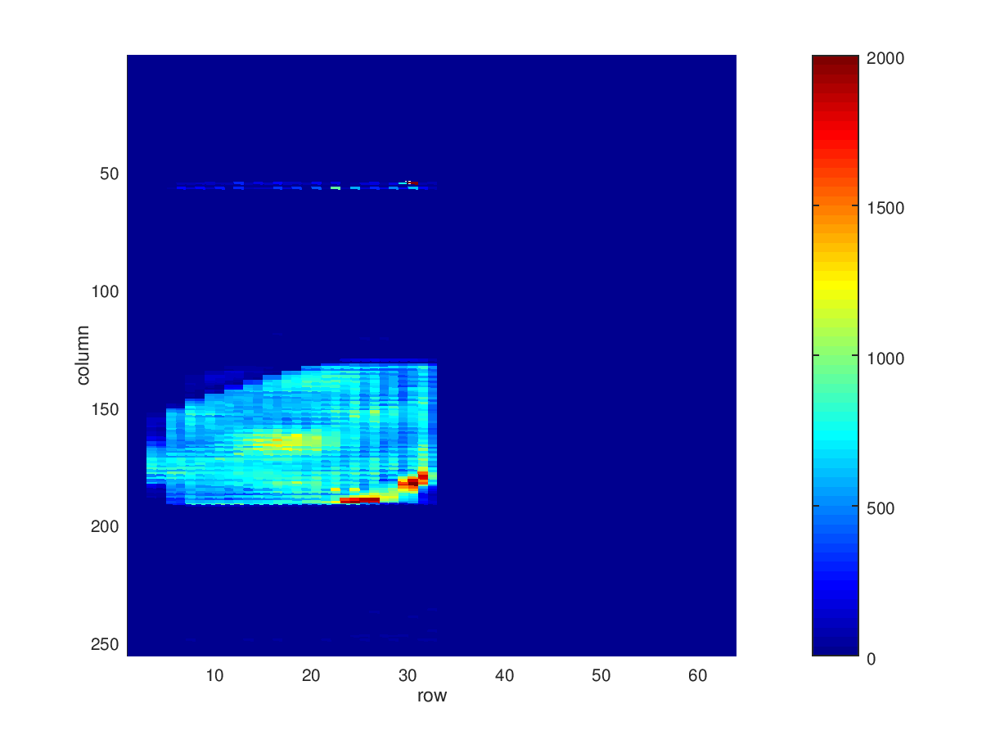
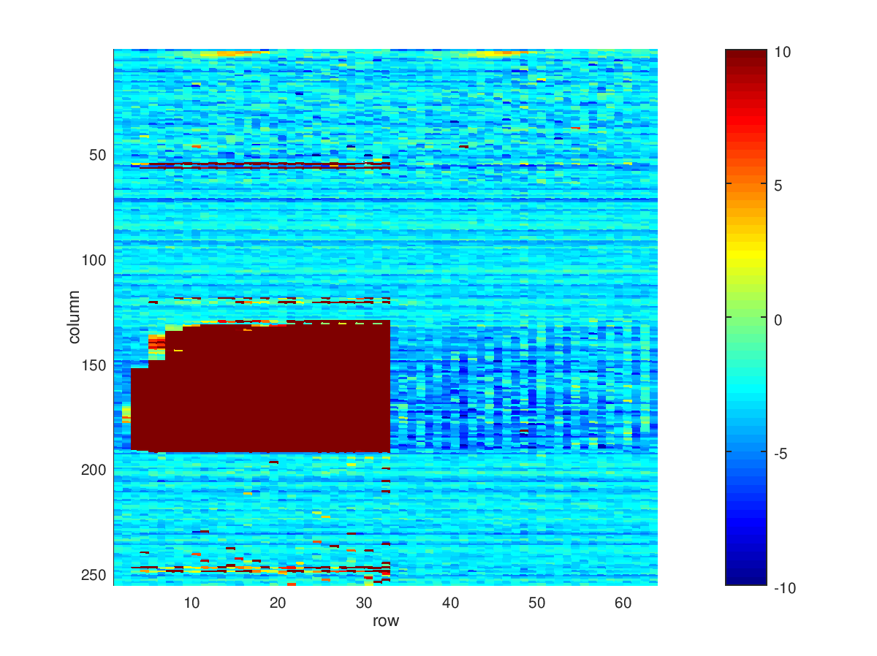
Backside Sweep
-79 V

Slide 25
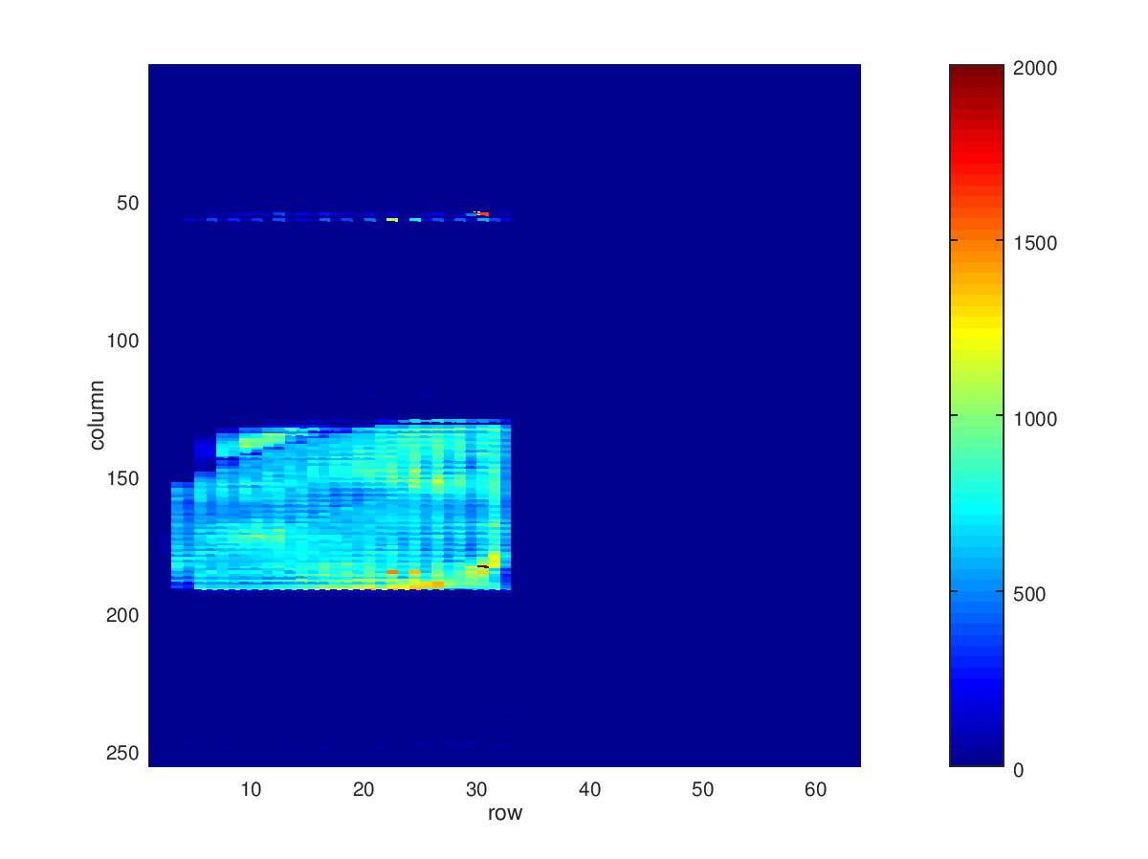
Backside Sweep
-80 V

Slide 26
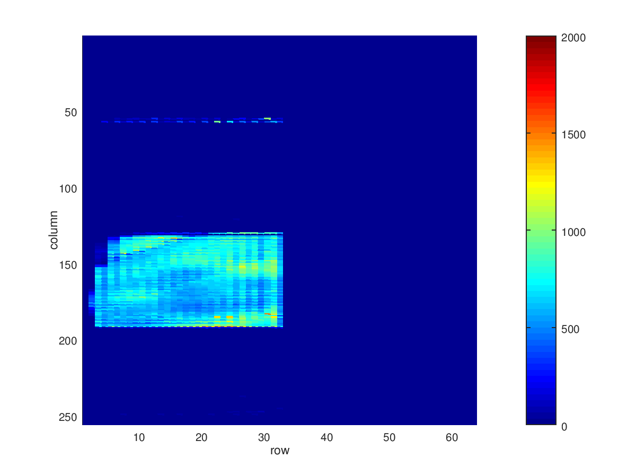
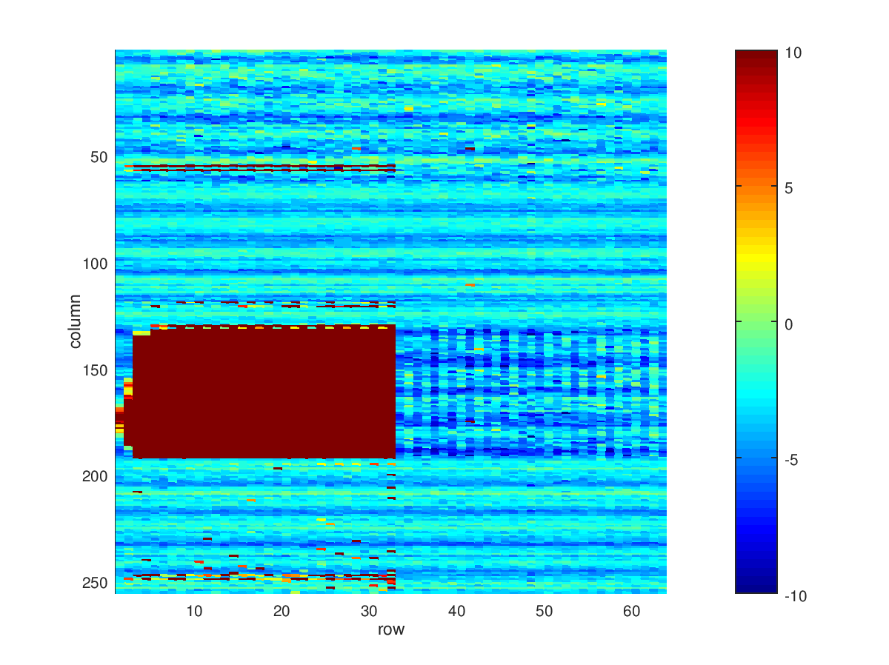
Backside Sweep
-81 V

Slide 27
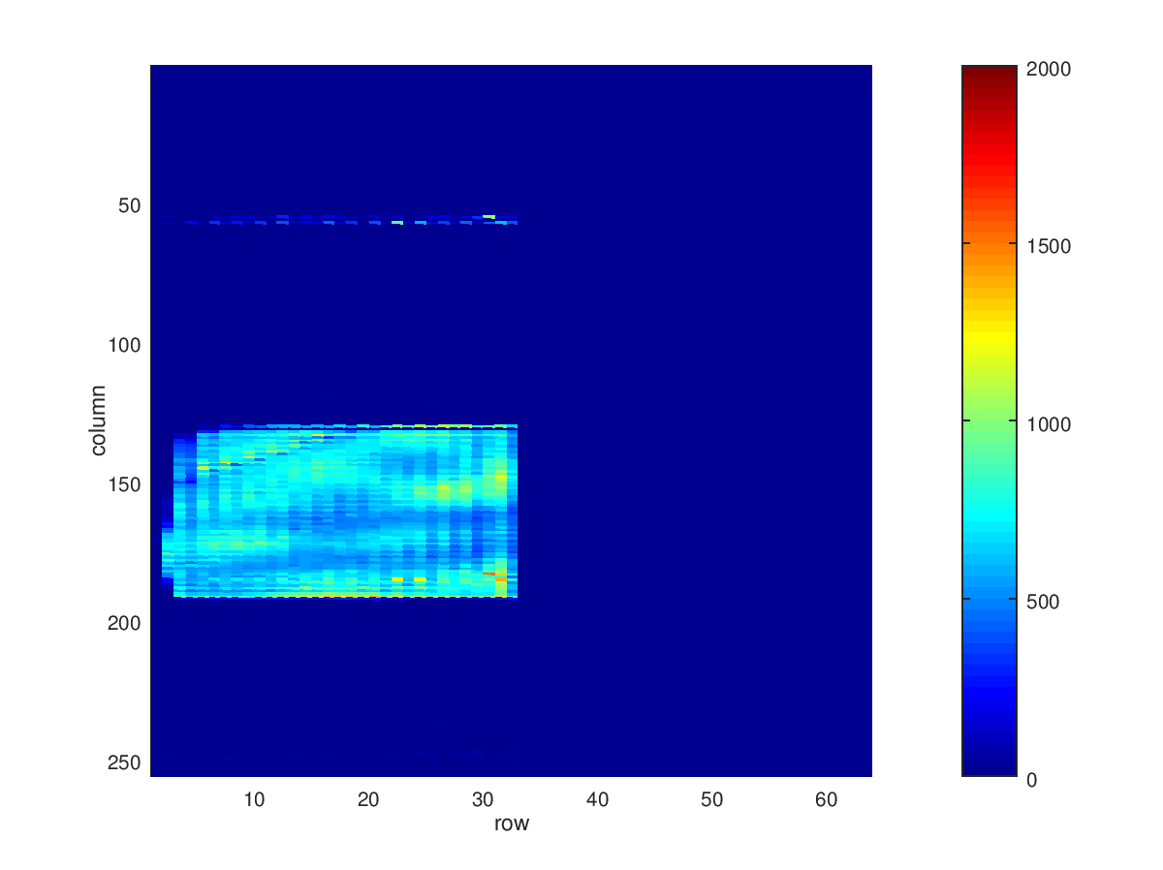
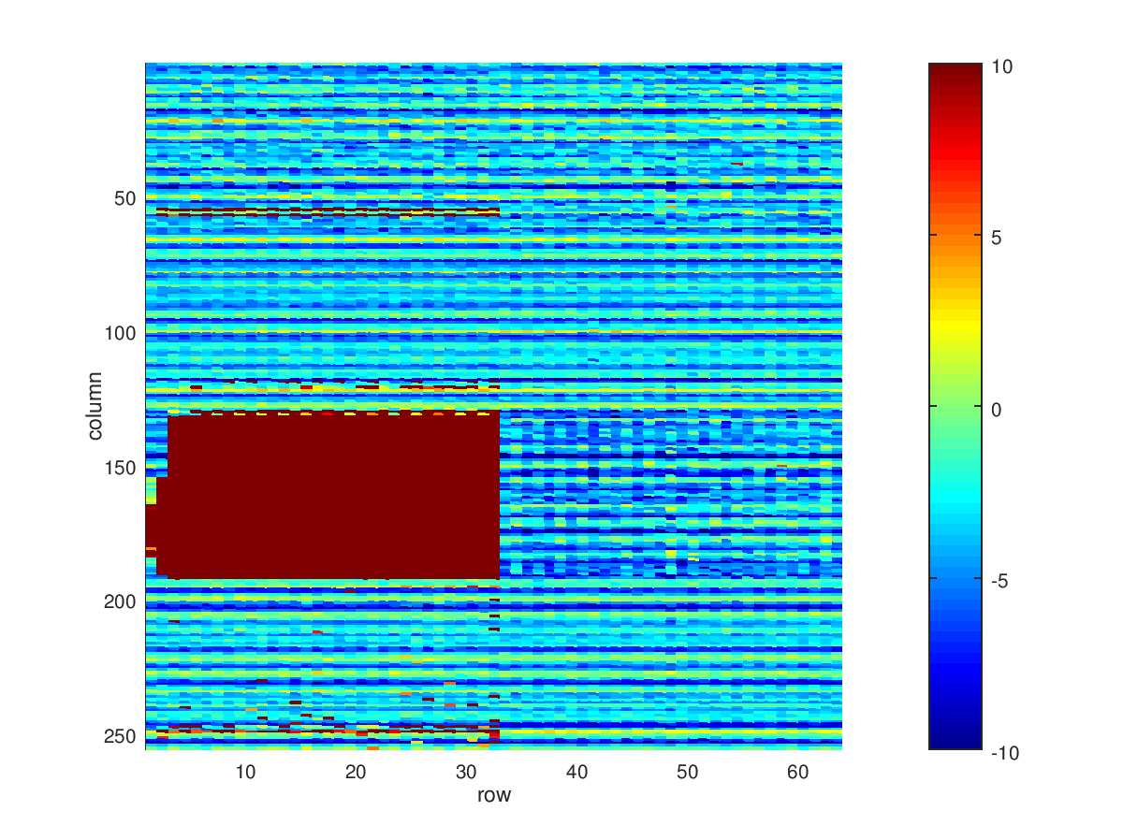
Backside Sweep
-82 V

Slide 28
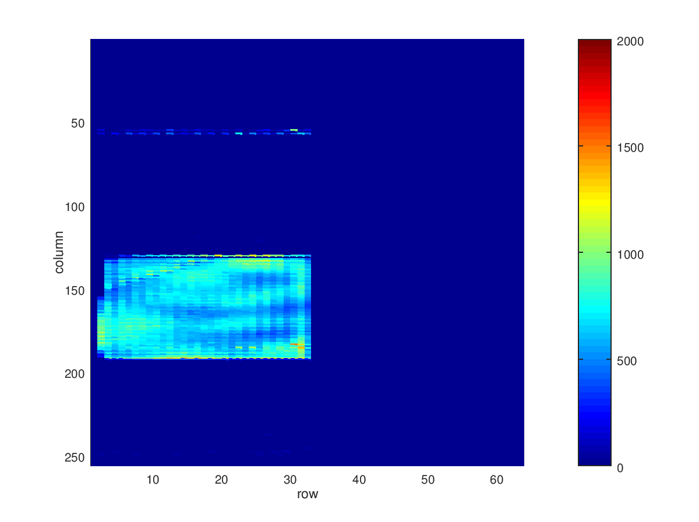
Backside Sweep
-83 V

Slide 29
Backside Sweep
-84 V

Slide 30
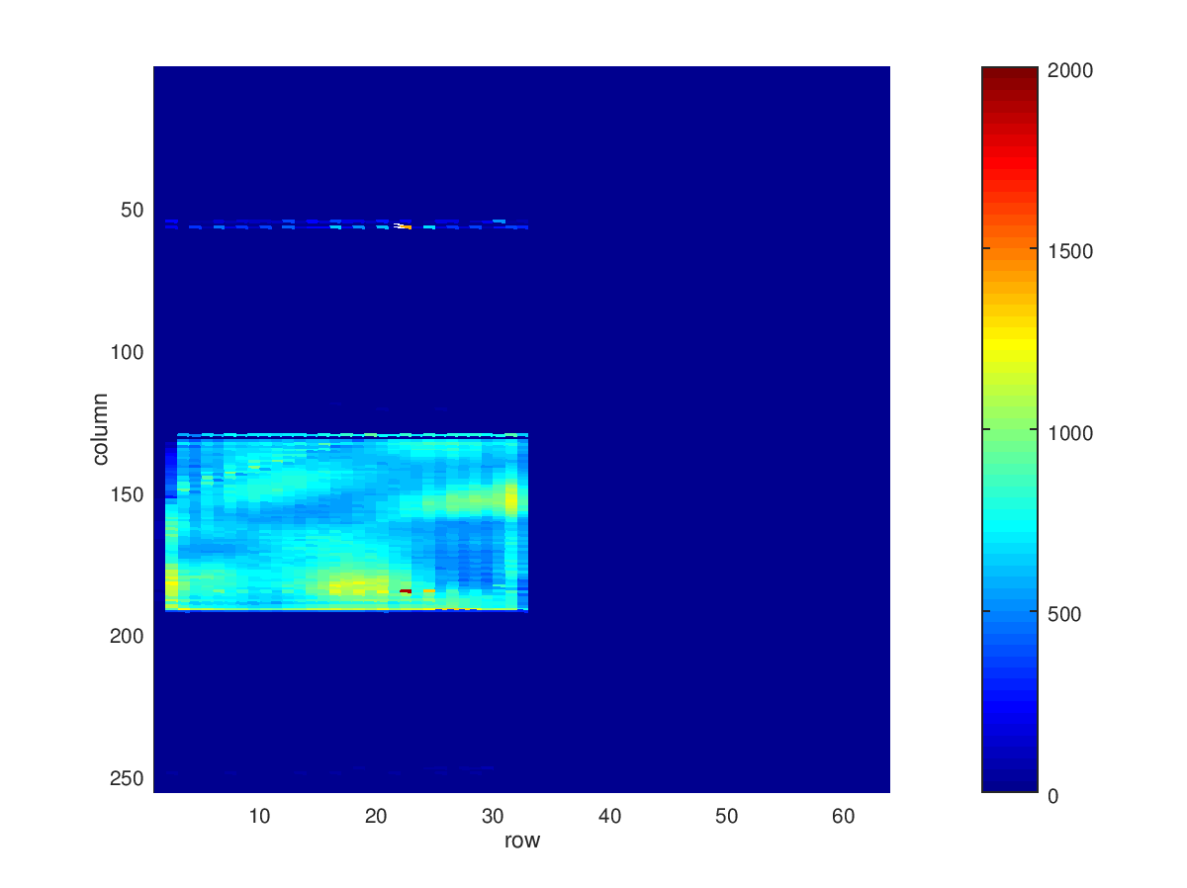
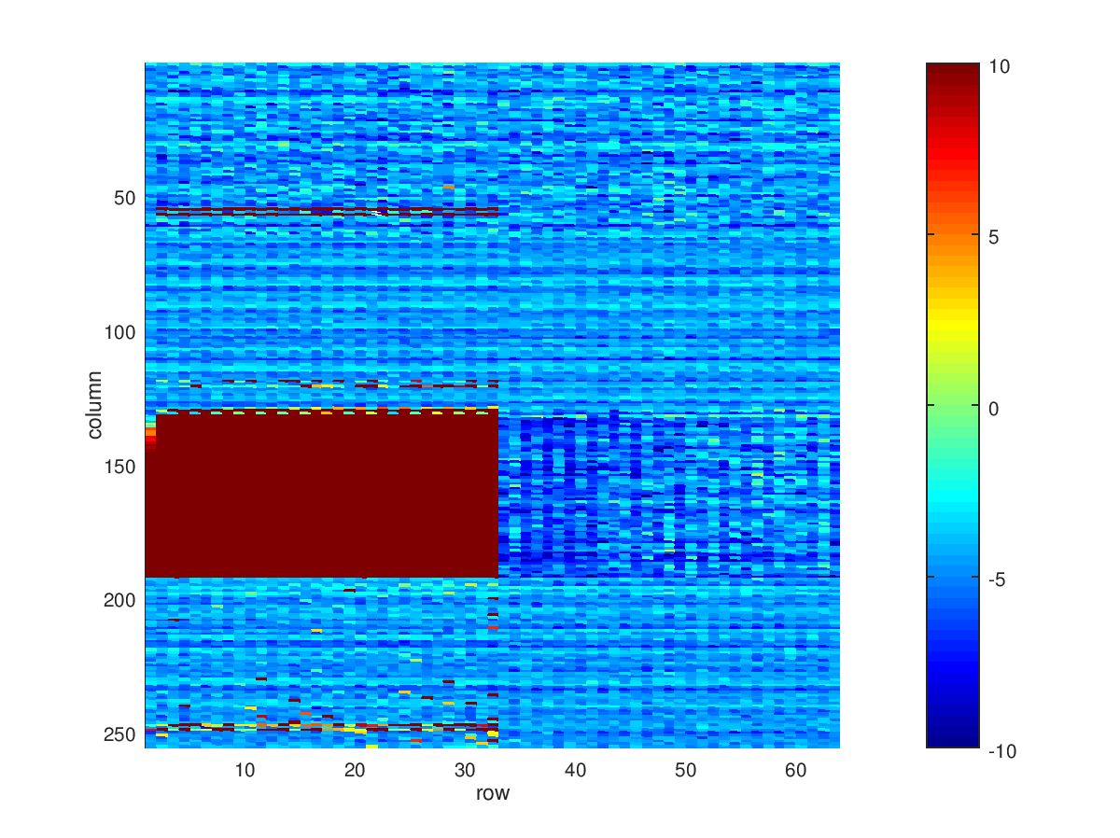
Backside Sweep
-85 V

Slide 31
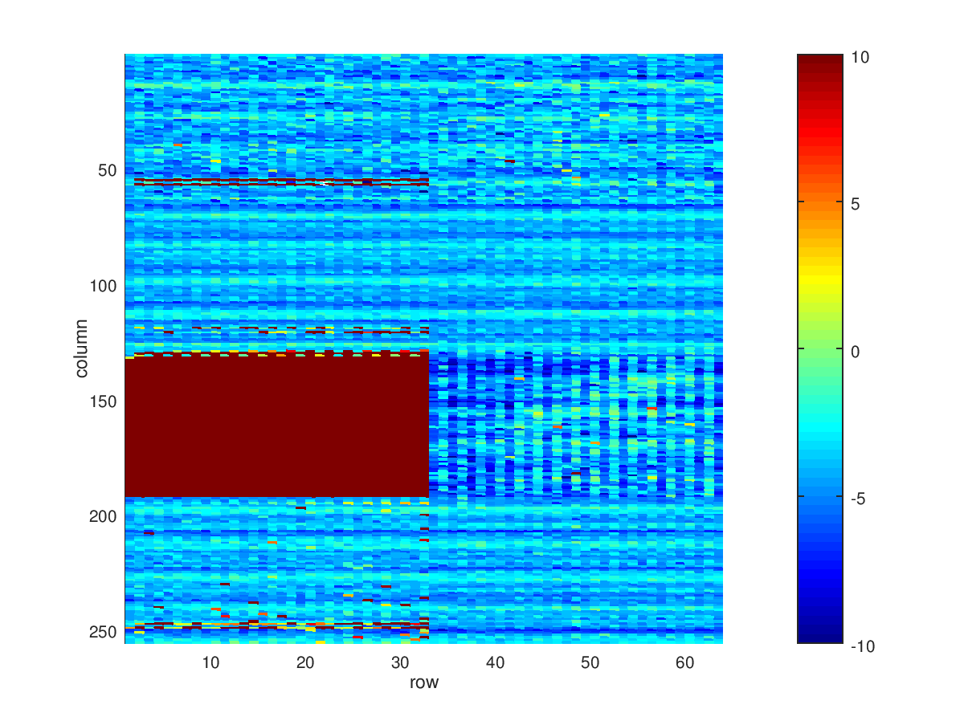
Backside Sweep
-86 V

Slide 32
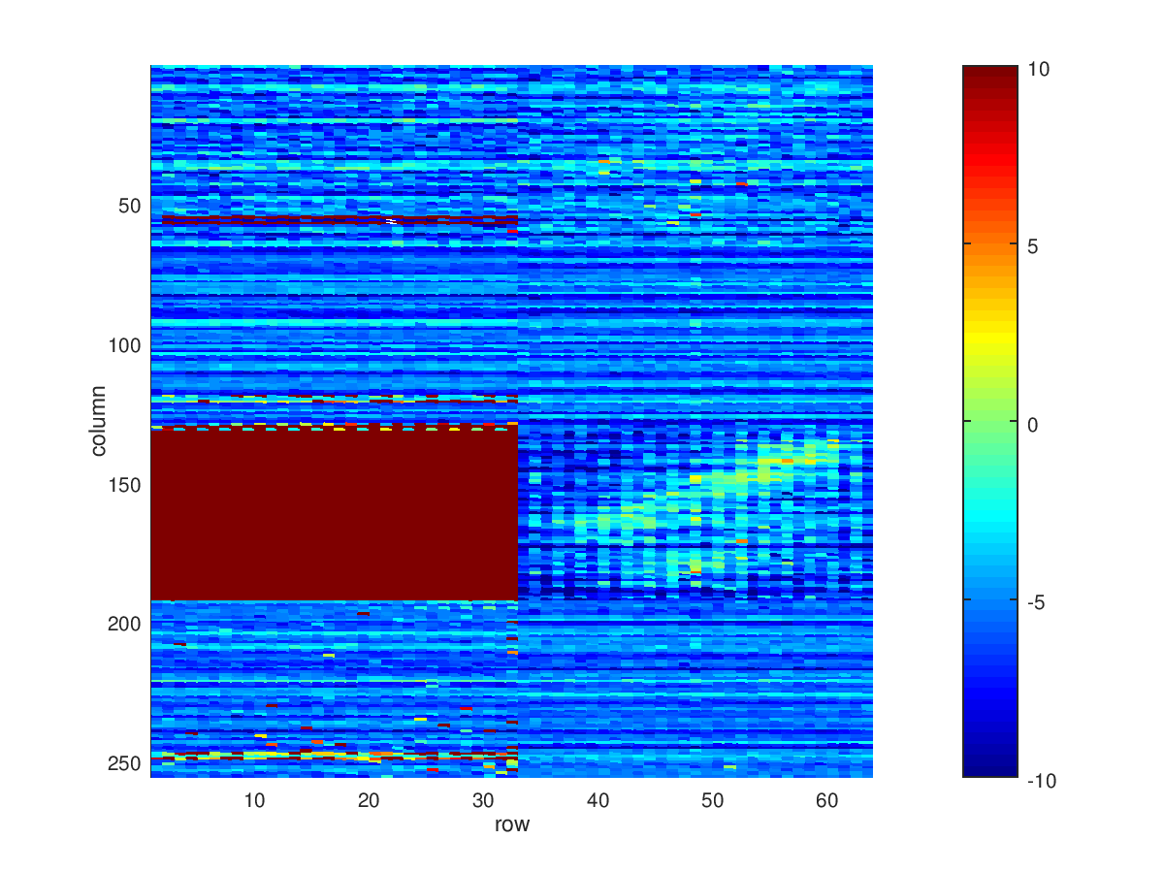
Backside Sweep
-87 V

Slide 33
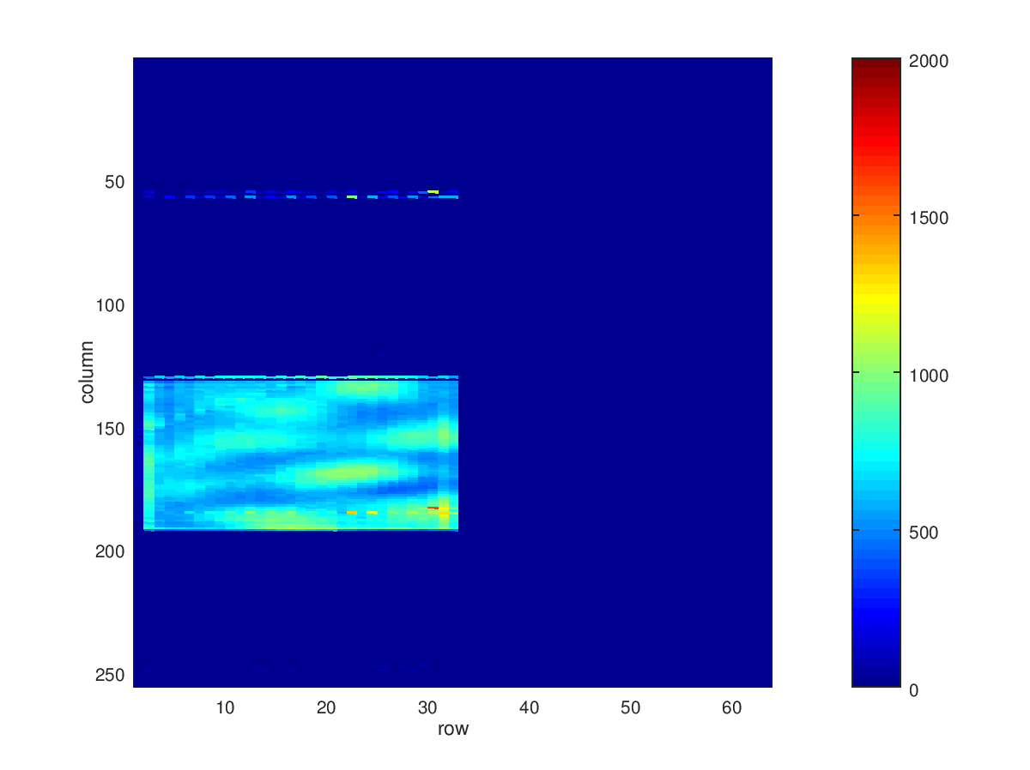
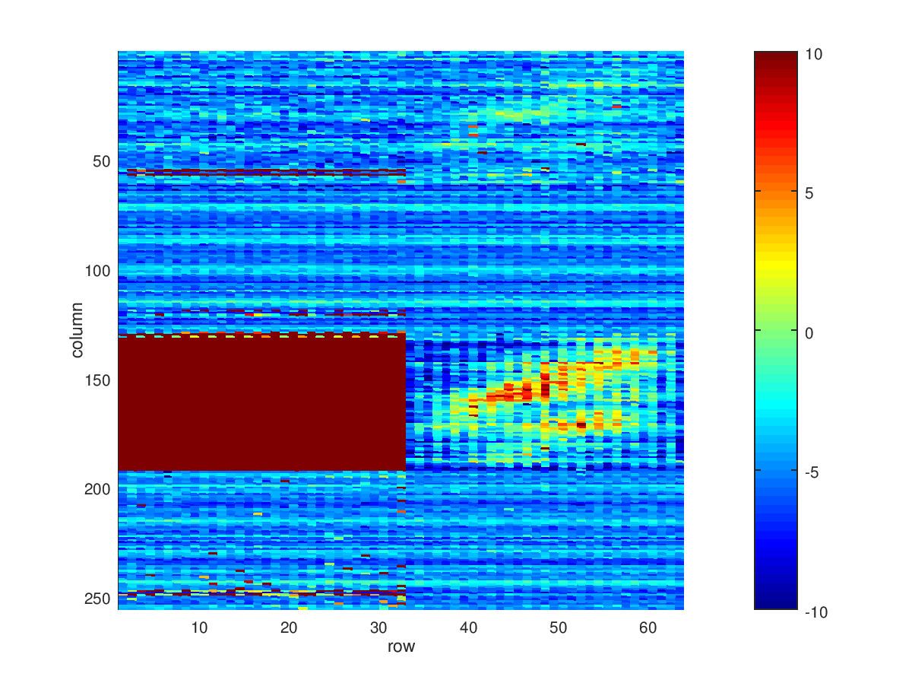
Backside Sweep
-88 V

Slide 34
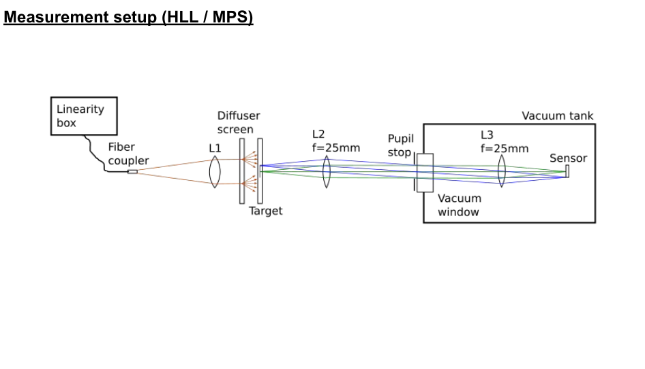
Measurement Setup
B
Notes:
Optical desing provided by Alexander Feller from MPS

Slide 35
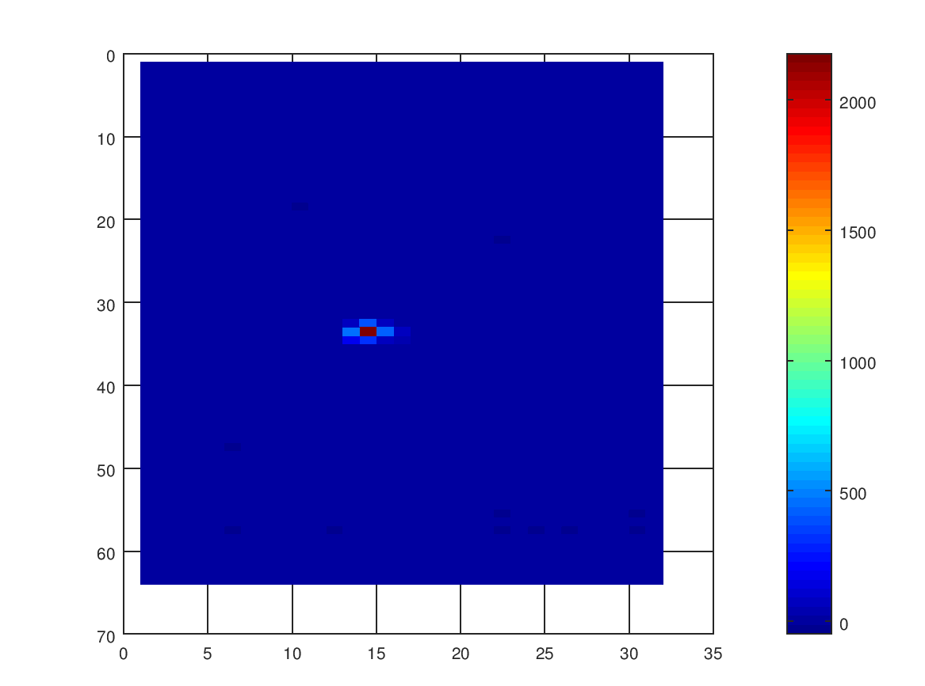
Pinhole Measurement

Slide 36
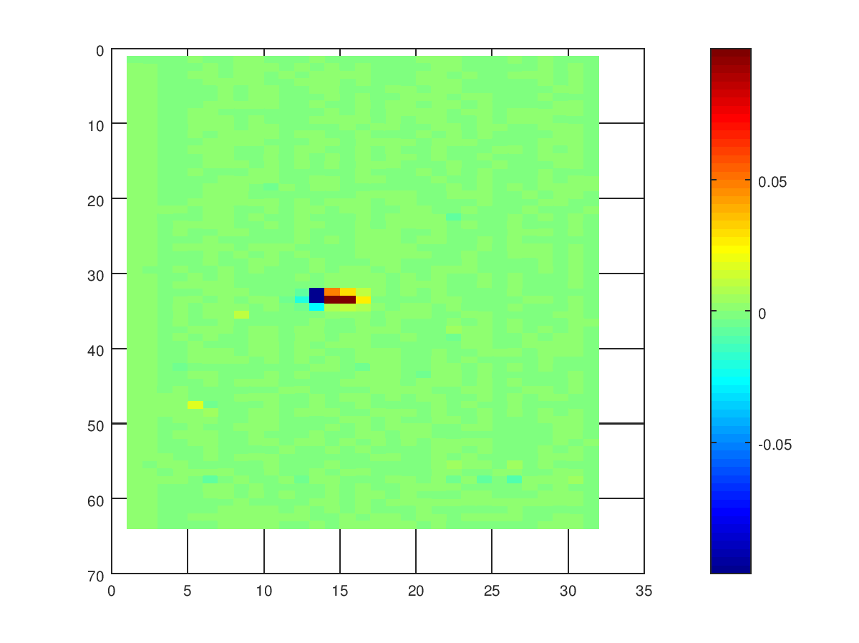
Pinhole Measurement / left-right

Slide 37
Pinhole Measurement / top-bottom

Slide 38
⁵⁵Fe Spectrum
T=-30C
median noise of:
2.9 e- (first readout)
2.4 e- (second readout)
FWHM ~ 150 eV

Slide 39
Intermediate Conclusion
Quadropix concept is functional
limited operation window for backside voltage
large and asymmetric spreading of charge over multiple pixels
B

Slide 40
Intermediate Conclusion
Quadropix concept is functional
limited operation window for backside voltage
large and asymmetric spreading of charge over multiple pixels
B

Slide 41
TCAD simulations
small operation window for standard geometry
optimization incrases operation window up to about 10 V
for details see: Bähr et al „Advanded DePFET concepts: Quadropix“
https://doi.org/10.1016/j.nima.2017.10.048

Slide 42
TCAD simulations
standard device, close approximation of testes sensor

Slide 43
TCAD simulations
standard device, thin (50 µm) substrate

Slide 44
TCAD simulations
standard device, thin (50 µm) substrate, focussing implant on the backside

Slide 45
Polarimetric Crosstalk (based on TCAD simulations)
center
lower left
standard device, close approximation of testes sensor

Slide 46
Polarimetric Crosstalk (based on TCAD simulations)
center
lower left
standard device, thin (50 µm) substrate, focussing implant on the backside

Slide 47
Conclusion
Quadropix concept functional
optimization of geometry already investigated by simulations -> possible
B

Slide 48
Thanks for your attention
B

