Slide 1
PXD9 Needle Card Module Testing and Reworks
22nd International Workshop on DEPFET Detectors and Applications
09.04.2018

Slide 2
Contents
Motivation for needle card testing
Needle card design and features
Setup at HLL
Testing protocol
Output of the tests
Failure mode analysis and module reworks
Test results overview
Comments and lessons learned
Summary

Slide 3
Motivation for needle card testing
PXD9 production workflow:
Wafer-level processing
Wafer-level tests (flying needle)
Wafer-level finalization & cutting
Flip-chip (DHPT, DCD, SwitcherB)
SMD passives assembly
Kapton cable attachment
Module testing
Wafer-level processing
Wafer-level tests (flying needle)
Wafer-level finalization & cutting
Flip-chip (DHPT, DCD, SwitcherB)
SMD passives assembly
Kapton cable attachment
Module testing
Last chance for reworks

Slide 4
Motivation for needle card testing
PXD9 production workflow:
Wafer-level processing
Wafer-level tests (flying needle)
Wafer-level finalization & cutting
Flip-chip (DHPT, DCD, SwitcherB)
SMD passives assembly
Needle card testing
Kapton cable attachment
Module testing
Pre-testing of modules before kapton attachment avoids having to remove the kapton in the case that the module doesn’t behave as expected, simplifying the rework procedure.
Without the kapton a needle card is required for this purpose.

Slide 5
Needle card design and features
The needle card directly interfaces the PXD9 modules to the Belle II PXD standard cableing:
RJ45 for slow control signals
Glenair cable for power delivery
Infiniband cable for HSL data transmission
In ideal contact, the module can be fully operated (at the lowest frequency and half rate) through the needle card

Slide 6
Needle card design and features
2 different needle card designs for the 2 different end-of-stave layouts of PXD9: A for IF/OB and B for IB/OF
Pad distrubution for PXD9:
59 small aluminum bond pads and 4 big copper pads for power and JTAG
8 pads for high speed differential lines
Design considerations:
114 needles (multiple needles for big pads) are required.
PCB size is limited by connectors for power supply and infiniband as well as available space in the probe station.
Design priority: rather simple and passive PCB (emulating the kapton cable), minimizing the path length of the high speed signals.

Slide 7
Setup at HLL
Modules are placed with their base jig on the cooling jig and secured with screws and vacuum.
Through the optical microscope the needles can be aligned with the module for touchdown.
Infiniband
Needles
Glenair
With the help of the micrometer on the left, the desired touchdown overtravel (~60 micrometer) is applied.
RJ45

Slide 8
Setup at HLL
2 needle cards for each type of EOS
1 Power breakout board (LMU_BB-04)
1 LMU power supply (LMUPS-05)
1 DHH carrier card (DHHCCv0.03)
1 DHE (DHE S/N: 0081)
1 JTAG breakout board
1 XJLink2 controller
1 DAQ PC
1 Archiver PC (only PS archived)
Cables and services

Slide 9
Testing protocol: Incremental steps
Visual inspection.
Check of voltages & currents for DHPT, SwitcherB and DCD-digital.
Chip configuration: JTAG write & read. Retrieving IDCODEs, uploading and reading switcher sequence, …
Boundary scan.
Establishing the HSL connections (no delay scan).
Retrieve the testpattern from the DCD.
Enable DCD-analog and check voltages & currents.
Enable and check DEPFET voltages & currents.
Read DEPFET pedestals.
Illuminate the matrix with a laser source.

Slide 10
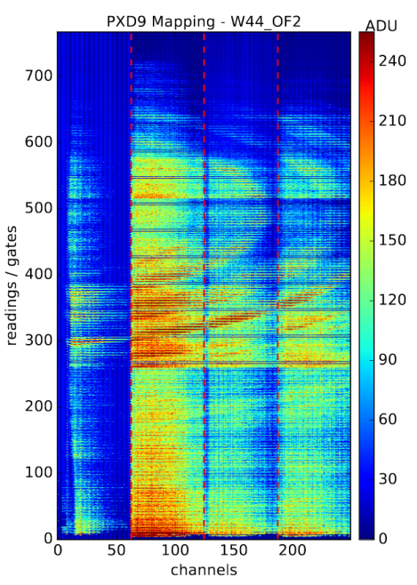
Output of the tests
A complete report for each module with all details is available in two different ELOG archives:
http://elog.mpp.mpg.de/DEPFET/
https://elog.belle2.org/elog/PXD-Mass-Testing/
A check list section for the tests tracks the testing progress for each module at the HephyDB: http://hephy.at/hephydb/hephydb/

Slide 11
Failure mode analysis
Contact is not always perfect, so several tests can be passed only partially or even be skipped without negative implications for the final module performance:
JTAG read/write stability
Boundary scan (JTAG stability)
High-speed-link stability
Missing parts in pedestals (HSL)
Other failure modes are show-stoppers and have to be investigated thoroughly to find possible reworks.
Up to now we encountered:
High SW-DVDD current (8 times)
DHP-Core/IO short (twice)
Failed boundary scan (once)
Low DCD-AVDD current (once)
Clear-On/Clear-Off short (twice)

Slide 12
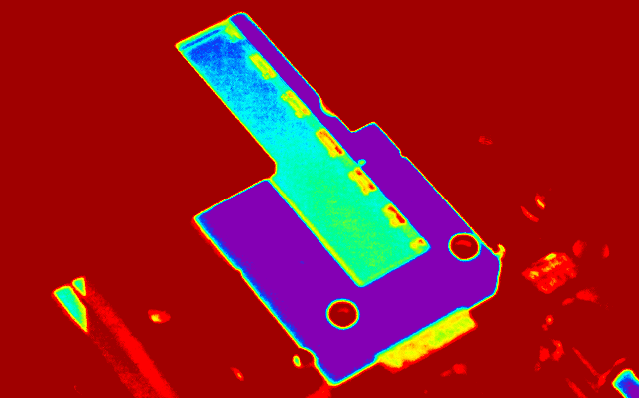
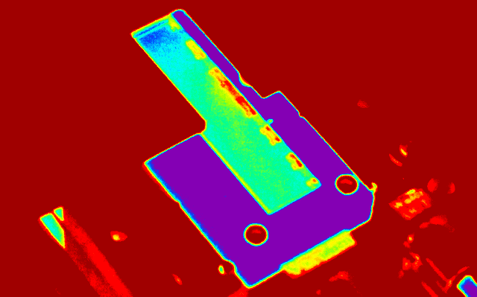
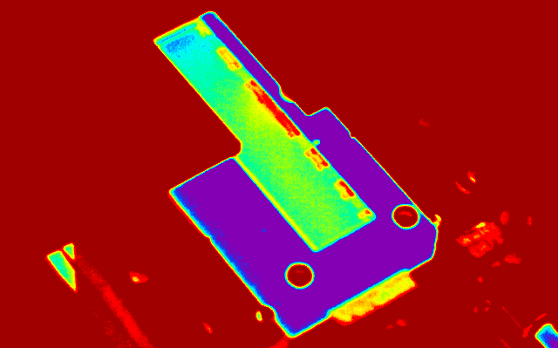
Failure mode analysis and module reworks
High SW-DVDD current
Results
Caused by faulty switcher drawing the high current.
Switcher can be identified for example via thermal imaging.
Switcher has to be replaced.
Module | Fault | Action | Result
W31_OB1 | SW | SW replaced | ClearOn/Off
W31_OB2 | SW | SW replaced | OK.
W38_IB | SW rotated | SW replaced | OK.
W43_OF1 | SW4 | SW4 replaced | OK.
W44_OF1 | SW | Matrix cracked (manual handling)
W44_OF2 | SW6 | SW6 replaced | ClearOn/Off
W09_OB1 | SW2 | SW2 replaced | OK.

Slide 13
Failure mode analysis and module reworks
DHP-Core/DHP-IO short
Results
Caused by faulty DHPT.
DHPT may be identified via thermal imaging at different setup because the needle card blocks visibility of the DHPTs and DCDs.
DHPT may be replaced but higher desoldering temperatures might be needed (1st try: ~320°C)
Module | Fault | Action | Result
W38_OB1 | ASIC not identified | None yet. | None yet.
W45_OF2 | DHPT3 | ASIC replaced with high temp. | OK.
W45_OF2 is proceeding to kapton attachment.
If working: W38_OB1 may be reworked as well.

Slide 14
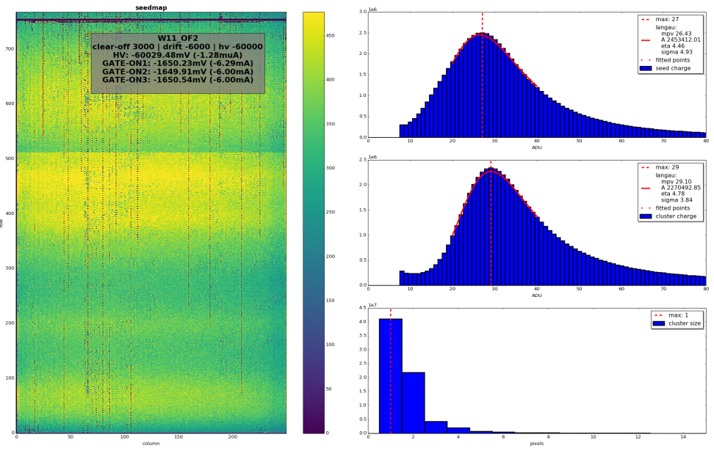
Failure mode analysis and module reworks
Failed boundary scan (W09_OF2)
Low DCD-AVDD current (W11_OF2)
As long as switchers are in the JTAG chain. Without switchers the boundary scan works fine.
Tought possibly to be due to bad touchdown, so module was sent to kapton attachment.
JTAG can be used so long as matrix voltages are off, breaks when module is further powered up.
Faulty switcher cannot be identified via thermal imaging or otherwise.
No rework possible.
Switching on the DCD analog parts, the more DCD are on, the less current is consumed per DCD.
No solution found yet, but module was sent to kapton attachment.
Module is working, no rework needed.

Slide 15
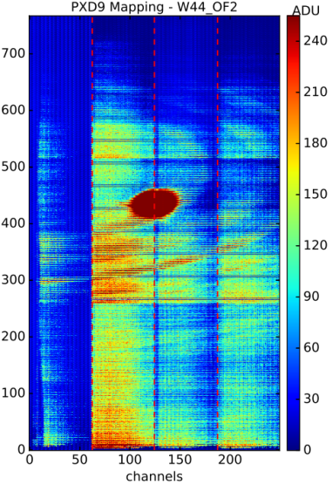
Failure mode analysis and module reworks
Clear-On/Clear-Off short
Results
Both voltages use the same net on the matrix and are toggled by the switchers, therefore a faulty switcher is likely the reason.
Faulty ASIC may be identified via thermal imaging.
Module | Fault | Action | Result
W31_OB1 | Not identified. | None taken. | Module glued to L2_010
W44_OF2 | Switcher3 | Replace Switcher3. | Module broke during rework.
No data on rework success.
Affected modules may work even without solving the fault (tested up to pedestals for W44_OF2).

Slide 16
Test results overview: Preproduction & Phase 2
Preprod. | Power | JTAG | Boundary | HSL | Analog Power | Matrix | Overall
W36_IF
W31_IF |  |  |  |  |  | 1,2,4
W31_IB (rew)
W31_OB1 |  | SW-DVDD |  |  |  |  | Reworked
W31_OB1 (rew) |  |  |  |  |  | Clear-On/Off | L2_010
W31_OB2 |  | SW-DVDD |  |  |  |  | Dummy
Phase 2 | Power | JTAG | Boundary | HSL | Analog Power | Matrix | Overall
W37_IF
W40_IF
W38_IB | SW_DVDD |  |  |  |  |  | Reworked
W38_IB (rew)
W37_OF1
W37_OB1
W38_OB1 | DHP-C/IO |  |  |  |  |  | On hold
Color code:
Perfect Passed Minor errors / Possible touchdown problems Show stopper
Yield (after reworks):
IF: 4/4 IB: 2/2 OF: 1/1 OB: 1(2)/4 Total: 8/11 (72%)

Slide 17
Test results overview: Phase 3 IF & IB modules
P3 IF | Pow | JTAG | Bound | HSL | Analog | Matrix | All
W02
W03
W05
W08
W32
W41
W42
W43
W44
W45
W46
W47 |  |  |  | 3,4 |  | 3,4
W04
W09
W13
P3 IB | Pow | JTAG | Bound | HSL | Analog | Matrix | All
W01 |  |  |  | 1,2,3
W02
W03 |  |  |  | 1,2
W09 |  |  |  | 2,3,4
W32 |  |  |  |  |  | 2,4
W41
W42 |  |  |  | 1,2,3 |  | 1,2,3
W43 |  |  |  | 1
W44
W45
W46
W47 |  |  |  | 1,2,3
W04
W13
Color code:
Perfect Passed Minor errors / Possible touchdown problems Show stopper
Yield (after reworks):
IF: 15/15 (100%) IB: 14/14 (100%)

Slide 18
Test results overview: Phase 3 OF modules
Phase 3 OF | Power | JTAG | Boundary | HSL | Analog Power | Matrix | Overall
W08_OF2 |  |  |  | 1,3 |  | 1,3
W09_OF1 |  |  |  | 1,3 |  | 1,3
W09_OF2
W11_OF1
W11_OF2 |  |  |  | 1,3 | DCD-AVDD |  | Tested: works
W12_OF1
W32_OF1
W32_OF2
W33_OF1
W33_OF2
W41_OF1
W43_OF1 | SW-DVDD |  |  |  |  |  | Reworked
W43_OF1 (rew)
W44_OF1 | SW-DVDD |  |  |  |  |  | Broken
W44_OF2 | SW-DVDD |  |  |  |  | Clear-On/Off | Broken
W45_OF1 |  |  |  |  |  | 1,2,4
W45_OF2 | DHP-C/IO |  |  |  |  |  | Reworked
W45_OF2 (rew)
W46_OF1 |  |  |  | 1,2
W46_OF2 |  |  |  | 1,2
W02_OF1
W03_OF2
W04_OF1
W05_OF1
Color code:
Perfect Passed Minor errors / Possible touchdown problems Show stopper
Yield (after reworks):
OF: 20/22 (91%)

Slide 19
Test results overview: Phase 3 OB modules
Phase 3 OB | Power | JTAG | Boundary | HSL | Analog Power | Matrix | Overall
W03_OB1
W05_OB1
W06_OB1
W08_OB1
W08_OB2
W09_OB1 | SW-DVDD |  |  |  |  |  | Reworked
W09_OB1 (rew)
W09_OB2
W12_OB1
W12_OB2
W32_OB2
W33_OB1
W42_OB1
W42_OB2
W44_OB1
W44_OB2
W45_OB2
W46_OB1
W46_OB2
W04_OB1
W10_OB1
Color code:
Perfect Passed Minor errors / Possible touchdown problems Show stopper
Yield (after reworks):
OB: 20/20 (100%)

Slide 20
Test results overview
The final yield (modules without show stoppers, and including reworks) of all the needle card tests is accounted in the following table:
A total of 82 modules were tested.
9 of them showed errors which were catalogued as show stoppers. Out of these 9 modules: 7 had switcher related problems, 2 had DHP related problems.
1 of them showed an error which was catalogued as show stopper at first, but left a working module in the end (W11_OF2)
Many errors could be debugged with the needle card setup and a thermal camera, and be repaired before kapton attachment.
Phase | IF | IB | OF | OB
Preproduction | 2/2 | 1/1 | 0 | 0/2
Phase 2 | 2/2 | 1/1 | 1/1 | 1(2)/2
Phase 3 | 15/15 | 14/14 | 20/22 | 20/20
Total | 19/19 (100%) | 16/16 (100%) | 21/23 (91%) | 21(22)/24 (~90%)

Slide 21
Comments and lessons learned
In most cases, testing an IF/OB module with one of the A needle cards was straightforward, meanwhile IB/OF modules (B cards) used to take more of an effort.
This switched around after maintenance and rework were performed on the B needle cards: Now IB/OF tests are very successful.
The sate of the needle card and the touchdown quality dominate the module behavior.
A type needle cards are going to be reworked by the manufacturer in the next weeks in case further tests are needed.
To improve the contact between the needles and the pads, we performed consecutive touchdowns in the same spot in order to scratch the surface of the pad a bit and allow for better contact.
This proved to be more efficient than trying another spot on the pad for better contact, which was the go-to solution for better contact in the beginning.
It has the additional effect of “damaging” less pad area with touchdowns, which should prove positive for bonding.

Slide 22
Comments and lessons learned
For an optimal contact, planarity between the needle card and the module is crucial. In this sense, the jig used to house the module can harshly affect the measurement.
Instead of using a unique jig for each of the modules (as it was intended), we found jigs that worked fairly well for each type of module and kept using those for all the measurements.
In the end a single jig was used for all types of modules because the planarity outweighed the difficulties introduced by suboptimal vacuum fixation of modules of the wrong type for the jig.
Needles
Module
Module-Jig
Cooling-
Adapter
Prober
Chuck

Slide 23
Summary
Two needle card designs to test the PXD9 modules before kapton attachment have been produced and are in operation.
A testing protocol for the mass production was developed and tested with real modules (thanks to Pablo Gomis @ IFIC, Universitat de València/CSIC)
Ideally we can fully operate the modules before kapton attachment to verify they are working as designed as far as ASICs and basic matrix functionality are concerned.
Unfortunately not all touchdowns are optimal and sometimes we can’t operate the full module as desired. Partially tested modules were sent to kapton attachment as long as no severe errors were encountered, giving them the benefit of the doubt.
In total we were able to test 82 modules, spotting show stopper errors on 9 of them and allowing for the refurbishment of about half of those.
Needle card tests give a baseline of the module performance for following testing procedures and error tracking.

Slide 24
Thanks for your attention.

