Slide 1
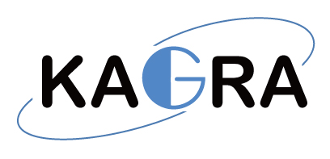

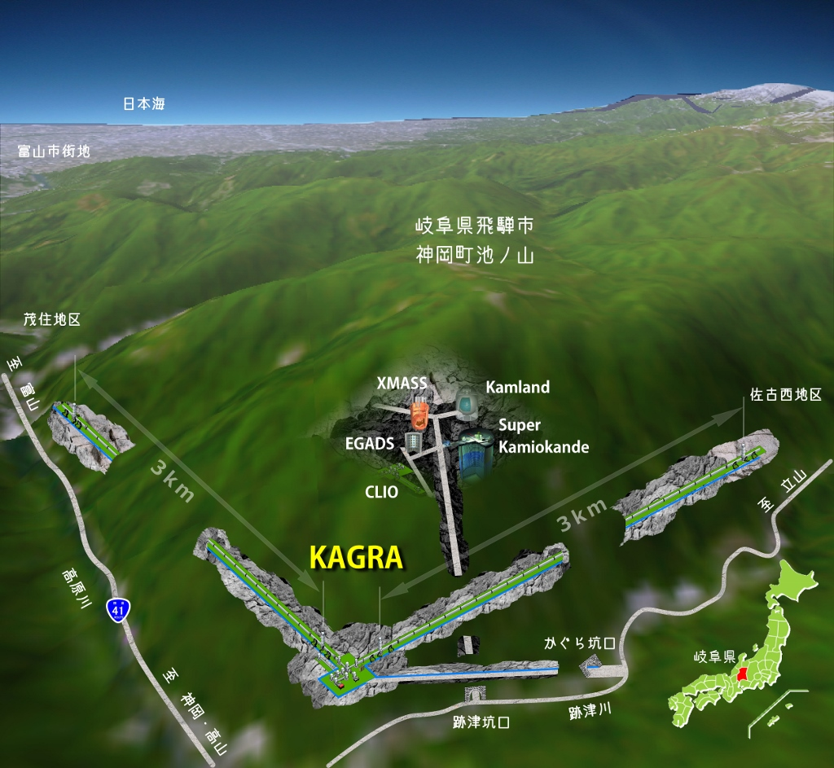




KAGRA – 3km Cryogenic Laser Interferometer
Masatake OHASHI (ICRR)

Slide 2
Two key features of KAGRA
1. KAGRA is constructed at underground site.
2. KAGRA uses cryogenic mirrors.

Slide 3
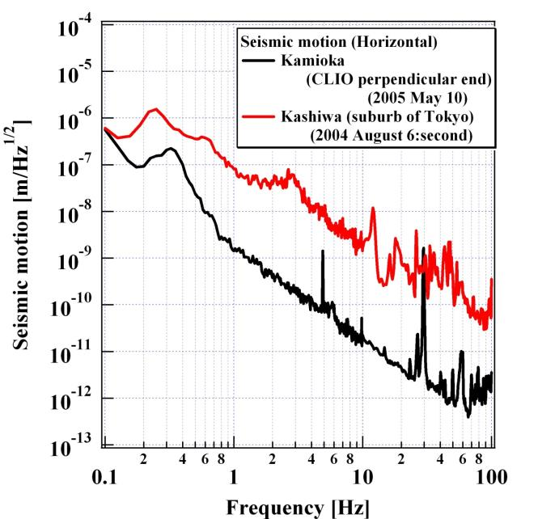
Seismic noise in Kamioka Mine

Slide 4
Difficulty of Underground site
Water

Slide 5
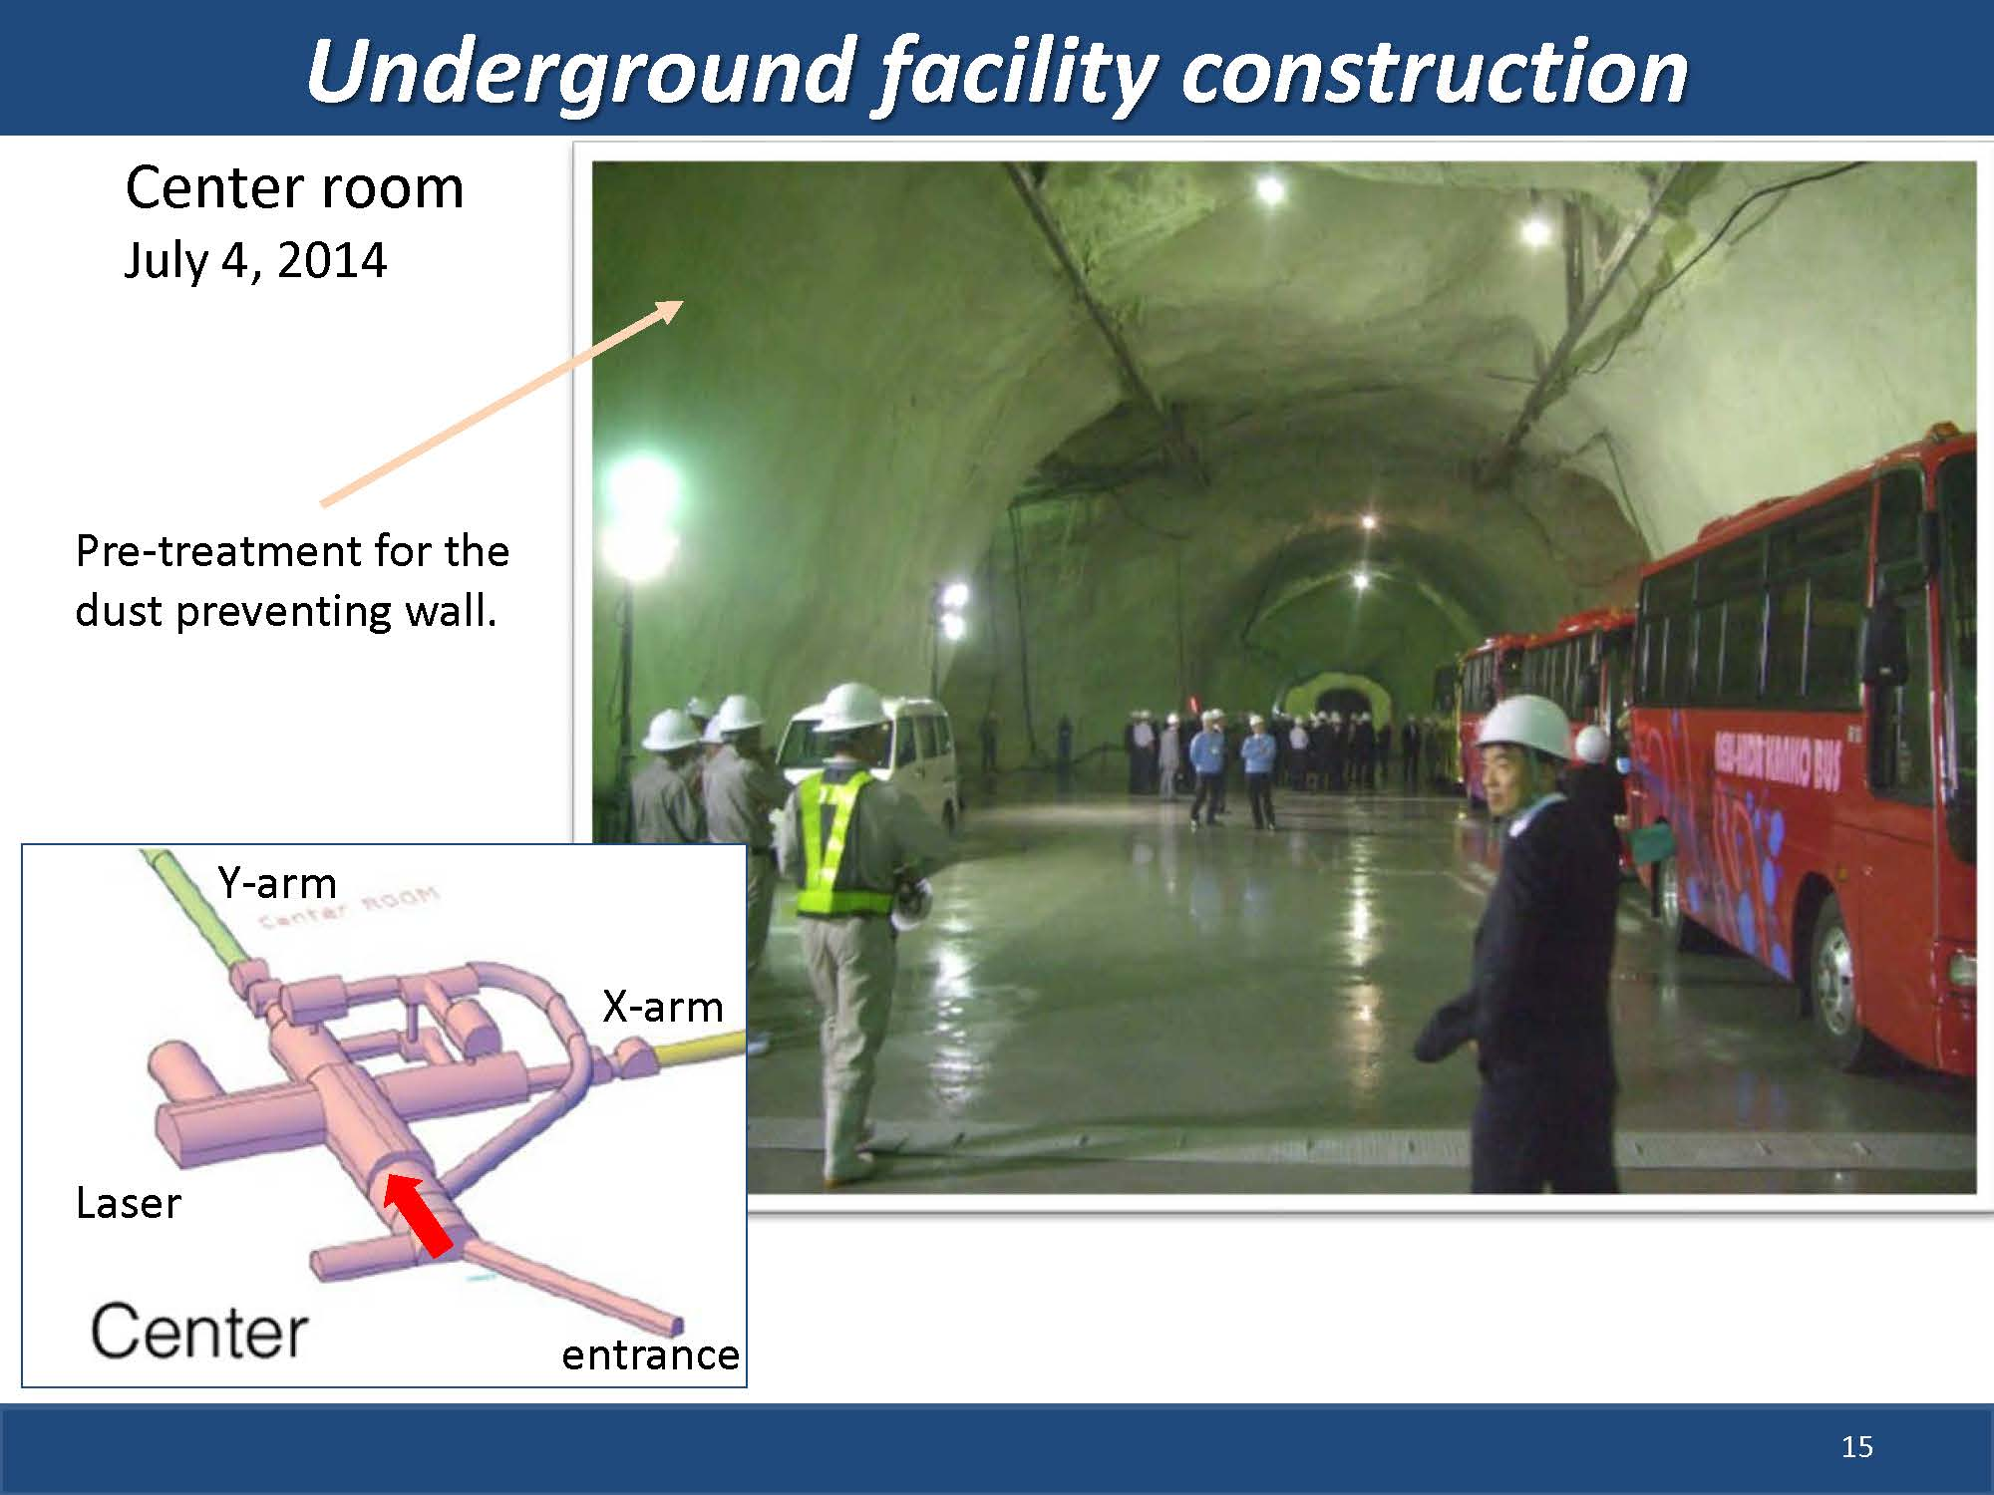

Slide 6
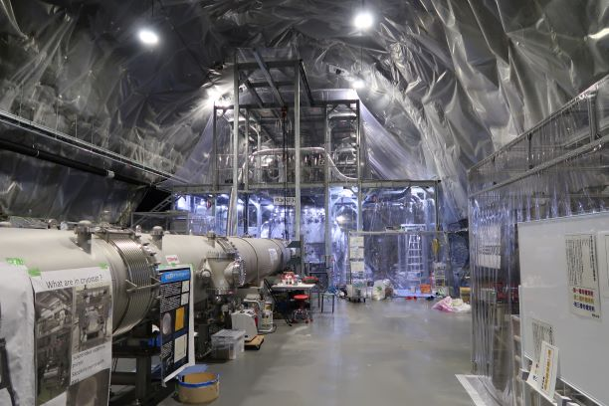
Spring water from wall surfaces
All surfaces were covered by waterproof sheets.

Slide 7
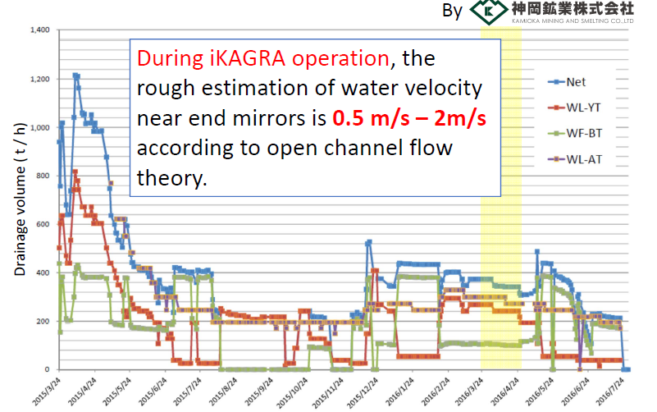
Water drain
Maximum drainage volume is
over 2,000 ton/hour
by melting snow

Slide 8
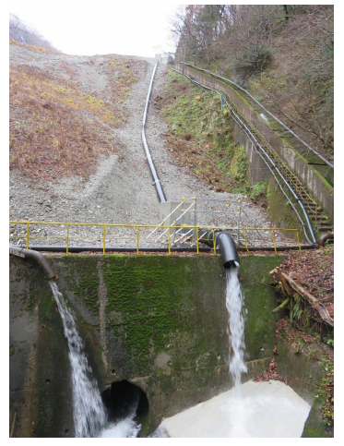
Water drain
KAGRA has two drain outlets.
The photo shows Y-end drain outlet.

Slide 9
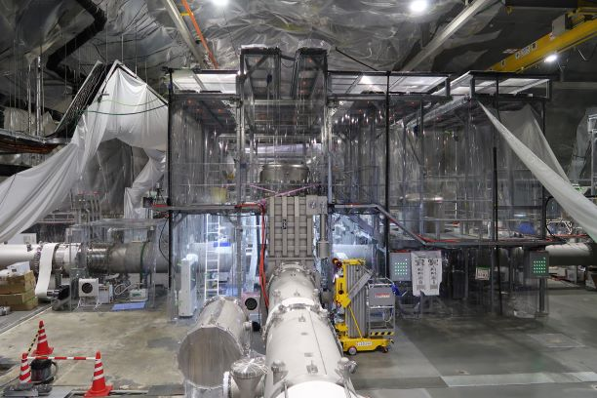
Today’s KAGRA

Slide 10
Two key features of KAGRA
1. KAGRA is constructed at underground site.
2. KAGRA uses cryogenic mirrors.

Slide 11
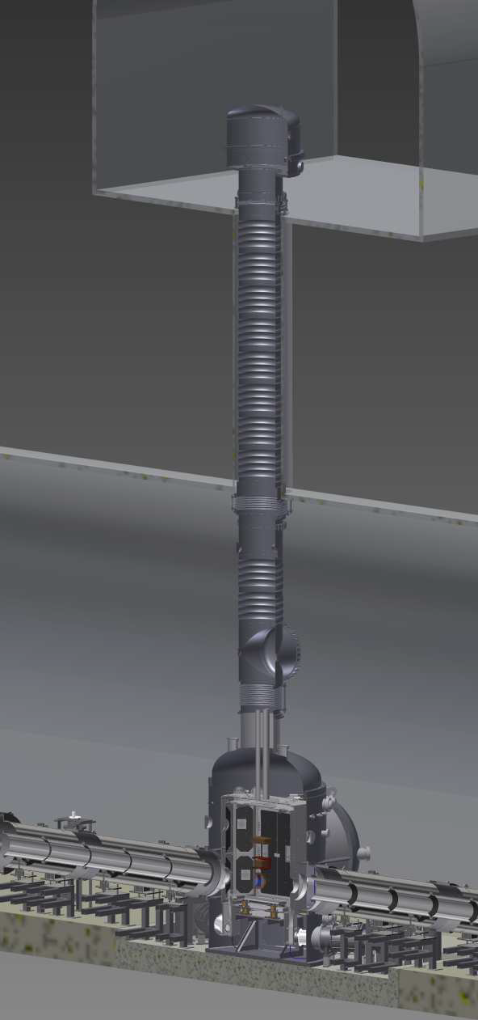
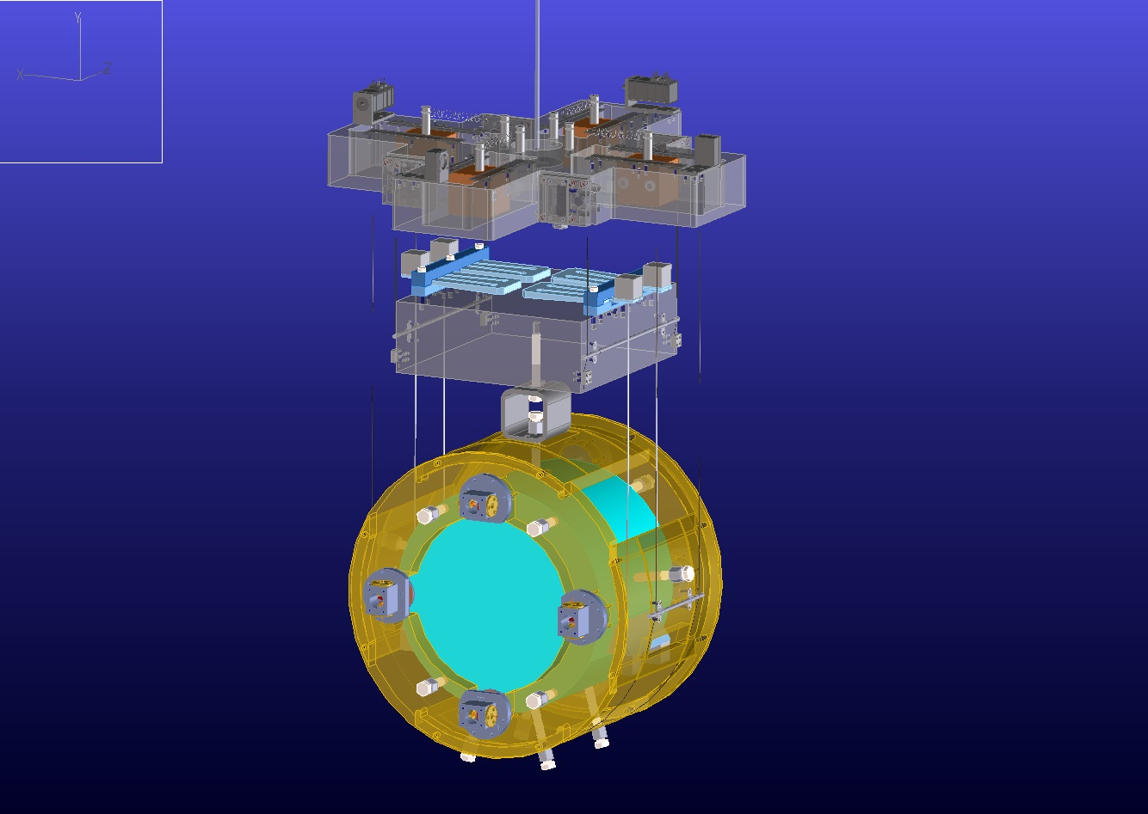
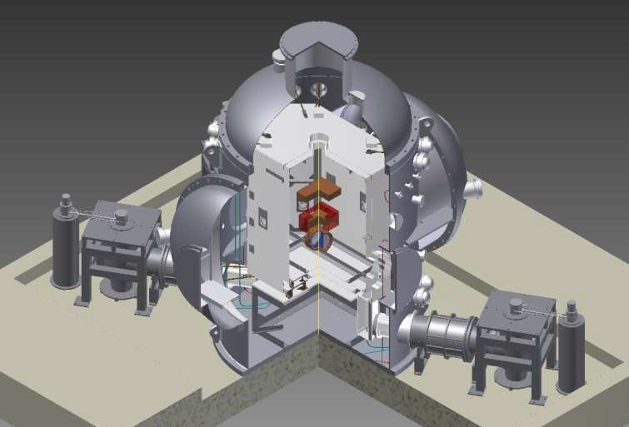
Cryogenic mirror system
~ 14 m

Slide 12
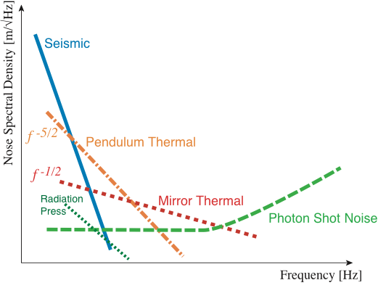
Thermal noises
Thermal noise degenerate the sensitivity
around 100Hz which is important for GW.

Slide 13
Mirror thermal noise
Amplitude of thermal noise is proportional to
(T/Q)^{1/2}.
In general, Q (inverse number of magnitude of
dissipation) depends on T (temperature).
KAGRA sapphire mirror is at 20K.

Slide 14
Conditions required to mirror cooling system
No exchange gas
No extra seismic noise
No Q degradation
…

Slide 15
Solution
To select sapphire substrates which
have low absorption of laser light
To cool mirrors by only heat transfer
through thin sapphire wires

Slide 16


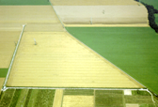

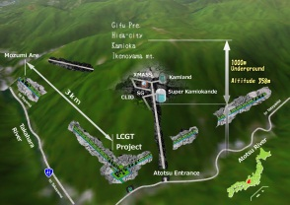

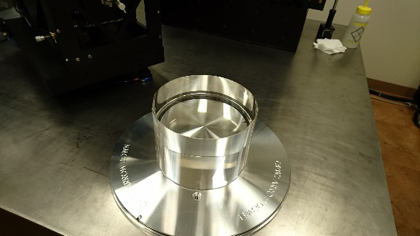
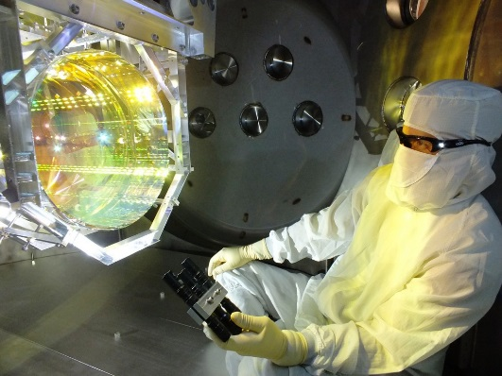
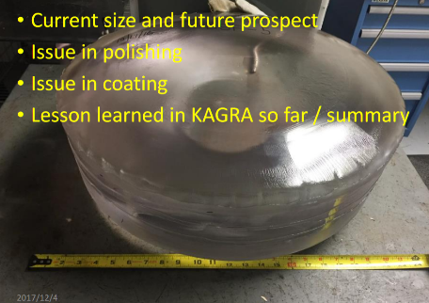
Completion of four sapphire mirrors
Advanced LIGO
Hanford
GEO600
KAGRA
Advanced LIGO
Livingston
Advanced
Virgo
LIGO-India
polish
coating
crystal
Crystal systems &
Shinkosha
Zygo
LMA

Slide 17
Solution
To select sapphire substrates which
have low absorption of laser light
To cool mirrors by only heat transfer
through thin sapphire wires

Slide 18
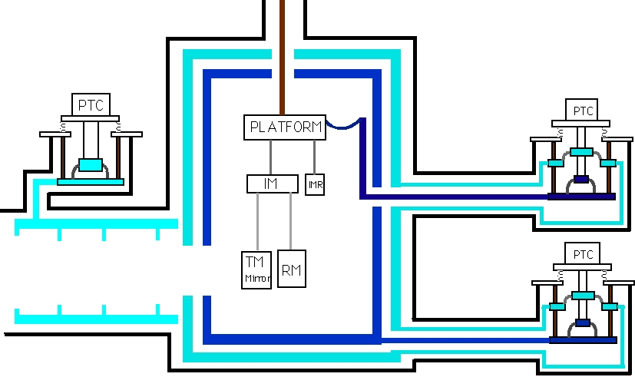
design of cryogenic mirror system
Pulse tube cryocoolers
Pulse tube cryocoolers
Sapphire fiber
Sapphire mirror (About 20K)

Slide 19
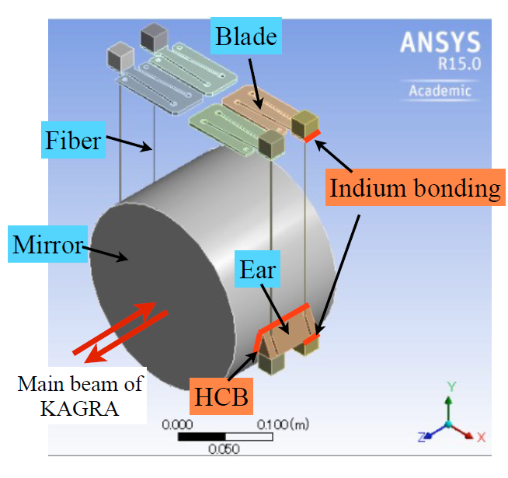
Cryogenic mirror
fiber break
Hydroxide Catalysis Bonding

Slide 20
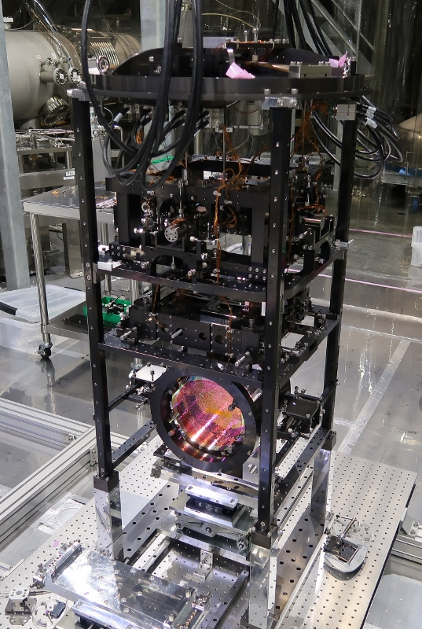
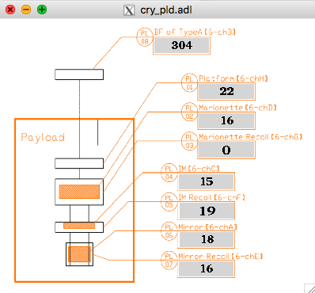
Cryogenic payload
Mirror was cooled below 20K
type A
Cryogenic payload with mirror

Slide 21
Merit of cryogenic mirror
Sapphire has high thermal conductivity
at low temperature.
So there is almost no thermal gradient.
Consequently,
there is almost no thermal lens effect.
No Thermal Compensation System

Slide 22
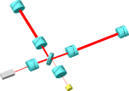

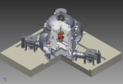
Schedule of KAGRA
 | 2010 | 2011 | 2012 | 2013 | 2014 | 2015 | 2016 | 2017 | 2018 | 2019 | 2020
Project start
Tunnel Excavation
iKAGRA
bKAGRA
3km Michelson Interferometer
iKAGRA
First operation
3km Cryogenic Interferometer
Final installation
Commissioning and Observation

Slide 23
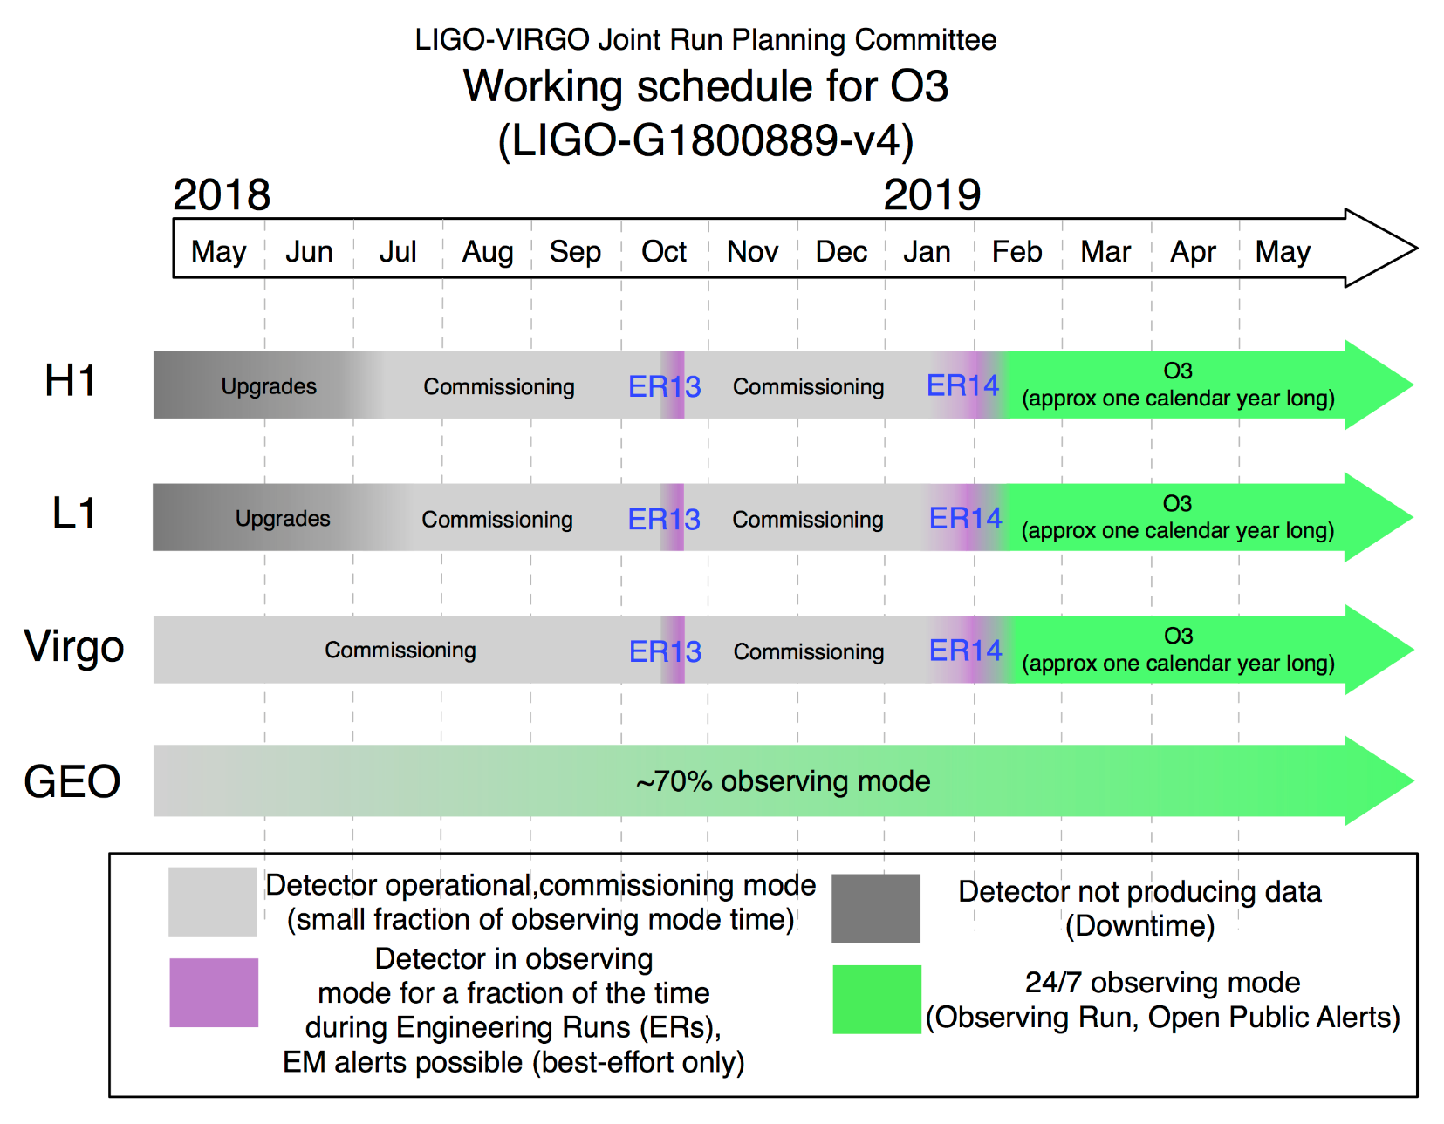
Schedule of LIGO and VIRGO

Slide 24
Toward joining O3
We have decided to accelerate KAGRA schedule to join O3.
acceleration

Slide 25
Summary
In the spring of 2019, we expect to complete the construction phase and move on to the commissioning phase. KAGRA plans to join O3 in the fall of 2019.
25

