Slide 1
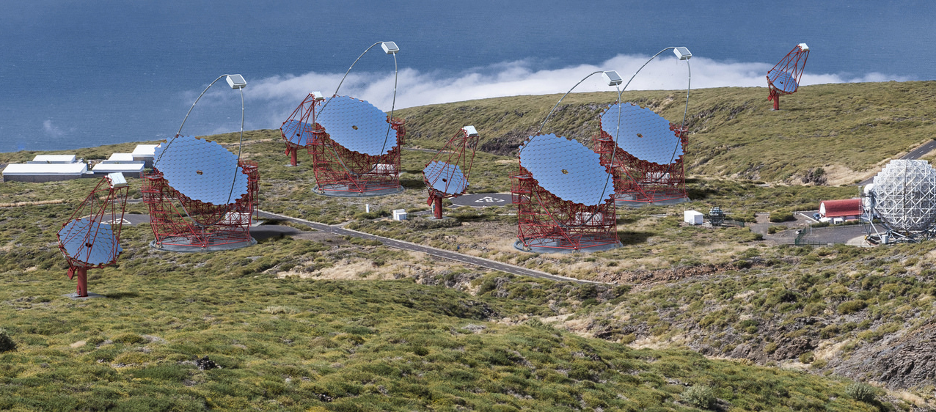
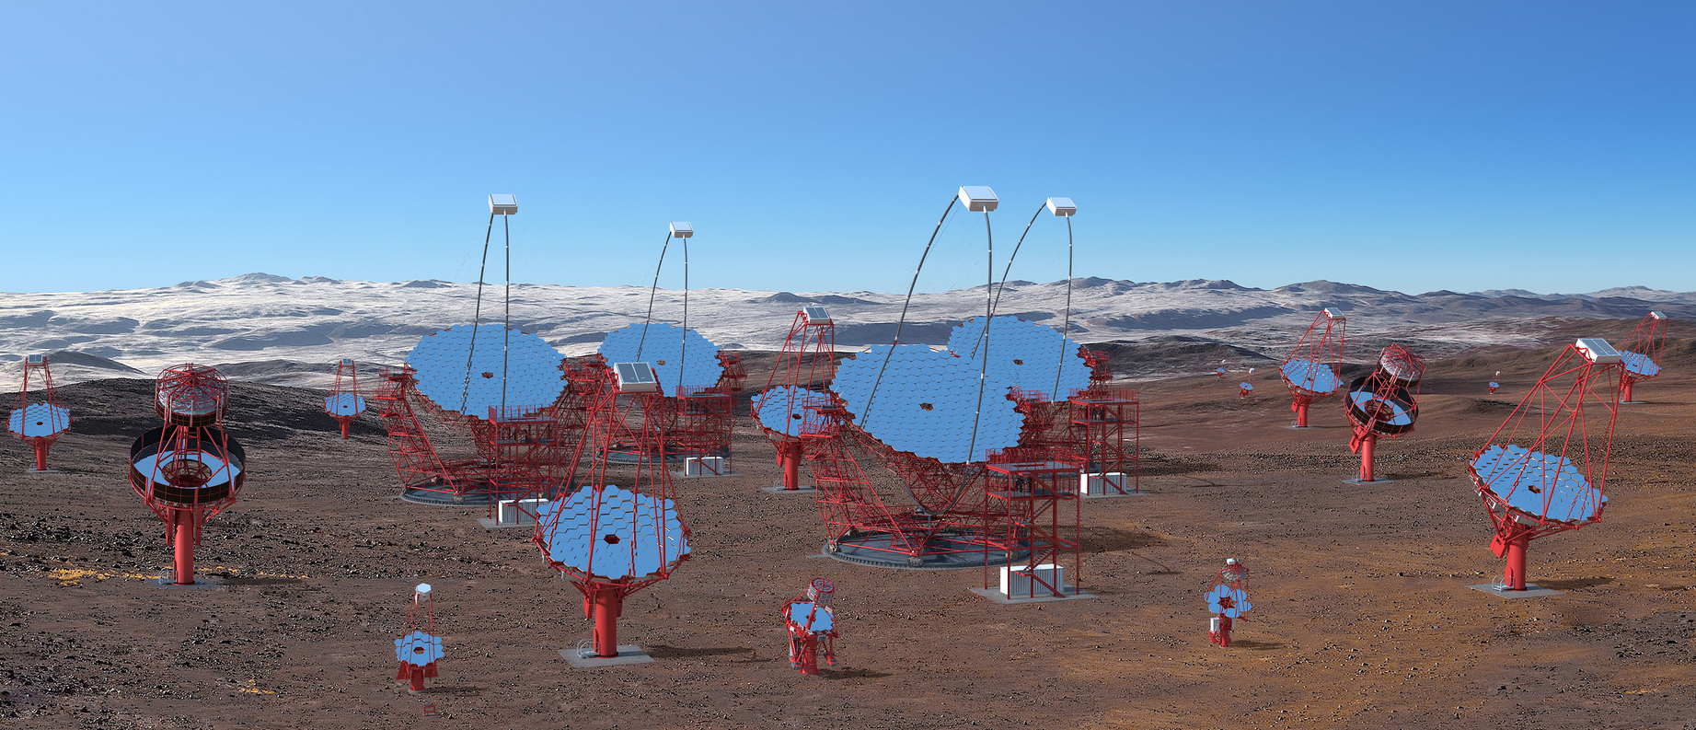
The Cherenkov Telescope Array
W. Hofmann, MPI für Kernphysik
for the CTA Consortium

Slide 2
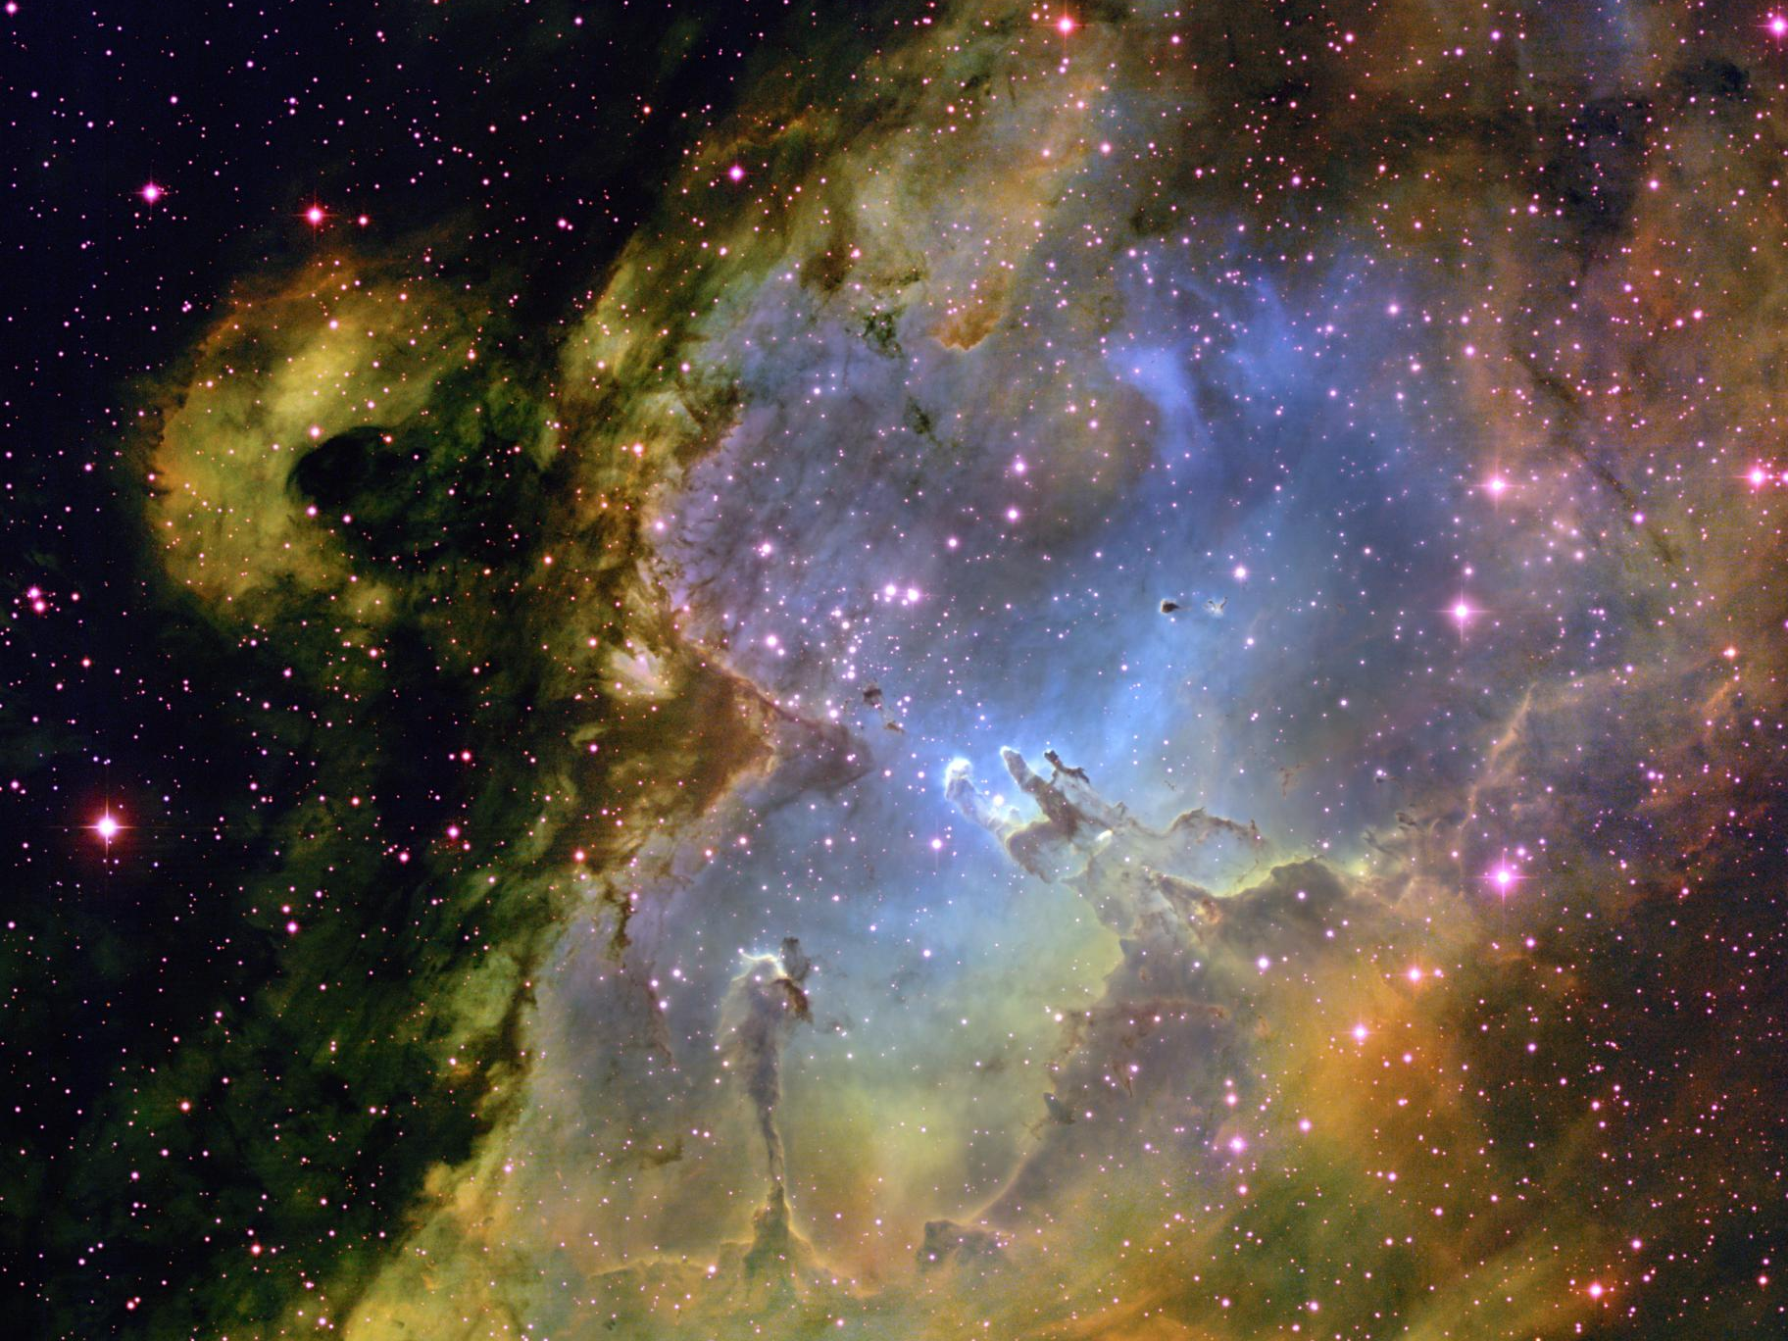
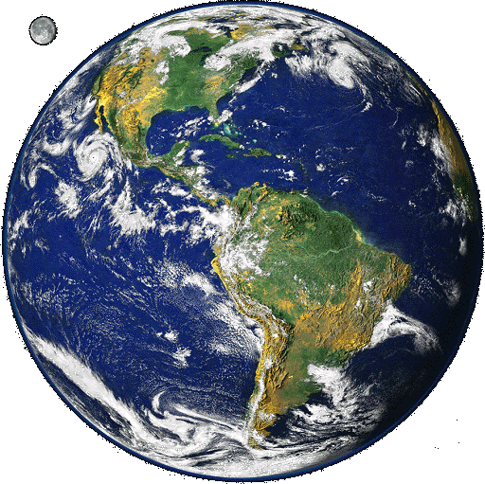
T. A. Rector & B. A. Wolpa, NOAO, AURA

Slide 3
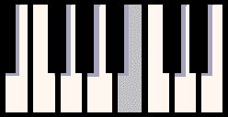
Radiation from the Cosmos: a 15 m long piano!
Very High Energy
Gamma Rays
(TeV = 10¹² eV)
Light
low frequency
low energy
high frequency
high energy
Visible spectrum
covers about
one octave

Slide 4

Radiation from the Cosmos: a 15 m long piano!
Very High Energy
Gamma Rays
(TeV = 10¹² eV)
Light
low frequency
low energy
high frequency
high energy
Visible spectrum
covers about
one octave
Well-known
piece of music,
only 1 octave

Slide 5
Radiation from the Cosmos: a 15 m long piano!
Very High Energy
Gamma Rays
(TeV = 10¹² eV)
Light
low frequency
low energy
high frequency
high energy
Visible spectrum
covers about
one octave
Full range

Slide 6
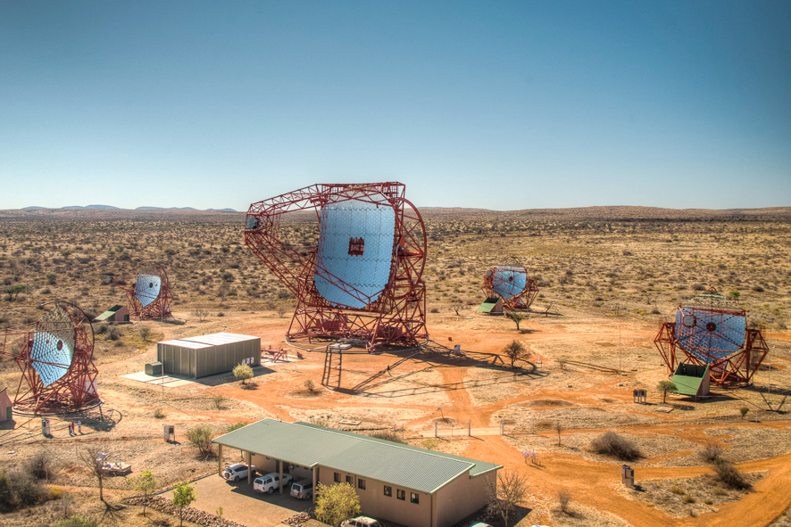
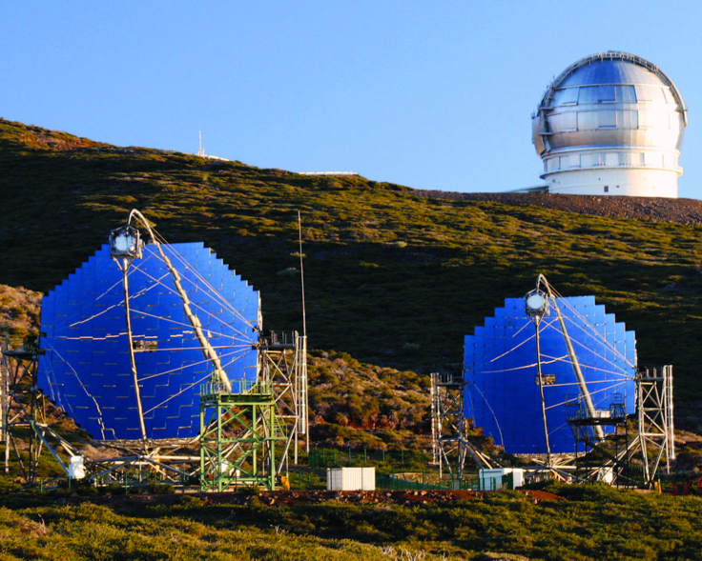
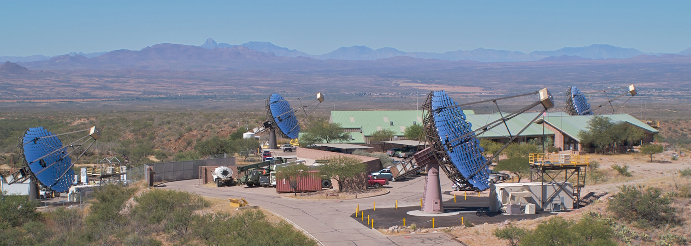
H.E.S.S. (Namibia)
4 x 108 m² (since 2003)
1 x 614 m² (since 2012)
MAGIC (La Palma)
2 x 236 m² (since 2003 / 2009)
VERITAS (Arizona)
4 x 110 m² (since 2007)
Notes:
Auch andere Väter haben schöne Töchter!

Slide 7
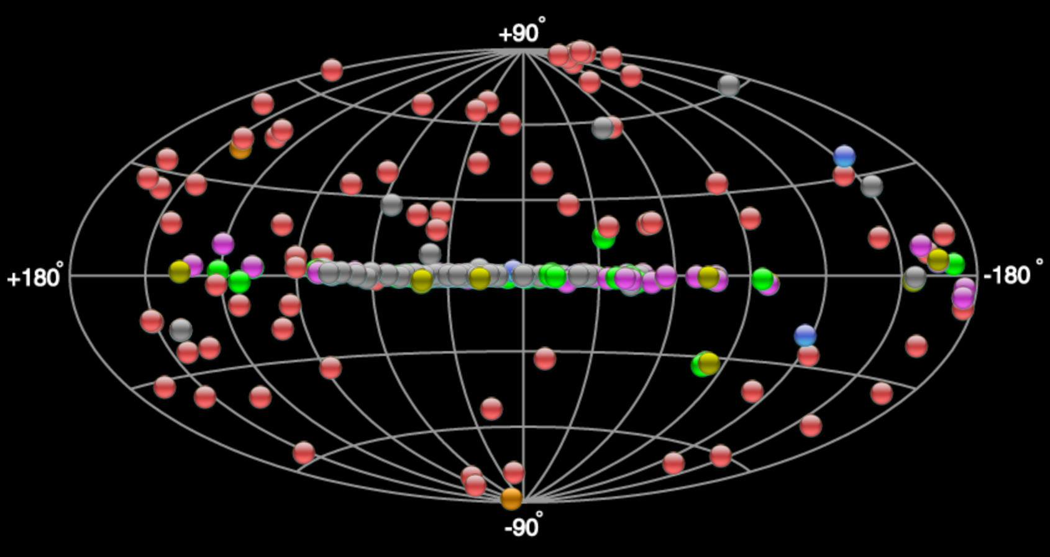
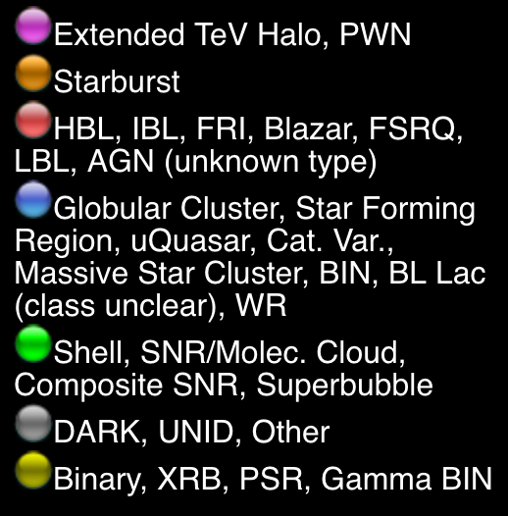
The Gamma Ray Sky at
Very High Energies
http://tevcat.uchicago.edu

Slide 8
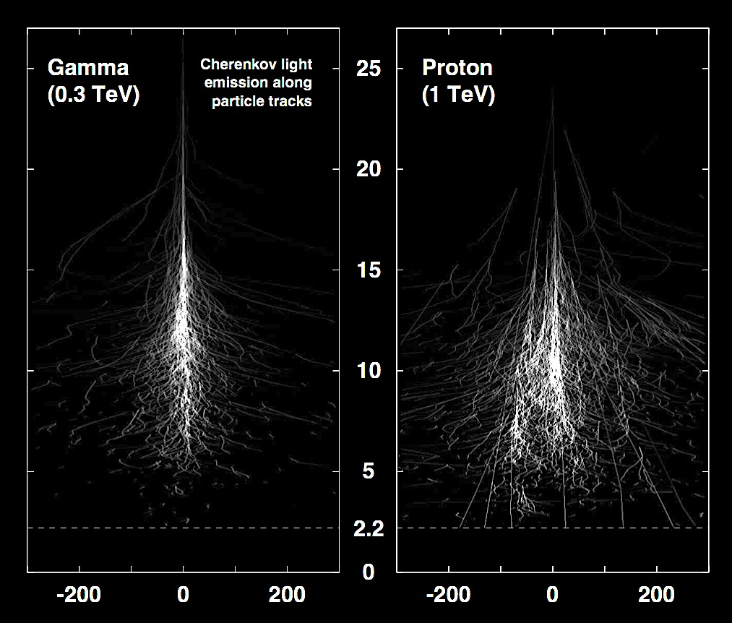
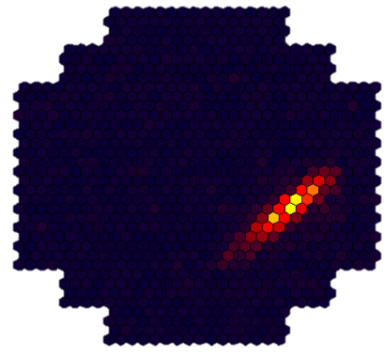
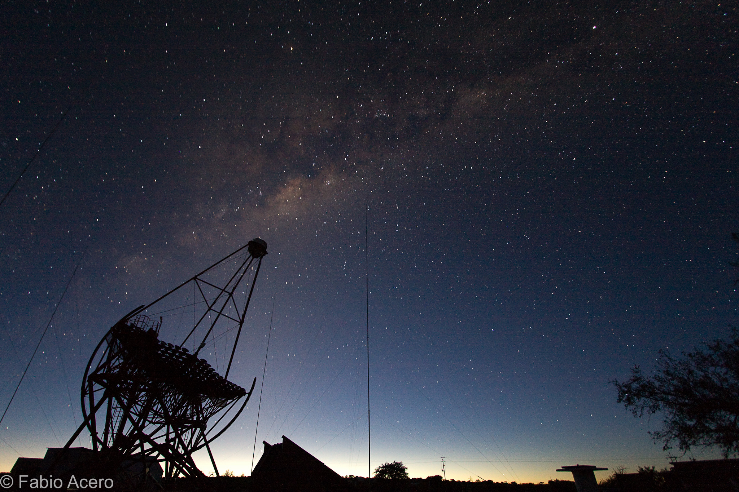
Cherenkov
telescopes
A bit like a meteor track, but
very faint (few photons per m²)
very short-lived (some 10⁻⁹ seconds)
250 m diameter “light pool”

Slide 9
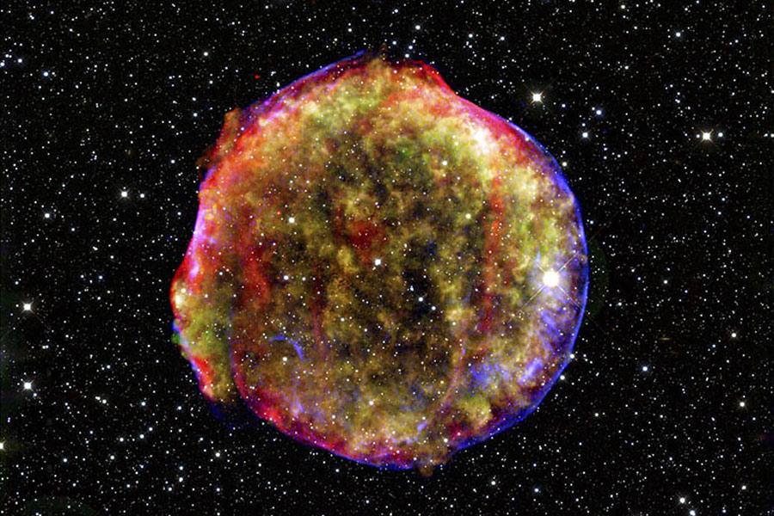

Supernova shock waves as cosmic accelerators
http://www.espn.com/espn/feature/story/_/id/14626909/surfers-risk-death-paddling-historic-80-foot-waves-jaws
Tycho’s Supernova remnant
NASA/CXC/Rutgers/J.Warren & J.Hughes et al.

Slide 10
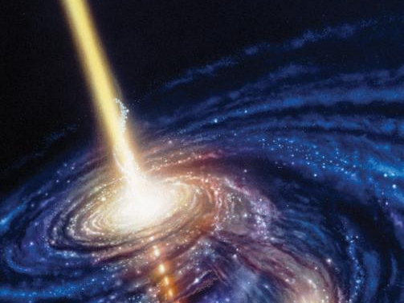
Not only supernova
remNants
Illustration: Scientific American

Slide 11
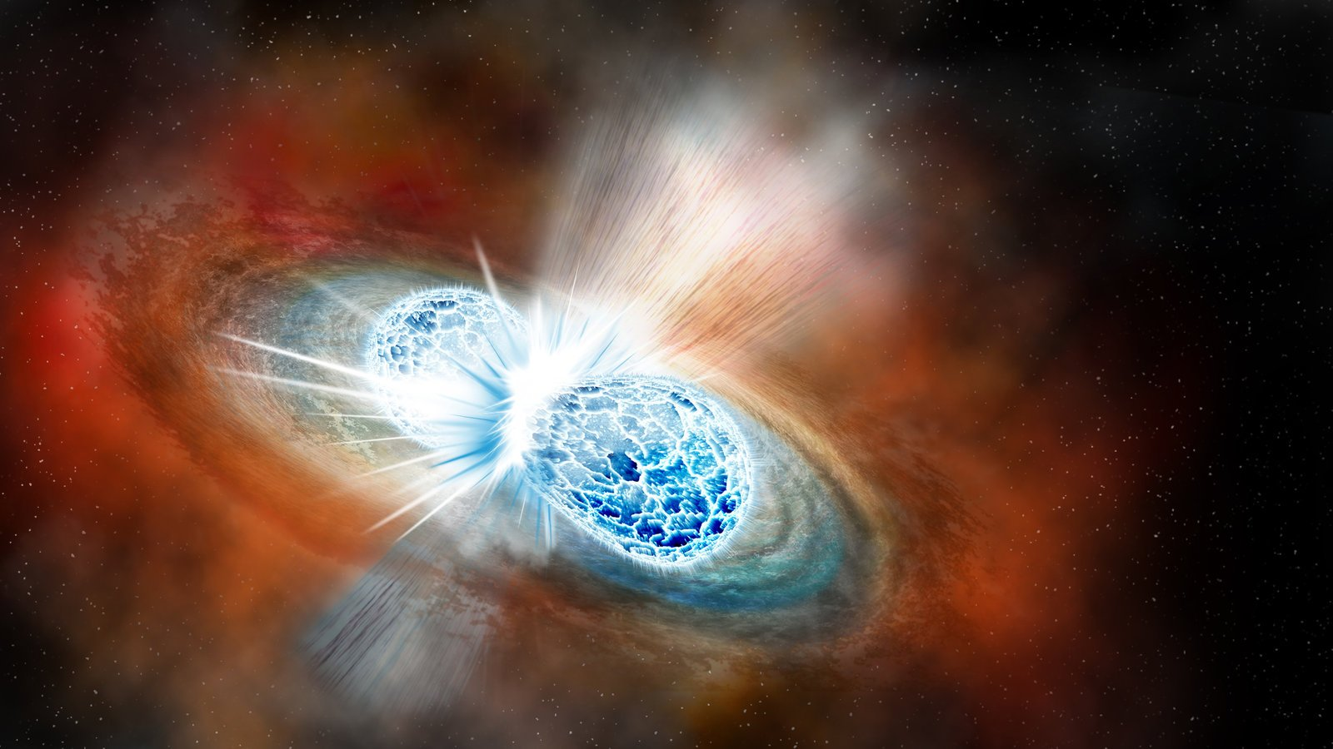
extreme transient cosmic events
Robin Dienel, Carnegie Institution for Science.

Slide 12
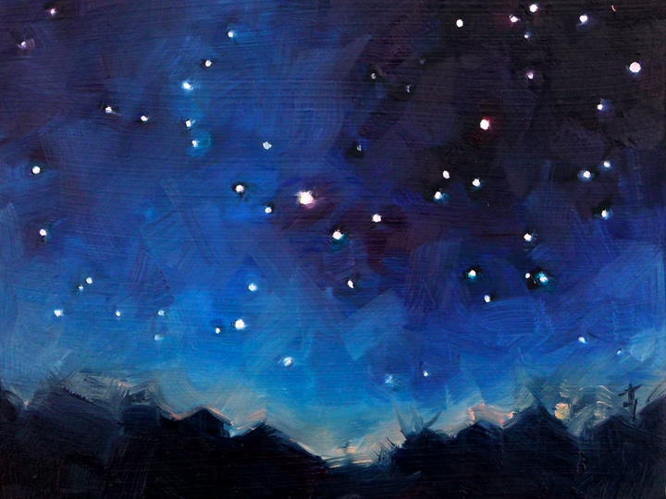

Slide 13
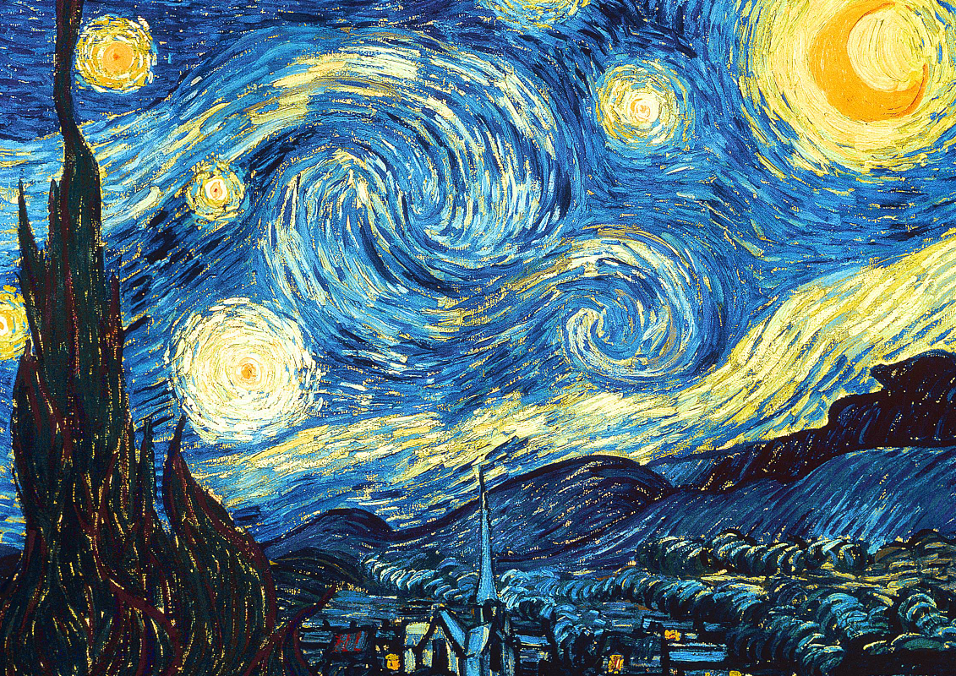
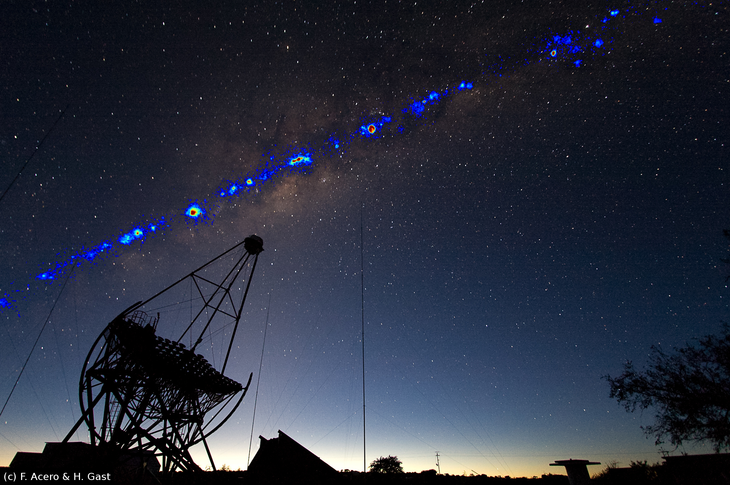

Slide 14
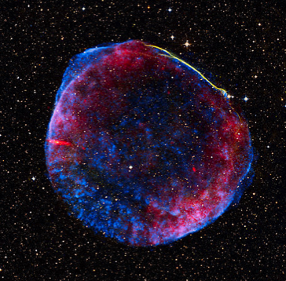
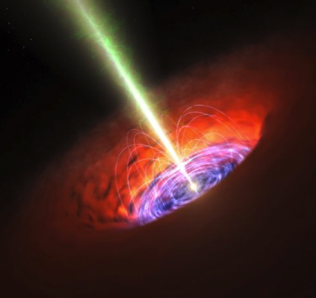
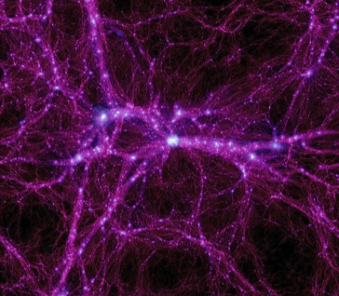
science themes
Theme 1: Cosmic Particle Acceleration
How and where are particles accelerated?
How do they propagate?
What is their impact on the environment?
Theme 2: Probing Extreme Environments
Close to neutron stars and black holes
Relativistic jets, winds and explosions
Cosmic voids
Theme 3: Physics Frontiers
What is the nature of Dark Matter?
Is the speed of light constant?
Do axion-like particles exist?

Slide 15
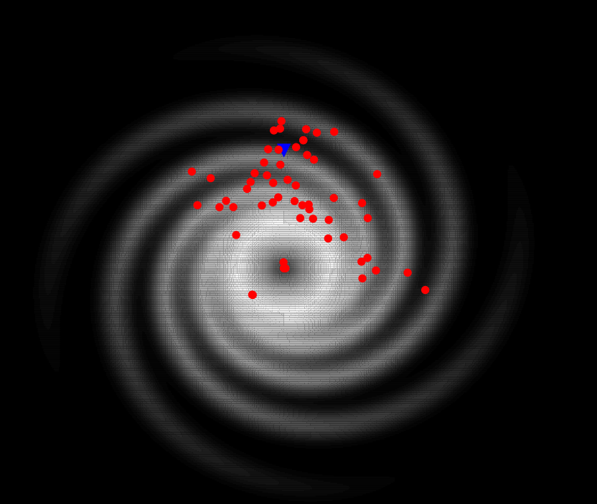
W. Hofmann
MPI for Nuclear Physics
CTA Observatory GmbH
Heidelberg
for the CTA Consortium
Cosmic particle
accelerators in
our Galaxy
Current Galactic
VHE sources (with
distance estimates)
Current
Instruments
CTA

Slide 16
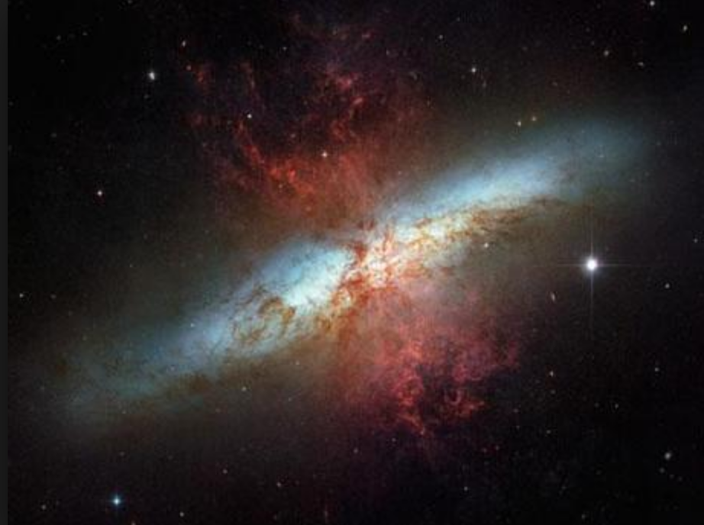
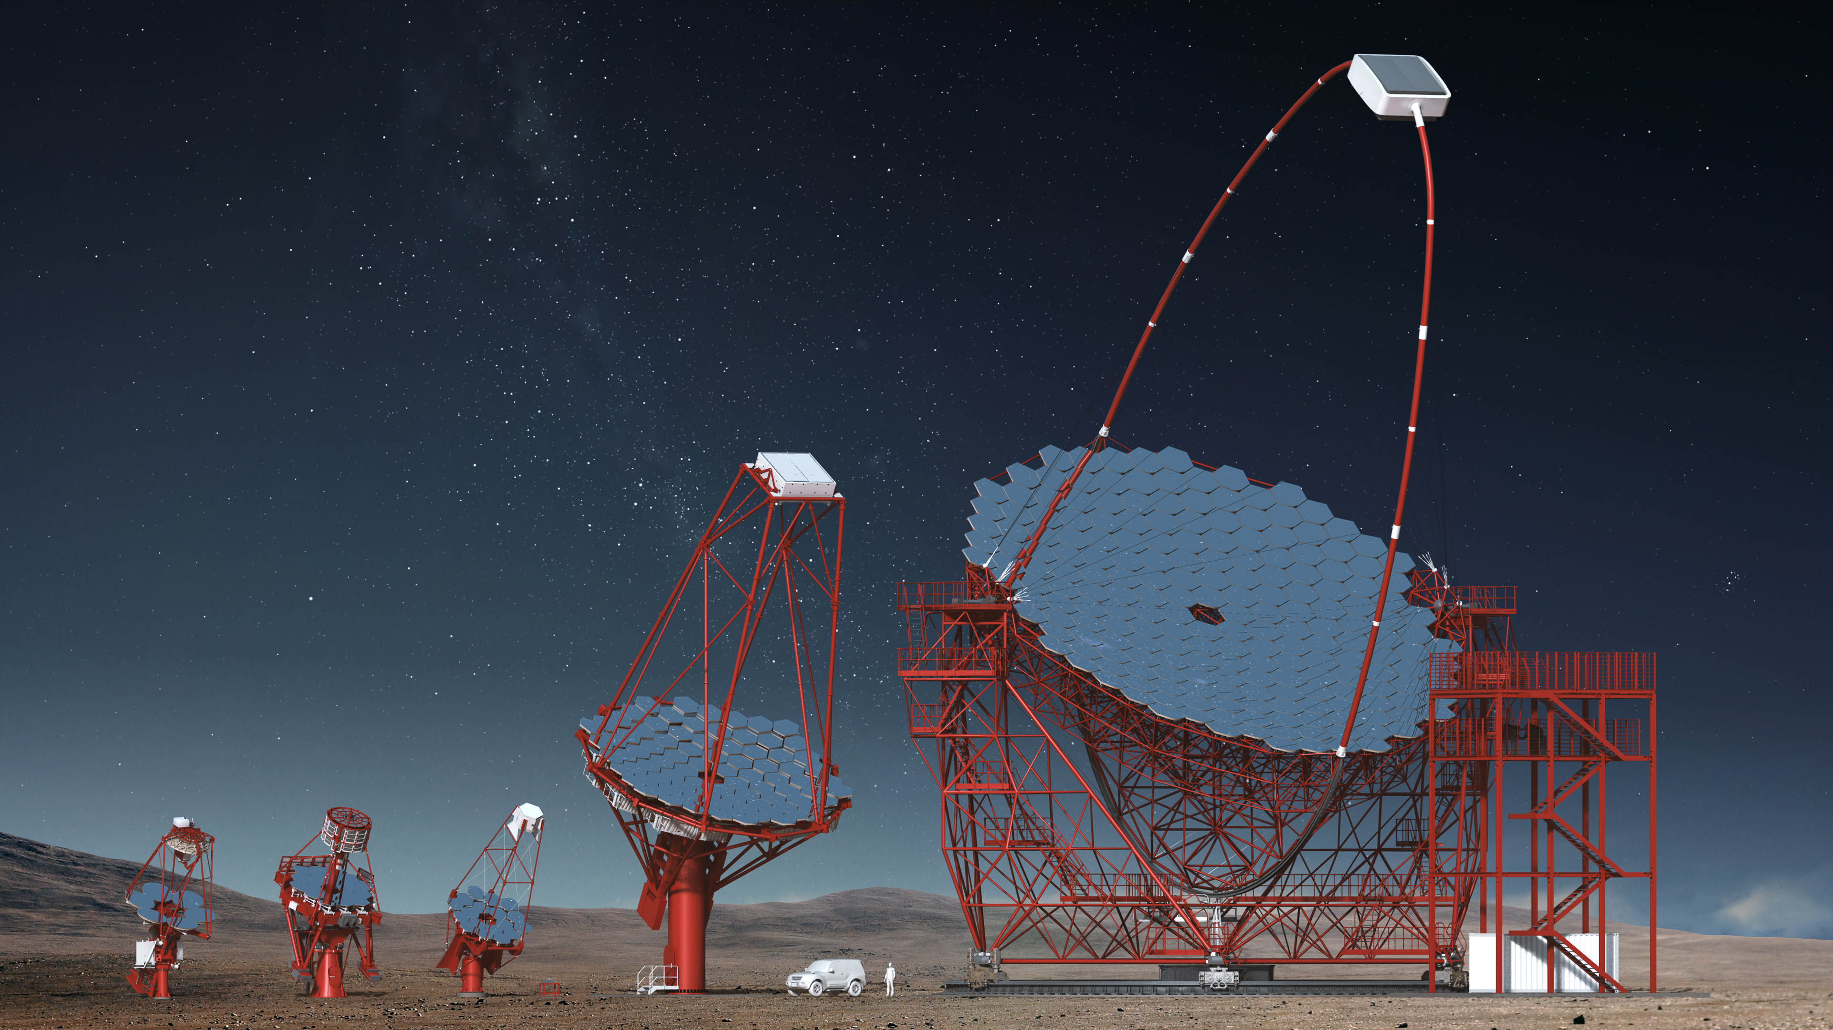
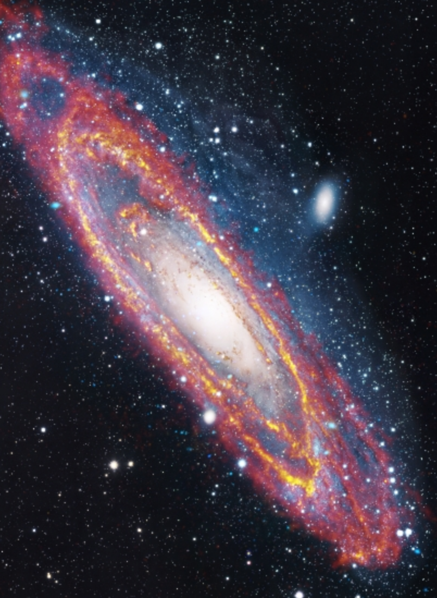
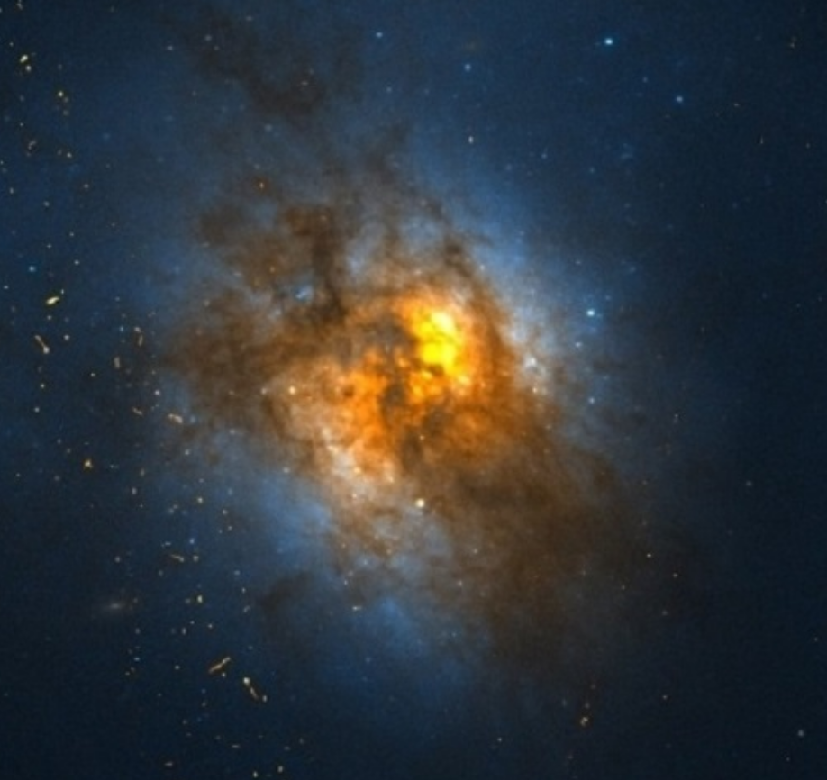
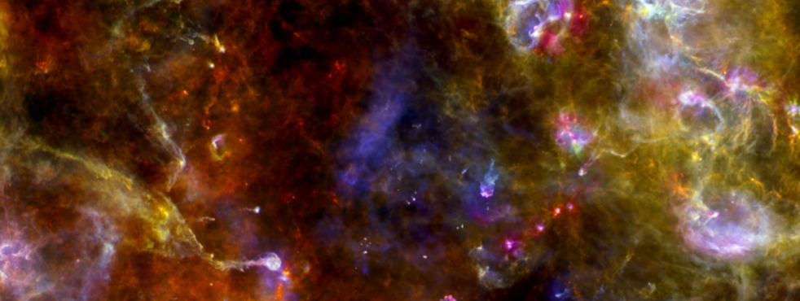
Goal:
a census of cosmic
particle accelerators
M82
M31
Cygnus
Region
NASA, ESA and the Hubble Heritage Team;
J. Gallagher, M. Mountain, P. Puxley
Arp 220
ESA/Herschel/PACS/SPIRE/J.Fritz, U.Gent/
XMM-Newton/EPIC/W. Pietsch, MPE/R. Gendler
across all scales
University of Oklahoma and NASA
ESA/PACS/SPIRE, Martin Hennemann & Frederique Motte

Slide 17
What is the jet made of?
Illustration: Scientific American

Slide 18
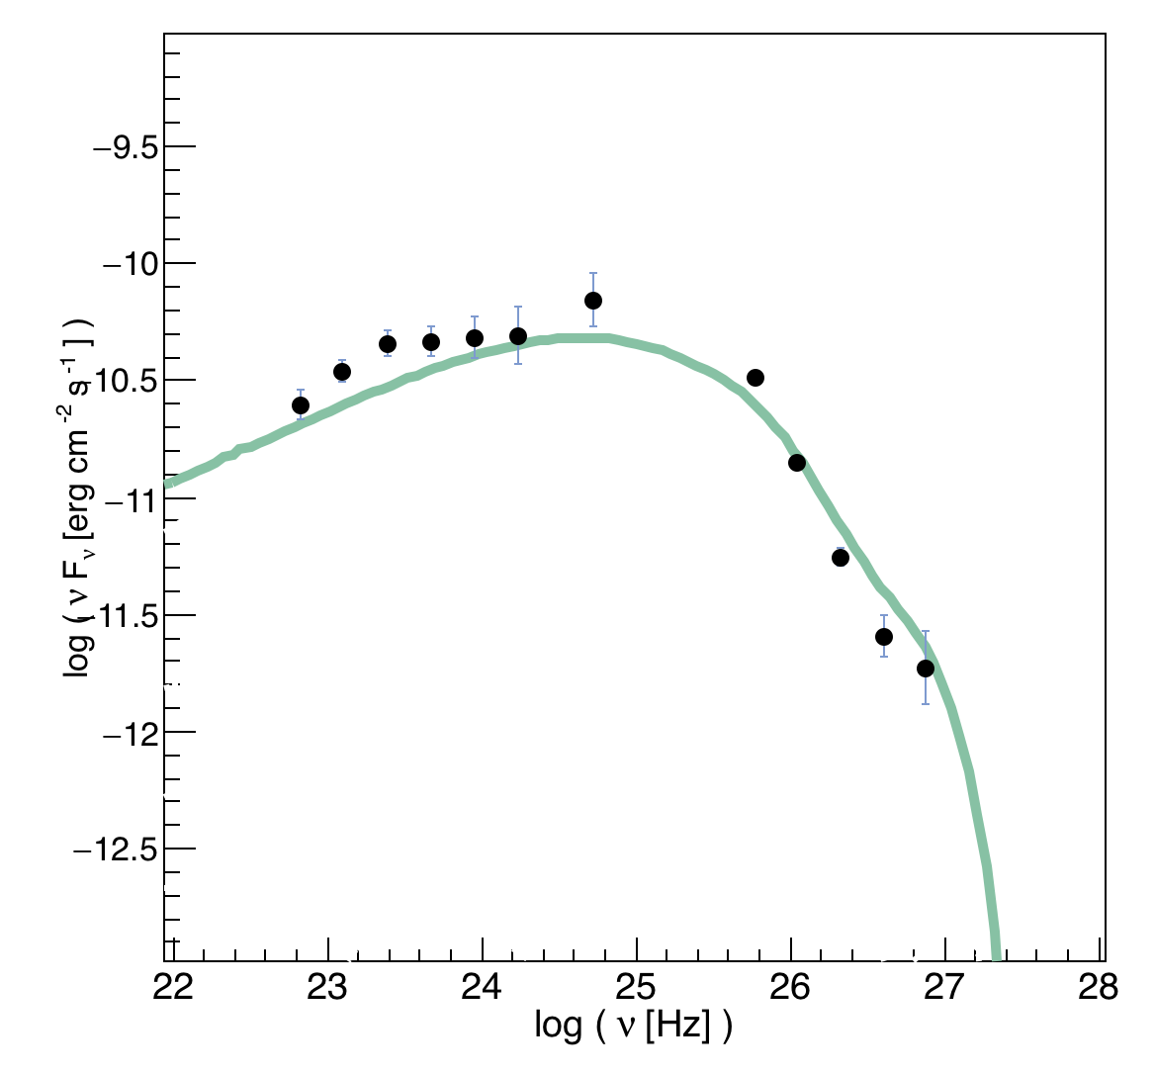
Electron-Positron Jet
Nuclei
in Jet
Nuclei
in Jet
Current data
Illustration: Scientific American

Slide 19
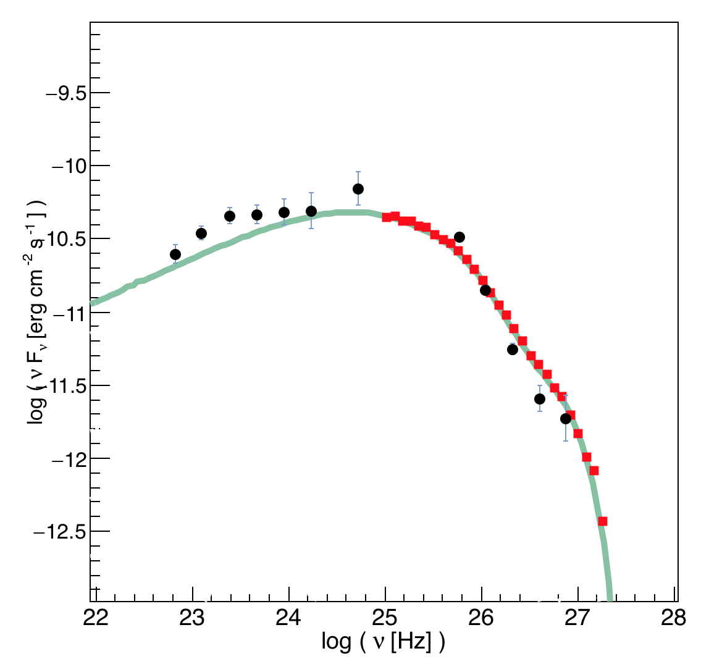
Electron-Positron Jet
Nuclei
in Jet
Nuclei
in Jet
CTA
Illustration: Scientific American

Slide 20
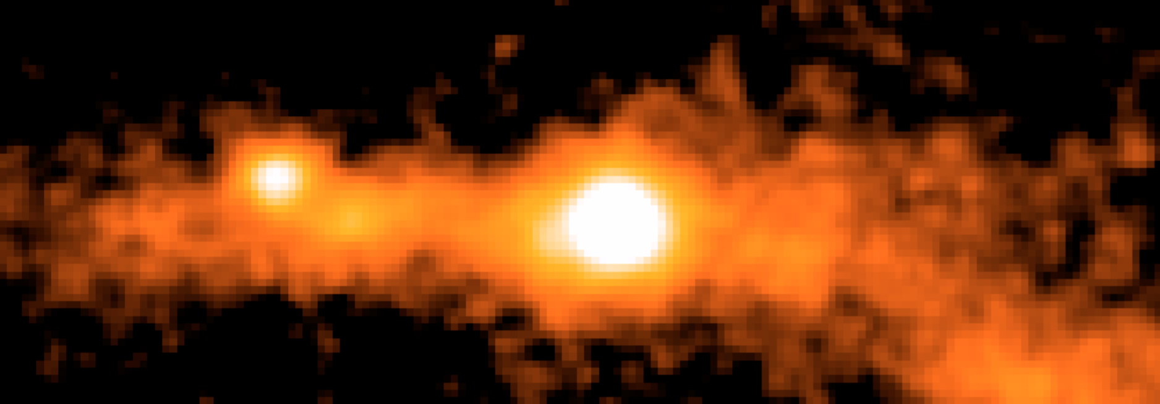
gamma rays trace annihilating or decaying relics
Weakly Interacting
Dark Matter Particles
τ
τ
Characteristic
spectral
signature
“known” from
particle physics
Annihilation
cross section
“known” from
Dark Matter
abundance

Slide 21
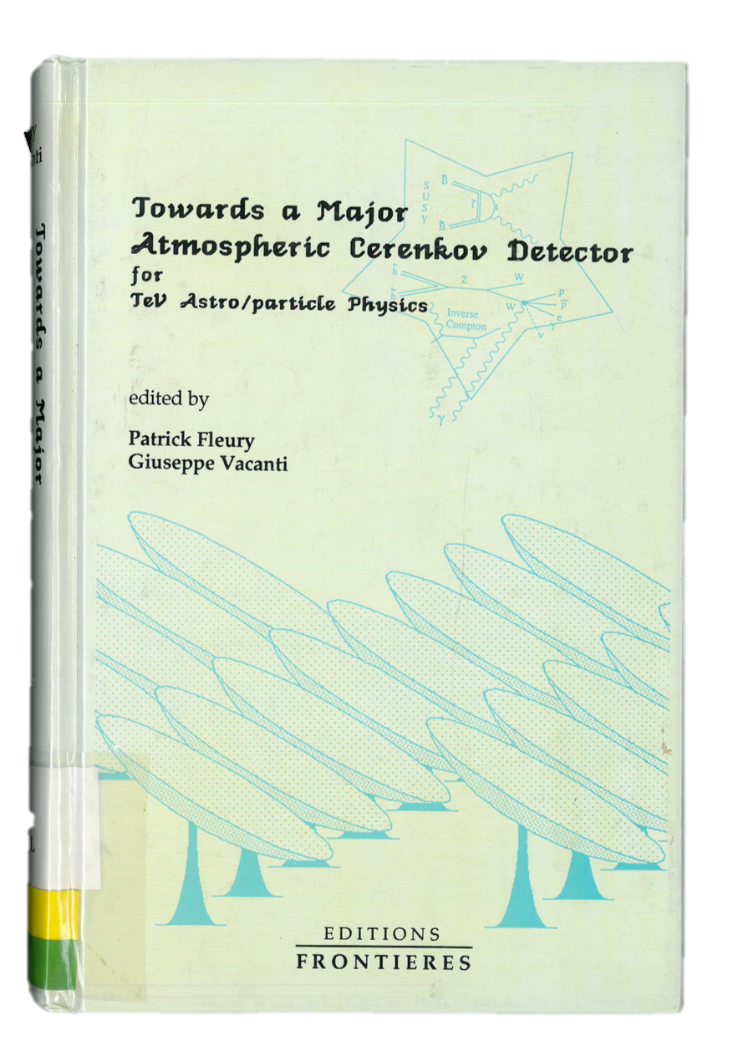
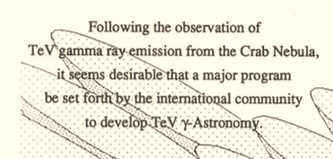
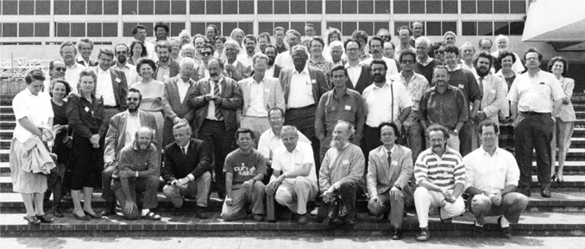
The 1992 Palaiseau Workshop

Slide 22
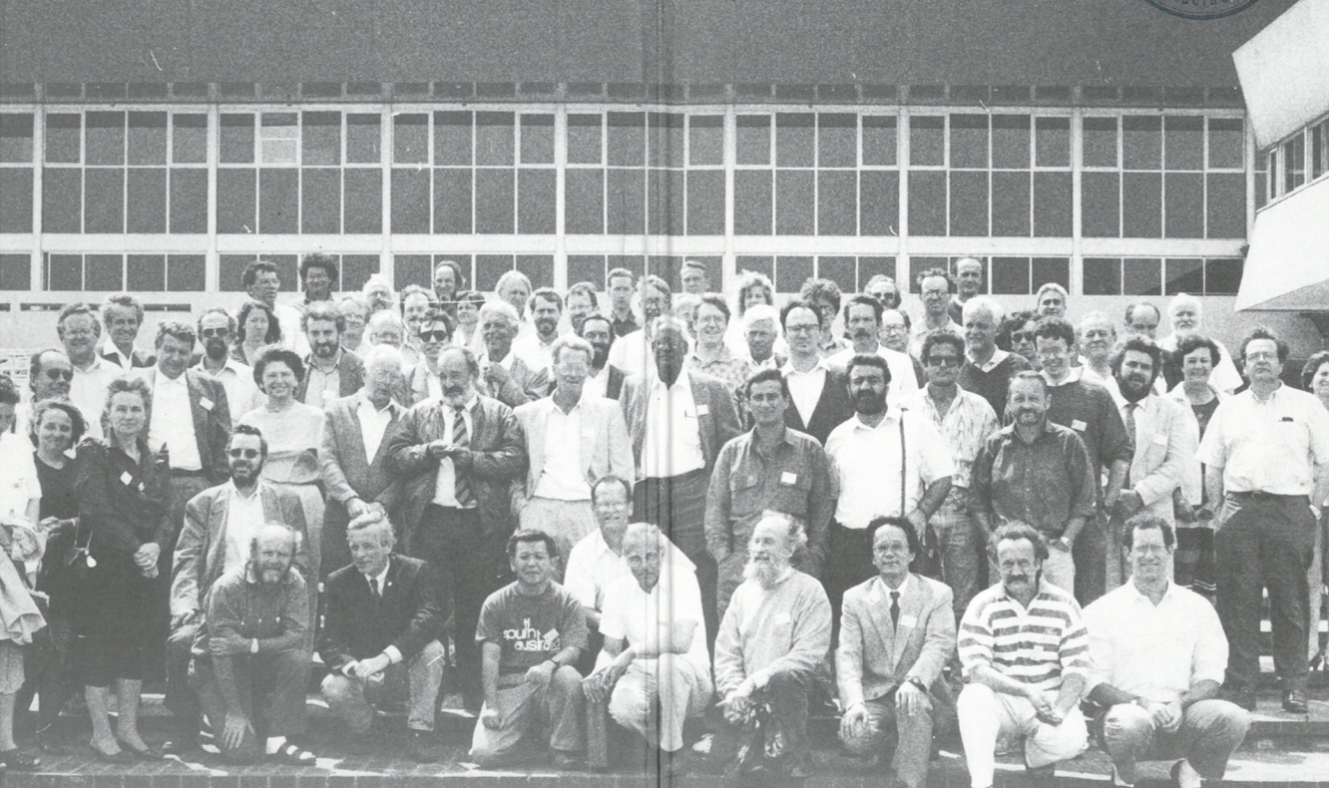
After Palaiseau & follow-up workshops
CANGAROO
H.E.S.S.
MAGIC
VERITAS

Slide 23

... but we finally got it right!
CANGAROO
H.E.S.S.
MAGIC
VERITAS
31 Countries
202 Institutes
1451 Members

Slide 24
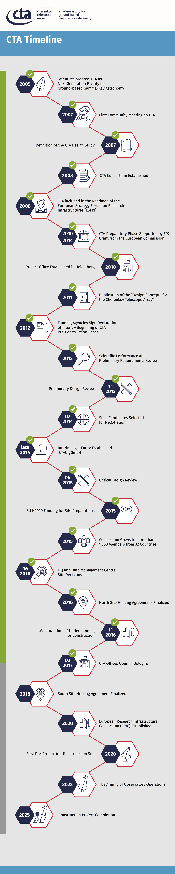
CTA becomes EFRI Landmark
LST1

Slide 25
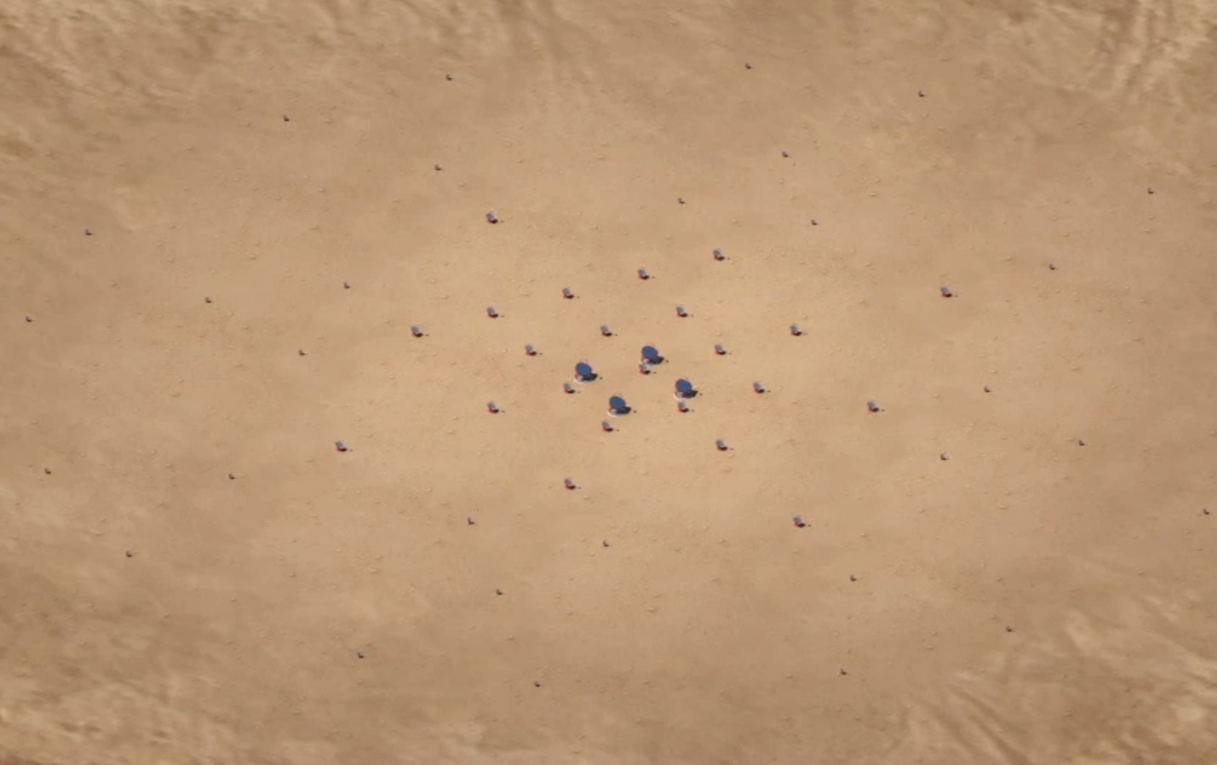
Cherenkov Telescope Array
10 GeV 100 GeV 1 TeV 10 TeV 100 TeV
1000 γ / h km²
10 γ / h km²
0.1 γ / h km²
Layout optimized
using detailed
simulations –
tens of millions CPU-h
Southern array
of Cherenkov telescopes
- about 3 km across

Slide 26
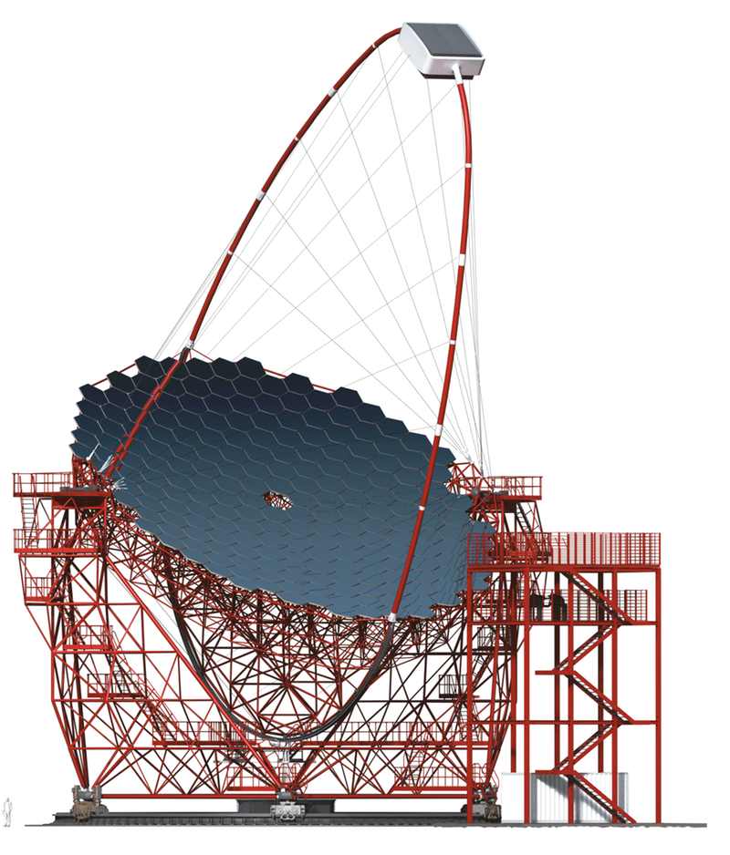
Cherenkov Telescope Array
10 GeV 100 GeV 1 TeV 10 TeV 100 TeV
4 x 23 m ∅ Large Size Telescopes (LST)

Slide 27
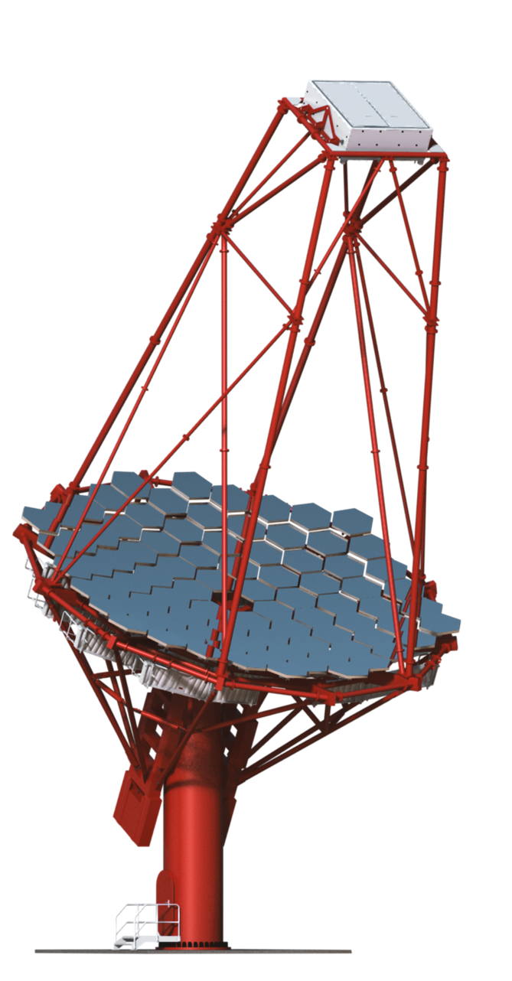
Cherenkov Telescope Array
10 GeV 100 GeV 1 TeV 10 TeV 100 TeV
25 x 12 m ∅ Medium Size Telescopes (MST) (North: 15)

Slide 28
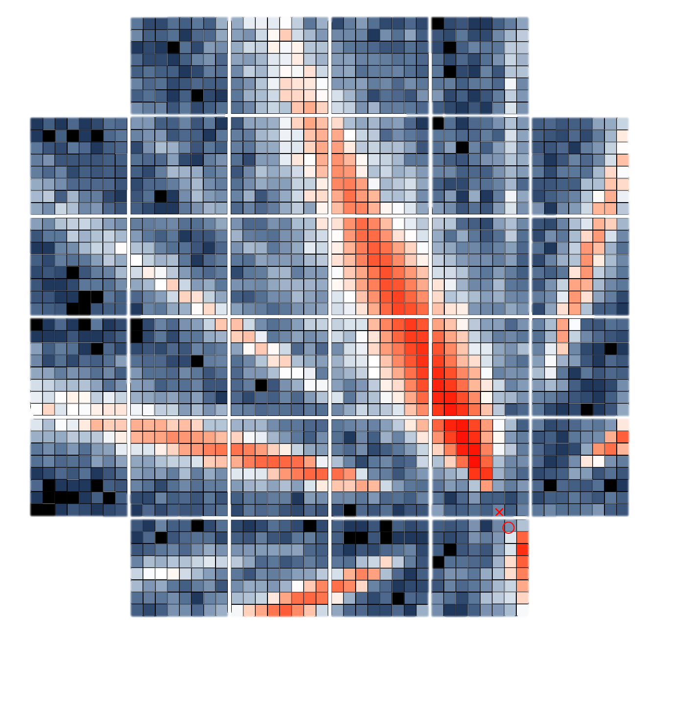
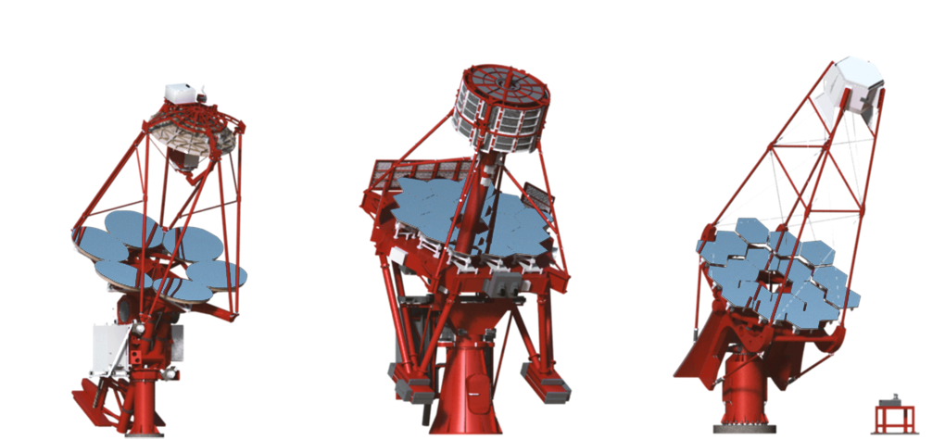
Cherenkov Telescope Array
10 GeV 100 GeV 1 TeV 10 TeV 100 TeV
70 x 4 m ∅ Small Size Telescopes (SST) (South only)
Compared to current instruments
up to 20 x better sensitivity
over 4 decades coverage in energy
much larger field of view
better resolution
up to 400 x increased survey speed

Slide 29


Slide 30
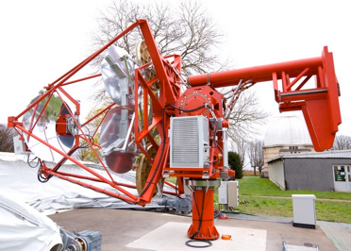
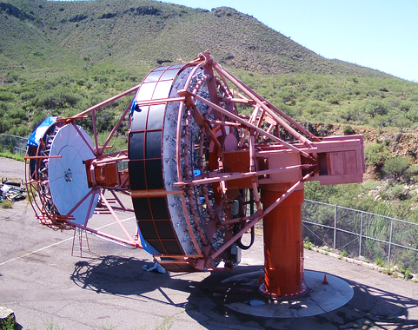
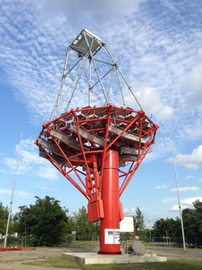
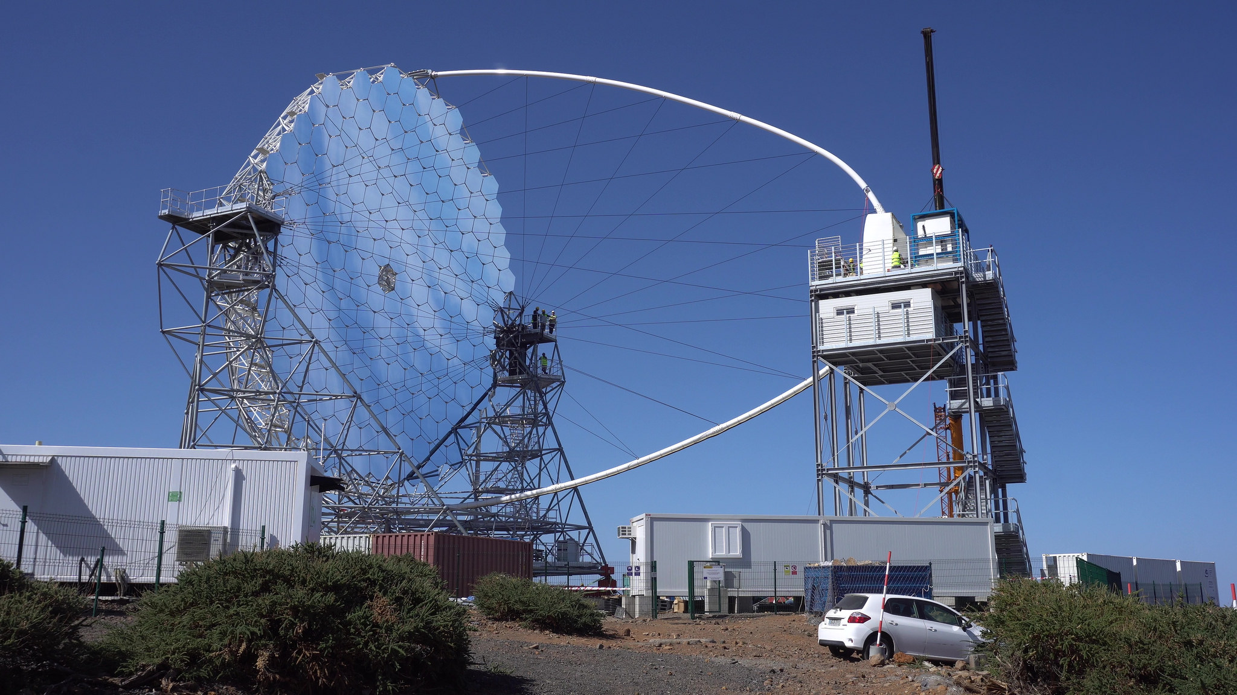
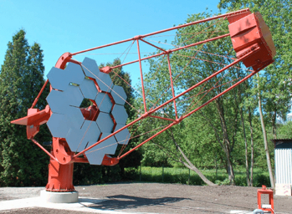
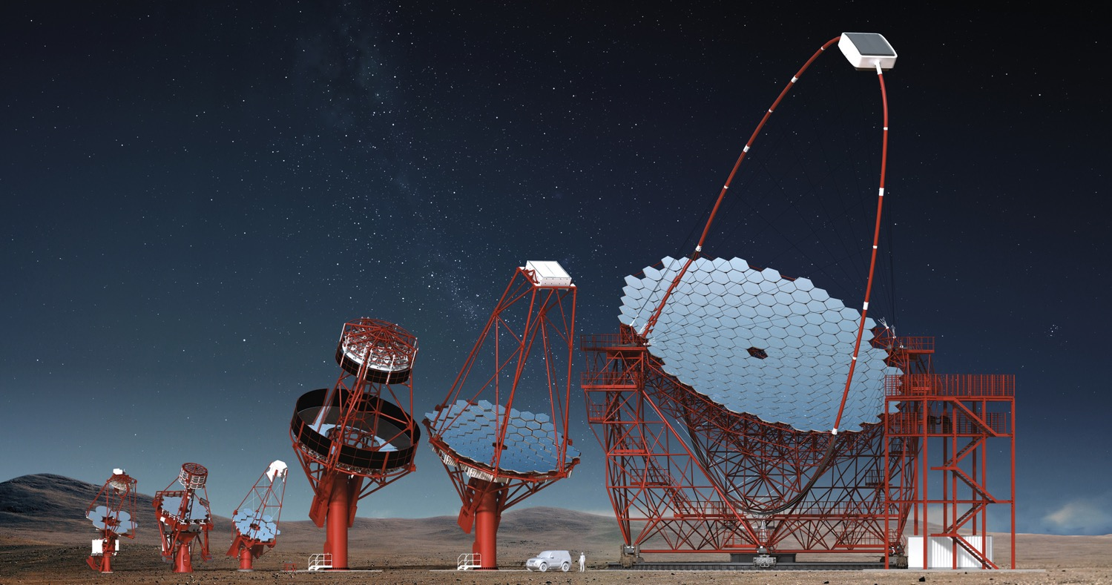
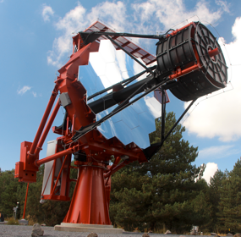
MST
GCT
SCT
MST
LST
SST-1M
Prototype
Telescopes
ASTRI

Slide 31
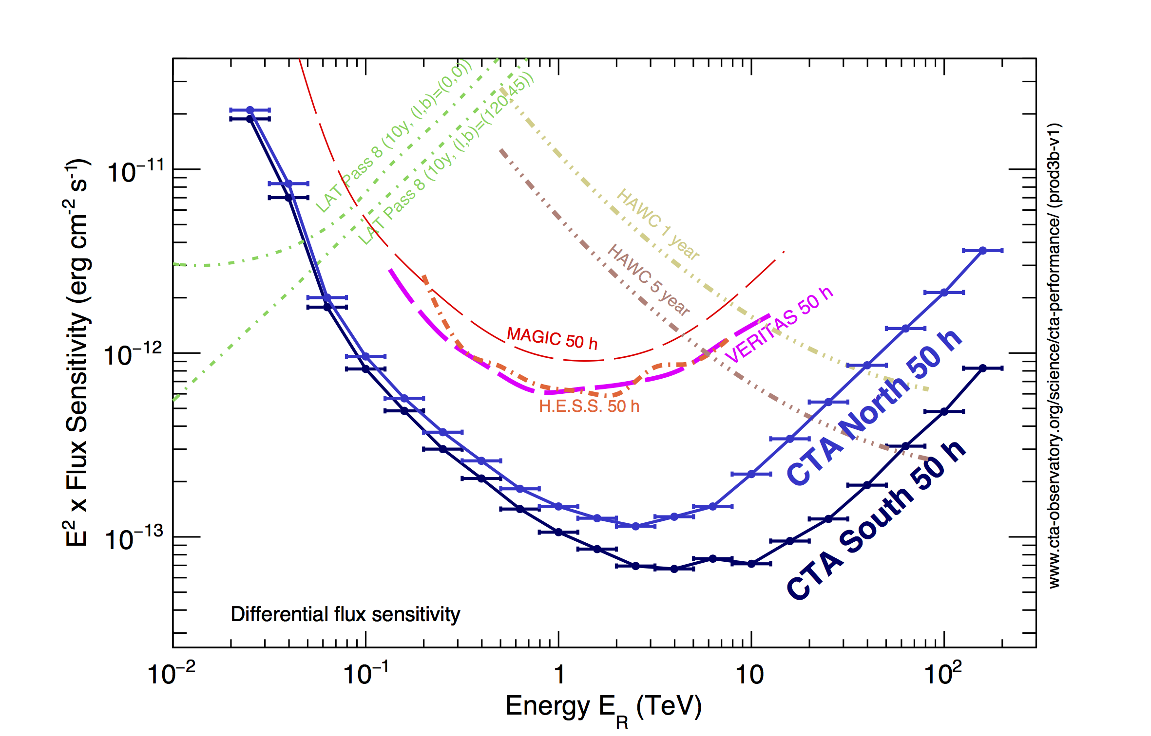
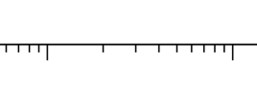
sensitivity (Steady sources)
Strongest emitters
of very high energy
gamma rays
Current
Cherenkov
telescopes
(50 h)
HAWC
1 to 5 yr
CTA North
Energy Flux
[erg/cm²s]
Fermi
Pass 8
LST
Faint and
distant
objects
CTA South
For steady sources –
integration time 50 h for CTs
years for Fermi, HAWC
Energy E[TeV]

Slide 32
sensitivity (Steady sources)
Strongest emitters
of very high energy
gamma rays
Current
Cherenkov
telescopes
(50 h)
HAWC
1 to 5 yr
CTA North
Energy Flux
[erg/cm²s]
Fermi
Pass 8
LST
Faint and
distant
objects
CTA South
For steady sources –
integration time 50 h for CTs
years for Fermi, HAWC
Energy E[TeV]

Slide 33


But: things happen to gamma rays along their way
… Absorption
e⁺
starlight
photon
TeV gamma ray
e–

Slide 34
sensitivity (Steady sources)
Current
Cherenkov
telescopes
(50 h)
HAWC
1 to 5 yr
CTA North
Energy Flux
[erg/cm²s]
Fermi
Pass 8
LST
CTA South
For steady sources –
integration time 50 h for CTs
years for Fermi, HAWC
Energy E[TeV]

Slide 35
sensitivity (Steady sources)
Redshift z=0.1
Current
Cherenkov
telescopes
(50 h)
HAWC
1 to 5 yr
CTA North
Energy Flux
[erg/cm²s]
Fermi
Pass 8
LST
CTA South
For steady sources –
integration time 50 h for CTs
years for Fermi, HAWC
Energy E[TeV]

Slide 36
sensitivity (Steady sources)
Redshift z=0.3
HAWC
1 to 5 yr
Current
Cherenkov
telescopes
(50 h)
CTA North
Energy Flux
[erg/cm²s]
Fermi
Pass 8
LST
CTA South
For steady sources –
integration time 50 h for CTs
years for Fermi, HAWC
Energy E[TeV]

Slide 37
sensitivity (Steady sources)
Redshift z=1
HAWC
1 to 5 yr
Current
Cherenkov
telescopes
(50 h)
CTA North
Energy Flux
[erg/cm²s]
Fermi
Pass 8
LST
CTA South
For steady sources –
integration time 50 h for CTs
years for Fermi, HAWC
Energy E[TeV]

Slide 38

sensitivity (Steady sources)
Redshift z=1
HAWC
1 to 5 yr
M. Azadi
Current
Cherenkov
telescopes
(50 h)
CTA North
Energy Flux
[erg/cm²s]
Fermi
Pass 8
AGN
activitiy
LST
CTA South
For steady sources –
integration time 50 h for CTs
years for Fermi, HAWC
Energy E[TeV]

Slide 39
sensitivity (Steady sources)
Redshift z=1
Robin Dienel, Carnegie Institution for Science.
HAWC
1 to 5 yr
Current
Cherenkov
telescopes
(50 h)
CTA North
Energy Flux
[erg/cm²s]
Fermi
Pass 8
LST
CTA South
For steady sources –
integration time 50 h for CTs
years for Fermi, HAWC
Energy E[TeV]
For transient sources

Slide 40

sensitivity (Steady sources)
Redshift z=1
HAWC
1 to 5 yr
Current
Cherenkov
telescopes
(50 h)
CTA North
Energy Flux
[erg/cm²s]
100000
Fermi
Pass 8
LST
CTA South
For steady sources –
integration time 50 h for CTs
years for Fermi, HAWC
Energy E[TeV]
For transient sources

Slide 41

But: things happen to gamma rays along their way
… Effects of Quantum Gravity
modify propagation
TeV gamma ray
Speed of light variation across TeV range <10⁻¹⁵

Slide 42




CTA Science
In-depth understanding
of known objects and
their mechanisms
Expected discoveries
of new object classes
The fun part:
Things we haven’t thought of
?

Slide 43
Congratulations
from all of CTA

