Slide 1
A new 3D Simulation for Germanium Detectors in Julia
L. Hauertmann, X. Liu, O. Schulz, M. Schuster, A. J. Zsigmond
IMPRS Young Scientist Workshop at Ringberg Castle
2018

Slide 2
Outline
Physics of a Germanium Detector
Why do we (GeDet, Gerda/Majorana, LEGEND, …) need a (new) simulation software?
Electric Potential Calculation
Why Julia?

Slide 3
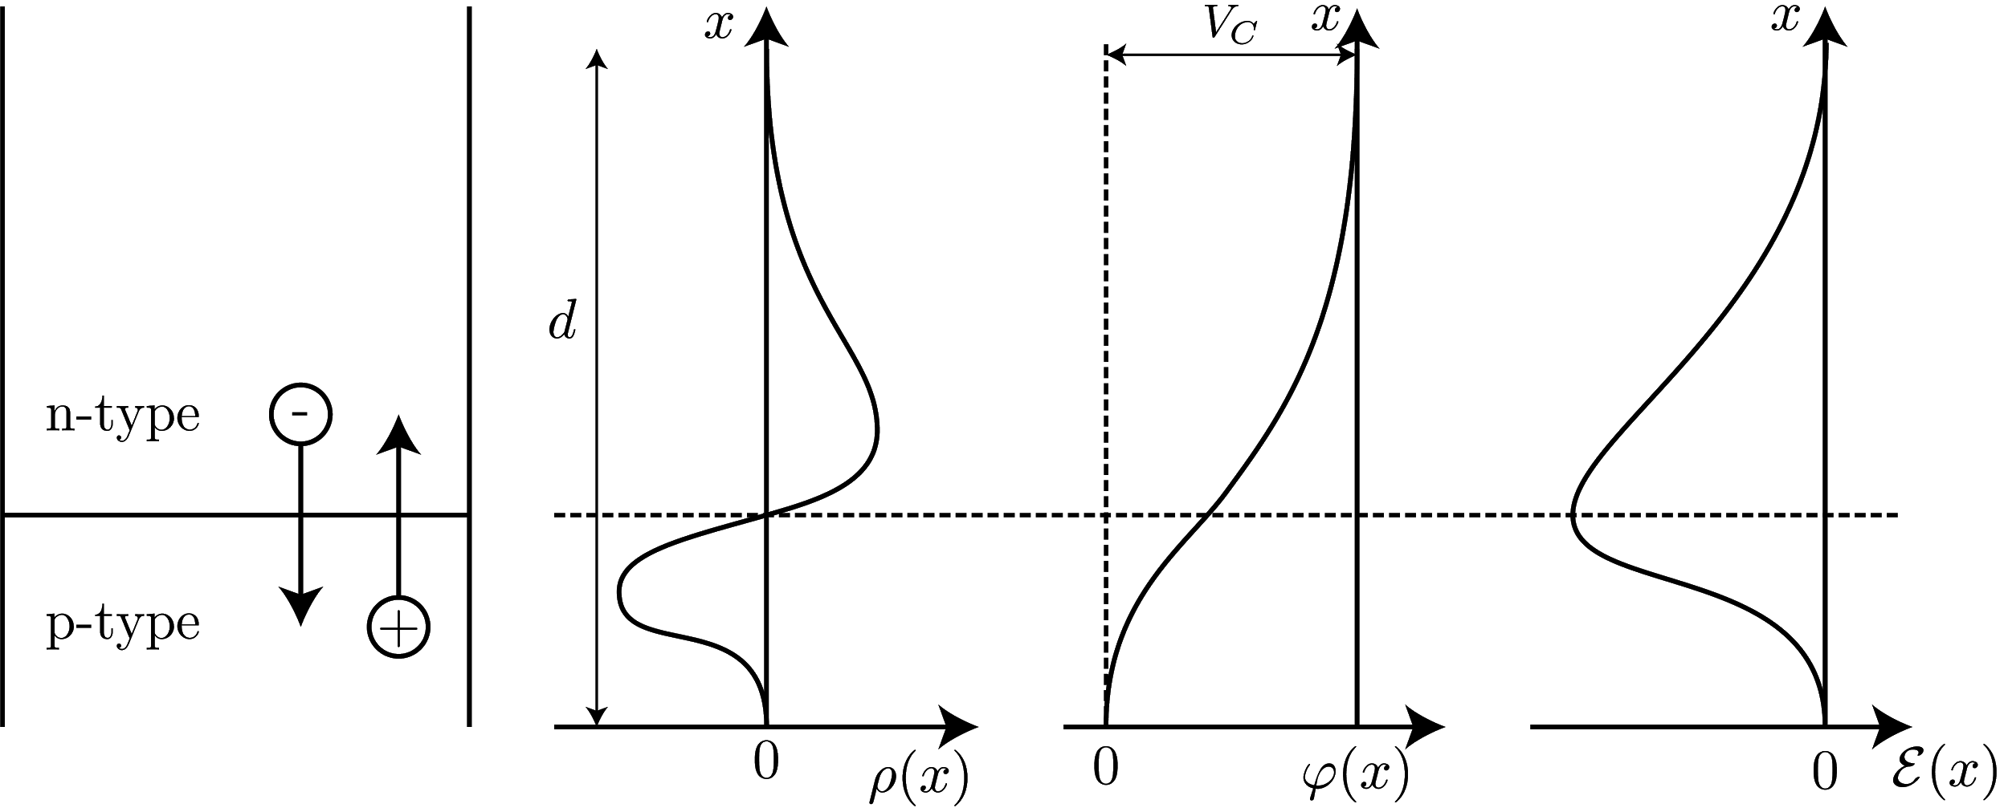
Physics of a Germanium Detector
A germanium detector is a diode.

Slide 4
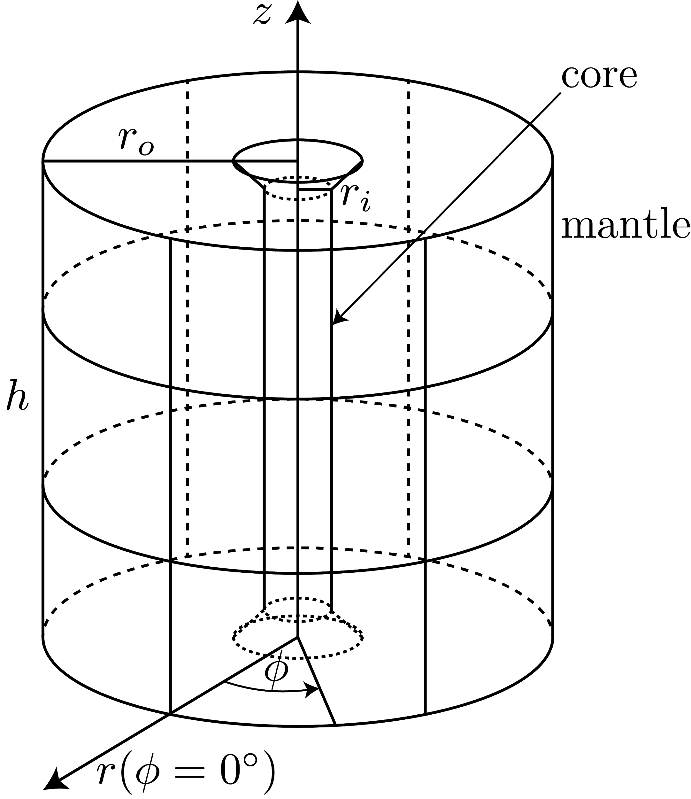
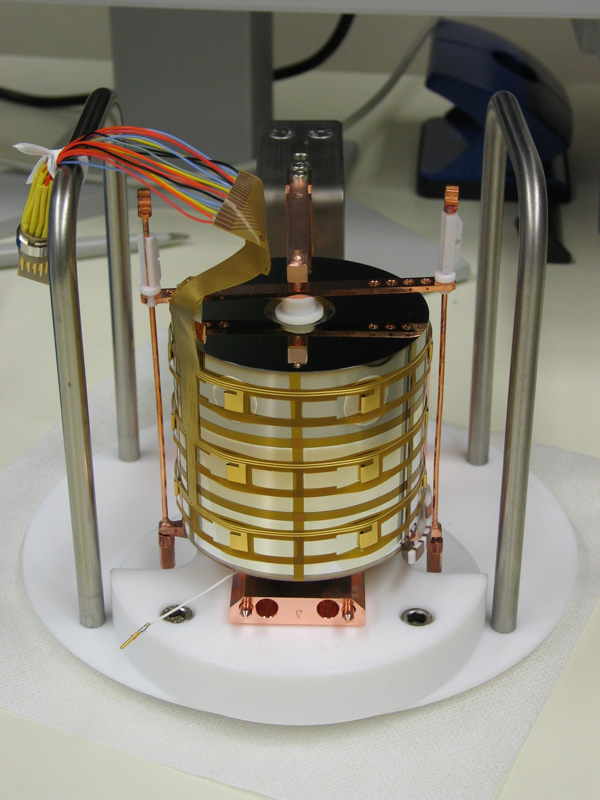
Germanium Detector Siegfried III

Slide 5
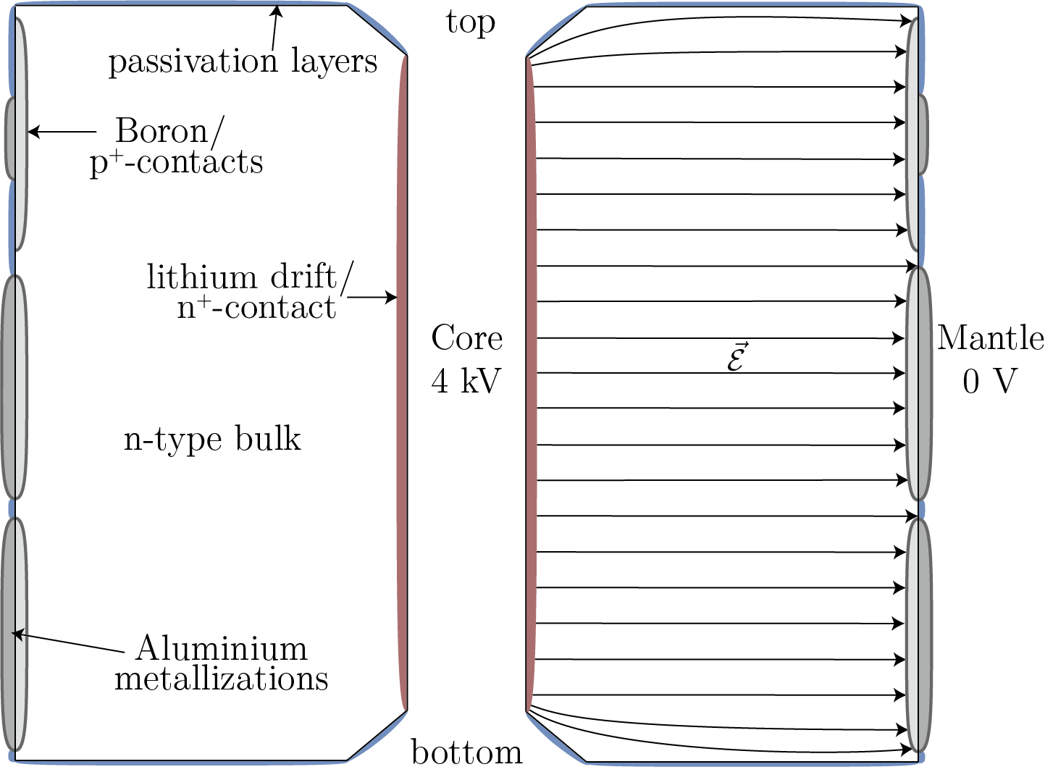
Illustration of the Electric Field

Slide 6
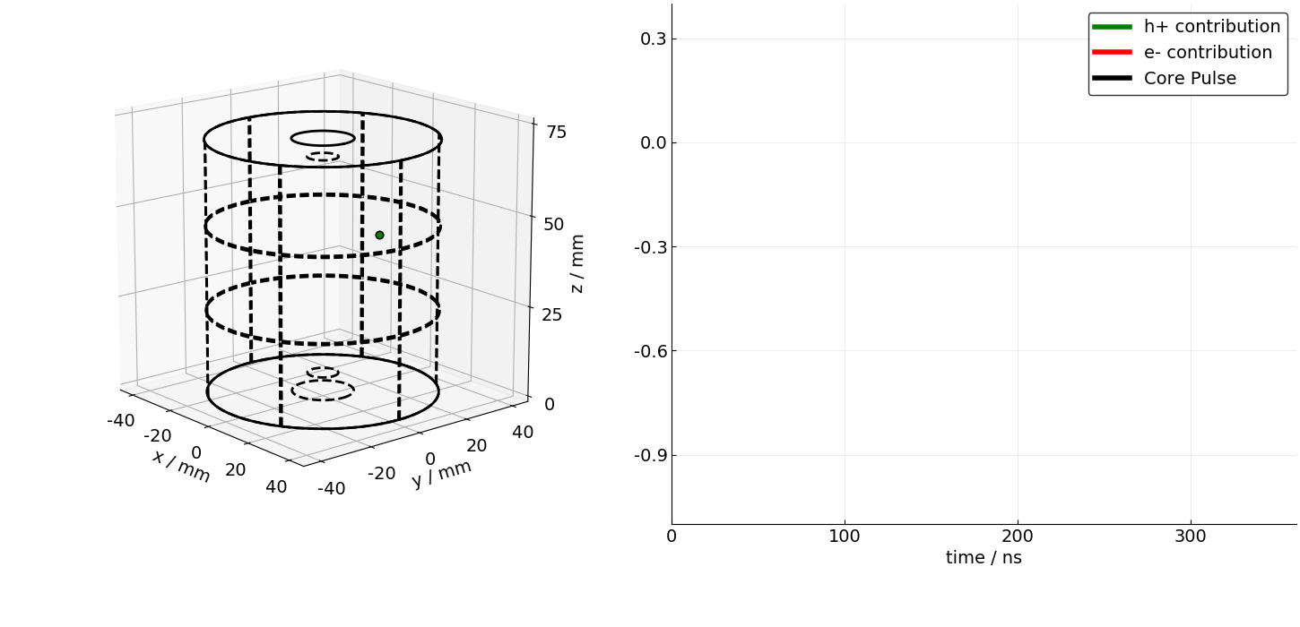
Signal Formation

Slide 7
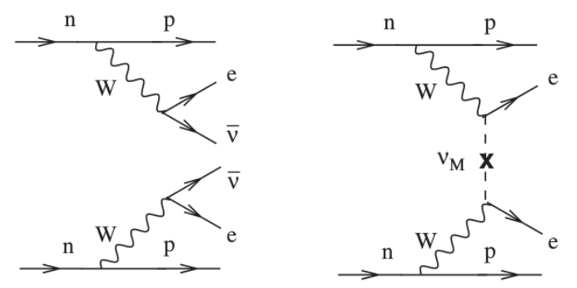
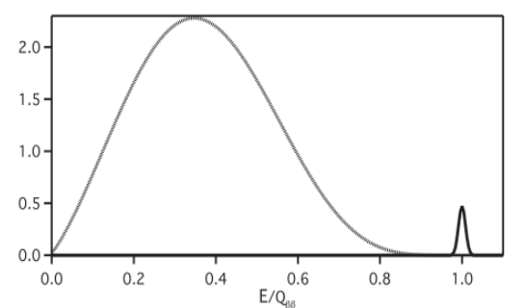
Neutrinoless Double Beta Decay
Ge based experiments: Gerda, Majorana and LEGEND
Ge-76: Q-Value = 2039 keV
Very rare decay -> Background suppression is very important

Slide 8
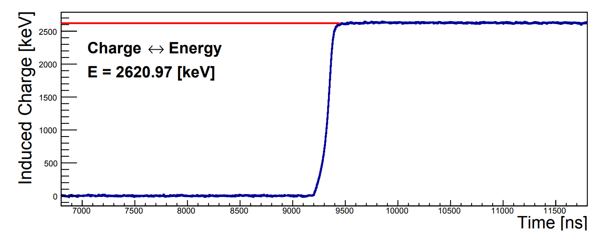
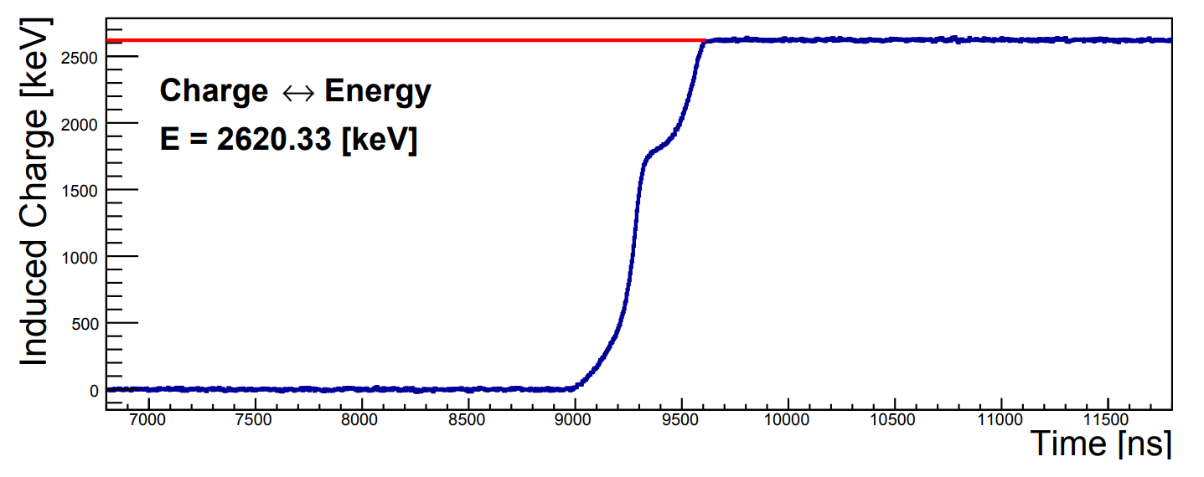
Neutrinoless Double Beta Decay
[PHYSICAL REVIEW LETTERS 120, 132503 (2018)]
Pulse Shape Discrimination (PSD) powerful tool to identify background events

Slide 9
Overview
Input: Detector geometry, Impurities, HV, mobility parameters, ...
Pulse shape analysis
Electric field
Weighting potential
Simulated event
Data events
Drift velocity
Signal
Noise
Charge drift
Electronics model

Slide 10
Overview
Input: Detector geometry, Impurities, HV, mobility parameters, ...
Pulse shape analysis
Electric field
Weighting potential
Simulated event
Data events
Drift velocity
Signal
Noise
Charge drift
Electronics model

Slide 11
What software do we have?
MaGe (MPP)
Solves just the Poisson equation
Limited options for different detector geometries
Written by multiple PhD-Students -> not that well written
Very slow, even it is written in C++/ROOT
FieldGen + SigGen (Majorana)
Only 2D
No segmentation
Also limited in detector geometries
No adaptive grid

Slide 12
Our Goals
3D Adaptive grid
Solve Gauss Law, not only Poisson equation (multiple materials)
Not limited to certain geometrical detector designs
Design new detectors
Also, not limited to germanium detectors at all
Fast and easy to use Julia

Slide 13
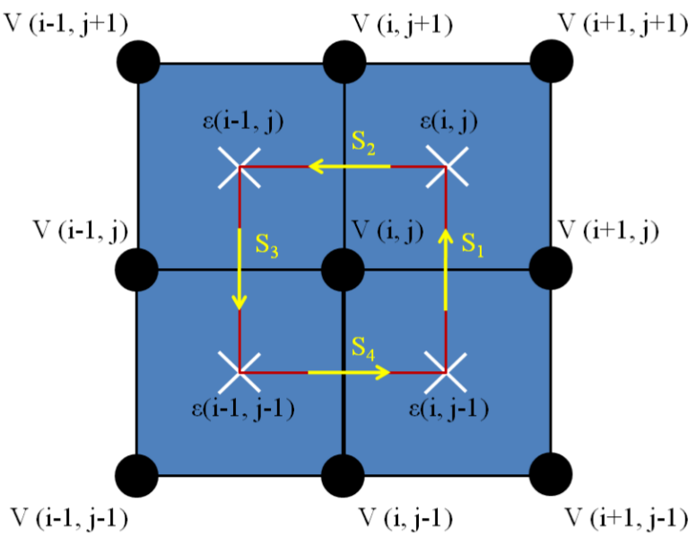
Field Calculation

Slide 14
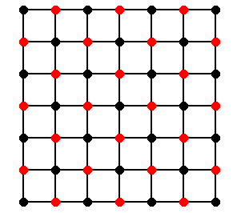
Field Calculation – How to be fast
Successive over-relaxation (SOR) → faster convergence https://people.eecs.berkeley.edu/~demmel/cs267-1995/lecture24/lecture24.html
Julia → fast (vectorized) loops https://software.intel.com/en-us/articles/vectorization-in-julia
Red-Black-Algorithm → parallelism https://people.eecs.berkeley.edu/~demmel/cs267-1995/lecture24/lecture24.html
Adaptive grid → only fine grid where you need it

Slide 15
Example: Field Calculation of Siegfried III

Slide 16
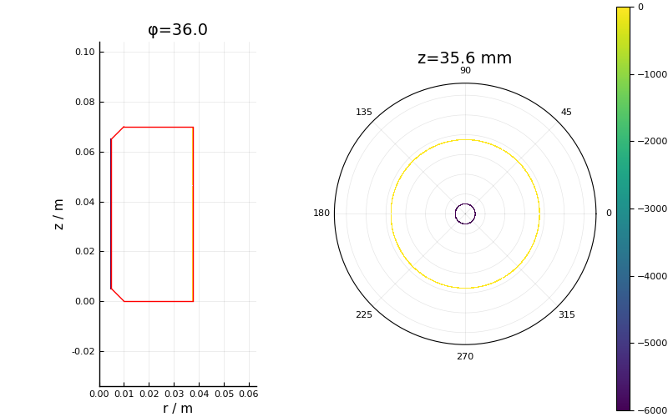
Example: Field Calculation of Siegfried III

Slide 17
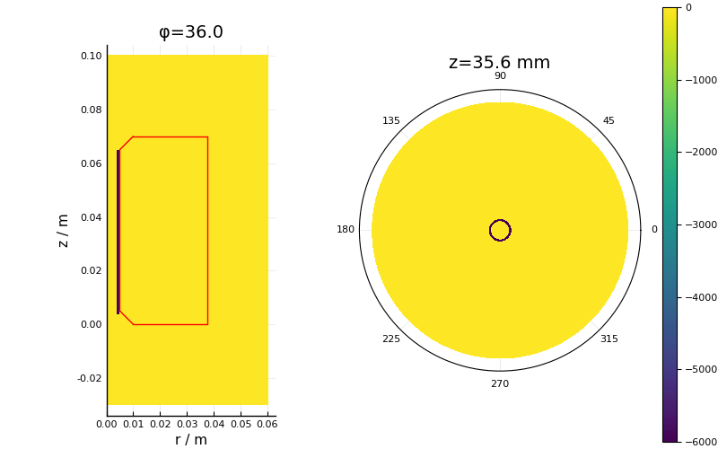
Example: Field Calculation of Siegfried III

Slide 18
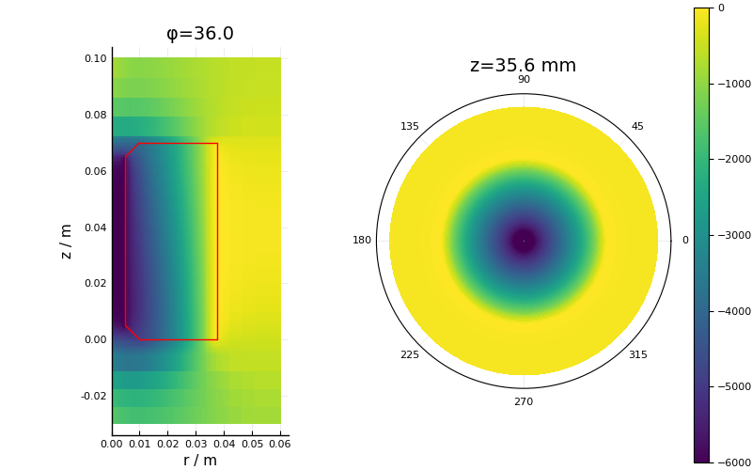
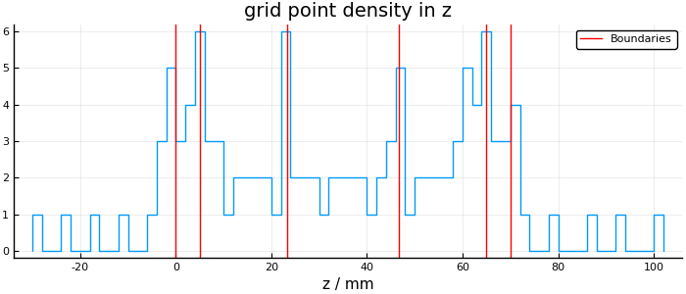
Example: Field Calculation of Siegfried III

Slide 19
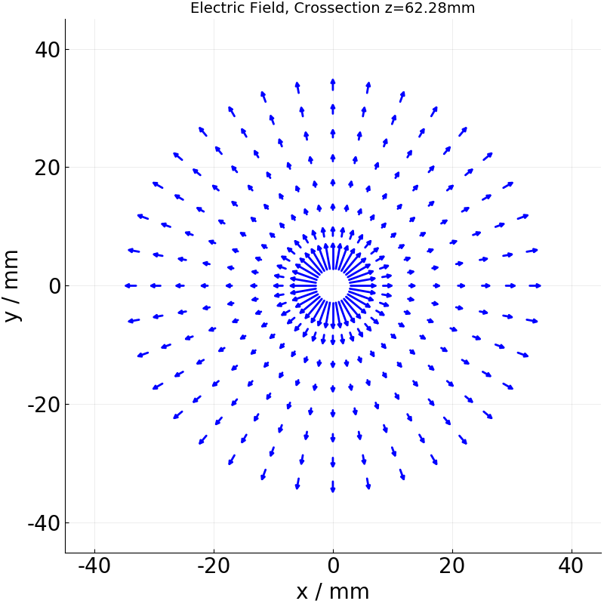
Electric Field

Slide 20
Charge Drift -> Pulses

Slide 21
Why Julia?
Development started in 2009, First version released in 2012
Made for us: Designed for high-performance computational science
Finally: v1.0 was just released in August 2018
`As fast as C, as easy as Python`
Compiled, not interpreted
Typesafe
No need to call C-Libraries to be fast (in contrast to Python (e.g. Numpy))
Fast (vectorized) loops, multithreading is quite easy
Tools to analyse your code (@time, @code_native, @code_llvm, @code_warntype, ...)
Make it work -> make it fast

Slide 22
Summary and Outlook
Detector Simulation is very important for background reduction in GERDA, MAJORANA & LEGEND
Design of new detectors
Expect usable version by the end of the year
Field Calculation can be used not only for germanium detectors
Give Julia a try

Slide 23
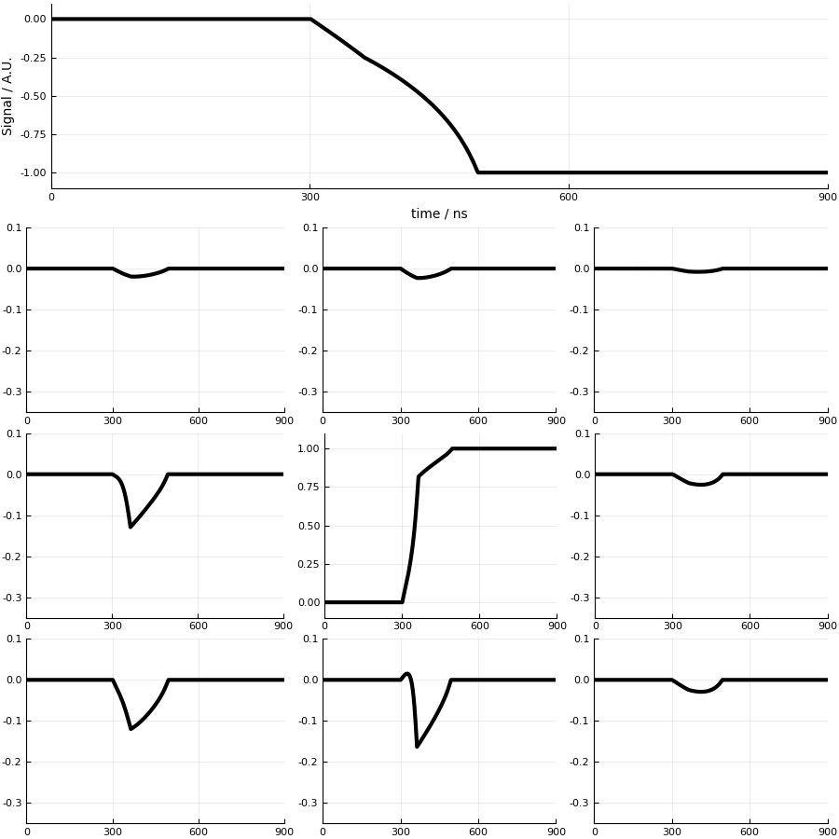
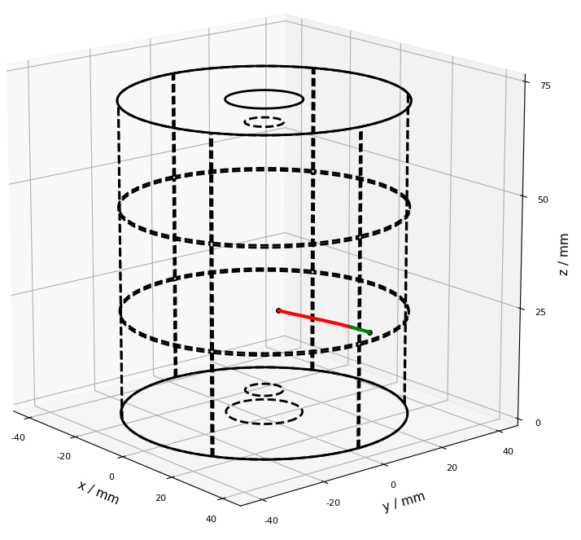
Signal and mirror pulses in segments
Energy deposition at:
r = 31 mm, ϕ = 5 deg, z = 25 mm

Slide 24
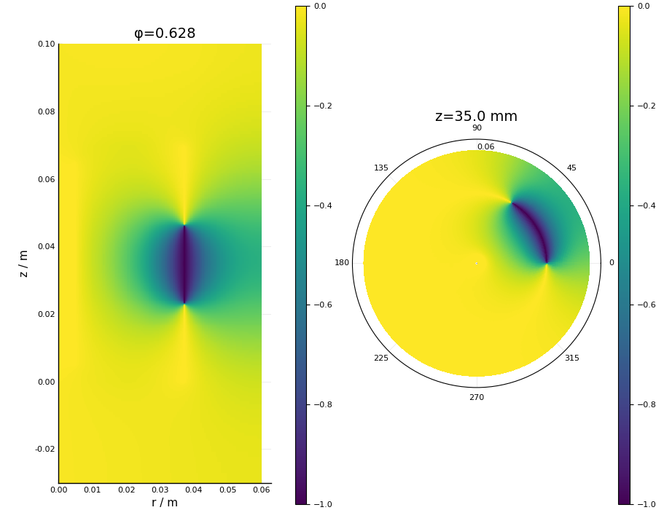
Weighting Potential

Slide 25
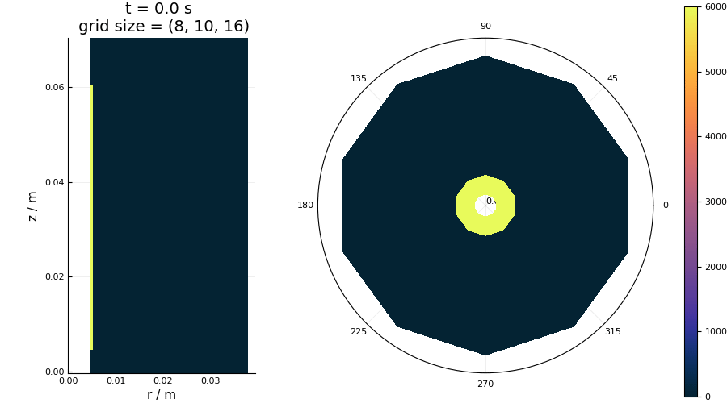
Backup: Field Calculation (Old)

Slide 26
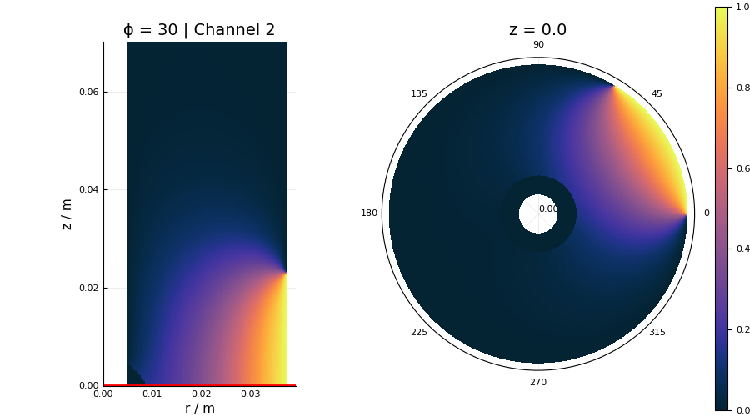
Backup: Weighting Potentials (Old)

